Slide 1
Unit 5.2 In-Class Activity A. Discharge.
Mark Abolins, Middle Tennessee State University

Slide 2

In-Class Activity A
This is what you are up against: 2017 Hurricane Harvey in Houston, Texas.
GOES 16 infrared satellite image of Hurricane Harvey making landfall
as a Category 4 storm on August 26, 2017.
Notes:
https://www.weather.gov/hgx/hurricaneharvey

Slide 3
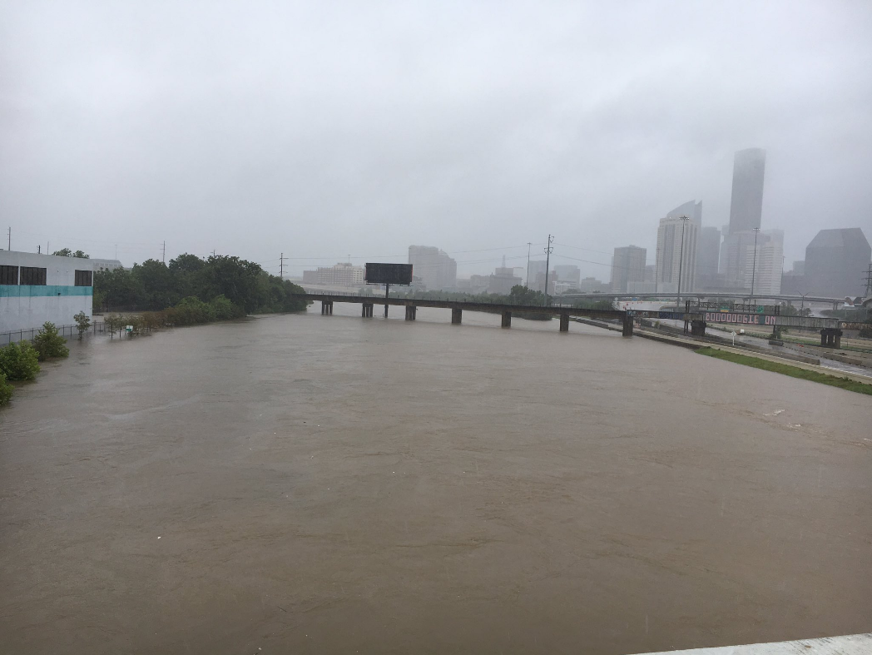
Hurricane Harvey, 2017
One trillion gallons of water fell across Harris County (county surrounding Houston, TX) in 4 days.
Flooding displaced almost 40,000 people and damaged over 200,000 homes.
$125 billion in damage.
Some streams experienced a 500-year flood, and some experienced flows so large that they are expected to happen even less often than a 500-year flood.
Catastrophic flooding as seen on one road near Houston on August 28, 2017. Source: National Weather Service.
Source: Harris County Flood Control District.
Notes:
Hurricane Harvey information from https://www.hcfcd.org/About/Harris-Countys-Flooding-History/Hurricane-Harvey . Photo from https://www.weather.gov/hgx/hurricaneharvey .

Slide 4
Discussion Question:
Where does the water come from when a river floods?
What is meant by the phrase “100-year flood”? How often would you expect a 100-year flood to occur?
What is a 500-year flood?

Slide 5
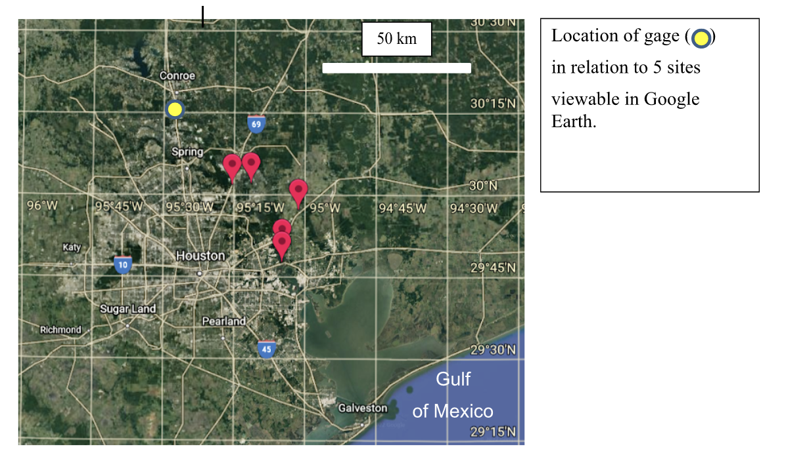
in relate to 5 sites
in HarveyInHouston.pdf

Slide 6
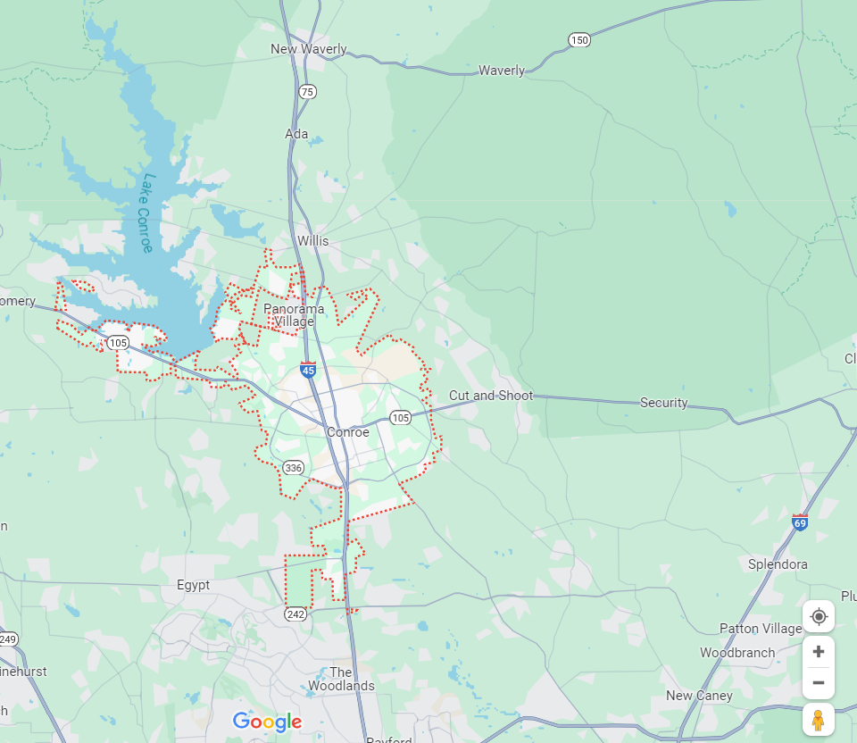
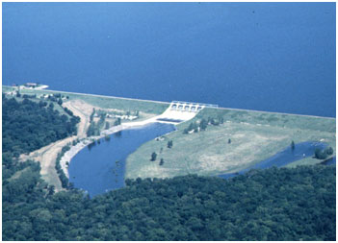
Harvey flooding downstream from dam
Water supply dam.
Not designed for flood control.
Lake lowered during April-May and August-September to accommodate precipitation.
Discharge through ~3 m conduit.
Emergency discharge through spillway controlled by 5 gates.
Max. design height of water: ~63.1 m.
Max. height during Harvey: ~62.9 m (record).
N
Conroe
Dam
Gage
8 km
Notes:
https://www.twdb.texas.gov/surfacewater/rivers/reservoirs/conroe/index.asp
https://www.sjra.net/lakeconroe/history/

Slide 7
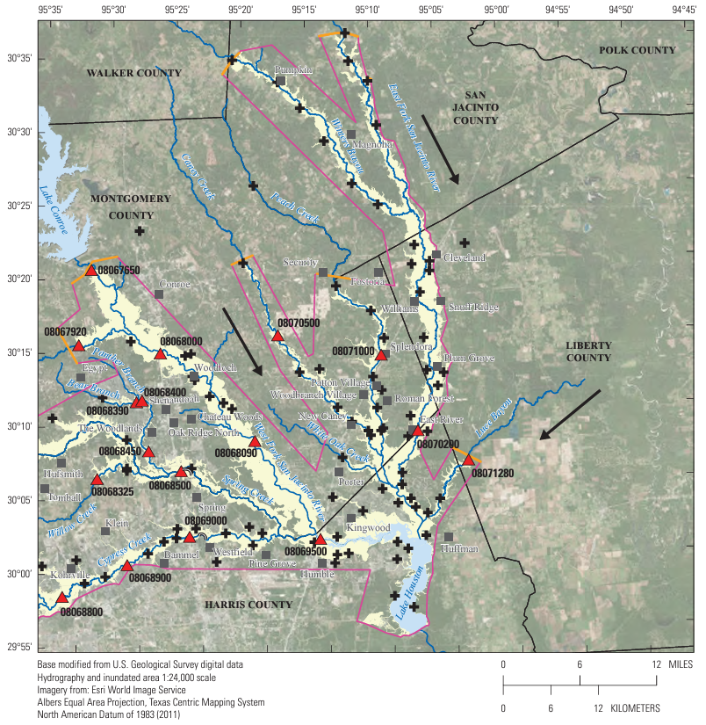
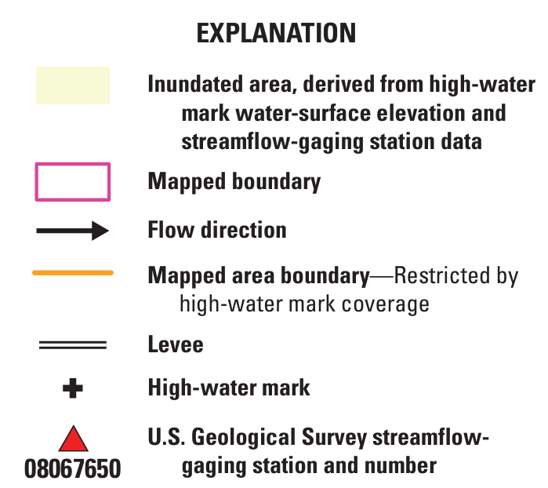
Harvey flooding
on the San Jacinto River, TX
(USGS)
Conroe
Lake
Conroe
Dam
Gage
Lake
Houston
Notes:
https://pubs.usgs.gov/publication/sir20185070

Slide 8
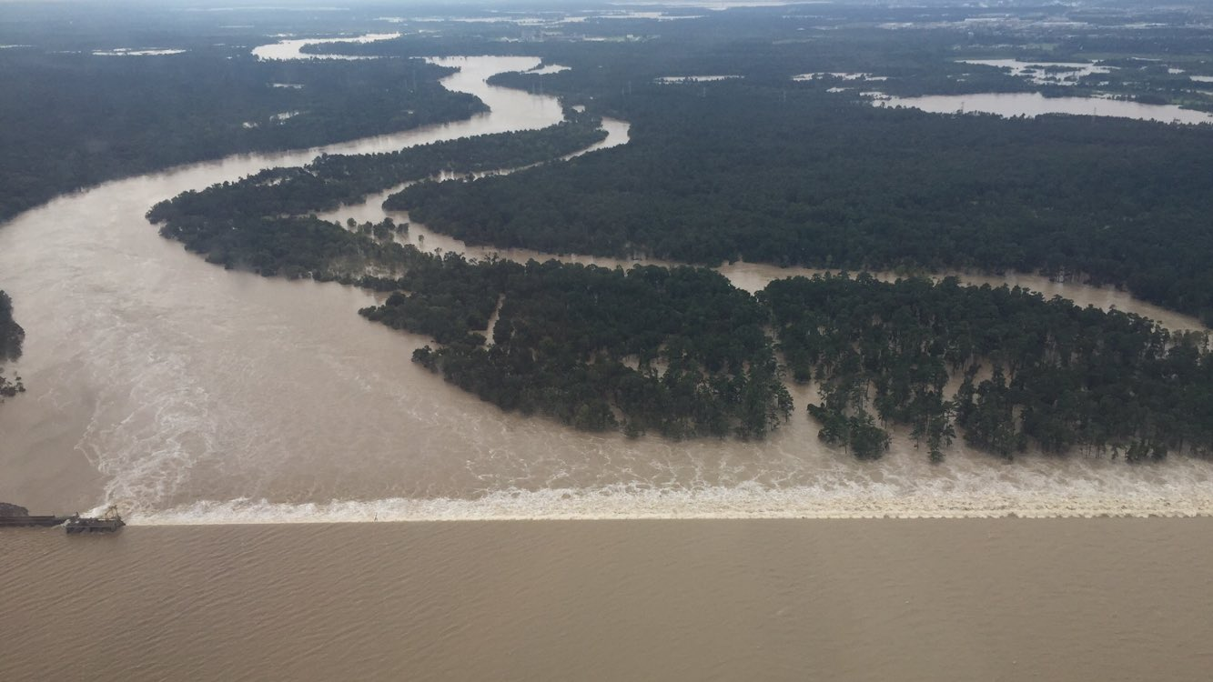
Extensive damage downstream from dam.
Downstream residents sued San Jacinto River Authority in 2017.
Dam reduced peak flow
from 3,681 m³/s to 2,237 m³/s.
Much of the water came from other sources.
Lawsuit and subsequent appeals dismissed in 2022.
Conroe Lake lowering policy modified.
Additional gates will be added to Lake Houston dam.
Lake Houston spillway on August 30, 2017
(National Weather Service)
Notes:
https://reduceflooding.com/2022/04/22/case-finally-closed-on-lake-conroe-association-lawsuit-against-city-sjra/
https://abc13.com/hundreds-of-harvey-victims-join-suit-against-river-authority/2433335/

Slide 9
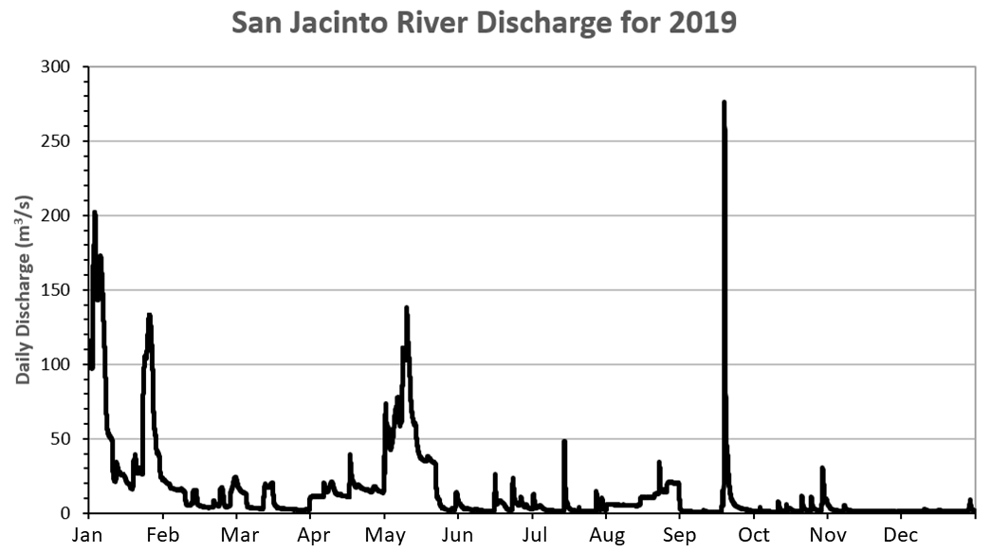

Slide 10
Human influence on discharge
Discharge is influenced by:
Human modifications of the physical landscape
Paving covers natural surfaces that might absorb water.
Storm sewers divert excess water into natural streams.
Past agricultural development replaced wetlands (natural water storage reservoirs).
Impoundment of water in artificial reservoirs.
Releases from artificial reservoirs.
We can minimize the damage caused by floods by either preventing them from happening, or by adjusting the way we live to minimize the impact when floods happen.

