Slide 1
Notes for Teaching
Memes not only help improve student engagement in classes, but can also provide analogies for students to understand complicated concepts with more familiar models.
Lucky, the cat, helps explain the principles of phase diagrams, mineral stability and reactions. A constructed diagram based on toy, food and litterbox visits illustrates these principles.

Slide 2
Thermodynamics and Phase Diagrams
Goal: to interpret mineral growth and stability as function of intensive and extensive variables controlled by thermodynamics.
Specific learning outcomes:
To be able to relate the tendency of systems toward minimum energies to nucleation, growth and mineral stability.
To apply Gibbs Phase Rule to mineral stability and reactions in phase diagrams.
Associated textbook chapters:
Winter (2014) Principles of Igneous & Metamorphic Petrology: chapter 5.
Perkins (2022) Introduction to Petrology, chapter 8 – phase equilibria and phase reactions.
Perkins (2020) Introduction to Mineralogy, chapter 8.4 – metamorphic reactions.

Slide 3
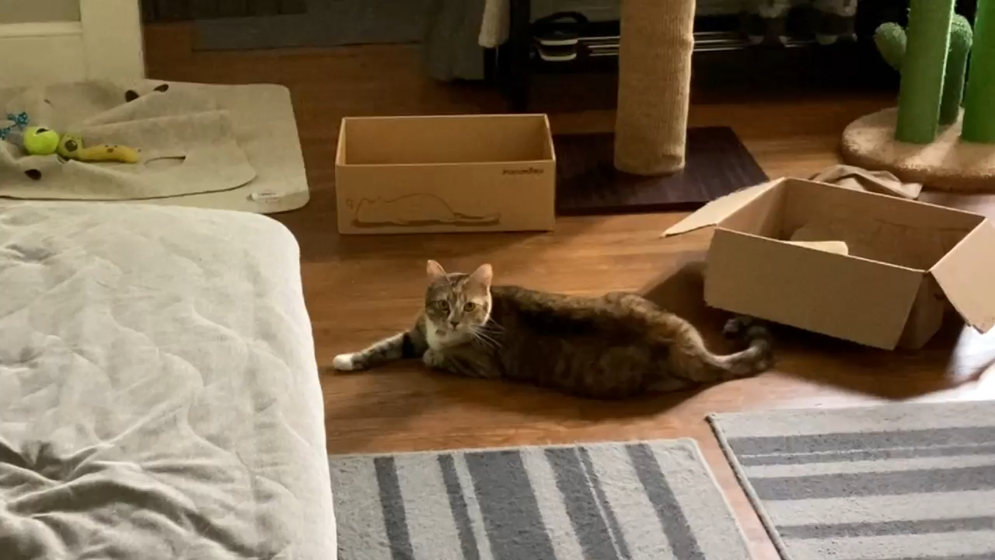
Thermodynamics & Phase Diagrams with Lucky

Slide 4
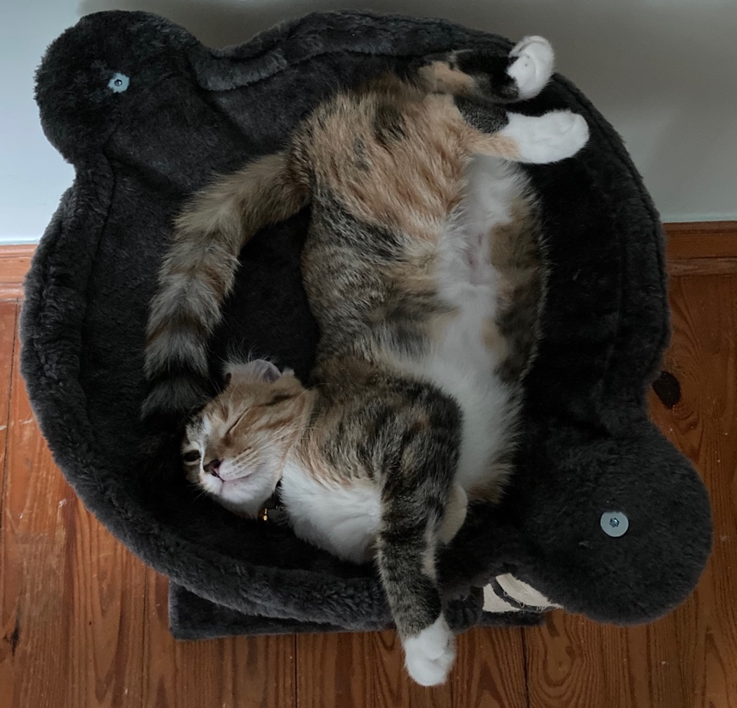
Thermodynamics
Natural systems tend toward states of minimum energy.
The energy that defines compound stability is called Gibbs free energy, after J. Willard Gibbs.

Slide 5
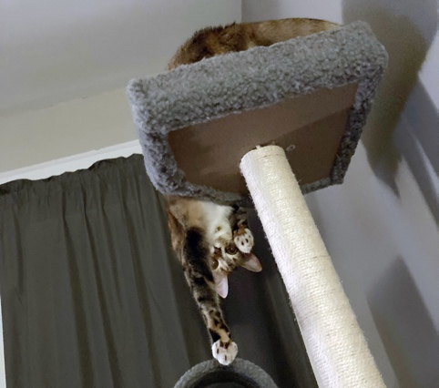
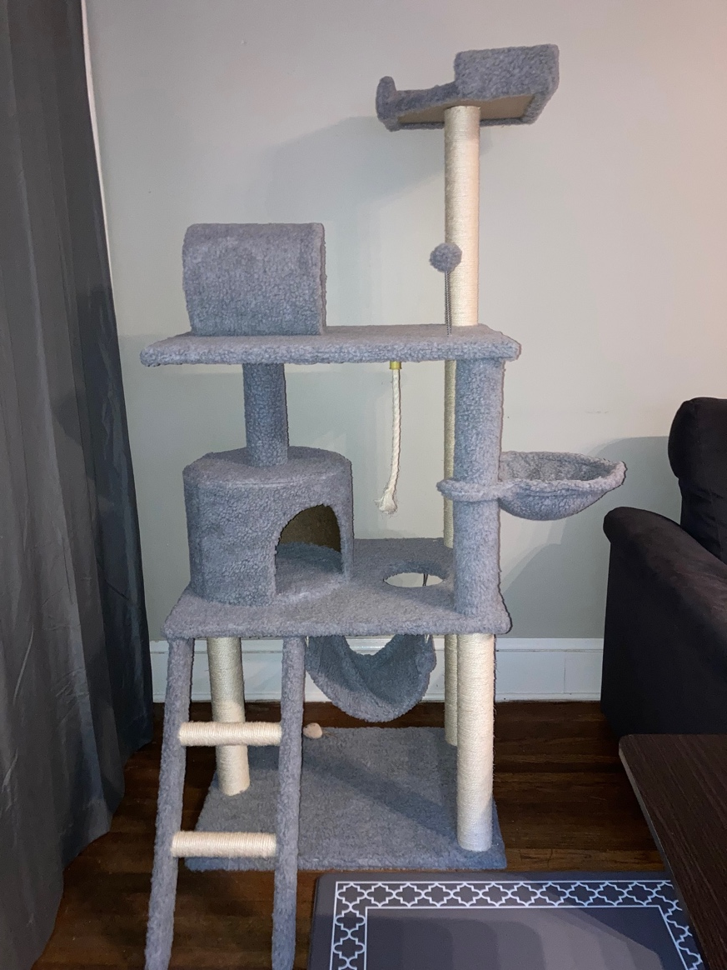

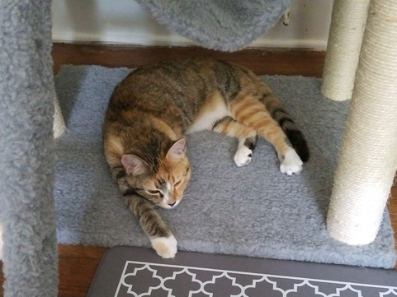
Stability of Minerals (Energy States)
Unstable
Metastable
Stable
Stable, metastable, unstable?

Slide 6
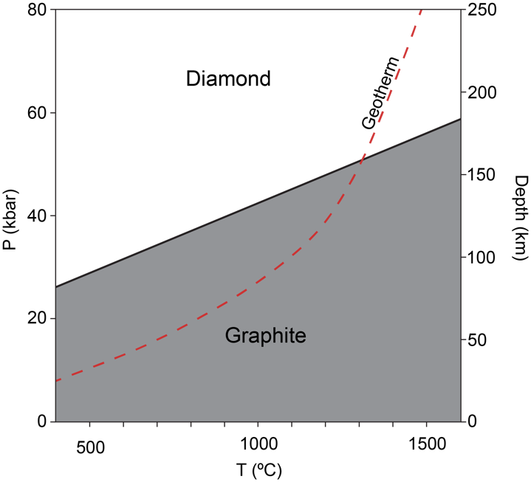
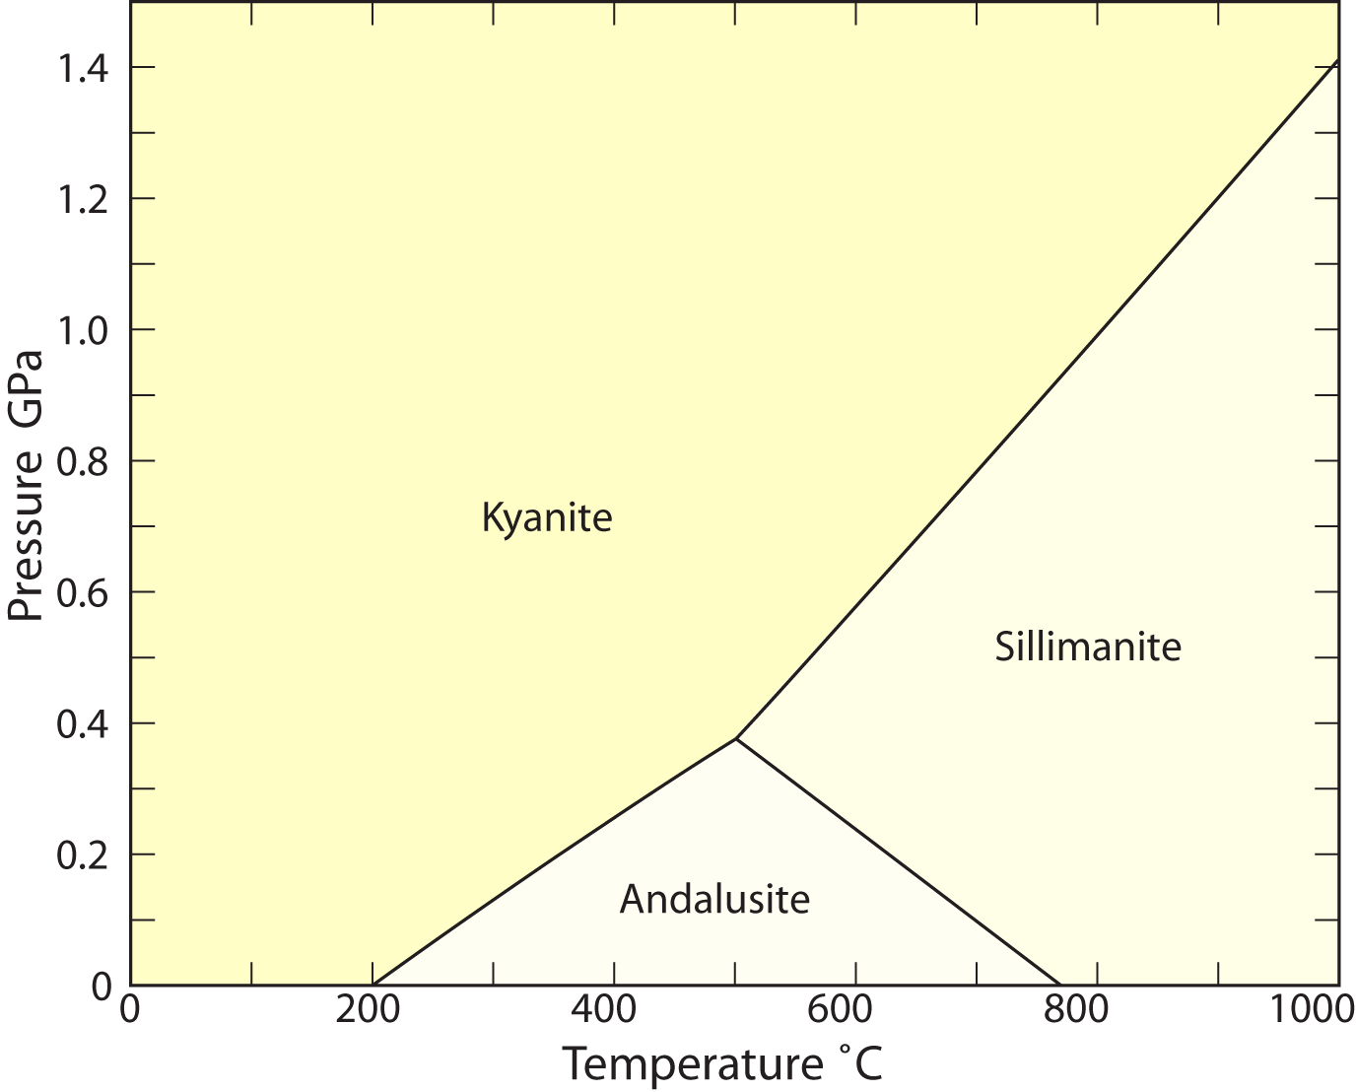
Stability of Minerals
Question 1: Diamond is not stable under normal Earth surface conditions. Yet, there are many examples of diamond at the Earth's surface.
Sillimanite is also not stable under normal Earth surface conditions, yet there is a lot of it in the mineral collections at Furman.
Explain these apparent contradictions.
Modified from Perkins (2006) https://serc.carleton.edu/NAGTWorkshops/petrology/teaching_examples/11685.html

Slide 7
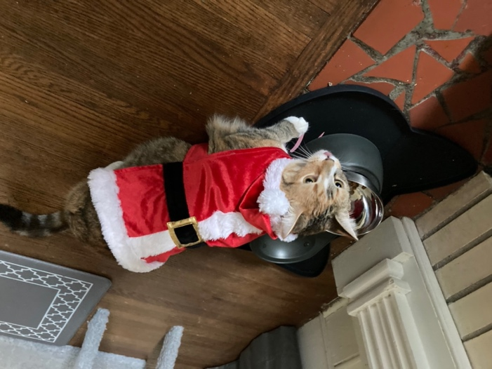
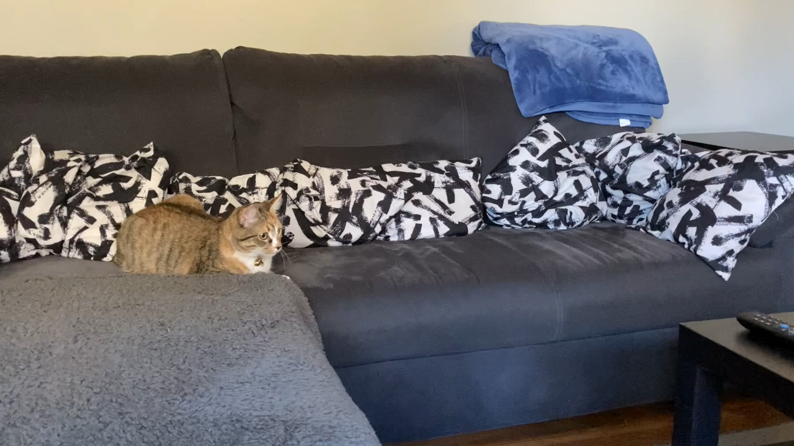
Basics of Thermodynamics
All phases, whether mineralogical or not have an associated Gibbs Free Energy of Formation value:
ΔG_{f}
This describes the amount of chemical energy that is released or consumed when a phase is created from other phases.
→
Notes:
Food gives Lucky the energy to play.

Slide 8

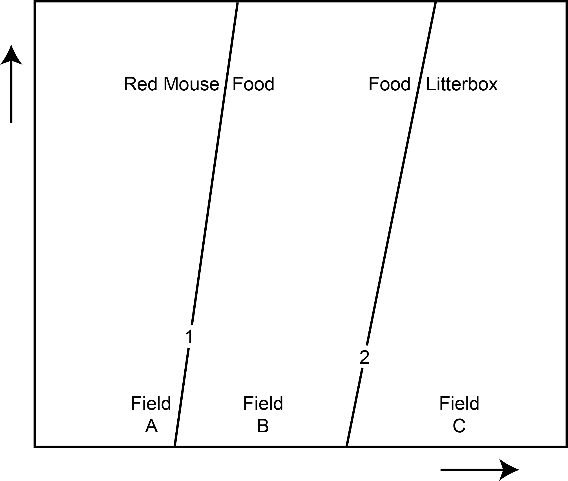

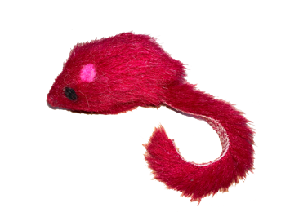
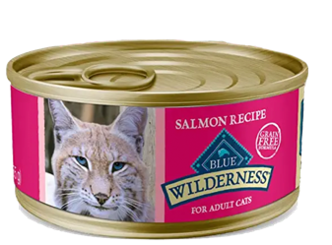
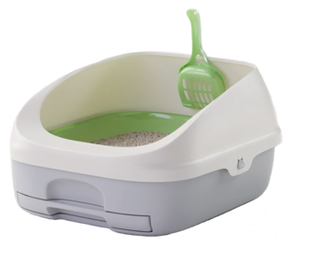
Gibbs Phase Rule & Phase Diagrams
Gibbs' Phase Rule also allows us to construct phase diagrams to represent and interpret phase equilibria in heterogeneous geologic systems.
Field: area where mineral or mineral assemblage is stable.
Reactions:
1: Red Mouse = Food
2: Food = Litterbox
Line/Curve: defines the boundaries of fields and represent reactions between the phase assemblages.
Arrows represent a change of intensive variables (e.g., temperature (T), pressure (P), composition (X)).
Notes:
Where are the following stable in the phase diagram?
Red Mouse
Food
Litterbox
Lucky

Slide 9

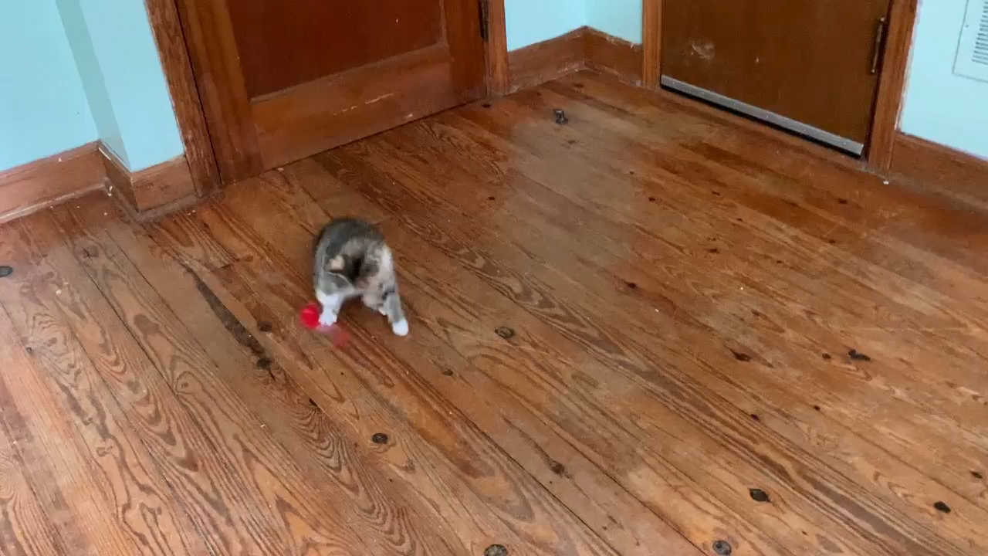

Red Mousey
Notes:
Red mouse was given to Lucky on her first vet visit and is still her favorite mouse six years later.

Slide 10

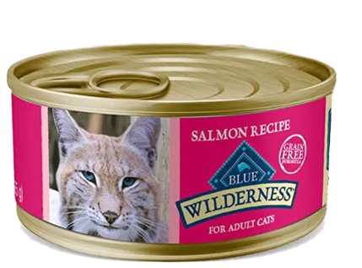


Stability of Phase Assemblages
Reaction 1:
Red mouse → food
Reaction 2:
food → litterbox
Red Mouse is stable in Field A and on Reaction 1.
Note: try not to think too hard about how this works…

Slide 11
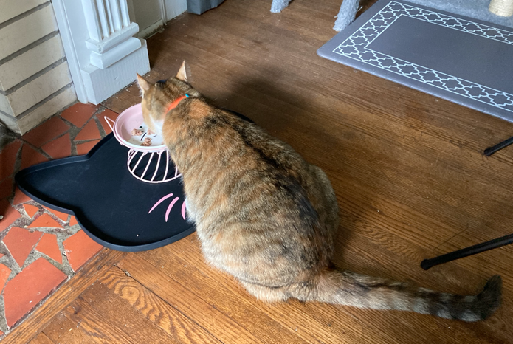
Stability of Phase Assemblages
Reaction 1:
red mouse → food
Reaction 2:
food → litterbox
Food is stable in Field B and on Reactions 1 & 2.
Note: try not to think too hard about how this works…

Slide 12
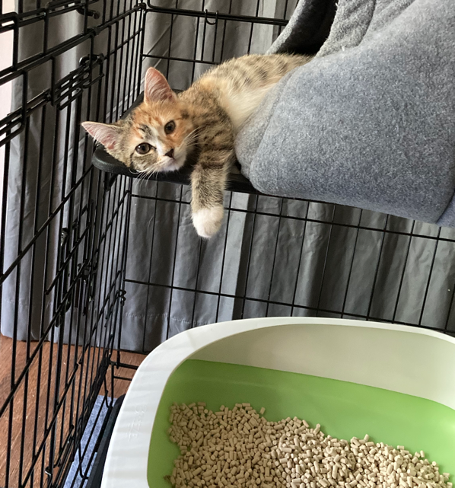
Stability of Phase Assemblages
Reaction 1:
red mouse → food
Reaction 2:
food → litterbox
Litterbox is stable in Field C and on Reaction 2.
Note: try not to think too hard about how this works…

Slide 13
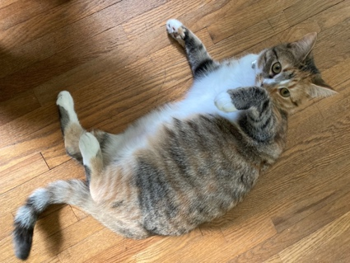
Stability of Phase Assemblages
Reaction 1:
red mouse → food
Reaction 2:
food → litterbox
Lucky is stable everywhere (no limiting reactions)
Note: try not to think too hard about how this works…

Slide 14
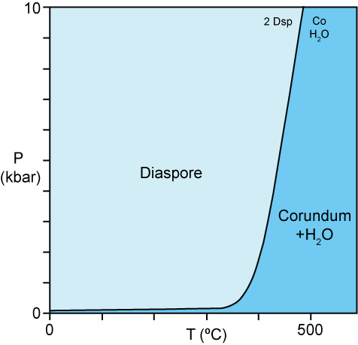
Stability of Phase Assemblages
Question 2: Where are each the assemblages in this diagram stable?
Consider for example the three phases:
  Diaspore (Dsp): AlO(OH)
  Corundum (Co): Al₂O₃
  Water: H₂O
The equation can be balanced and written as:
2 Dsp = Co + H­₂O
Most mineral equilibria are heterogeneous, and most involve more than a single component.
Assemblage | # of minerals in assemblage
Diaspore | 1
Corundum | 1
H₂O | 1
Diaspore-corundum | 2
Diaspore-H₂O | 2
Corundum-H₂O | 2
Diaspore-corundum-H₂O | 3
Phase diagram showing the reaction 2Dsp = Co + H₂O
From Perkins (2006) https://serc.carleton.edu/NAGTWorkshops/petrology/teaching_examples/11685.html

Slide 15
Stability of Phase Assemblages
The stable assemblages are:
Assemblage | # of minerals in assemblage
Diaspore | 1
Corundum | 1
H₂O | 1
Diaspore-corundum | 2
Diaspore-H₂O | 2
Corundum-H₂O | 2
Diaspore-corundum-H₂O | 3
Question 2: Where are these stable?
It may help to consider:
  Limiting reactions: a reaction that eliminates a phase/assemblage.
  Whether the exact assemblage is represented in the phase diagram or not.
Phase diagram showing the reaction 2Dsp = Co + H₂O
From Perkins (2006) https://serc.carleton.edu/NAGTWorkshops/petrology/teaching_examples/11685.html

Slide 16
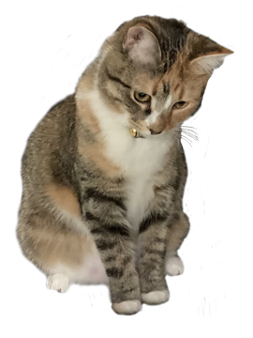
Stability of Phase Assemblages
Reaction 1:
red mouse → food
Reaction 2:
food → litterbox
Red mouse & Food can exist together on shared reaction line.
Food & Litterbox can exist together on shared reaction line.
Red mouse & Litterbox are never stable together as they are separated by a field
Note: try not to think too hard about how this works…

Slide 17
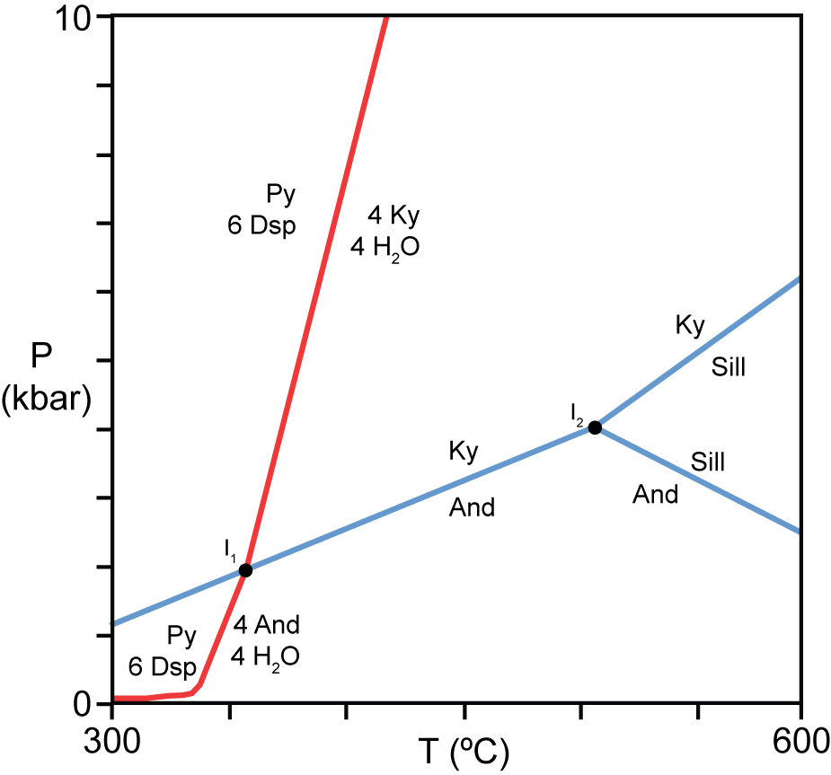
Stability of Phase Assemblages
Question 3: The reactions in the simplified phase diagram are:
  Py + 6 Dsp = 4 Ky + 4 H₂O
  Py + 6 Dsp = 4 And + 4 H₂O
  Al₂SiO₅ = Al₂SiO₅
There are 63 possible stable assemblages (in the entire system).
Which assemblages are stable nowhere on the diagram?
Phase diagram showing some reactions in the system Al₂O₃ – SiO₂ – H₂O
From Perkins (2006) https://serc.carleton.edu/NAGTWorkshops/petrology/teaching_examples/11685.html

Slide 18
Reactions in Phase Diagrams
Reaction 1:
red mouse → food
Reaction 2:
food → litterbox
1 food = ??
6 food = ??
2 food + 1 Lucky = ??
Note: try not to think too hard about how this works…
Notes:
Complete the equations

Slide 19
Reactions in Phase Diagrams
Reaction 1:
red mouse → food
Reaction 2:
food → litterbox
1 food = 1 litterbox
6 food = 6 litterbox
(lots of food means lots of litterbox visits).
2 food + 1 Lucky = 2 litterbox + 1 Lucky.
(Lucky is not changed by her litterbox visit, but is still present)
Note: try not to think too hard about how this works…
Notes:
Complete the equations

Slide 20
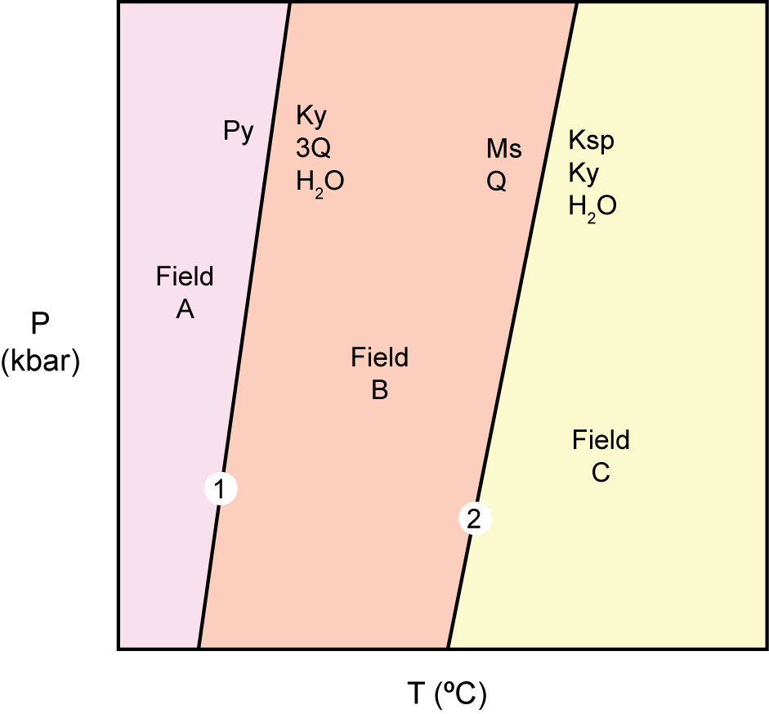
Reactions in Phase Diagrams
Schematic phase diagram showing reactions that can occur in aluminous schists.
The schematic phase diagram represents the reactions:
  Py = Ky + 3Q + H₂O
  Ms + Q = Ksp + Ky + H₂O
Question 4: For each assemblage describe what (if any) changes will occur as it is heated.
Carefully consider the phases in the starting compound, compared to the reacting phases, along with number of moles of each phase in the starting compound.
# | Minerals (and amounts) in Field A | Minerals (and amounts) in Field B | Minerals (and amounts) in Field C
1 | 3 Py
2 | 2Py, 2Q
3 | 1Py, 3Q
4 | 1Py, 3Ms
5 | 1Py, 5Ms
From Perkins (2006) https://serc.carleton.edu/NAGTWorkshops/petrology/teaching_examples/11685.html

