Slide 1
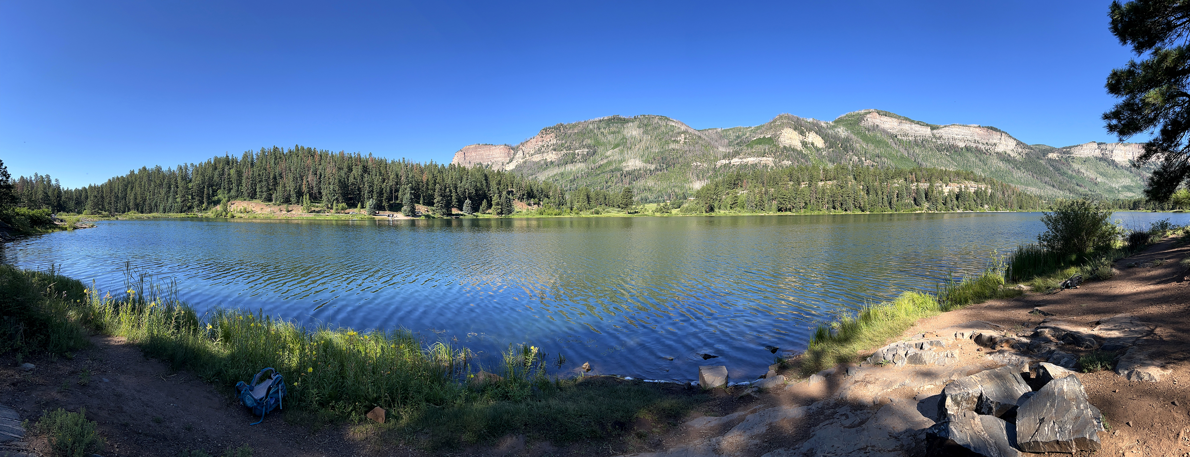
What’s so exciting about Haviland Lake?
Hermosa Cliffs
Haviland Lake

Slide 2
Overview
Setting of this virtual field experience
Exploring field stop #1
  Make observations on two 3D outcrop models
  Ask questions
  Identify the type of rock and the age
Exploring field stop #2
  Make observations
  Ask questions
  Identify the type of rock and the age
Telling a geologic story
  Determine the age difference between the rocks
  Put together a plausible sequence of geologic events

Slide 3
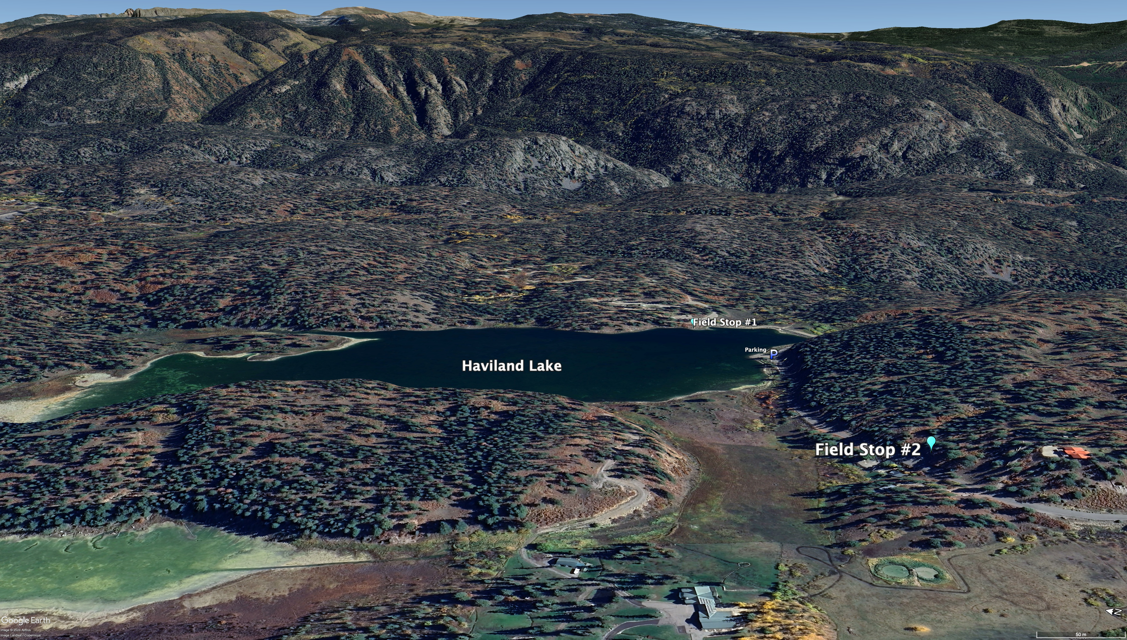
Where is this lake?
Play the overview tour (see lab handout for instructions)
Discussion questions:
  Where is Fort Lewis College relative to your school & have you been to the region?
  What did you find most striking during the fly through from FLC to Haviland Lake?
Notes:
If your students have never used Google Earth, there are several introductory instructions that they can use (see the end of the instructor handout for an example). You want to make sure that they have Google Earth Pro on desktop (https://www.google.com/earth/about/versions/#download-pro). It’s free! They should be able to:
Expand folders and navigate to placemarks by double-clicking on the placemark and waiting for it to ‘fly in’
Enter street view in Google Earth Pro
Turn placemarks/folders off and on
There is no dialogue to the Google Earth tour, so everyone can watch it on their own or you can show the tour at the front of the classroom. Key landmarks that we would point out while driving to the lake are labelled.

Slide 4
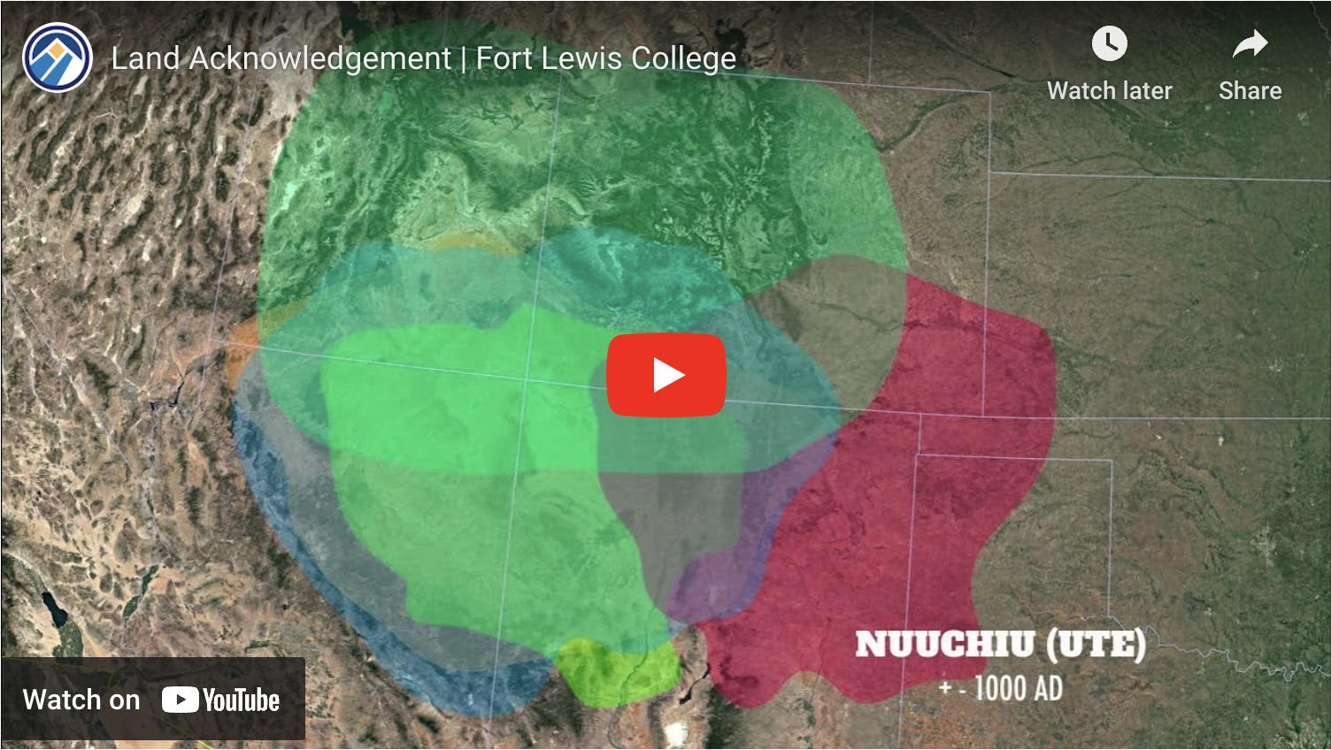
Regional & cultural context
We acknowledge the land that Fort Lewis College is situated upon is the ancestral land and territory of the Nuuchiu (Ute) people who were forcibly removed by the United States Government. We also acknowledge that this land is connected to the communal and ceremonial spaces of the Jicarilla Abache (Apache), Pueblos of New Mexico, Hopi Sinom (Hopi), and Diné (Navajo) Nations. It is important to acknowledge this setting because the narratives of the lands in this region have long been told from dominant perspectives, without full recognition of the original land stewards who continue to inhabit and connect with this land. Thank you for your attention and respect in acknowledging this important legacy.
Notes:
The video showing the ancestral territories prior to colonization is linked to the screencap above. If it does not find the correct video, you can follow this link: https://youtu.be/v4yCnwJE8_M. The land acknowledgement (to the left) is not included in the video, but the video helps to put the land acknowledgement into spatial context. To read more about our land acknowledgement and our history, please see the following link: https://www.fortlewis.edu/about-flc/leadership/presidents-office/land-acknowledgment.
Note that Fort Lewis College is a Native American Serving Non-tribal Institution. All enrolled citizens in a federally-recognized American Indian Tribal Nation and all Alaska Village Natives attend FLC with free tuition (https://www.fortlewis.edu/tuition-aid/native-american-tuition-waiver). This tuition waiver is federally mandated. The land that FLC is on was owned by the U.S. government in the 1800s and was granted to the State of Colorado in 1911 under the stipulation that: the property must remain an educational center and be inclusive of Native American students who would be admitted tuition-free and offered an education equal to all students. Around 45% of our students are Native American or Alaska Native, and they represent over 185 tribes and villages.
During the 1800’s, the original Fort Lewis site in Hesperus, CO was a Federal Indian Boarding School. The land was granted to the state in 1911 when the boarding school closed, and Fort Lewis College (at its current location) opened. This history has significant intergenerational impacts on our former and current students, and FLC is dedicated to reconciliation. Although this is not the point of this field trip, it is important to note this history, and we wanted to provide resources in case you wanted to learn more or in case it came up with your students. To learn more about the Native American Boarding School Research Program Act, the findings for Fort Lewis Indian Boarding School, and actions towards reconciliation, please see our website: https://www.fortlewis.edu/about-flc/leadership/diversity-affairs/reconciliation.

Slide 5
How do we get between the field stops?
Using street view at the parking placemark (see lab handout for instructions)
  Imagine that you hop out of the van and are about to head towards Field Stop #1. Which way are you going to go and how will you get there?
  Which way will you need to go to get from Field Stop #1 to #2?
Some of these street views aren’t as warm and sunny as the pictures we have. Even FLC students can’t always explore these rocks!

Slide 6
Exploring Field Stop #1

Slide 7
Sharing coolest thing from the outcrop
Explore for 10 mins
Upload a screen cap for your group to LOCATION
Be prepared to share

Slide 8
Group observations
(space to make notes from class observations)
Notes:
You can pool the observations from the groups in this slide or you can do it on the board

Slide 9
What is the rock in this outcrop?
Tasks:
  Hypothesize which of the three main classes this belongs to using the 3D model observations.
  Brainstorm 1-3 ways you could test your hypothesis if you were in the field or observations that you could make that would help you select a specific rock name.
  Ask your instructor questions based on your brainstorm in step #2.
  Evaluate your hypothesis based on the answers that you get in step #3
  Repeat until you feel confident about your rock identification!
Notes:
Images and answers for common questions are included in the next section.

Slide 10
Q&A for Field Stop #1
Use your discretion to tie the students’ actual questions to the ones listed here.
Notes:
You can print these individual cards or just show the teams the slides as they come up with questions. Some of the questions they will pose may not have slide answers, and you can use your judgement and understanding of the geology. Feel free to change how the answers are worded!

Slide 11
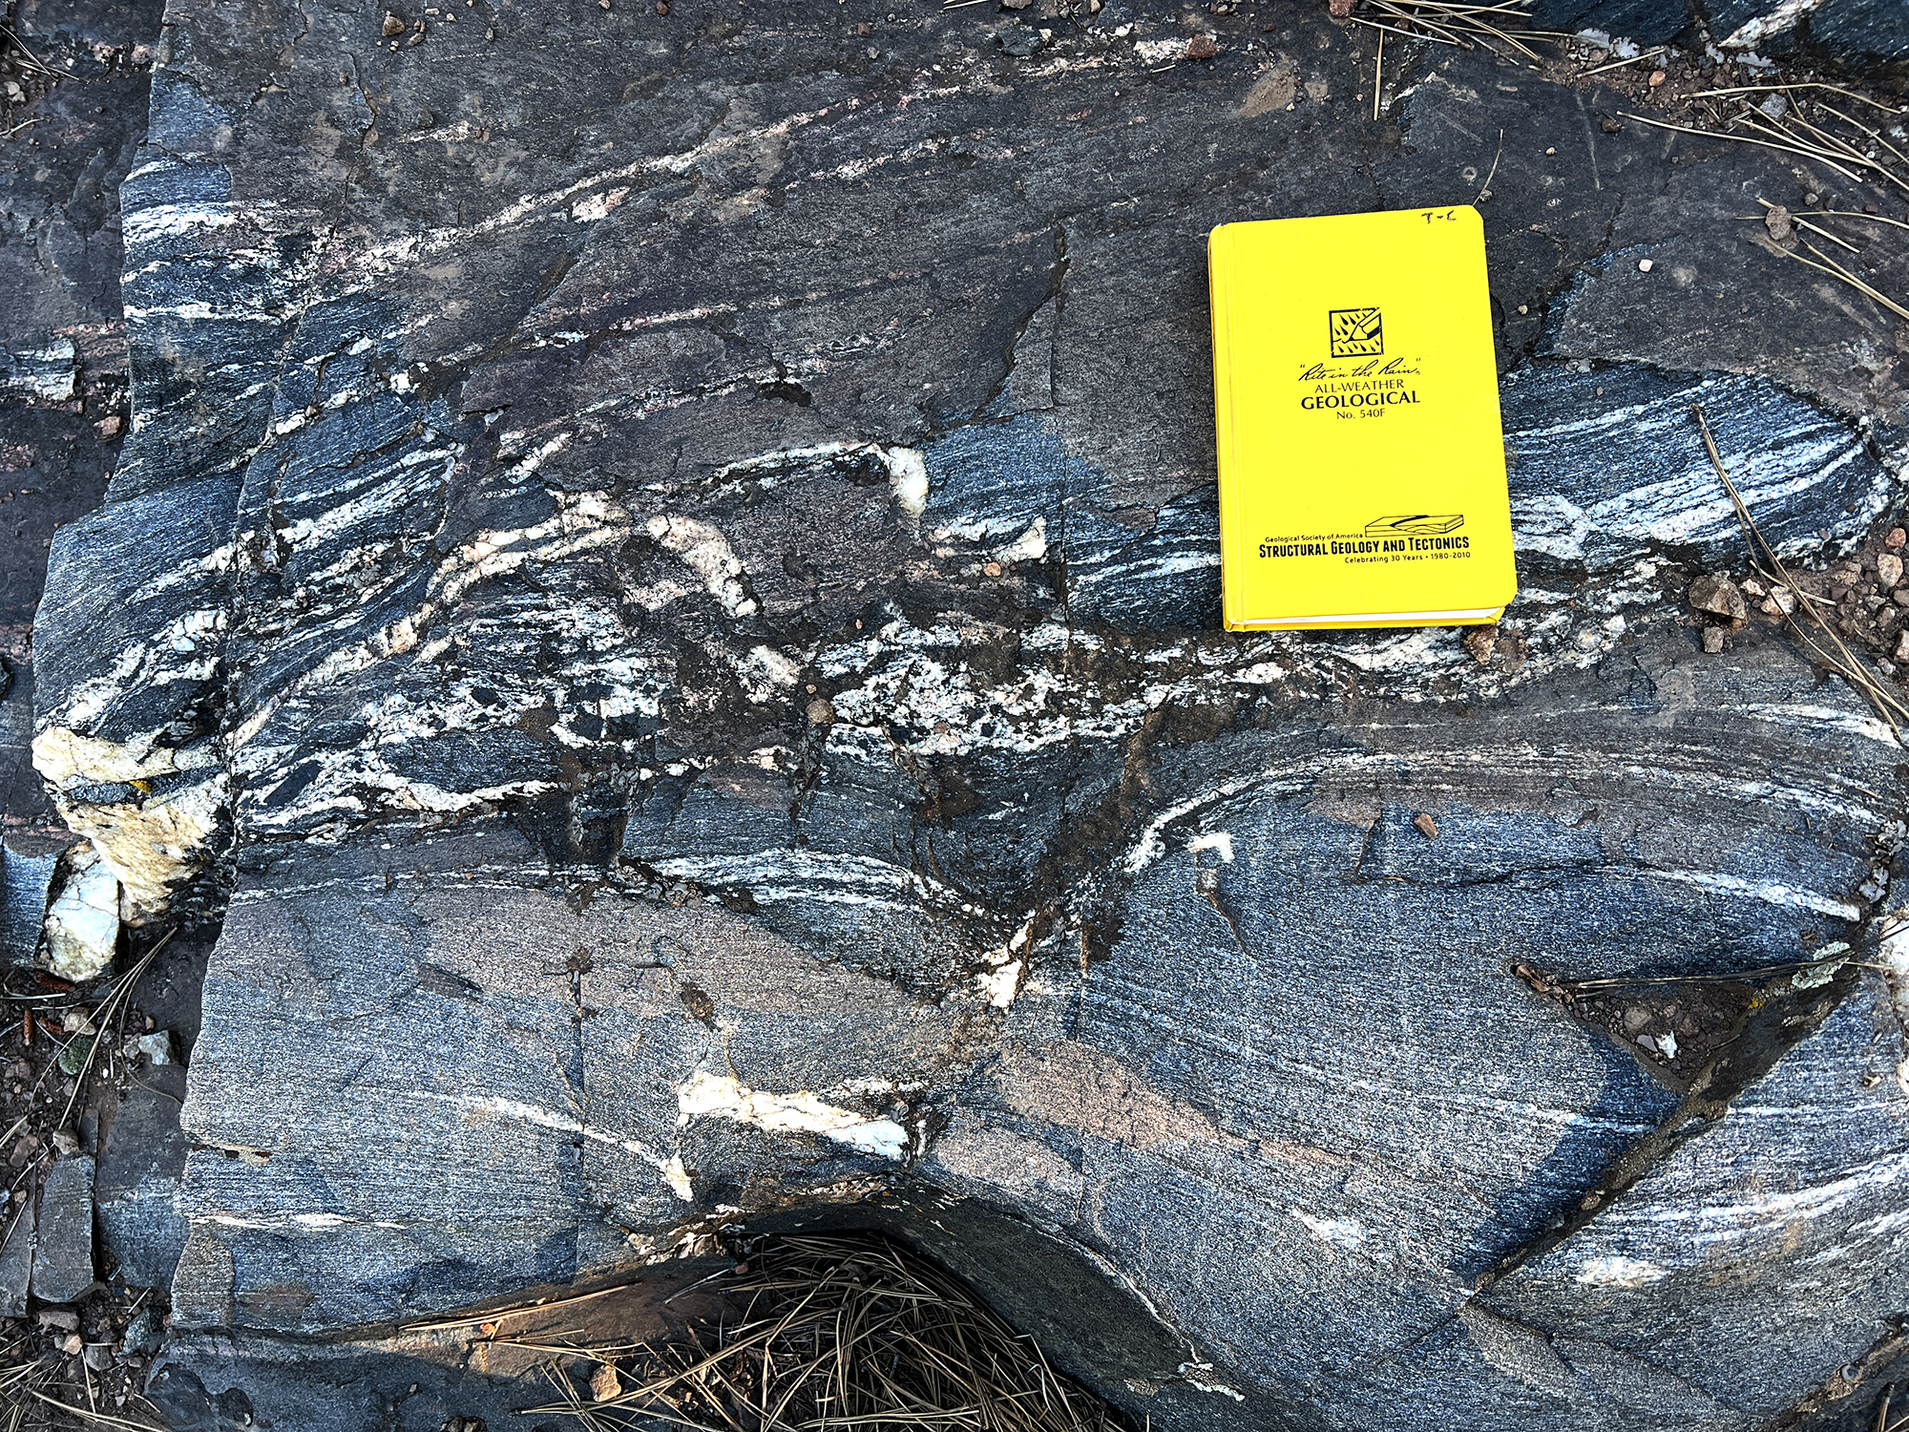
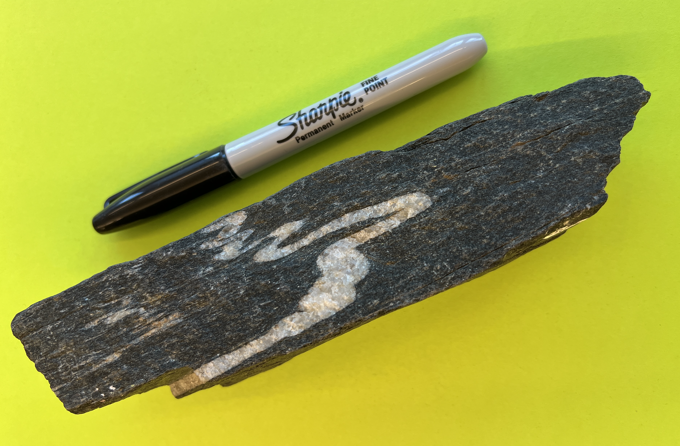
Minerals that make up this rock
Hornblende
Biotite Mica
Quartz
Plagioclase Feldspar
Potassium Feldspar
Muscovite Mica

Slide 12
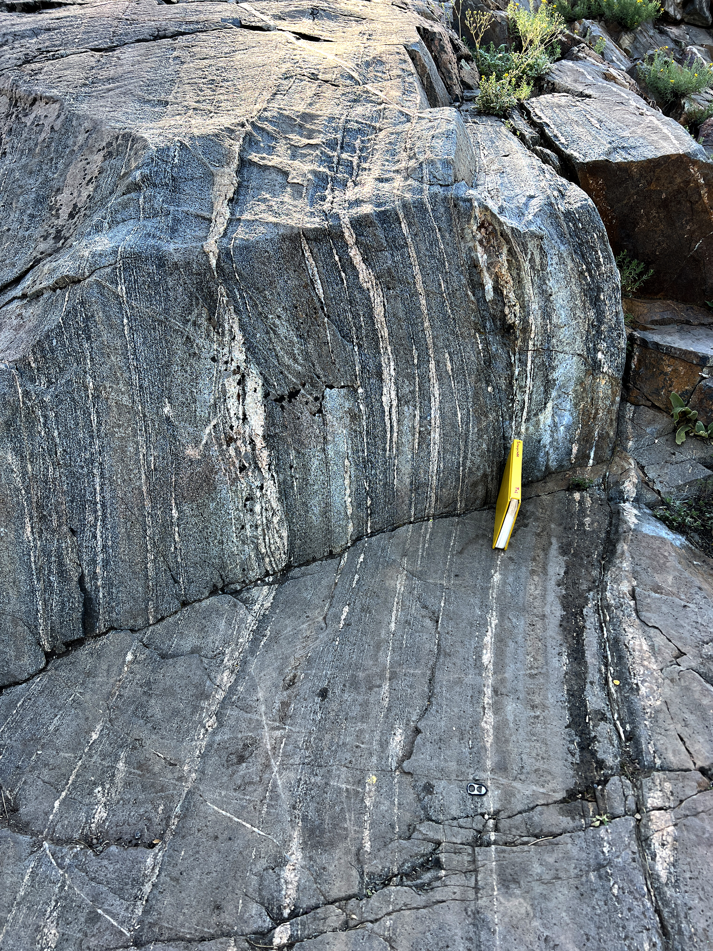
Planar features within this rock
This rock has planes of aligned micas & hornblende alternating with planes of quartz and feldspar. These planes are nearly vertical.
Notes:
This could be sedimentary, igneous, or metamorphic features, and how the students will ask about this will depend on what they think this rock is to begin with. This rock is well-foliated (near vertical) and moderately lineated (defined by stretched hornblendes, steeply plunging).

Slide 13
Crystalline vs. clastic
When you look at this rock through a hand lens, the minerals are interlocking.

Slide 14
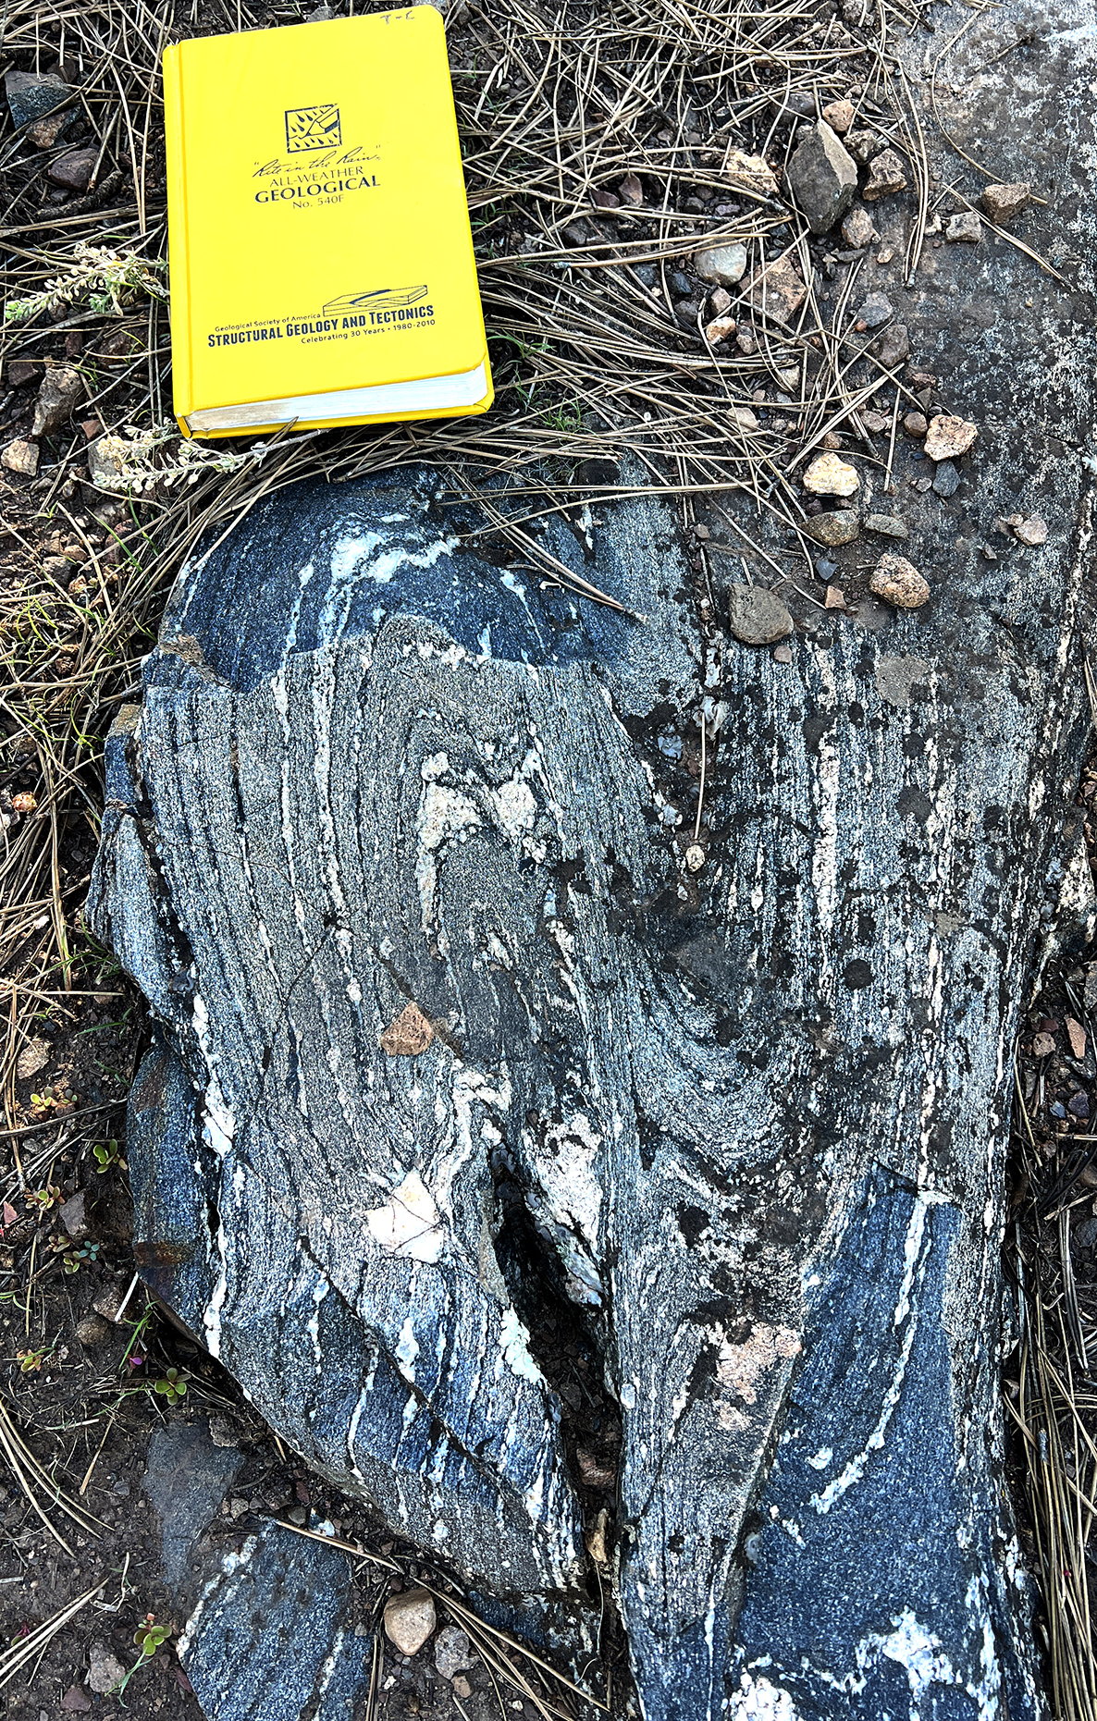
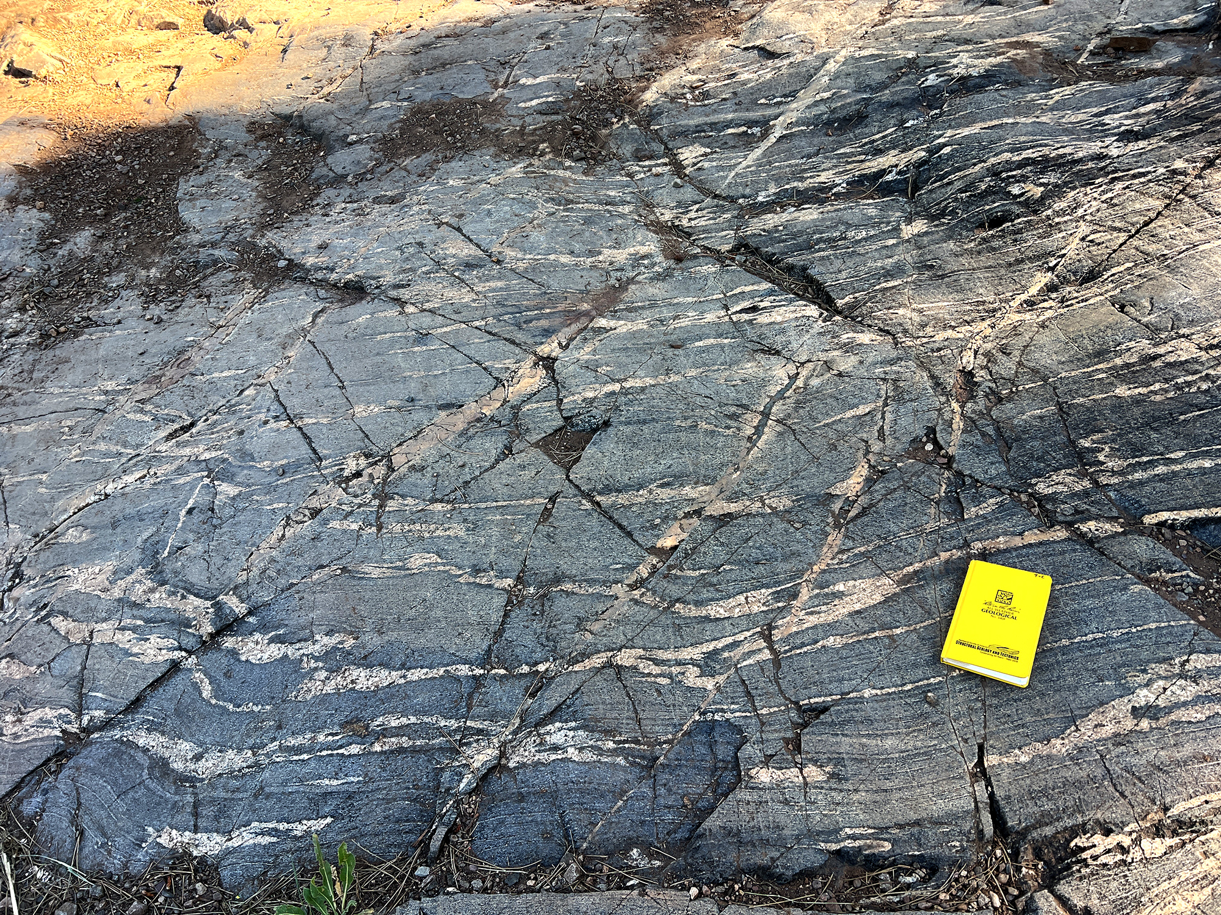
Deformation features within this rock
Folds
Brittle veins

Slide 15
Are there fossils in this rock?
No

Slide 16
Be prepared to share:
Classification of this rock into igneous, sedimentary, or metamorphic and the specific rock name
How might this activity have been different if you were actually in the field?

Slide 17
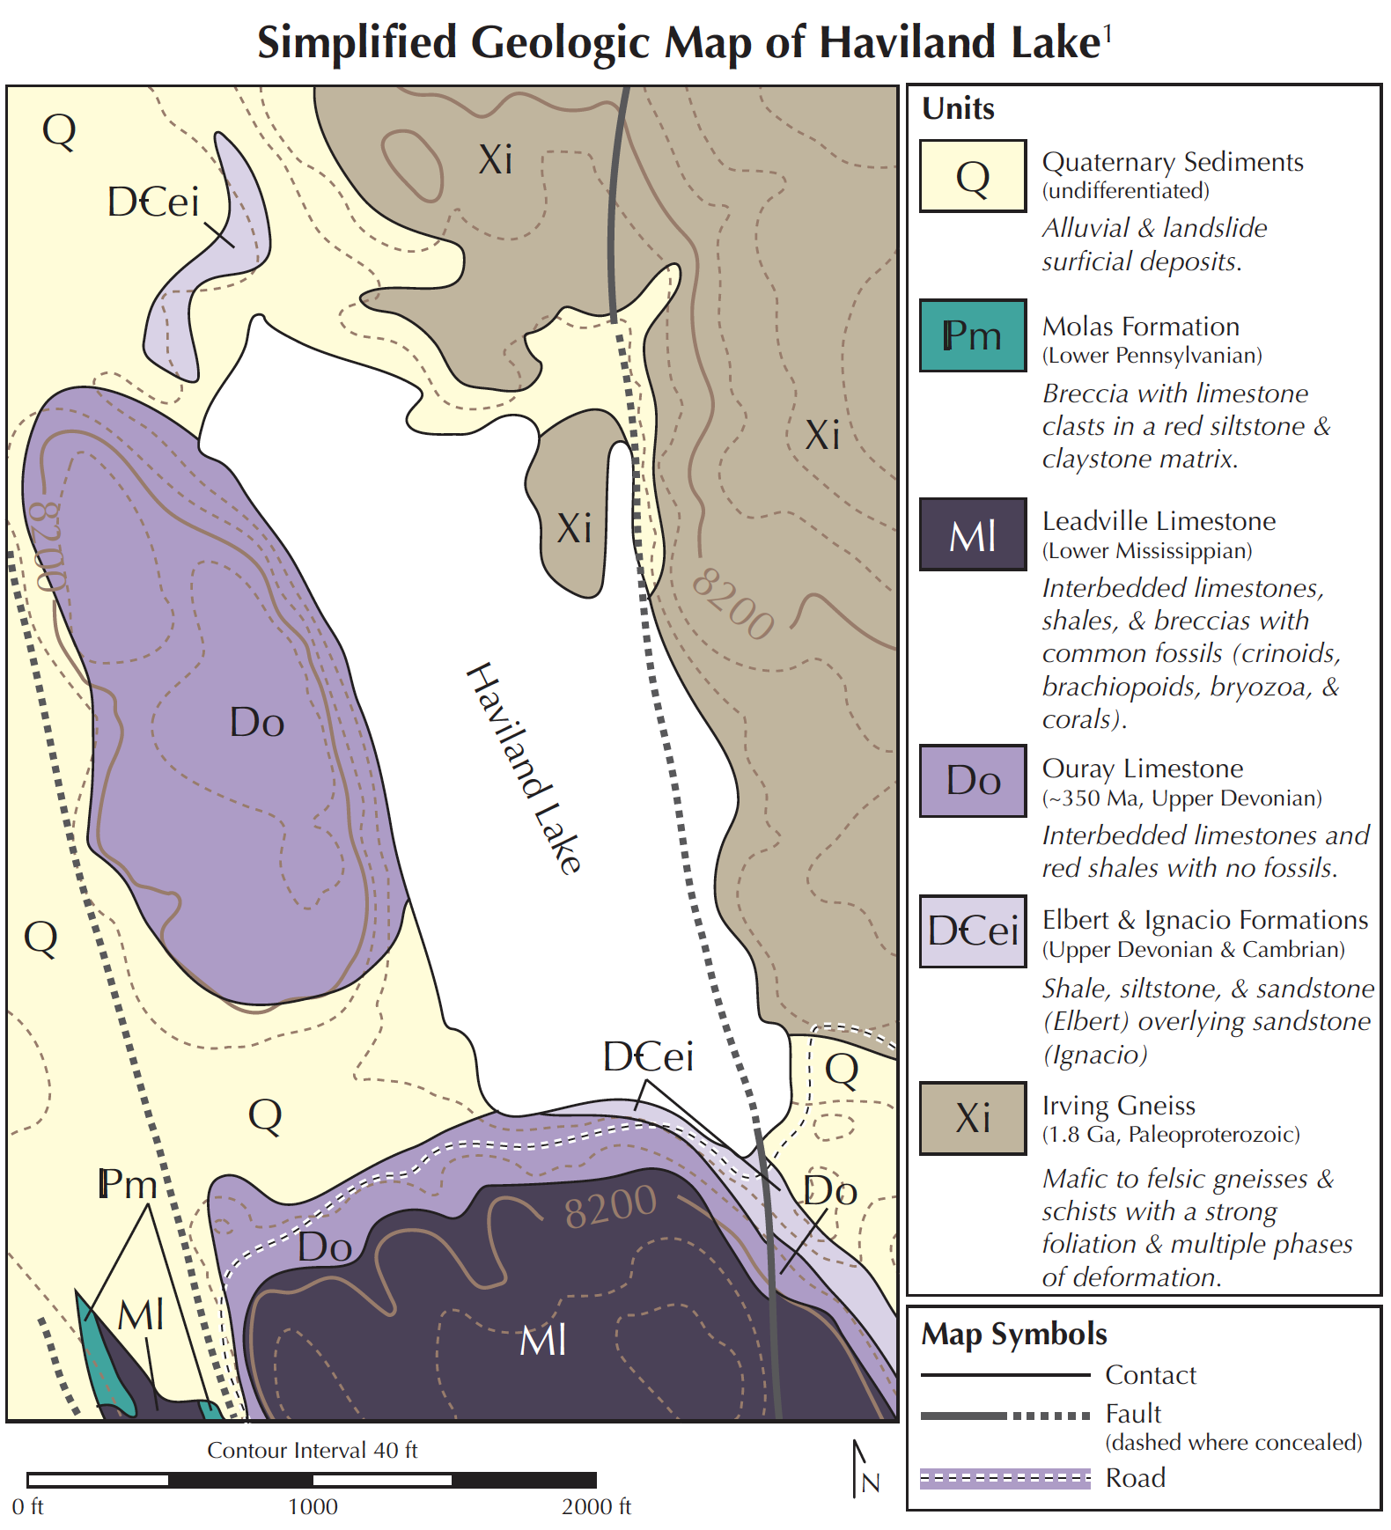
Finding this rock on a geologic map
¹Simplified from Gonzales, et al., 2003, Geologic map of the Electra Lake 7.5-minute quadrangle, La Plata County, Colorado: Colorado Geological Survey, OF 03-21
Notes:
The students should work with their group and Google Earth to orient themselves. The lake and the road are good landmarks to estimate the location of each field stop. If they’ve come up with a good rock ID, this should be fairly straightforward. This map is available as a layer in the .kmz, so they can check their answers, and they’re asked to reflect in the lab on what worked and what didn’t (if they came up with the wrong answer).

Slide 18
Exploring Field Stop #2

Slide 19
Sharing observations from the outcrop
Explore for 10 mins
Be prepared to share your list of observations

Slide 20
Group observations
(space to make notes from class observations)
Notes:
You can pool the observations from the groups in this slide or you can do it on the board

Slide 21
Identifying this rock
Tasks:
  Hypothesize which of the three main classes this belongs to using the 3D model observations.
  Brainstorm 1-3 ways you could test your hypothesis if you were in the field or observations that you could make that would help you select a specific rock name.
  Ask your instructor questions based on your brainstorm in step #2.
  Evaluate your hypothesis based on the answers that you get in step #3
  Repeat until you feel confident about your rock identification!
Notes:
Images and answers for common questions are included in the next section.

Slide 22
Q&A for Field Stop #2
Use your discretion to tie the students’ actual questions to the ones listed here.
Notes:
You can print these individual cards or just show the teams the slides as they come up with questions. Some of the questions they will pose may not have slide answers, and you can use your judgement and understanding of the geology. Feel free to change how the answers are worded!

Slide 23
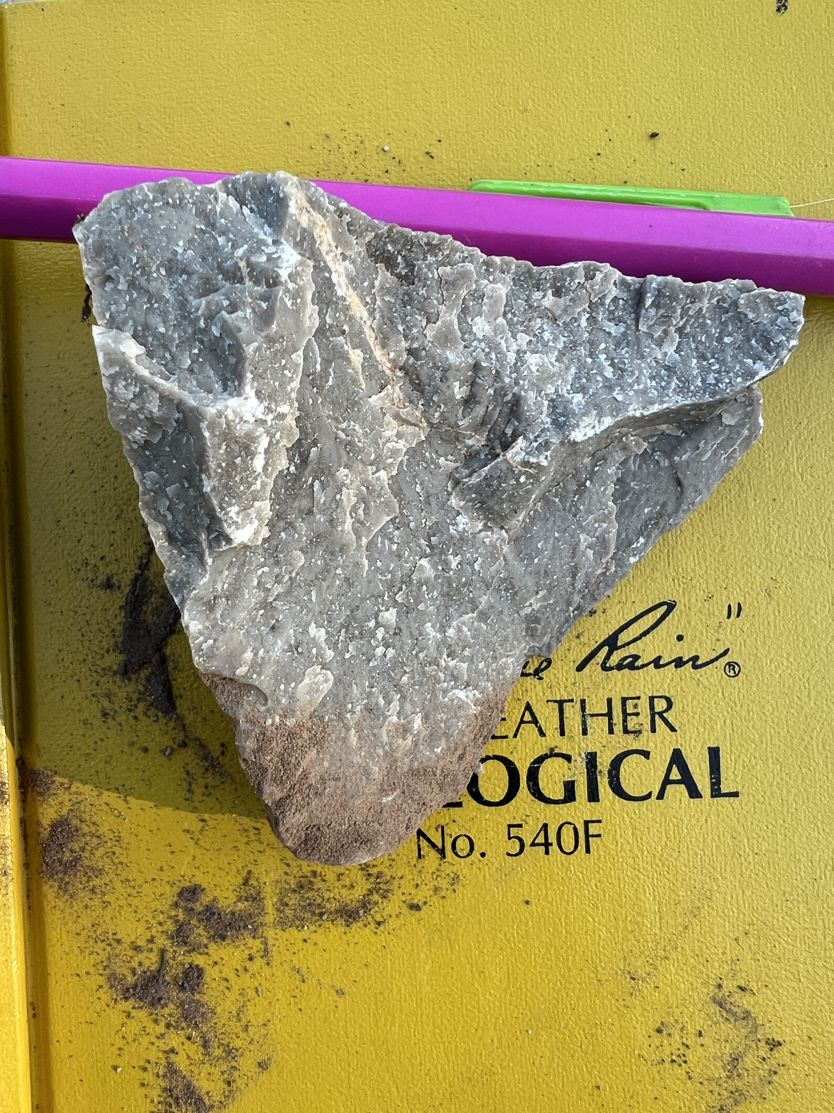
Minerals?
Most of this outcrop is a gray rock that is made up of a clear mineral, but you can’t tell anything more without further tests.

Slide 24
Mineral hardness
This mineral is quite soft and can be scratched easily with a knife. You cannot scratch it with your fingernail.

Slide 25
HCl test
This rock fizzes when dilute HCl is dripped onto the surface!

Slide 26
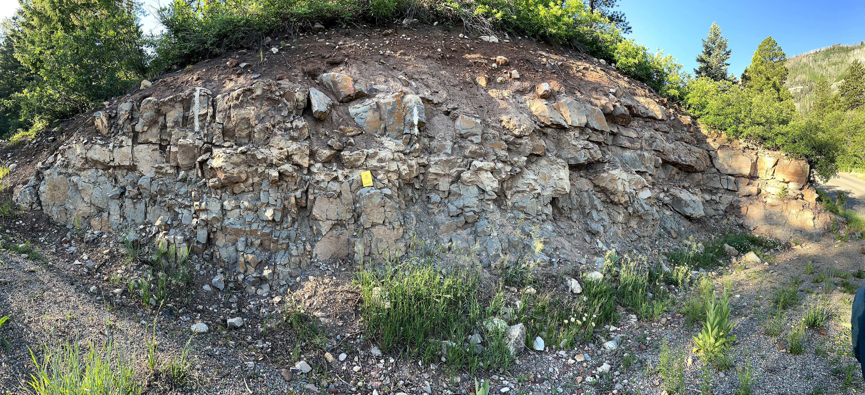
Planar features
This outcrop has two sets of planar features: a close to vertical and a close to horizontal set.
  One of these is a set of fractures
  One of these is bedding

Slide 27
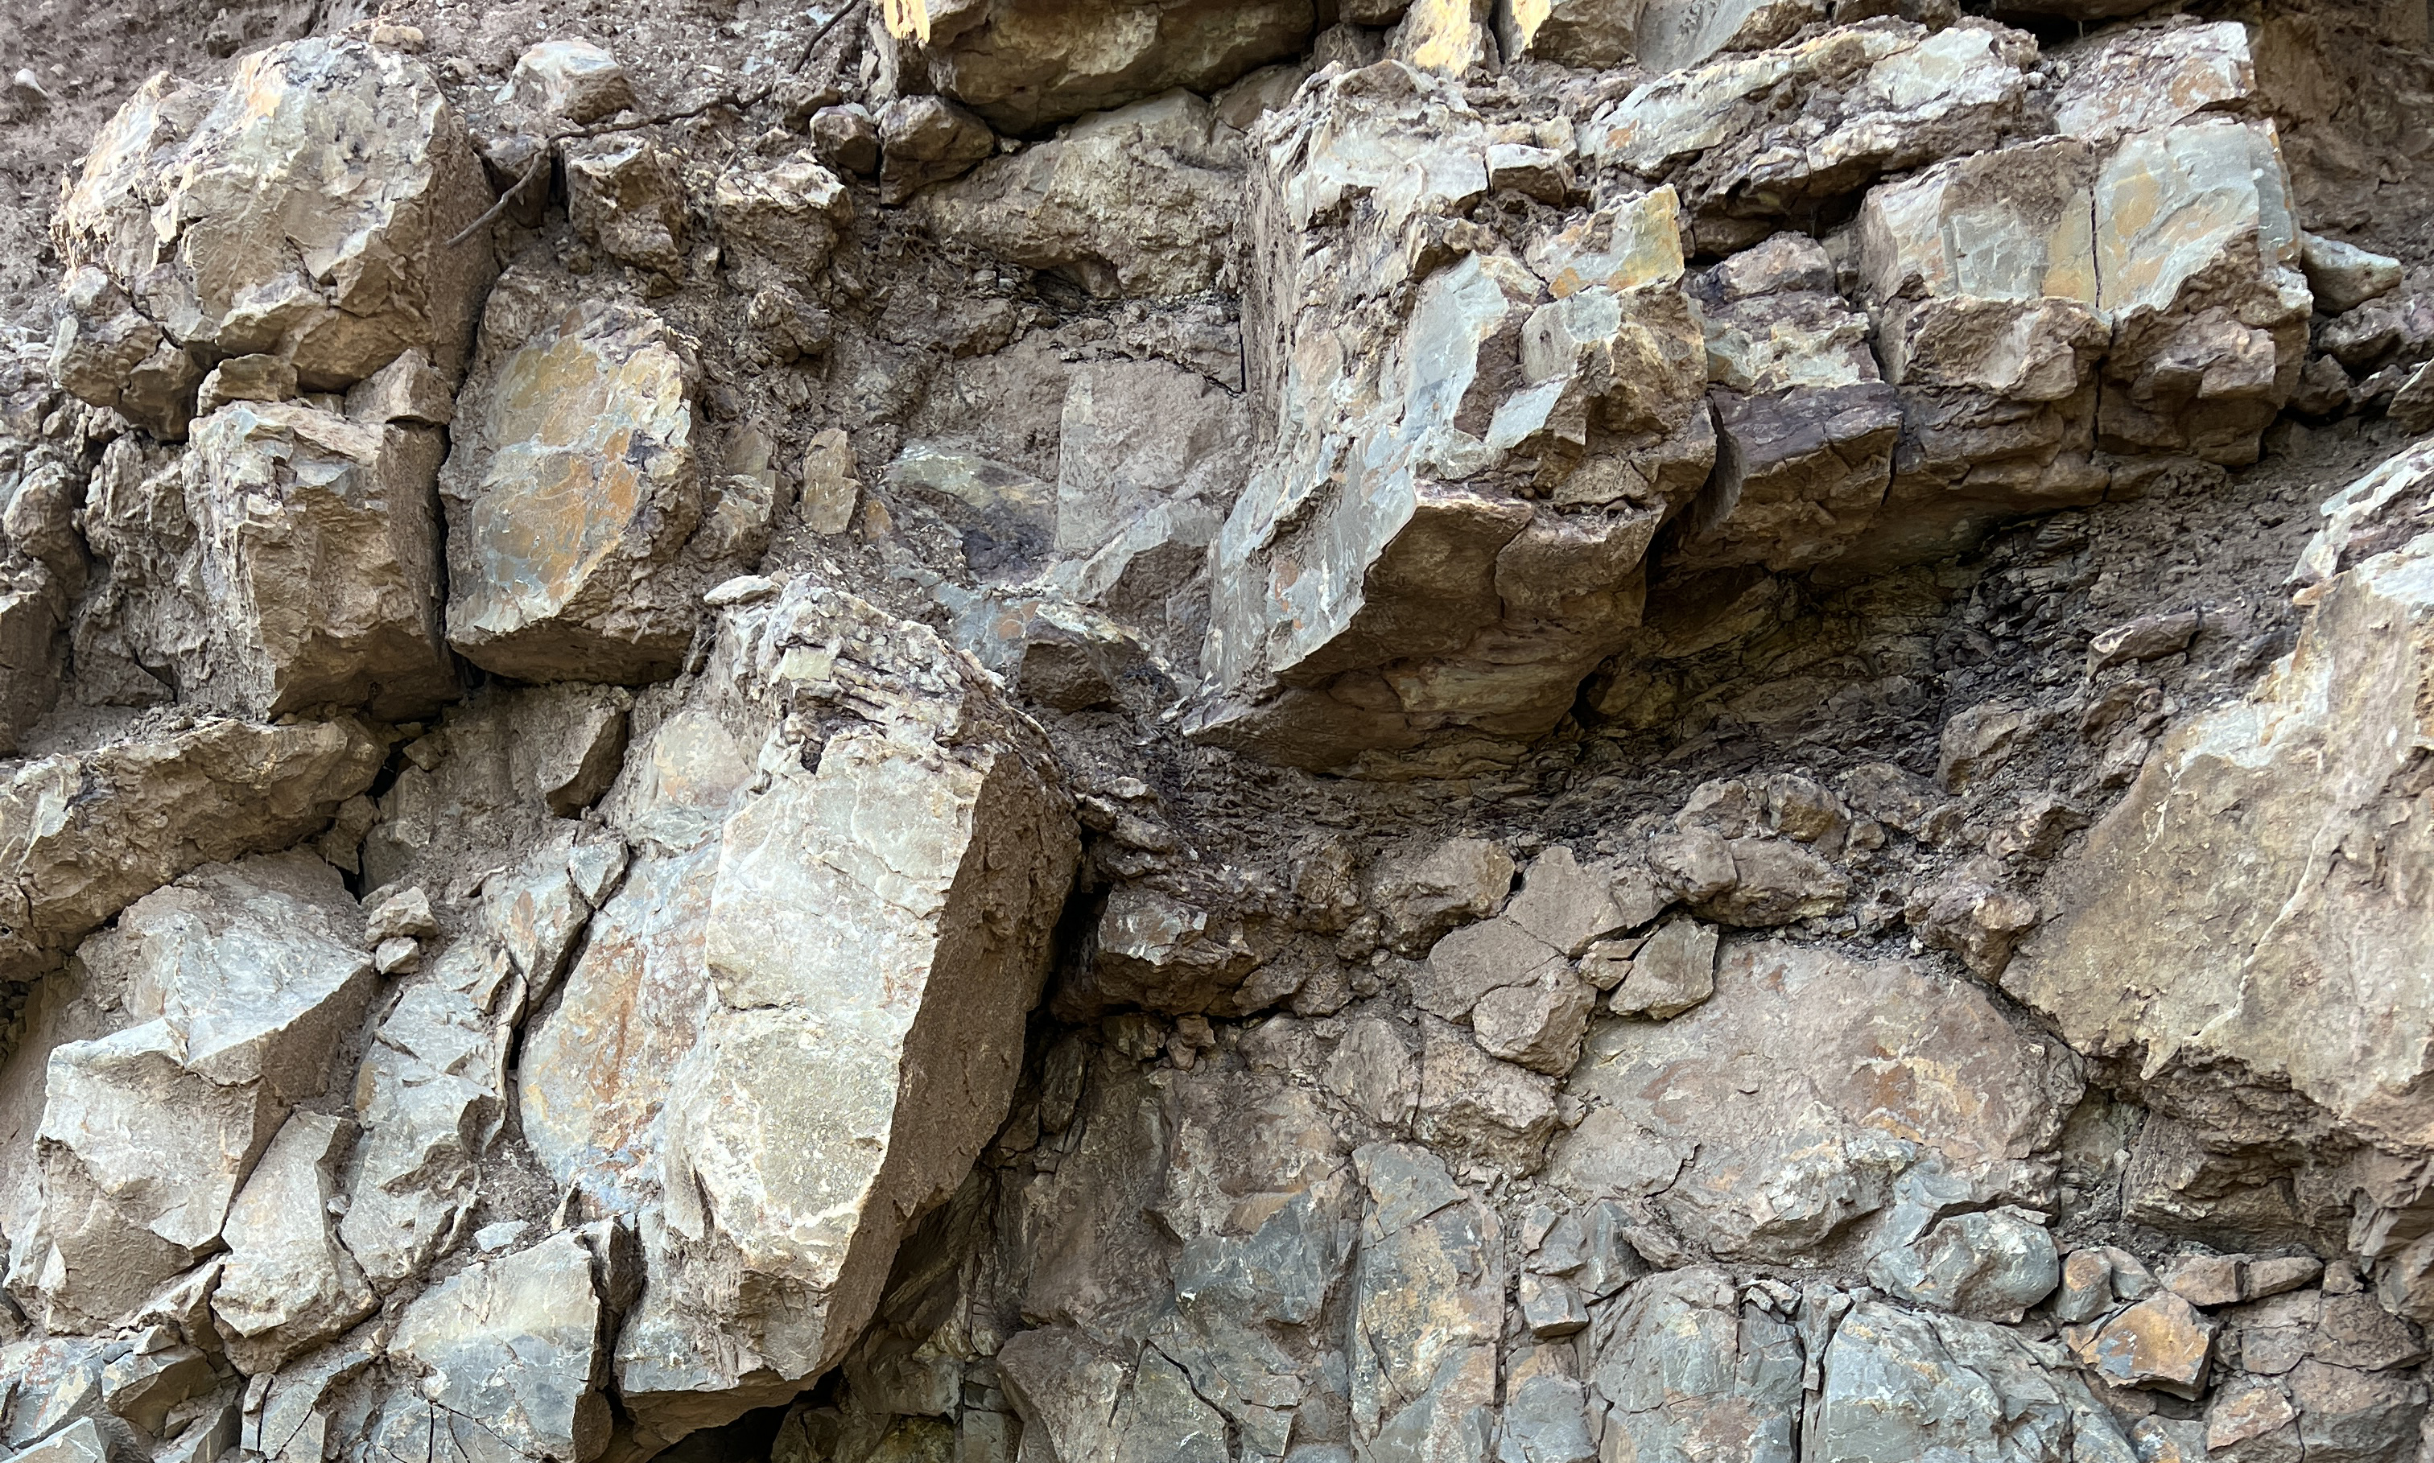
What are the other layers?
This outcrop is mostly a gray rock made up of a clear minerals, but there are some places with layers of a different rock.
  The other rock is reddish-brown with very thin layers
  It is made up of clays

Slide 28
Crystalline vs. clastic
When you look at this rock through a hand lens, the minerals are interlocking.

Slide 29
Are there fossils in this rock?
There are no fossils visible in this rock.

Slide 30
Be prepared to share:
Classification of this rock into igneous, sedimentary, or metamorphic and the specific rock name
Was this easier or harder than answering for Field Stop #1? Why?

Slide 31
Finding this rock on a geologic map
¹Simplified from Gonzales, et al., 2003, Geologic map of the Electra Lake 7.5-minute quadrangle, La Plata County, Colorado: Colorado Geological Survey, OF 03-21
Notes:
As previously, the students should use Google Earth to help figure out where the field stops are on this map. If they’re struggling to decide between different units (e.g., is it Leadville or Ouray), they could always ask another question from you (does the rock have fossils), if they haven’t asked it before.

Slide 32
Demo: how do we figure out depth?
Assuming a geothermal gradient of 25°C/km, how far into the Earth do we need to go to reach 1000°C?
If we were measuring using the Empire State Building (381 m), how many Empire State Buildings would it take?
Notes:
You can use any examples that you want, but I’d recommend running through an example of these calculations explicitly on the board, unless you have a universally math-savvy class. In the lab, they will be asked to find depth from temperature (reversed from above) and then pick something they want to use to put the depth in context.
For this example:
1000 °C/(25 °C/km) = 40 km
40 km/(0.381 km/esb) ~= 105 empire state buildings!
The intention here is to get them to create their own knowledge by picking an object that might not be what we’d pick/assign! They may need to do some unit conversions. You can have them google or have them practice unit conversions, depending on your focus. The Math You Need When You Need it is a great resource for students to review unit conversions: https://serc.carleton.edu/mathyouneed/units/index.html

Slide 33
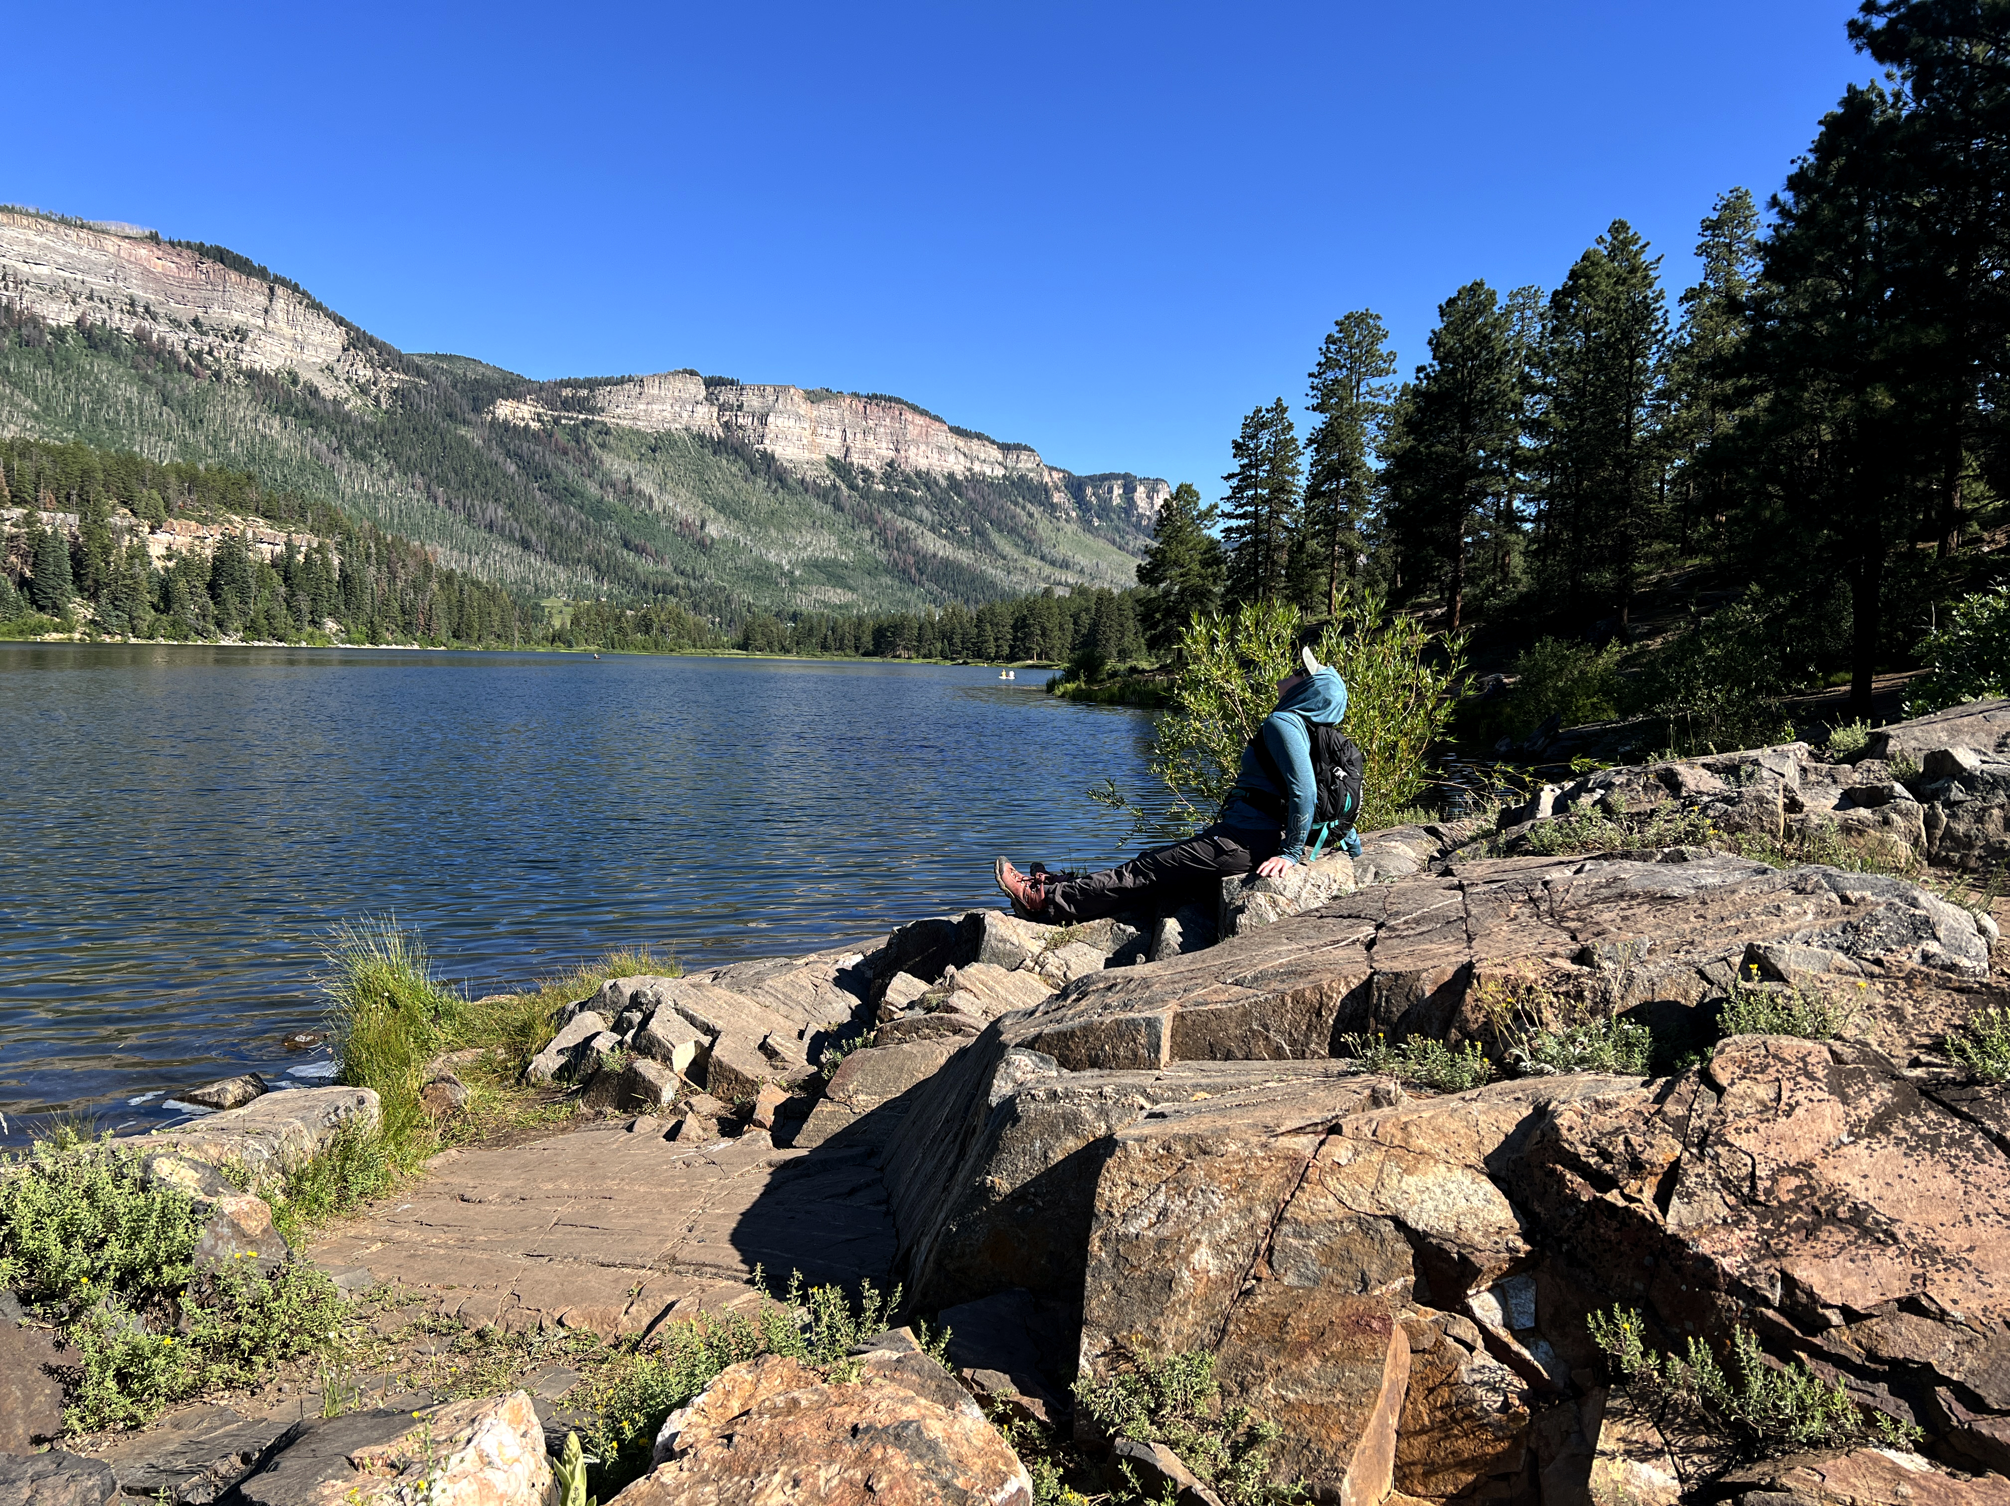
Notes:
Since your students won’t be able to stand directly on the rocks, encourage them to picture that they’re able to sit on the rocks and look up. Picture to help!

Slide 34
Earth’s history in a single day
Imagine that the 4.54 billion year history of the Earth was squeezed into a single 24 hour day. How long would 10 years last?
Now calculate how long the gap in time represented in this location would last.
  Be prepared to share your answers about what you could do in that amount of time!
Notes:
As with the depth conversions, we’re demoing the math using a different length of time. They’re then asked to run the calculation for the length of the unconformity represented here at Haviland Lake.
24 hours/4,540,000,000 years = x/10 years
X = 5.2e-8 years = 1.7 seconds
Unconformity is ~7.4 hours

Slide 35
Geologic history discussion questions
Where did the gneisses metamorphose (at depth or near the surface of the Earth)?
What are potential depositional environments for the sedimentary rocks?
  Did they form at/near the surface of the Earth or deep below the surface?
Brainstorm a list on a scrap sheet of paper by yourself
  What had to happen between the gneisses metamorphosing and the limestones being deposited?
  Share with your group and come up with an order of events
  Be prepared to share your list of events
Notes:
This will probably be best as a guided whole-class discussion. The reality that there must be uplift and erosion to expose the metamorphic rocks at the surface before deposition of the limestone is hard to conceptualize. By doing a think-pair-share on the geologic history, you will hopefully have a couple of groups that hit on this stage, and then you can pool the list of events for each group onto the board. By seeing what other people came up with, it might spark questions or additions to the students’ lists. If the uplift/erosion stage is missing, you could prompt with questions like, ”If the gneisses metamorphosed at 10 km deep, how could the limestones be directly on top of them?” Discussion questions continue on the next slide to get at the last little bit of history.
Correct sequence (starting with metamorphism):
Metamorphism of parent igneous rocks to form gneiss
Uplift and erosion to expose the gneisses at the surface
Deposition of the Ouray Limestone
Deposition of a significant thickness of sedimentary sequences through the KP boundary as you go south of Durango into the San Juan Basin in northern New Mexico. In this region, deposition stopped and erosion started during the uplift of the Rocky Mountains ~65 Ma.
Modern erosion (glacial, fluvial) to expose the unconformity

Slide 36
Geologic history discussion questions, 2
The Ouray Limestone is also pretty old, so what happened after it was deposited?
Middle Pennsylvanian Hermosa Group
Field Stop #2
Field Stop #1
Notes:
This is to help get the idea deposition of sedimentary rocks continued throughout this region for a very long time. You can prompt with questions like:
Are the rocks in the cliffs (see image above) older or younger than the rocks at Field Stop #2? Would they have originally been deposited on top of or below the rocks at Field Stop #2?
Go back to the overview fly through from Durango. Are there even younger sedimentary rocks that might have been above the rocks at Field Stop #2 at some point?
(Depending on student ability) Explore the larger geologic map of this region (available here: https://ngmdb.usgs.gov/Prodesc/proddesc_76332.htm). Does the Hermosa Group occur on both sides of the valley? Based on lateral continuity, does that suggest (or not) that the Hermosa Group originally extended across the valley where Haviland Lake now sits.
We don’t actually know that all of these rocks were on top of the area of Haviland Lake, but we can propose from lateral continuity that the Hermosa Group (at least) was originally deposited on top of these rocks and has since been eroded away. The Hermosa varies significantly in thickness, but is ~2,000 ft (600 m) on average (Hite, R.J., Anders, D.E., and Ging, T.G., 1984, Organic-rich source rocks of Pennsylvanian age in the Paradox basin of Utah and Colorado, IN Woodward, Jane, Meissner, F.F., and Clayton, J.L., eds., Hydrocarbon source rocks of the greater Rocky Mountain region: Rocky Mountain Association of Geologists Field Conference Guidebook, p. 255-274.), so it’s a pretty significant thickness of rocks that have been eroded away!

Slide 37
Infographic instructions
What makes a good infographic?
  Watch this short video
  Google ‘infographic examples’
  Find 1-2 examples that you like & upload a link/screencap to LOCATION
  Be prepared to share what you/your group like!
Take 10-15 mins to plan out your infographic on scrap paper/white boards/etc. before you start on the final version
Notes:
Students may (or may not) be familiar with infographics. They have probably seen them but may not have heard the name and/or given them much thought. They’ll make an infographic that is aimed at sharing what they learned with the general public as their final formative assessment of the lab, and it helps to get them started on the right track.

Slide 38
Key points
Lesson objectives
  Apply effective strategies to identify rock types in the field.
  Evaluate multiple lines of evidence to determine the type of contact and unconformity.
  Determine the length of missing time represented by the contact using geologic maps and the geologic time scale.
  Create an evidence-based geologic history of a field location.
What’s so exciting about Haviland Lake?
  Nonconformity and a depositional contact (limestones deposited on top of gneisses)
  Exposure of the ‘Great Unconformity’
    Over a quarter of Earth’s history missing in the geologic record!
  Complex geologic history to get to how its exposed today

