Slide 1


Exploring the Glacier Basin System
Unit 3, Part 1: Supraglacial and Englacial Melt Features
Supported by the National Science Foundation Directorate for Education and Human Resources Award OPP-2021503
Version 2021-11-29
Questions or comments? Contact polarpass@colorado.edu
Website: serc.carleton.edu/polarpass

Slide 2
Teaching note: This slide deck provides a visual introduction to supraglacial and englacial melt features within the ice sheet Driving Question: How does water move through the glacier system and how does it influence glacier behavior? Learning Goals: 1) Map the movement of water through and underneath the glacier system. 2) Evaluate seasonal change in a glacier system and be able to predict glacier behavior (speed, englacial/subglacial evolution) throughout a year.

Slide 3
Instructions: Show photos of supraglacial melt ponds/lakes, channels, moulins, ice caves/conduits at margin. Students hypothesize on water paths through the ice and glacier system changes. Then discuss ideas, terms, evidence. Afterward: Show Video: Unit 3 Part 1: Greenland 2014: Follow the Water

Slide 4
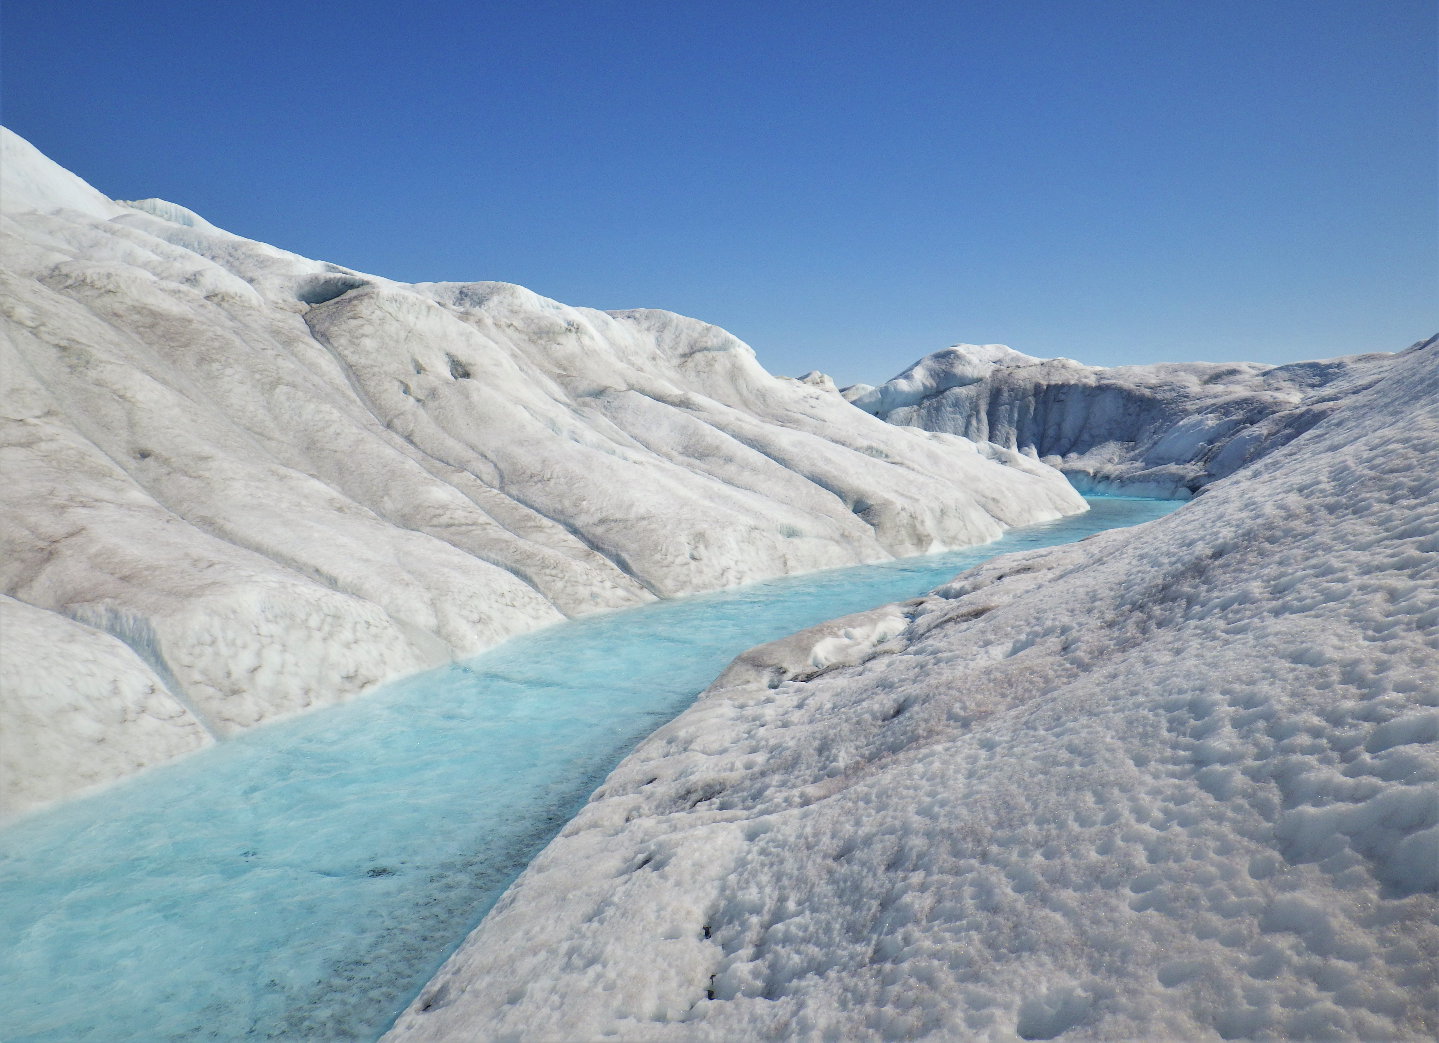
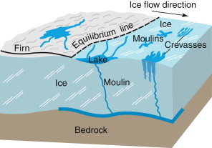
Supraglacial melt streams and rivers
S. Leidman

Slide 5
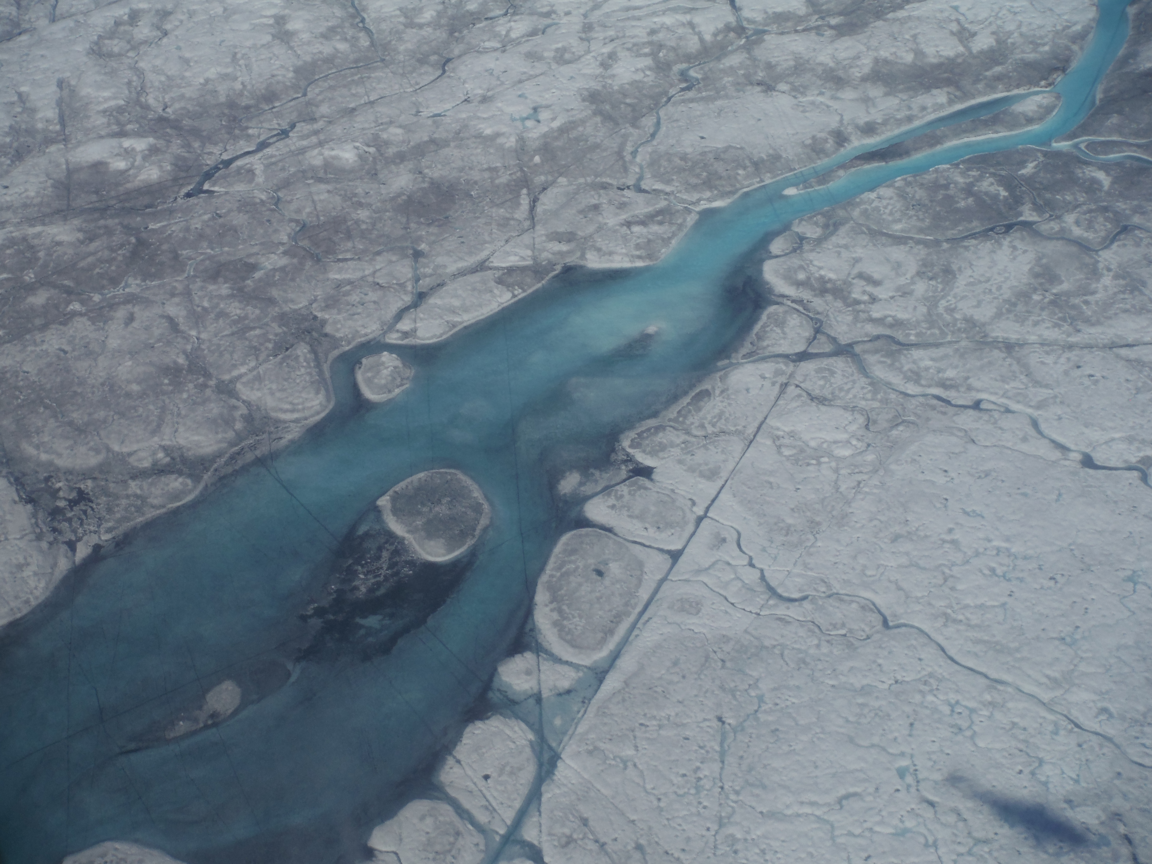
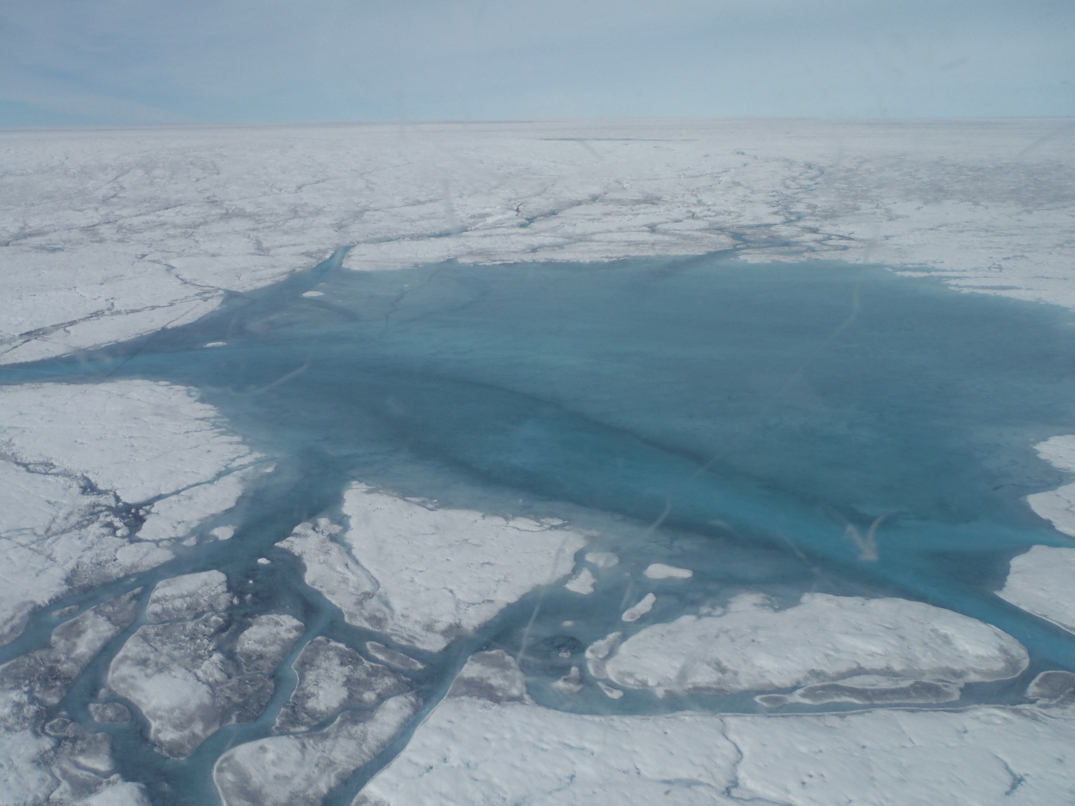
Supraglacial melt streams and lakes
S. Leidman

Slide 6
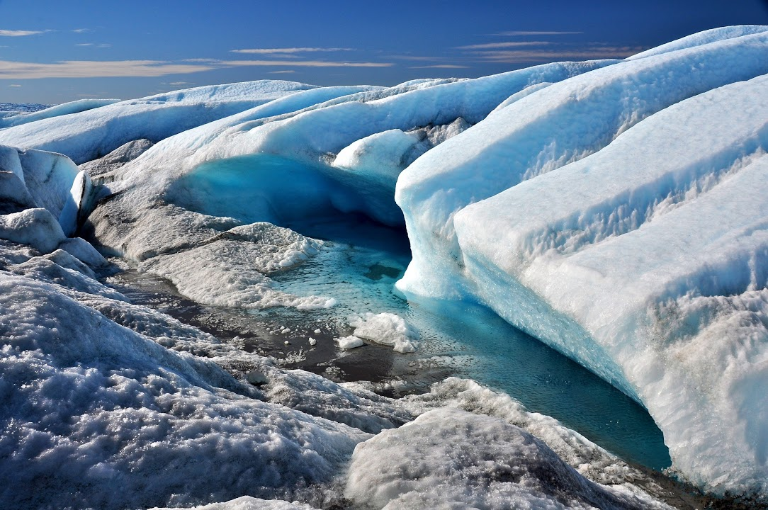
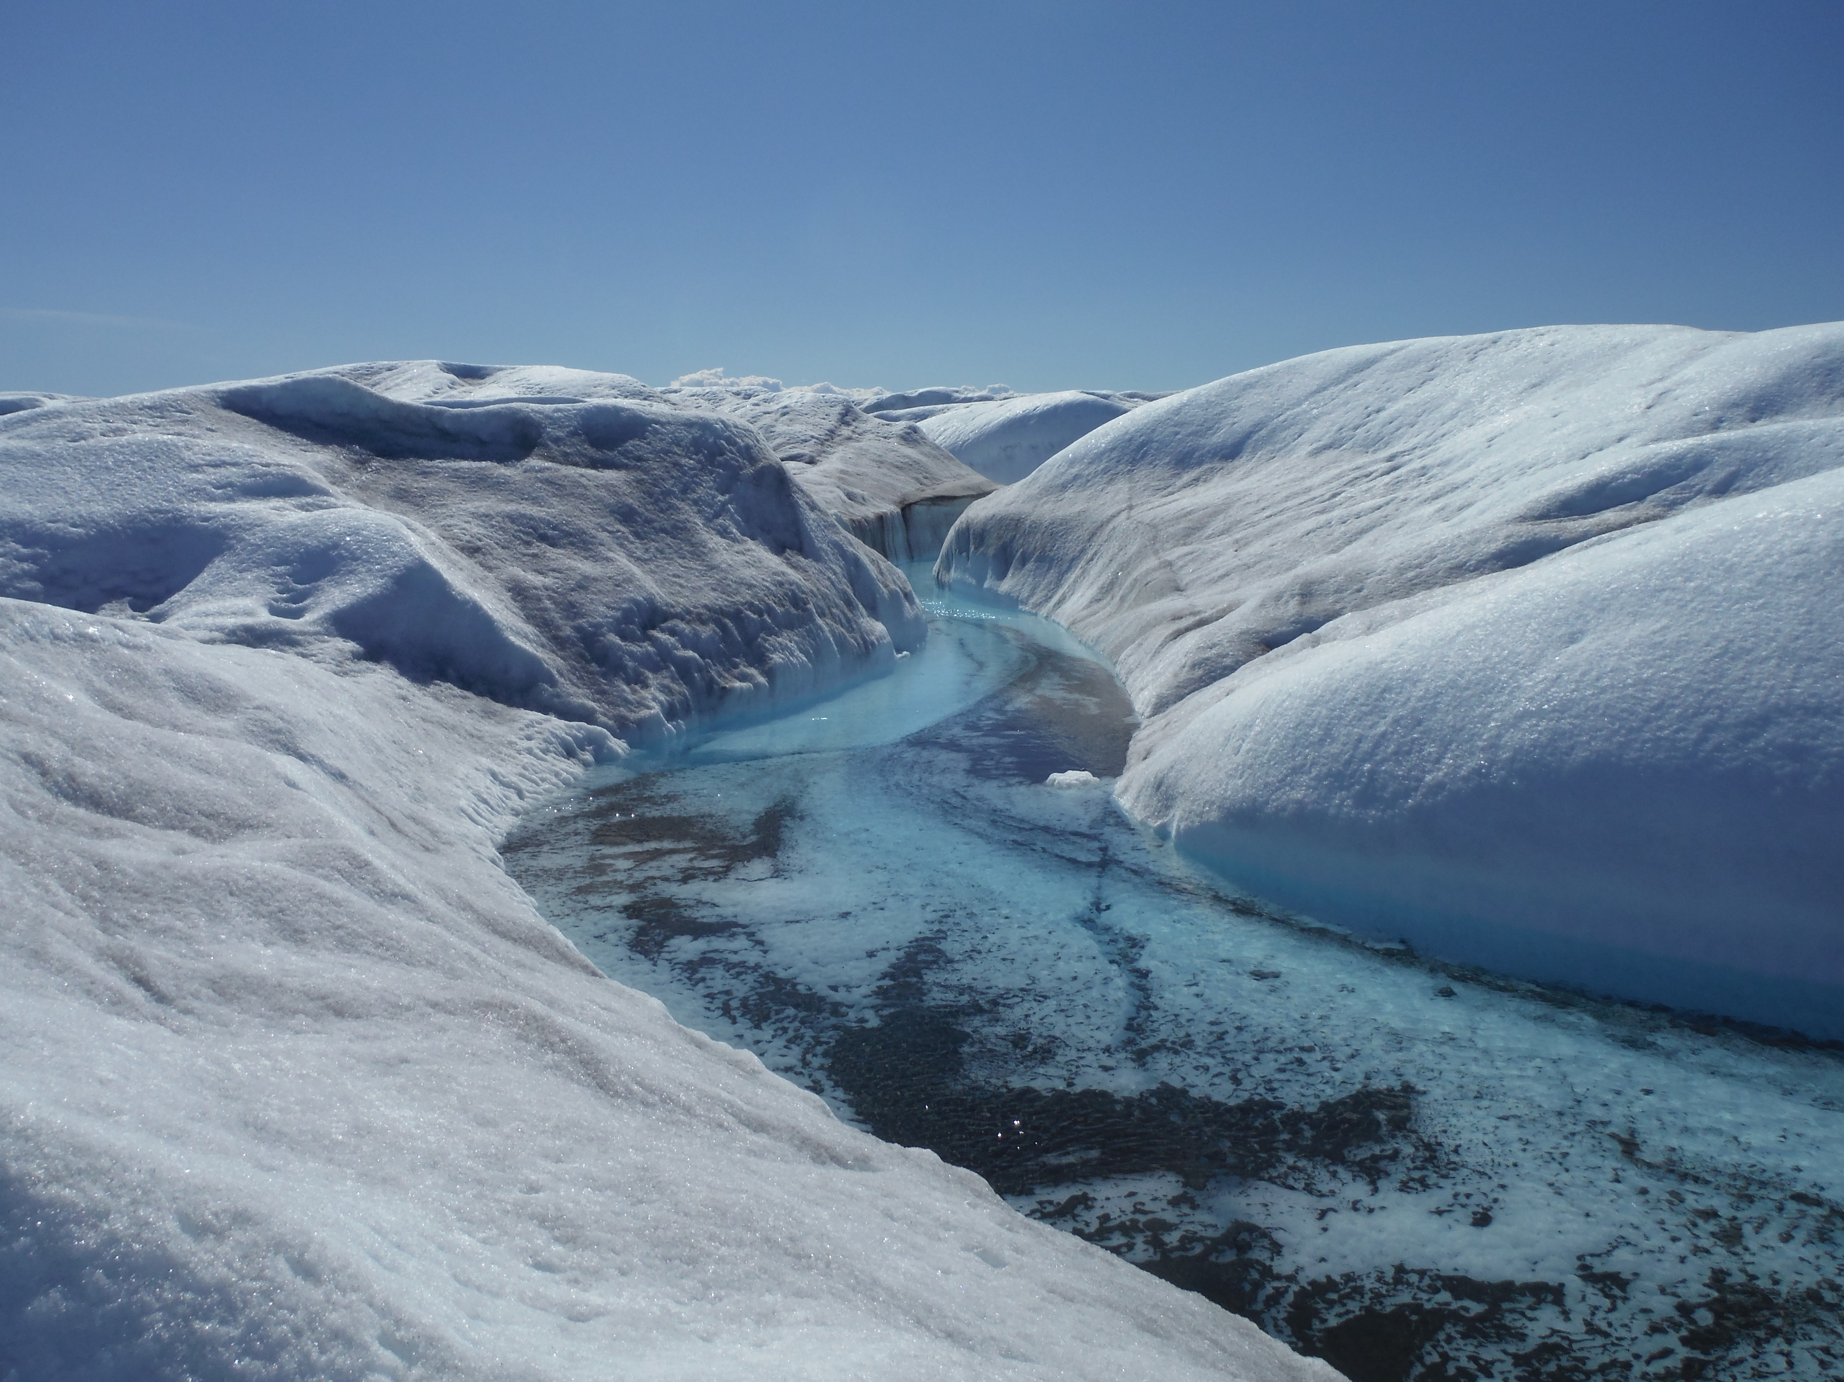
Supraglacial melt and marginal streams
S. Czerch

Slide 7
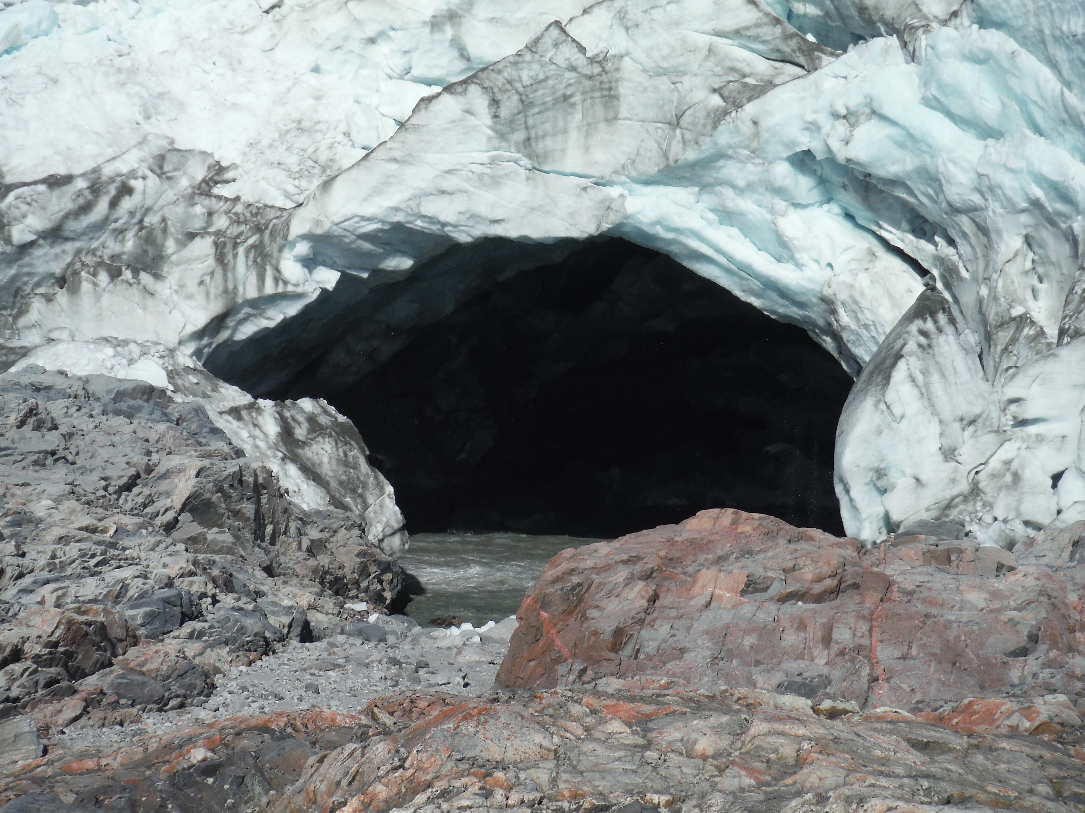
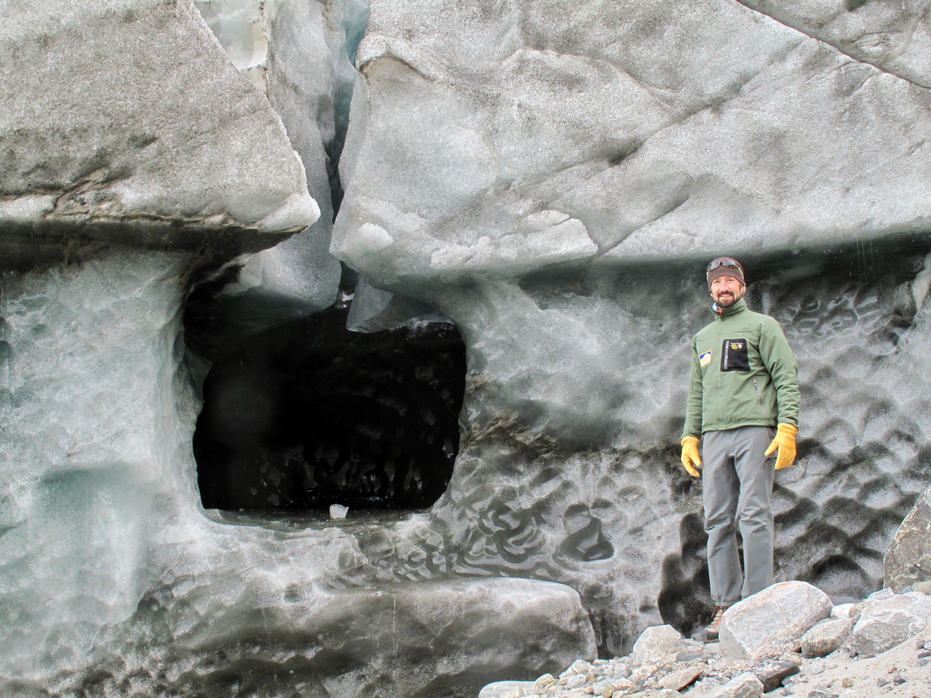
Englacial conduit and caves
S. Leidman

Slide 8
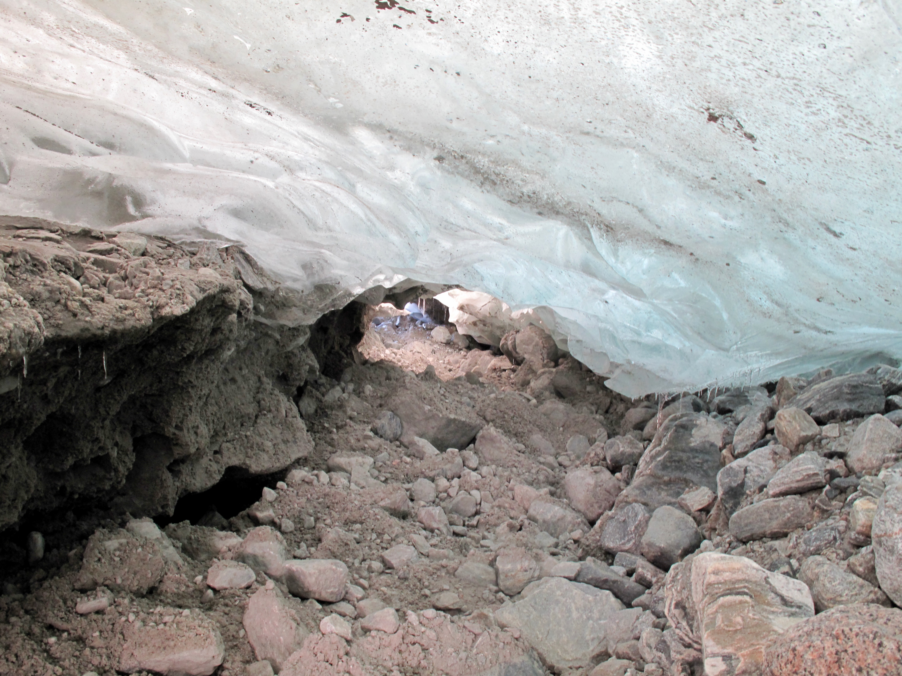
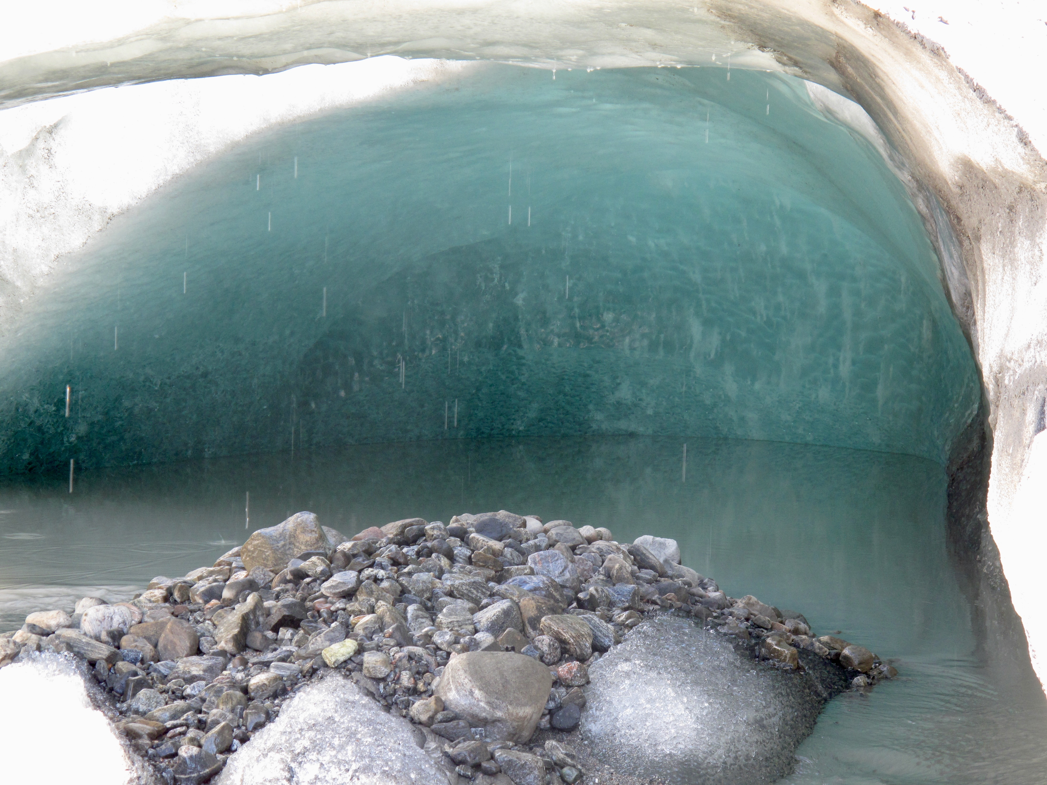
Subglacial channels and caves

Slide 9
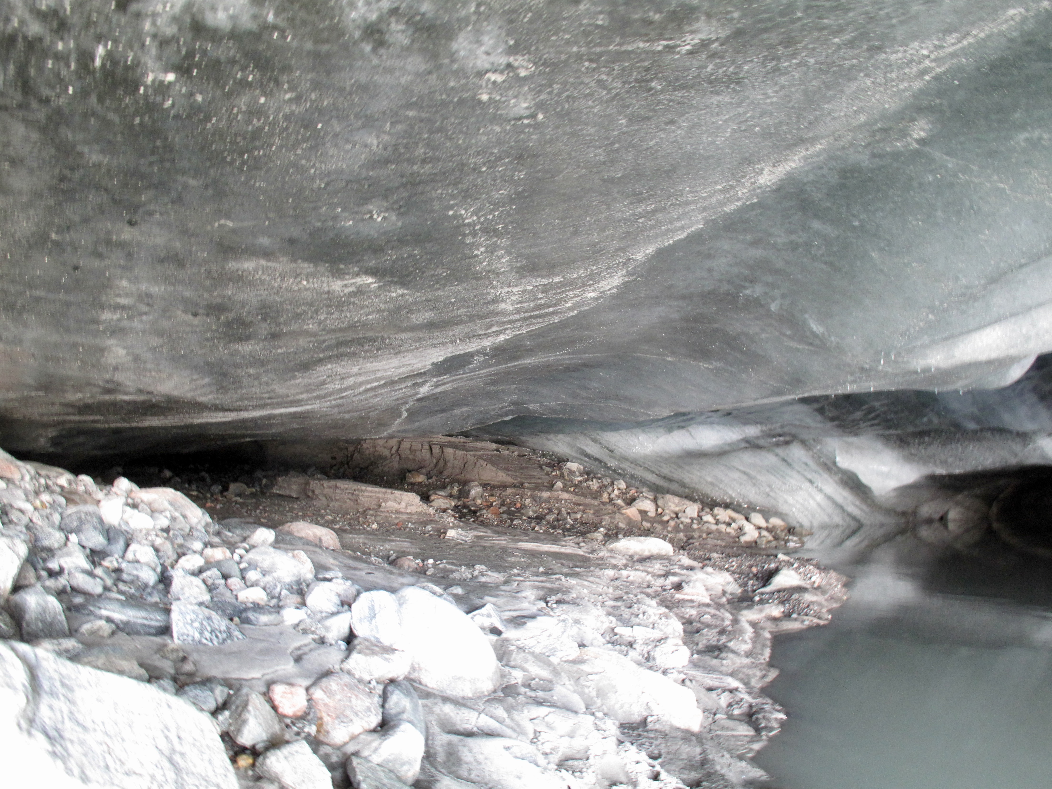
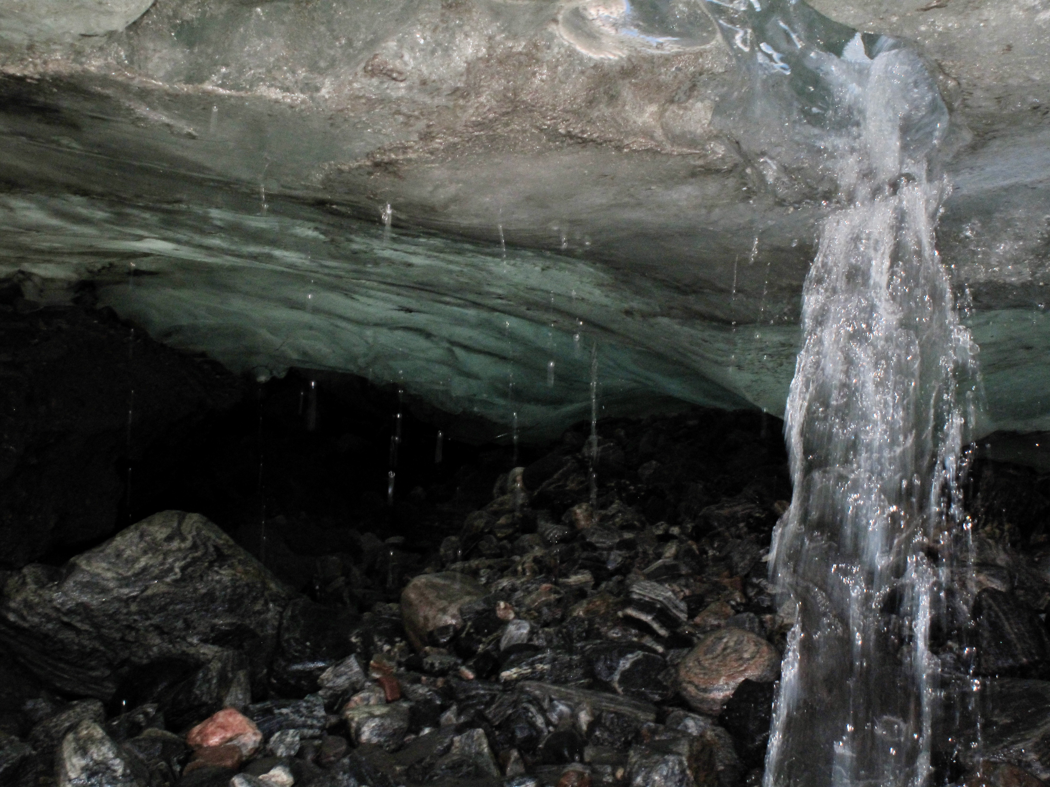
Subglacial channels and caves

Slide 10
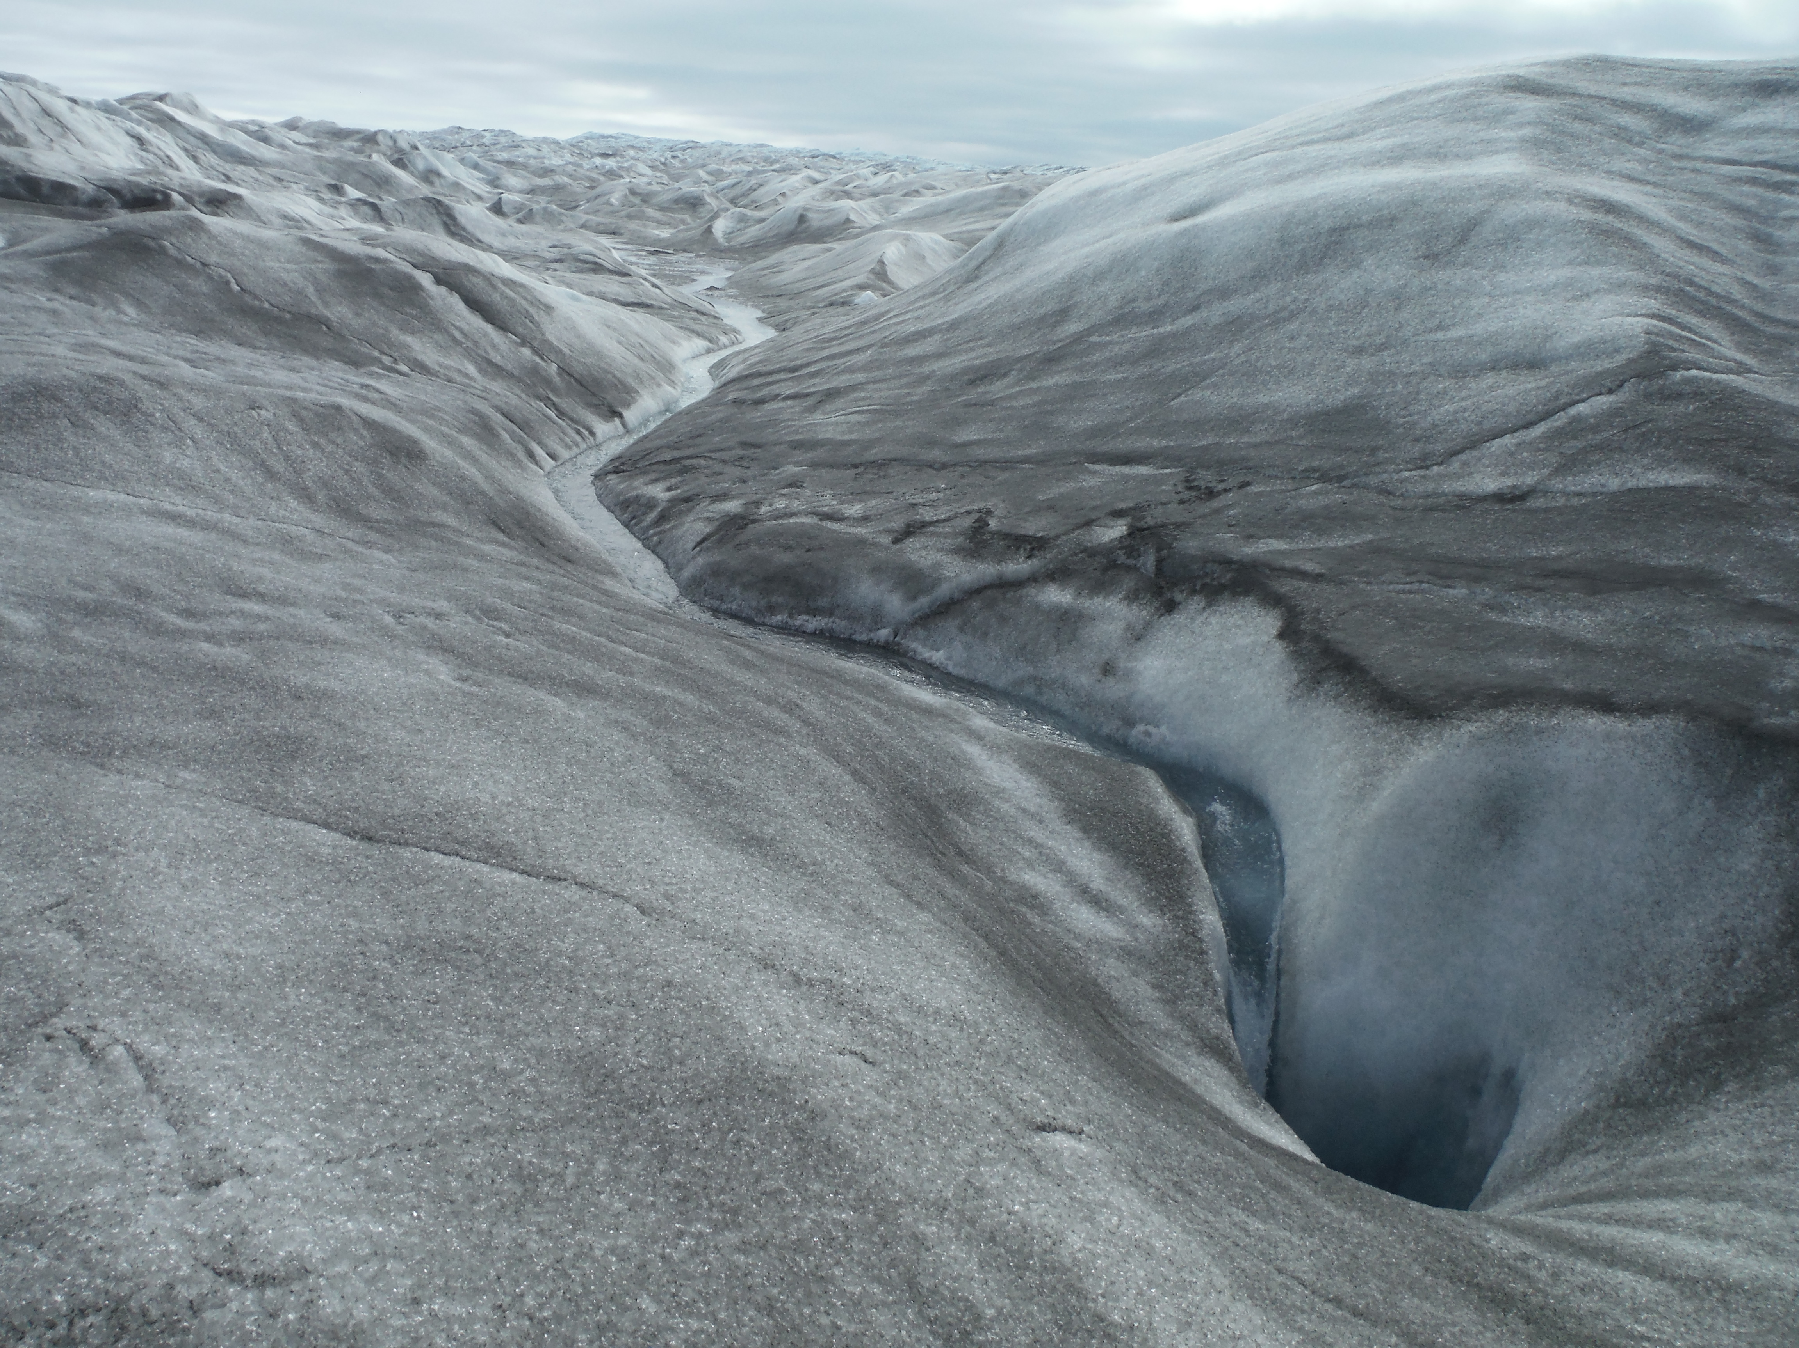
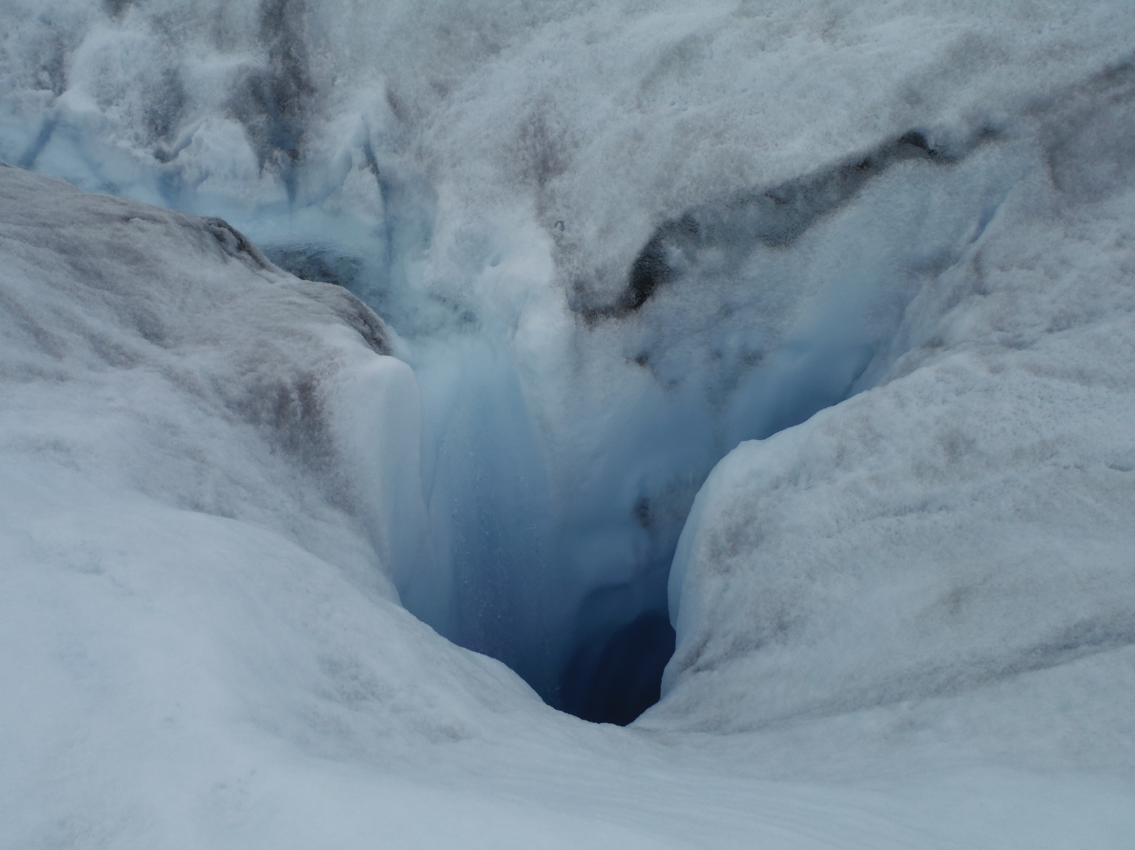
Supraglacial and Englacial: Moulins
S. Leidman
S. Leidman

Slide 11
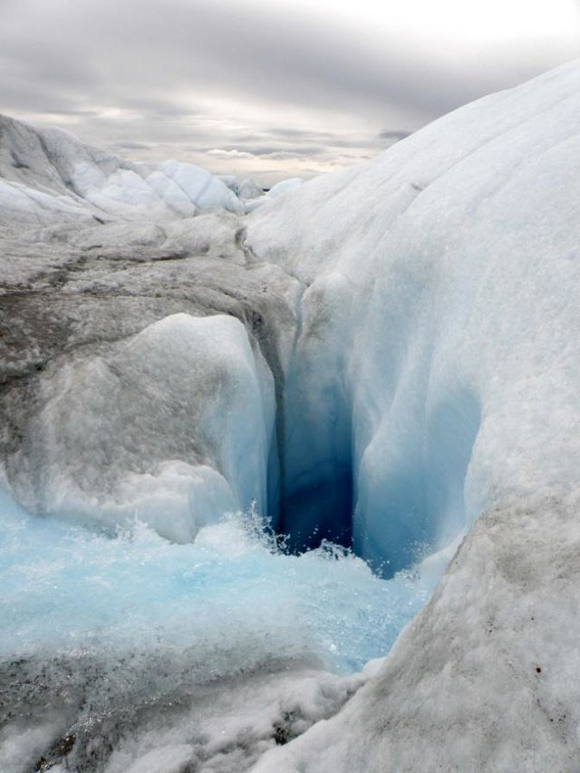
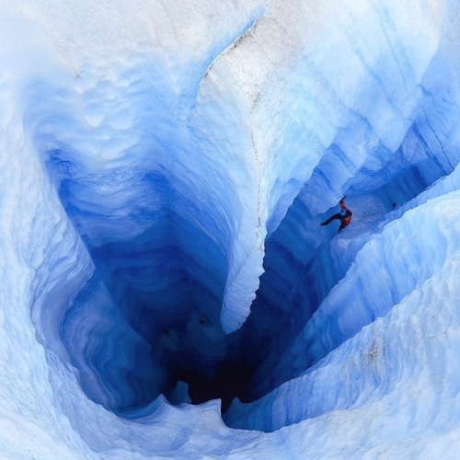
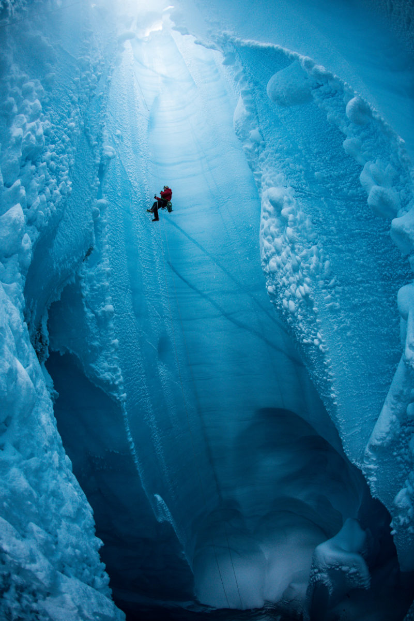
Supraglacial and Englacial: Moulins
C. Pondella
C. Clason

Slide 12
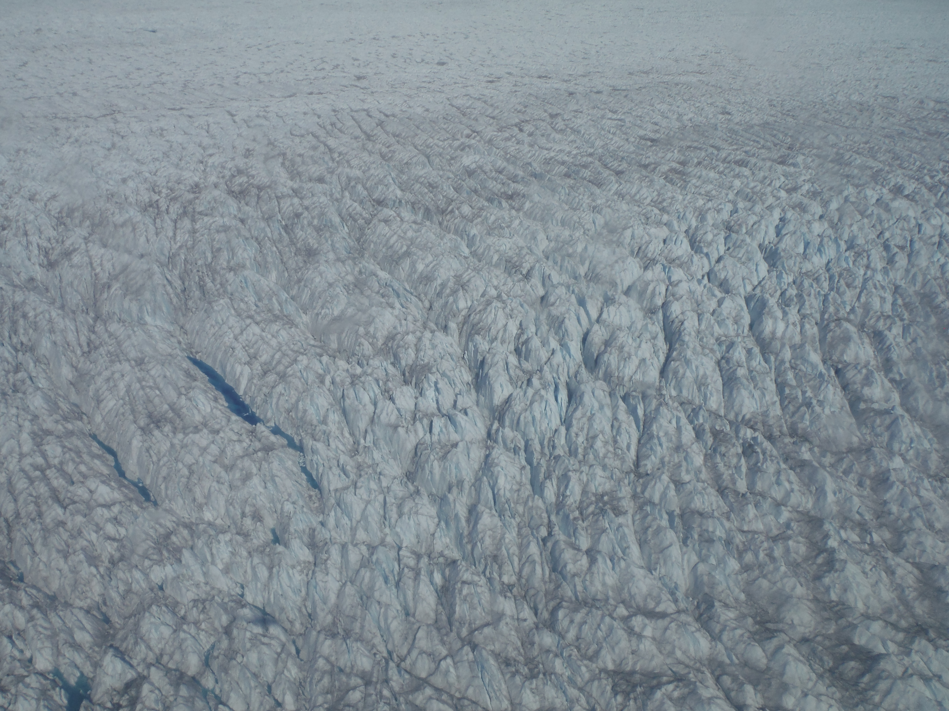
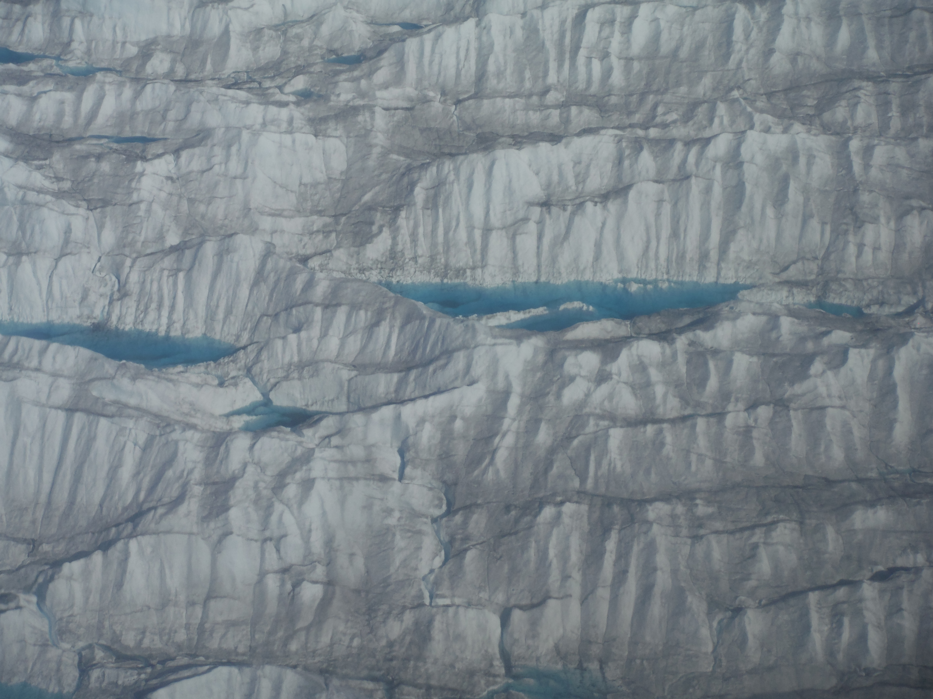
Supraglacial: Water Filled Crevasses
S. Leidman

Slide 13
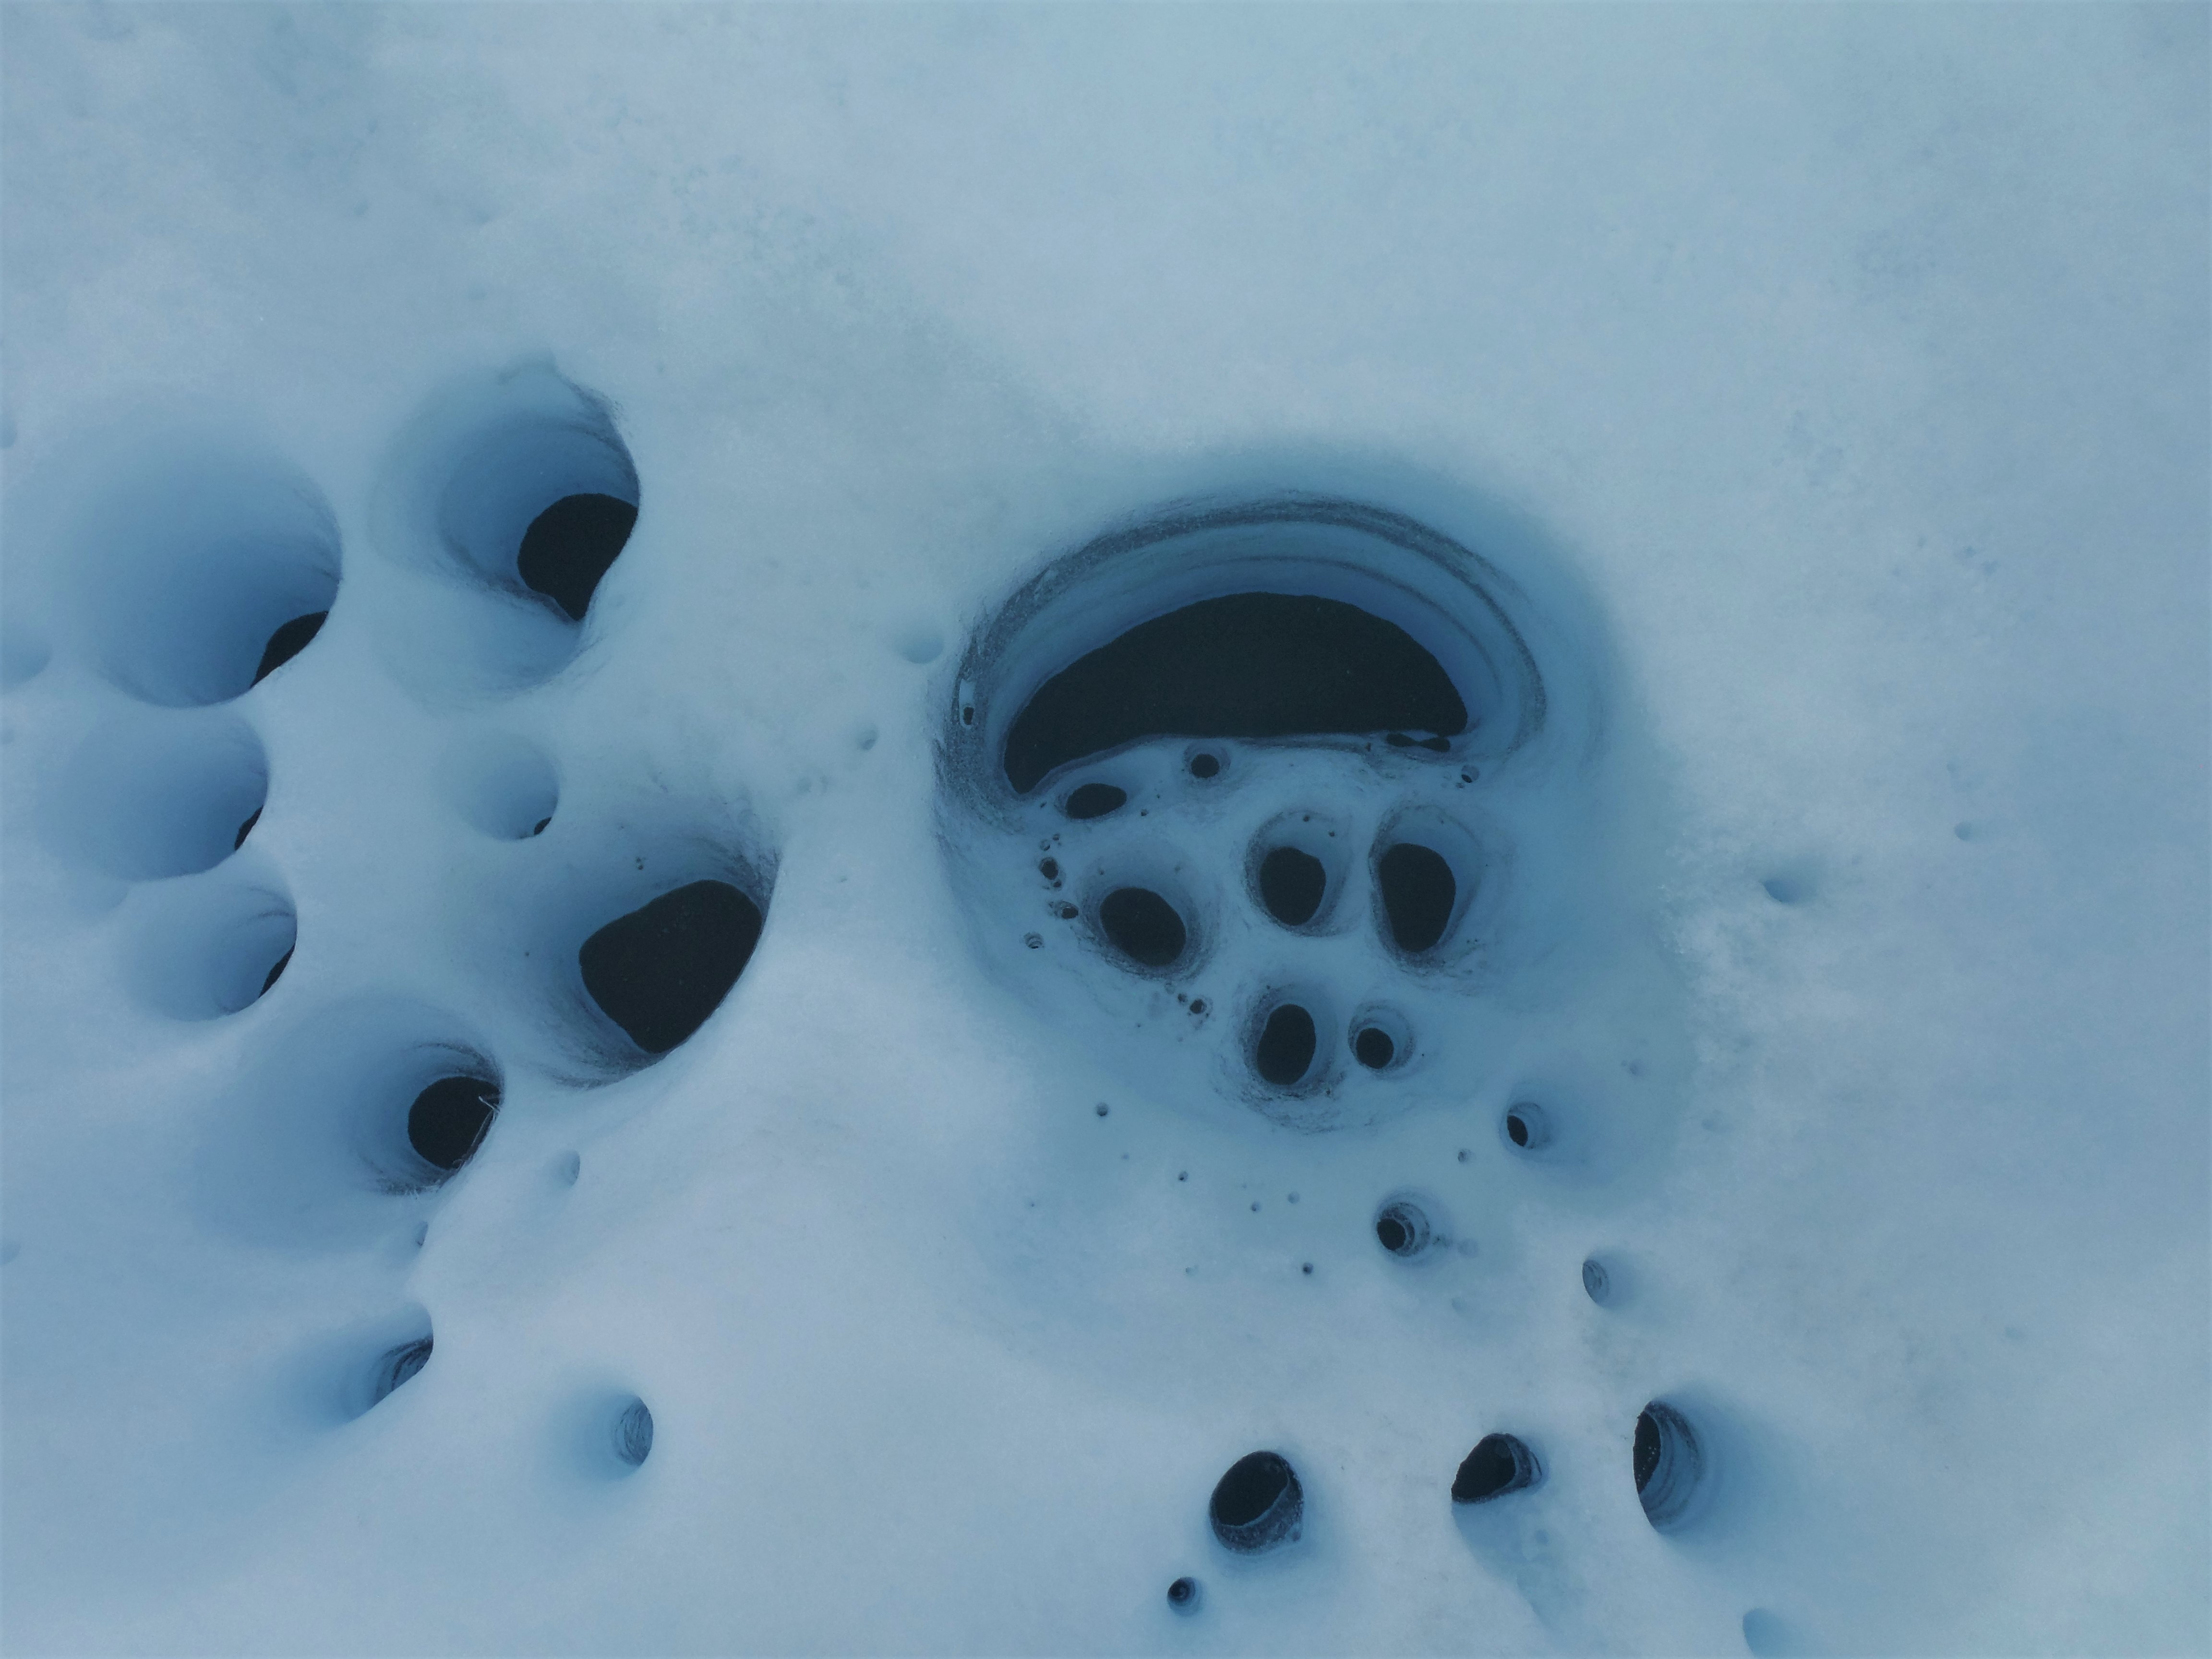
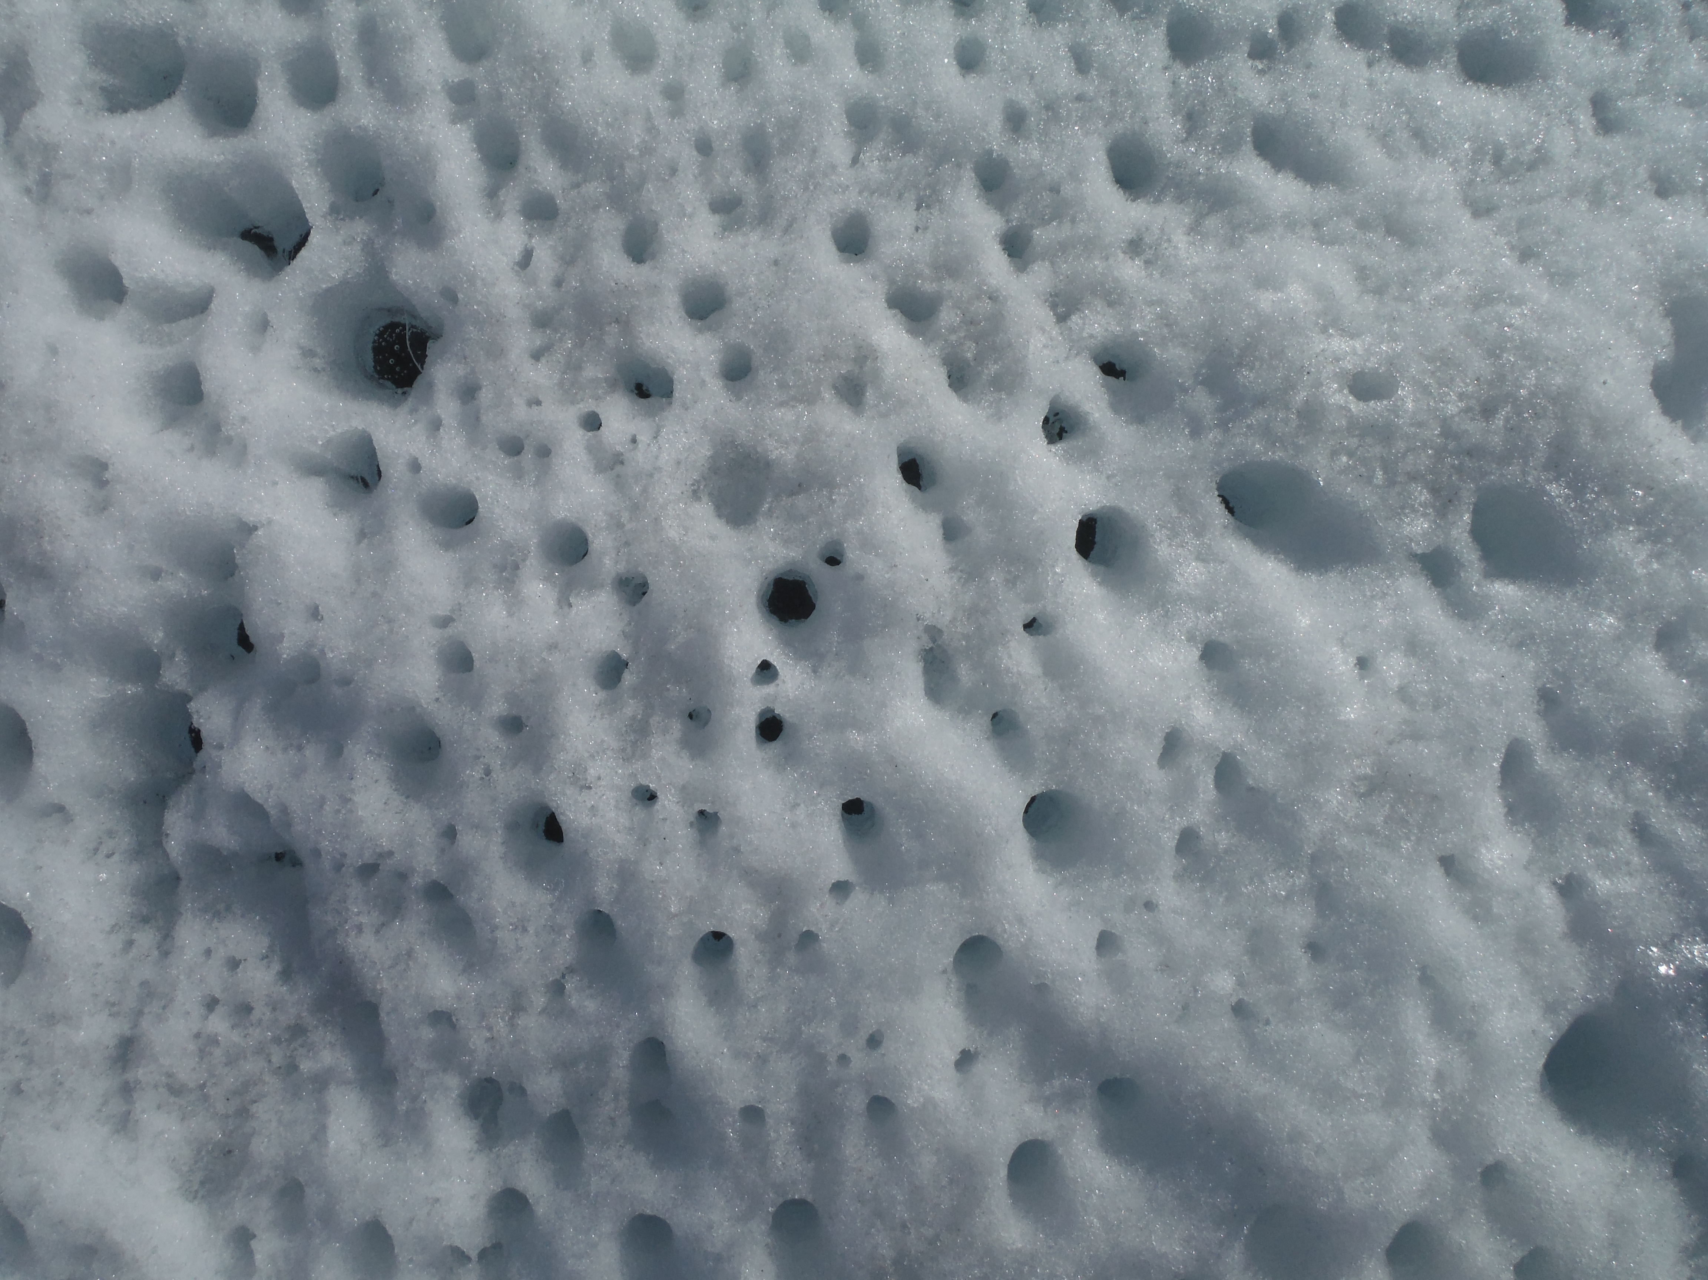
Supraglacial melt: Cryoconite holes

Slide 14
Reminders: After pairs of students review the slides have them hypothesize on water paths through the ice and glacier system changes. Then discuss ideas, terms, evidence.

