Slide 1



Teaching and Learning about the Climate in Geoscience Classrooms
Tamara Ledley, TERC
Anne Gold, CIRES
Deb Morrison, CU Boulder
GSA 2013 - Denver

Slide 2
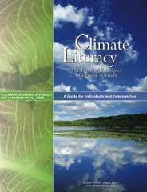
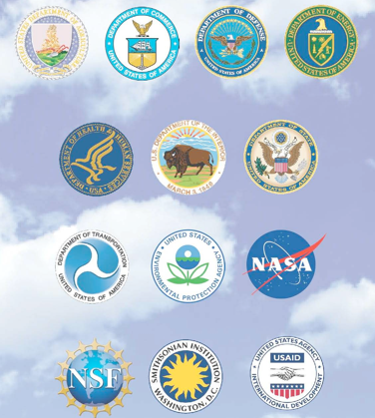
Climate Literacy Essential Principles

Slide 3
Overview
GP: Humans can take actions to reduce climate change and its impacts.
1. The Sun is the primary source of energy for Earth's climate system.
2. Climate is regulated by complex interactions among components of the Earth system.
3. Life on Earth depends on, is shaped by, and affects climate.
4. Climate varies over space and time through both natural and man-made processes.
5. Our understanding of the climate system is improved through observations, theoretical studies, and modeling.
6. Human activities are impacting the climate system.
7. Climate change will have consequences for the Earth system and human lives.
SCIENCE
HUMAN ASPECT

Slide 4
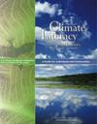
Guiding Principle of Climate Literacy Essential Principles
Humans can take actions to reduce climate change and its impacts.
a. Climate information can be used to reduce vulnerabilities or enhance the resilience of communities and ecosystems affected by climate change. Continuing to improve scientific understanding of the climate system and the quality of reports to policy and decision-makers is crucial.
b. Reducing human vulnerability to the impacts of climate change depends not only upon our ability to understand climate science, but also upon our ability to integrate that knowledge into human society. Decisions that involve Earth's climate must be made with an understanding of the complex inter­connections among the physical and biological components of the Earth system as well as the consequences of such decisions on social, economic, and cultural systems.
c. The impacts of climate change may affect the security of nations. Reduced availability of water, food, and land can lead to competition and conflict among humans, potentially resulting in large groups of climate refugees.
d. Humans may be able to mitigate climate change or lessen its severity by reducing greenhouse gas concentrations through processes that move carbon out of the atmosphere or reduce greenhouse gas emissions.

Slide 5
Guiding Principle of Climate Literacy Essential Principles
Humans can take actions to reduce climate change and its impacts
e. A combination of strategies is needed to reduce greenhouse gas emissions. The most immediate strategy is conservation of oil, gas, and coal, which we rely on as fuels for most of our transportation, heating, cooling, agriculture, and electricity. Short-term strategies involve switching from carbon-intensive to renewable energy sources, which also requires building new infrastructure for alternative energy sources. Long-term strategies involve innovative research and a fundamental change in the way humans use energy.
f. Humans can adapt to climate change by reducing their vulnerability to its impacts. Actions such as moving to higher ground to avoid rising sea levels, planting new crops that will thrive under new climate conditions, or using new building technologies represent adaptation strategies. Adaptation often requires financial investment in new or enhanced research, technology, and infrastructure.
g. Actions taken by individuals, communities, states, and countries all influence climate. Practices and policies followed in homes, schools, businesses, and governments can affect climate. Climate-related decisions made by one generation can provide opportunities as well as limit the range of possibilities open to the next generation. Steps toward reducing the impact of climate change may influence the present generation by providing other benefits such as improved public health infrastructure and sustainably built environments.

Slide 6
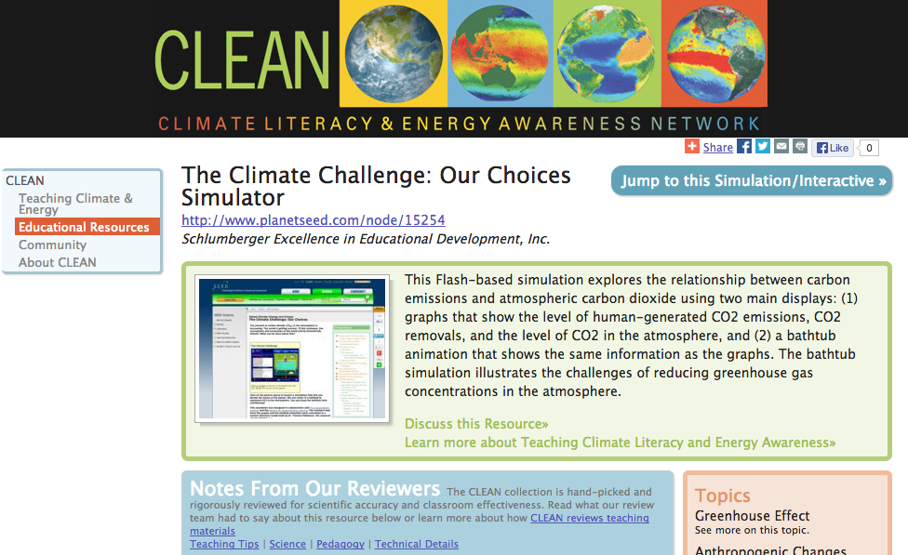
Climate Change – Our choices simulator
CLEAN Resource Link - http://cleanet.org/resources/42833.html

Slide 7
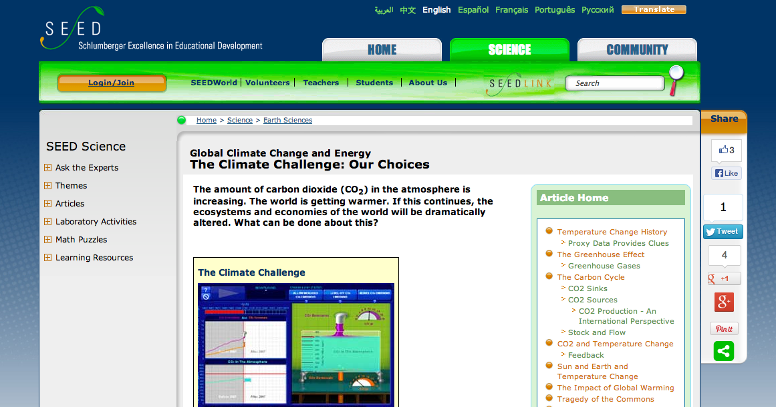
Climate Change – Our choices simulator
Climate Change Our Choices Simulator Homepage http://www.planetseed.com/relatedarticle/climate-challenge-our-choices

Slide 8
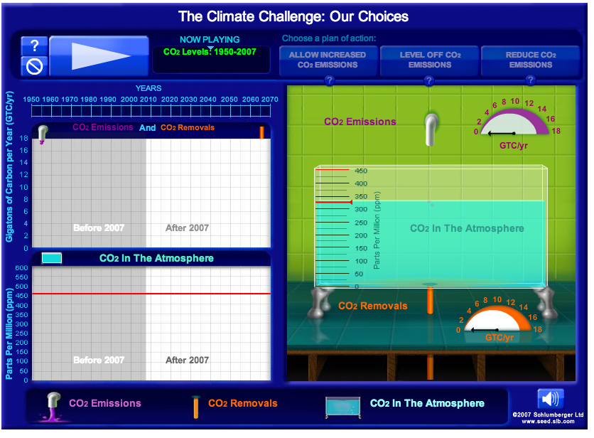
Climate Change – Our choices simulator
Climate Change Our Choices Simulator http://www.planetseed.com/files/flash/science/features/earth/climate/en/challenge/index.htm?width=835&height=680&popup=true

Slide 9
Climate Literacy Essential Principle 1
The Sun is the primary source of energy for Earth’s climate system
1a. Sunlight reaching Earth can heat the land, ocean, and atmosphere. Some of that sunlight is reflected back to space by the surface, clouds, or ice. Much of the sunlight that reaches Earth is absorbed and warms the planet.
1b. When Earth emits the same amount of energy as it absorbs, its energy budget is in balance, and its average temperature remains stable.
1c. The tilt of Earth's axis relative to its orbit around the sun results in predictable changes in the duration of daylight and the amount of sunlight received at any latitude throughout a year. These changes cause the annual cycle of seasons and associated temperature changes.
1d. Gradual changes in Earth's rotation and orbit around the sun change the intensity of sunlight received in our planet's polar and equatorial regions. For at least the last 1 million years, these changes occurred in 100,000-year cycles that produced ice ages and the shorter warm periods between them.
1e. A significant increase or decrease in the sun's energy output would cause Earth to warm or cool. Satellite measurements taken over the past 30 years show that the sun's energy output has changed only slightly and in both directions. These changes in the sun's energy are thought to be too small to be the cause of the recent warming observed on Earth.

Slide 10
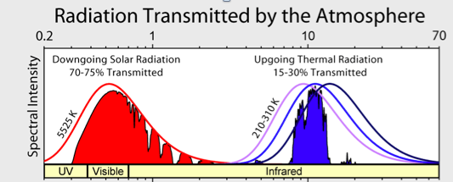
Transmission of Solar and Terrestrial Radiation by the Atmosphere
Global Warming Art
http://www.globalwarmingart.com/wiki/File:Atmospheric_Transmission_png

Slide 11
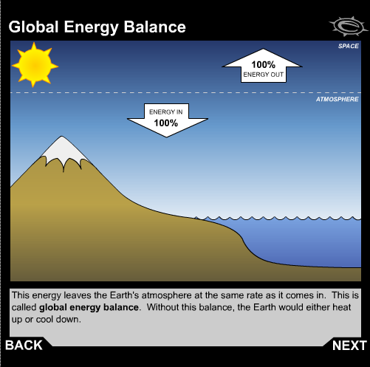
Global Energy Balance
http://earthguide.ucsd.edu/earthguide/diagrams/energybalance/
Scripps Institution of Oceanography

Slide 12
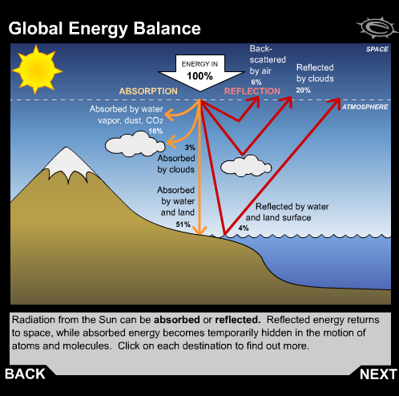
Global Energy Balance - Incoming
http://earthguide.ucsd.edu/earthguide/diagrams/energybalance/
Scripps Institution of Oceanography

Slide 13
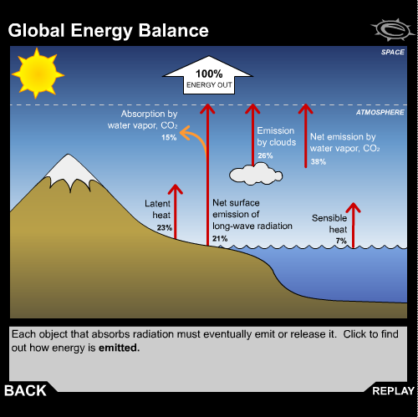
Global Energy Balance - Outgoing
http://earthguide.ucsd.edu/earthguide/diagrams/energybalance/
Scripps Institution of Oceanography

Slide 14
Climate Literacy Essential Principle 2
Climate is regulated by complex interactions among components of the Earth System 2a Earth’s climate is influenced by interactions involving different components of the Earth system (Sun, atmosphere, clouds, etc.). Climate varies by region due to local differences in these interactions. 2b Oceans act as a climate control and redistribute heat and water vapor globally through density-driven currents and atmospheric circulation. 2c Greenhouse gases affect the amount of solar energy absorbed or radiated by the Earth. The process is described by the greenhouse effect. 2d The abundance of greenhouse gases in the atmosphere is controlled by the cycling of carbon between ocean, land, and atmosphere reservoirs. 2e The role of aerosols in the climate system. 2f A change in one component of the Earth system can disrupt the equilibrium of the entire system. Positive feedback loops can amplify these effects and trigger abrupt changes in the climate system.

Slide 15
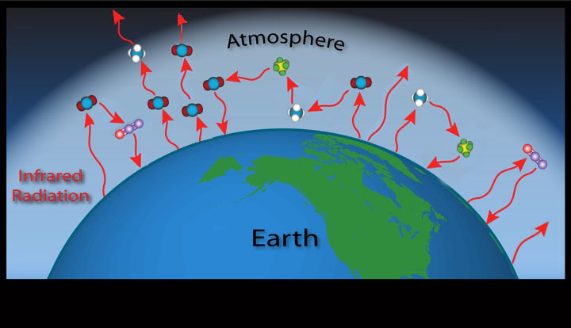
The Natural Greenhouse Effect
Globally Average Temperature of the Earth
Without an Atmosphere | Between 1960-90
-18 deg C | +14 deg C
-0.4 deg F | 57.2 deg F
modified from Barb Delusi, NOAA

Slide 16
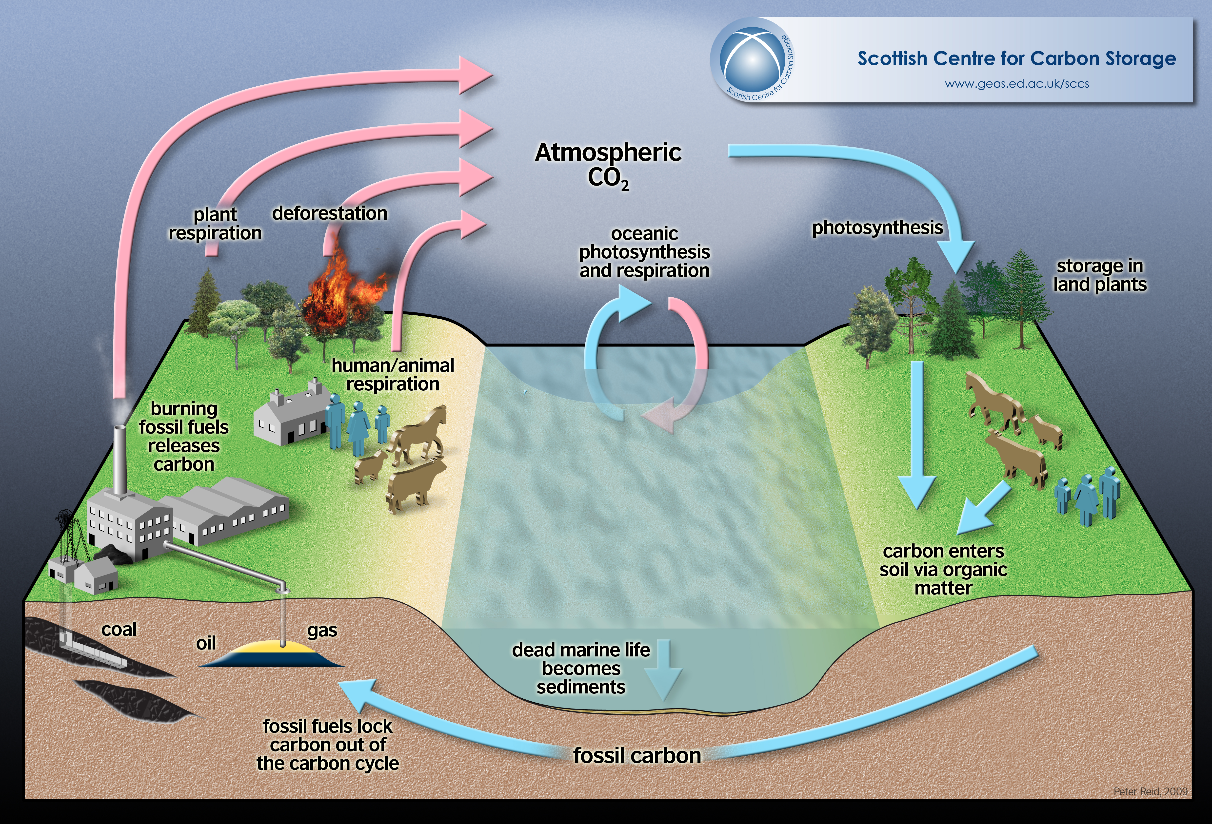

Slide 17
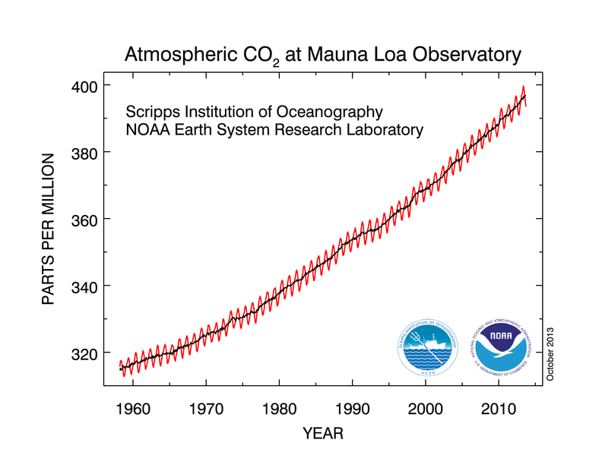

Slide 18
Climate Literacy Essential Principle 3
Life on Earth depends on, is shaped by,
and affects climate.
a. Individual organisms survive within specific ranges of temperature, precipitation, humidity, and sunlight. Organisms exposed to climate conditions outside their normal range must adapt or migrate, or they will perish.
b. The presence of small amounts of heat-trapping greenhouse gases in the atmosphere warms Earth's surface, resulting in a planet that sustains liquid water and life.
c. Changes in climate conditions can affect the health and function of ecosystems and the survival of entire species. The distribution patterns of fossils show evidence of gradual as well as abrupt extinctions related to climate change in the past.
d. A range of natural records shows that the last 10,000 years have been an unusually stable period in Earth's climate history. Modern human societies developed during this time. The agricultural, economic, and transportation systems we rely upon are vulnerable if the climate changes significantly.
e. Life—including microbes, plants, animals and humans—is a major driver of the global carbon cycle and can influence global climate by modifying the chemical makeup of the atmosphere. The geologic record shows that life has significantly altered the atmosphere during Earth's history.

Slide 19
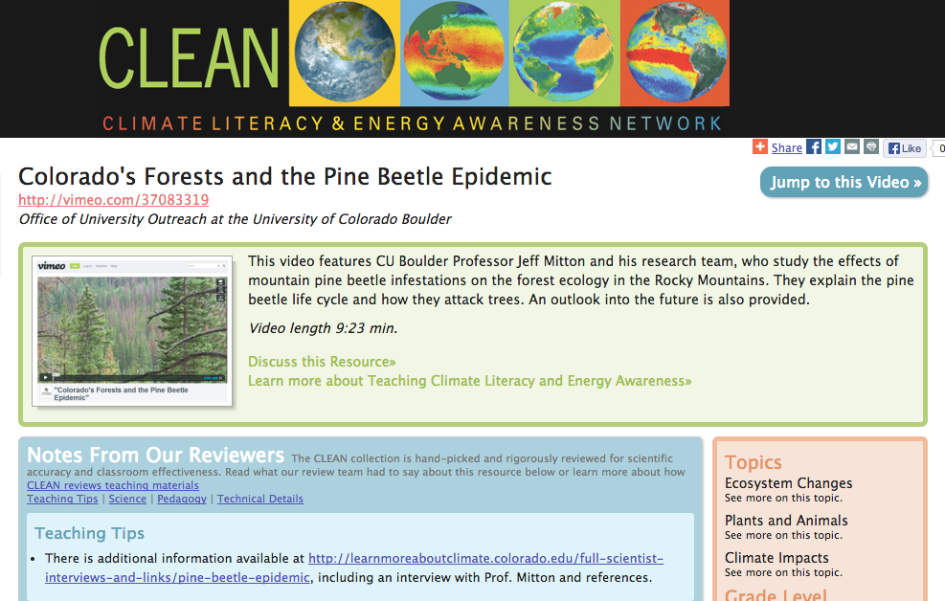
Colorado’s forests and the pine beetle epidemic
CLEAN Resource Link - http://cleanet.org/resources/43805.html

Slide 20
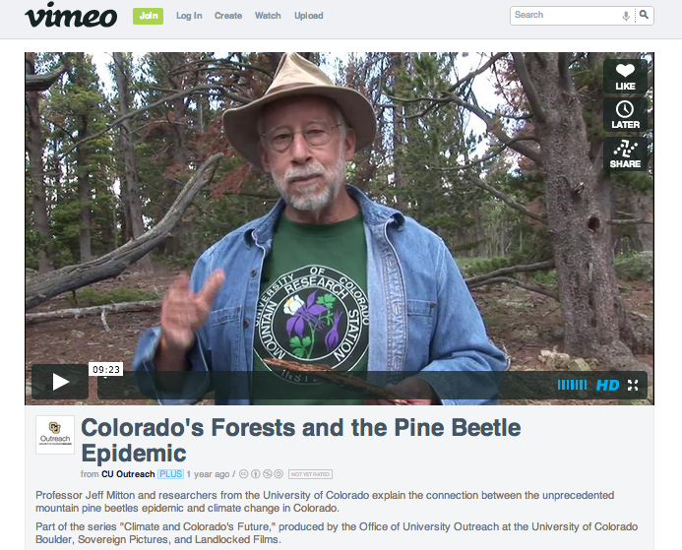

Learn More About Climate Video of Dr. Jeff Milton
Video on Colorado's Forests and the Pine Beetle Epidemic by CU Boulder Dr. Jeff Milton (Learn More About Climate) http://vimeo.com/37083319
Notes:
Video on Colorado's Forests and the Pine Beetle Epidemic by CU Boulder Dr. Jeff Milton (Learn More About Climate) http://vimeo.com/37083319

Slide 21
Learn More About Climate Video of Dr. Jeff Milton
Video on Colorado's Forests and the Pine Beetle Epidemic by CU Boulder Dr. Jeff Milton (Learn More About Climate) http://vimeo.com/37083319
Notes:
Video on Colorado's Forests and the Pine Beetle Epidemic by CU Boulder Dr. Jeff Milton (Learn More About Climate) http://vimeo.com/37083319

Slide 22
Climate Literacy Essential Principle 4
Climate varies over space and time through both natural and man-made processes - I
4a. Climate is determined by the long-term pattern of temperature and precipitation averages and extremes at a location. Climate descriptions can refer to areas that are local, regional, or global in extent. Climate can be described for different time intervals, such as decades, years, seasons, months, or specific dates of the year.
4b. Climate is not the same thing as weather. Weather is the minute-by-minute variable condition of the atmosphere on a local scale. Climate is a conceptual description of an area's average weather conditions and the extent to which those conditions vary over long time intervals.
4c. Climate change is a significant and persistent change in an area's average climate conditions or their extremes. Seasonal variations and multi-year cycles (for example, the El Niño Southern Oscillation) that produce warm, cool, wet, or dry periods across different regions are a natural part of climate variability. They do not represent climate change.
4d. Scientific observations indicate that global climate has changed in the past, is changing now, and will change in the future. The magnitude and direction of this change is not the same at all locations on Earth.

Slide 23
Climate Literacy Essential Principle 4
Climate varies over space and time through both natural and man-made processes – II
4e. Based on evidence from tree rings, other natural records, and scientific observations made around the world, Earth's average temperature is now warmer than it has been for at least the past 1,300 years. Average temperatures have increased markedly in the past 50 years, especially in the North Polar Region.
4f. Natural processes driving Earth's long-term climate variability do not explain the rapid climate change observed in recent decades. The only explanation that is consistent with all available evidence is that human impacts are playing an increasing role in climate change. Future changes in climate may be rapid compared to historical changes.
4g. Natural processes that remove carbon dioxide from the atmosphere operate slowly when compared to the processes that are now adding it to the atmosphere. Thus, carbon dioxide introduced into the atmosphere today may remain there for a century or more. Other greenhouse gases, including some created by humans, may remain in the atmosphere for thousands of years.

Slide 25
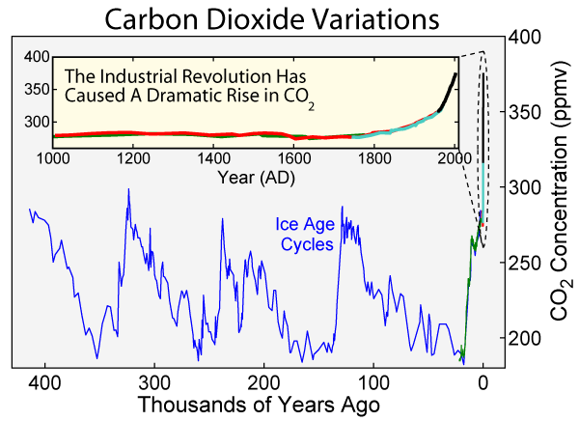
Carbon Dioxide Concentration Variations on ice age time scales
http://cleanet.org/resources/42761.html
http://www.globalwarmingart.com/wiki/File:Carbon_Dioxide_400kyr_Rev_png

Slide 27
Climate Literacy Essential Principle 5
Our understanding of the climate system is improved through observations, theoretical studies, and modeling
5 a. The components and processes of Earth's climate system are subject to the same physical laws as the rest of the Universe. Therefore, the behavior of the climate system can be understood and predicted through careful, systematic study.
5b. Environmental observations are the foundation for understanding the climate system. From the bottom of the ocean to the surface of the Sun, instruments on weather stations, buoys, satellites, and other platforms collect climate data. To learn about past climates, scientists use natural records, such as tree rings, ice cores, and sedimentary layers. Historical observations, such as native knowledge and personal journals, also document past climate change.
5c. Observations, experiments, and theory are used to construct and refine computer models that represent the climate system and make predictions about its future behavior. Results from these models lead to better understanding of the linkages between the atmosphere-ocean system and climate conditions and inspire more observations and experiments. Over time, this iterative process will result in more reliable projections of future climate conditions.
5 d. Our understanding of climate differs in important ways from our understanding of weather. Climate scientists' ability to predict climate patterns months, years, or decades into the future is constrained by different limitations than those faced by meteorologists in forecasting weather days to weeks into the future.
5 e. Scientists have conducted extensive research on the fundamental characteristics of the climate system and their understanding will continue to improve. Current climate change projections are reliable enough to help humans evaluate potential decisions and actions in response to climate change.

Slide 28
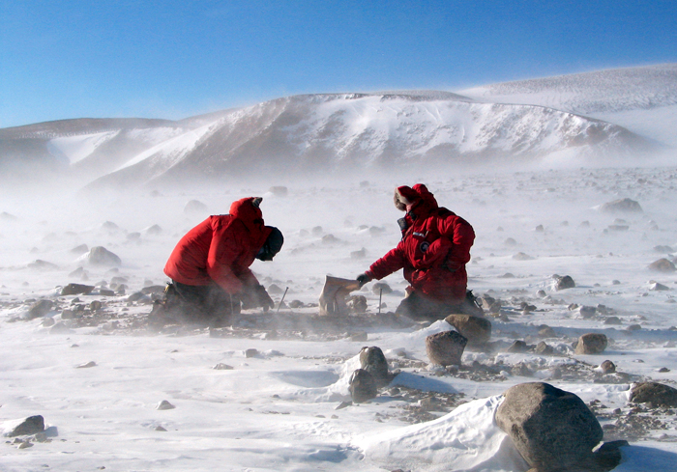

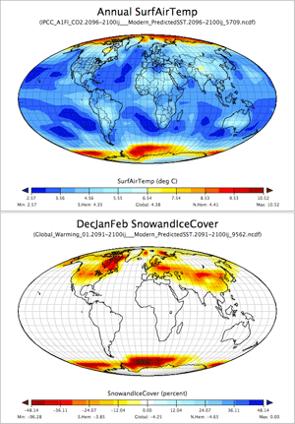
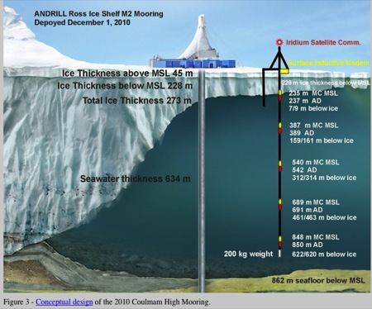
How Do Scientists know what they know

Slide 29
Climate Literacy Essential Principle 6
Human activities are impacting the climate system.
a. The overwhelming consensus of scientific studies on climate indicates that most of the observed increase in global average temperatures since the latter part of the 20th century is very likely due to human activities, primarily from increases in greenhouse gas concentrations resulting from the burning of fossil fuels.
b. Emissions from the widespread burning of fossil fuels since the start of the Industrial Revolution have increased the concentration of greenhouse gases in the atmosphere. Because these gases can remain in the atmosphere for hundreds of years before being removed by natural processes, their warming influence is projected to persist into the next century.
c. Human activities have affected the land, oceans, and atmosphere, and these changes have altered global climate patterns. Burning fossil fuels, releasing chemicals into the atmosphere, reducing the amount of forest cover, and the rapid expansion of farming, development, and industrial activities are releasing carbon dioxide into the atmosphere and changing the balance of the climate system.

Slide 30
Climate Literacy Essential Principle 6
Human activities are impacting the climate system.
d. Growing evidence shows that changes in many physical and biological systems are linked to human caused global warming. Some changes resulting from human activities have decreased the capacity of the environment to support various species and have substantially reduced ecosystem biodiversity and ecological resilience.
e. Scientists and economists predict that there will be both positive and negative impacts from global climate change. If warming exceeds 2 to 3°C (3.6 to 5.4°F) over the next century, the consequences of the negative impacts are likely to be much greater than the consequences of the positive impacts.

Slide 31
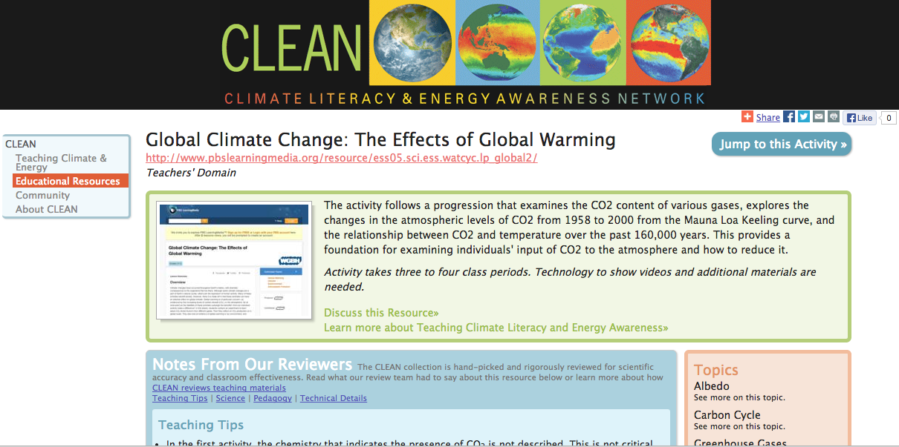
PBS Lesson on the effects of climate change
CLEAN Resource Link - http://cleanet.org/resources/41876.html

Slide 32
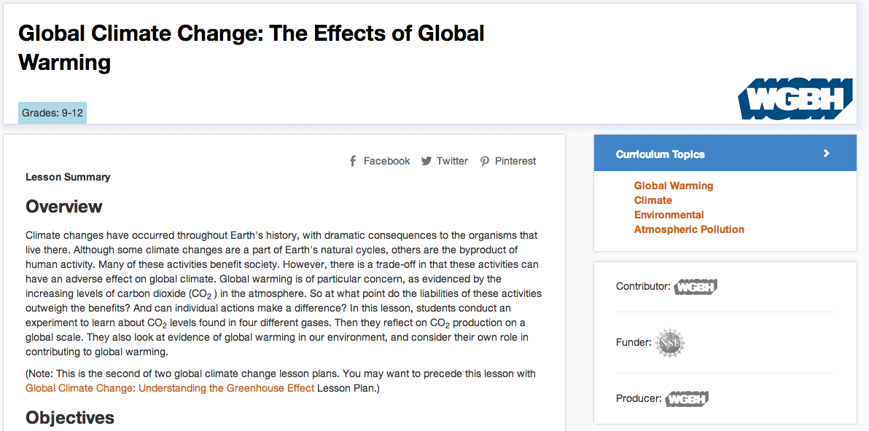
PBS Lesson on the effects of climate change
Global Climate Change: The Effects of Global Warming (PBS Learning) http://www.pbslearningmedia.org/resource/ess05.sci.ess.watcyc.lp_global2/global-climate-change-the-effects-of-global-warming/

Slide 33
Climate Literacy Essential Principle 7
Climate change will have consequences for the Earth system and human lives - I
7a. Melting of ice sheets and glaciers, combined with the thermal expansion of seawater as the oceans warm, is causing sea level to rise. Seawater is beginning to move onto low-lying land, contaminating coastal fresh water sources, and gradually submerging coastal facilities and barrier islands. Sea-level rise increases the risk of damage to homes and buildings from storm surges such as those that accompany hurricanes.
7b. Climate plays an important role in the global distribution of freshwater resources. Changing precipitation patterns and temperature conditions will alter the distribution and availability of freshwater resources, reducing reliable access to water for many people and their crops. Winter snowpack and mountain glaciers that provide water for human use are declining as a result of global warming.
7c. Incidents of extreme weather are projected to increase as a result of climate change. Many locations will see a substantial increase in the number of heat waves they experience per year and a likely decrease in episodes of severe cold. Precipitation events are expected to become less frequent but more intense in many areas, and droughts will be more frequent and severe in areas where average precipitation is projected to decrease.

Slide 34
Climate Literacy Essential Principle 7
Climate change will have consequences for the Earth system and human lives – II
7d. The chemistry of ocean water is changed by absorption of carbon dioxide from the atmosphere. Increasing carbon dioxide levels in the atmosphere are causing ocean water to become more acidic, threatening the survival of shell-building marine species and the entire food web of which they are a part.
7e. Ecosystems on land and in the ocean have been and will continue to be disturbed by climate change. Animals, plants, bacteria, and viruses will migrate to new areas with favorable climate conditions. Infectious diseases and certain species will be able to invade areas that they did not previously inhabit.
7f. Human health and mortality rates will be affected to different degrees in specific regions of the world as a result of climate change. Although cold-related deaths are predicted to decrease, other risks are predicted to rise. The incidence and geographical range of climate-sensitive infectious diseases— such as malaria, dengue fever, and tick-borne diseases—will increase. Drought-reduced crop yields, degraded air and water quality, and increased hazards in coastal and low-lying areas will contribute to unhealthy conditions, particularly for the most vulnerable populations.

