Slide 1



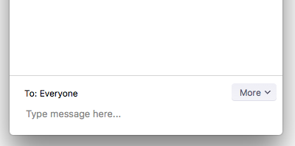
Welcome to the NAGT webinar series
Improving Earth education one hour at a time
Webinar Wow
As you enter, please review the Zoom controls below. Leave your audio and video off, unless prompted by a host. You can post any questions in the chat box. Thank you!
Please leave your audio muted and video off (both indicated by a red slash).
Click to open the Participants box. This will allow you to give nonverbal feedback.
Click to open the Chat box. This will allow you to chat with Hosts and Participants.
Join or Renew Today!
http://nagt.org/37340

Slide 2
Webinar Wow!
Introduction to
Webinar Design Best Practices
Utilizing the Web Tools
Sean Tvelia, Suffolk County Community College
Chair, NAGT Professional Development Committee

Slide 3
The NAGT Webinar Series
Professional development and topical webinars for educational and instructional purposes.
Address themes on:
improving teaching and learning,
diversity, equity, and inclusion,
engaging communities and society,
implementing the NGSS,
strengthening your department,
supporting geoscience education research

Slide 4
Before we begin let’s get acquainted
Now, using the participant controls, raise your hand if you have previously participated in any webinars.
Now, lower your hand if you have never participated in a NAGT webinar.
Open the chat box and let us know the title or theme of the webinar you are planning to develop.

Slide 5
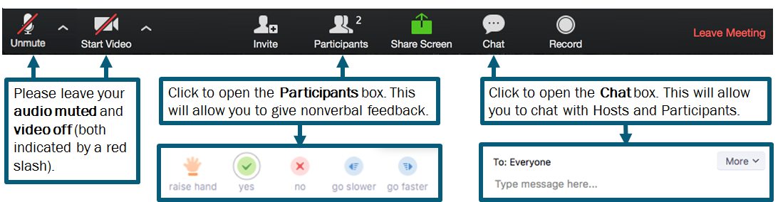
Before we begin let’s get acquainted with Zoom’s participant controls

Slide 6
Objectives for today’s webinar
Develop a clear objective for your upcoming webinar
Learn the best practices for webinar development
Learn about the tools available in Zoom that will help you engage your participants
Learn about upcoming NAGT Webinar programs

Slide 7
Preparing for your Webinar
Information needed from the presenter(s). Any information ASAP is best, but items 1 through 4 should be at available 2 months before and no closer to the webinar than a month.
Title
Presenter name(s) and affiliation(s)
Summary (75 - 100 words)
Short description ( ~200 characters with spaces)
Webinar goals (3 - 4, these can come later, by a month before the webinar)
Relevant image for webpage (optional)
Resources (optional and can be posted after webinar, same time as recording)

Slide 8
Preparing the webinar series
2+ months prior to webinar: potential presenters identified and titles chosen with presenters. (committee member)
~1 month prior to webinar: Schedule a call with the presenters to outline their talk and how to make their presentation interactive and to finalize information (e.g. goals and description if not already included) for the webinar page (committee member)
~2 weeks prior to webinar: (optional): Set date for practice run (committee member)
~2 - 4 days prior to webinar: Practice run of the webinar to check technical issues (support staff and/or committee member)
2 days prior to webinar: Close registration (support staff) and combine presenter and webinar series slides into single slide deck for presenter to use and also upload to the webinar page
1 day prior to webinar: Email registrants, including presenters, with Zoom connection information (support staff)

Slide 9
Our experiences with webinars
Take a minute to recall a webinar (or workshop) you attended that you found to be ineffective. Describe the characteristics of the webinar/workshop
Using a smartphone, tablet, or other computer navigate to:
https://pollev.com/tvelias/
Use the form to enter as many words or phrases you wish to describe an ineffective webinar.
You will need to click submit for each entry
Text “TVELIAS" to 37607 to join poll then text each response.
Text “LEAVE” to exit the poll
Or

Slide 10
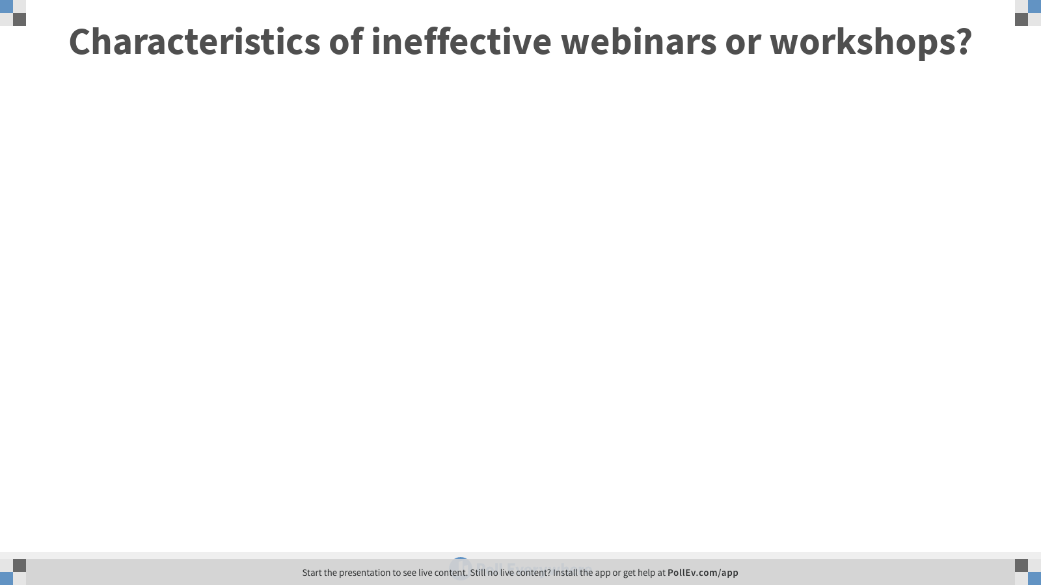
Notes:
Characteristics of ineffective webinars or workshops?
https://www.polleverywhere.com/free_text_polls/mHnbXX81NgEhlbxtKokNx

Slide 11
Our experiences with webinars
Now take a minute to recall a webinar (or workshop) you attended that you found very effective. What characteristics of the webinar were so effective?
Using a smartphone, tablet, or other computer navigate to:
https://pollev.com/tvelias/
Use the form to enter as many words or phrases you wish to describe an ineffective webinar.
You will need to click submit for each entry
Text “TVELIAS" to 37607 to join poll then text each response.
Text “LEAVE” to exit the poll
Or

Slide 12
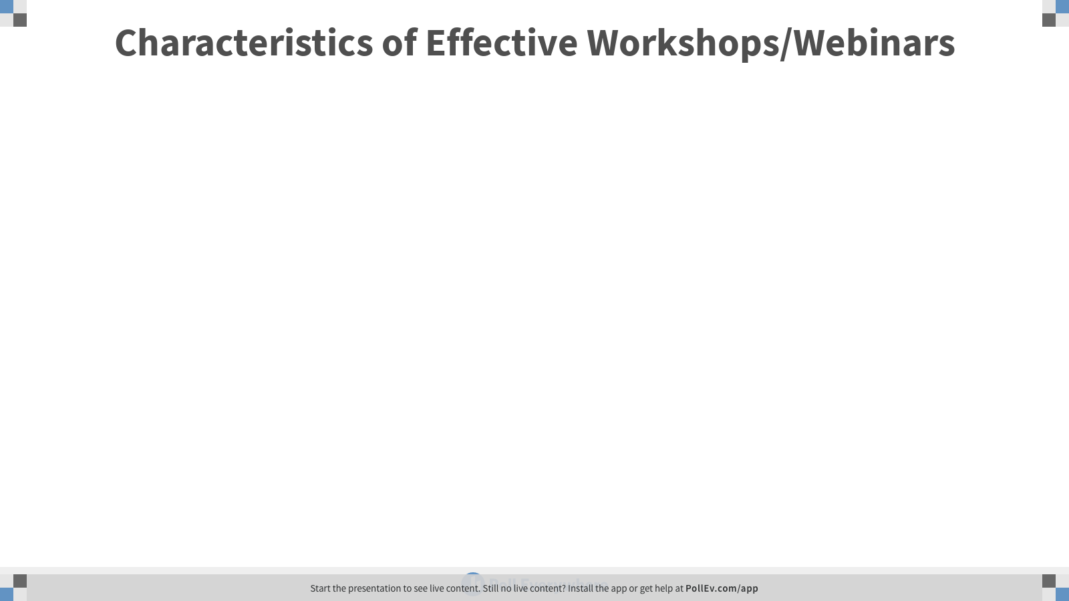
Notes:
Characteristics of Effective Workshops/Webinars
https://www.polleverywhere.com/free_text_polls/32jejLU7x9wg2ILUZWkTw

Slide 13
General Webinar/Workshop Design Principles
Engage: Try to engage your participants from the very start. Throughout the webinar maximize potential participant activities.
Learn: Provide participants with relevant materials and explanation based on the stated objective of the webinar.
Reflect/Apply: Provide time for participants to reflect on the presented material and potentially apply it to their own goals for attending.
Carefully balance your speaking with participant engagement. In general plan for:
~45 minutes of presenting
~10 minutes of Discussion
~5 minutes for evaluation
Repeat this cycle throughout the webinar

Slide 14

Example from September 12, 2019: Using the NGSS to Change Worlds
Presenter Matt Krehbiel
NAGT Webinar Series

Slide 15
Webinar Design and Best Practices
Think of your webinar as a well designed lesson
What are your goals for the workshop?
How will you assess if the participants successfully met your goals?
What activities will allow you to achieve your goals for the workshop?
1.Workshop Goals
3. Workshop Activities
2. Feedback & Assessment
Situational Factors (e.g., program objective, time frame, participant experience, etc.)

Slide 16
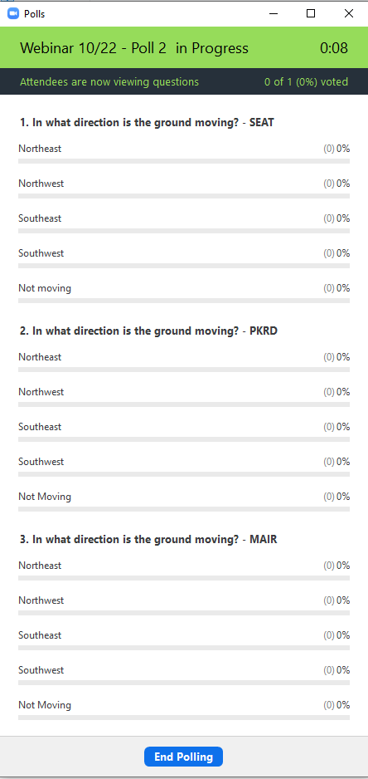
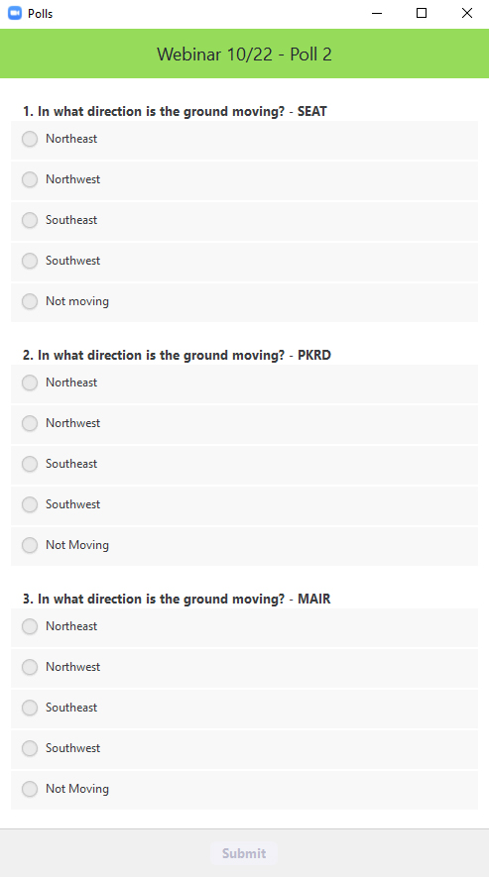
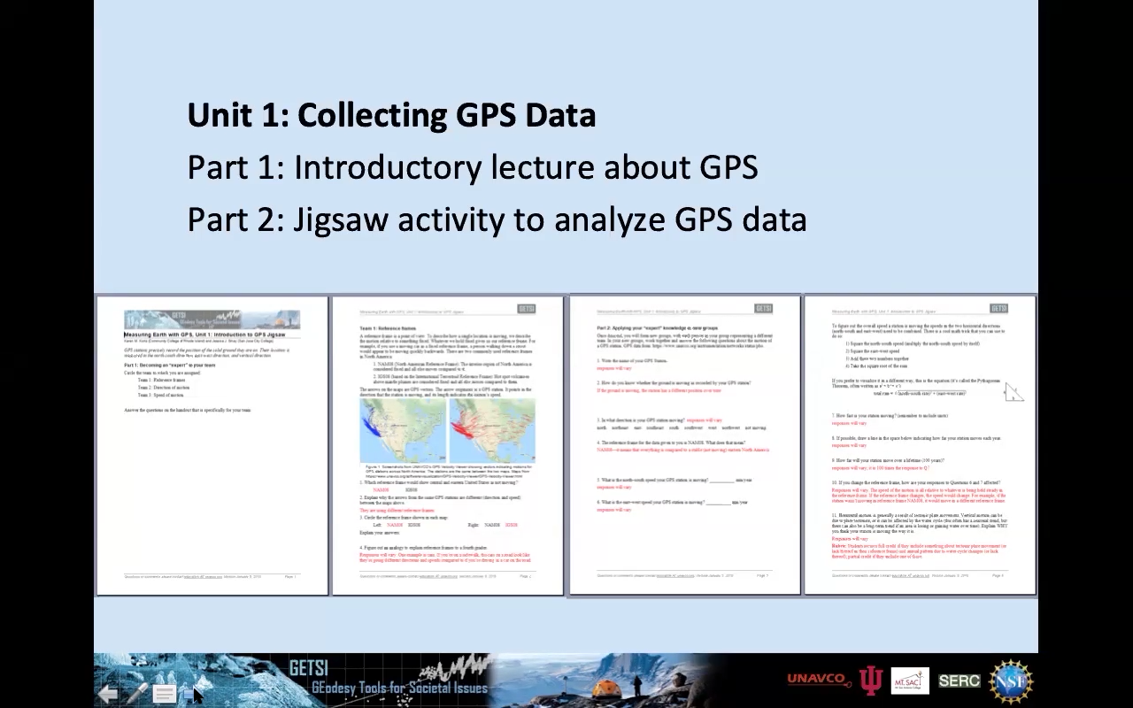
Example from October 22, 2019: Using GPS Data to Teach about the Earth in Introductory Undergraduate Courses: Plate Tectonics, Earthquakes, Water Cycle, and Ice Mass Change
Presenters:
Karen Kortz (Community College of Rhode Island)
Beth Pratt-Sitaula (UNAVCO)
NAGT Webinar Series

Slide 17
Developing your webinar
Call up into your mind what you want to accomplish during your webinar. (what are your goals/objective?)
Write into the chat at least one objective for your webinar and one activity you might do during the webinar to meet that goal and engage your participants.

Slide 18
Workshop Best-Practices
Active engagement of participants during the workshop: Nothing is deadlier or less effective than a workshop where participants do not participate. Give people an opportunity to participate actively in every session using a variety of techniques.
Model effective pedagogy: The most successful webinars are those taught with good active pedagogy in mind and the least successful sessions are those where a presenter simply talks or reads from the slide.
Emphasize practical applications: An emphasis on practical applications and strategies is an important aspect of effecting change in teaching practice.
Give participants time to interact and share experience/knowledge: Participants bring valuable experience and ideas to webinars. Structured mechanisms for sharing experiences and expertise must be an integral part of every workshop program.
Provide materials and examples: Examples of how the webinar topics can be applied in the classroom and field are particularly valuable resources for participants.
Give participants time to make progress on a specific task that connects the workshop topic to their teaching: Time to work individually during the workshop allows participants to reflect and to make progress on adapting webinar content to their own needs.
Make sure that participants leave the workshop with specific plans for future action: Workshops can produce a wide variety of results ranging from changes in teaching practice and development of new learning resources to department-level planning and community-wide action. In all cases, workshop time devoted to planning next steps and feedback from peers is critical.

Slide 19
What is the most challenging thing you need to do to get ready for your webinar?
Finding time is not a good answer – though undoubtedly true
Using a smartphone, tablet, or other computer navigate to:
https://pollev.com/tvelias/
Use the form to enter as many words or phrases you wish to describe an ineffective webinar.
You will need to click submit for each entry
Text “TVELIAS" to 37607 to join poll then text each response.
Text “LEAVE” to exit the poll
Or

Slide 20
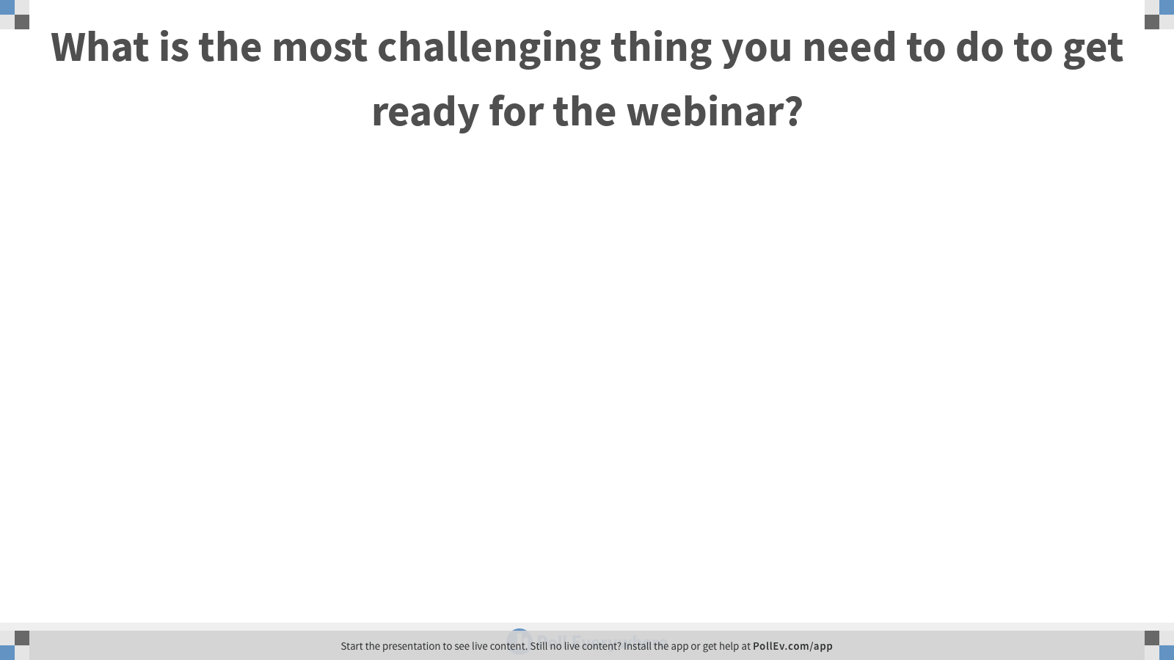
Notes:
What is the most challenging thing you need to do to get ready for the webinar?
https://www.polleverywhere.com/free_text_polls/LnDxoO2mTb6Gt8x3bM13P

Slide 21
Developing, Publishing, Marketing Your Webinar
Drawing an Audience
Which sections/divisions are you most likely to draw from?
Consider your audience when developing the webinar despcription.
Notify relevant division/section leaders.
How might you attract other areas?
Creating a Successful Workshop
As you are developing the webinar maximize your use of webinar best practices.
Preparing a Lasting Record—No pressure but your webinar is recorded.
Practice makes perfect. Plan to do a pre-show run-through to ensure participant activities work and that presenter roles are clear.

Slide 22
Things that were challenging for me
You don’t know who is coming in advance
This is a really short amount of time
Developing and Balancing learning and applying

Slide 23
Utilize the Web Tools
Participant tools:
Raise hand and Yes/No: Provides a means for audience responses and interaction that is temporary, doesn't require typing into the chat, and can be counted.
Polling: allows you to pose multiple answer/yes-no questions to the audience and receive immediate feedback during the webinar. We can set up specific multiple choice/single choice polling questions and answers.
Chat: allows participants to ask the presenter (you) questions and also discuss topics with each other. This allows for conversation without having people have to talk via the audio.

Slide 24
Other Web Resources
Use your webinar webpage for participant resources
Participants will not be able to click on your presentation.
If you have online resources you want them to explore have those links available to you or your co-presenter to paste into the chat.
Work with staff to have links or files available from the program website.
Poll Everywhere
Google Docs
Kahoot
Be careful using other web resources. Online tools don’t easily scale and can introduce confusion/frustration into your program

Slide 25
Preparatory Website/webinar Support
NAGT Staff:
Andrew Haveles - ahaveles@carleton.edu
Will assist you with website descriptions and Zoom tools if needed.
The NAGT Webinar Series Committee Members
Webinar Committee members will help you develop your ideas and assist you with your webinar practice run

Slide 26
NAGT Events Code of Conduct
In fulfilling its vision and mission, NAGT promotes, provides, expects and endorses a professional and respectful atmosphere and values a diversity of views and opinions at NAGT supported events and programs. All NAGT meetings and events participants are expected to abide by the NAGT Code of Conduct, which applies in all venues, events, and on-line forums associated with NAGT. This Code of Conduct is intended to align with the American Geosciences Institute's Statement on Harassment in the Geosciences. Please read the full NAGT Code of Conduct Policy for details.
https://nagt.org/nagt/about/code_of_conduct.html

Slide 27


Upcoming Webinars
Teaching About Volcanoes with Monitoring Data and Communicating Risk
Presenters: Kaatje Kraft, Whatcom Community College Beth Pratt-Sitaula, UNAVCO
January 29, 2020 Time: 1:00 pm PT | 2:00 pm MT | 3:00 pm CT | 4:00 pm ET
On-Ramps to more effective teaching: quick-start guides to strategies for actively engaging students to improve learning
Presenters: Barb Tewksbury, Hamilton College, Phil Resor, Wesleyan University, Jen Wenner, University of Wisconsin-Oshkosh
February 6, 2020 Time: 11:00 am PT | 12:00 pm MT | 1:00 pm CT | 2:00 pm ET
https://nagt.org/nagt/profdev/webinars/webinar_series_schedule.html

Slide 28
Questions?

