Slide 1
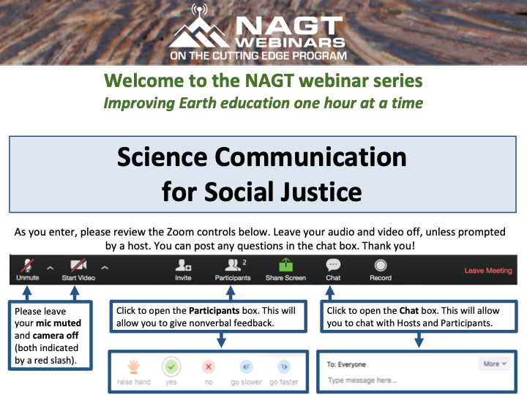

Slide 2


Slide 3
Science Communication for Social Justice
Beth Bartel, formerly UNAVCO now Michigan Tech
and
Wendy Bohon, IRIS
August 27, 2020

Slide 4
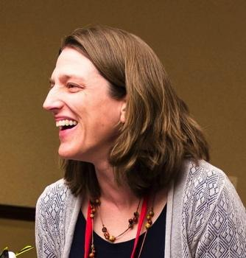
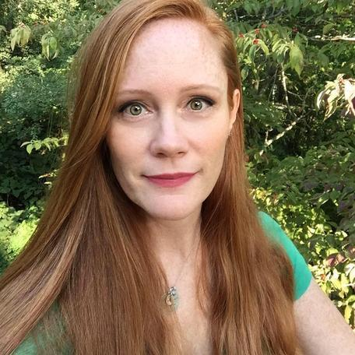
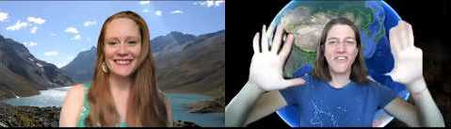

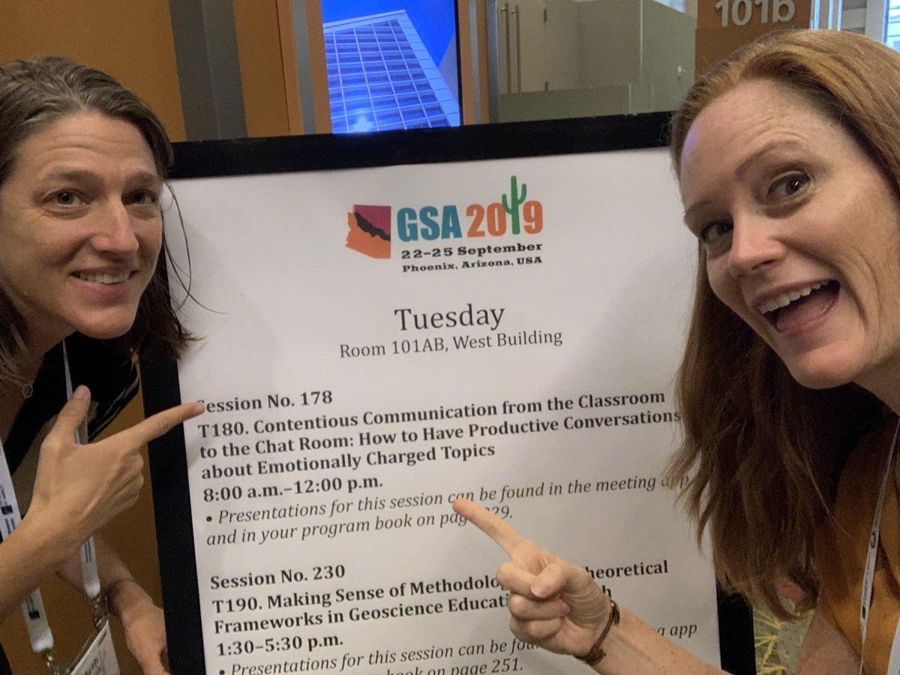


Who We Are
Beth Bartel (she/her)
SciComm Specialist / PhD student
*Keweenaw Bay tribal land
Dr. Wendy Bohon (she/her)
Geologist / SciComm Specialist
*Piscataway homeland
Notes:
You’re the best

Slide 5

Acknowledgements
We would like to acknowledge the previous work done to address racism, DEI and social justice in STEM, especially work done by people of color, including
Dr. Chanda Prescod-Weinstein
Dr. Kuheli Dutt
Dr. Angela Saini
Dr. Danielle Lee
Dr. Keolu Fox
Dr. Kim Tallbear
Dr. Safiya Noble

Slide 6

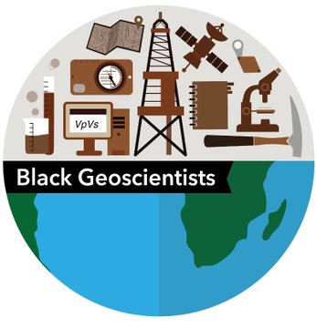
Black in Geoscience Week
Sept 6-12 | @BlkinGeoscience | #BlackInGeoscience
Logos by Dr. Lucía Pérez Díaz

Slide 7

Your Goals
Thank you for showing up.
So… why are you here?
What do you hope to get out of this webinar?
How do you hope to use it?
Notes:
have people write in chat

Slide 8
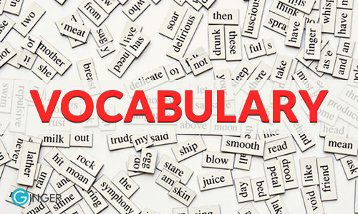
Notes:
One of the tenants of good science communication is to either avoid or define words that audience may not be completely familiar with.

Slide 9
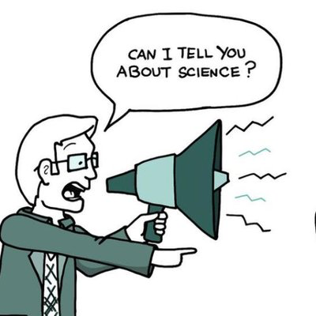
What is Science Communication?
Science communication is the practice of informing, educating, sharing wonderment, and raising awareness of science-related topics. - Wikipedia
Communicator
Audience
Platform
Often bidirectional communication channels
Social, emotional and physical context

Slide 10

What is Social Justice?
Justice in terms of the distribution of wealth, opportunities, and privileges within a society.
- Oxford Languages
Notes:
Add a word cloud?
Beth

Slide 11
What is Social Justice?
Justice in terms of the distribution of wealth, opportunities, and privileges within a society.
- Oxford Languages
www.menti.com
53 81 55 3
Where do the inequities lie in geoscience?
Notes:
Add a word cloud?
Beth

Slide 12
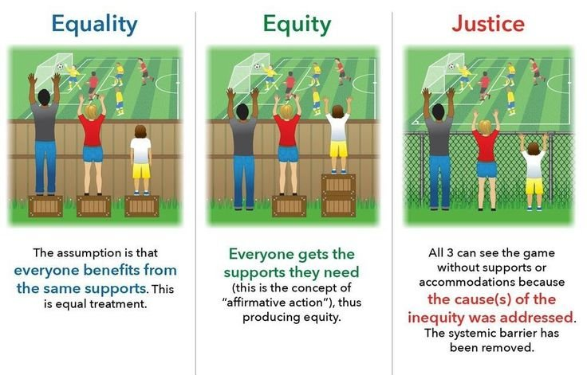

Slide 13
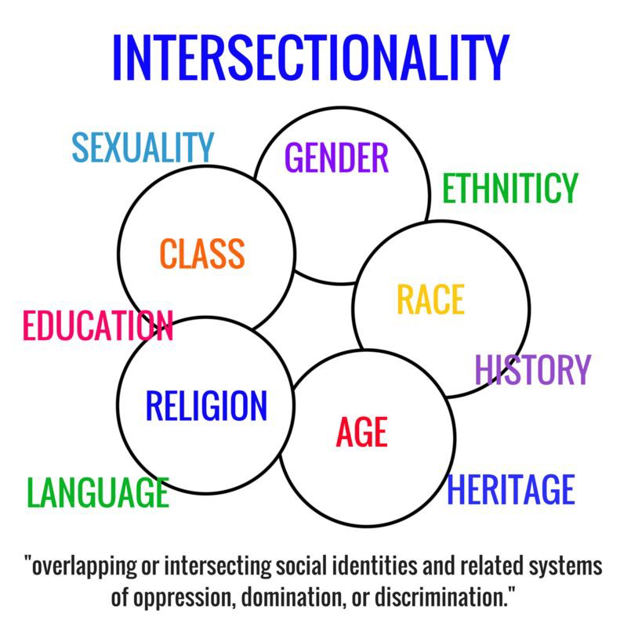
Intersectionality - coined by Kimberlé Crenshaw 30 years ago
Describes how race, class, gender, and other individual characteristics “intersect” with one another and overlap.
Notes:
Intersectionality – is the acknowledgement that humans are complex, and cannot be defined by one identity. Further, different identities will have different oppressions depending on the situation and location.
How much an individual identifies, with each will vary as well.

Slide 14
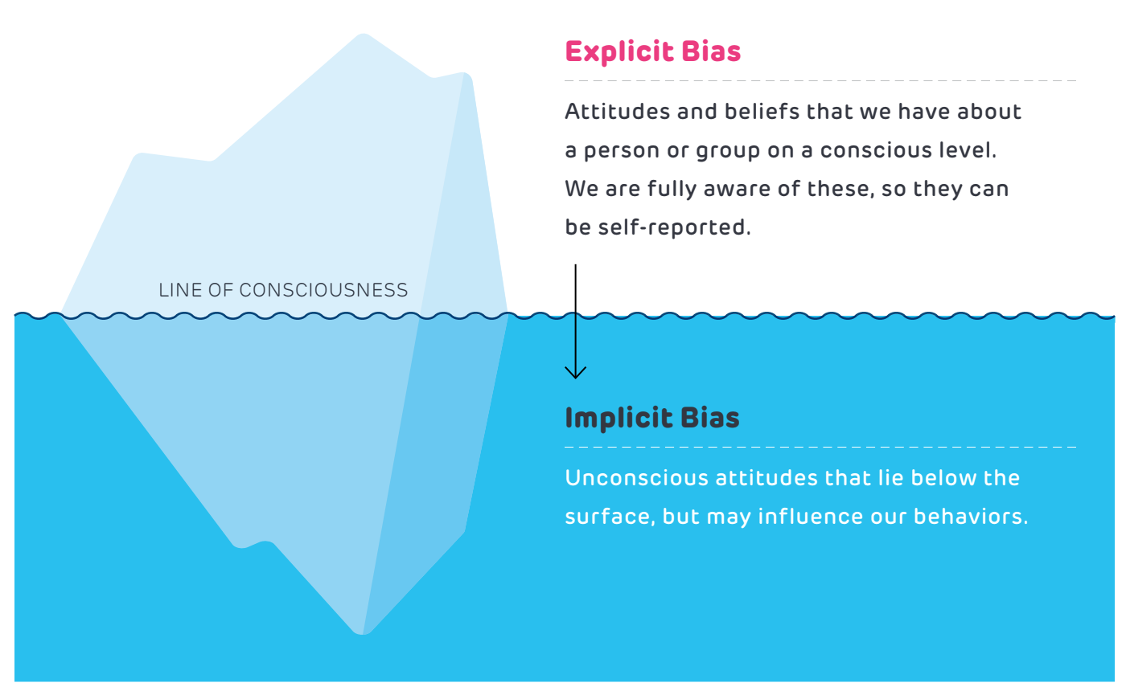
Implicit and Explicit Bias
policyLab
Test your implicit bias with “Project Implicit”
Notes:
In the case of explicit bias, the person is very clear about their feelings and attitudes, and related behaviors are conducted with intent.
Implicit or unconscious bias operates outside of the person’s awareness and can be in direct contradiction to a person’s espoused beliefs and values. What is so dangerous about implicit bias is that it automatically seeps into a person’s affect or behavior and is outside of the full awareness of that person. More difficult to address something that you’re not aware, of, but it has real and last impacts on attitudes and behaviors.

Slide 15
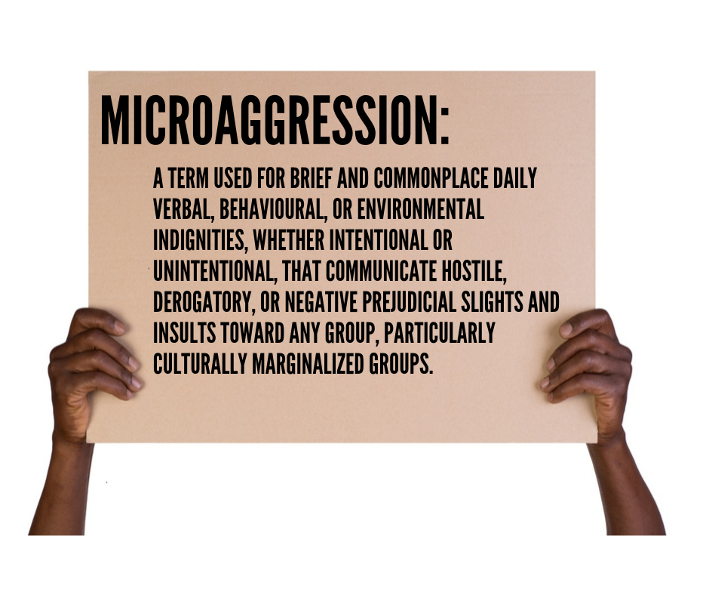
Microaggressions
Small differences in treatment can pile up, resulting in large disparities (Valian, 1998)
“Those who differ from the norm encounter a cycle of cumulative disadvantage, while those who fit the norm experience a cycle of advantage.” (Turner, 2002, pp. 76-77)
Notes:
And a key part of what makes them so disconcerting is that they happen casually, frequently, and often without any harm intended. But for the person on the receiving end it’s like death by a thousand cuts.

Slide 16
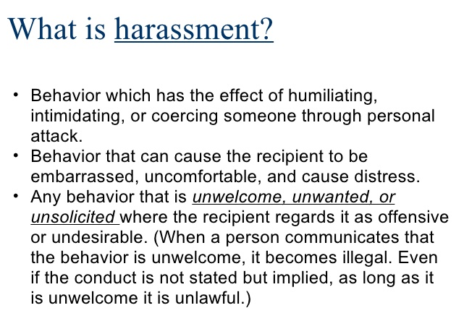

Slide 17
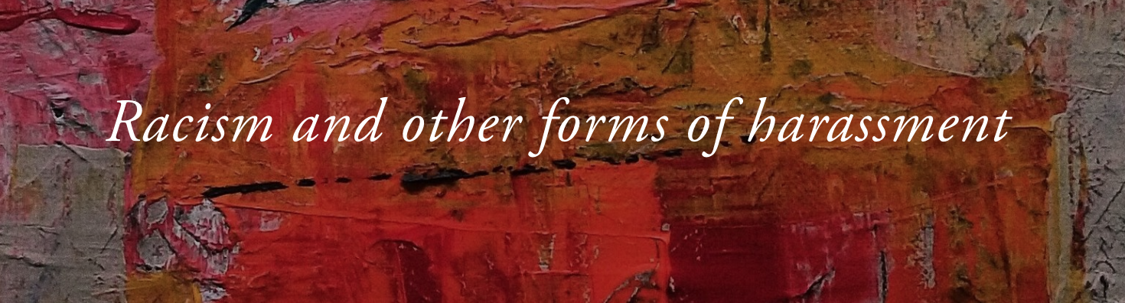
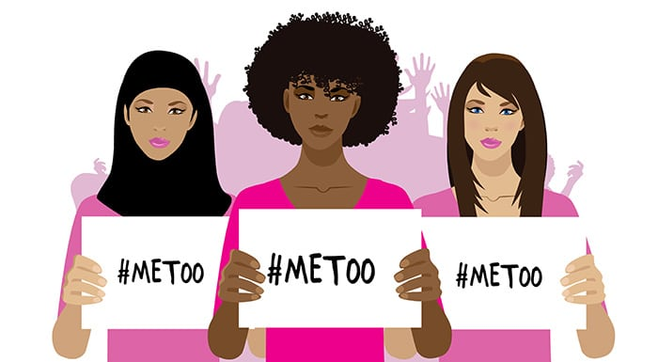
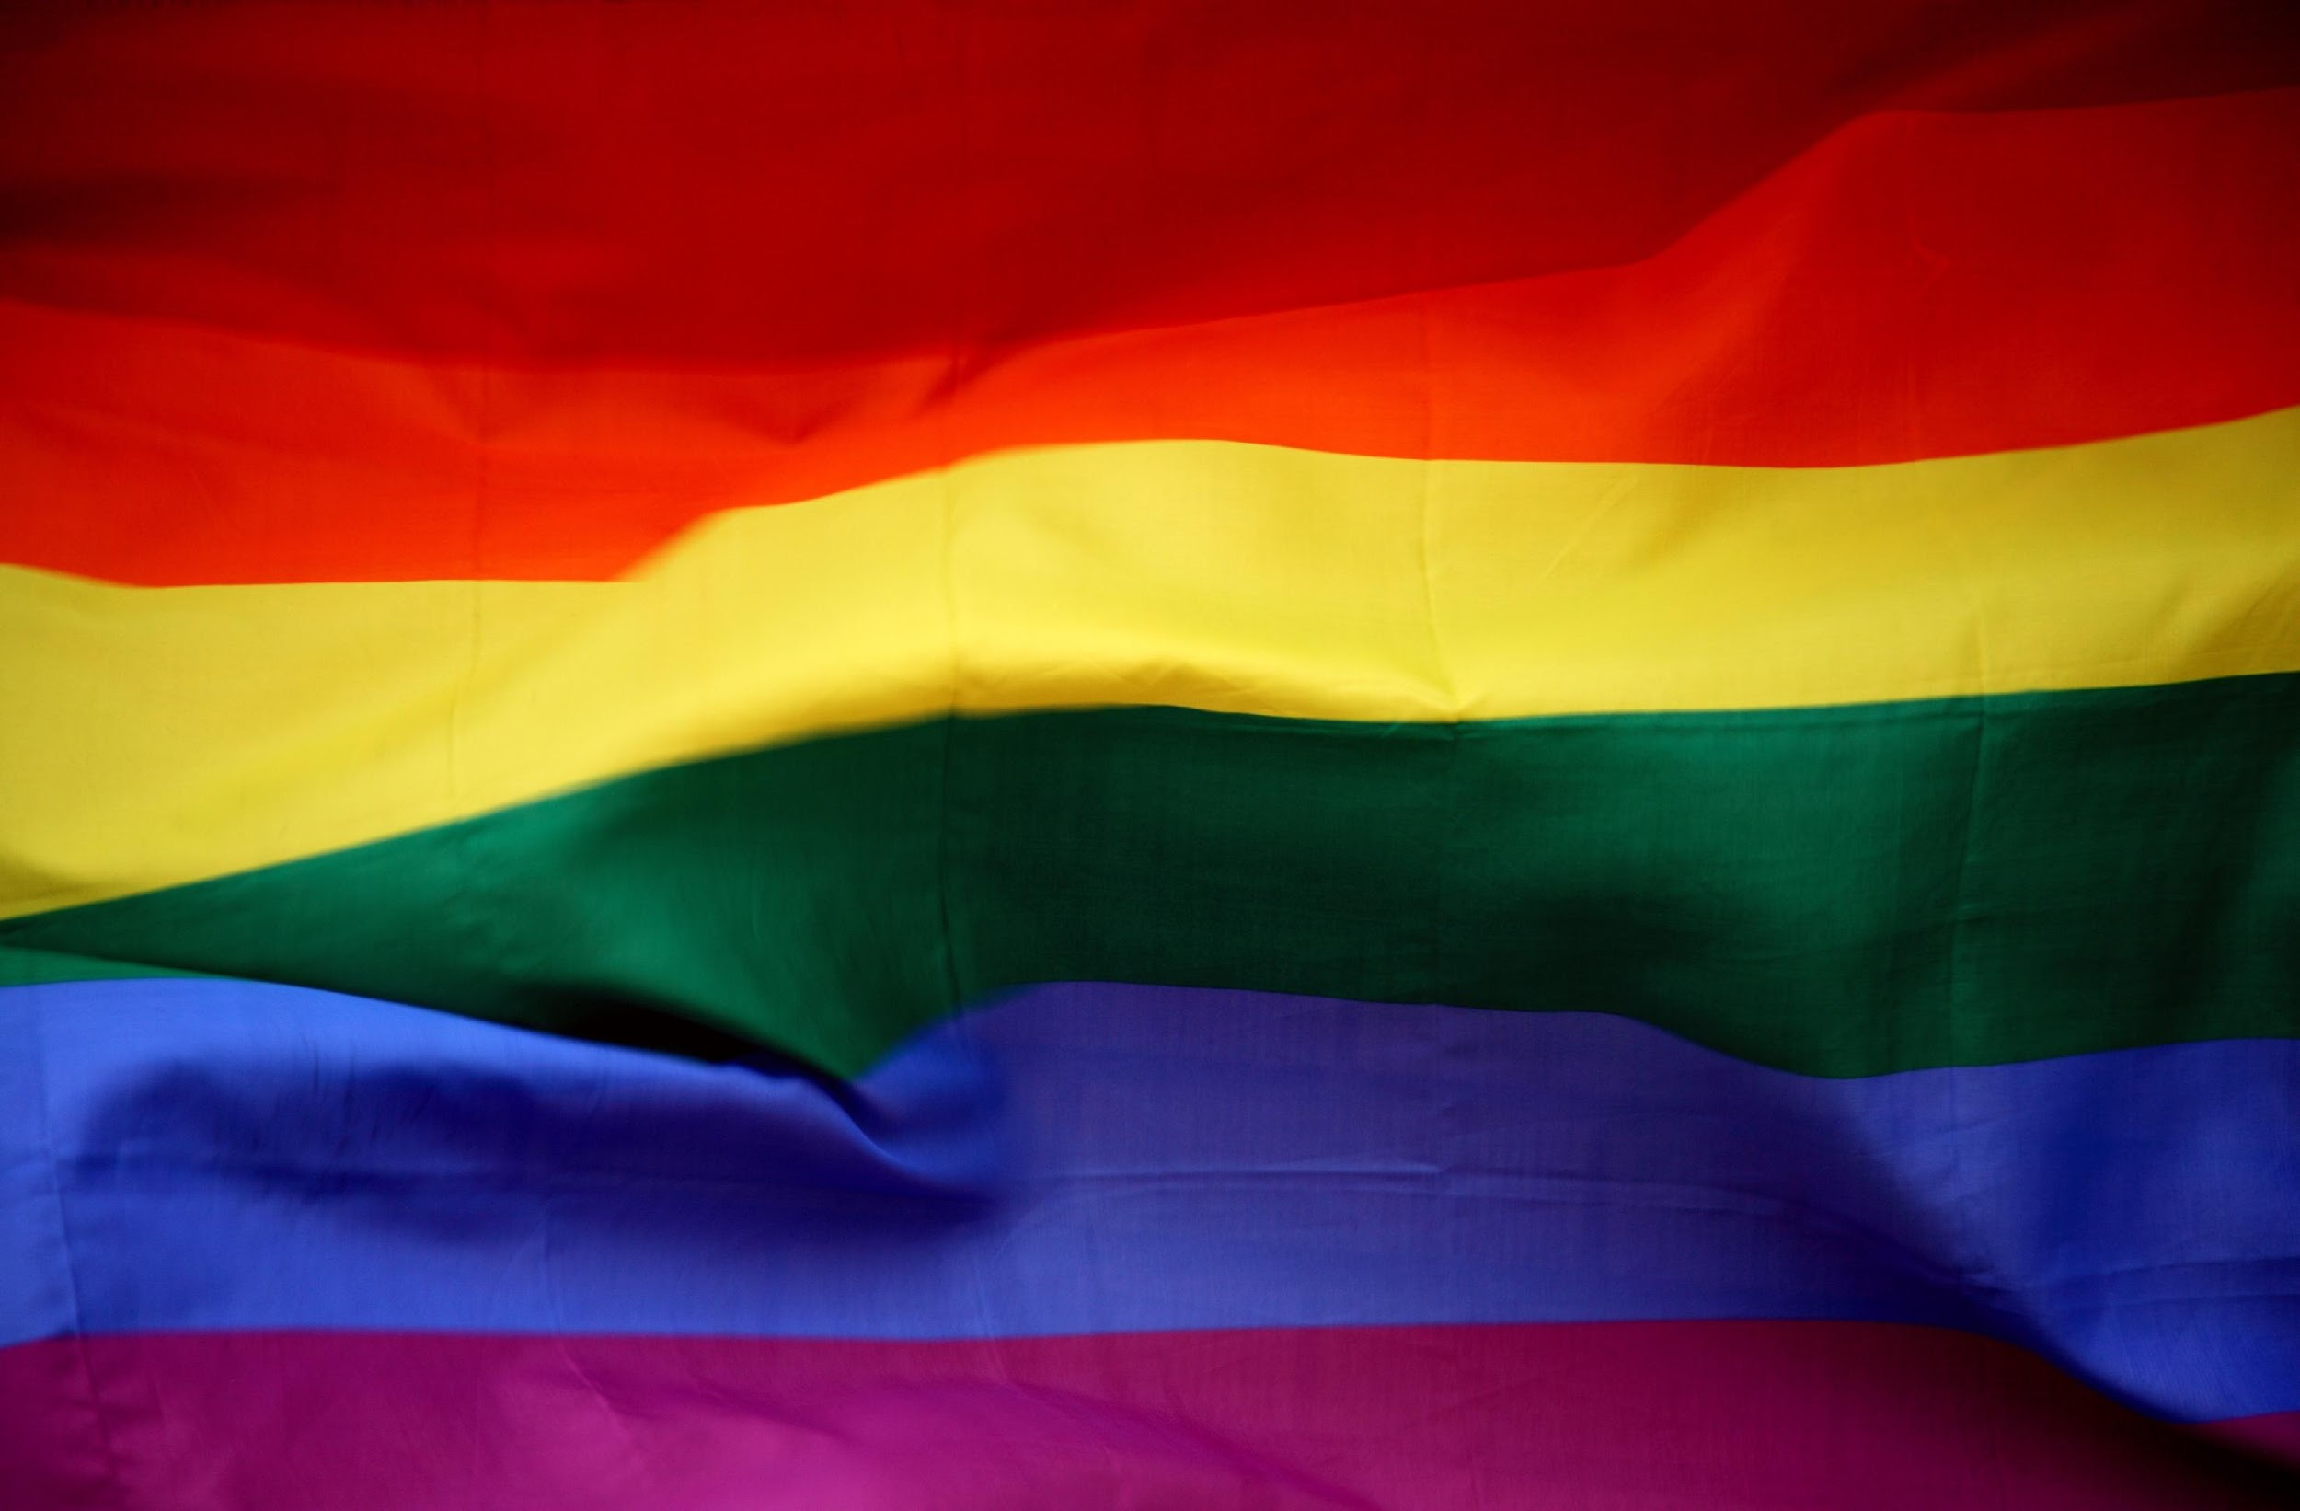
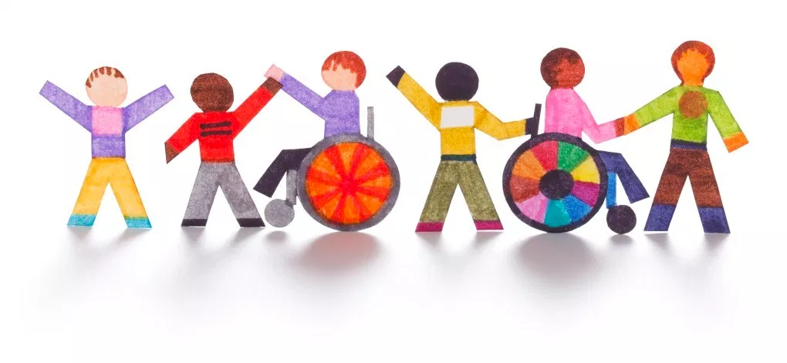
Notes:
Sexual harassment is only one form of harassment; people of color deal with racial harassment and women of color experience both. This is called the double bind.
Harassment, discrimination, explicit and implicit biases go well beyond gender and race.
Including homophobia and transphobia, discrimination of disabilities.

Slide 18
Institutional
Discrimination is built into the foundation of science and society
Colonialist and Euro-centric education
Dominate gender and social norms
Unequal pay for equal work
Inadequate family leave policies
Inflexible work schedules
Workplace harassment
Culture of exclusion
Notes:
Institutiional discrimination is building into the foundation of science and our society.
Early on, girls are discouraged from pursuing science by teachers and peers, and as a result, often opt out of STEM studies.
Overt and unconscious gender biases continue to affect women in undergraduate science classes, where female students are perceived to be less knowledgeable than male students.
Male faculty tend to train and employ fewer female graduate students and postdoctoral researchers than their female colleagues.
Women and underrepresented minorities are less likely to receive mentorship across disciplines than white men.
Women also publish less, are judge more harshly. Women are also less frequently cited,
In the classroom, women of color have their authority and competency challenged and expertise discredited.
Recent research highlights how biases against women who identify as lesbian, bisexual, or transgender are particularly strong in STEM environments compared to other occupational fields.
I want to zoom in in workplace harassment

Slide 19
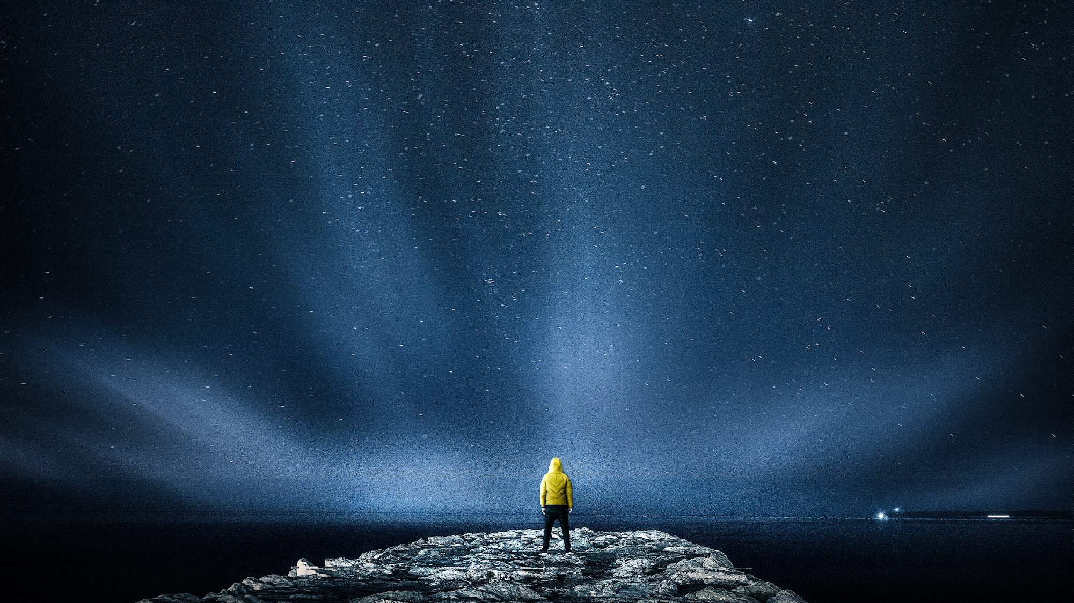
49%
18%
of the STEM
workforce
are white men
only
of the STEM
workforce
are white women
Notes:
obviously we have a problem - women are woefully underrepresented in STEM fields, which gives the idea that STEM is something that can only be done by a certain class of people
there have been a number of campaigns that have attempted to right this imbalance.
but these campaigns are often not based in evidence. Further, they often do not address the root of the problem. Maybe you recognize this in current initiatives – jobs that bring women in, but give no support once they are there.

Slide 20
49%
2%
of the STEM
workforce
are Black and
Hispanic women
of the STEM
workforce
are white men
only
Notes:
obviously we have a problem - women are woefully underrepresented in STEM fields, which gives the idea that STEM is something that can only be done by a certain class of people
there have been a number of campaigns that have attempted to right this imbalance.
but these campaigns are often not based in evidence. Further, they often do not address the root of the problem. Maybe you recognize this in current initiatives – jobs that bring women in, but give no support once they are there.

Slide 21
In the classroom, women of color have their authority and competency challenged and expertise discredited (Pittman, 2010)

Slide 22
Biases against people who identify as gay, bisexual, or transgender are particularly strong in STEM environments compared to other occupational fields (Cech and Pham, 2017).

Slide 23
<10% of geoscience PhDs go to recipients of color ^{(AGI, 2016)}

Slide 24
Only 69 Black women and 20 Indigenous women have received PhD in the geosciences in 40 years ^{(Bernard and Cooperdock, 2018)}

Slide 25
Women ^{(Holmes et al., 2015)}, people from sexual and gender minorities ^{(Hughes, 2018)}, and Black and Hispanic people^{(Riegle-Crumb et al., 2019)} all leave the field at higher rates than the average student or practitioner.

Slide 26
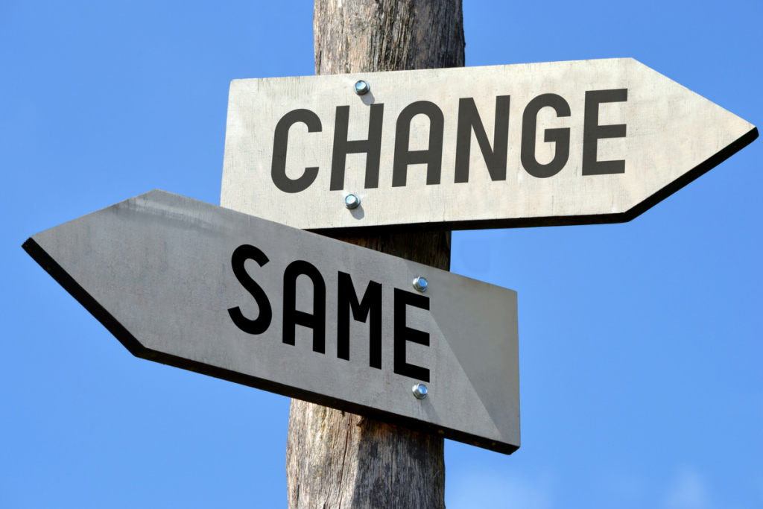

Slide 27
www.menti.com
53 81 55 3
Describe the stereotypical geoscientist.
Notes:
We’ll ask people to make their own notes about who this portrays as a geoscientist - word cloud this using Menti

Slide 28
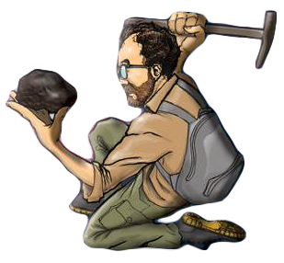
Representation Matters!
www.menti.com
53 81 55 3
Who do you see?
Notes:
We’ll ask people to make their own notes about who this portrays as a geoscientist - word cloud this using Miro or other

Slide 29
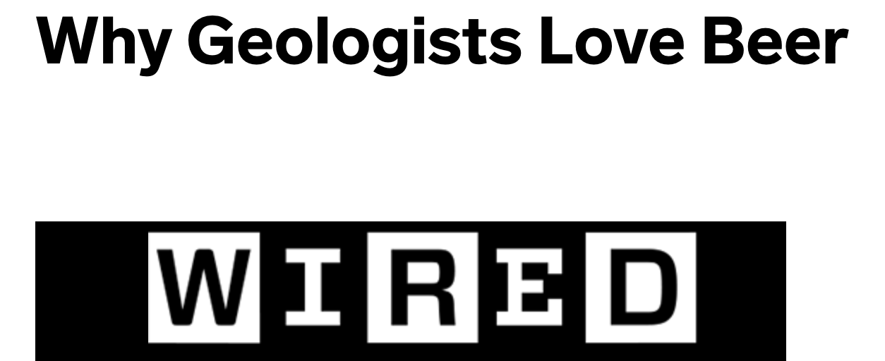
Representation Matters
White
Male
Outdoorsy
Fit
Rock-hammer wielding
Rock-holding
Sexual orientation?
Interests?
Religion?
Notes:
We’ll ask people to make their own notes about who this portrays as a geoscientist

Slide 30
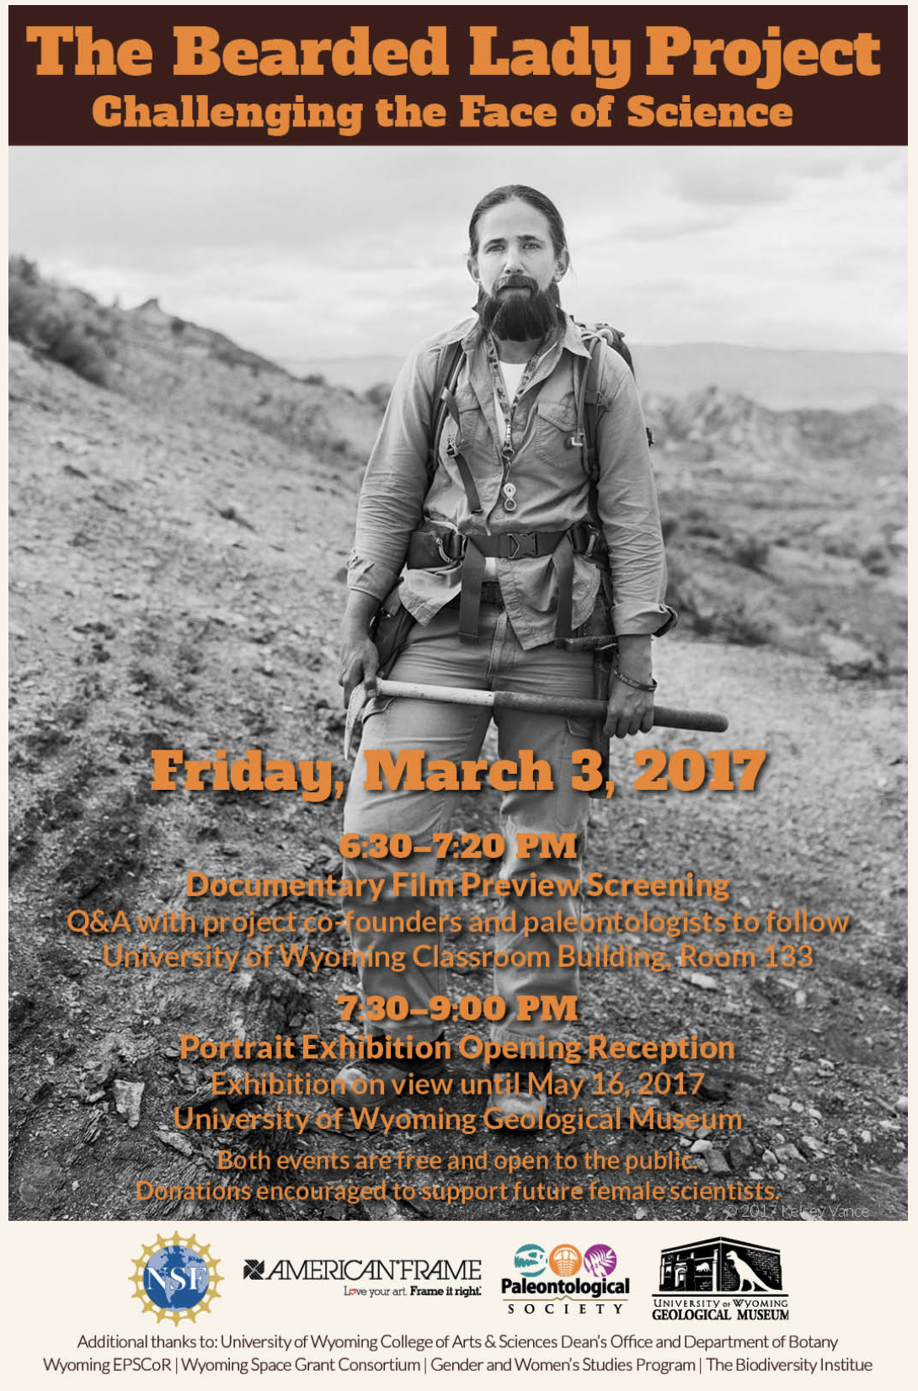
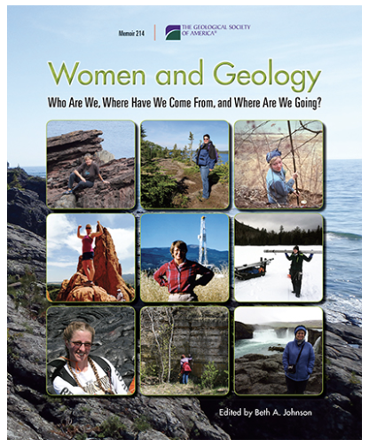
Efforts are being made!
Efforts within the geosciences to change perceptions

Slide 31
Efforts are being made!
Efforts within the geosciences to change perceptions
White
Male
Outdoorsy
Fit
Rock-hammer wielding
Rock-holding
Sexual orientation?
Interests?
Religion?
Notes:
Efforts within the geosciences
But…
Need to work on challenging more of these stereotypes – still white, thin, field-loving, possibly beer-loving

Slide 32
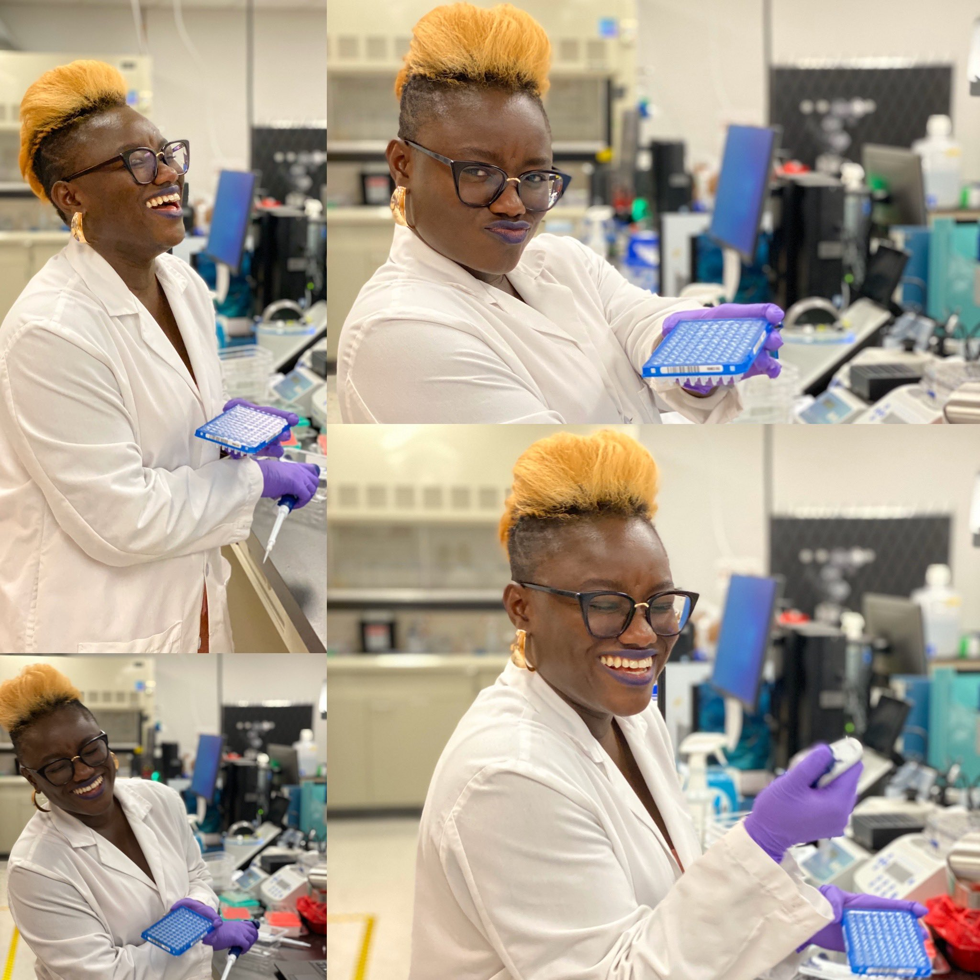
Don’t alter the mold; break it
Need to think more about representation (and challenging assumptions) of all these factors:
Race and ethnicity
Gender identity
Style
Body type and physical ability
Tools
Field
Sexual orientation
Interests
Religion
Age
Dr. Danielle Twum
“Advertising also impact values. While it reflects society to a certain degree, it also has the effect of ‘normalising’ values or behaviours.”
Jeremy Williams, “The Cultural Impact of Advertising”
Notes:
Public perceptions for the next generation
But ALSO perceptions within our geologic community
at meetings - where people see banners
belonging
not being presented in a photo is one of those mistreatments
this is one piece of that disadvantage
mentors
create more balanced or equitable graphics for our community
imposter syndrome - how can you feel like you belong if you don’t see yourself
POC in leadership roles - not always being taught to

Slide 33
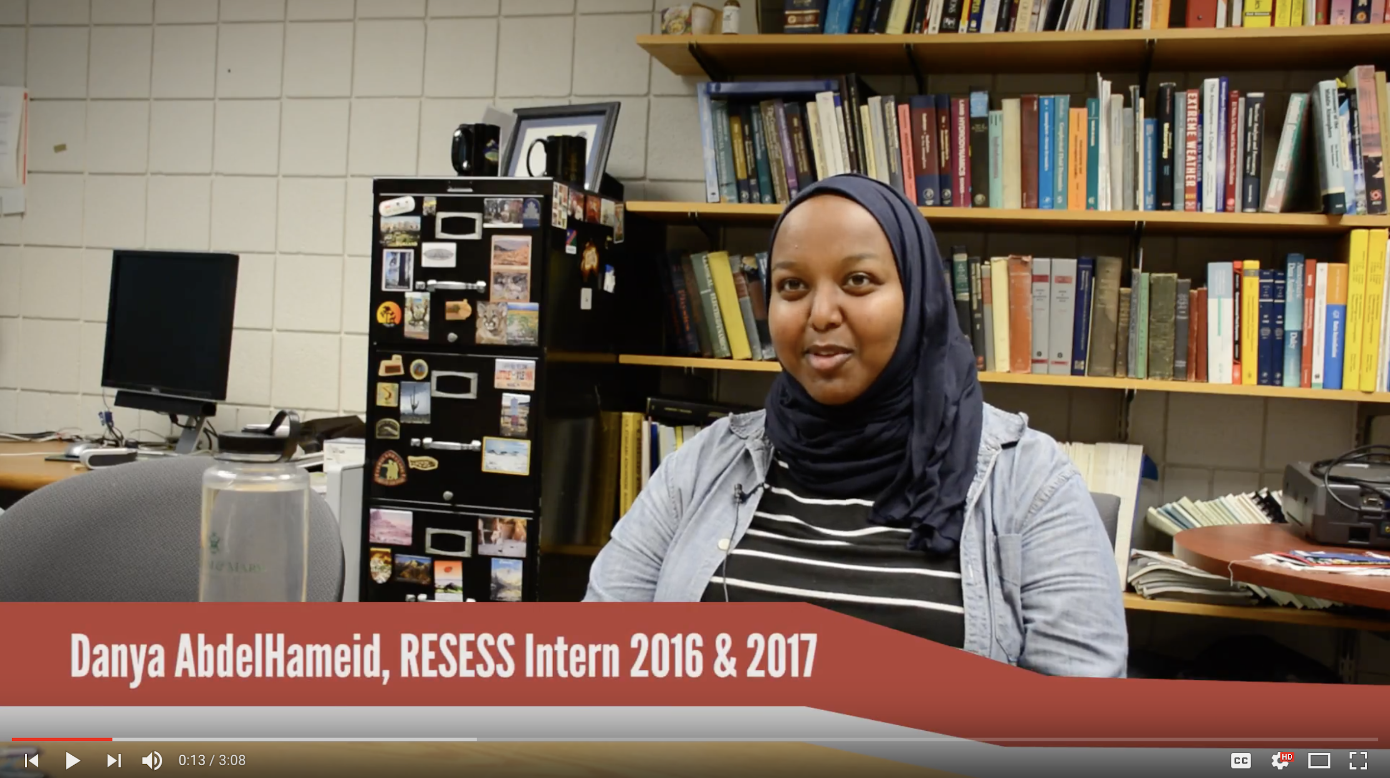

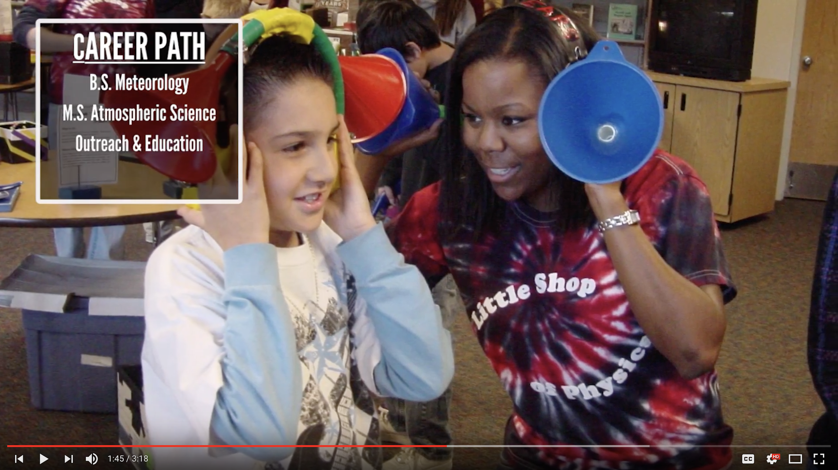
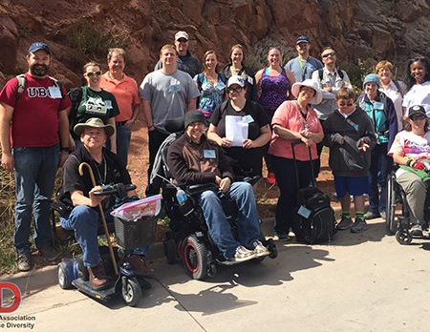
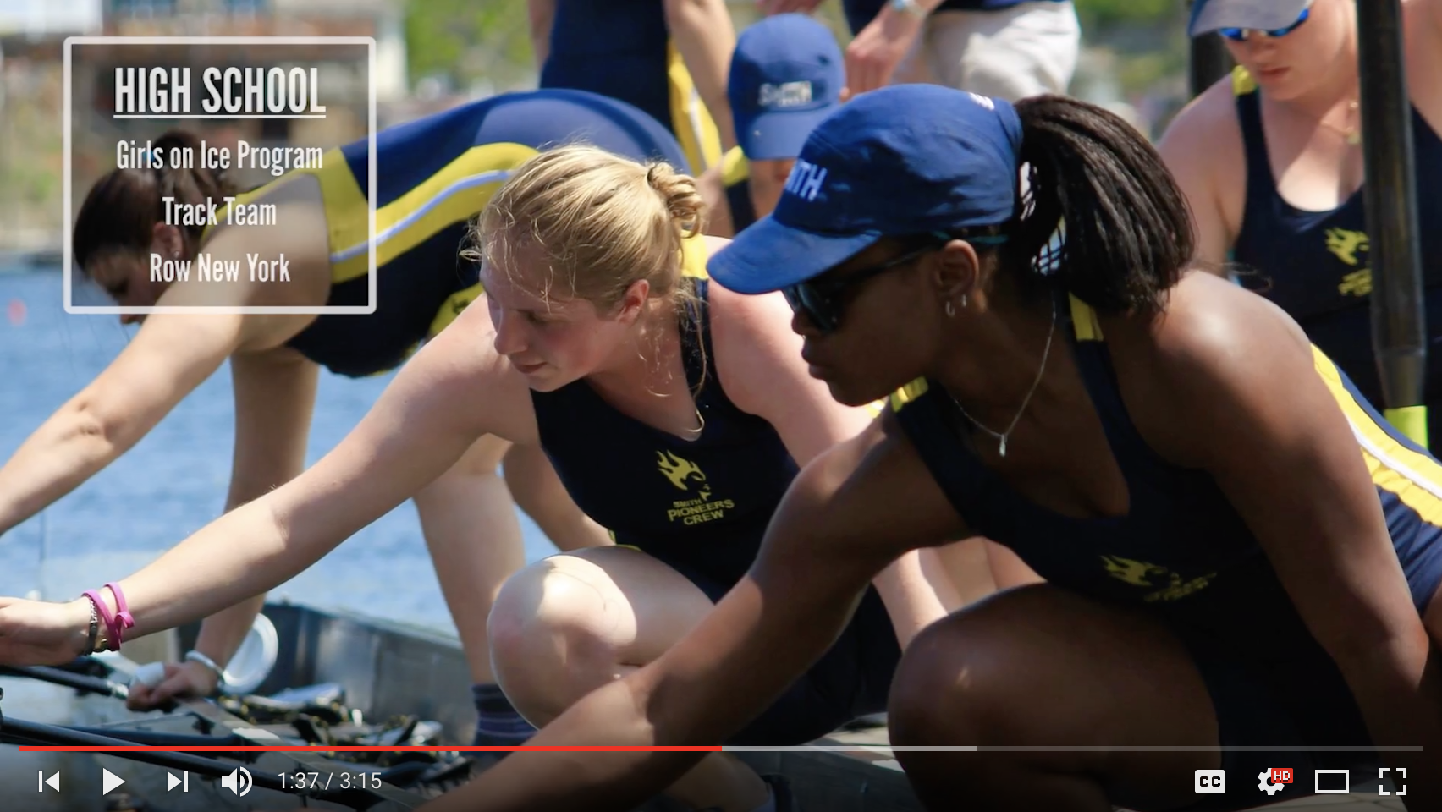
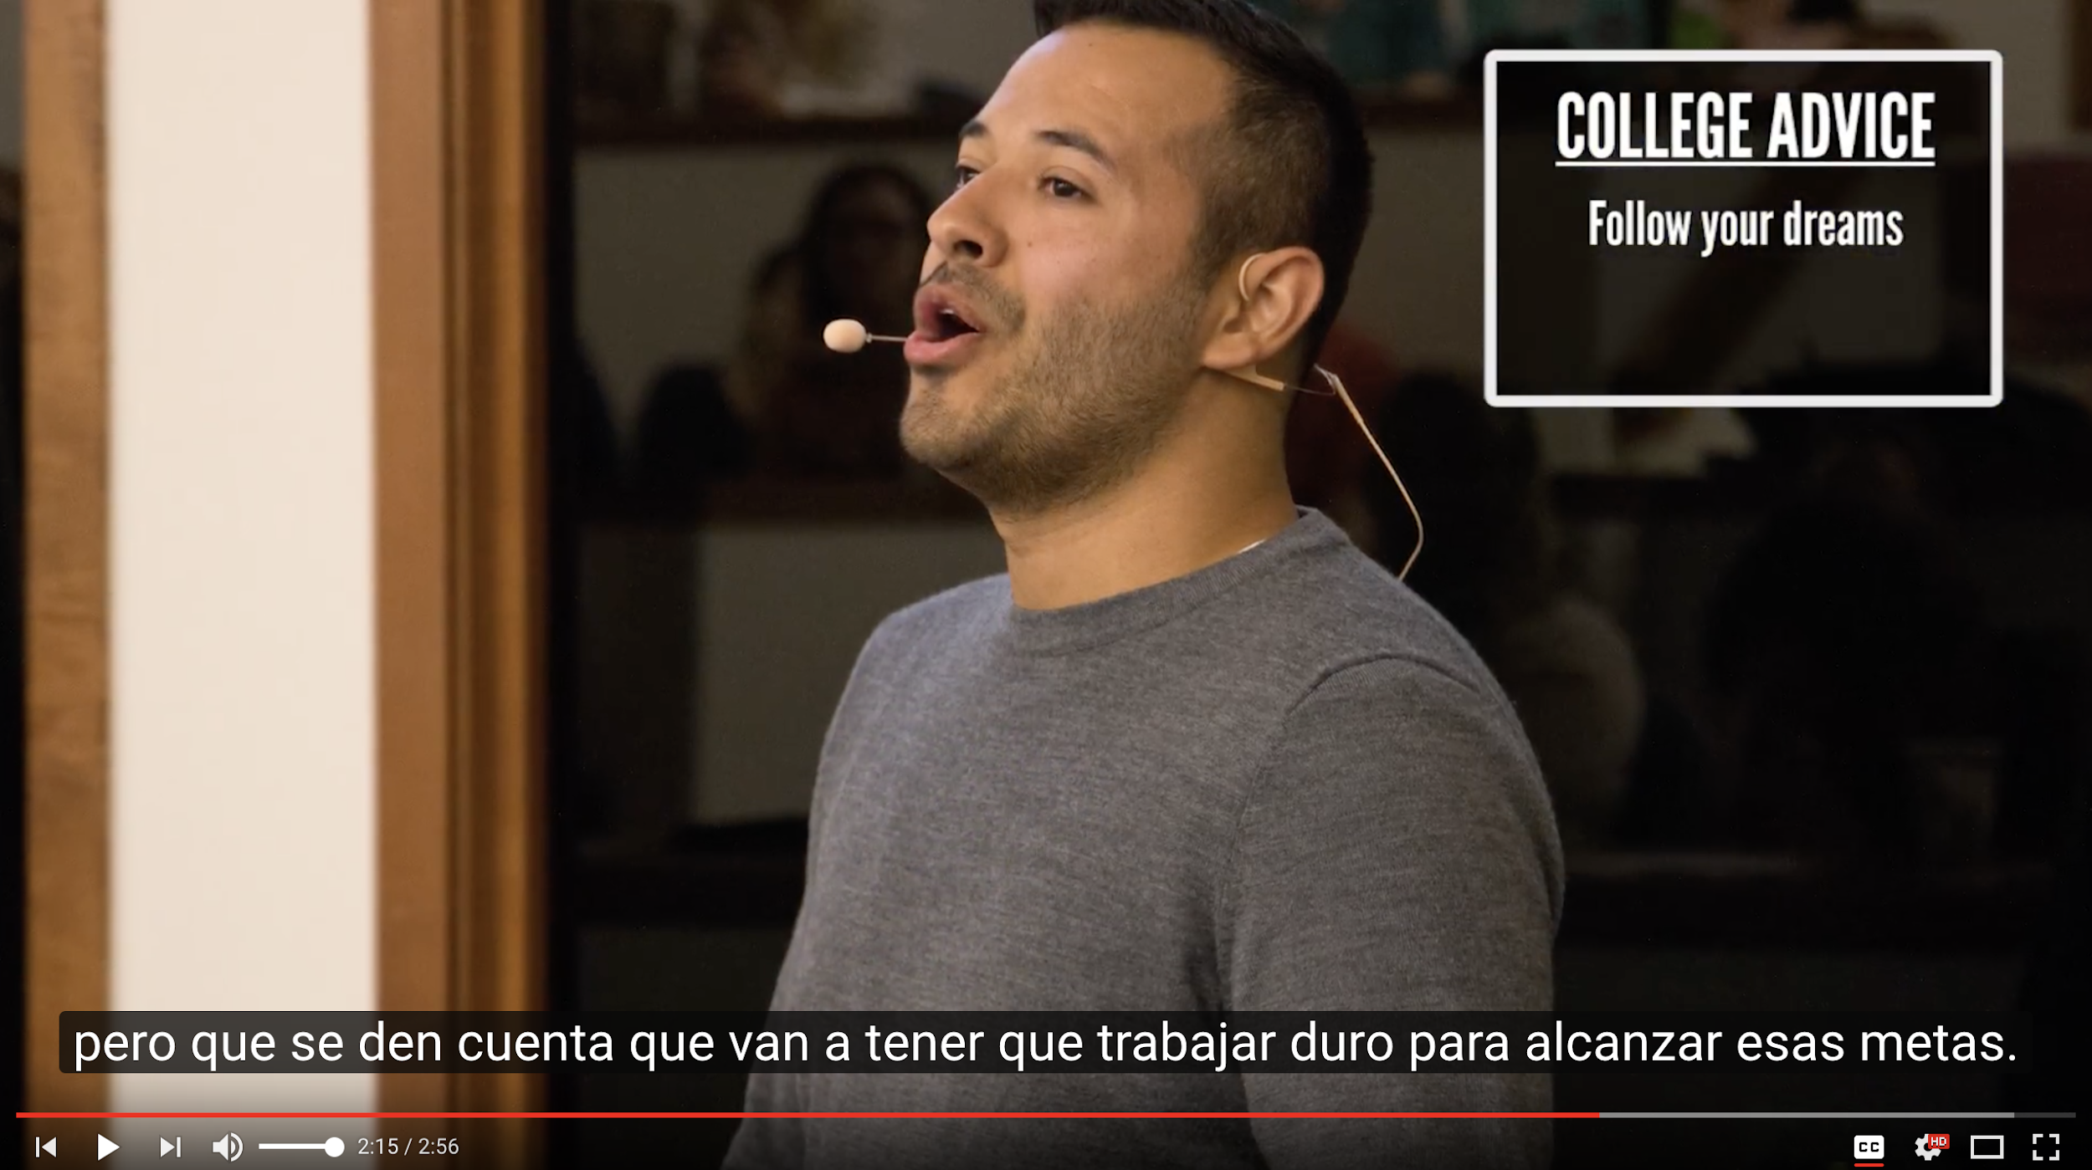

We need to get specific and be intentional with the imagery we choose
Center people of color, people with disabilities, people representing intersectionality, and other people who are visually underrepresented in the geosciences
Show these demographics in leadership roles
Notes:
Also diversity in who is leading: what roles are people who break stereotypes or assumptions in? Are they always in learning roles, or are they in teaching/leadership roles as well?
I try to almost never show a white man leading a group or a discussion, not because we don’t have them within our community but because we’ve seen that before.

Slide 34
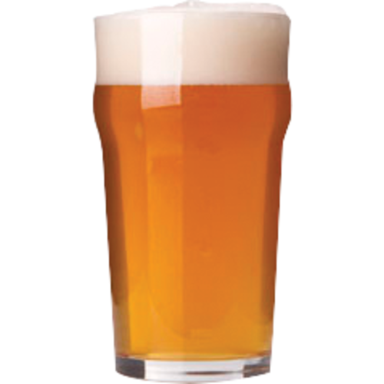
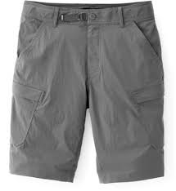
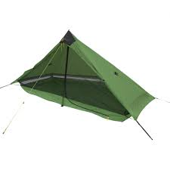

Help change geoscience culture by promoting an inclusive culture without assumptions of preferred behaviors or perspectives

Slide 35

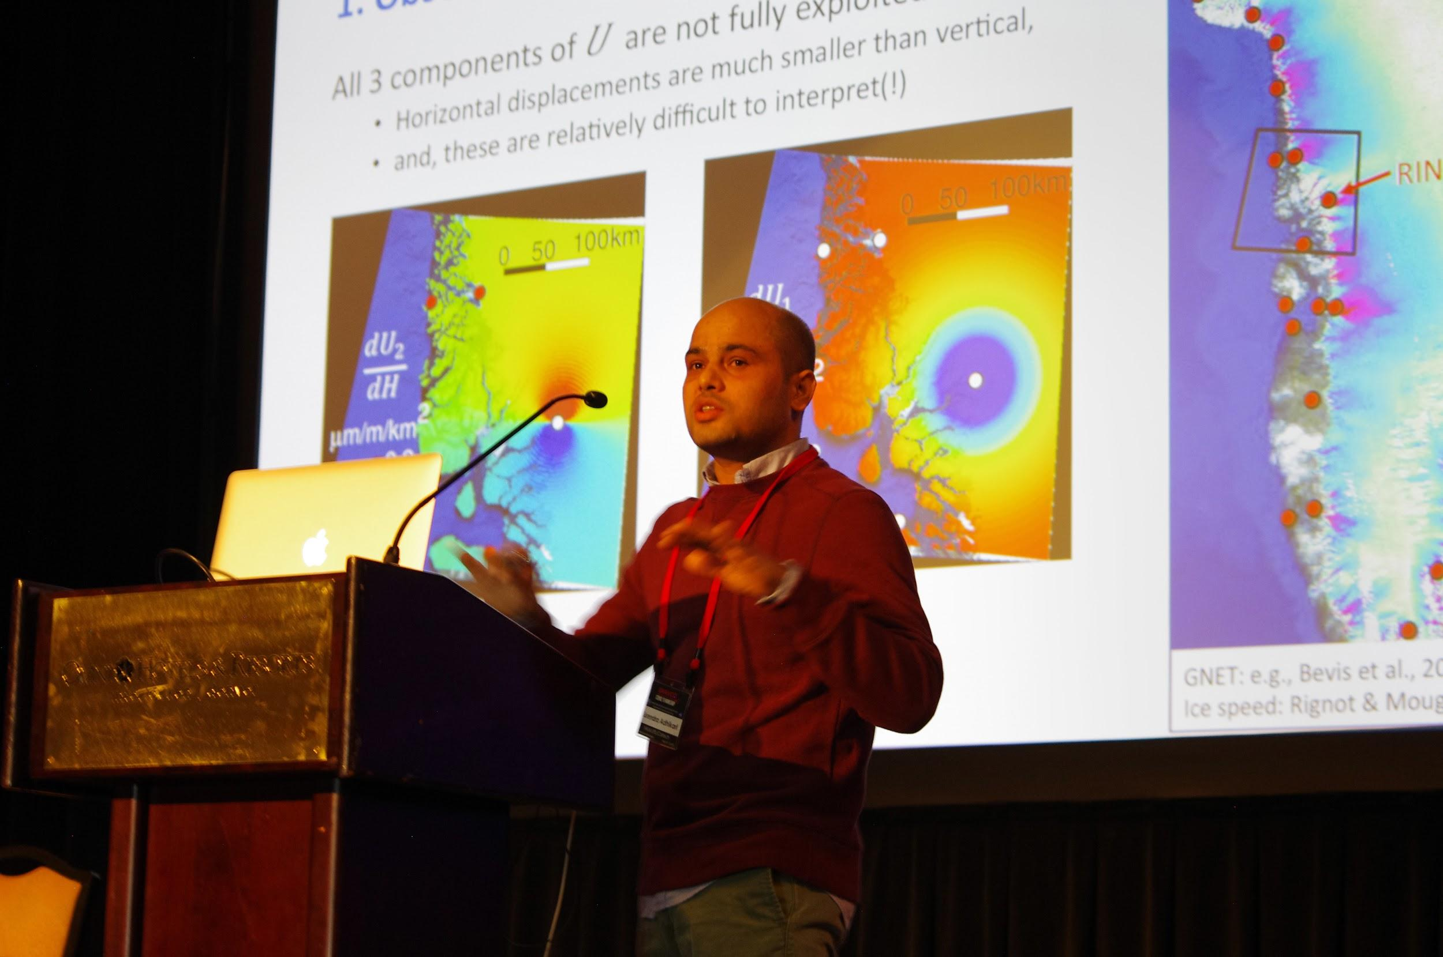
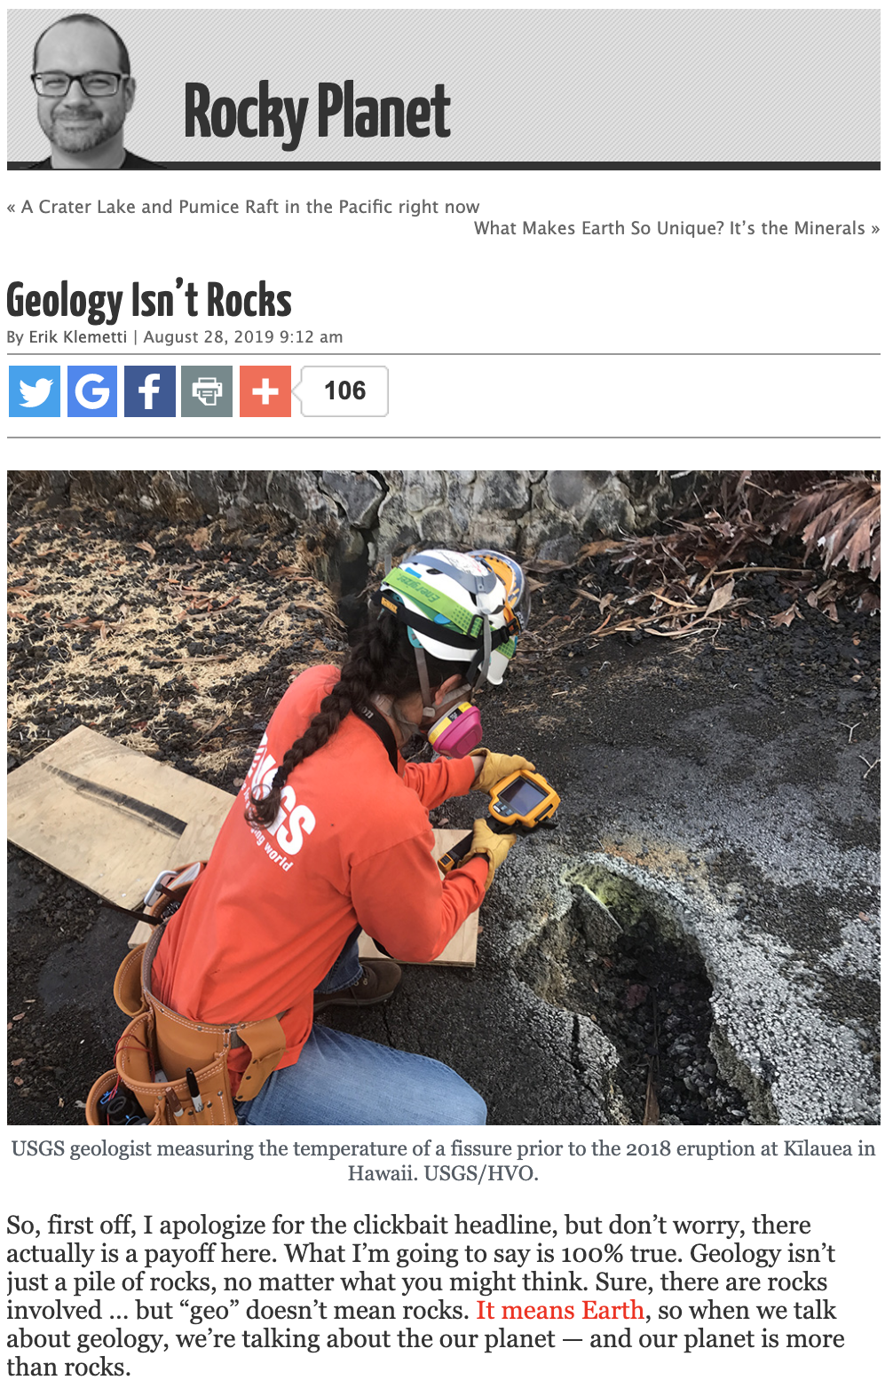
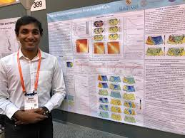
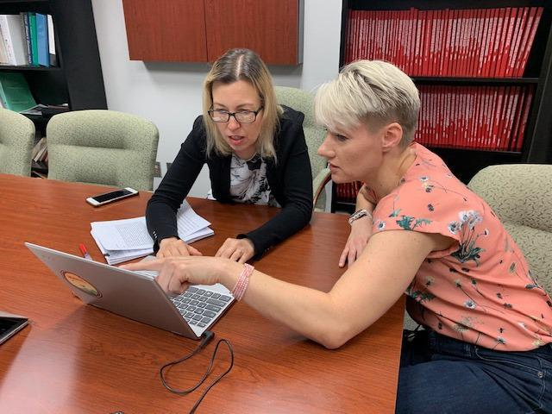
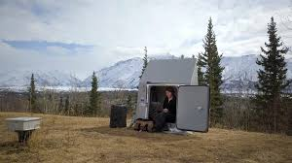
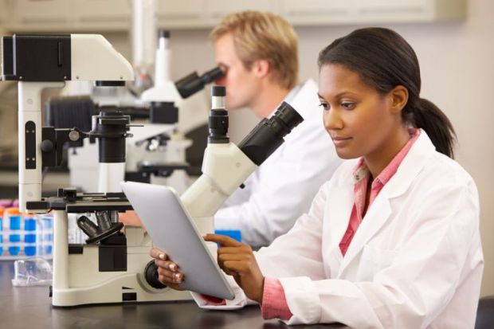
Expand the view of what geoscience is by presenting all aspects of geoscience

Slide 36
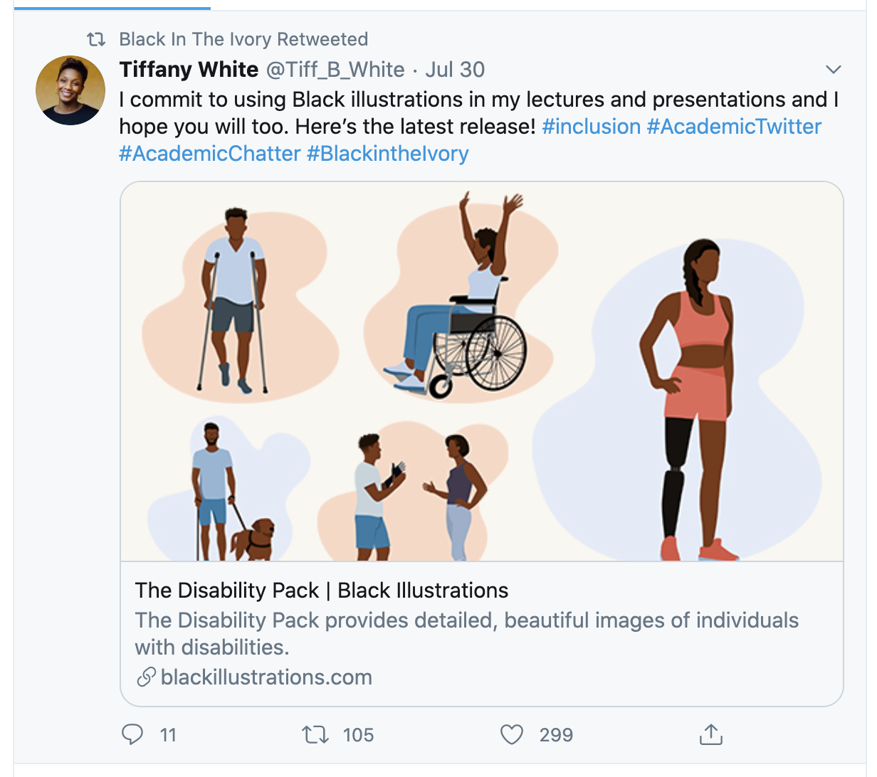
Representation Checklist
Can we better represent a diversity of geoscientists?
Can we better represent a diversity of geoscience, and ways to do it, that will appeal to an audience broad in interests, abilities, and skillsets?
Are we representing people of color and other minoritized peoples in positions of leadership, as opposed to only as receivers of information and resources?

Slide 37

Accessibility and Inclusion

Slide 38
Word Choices
You
He/She
manned, man-made
disabled person, handicapped
people of color
black, African American
Latino/Latina
We
They
crewed / staffed, human-made
person with a disability
be specific
Black
Latinx
Notes:
e.g. different ways of knowing, e.g. Indigenous knowledge

Slide 39
Self-Awareness
Speak with humility
Speak with pride!
Recognize our biases to counter them
Explore a concept before negating it
Notes:
e.g. different ways of knowing, e.g. Indigenous knowledge

Slide 40
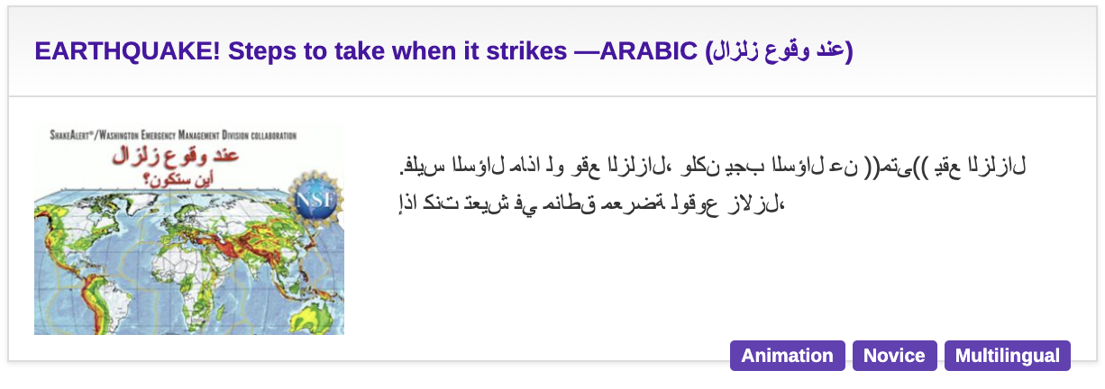
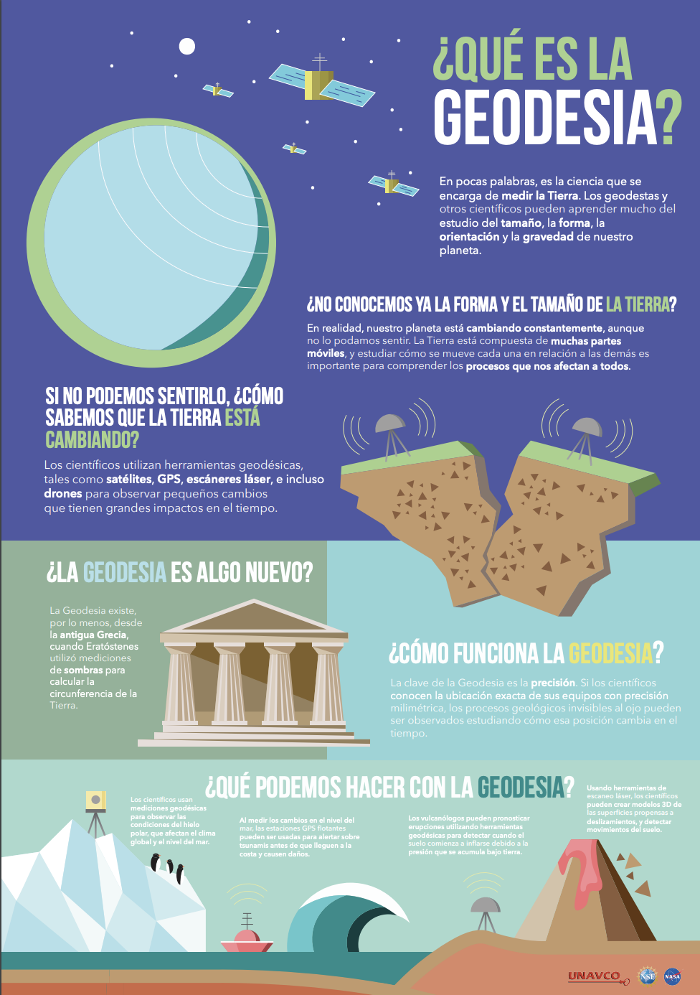
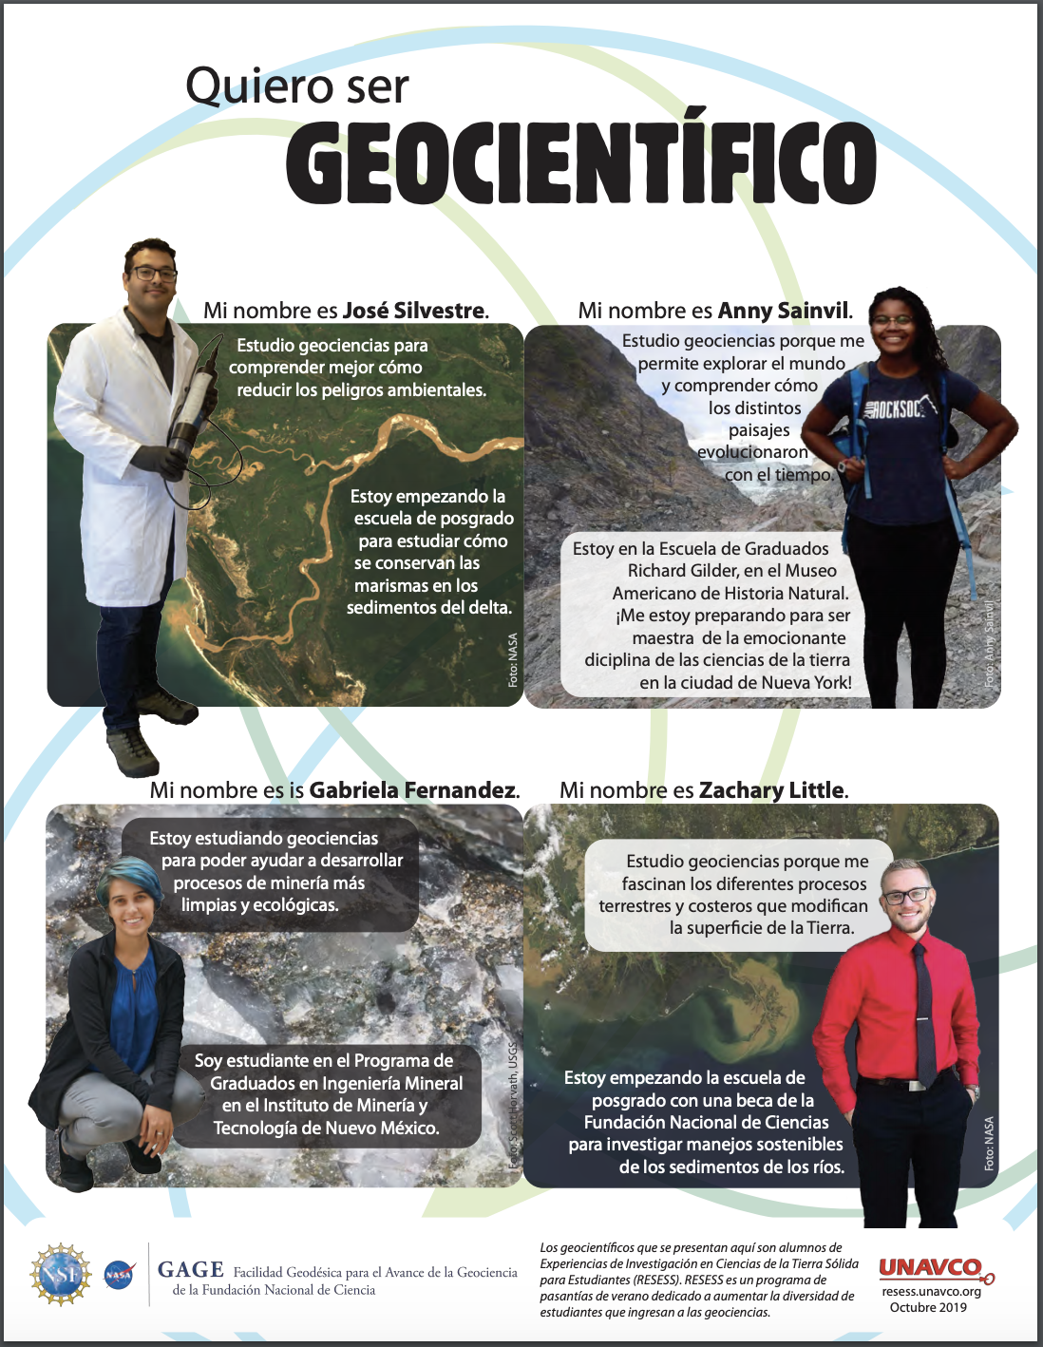
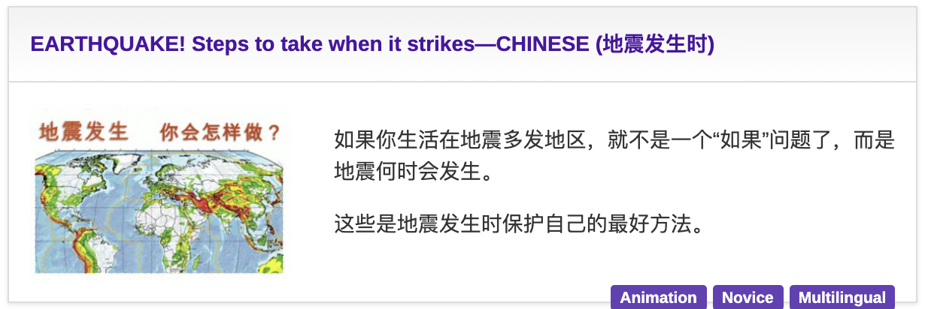
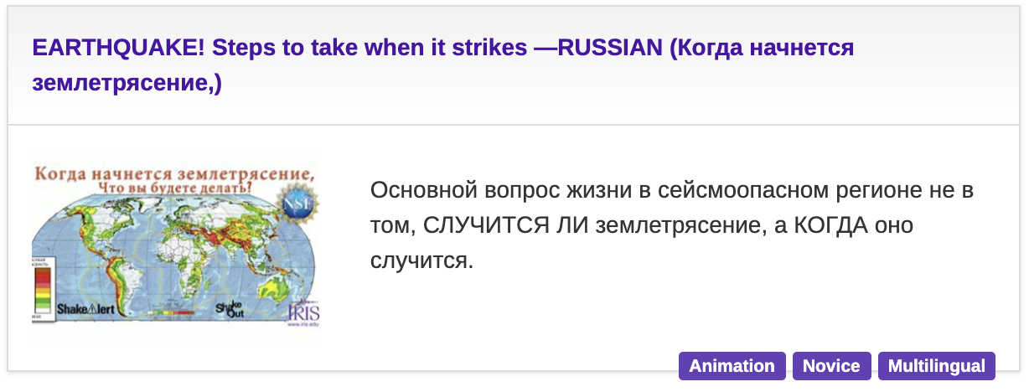
Language

Slide 41
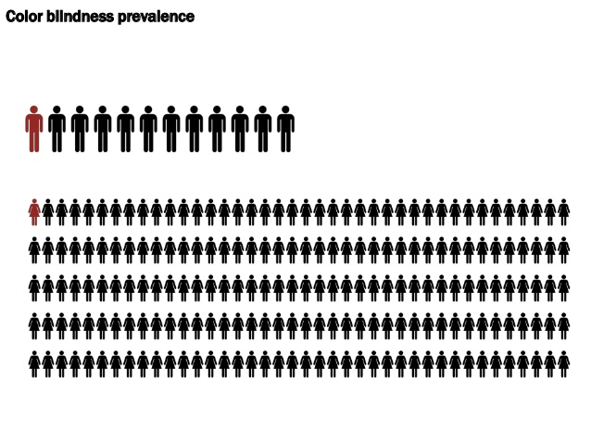
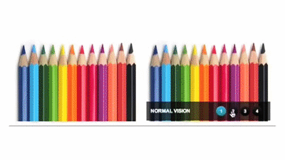
Visuals
Color schemes for vision-impared
  300 million people worldwide are colorblind (http://www.colourblindawareness.org/)
  Use an online or in-program/app tool for colorblindness
Use alt text for images

Slide 42


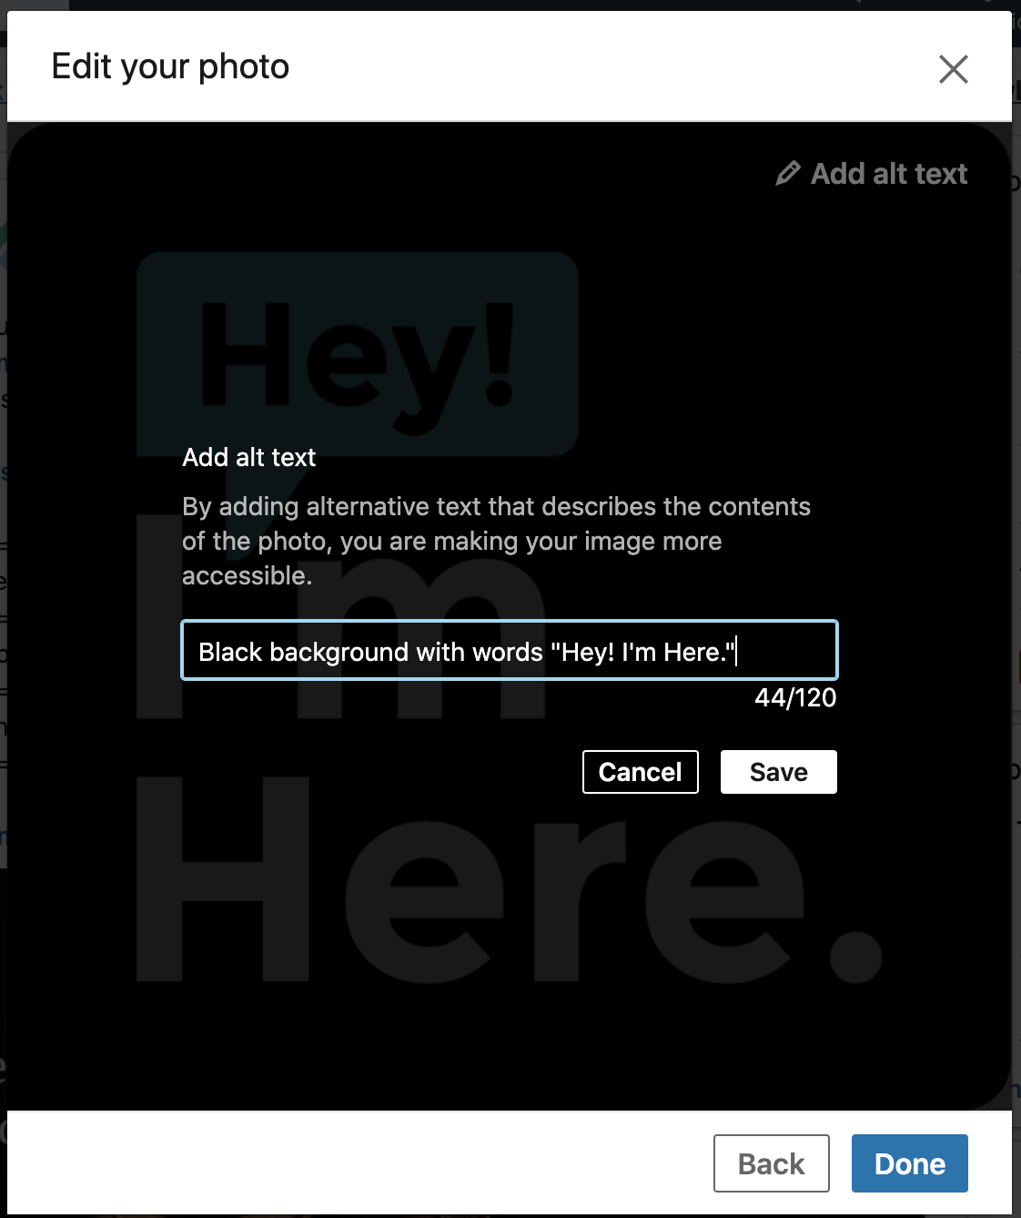
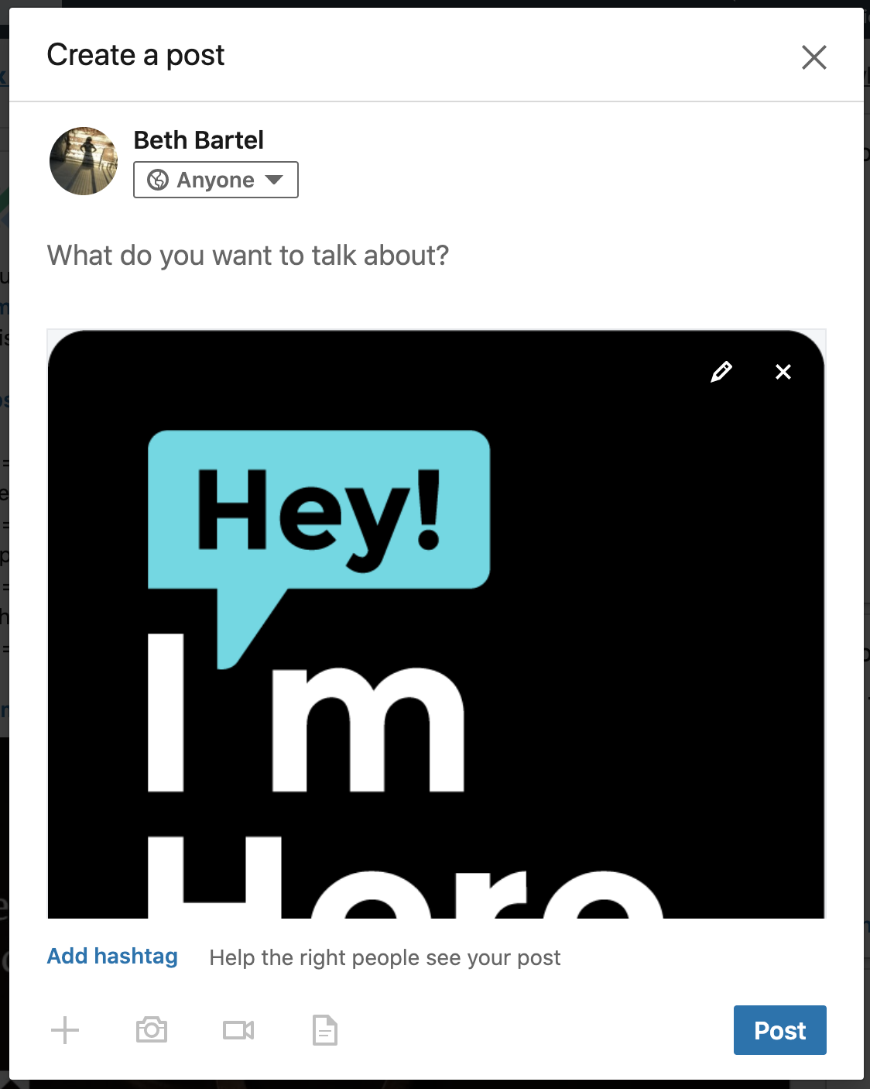
Alt Text: LinkedIn

Slide 43

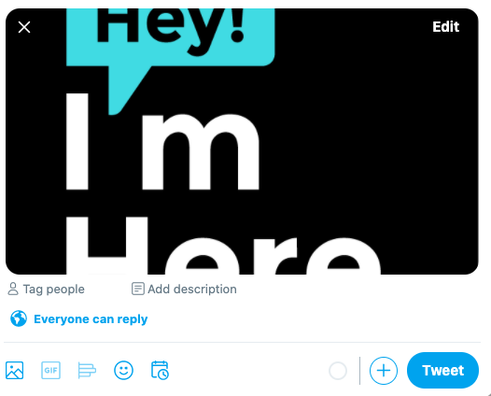

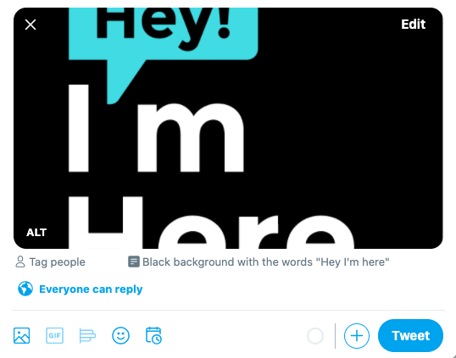
Alt Text: Twitter

Slide 44

Audio
Provide closed captioning
Provide a sign language interpreter
Use a mic

Slide 45
Accessibility Checklist
Is the language sufficiently simple to be understood by target audience(s)? Address or eliminate jargon.
Are we using references that are cultural, making assumptions that everyone will understand them?
Can it be translated?
Are there closed captions and/or a sign language interpreter?
Do we use alt text?
Does it pass a color blindness test?
Is linked text descriptive, as opposed to using the word “here”?
Is there a mic?
Can we make the text/font larger?

Slide 46

Social Media

Slide 47

Perception of science
Science is a process, not a set of facts.
Ideas
Challenges
Observations
Discoveries
Null Results

Slide 48




Representation of scientists
  Diversity – not all older white men in lab coats
  Visibility
    #blackandSTEM, #vanguardandSTEM, #GirlsWhoCode #disabledandSTEM #LatinandSTEM #BiandSci #scimom
    @500QueerScientists, @500womensci, @Also_AScientist, @IfThenSheCan, @ESWN, @blackandSTEM, @geolatinas, @SACNAS
    #StillAScientist, #ThisIsWhatAScientistLooksLike, #DayofScience, #BlackInGeoscience

Slide 49


Cultivate communities of support
Provide connection, community, mentoring, sponsorship and advocacy (Gerrero-Medina et al., 2013; Matthew, 2016; Tull et al., 2017)
Low cost, low barrier engagement tool (Montgomery, 2018)
Increase structural diversity and representation (Hurtado et al., 1998), promote and bring awareness to intersectionality (Montgomery, 2018), reduce feelings of isolation for minority scientists (Simard, 2009), promote an increased sense of belonging and cultural wealth (Tull et al., 2017)
“[People are] using digital spaces to intentionally cultivate communities to support the success of individuals underrepresented in particular spaces and in the academy as a whole.” –Montgomery, 2018

Slide 50

Taking Action
Notes:
LEARN from people - use #BlackInTheIvory

Slide 51





Educate Yourself
Educate yourself before speaking
The less intersectionality we have, the more education we may need
#BlackInTheIvory
Notes:
LEARN from people - use #BlackInTheIvory

Slide 52
Start a Movement, Join a Movement, Amplify a Movement, Fund a Movement
#blackandSTEM, @blackandSTEM #vanguardandSTEM,
#GirlsWhoCode
#disabledandSTEM
#LatinandSTEM
#BiandSci
#scimom
#LGBTSTEMday
#ThisIsWhatAScientistLooksLike
@500QueerScientists
@500womensci
@Also_AScientist
@IfThenSheCan
@ESWN
@geolatinas
@SACNAS
@GeoSpaceLatinx
@PridePolar
#StillAScientist
#DayofScience
Before the murder of George Floyd
After
#BlackinEngineering
#BlackInNeuro
#BlackInNature
#BlackBirdersWeek
#BlackInGeoScience, @BlkinGeoscience
#BlackInGeoscienceWeek
#BiGweek
#BlackGeoscientist
#BlackInChemistry
@BlackInNeuro
@BlkLivesMatter
#BlackInTheIvory
#ShutDownSTEM
#ShutDownAcademia
#Strike4BlackLives
#SayHerName
#BlackLivesMatter
Notes:
Acknowledge the work done before George Floyd’s death, and the movement since - the many accounts and hashtags before, thenBlack Birders Week, Black in Geosci, etc.

Slide 53
Start a Movement, Join a Movement, Amplify a Movement, Fund a Movement
#blackandSTEM, @blackandSTEM #vanguardandSTEM,
#GirlsWhoCode
#disabledandSTEM
#LatinandSTEM
#BiandSci
#scimom
#LGBTSTEMday
#ThisIsWhatAScientistLooksLike
@500QueerScientists
@500womensci
@Also_AScientist
@IfThenSheCan
@ESWN
@geolatinas
@SACNAS
@GeoSpaceLatinx
@PridePolar
#StillAScientist
#DayofScience
Before the murder of George Floyd
After
#BlackinEngineering
#BlackInNeuro
#BlackInNature
#BlackInGeoScience, @BlkinGeoscience
#BlackInGeoscienceWeek
#BiGweek
#BlackGeoscientist
#BlackInChemistry
@BlackInNeuro
@BlkLivesMatter
#BlackInTheIvory
#ShutDownSTEM
#ShutDownAcademia
#Strike4BlackLives
#SayHerName
#BlackLivesMatter
Sometimes centering certain voices means not adding our own.
Listen to the people who are leading - if they ask allies to take a step back, do it.
Notes:
Acknowledge the work done before George Floyd’s death, and the movement since - the many accounts and hashtags before, thenBlack Birders Week, Black in Geosci, etc.

Slide 54

Start a Movement, Join a Movement, Amplify a Movement
#blackandSTEM, @blackandSTEM #vanguardandSTEM,
#GirlsWhoCode
#disabledandSTEM
#LatinandSTEM
#BiandSci
#scimom
#LGBTSTEMday
#ThisIsWhatAScientistLooksLike
@500QueerScientists
@500womensci
@Also_AScientist
@IfThenSheCan
@ESWN
@geolatinas
@SACNAS
@GeoSpaceLatinx
@PridePolar
#StillAScientist
#DayofScience
Before the murder of George Floyd
After
#BlackinEngineering
#BlackInNeuro
#BlackInNature
#BlackInGeoScience, @BlkinGeoscience
#BlackInGeoscienceWeek
#BiGweek
#BlackGeoscientist
#BlackInChemistry
@BlackInNeuro
@BlkLivesMatter
#BlackInTheIvory
#ShutDownSTEM
#ShutDownAcademia
#Strike4BlackLives
#SayHerName
#BlackLivesMatter
Sometimes centering certain voices means not adding our own.
Listen to the people who are leading - if they ask allies to take a step back, do it.
Notes:
Acknowledge the work done before George Floyd’s death, and the movement since - the many accounts and hashtags before, thenBlack Birders Week, Black in Geosci, etc.

Slide 55

Call out Injustices as You See Them
We can all share the burden of this work. Be ready to step in thoughtfully.

Slide 56


Make a Statement
Authentic
Thoughtful
Direct
Aware
Specific and actionable
Notes:
post statements from AGU, GSA, IRIS, UNAVCO, GSA G&S Division, Paleo Society
As an organization OR as an individual.

Slide 57

If You Can’t Make a Statement,
Make a Statement
Post articles, statistics and information on social media to advocate and educate
Center BIPOC scientists in your work or feeds
Think of places where you have relative power and push for inclusion, equity and justice
  Classrooms, boardrooms, chatrooms
Notes:
e.g., Before our orgs drafted official statements about BLM, we posted material about diversity in geoscience and centered black scientists in our posts

Slide 58

Teach the History
Colonial history of geoscience
Inequities in harm caused by environmental damage
AND the work of minoritized scientists in addressing it
GreenMatters

Slide 59


Own up to Mistakes
We WILL make mistakes.
If you make a mistake, own up to it. We can’t hold institutions accountable if we don’t hold ourselves accountable. Acknowledge harm, apologize, and do the research yourself, without asking someone else to do the work for you.
Notes:
LEARN from people - use #BlackInTheIvory

Slide 60




Not the solution - but part of it
Every time we communicate about science, we have the opportunity to challenge pre-existing beliefs and work towards greater equity and justice in science and society.

Slide 61

Black in Geoscience Week
Sept 6-12 | @BlkinGeoscience | #BlackInGeoscience
Black in SciComm Week
Oct 4-10 | #BlackInSciCommWeek
Logos by Dr. Lucía Pérez Díaz

Slide 62

@Reclaiming_STEM
Diverse & inclusive #SciComm workshop on both coasts created by @wardofplants & @Microbe_Meows to empower scientists to use STEM for social justice ✊🏼✊🏾✊🏿✊🏽

Slide 63


Slide 64
Acknowledgements
Aisha Morris
Andi Ellis
Maryam Zaringhalam
Kelly Sierra

Slide 65







Notes:
Also diversity in who is leading: what roles are people who break stereotypes or assumptions in? Are they always in learning roles, or are they in teaching/leadership roles as well?

Slide 66


Slide 67

What, Who, How?
Notes:
What are we presenting when we present geology, who are we presenting, and how are we presenting it/them?

Slide 68


Slide 69
No shortage of efforts to change the perception of a geologist or geoscientist
AND… we need to keep working at this, in all the media we produce to represent science
And all media we produce represents science….

Slide 70

Notes:
Within our community, still perpetuating this perception
(lovable poster, but two dudes)

Slide 71



Imagery
Stones from a glass house?
Notes:
We don’t always do this well.
Three white male talking heads with glasses.
Ambiguity doesn’t challenge stereotypes and bias – because we can still make assumptions about who we think it is; allows us to maintain our assumptions and biases

Slide 72

The problem with ambiguity
Notes:
We don’t always do this well.
Three white male talking heads with glasses.
Ambiguity doesn’t challenge stereotypes and bias – because we can still make assumptions about who we think it is; allows us to maintain our assumptions and biases

Slide 73


Who is a geologist?
What does a geologist do?
Thin!
Atheist!
White!
Bearded!
Male!
Hammer!
Beer!
Rock!
Notes:
Three audiences, at least, to be concerned about:
Public (non-geoscientists)
Next generation (potential future geoscientists – can nod to IF/THEN)
Current geoscience community – state why – need to change our implicit biases over who is able, who is engages, who gets hired, who gets promotions, who gets respect, who gets the assumption of competence

Slide 74
Center people of color
Centering people of color is about shifting power, control, and well-being/comfort to people of color.
Well-being looks like
where is the meeting,
is it culturally attuned,
who is in the majority,
who is included in the conversation.
Seeing people and communities of color as the experts is necessary to solving problems.
https://fakequity.com/2018/04/20/five-ways-to-center-people-of-color/
Notes:
People of color are not the only people who need to see this. We need to change our assumptions internally of who an expert is, who is qualified. We want to work to change our implicit bias about who is a geoscientist. When we get that resume across our desk, we want Of course, media representation is only one way to do this. We need to see role models organizing the meetings, teaching, leading discussions, taking the lead. Visual representation in media is one piece of the broad puzzle.

Slide 75


Representation Matters!
In 2018 the Geena Davis Institute for Gender in Media surveyed 2,021 women about Dana Scully of the X-Files. They found that...
91% say she is a role model for girls and women.
Nearly two-thirds (63%) of women that work in STEM say Dana Scully served as their role model.
63% say Scully increased their confidence that they could excel in a male-dominated profession.

Slide 76

Please Don’t
Do NOT share violent images and/or videos depicting the harming of Black and brown bodies.
Do NOT use the hashtag #AllLivesMatter. This is a white supremacist slogan.
Do NOT double down on ignorance. Listen to and center marginalized voices.
Notes:
e.g., Before our orgs drafted official statements about BLM, we posted material about diversity in geoscience and centered black scientists in our posts

Slide 77


Go to Your Audience
Give a talk or do outreach
MSI, HBCU
Festival or market
Partner with local BIPOC-run organizations
Outdoor Afro
Latino Outdoors
Elevate BIPOC presenters and producers
professional development, visibility, legitimacy, role modeling

Slide 78
Representation Matters!
In 2018 the Geena Davis Institute for Gender in Media surveyed 2,021 women about Dana Scully of the X-Files. They found that...
91% say she is a role model for girls and women.
Nearly two-thirds (63%) of women that work in STEM say Dana Scully served as their role model.
63% say Scully increased their confidence that they could excel in a male-dominated profession.

