Slide 1
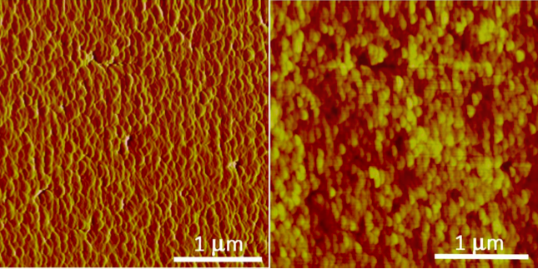
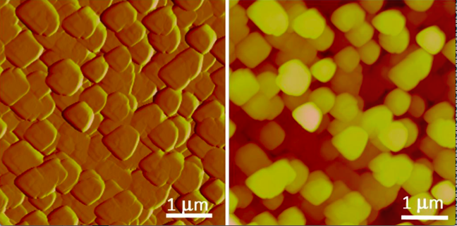

Imaging nano particles during crystal growth using atomic force microscopy
Christine V. Putnis
Institut für Mineralogie, University of Münster, Germany
Department of Chemistry, Curtin University, Perth, Australia
putnisc@uni-muenster.de; christine.putnis@curtin.edu.au
Notes:
1

Slide 2
The nano world:
Nano-particles are all around us. The world is made up from nano-particles.
Advanced analytical techniques have enabled us to image was was previously only postulated.
What is more, they are worth billions of dollars – we pay billions to make them and billions to get rid of them!
Notes:
2

Slide 3
AFM Nanoscale observations
fluid out
fluid in
O-ring
sample
cup mount
cantilever
scanner
Diagrams: JM Astilleros

Slide 4
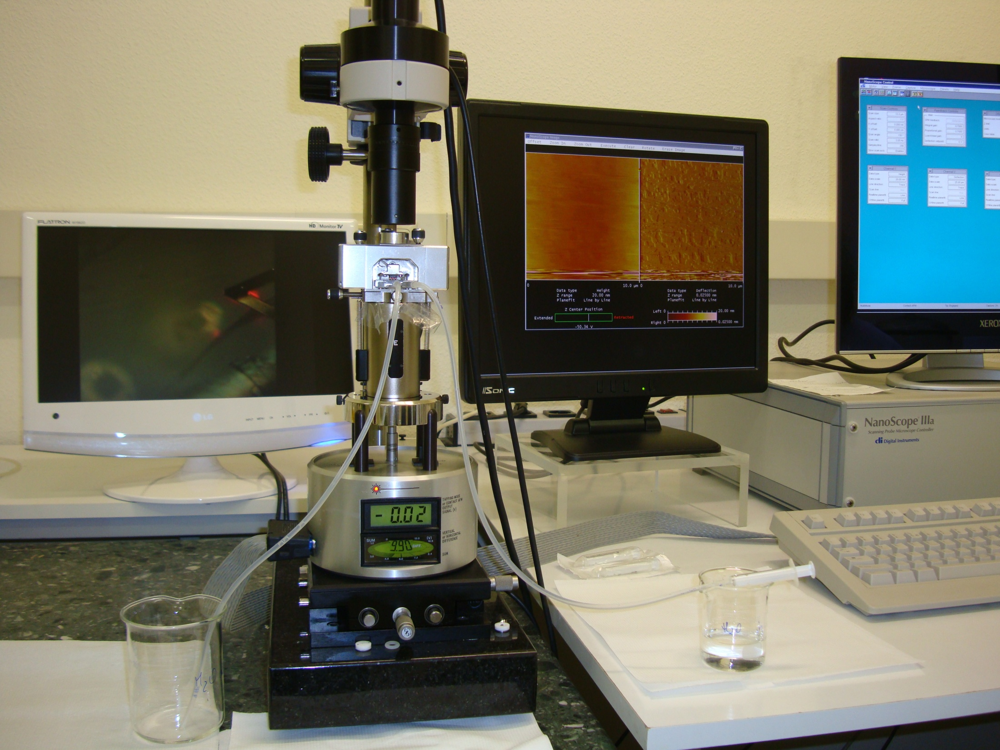
Desorción libre de agua
Bruker MultiMode AFM in Münster

Slide 5
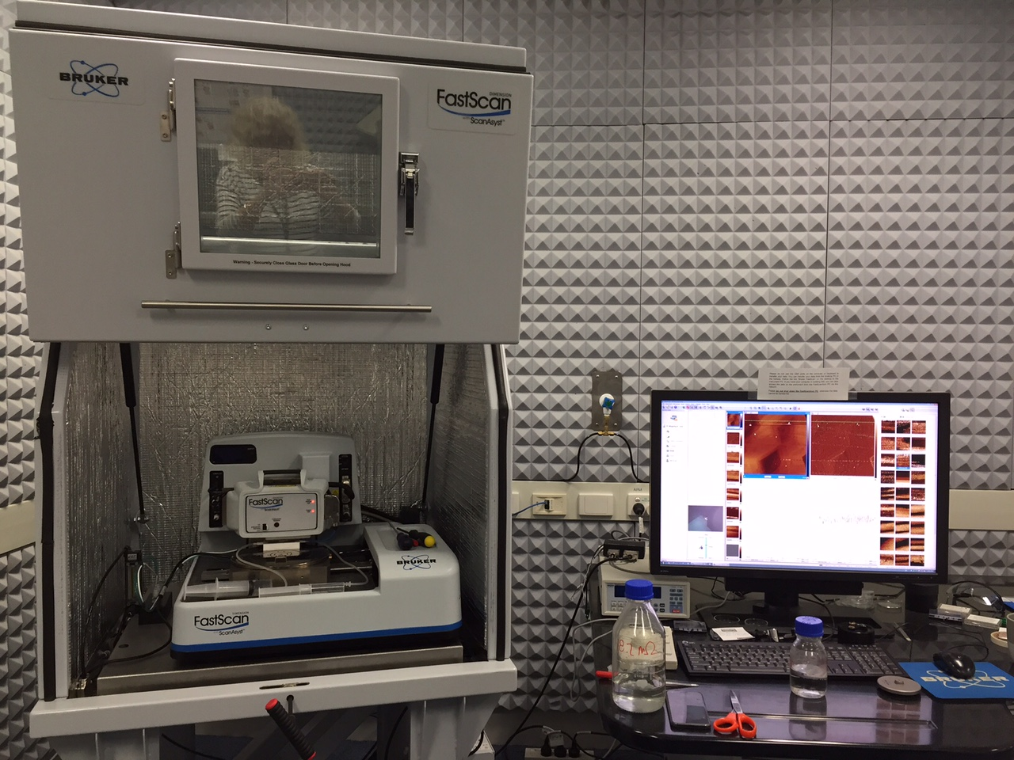
Bruker Fastscan AFM
in Curtin University, Perth

Slide 6
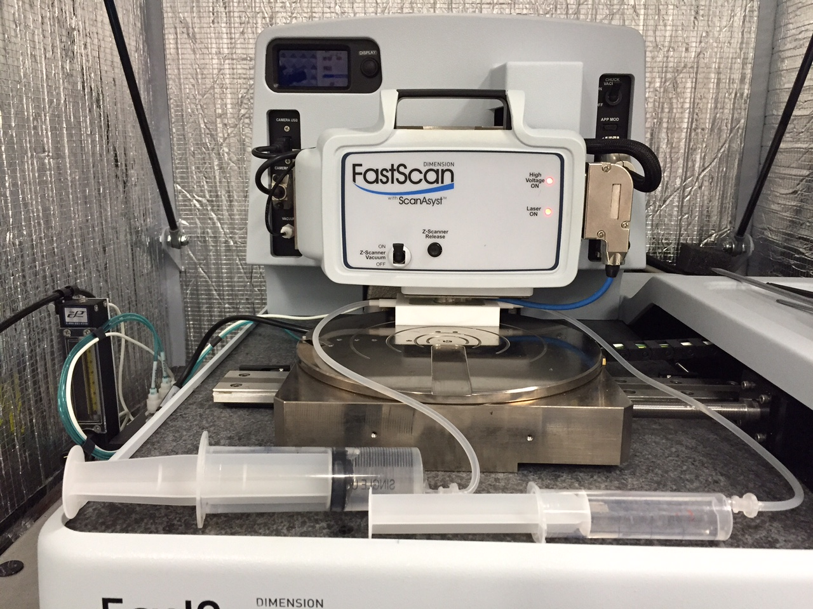

Slide 7
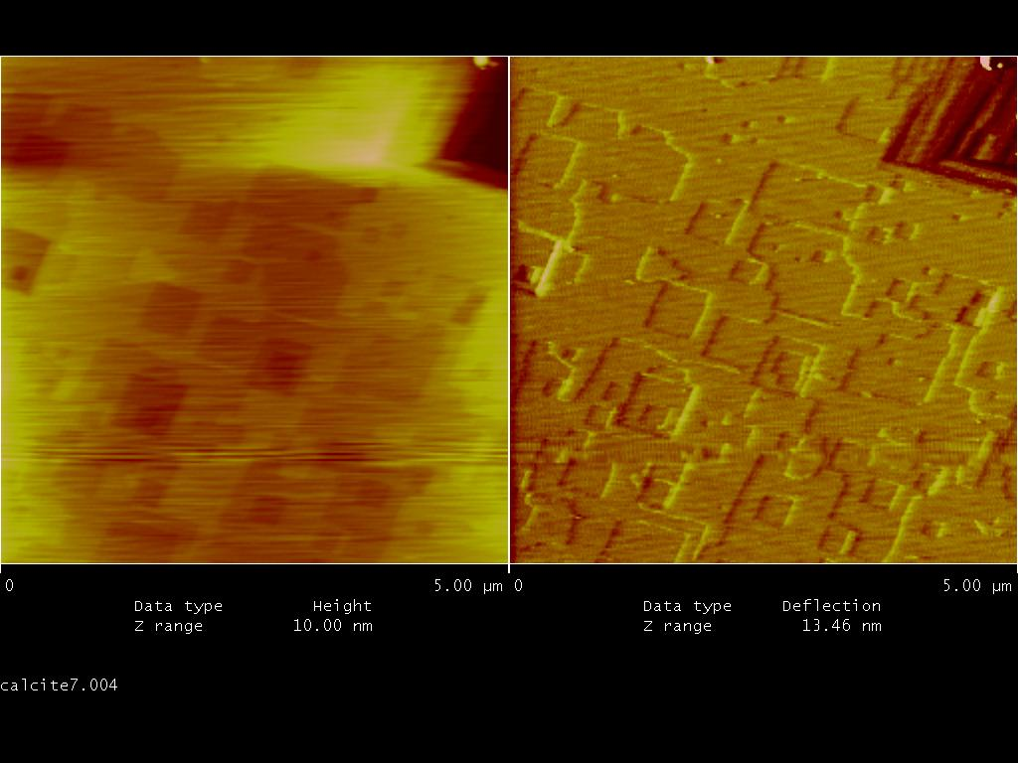
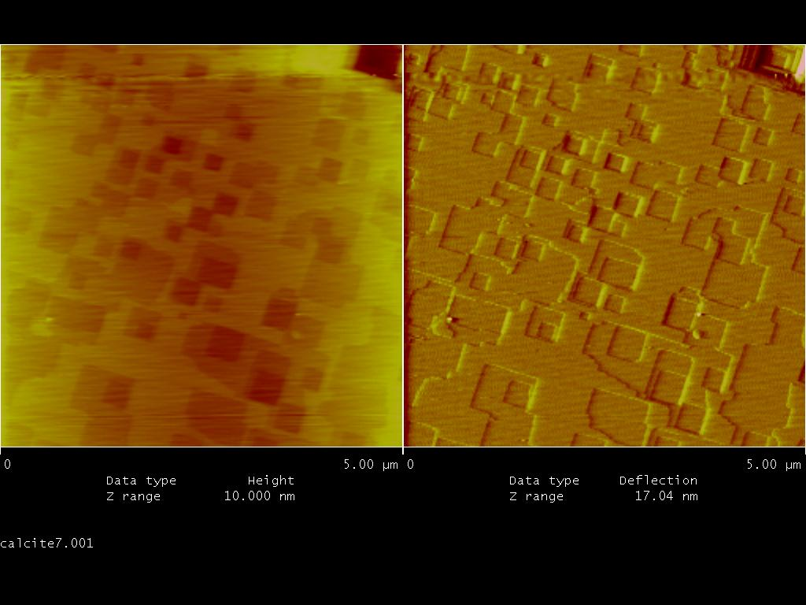
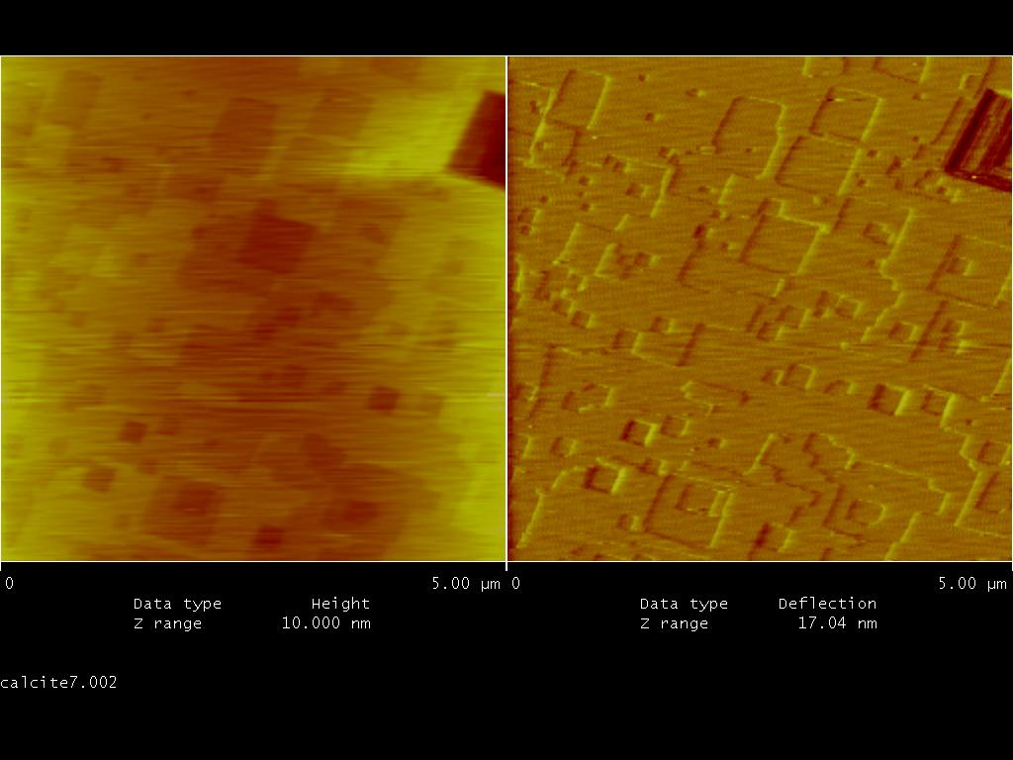
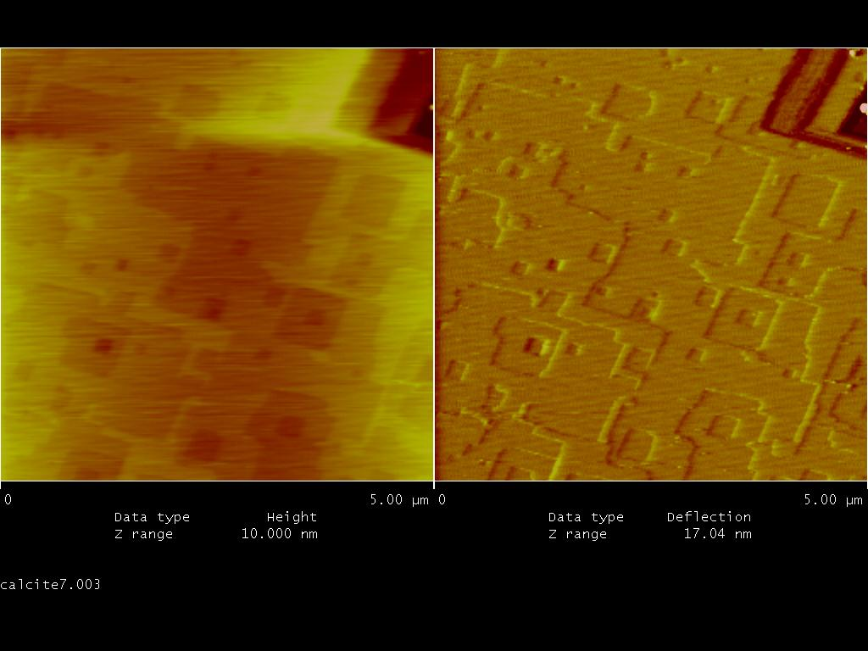
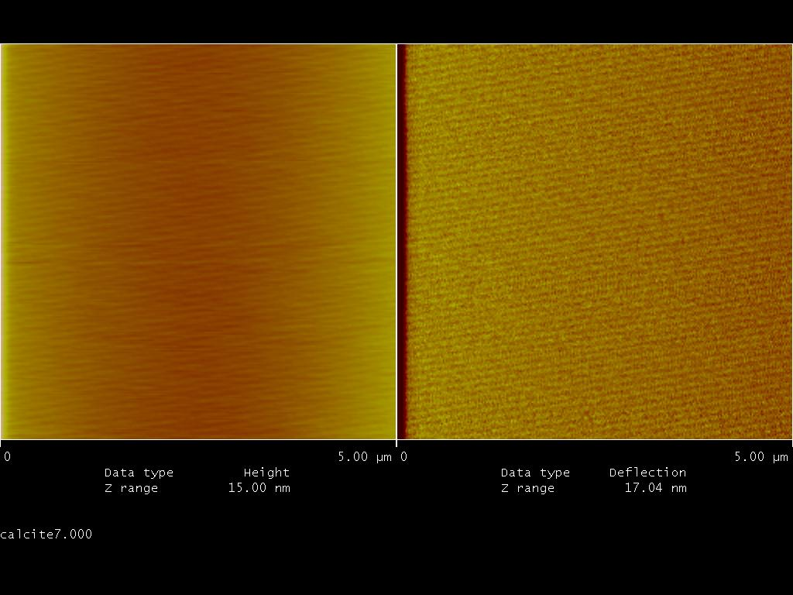
Morphology of dissolution features of calcite
Notes:
7

Slide 8
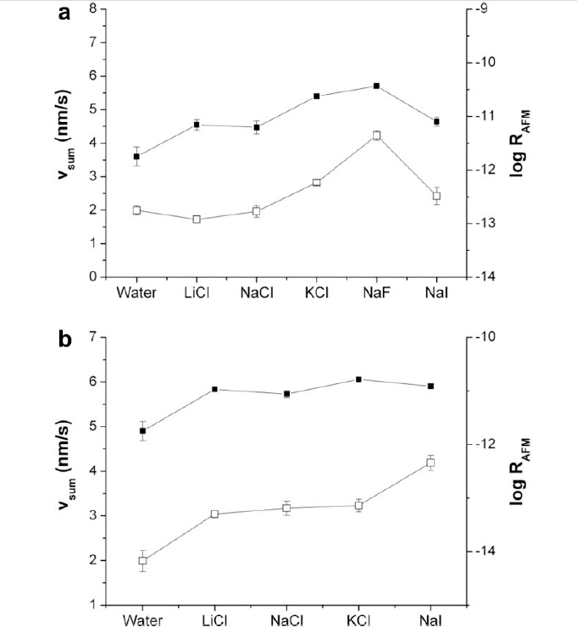
D
Dissolution rates of calcite in the presence of various ions
Etch pit spreading rates (open symbols) vs. dissolution rates (filled symbols)
IS = 0.001 M
(b) IS = 0.1M for the different
electrolytes tested.
Notes:
8

Slide 9
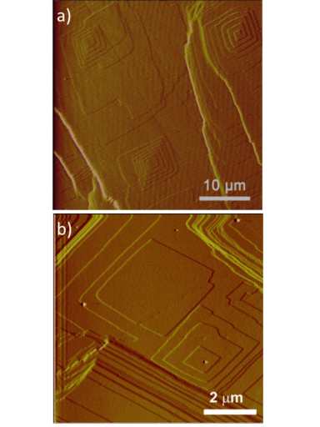
Nanoscale observations – calcite growth
Growth mechanisms on calcite {10-14} surfaces as seen by AFM:
(a) spiral growth;
(b) two-dimensional nucleation or island growth.
Notes:
9

Slide 10
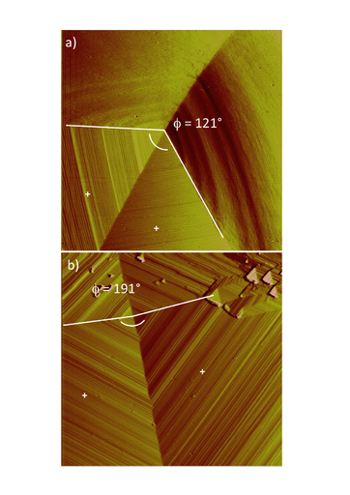
Nanoscale observations – calcite growth
Development of reverse morphologies in spiral hillocks: (a) growth hillock formed during growth in NaCl-bearing solutions;
(b) the same spiral in (a) after changing the background electrolyte of the growth solution to CsCl.
Images are 10 mm x 10 mm.
Notes:
10

Slide 11
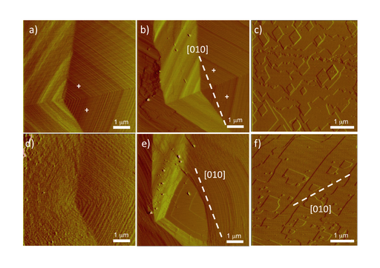
Nanoscale observations – calcite growth and dissolution
Changes in the morphology of (a,b,d,e) growth and (c,f) dissolution features induced by the presence of additives. (a,b) Growth spirals; and (c) etch pits formed in pure solutions. The same features in (a,b,c) after adding (d) L-aspartic acid;
(e,f) Li+ to the solution.
Notes:
11

Slide 12
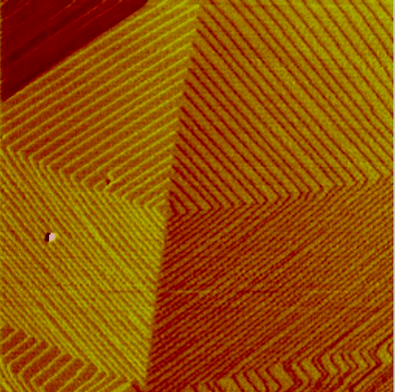
Nanoscale observations – calcite growth in the presence of Se
1 μm
Notes:
12

Slide 13
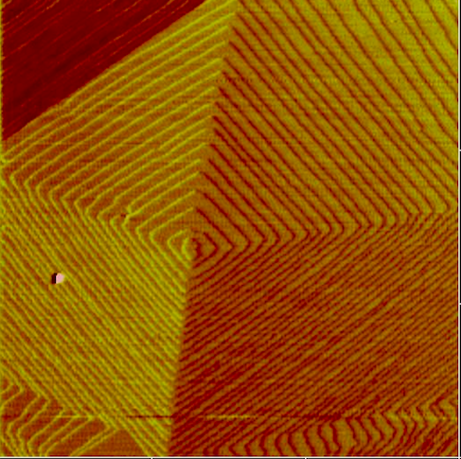
Nanoscale observations – calcite growth in the presence of Se
1 μm
Notes:
13

Slide 14
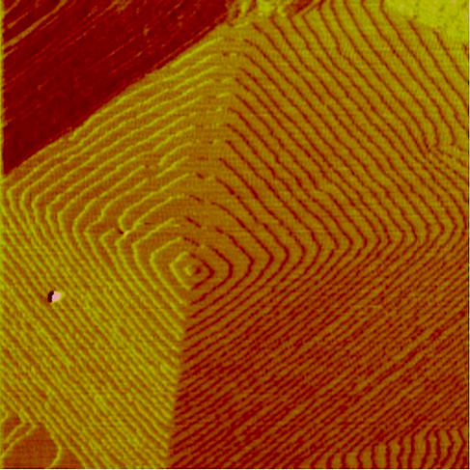
Nanoscale observations – calcite growth in the presence of Se
1 μm
Notes:
14

Slide 15
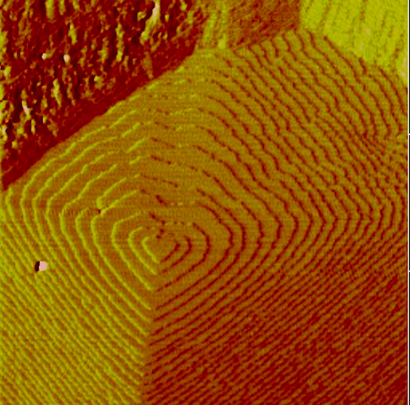
Nanoscale observations – calcite growth in the presence of Se
1 μm
Notes:
15

Slide 16
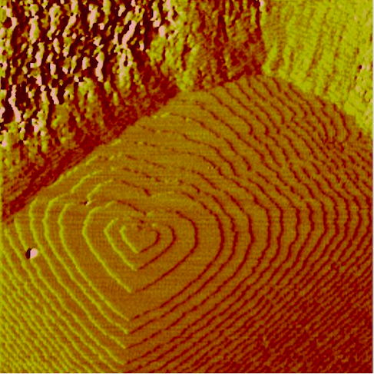
Nanoscale observations – calcite growth in the presence of Se
1 μm
Notes:
16

Slide 17
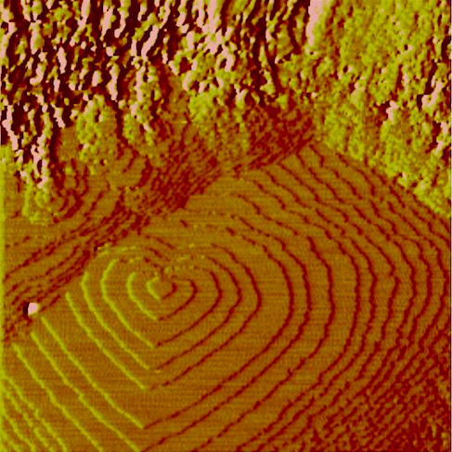
Nanoscale observations – calcite growth in the presence of Se
1 μm
Notes:
17

Slide 18
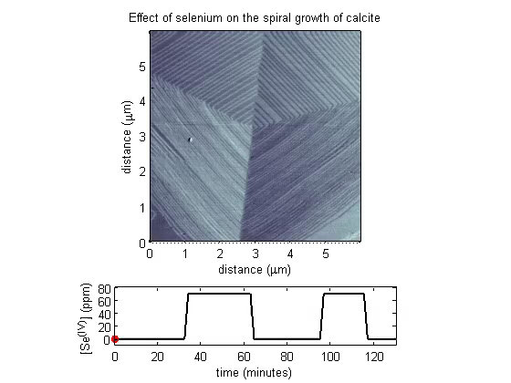
Nanoscale observations – calcite growth in the presence of Se
Notes:
18

Slide 19
Nanoscale observations
Crystal growth from undersaturated solutions?
Notes:
19

Slide 20
Supersaturation of an aqueous solution relative to a simple stoichiometric end-member solid.
The thermodynamic definition of supersaturation :
IAP
Ω =
K_{sp}
For a simple mineral such as calcite CaCO₃, for example
{Ca²⁺}.{CO₃²⁻}
Ω =
K_{sp}

Slide 21
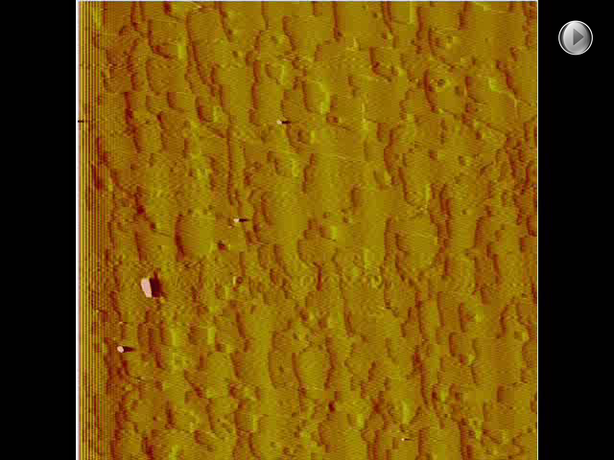
Calcite dissolving in the presence of 50 mM solution of (NH₄)₂HPO₄
T 2.5 h
Surface 5x5 µm
Notes:
21

Slide 22
Calcite dissolving in the presence of 50 mM solution of (NH₄)₂HPO₄
1 mm
Notes:
22

Slide 23
Dissolution of Cararra marble (CaCO₃) in the presence of (NH₄)₂HPO₄
unreacted
2 days 200°C
4 days 200°C
6 days
200°C
Images:
E. Trindade Pedrosa
Notes:
23

Slide 24
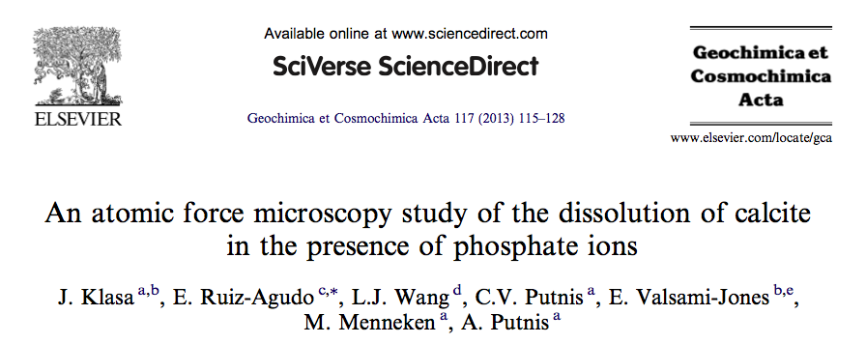
Notes:
24

Slide 25
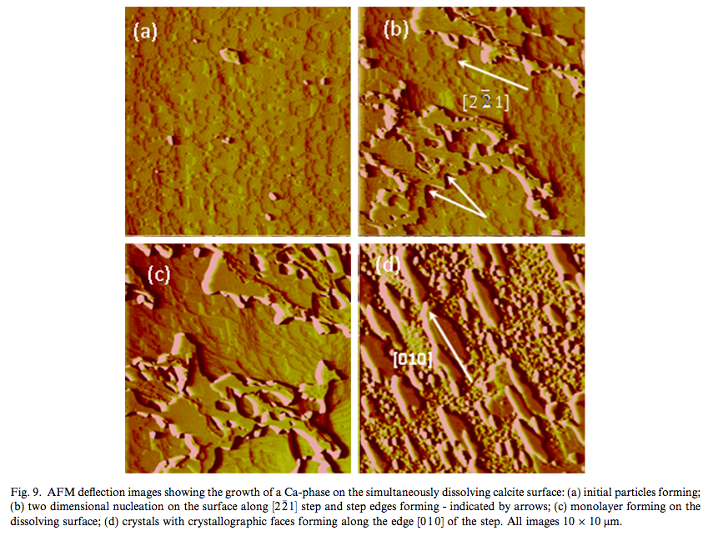
Notes:
25

Slide 26
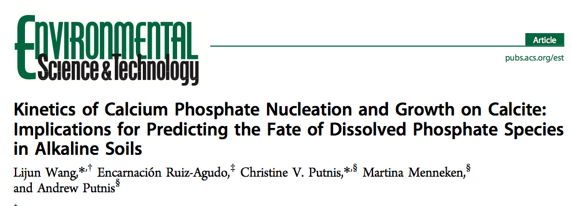
Notes:
26

Slide 27
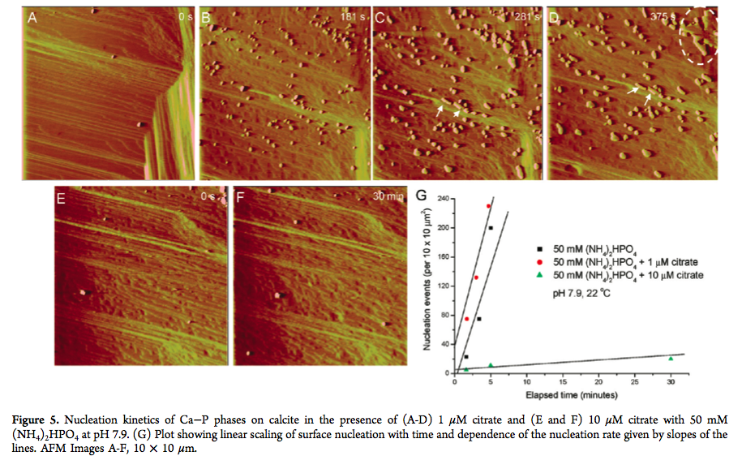
Notes:
27

Slide 28
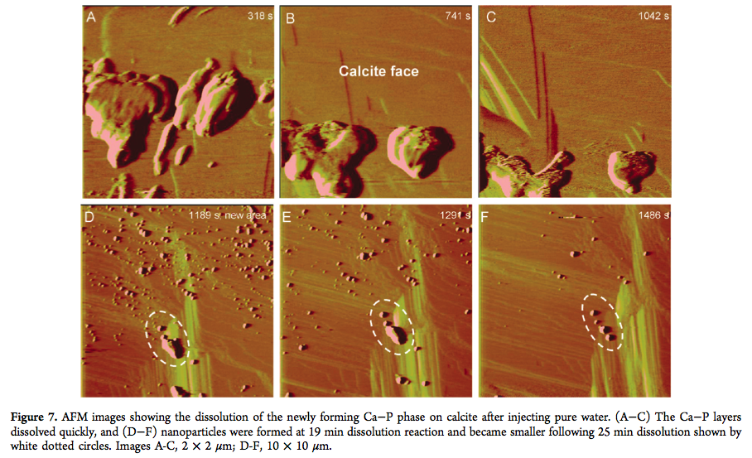
Notes:
28

Slide 29
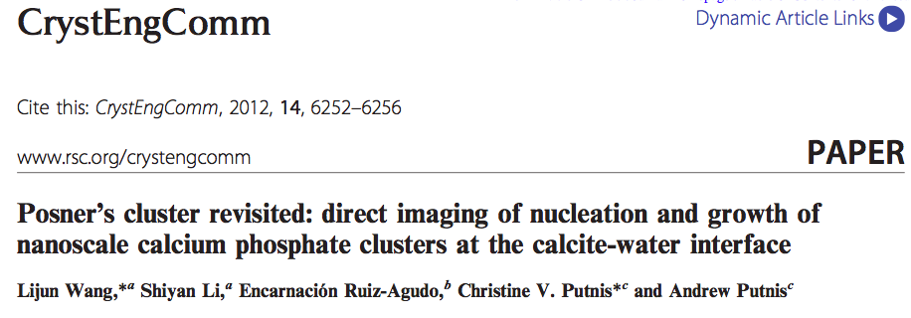
Notes:
29

Slide 30
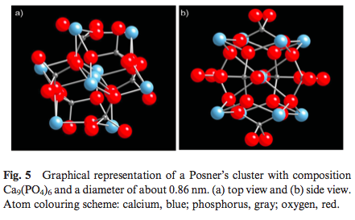
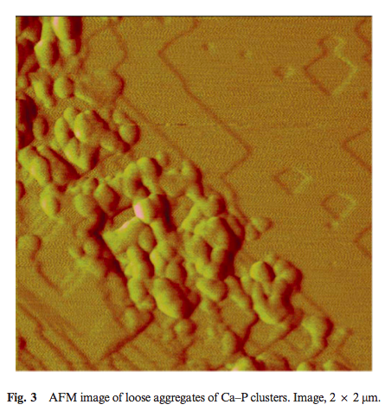
Posner’s clusters (Posner and Betts, 1975)
The mineral-surface assisted formation of Ca-P phases may proceed through the aggregation of metastable clusters, rather than by addition of ions or molecules to a nucleus, and subsequently form stable ACP plates prior to the transformation to the final crystalline phase.
Notes:
30

Slide 31
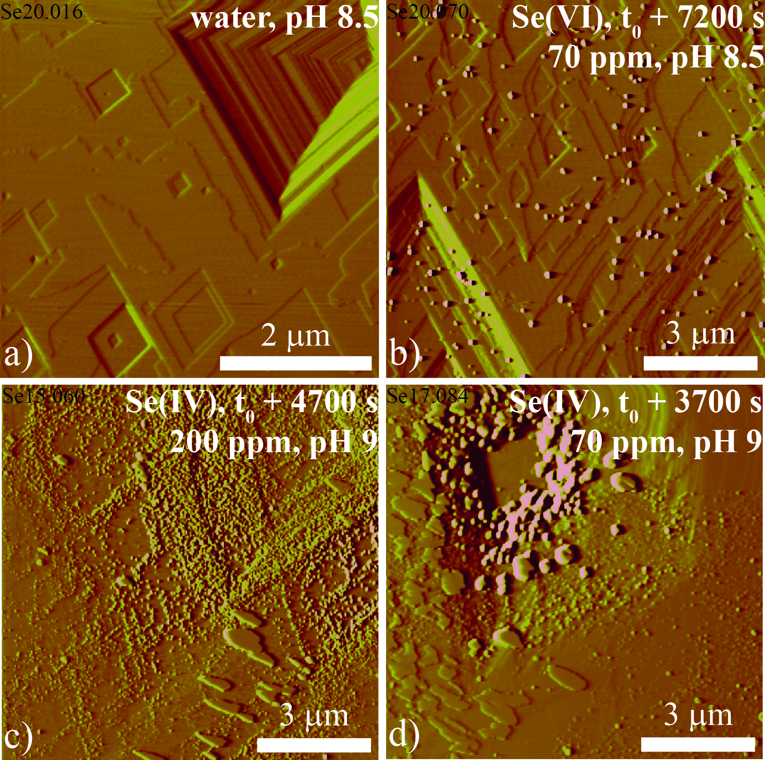
Calcite dissolving in the presence of Se ions

Slide 32
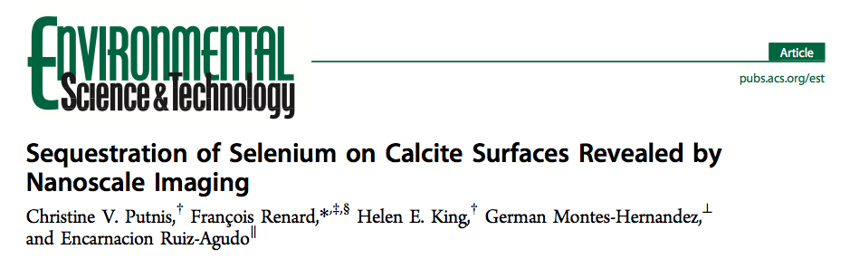
Notes:
32

Slide 33
Brucite Mg(OH)₂ dissolution
Direct in situ observations of brucite dissolution in water in contact CO₂ pH 3.5

Slide 34
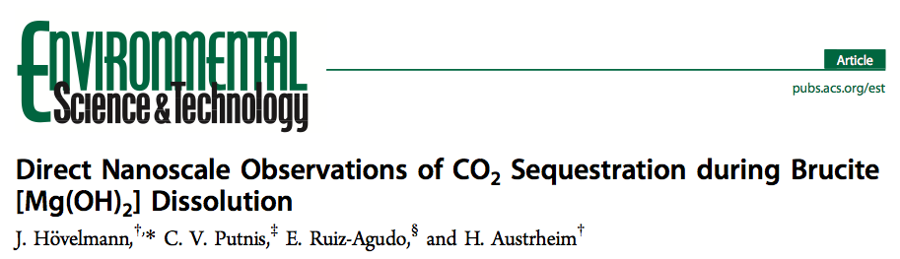
Notes:
34

Slide 35
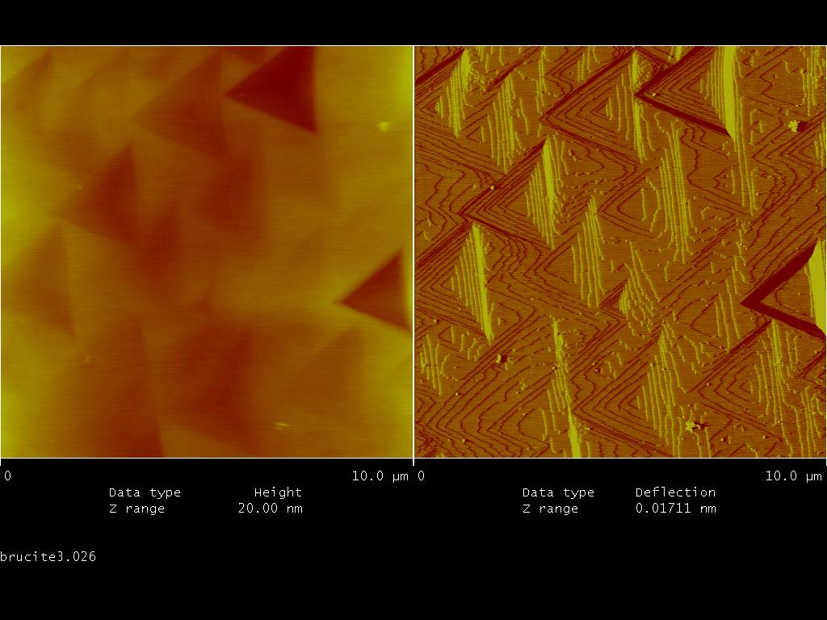
Morphology of dissolution features of brucite

Slide 36
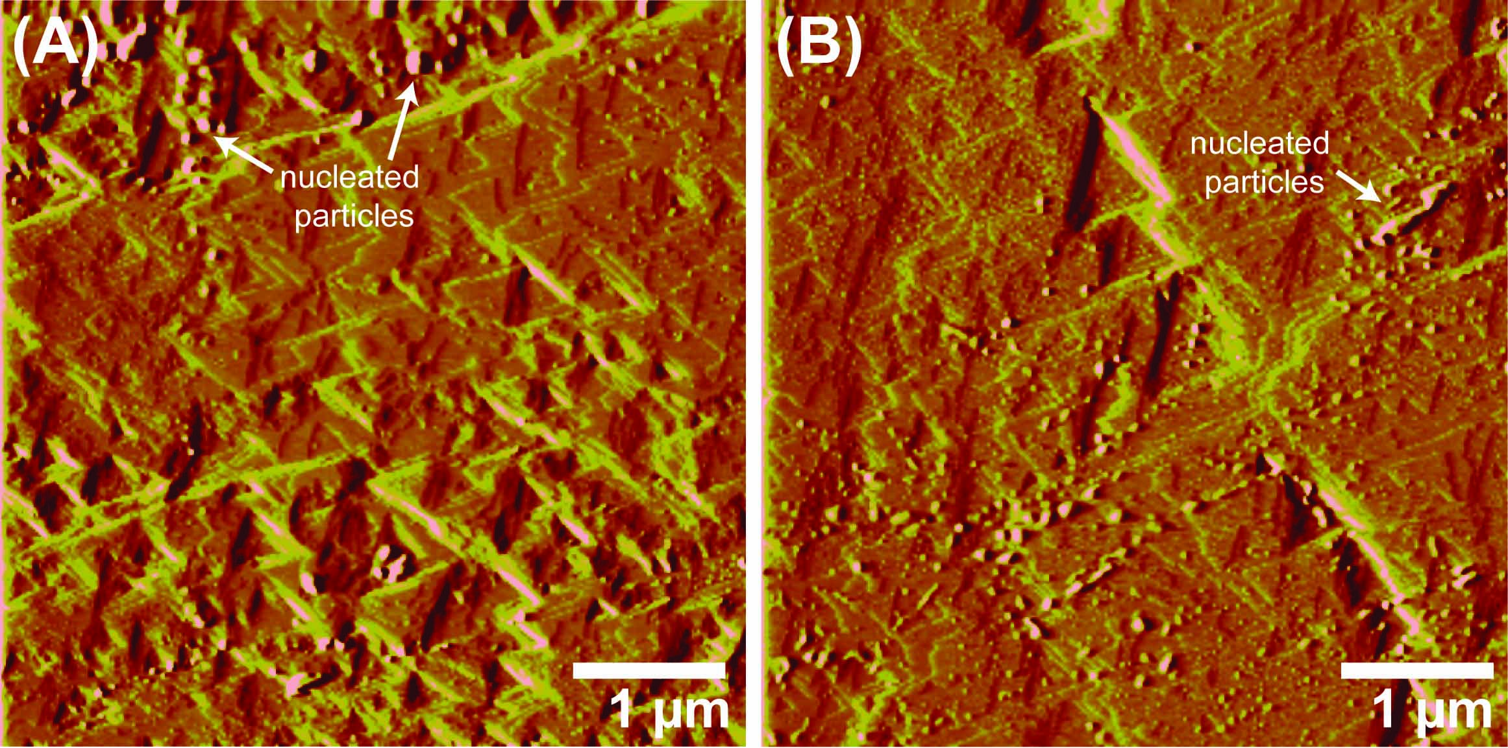
Dissolution - Precipitation

Slide 37
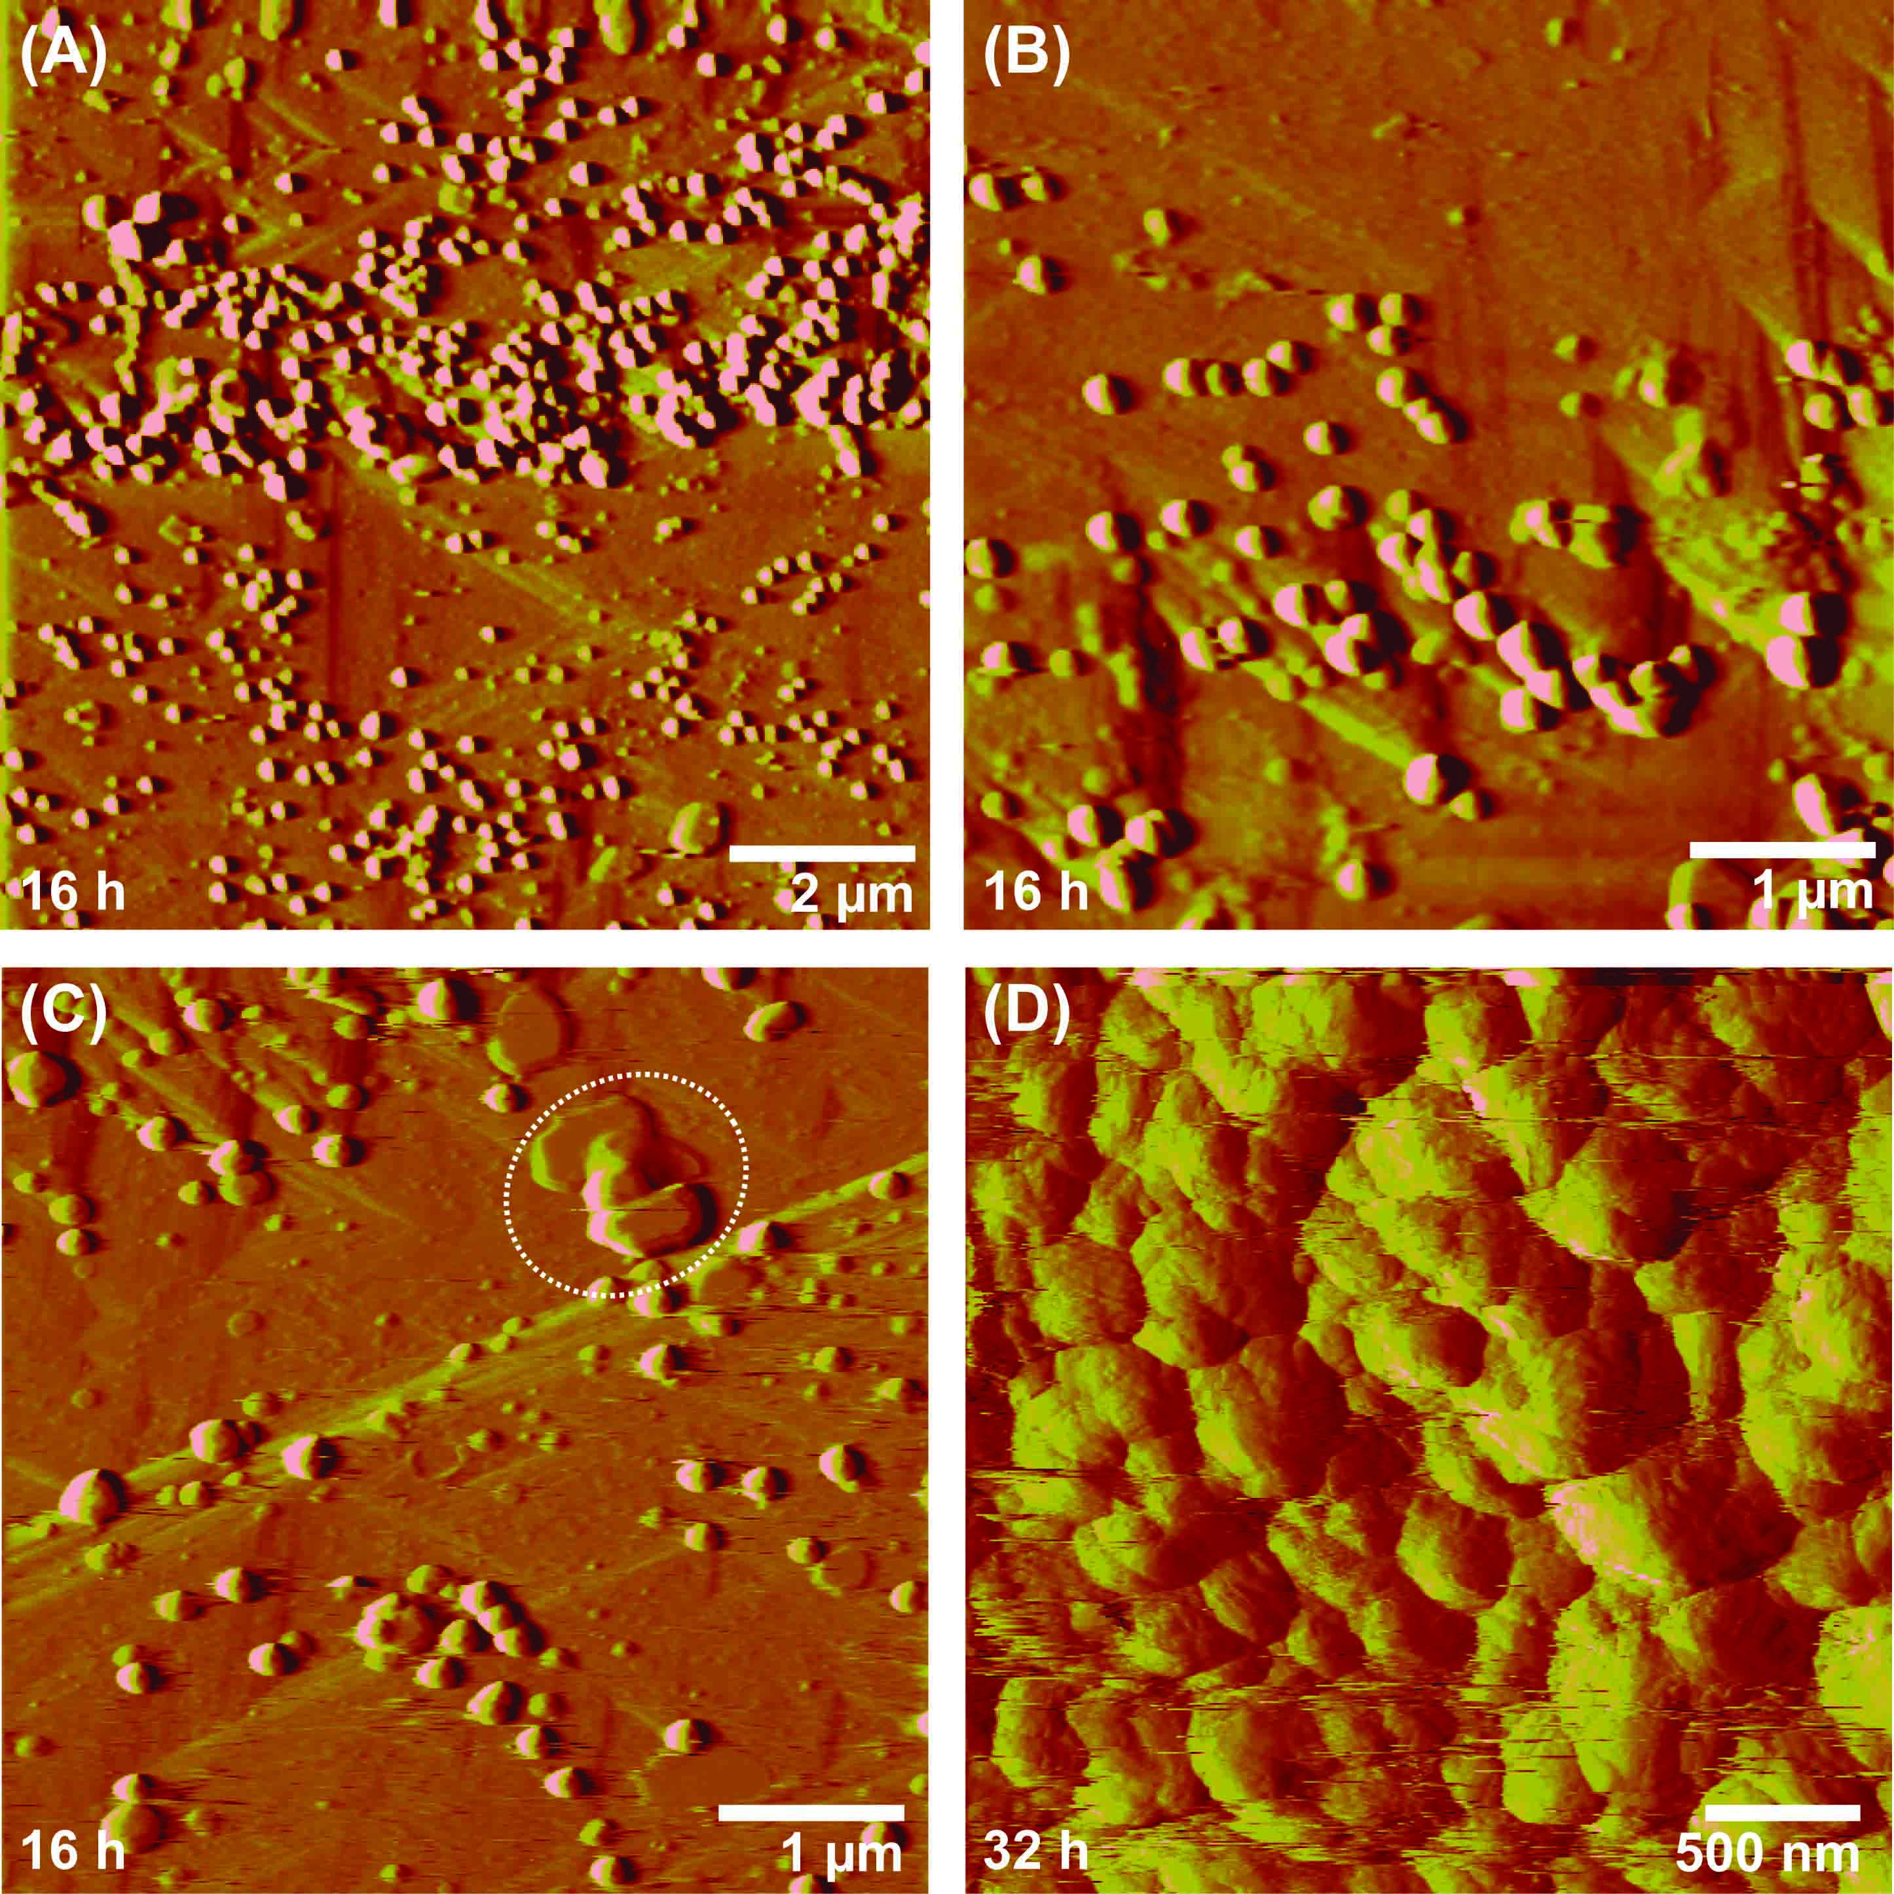
Dissolution - precipitation
Dissolution of brucite and precipitation of Mg-carbonate

Slide 38

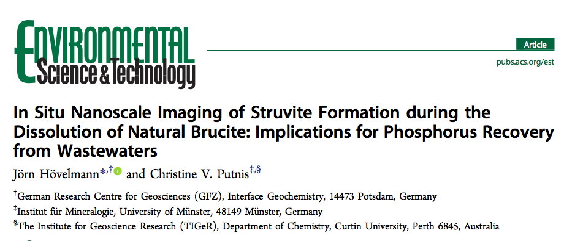
Notes:
38

Slide 39
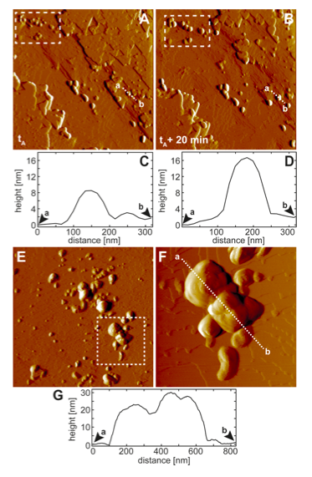
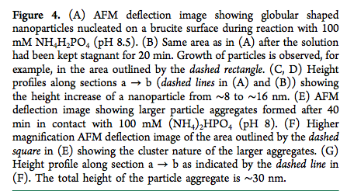
Notes:
39

Slide 40
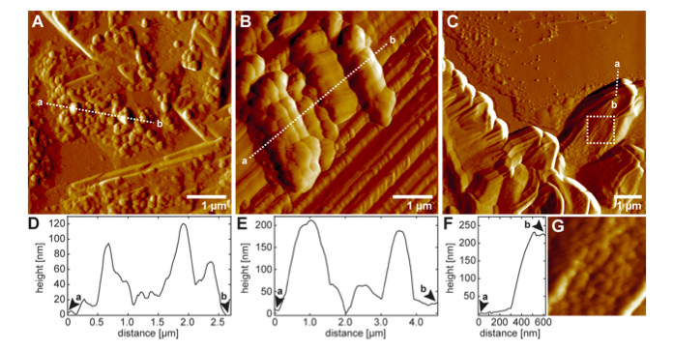
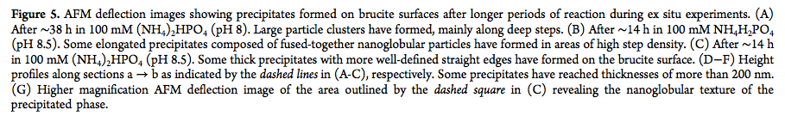
Notes:
40

Slide 41
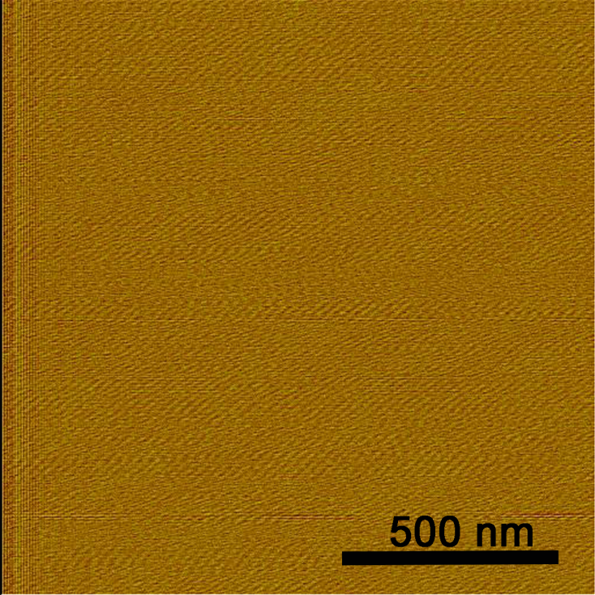
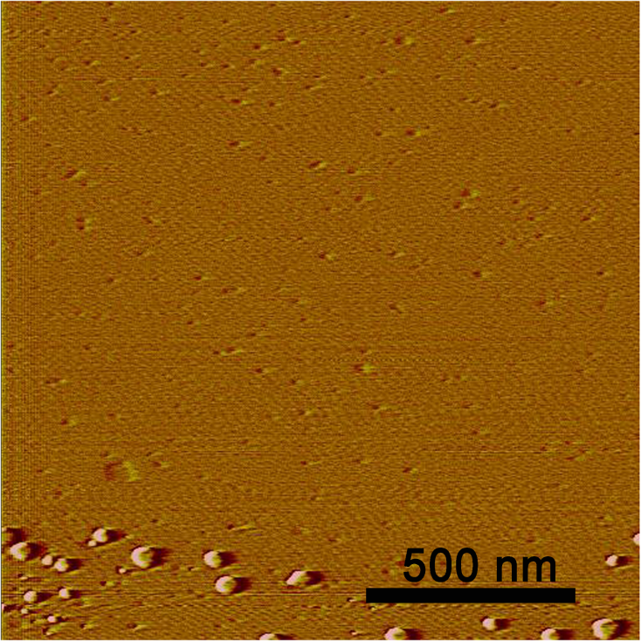
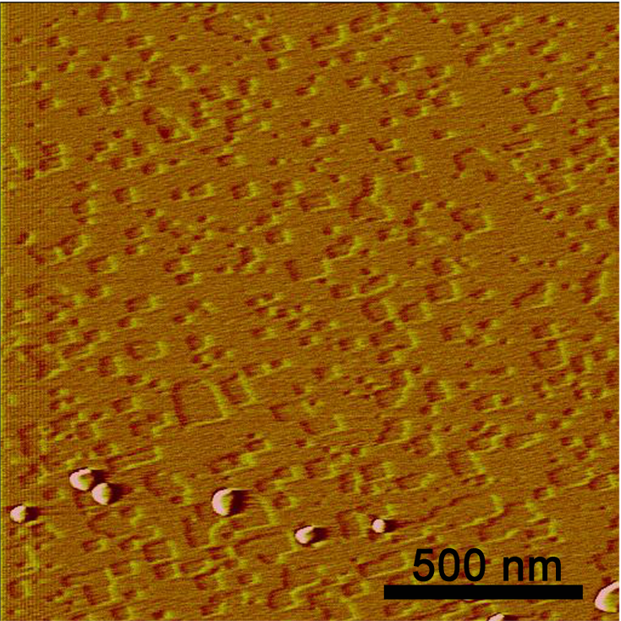
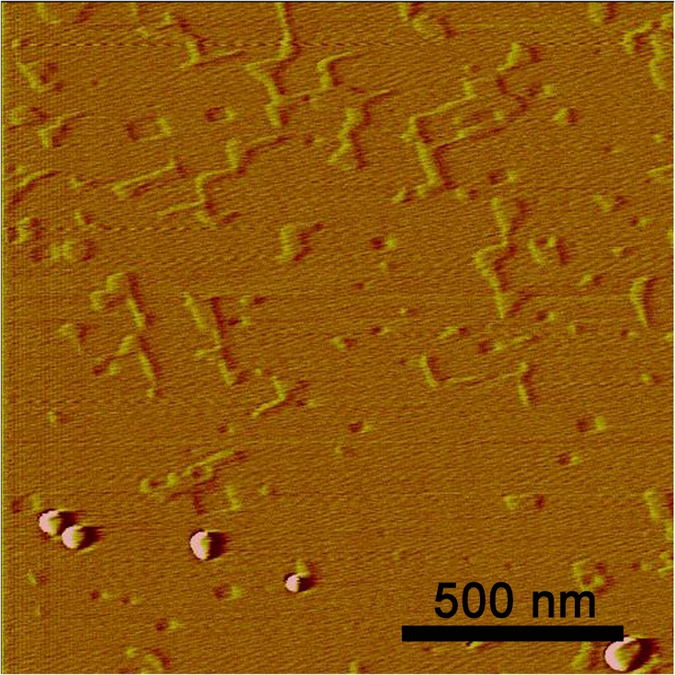
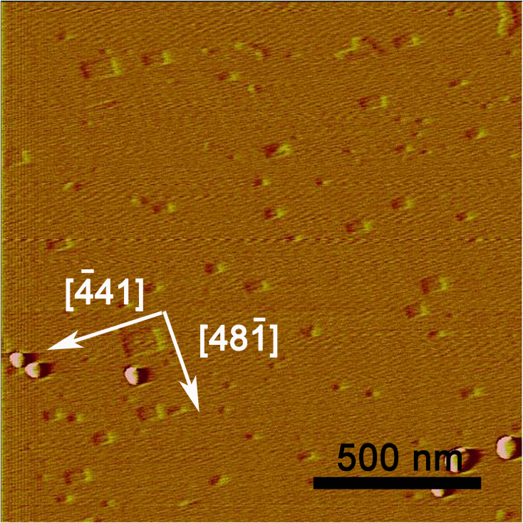
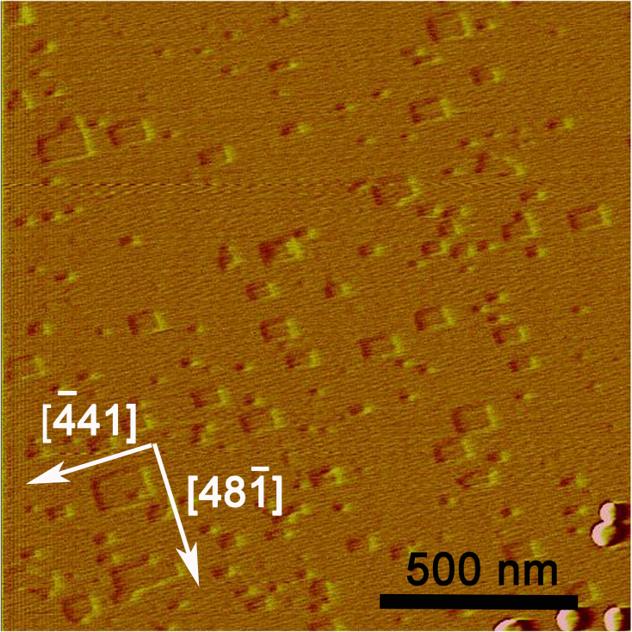
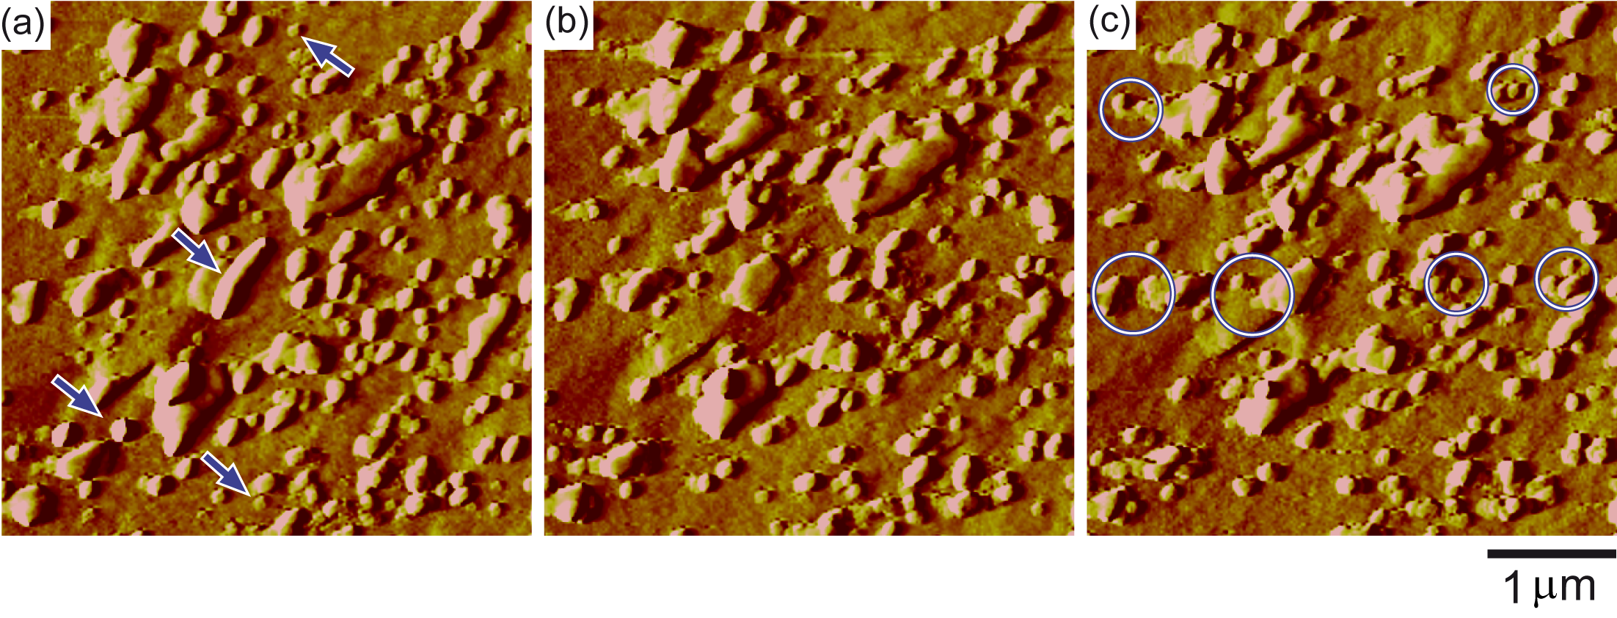
In situ AFM observations of dolomite Ca,Mg(CO₃)₂ dissolution (pH 7)
a
t = 0´
b
t = 313´
c
t = 699´
d
t = 1142´
e
t = 1312´
f
t = 1569´
Notes:
However, from our in situ, nanoscale observations of the reacting surface we found no experimental evidence that supports the hypothesis of a preferential release of calcium. Moreover, our AFM results clearly indicate that this “incongruent” behavior (non-stoichiometric dissolution) is the result of a dissolution-precipitation process. According to our observations, dolomite dissolution occurs at step edges parallel to < 41>, and dissolution at such step edges is a stoichiometric process, i.e. equal amounts of Ca²⁺ and Mg²⁺ are present along such steps and thus are equally released to the solution as the steps spread.

Slide 42
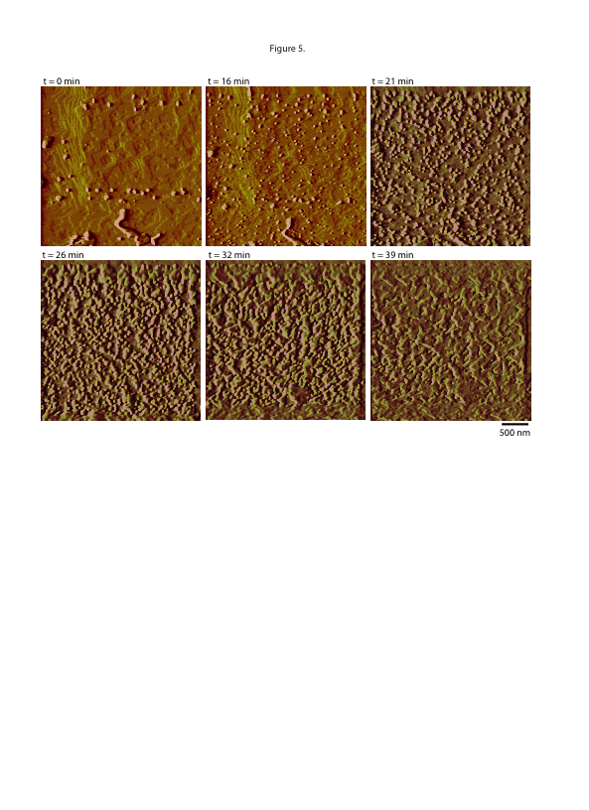
In situ AFM observations of dolomite dissolution (pH 3)

Slide 43
Dolomite dissolution

Slide 44
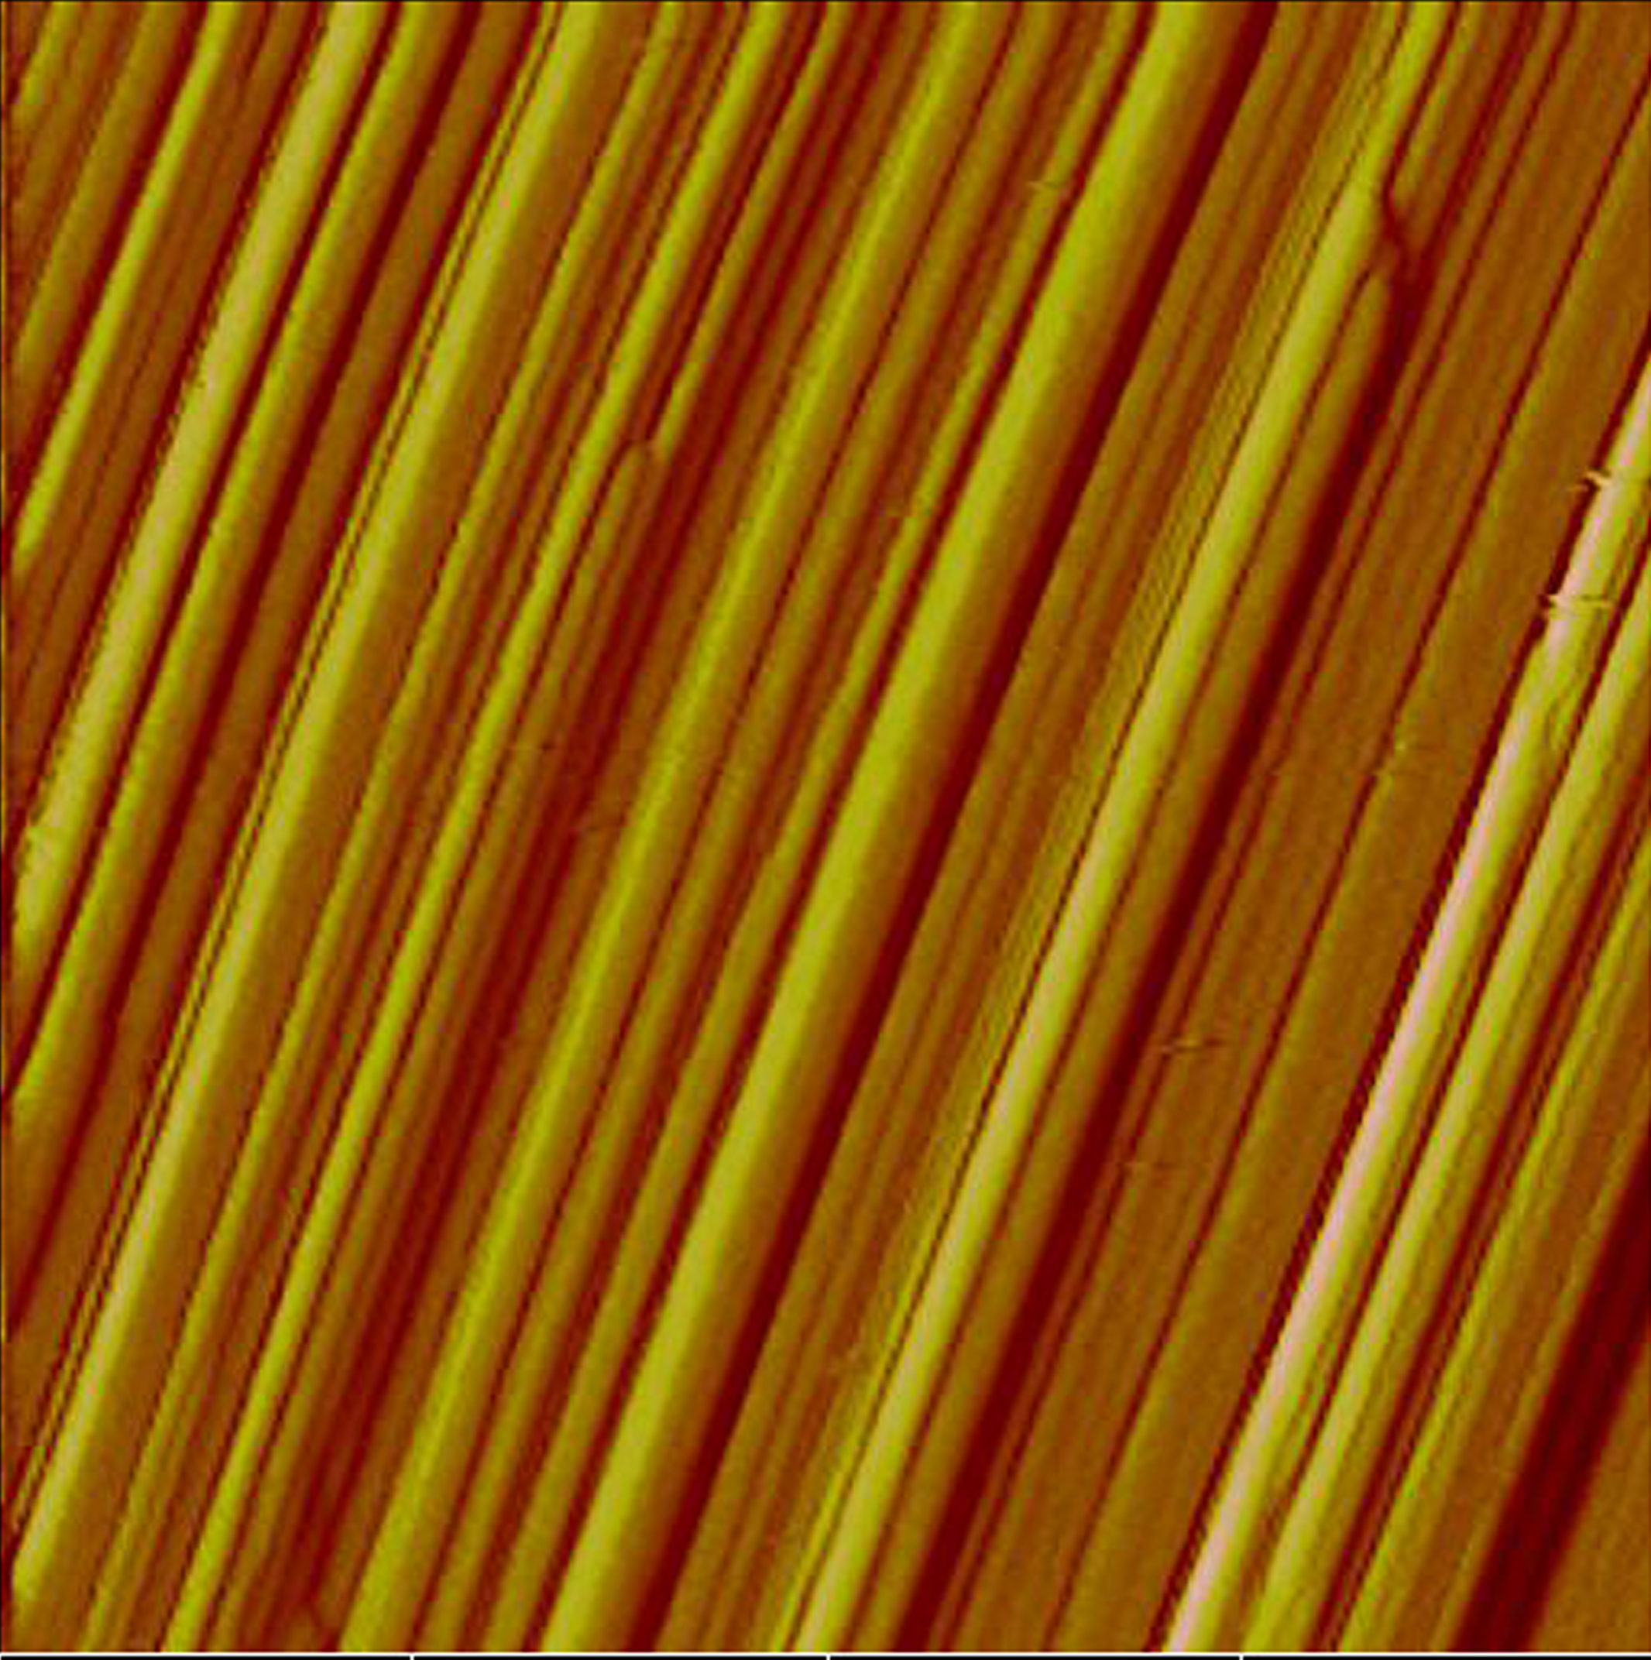







In situ AFM observations of wollastonite CaSiO₃ dissolution
pH 3
2 μm
Notes:
Freshly cleaved {100} wollastonite surfaces show numerous steps parallel to the b-axis (Figure 1a). Initially, dissolution at acidic pH occurs by retreat of pre-existing steps;

Slide 45


Weathering of minerals
2012
Geology 2016

Slide 46

Nanoparticle formation
Immediate precipitation on contact of calcite surface with saturated Ca(OH)2
After 20 min

Slide 47


Notes:
47

Slide 48


Angelika Kühnle: Tues. 15.08.17 Keynote in Session 08f:
Reactions at the Mineral-Fluid and Mineral-Organic Interfaces: From Molecular Mechanisms to Macroscopic Observations
Notes:
48

Slide 49
Acknowledgements
Many colleagues have contributed to the research in Münster on dissolution-precipitation reactions:
Encarnación Ruiz-Agudo - Granada, Spain
Helen King – Utrecht, The Netherlands
François Renard - Grenoble, France
Lijun Wang – Wuhan, China
Jörn Hövelmann – GFZ Potsdam, Germany
Andrew Putnis – TIGeR, Curtin University, Perth, Australia
Funding: mostly Marie Curie EU Initial Training Networks;
ARC grant awarded to Julian Gale, Department of Chemistry, Curtin University, Perth, Australia
putnisc@uni-muenster.de; christine.putnis@curtin.edu.au
Notes:
49

Slide 50


Slide 51


Notes:
51

Slide 52

{1014} cleavage surface Iceland Spar (ca. 3x4x1 mm)
CaCO₃
+
0.01 M HEDP
Hydroxy Ethylene Diphosphonic acid,
No Ca²⁺ or CO₃²⁻ pH = 8

Slide 53

Reaction time: 2.5 hours

Slide 54
Calcite + 0.5 M NaCl
+ 0.1 M solution NaHCO₃

Slide 55

Reaction time: 40 min

Slide 56
Mechanism
1. Mineral such as calcite, dolomite, brucite or silicates dissolve congruently in water, releasing ions to solution
2. The mineral-fluid interface becomes increasingly saturated with a new phase (such as, Ca-phosphate or Mg-carbonate or silica), until supersaturation allows precipitation
3. The solution at the interface is then no longer supersaturated and dissolution of the mineral continues until once again supersaturation is reached
4. The cycle is repeated
This is interface-coupled dissolution-precipitation

Slide 57
In a coupled dissolution-precipitation mechanism the rate-controlling step is dissolution and nucleation is not a problem

Slide 58
Considerations for the calculation of the boundary fluid layer:
For precipitation to occur, the fluid layer must be supersaturated with respect to the precipitating phase. Therefore we need to know:
1. The solubility of the solid in the fluid phase.
2. The diffusion rate of the solid ions in the fluid phase.
3. The composition of the fluid phase.
4. The saturation index of all possible precipitating phases.
5. Possible epitaxial relationships of the precipitating phase on the substrate.

Slide 59
Calculation of the boundary layer maximum thickness
V_{FLUID} = 38 µL
V_{FLUID CELL} = 50 µL
h, thickness of the boundary layer
V_{CRYSTAL} = 12 µL
Crystal size = 4x3x1 mm
K_{sp} = [Ca²⁺][HEDP²⁻] =1.35·10⁻⁵ (calculated from Browning and Fogler, Langmuir 1996,11, 4143-4152)
Assuming that precipitation occurs close to the equilibrium and for dilute solutions,
[Ca²⁺]_{BL}≈ [HEDP²⁻]/ K_{sp} ≈ (moles Ca²⁺)/ V_{BL}
The threshold activities of Ca²⁺ and HEDP²⁻ are 2.20·10⁻⁵ and 1.60·10⁻⁴ (calculated from a dissolution rate of 9.17·10⁻⁹ mol/s, a time lapse between injections of 90 s and assuming no precipitation of Ca-HEDP phases)
[Ca²⁺]_{threshold} ≈ (moles Ca²⁺)/ V_{FLUID}
(moles Ca²⁺) = [HEDP²⁻] ·V_{BL} / K_{sp}= [Ca²⁺]_{threshold} ·V_{FREE}
V_{BL} = K_{sp·}[Ca²⁺]_{threshold} ·V_{FLUID} /[HEDP²⁻]
V_{BL} = 9.89·10⁻³ µL
h = 380 nm
Notes:
59

Slide 60

Interface-coupled dissolution-precipitation
crystal
a
b
c
d
e
Dissolution of even a few monolayers of the parent crystal may result in an interfacial fluid layer which is supersaturated with respect to another phase
(b) This product phase may nucleate on the surface of the parent
Notes:
60

Slide 61
Interface-coupled dissolution-precipitation
crystal
a
b
c
d
e
(c) The porosity generated depends on both the solid molar volume change and the relative solubilities of parent and product in the fluid
(d-e) A reaction/replacement interface moves through the parent crystal
Notes:
61

Slide 62
Experimental set up:
camera
KBr
Saturated KCl solution (0.5ml)
A pure crystal of KBr 2 x 2 x 5 mm was placed in a small glass beaker and saturated KCl solution added up to but not covering the surface.
Observations were made using time lapse photography with a camera fitted to a stereoscope microscope.
Notes:
62

Slide 63

Reaction time: 2 hours
Notes:
63

Slide 64


Porosity in the new phase
a
b
SEM image of the porous surface of a KBr crystal after replacement, showing the orientation of pores parallel to cleavage directions:
a) surface of replaced crystal;
b) magnification of (a) from a central area.
Notes:
64

Slide 65
Analysis of the fluid phase
Phase Shift Interferometry used to record the solution composition changes at the crystal surface during the replacement process.
Katsuo Tsukamoto and Yoshihiro Nishimura
Tohoku University, Sendai, Japan
Notes:
65

Slide 66

100µm

Slide 67
100µm

Slide 68
Nanoscale observations
Direct in situ observations using
Atomic force microscopy
AFM
Notes:
68

