Slide 1



Welcome to the
2018-19 InTeGrate Professional Development
Webinar Series
As you enter, please review the Zoom controls below. Leave your audio and video off, unless prompted by a host. You can post any questions in the chat box. Thank you!
Please leave your audio muted and video off (both indicated by a red slash).
Click to open the Participants box. This will allow you to give nonverbal feedback.
Click to open the Chat box. This will allow you to chat with Hosts and Participants.
Notes:
Click to open the Chat box. This will allow you to chat with Hosts and Participants.

Slide 2
Welcome to the
2018-19 InTeGrate Professional Development
Webinar Series
Free and open to the public, this series aims to help faculty teach about the earth in the context of societal issues. The series incorporates InTeGrate principles into teaching practices, provides materials available for adoption, and creates a forum for participants to learn and share teaching strategies.
https://serc.carleton.edu/integrate/workshops/webinars/2018_2019/intro_integrate/index.html

Slide 3
Introductory InTeGrate-rich Physical Geology course
Elizabeth Nagy-Shadman
Associate Professor
Geology/Natural Sciences
Pasadena City College

Slide 4
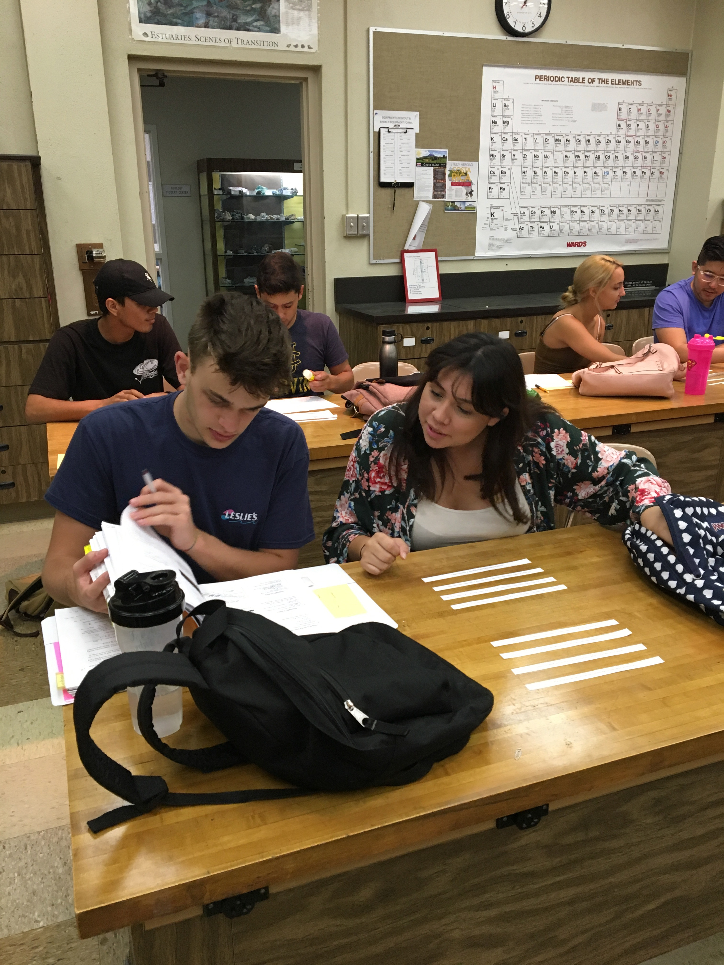
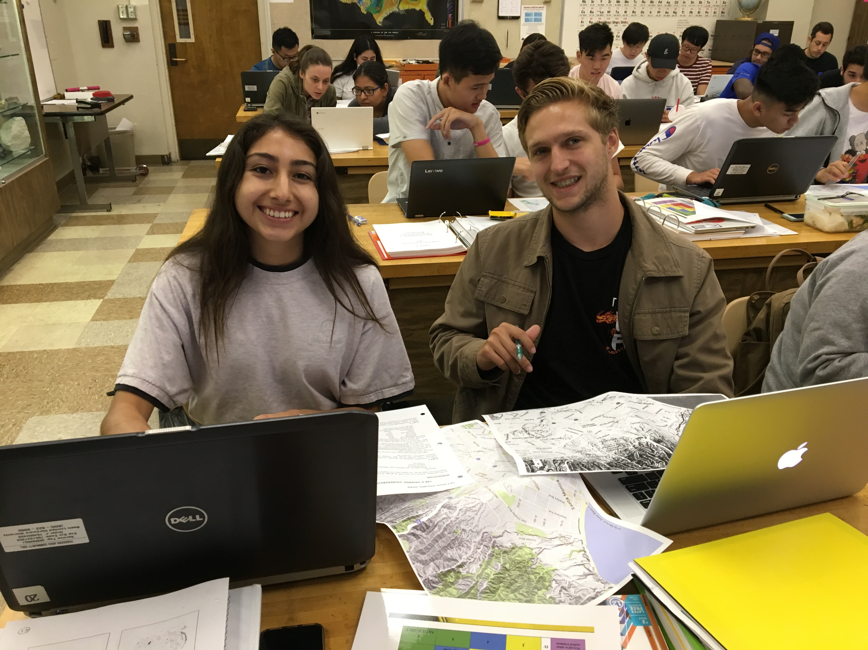
Presentation Outline
Overview of Integrate classroom materials
Syllabus overhaul
Natural hazards
Plate tectonics
Mineral Resources
Modifications

Slide 5
Presentation Outline
Overview of Integrate classroom materials
Syllabus overhaul
Natural Hazards
Plate Tectonics
Mineral Resources
Modifications

Slide 6

https://serc.carleton.edu/integrate

Slide 7
Presentation Outline
Overview of Integrate classroom materials
Syllabus overhaul
Natural Hazards
Plate Tectonics
Mineral Resources
Modifications

Slide 8
Laboratory Activities FALL 2015 | REVISED Laboratory with InTeGrate Activities Fall 2018
Lab #1: Measurement | Lab #1a: Measurement
Lab #2: Geologic Time Scale | Lab #1b: Geologic Time Scale/Geography Review
Lab #3: Absolute Geologic Time | Lab #2: Plate Tectonics
Lab #4: Plate Tectonics | Lab #2: (continued)
Lab #4: (continued) | Lab #3: Map your hazards Unit 1
Lab #5: California Fault Maps | Lab #4: Living on edge Units 1-2
Lab #6: Earthquake Analysis | Lab #5: Living on edge Units 3-4
Lab #6: (continued) | Lab #6: Living on edge Units 5-6
Lab #7: Strss and Strain/Faults and Folds | Lab #7: Stress and Strain/Faults and Folds
Lab #8: Case Study: San Andreas Hazard | Lab #8: Earthquakes and Tsunamis
Lab #9: Introduction to Minerals | Lab #9: Case Study: San Andreas Hazard
Lab #10: Igneous Mineral Identification | Lab #10: Introduction to Minerals
Lab #11: Igneous Rock Identification | Lab #11: Mineral Resources Unit 1
Lab #11: (continued) | Lab #12: Mineral Resources Units 2.1 and 2.2
Lab #12: Slab Dip | Lab #13: Igneous Mineral Identification
Lab #13: Sedimentary Mineral Identification | Lab #14: Igneous Rock Identification
Lab #14: Sedimentary Rock Identification | Lab #14: (continued)
Lab #14:(continued) | Lab #15: Rock Cycle
Lab #15: Metamorphic Mineral Identification | Lab #16: Sedimentary Mineral Identification
Lab #16: Ore Mineral Identification | Lab #17: Sedimentary Rock Identification
Lab #17: Metamorphic Rock Identification | Lab #18: Metamorphic Mineral Identification
Lab #17: (continued) | Lab #19: Metamorphic Rock Identification
Lab #18: Rock Cycle | Lab #20: Ore Mineral Identification
Lab #19: Relative Geologic Time | Lab #21: Mineral Resources Unit 3
REMOVED
REMOVED
CONDENSED
REMOVED
CONDENSED
CONDENSED
REMOVED
removed
removed
removed
removed

Slide 9
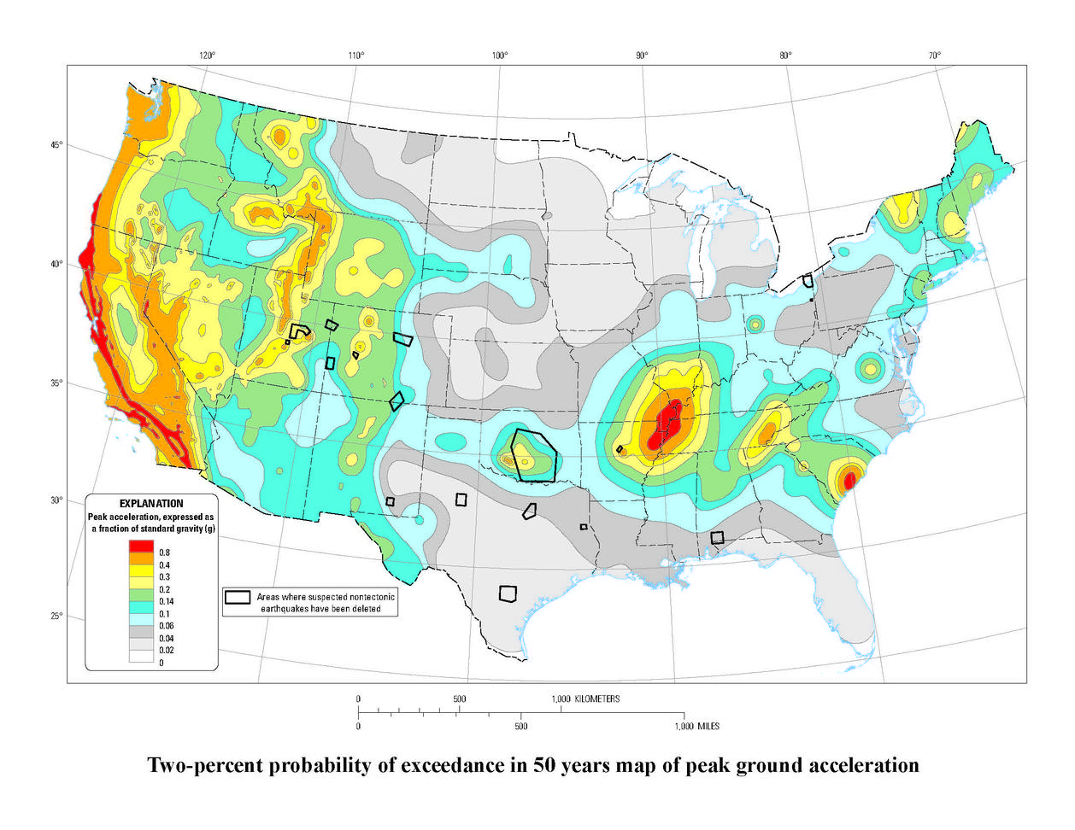
Presentation Outline
Overview of Integrate classroom materials
Syllabus overhaul
Natural Hazards
Plate Tectonics
Mineral Resources
Modifications
USGS Earthquake Hazard Map

Slide 10
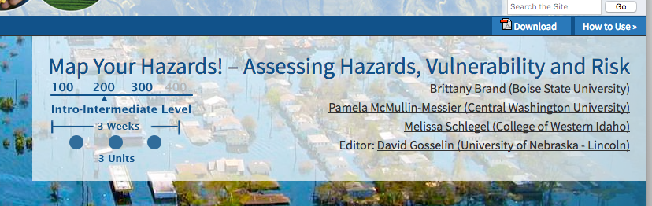
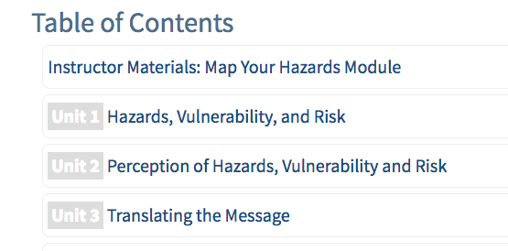
Students discover local natural hazards and social vulnerabilities, and assign levels of risk to areas within their community.

Slide 11
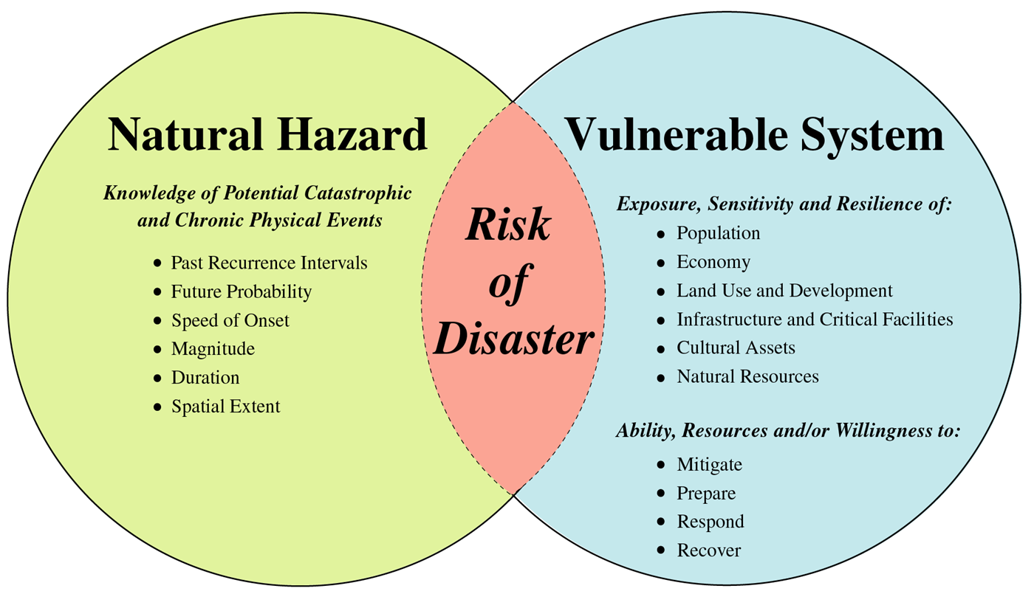
Risk is where natural hazards and vulnerability overlap
Wood, N., 2011. Understanding risk and resilience to natural hazards. U.S. Geological Survey Fact Sheet 2011-3008 – Venn diagram modified from http://pubs.usgs.gov/fs/2011/3008

Slide 12
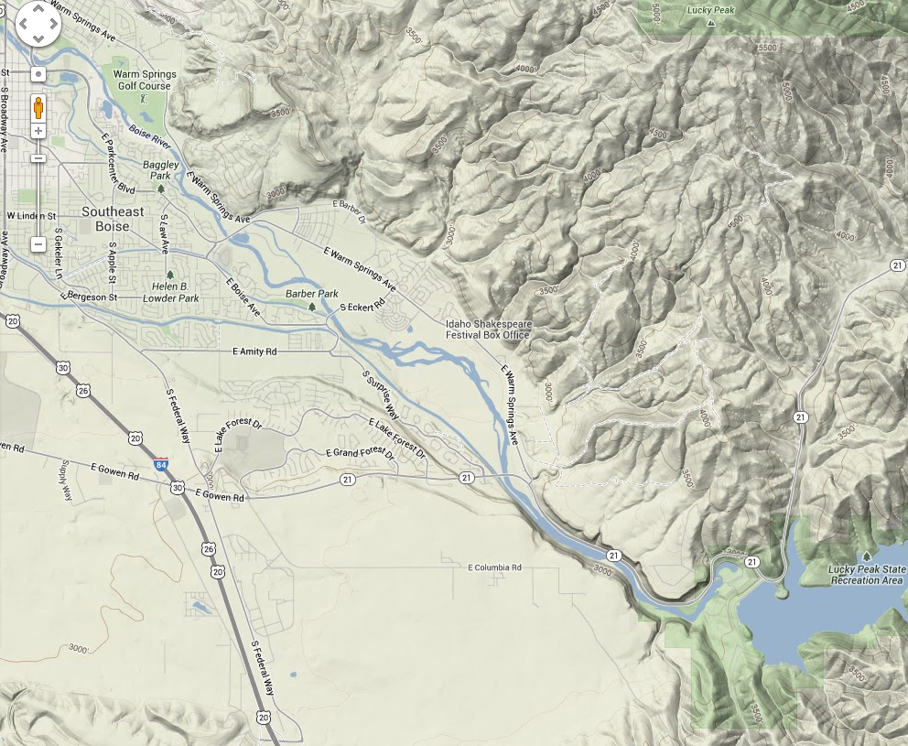
Base Map
Example: East-Southeast Boise, Idaho
Notes:
All base maps are pasted from maps.google.com. Transparent shapes were drawn over the base maps by the students, who referenced the Ada County Hazard Vulnerability Analysis (http://www.accem.org/pdf/adacountyhva-sec.pdf)

Slide 13
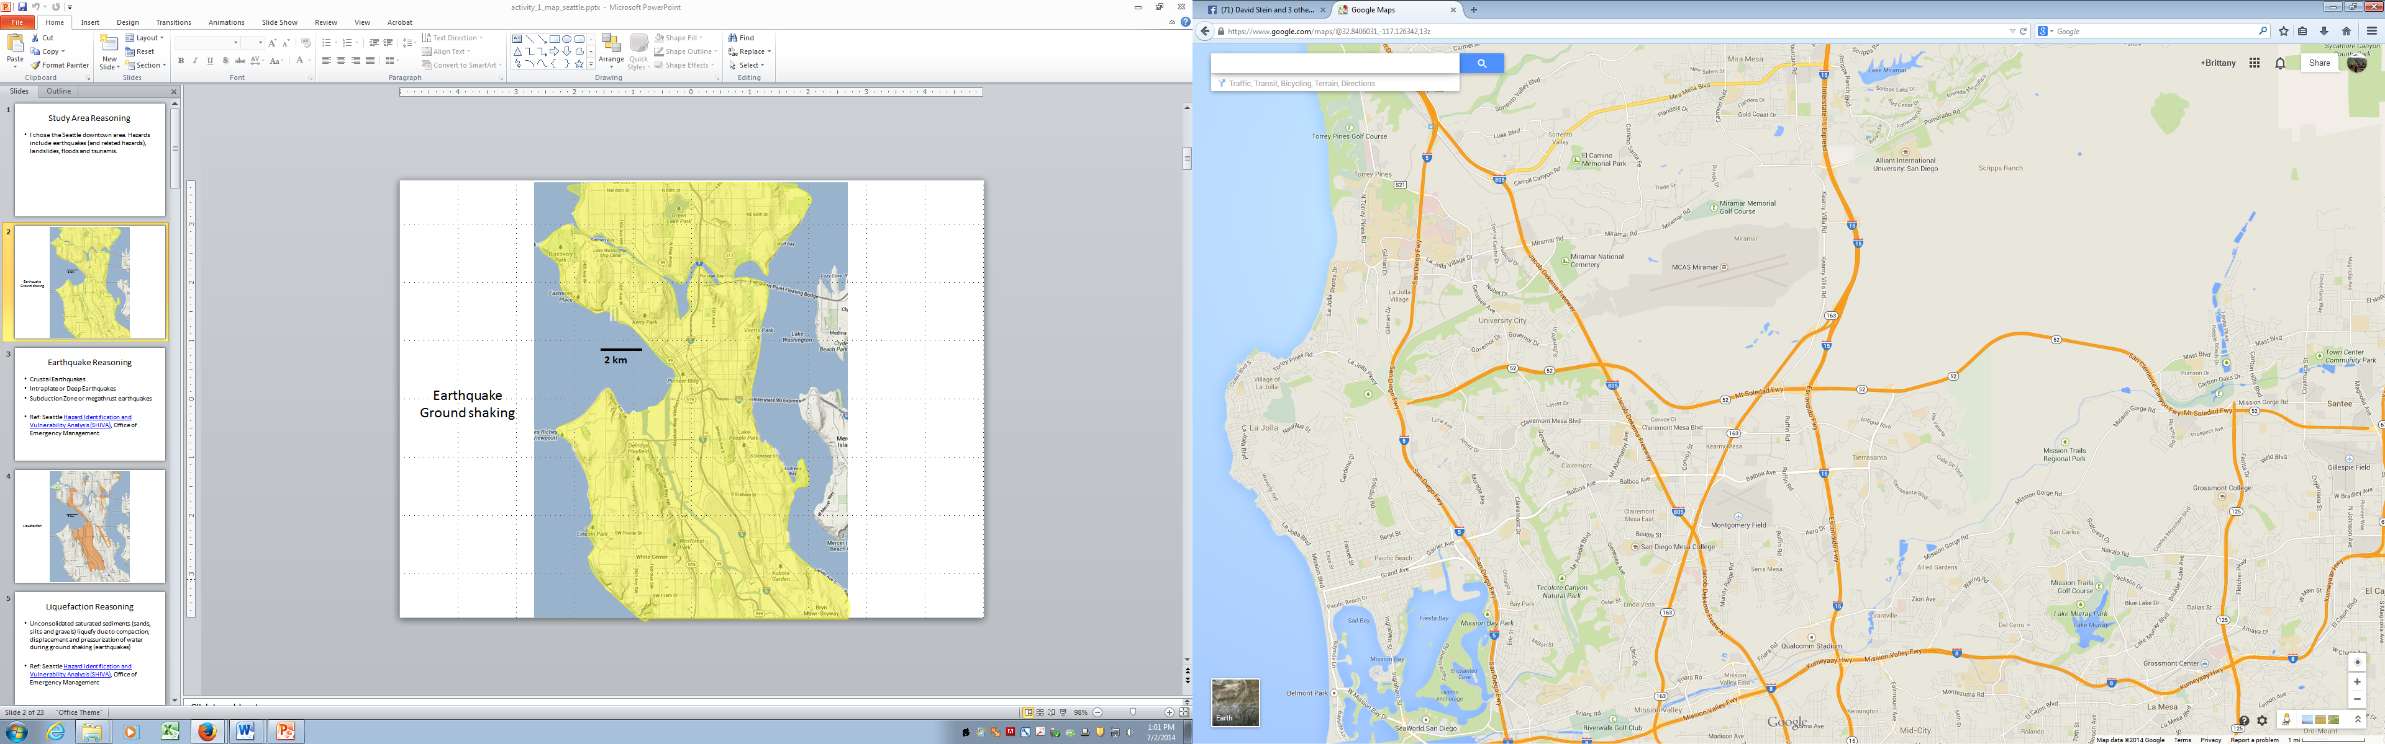
Hazard Map
Key:
Wildfire Danger
Flooding (Rainfall, Snowmelt, etc.)
Flooding ( Lucky Peak Dam Failure)
Lightning & Thunderstorm
1 mi
1 km

Slide 14
Map of Vulnerabilities
Key:
Retirement Homes
Schools
Bridges
Recreation
M
Micron
M
1 mi
1 km

Slide 15
Combined Hazards & Vulnerabilities Map
Key:
Retirement Homes
Schools
Bridges
Recreation
M
Micron
Wildfire Danger
Flooding (Rainfall, Snowmelt, etc.)
Flooding ( Lucky Peak Dam Failure)
M
Lightning & Thunderstorm
1 mi
1 km

Slide 16
Risk Level Map
Key:
High Risk
Moderate Risk
Low Risk
M
1 mi
1 km

Slide 17
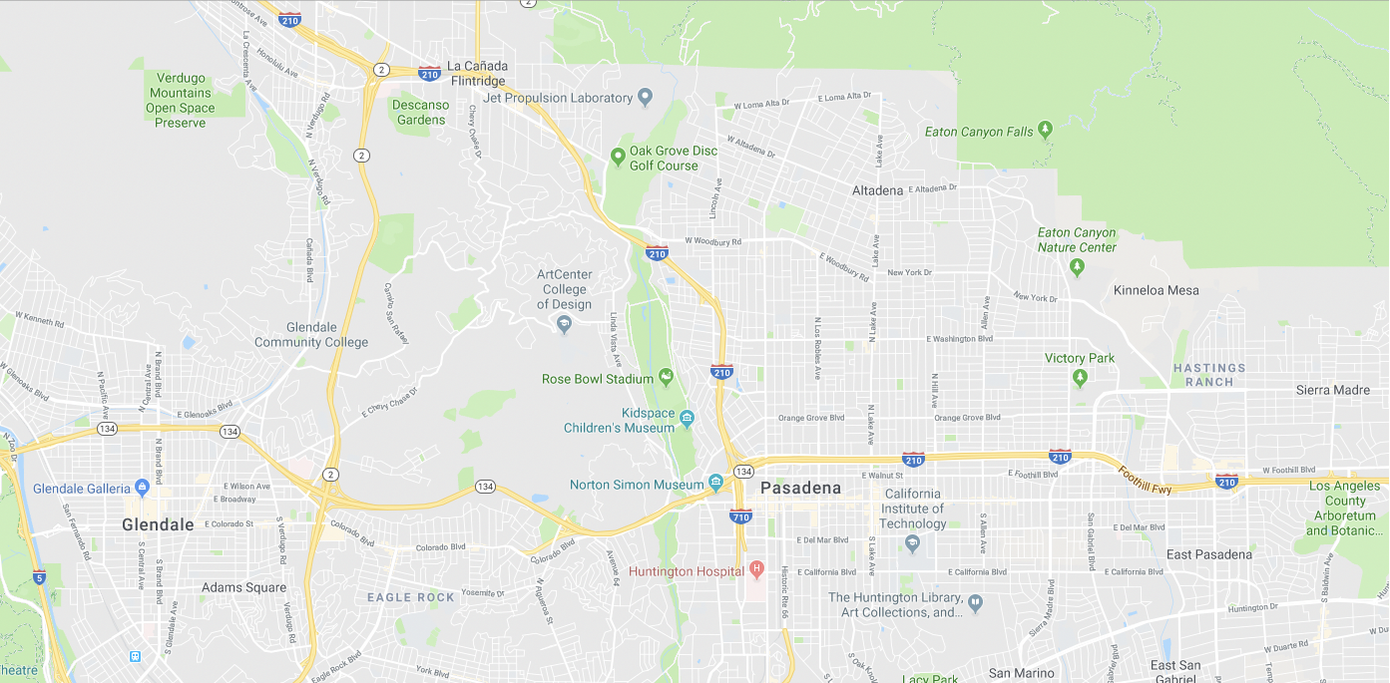
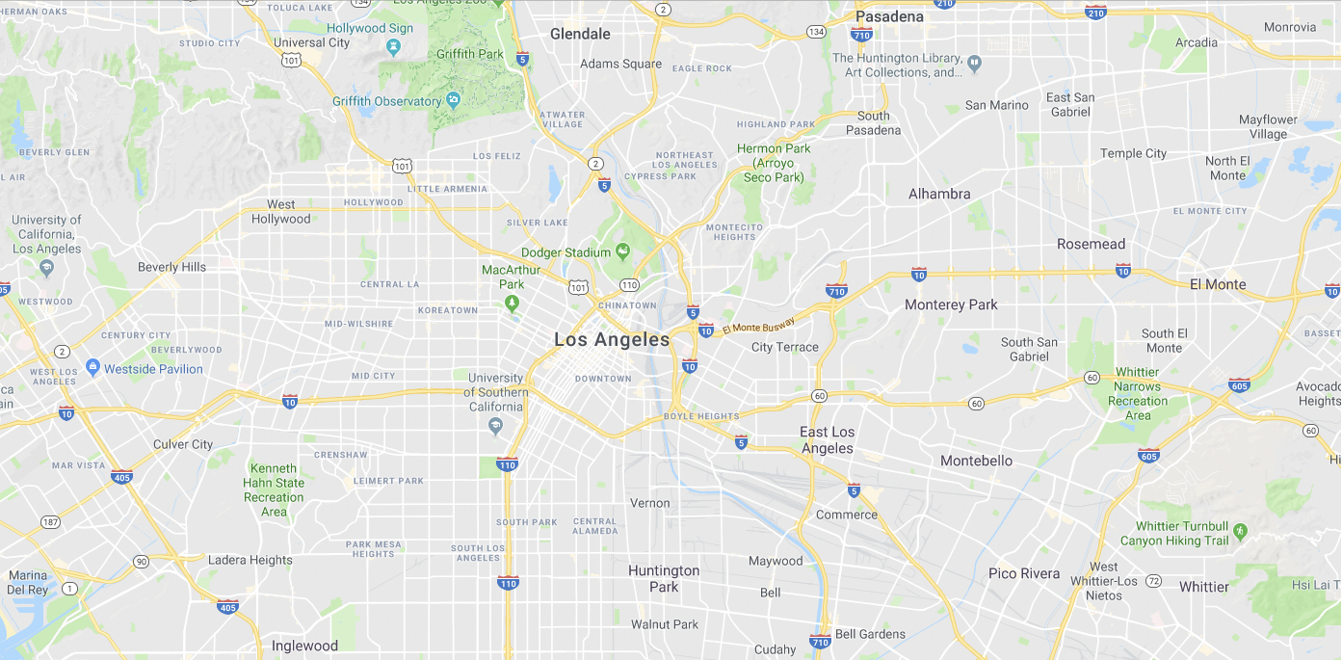
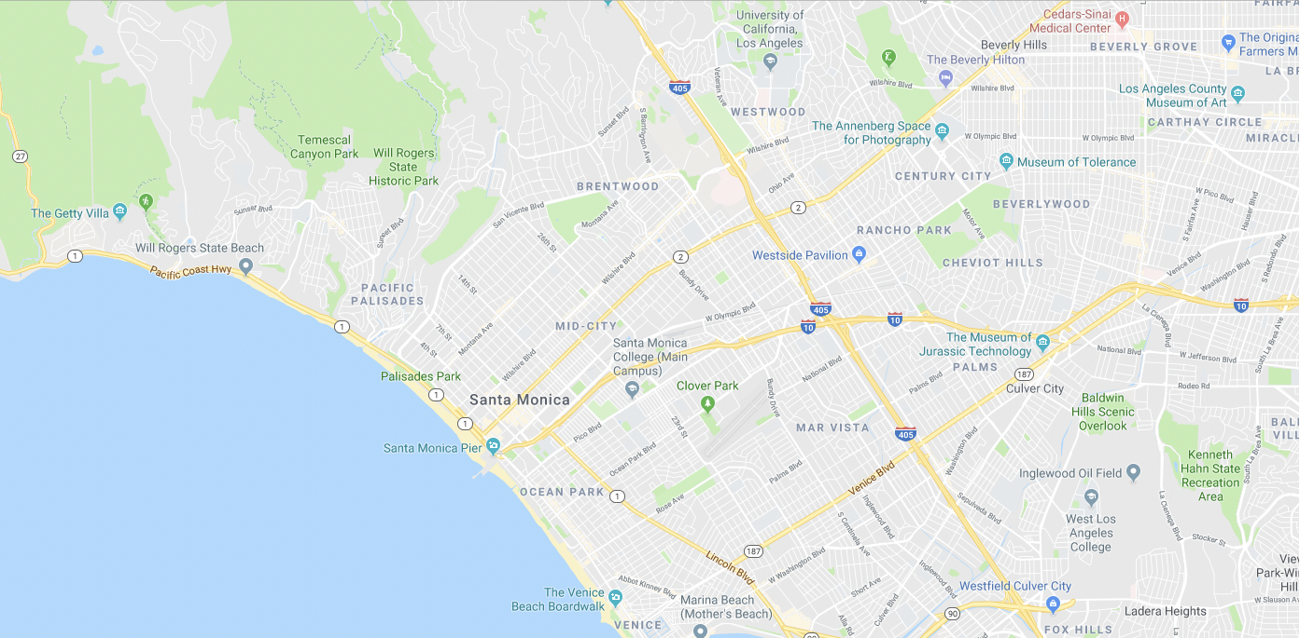
Base Maps
Downtown Los Angeles
Pasadena
Santa Monica
Notes:
Coverage is about 12 square miles (Santa Monica) to 70 square miles (L.A) to 20 square miles (Pasadena)

Slide 18


Slide 19
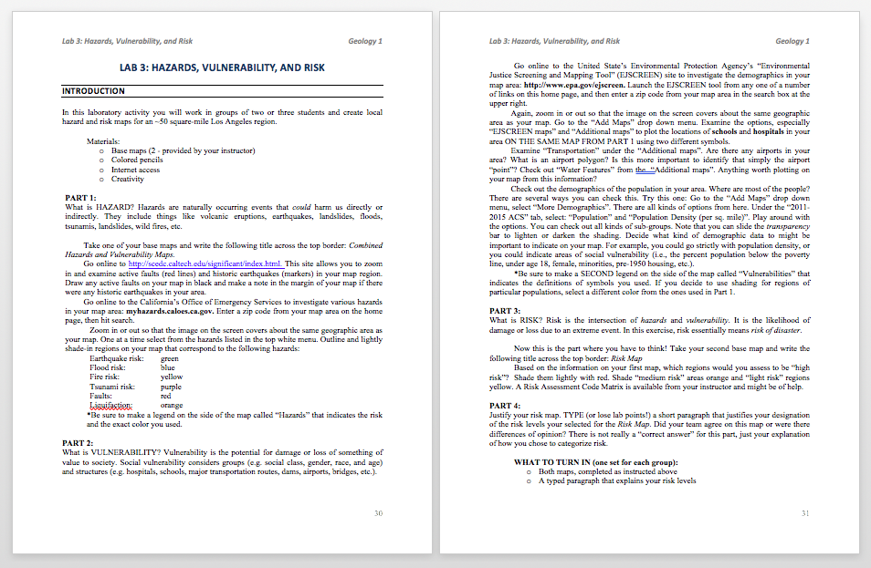
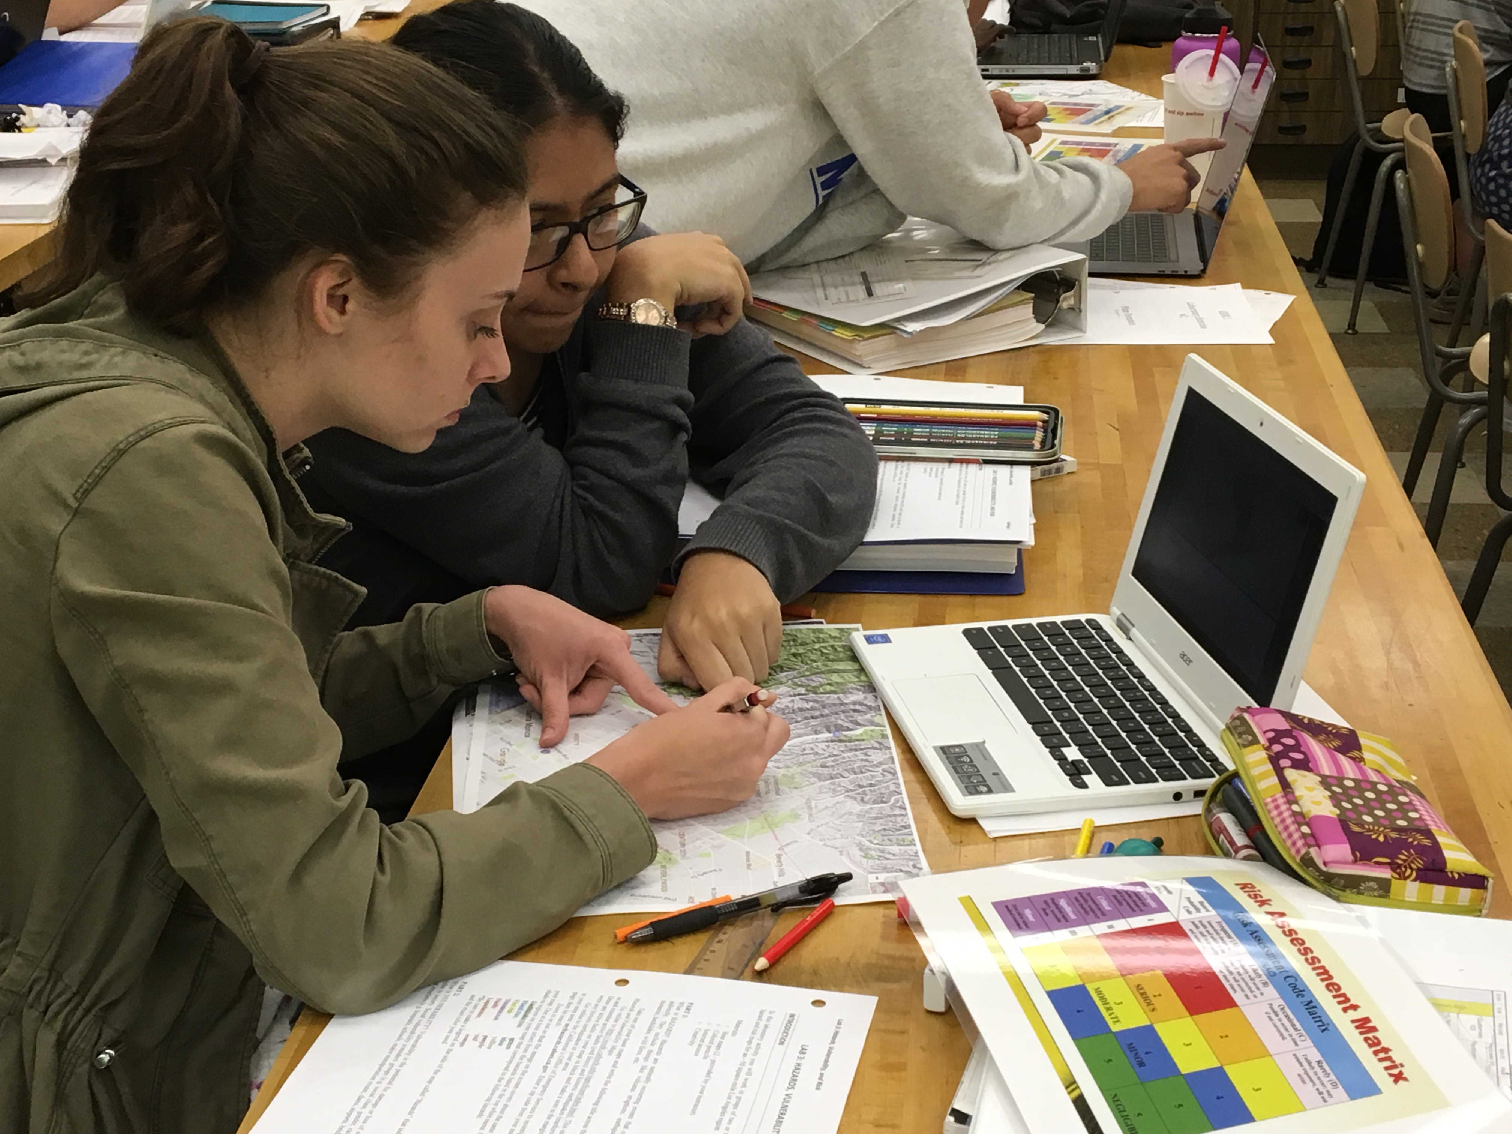
http://scedc.caltech.edu/significant/index.html active faults and historic earthquakes
California’s Office of Emergency Services to investigate various hazards in your map area: http://myhazards.caloes.ca.gov
United State’s Environmental Protection Agency’s “Environmental Justice Screening and Mapping Tool” (EJSCREEN) site to investigate the demographics in your map area: http://www.epa.gov/ejscreen

Slide 20
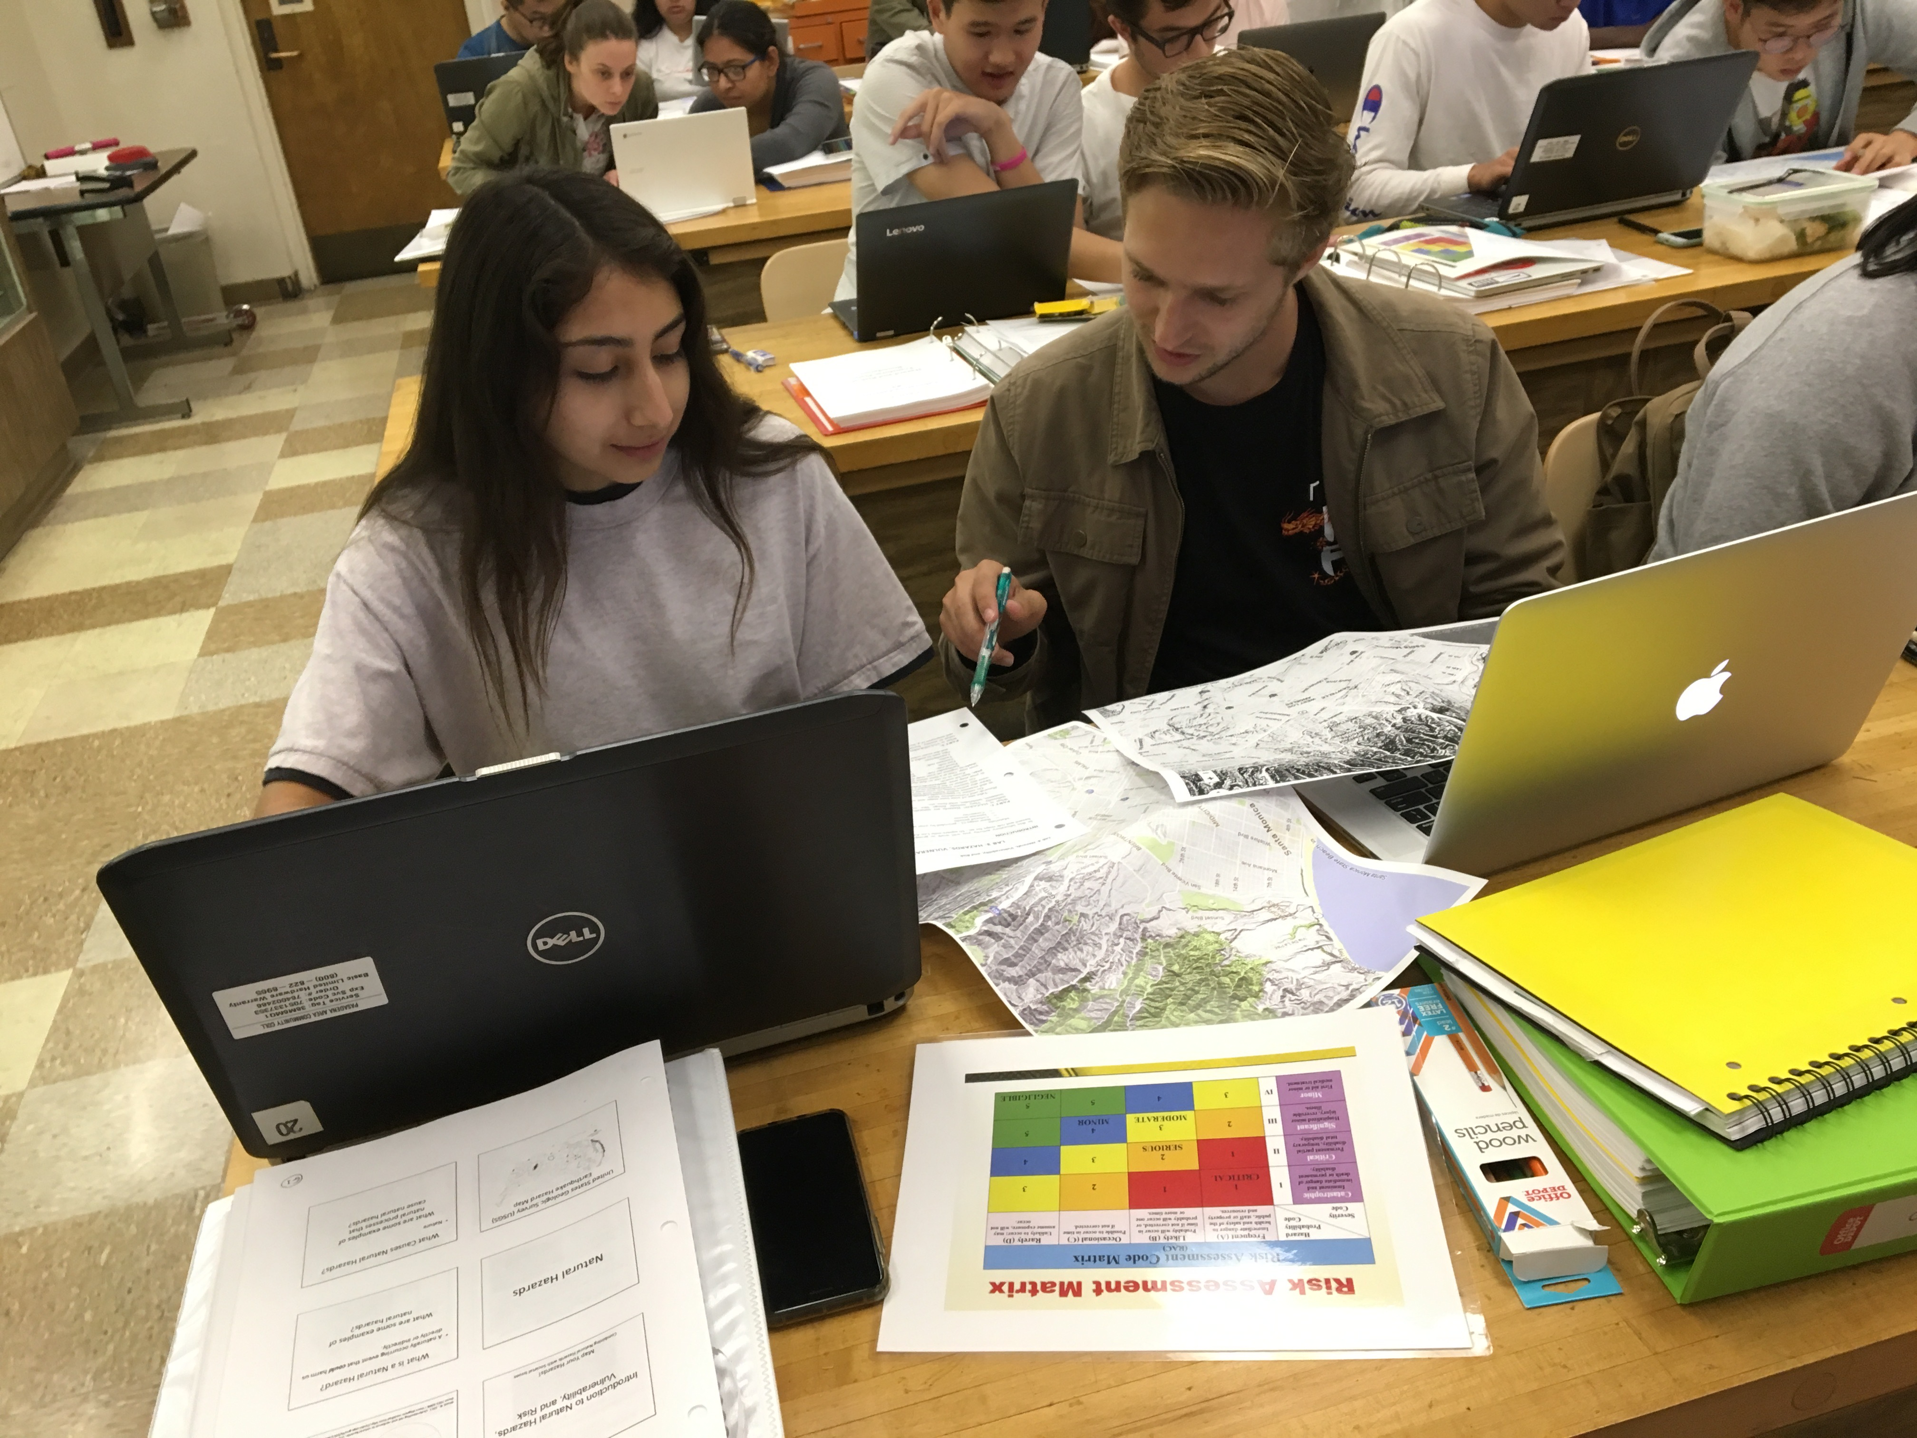
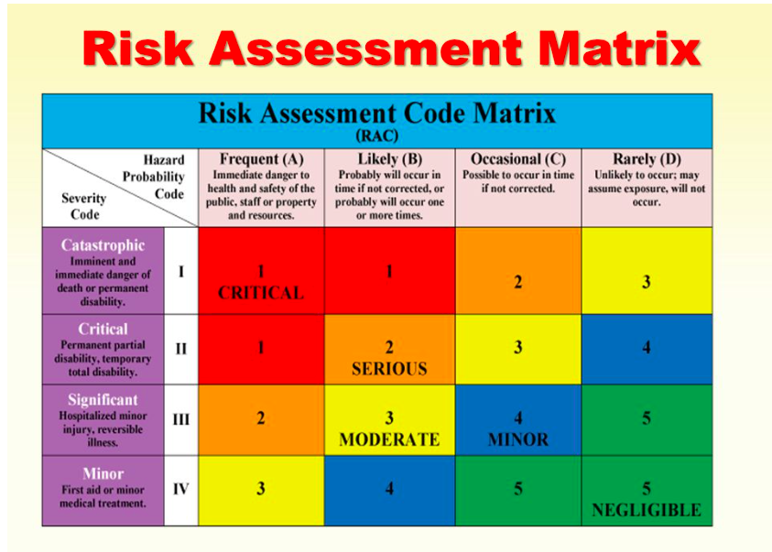


Slide 21
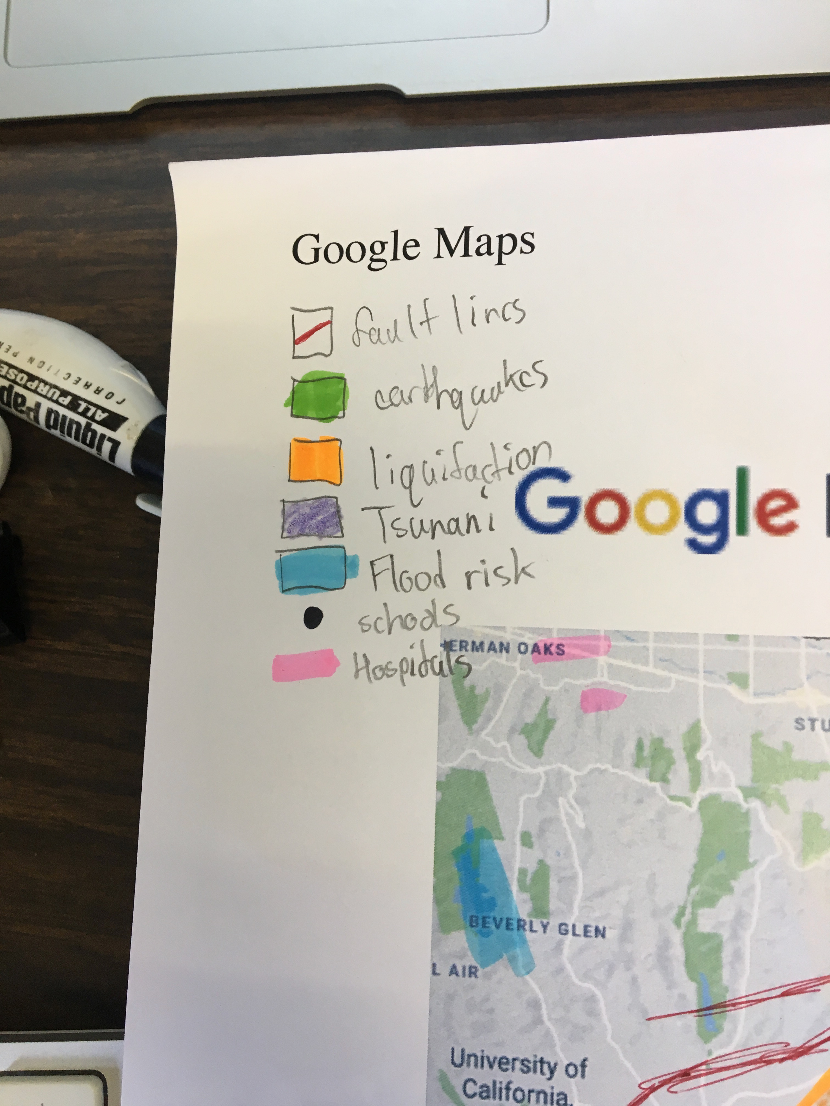
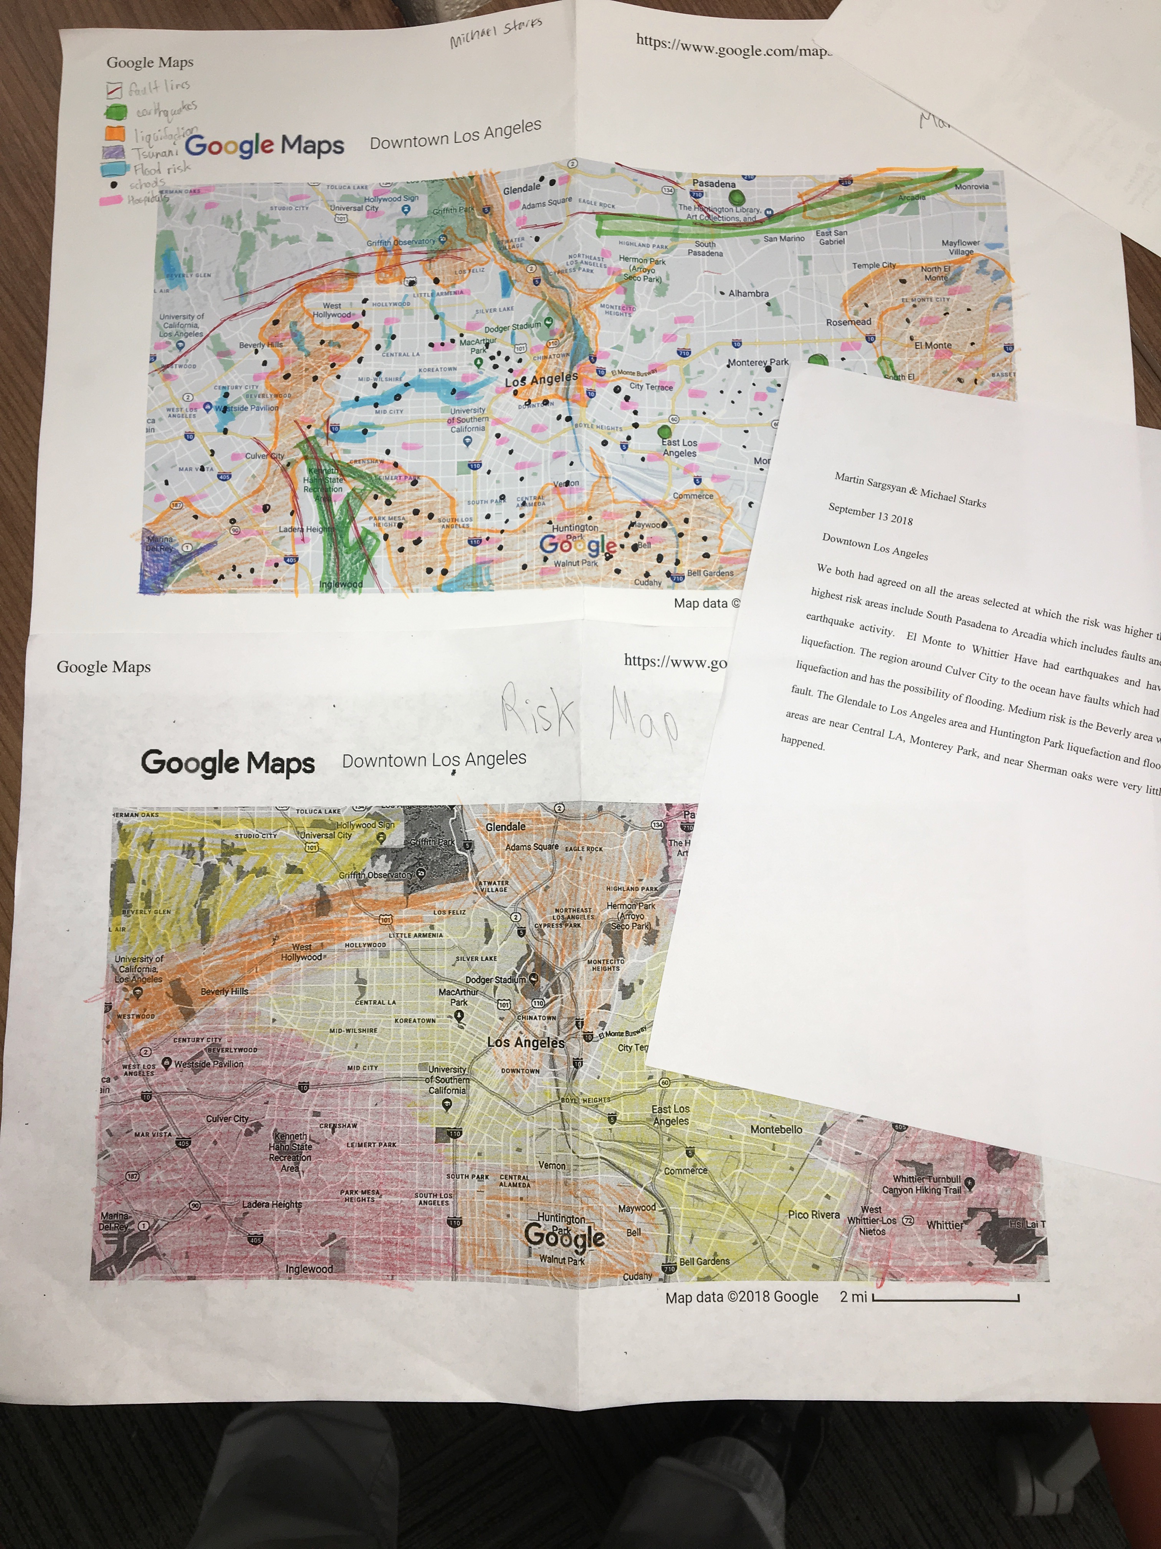

Slide 22
Third lab assignment of the semester: BENEFITS
Introduces group/team work to the course
Illustrates lab activity structure that requires judgement calls (not limited to “right” and “wrong” answers)
Familiarizes students with risk and hazard which are the topics of next three labs
Provides relevance (local hazards)

Slide 23
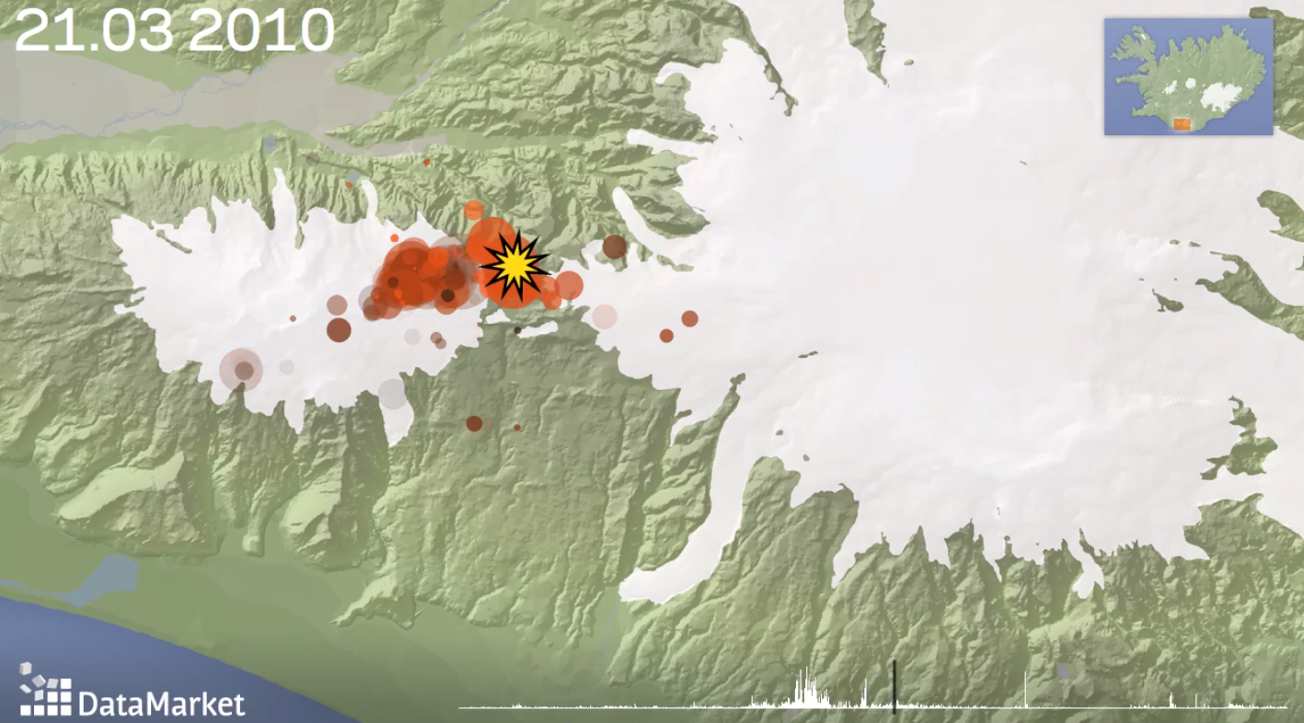
Presentation Outline
Overview of Integrate classroom materials
Syllabus overhaul
Natural Hazards
Plate Tectonics
Mineral Resources
Modifications
Still from a 70-second visualization showing earthquakes leading up to and during two eruptions in Eyjafjallajökull, Iceland in March and April 2010.

Slide 24
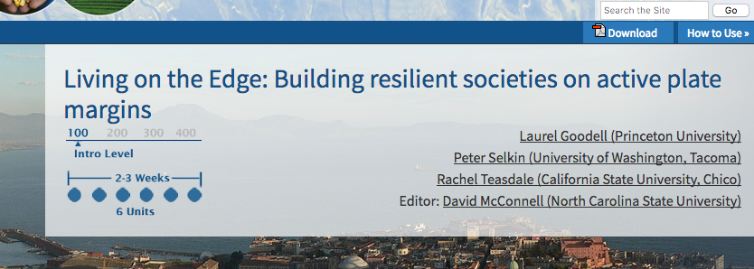
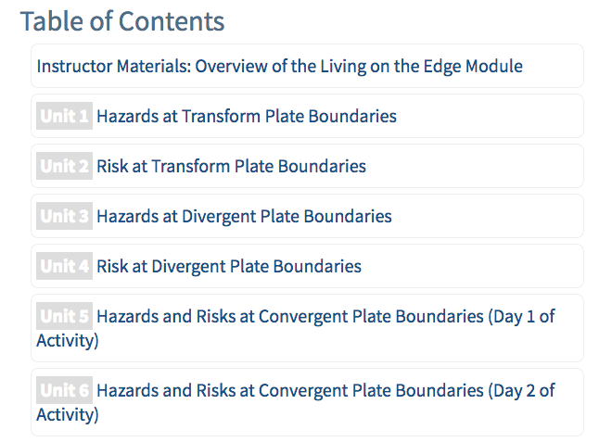
Lab 4: Transform Boundaries
Lab 5: Divergent Boundaries
Lab 6: Convergent Boundaries

Slide 25
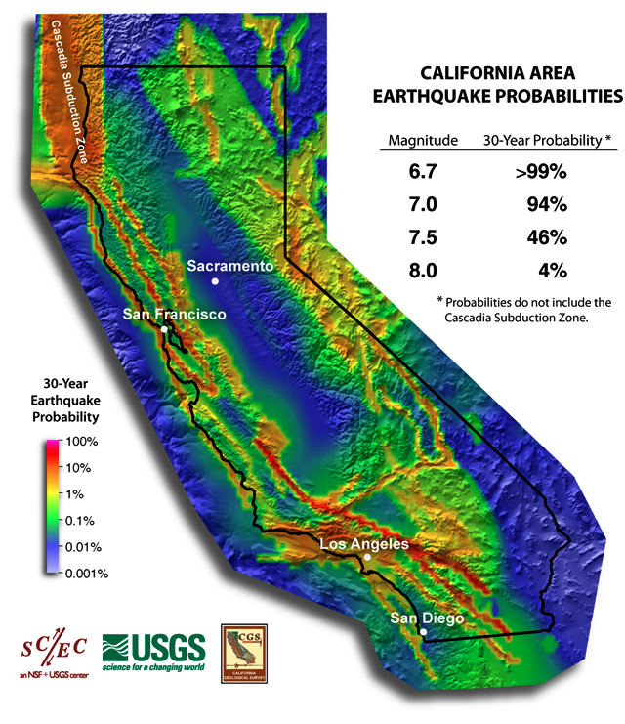
RISKS and HAZARDS AT TRANSFORM BOUNDARIES
STATEWIDE
How do scientists calculate the probability of large events occurring?
…Especially if they have not happened in the past?
For M>=6.7 earthquakes
UNITS 1 and 2

Slide 26

Column D: Calculate the mean recurrence interval (MRI), or average time between earthquakes, for each magnitude range. One way to get this is to take the reciprocal of the average number of earthquakes per year.
San Francisco area
A | B | C | D
magnitude range | total # of earthquakes 1983-2012 (30 years) | average # of earthquakes per year | MRI (mean recurrence interval) in years
 | from database
2.0-2.9 | 1716 | 57.20 | 0.017
3.0-3.9 | 1326 | 44.2
4.0-4.9 | 161 | 5.37
5.0-5.9 | 13 | 0.43
6.0-6.9 | 3 | 0.10
7.0-7.9 | 0 | 0
8.0-8.9 | 0 | 0
9.0-9.9 | 0 | 0
Complete Column D.

Slide 27
RISKS and HAZARDS AT TRANSFORM BOUNDARIES
Column D: Determining extrapolated MRIs
-- On the graph, plot MRIs for earthquakes that have occurred
San Francisco area
A | D
magnitude range | MRI (mean recurrence interval) in years
2.0-2.9 | 0.017
3.0-3.9 | 0.023
4.0-4.9 | 0.186
5.0-5.9 | 2.308
6.0-6.9 | 10.000
7.0-7.9
8.0-8.9
9.0-9.9

Slide 28
RISKS and HAZARDS AT TRANSFORM BOUNDARIES
Column D: Determining extrapolated MRI’s
San Francisco area
A | D
magnitude range | MRI (mean recurrence interval) in years
2.0-2.9 | 0.017
3.0-3.9 | 0.023
4.0-4.9 | 0.186
5.0-5.9 | 2.308
6.0-6.9 | 10.000
7.0-7.9 | 50
8.0-8.9 | 300
9.0-9.9 | 1600

Slide 29
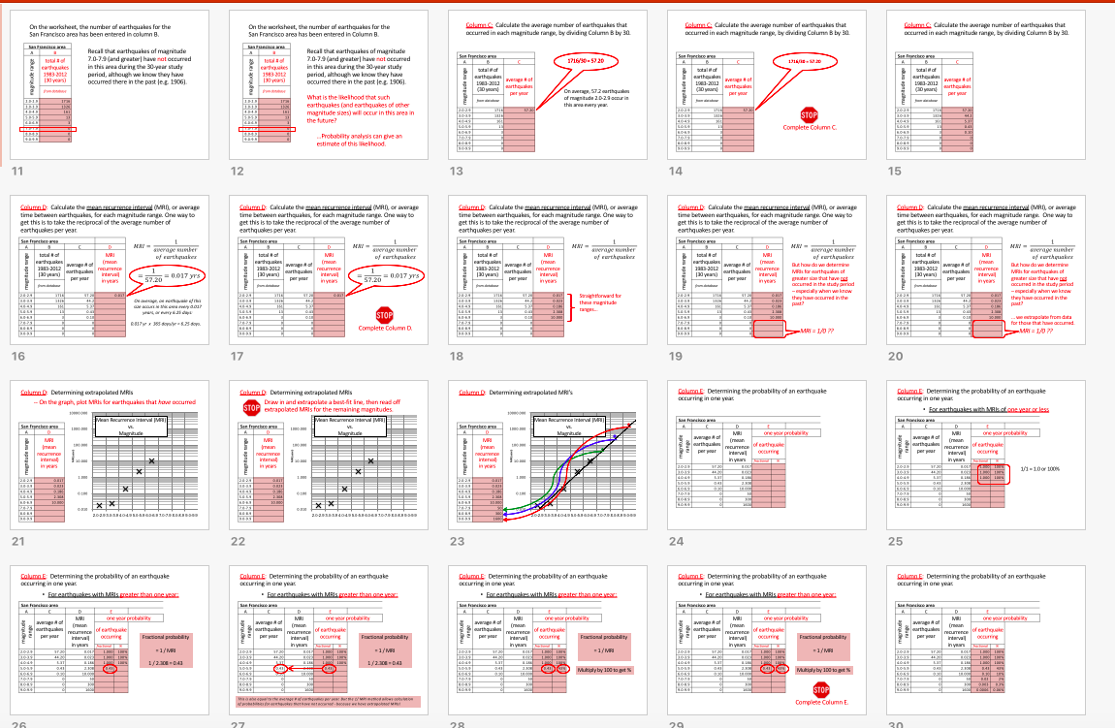
RISKS and HAZARDS AT TRANSFORM BOUNDARIES

Slide 30

RISKS and HAZARDS AT TRANSFORM BOUNDARIES
So even though an earthquake of magnitude 7.0 or greater has not occurred in the San Francisco area in over 100 years, we calculate there is a 46% chance that a 7.0-7.9 will occur in the next 30 years.
Should resources for earthquake preparedness be spread evenly across the state? Support your position.
Students repeat the entire exercise for Los Angeles.
For M>=6.7 earthquakes

Slide 31
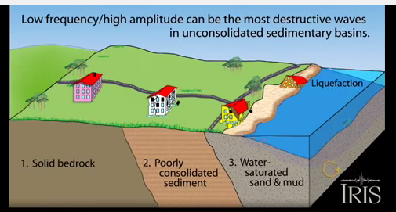
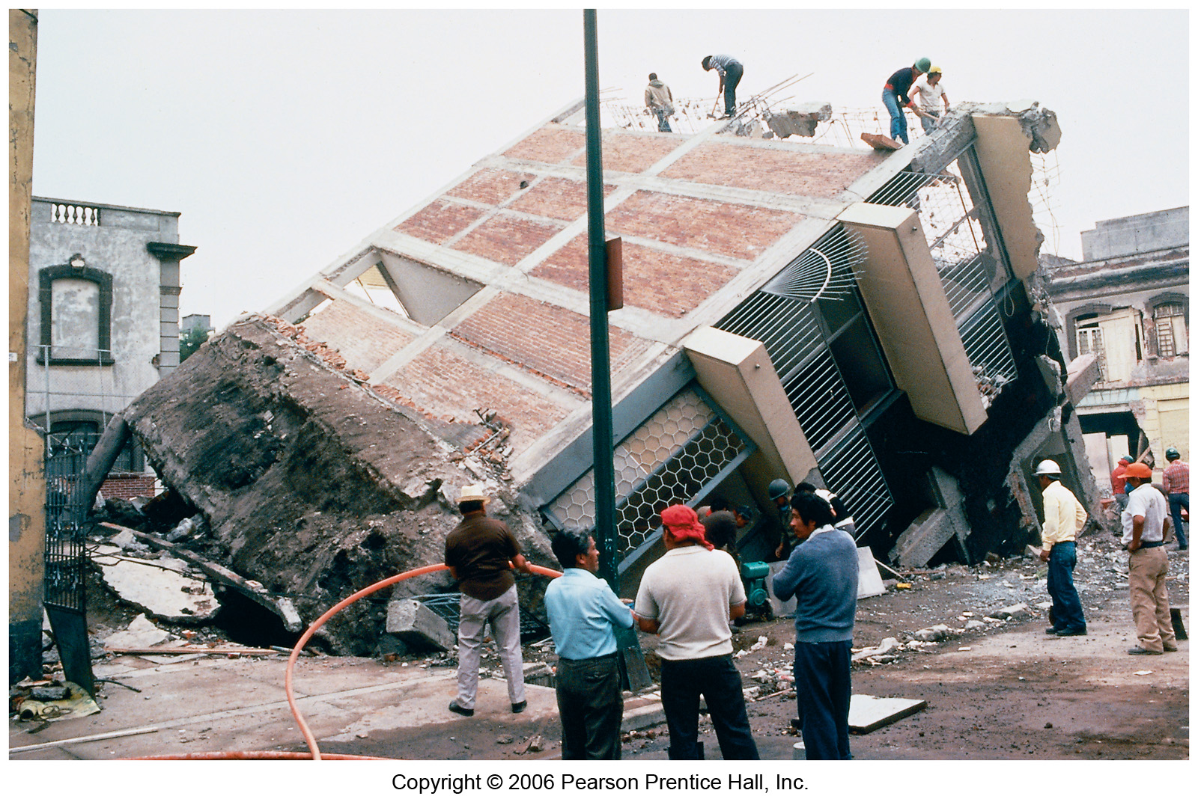
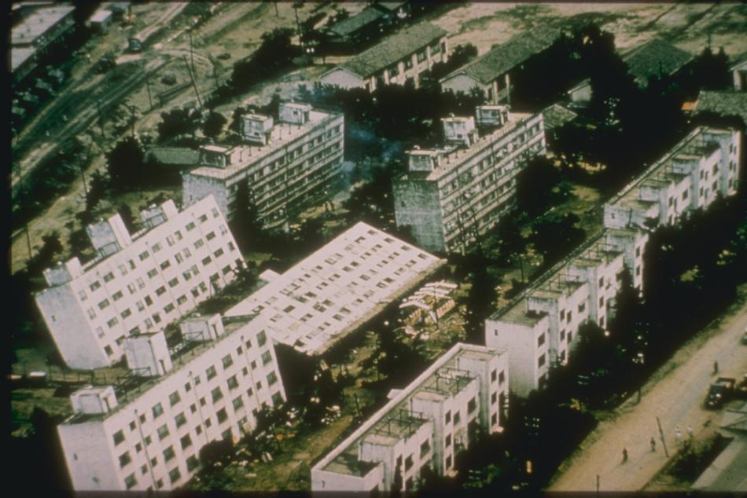
RISKS and HAZARDS AT TRANSFORM BOUNDARIES
Students learn about liquefaction in a pre-lab assignment.
1985 Mexico earthquake
1964 Japan earthquake

Slide 32
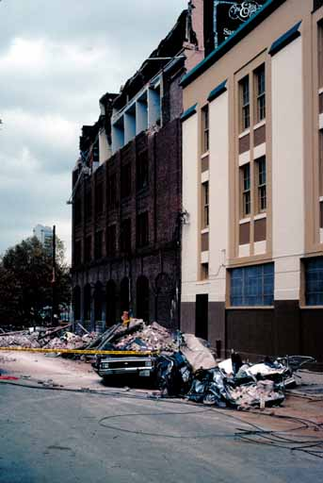
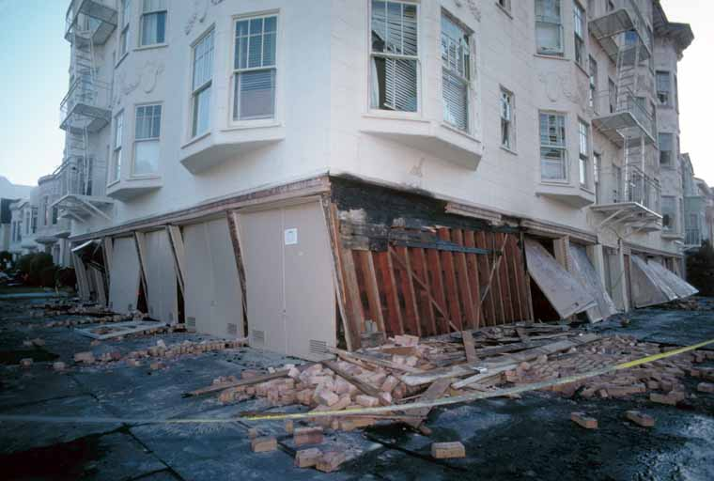
RISKS and HAZARDS AT TRANSFORM BOUNDARIES
Students learn about factors that influence earthquake damage:
  Soft stories
  Depth to earthquake focus
  Landslides
  Building materials
  Liquefaction
We also discuss mitigation strategies.

Slide 33
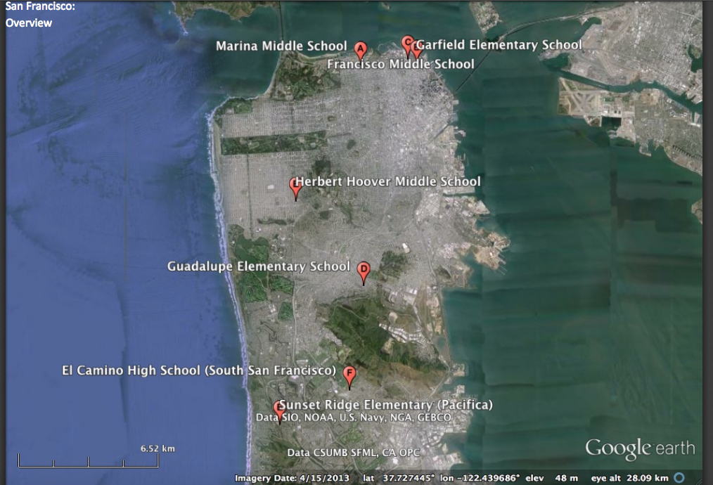
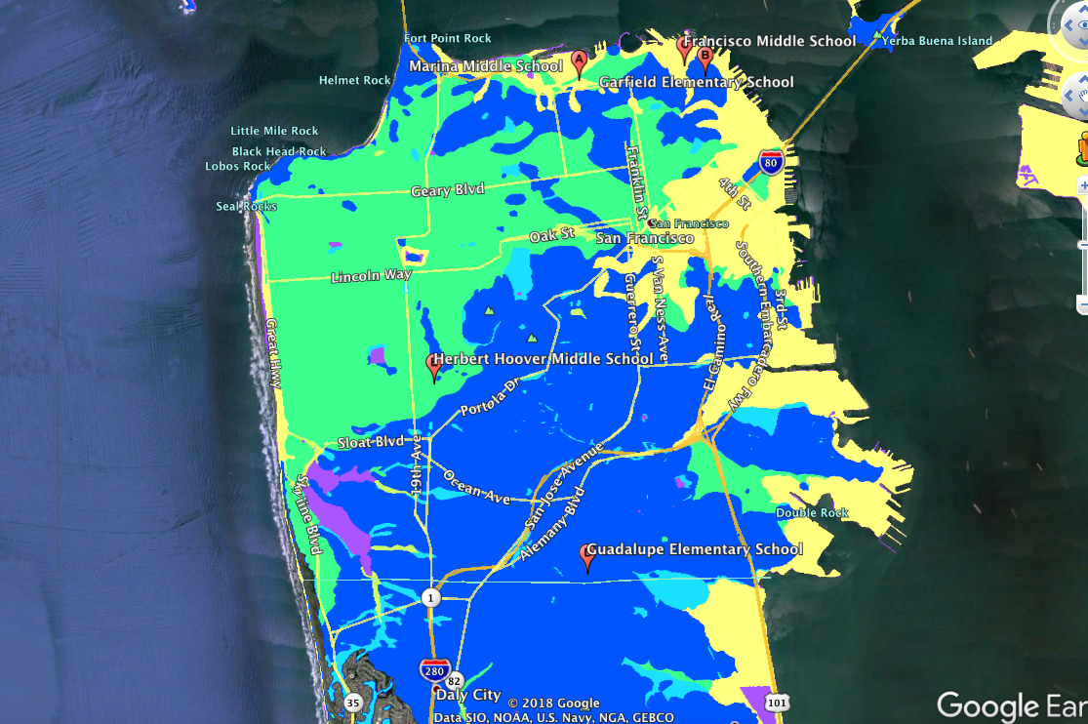
Group Activity
RISKS and HAZARDS AT TRANSFORM BOUNDARIES
Small groups of students evaluate the seismic risk at one of five school campuses in San Francisco using Google Earth or provided paper maps.
Which two schools should receive $10 million for seismic retrofitting?
Based on your risk assessment of the five schools in this activity, make the case for funding upgrades to buildings at two schools.
Location Map
Liquefaction Susceptibility Map

Slide 34
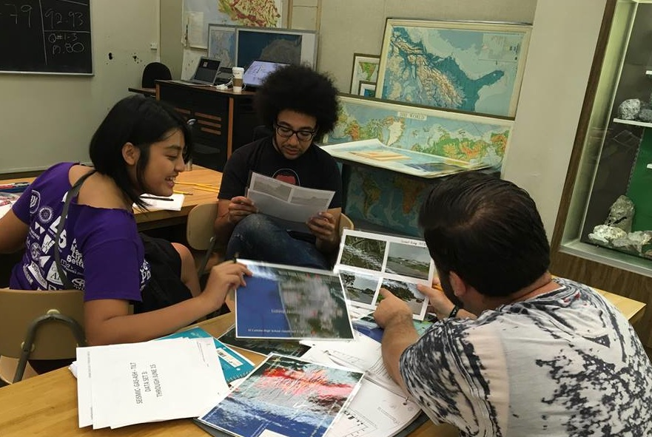
RISKS and HAZARDS AT TRANSFORM BOUNDARIES
 | Hazard |  |  | Vulnerability |  |  | Value | Analysis
Name of School | A: Peak Ground Acceleration | B: Liquefaction Potential | C: Landslide Potential | D: Soft Stories? | E: Unreinforced Masonry | F: Vertical or Plan Irregularity | G: Number of Students | Risk Factor | Recommendation (from class discussion)
Marina1
Marina2
Francisco1
Francisco
Garfield1
Garfield2
HHoover1
HHoover2
Guadalupe1
Guadalupe2
Sunset1
Sunset2

Slide 35
UNITS 1 and 2
Fourth lab assignment of the semester: BENEFITS
Adds a quantitative/statistics-based activity
Deepens understanding of natural hazard risk maps and the concept of mitigation
Group/team work, role playing, and dynamic class discussion
More judgement calls (who should get funding?)
Introduces students to many earthquake-related concepts (liquefaction, building damage, epicenter location/depth,…)

Slide 36
RISKS and HAZARDS AT DIVERGENT BOUNDARIES
UNITS 3 and 4
Learning Objectives
By the end of this unit you will be able to:
Interpret data to characterize geologic activity associated with divergent plate boundaries
Compare and contrast divergent plate boundaries on land and the ocean floor
Explain how geologists use multiple types of data to characterize geologic activity associated with volcanic eruptions

Slide 37
RISKS and HAZARDS AT DIVERGENT BOUNDARIES
Table 1: as a debrief from pre-work, fill in Submarine Divergent Plate Boundary column
Data/PB type | Submarine Divergent PB | Terrestrial Divergent PB
Earthquake (EQ) characteristics (size/depth)
Volcanism characteristics (erupted products, distance affected)
Hazards to Humans (how are humans affected — at what scale?)

Slide 38
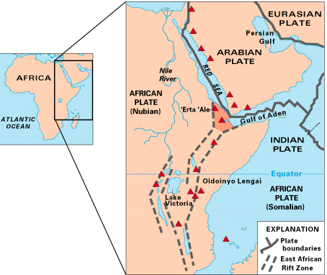
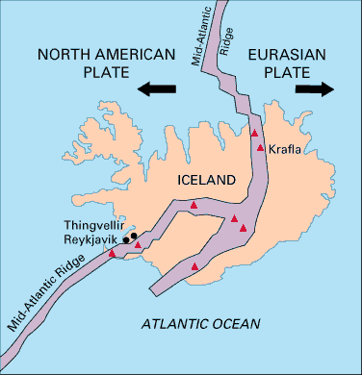
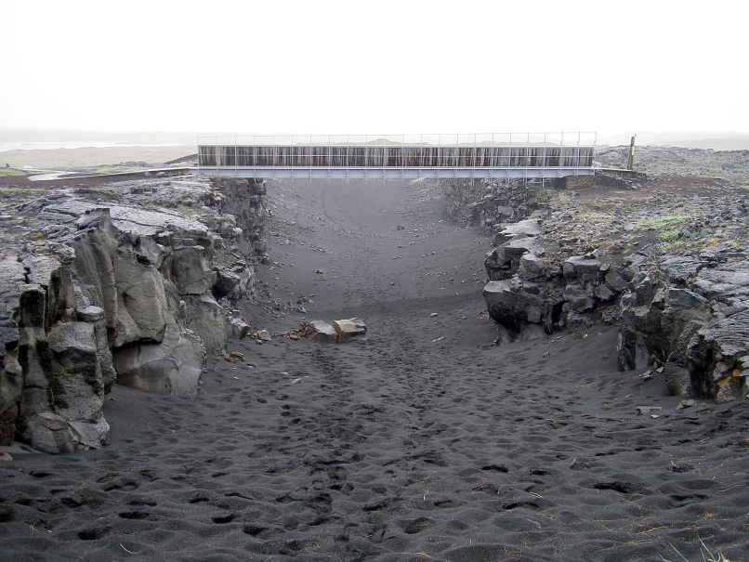
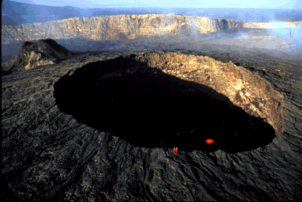
RISKS and HAZARDS AT DIVERGENT BOUNDARIES
Divergent plate boundaries on land
http://pubs.usgs.gov/gip/dynamic/understanding.html
Iceland
East African Rift
http://en.wikipedia.org/wiki/Divergent_boundary#mediaviewer/File:Bridge_across_continents_iceland.jpg
Notes:
Credits: Upper left: USGS, http://pubs.usgs.gov/gip/dynamic/understanding.html, Accessed Sept 2014
Upper right: USGS, http://pubs.usgs.gov/gip/dynamic/East_Africa.html, Accessed Sept 2014
Lower left: Wikipedia, http://en.wikipedia.org/wiki/Divergent_boundary#mediaviewer/File:Bridge_across_continents_iceland.jpg
, Accessed Sept 2014
Lower right: USGS, http://pubs.usgs.gov/gip/dynamic/Erta_Ale.html, Accessed Sept 2014

Slide 39
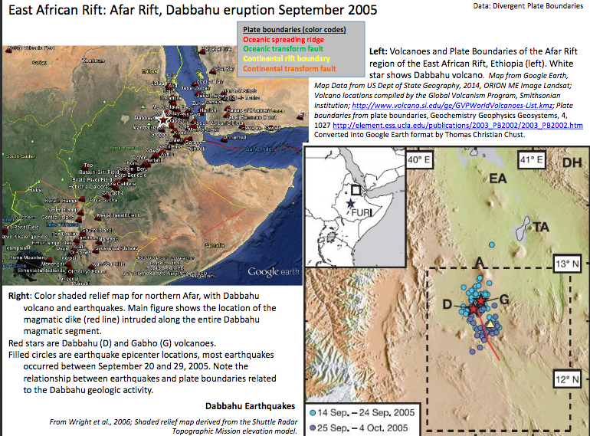
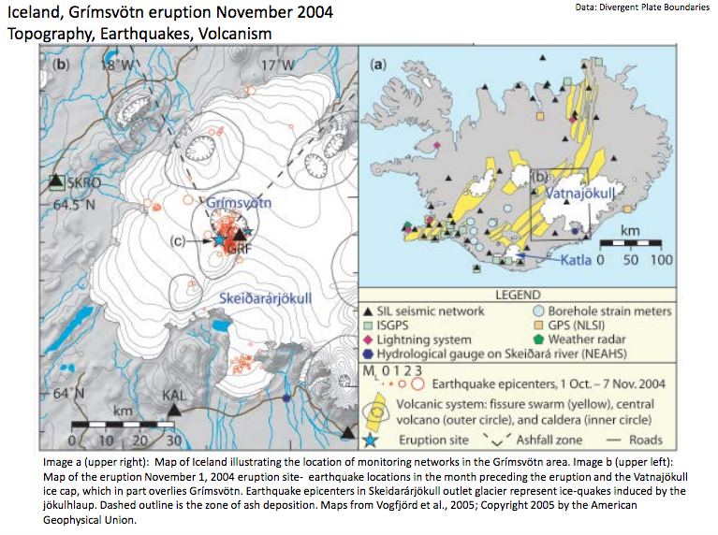
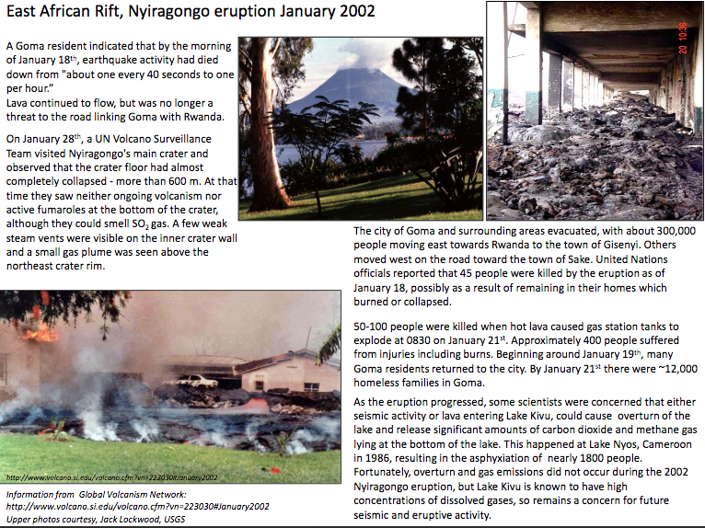
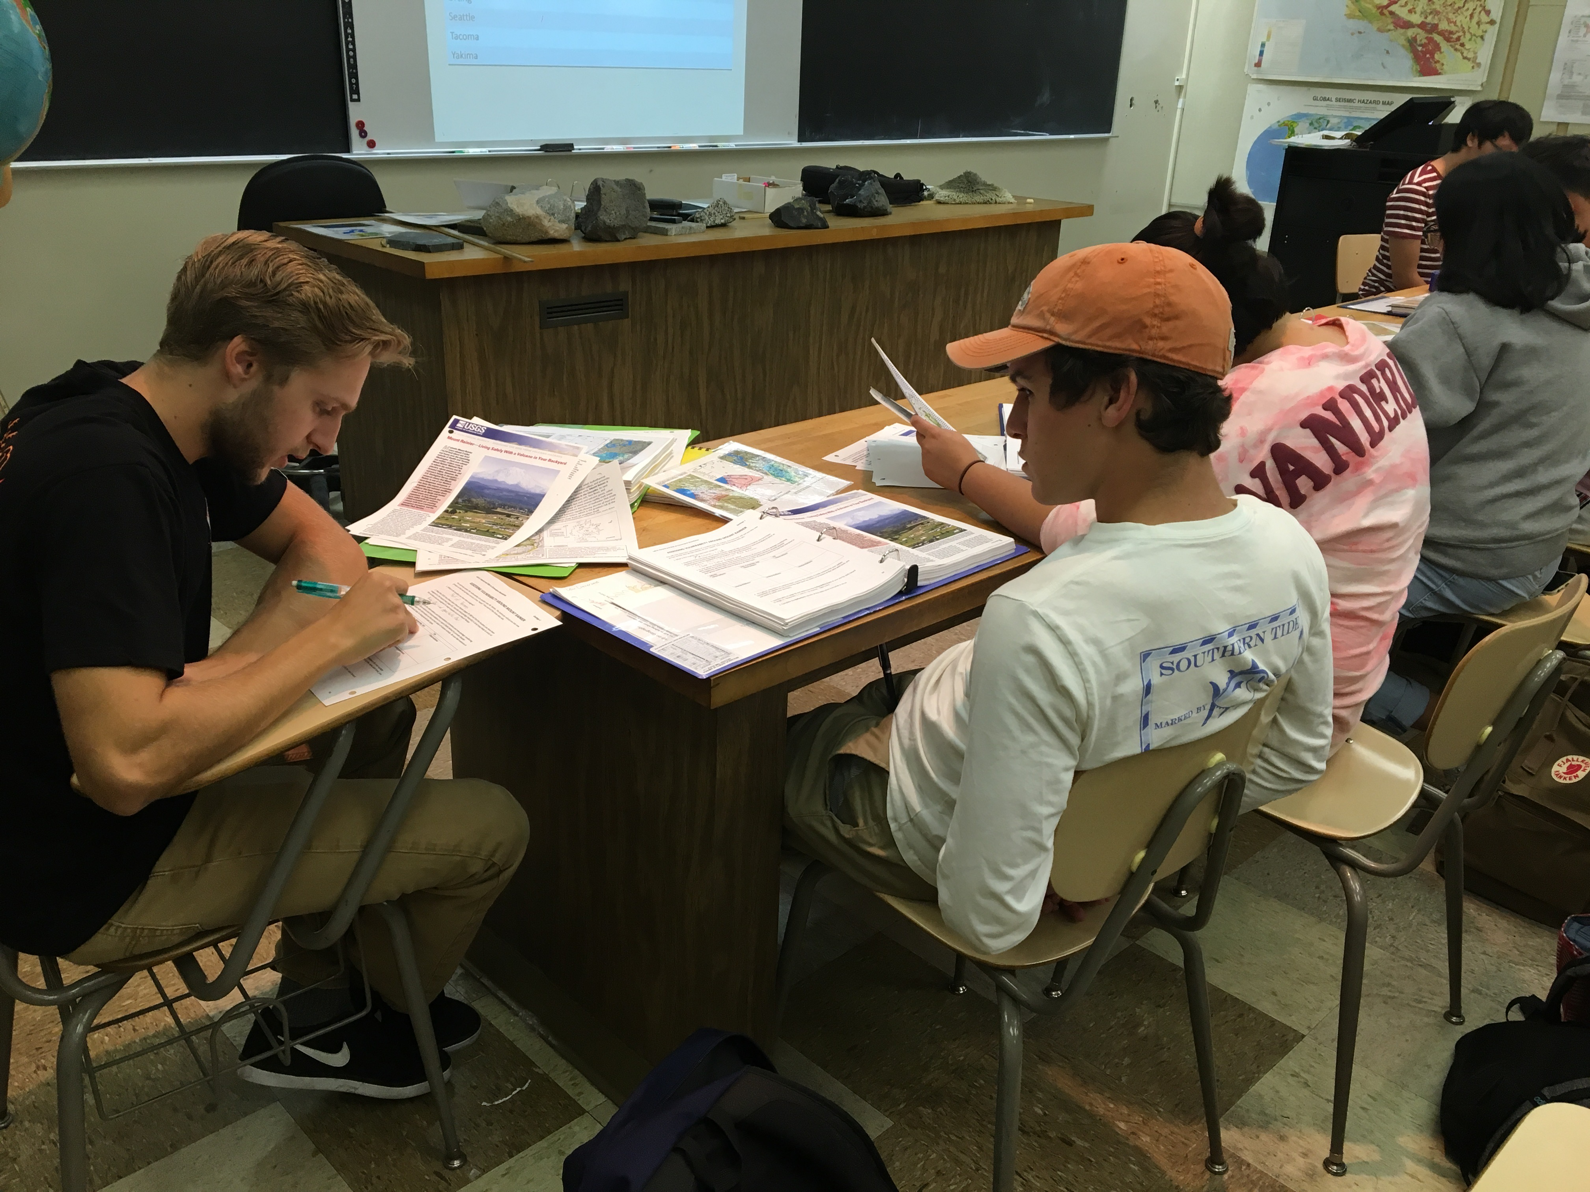
RISKS and HAZARDS AT DIVERGENT BOUNDARIES

Slide 40
RISKS and HAZARDS AT DIVERGENT BOUNDARIES
Group Activity Instructions: Examine data for one of the divergent plate boundaries below and fill in the characteristics in the appropriate column of Table 2:
Table 2: Use data provided to describe the activity and hazards associated with the following divergent PB located on land
Data/Location | Mid-Atlantic Ridge: Iceland (Grimsvotn) Nov 2004 | East African Rift: Dabbahu Volcano, Afar Region Sept 2005 | East African Rift: Nyiragongo Volcano Jan 2002 |  | Explain how this type of data related to activity at Divergent Plate Boundaries
Earthquake (EQ) Hazards Specific spatial patterns/depth/size
Volcanic Hazards Erupted products, distance affected
Other associated activity/hazards
What additional data would you like to have?

Slide 41
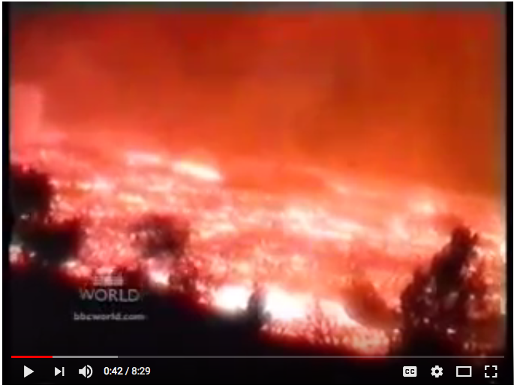
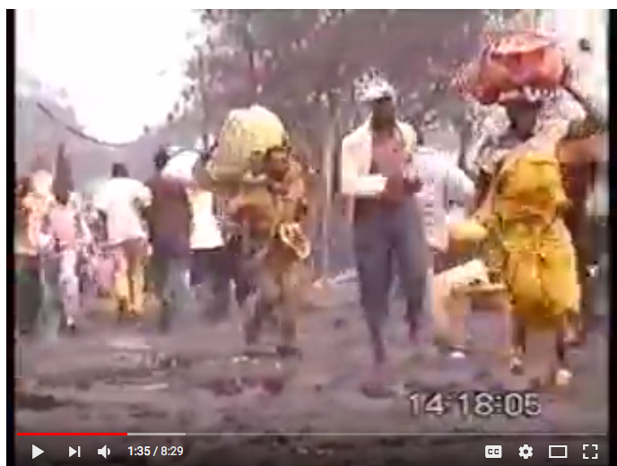
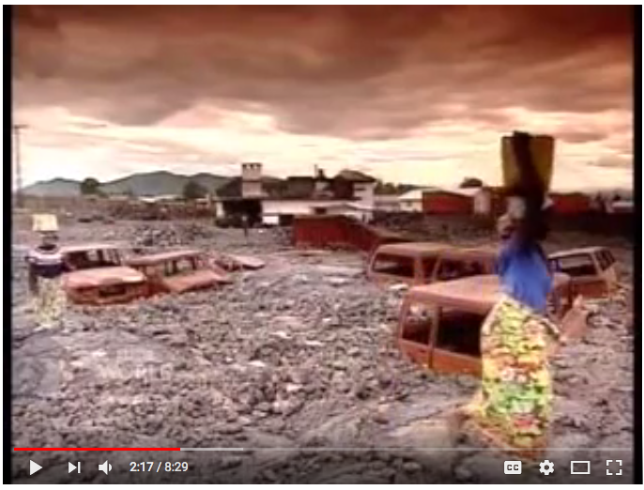
Watch this video about the January 2002 eruption of Nyiragongo Volcano:
https://www.youtube.com/watch?v=rZLSvO6vJZ0#t=40
How far did the lava flow to reach the town of Goma?
How high did the column of lava go?
How thick is the cooled lava in Goma?
Was there a volcanic observatory in Goma prior to this eruption?
What types of problems are presented by the volcanic gases?
Notes:
16 km
60 meters
3 meters
No
It is the same a breathing pollution, it produces acid rain, it forced one of the scientific expeditions to turn back

Slide 42
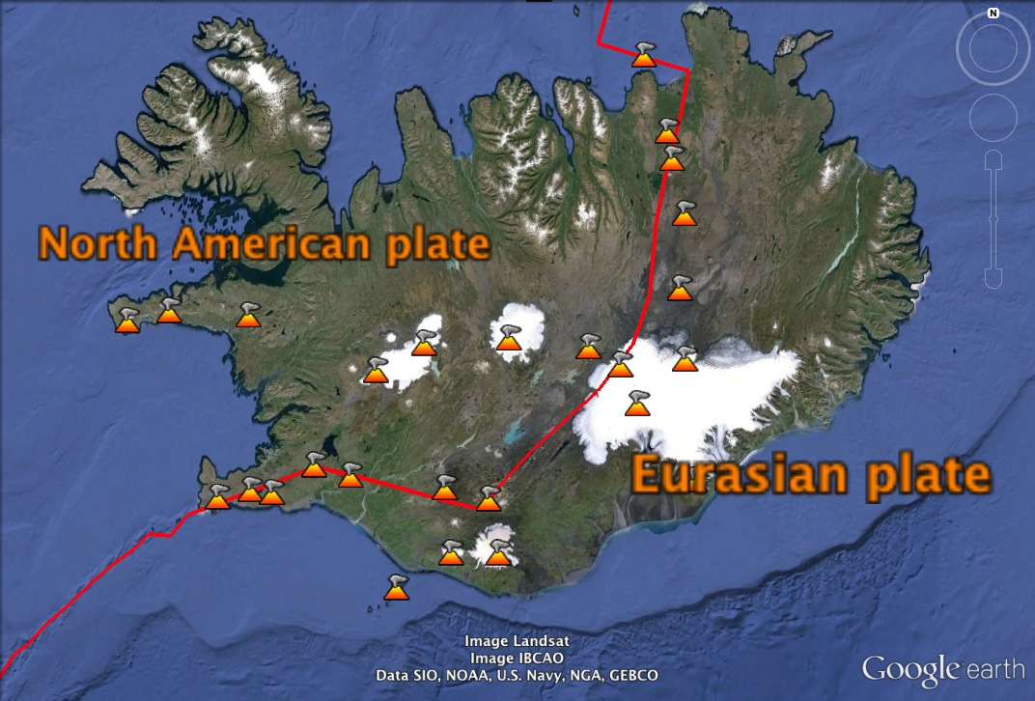
RISKS and HAZARDS AT DIVERGENT BOUNDARIES
  Anatomy of an eruption – 2010 events at Eyjafjallajokull
Eyjafjallajökull

Slide 43
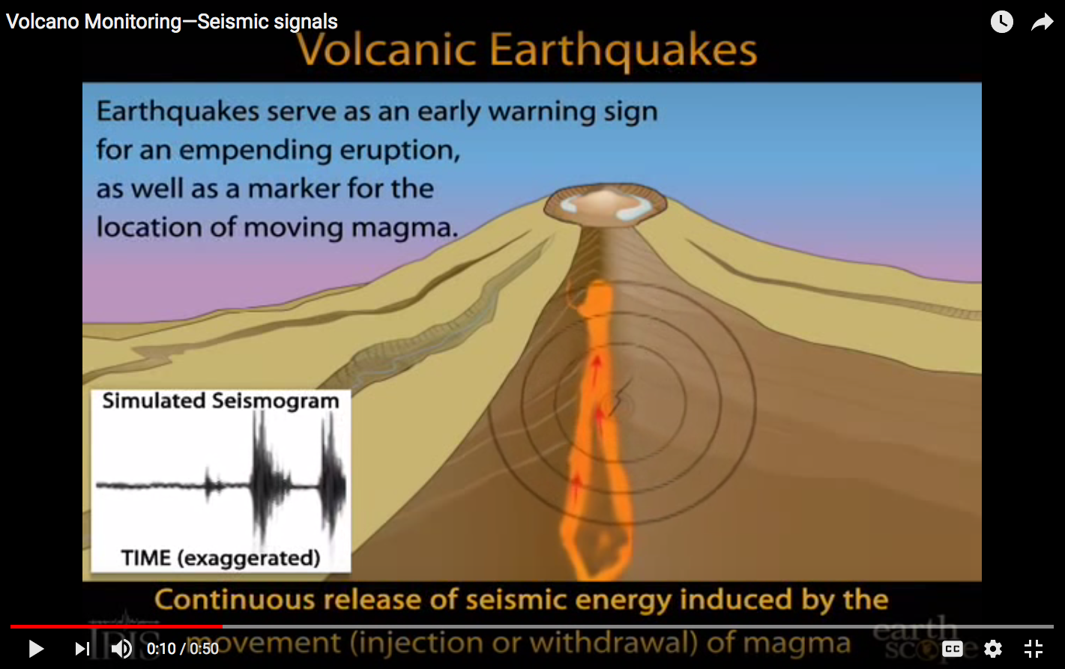
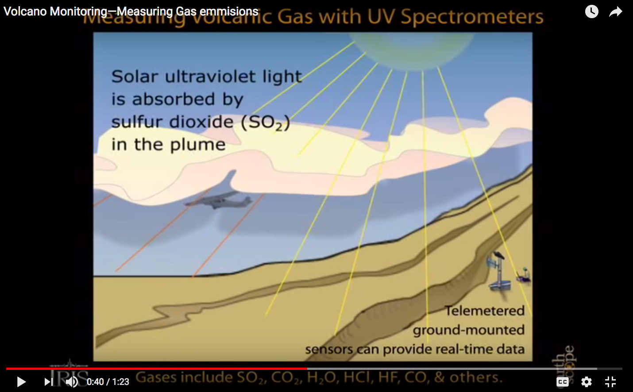
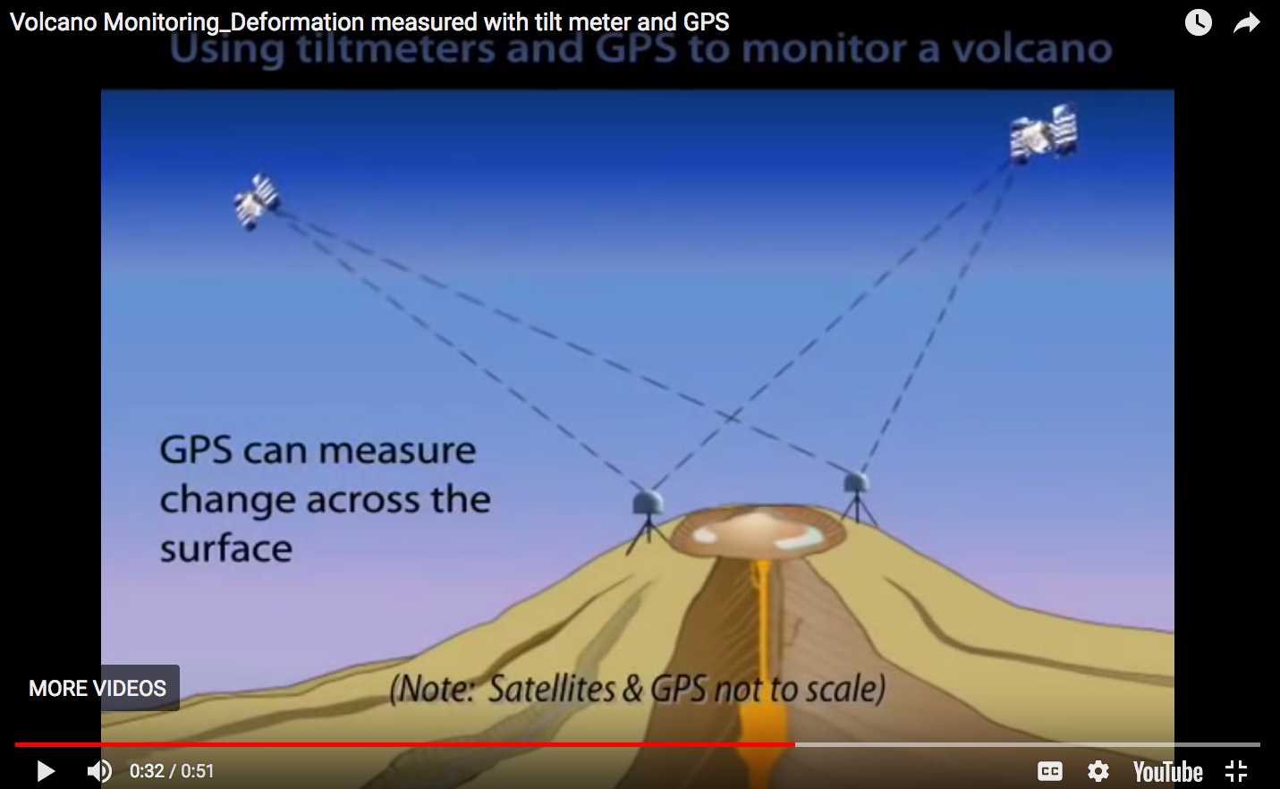
RISKS and HAZARDS AT DIVERGENT BOUNDARIES

Slide 44
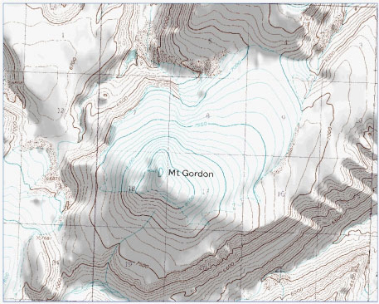
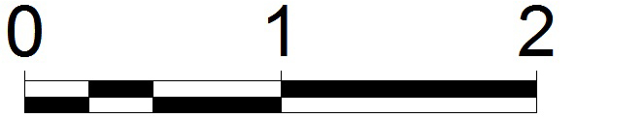
RISKS and HAZARDS AT DIVERGENT BOUNDARIES
1. Imagine that a body of magma intrudes below the summit of the volcano, without erupting. Predict how the GPS stations will move.
km

Slide 45
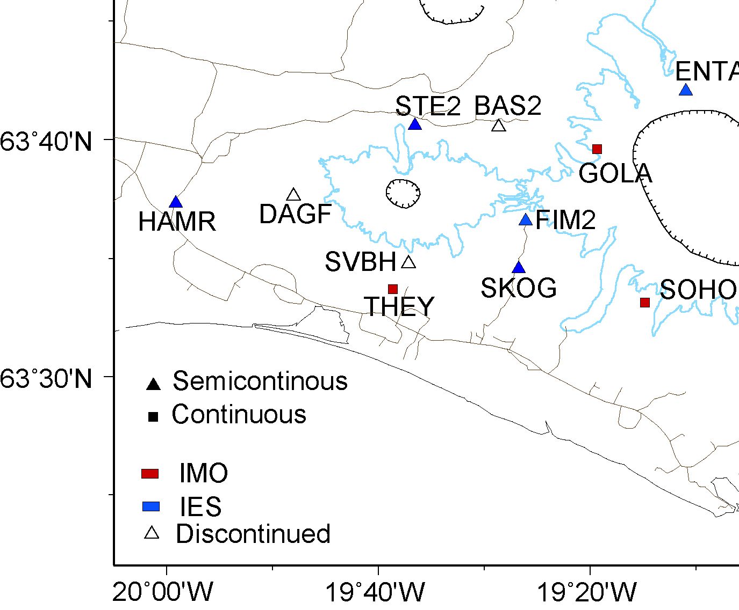
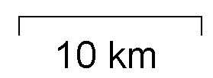
RISKS and HAZARDS AT DIVERGENT BOUNDARIES
x
Map of study area showing
the summit of Ejafjallajokull (x) and the locations of GPS stations.

Slide 46
RISKS and HAZARDS AT DIVERGENT BOUNDARIES
40
20
0
-20
-40
North
northward
southward
No N-S
movement
Reading GPS time series: motion is resolved into three components
40
20
0
-20
-40
East
eastward
westward
No E-W
movement
80
40
0
-40
-80
Up
upward
downward
No vertical
movement
Time
Time
Notes:
Figure by Laurel Goodell, Princeton University; provided under terms of the Creative Commons Public License 3.0.

Slide 47
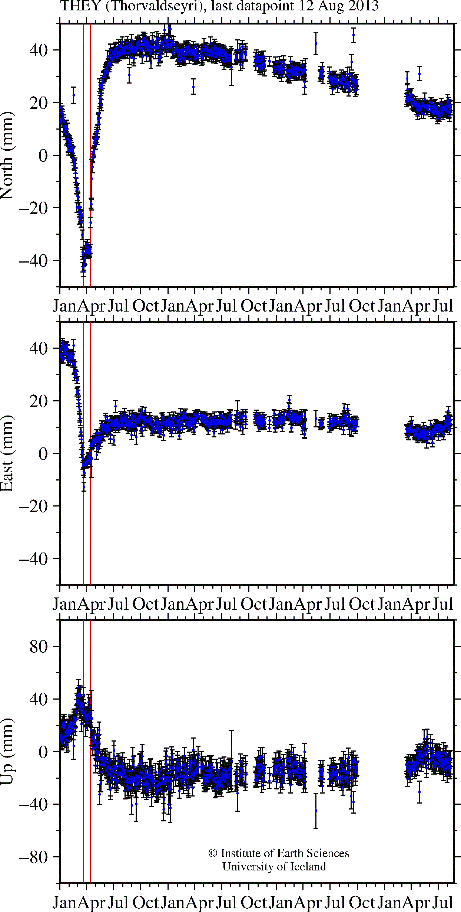

RISKS and HAZARDS AT DIVERGENT BOUNDARIES
Time
Notes:
Figure by Laurel Goodell, Princeton University; provided under terms of the Creative Commons Public License 3.0.

Slide 48
RISKS and HAZARDS AT DIVERGENT BOUNDARIES
x
UP
UP
Eyjafjallajokull
x
Down
x
Down
Down
UP
UP
BEFORE AFTER
Time
Notes:
Figure by Laurel Goodell, Princeton University; provided under terms of the Creative Commons Public License 3.0.

Slide 49
UNITS 3 and 4
Fifth lab assignment of the semester: BENEFITS
Getting more comfortable with group work
Prepares them to interpret seismic, GPS, and volcanic gas data (important for next lab)
Case studies provide a human element to living at plate boundaries
Continued work with real data (not canned)
Introduction to volcanic concepts such as inflation, deflation, lava flows, ash plumes, fissure eruptions, …

Slide 50

RISKS and HAZARDS AT CONVERGENT BOUNDARIES
UNITS 5 and 6
Students monitor an evolving volcanic crisis at a convergent plate boundary (Cascadia), and make a series of forecasts for the impending eruption and associated risks.

Slide 51




RISKS and HAZARDS AT CONVERGENT BOUNDARIES
  Students analyze simulated pre-eruption seismic, tilt, and gas emission data from Mount Rainier, and act as "experts" for a particular data set.
  They alert the community with their eruption forecast.
GROUP 1: seismologists
GROUP 2: gas geochemists and ash dispersal
HYPOTHETICAL DATA
Alert 1: mid-May to June 8
Alert 2: up to June 12
Alert 3: up to June 15
GROUP 3: tilt data

Slide 52


RISKS and HAZARDS AT CONVERGENT BOUNDARIES
  Students “jigsaw” into new groups where each member acts as the "expert" for a particular data set.
  These new groups assess the vulnerability of an assigned location near Mount Rainier, and revise their earlier forecast .

Slide 53
UNITS 5 and 6
Sixth lab assignment of the semester: BENEFITS
Students are applying what they learned about hazards and risks during previous labs to a new situation
They are held accountable on a team for ”their” data set
Must deal with ambiguous data
Brings up the importance of geological monitoring to help us plan and respond to catastrophic events

Slide 54

Presentation Outline
Overview of Integrate classroom materials
Syllabus overhaul
Natural Hazards
Plate Tectonics
Mineral Resources
Modifications

Slide 55



Pre-Module → Project
Pre-Lab → Project

Slide 56
Common Theme: Economic Factors Concept Map
land availability
ore grade (concentration of mineral)
regulations
resources needed (water, energy, labor, etc.)
mining/ processing technology
distance to market
mineral resource
is determined by things like
if value exceeds
mining cost, becomes
mining/processing cost
if too high, consumers
or product makers seek
substitute mineral/
product
value/ price
if low, might increase
use lowers
mineral reserve
when higher, will increase the
when lower, will cause a drop in
is mined to
increase
when higher, lowers the
when lower, increases the
consumer demand
decreases when
used in
if desirable,
will increase
mineral supply
are developed
to use
technology/
products
adds to
about
about
if positive, will increase
recycled/reused
mineral
consumer opinions/
preferences
if negative, will cause
consumers will seek

Slide 57

Pre-Lab → Project
MINERAL RESOURCES: Pre-Module Project
Each student will choose one mineral resource and build a concept map over the next several weeks.

Slide 58







MINERAL RESOURCES: Activity 1.1
Complete this chart

Slide 59
MINERAL RESOURCES: Activity 1.2
Introduces definitions of minerals, rocks, rock cycle, and concept maps.
solid
coherent
igneous
natural
are
are
sedimentary
combine
to make
rocks
can be
minerals
are usually
made of
metamorphic
are made of
must also be
used in products are
elements
crystalline
when
combined
in the same
way in the
whole solid
means that the
solid is
mineral
resources
that can be mined
economically are
chemically
homogeneous
mineral
reserves

Slide 60


MINERAL RESOURCES: Activity 1.3
Explores the relationship between economic development and resource use.
TED TALK
Hans Rosling
Global Population Growth, Box by Box
http://www.ted.com/talks/hans_rosling_on_global_population_growth.html.

Slide 61



MINERAL RESOURCES: Activity 2.1
Examines mineral resources used to make rechargeable batteries.

Slide 62




MINERAL RESOURCES: Activity 2.2

Slide 63







MINERAL RESOURCES: Pre-Activity 3 Homework
INDIVIDUAL PROJECT
Learning objective
Describe how wastes are created and managed during the different stages of mineral resource production and what can be done to minimize the negative effects of mining and related processes.

Slide 64





MINERAL RESOURCES: Activity 3.1
Exploration
Extraction
Ores need to be located (___________), obtained (__________), and then concentrated (_____________/Smelting/Refining).
Beneficiation
Blasting.
Golden Sunlight Gold Mine mill.
Geological map.
Waste rock revegetation.
Surface and underground impacts will need to be remediated, the land reclaimed, and the mine safely closed once mining is completed.
Notes:
Image Information Slide 3 Getting from there to here (II):
Geologic Map: Credit: Lundstrom, S. C., Page, W. R., Langenheim, V. E., Young, O. D., and Mahan, S. A. 1998. Preliminary Geologic Map of the Valley Quadrangle, Clark County, Nevada. Downloaded from http://ngmdb.usgs.gov/Prodesc/proddesc_19423.htm under public domain courtesy of the U.S. Geological Survey (http://www.usgs.gov/laws/info_policies.html and http://www.usgs.gov/visual-id/credit_usgs.html).
Blasting at Mine: Credit: Travis Hudson, American Geological Institute. “Blasting to break ore into fragments that can then be loaded into very large trucks.” Image courtesy of the Earth Science World Image Bank http://www.earthscienceworld.org/images. Reproduction under certain conditions is allowed for noncommercial use (http://www.earthscienceworld.org/images/imageuse.html).
Golden Sunlight Mine Mill, credit: Leah Joseph.
Reclamation at Mine; credit: Stuart Jennings, Montana State University. 1996. “Waste rock revegetation at Zortman-Landusky Mine, circa July 1996.” Image courtesy of the Earth Science World Image Bank http://www.earthscienceworld.org/images. Reproduction under certain conditions is allowed for non-commercial use (http://www.earthscienceworld.org/images/imageuse.html).

Slide 65



MINERAL RESOURCES: Activity 3.2
Ore Grades, Waste, and Remediation
Notes:
Image Information Slide 3 Getting from there to here (II):
Geologic Map: Credit: Lundstrom, S. C., Page, W. R., Langenheim, V. E., Young, O. D., and Mahan, S. A. 1998. Preliminary Geologic Map of the Valley Quadrangle, Clark County, Nevada. Downloaded from http://ngmdb.usgs.gov/Prodesc/proddesc_19423.htm under public domain courtesy of the U.S. Geological Survey (http://www.usgs.gov/laws/info_policies.html and http://www.usgs.gov/visual-id/credit_usgs.html).
Blasting at Mine: Credit: Travis Hudson, American Geological Institute. “Blasting to break ore into fragments that can then be loaded into very large trucks.” Image courtesy of the Earth Science World Image Bank http://www.earthscienceworld.org/images. Reproduction under certain conditions is allowed for noncommercial use (http://www.earthscienceworld.org/images/imageuse.html).
Golden Sunlight Mine Mill, credit: Leah Joseph.
Reclamation at Mine; credit: Stuart Jennings, Montana State University. 1996. “Waste rock revegetation at Zortman-Landusky Mine, circa July 1996.” Image courtesy of the Earth Science World Image Bank http://www.earthscienceworld.org/images. Reproduction under certain conditions is allowed for non-commercial use (http://www.earthscienceworld.org/images/imageuse.html).

Slide 66

MINERAL RESOURCES: Unit 5
Mineral Resources Created by Igneous & Metamorphic Processes
Students weigh the pros and cons of opening a hypothetical new mine near Yellowstone National Park or on the shores of Lake Superior:
  They learn how mineral resources are concentrated by hydrothermal activity, and how this links to intrusions, volcanism, and plate tectonics.
  Identify the potential environmental impacts of sulfide mining and associated activities.
  Identify stakeholders, and weigh their diverse views in determining if, how, and where to mine.
Students learn how economic deposits of gold, silver, and sulfide minerals formed near the Homestake Mine in Montana.

Slide 67
Minerals and Economics: BENEFITS
RELEVANCE!
Increased awareness of mineral resources in their lives
Introduction to environmental and political concerns
Understanding of mining issues such as methods of exploration, extraction, beneficiation, reclamation, and remediation
Appreciation that managing mineral resources is a global challenge

Slide 68
Presentation Outline
Overview of Integrate classroom materials
Syllabus overhaul
Natural Hazards
Plate Tectonics
Mineral Resources
Modifications
  Personalized existing power point slides and handouts
  Created scaffolding where necessary
  Tailored lessons and assessments to my course priorities
  Pre-lab assignments onto CMS– easy grading
  Laminated reusable materials
  Added “small teaching” activities like think-pair-share, recall, Got It! - muddiest point, starter questions, …

Slide 69
Upcoming opportunities
Next InTeGrate webinar:
  Beyond Teaching: Using Context Diversity to help students thrive while broadening diversity in the geosciences
  Monday, October 22, 2018
  Consider your department or course for NAGT’s Traveling Workshops Program
Earth Educators’ Rendezvous 2019 – Nashville, TN
Join the InTeGrate Webinar Series Community Discussion
  https://serc.carleton.edu/integrate/participate/webinar_community/introductory_integrate-rich_ph.html
We appreciate your feedback and ideas
Webinar evaluation
https://serc.carleton.edu/integrate/workshops/webinars/2018_2019/intro_integrate/evaluation.html

