Slide 1
https://serc.carleton.edu/199605

Slide 2
https://serc.carleton.edu/199605

Slide 3
InTeGrate resources, guiding principles and the NGSS
Introduction to the K-12 workshops at Goldschmidt 2018

Slide 4
What is InTeGrate?
NSF’s STEP Center in Geoscience
A community effort (2012-present) to improve Earth literacy and build a workforce prepared to address human sustainability on the planet
InTeGrate supports integrated interdisciplinary learning about resource and environmental issues across the undergraduate curriculum to help create a sustainable and just civilization.
Notes:
Some of you might already know the answer to this question, but I want to remind you of it because it helps place our guiding principles and adapting the materials in the bigger context.

Slide 5
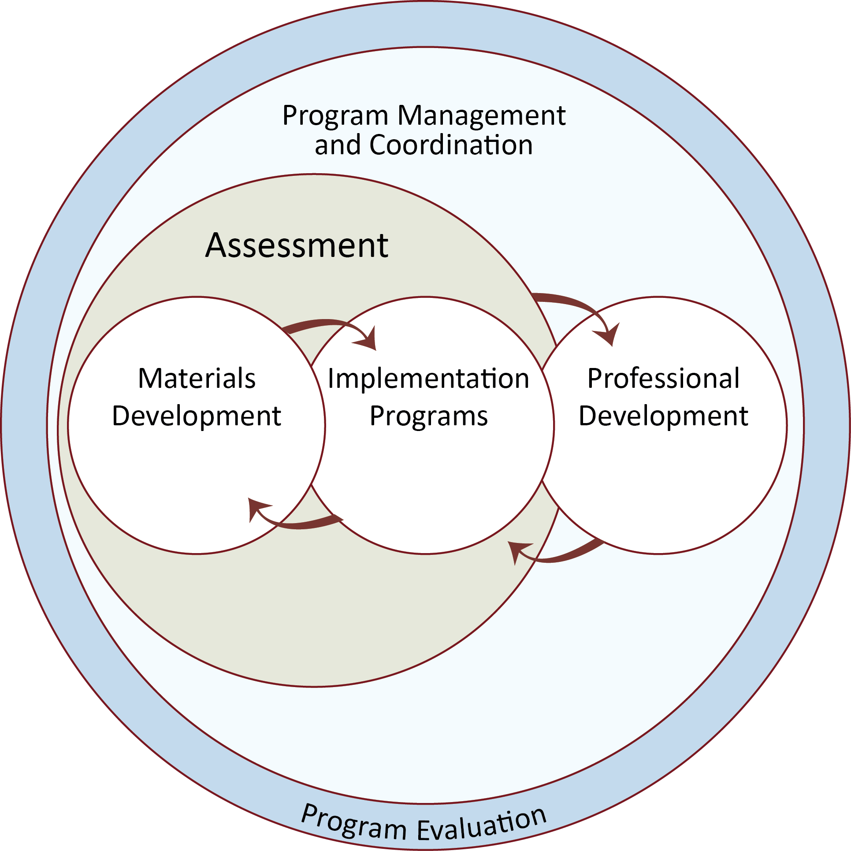
Systems approach:
Any given action will have multiple outcomes or consequences;
Any desirable outcome will require multiple nudges or influencers.
Courses
Programs/
Institutions
Community/
Network
http://serc.carleton.edu/integrate

Slide 6
What kinds of curricular materials will help students make sustainable decisions in the future?
http://serc.carleton.edu/integrate
Curricular materials that …
Engage all students in a variety of settings
Address grand challenges society is facing
Use rigorous, data-based science
Use evidence-based practices in learning
Are adaptable and adoptable by instructors
How do we ensure that all of these conditions are met in the materials we develop?

Slide 7
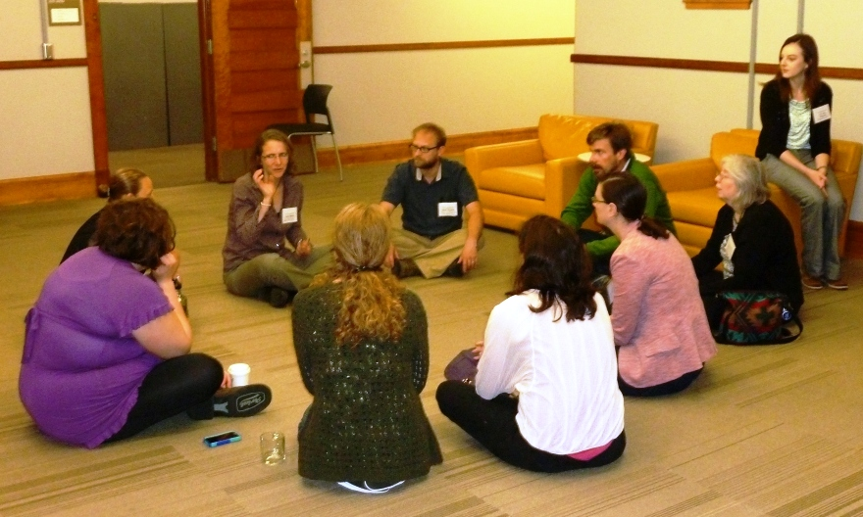
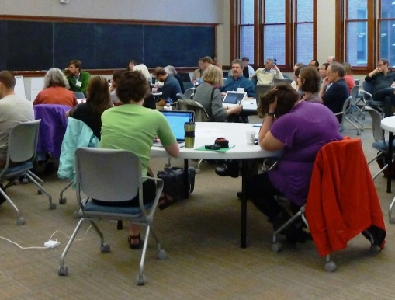
1. Design of development teams
http://serc.carleton.edu/integrate
Three instructors from three different institutions (and often from three different disciplines)
Assessment consultant from assessment team
Web consultant from web team
Content area leader from leadership team
Collaboration and consultation are built in

Slide 8
2. Goals are encoded in a design rubric
http://serc.carleton.edu/integrate
Guiding Principles
Learning Objectives and Outcomes
Assessment and Measurement
Resources and Materials
Instructional Strategies
Alignment

Slide 9

Guiding principles
Address one or more geoscience-related grand challenges facing society
Develop students’ abilities to address interdisciplinary problems
Improve students’ geoscientific thinking skills
Make use of authentic geoscience data
Develop students’ systems thinking skills

Slide 10
The Rest of the Rubric
Drawn from high-impact practices and research on learning
Based on a backward design model*
  Identify the desired results (learning outcomes)
  Determine how you will know that students have met the outcomes (assessment)
  Develop the learning experiences and activities that will give students practice
*Wiggins and McTighe, 1999

Slide 11
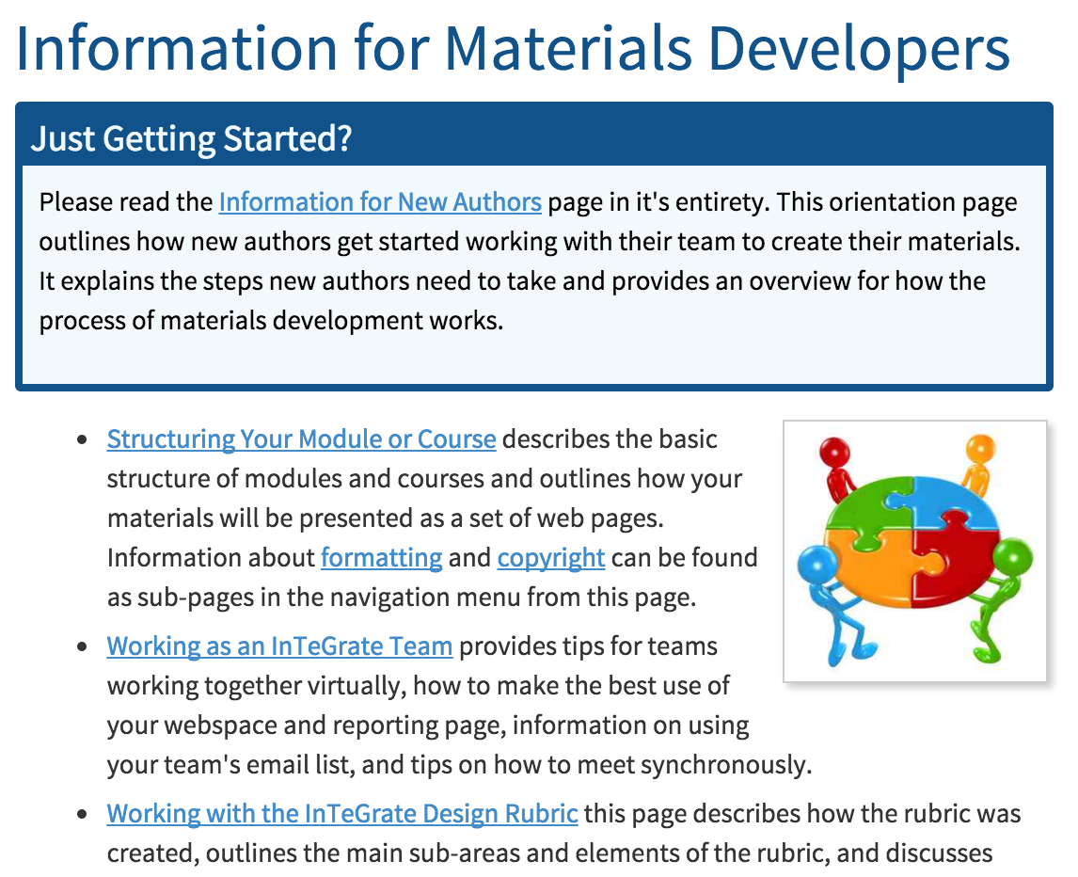
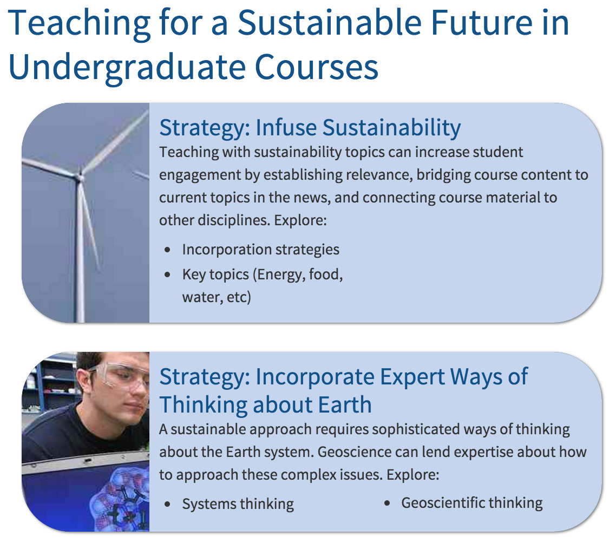
3. Supporting website
Inward-facing
Outward-facing
http://serc.carleton.edu/integrate

Slide 12
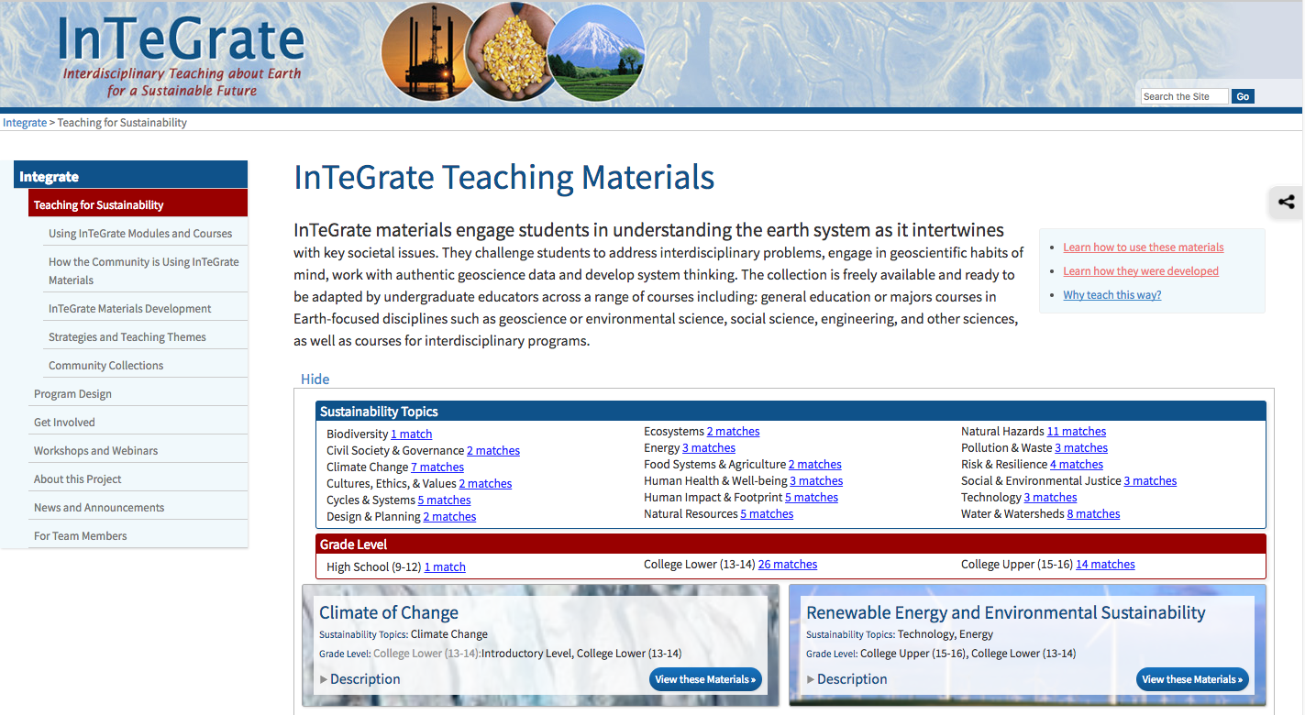
http://serc.carleton.edu/integrate
Notes:
Materials are now freely available on the web – if you want to learn more about the development process, go here.

Slide 13
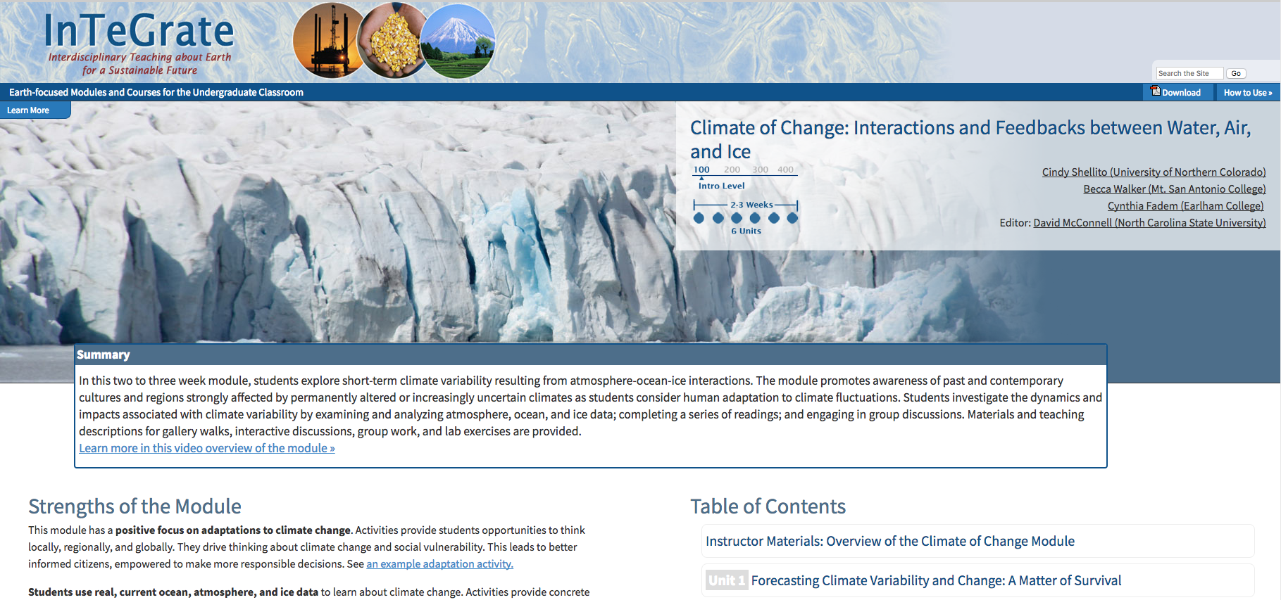
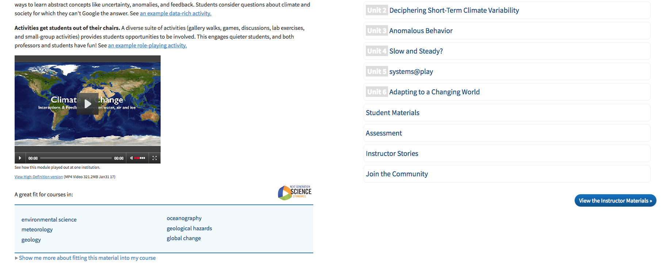
Notes:
Here’s an example… these are very rich materials and there are lots of them.Easy to get overwhelmed.

Slide 14


InTeGrate and the
186 individual activity pages
Notes:
The NGSS are designed for K-12, but they do a nice job of articulating the process of science, especially through the Science and Engineering Practices and the Cross-cutting concepts. At the Earth Educators’ Rendezvous, we convened a group of experienced educators to “tag” the materials with the NGSS – practices, core ideas, concepts, and Pes.

Slide 15

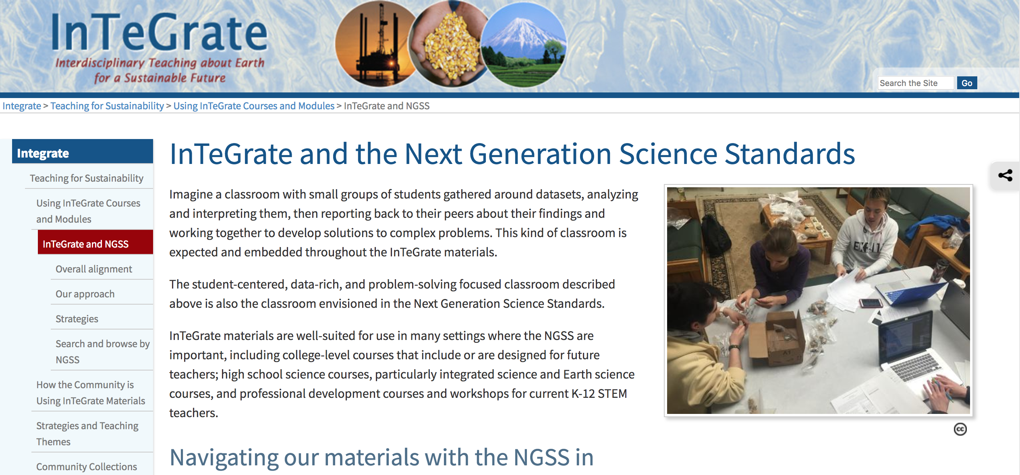
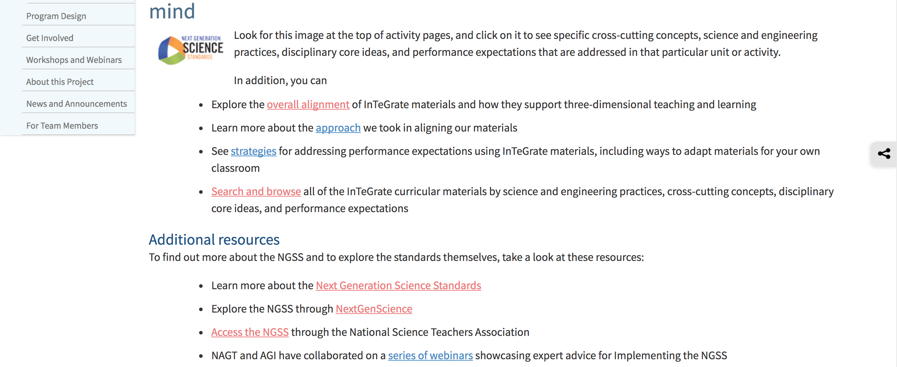

Slide 16
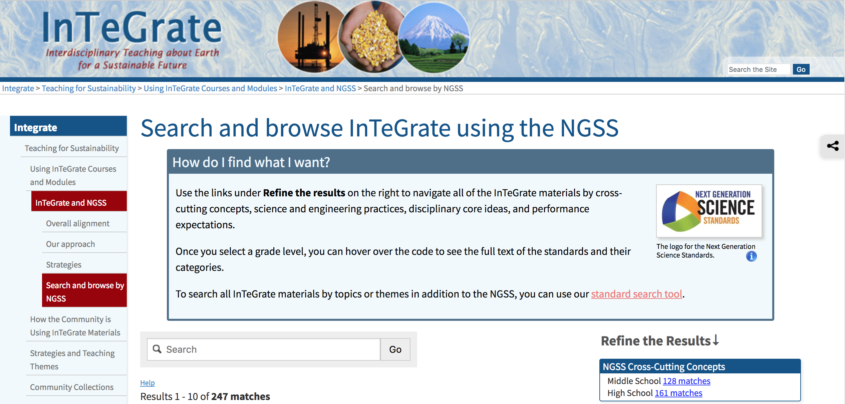
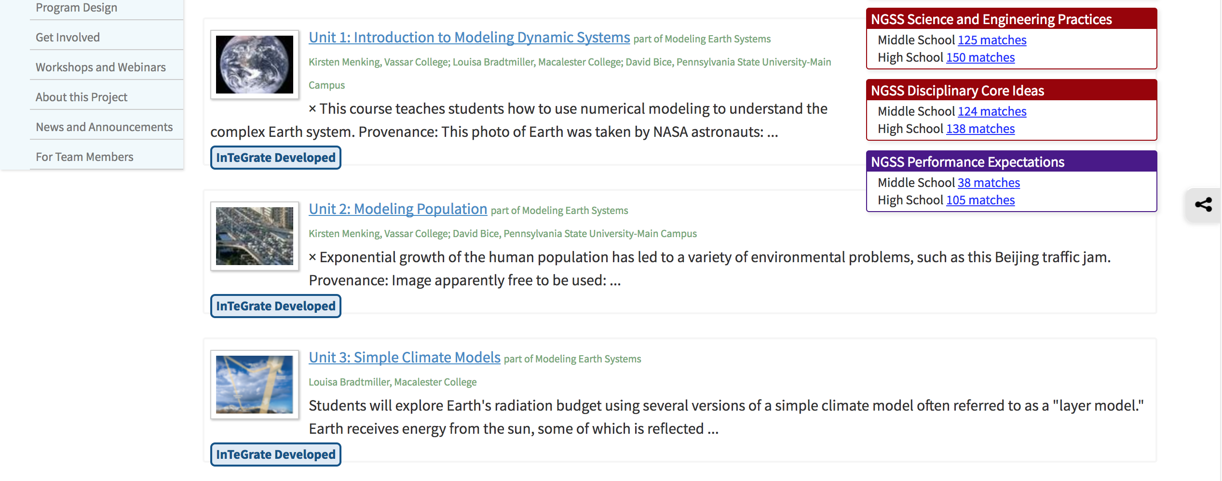

Slide 17
Earth Materials and Systems
Earth’s systems, being dynamic and interacting, cause feedback effects that can increase or decrease the original change
Natural Resources
All forms of energy production and other resource extraction have associated economic, social, environmental, and geopolitical costs and risks as well as benefits. New technologies and social regulations can change the balance of these factors
Human Impacts on Earth Systems
The sustainability of human societies and the biodiversity that supports them requires responsible management of natural resources.

Slide 18
Developing and using models
Develop, revise, and/or use a model based on evidence to illustrate and/or predict the relationships between systems or between components of a system
Analyzing and interpreting data
Construct, analyze, and/or interpret graphical displays of data and/or large data sets to identify linear and nonlinear relationships.
Use graphical displays (e.g., maps, charts, graphs, and/or tables) of large data sets to identify temporal and spatial relationships.

Slide 19
Patterns
Empirical evidence is needed to identify patterns
Graphs, charts, and images can be used to identify patterns
Cause and effect
Cause and effect relationships can be suggested and predicted for complex natural and human designed systems by examining what is known about smaller scale mechanisms within the system.
Systems and system models
Systems may interact with other systems; they may have sub-systems and be a part of larger complex systems.

Slide 20
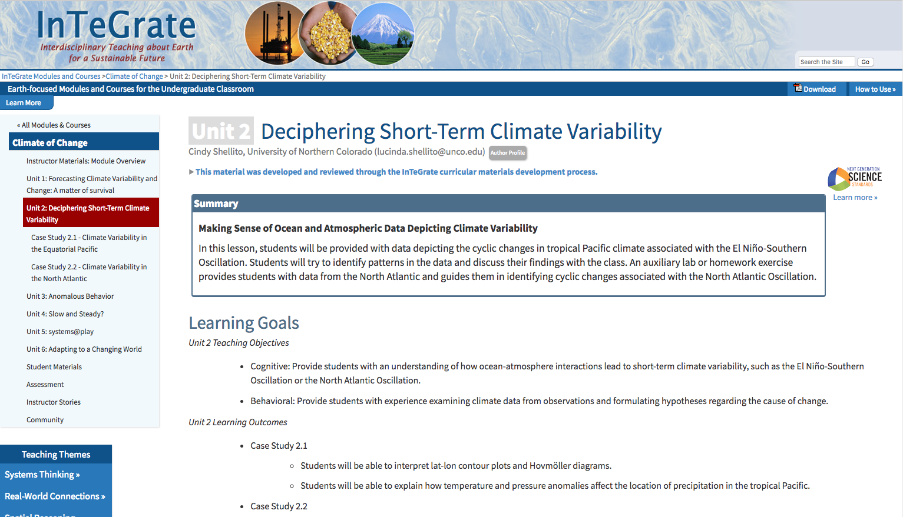
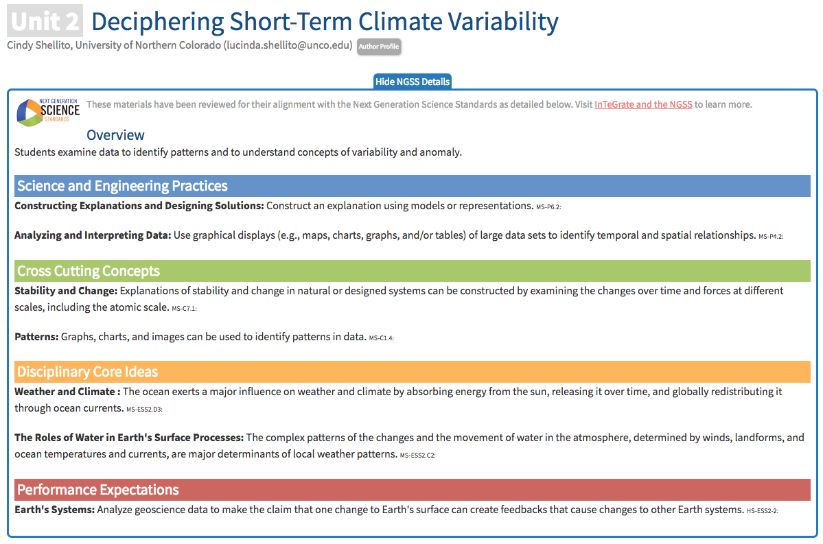

Slide 21
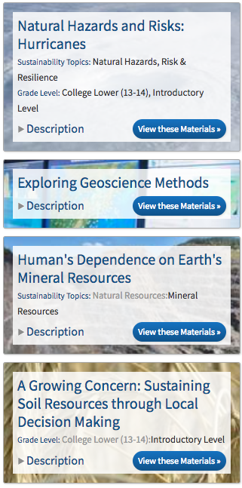
But…
These were designed and written for the undergraduate classroom
Taggers noted several things that would be helpful:
  Help for teachers to create “blended” lessons rather than just searching on tags
  Shows teachers how to get what they need right away
  Examples of talk moves and other components of group discussion
  Summaries that include descriptions of what students are doing in the classroom
  Stories from teachers who have used them
This is where you come in.

Slide 22
The rest of this workshop:
You will be working in groups to develop a “practice web” for teachers to use these materials within a particular content area
You will be developing your own action plan for implementing the materials in your classroom

Slide 23
Notes:
https://serc.carleton.edu/integrate/teaching_materials/hazards/unit1.html

Slide 24
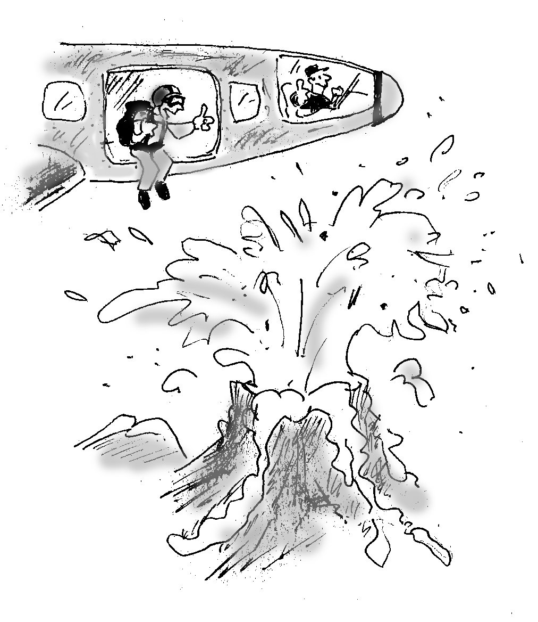
Hazard or risk?
In this cartoon, what are the hazards?
How could the parachutist minimize her risk from these hazards?
(Richard J. King, 2012)
Notes:
Sample answers:
--Hazards: volcanic ejecta (pyroclastic material, ash); poisonous gases
--Ways to Minimize Risk: avoid death/injury by not jumping into the volcano, or not jumping at all; in advance, plan a different route to avoid ash clogging engine

Slide 25
Hazard or risk?
In this cartoon, what are the hazards?
2. How could the parachutist minimize her risk from these hazards?
(Richard J. King, 2012)
Notes:
Sample answers:
--Hazards: volcanic ejecta (pyroclastic material, ash); poisonous gases
--Ways to Minimize Risk: avoid death/injury by not jumping into the volcano, or not jumping at all; in advance, plan a different route to avoid ash clogging engine

Slide 26
Geologic Hazards
Phenomenon capable of causing harm to humans
  Tsunami
  Flood
  Volcanic ash
  Lahar
  Fire
  Liquefaction
  Landslide
  …. Can you think of others?
Primary Hurricane Hazards
Wind
Storm Surge
Rain
Waves
Secondary Hurricane Hazards
(caused by a primary hazard)
Flooding
Fire
Landslides
Coastal Erosion

Slide 27
Risk
The likelihood and cost of a hazard happening to YOU
Factors:
  Cost
    human life
    damage to property and infrastructure
  Likelihood
    recurrence interval
    dependent on location
    large events are generally less likely than small ones
Other lessons learned from Diamond (2013)?

Slide 28
Risk = Likelihood x Cost
Example : If your area was hit by 1 hurricane in the last 100 years, and your house is worth $300,000, what is the risk to your house being hit by a hurricane this year?
Answer: 1 hurricane every 100 years means a 1 in 100 (0.01) chance in any given year (or 1% per year). Your home's risk would be: 0.01/year x $300,000 = $3,000/year

Slide 31
Step | InTeGrate module/activity OR other activity | What students are doing | Connections to cross-cutting concepts

Slide 33
1

Slide 34
Earth’s systems; Weather and climate; Natural hazards
Analyze geoscience data that have consequences for human life and economics
Communicating your findings
Combining them with others
3
2,5
Analyzing your dataset
Calculating rates, plotting
1
4
Using maps to identify patterns; Using patterns as empirical evidence for causality
6
Using evidence to make decision

Slide 35
https://serc.carleton.edu/199605

