Slide 1
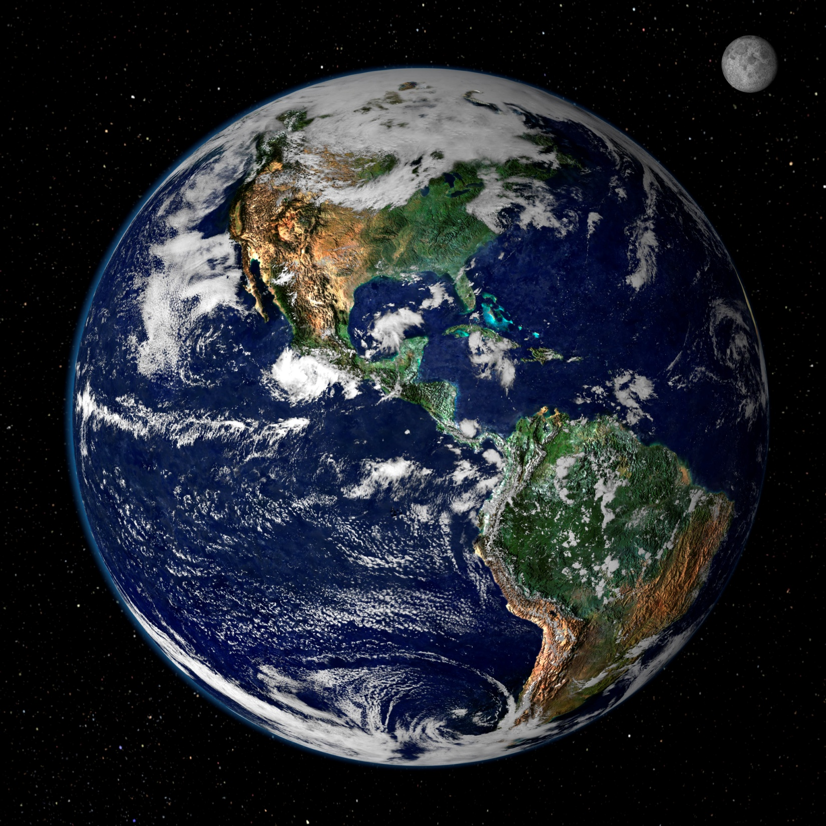
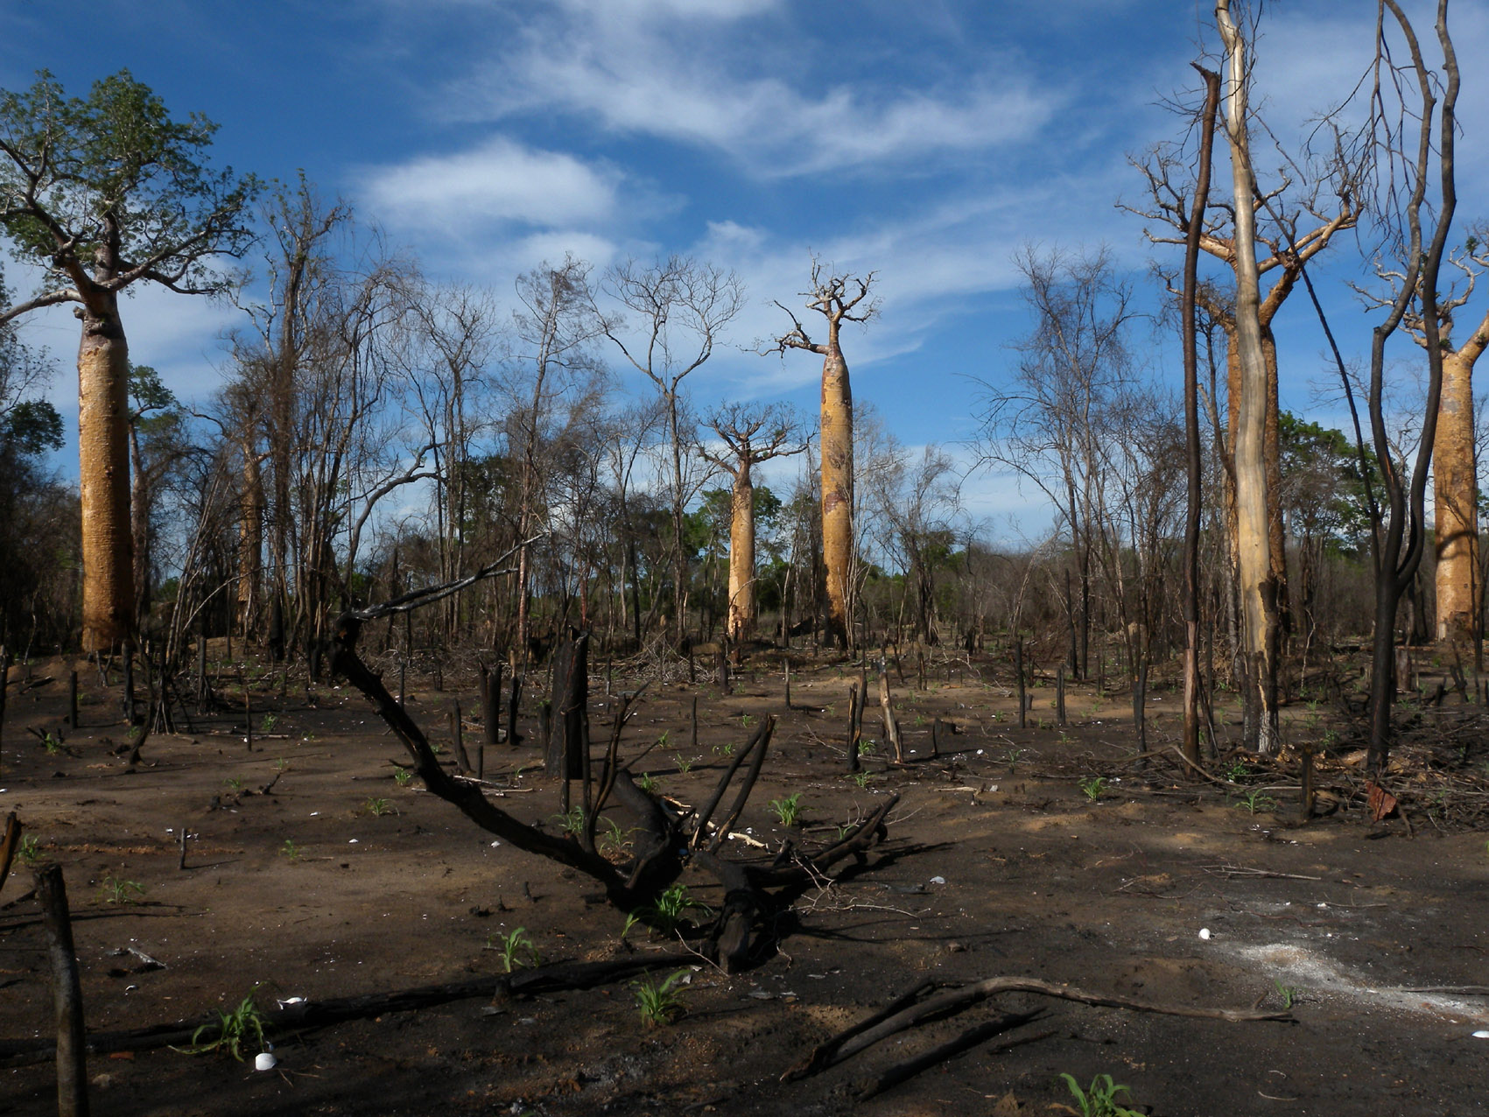
How do carbon emissions affect the Earth System?
Composite image by NASA GSFC
Notes:
Review.

Slide 2
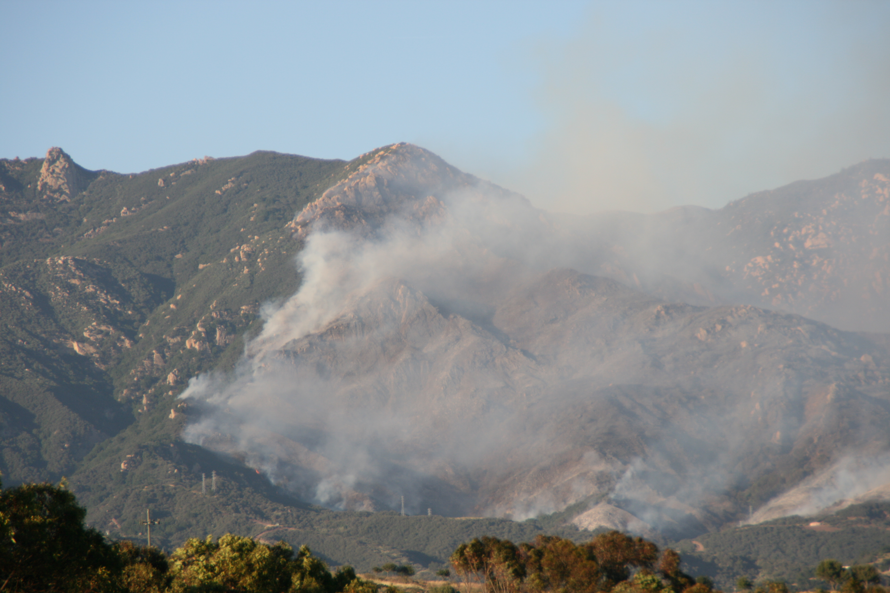
forcing
emissions → more green → warming → impacts to natural & human
house effect
systems
feedbacks
Notes:
Example system diagram for material covered in Unit 1 and 2. You can also show the green side of the Module System Diagram in extra slides below.
The photos are examples of feedbacks that alter albedo: forest fires and ice cover.
Photo by R. Smyth and S. Penny

Slide 3
MODEL
INPUTS
OUTPUTS
Notes:
Inputs AKA drivers
Outputs AKA predictions
Instructor can decide how much detail is needed here.

Slide 4
Water Feedbacks
webdice.rdcep.org
Ice-Albedo Feedback
Vegetation Feedbacks
Global Temperature
Permafrost Feedback
Other Feedbacks

Slide 5

In webDICE,
Water Feedbacks
www.rdcep.org
Ice-Albedo Feedback
Vegetation Feedbacks
Global Temperature
Permafrost Feedback
Other Feedbacks
Climate Sensitivity
Notes:
http://webdice.rdcep.org/advanced#option:parameters

Slide 6
Are there situations in which webDICE's output will be of limited value or potentially misleading?

Slide 7
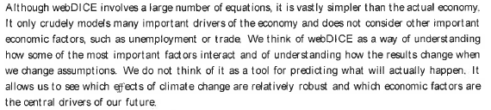
Assumptions & limitations
-Pg. 2 of webDICE Documentation
Notes:
It is a tool with limitations

Slide 8
http://webdice.rdcep.org/

Slide 9
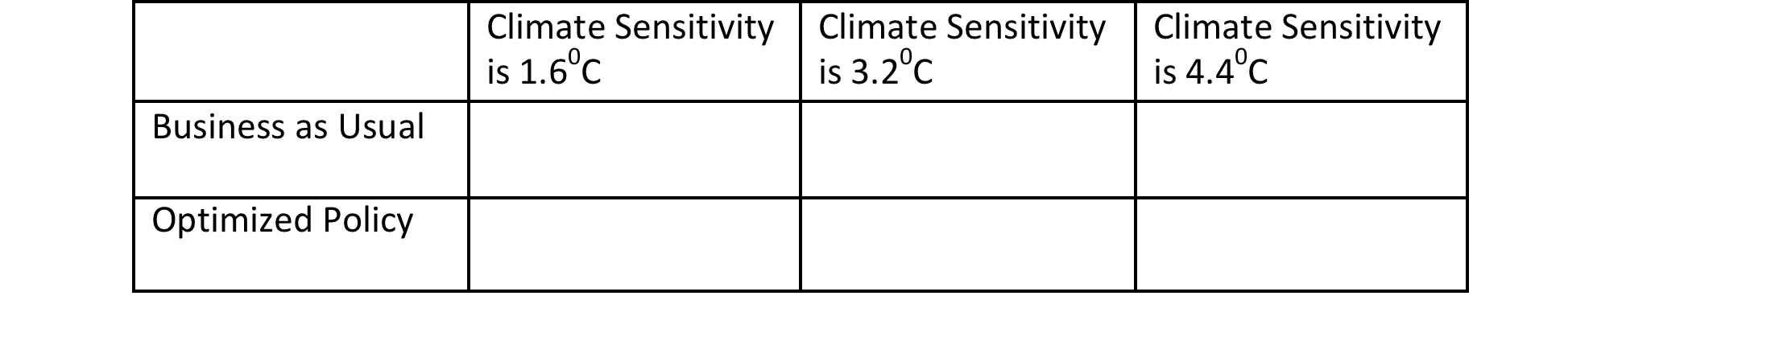
Notes:
Data table

Slide 10
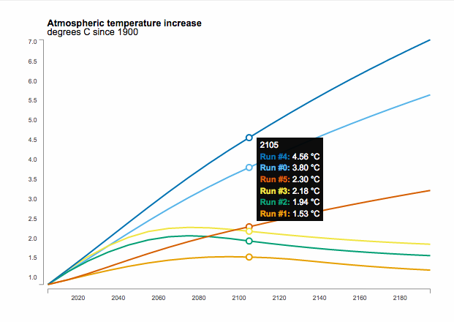
 | 1.6°C | 3.2°C | 4.4°C
BAU | Run #5 | Run #0 | Run #4
OP | Run #1 | Run #2 | Run #3
Atmospheric temperature increase (degrees C since 1900)
Year
Notes:
Outcome of Task A on student worksheet (Note: their colors may vary depending on the order the students did the runs in)

Slide 11
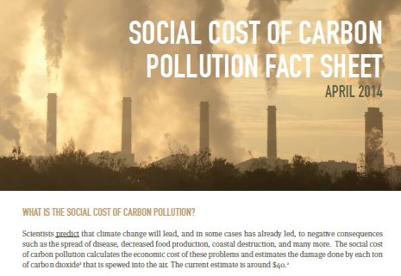
Notes:
Replace with webDICE figure

Slide 12
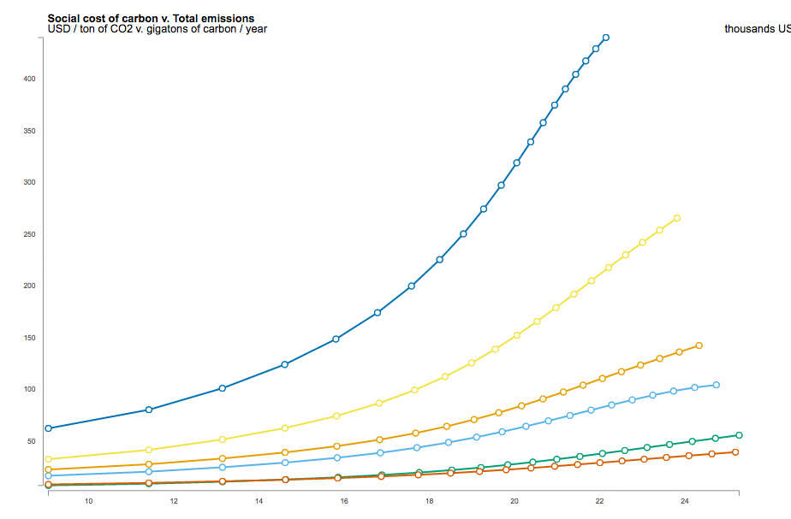
Climate Sensitivity
 | 1.6°C | 3.2°C | 4.4°C
1.5 |  | Run #5
2 | Run #2 | Run #0 | Run #1
2.5 |  | Run #3
3 |  | Run #4
Harms
Social cost of carbon ($/tonCO₂)
Total emissions (GigatonsC/year)
Notes:
Make sure students clear Optimized Policy runs out before plotting the SCC. SCC does not make sense under the OP scenario

Slide 13
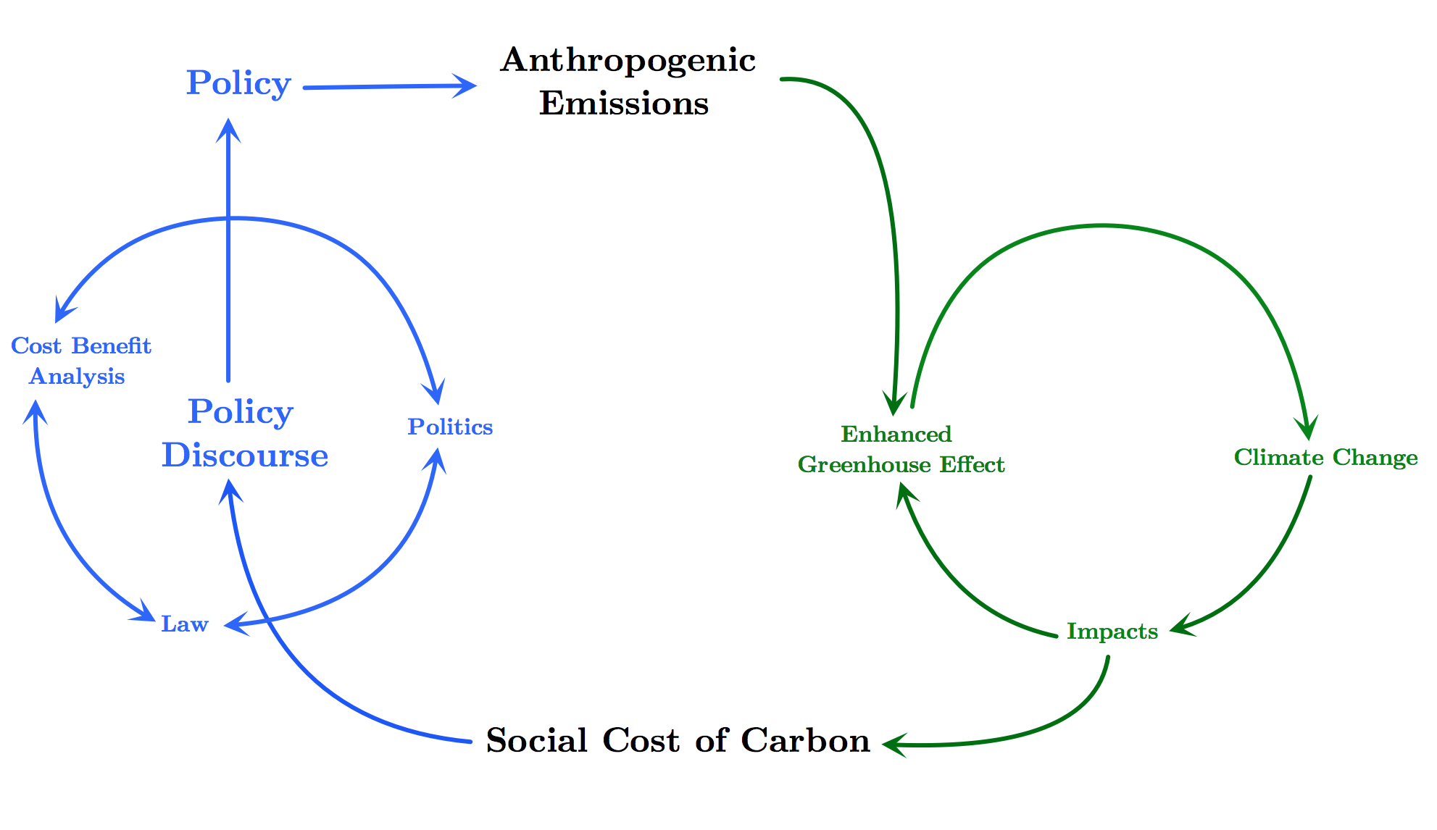
Policy?

