Slide 1
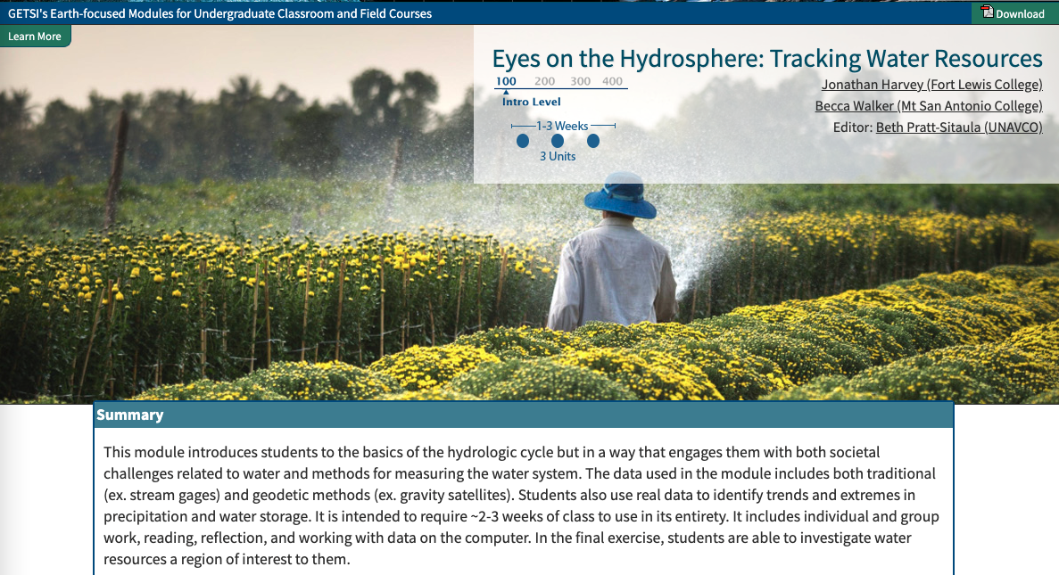
Teaching about Eyes on the Hydrosphere: Tracking Water Resources
serc.carleton.edu/getsi – see Intro Level section

Slide 2
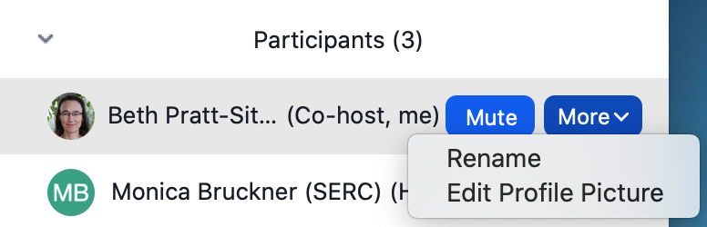
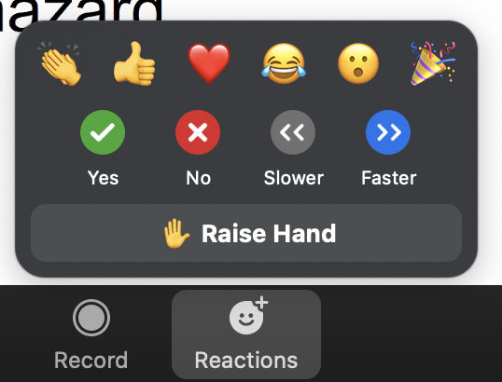
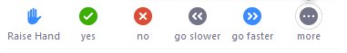
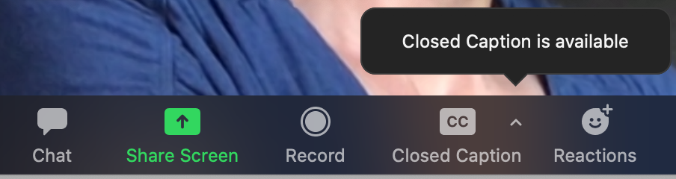
Technology
Please stay muted when you are not talking
Best to use earphones
Please make sure your real name shows
in the Zoom Participant list
Use chat box a lot! (group or private messages)
Raise your hand if you have something more complicated
so we can call on you. Then
you can unmute to speak.
We will not be recording the session, but will save the chat.
In breakout groups it is best to turn on videos to facilitate interactions (internet withstanding).
Closed captions are available in main Zoom room (if you depend on closed captions, please private-message “SERC host” so you can be put in a breakout group that stays in
the main room)

Slide 3
Water resource monitoring GEODETIC & TRADITIONAL METHODS

Slide 4
High Precision vertical GPs

Slide 5
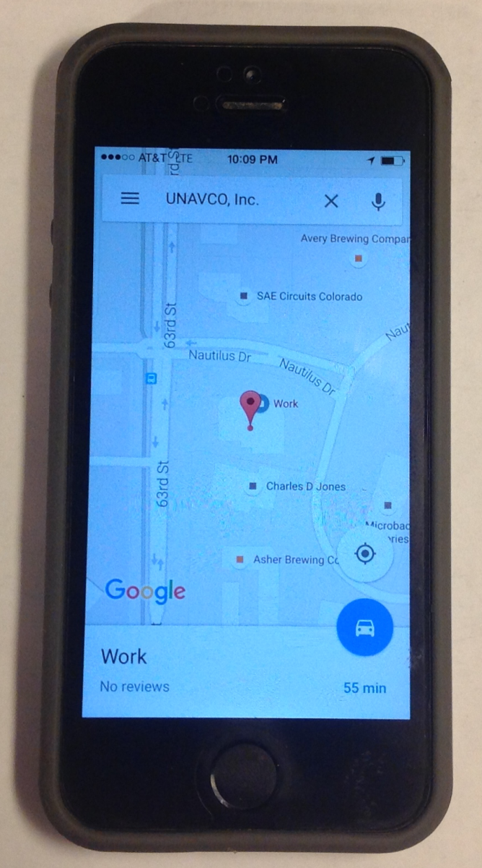
What Is GPS?
GPS receivers are in phones, cars, etc.—basically anything that tells you where you are
This is a great entry point for engaging students
Note: global positioning system (GPS) is technically just the US component of the global navigation satellite system (GNSS) which includes Russia, Europe, China, and others
Notes:
Whether they know it or not, students use GPS receivers daily in their cars, phones, cameras, and handheld recreational GPS. Most have heard the term “GPS,” but few know much about how the system actually works or high-precision GPS for science and industrial use.
Note: Although the term GPS (Global Positioning System) is more commonly used in everyday language, it officially refers only to the USA's constellation of satellites. GNSS (Global Navigation Satellite System) is a universal term that refers to all satellite navigation systems including those from the USA (GPS), Russia (GLONASS), European Union (Galileo), China (BeiDou), and others. In this module, we use the term GPS even though, technically, some of the data may be coming from satellites in other systems.
Images from UNAVCO

Slide 6
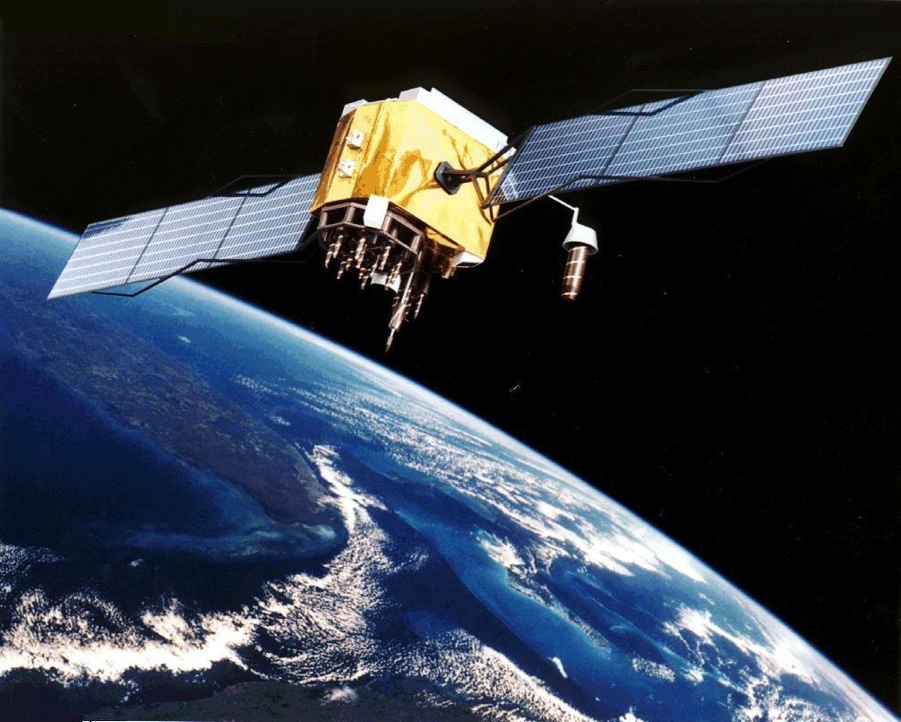
How Does GPS Work?
A receiver obtains signals from GPS satellites
Artist’s conception of a GPS Block II-F satellite in Earth orbit
Notes:
From the users point of view, GPS is a passive system: you need only a low-powered receiver to obtain the signals, which contain all the information you need to determine your position. This requires that the satellites carry atomic clocks to keep accurate time and transmit to the user the position of the satellite in the sky. The orbits are computed by the Department of Defense (DoD) by tracking the satellites from ground control stations. GPS control segment consists of a global network of ground facilities that track the GPS satellites, monitor their transmissions, perform analyses, and send commands and data to the constellation. The current (as of 2015) operational control segment includes a master control station, an alternate master control station, 12 command and control antennas, and 16 monitoring sites. The ground control stations have known positions that are uploaded to the satellites, which then transmit the information continuously along with the time. With handheld receivers, it is possible to find your position to within a few meters, limited primarily by the accuracy of the broadcast orbits. As we shall see, the civilian scientific community uses more than 200 stations to determine the orbits with an accuracy of a few centimeters, allowing millimeter positioning after several hours of tracking.
Image: Artist’s conception of a GPS Block II-F satellite in Earth orbit. (public domain from NASA)

Slide 7
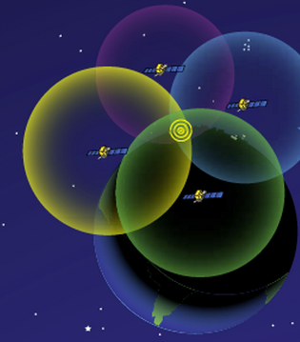
How Does GPS Work?
Receiver position is determined by calculating the distances to at least 4 satellites (>6 is much better)
Solve for the variables:
  North–South position
  East–West position
  Elevation
  Time
http://spaceplace.nasa.gov/gps-pizza/en/
Notes:
The time element is needed because of the difference between the highly accurate atomic clock on the satellites (US$100,000 each) and the much cheaper clock in the GPS receivers.
Although 4 is a technical minimum number of satellites, for geoscience research work it is highly recommended to have at least 6 satellites.
Although people will often refer to this process and “triangulation,” in fact it is “trilateration” because it depends on distances rather than angles.
For a nice explanation of trilateration versus triangulation visit https://gisgeography.com/trilateration-triangulation-gps/.
Images from NASA (public domain) http://spaceplace.nasa.gov/gps-pizza/en/

Slide 8
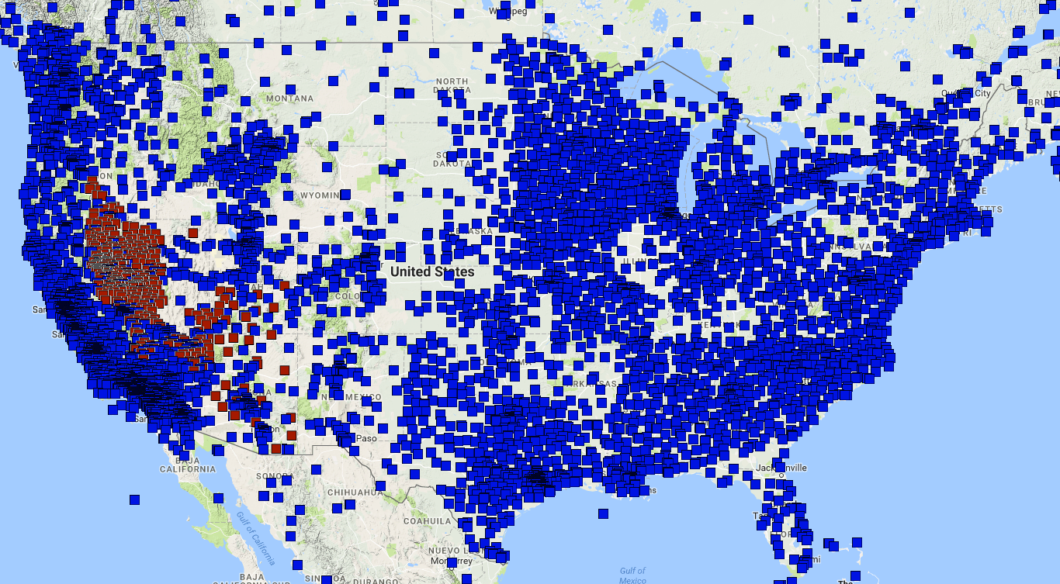

GPS Networks
Thousands of stations across continental United States
Data latency of seconds to ~1 day
http://geodesy.unr.edu/NGLStationPages/gpsnetmap/GPSNetMap.html
Notes:
GPS stations are widely distributed around the USA and most data are available with a day or so. Some are available with seconds.
Image from Nevada Geodetic Laboratory (http://geodesy.unr.edu/sitemap.php) and used with permission. Base map by Google Maps.

Slide 9
GPS Vertical Position
The solid Earth responds elastically to changes in load, such as water loss from regional groundwater pumping or drought
instantaneous, reversible, linear
Station anchored up to 10 meters into the ground
If the ground moves, the GPS records that change with accuracy within millimeters
Network of the Americas station P037
Notes:
This is not the same as the isostatic adjustment to surface loads (long time scale, spatial pattern affected by flexural characteristics of lithosphere, total magnitude depending on crust/mantle density contrast).
The reverse also happens: add groundwater, TWS increases, the land surface moves down
Image from UNAVCO (http://www.unavco.org/instrumentation/networks/status/nota/overview/P037)

Slide 10
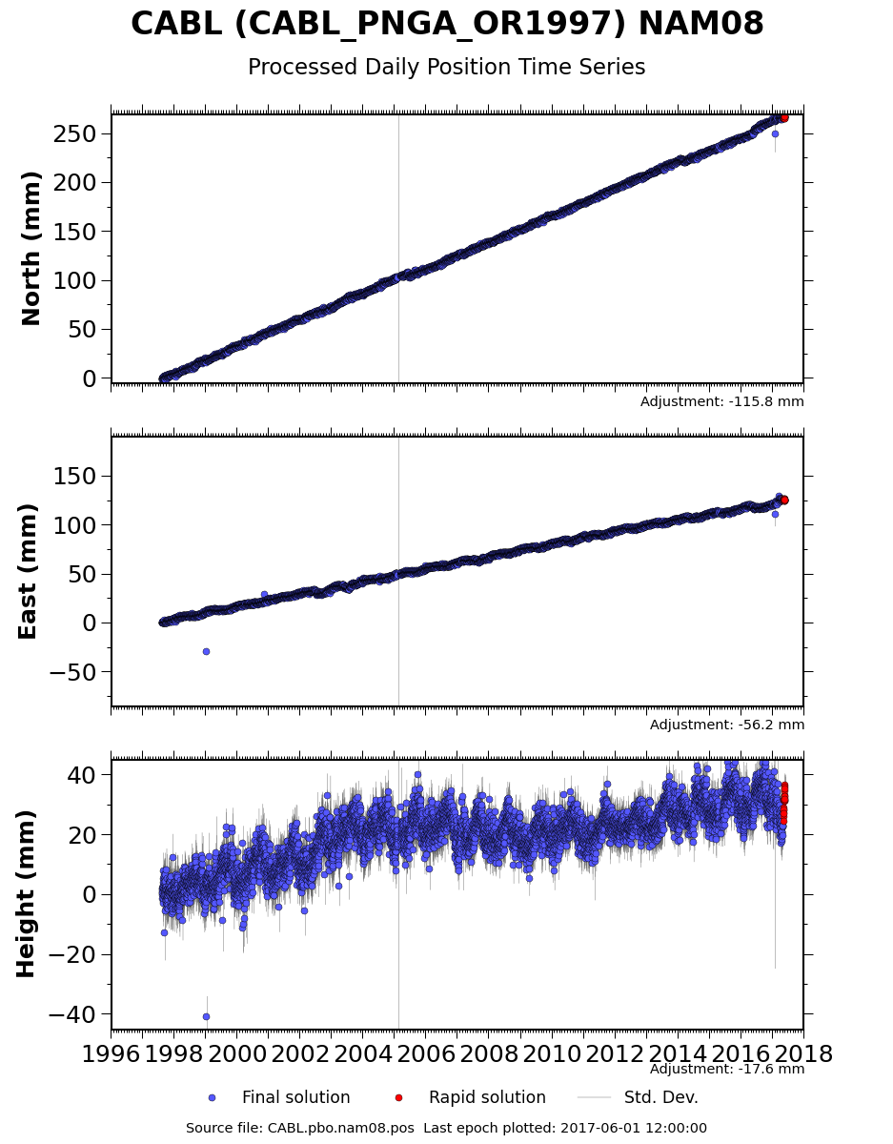
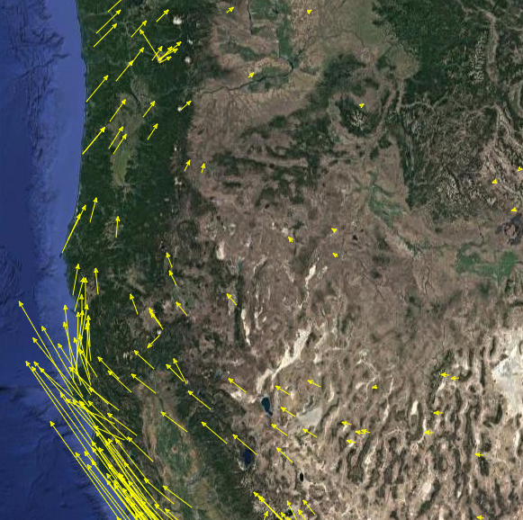
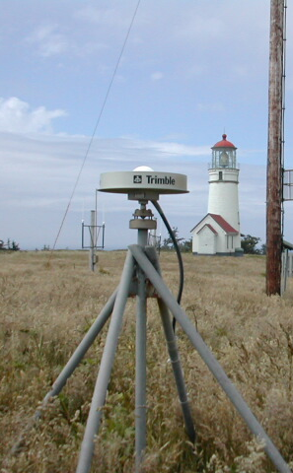
GPS Data
Cycles in vertical position are related to the seasonal water changes.
Notes:
GPS stations such as those in the Network of the Americas (NOTA; https://www.unavco.org/instrumentation/networks/status/nota) were originally installed to measure things such as plate tectonic motion (horizontal motions shown in the left image). However, as the data came in, it became clear that elements of the vertical motion is related to changes in the terrestrial water storage (TWS) and there were much wider uses for GPS data than originally imagined.
Rear image: UNAVCO Velocity Viewer http://www.unavco.org/software/visualization/GPS-Velocity-Viewer/GPS-Velocity-Viewer.html (base image from Google Maps)
GPS and GPS data from https://www.unavco.org/instrumentation/networks/status/nota/overview/CABL

Slide 11
Reflection GPS for snow depth

Slide 12
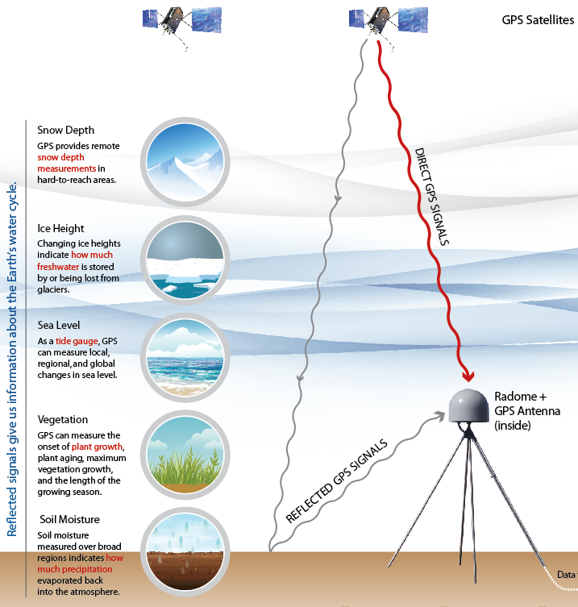
Reflecting GPS Signals
Changes in the ground such as added snow change the path and characteristics of the reflect GPS signal
Notes:
GPS stations were originally installed to measure tectonic motions. Position is determined by calculating the distances from satellites using the direct incoming signals. Originally all signals that reflected off surrounding surfaces were considered noise and researchers did their best to filter them out. However, more recently researchers at the University of Colorado Boulder realized that the the reflected signal could be used to determine things such as changes in height or conditions of the surrounding ground.
Image from UNAVCOO.

Slide 13
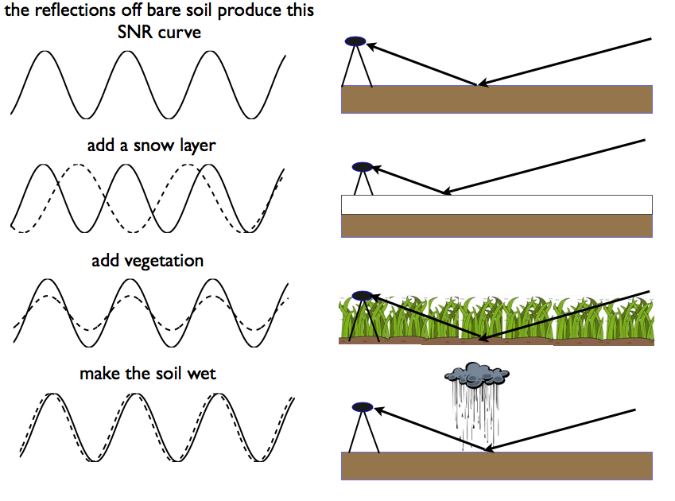
Reflected GPS Signals

Slide 14
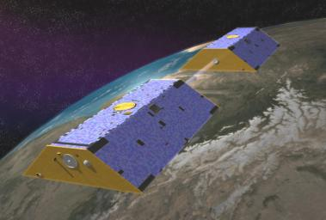
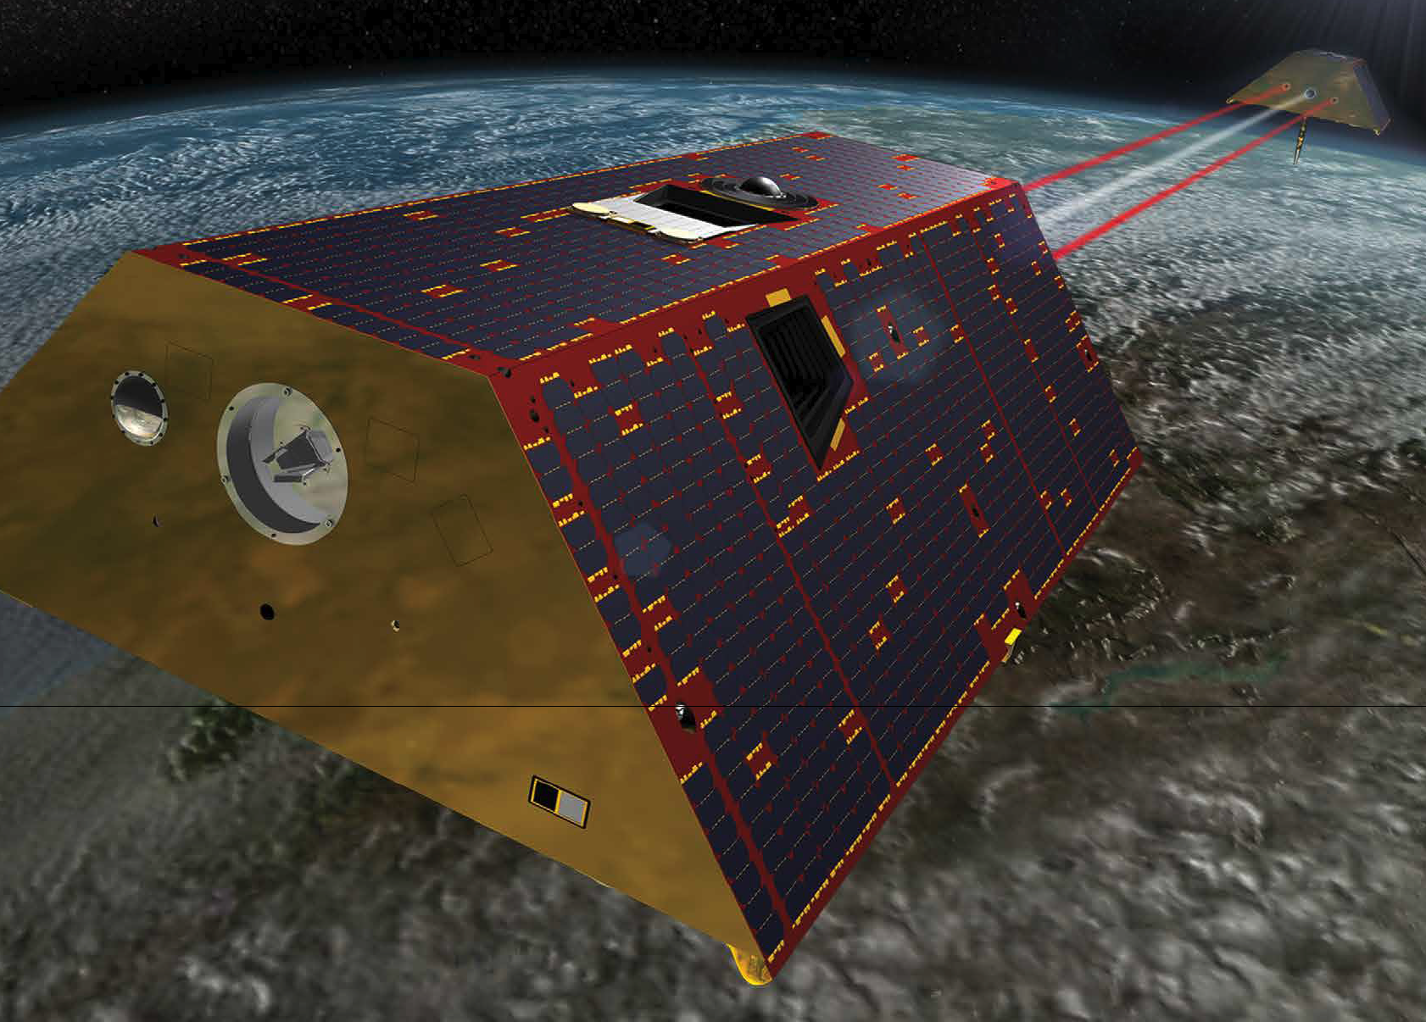
GRACE Missions:
Gravity Recovery and Climate Experiment
Original GRACE satellites 2002-17
GRACE Follow-on launched 2018
Notes:
http://photojournal.jpl.nasa.gov/jpegMod/PIA04235_modest.jpg (public domain)
https://gracefo.jpl.nasa.gov/resources/71/grace-fo-mission-brochure/

Slide 15
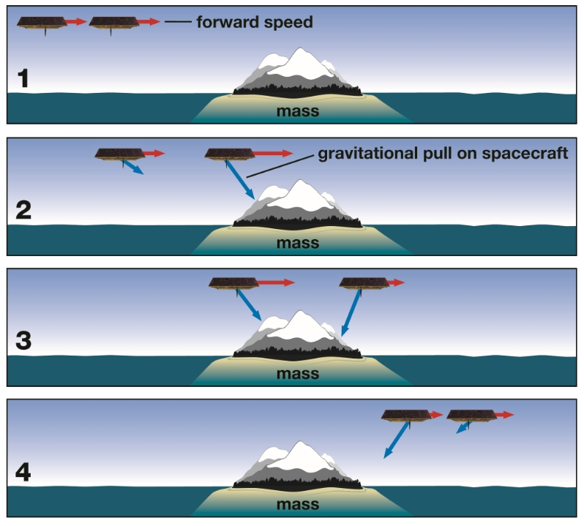
How GRACE Measures Gravity
Notes:
This graphic from NASA is specifically illustrating the Caribbean Sea, Colombia, and Peru but can be used as a general explanation of how GRACE measures gravity. From https://gracefo.jpl.nasa.gov/resources/50/how-grace-fo-measures-gravity/
A simplified example of how the distance between the GRACE-FO satellites changes as they pass over areas with lower mass (example: the ocean) and areas with higher masses (example: land.)
Panel 1: When both spacecraft are over the ocean, the distance between them is relatively constant.
Panel 2: When the leading spacecraft encounters a more massive object (in this case, land), the more massive area’s higher gravity pulls it away from the trailing spacecraft, which is still over the less massive area.
Panel 3: Once the second satellite also encounters the more massive area, it too is pulled toward the higher mass and consequently toward the leading spacecraft. As the lead spacecraft moves past the more massive area, it is pulled back slightly by the higher gravity of that area.
Panel 4: When both spacecraft are over the less massive object (in this case, the ocean) again, the trailing spacecraft is slowed by land before returning to its original distance behind the leading spacecraft.

Slide 16
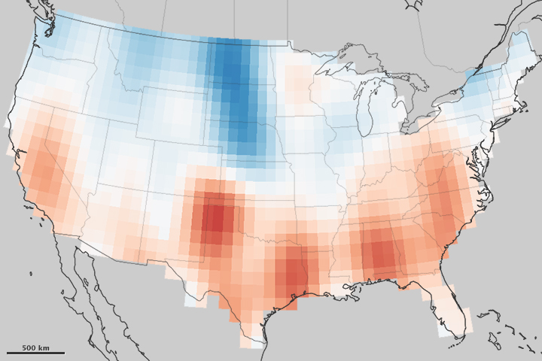

Example of GRACE Groundwater Data
Notes:
A decade of GRACE data shows the overall changes in aquifers across the USA.
Image from: https://earthobservatory.nasa.gov/IOTD/view.php?id=82266
NASA site also includes a related article which instructors could use to bring in more aspects of specific societal challenges from groundwater loss.

Slide 17
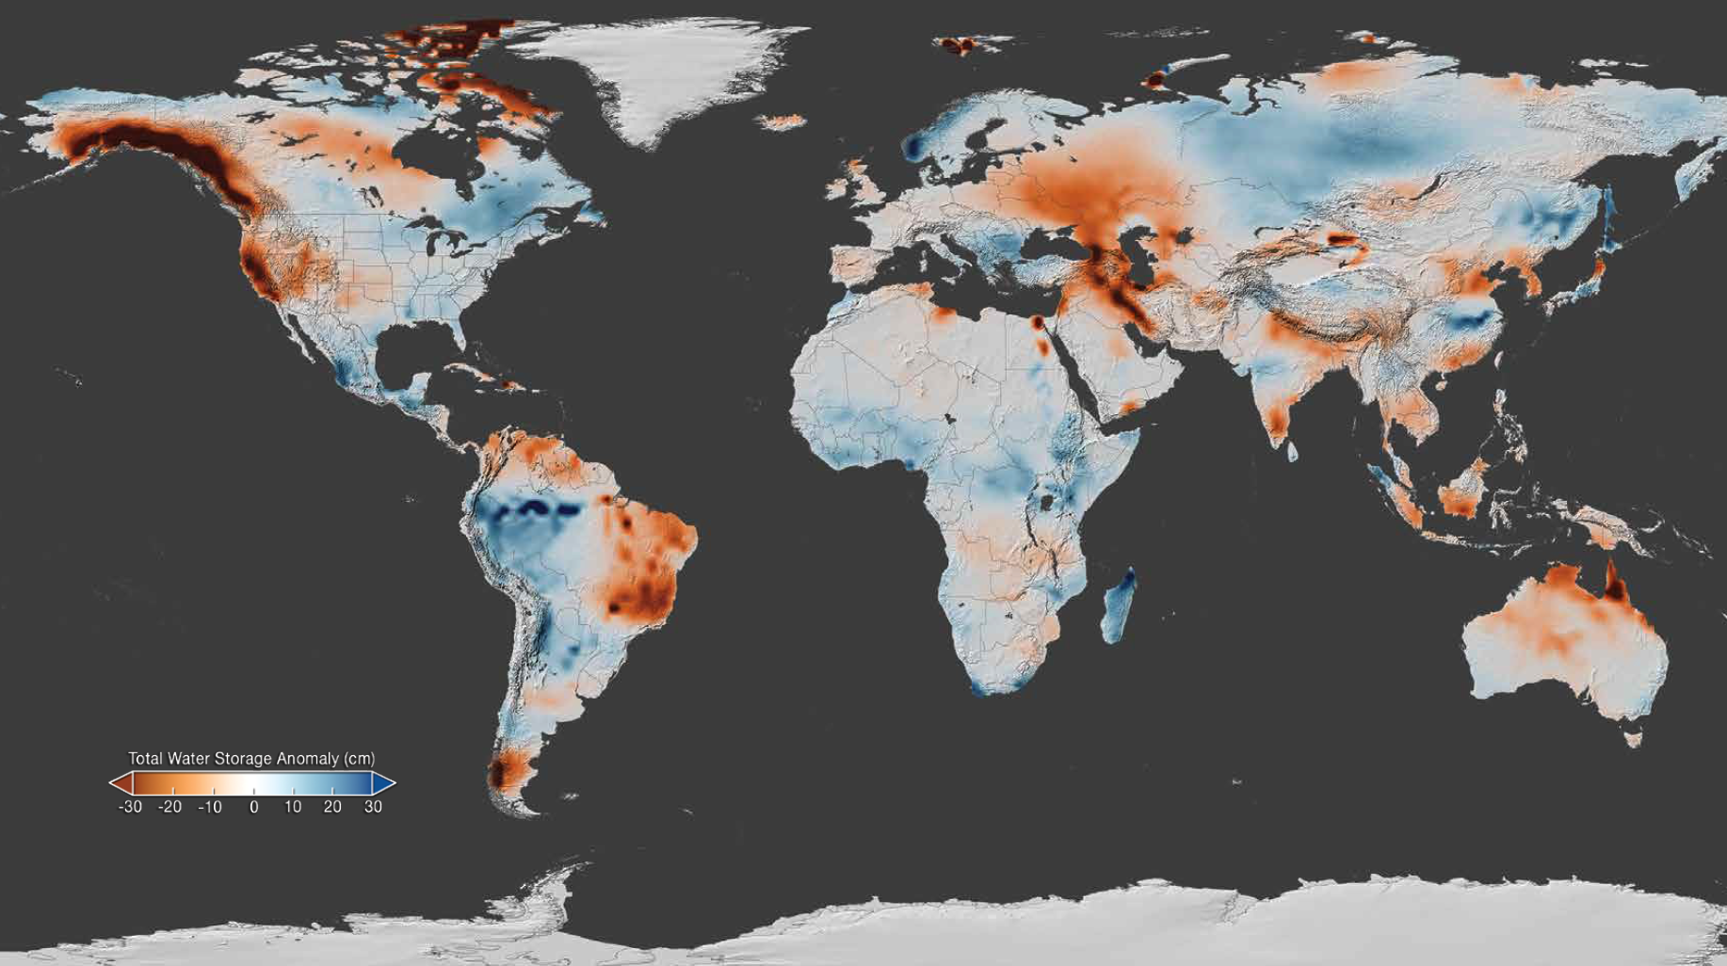
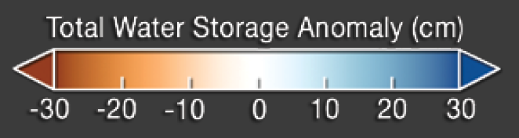
GRACE April 2015 anomaly from 2002-2015 average
Notes:
The gravity variations measured by GRACE can be used to determine water storage on land. By comparing current data to an average over time, scientists can generate an anomaly map to see where terrestrial water storage has decreased or increased. This map, created using GRACE data, shows the global terrestrial water storage anomaly in April 2015, relative to the 2002-2015 mean. Rust colored areas show areas where water has decreased, and areas in blue are where water levels have increased. Note the significant decreases in water storage across most of California are related to groundwater, while decreases along the Alaska coastline are due to glacier melt.
https://gracefo.jpl.nasa.gov/resources/71/grace-fo-mission-brochure/

Slide 18
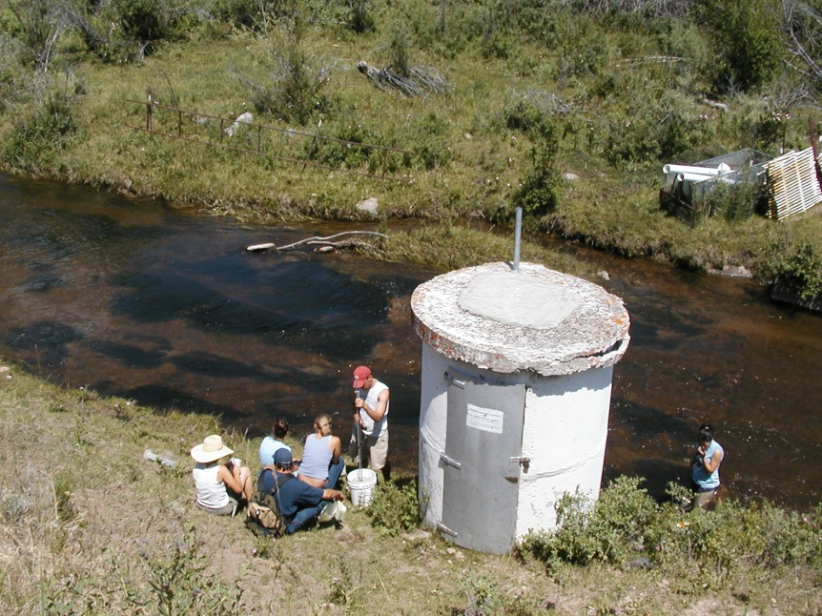
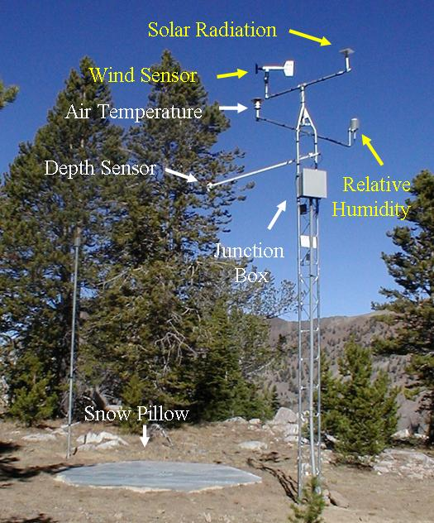
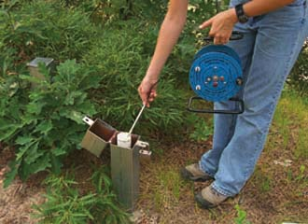
Traditional Methods Also Included
Stream gauges
SNOTEL – snow pillows
Groundwater
wells

Slide 19
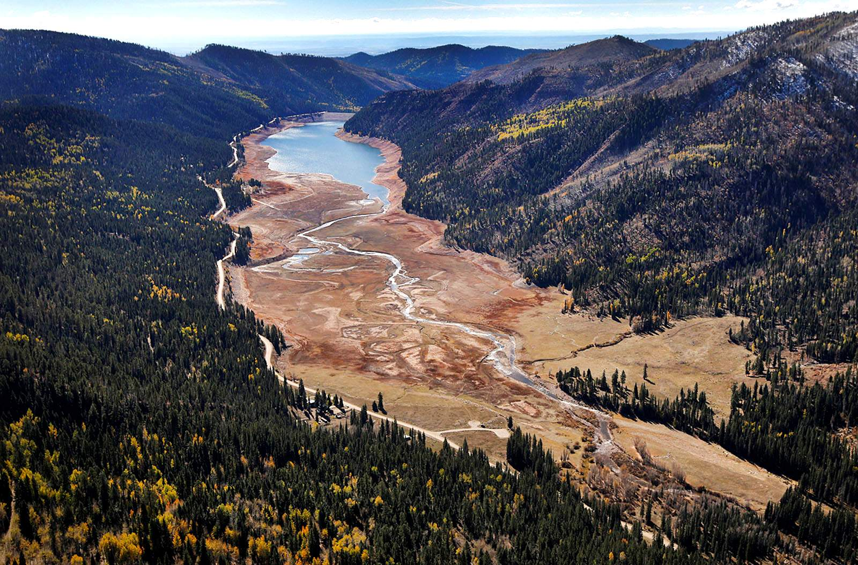
Using GETSI’s Eyes on the Hydrosphere module in your classroom
Photo: Durango Herald
Authors: Jon Harvey and Becca Walker
Editor: Beth Pratt-Sitaula

Slide 20
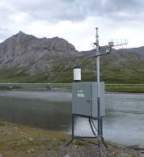
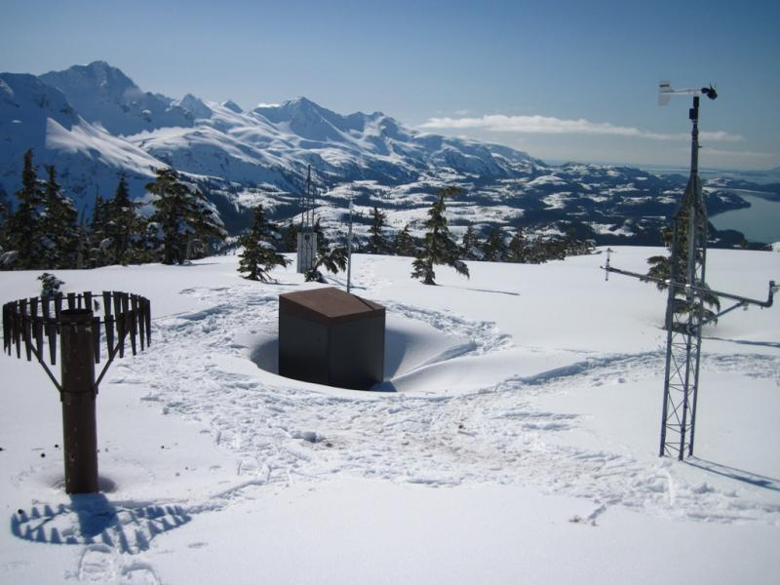
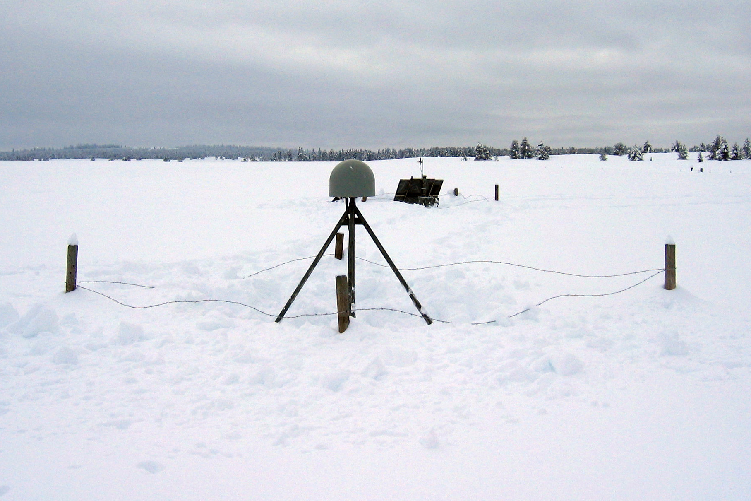
Eyes on the Hydrosphere module goals
Students will analyze the major reservoirs of the hydrosphere and the traditional and geodetic means of measuring their relative contributions to a water budget.
Students will interpret real geodetic and traditional data sets from different watersheds with different hydroclimatic regimes and assess short- and long-term trends in water availability for these watersheds.
Students will use real data to evaluate the societal effects of changing water supply and demand related to both natural and anthropogenic forcings.
SNOTEL (USDA)
Reflection GPS (UNAVCO)
Surface Water (USGS)

Slide 21
Module units
Unit 1:Exploring the Reservoirs and Pathways and Methods to Measure the Hydrologic Cycle
Unit 2: Monitoring Surface and Groundwater Supply in the Western US
Unit 3: What’s in YOUR Watershed?
Whole-module adoption ~2.5-3 weeks of class time
All teaching materials available here: https://serc.carleton.edu/getsi/teaching_materials/index.html

Slide 22
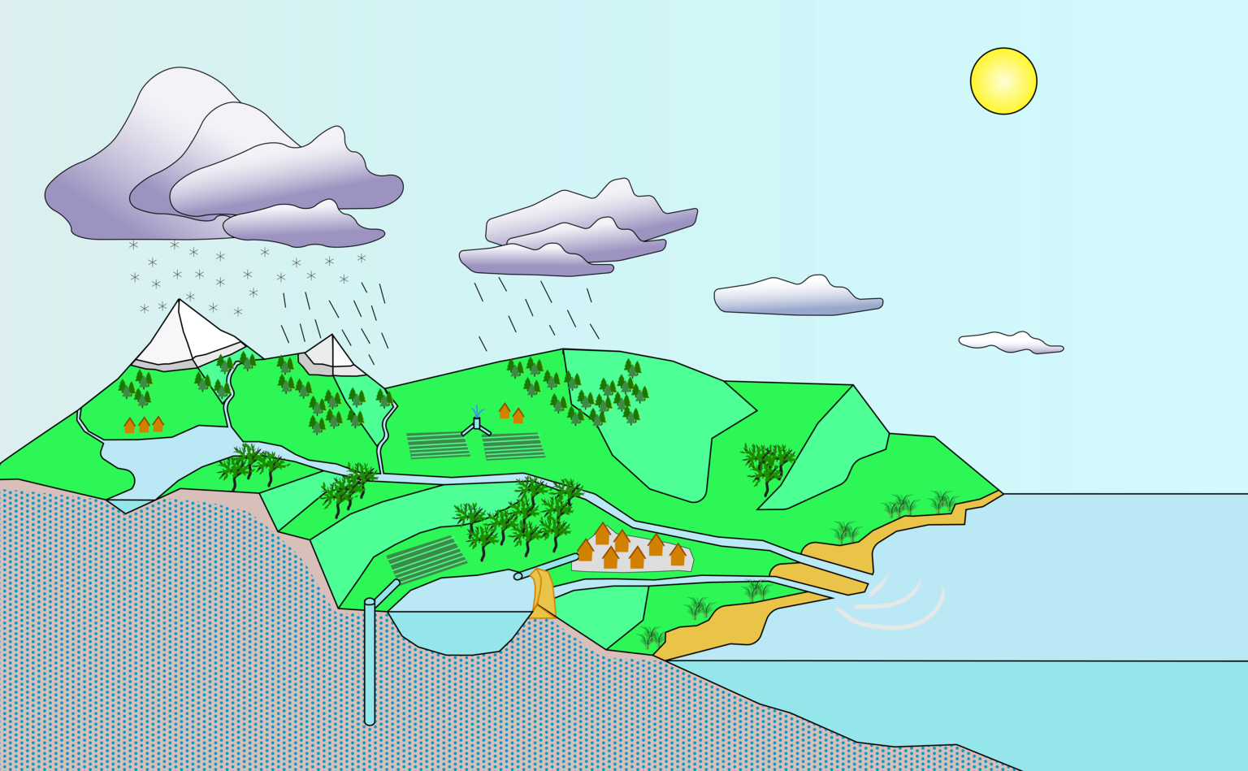
Unit 1: Exploring the Reservoirs and Pathways and Methods to Measure the Hydrologic Cycle
Unit 1.1: Reservoirs and transport pathways of the hydrosphere
  Pre-readings on water issues in Los Angeles, Las Vegas, and Salt Lake City
  Students are asked to populate a hydrologic cycle schematic with any reservoirs and transport pathways they can think of
  In class, students compare their diagrams with colleagues’ diagrams with subsequent whole-group discussion
Right: blank hydrologic cycle diagram for students
to populate with reservoirs and transport pathways.
Black and white version also available.

Slide 23
Unit 1: Exploring the Reservoirs and Pathways and Methods to Measure the Hydrologic Cycle
Unit 1.2: Traditional and Geodetic Methods for Tracking Water: preparation
  Each student is given a 1-pager on a method for measuring the hydrosphere
    Stream gaging
    Depth-to-groundwater
    SNOTEL
    Vertical GPS
    GRACE
    Reflection GPS
  Each 1-pager includes an image of the method, how it works, an example time-series, and a link to some kind of multimedia (animation, film clip, tutorial, etc.) about the method
  They must be prepared to discuss their method during the next class meeting

Slide 24
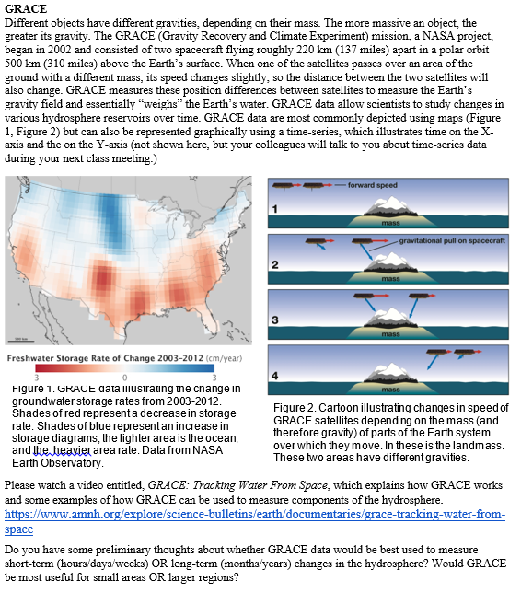
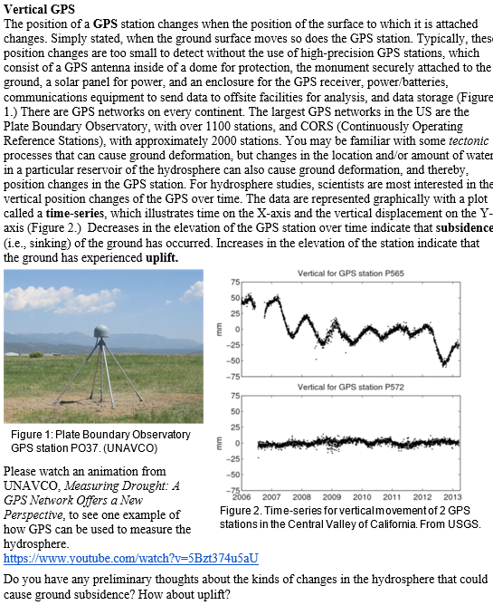

Slide 25
Unit 1: Exploring the Reservoirs and Pathways and Methods to Measure the Hydrologic Cycle
Unit 1.2: Traditional and Geodetic Methods for Tracking Water: in-class
Part 1: Students confer with colleagues who researched the same method and respond to some quick questions
Part 2: Students form new groups with (a) representative(s) for each method and give brief, informal presentations
GRACE
GRACE
GRACE
vertical GPS
vertical GPS
vertical GPS
SNOTEL
SNOTEL
SNOTEL
reflection GPS
reflection GPS
reflection GPS
stream gage
stream gage
stream gage
depth to gw
depth to gw
depth to gw
SNOTEL
vertical GPS
stream gage
SNOTEL
vertical GPS
stream gage
reflection GPS
GRACE
depth to gw
reflection GPS
GRACE
depth to gw
SNOTEL
vertical GPS
stream gage
reflection GPS
GRACE
depth to gw

Slide 26
Unit 1: Exploring the Reservoirs and Pathways and Methods to Measure the Hydrologic Cycle
Part 3:
Students complete exercise with example datasets for almost every technique and asks students to identify which method is illustrated for each
Students add methods to their hydrologic cycle diagram
  (stream gaging, depth-to-groundwater, SNOTEL, vertical GPS, GRACE, reflection GPS)

Slide 27
Using unit 1 in the remote classroom
Nice (not essential) if students have hard copies of the hydrologic cycle diagram.
May have to shuffle students in breakout rooms for the methods discussion if students are missing.
Encourage students to use their screen share and annotate functions on Zoom.

Slide 28
Breakout session 1: methods for measuring the water cycle
Time: ~15 minutes
Materials provided: partially annotated water cycle diagram
What to do:
  Add any reservoirs and transport pathways necessary;
  Drag the 6 methods to where they belong on the diagram (ex: show GRACE measuring glaciers)
    Stream gaging
    Depth to groundwater
    Vertical GPS
    Reflection GPS
    SNOTEL
    GRACE
Think about and discuss:
  How would this exercise look in my face-to-face and/or remote classroom?

Slide 29
Breakout session #1 discussion

Slide 30
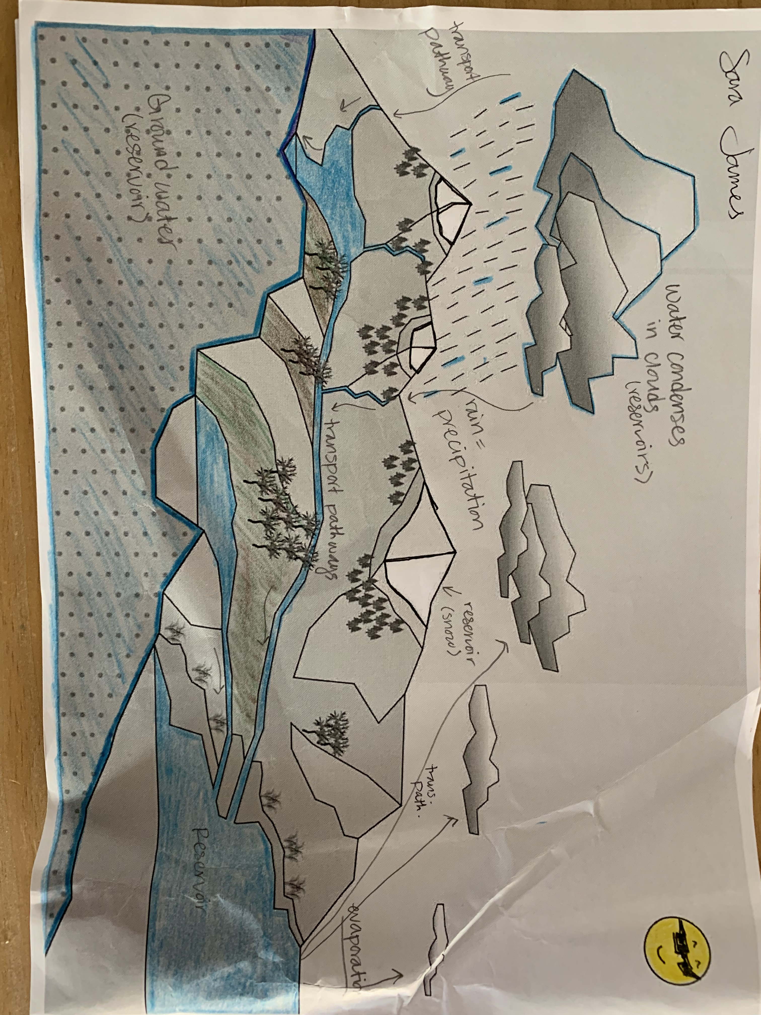
Example student work (earlier diagram version)

Slide 31
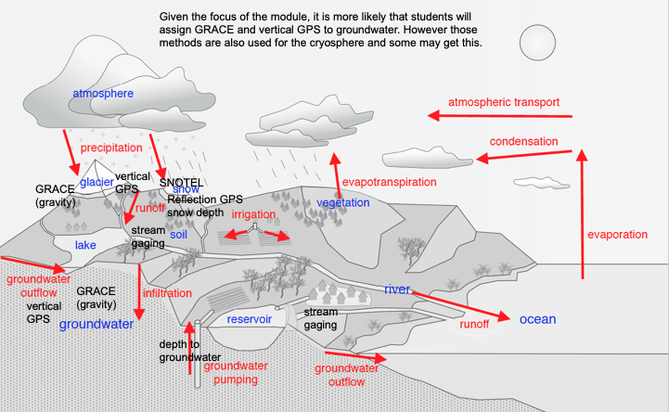
More complete answer key

Slide 32
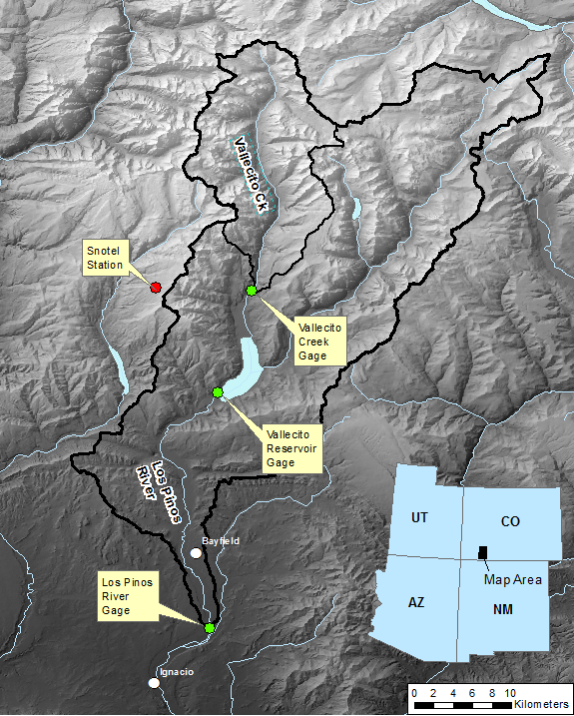
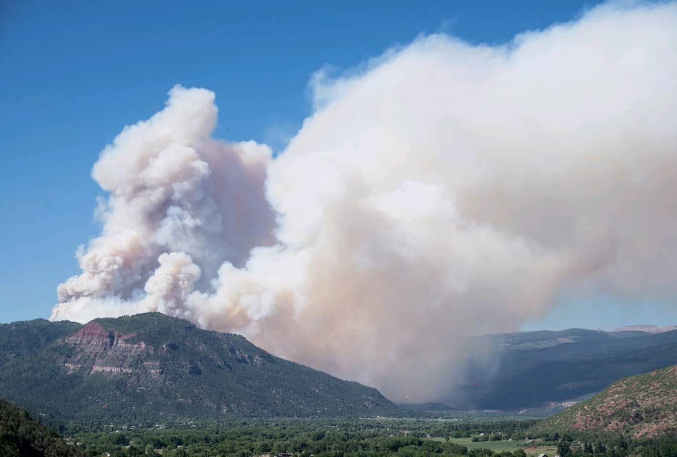
Unit 2: Monitoring surface and groundwater supply in the western US
Unit 2.2: Tracking Water Resources in a Western Mountain Watershed
  Investigating and interpreting SNOTEL, reflection GPS, and stream gage time-series data from a typical mountainous watershed in the western U.S.

Slide 33
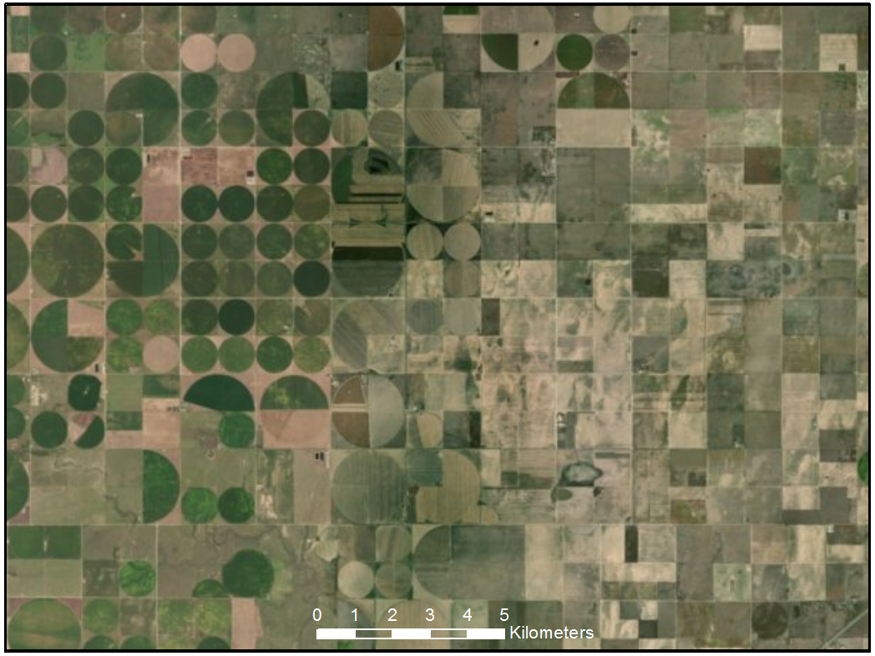
Unit 2: Monitoring surface and groundwater supply in the western US
Unit 2.1: Tracking Water Resources in the High Plains Aquifer
  Investigate and interpreting GRACE, vertical GPS, and depth-to-groundwater time-series data
  Compare groundwater trends from shallow, rechargeable aquifer and deeper, rapidly-depleting aquifer
Irrigated crops
and pasture
Uncultivated
land

Slide 34
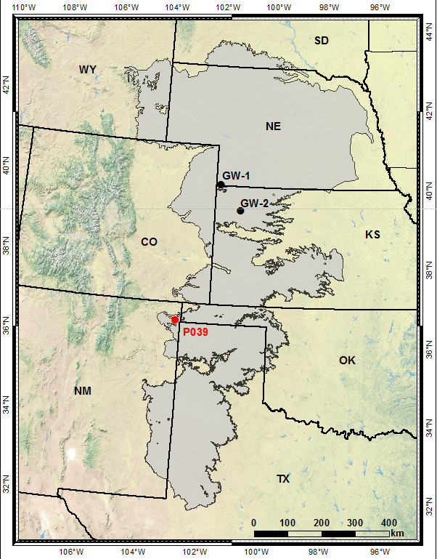
Why study the High Plains Aquifer? (HPA)
~1/3 of American irrigated cropland is irrigated with water pumped from HPA
>2 billion worldwide depend on aquifer water
An opportunity for students to:
  Interpret hydrologic time-series data
  Identify seasonal and annual patterns
  Identify long-term trends in groundwater using geodetic and traditional
  methods
  Articulate environmental and
  human use factors that
  influence water availability

Slide 35
Using unit 2 in the remote classroom
Nice (not essential) if at least one student per group can view (and screen share) the data in Excel; “hovering” over the data yields precise dates and magnitudes.
I like to start with the Western Mountain Watershed case study (Unit 2.1) and conclude with the High Plains Aquifer case study (Unit 2.2).
Encourage students to use their screen share and annotate functions on Zoom.

Slide 36
Breakout session #2: High Plains Aquifer
Time: ~25 minutes
Materials provided:
  Participant Google slides – START ON SLIDE 6
  Unit 2.1 student exercise
What to do:
  Complete questions in Google Slides document (drawn from the student exercise)
Think about:
  What will your students will most find challenging and how would you scaffold their learning?

Slide 37
Breakout session #2 discussion

Slide 38
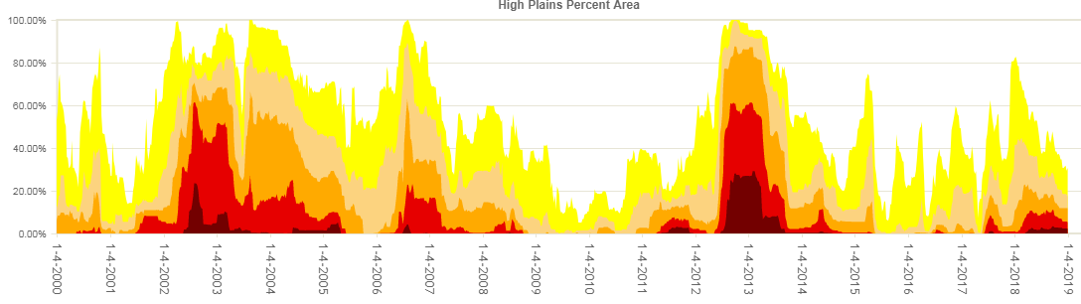
Figure 5: Data showing percent of High Plains Aquifer area that was in a state of drought between 2000 and 2019. Periods with a lot of orange-red-maroon colors are times of widespread severe drought. From US Drought Monitor.
3. Based on Figure 5, list any periods of time that look particularly dry in the High Plains Aquifer.

Slide 39
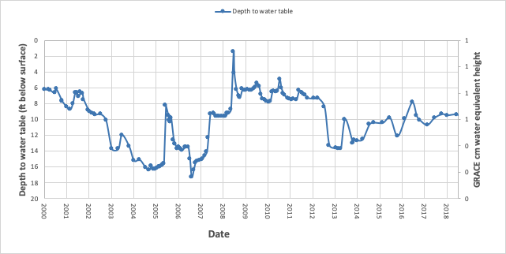
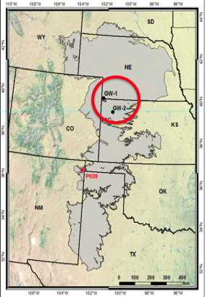
Showed significant drawdown in drought years
Aquifer has maintained similar long-term average

Slide 40
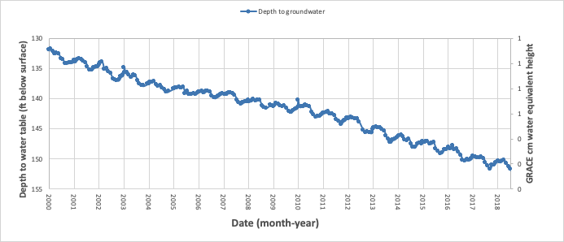
No change in drought years
Shows consistent decrease over long-term

Slide 41
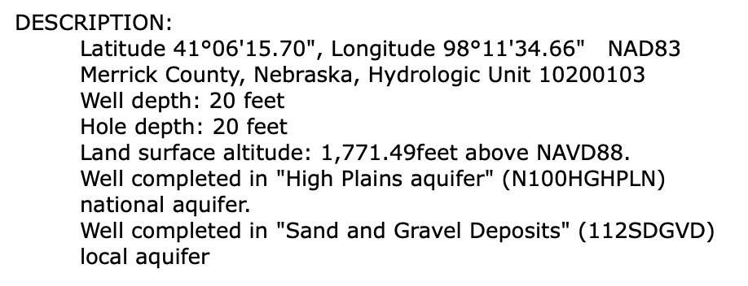
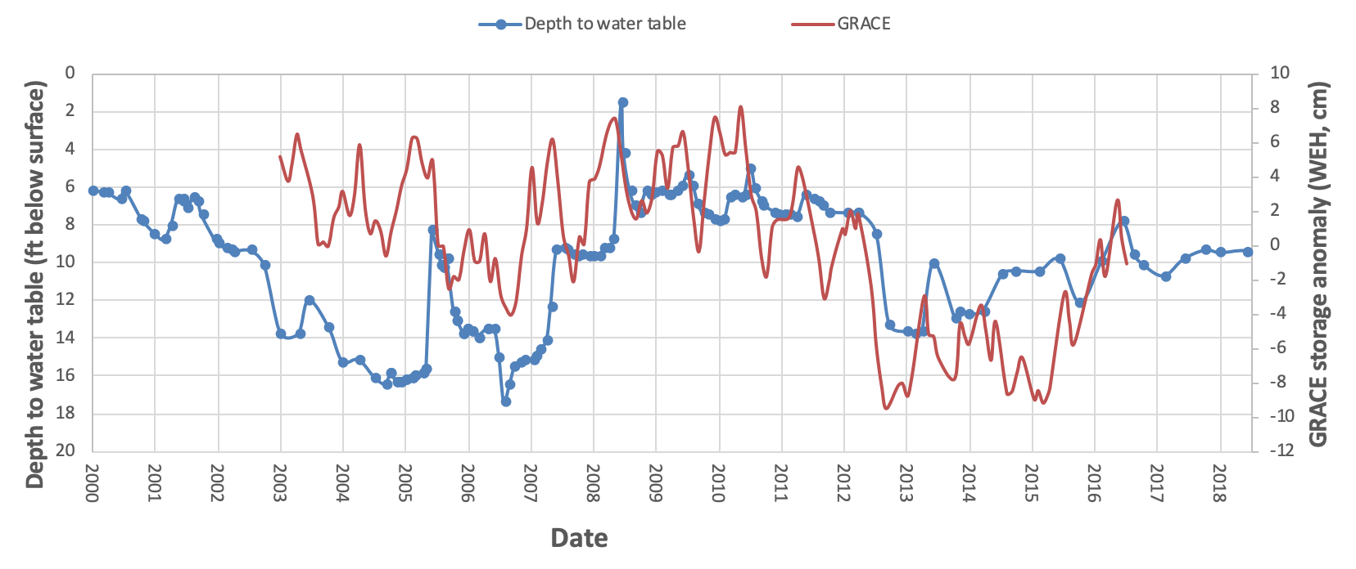
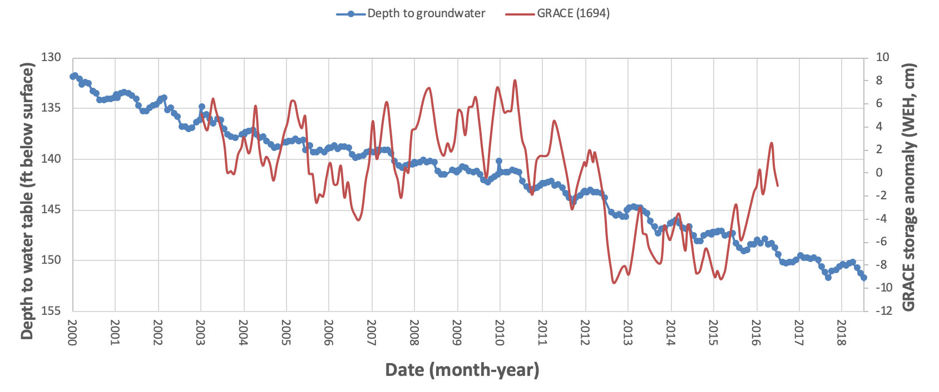
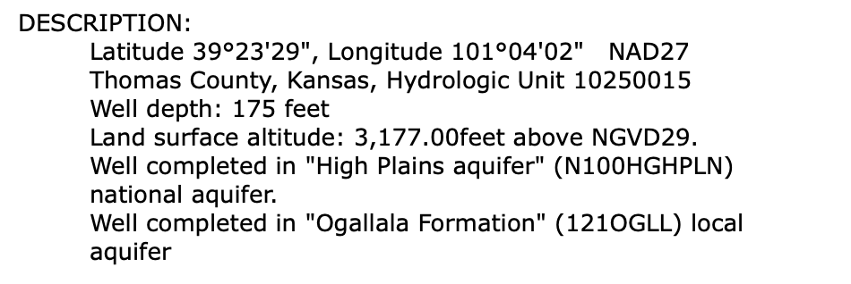
Why the difference in pattern between the 2 ground water wells?
GW-1
GW-2
Notes:
Poll #2 (long so page down all the way)

Slide 42
Relationship between GRACE data and the two groundwater wells
Notes:
The GRACE data records signals of both the shallow and deeper aquifers. It does show some of the drought-related interannual changes but it also records a long-term decrease in mass overall.

Slide 43
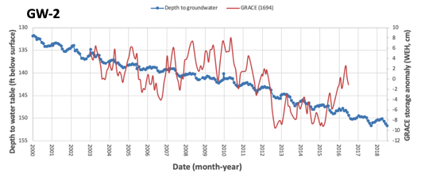
How much water is that really? To real people in their lives? - using GRACE data
8 - -10 = 18cm
15. Volume of water lost between May 2010 and Oct 2012 in cubic kilometers (km³).
16a. For how many years could a million-family city operate if they had access to the volume of water lost from the High Plains Aquifer from 2010 to 2012?
18cm
x 453,000km² = 82 km³
100,000cm/km
~215 years

Slide 44
Unit 3: What’s in YOUR Watershed?
3.1 Stakeholder analysis exercise
  Instructor leads students through discussion of the human component of water scarcity, focusing in on the local watershed or a locale of the instructor’s choice.
3.2 What’s in YOUR watershed?
  Students explore hydrosphere measurement data for their hometown or location of interest:
    What are the important reservoirs/transport pathways for that location?
    What methods and datasets are most relevant?
    What can students infer about seasonal – interannual variability and overall security of water resources for the study area?
    ***PowerPoint tutorial provided with screen shots and steps on how to access hydrosphere time-series for their location

Slide 45
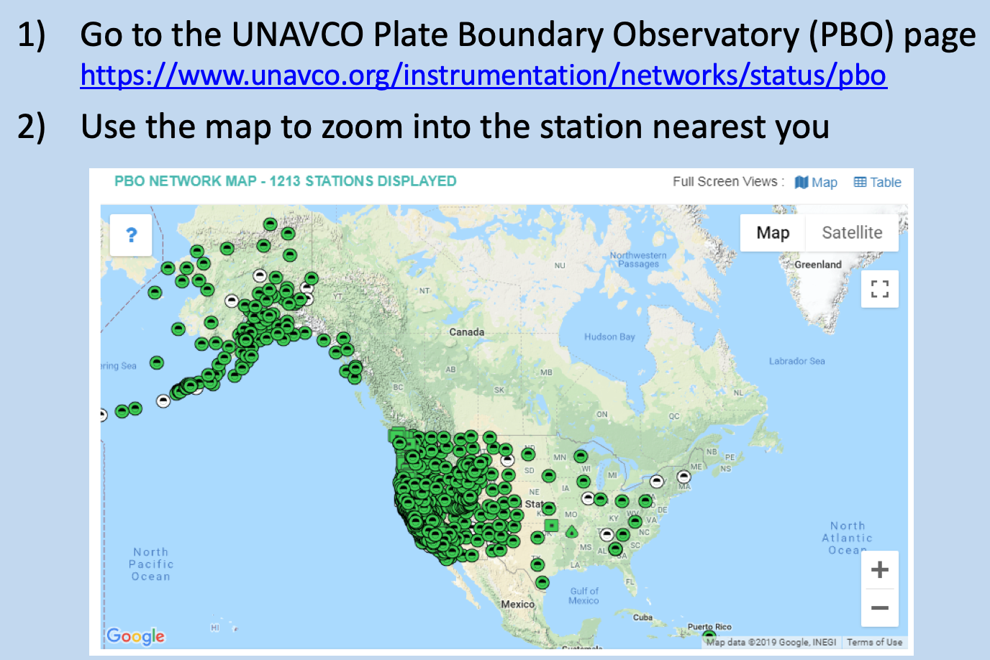
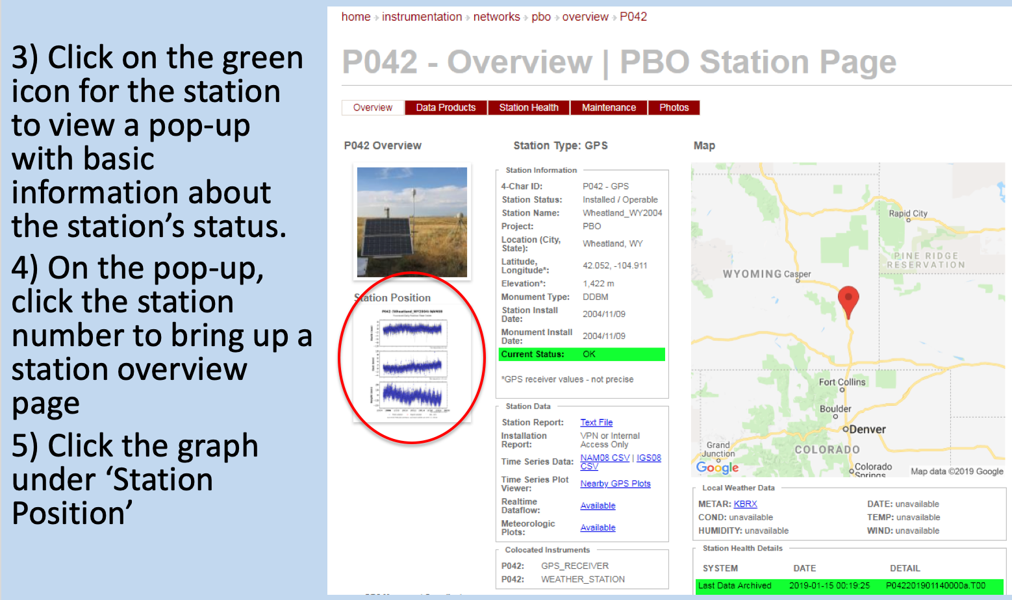
Accessing hydrologic data for your region
Screen shots of step-by-step instructions for each method showing how to:
(1) find the database
(2) obtain data for your desired location

Slide 46
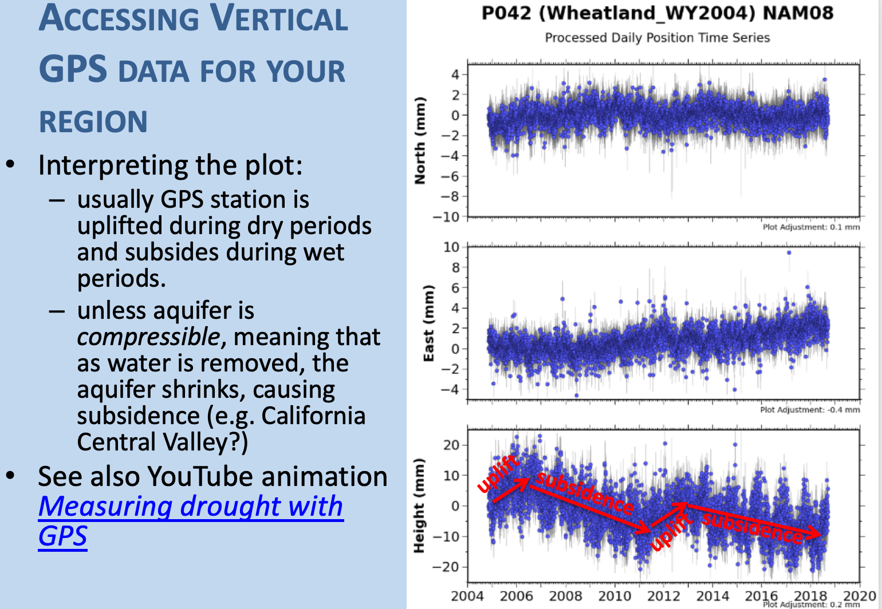
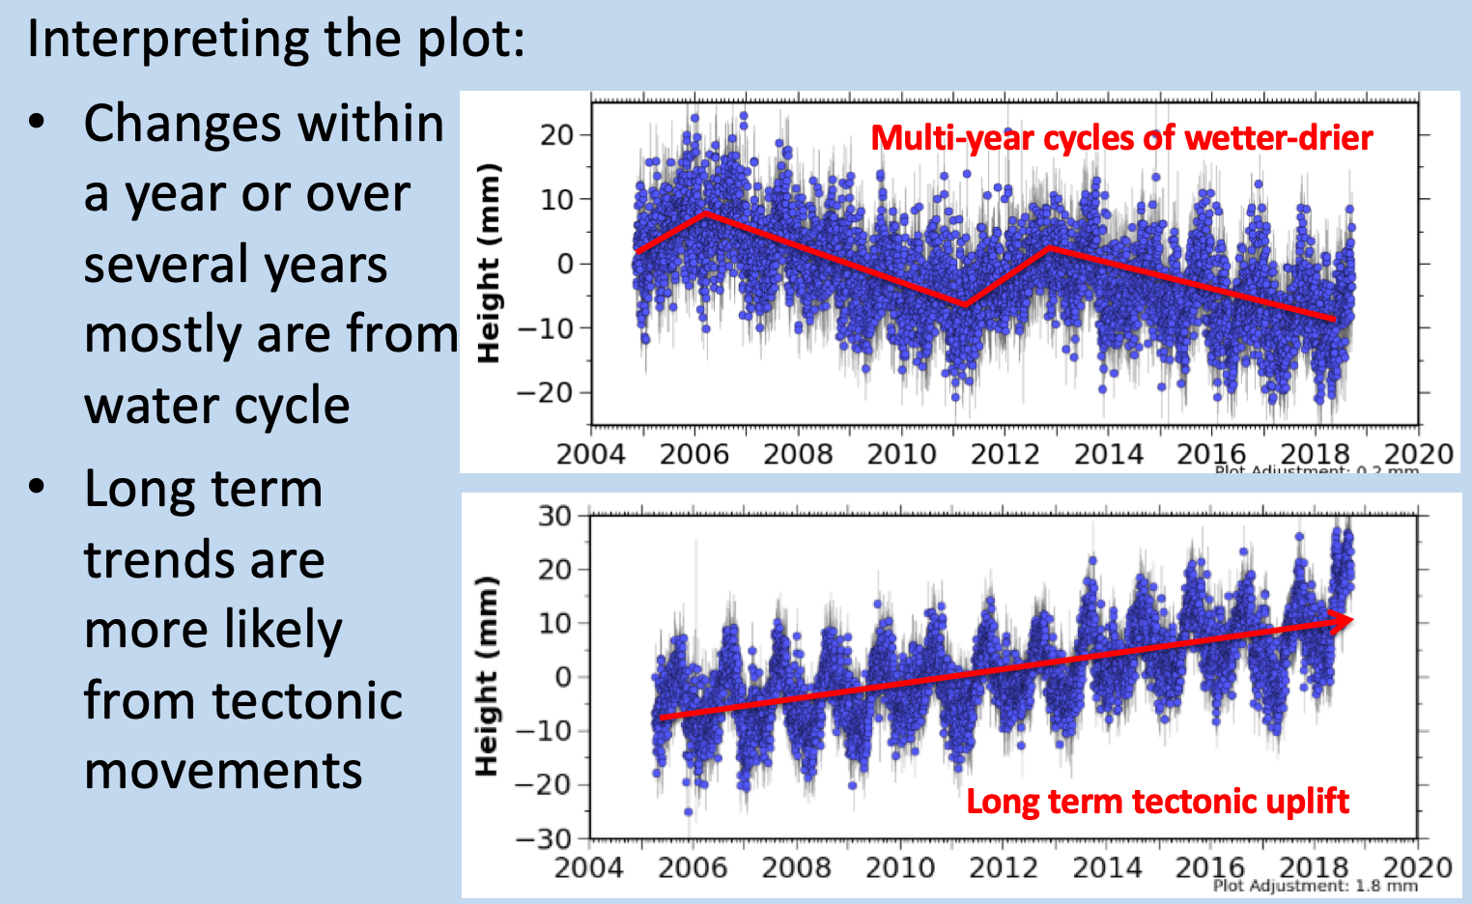
Accessing hydrologic data for your region
Screen shots of step-by-step instructions for each method showing how to:
(3) interpret the data

Slide 47
Using unit 3 in the remote classroom
I have been doing “What’s in YOUR Watershed” as a part of a city habitability project—would work nicely for synchronous and asynchronous classes.

Slide 48
Eyes on the Hydrosphere assessment
Formative and summative assessment ideas, questions, and rubrics provided for each unit
Summative assessment addresses module goals
Students will analyze the major reservoirs of the hydrosphere and the traditional and geodetic means of measuring their relative contributions to a water budget.
Students will interpret real geodetic and traditional data sets from different watersheds with different hydroclimatic regimes and assess short- and long-term trends in water availability for these watersheds.
Students will use real data to evaluate the societal effects of changing water supply and demand related to both natural and anthropogenic forcings.

Slide 49
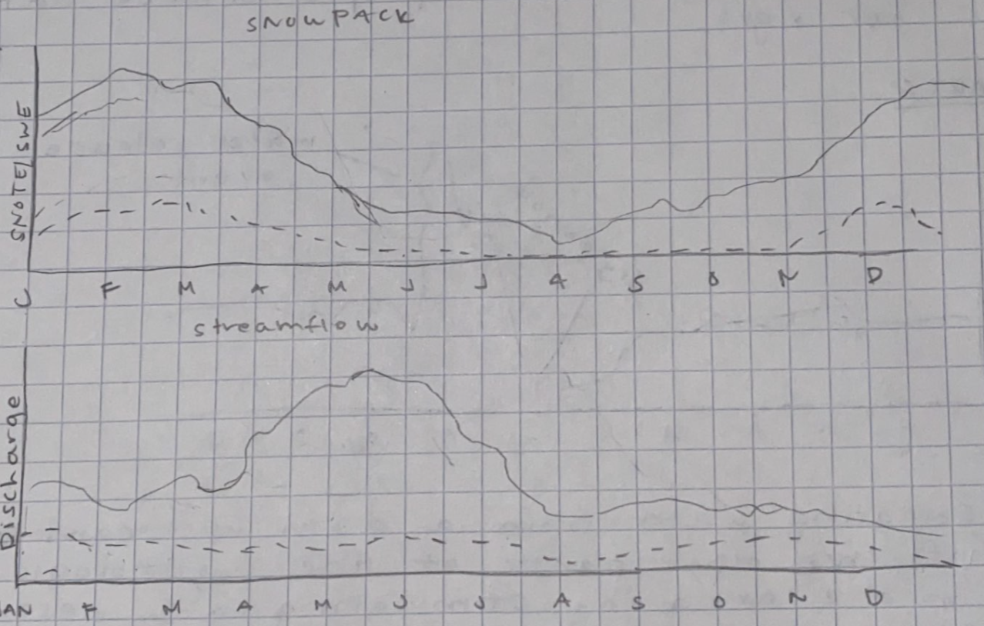
How might global warming show up in the 'water calendar' of a western mountain watershed? Answer by drawing representative annual curves for a typical western mountain watershed in solid lines, and in dashed lines, curves for those same plots in a world where average annual temperatures are warmer.

Slide 50
Questions?
Please type your questions in the Chat Box.
Or unmute and ask your question aloud

Slide 51
Implementation Planning-Exploring-Feedback
Spend the remaining time of the mini-course working on implementation planning
  Explore other aspects of the module or GETSI
  Write down steps you need to do to get ready to teach with this module
  Fill out form: link posted in the chat
  Complete by Sunday April 18 for stipend eligibility*
Majors-level module on water resources
  Measuring Water Resources with GPS, Gravity, and Traditional Methods
*US Citizens and residents only for stipend. Stipends will be compiled after the end of the term and sent together. But the implementation plan is useful to all participants!

Slide 52
Further Involvement w GETSI
If you use a GETSI module in your teaching, please fill out a “Share Your Experience” survey afterwards ($100 stipend)
GETSI Field project now has
teaching kits of GPS survey
equipment available to borrow.
See our Equipment page if
interested.

