Slide 1

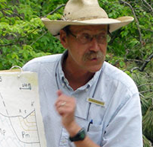
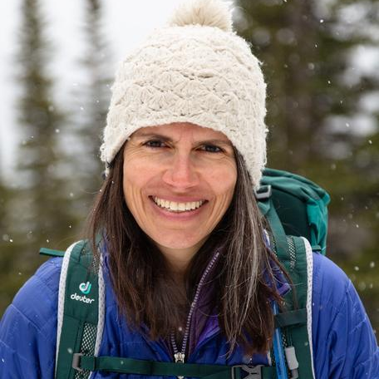
Engaging Undergraduates with the Data Behind Melting Ice and Changing Sea Levels
Understanding Our Changing Climate module
by Susan Kaspari (CWU) & Bruce Douglas (Indiana U)
serc.carleton.edu/234309
Beth Pratt-Sitaula
UNAVCO
Bruce Douglas
Indiana University
Susan Kaspari
Central Washington University

Slide 2

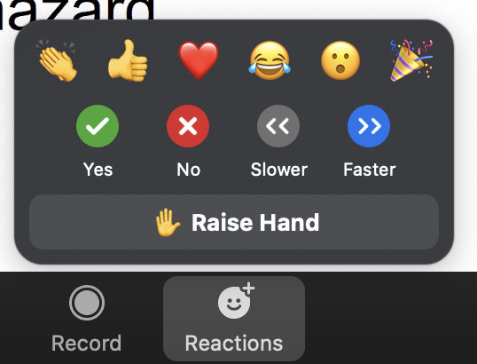

Technology
Poll #1
Please stay muted when you are not talking
Best to use earphones
Please make sure your real name shows
in the Zoom Participant list
Use chat box a lot! (group or private messages)
Raise your hand if you have something more complicated
so we can call on you. Then
you can unmute to speak.
We will not be recording the session, but will save the chat.
In breakout groups it is best to turn on videos to facilitate interactions (internet withstanding).
Closed captions are available in main Zoom room (if you depend on closed captions, please private-message “SERC host” so you can be put in a breakout group that stays in
the main room)
Notes:
Poll # 1
1. What is the primary course you are anticipating teaching these module materials in? (single choice)
Geoscience (majors-level)
Climate-specific course (majors-level)
Environmental science/geology (majors-level)
Cryosphere/glaciology (majors-level)
Introductory earth science (all types intro courses)
Other - put in chat
2. How long have you taught water resources/hydrogeology topics? ( Single Choice)
More than 10 years
2-9 years
Less than 2 years (including I haven't taught yet)

Slide 3
Introduction to Geodetic methods for measuring Aspects of the climate System

Slide 4
Satellite Radar Altimetry

Slide 5
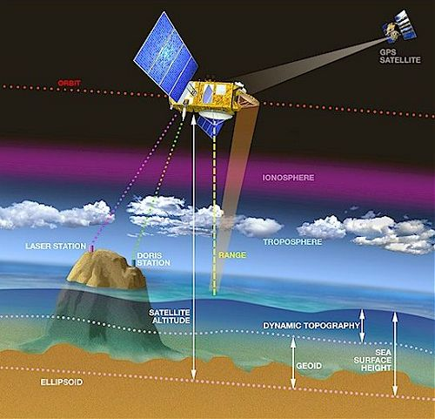
The basic principle of satellite radar altimetry
Altimetry is a technique for measuring height.
Satellite radar altimetry measures the time taken by a radar pulse to travel from the satellite to the surface and back.
Time-varying level due to tides, currents, and sea level change since geoid was established
Geoid - best approximate sea level
ESA
Ellipsoid - smoothed Earth shape
Diagram not to scale
Notes:
To measure sea surface height scientists must know the satellite’s position in its orbit and the height between the satellite and the ocean’s surface. Other factors that may need to be corrected for include variable amounts of water vapor in the lower atmosphere, and free electrons in the upper atmosphere, both of which can delay microwave pulses.
Text from: https://sealevel.jpl.nasa.gov/overview/oceansurfacetopo/
Image: http://www.altimetry.info/radar-altimetry-tutorial/how-altimetry-works/basic-principle/
--this is an ESA (European Space Agency) website and materials are available for educational use

Slide 6
Measuring sea level using satellite radar altimetry
Satellite altimeter radar measurements can be combined with precisely known spacecraft orbits to measures sea level globally with high accuracy (3-4 mm).
A series of satellite missions have estimated global mean sea level every 10 days since 1992.
Notes:
https://www.star.nesdis.noaa.gov/sod/lsa/SeaLevelRise/

Slide 7
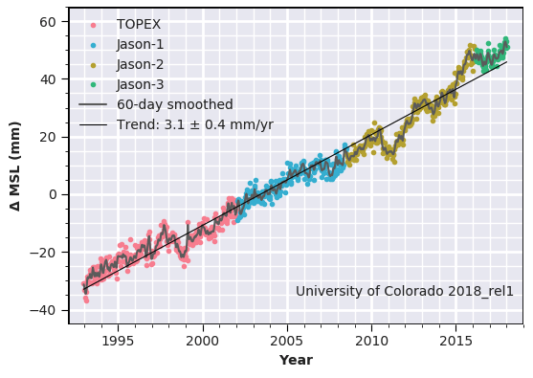
Global mean sea level from satellite missions TOPEX/Poseidon, and Jason-1, Jason-2 and Jason-3
Notes:
Global mean sea level with seasonal signals removed. The colors show data collected during the different satellite missions. A image capture of the site where this image can be found is in the resources section at end of this PowerPoint.
http://sealevel.colorado.edu/

Slide 8
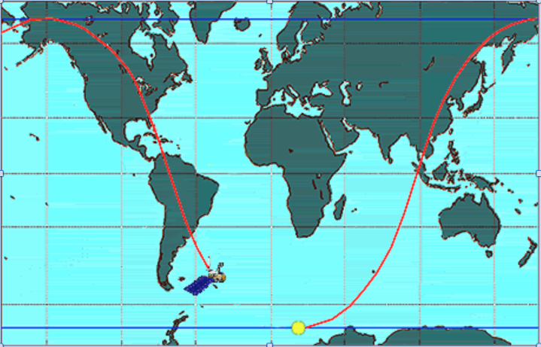

TOPEX/Poseidon Ground Tracks
~2 hours/orbit
Earth turns under the satellite
Every 10 days repeats within 1 km of previous track
Notes:
Every 10 days the Jason series of satellites (2002-present) measure the sea level height of more than 90% of the world’s ice free oceans with radar altimetry.
https://sealevel.jpl.nasa.gov/overview/oceansurfacetopo/ (public domain)

Slide 9
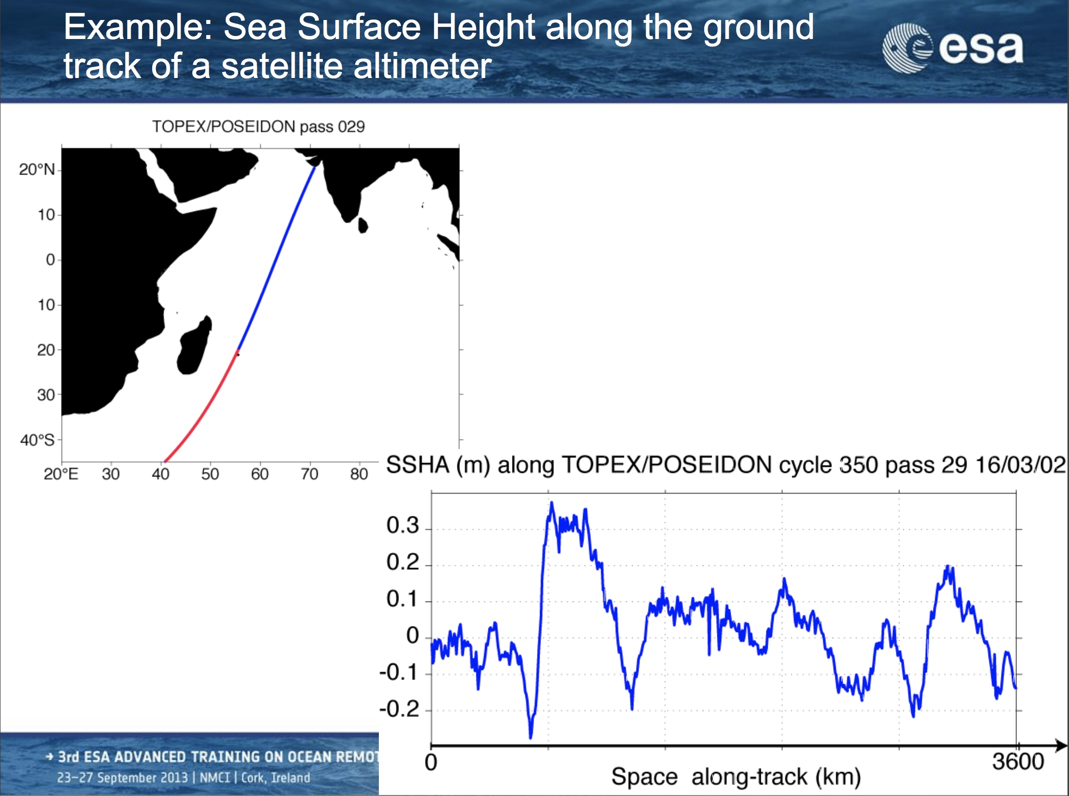
How bumpy is bumpy?
→What is approximate rise-over-run for this ocean section?
Poll #2
meters
720
2880
Notes:
Poll #2
What is the approximate rise-over-run for the ocean section circled in green on the graph?
6 cm over 100 km
0.6 m over 100 km
0.6 m over 600 km
Example of a portion of a single track from the TOPEX/Poseidon satellite altimeter showing the sea surface height anomaly in meters.
https://earth.esa.int/documents/10174/950521/01_Tuesday_OCT2013_Cipollini_Altimetry_1.pdf - Paolo Cipollini, Helen Snaith
ESA images are allowed to be used for educational purposes. https://www.noc.ac.uk/disclaimer
Poll#1
What is approximate rise-over-run for this ocean section?
6 cm over 100 km
0.6 m over 100 km
0.6 m over 600 km

Slide 10
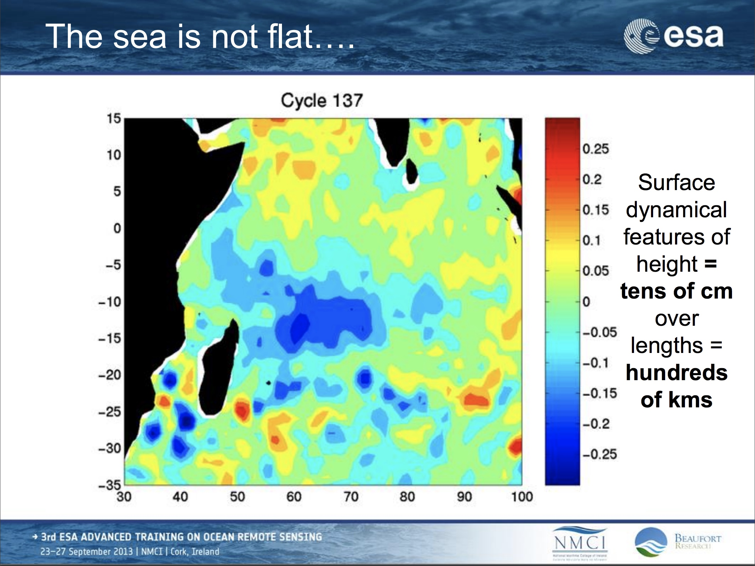
meters
Notes:
Scale bar given in meters
https://earth.esa.int/documents/10174/950521/01_Tuesday_OCT2013_Cipollini_Altimetry_1.pdf - Paolo Cipollini, Helen Snaith
ESA images are allowed to be used for educational purposes. https://www.noc.ac.uk/disclaimer

Slide 11
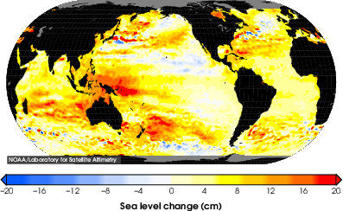
Total Sea Level Change Since 1993
Notes:
Sea level rise is spatially heterogeneous.
Note- this data set doesn’t indicate which year this graph was made.
https://www.star.nesdis.noaa.gov/sod/lsa/SeaLevelRise/

Slide 12
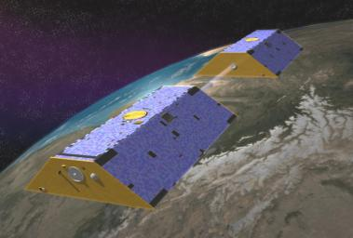
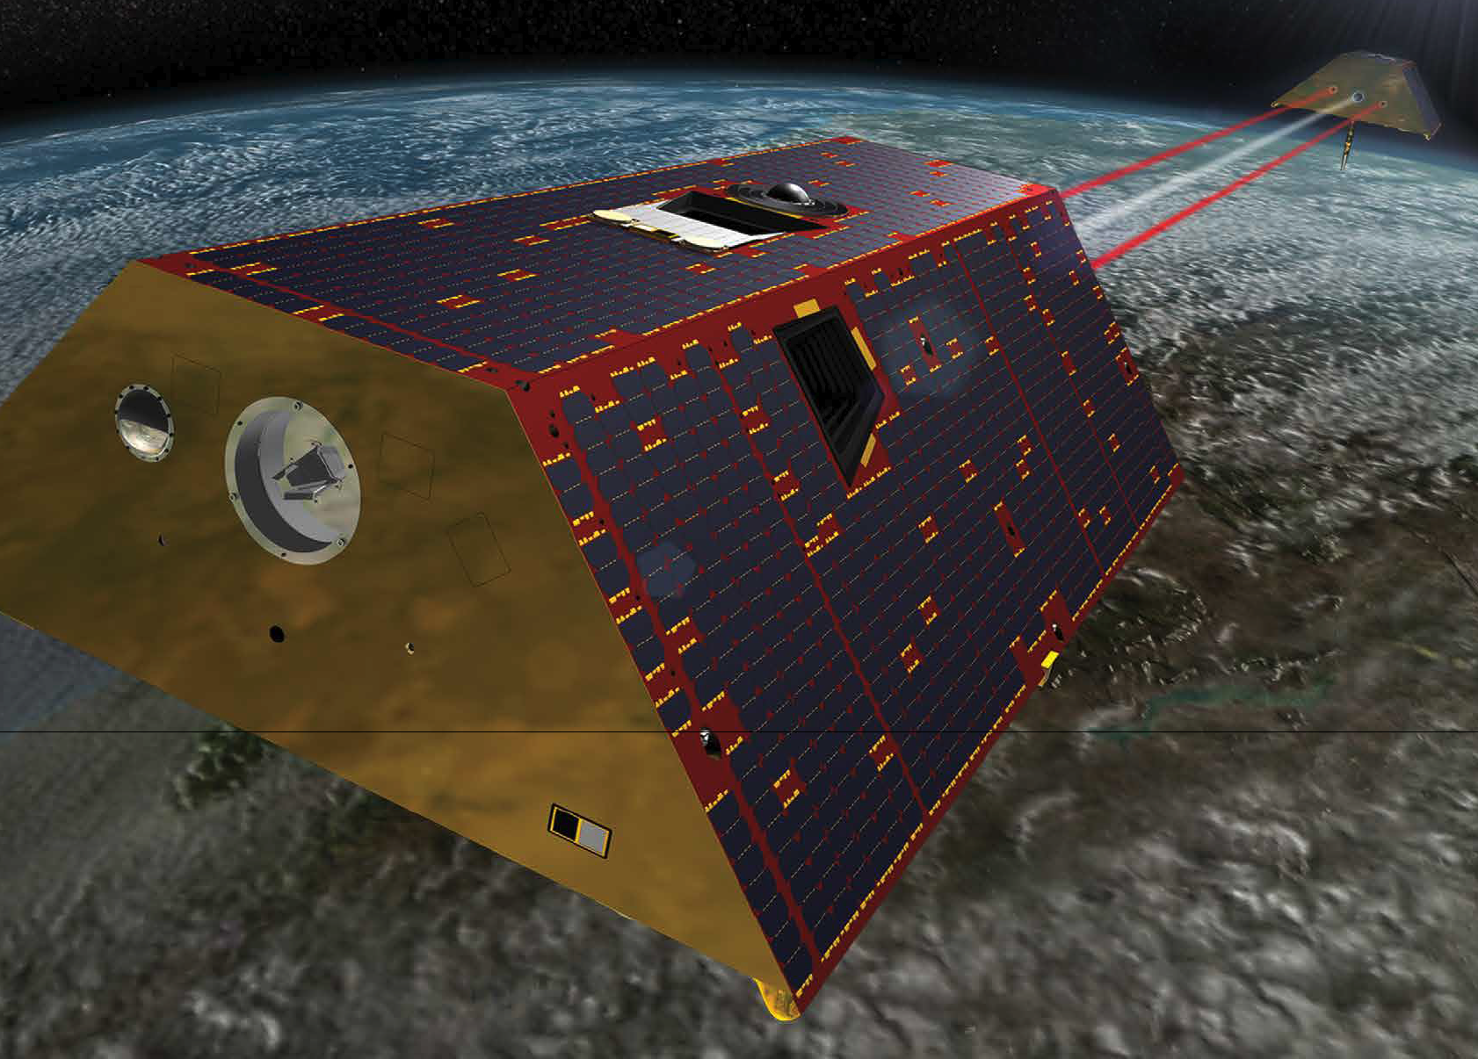
GRACE Missions:
Gravity Recovery and Climate Experiment
Original GRACE satellites 2002-17
GRACE Follow-on launched 2018
Notes:
http://photojournal.jpl.nasa.gov/jpegMod/PIA04235_modest.jpg (public domain)
https://gracefo.jpl.nasa.gov/resources/71/grace-fo-mission-brochure/

Slide 13
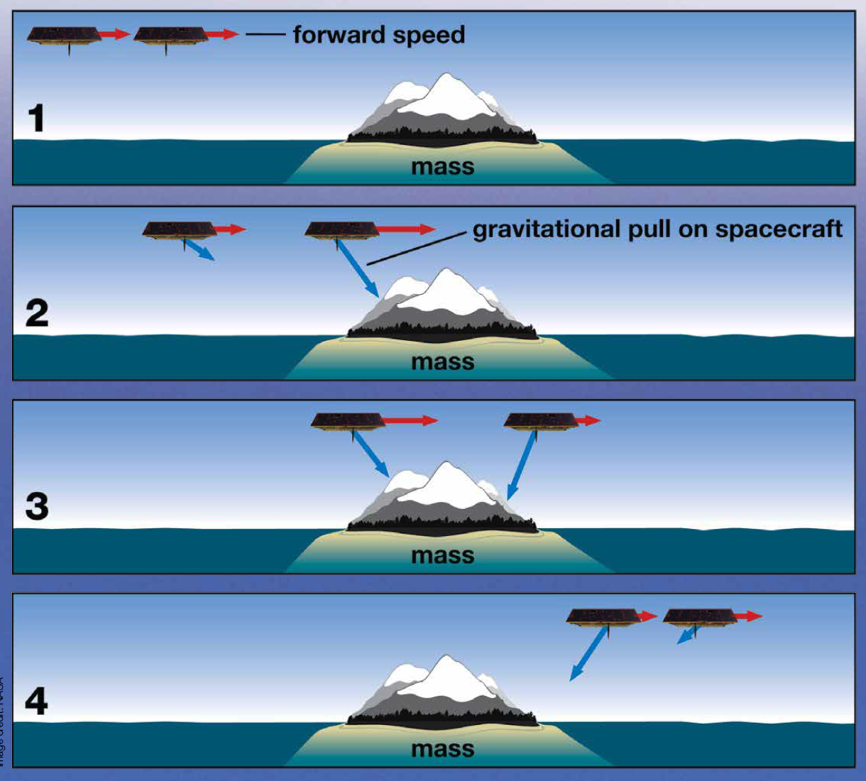
GRACE satellites sensing gravity changes
Notes:
https://gracefo.jpl.nasa.gov/resources/71/grace-fo-mission-brochure/
The distance between the satellites provides a way to measure the changing gravity field.

Slide 14
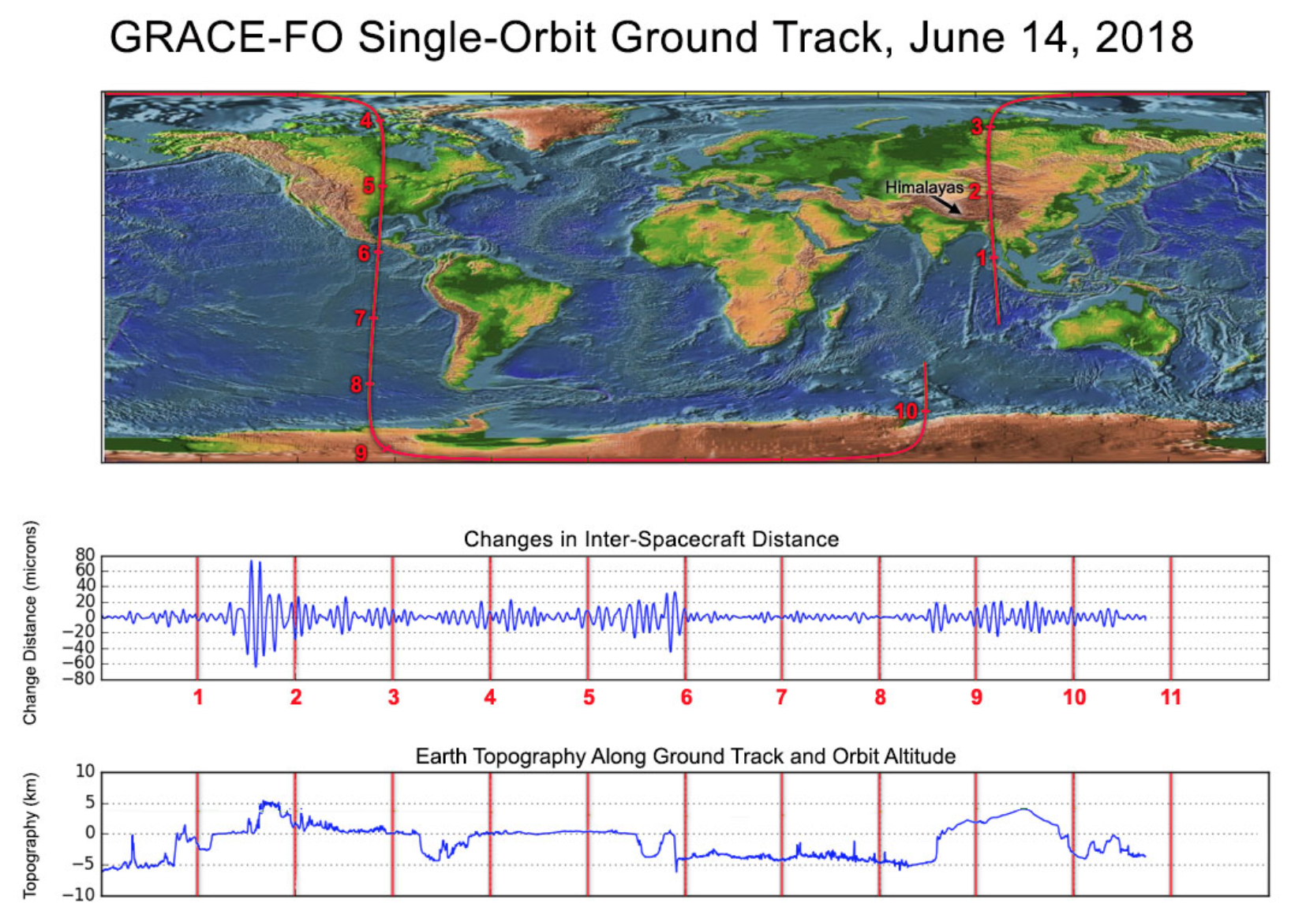
Example of distance & topography relationship
Notes:
OPTIONAL
https://gracefo.jpl.nasa.gov/news/138/first-laser-light-for-grace-follow-on/
“Along the satellites' ground track (top), the inter-spacecraft distance between them changes as the mass distribution underneath (i.e., from mountains, etc.) varies. The small changes measured by the Laser Ranging Interferometer (middle) agree well with topographic features along the orbit (bottom).”
This may be more information that you wish to get into with students but in reality there is a somewhat complex relationship between the distance between the satellites and the underlying topography/gravity with oscillations that need to be converted into a gravity value.

Slide 15
GRACE data characteristics:
2-6 month latency
Monthly data (some months missing)
Coarse spatial resolution (~100’s km)
GRACE original mission ran 2002-2017 (5-year expected duration was far outlived although by late 2016 GRACE was under modified operations to prolong battery life)
GRACE Follow-on mission launched May 2018, initially had some issues with onboard equipment, but data flow is proceeding in 2019.

Slide 16
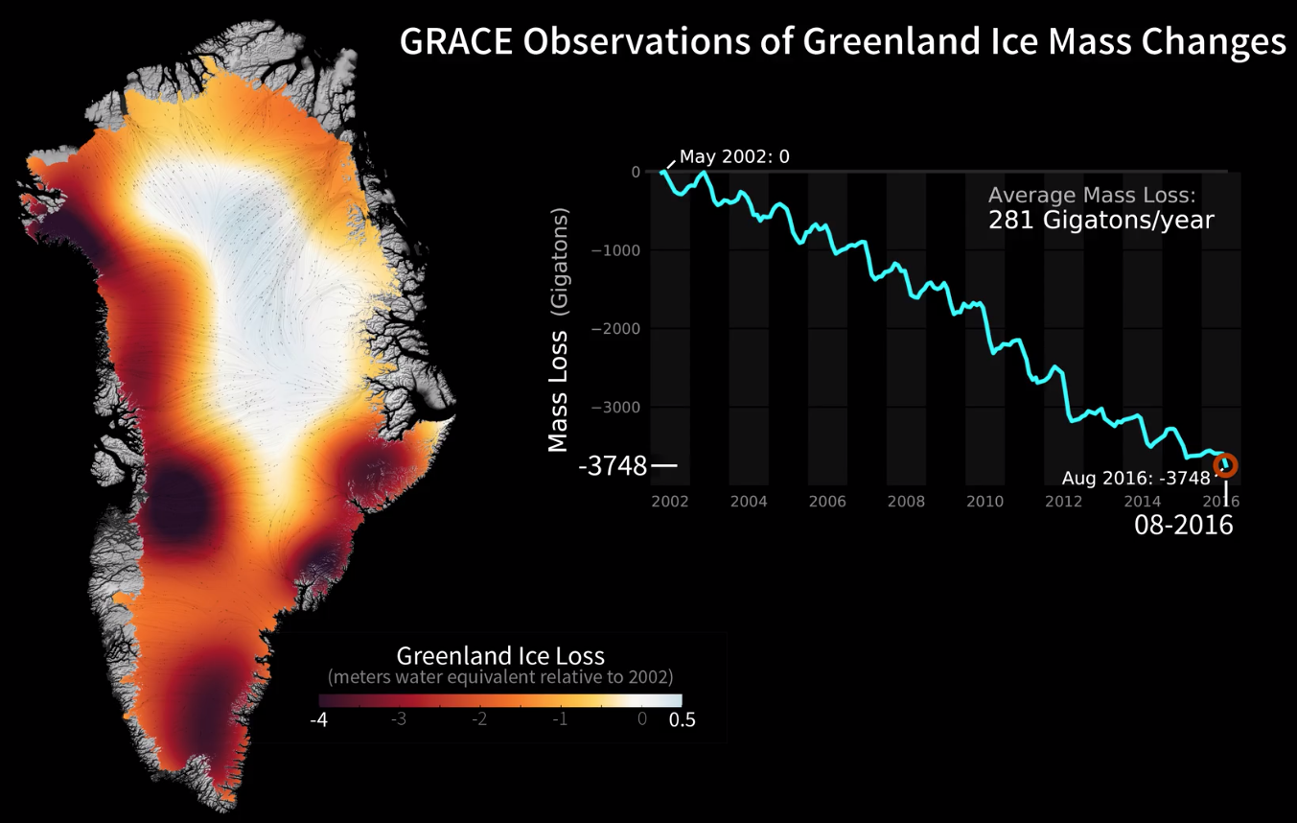

Animation of Greenland GRACE available from https://svs.gsfc.nasa.gov/30879
Notes:
Note: this color scale runs from -4 to 0.5 meters instead of -3 to 1 meters in Antarctica

Slide 17
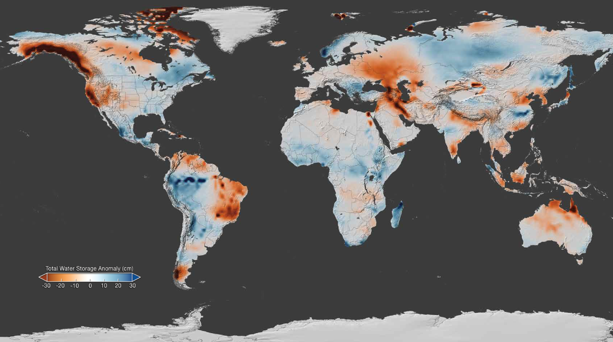
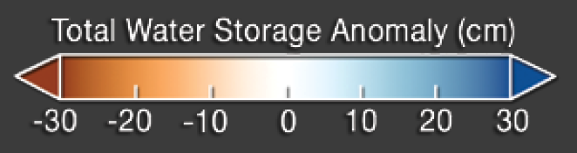
GRACE April 2015 anomaly from 2002-2015 average
Notes:
The gravity variations measured by GRACE can be used to determine water storage on land. By comparing current data to an average over time, scientists can generate an anomaly map to see where terrestrial water storage has decreased or increased. This map, created using GRACE data, shows the global terrestrial water storage anomaly in April 2015, relative to the 2002-2015 mean. Rust colored areas show areas where water has decreased, and areas in blue are where water levels have increased. Note the significant decreases in water storage across most of California are related to groundwater, while decreases along the Alaska coastline are due to glacier melt.
https://gracefo.jpl.nasa.gov/resources/71/grace-fo-mission-brochure/

Slide 18
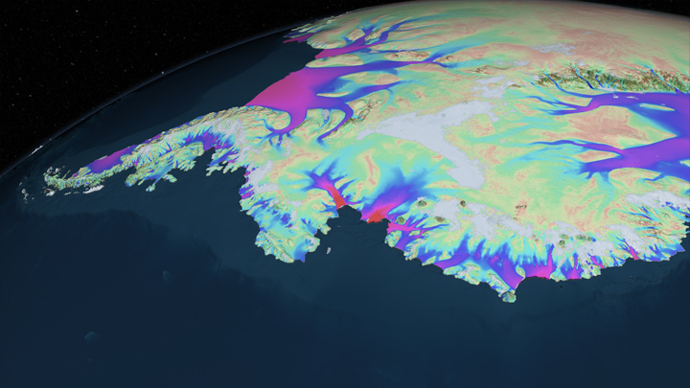

Using SAR to Measure Ice Velocity
Notes:
Image of the velocity of the ice sheet over West Antarctic as determined using SAT data. The color bar indicating the values associated with the colors. https://svs.gsfc.nasa.gov/4168

Slide 19
SAR (Synthetic Aperture Radar) satellite data
…is used to determine ice velocities using repeat imagery in two ways
InSAR
Speckle tracking (similar to feature tracking, which is done with optical images)

Slide 20
InSAR
Interferometric
Synthetic
Aperture
Radar
use wave interference
pretend you have a big radar antenna
emit microwaves,
measure echoes
Notes:
SAR (Synthetic Aperture Radar) is an imaging technique in its own right that uses the amplitude (intensity) of backscattered radar from the ground as a means of imaging it. A single image acquisition is all that is needed to produce a SAR image. Typically we do not use the phase of a single SAR image for imaging purposes.
On the other hand, we can use the phases of multiple SAR images. InSAR is a method that uses two or more SAR images to measure movements of Earth’s surface, by calculating the interference between the phases of the SAR images.
Elements of this InSAR presentation are taken from a presentation developed by Gareth Funning (UC Riverside) for GETSI module “Imaging Active Tectonics” Unit 3. https://serc.carleton.edu/details/files/63910.html

Slide 21
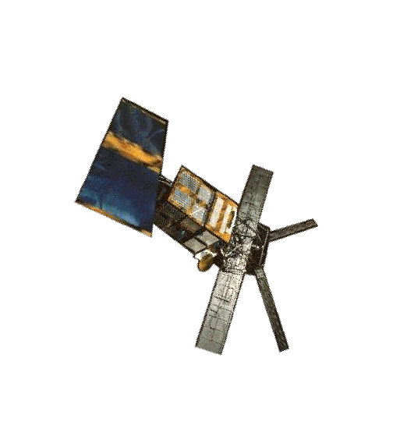
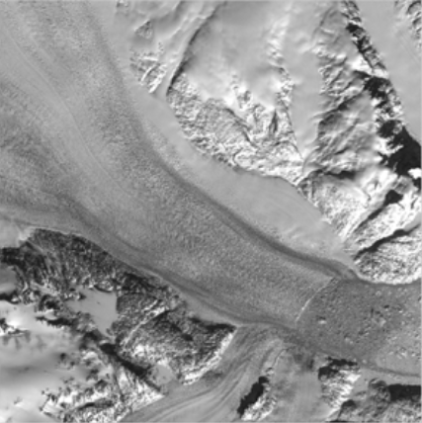
SAR: how it works
Satellite emits radar pulse
Radar is backscattered
Amplitude (intensity) and phase of echo recorded at the satellite
Glacier flow
Notes:
The radar antenna on a satellite (shown here is ERS-1, the first long-lived orbiting SAR satellite, launched in 1991) is both an emitter of radar and a detector of radar. A pulse of microwave radiation is emitted toward the ground, and some of it is scattered back to the satellite. The antenna records both the amplitude (intensity) and phase of the backscattered radar. A typical radar satellite makes over a thousand such measurements every second (in the case of ERS-1, 1680 measurements per second).
Image from: https://nsidc.org/sites/nsidc.org/files/technical-references/GIMP-ATBD-Version2.pdf
Landsat image of the Kangerdlussuaq Glacier is used for illustration purposes.

Slide 22
InSAR images record:
Phase → records distance between satellites and earth.
Amplitude → records terrain slope and surface roughness.
Phase change implies ground motion such as glacier/ice movement, landslide, faulting …
Time-series approach→ two or more images of the same area taken at different times.
If distance between sensor and repeat target is non-zero following corrections→ motion
Notes:
SAR imaging uses amplitude (intensity) of backscattered echoes. Radar sees through clouds—all-weather imaging is possible.
Don’t need illumination by the Sun—can image day and night
Surface roughness and slopes control the strength of the backscatter

Slide 23
Phase
Phase is a function of the distance from the satellite to the ground.
ERS-1
~6 cm
~780 km
Glacier flow
Notes:
In this example, the ERS-1 satellite has a wavelength of ~6cm (called “C-band”), so the resolution of changes is ½ the wavelength and thus ~3cm.
Recall that one wavelength of path length is equivalent to 2π of phase. Given that radar satellites orbit at several hundred km of elevation, it is not feasible to count the number of phase cycles for a single image . . .
Image from: https://nsidc.org/sites/nsidc.org/files/technical-references/GIMP-ATBD-Version2.pdf
Landsat image of the Kangerdlussuaq Glacier for illustration purposes.

Slide 24
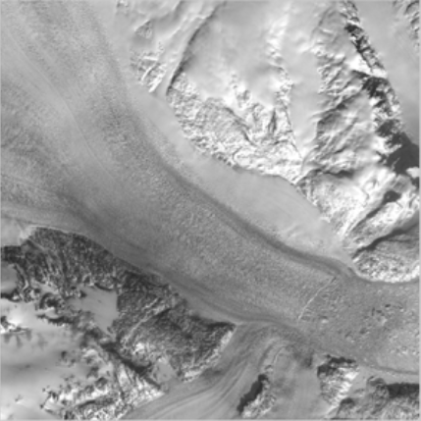
InSAR: No Change
Pass 1
Pass 2
Glacier flow
Notes:
. . . So what we do is compare (difference) the phase from two different passes of the same satellite over the same point on the ground. Assuming that we can correct for the position of the satellite (and we can), then any difference in phase between the two passes must be related to a change in distance between the satellite and the ground (i.e. a movement of the ground or the ice or glacier in this case).
In the example shown here, there is no change between the two passes (actually they are the same image), so we would determine no movement.

Slide 25
InSAR: Change in time
Pass 1
Pass 2
Phase=φ₁
Phase=φ₂
Phase shift due to ice movement.
Glacier flow
April 5, 2001
April 14, 2001
Notes:
In this case there is change (although to the human eye, it would be hard to detect) between the two passes taken 9 days apart, so we can detect a phase shift when we subtract the phase of the second image from the phase of the first!
It is important to note that we can only measure displacement of the ground toward or away from the satellite, in the line-of-sight direction between the two. Everything we measure is a “line-of-sight” displacement.
For InSAR-derived velocities, researchers typically use the most frequent repeat times available – especially for fast-moving areas where flow is over a kilometer per year. Sentinel-1 satellites have repeat times of 6 days. Other satellites range may only repeat every ~30–90 days

Slide 26
InSAR: How it works—Summary
Phase shift varies in different parts of the ice because of different velocities
One interferogram records motion in only one direction (Line of Sight), orthogonal to the flight path.
Assuming surface-parallel ice movement, interferograms from ascending and descending orbits can be combined to create 3D motion.
Notes:
It is important to note that the only way we know that there has been movement is if different areas of the ice/glacier move with different amounts—InSAR makes measurements of relative deformation. If the whole area moved by the same amount we would not see any relative phase shift. In the Landsat image shown here we would expect the glacier/ground would move farther away from the satellite.

Slide 27
Speckle tracking
Computer algorithm scans the intensity SAR for identifiable patterns in the pixels (“speckles”) and measure how much they shift between scenes.
Can help to think of “feature tracking” with optical satellite data wherein identifiable features are tracked over time.
Glacier
Initial image
Second image

Slide 28
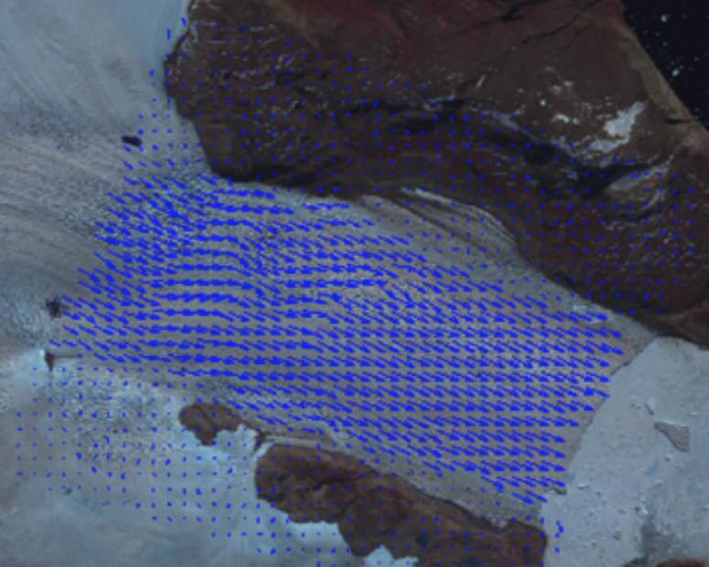

Speckle tracking
Speckle tracking calculates probabilities that a patch of “speckles” is the same patch of ice but moved.
Pairs of SAR images are co-registered with sub-pixel accuracy.
Co-registration is from cross-correlation of speckle patterns.
These registration offsets provide a vector estimate of displacement, although with poorer
resolution and accuracy
than conventional interferometry.
Glacier
Example of how resulting vector field looks
Initial image
Second image
Notes:
Image from: https://nsidc.org/sites/nsidc.org/files/technical-references/GIMP-ATBD-Version2.pdf
Some of the text by Ian Joughin (UW). Used with permission

Slide 29
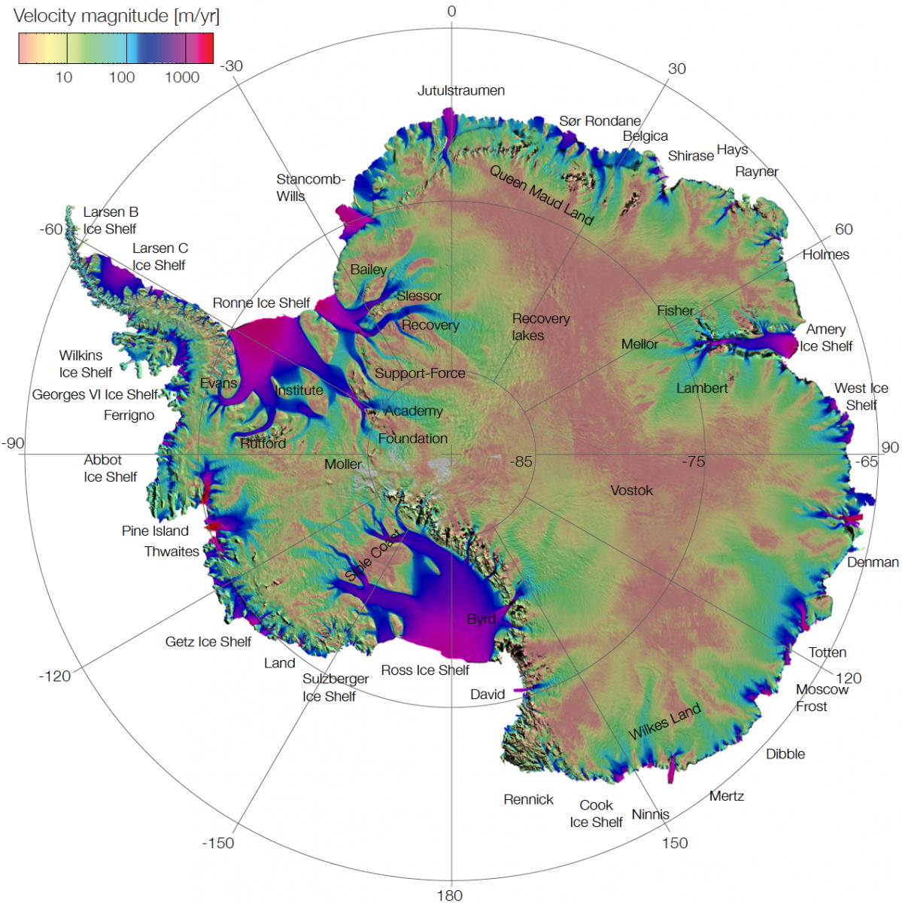
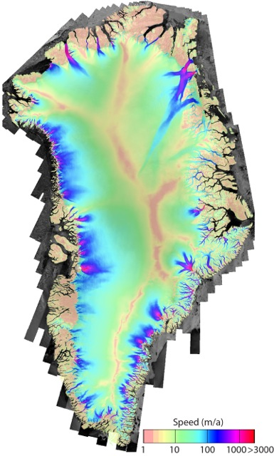
Velocity Images of Antarctica and Greenland
High spatial variability is very challenging to fully capture
Final products are error-weighted mosaics of 100s-1000s of interferograms and speckle tracking vector fields
Notes:
These maps demonstrate that ice sheet ice velocity is highly variable, and that there are certain regions of the ice sheets referred to as ice streams that transfer ice from the interior of the ice sheets to the ocean. The combination of InSAR and speckle tracking methods are needed in order to capture the large spatial variability.
https://nsidc.org/sites/nsidc.org/files/images/data/measures/0484v2/SampleImage.png (public domain)
https://nsidc.org/data/nsidc-0484
References for above Images and related videos
http://nsidc.org/data/NSIDC-0670#
http://nsidc.org/data/measures
https://www.youtube.com/watch?v=GDXq8Oa5d5Q
https://www.jpl.nasa.gov/video/details.php?id=1015
Further information on ice streams is available at: http://www.antarcticglaciers.org/modern-glaciers/types-of-glacier-2/ice-streams/

Slide 30
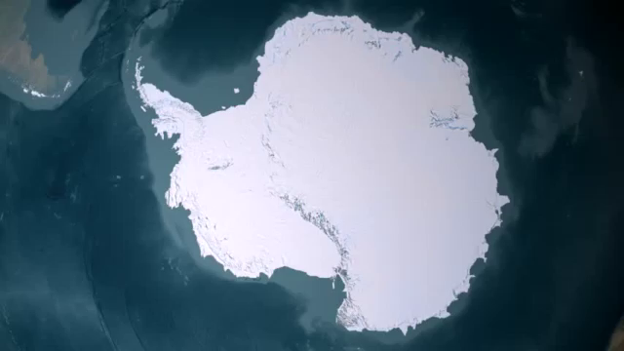
Animation: Antarctica on the Move
Notes:
Antarctica on the Move
“While Antarctica may appear stationary, it is actually a mosaic of moving ice sheets. Ice is naturally transported from the interior regions (where it accumulates from snowfall to the coastal regions) and is discharged to the ocean as tabular icebergs and ice-shelf melt water. This visualization shows the velocity of ice on Antarctica representing hundreds to thousands of years of motion. Ice velocity is color coded on a logarithmic scale with values varying from 1 meter per year (brown to green) to 3000 meters per year (green to blue to red). These observations have vast implications for our understanding of the flow of ice sheets and how they might respond to climate change in the future and contribute to changes in global sea level. “
SVS Animation 3848 - NASA Research Leads to First Complete Map of Antarctic Ice Flow

Slide 31
Vertical GPS

Slide 32
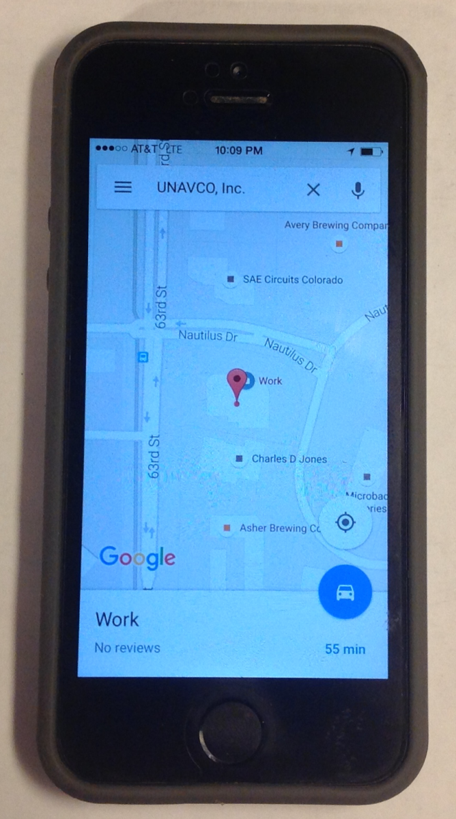
What Is GPS?
GPS receivers are in phones, cars, etc.—basically anything that tells you where you are
This is a great entry point for engaging students
Note: global positioning system (GPS) is technically just the US component of the global navigation satellite system (GNSS) which includes Russia, Europe, China, and others
Notes:
Whether they know it or not, students use GPS receivers daily in their cars, phones, cameras, and handheld recreational GPS. Most have heard the term “GPS,” but few know much about how the system actually works or high-precision GPS for science and industrial use.
Note: Although the term GPS (Global Positioning System) is more commonly used in everyday language, it officially refers only to the USA's constellation of satellites. GNSS (Global Navigation Satellite System) is a universal term that refers to all satellite navigation systems including those from the USA (GPS), Russia (GLONASS), European Union (Galileo), China (BeiDou), and others. In this module, we use the term GPS even though, technically, some of the data may be coming from satellites in other systems.
Images from UNAVCO

Slide 33
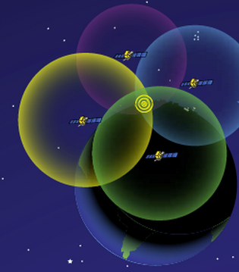
How Does GPS Work?
Receiver position is determined by calculating the distances to at least 4 satellites
Solve for the variables:
  North–South position
  East–West position
  Elevation
  Time
3D
http://spaceplace.nasa.gov/gps-pizza/en/
Notes:
The time element is needed because of the difference between the highly accurate atomic clock on the satellites (US$100,000 each) and the much cheaper clock in the GPS receivers.
Although 4 is a technical minimum number of satellites, for geoscience research work it is highly recommended to have at least 6 satellites.
Although people will often refer to this process and “triangulation,” in fact it is “trilateration” because it depends on distances rather than angles.
For a nice explanation of trilateration versus triangulation visit https://gisgeography.com/trilateration-triangulation-gps/.
Images from NASA (public domain) http://spaceplace.nasa.gov/gps-pizza/en/

Slide 34
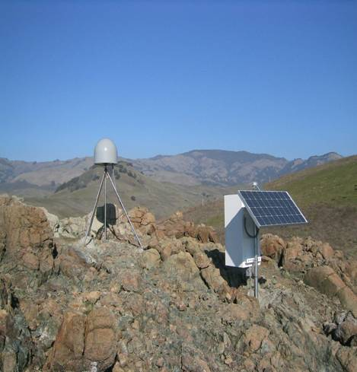
High-Precision Permanent GPS station
GPS antenna inside of dome
Monument solidly attached into the ground with braces.
If the ground moves, the station moves.
Solar panel for power
Equipment enclosure
GPS receiver
Power/batteries
Communications/radio/modem
Data storage/memory
Notes:
Example of a typical remote GPS station. In urban areas, some are also fixed to the roofs of large reinforced buildings and hooked into grid power supply with battery backup. Many stations are now being equipped with “real-time” communication to allow immediate transfer of data to researchers. In other places logistics or country-specific regulations require that data not be transmitted but is instead downloaded manually on a given schedule (monthly, quarterly, or annually, depending on the site).

Slide 35
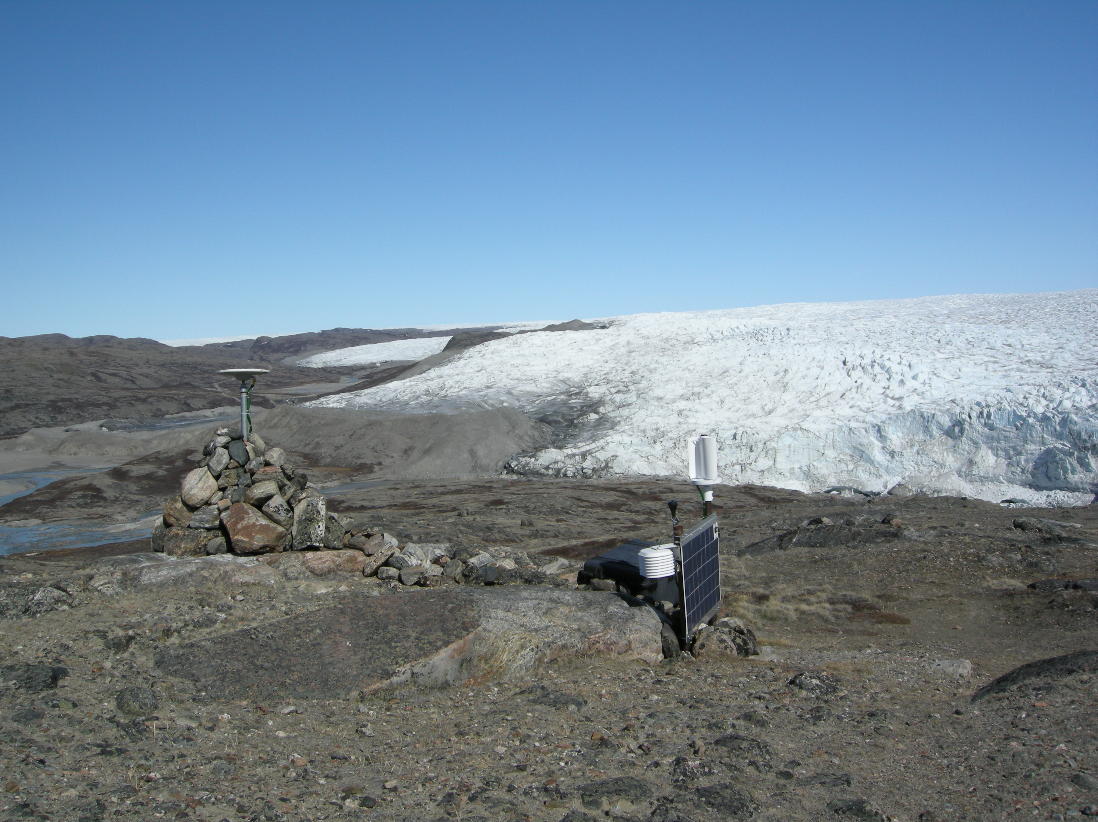
GPS station in western Greenland near the town of Kangerlussuaq

Slide 36
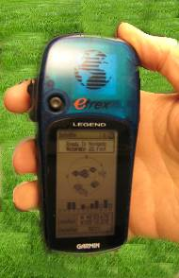
Antennas receive data streams
Works the same…
Your location is:
37º 23.323’ N
122º 02.162’ W
The time is:
11:34.9722 (UTC)
ERRORS (after 8 hrs)
Horiz: ± 2-4 mm
Vert: ± 10-15 mm
ERRORS
Horiz: ± 10 m
Vert: ± 15 m
RATES
~1 mm/year
after ~2 years
Notes:
Since each satellite maintains time very accurately (~1 nanosecond = 30 cm), it can tag its signal with the time of transmission. This information, together with the location of the satellite, also transmitted to the receiver, is sufficient to allow the receiver to calculate the range to each satellite, provided that the receiver also knows the time. Equipping receivers with atomic clocks would be very expensive, so the receiver tags the signal with the time of its internal clock to create a “pseudorange” (range plus an unknown clock correction). The software in the receiver then uses the pseudoranges from four satellites to solve for the four unknowns: three coordinates and the receiver clock correction.
Images: Vince Cronin (Baylor University)
High precision rates taken from GAMIT/GLOBK 10.6 release notes - http://geoweb.mit.edu/gg/
After 24 hours
Horz: +/- 1-2 mm
Vert: +/- 5 mm

Slide 37
Understanding Our Changing Climate: Data Behind Melting Ice and Changing Sea Level
About the module itself
Notes:
Climate change is a defining challenge of the current age, and sea-level rise is one of the greatest effects. This module helps students to learn about primary stakeholders in sea-level change and explore a wide variety of climate-related data.

Slide 38
Module Goals
Analyze geodetic data to assess ice-sheet changes and the causes of observed sea level, and make predictions of future sea-level rise.
Assess the societal and economic consequences of observed and projected sea-level changes on regions most vulnerable to sea-level rise.
Notes:
looded villages and fields around a river in Bangladesh the day after the 1991 Bangladesh cyclone had struck the country. In this unit, students will asses the potential societal impacts of sea level change, as shown in this image.

Slide 39
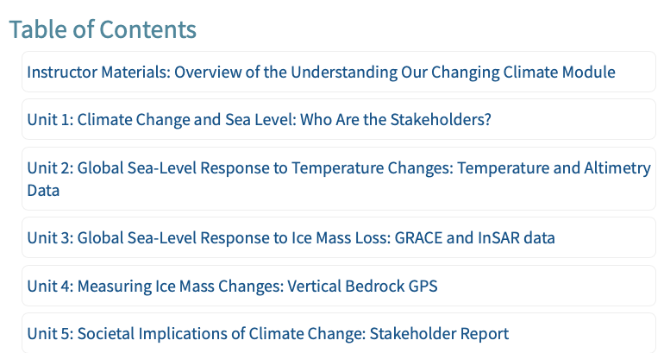
Module Components
Unit 1: Students learn about primary stakeholders in sea-level change
Students investigate factors influencing sea level:
thermal expansion (Unit 2)
ice mass loss (Unit 3)
changes in land water storage (Unit 4)
Students also consider how much more sea levels will rise this century (Unit X)
Students synthesize current knowledge in a final stakeholder report (Unit 5).
Students gain considerable spreadsheet analysis skills in Units 2-4

Slide 40
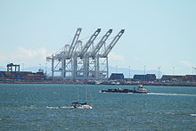
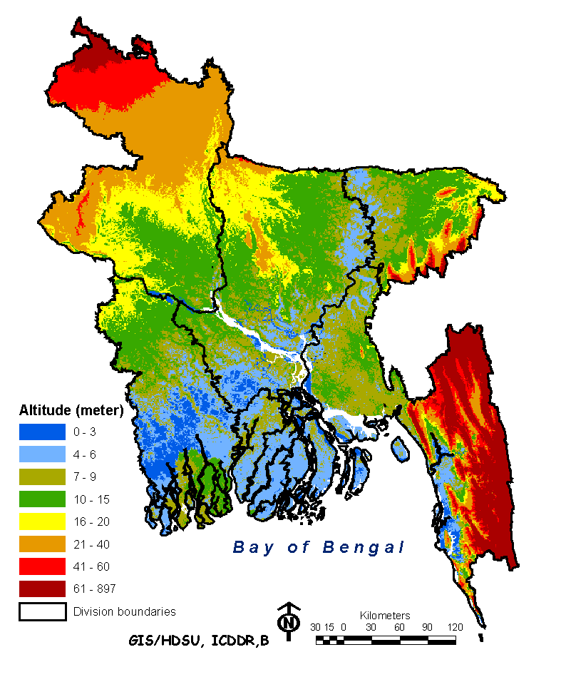
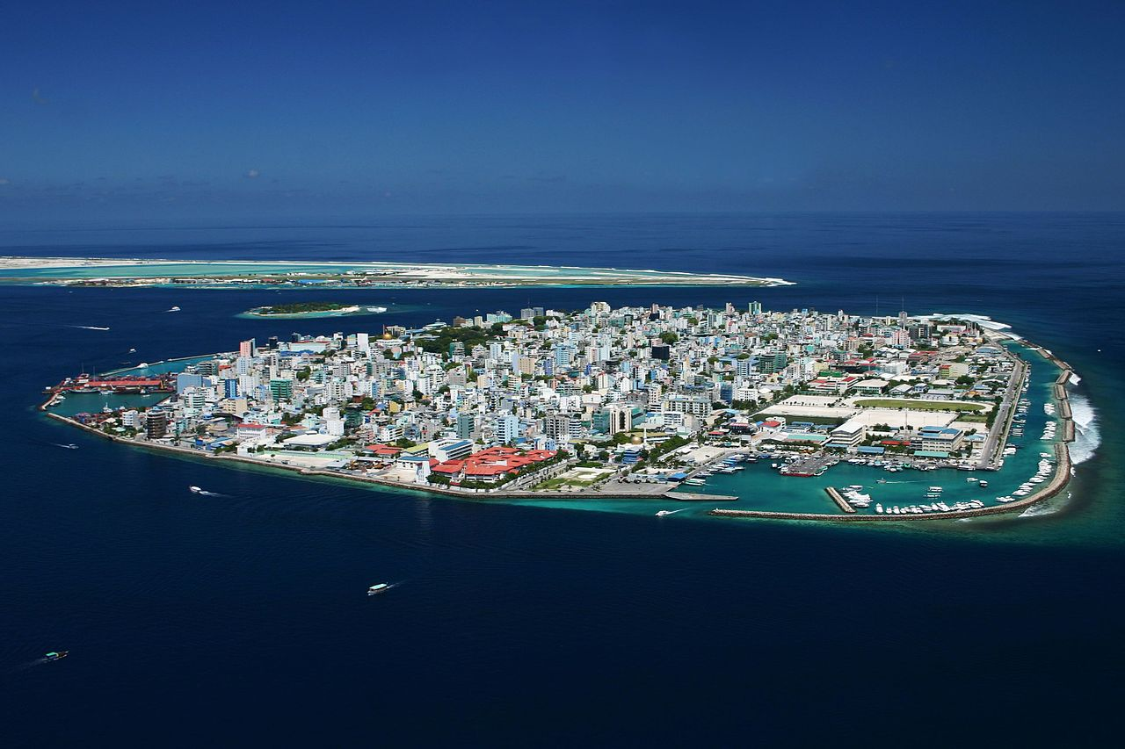
Unit 1: Climate Change and Sea Level:
Who are the Stakeholders?
Stakeholder analysis from three different settings enables students to explore the large difference in impacts from sea-level rise depending on geographic and socioeconomic factors.
Southern California
Bangladesh
Maldives
Notes:
Stakeholder analysis helps put a "face" on how people are and will be affected as sea-level change progresses- provides a human context for sea level rise.
Rising sea levels will affect nearly everyone on the planet in one way or another, but people living in coastal areas will be touched first/most. Three areas we will consider here:
Low-lying, developing nation (ex. Bangladesh)
Coastal urban area (ex. Southern California)
Small island nations (ex. Maldives)
From Bruce:
Learning Outcomes
Teaching Objectives
Context for Use
Description and Teaching Materials
PowerPoint Presentations
Student Handouts and Data Sets
Answer Keys
Teaching Notes and Tips
Assessment
Links to Additional Resources
Unit 5 Stakeholder Report

Slide 41
Stakeholder Analysis
Direct
Widely used method for defining and analyzing contentious issues
Can be implemented by individuals with little or no prior experience
-Neighboring residents
-Neighboring communities
-Other infrastructure users
-Related businesses
Proximal
-Residents
-Users
-Government regulators
-Landowners
-Key industry representatives
Indirect or
Self-designated
-Government entities
-NGOs
-Distant residents
Notes:
Stakeholder(s) are an individual, group or organization who may be affected by a decision, actifity, or outcome” Helps to understand who will be affected by sea level rise.
This figure provides some ideas for the type of stakeholders that go into the different categories.

Slide 42
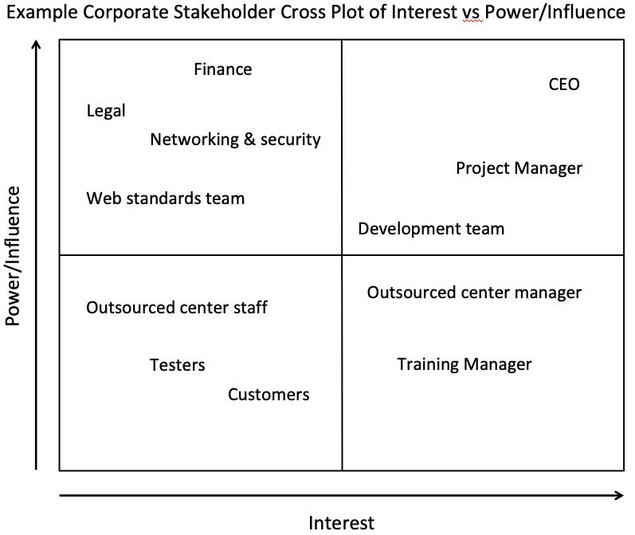
Breakout #1 (15 minutes)
Part of Unit 1 student exercise related to conducting a stakeholder analysis
Each breakout group will have a Google Slides file
You will fill in stakeholder Power vs Interest chart and discuss two of the homework questions
  Thinking and talking about how
  this might work in your online
  and/or face-to-face class
Your facilitator will be ready to
report out if called on (2 min
max)

Slide 43
Overview of Unit 1 Student Homework
Which two problems caused by sea level do you consider to be most important?
How does one problem causes by sea level rise amplify another problem?
Are there any positive impacts of sea level rise?
What (if any) role should developed countries take in assisting communities impacted by sea level rise?
Is mitigation (efforts to stop or slow down sea level rise) or adaptation (adjust to sea level rise) more feasible for the community you are reading about?
Who are five potential stakeholders who might be impacted by sea level rise?

Slide 44
MALDIVES – Small Island Nation

Slide 45
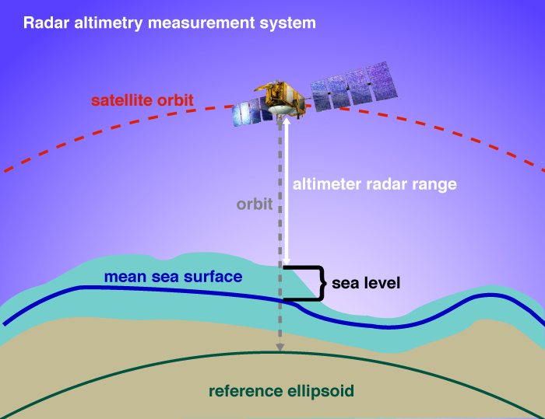
Unit 2: Global Sea Level Response to Temperature Changes:
Temperature and Altimetry Data
Assess recent sea surface temperature change.
Calculate how much sea-level rise has occurred due to thermal expansion of the oceans.
Contrast observed sea-level rise data with the calculated sea-level rise due to thermal expansion and determine how much observed sea-level rise is attributable to thermal expansion.
Propose additional sources of sea-level rise.
Sea Surface Temperature
from Buoys and Ships
Sea Level Rise from Radar Altimetry
Notes:
Have participants then reiew Unit 2 answer key.

Slide 46
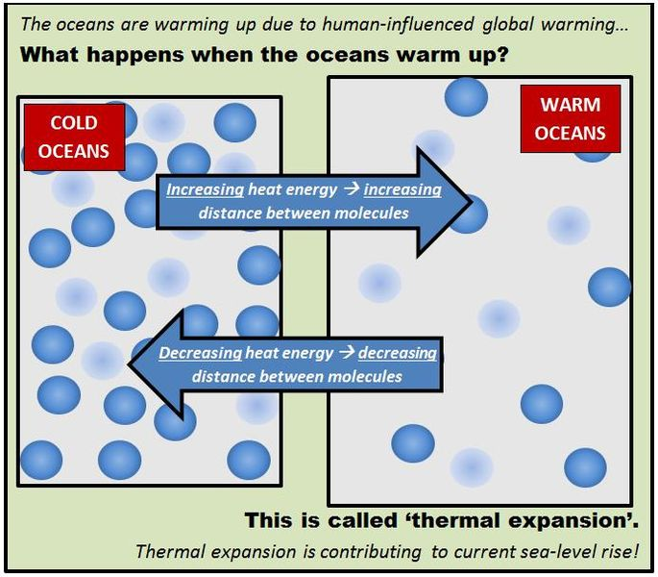
Thermal Expansion of Water
As the ocean warms, the density decreases. Thus even at constant mass the volume of the ocean increases when warmed.
Thermal expansion occurs at all ocean temperatures and is a major contributor to sea-level changes.
Notes:
http://www.ipcc.ch/ipccreports/tar/wg1/411.htm
Image: https://commons.wikimedia.org/wiki/File:Thermal_expansion_cartoon.jpg

Slide 47
The majority of additional energy in the Earth’s climate system is stored in the oceans
Ocean warming dominates the total energy change inventory.
Plot of energy accumulation in ZJ (1 ZJ = 10²¹ J) within distinct components of the Earth’s climate system relative to 1971 and from 1971 to 2010 unless otherwise indicated (IPCC 2014).
Notes:
Energy in > energy out in the Earth system, which is leading to climate warming. This graph shows that ocean warming dominates the surplus energy change inventory.
http://www.climatechange2013.org/images/figures/WGI_AR5_FigBox3.1-1.jpg
IPCC=Intergovernmental Panel on Climate Change
IPCC2014: Ocean warming dominates the total energy change inventory, accounting for roughly 93% on average from 1971 to 2010 (high confidence). The upper ocean (0–700 m) accounts for about 64% of the total energy change inventory. Melting ice (including Arctic sea ice, ice sheets, and glaciers) accounts for 3% of the total, and warming of the continents 3%. Warming of the atmosphere makes up the remaining 1%.
“Ocean warming (heat-content change) dominates, with the upper ocean (light blue, above 700 m) contributing more than the mid-depth and deep ocean (dark blue, below 700 m; including below 2000 m estimates starting from 1992). Ice melt (light grey; for glaciers and ice caps, Greenland and Antarctic ice sheet estimates starting from 1992, and Arctic sea ice estimate from 1979 to 2008); continental (land) warming (orange); and atmospheric warming (purple; estimate starting from 1979) make smaller contributions. Uncertainty in the ocean estimate also dominates the total uncertainty (dot-dashed lines about the error from all five components at 90% confidence intervals).“

Slide 48
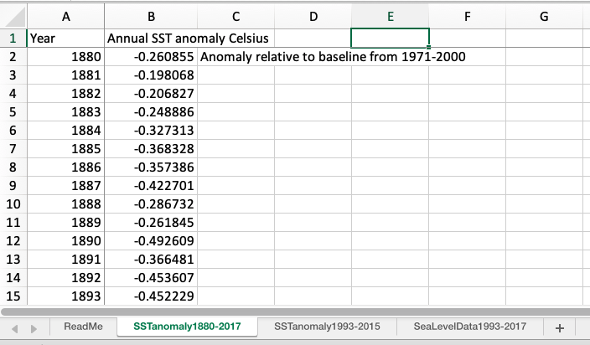
Unit 2 Part I. Assessing Changes in Sea Surface Temperature
The historical record from 1880-2017. Students use spreadsheet data to calculate how much Sea Surface Temperature(SST) increased.

Slide 49
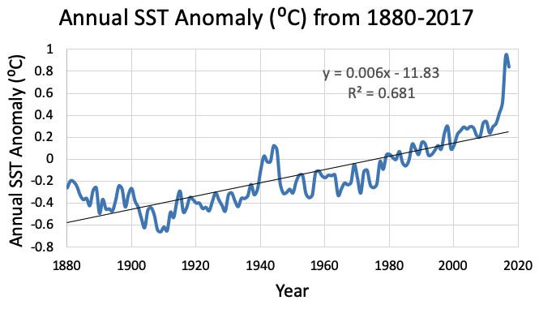
Unit 2 Part I. Assessing Changes in Sea Surface Temperature
Poll #3
The historical record from 1880-present.
Students calculate how much Sea Surface Temperature(SST) increased based on this graph they generate from spreadsheet data.
2. Based on the graph you created, how much have SST increased over the period of the record? Describe how you assessed the SST increase (Which years did you compare? What was your
methodology?). (3 pts)
Answers may range from 0.8–1.6 C, depending on approach used to make the calculation.
Applying a linear trend (y = 0.006*1880 - 11.83 = -0.57) and (y = 0.006*2017 - 11.83 = 0.25)
gives a difference of 0.25- -0.57 = 0.82C
Max-min= 0.94- -.66=1.6C
Notes:
POLL #3
How much has sea surface temperature increased between 1880 and 2017?
0.6 C
1.1 C
1.6 C
2.1 C
Then talk a bit about the math and how different students might approach it. Either 2nd or 3rd answers are fairly valid depending on the math approach students take.

Slide 50
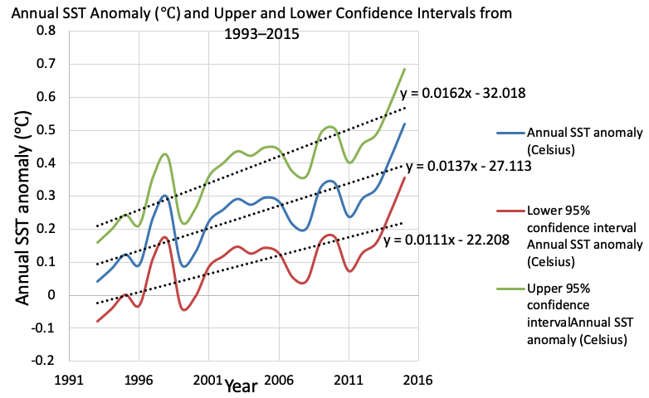
Unit 2 Part I continued. Assessing Changes in Sea Surface Temperature
Question 3. Next you will examine the trends in SST for the period 1993-2015. This is the period that overlaps with the satellite altimetry measurements.
Allows students to consider uncertainty

Slide 51
Unit 2 Part II. Assessing Sea Level Rise Due to Thermal Expansion
Parameter | Annual SST Anomaly | Lower 95% confidence interval Annual SST anomaly | Upper 95% confidence interval Annual SST anomaly
SST Temperature change (Celsius) between 1993 and 2015 based on linear equations | 0.30 | 0.24 | 0.36
Calculated Sea level rise (mm) between 1993-2015 due to thermal expansion and based on SST linear equations | 30.1 | 24.4 | 35.6
After students have calculated how much sea surface temperature has increased, students calculate how much sea level rise would occur due to thermal expansion:
Sea level rise=(SST °C)*(100mm/ °C)
SST = the sea surface temperature increase.

Slide 52
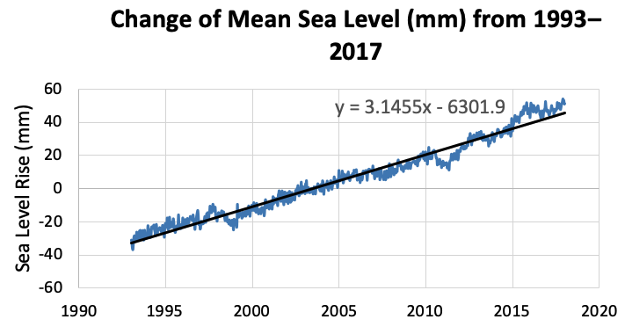
Unit 2 Part II. Assessing Sea Level Rise Due to Thermal Expansion
Students plot observed changes in sea level, and calculate how much sea level actually increased.
Students will find that sea level increase was ~2.5-3X greater than what they calculated due to thermal expansion.
Students consider potential causes for
the discrepancy:
  Additional sources of sea level rise
  Approach to calculating thermal expansion is simplistic
Unit ends with a reflection:
What have you learned through this analysis? What do you know now about the role of thermal expansion in sea level rise that you didn’t know prior to completing this activity?

Slide 53
Unit 3: Global Sea Level Response to Ice Mass Loss:
GRACE and InSAR data
Unit 3 Learning Outcomes
Create time-series graphs of GRACE ice-sheet mass loss and calculate how much the ice loss contributes to sea-level rise.
Infer which regions of the ice sheets are losing the greatest mass by examining maps of ice velocity constructed from InSAR data.
Evaluate the sources of sea-level rise and rank the sources from largest to smallest contributors to sea-level rise.
Extrapolate how much sea-level rise is projected by 2100 based on current sea-level rise rates.

Slide 54
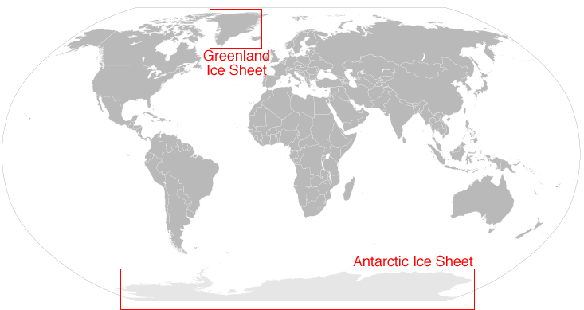
Location of Greenland and Antarctic Ice Sheets
Notes:
Map from: https://nsidc.org/sites/nsidc.org/files/images//map_icesheet.png (public domain)
https://nsidc.org/cryosphere/quickfacts/icesheets.html
Ice sheet facts
An ice sheet is a mass of glacial land ice extending more than 50,000 square kilometers (20,0000 square miles).
Ice sheets today include Antarctica and Greenland, but during the last ice age ice sheets also covered much of northern North America and Scandinavia.
Antarctica and Greenland contain more than 99% of freshwater ice on earth.
Antarctica ice sheet extends 14 million square kilometers (5.4 million square miles) and is roughly the size of the United States and Mexico combined.
The Greenland ice sheet extends 1.7 million square kilometers (656,000 square miles)- roughly three times as large as Texas.

Slide 55
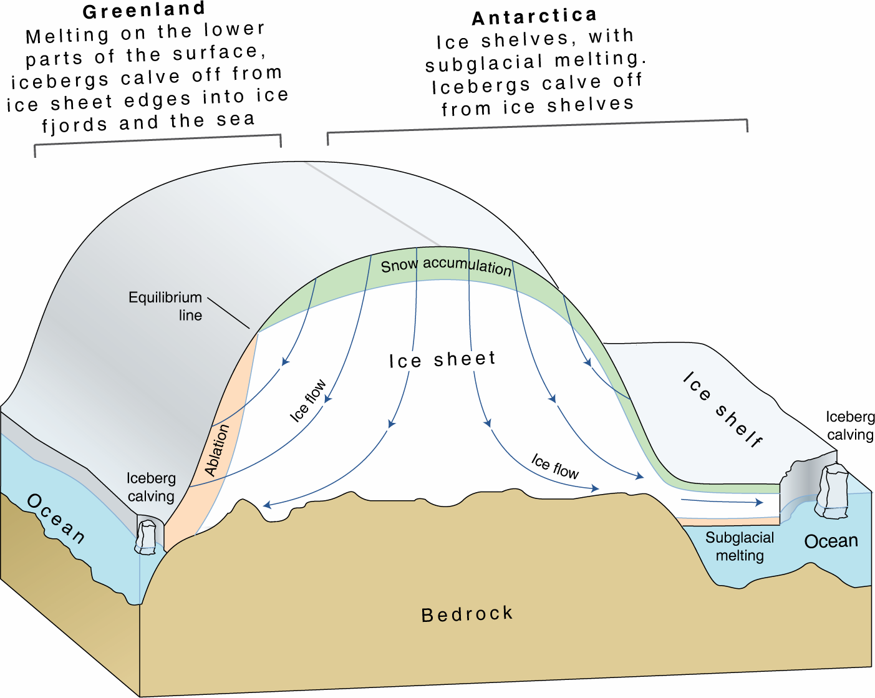
Ice Sheet Components
Very vertically exaggerated
Notes:
This cartoon shows numerous important components of ice sheets, including the differences between Antarctica and Greenland.
Notice that Greenland and Antarctica both gain mass through snow accumulation, whereas the processes dominating mass loss are different. Both ice sheets undergo iceberg calving, whereas surface melting of the lower elevation regions is a major source of ice mass loss only in Greenland. Antarctica ice flow drains into many ice shelves that surround the periphery of West and East Antarctica. Ice mass is is lost from the ice shelves due to subglacial melting and iceberg calving. Greenland has few ice shelves.
https://lima.nasa.gov/img/UNEP_icesheetcartoon.png (public domain)
https://lima.nasa.gov/antarctica/

Slide 56
GRACE Mass Change for Antarctica and Greenland

Slide 57
Interferometric Synthetic Aperture Radar (InSAR) Images of Antarctica and Greenland
Notes:
Note: these images are included in the Unit 3 Student Exercise, which includes questions that require students to interpret these maps. Instructors will need to decide if they want to discuss these images in class, or leave students to conduct interpretation of these individually. These maps demonstrate that ice sheet ice velocity is highly variable, and that there are certain regions of the ice sheets referred to as ice streams that transfer ice from the interior of the ice sheets to the ocean.
https://nsidc.org/sites/nsidc.org/files/images/data/measures/0484v2/SampleImage.png (public domain)
https://nsidc.org/data/nsidc-0484
References for above Images and related videos
http://nsidc.org/data/NSIDC-0670#
http://nsidc.org/data/measures
https://www.youtube.com/watch?v=GDXq8Oa5d5Q
https://www.jpl.nasa.gov/video/details.php?id=1015
Further information on ice streams is available at: http://www.antarcticglaciers.org/modern-glaciers/types-of-glacier-2/ice-streams/

Slide 58
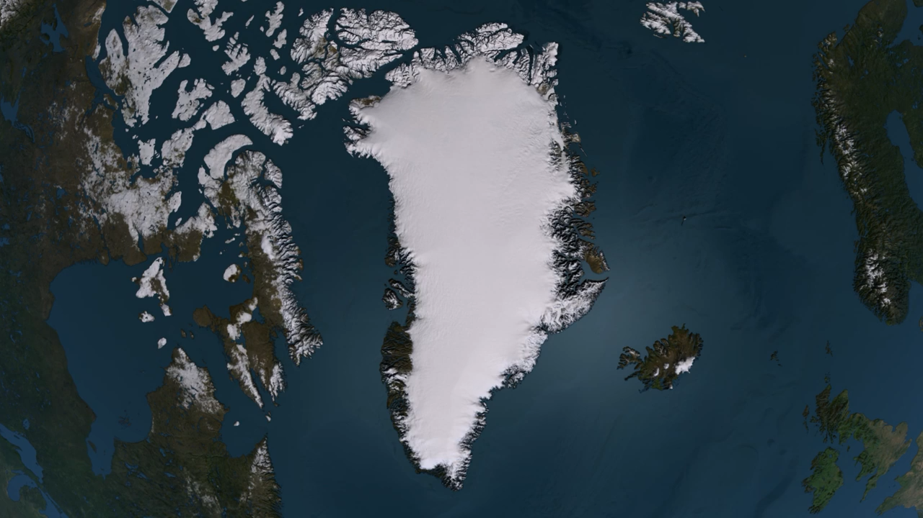
Notes:
NASA https://www.youtube.com/watch?v=GDXq8Oa5d5Q

Slide 59
Unit 3 Part II: Ice Sheet Mass Loss and Equivalent Sea Level Rise
Students calculate how much sea level rise would occur based on the GRACE ice mass loss data
  SLE (mm) = mass of ice (Gt) x (1 (mm) / 361.8 (Gt)

Slide 60
Breakout session #2 – 15 min
Your group will through some data and questions in Part II of the Unit 3 student exercise.

Slide 61
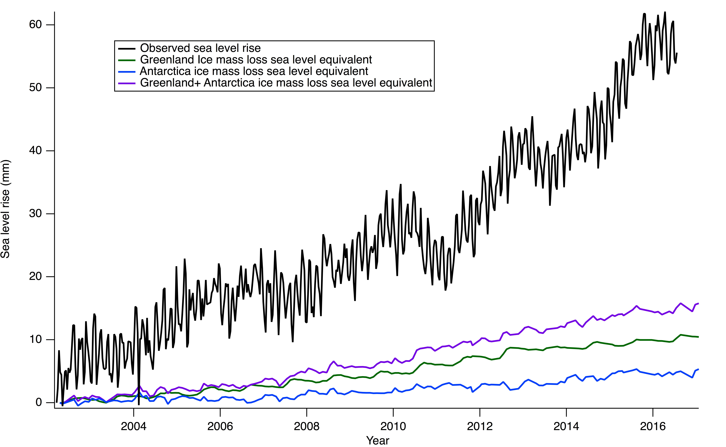
Unit 3 Part II: Question 9
Does ice sheet mass loss account for observed sea level? No – not even close
What additional sources of sea level rise need to be accounted for that aren’t plotted on this graph? could include: thermal expansion, melting glaciers/ice caps, terrestrial water
Notes:
Students should note that ice sheet mass loss does not account for the total sea level rise. Additional sources that need to be considered include thermal expansion, melting glaciers/ice caps or groundwater sources moved to land Figure is available as a separate handout on the GETSI website.
The main point here is that in addition to ice mass loss from Antarctica and Greenland there are other important sources of sea level rise.

Slide 62
Unit 3 Part II: Question 10
a. Which contributes greater to sea-level rise: inputs of mean ocean mass, or steric sea-level rise? Inputs of mean ocean mass
c-d. Look at panels b and c. Consider why sea-level rise is occurring more rapidly in some regions relative to other regions Changing winds that force redistribution of ocean volume related to ocean atmosphere interactions such as the Pacific Decadal Oscillation or the El Niño Southern Oscillation.

Slide 63
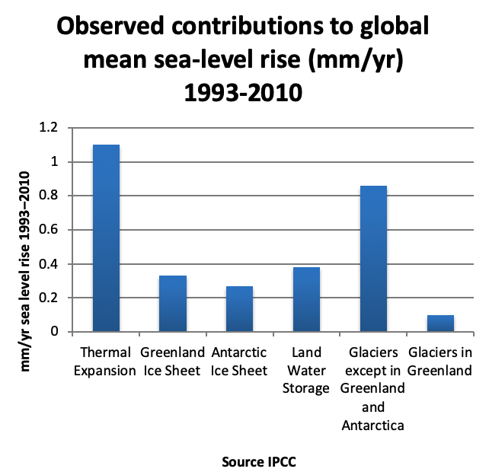
Unit 3 Part III: Global Mean Sea Level Budget Summarized
Source | mm/yr sea level rise | Ranking
Thermal Expansion | 1.1 | 2
Total melting ice | 1.56 | 1
Land Water Storage | 0.38 | 3

Slide 64
Unit 3 Part IV: Projecting Sea Level Rise by the year 2100
Notes:
POLL
What is the change in rate in the last decade compared…

Slide 65
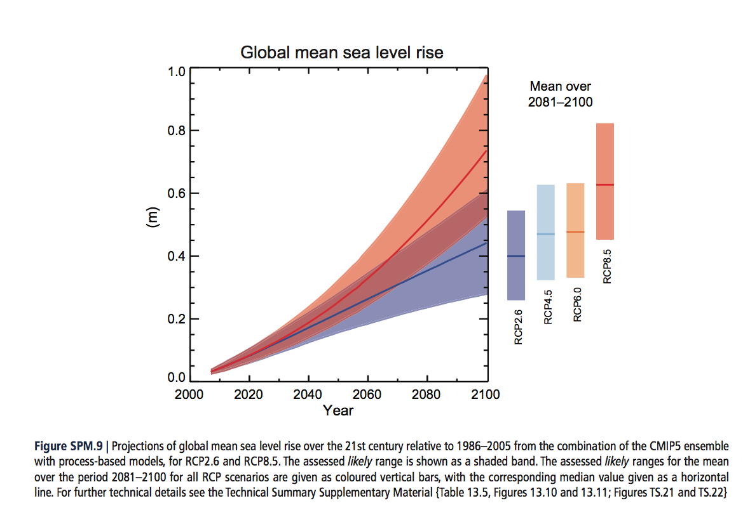
Unit 3 Part IV Question 16:
For the scenarios that don’t match, why? What do you think are factors that would lead to higher sea level rise than those that you calculated?
Notes:
The depth of the student answer here will depend on the type of course the module is being used in. Expected student answers may include that temperatures are projected to increase later this century, resulting in higher sea level rise due to greater thermal expansion and further melt from ice sheets and glaciers.

Slide 66
Unit 4: Measuring Ice Mass Changes: Vertical Bedrock GPS
Unit 4 Learning Outcomes
Calculate trends in GPS vertical-position data due to changes in snow and ice mass.
Quantitatively compare records from GPS sites that may be dominated by the elastic response (instantaneous response of the rocks) to ice mass loss versus those dominated by the viscoelastic response to post-glacial rebound.
Contrast the spatial variations in the magnitude of changes in Earth's surface elevation that can be observed.
GPS station in western Greenland near Kangerlussuaq
Notes:
This unit is centered around analysis of vertical-position data from six GPS stations in Greenland installed on bedrock.
Allows students to look at bedrock uplift due to unweighting from ice loss
Most undergraduate geology majors have heard of isostasy, so they might think the vertical displacement due to snow and ice mass changes is an isostatic adjustment. It needs to be clarified that what is being studied is an elastic response of the rocks themselves, not an isostatic adjustment that involves viscoelastic processes. Elastic response is instantaneous and ~20 times smaller; whereas isostatic viscoelastic adjustment associated with post glacial rebound has time scales of hundreds to thousands of years but ultimately the adjustment will be much greater. Most likely there is some component of the long term trend in the GPS measurements that is related to isostatic adjustment, but it is not what causes the seasonal and year-to-year variations. Depending on the length of the time series and the distance between the ice front and GPS station there may also be a flexural response which will be dependent on the effective elastic thickness which is a function of the crust and mantle rheological properties.
Higher uplift rates are associated
The primary goal of the exercise is for the students to identify how the GPS sites are affected by snow and ice mass changes. This is further affected by where the stations are located relative to the present ice front and the flow properties of the local glaciers.

Slide 67
Unit 4: Measuring Ice Mass Changes: Vertical Bedrock GPS
Notes:
POLL#3
Comparing the two stations,
select all that apply:
Very different uplift rates
Similar ice velocity
Uniform uplift rates over time
Same period of record

Slide 68
Unit 4: Measuring Ice Mass Changes: Vertical Bedrock GPS
Higher rates of uplift are associated with areas of high ice velocities and high ice mass loss.

Slide 69
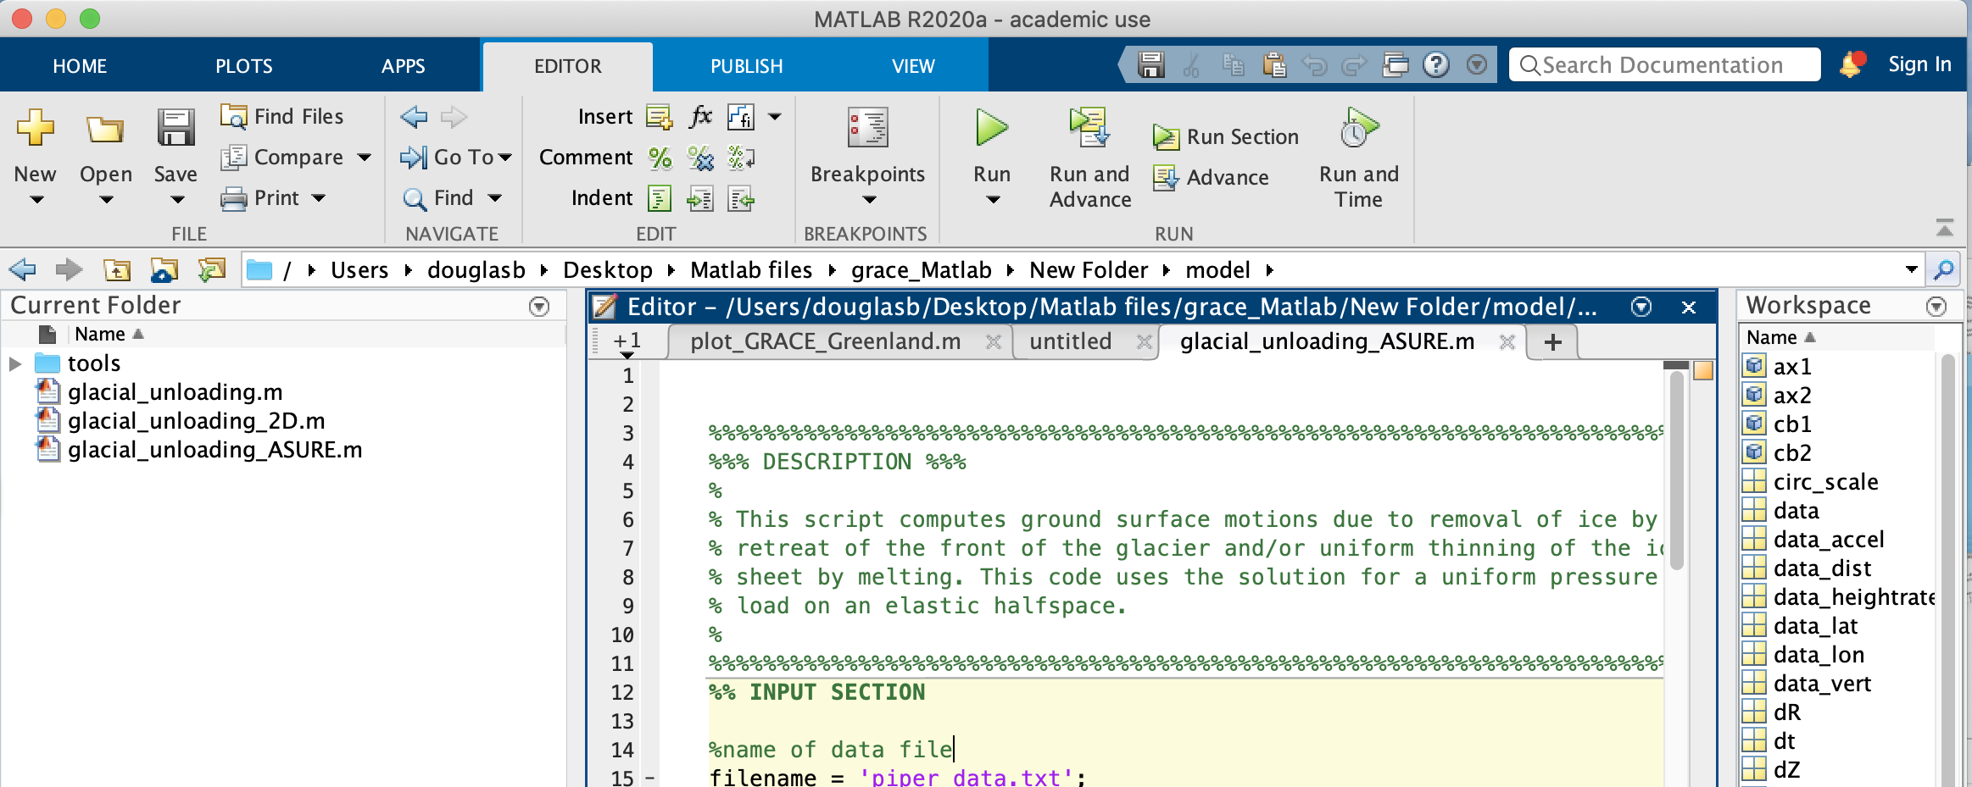
Unit 4 – some MATLAB options are coming

Slide 70
Unit 5: Societal Implications of Climate Change: Stakeholder Report
Students will integrate the stakeholder analysis in Unit 1 with the geodetic data (radar satellite altimetry, GRACE [Gravity Recovery and Climate Experiment], InSAR, and GPS) of ice mass loss and sea level rise from Units 2-4 in their analysis.
The report is written to or on behalf of one of the identified stakeholder groups
Unit 5 is the summative assessment for the module.

Slide 71
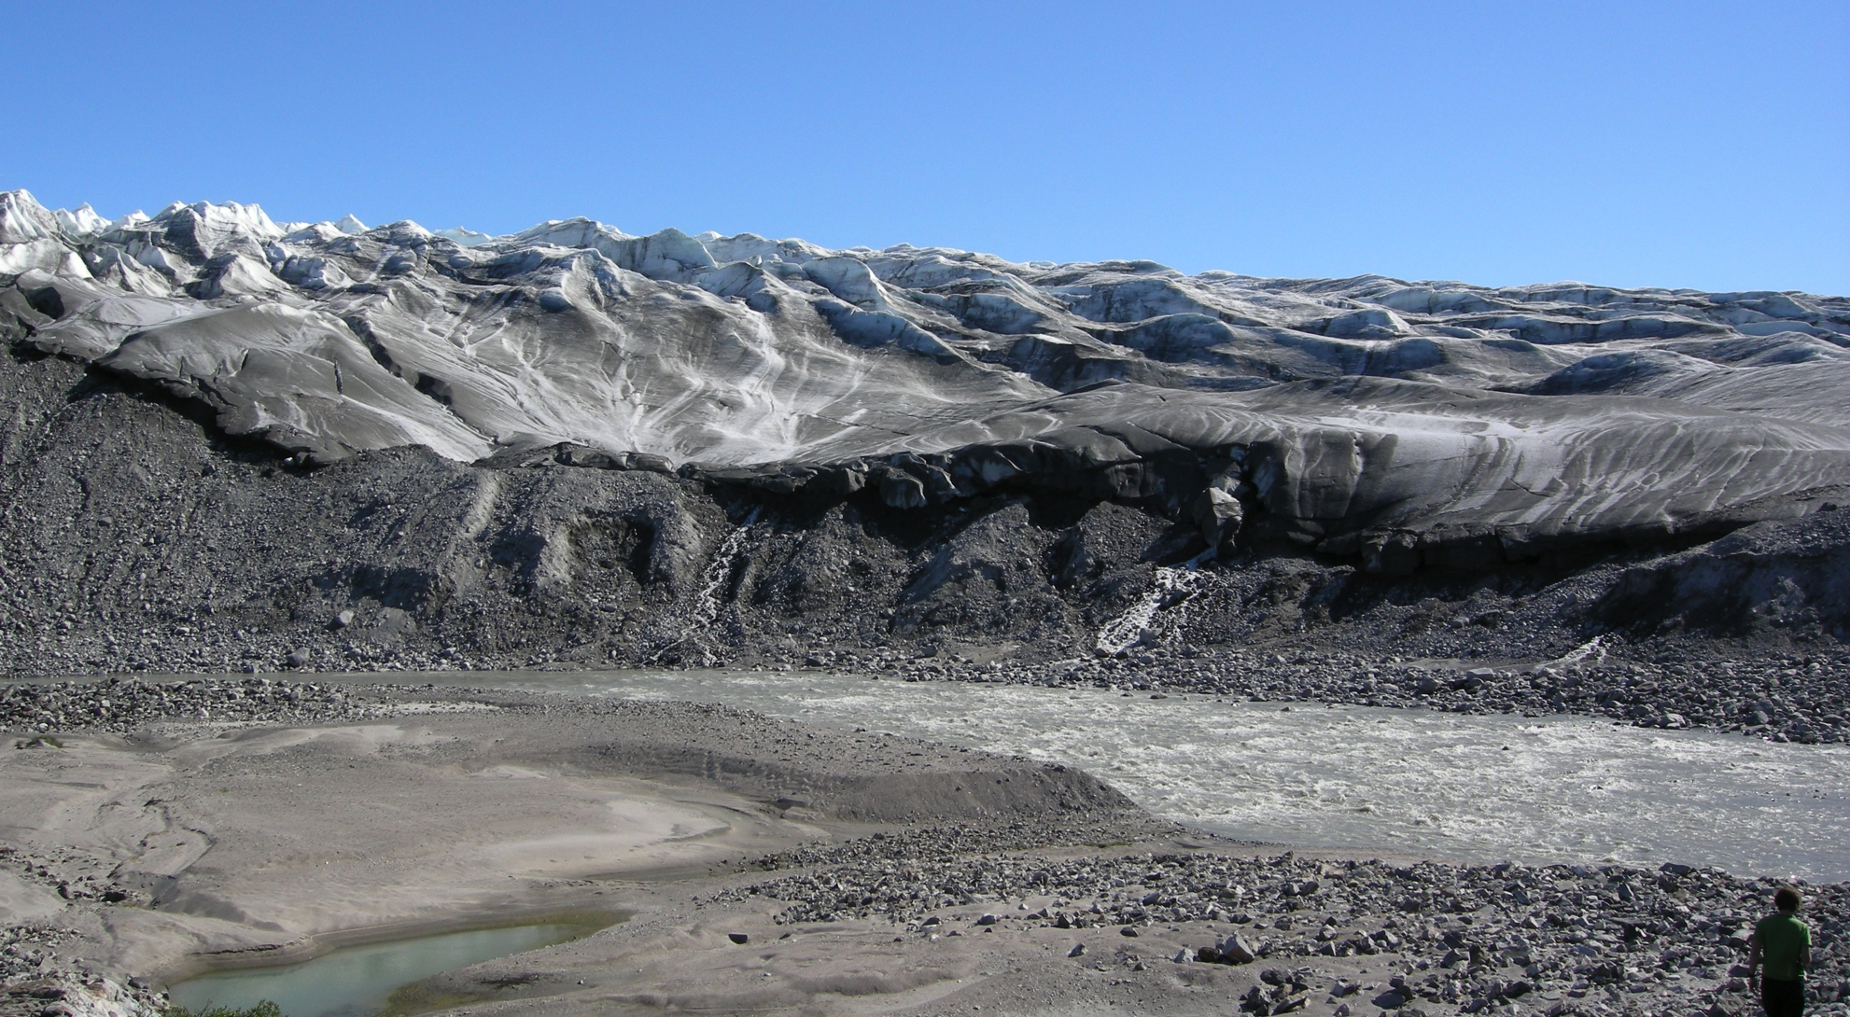

Slide 72
Implementation Planning-Exploring-Feedback
Spend the remaining time of the mini-course working on implementation planning
  Explore other aspects of the module or GETSI
  Write down steps you need to do to get ready to teach with this module
  Fill out form: link posted in the chat
  Complete by Sunday Jan 31 for stipend eligibility*
Intro-level climate change module
Ice Mass and Sea Level Changes
*US Citizens and residents only for stipend. Stipends will be compiled after the end of the term and sent together. But the implementation plan is useful to all participants!

Slide 73
Upcoming GETSI Mini Courses
Teaching about Measuring the Earth with GPS: Plate Motion and Changing Ice-Water [Intro-level module]
Date: Tuesday February 9, 2021
Teaching about Monitoring Volcanoes and Communicating Risks [Introductory-level module]
Date: February 24, 2021
If you use a GETSI module in your teaching, please fill out a “Share Your Experience” survey afterwards ($100 stipend).

