Slide 1


A Brief History of Geodesy in Field Education (supported by UNAVCO)
Bruce Douglas (IU), Nathan Niemi & Marin Clark (U. Michigan),
David Phillips (UNAVCO) + numerous faculty & students

Slide 2
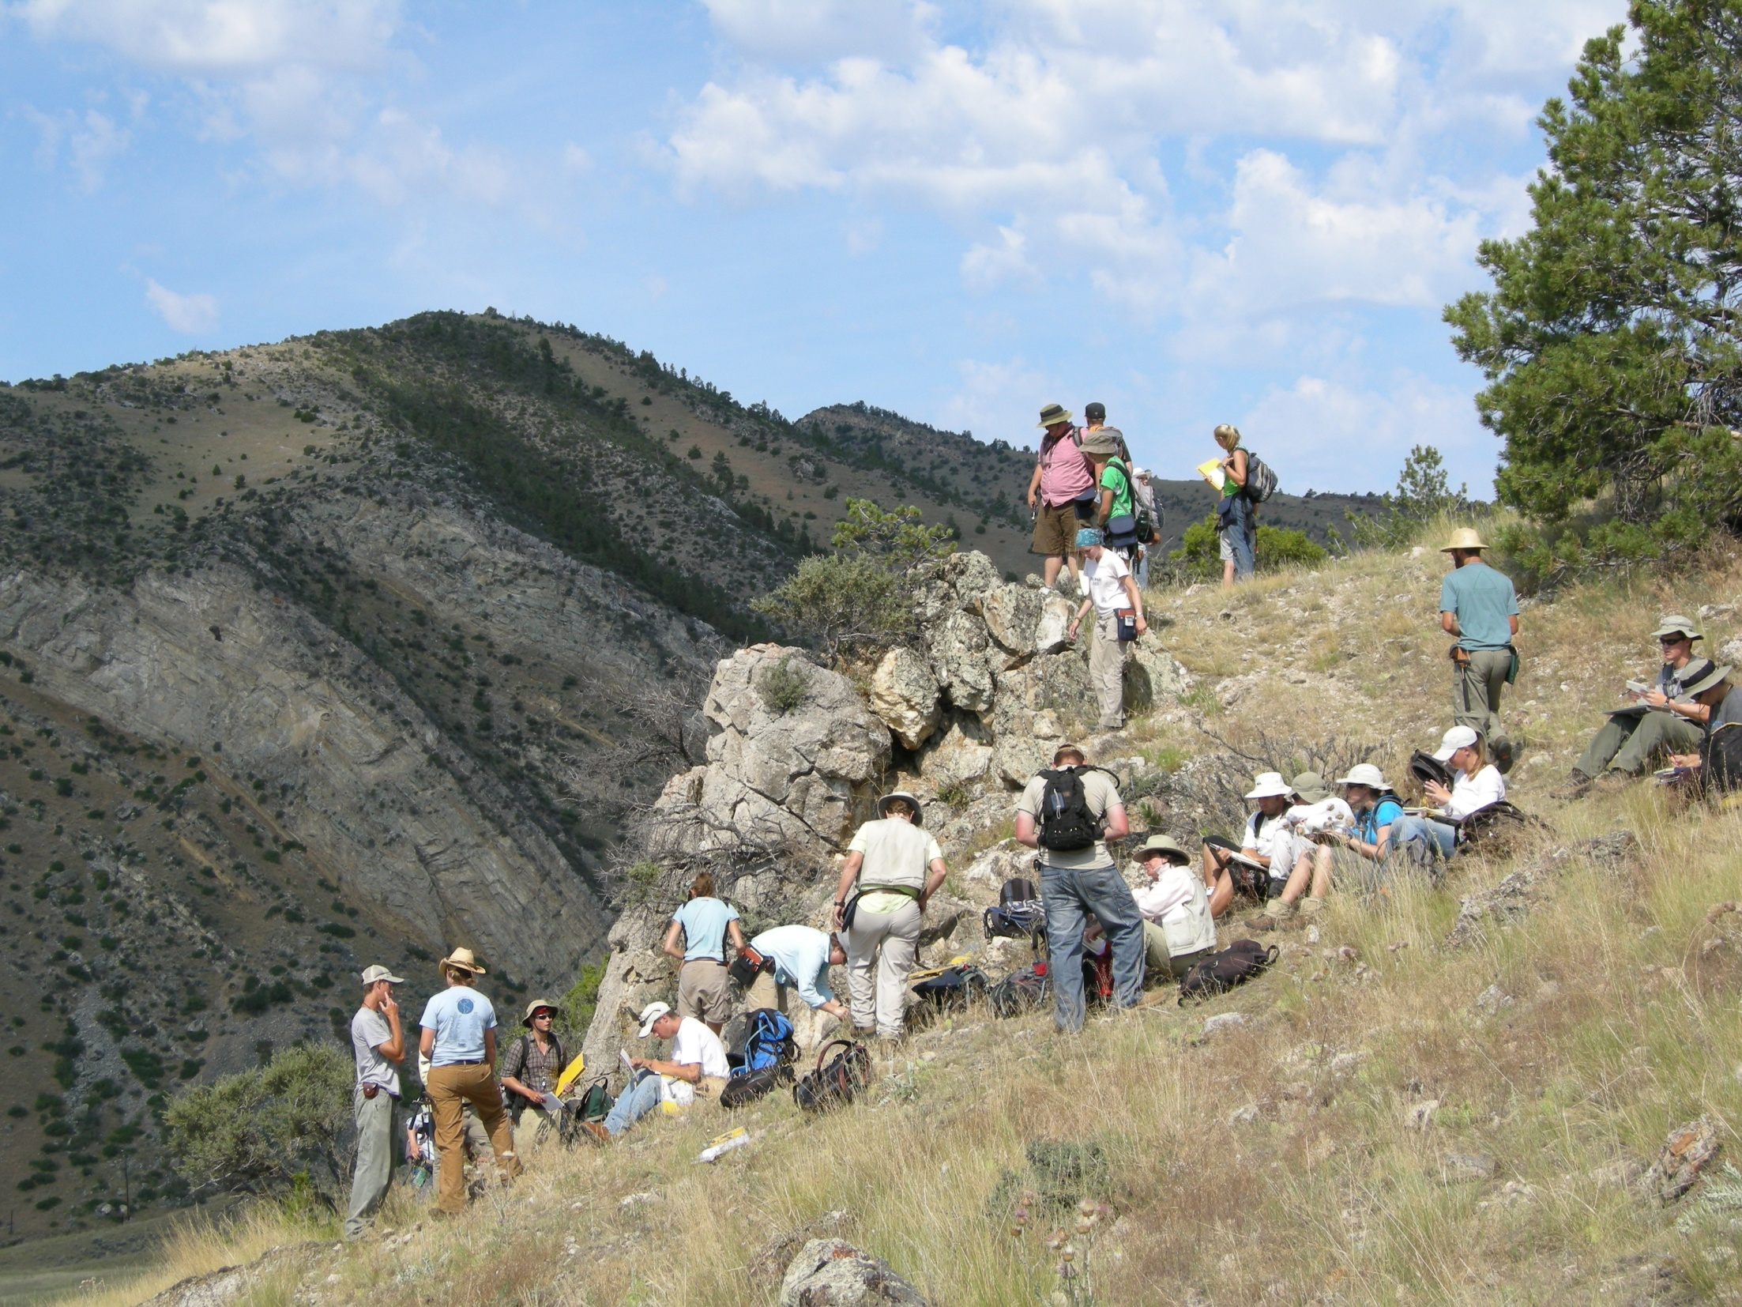
IUGFS G429 – A Traditional Field Course
Cardwell, MT

Slide 3
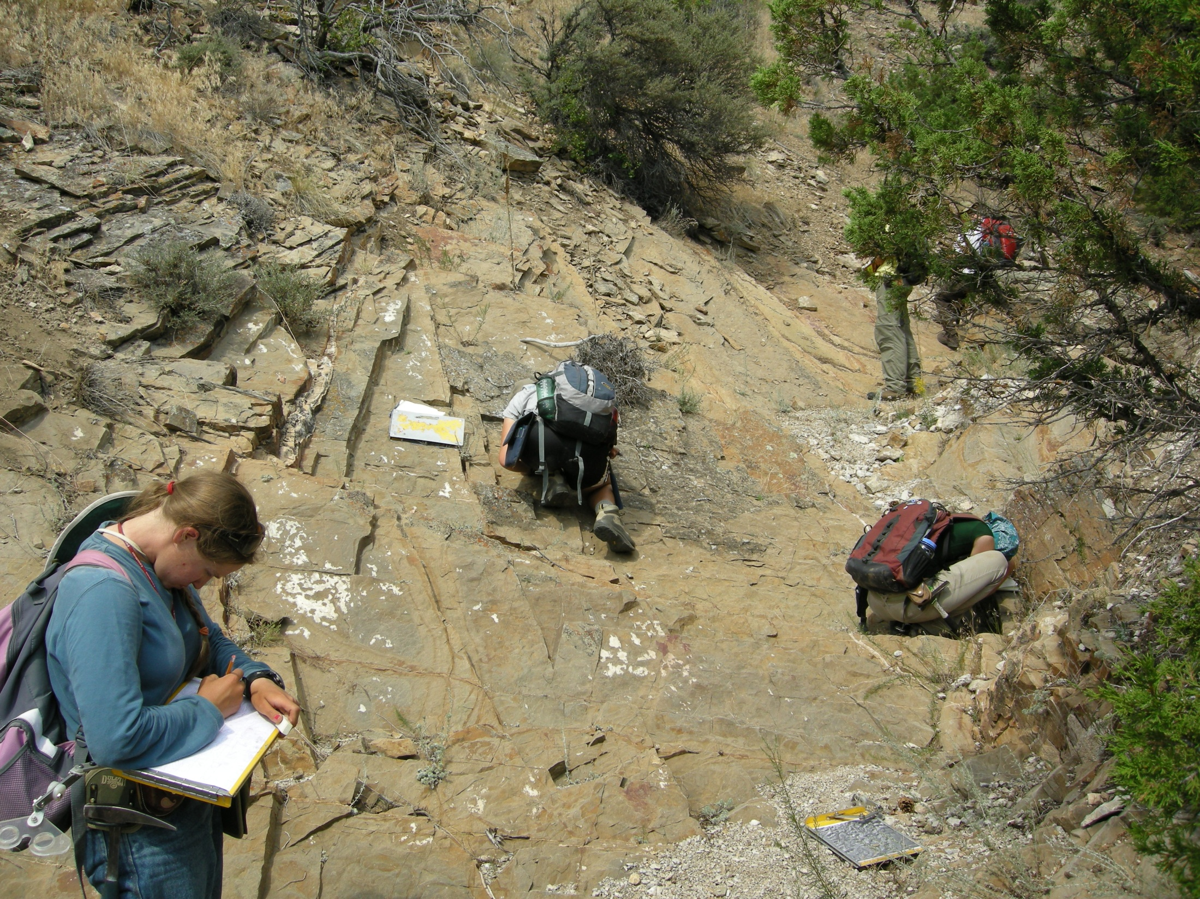
Traditional Methods
Individual Work

Slide 4
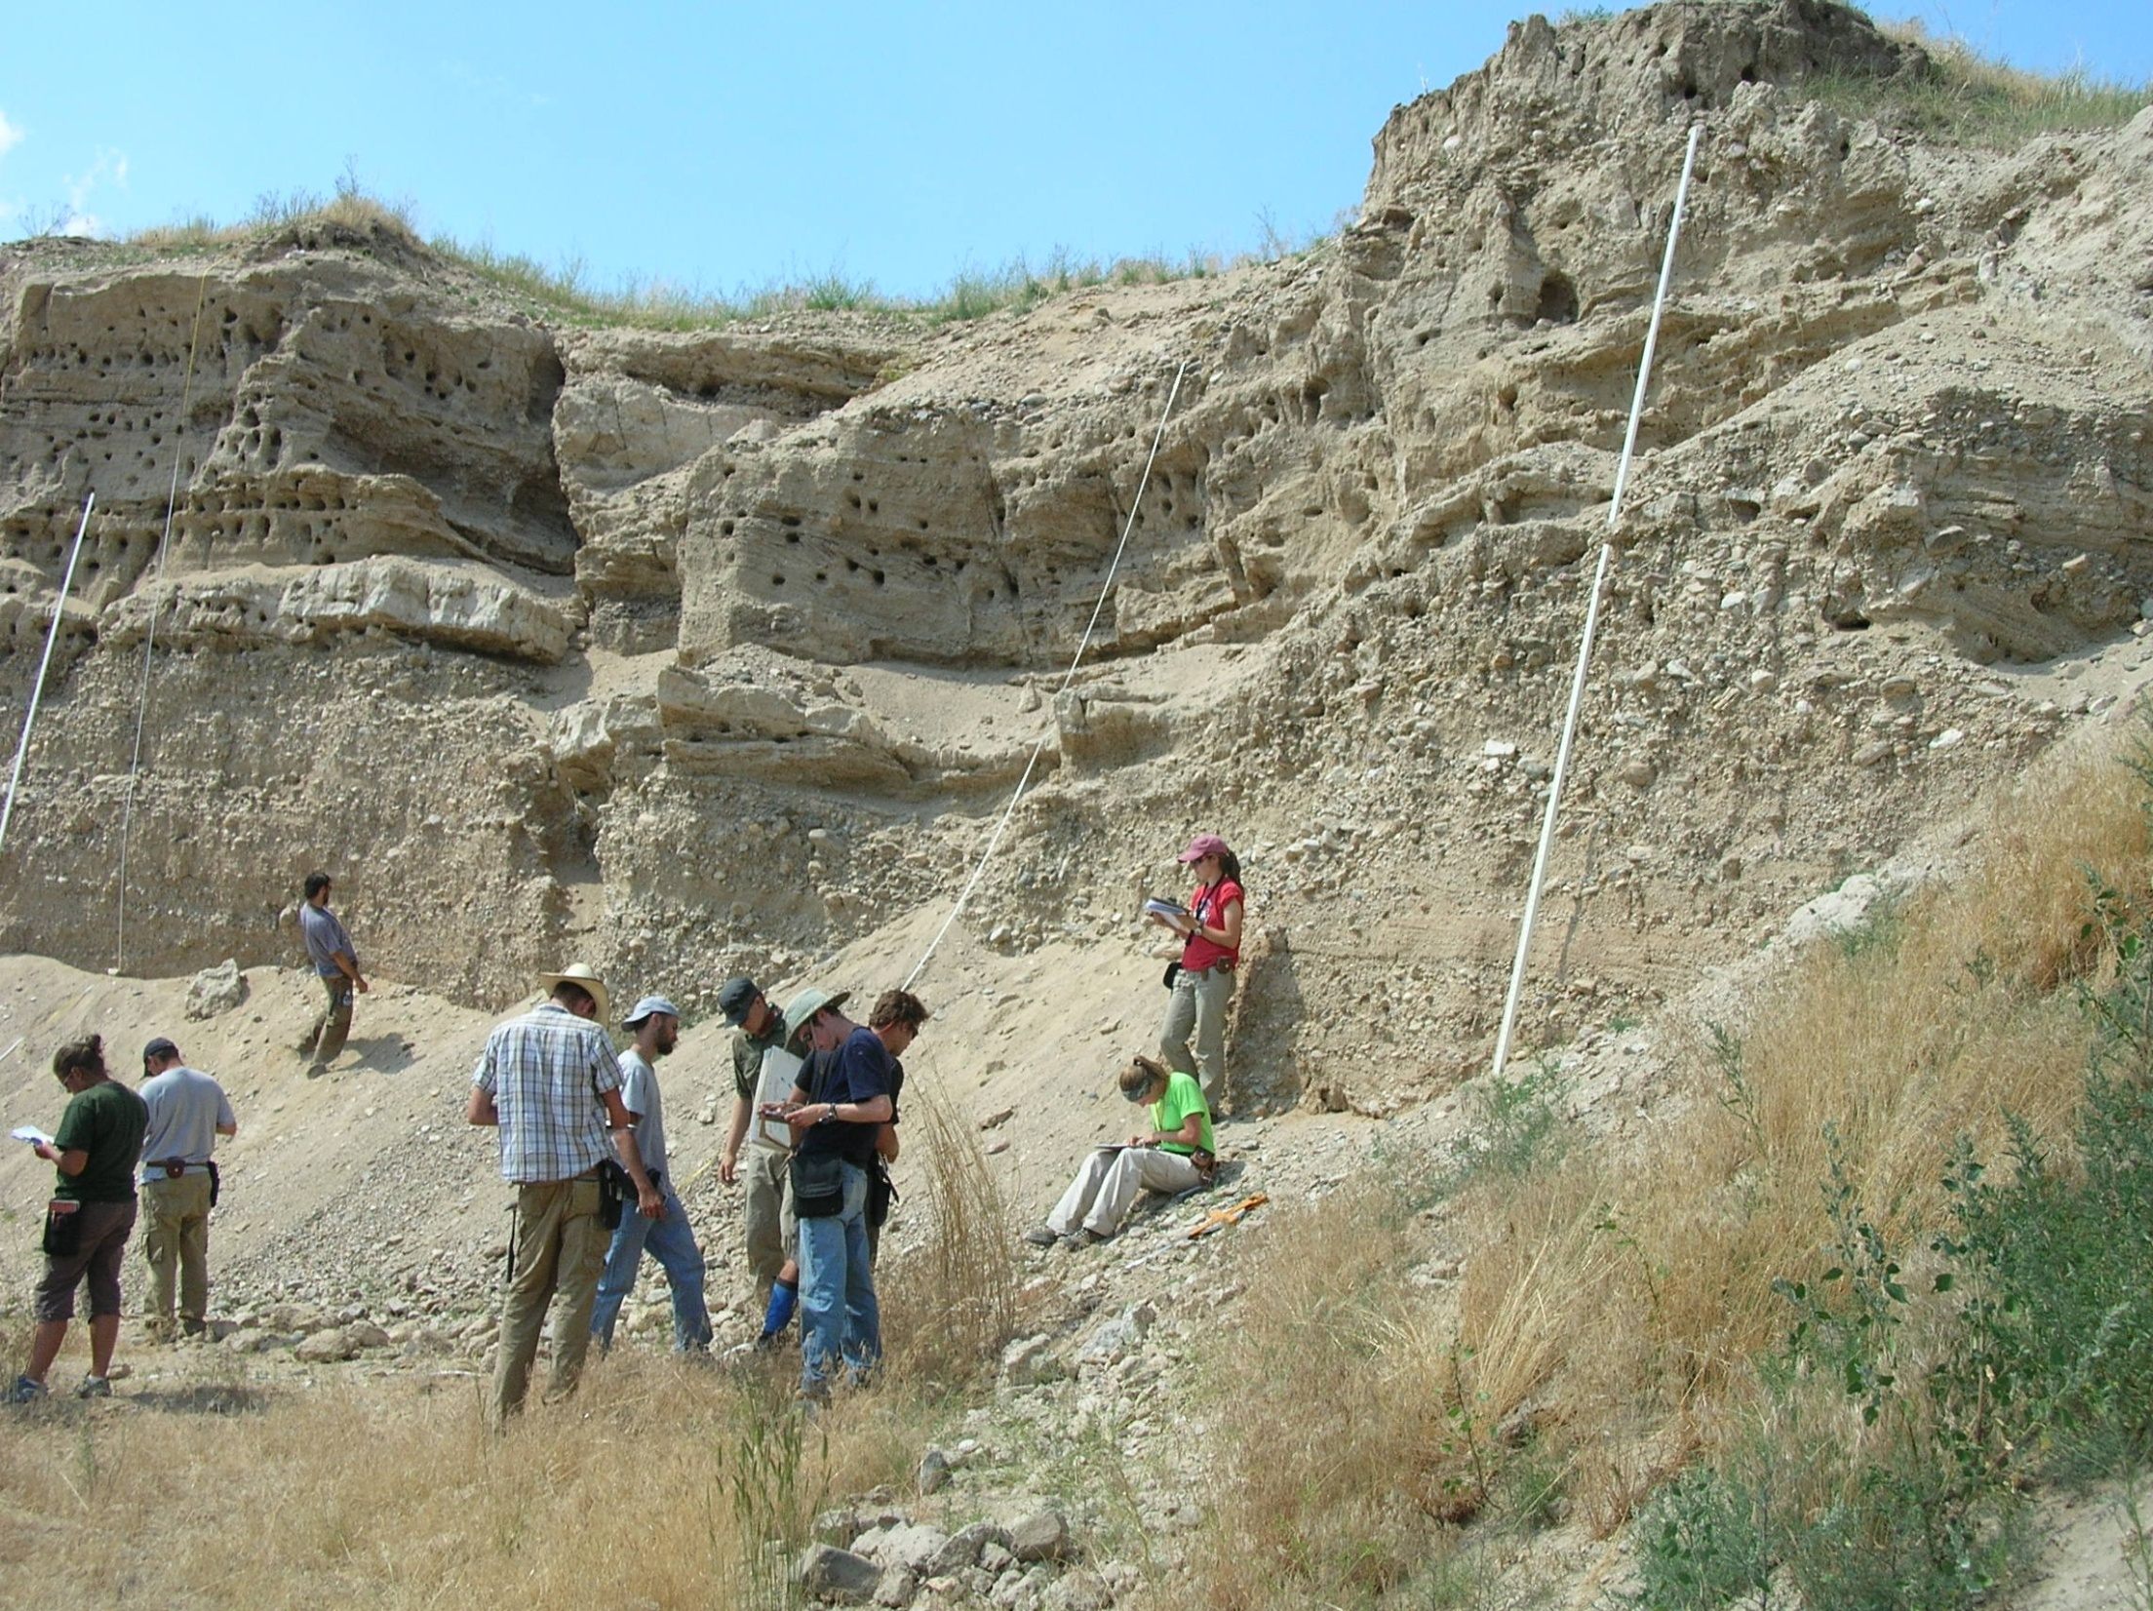
Limitations Associated with Traditional Field Techniques

Slide 5
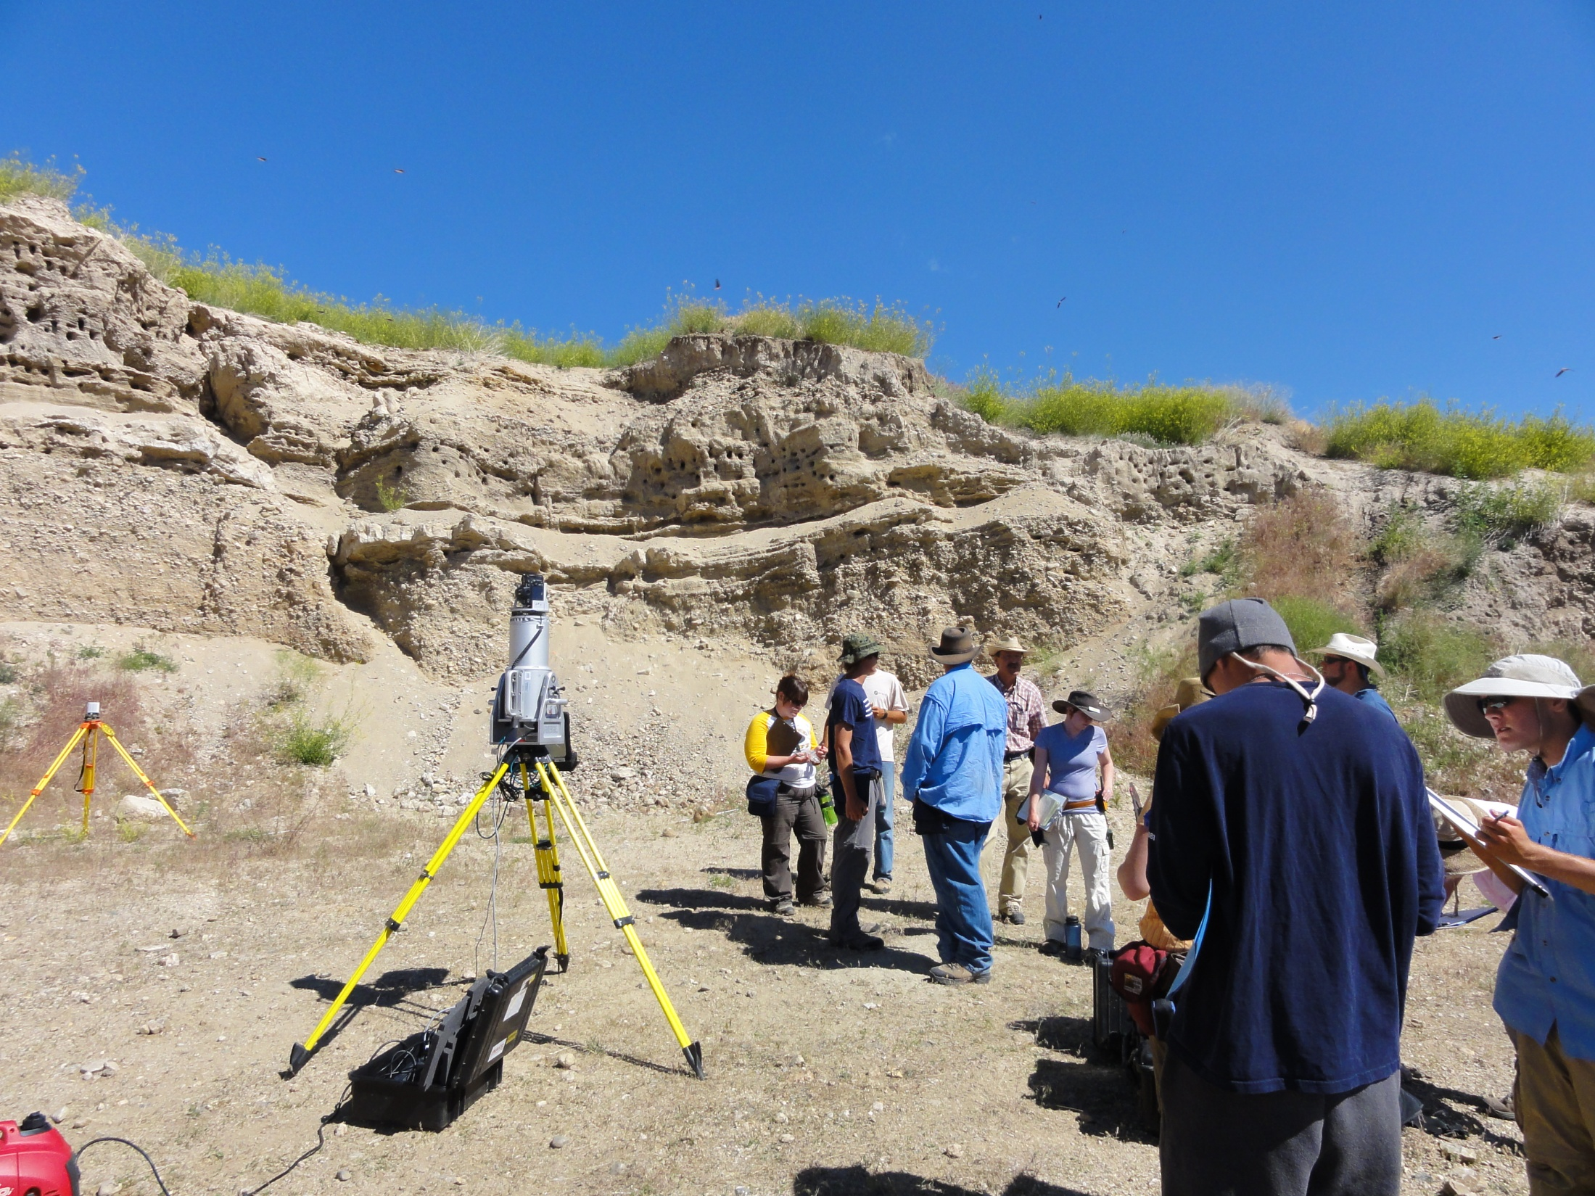
2009: 1st efforts to introduce TLS into IUGFS G429 as one week elective

Slide 6
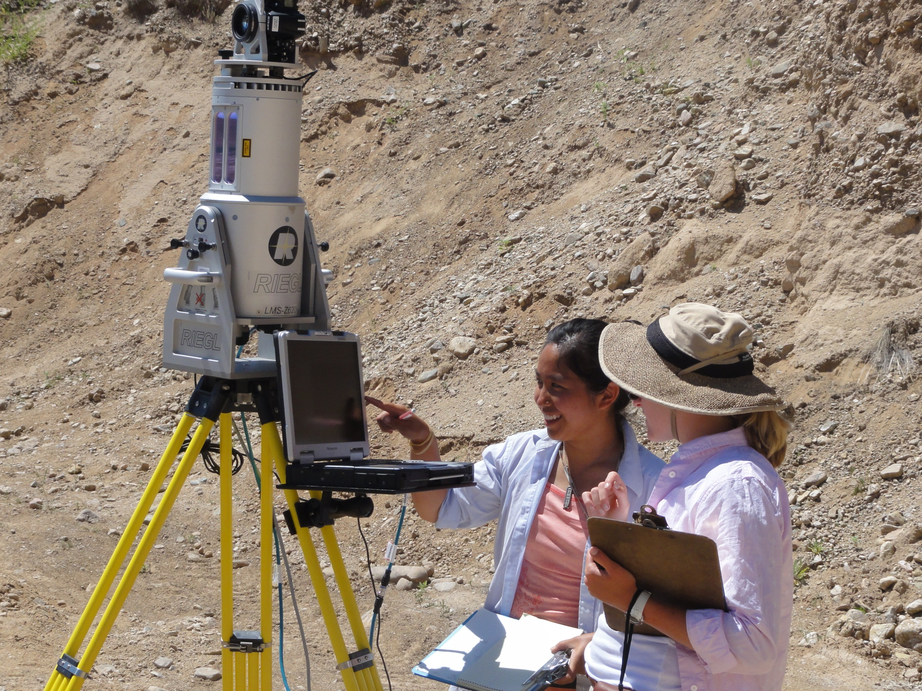
Collaborative Learning
Incorporation of Instrumentation
into traditional field work

Slide 7
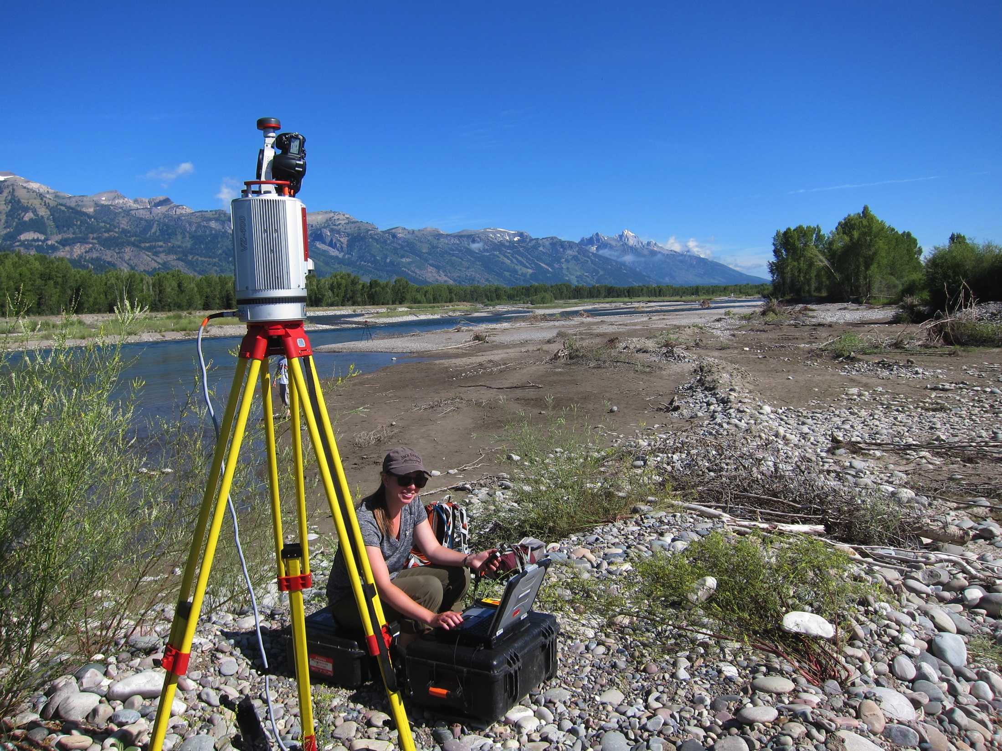
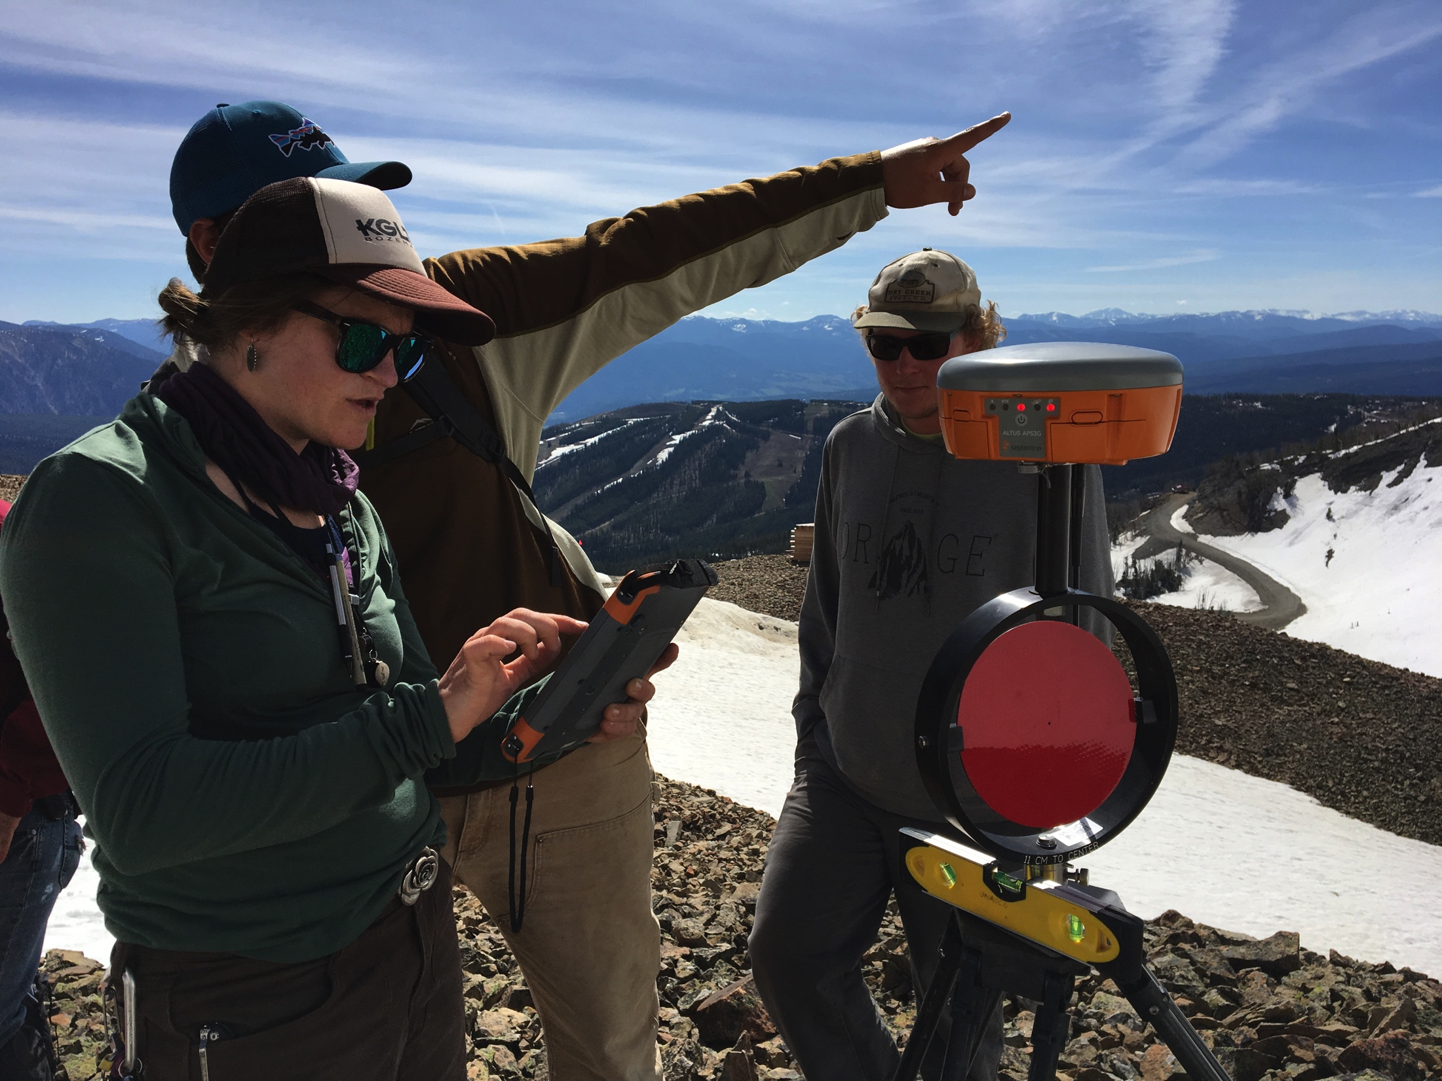
Two dozen field education projects since ‘09
Indiana University (8x)
University of Michigan (7x),
University of Houston (3x)
UC Santa Cruz, Cal Poly Pomona, U. Saint Thomas, Stanford, NM State University, Montana State University

Slide 8
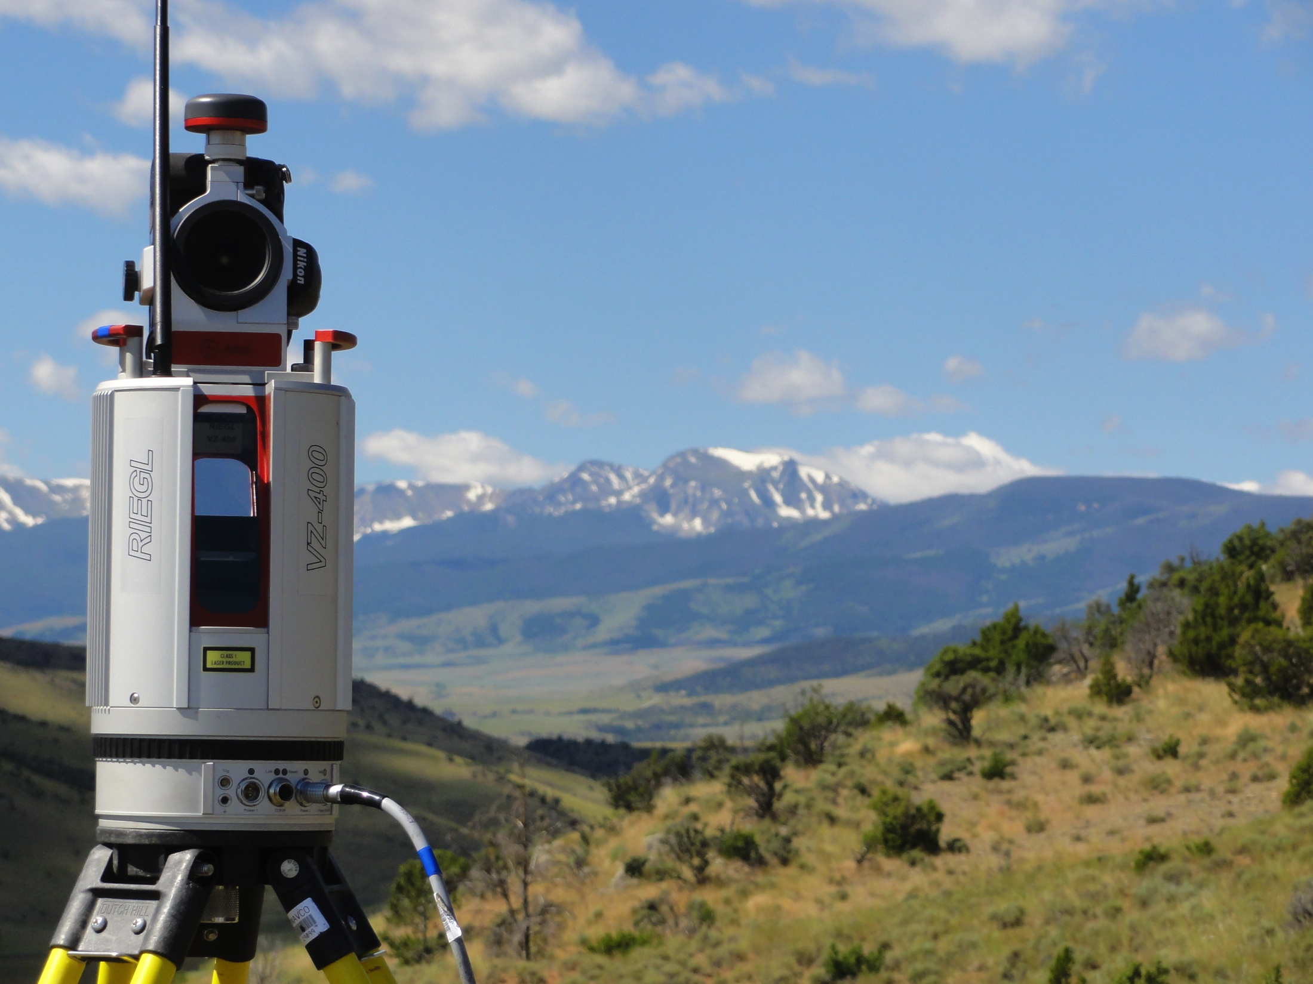
Critical Points to Consider When Deciding to Incorporate TLS into a Field Curriculum
Length of allotted time for field work, data reduction, and data analysis
Logistical limitations imposed by both field sites and computer access
Selection of geologic problems to be addressed
Means to develop supporting materials

Slide 9
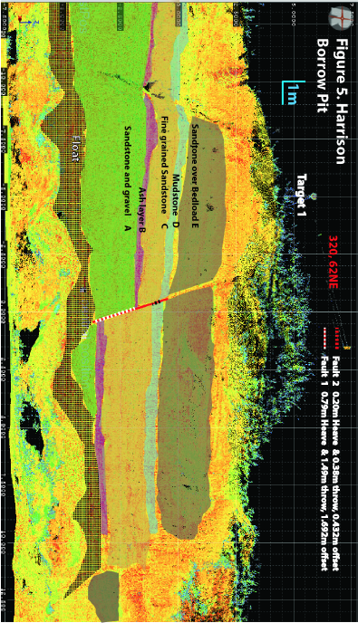
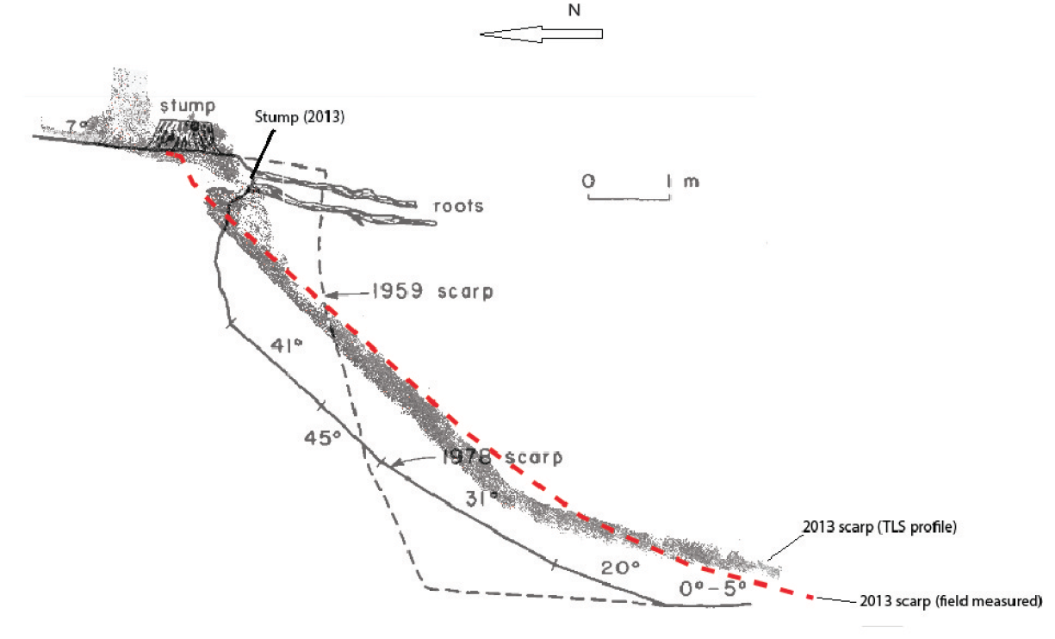
Examples TLS Field Course Applications
Outcrops: sequence stratigraphy, structural geology
Geomorphology/mapping: fault scarps, fluvial systems
Geomorphic change detection:
Rock fall, landslides, fluvial and shoreline change

Slide 10
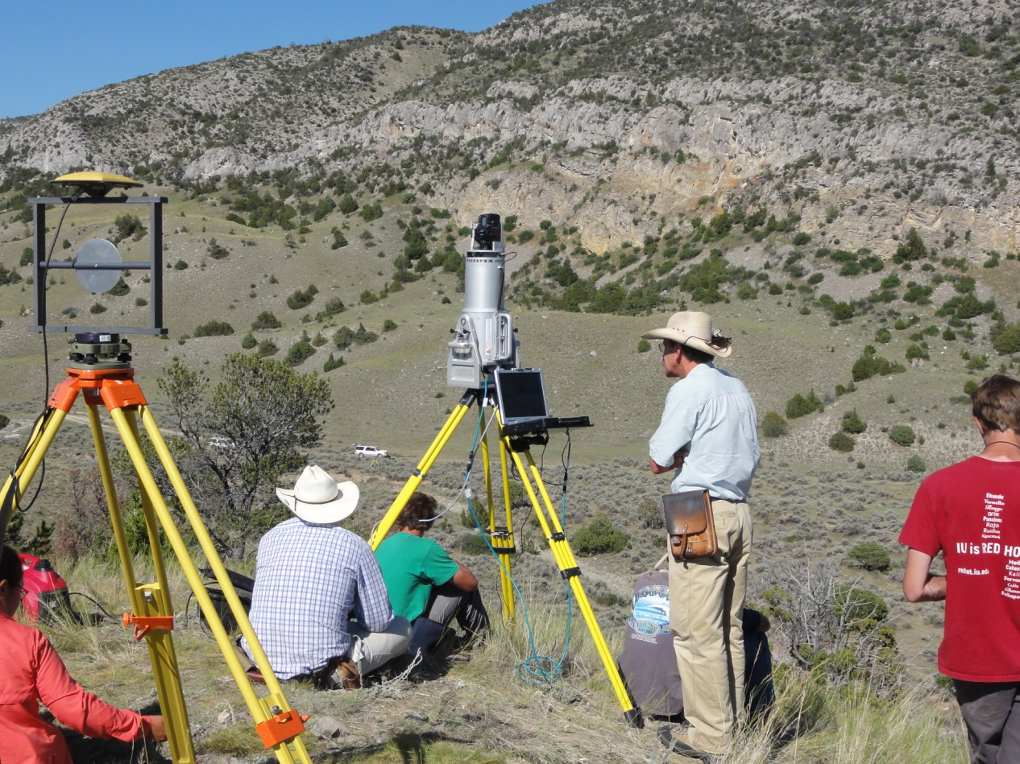
Project Selection
Projects should have a well defined geologic question with appropriate background material provided
Logistical considerations need to be carefully considered (vehicle access, scan distances, scale, scanner and target positioning, topography)
Plans to keep students occupied

Slide 11
Typical Schedule
Assuming ~5 day field course:
Day 1
Introductory lectures (intro to technology and applications)
Introduction to field methods
Day 2
Themed Project TLS data acquisition with supervision
Data refinement and analysis
Day 3
Themed Project TLS data acquisition with supervision
Data refinement and analysis
Day 4
Additional field day OR lab day for data processing and analysis
Day 5
Project write-ups, group presentations, summative assessment

Slide 12
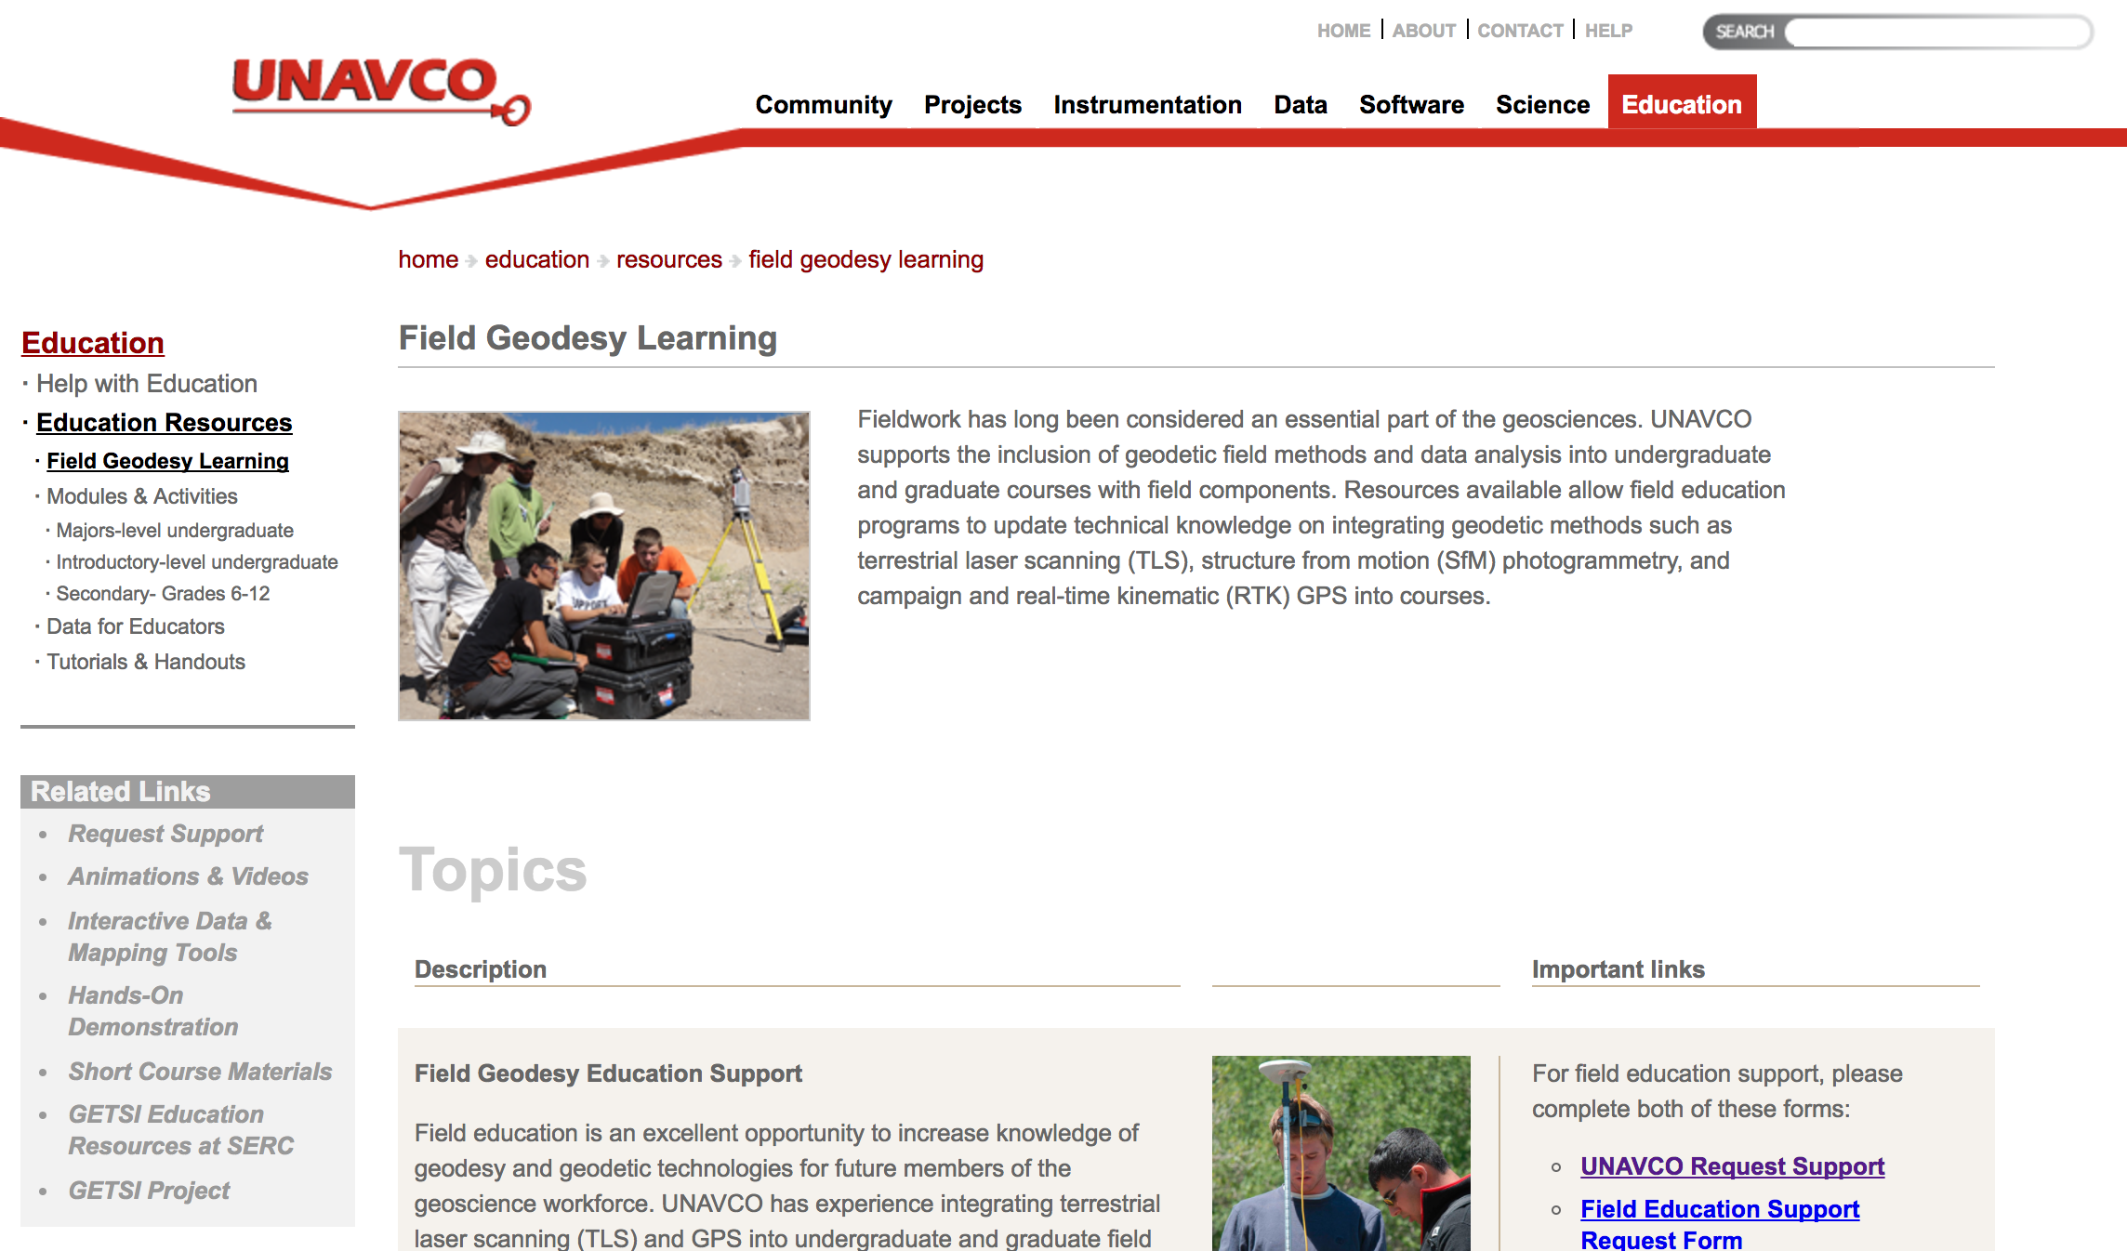
Beyond TLS
Laser scanning = $$ & access for universities is limited
Considerable opportunities for structure from motion photogrammetry & GPS in field course settings.
Motivated recent efforts to formalize and broaden UNAVCO support for geodesy field education

Slide 13
Conclusions: TLS vs SFM in a field education context
TLS:
Team activity, requires coordination, patience, group builds a single dataset to analyze.
Scanners are $$$, but data can be analyzed straight out of field.
SfM:
Independent (or paired) activity. Every student builds their own dataset to analyze.
Cameras are cheap, but data processing may take time.

Slide 14


