Slide 1
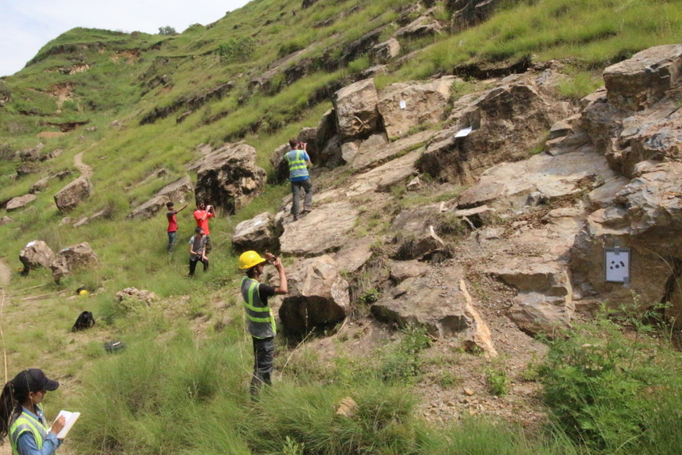
Introduction to the Short Course
@GSA Short course: Teaching SfM and GNSS/GPS Methods to Undergraduates in the Field
Friday October 7

Slide 2
Culture of Effective Collaboration
Treat others with respect and consideration, value a diversity of views and opinions.
Be considerate, inclusive, respectful, and collaborative.
Communicate openly with respect for others, critiquing ideas rather than individuals.
This group comes from a diversity of teaching institutions from community colleges to research universities
  Remember the teaching realities will vary
  Believe others if they describe situations and students that seem different than your experience
  Support each other in brainstorming solutions based on different realities
Please communicate with leaders if you have any issues or would like to switch breakout groups.

Slide 3
Goals for the Course
Participants will:
Be able to conduct SfM and kinematic GPS surveys and produce a georeferenced point cloud
Consider ways to teach SfM and/or GPS methods applied to a geoscience research question of societal relevance
Make implementation plans for teaching the method/s in their own course/s

Slide 4
Some Logistics
Toilets and water fountain back towards the front door
Lunch room/kitchen out the other door and turn right
Stores a bit east of the hotel

Slide 5
Schedule for the course
Friday October 7 - Introduction to SfM & GPS
  Morning–Intro to the course, Intro to SfM/MetaShape
  Afternoon–Intro to GPS/GNSS, field surveying w/both
Saturday October - Making georeferenced point clouds & teaching implementation
  Morning – More MetaShape, Other resources/tools
  Afternoon – Teaching implementation planning

Slide 6
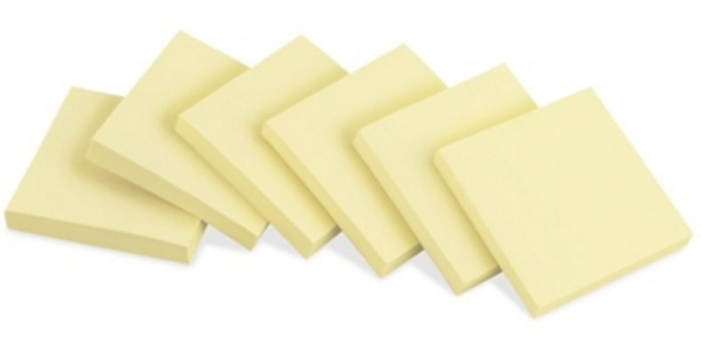
Contribute your thoughts
Use post-it notes to jot down ideas and questions
Put in the ”parking lot” and we’ll address periodically
Also great to just ask questions as you think of them

Slide 7
Folders & other resources

Slide 8
Leaders/Instructors

Slide 9
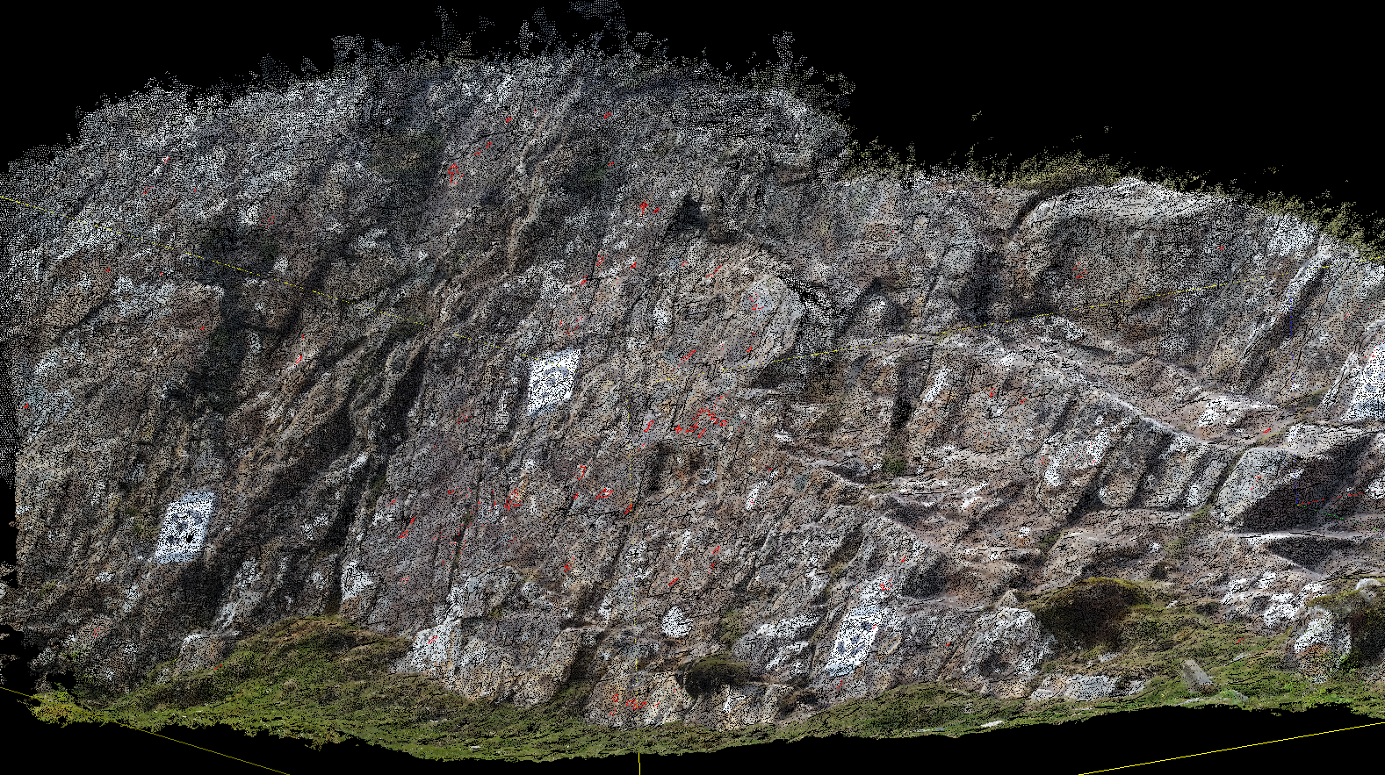
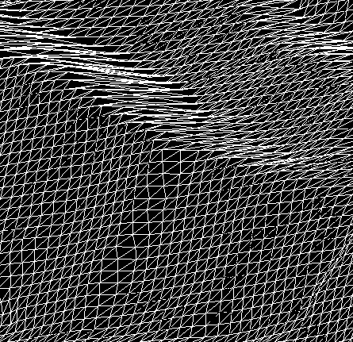
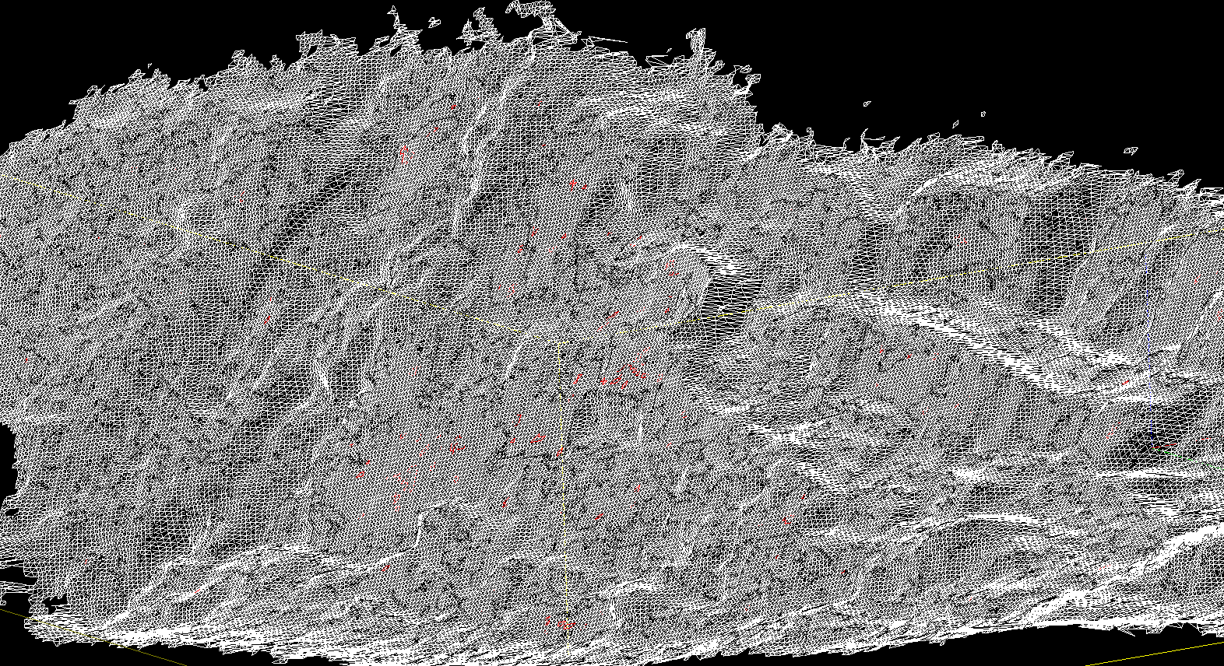
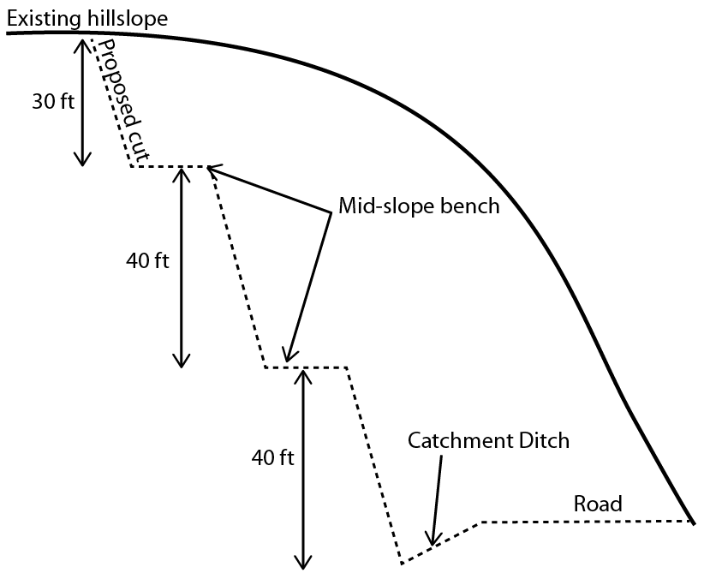
SfM teaching in Nepal field camp
Analyzing High Resolution Topography module
Unit 2.1 Surveying outcrop for road cut design

Slide 10
Ben Crosby – Idaho State University

Slide 11
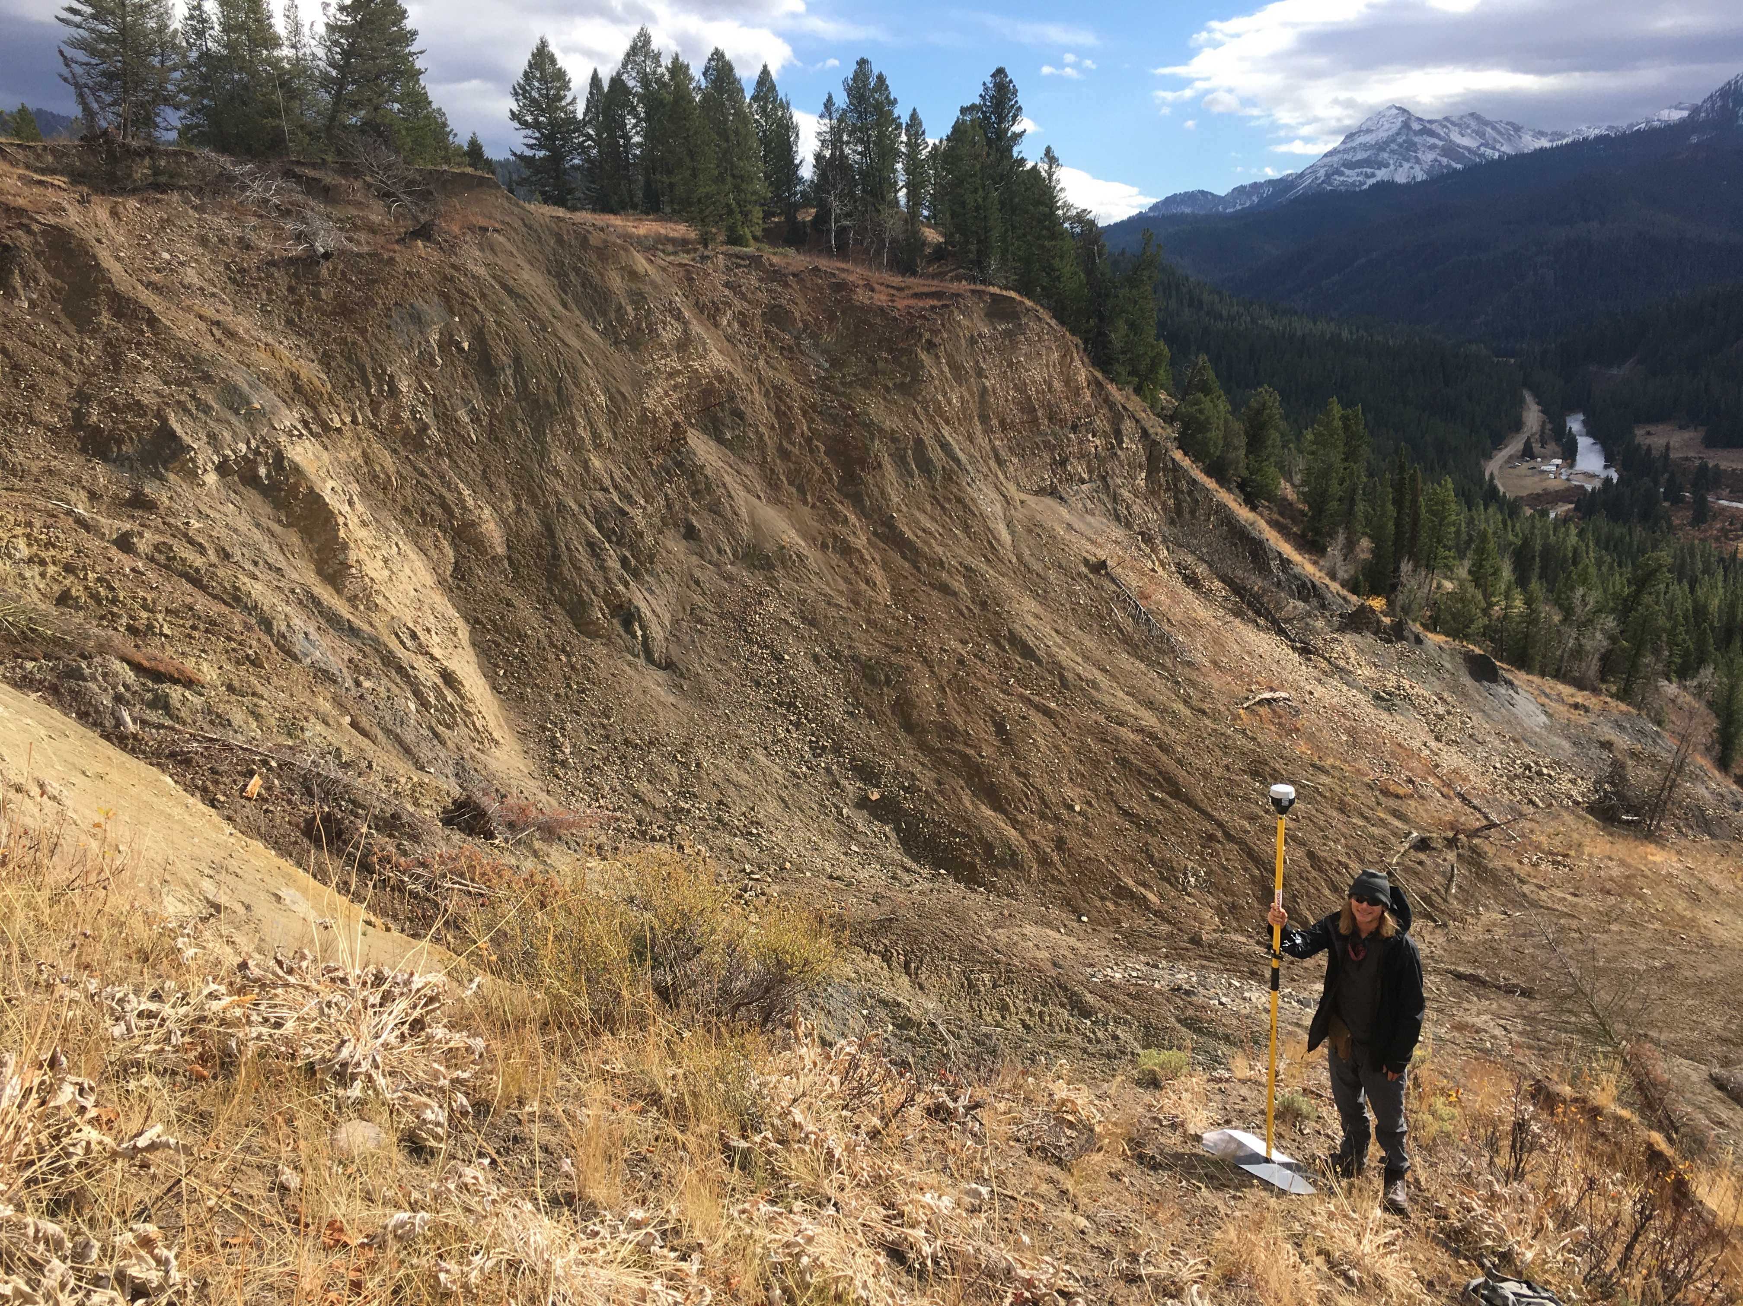

Slide 12
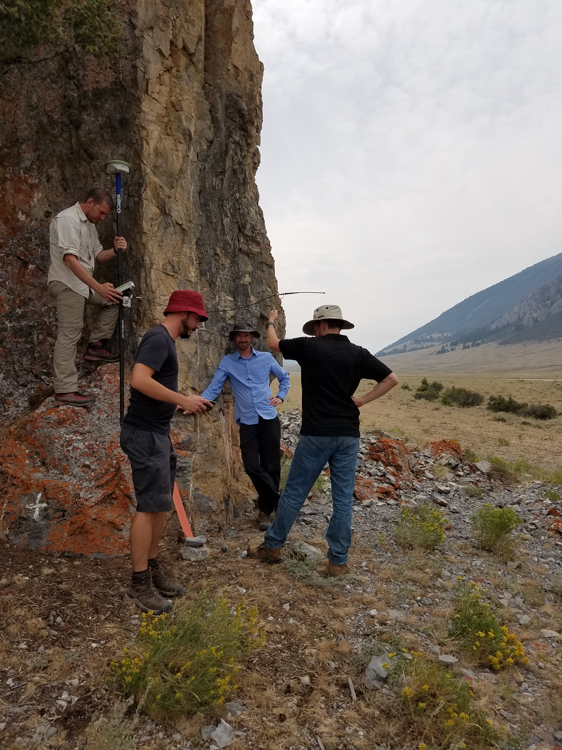

Slide 14
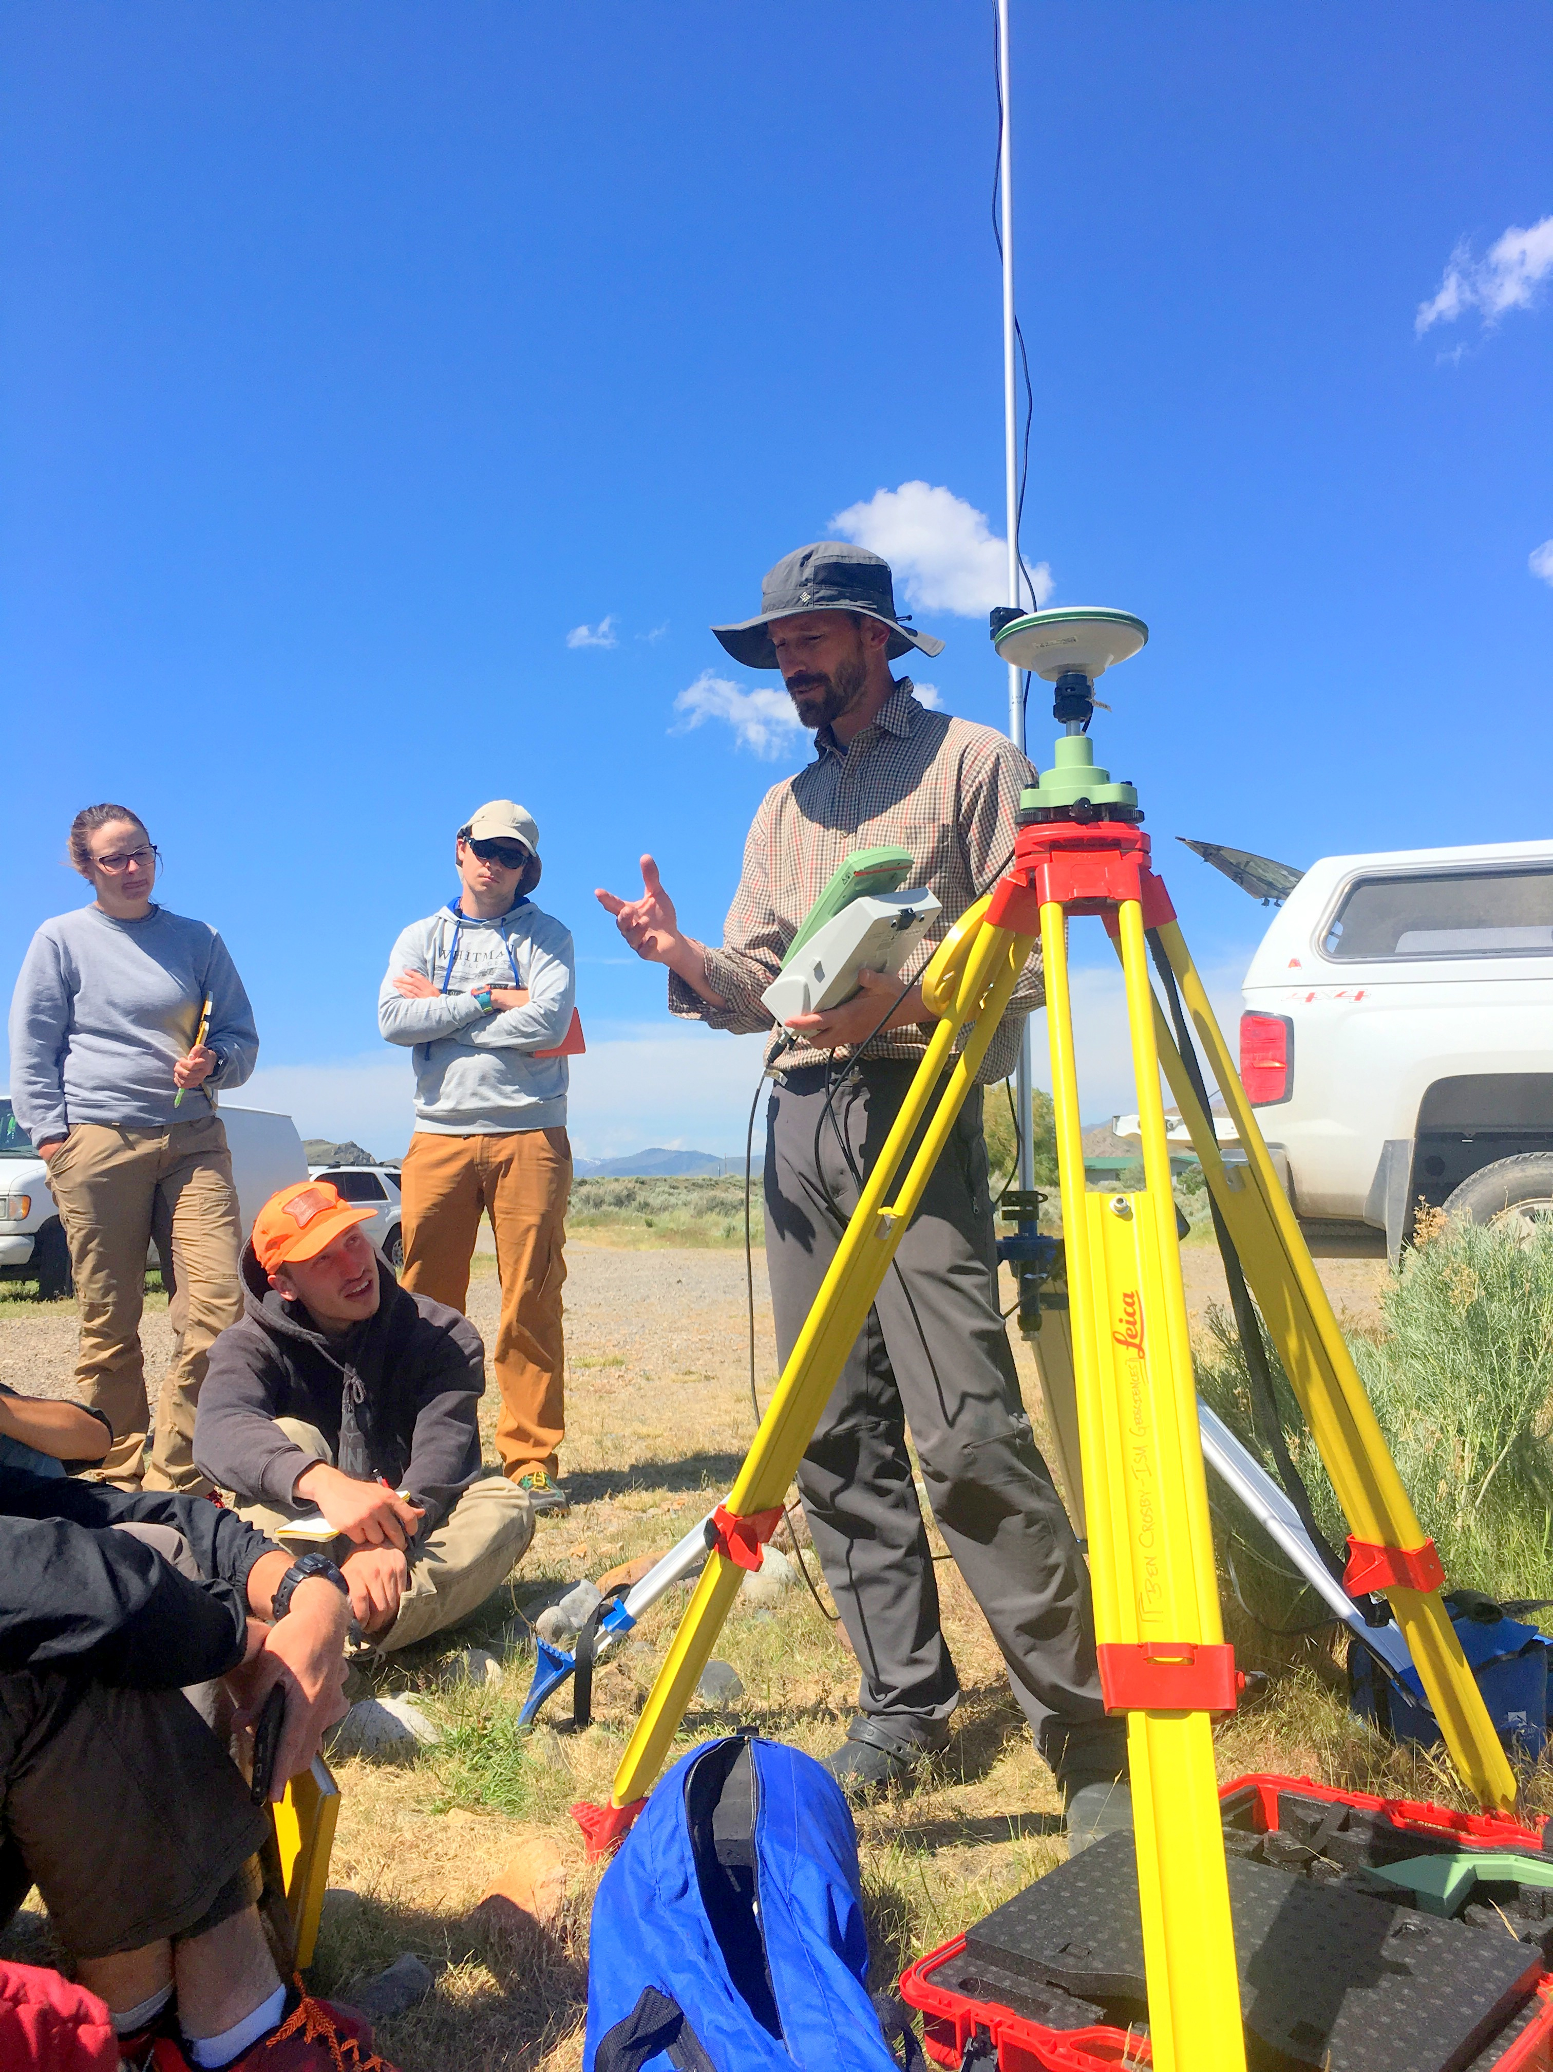

Slide 15
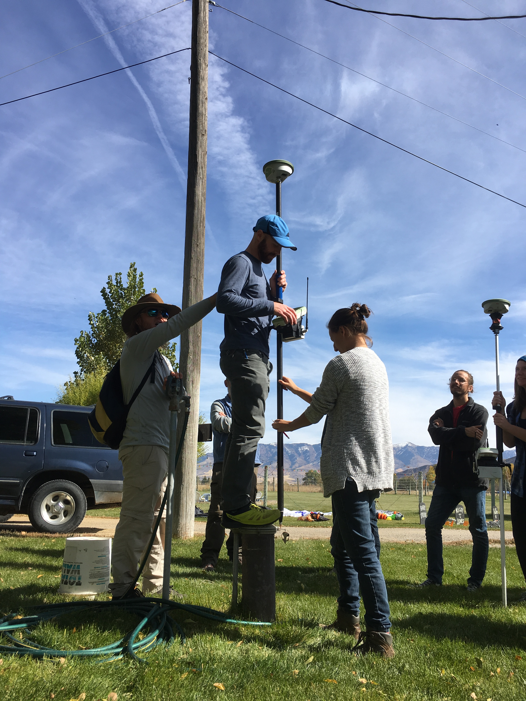

Slide 16
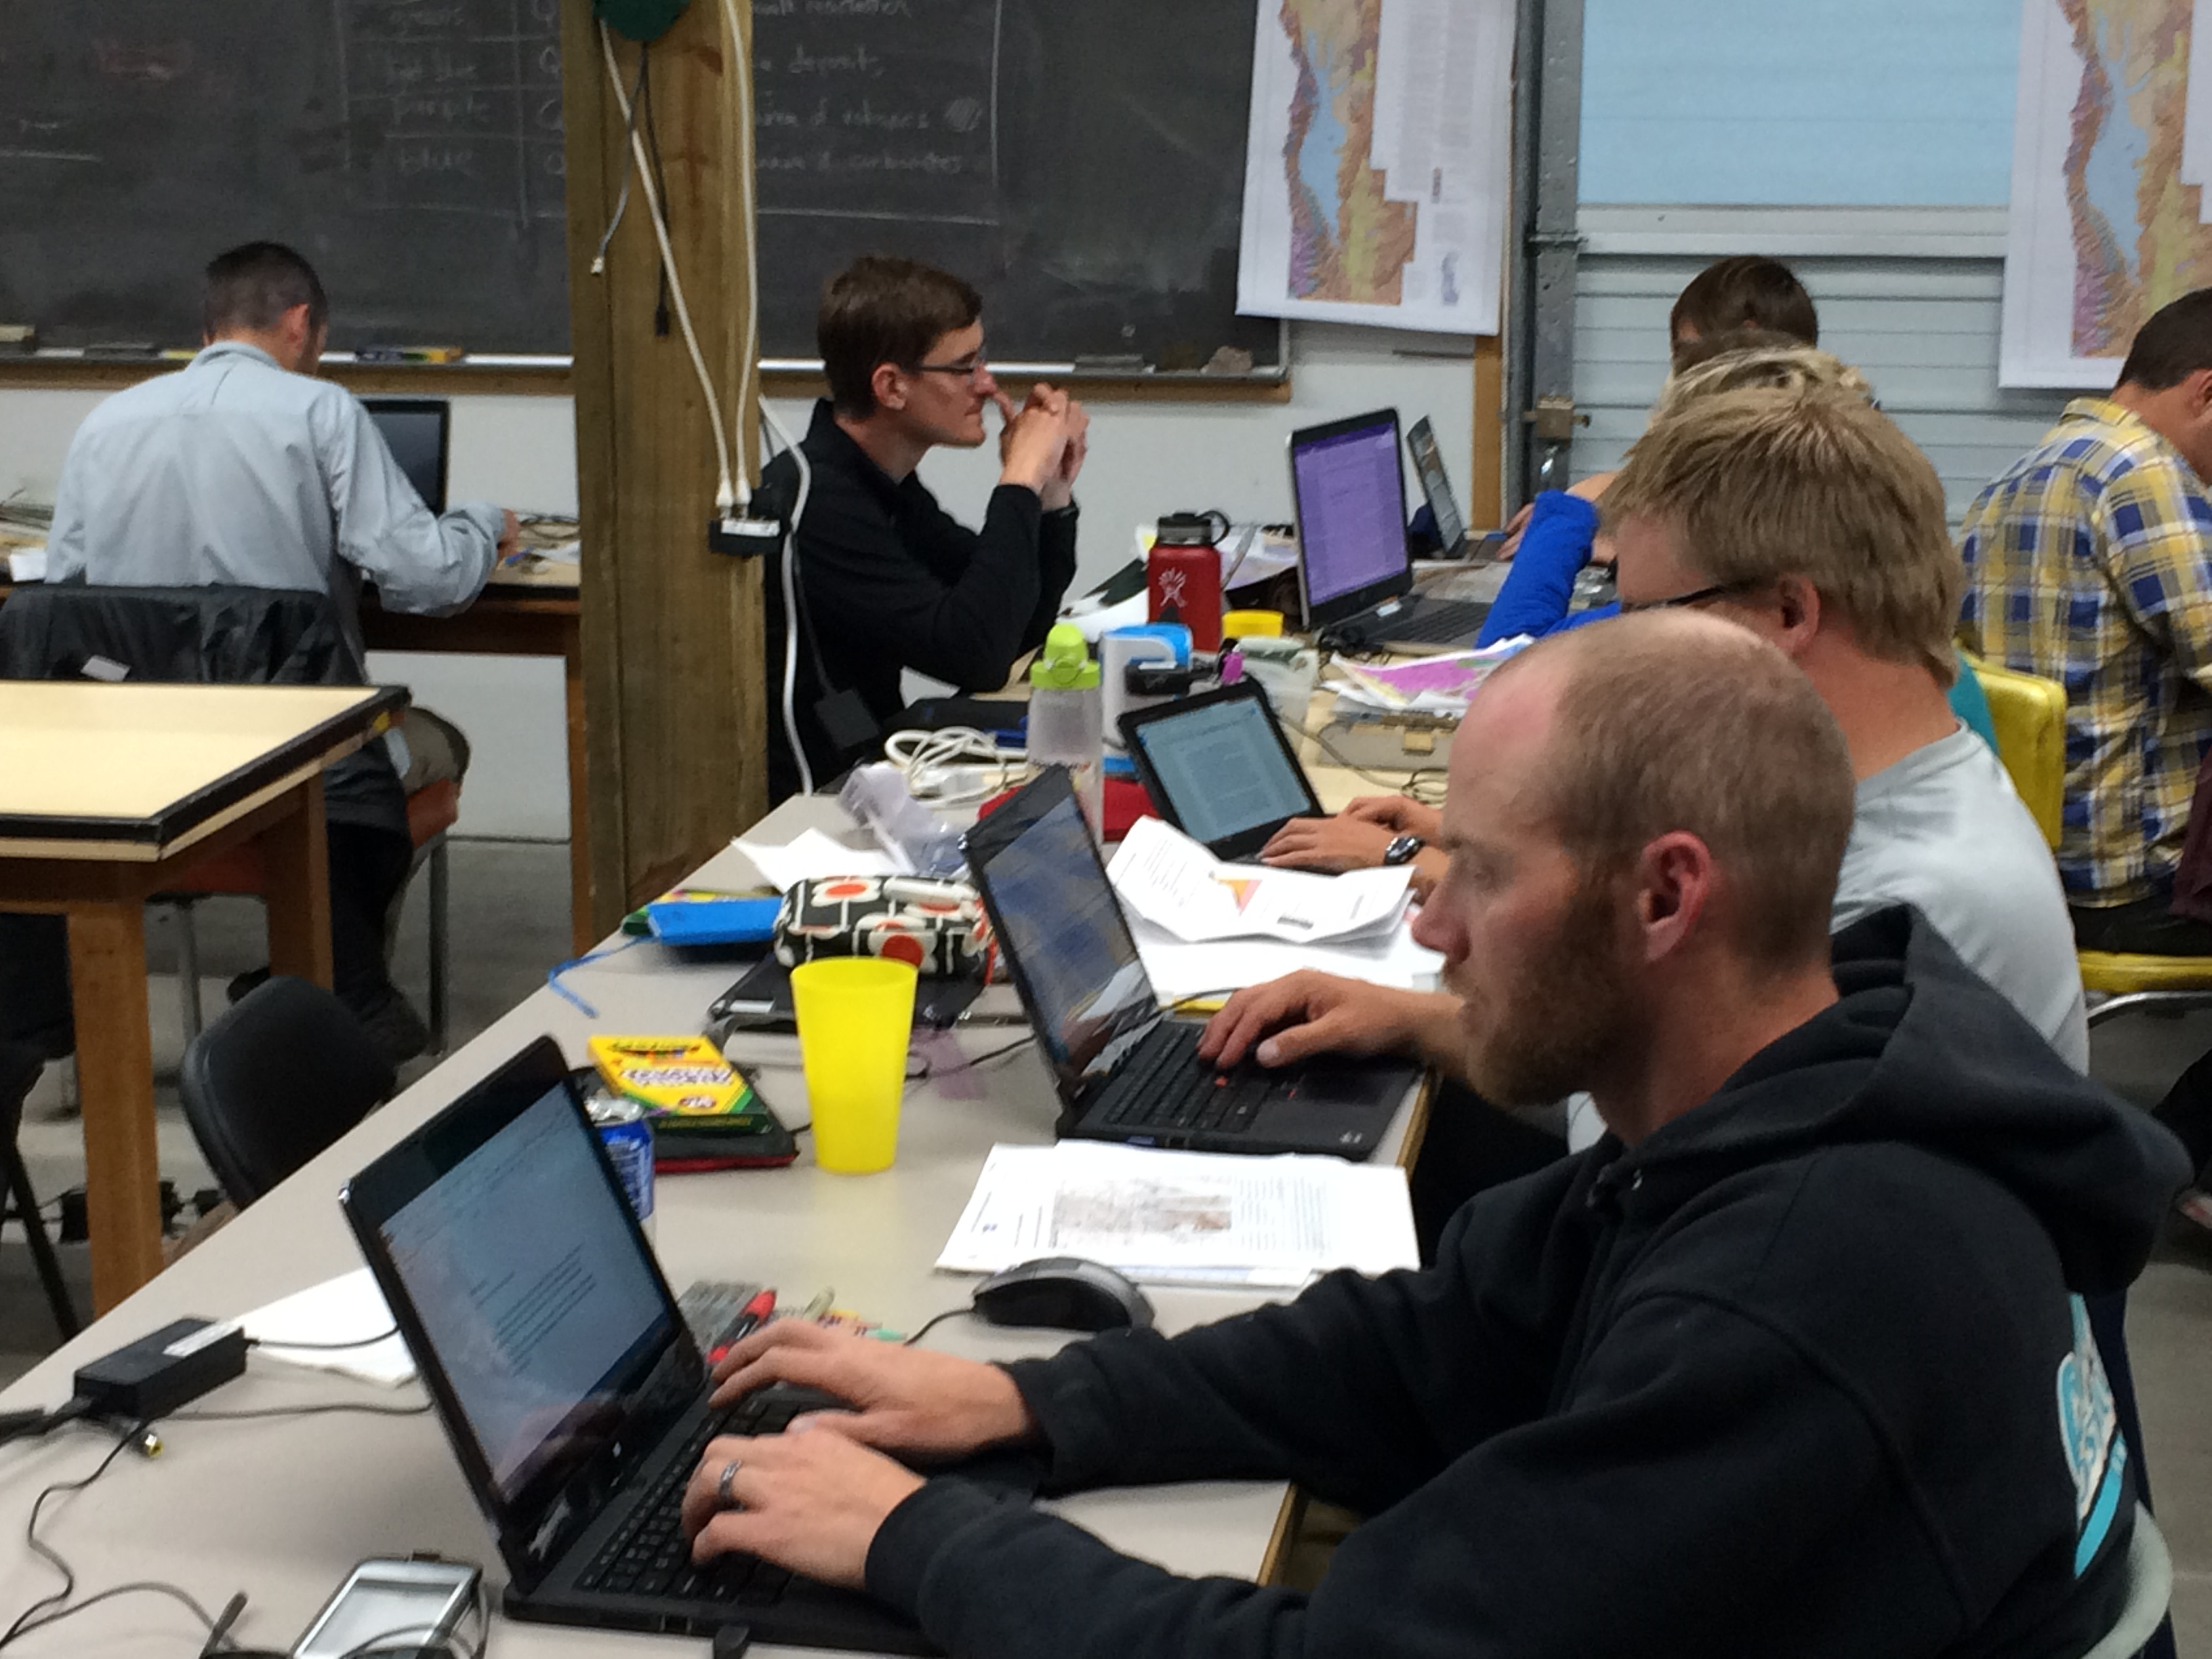

Slide 17
Bruce Douglas – Indiana University

Slide 18
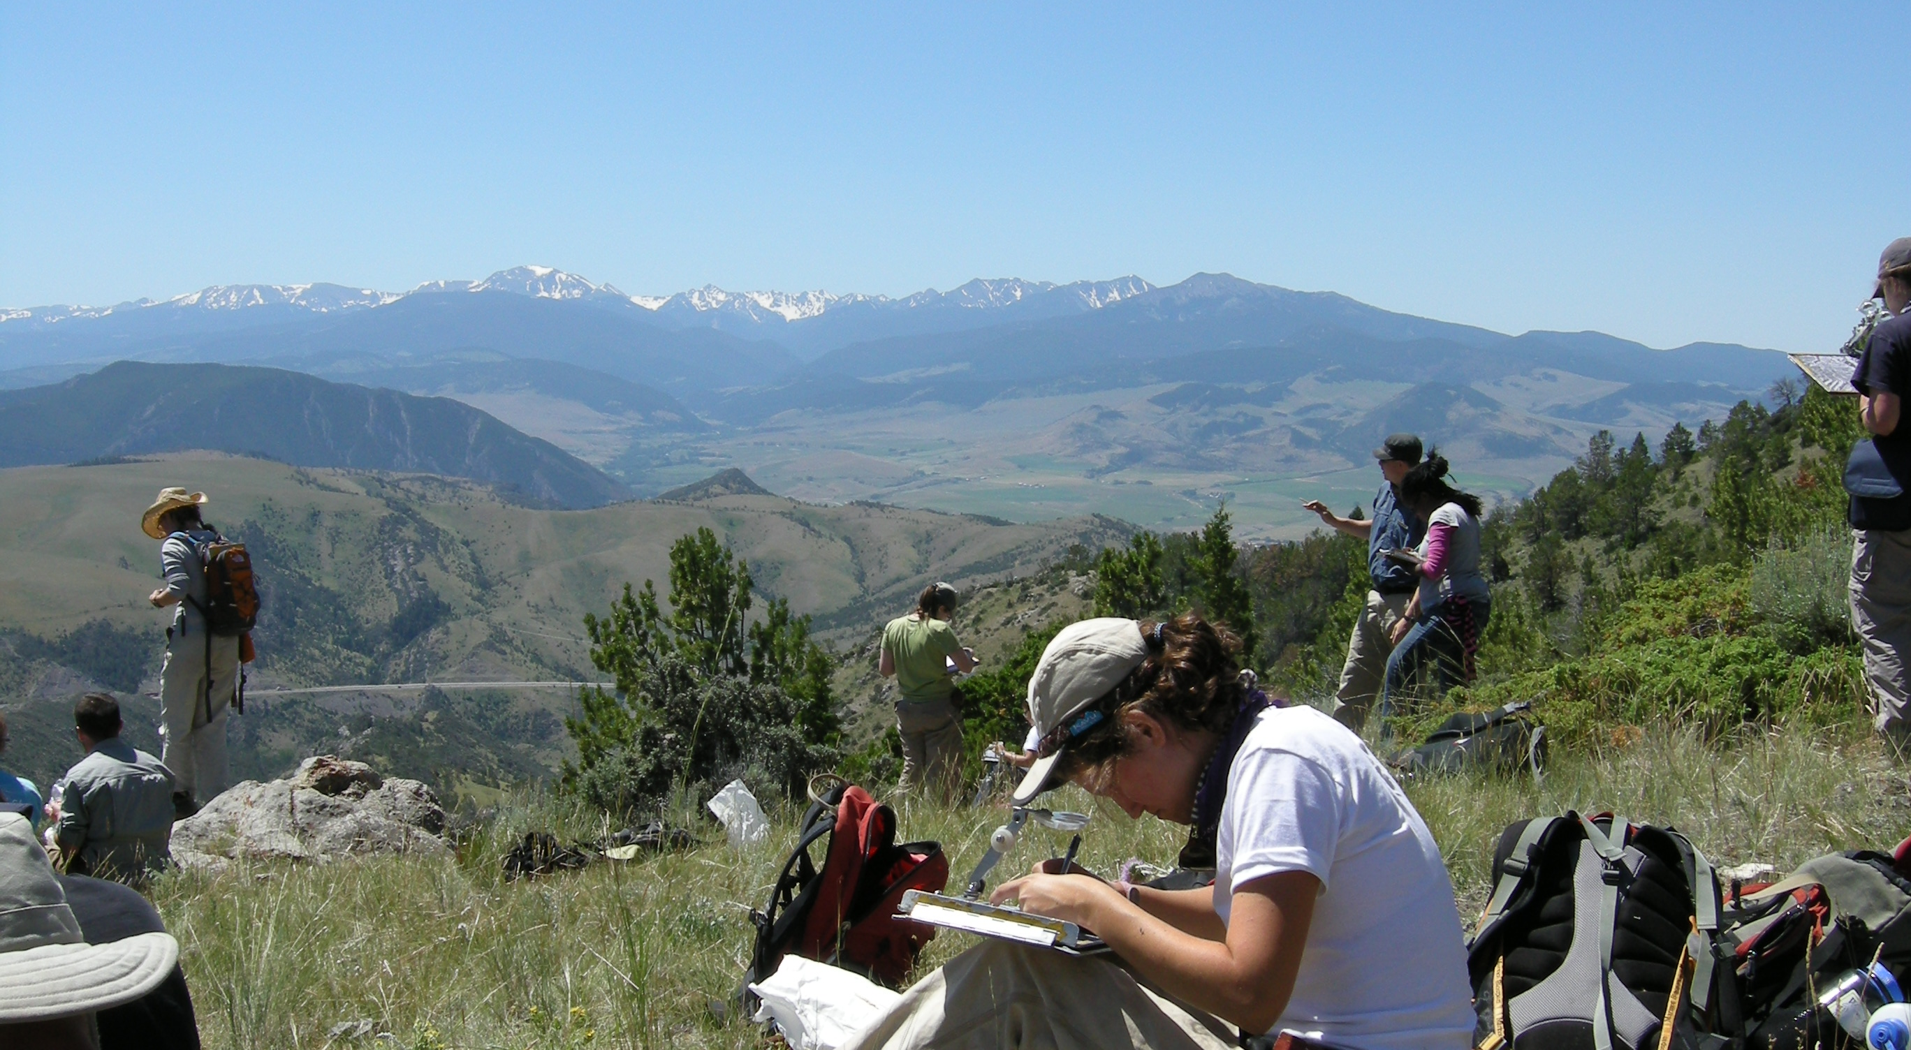

Slide 19
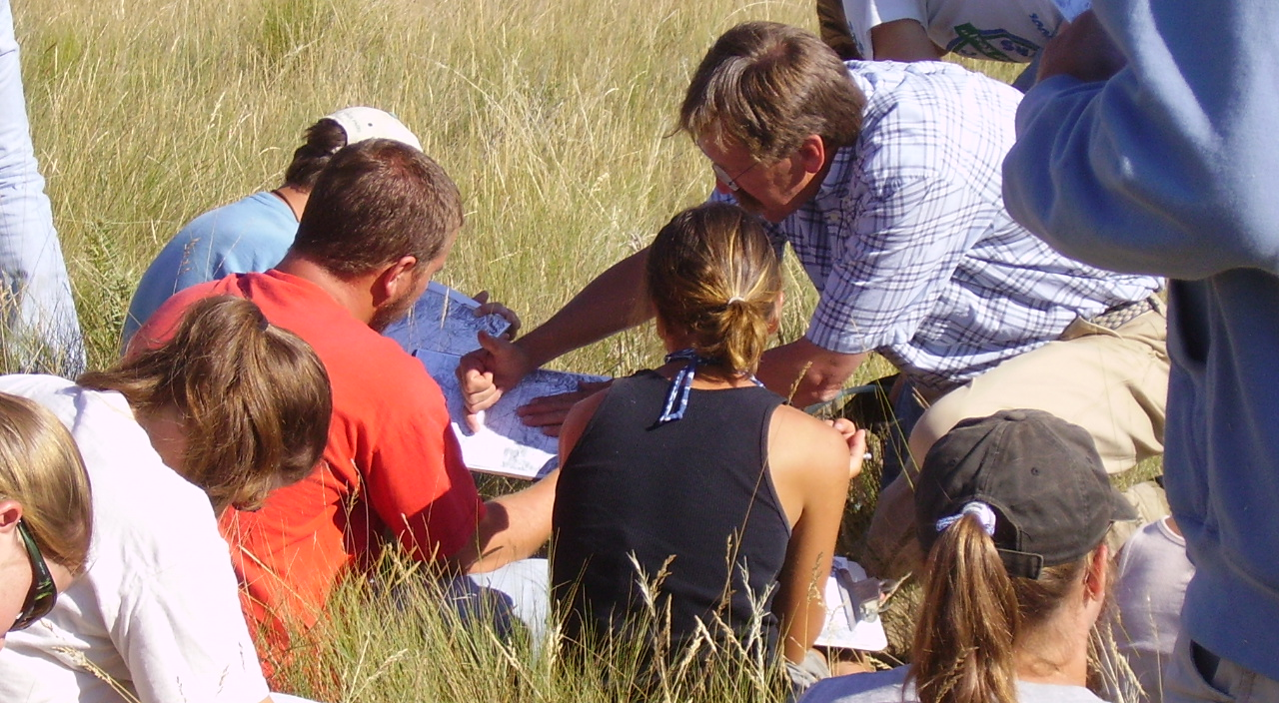

Slide 20
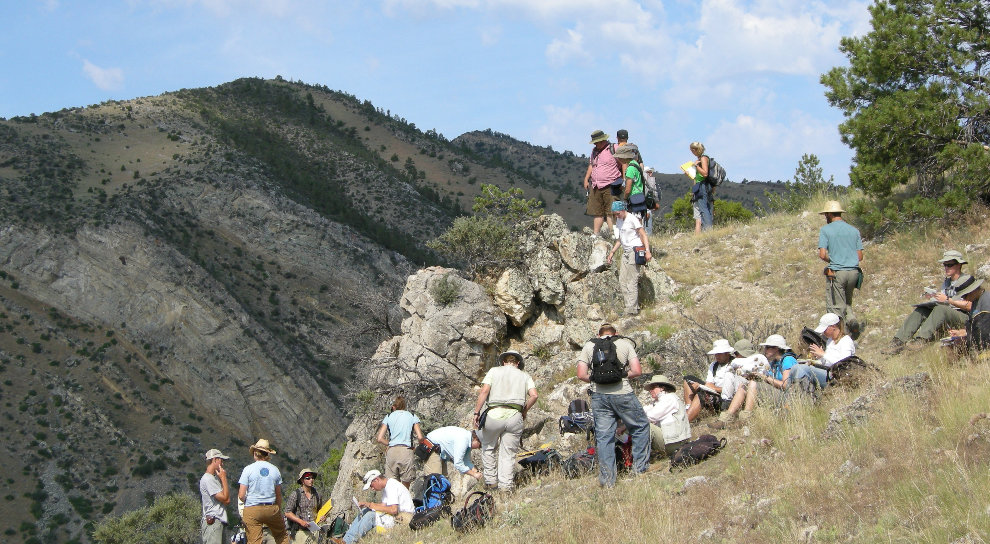

Slide 21
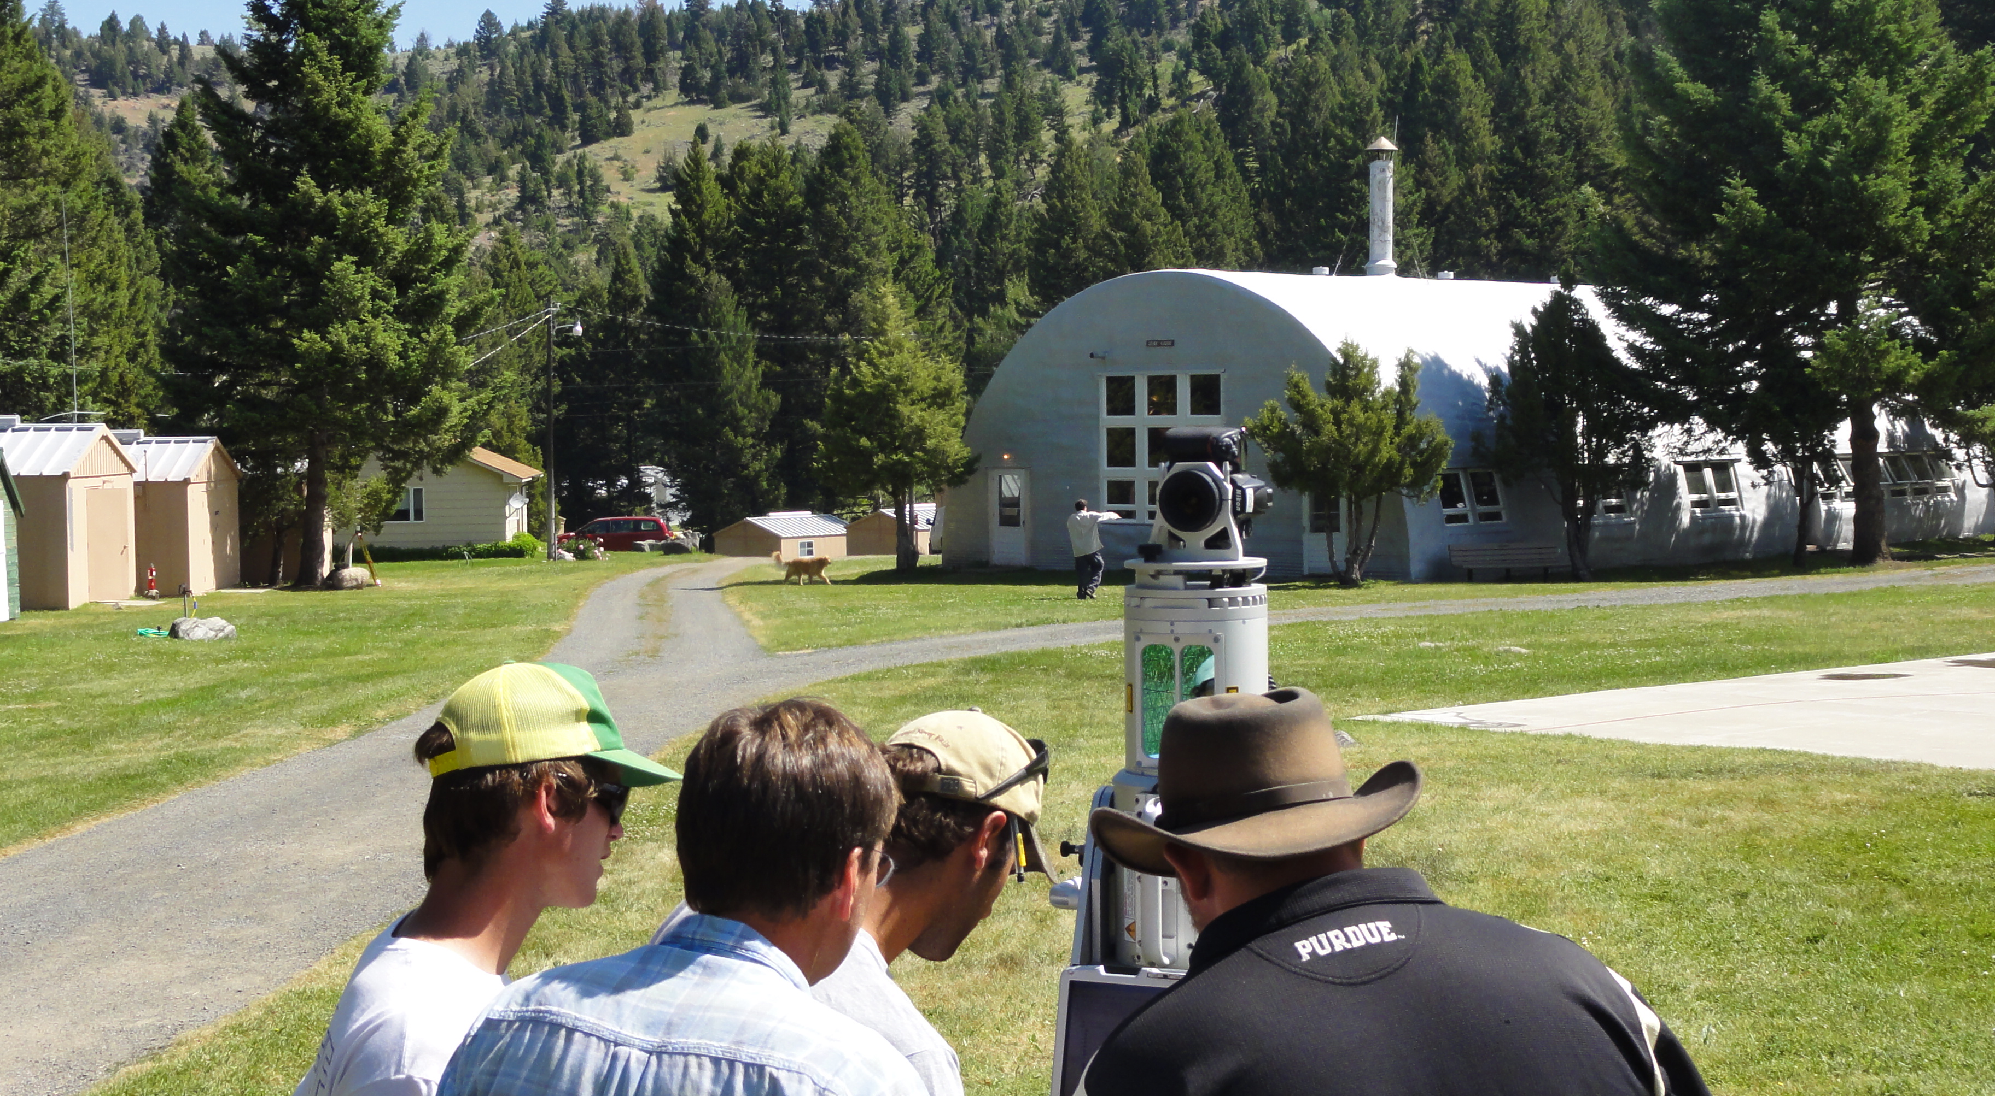

Slide 22
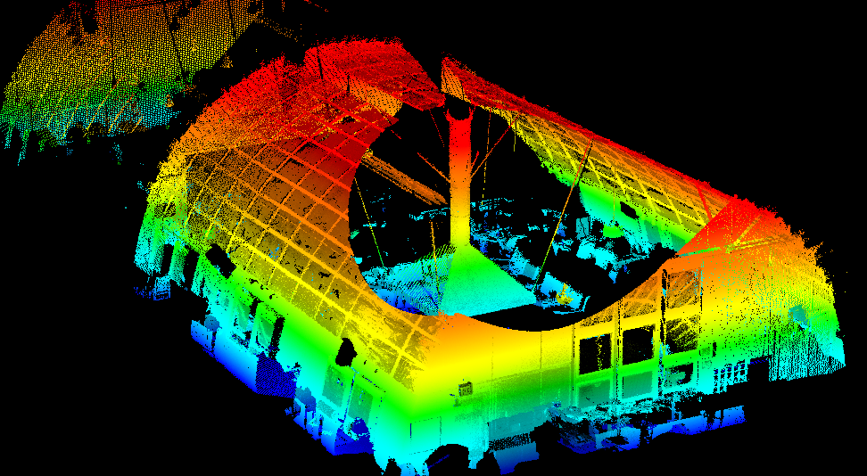

Slide 23
What is your primary discipline?
Geodesy/geophysics
Structural geology/tectonics
Geomorphology/geography
Something else

Slide 24
Where is your field teaching site located?
(the one you might integrate field geodesy into)
West coast (CA, OR, WA)
Rockies/Southwest
Central-Eastern USA
Somewhere else

Slide 25
How much experience do you have with GPS or SfM in geoscience research?
I have a lot of experience using it
I have some experience using it
I’ve heard about it but haven’t used it
D. I have not used GPS or SfM and don’t know much yet

Slide 26
GEodesy Tools for Societal Issues GETSI
Develop and disseminate teaching and learning materials that feature geodesy data & quantitative skills applied to critical societal issues such as climate change, water resources, and natural hazards
FIELD COLLECTION – integrate geodetic methods into geoscience field learning

Slide 27
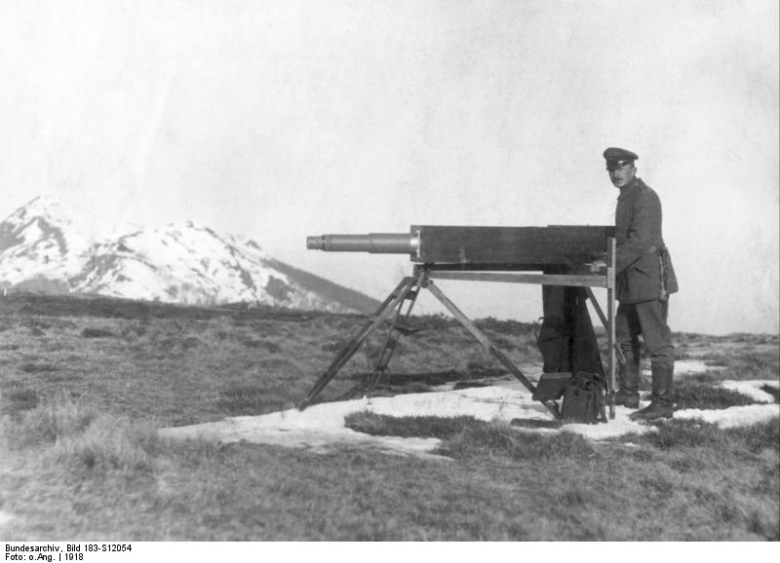
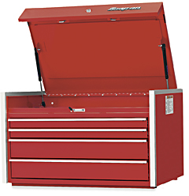
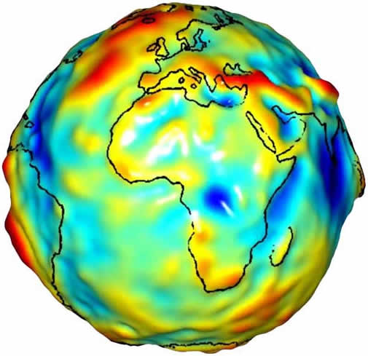
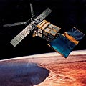
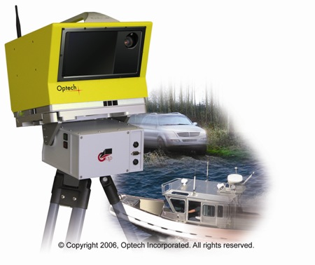

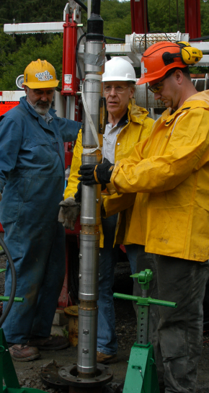
Geodesy is…
…the science of accurately measuring the Earth’s size, shape, orientation, mass distribution and the variations of these with time.
Traditional geodesy:
Precise positioning of points on the surface of the Earth
Modern geodesy:
A toolbox of techniques to better measure the Earth
wikipedia.org
JPL/NASA
27
Notes:
27
27
To make sure we are on the same page about what geodesy is…
As we got better and better at measuring points on the Earth, it evolved into being able to determine how they change.
Think of geodesy as a toolbox of ways to better measure the Earth’s size, shape…etc

Slide 28
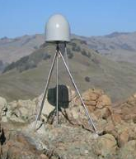
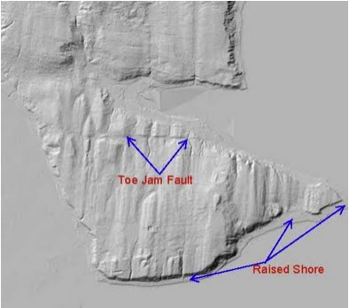
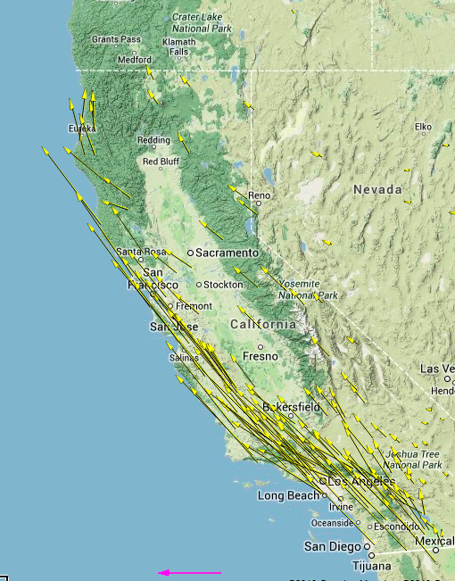
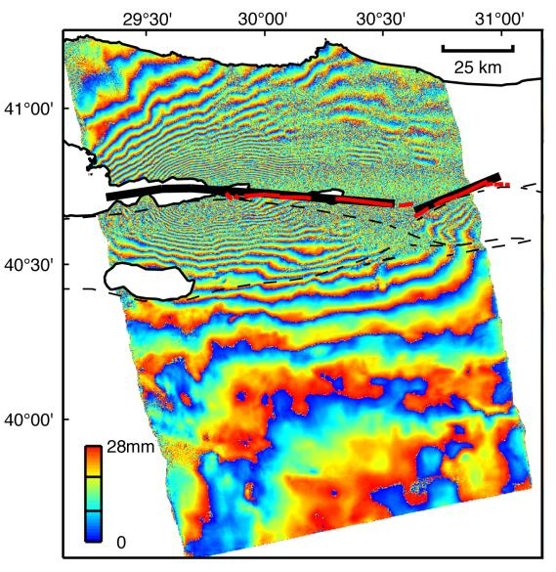
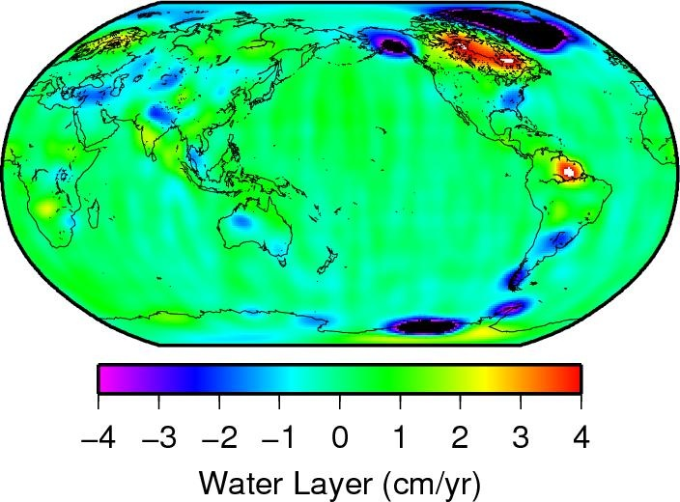
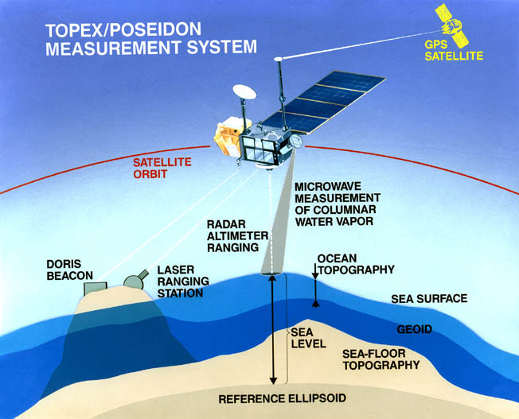
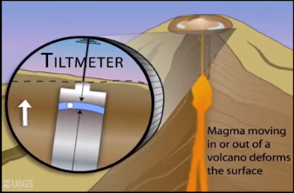
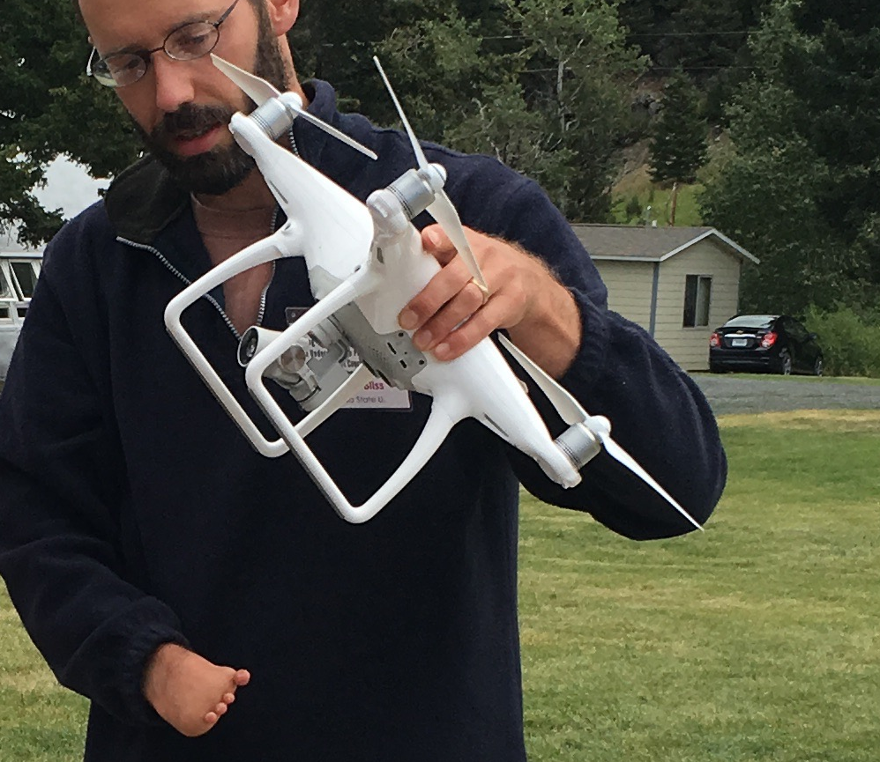
Unpacking the Geodesy Toolbox
GPS (Global Positioning System)
InSAR (Interferometric synthetic aperture radar)
LiDAR (Light detecting and ranging)
Structure from Motion
Strain meters, tiltmeters, creep meters
Gravity measurements
Sea level altimetry
GPS (Global Positioning System)
InSAR (Interferometric synthetic aperture radar)
LiDAR (Light detecting and ranging)
Structure from Motion
Strain meters, tiltmeters, creep meters
Gravity measurements
Sea level altimetry
usgs.gov
http://www.nasa.gov/topics/earth/features/graceImg20091214.html
www.jpl.nasa.gov
http://photojournal.jpl.nasa.gov/catalog/PIA00557
http://facility.unavco.org/data/maps/GPSVelocityViewer/GPSVelocityViewer.html
http://www.iris.edu/
Notes:
Geodetic methods include…

Slide 29
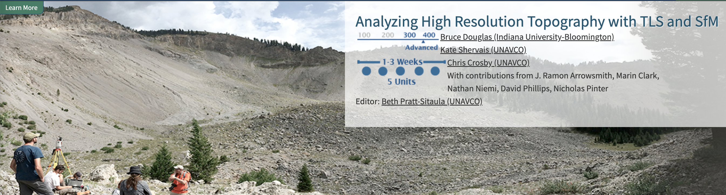
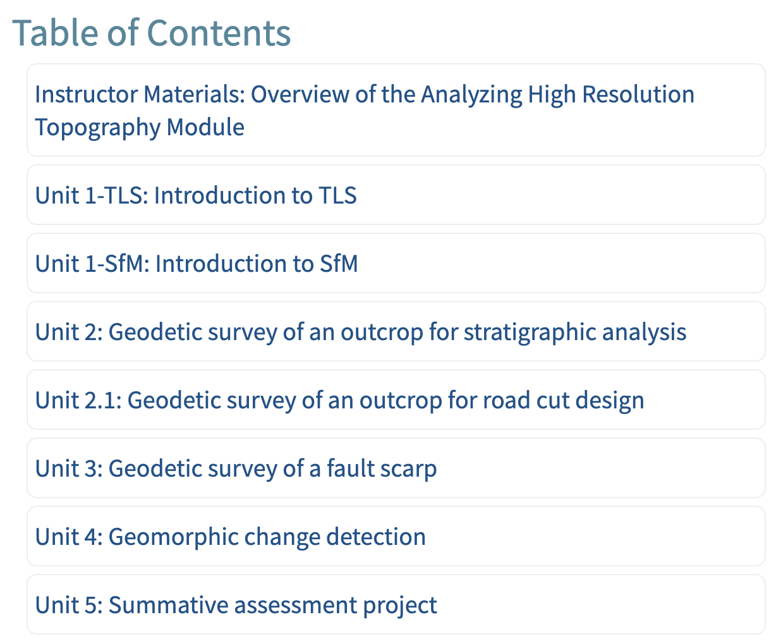

Slide 30
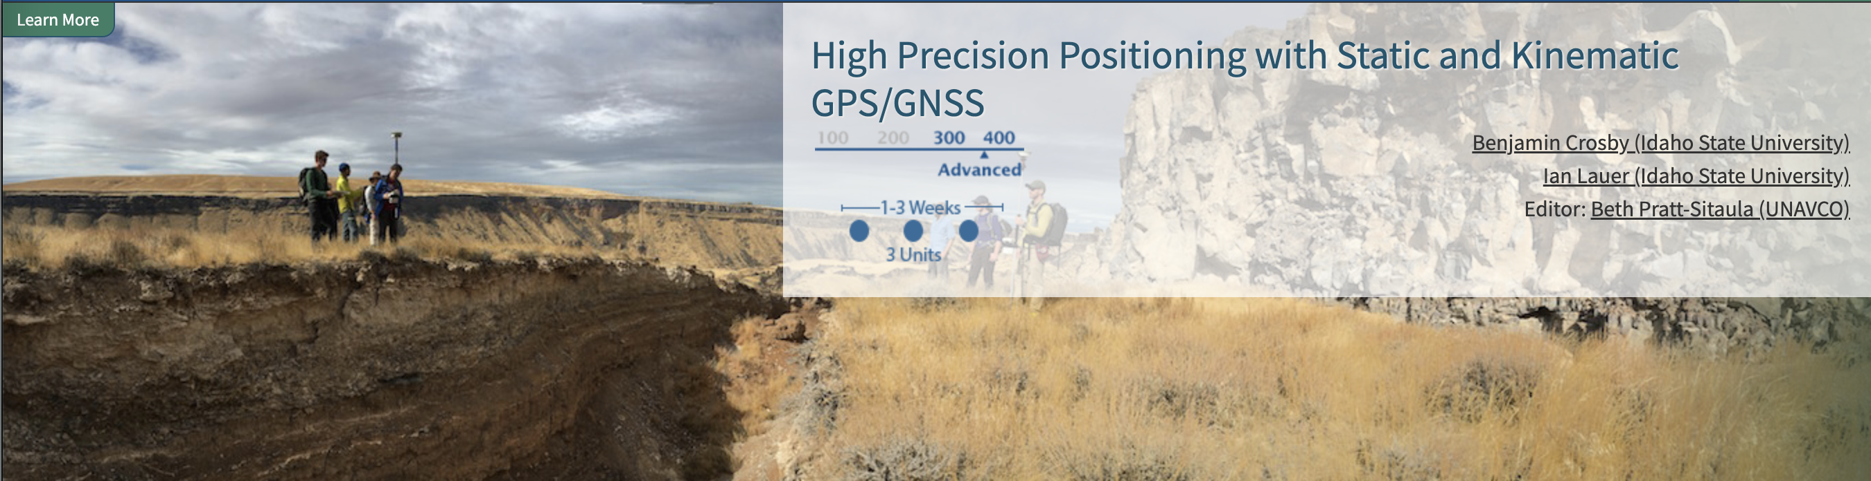
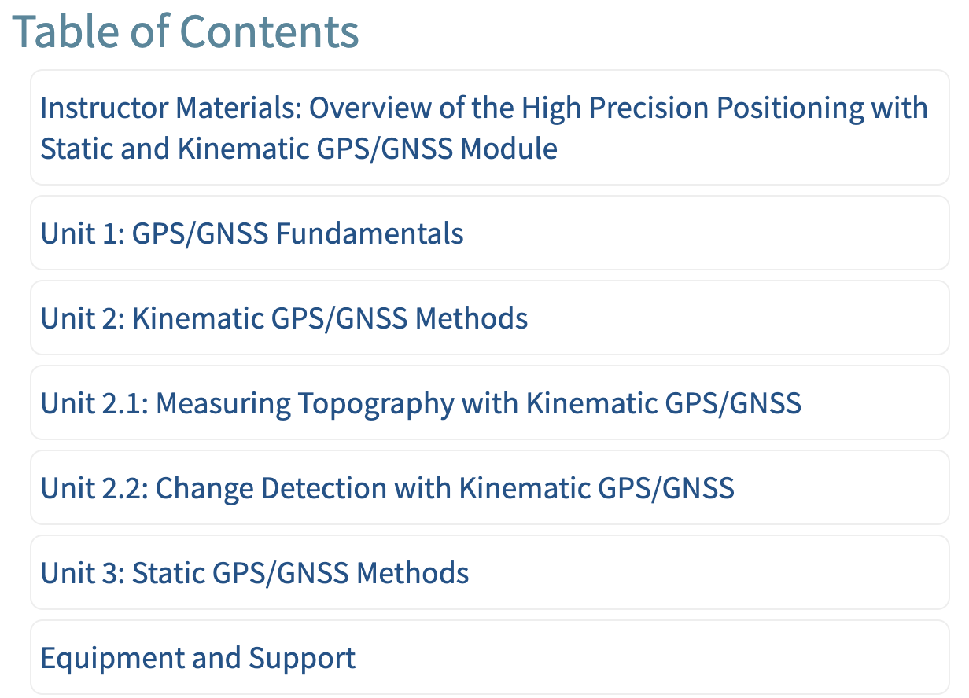

Slide 31
Schedule and web resources
Search “serc getsi” > Workshops > our workshop > Agenda
serc.carleton.edu/getsi/workshops/
gsa22_field/agenda.html

Slide 32
Maximizing effectiveness
Please give us feedback
  More info needed? Too much detail?
Ask lots of questions
Leverage the power of the group
Ask questions, share challenges, and communicate successes

Slide 33
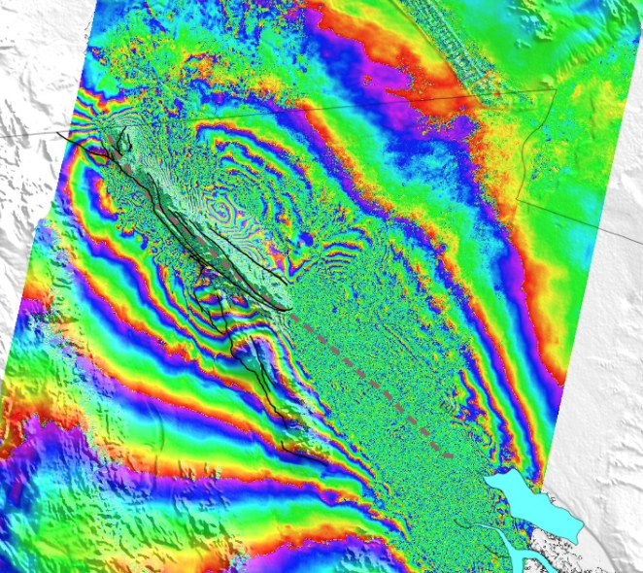
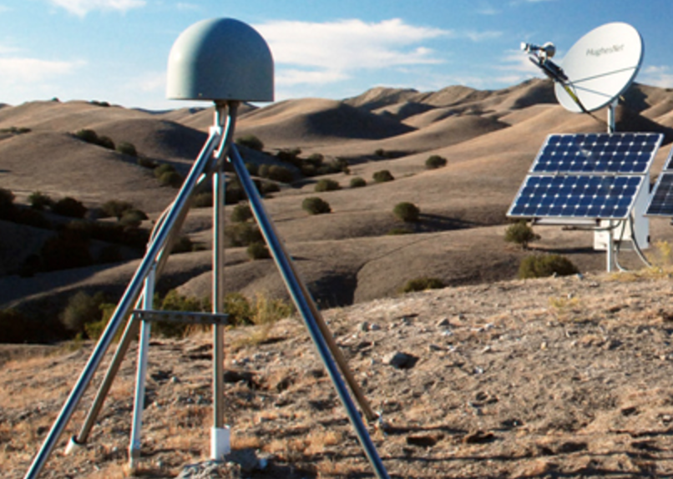
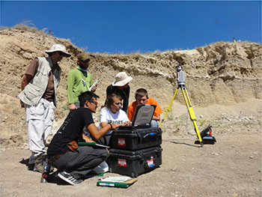
History behind GETSI Project
Geoscience/geodesy community members with great ideas
Other community members asking for more available teaching resources/support
UNAVCO collaborating with SERC & community members to do this
Notes:
Images: UNAVCO, UNAVCO, NASA/JPL

Slide 34
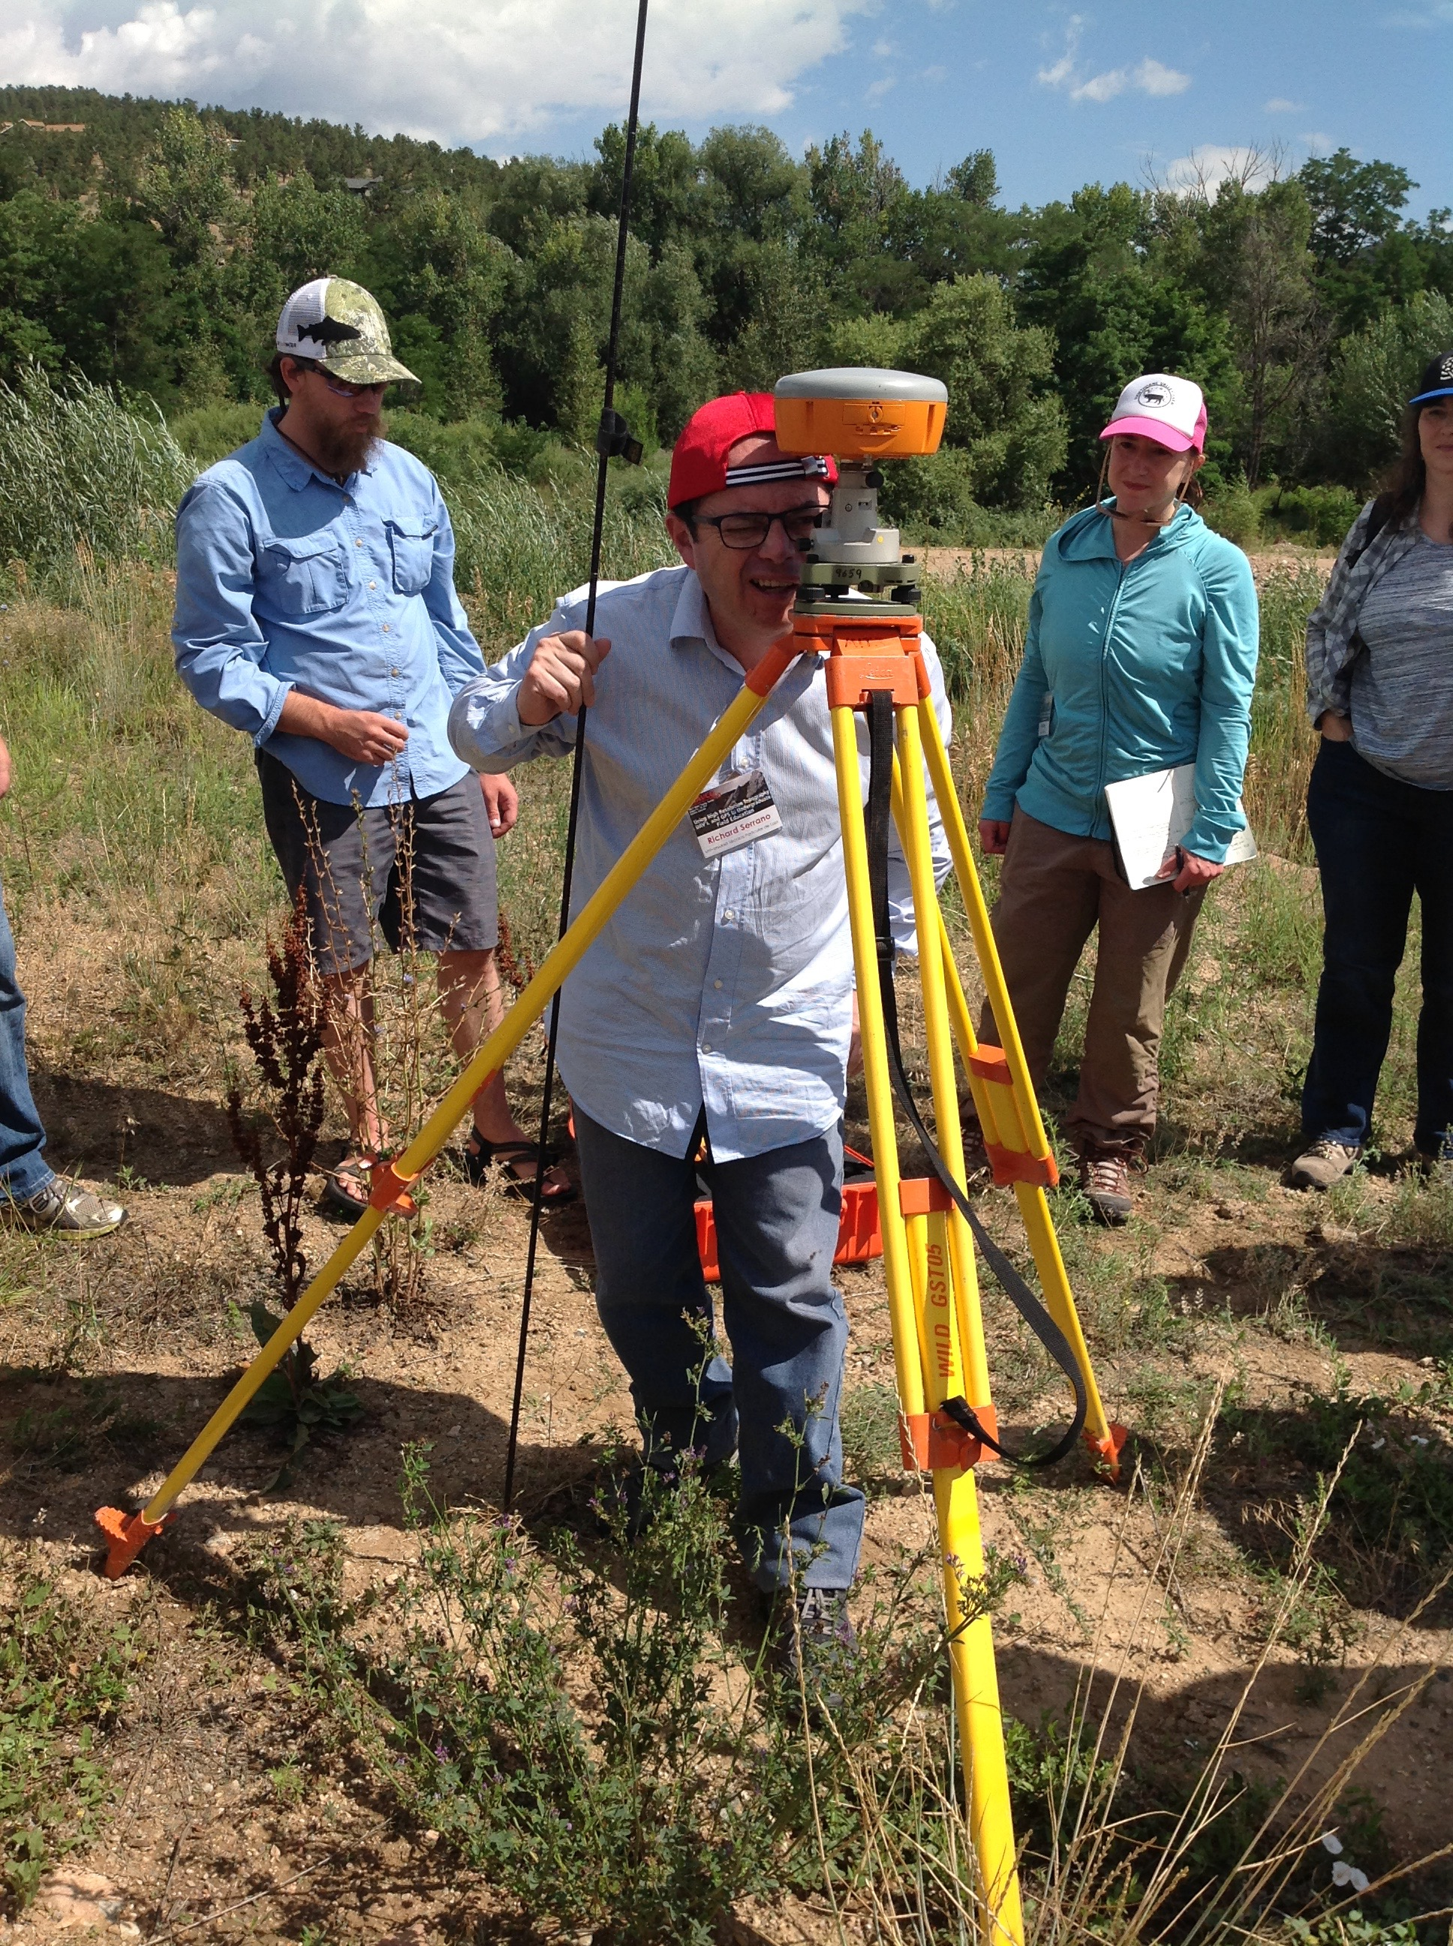
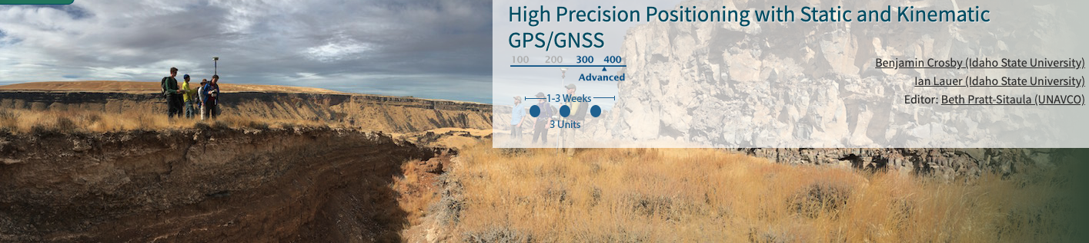
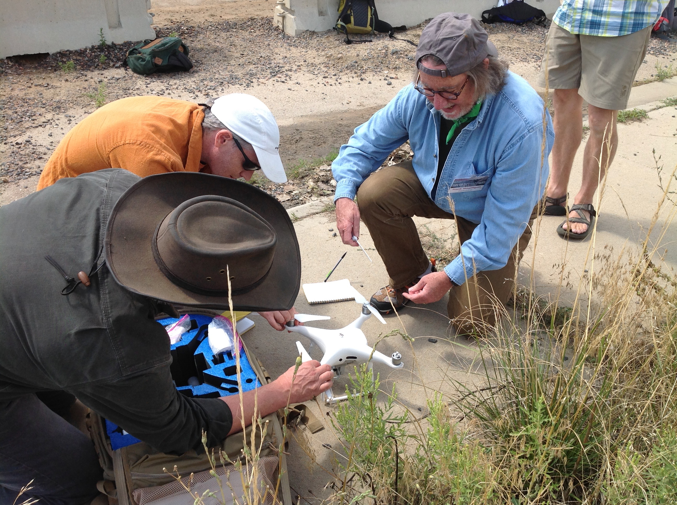
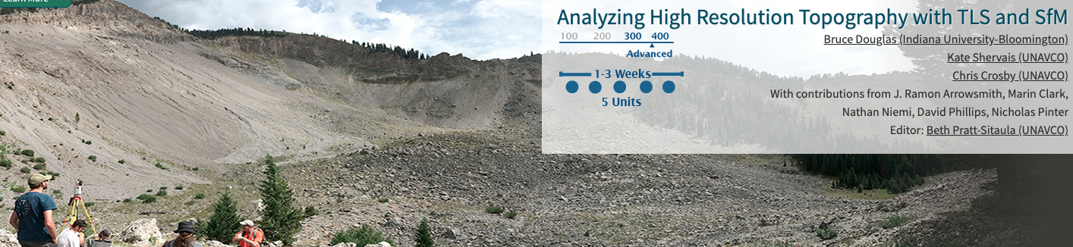
Field Phase 1 (2016-18)
2 teaching modules
3 short courses
53 participants (10 came twice)
>650 student reached

Slide 35
Field Phase 2 (2019-22…2023?)
Engineer support & equipment pool
Short courses
  Pivoted to virtual for 2021
  This is our first in-person short course in Phase 2
  Another couple in 2022-23
Refine modules, manuals, prepared data sets
Recommendations for needed support level to maximize adoption (bang for buck)

Slide 36
Participant Prep - Software Troubleshooting
Software
  Agisoft MetaShape Pro - you will be able to request a fully functional 30-day free trial (so don't activate this too early so that the license runs out before the course ends)
  Emlid Studio - free (not totally required for the course but you may like to learn its uses)
EmlidReach3 app
  App Store or Google Play

