Slide 1
Introduction to GPS/GNSS
Excerpts from GETSI module presentations for the 2026 Teaching Near-surface Geophysics Workshop
Notes:
DO REMEMBER to include attribution information for all the figures you include. Even if you took the picture or made the diagram, it will make it easier later if we just have that recorded.
ALSO – it is much easier to make notes (at least preliminary ones) for each slide NOW compared to several months later. Think about the information that future instructors using this materials will need to know in order to understand what the point of the different slides are. If all the relevant text is on the slide, notes may not be necessary, BUT if there are images, most likely some notes will be needed for future users.

Slide 2
Goals
Describe the GPS/GNSS and how it enables positioning
Distinguish different grades of GPS/GNSS receivers, their uses, and their accuracies
Highlight applications of GPS/GNSS in geosciences

Slide 3
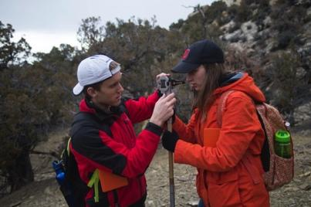
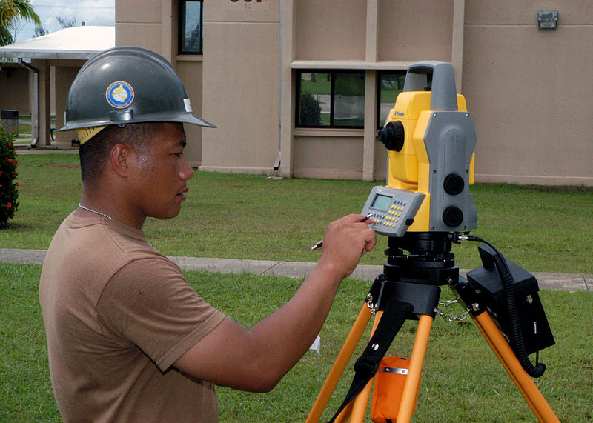
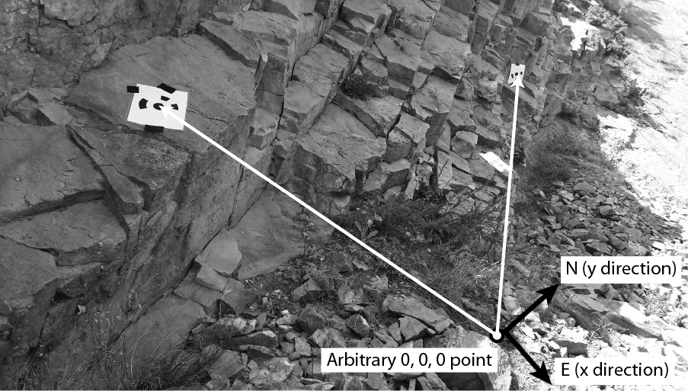
Georeferencing - Local
References to a local zero point
  Hand measuring with tape and compass
  Total station – laser for distance, inclinometer for angles
Notes:
Left image: Beth Pratt-Sitaula (EarthScope, GETSI Project)
Top right image: https://scotthuckphoto.wordpress.com/2014/03/05/geology-sed-strat-spring-break-day – used with permission
Bottom right image: https://commons.wikimedia.org/wiki/File:US_Navy_070801-F-8678B-039_Engineering_Aide_2nd_Class_Randy_Felipe_attached_to_Naval_Mobile_Construction_Battalion_(NMCB)_4,_trains_on_the_new_Trimble_5600DX_Total_Station_series,_survey_equipment.jpg

Slide 4
GNSS Composed of Multiple Satellite Systems
There are multiple Global Navigation Satellite Systems (GNSS)
  GPS: USA, global
  GLONAS: Russia, global
  BeiDou: China, global
  Galileo: Europe, global
  India, France, and Japan: regional systems
Notes:
Most modern systems take advantage of the first two systems listed here…even smartphones. The more satellites, the more likely you will get a position even in areas with limited sky such as in a city with tall buildings.

Slide 5
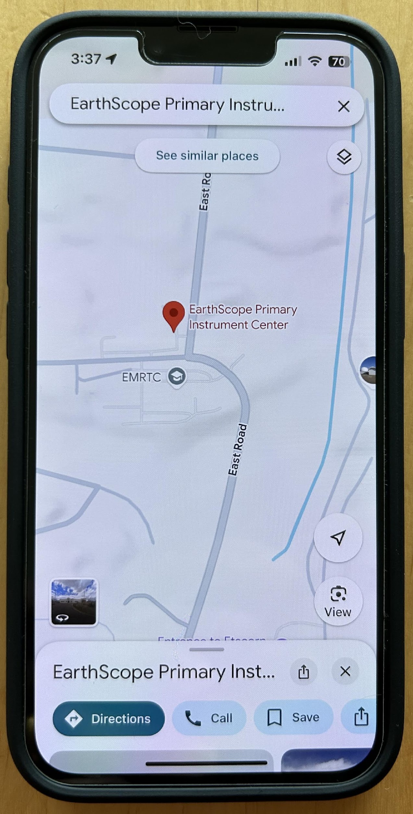
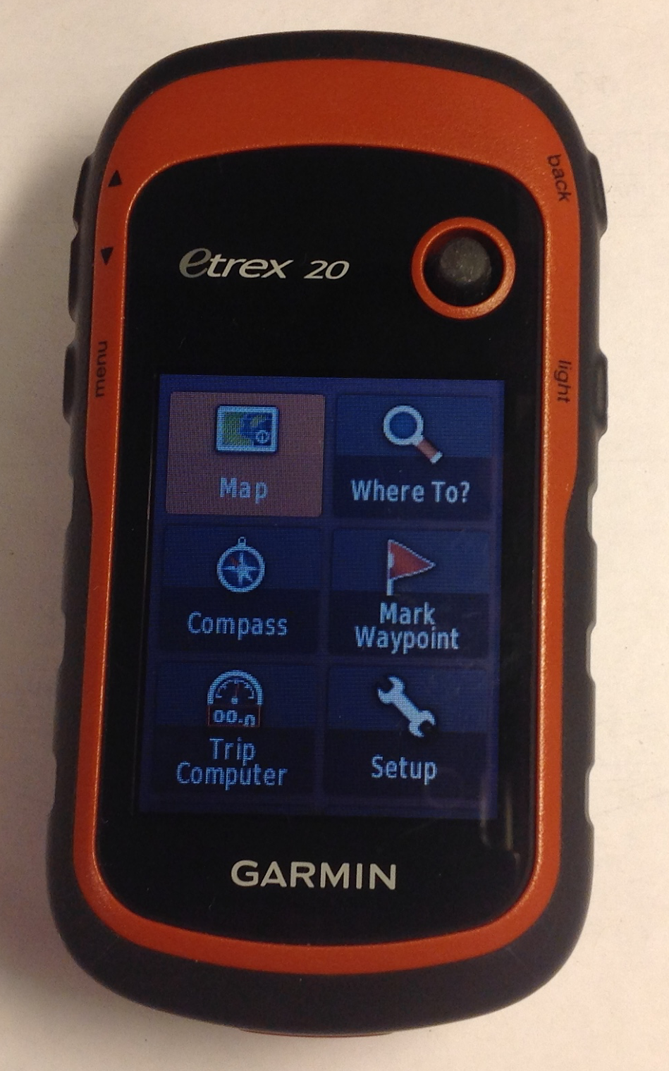
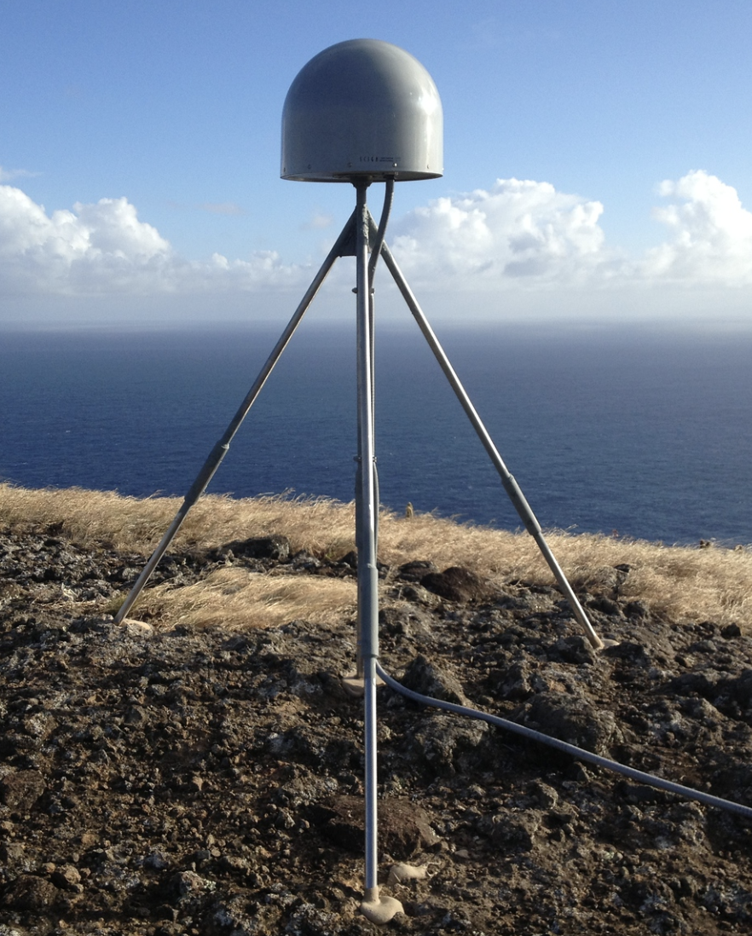
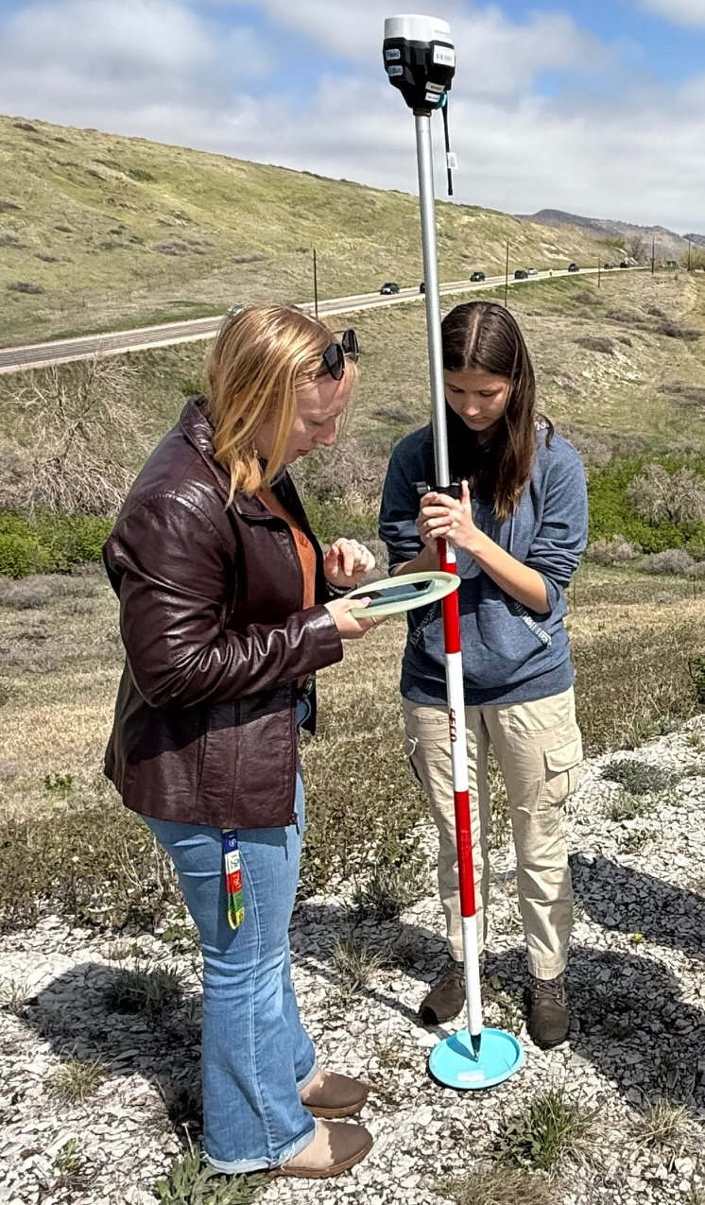
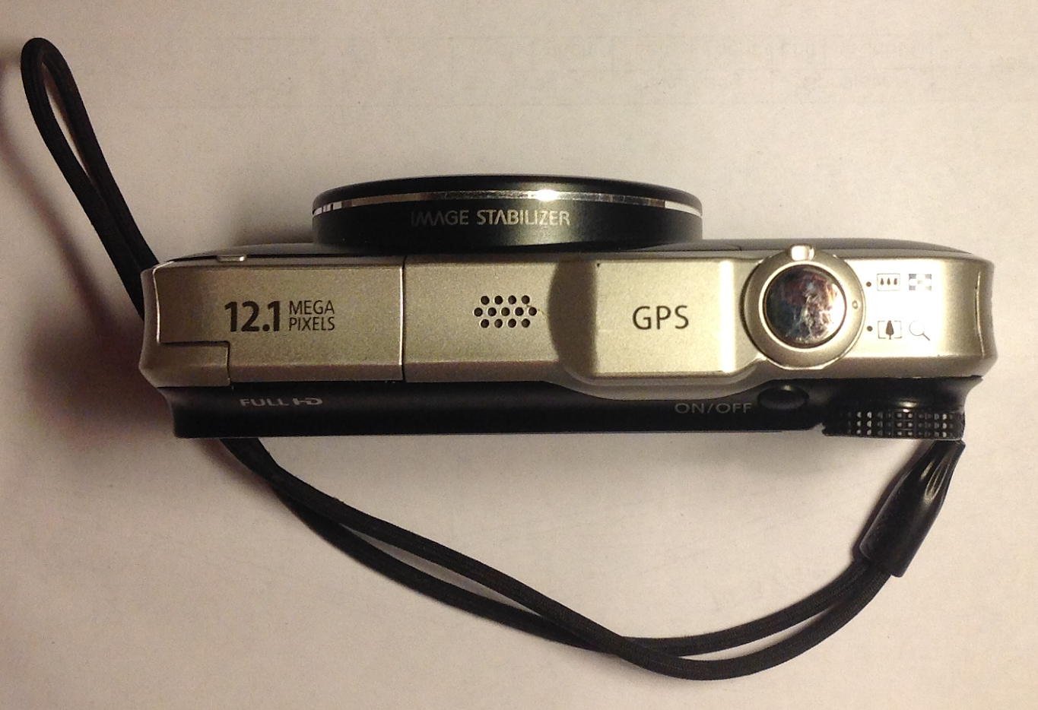
GPS Receivers All Around Us
Notes:
Whether they know it or not, students use GPS receivers daily in their cars, phones, cameras, and handheld recreational GPS. Most have heard the term “GPS” but few know much about how the system actually works or high-precision GPS for science and industrial use.
Images from EarthScope; student surveyers: John Galetzka (NGS)

Slide 6
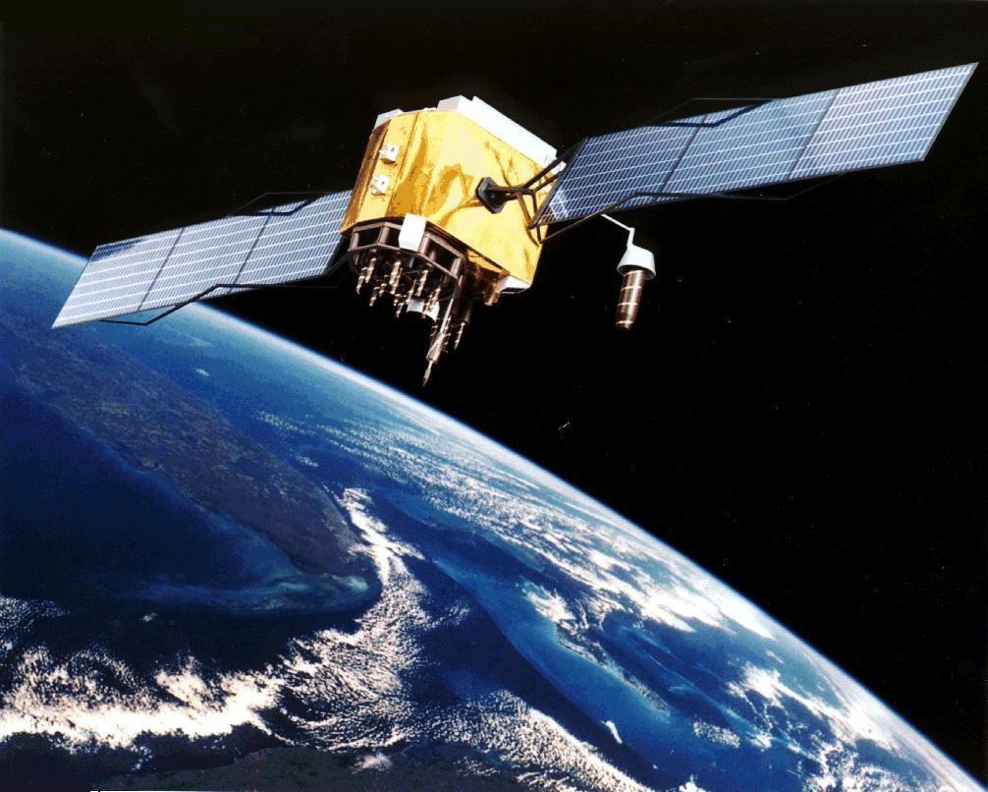
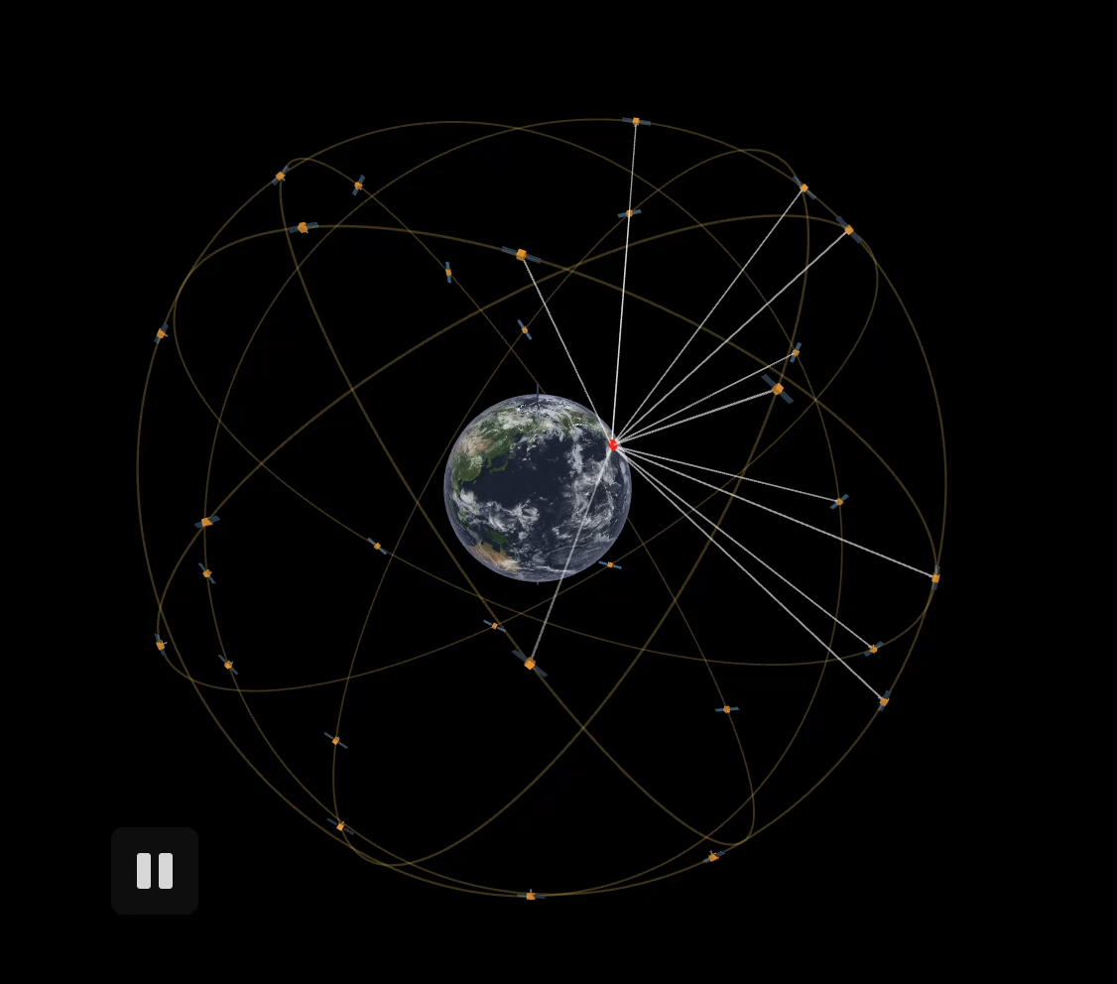
The Global Positioning System
24–32 satellites
20,200 km altitude
55 degrees inclination
12-hour orbital period
Ground control stations
Notes:
From the users point of view, GPS is a passive system: you need only a low-powered receiver to obtain the signals, which contain all the information you need to determine your position. This requires that the satellites carry atomic clocks to keep accurate time and transmit to the user the position of the satellite in the sky. The orbits are computed by the Department of Defense (DoD) by tracking the satellites from ground control stations. GPS control segment consists of a global network of ground facilities that track the GPS satellites, monitor their transmissions, perform analyses, and send commands and data to the constellation. The current (as of 2015) operational control segment includes a master control station, an alternate master control station, 12 command and control antennas, and 16 monitoring sites. The ground control stations have known positions and are then uploaded to the satellites, which then transmit the information continuously along with the time. With handheld receivers, it is possible to find your position within a few meters, limited primarily by the accuracy of the broadcast orbits. As we shall see, the civilian scientific community uses more than 200 stations to determine the orbits with an accuracy of a few centimeters, allowing millimeter positioning after several hours of tracking.
Upper image: Artist’s conception of a GPS Block II-F satellite in Earth orbit (public domain from NASA)
Lower image: https://ciechanow.ski/gps/ (2/17/22)

Slide 7
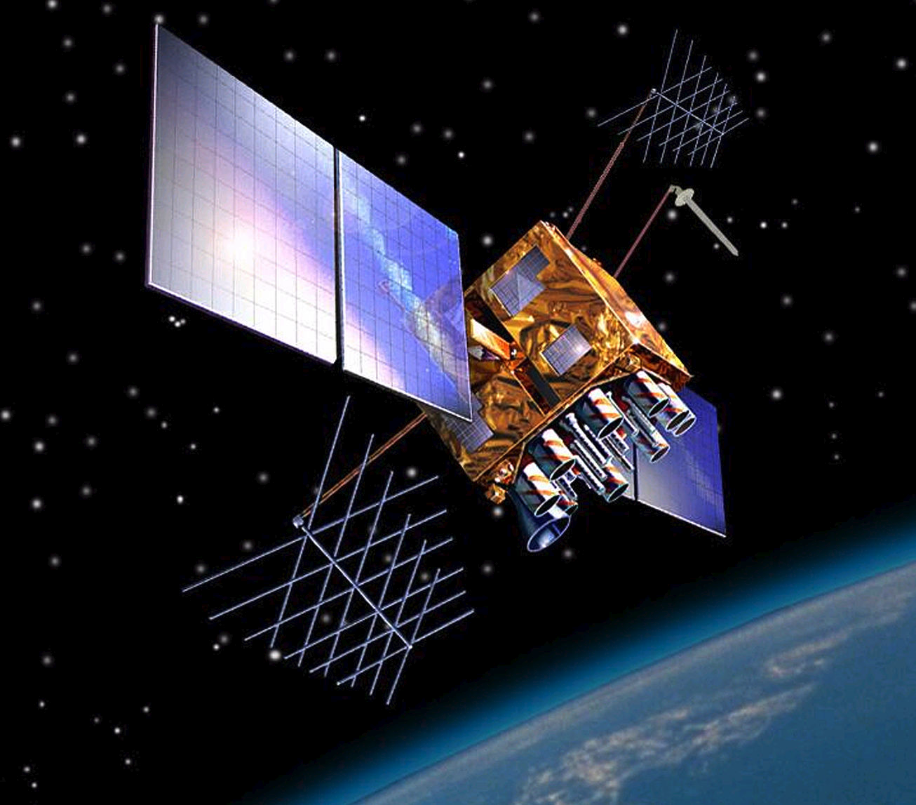
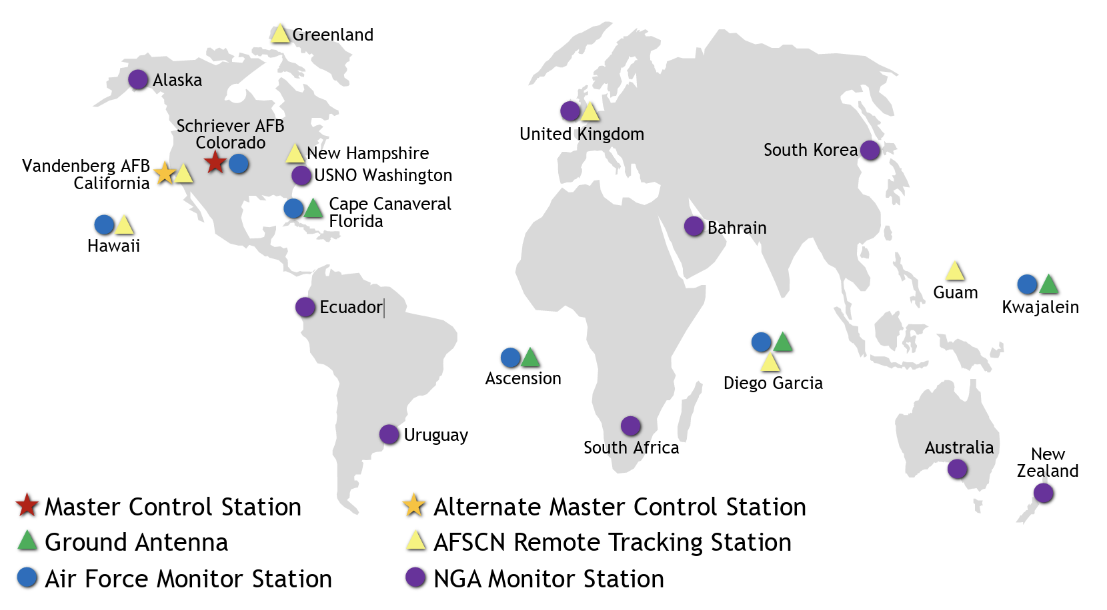
Not just satellites
Each GPS satellite has 4 atomic clocks accurate to 1 nanosecond
Network of ground-based monitoring stations track GPS satellites and re-synchronize satellite atomic clocks
Notes:
GPS depends on extremely accurate time keeping, so the very best clocks must be used.
Image by US Government - US National Executive Committee for Space-Based Positioning, Navigation and Timing, Public Domain, https://commons.wikimedia.org/w/index.php?curid=7567464

Slide 8
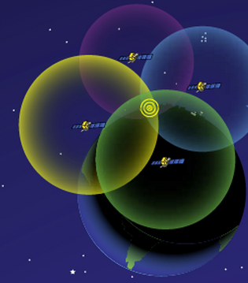
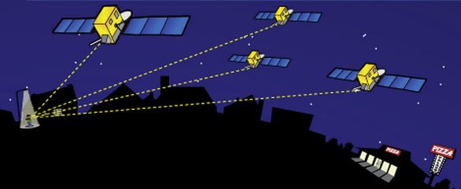
How Actual Location is Determined
http://spaceplace.nasa.gov/gps-pizza/en/
Antenna position is determined by calculating the distances to at least 4 satellites. This enables the solving for four variables: x, y, z and time using trilateration.
Notes:
The time element is needed because of the difference between the highly accurate atomic clock on the satellites ($100,000 each) and the much cheaper clock in the GPS receivers.
Although 4 is a technical minimum number of satellites, for geoscience research work it is highly recommended to have at least 6 satellites.
Although people will often refer to this process and “triangulation” in fact it is “trilateration” because it depends on distances rather than angles.
For a nice explanation of trilateration versus triangulation, visit https://gisgeography.com/trilateration-triangulation-gps/.
Images from NASA (public domain) http://spaceplace.nasa.gov/gps-pizza/en/

Slide 9
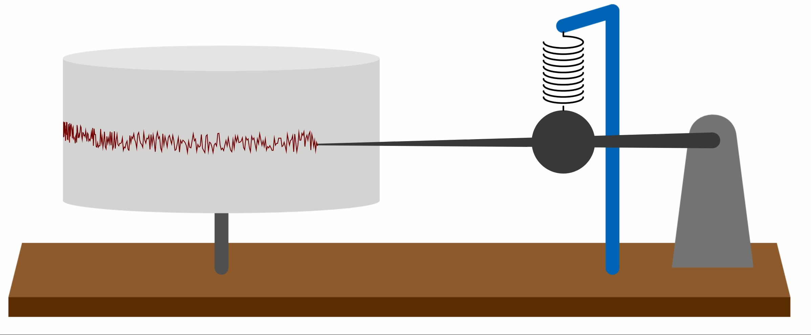
A seismometer is a zero baseline instrument….
https://javalab.org/en/seismometer_and_inertia_en/ (2/17/22)
https://www.avo.alaska.edu/webicorders/ (2/17/22)
Notes:
Slide from David Mencin, EarthScope - Lunch & Learn – February 2022

Slide 10
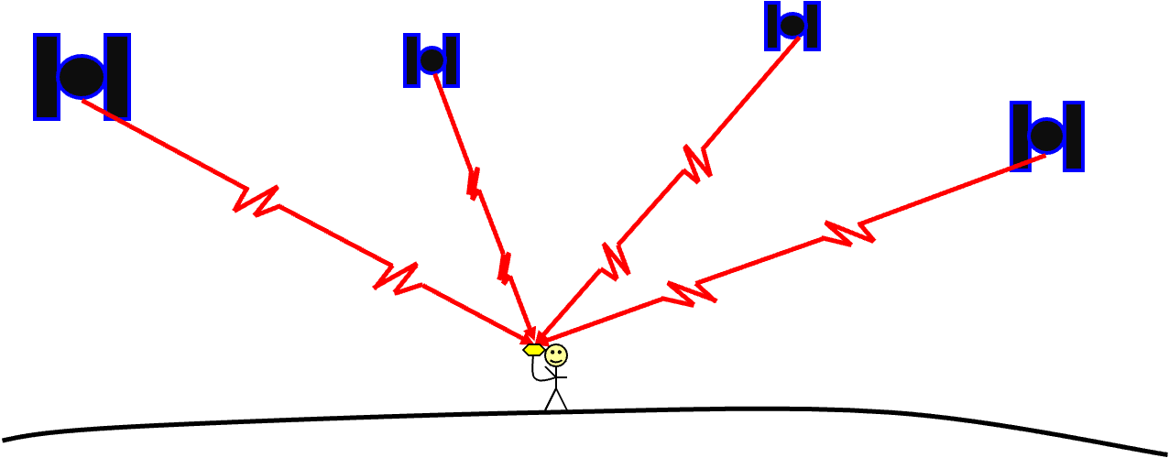
What does a GNSS receiver measure?
t0:psuedorange, phase, doppler, SNR … t1:psuedorange, phase, doppler, SNR … t2:psuedorange, phase, doppler, SNR …
Thanks Marianne
t0:X,Y,Z t1:X,Y,Z t2:X,Y,Z t3:X,Y,Z ….
Notes:
Slide from David Mencin, EarthScope
Drawing from Marianne Okal (GNSS Basics - 2021-01-15 - FE Training - final)

Slide 11
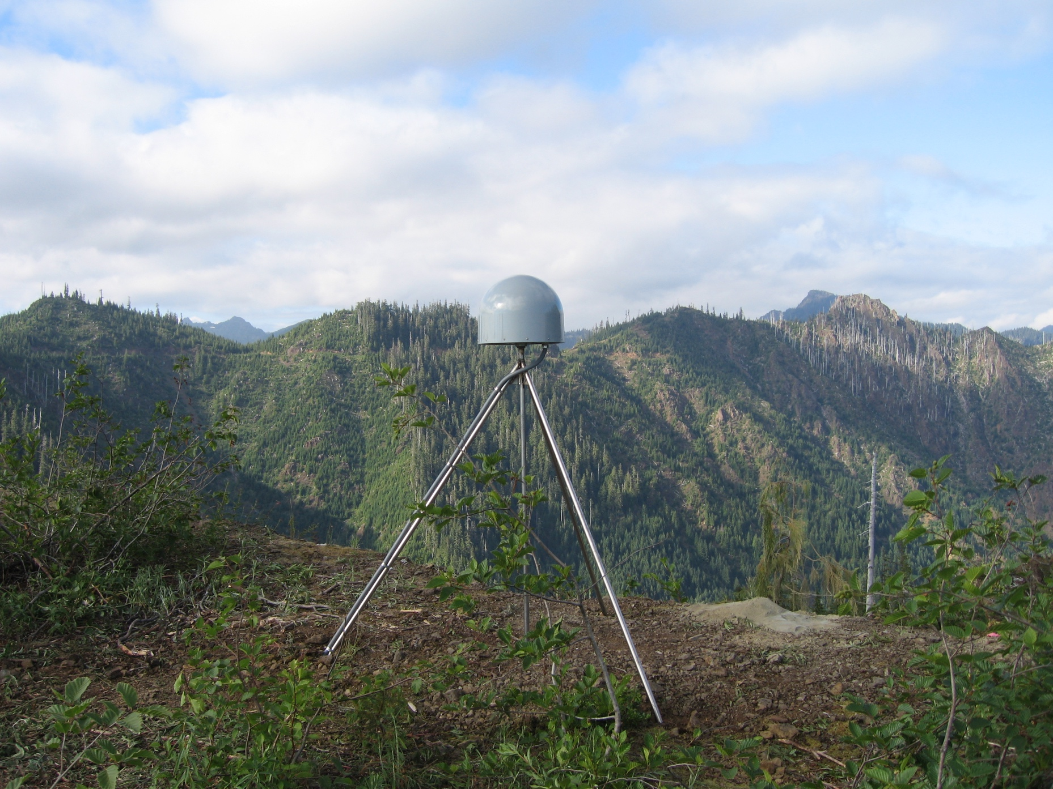
How do we get from the receiver to a time series?
GNSS is not zero baseline instrument….
lots of data processing
Notes:
Slide from David Mencin, EarthScope

Slide 12
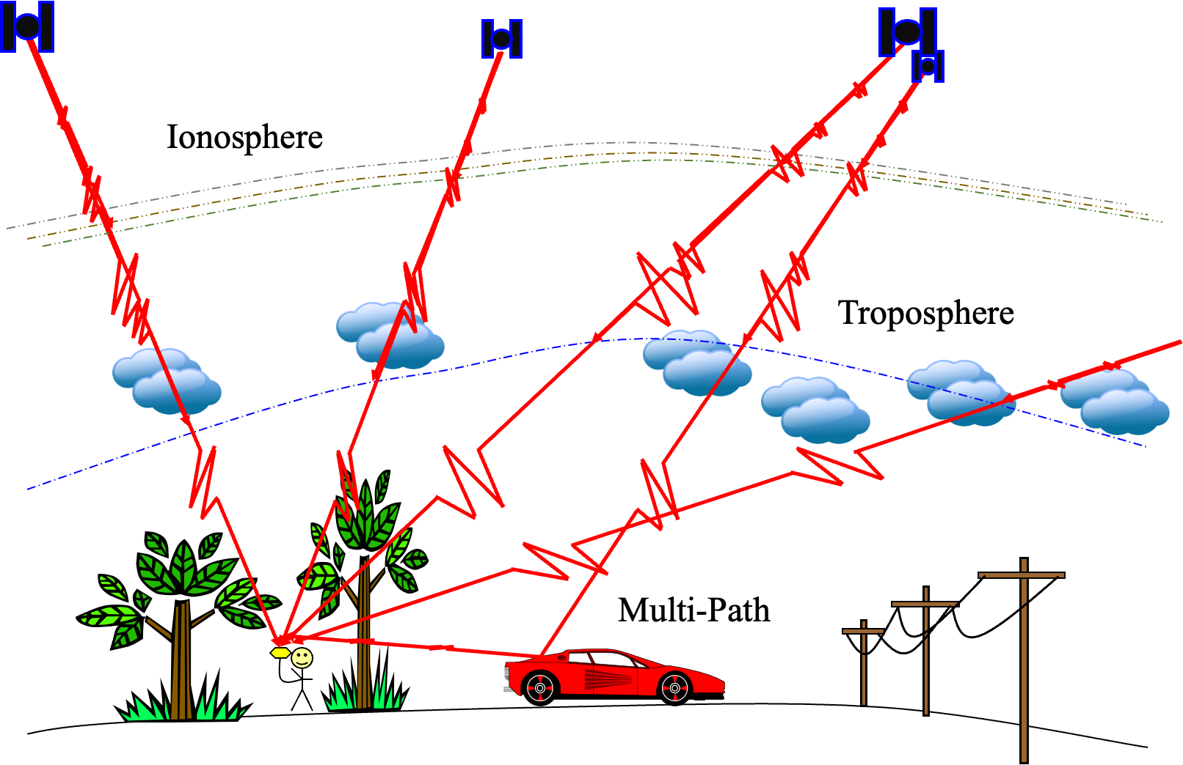
Level-0 data now what?
Notes:
Slide from David Mencin, EarthScope
Drawing from Marianne Okal (GNSS Basics - 2021-01-15 - FE Training - final)

Slide 13
Some sources of error
Clock errors (bias and drift, including relativity)
Atmospheric delays – speed of light is affected by water content and other variables (ex. ionosphere)
Multi-path – GPS signals can bounce off the ground or objects and then enter the antenna
Satellite orbit irregularities
Human error – Incorrect base
or rover antenna heights, errors
in post-processing, datum and
projection errors.

Slide 14
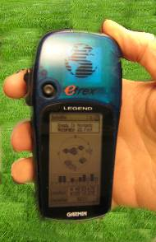
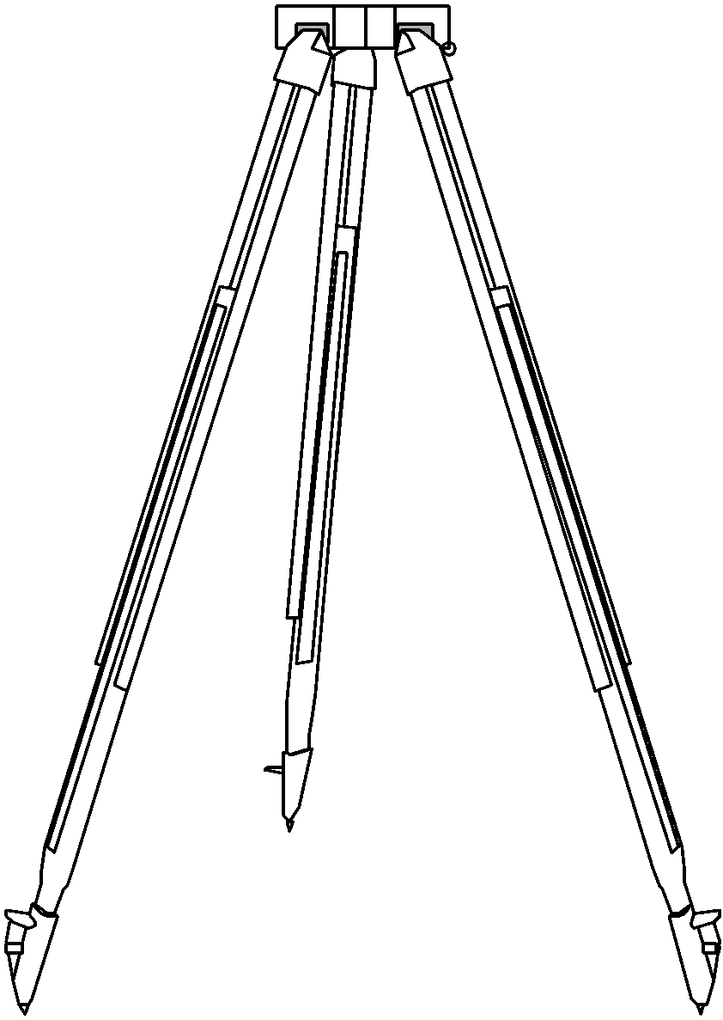
Antennas Receive Data Streams
Your location is:
37º 23.323’ N
122º 02.162’ W
The time is:
11:34.9722 (UTC)
ERRORS (after 24 hrs)
Horiz: ± 1–2 mm
Vert: ± 5 mm
ERRORS
Horiz: ± 10 m
Vert: ± 15 m
Notes:
Since each satellite maintains time very accurately (~1 nanosecond = 30 cm), it can tag its signal with the time of transmission. This information, together with the location of the satellite, also transmitted to the receiver, is sufficient to allow the receiver to calculate the range to each satellite, provided that the receiver also knows the time. Equipping receivers with atomic clocks would be very expensive, so the receiver tags the signal with the time of its internal clock to create a “pseudorange” (range plus an unknown clock correction). The software in the receiver then uses the pseudoranges from four satellites to solve for the four unknowns: three coordinates and the receiver clock correction.
Images: Vince Cronin (Baylor University)
High precision rates taken from GAMIT/GLOBK 10.6 release notes - http://geoweb.mit.edu/gg/

Slide 15
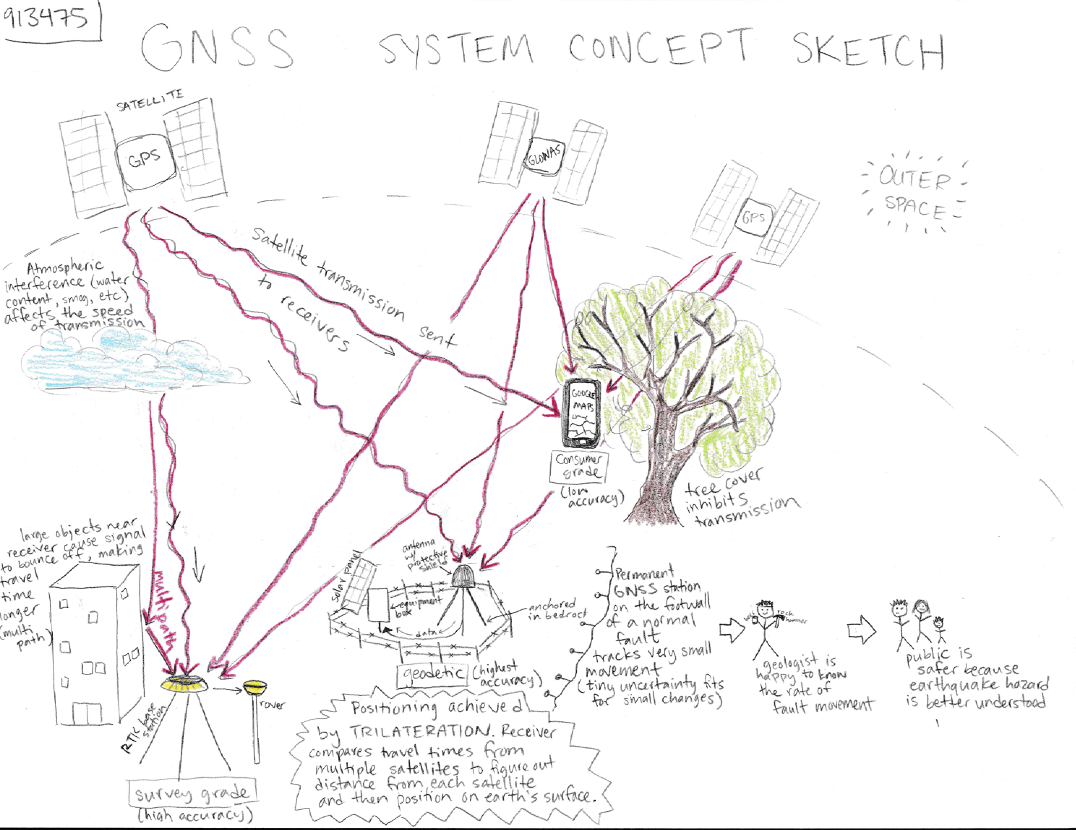

Slide 16
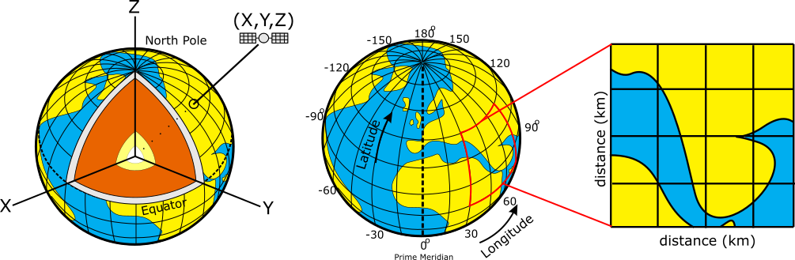
GPS Provides 3D Positioning
Positions on the Earth can be reported using:
  Geocentric coordinates (relative to the Earth’s center)
  Geographic coordinates (lat/long/elev, in degrees)
  Projected coordinates (UTM/state plane, in m or ft)
Geocentric (X,Y,Z)
Geographic System
Projected System
Notes:
It is important for students to understand that position data can be reported to a user in a number of different formats.
Geocentric (also Earth-Centered Earth-Fixed) Coordinate system (a type of Cartesian coordinate system) will probably be least familiar to students. While it isn’t used much by typical geoscientists, it is often used by people processing GPS data for research or calculating satellite locations.
Geographic is widely used and will be familiar (at least vaguely) for most geoscience students and more generally, people familiar with maps.
Projected coordinate systems are used a fair amount by scientists and surveyors working on a local/regional scale -- for whom distances (meters, feet) will be more useful than lat/long locations.
Figures: Ian Lauer, modified from Public Domain

Slide 17
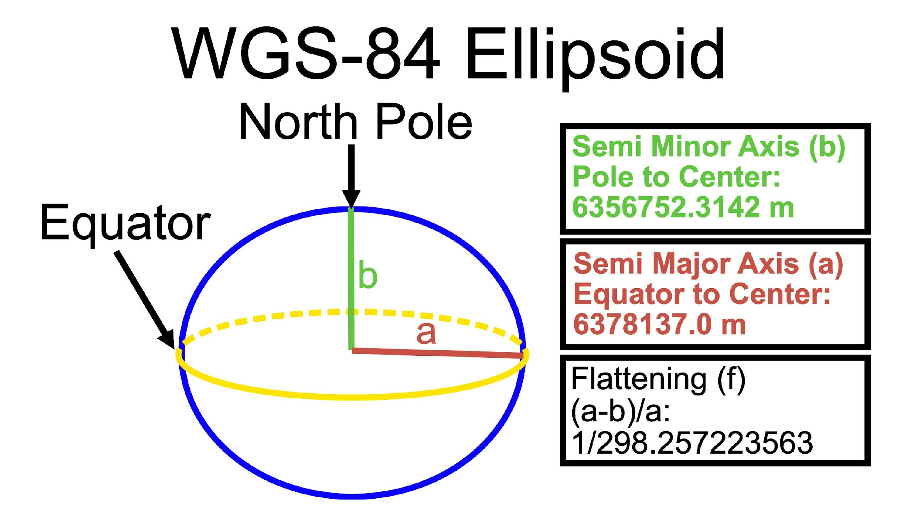
Typical GPS Coordinates – WGS 84
Most survey GPS data is recorded and reported using: World Geodetic System 1984 (WGS 84)
  WGS 84 defines a reference surface (an ellipsoid)
  And a set of parameters to relate latitude, longitude, and altitude to points on or near the Earth's surface
21.4 km
difference
Notes:
Figure: Ian Lauer

Slide 18
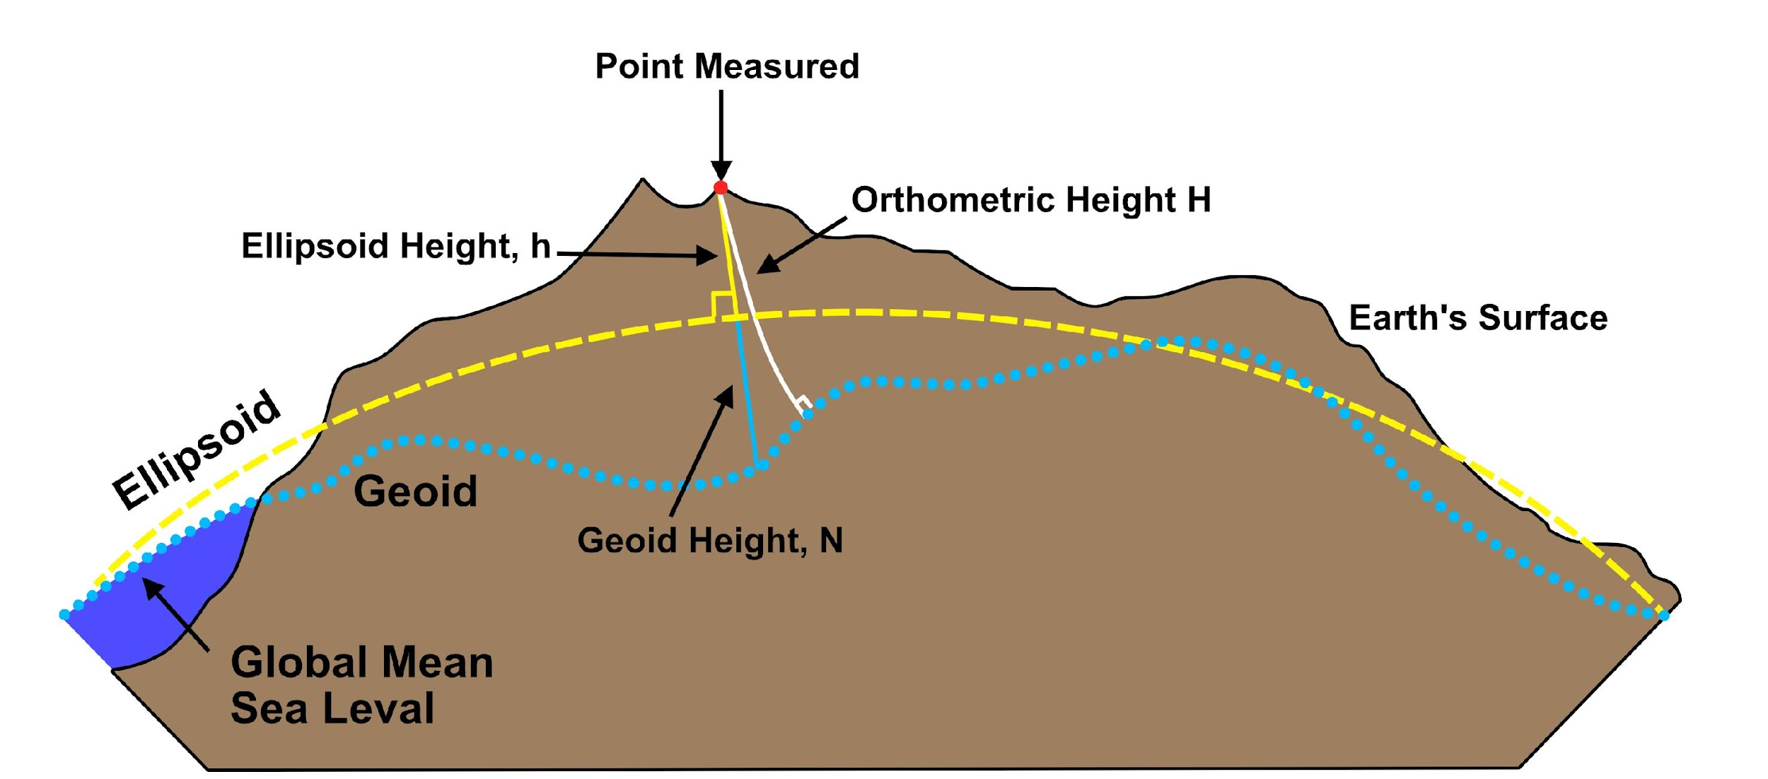
Typical GPS Coordinates - Vertical
Geoid - gravitational equipotential surface
(i.e. what “sea level” would be) (ex. EGM96)
GPS reports ellipsoid height
Orthometric height = height above “sea level” of the geoid (more common for maps)
What is the geoid-ellipsoid relationship in Golden CO?
Geoid ~17m below Ellipsoid
Notes:
Figure: Ian Lauer

Slide 19
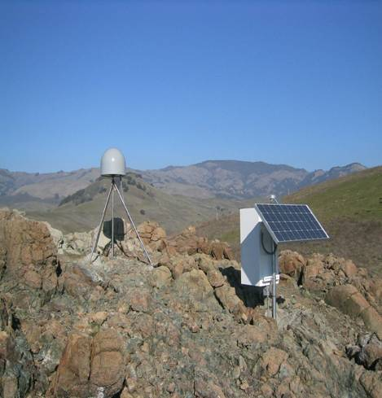
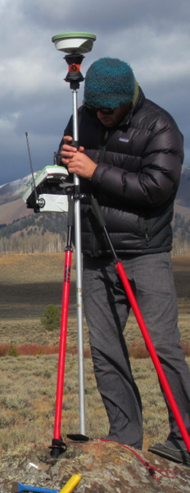
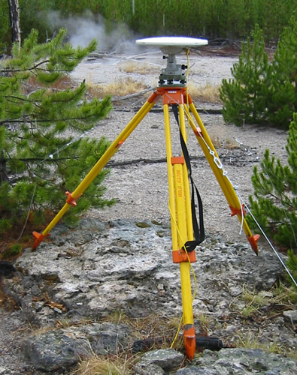
Precision depends on system
Static, Geodetic Campaign Systems
Occupation Time - Effort Required - $$
Kinematic Systems
Easy Hard
Consumer & Mapping Systems
Survey Grade
0.5-5 m 0.01–0.03 m 0.005m
Precision of Position
Notes:
Images: Ben Crosby, EarthScope

Slide 20
Anatomy of a Permanent “Static” GNSS Station
Antenna inside of dome
Monument solidly attached into the ground with braces.
If the ground moves,
the station moves.
Solar panel for power
Equipment enclosure
GNSS receiver
Power/batteries
Communications/radio/modem
Data storage/memory
Notes:
Example of a typical remote GPS station. In urban areas, some are also fixed to the roof of large reinforced buildings and hooked into grid power supply with battery backup. Many stations are now being equipped with “real-time” communication to allow immediate transfer of data to researchers. In other places logistics or country-specific regulations require that data not be transmitted but is instead downloaded manually on a given schedule (monthly, quarterly, or annually, depending on the site).
Image from EarthScope

Slide 21
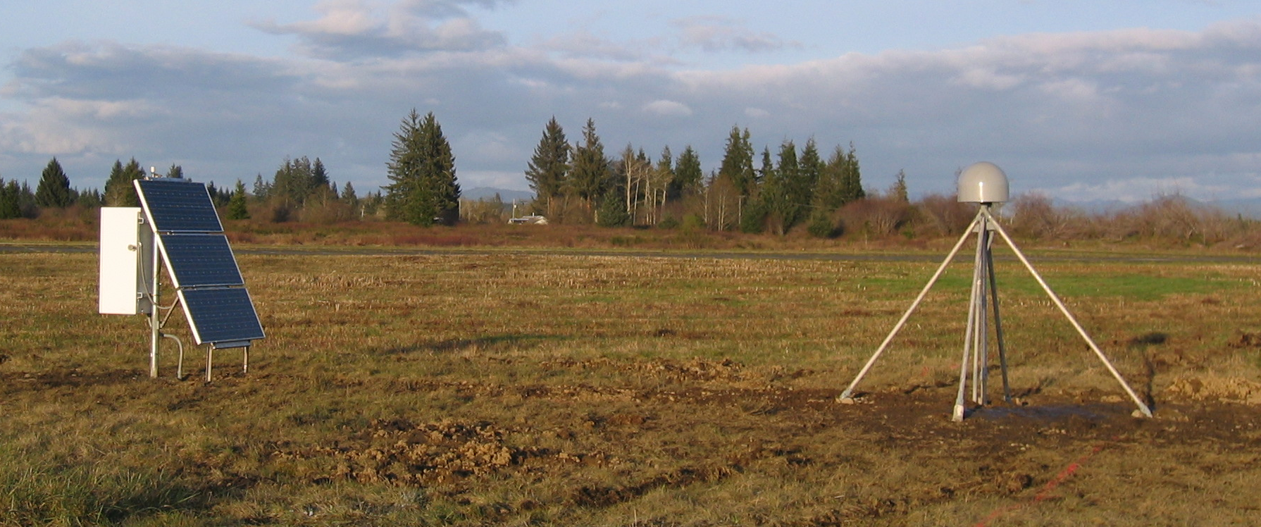
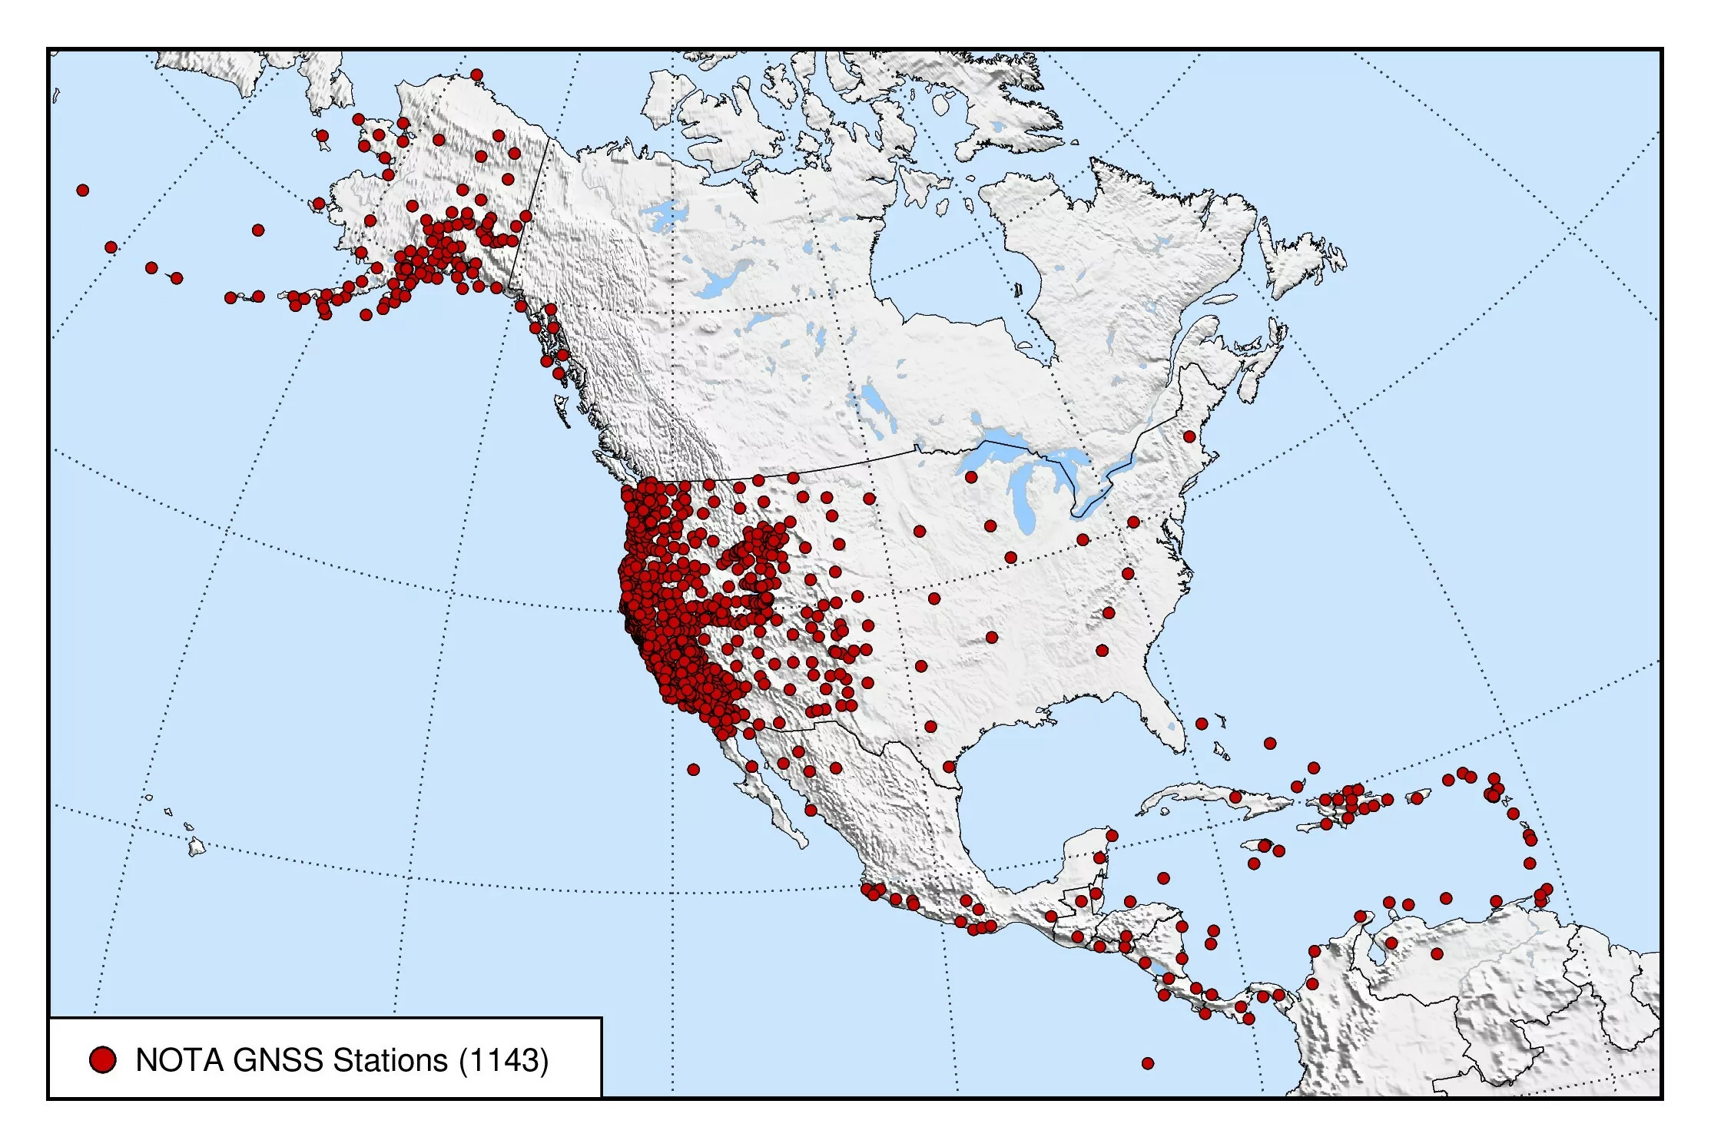
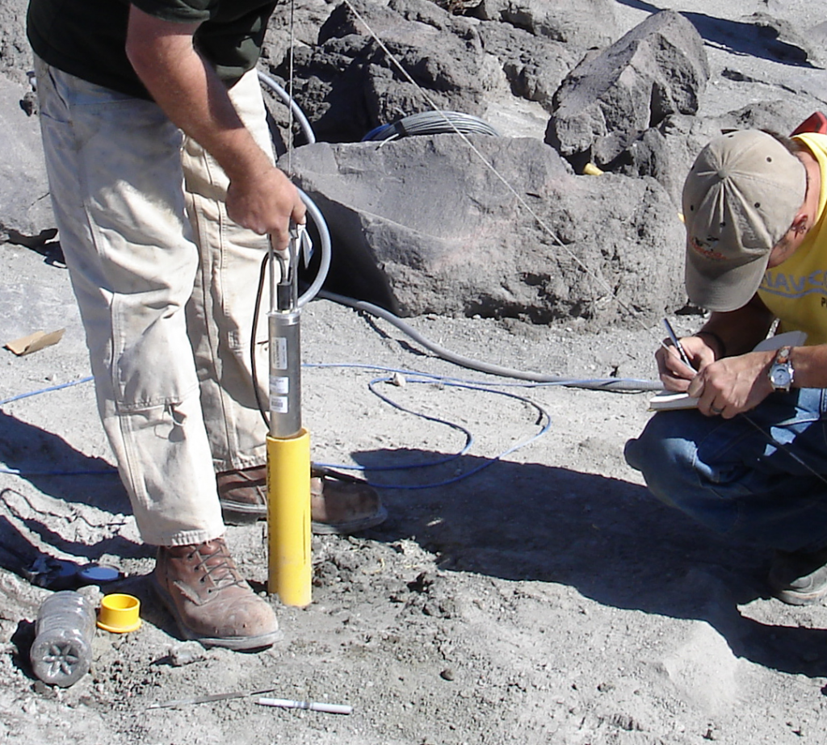
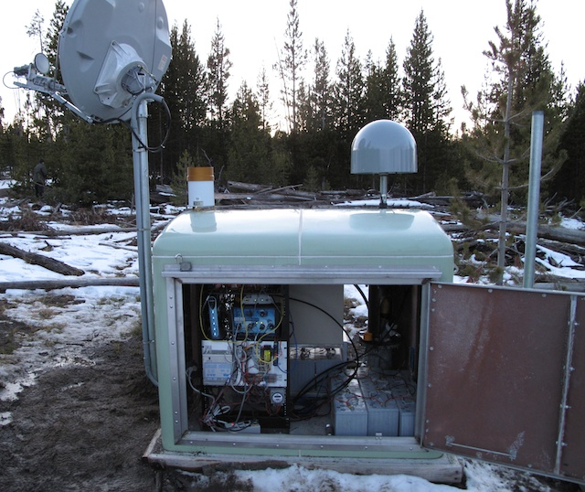
Network of the Americas (NOTA)
>20 countries and >1200 continuously operating instruments
High-precision GPS/GNSS stations and borehole strain, seismic, and tilt instruments.
Notes:
NOTA is mostly GNSS (GPS) stations but also includes borehole tiltmeters and strainmeters
https://www.earthscope.org/nota/

Slide 22
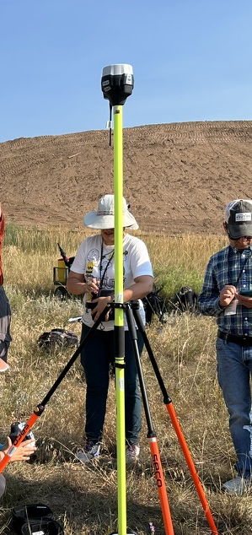
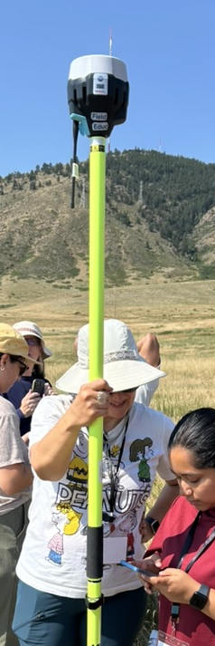
Kinematic components
Base Station and Radio
Rover and Radio
Notes:
Images: EarthScope (Pratt-Sitaula)

Slide 23
Kinematic systems
“RTK” = Real-time Kinematic
Base station antenna receives data from satellites.
The position drifts over time relative to the known, stable location of the antenna. This offset is communicated to the rover as a correction.
At the same time, rover antenna also receives position data from satellites.
Rover also receives a position correction from the base, in real time for RTK.
Base
Rover
(Images: Ben Crosby)

Slide 24
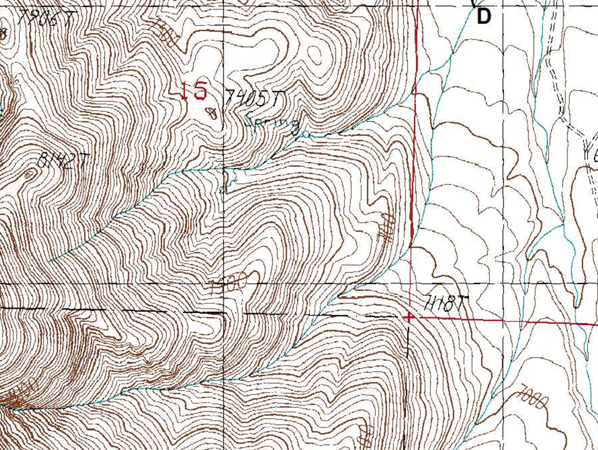
Map View of a Kinematic Survey
Base Station
Three Different Rover Positions
assumed ‘here’
raw base obs.
raw rover obs.
rover RTK adj.
t₁
corrected base
t₂
t₁
corrected rover
t₃
t₂
t₃

Slide 25
Put ideas in Chat
What are some applications of GPS/GNSS?
What are some example applications where a kinematic survey would be the most useful?
What about when your phone is enough?

Slide 26
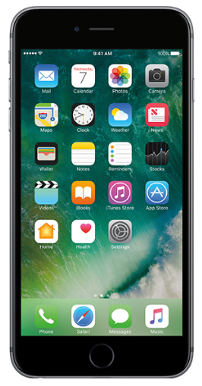
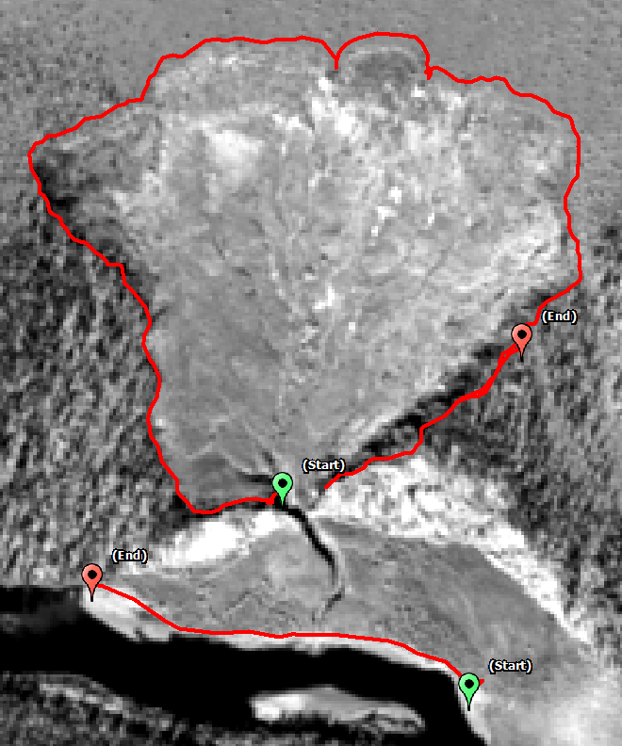
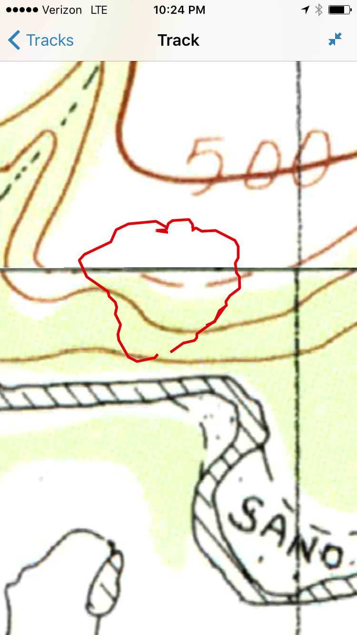
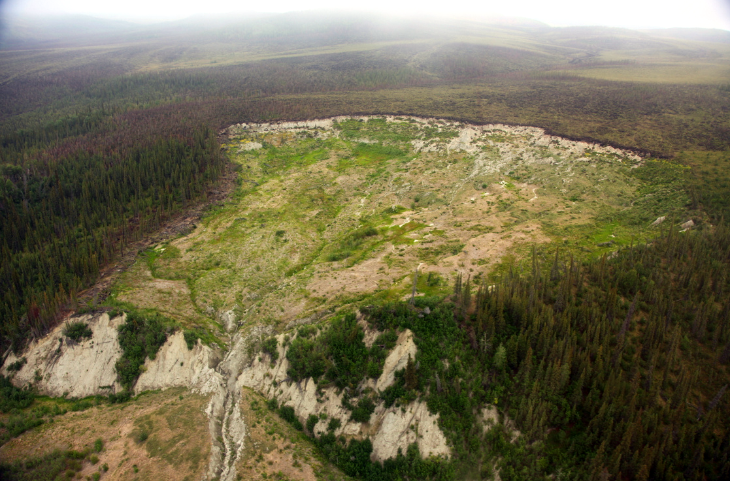
Tracking Position
Using Recreational Systems
  Use a phone to track your position during a field day.
  Can quickly assess the area or position of an object.
From the field… …to the phone… …to analysis in GIS.
Notes:
Images: Ben Crosby

Slide 27
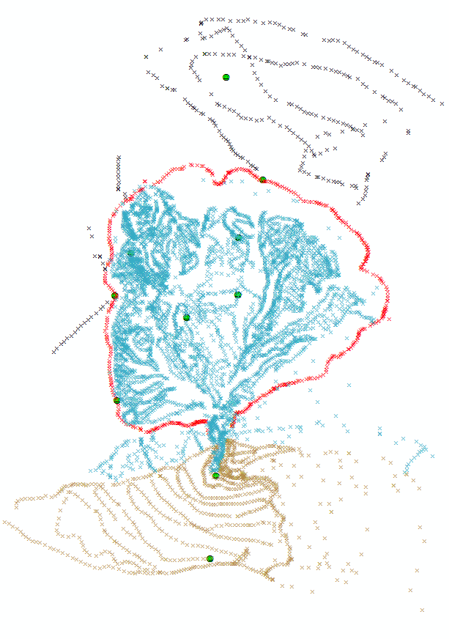
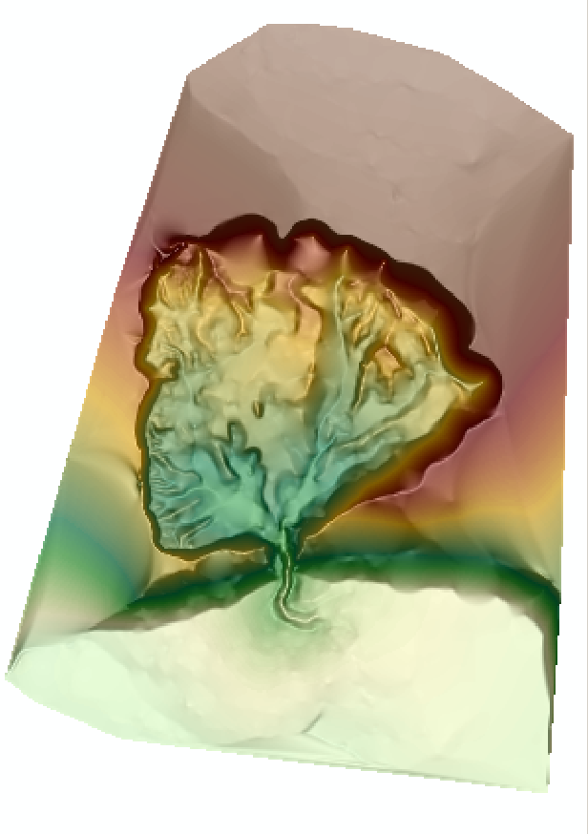

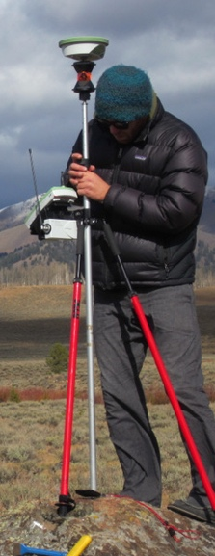
Creating Topography
Using Kinematic Systems
  Quickly measure many points with high accuracy and precision – landslides, permafrost morphology, moraines, fault scarps
From the field … … to post- … to surface generation
processed points … using GIS.
Notes:
Images: Ben Crosby

Slide 28
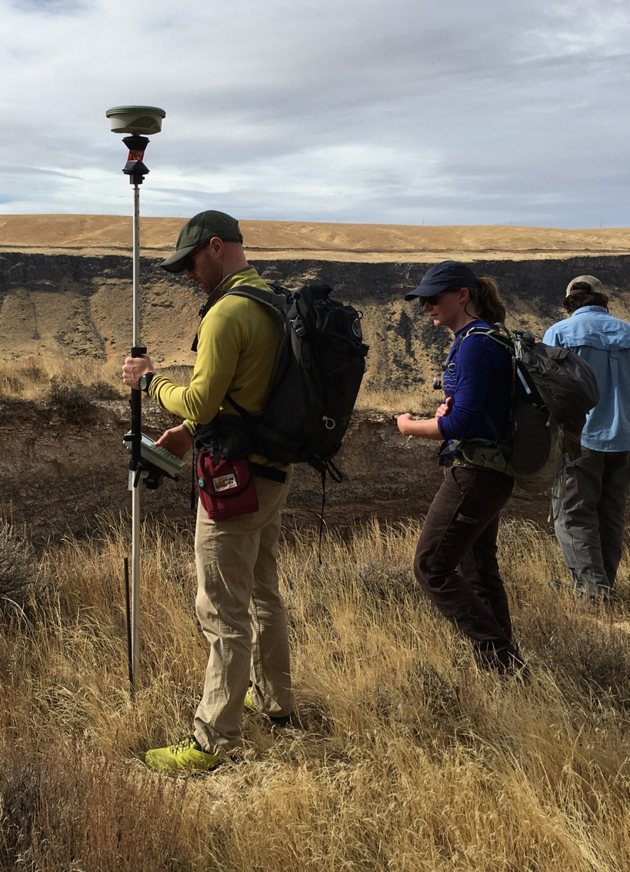
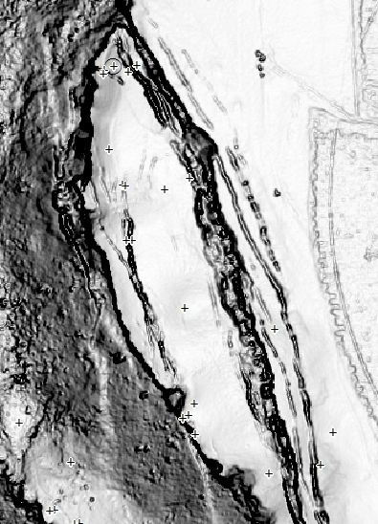
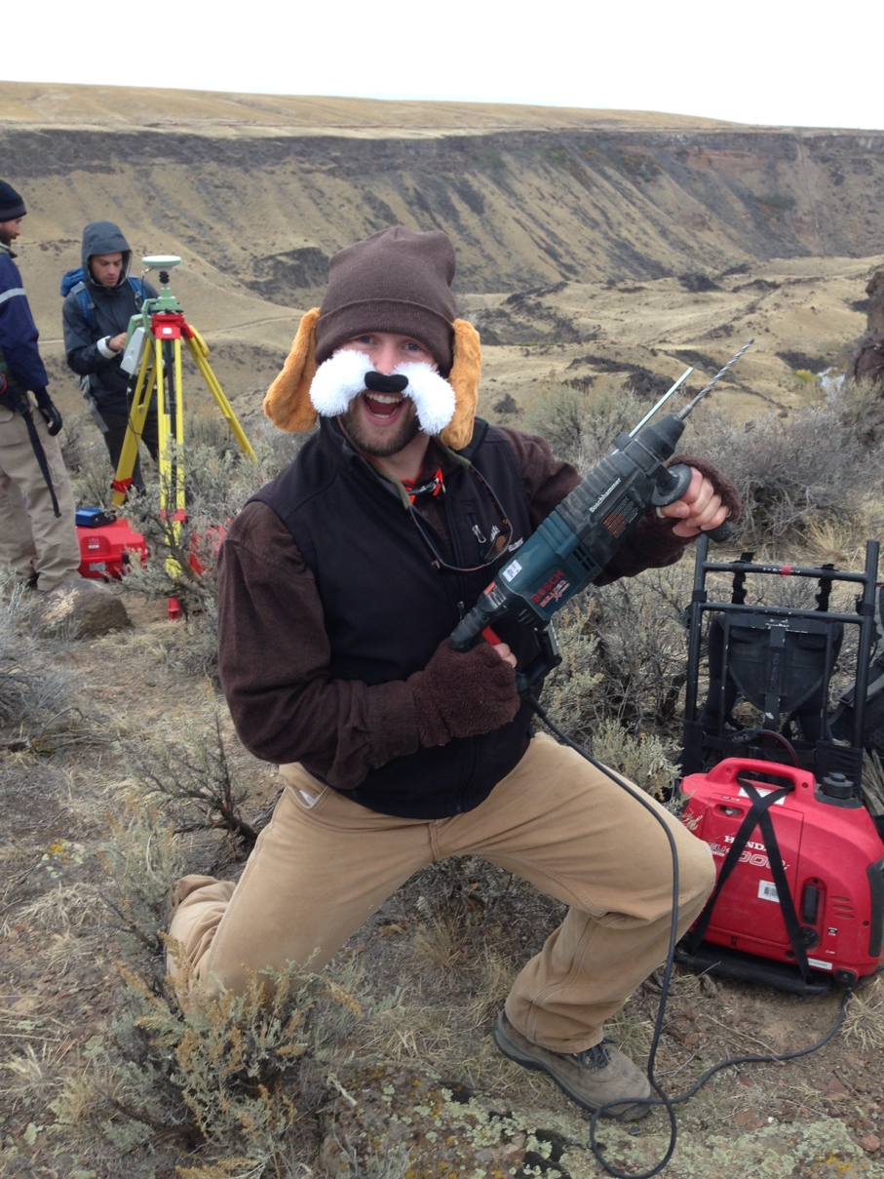
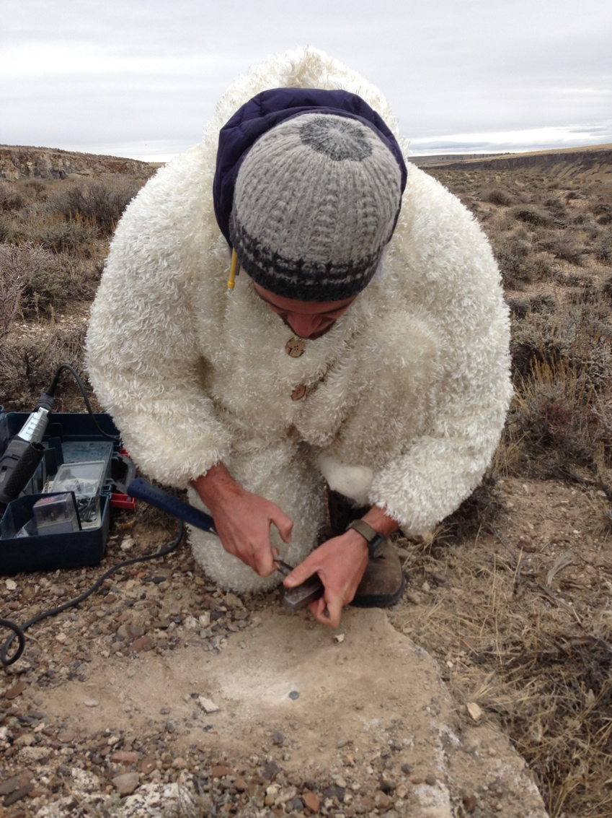
Change Detection
~85 points surveyed across slide
Some previously monumented (rebar, etc.)
Some new monuments added in rock

Slide 29
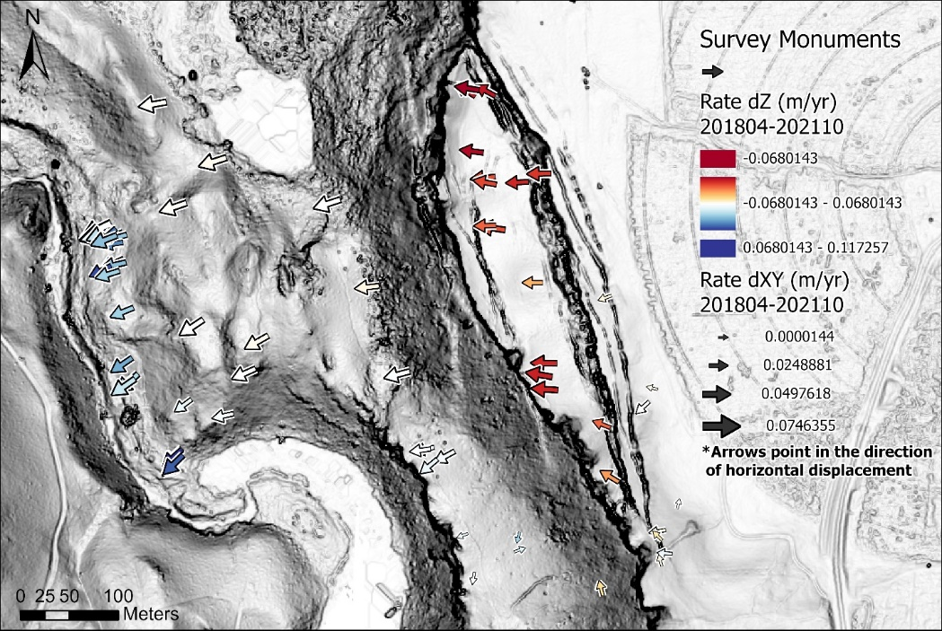
Change Detection
2018-04 🡪 2021-10

Slide 30
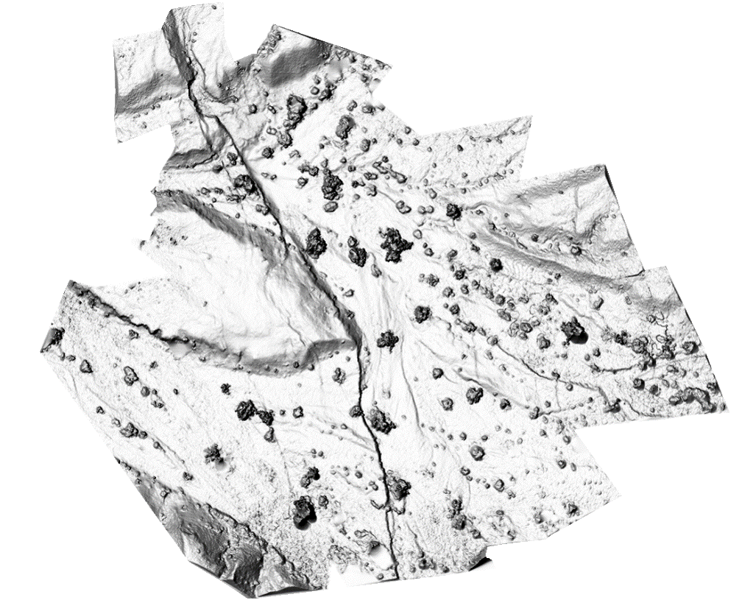
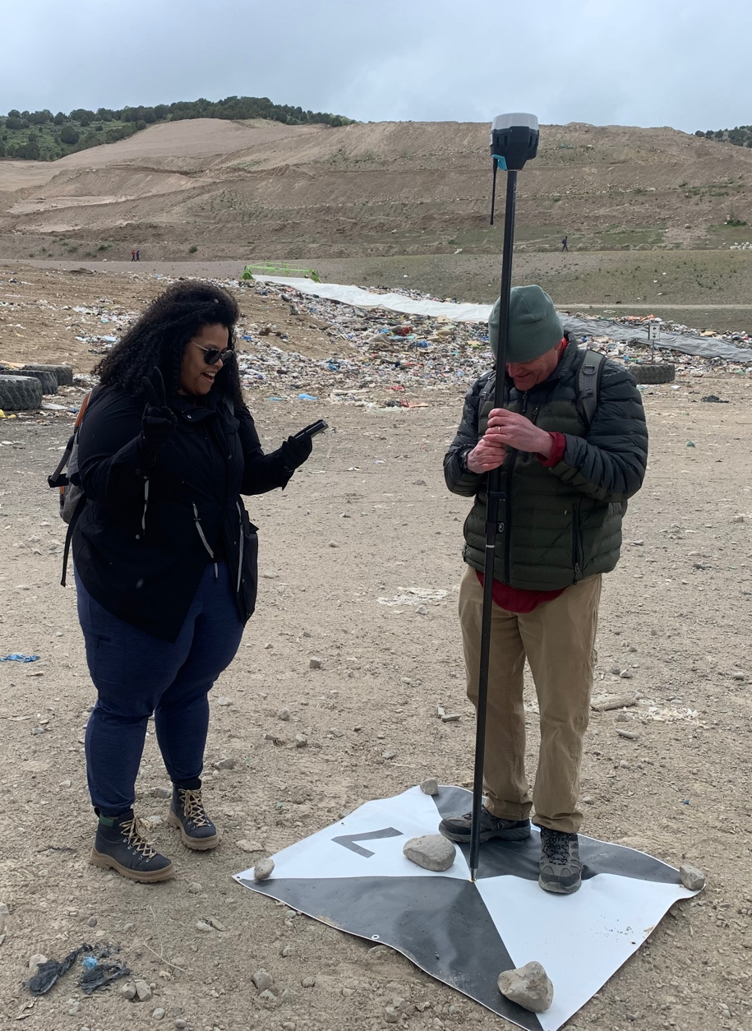
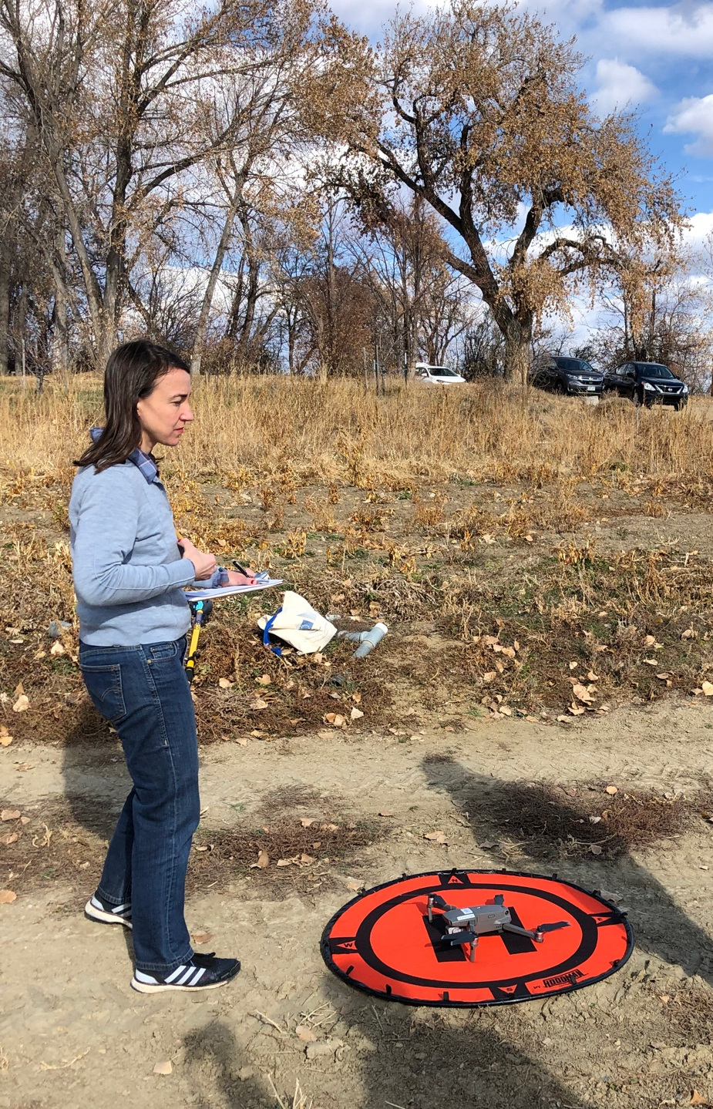
Georeferencing other projects
Drone or pole-based photogrammetry survey to define topography
Notes:
Photo: Beth Pratt-Sitaula, EarthScope
Map: Ed Nisson

Slide 31
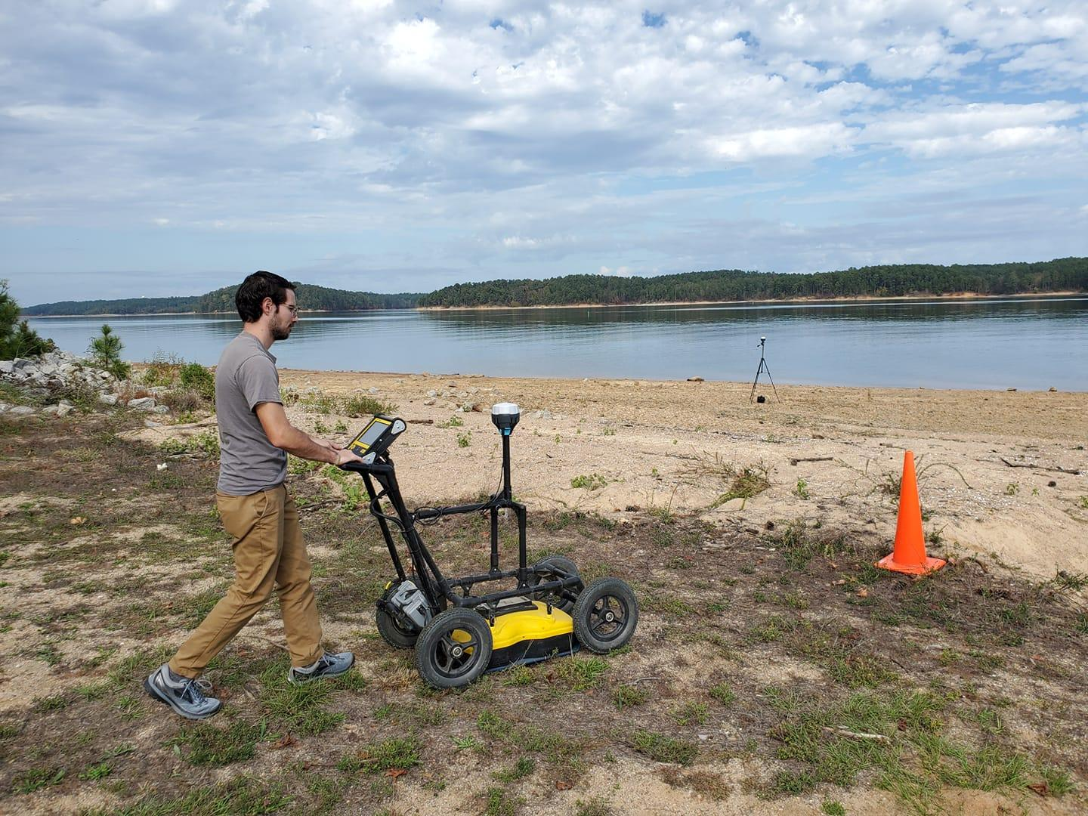

Georeferencing other projects
Other surveys – ex. GPR
Nodal array deployments
Notes:
Image right: https://www.nature.com/articles/s41598-018-19728-w/figures/1 (do not further disseminate; not CC)
Image left: Bigman Geophysical (do not further disseminate; not CC)

Slide 32



Slide 33


Slide 34
Kinematic survey considerations

Slide 35

Collecting GPS on a Landslide
Where would you put a base station in this landscape?
Chat or unmute and talk
Notes:
This is an example from field camp. The large basin in the center of the image (with the lake) is ringed by the headscarp of an enormous landslide. If you were to collect GPS data in the image, where would you position a base station?

Slide 36


Thinking About Base Stations
Site Access
Site Permissions
Site Security
High Ground
Stable Ground
Clear sky view
Line-of-sight and distance to Rover
Minimal multipath issues
cliffs, buildings, or high topography can block sky view of satellites and cause multi-path issues
good positions will be free of large obstacle on ground over overhead, have good sky view, and positioned on stable ground or otherwise anchored
long grass or obstacles directly near or underneath antennas can create multi-path or other signal distortions
Notes:
Images: Weston Renoud (https://www.flickr.com/photos/weston/3666328474/), EarthScope (Ian Lauer)

Slide 37
Kinematic survey design
Base Station
  Located in a stable, safe, unobstructed place
  Line of sight for radio communication to rover
  < 10 km from rover location
  Ideally set up over known monument
Rover
  Close to and in line of site with base for corrections
  Occupy points for 5–120 sec, keep pole vertical
  Name and describe each point in field book
  Avoid cover and multi-path, confirm
  corrections

Slide 38

Questions?

Slide 40


Kinematic workflow
If base is not over a known point, you must post-process to get an accurate position

Slide 41
Kinematic post-processing
Post processing is only necessary if the base was set up over an unknown point or you use a PPK system.
Download data from base to PC software for your hardware.
Export base dataset as a RINEX formatted file
Upload RINEX to OPUS or CSRS website, specifying all necessary information regarding base antenna type and height (need to wait 2+ hours after collection before uploading)
Update your base position with the new, corrected position in your PC software
Propagate the change in base to all your rover positions

Slide 42

Data Collection Duration
Data Processing
NRCAN
(CSRS-PPP)
2hrs +
Ultra Rapid
Rapid
Final Orbits
2hr 24hr 14 days
Time Post-Survey
15min – 2hrs
Rapid Static
OPUS
2hrs +
Static

Slide 43
Applications of RTK GNSS
Students discuss at first:
Text here

Slide 44
Applications of RTK GNSS
Students discuss at first:
Delineating or measuring migration of a river channel with proximity to a valuable resource or infrastructure
Measuring movement on a natural hazard such as a landslide, earthflow, or slump
Delineate or measure motion of monuments on a glacier, glacial retreat or snowpack change
Measuring a scarp surface or profile to determine potential hazard to infrastructure with earthquakes
Creating topographic models of flood plains to calculate flood volume and determine potential for flood hazard at various stage levels
Create digital elevation models to determine slope stability with addition of roadcuts or other infrastructure

