Slide 1
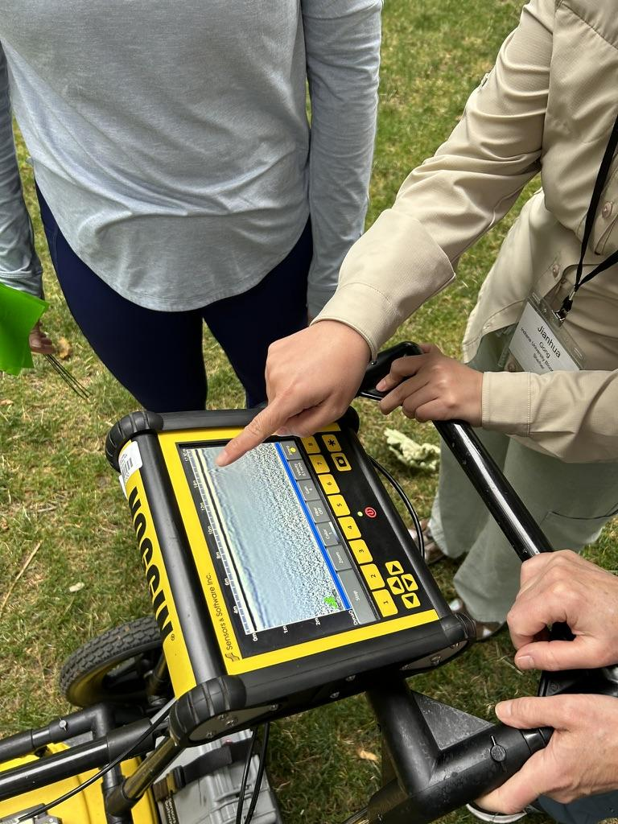
What is Ground Penetrating Radar?
12:00 PM MDT, June 22, 2026 | Online
Dr. Anuradha “Maha” Mahanama
Slides based on materials prepared by S. Kruse, University of South Florida,
and modified by A. Persekin, University of Wyoming
Notes:
Image: EarthScope Consortium (Pratt-Sitaula)

Slide 2
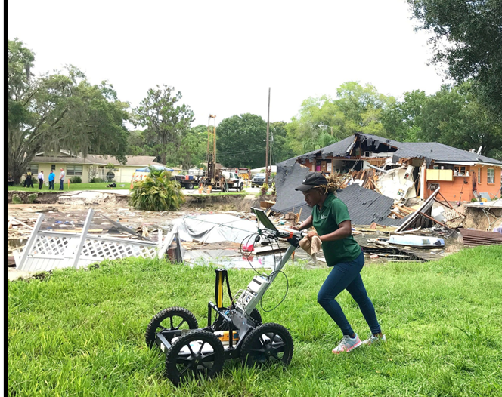
Webinar Goals
Typical geoscience (and commercial) applications
How GPR works
Survey design considerations

Slide 3

Quick Warm-Up: Where Are You with GPR?
1 = Brand new to GPR, I know nothing!
2 = Know a little theory
3 = Used GPR in the field
4 = Processed GPR data
5 = Comfortable with theory, fieldwork, and processing
6 = GPR expert. Please do not quiz me too hard.
Drop your number in the chat. No pressure, this is just to see where we are starting from.

Slide 4
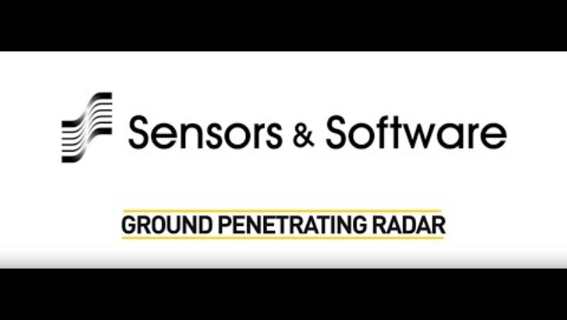
A short introduction to GPR, with a focus on where and how it is used in real-world applications
Watch video here: https://youtu.be/Jmc0n2bfrEs?list=PL2KbqZ4LoYmTcODw0R_uL1zYXMGY932pb&t=41
Notes:
This video illustrates some basics and many commercial applications; start at 0:43

Slide 5
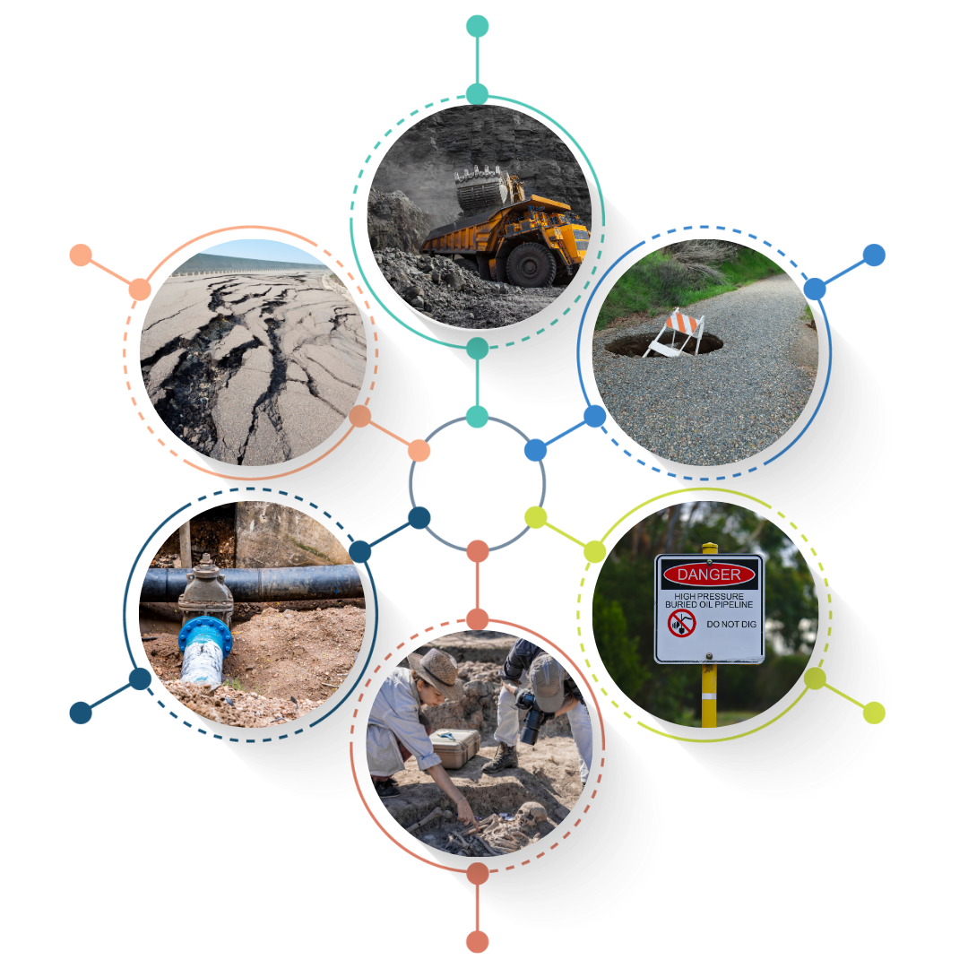
GPR applications summary
Where to dig?
Mapping out cracks in roads or bridges
Mitigating Hazards (i.e. sinkholes)
Mapping buried utilities
Where not to dig?
Locating lost or unknown objects
Adapted from: GETSI Teaching Materials
Notes:
GPR Applications: Key Points
GPR works best when the target is different from the surrounding material.
One advantage of GPR is that it provides a near real-time view of subsurface cross sections along survey lines.
Utility locating is one of the most common GPR applications.
GPR can detect metal pipes, plastic conduits, and other buried utilities.
For plastic pipes, the reflection often comes from the material inside the pipe, such as air, water, or gas, rather than from the plastic itself.
Concrete scanning is another major application.
Common targets include rebar, conduits, post-tension cables, and voids.
Typical investigation depth is about 12 to 18 inches, depending on antenna frequency and concrete condition.
GPR is useful for detecting voids, cavities, fractures, and tunnels.
These features often produce strong reflections because of dielectric contrast.
For example, rock may have a dielectric constant around 6, while air is close to 1.
In road surveys, GPR can image pavement layers, including the bottom of asphalt and the bottom of granular base layers.
In bridge deck studies, reflection strength can help identify possible deterioration, moisture, or delamination.
In environmental studies, GPR can help locate underground storage tanks.
Exact diameter may be difficult to determine, but profiles and depth slices can help estimate position and length.
GPR is also used for tree-root mapping, archaeology, forensics, and shallow geologic studies.
For geology, dry sandy environments are ideal.
In favorable conditions, GPR can image more than 20 meters deep.

Slide 6
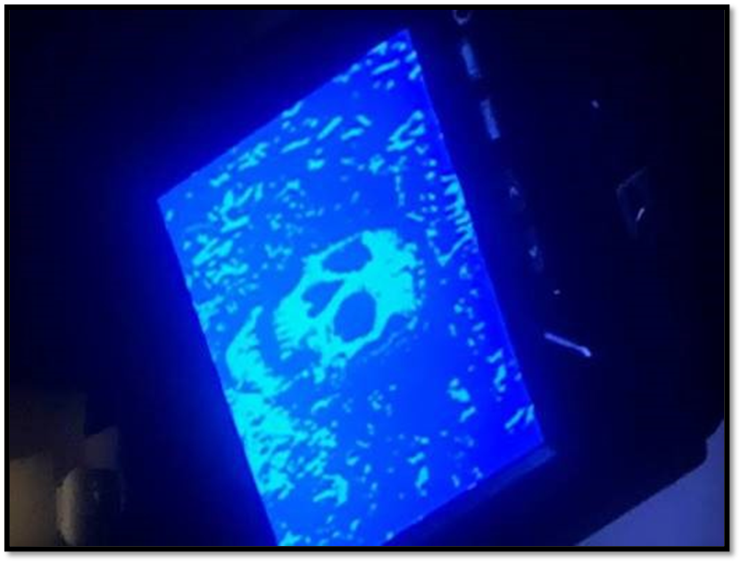

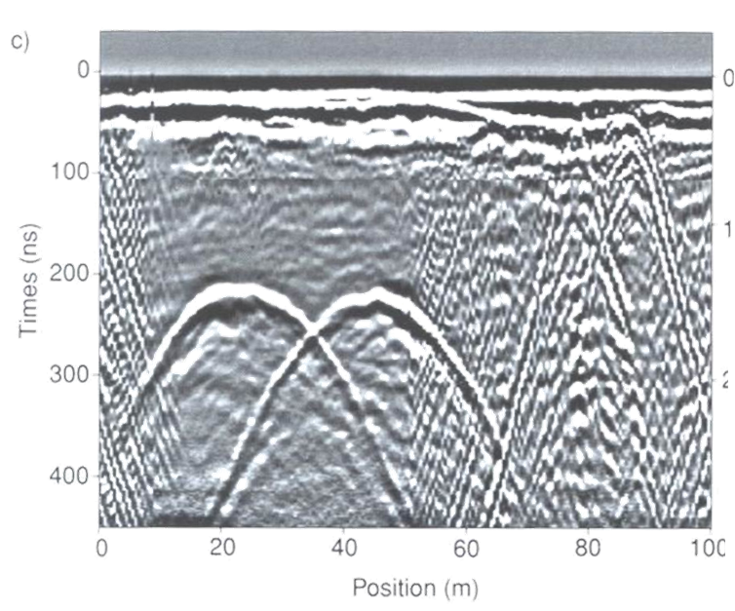
GPR images give a distorted view of the subsurface
GPR in Hollywood
GPR in real life
From Criminal Minds
Notes:
Indirect evidence as Soil disturbances.
What’s Tough About GPR?
The ground is complicated.
GPR data can contain many overlapping signals.
Some soils absorb the signal quickly.
Interpretation is not always straightforward.
Even experienced users can get it wrong.
Results must be interpreted with site context.

Slide 7
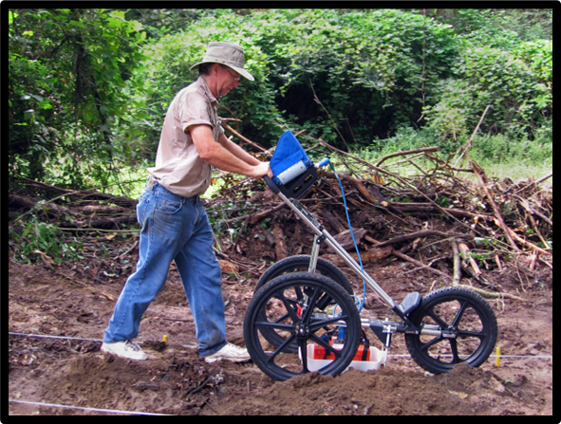
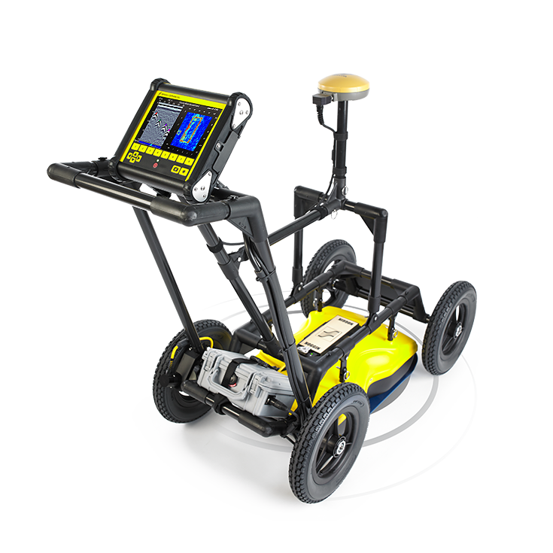
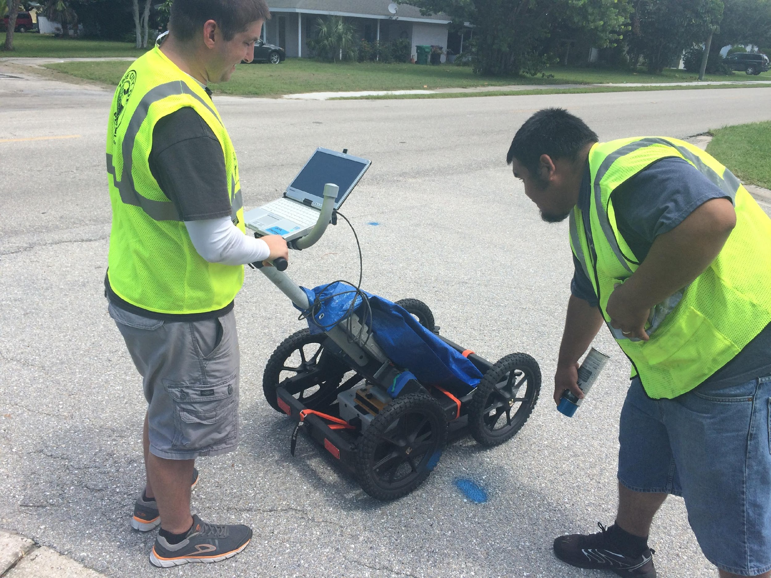
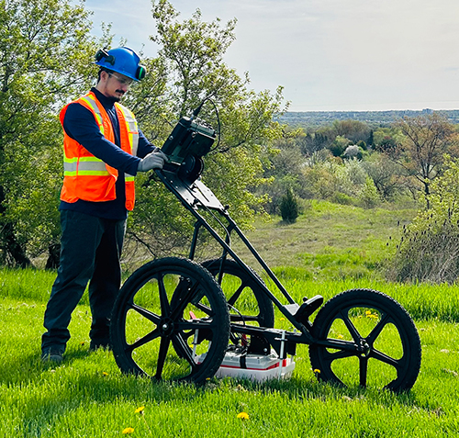
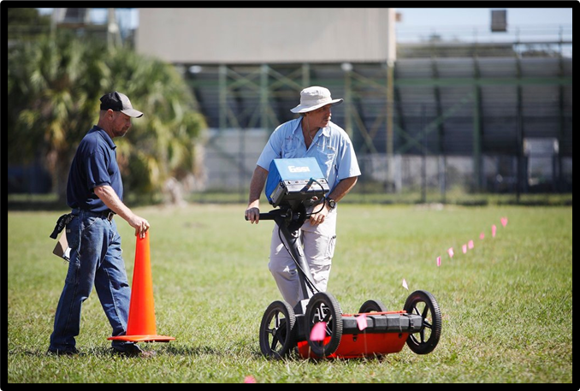
Introduction to GPR
Antenna
Console
Figures taken from: GETSI Teaching Materials & telonix.ca/product/noggin-gpr-configuration-details

Slide 8

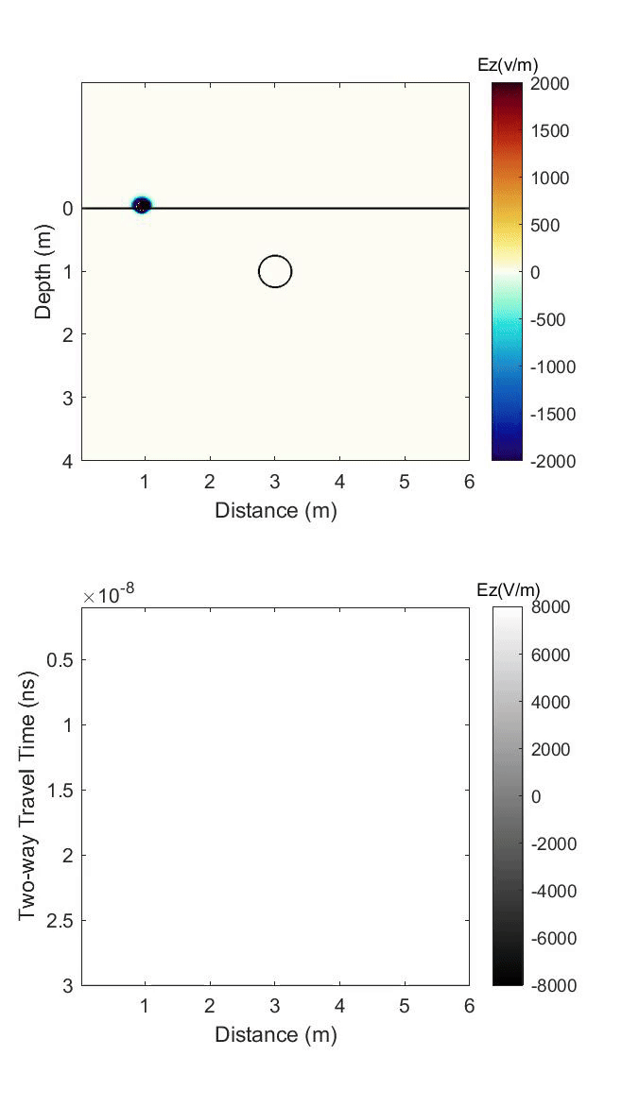
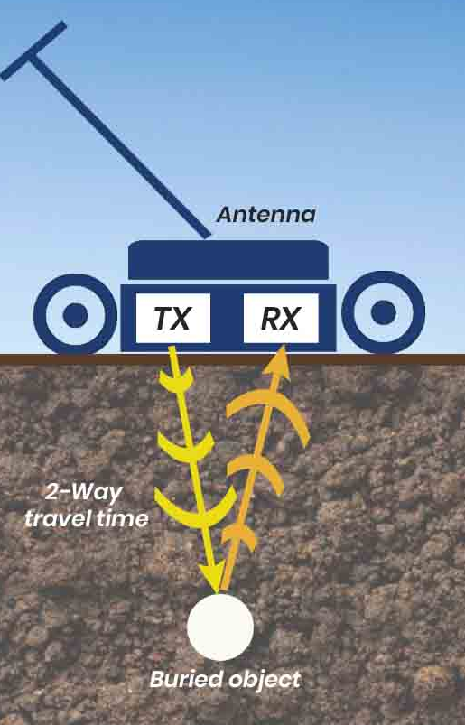
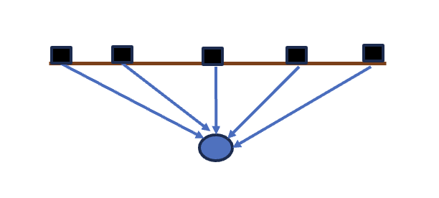
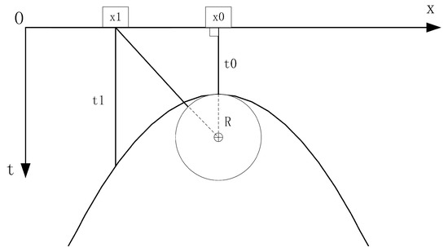
How GPR Works..
Diffraction Hyperbolas from Point-like Objects
Radargram
Notes:
Features that behave more like point targets than continuous layers produce hyperbolas in GPR data.
These can be small objects such as rocks, buried objects, or voids.
Linear objects, such as pipes, can also produce hyperbolas when the survey line crosses them nearly perpendicular.
GPR energy does not travel straight down like a laser beam.
The signal spreads out in a cone-shaped pattern.
As the cart moves, the antenna can receive energy from targets ahead of it, directly below it, and behind it.
The shortest travel time occurs when the antenna is closest to the target.
The GPR system records two main things: the amplitude of the reflected signal
the time between sending the pulse and receiving the reflected signal
This time is called the two-way travel time.
As the antenna moves away, the travel path becomes longer, creating the hyperbolic shape.
Shallow targets usually produce sharper, more pointed hyperbolas.
Deeper targets usually produce broader, more rounded hyperbolas.
This change in shape is mainly due to geometry.
Diffraction pattern app: https://editor.p5js.org/ChMaDowns/full/zmu3li6U

Slide 9
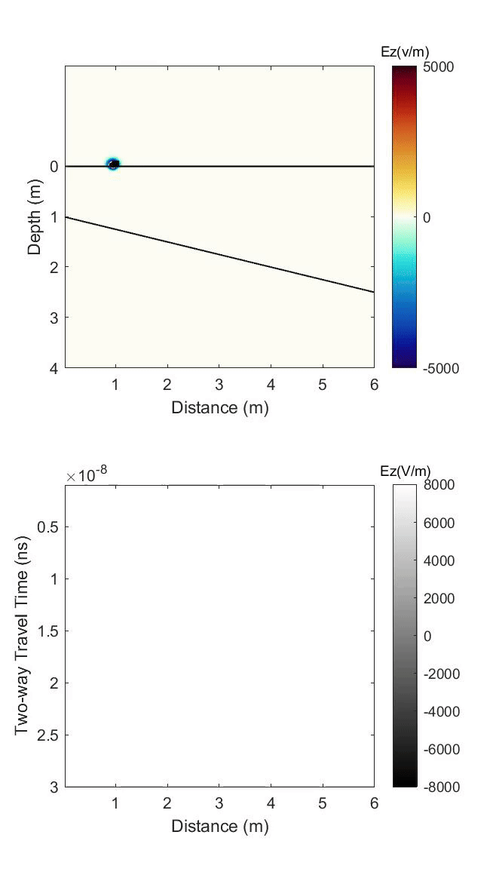
How GPR Works..
Reflections from layer boundary
Quick Question
When a GPR signal hits a buried target, does All of the energy reflect back to the receiver?
Type in the chat:
A = Yes, all of it reflects back
B = No, only part of it reflects back
C = Not sure
The amount of energy reflected from a target depends on:
The contrast between the target and the surrounding material
The material the signal travels through
The size, shape, and orientation of the target
Notes:
Not all GPR energy that reaches a boundary reflects back to the surface.
Some energy reflects back, while some transmits through the boundary and continues traveling downward. The reflected percentage depends on the contrast between the two materials. In many cases, only a portion of the energy reflects back. ( ~30%-60%)
The deeper the boundary, the longer the two-way travel time.
If the boundary gets deeper along the survey line, the reflection arrives later from trace to trace.
This is why a dipping boundary appears as a dipping layer in the radar profile.
Layer boundaries usually show the correct dip direction in the radargram.
However, the apparent dip seen on the GPR profile may not be the true dip angle, especially if the survey line is not parallel to the true dip direction.

Slide 10
Case Study
Let’s consider a real GPR profile and explore the information it holds

Slide 11
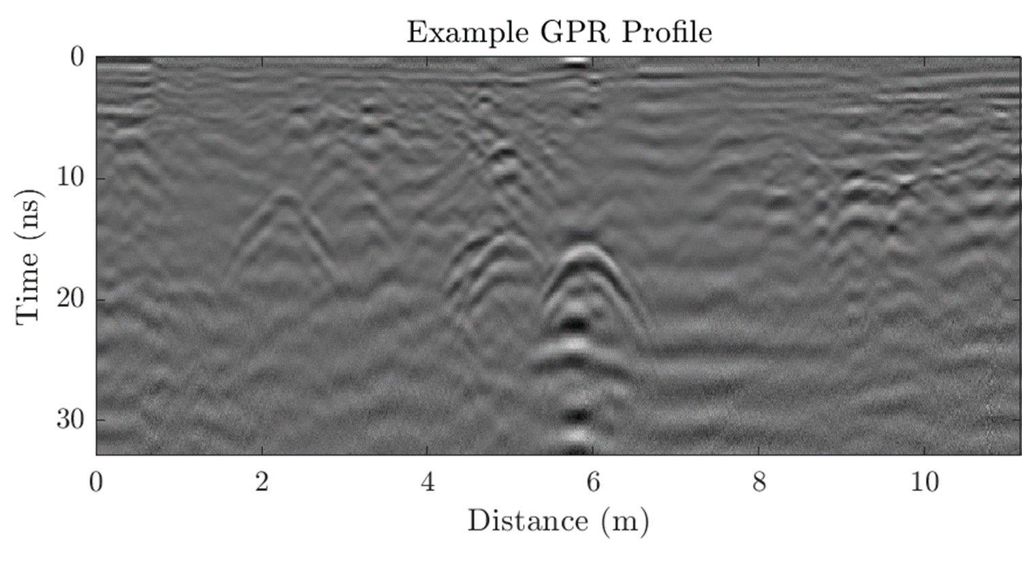
Question: Over what distance did the GPR cart travel to make this image?
Answer in the Chat
Two-way travel time (ns)

Slide 12
Question: Over what distance did the GPR cart travel to make this image?
11 meters
Answer in the Chat
Answer: the x-axis is the distance the GPR cart is pushed. In this example, the radar was pushed for
Two-way travel time (ns)

Slide 13
Question: What is the longest travel time recorded?
Two-way travel time (ns)

Slide 14
Question: What is the longest travel time recorded?
32 ns*
In this example, the receiver recorded reflected signal up to
Two-way travel time (ns)
GPR waves travel so fast that we mark the two way travel time in nanosecond (ns)!

Slide 15

Question: What key features do you see?
Two-way travel time (ns)
Notes:
Two main features to look for in GPR data are hyperbolas and boundaries.
Hyperbolas are usually caused by point-like targets or linear objects crossed by the survey line, such as pipes, utilities, rocks, or voids.
Boundaries are usually caused by changes in material properties.
A boundary can represent a change from one material to another, such as soil to rock, or a change within the same material, such as a change in water content. Crossing the target perpendicular to its orientation gives the clearest hyperbola.
In the field, we often do not know the exact orientation of the target.
If the survey line crosses a utility at an angle less than 90°, the hyperbola becomes broader and flatter.
This broadening is a geometric effect caused by the antenna staying close to the target over a longer distance along the survey line.

Slide 16
Question: What key features do you see?
Answer: The upside-down ‘U’s shown here are hyperbolas.
They are indicative of features in the ground that have different properties than the ground itself.
Two-way travel time (ns)
Notes:
GPR signals become weaker with depth.
The depth of penetration depends strongly on material attenuation.
Material attenuation is mainly controlled by the electrical conductivity of the soil or rock.
Clay-rich soils often cause strong signal loss because they usually have higher electrical conductivity.
The main issue with clay is not just its dielectric constant, but its high electrical conductivity and associated attenuation.

Slide 17
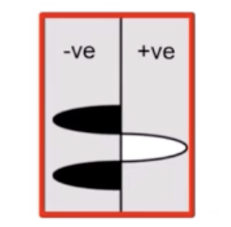
Quick Question
When you see a hyperbola, why do you see several white-black-white bands stacked together?
Type in the chat:
A = They are multiple buried objects
B = They are different phases of the same reflected GPR wavelet
C = They are random noise
D = Not sure
Correct answer: B
GPR pulse is a wavelet with positive and negative phases. So, the stacked bands usually do not mean several objects. They are often different phases of the same target response.
Two-way travel time (ns)
Notes:
A GPR signal is a wave, so it has peaks and troughs.
A typical reflected wavelet may contain multiple bands, such as two peaks and one trough, or two troughs and one peak.
Reflections in the radargram mimic the shape of the transmitted GPR wavelet.
Therefore, one reflection is often seen as a group of white-black-white or black-white-black bands.
A single white or black band should not always be interpreted by itself.
The full group of bands represents the reflected wavelet.

Slide 18






Causes for GPR to Reflect
Reflections occur when the wave encounters a change in the ground’s dielectric constant, which also controls the ground’s wave velocity.
Conductivity
Dielectric constant
Permittivity
AIR
~ 1
The GPR wave velocity $(v)= \frac{c}{\sqrt{dielectric}}$
Permeability
Where c is the speed of light ($3×{10}^{8} m/s)$
Quick Question : How much slower does a GPR wave travel in water than in air?
AIR: $v≈\frac{0.30}{\sqrt{1}}=0.30 \text{m}\text{/}\text{ns}$
WATER: $v≈\frac{0.30}{\sqrt{81}}≈0.033 \text{m}\text{/}\text{ns}$
For reference, a ground velocity of 0.1 m/ns is 223, 700, 000 miles per hour (mph)!
WATER
~ 81
Notes:
The GPR instrument does not control how fast the radar wave travels.
Wave velocity is controlled by the material the wave travels through.
The key material property is relative permittivity, often described in GPR as the dielectric constant.
In GPR, “relative permittivity” and “dielectric constant” are often used to describe the same property.
Different names are common in science because terms often develop from different fields or historical usage.
Air has a dielectric constant of about 1. Fresh water and distilled water have a dielectric constant of about 80.
Seawater also has the same dielectric constant around 80, but its high electrical conductivity causes strong signal attenuation.
Metals behave very differently from ordinary dielectric materials. For practical GPR interpretation, metals act almost like perfect reflectors because of their extremely high conductivity.

Slide 19
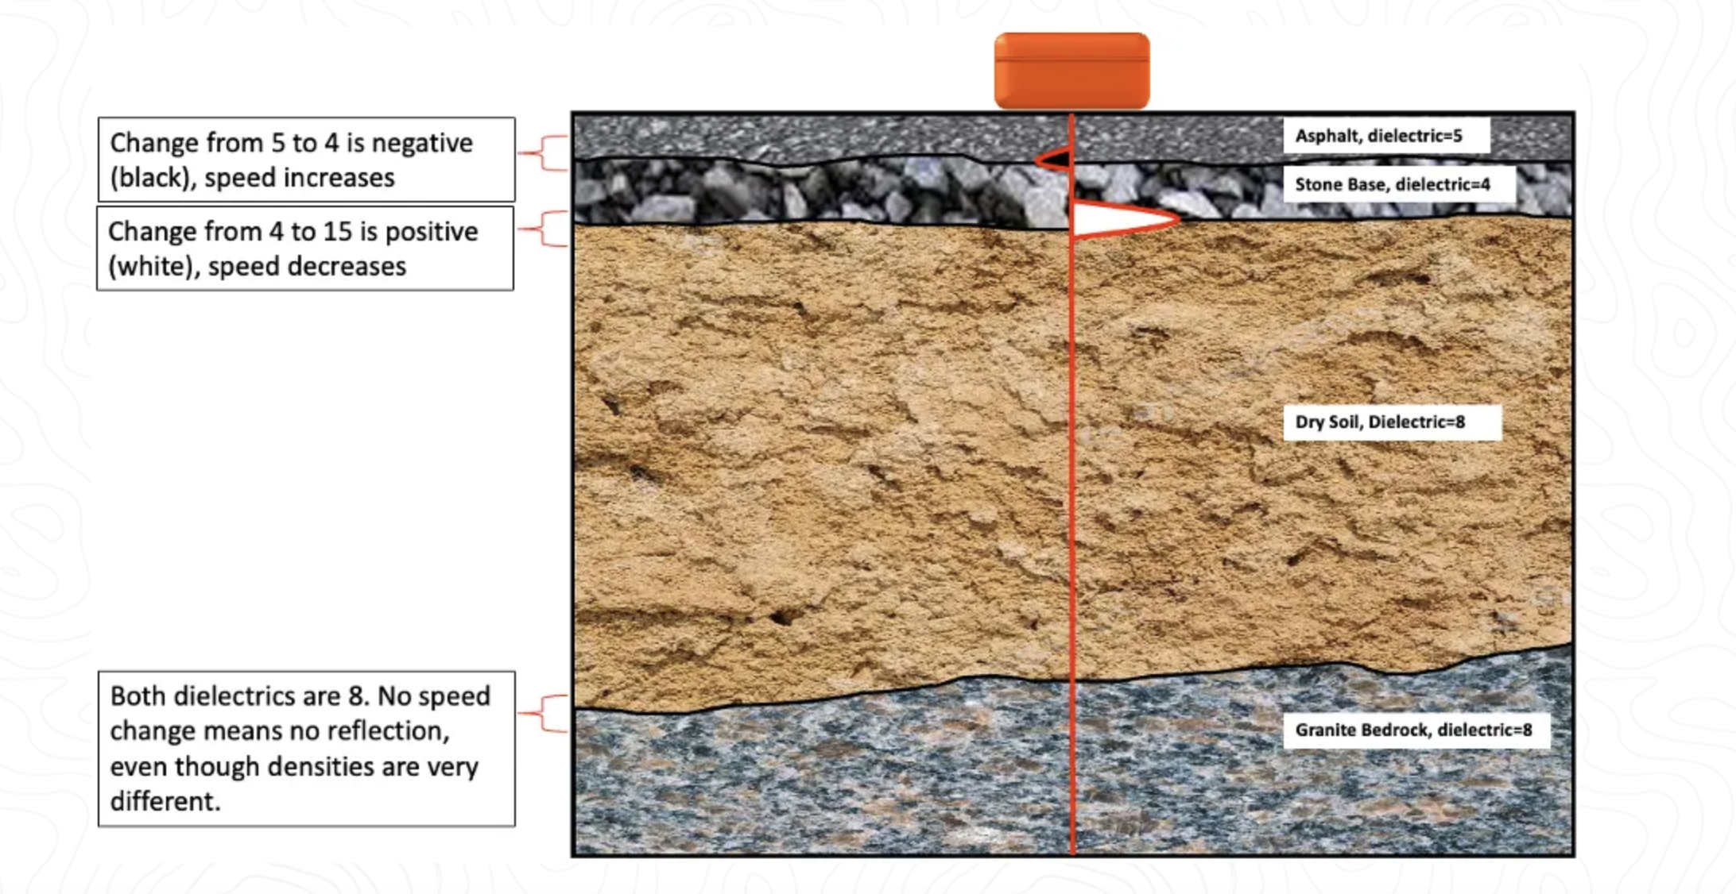
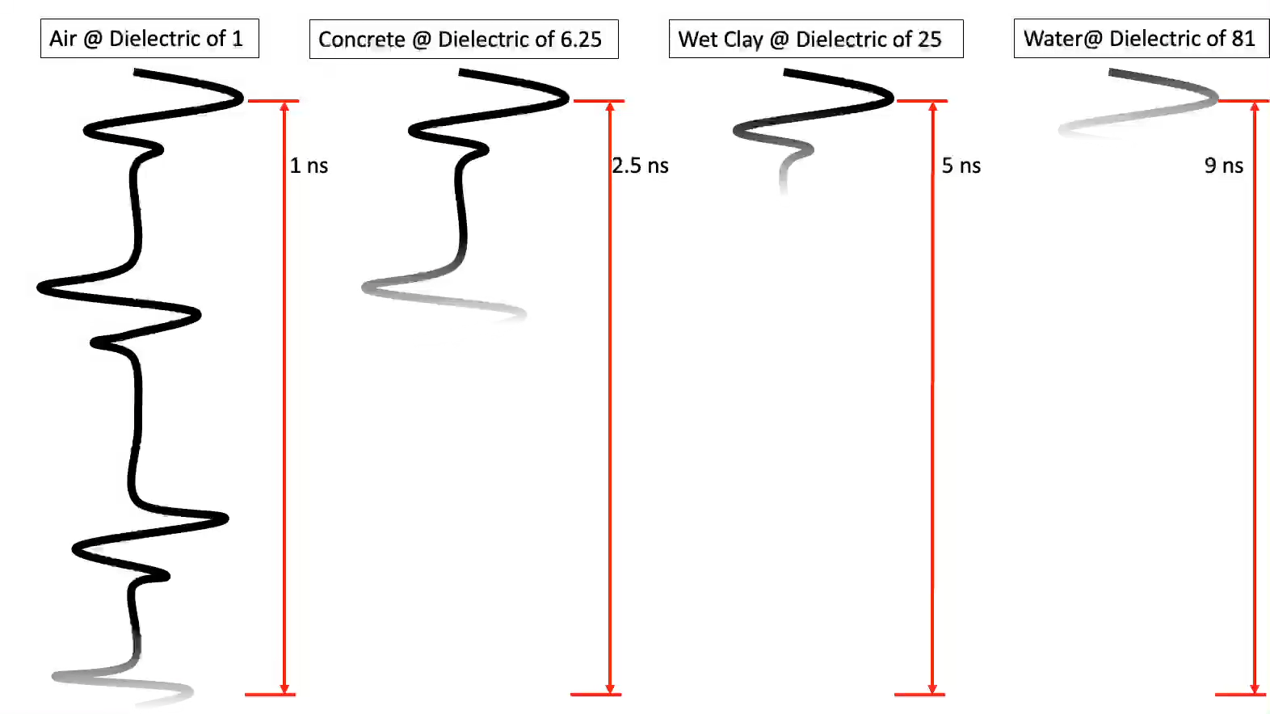
Anatomy of GPR
Adopted from : gp-radar.com/manuals/ground-penetrating-radar-dielectrics

Slide 20
Change in… | Examples that cause GPR wave reflection
porosity (amount of air-filled space) | Boundary between: loose sand & compacted sand sediment/rock & an air-filled cavity sediment & hard rock
water saturation | Top of the water table Encountering organic material with a higher water content (i.e. tree roots or buried remains)
composition | Boundary between: sandstone and siltstone rock layers or rock bodies
clay content | Boundary between: sand/silt with little clay and clay-rich sediments
iron content | Encountering a metallic body (GPR waves do not penetrating metal so all of the energy reflects)

Slide 21
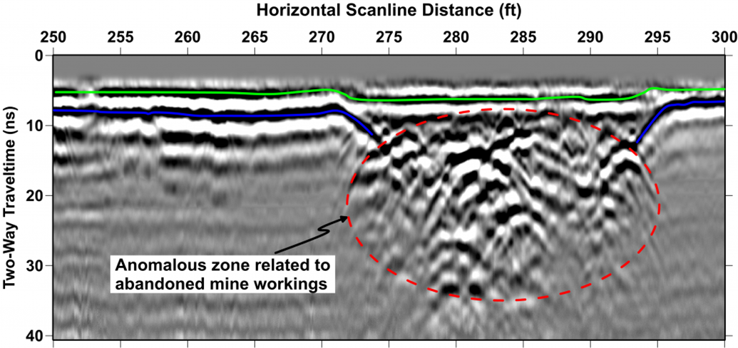
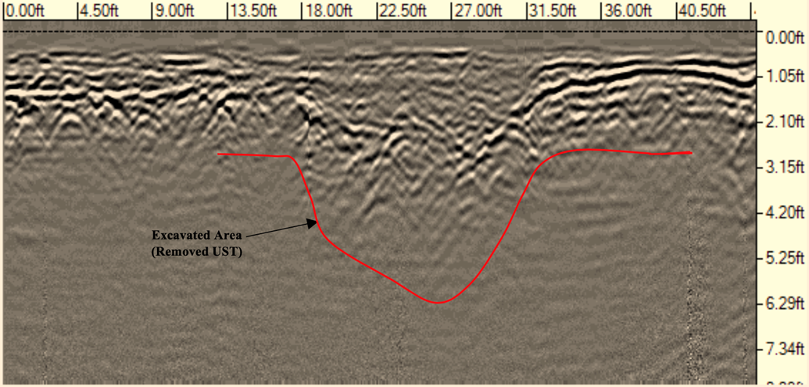
Porosity
Boundary between:
loose sand & compacted sand
sediment/rock & an air-filled cavity
sediment & hard rock

Slide 22
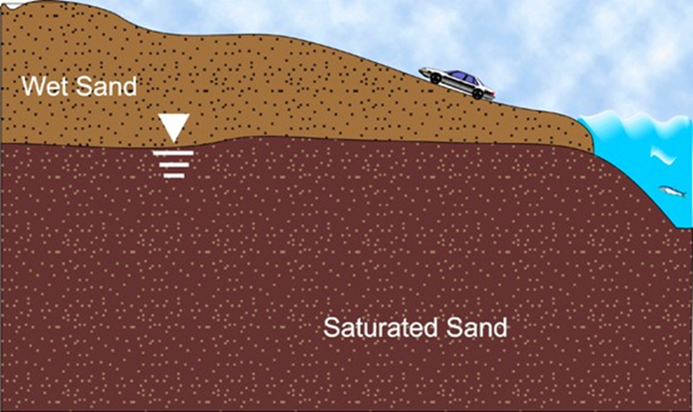
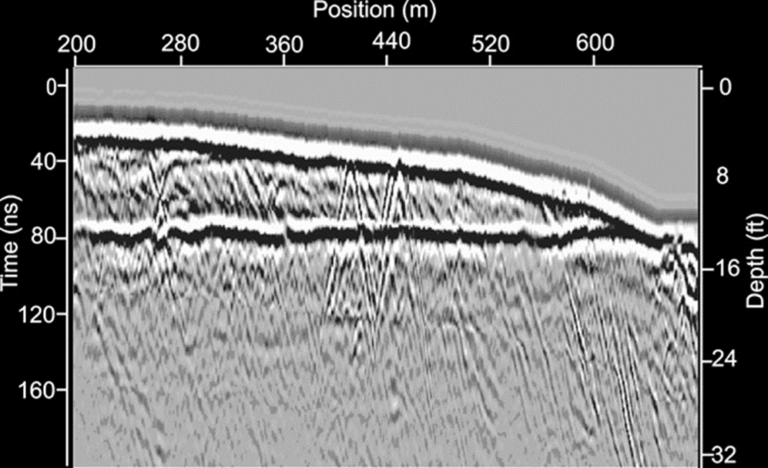
Water Saturation
Top of the water table (sometimes!)
Encountering organic material with a higher water content (i.e. tree roots or buried remains)
Notes:
The water table can often be identified in GPR data because of the strong contrast between unsaturated and saturated material.
For example, the dielectric constant may change from about 5 in dry or slightly moist sand to about 25 in saturated sand.
This contrast can produce a strong reflection from the top of the saturated zone, with a reflectance of around 38%.
It is not correct to say that GPR cannot penetrate water-saturated soil.
GPR can penetrate saturated material when the electrical conductivity is low enough.
The main limitation is not water saturation alone.
The bigger issue is high electrical conductivity, especially in clay-rich or saline environments.

Slide 23
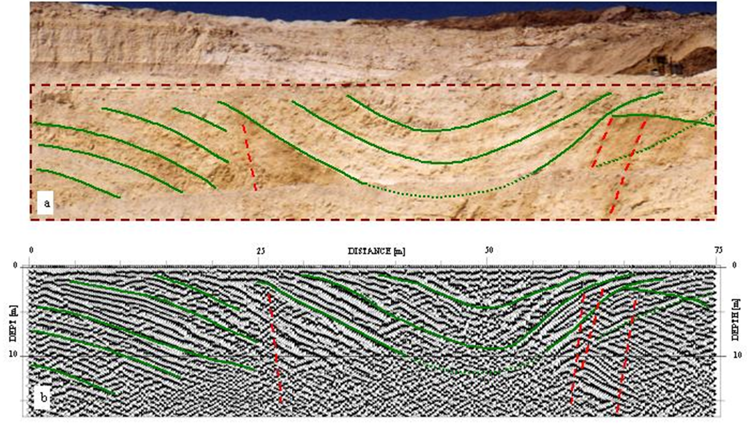
Composition
Boundary between:
sandstone and siltstone
rock layers or rock bodies

Slide 24
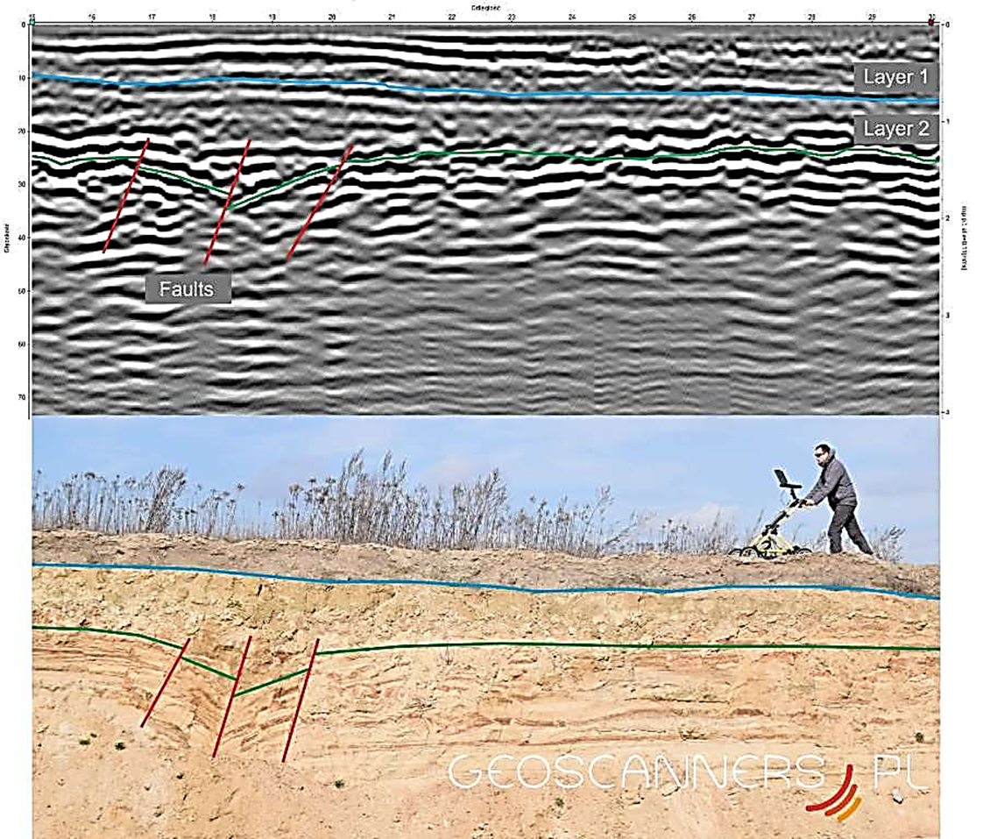
Also Composition
GPR can detect subsurface faults!

Slide 25
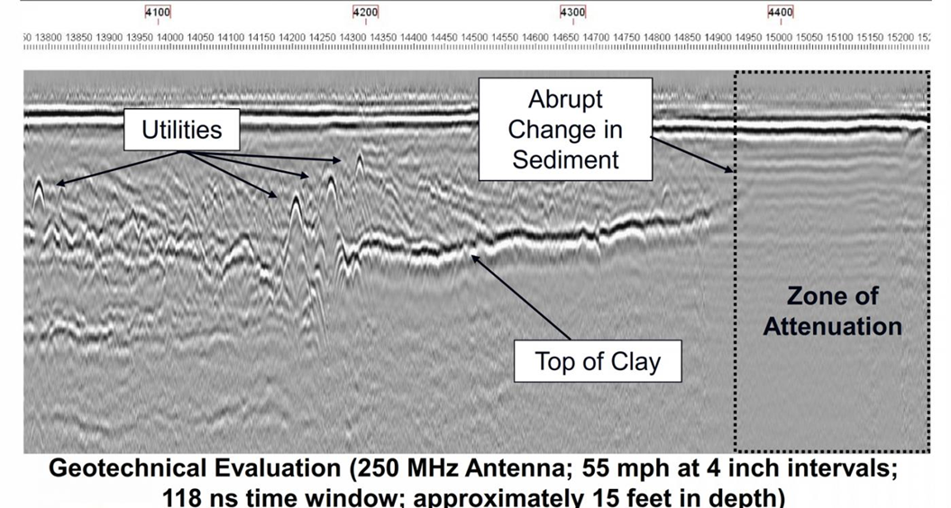
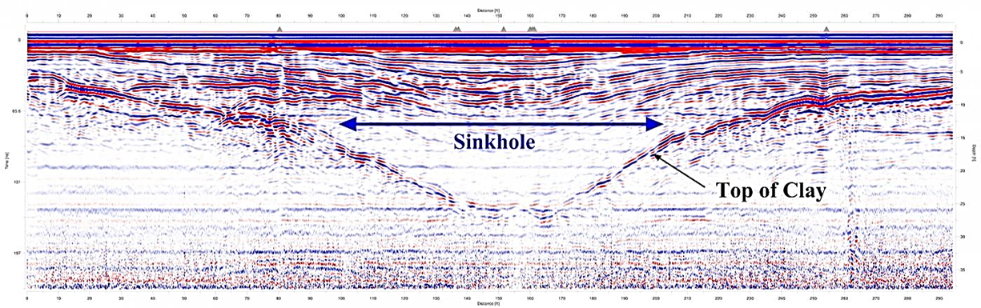
Clay Content
Boundary between:
sand/silt with little clay and clay-rich sediments
We can’t tell just from the GPR data what the layer is made of.
To confirm that it is clay, we’d have to dig or have other information.

Slide 26
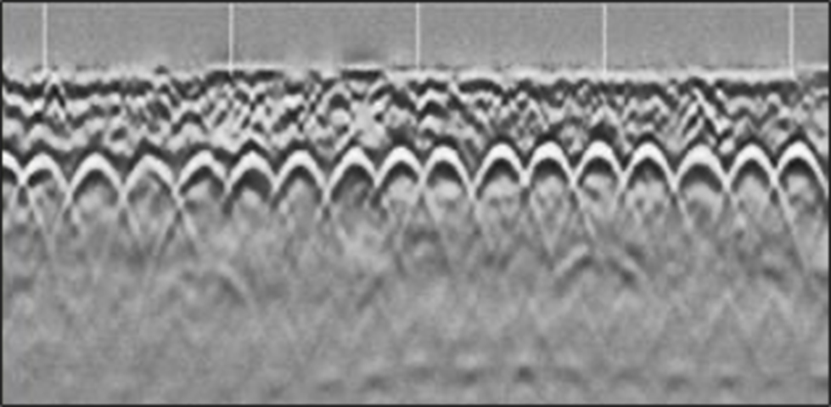
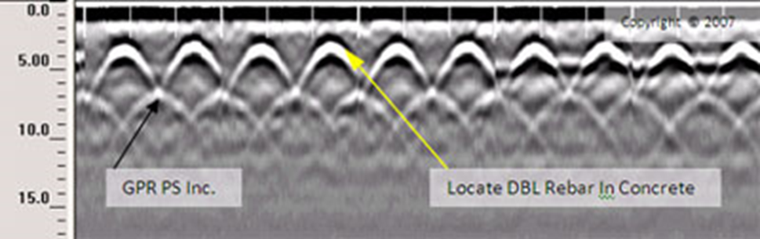
Iron Content
Encountering a metallic body (GPR waves do not penetrate metal so all of the energy reflects)

Slide 27
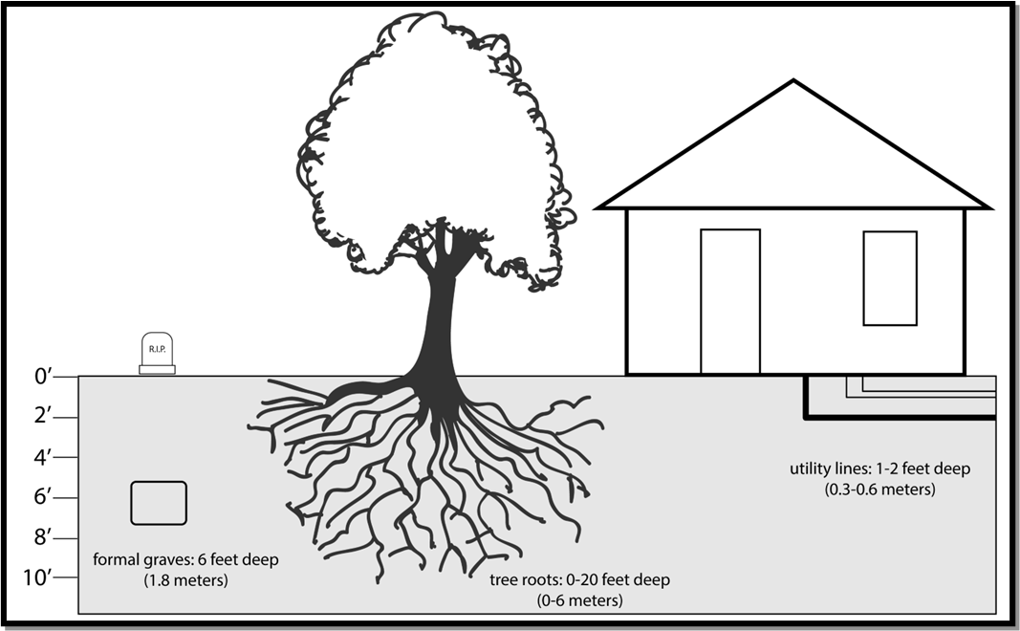
What could you image on or near your campus?
How deep is our target?
Consider the depths that you expect your targets to be.
Here are a few common examples:
Utility lines: 1–2 feet (0.3–0.6 m)
Tree roots: 0–20 feet (0–6 m)
Graves: 1–6 feet (0.3–1.8 m)

Slide 28
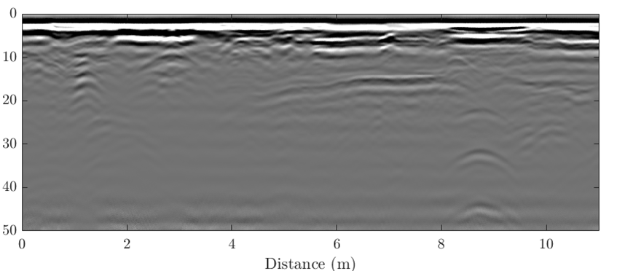
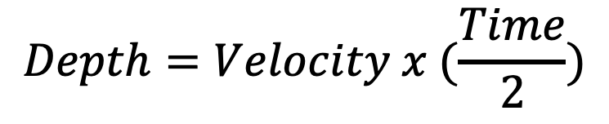
Determining Depth
In this example, some buried object at about 8.8 meters along the profile produces a diffraction hyperbola with a peak at 31 ns TWTT.
Two-way travel time (ns)
Two-Way Travel Time
$$Depth=Velocity x (\frac{Time}{2})$$
Two-Way Travel Time is not enough information

Slide 29
Determining Depth Cont.…
If we don’t know the accurate velocity, the same travel time could be caused by:
Measured TWTT (ns) | If the velocity were (m/ns) | Then the depth would be (m)
31 | 0.05 | 0.78
 | 0.1 | 1.55
 | 0.15 | 2.33
An object at 0.78 m depth with a wave velocity of 0.05 m/ns
An object at 2.33 m depth with a wave velocity of 0.15 m/ns
Or

Slide 30
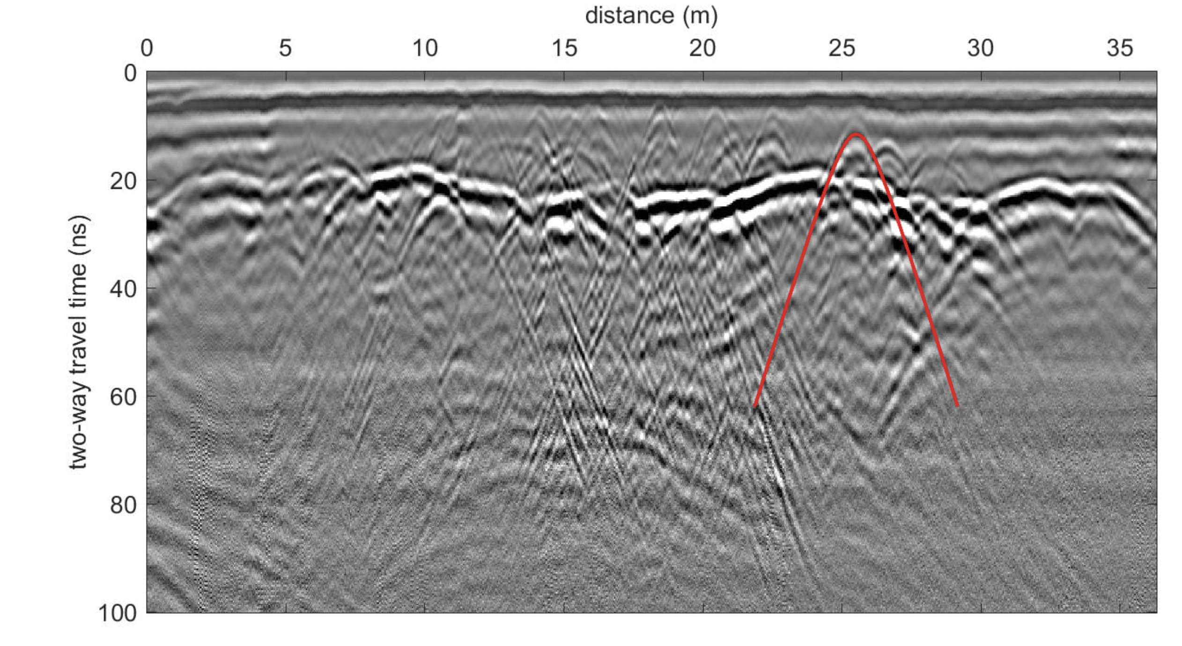
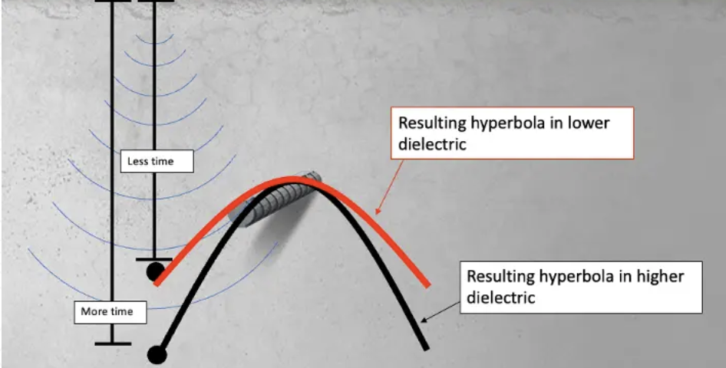
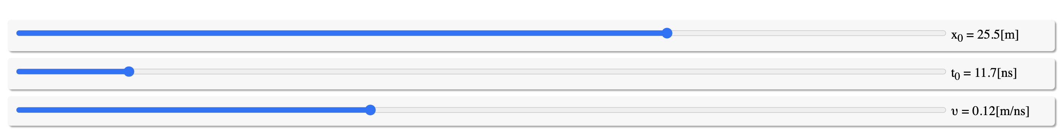
Can use the shape of hyperbolas to determine velocity
- convert travel time to depth
Adopted from : gp-radar.com/manuals/ground-penetrating-radar-dielectrics
Hyperbola Match:
GPR Fit Practice:
https://www.iris.edu/app/gpr-fit/
Depth accuracy estimated between 5%-15%

Slide 31
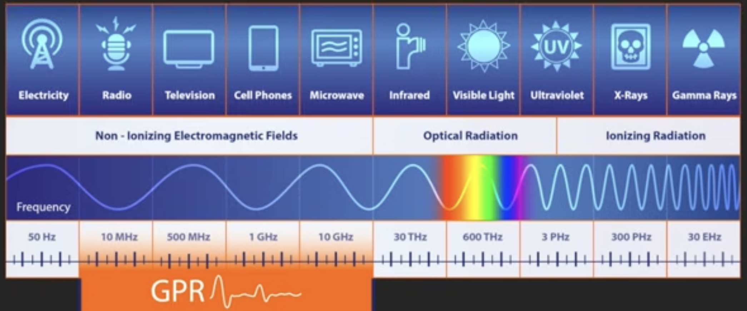
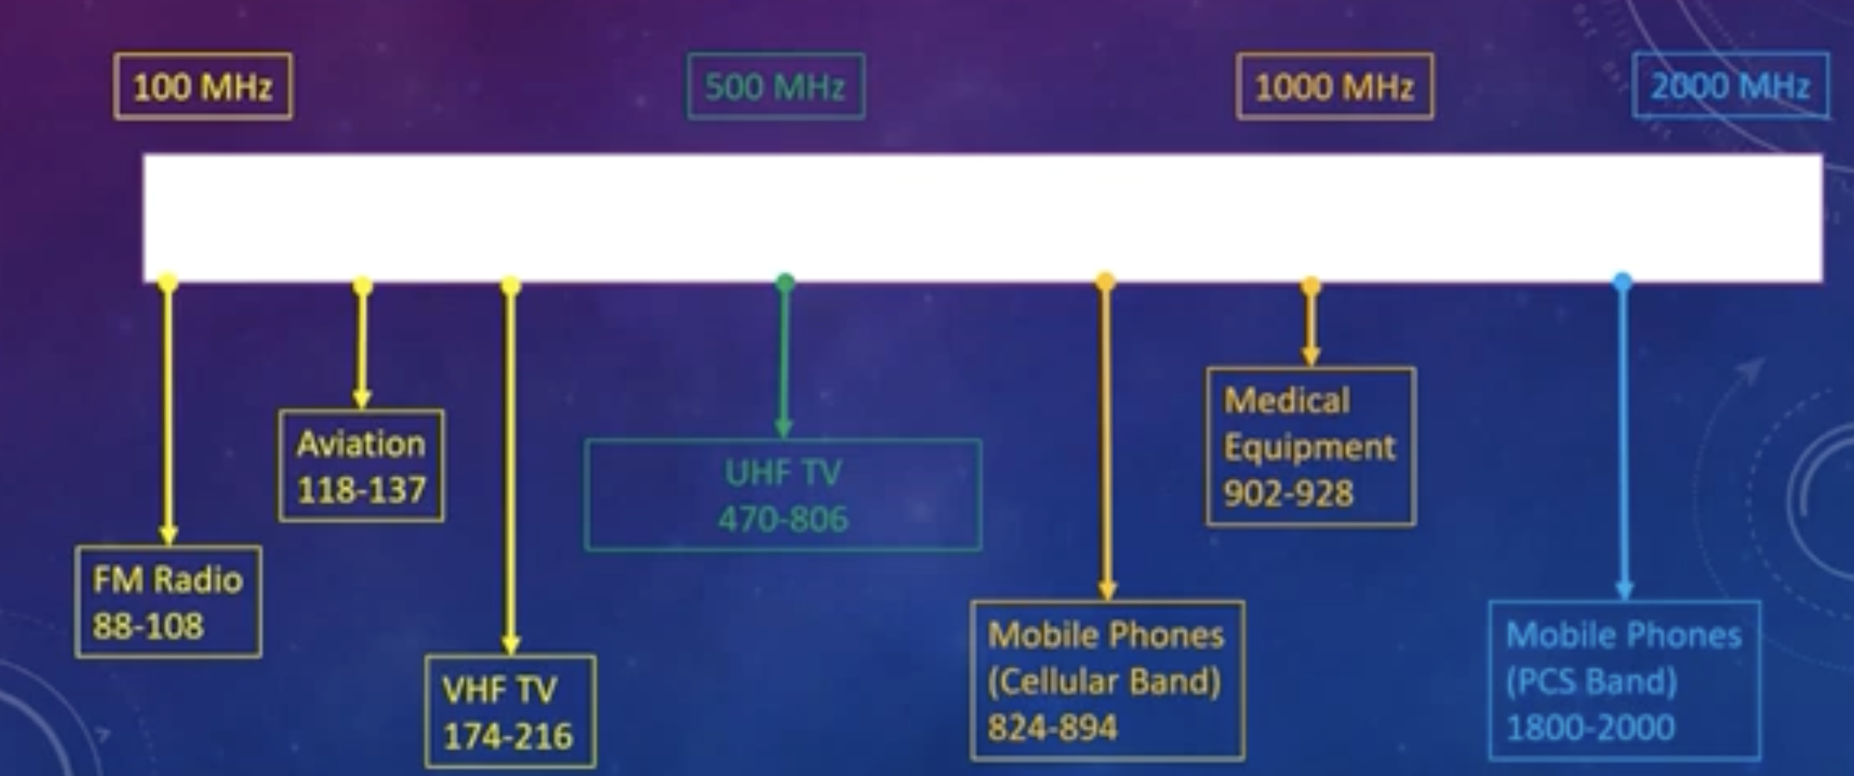
Antenna frequency
Images taken from:
GPR (Ground Penetrating Radar) for Utility Locating Webinar

Slide 32
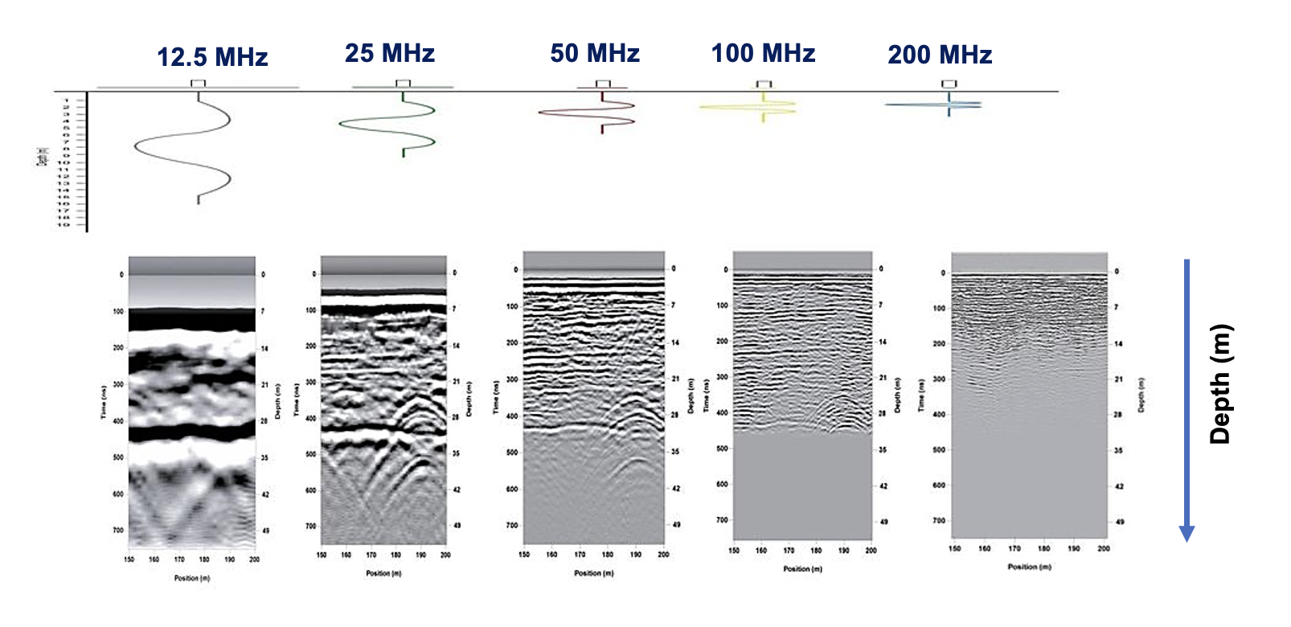

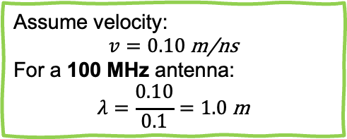

Antenna frequency tradeoffs
Lower Frequency
Higher Frequency
Longer Wavelength
Smaller Wavelength
Deeper Penetration
Less Penetration
Less Resolution
Higher Resolution
Assume velocity:
$$v=0.10 \text{m}\text{/}\text{ns}$$
For a 100 MHz antenna:
$$λ=\frac{0.10}{0.1}=1.0 \text{m}$$
A common GPR rule of thumb is:
$$\text{Vertical} \text{resolution}≈\frac{λ}{4}$$
Two reflectors need to be separated by about 25 cm or more vertically for us to see them as separate events.

Slide 33
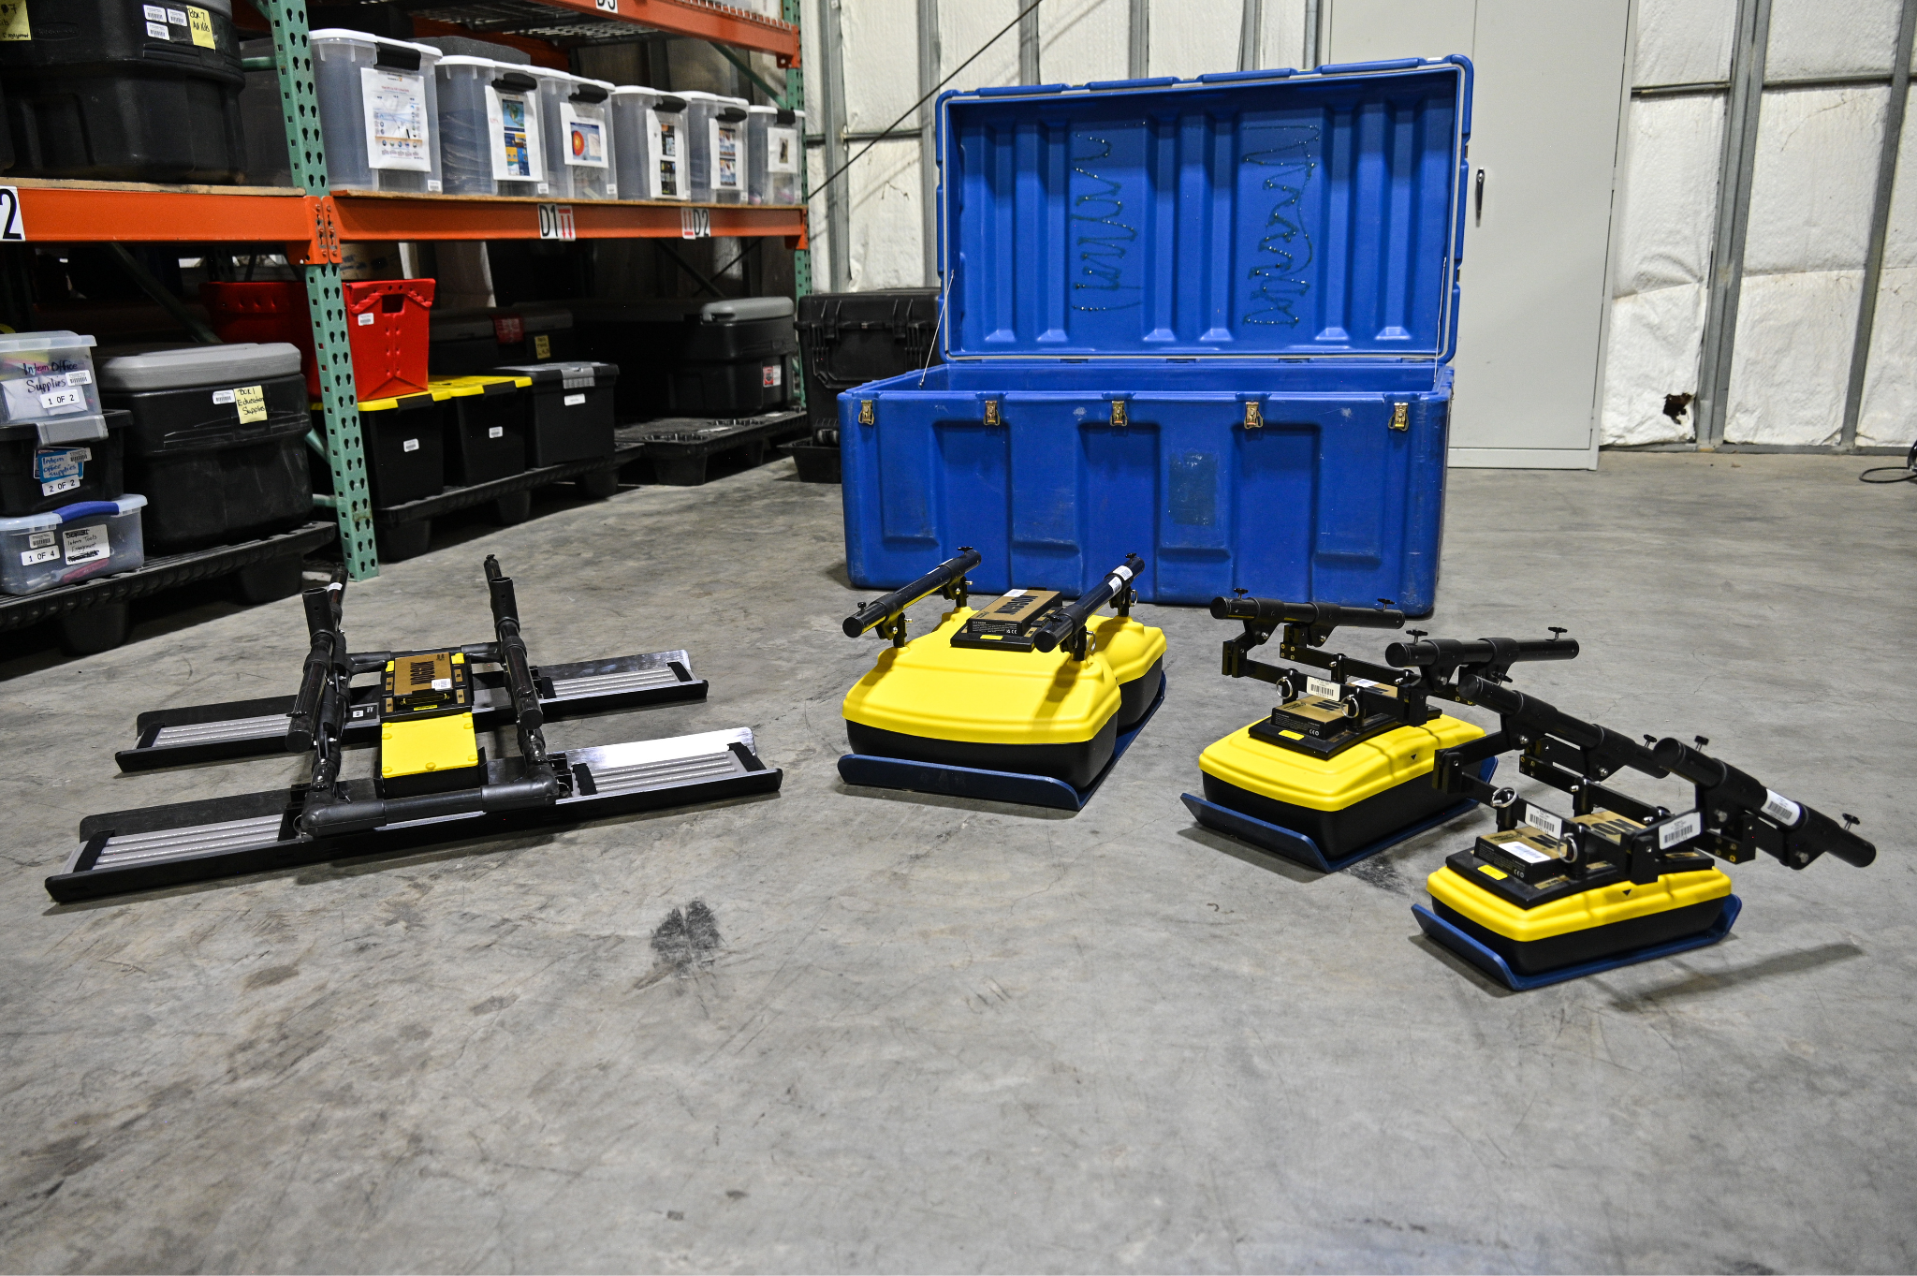
Common GPR Antenna Uses
250 MHz
500 MHz
100 MHz
1000 MHz
Penetrates deeper
Lower resolution
Shallower penetration
Higher resolution

Slide 34
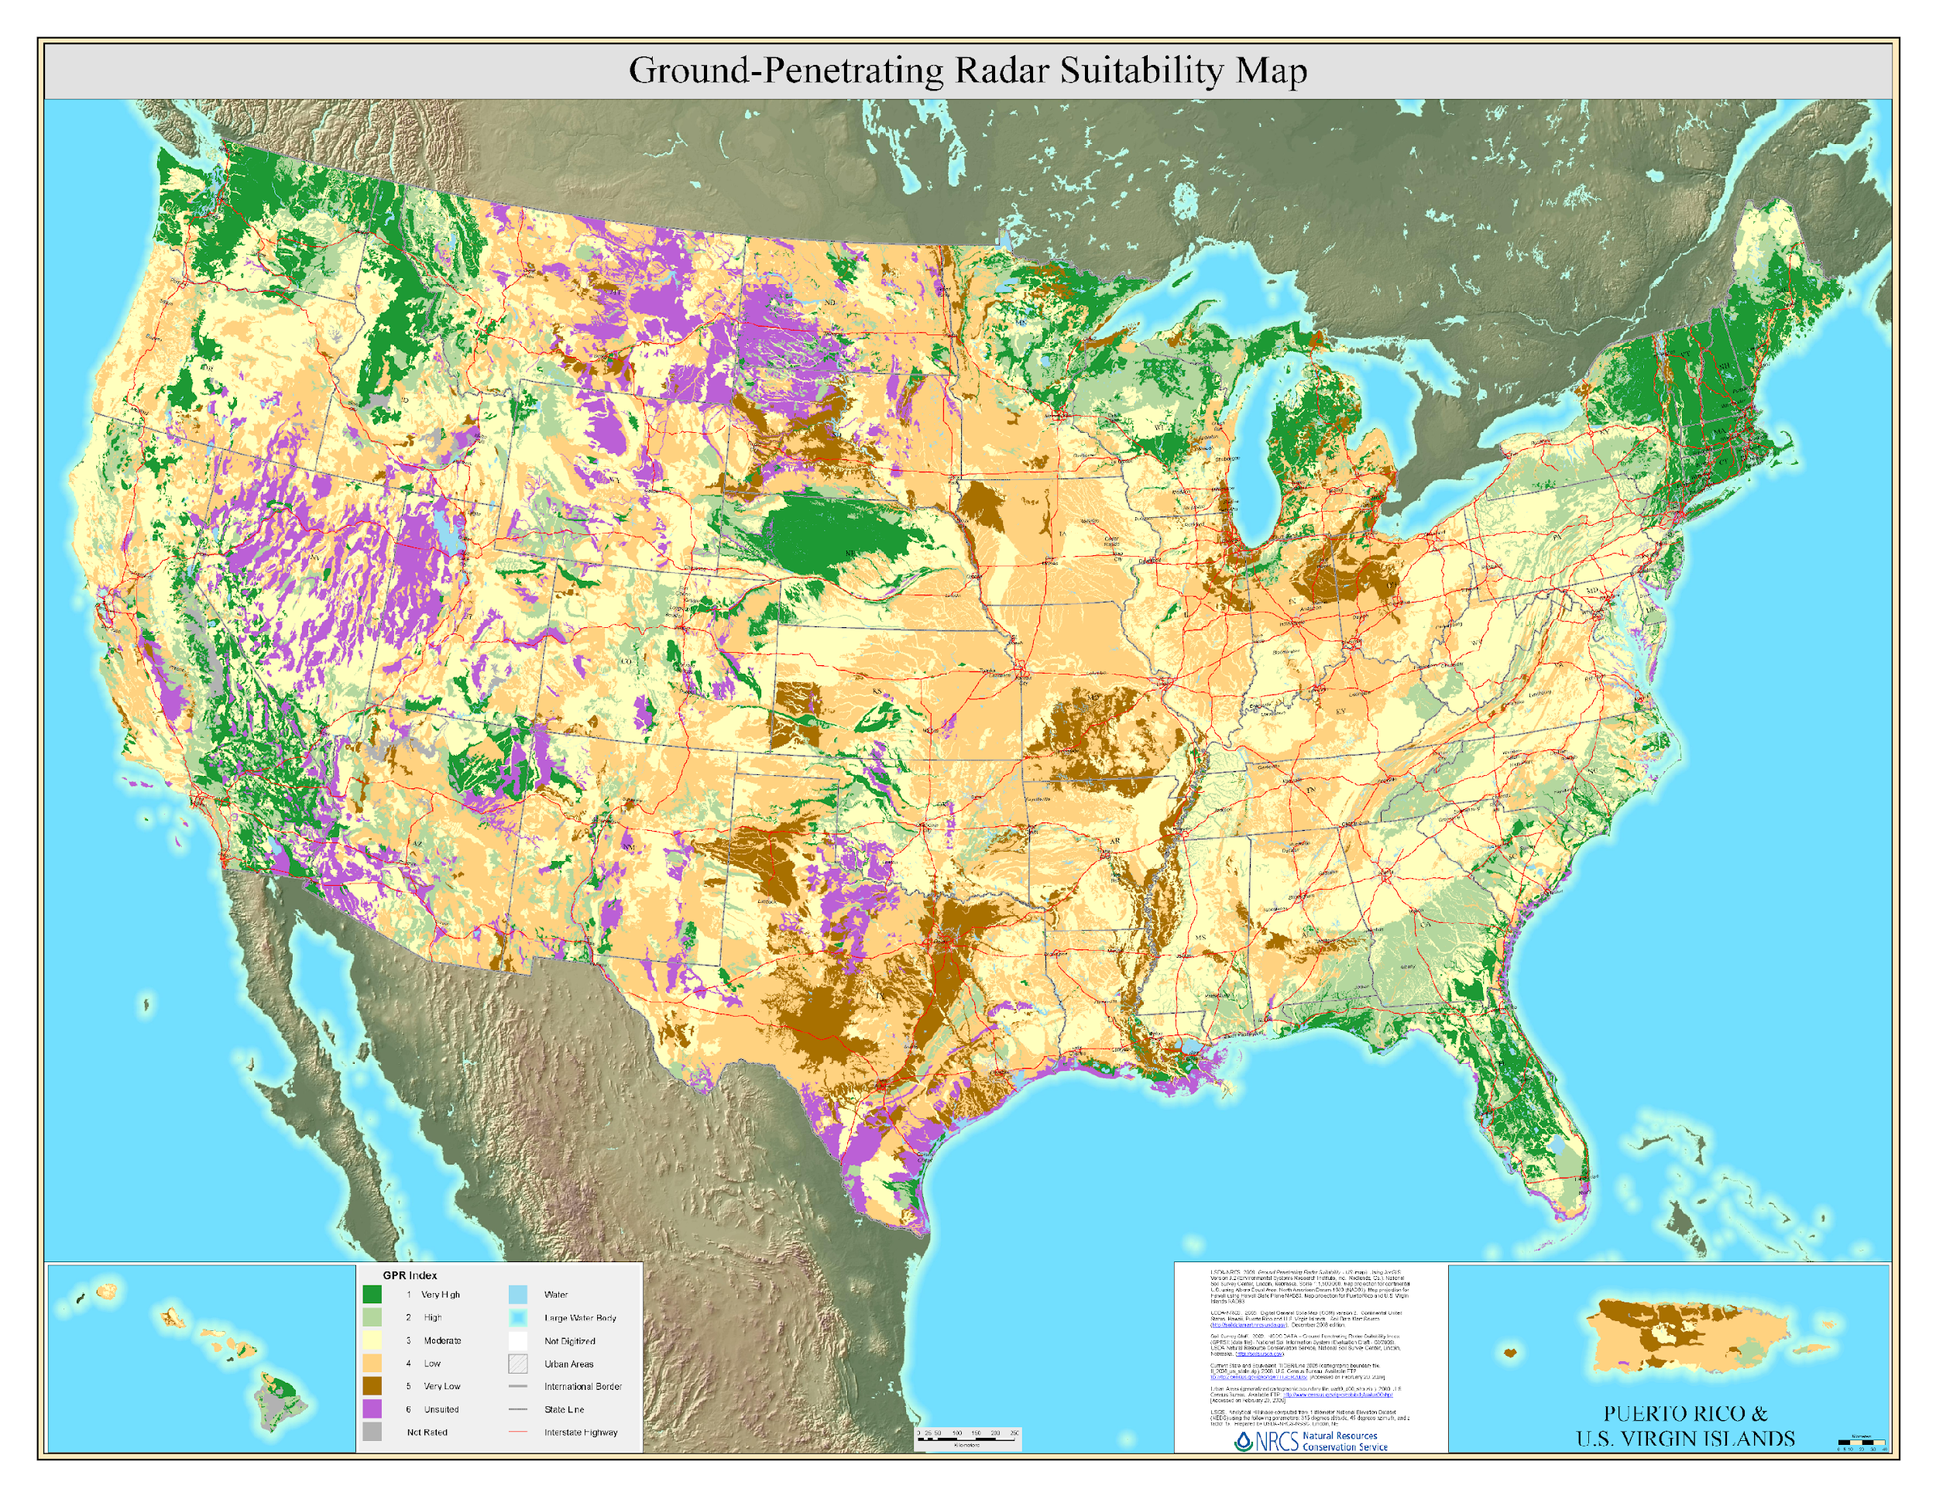
Designing surveys
Dry sand, dry soil, ice, clean rock: Deeper penetration
Wet soil, clay, saline water, conductive ground: Shallow penetration
Primarily based on soil maps
They are giving an index where you can find suitability
Best
Moderate to Low
Undesirable
GPR Suitability Map for lower 48 States Puerto Rico US Virgin Islands and Hawaii
US Department of Agriculture
Notes:
Such maps are also for individual states. USDA keeps moving these around, currently only in archives. Will try to update link as they change this.

Slide 35
Road Map for Designing a survey
If you have a suitable soil
1
Suitable targets
Soil/Rock layers
Tree roots/ Pipes
Historical cemeteries
Buried utilities
2
Soil survey suitability Map
3
Test survey with low frequency antennas
250 MHz or 100 MHz antennas
4
If see features, then move to higher frequency
Possibly a higher resolution
GPR Suitability Map for lower 48 States Puerto Rico US Virgin Islands and Hawaii
US Department of Agriculture
Notes:
Such maps are also for individual states. USDA keeps moving these around, currently only in archives. Will try to update link as they change this.

Slide 36
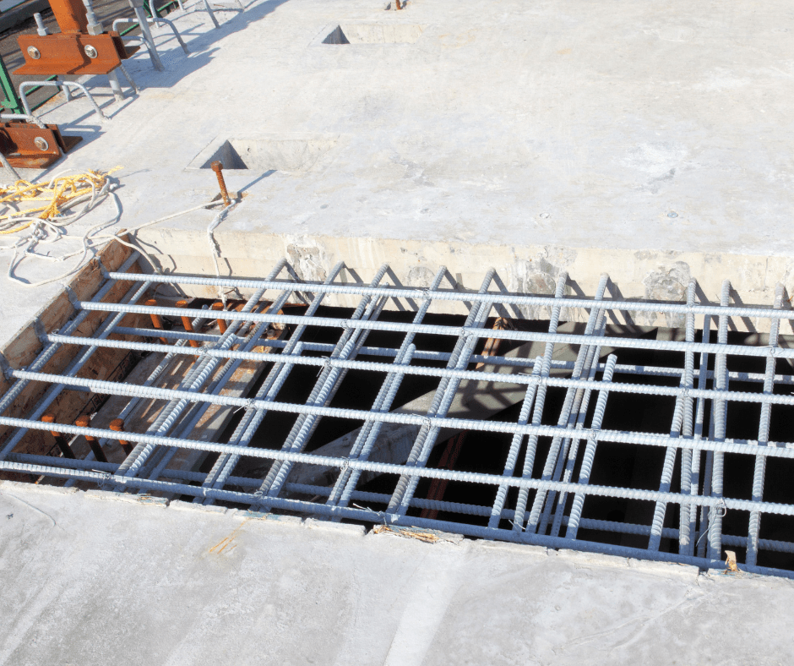
Road Map for Designing a survey
If you have a less suitable soil
1
Suitable targets
Even if it’s clay, it’s often possible to image point-type diffractions
Tree roots/ Pipes
Buried utilities
2
Test survey with low frequency antennas
250 MHz or 100 MHz antennas
3
If see features, then move to higher frequency
Around 1000 MHz
GPR Suitability Map for lower 48 States Puerto Rico US Virgin Islands and Hawaii
US Department of Agriculture
If there is nothing, rebar in concrete is your friend!
Notes:
Such maps are also for individual states. USDA keeps moving these around, currently only in archives. Will try to update link as they change this.

Slide 37
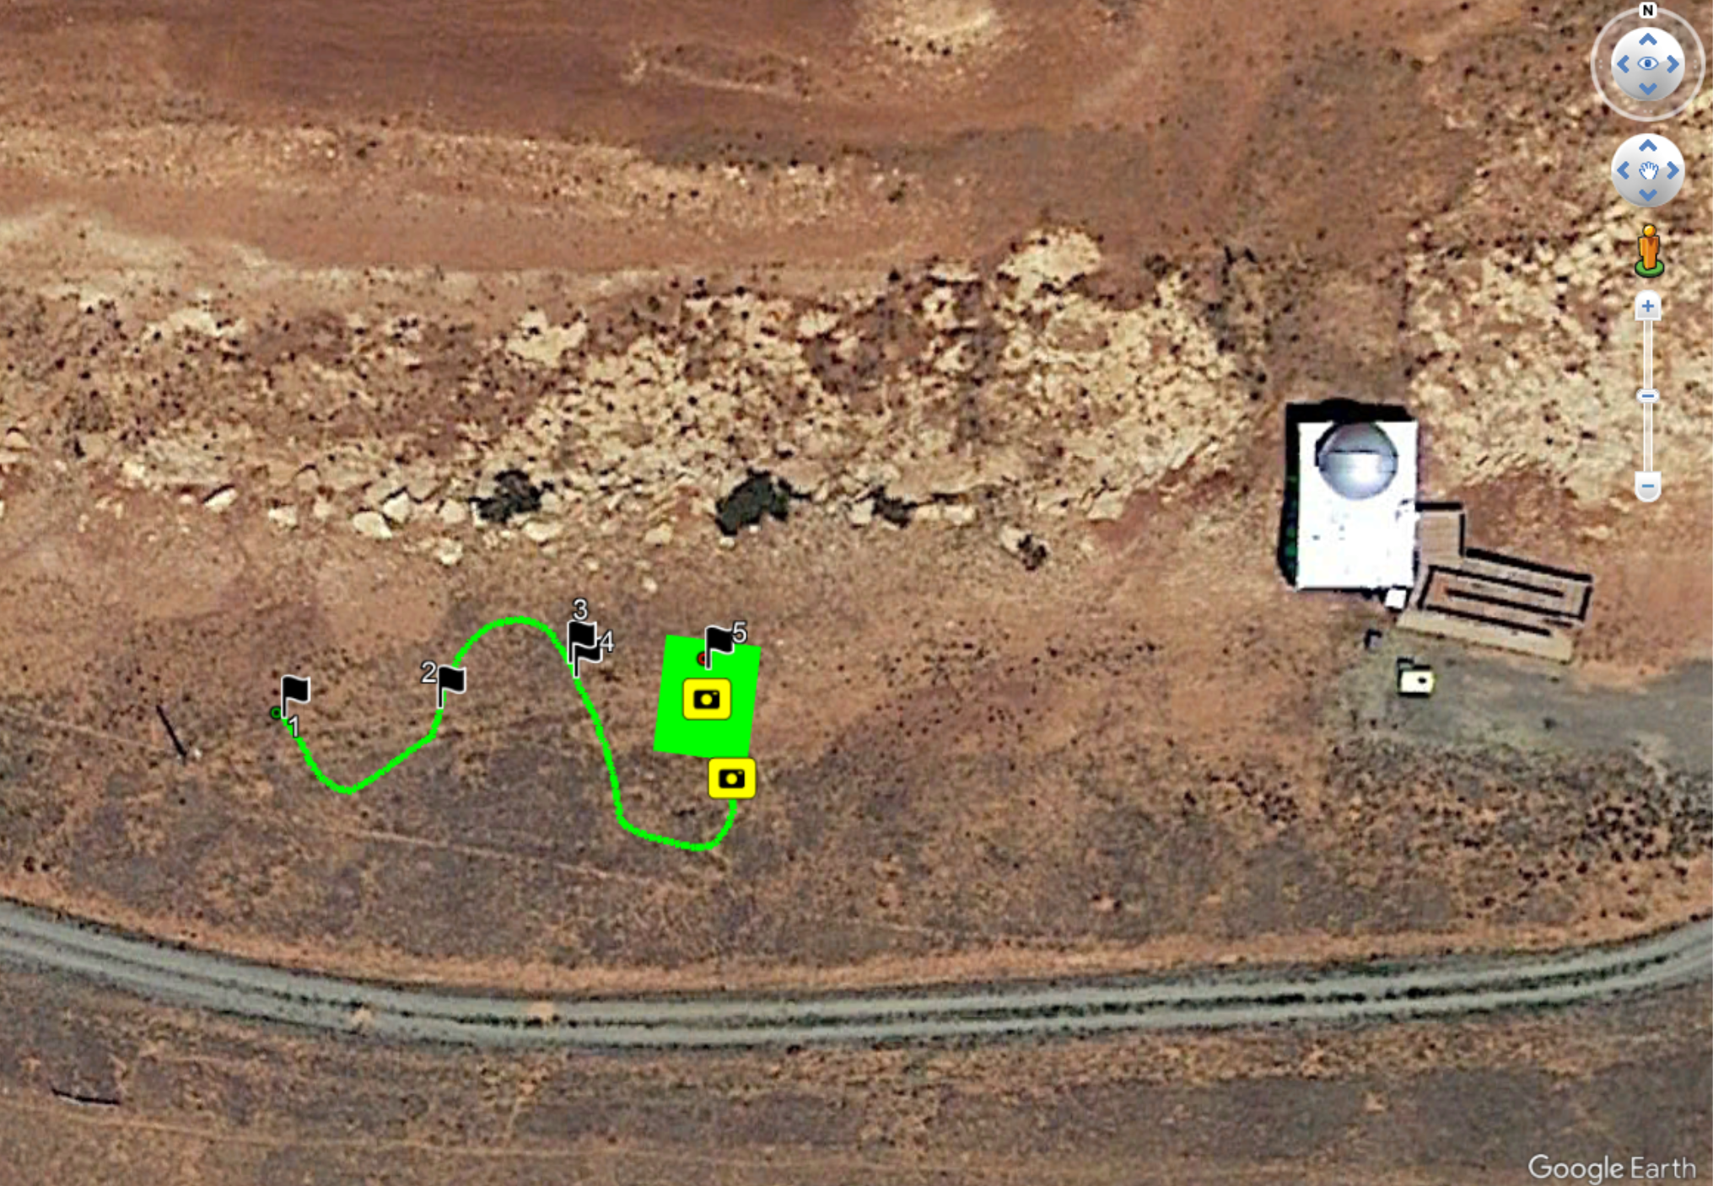
Run test lines
Kind of walk around with the instrument
The data is showing up on the screen
Put on a pin flag in program also on ground
Run test lines
For presence and orientation of features
For utilities:
between buildings and streetlights, around buildings
For tree roots:
in circle around tree – just outside canopy
Rebar in concrete:
floors of most multistory buildings
An ariel photo of a workshop ran by Andy Persakin in Wyoming.
They found a nice target under flag 5 that worth doing 3D imaging.
Notes:
Noticed power line went underground at pole on left, assumed it ran to building on right. Noted sandstone layers outcropping in band across image.

Slide 38
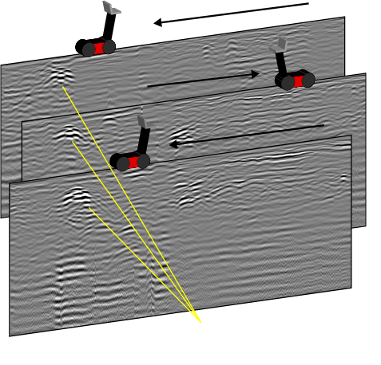
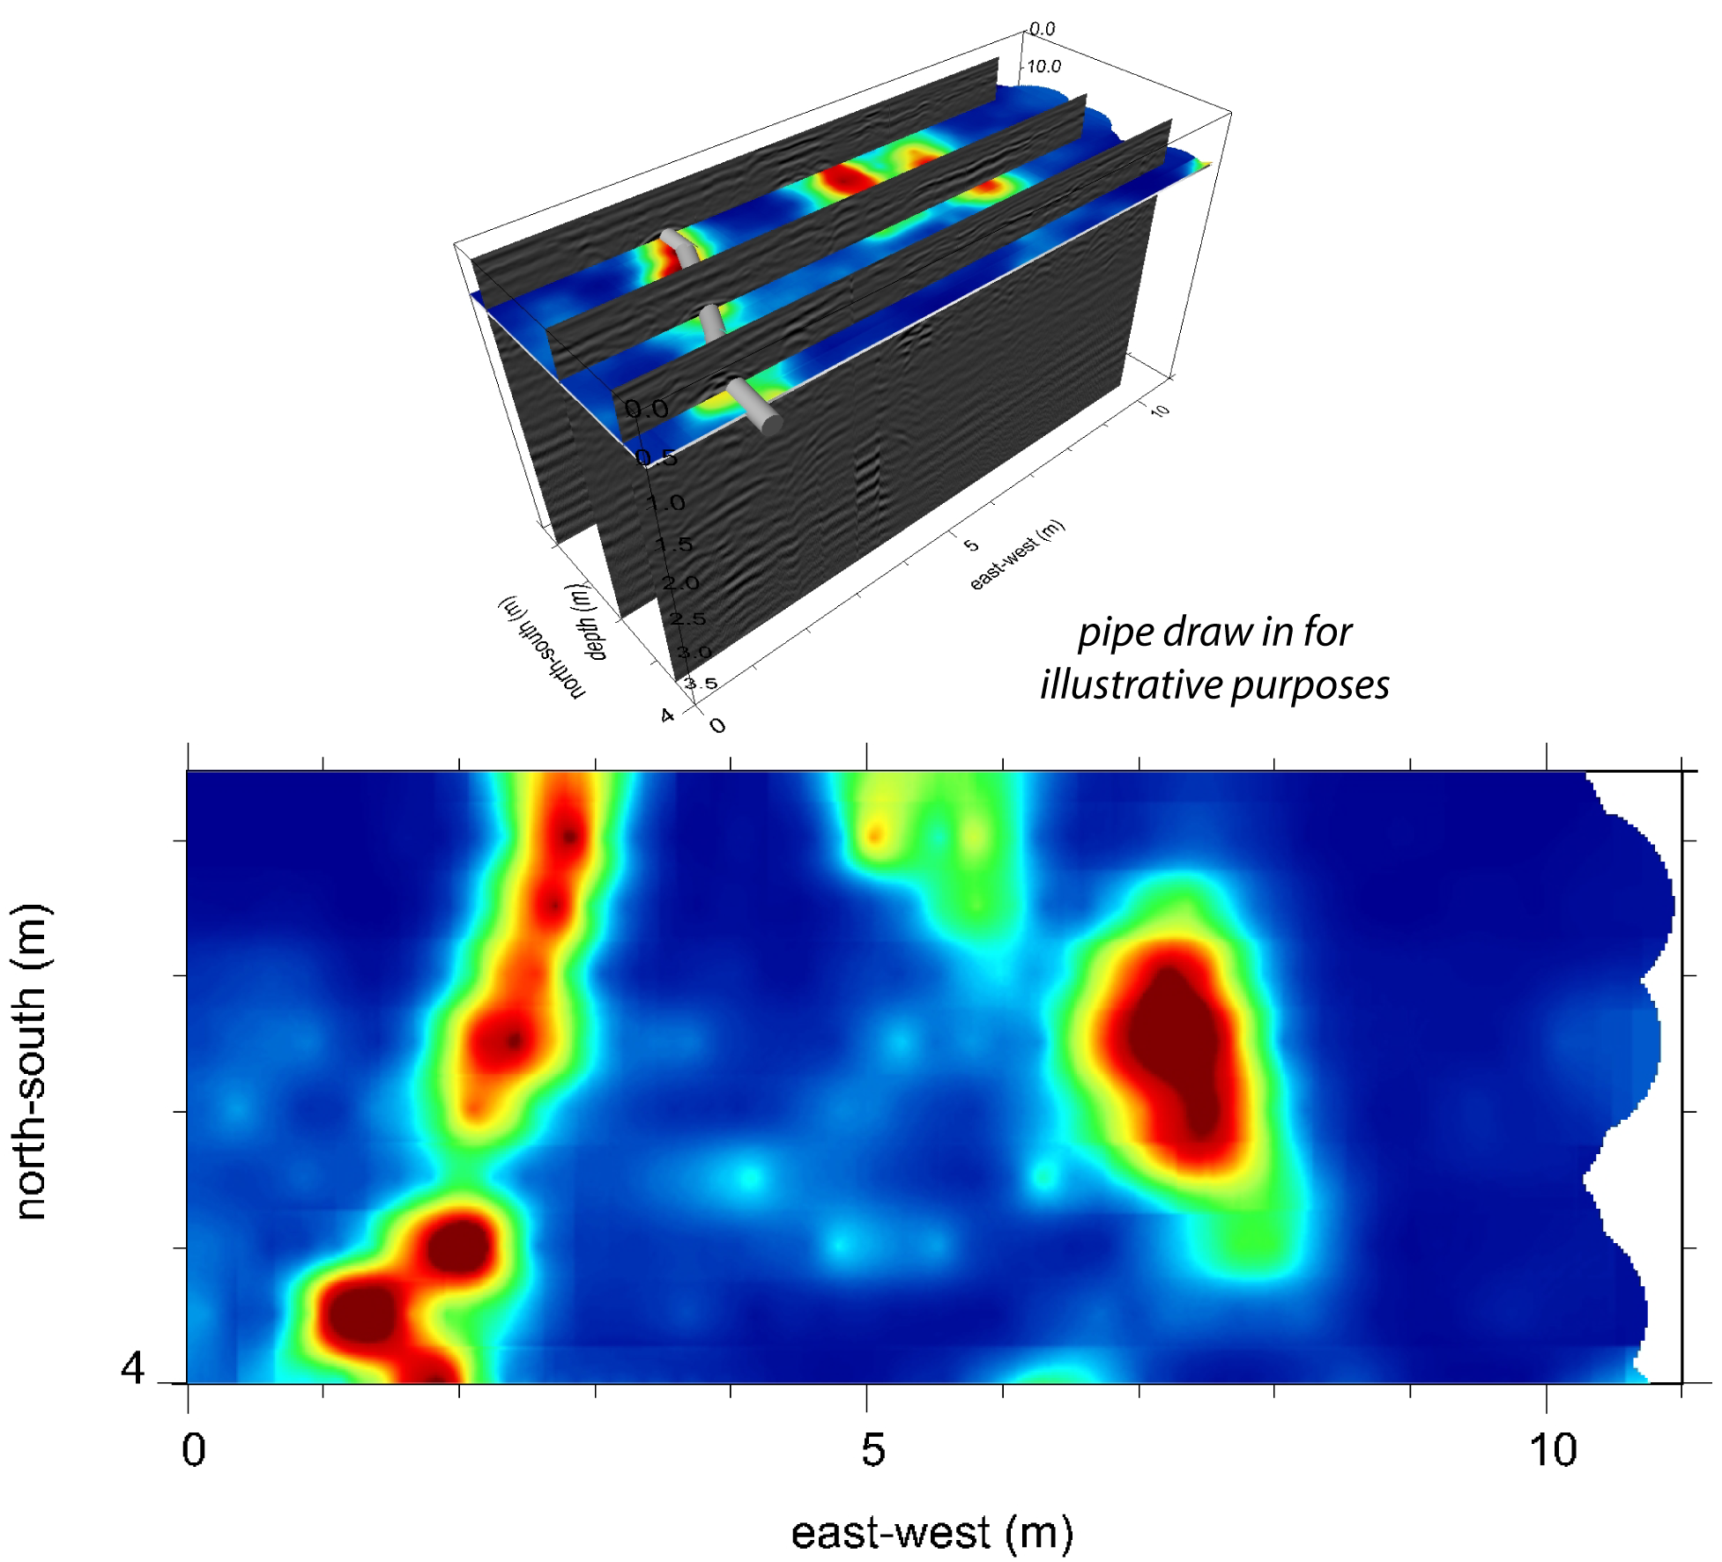
Lines vs. Grids?
Which one to teach
Lines
Grids
You get 2D depth slice
Smaller amount of Data
Computers will work a bit faster
Multi dimensional images
Take more time to acquire 3D images
Computers will work a little slower
Grids: labor intensive! Do only after targets identified
Notes:
In each individual profile crossing, a pipe appears as a small circle or point. In the radargram, it behaves like a point-like target.
When several profiles cross the same pipe, the pipe can produce a diffraction hyperbola in each profile.
A line scan produces a vertical slice beneath the GPR survey line.
When collecting GPR data over fresh water, data can be collected in free-run mode.
Salt water strongly attenuates GPR energy, so GPR is generally not effective in saltwater environments.
A set of parallel line scans forms a grid survey.
Grid surveys can be displayed as depth slices and, in some cases, as 3-D visualizations.
Multichannel GPR systems can cover wider areas during grid surveys and help speed up data collection.

Slide 39
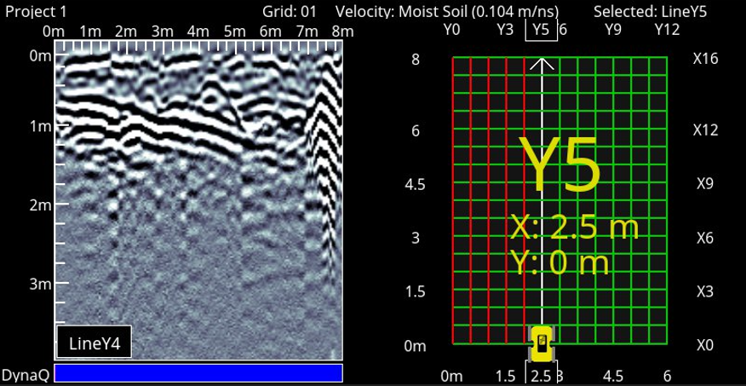
Grids are labor-intensive, but the results are compelling and fun to interpret.
Diffraction
Dipping Reflector
Single line in the grid
Notes:
The EPIC typically uses the proprietary EKKO_Project software from Sensors & Software for GPR data processing. Field laptops with this software installed and temporary licenses are available through the EPIC
Background subtraction can help remove direct arrivals and other horizontal banding in the radargram.
If the GPR depth range is set deep enough, you may see background noise near the bottom of the profile.
This deeper noise is often related to radio-frequency noise or system/background noise.
It usually appears after the useful GPR signal has become too weak to clearly image subsurface features.

Slide 40
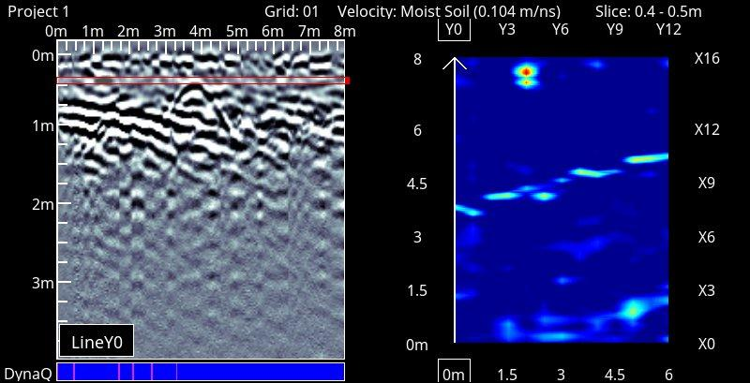
Depth Slice
Depth slice
@ 0.4 m
Depth
Single line in the grid
Probably associated with a pipe going across

Slide 41
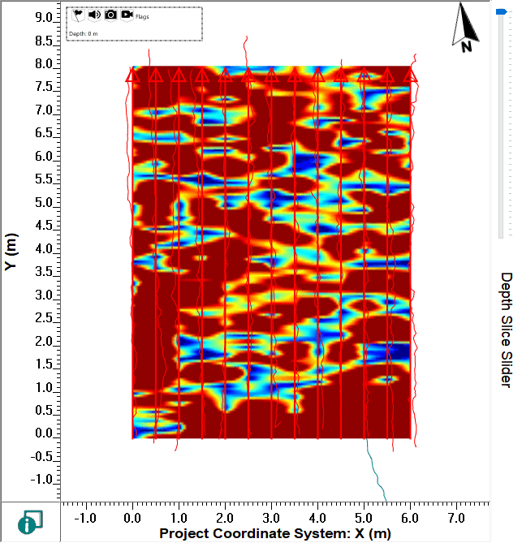
Depth Slices!
Shallow
Deep (3.8m)
Color map is signal amplitude

Slide 42
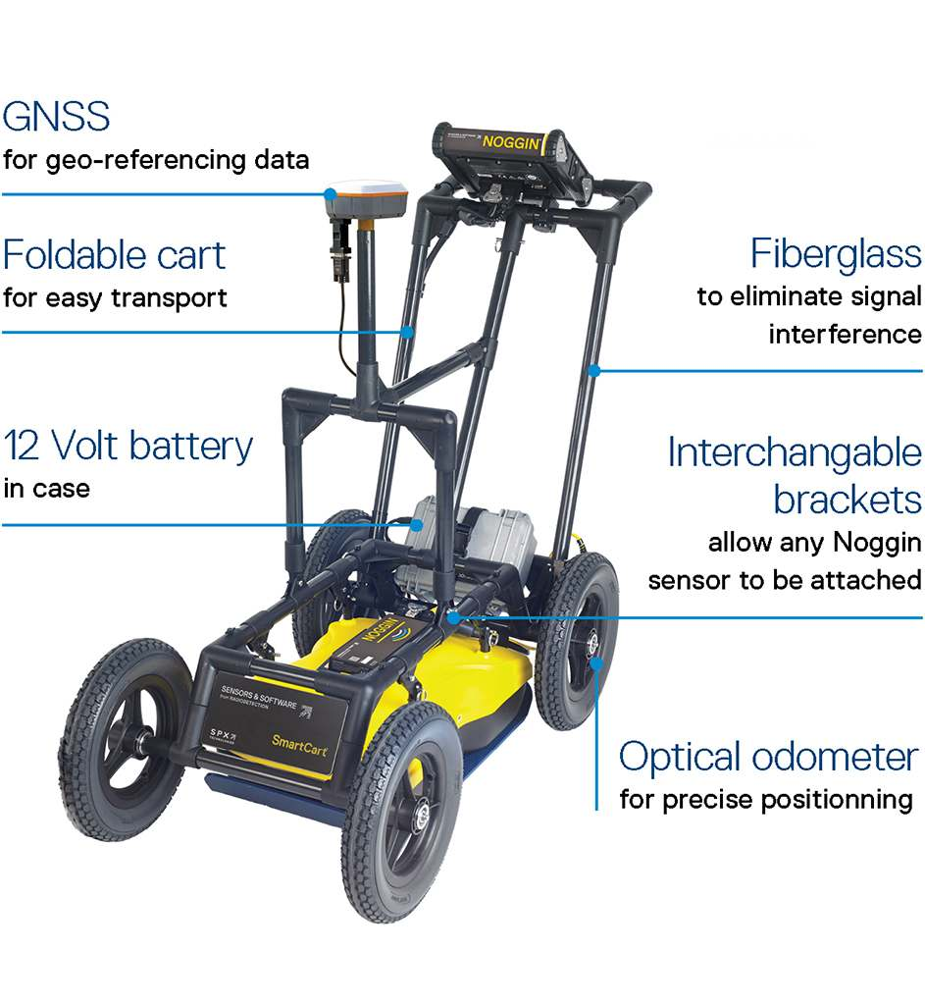
Questions?

Slide 43
Participant Checklist
serc.carleton.edu/getsi/workshops/Summ2025_field/participant_checklist.html
Some general tasks (complete by Friday July 25)
  Short knowledge assessment (will be emailed Tue July 15)
  Complete the field trip waiver form (will be sent via DocuSign)
  IF YOU HAVE NOT ALREADY, make the following accounts
    EarthScope instrument request system: https://epic.earthscope.org/sdb/newuser_application
    SERC: https://serc.carleton.edu/account/loginout.php
Look through teaching modules
Download software
Watch helpful videos

