Slide 1
Introduction to GPS/GNSS
Excerpts from GETSI module presentations for the 2025 Teaching Near-surface Geophysics Workshop
Notes:
DO REMEMBER to include attribution information for all the figures you include. Even if you took the picture or made the diagram, it will make it easier later if we just have that recorded.
ALSO – it is much easier to make notes (at least preliminary ones) for each slide NOW compared to several months later. Think about the information that future instructors using this materials will need to know in order to understand what the point of the different slides are. If all the relevant text is on the slide, notes may not be necessary, BUT if there are images, most likely some notes will be needed for future users.

Slide 2
Goals
Describe the GPS/GNSS and how it enables positioning
Distinguish different grades of GPS/GNSS receivers, their uses, and their accuracies.
Highlight applications of GPS/GNSS in the Geosciences
Get started using Emlids Reach RS2/2+/3 instruments

Slide 3
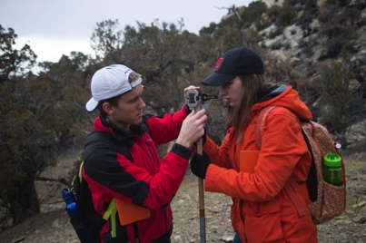
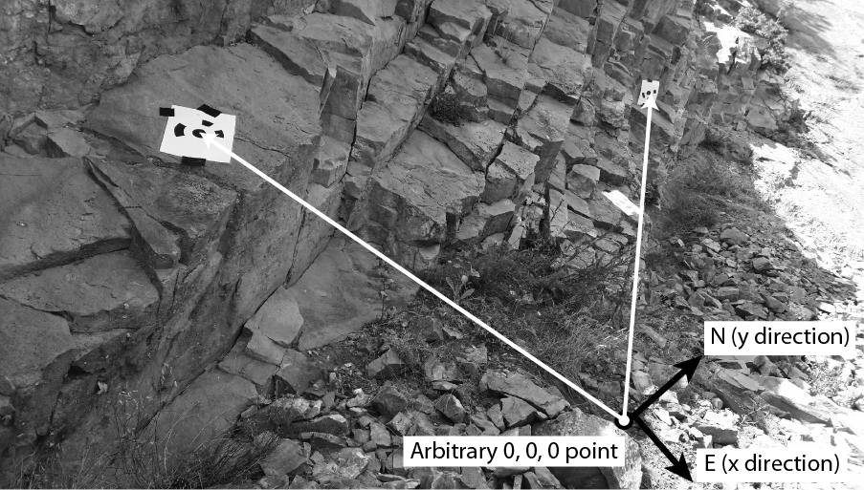
Georeferencing - Local
References to a local zero point
  Hand measuring with tape and compass
  Total station – laser for distance, inclinometer for angles
Notes:
Left image: Beth Pratt-Sitaula (EarthScope, GETSI Project)
Top right image: https://scotthuckphoto.wordpress.com/2014/03/05/geology-sed-strat-spring-break-day – used with permission
Bottom right image: https://commons.wikimedia.org/wiki/File:US_Navy_070801-F-8678B-039_Engineering_Aide_2nd_Class_Randy_Felipe_attached_to_Naval_Mobile_Construction_Battalion_(NMCB)_4,_trains_on_the_new_Trimble_5600DX_Total_Station_series,_survey_equipment.jpg

Slide 4
Multiple Satellite Systems
There are multiple Global Navigation Satellite Systems (GNSS)
  GPS: USA, global
  GLONAS: Russia, global
  BieDou: China, global
  Galileo: Europe, global
  India, France, and Japan: regional systems
Notes:
Most modern systems take advantage of the first two systems listed here…even smartphones. The more satellites, the more likely you will get a position even in areas with limited sky such as in a city with tall buildings.

Slide 5
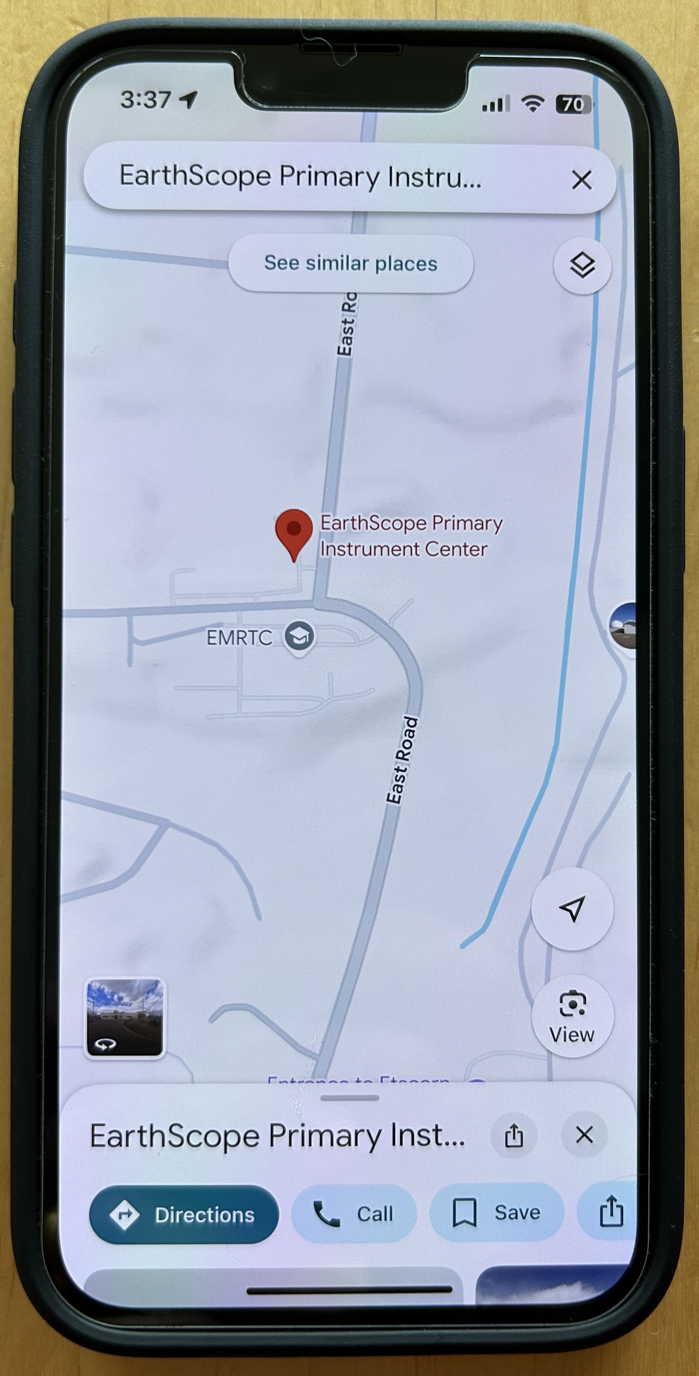
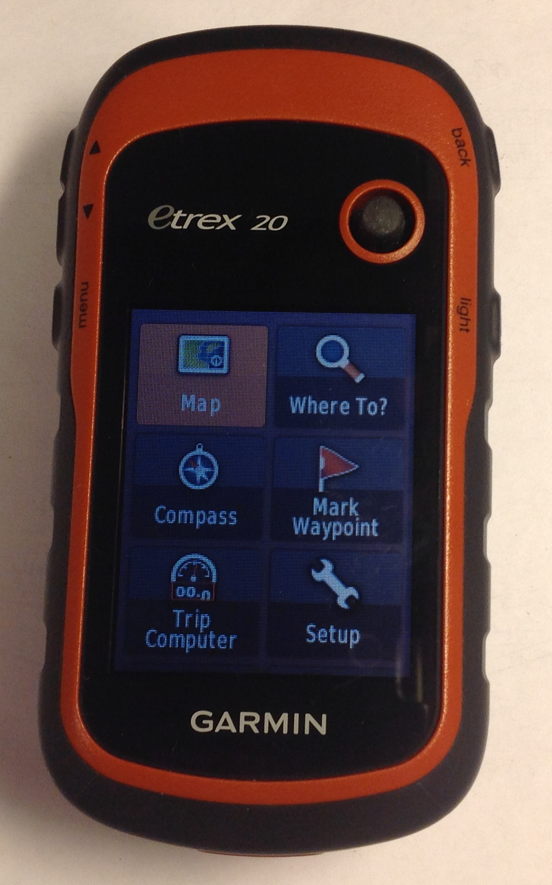
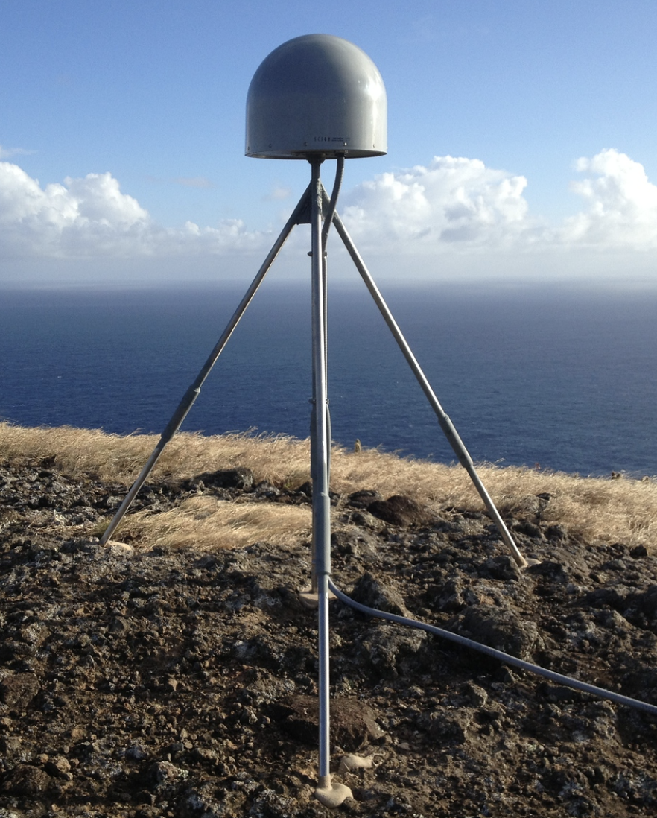
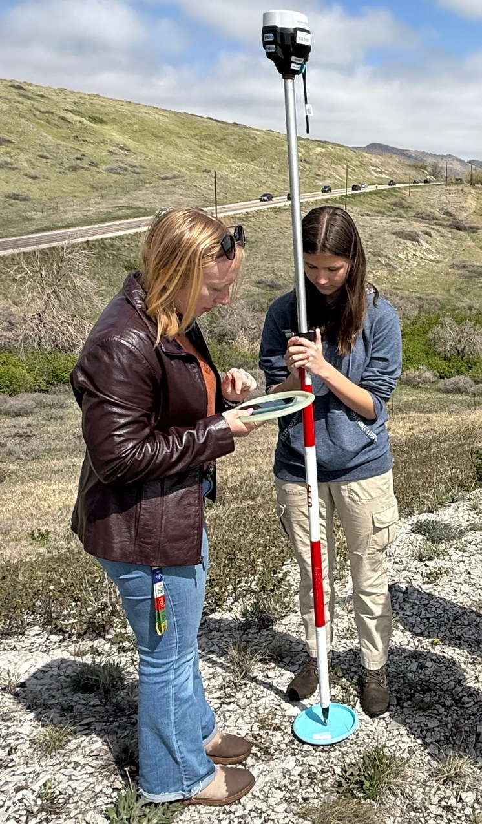
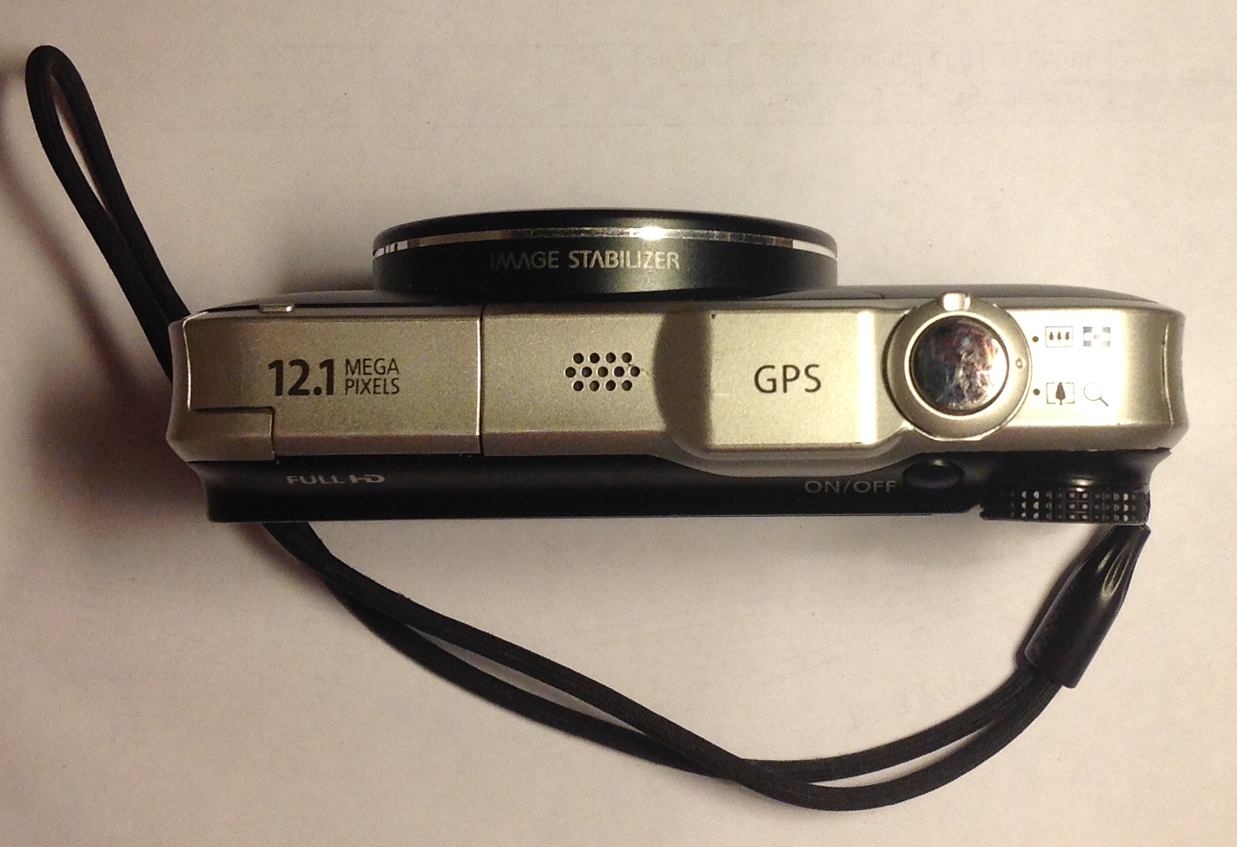
GPS Receivers All Around Us
Notes:
Whether they know it or not, students use GPS receivers daily in their cars, phones, cameras, and handheld recreational GPS. Most have heard the term “GPS” but few know much about how the system actually works or high-precision GPS for science and industrial use.
Images from EarthScope; student surveyers: John Galetzka (NGS)

Slide 6
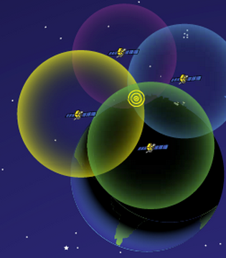
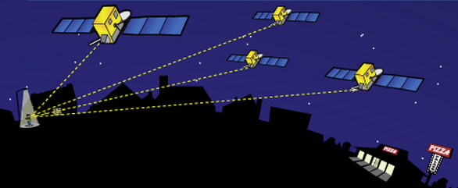
How Actual Location is Determined
http://spaceplace.nasa.gov/gps-pizza/en/
Antenna position is determined by calculating the distances to at least 4 satellites. This enables the solving for four variables: x, y, z and time using trilateration.
Notes:
The time element is needed because of the difference between the highly accurate atomic clock on the satellites ($100,000 each) and the much cheaper clock in the GPS receivers.
Although 4 is a technical minimum number of satellites, for geoscience research work it is highly recommended to have at least 6 satellites.
Although people will often refer to this process and “triangulation” in fact it is “trilateration” because it depends on distances rather than angles.
For a nice explanation of trilateration versus triangulation, visit https://gisgeography.com/trilateration-triangulation-gps/.
Images from NASA (public domain) http://spaceplace.nasa.gov/gps-pizza/en/

Slide 7
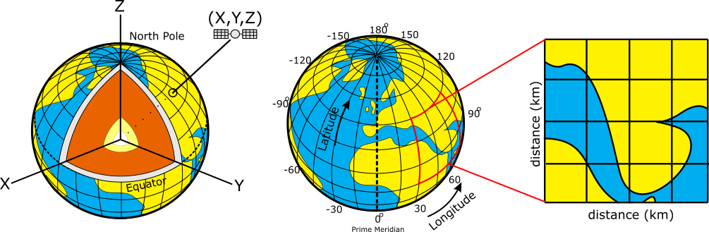
GPS Provides 3D Positioning
Positions on the Earth can be reported using:
  Geocentric coordinates (relative to the Earth’s center)
  Geographic coordinates (lat/long/elev, in degrees)
  Projected coordinates (UTM/state plane, in m or ft)
Geocentric (X,Y,Z)
Geographic System
Projected System
Notes:
It is important for students to understand that position data can be reported to a user in a number of different formats.
Geocentric (also Earth-Centered Earth-Fixed) Coordinate system (a type of Cartesian coordinate system) will probably be least familiar to students. While it isn’t used much by typical geoscientists, it is often used by people processing GPS data for research or calculating satellite locations.
Geographic is widely used and will be familiar (at least vaguely) for most geoscience students and more generally, people familiar with maps.
Projected coordinate systems are used a fair amount by scientists and surveyors working on a local/regional scale -- for whom distances (meters, feet) will be more useful than lat/long locations.
Figures: Ian Lauer, modified from Public Domain

Slide 8
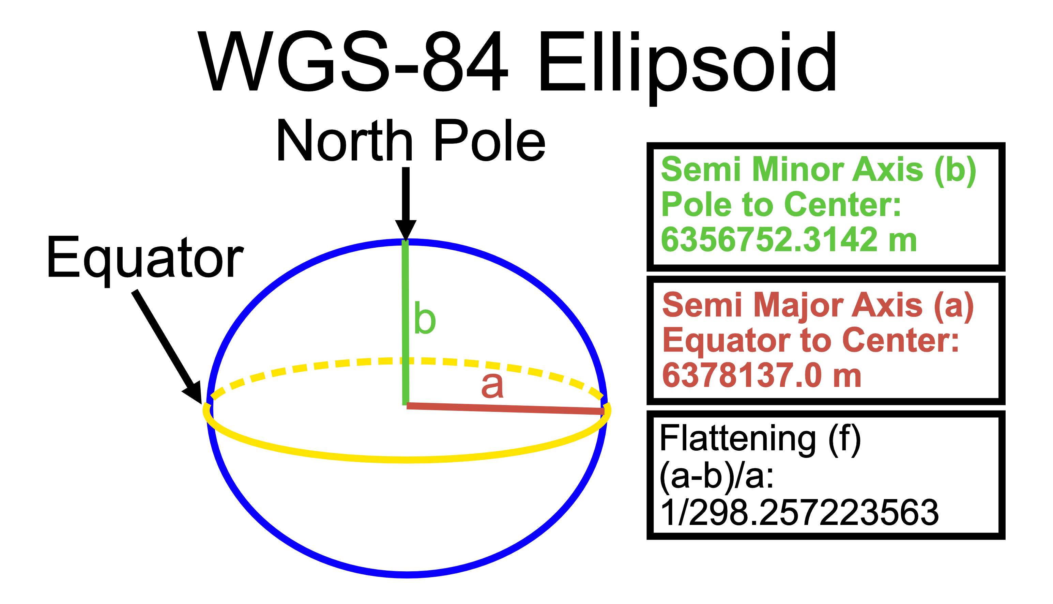
Typical GPS Coordinates – WGS 84
Most survey GPS data is recorded and reported using: World Geodetic System 1984 (WGS 84)
  WGS 84 defines a reference surface (an ellipsoid)
  And a set of parameters to relate latitude, longitude, and altitude to points on or near the Earth's surface
21.4 km
difference
Notes:
Figure: Ian Lauer

Slide 9
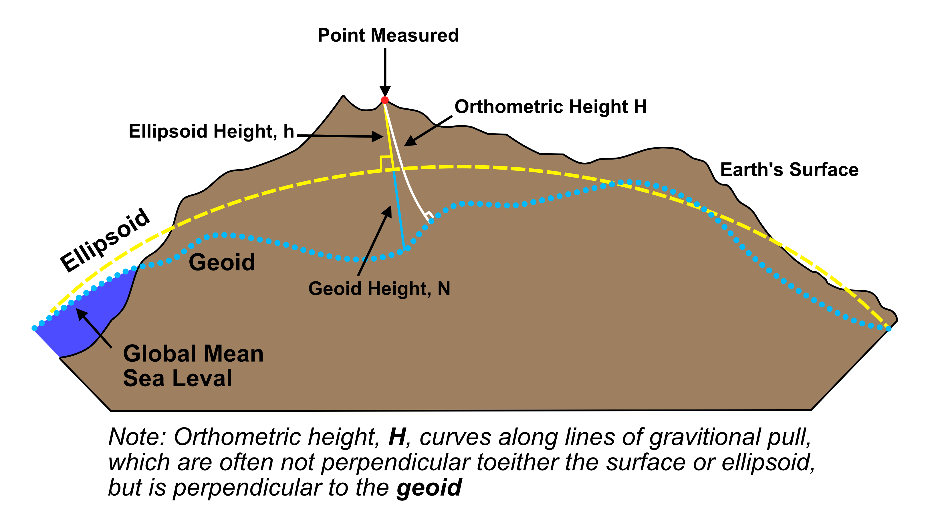
Typical GPS Coordinates - Vertical
Geoid - gravitational equipotential surface
(i.e. what “sea level” would be) (ex. EGM96)
GPS reports ellipsoid height
Orthometric height = height above “sea level” of the geoid (more common for maps)
Notes:
Figure: Ian Lauer

Slide 10
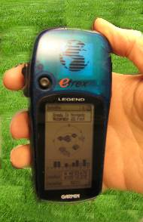
Antennas Receive Data Streams
Your location is:
37º 23.323’ N
122º 02.162’ W
The time is:
11:34.9722 (UTC)
ERRORS (after 24 hrs)
Horiz: ± 1–2 mm
Vert: ± 5 mm
ERRORS
Horiz: ± 10 m
Vert: ± 15 m
Notes:
Since each satellite maintains time very accurately (~1 nanosecond = 30 cm), it can tag its signal with the time of transmission. This information, together with the location of the satellite, also transmitted to the receiver, is sufficient to allow the receiver to calculate the range to each satellite, provided that the receiver also knows the time. Equipping receivers with atomic clocks would be very expensive, so the receiver tags the signal with the time of its internal clock to create a “pseudorange” (range plus an unknown clock correction). The software in the receiver then uses the pseudoranges from four satellites to solve for the four unknowns: three coordinates and the receiver clock correction.
Images: Vince Cronin (Baylor University)
High precision rates taken from GAMIT/GLOBK 10.6 release notes - http://geoweb.mit.edu/gg/

Slide 11
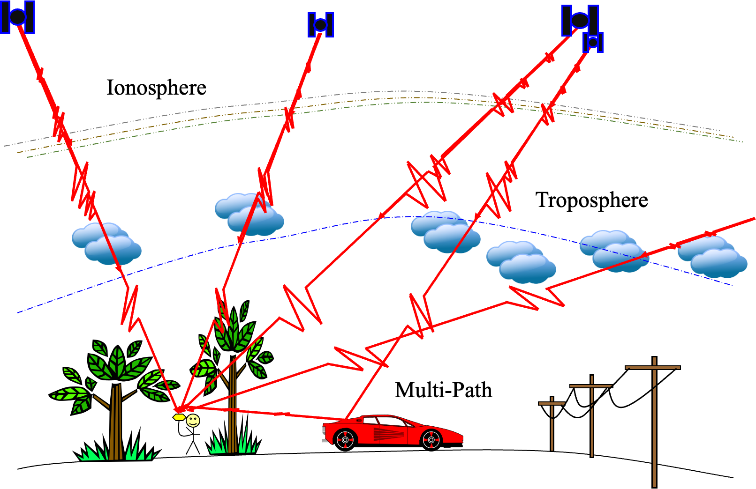
Sources of Error
Notes:
Marianne Okal (EarthScope)

Slide 12
Sources of Error
Clock errors (bias and drift, including relativity)
Satellite orbit irregularities
Atmospheric delays – speed of light is affected by water content and other variables (ex. ionosphere)
Multi-path – GPS signals can bounce off the ground or objects and then enter the antenna
Human error – Incorrect
base or rover antenna
heights, errors in post-
processing, datum and
projection errors.
Notes:
There is a complex field of engineering and science behind post-processing GPS data to reduce error sources.
In addition to those mentioned above, specific sites may measure movements not associated with the parameter the researcher wants to measure. For instance:
Seasonal groundwater fluctuations may cause the ground to rise and fall annually, in a way that is not related to plate motion at all.
A site could be sliding downhill because of a creeping landslide.
A melting glacier or a falling lake level will “unweight” an area, leading to rebound and upward movement measured by the GPS.
It is best to collect multiple years of data before trying to draw conclusions.

Slide 13
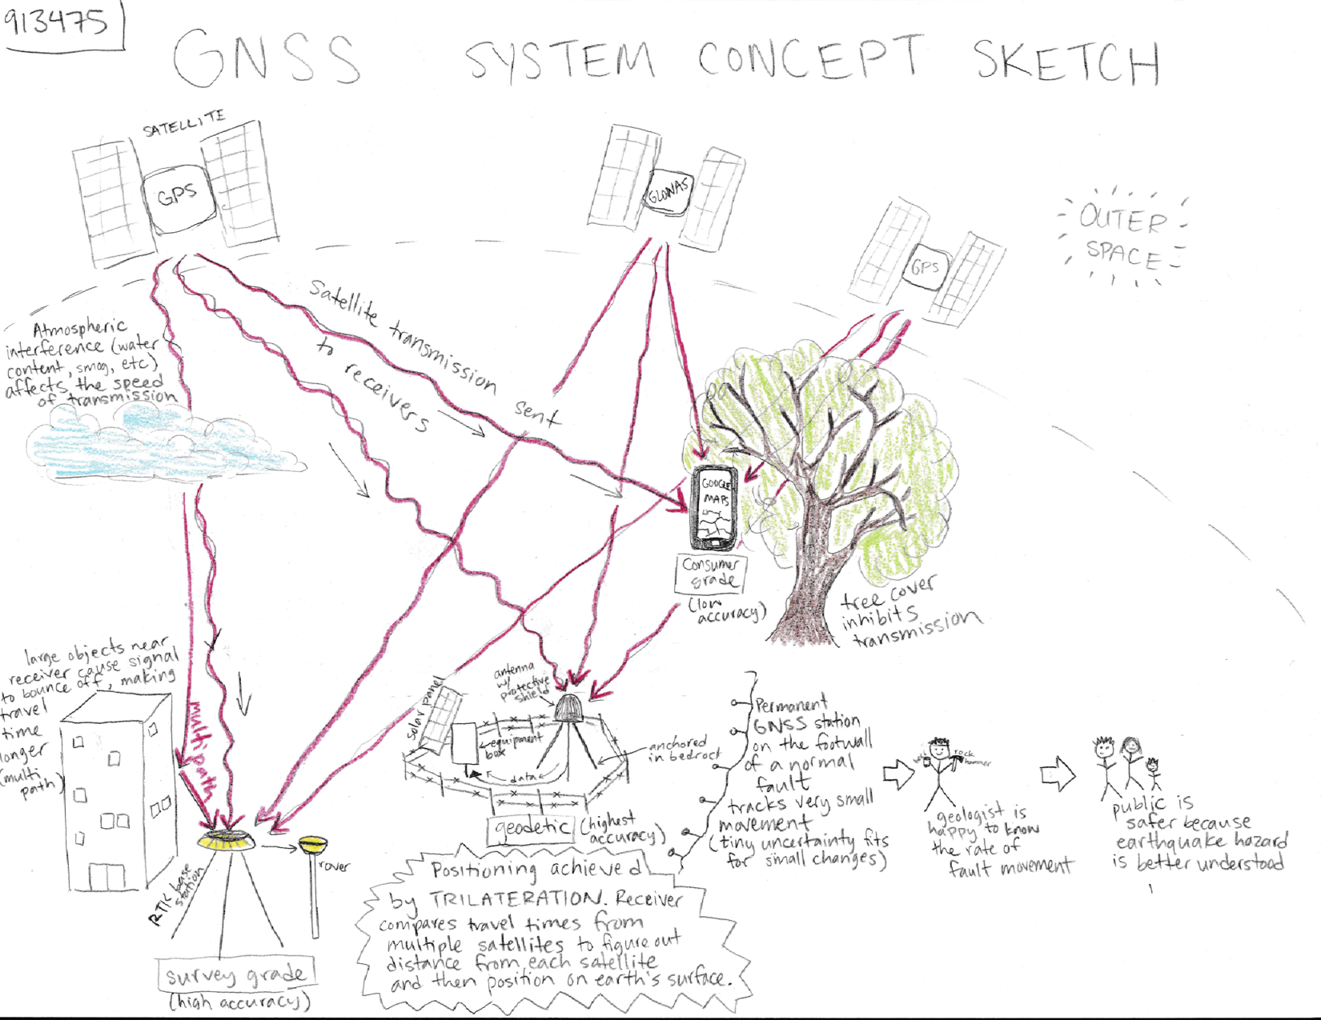

Slide 14
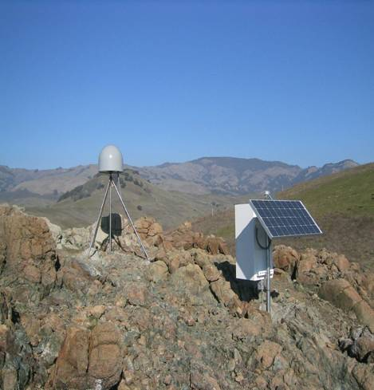
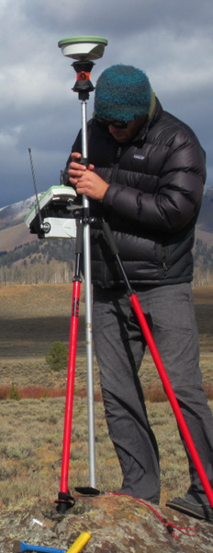
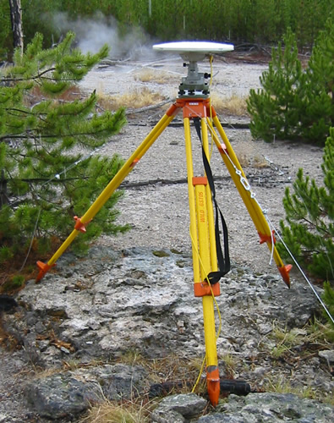
Precision depends on system
Static, Geodetic Campaign Systems
Occupation Time - Effort Required - $$
Kinematic Systems
Easy Hard
Consumer & Mapping Systems
Survey Grade
0.5-5 m 0.01–0.03 m 0.005m
Precision of Position
(Images: Ben Crosby)

Slide 15
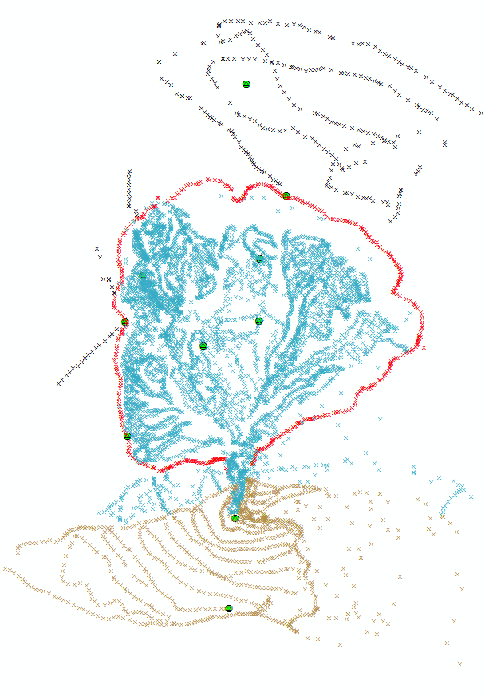
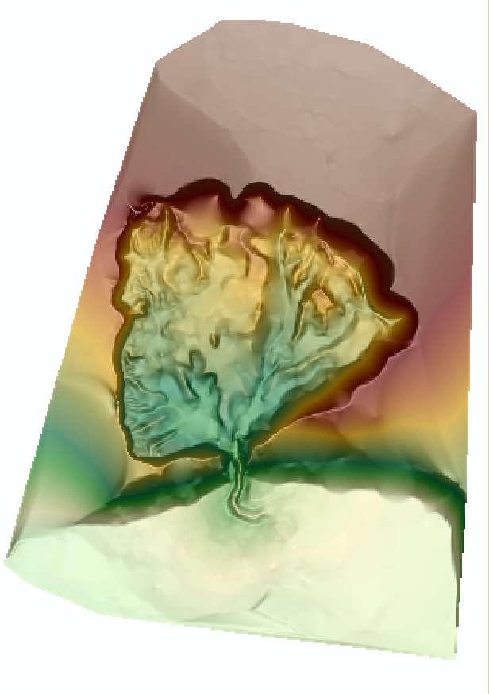
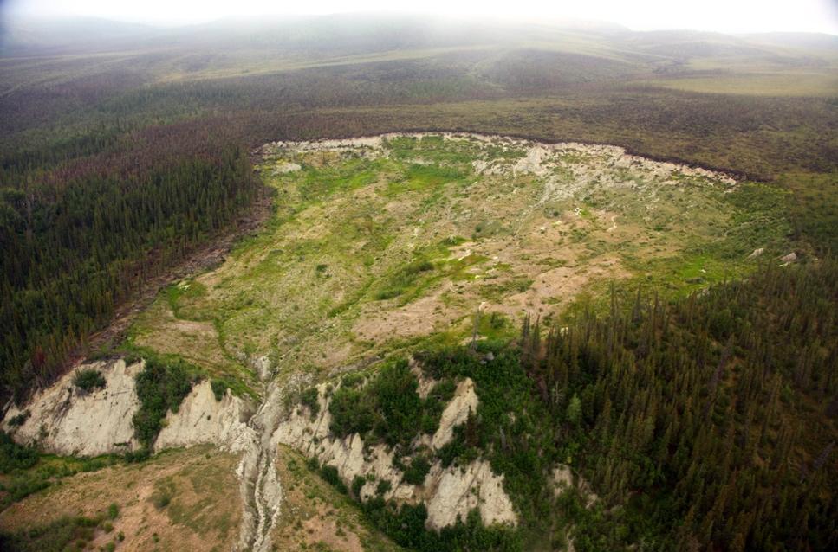
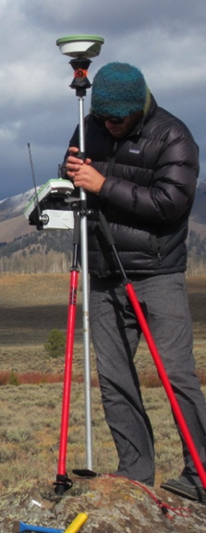
Creating Topography
Using Kinematic Systems
  Quickly measure many points with high accuracy and precision – landslides, permafrost morphology, moraines, fault scarps
From the field … … to post- … to surface generation
processed points … using GIS.
(Images: Ben Crosby)

Slide 16
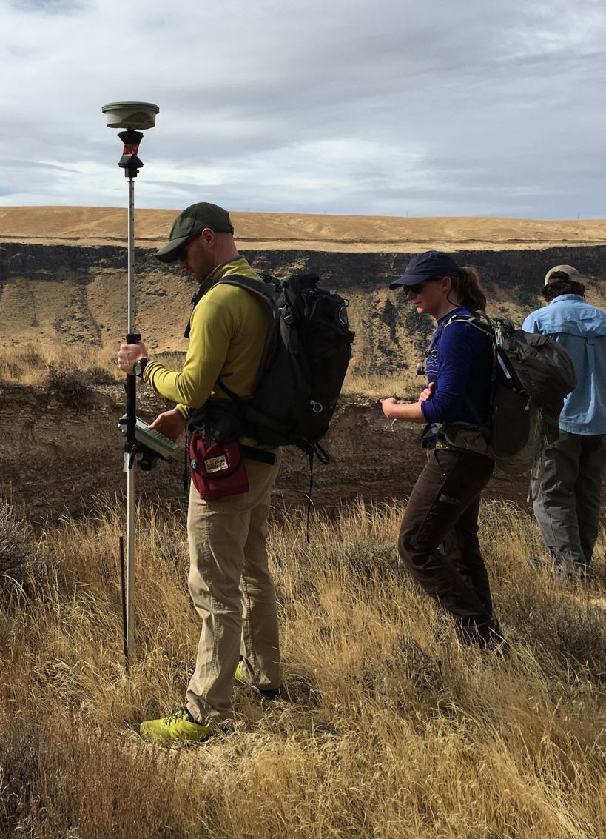
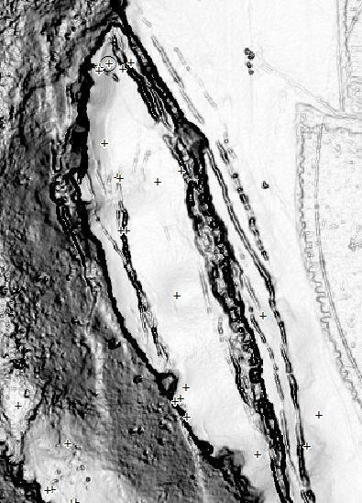
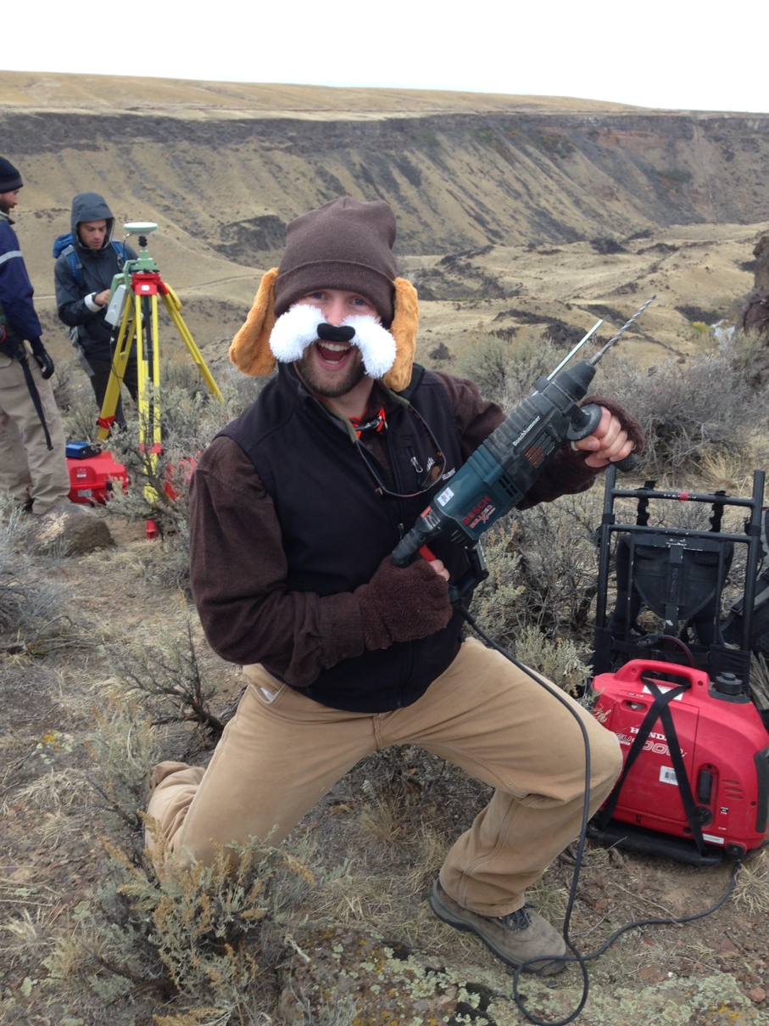
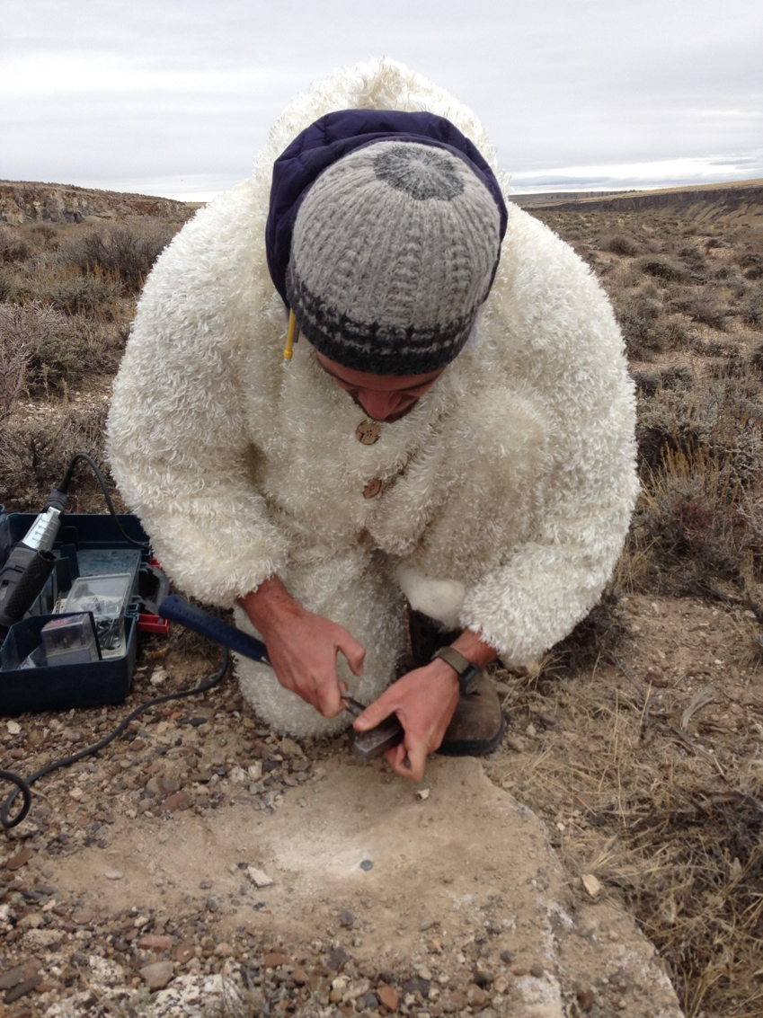
Change Detection
~85 points surveyed across slide
Some previously monumented (rebar, etc.)
Some new monuments added in rock

Slide 17
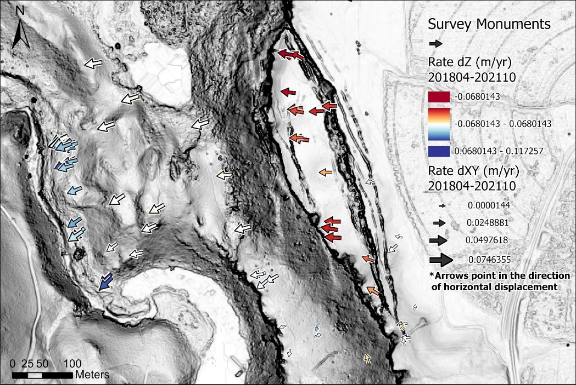
Change Detection
2018-04 → 2021-10

Slide 18
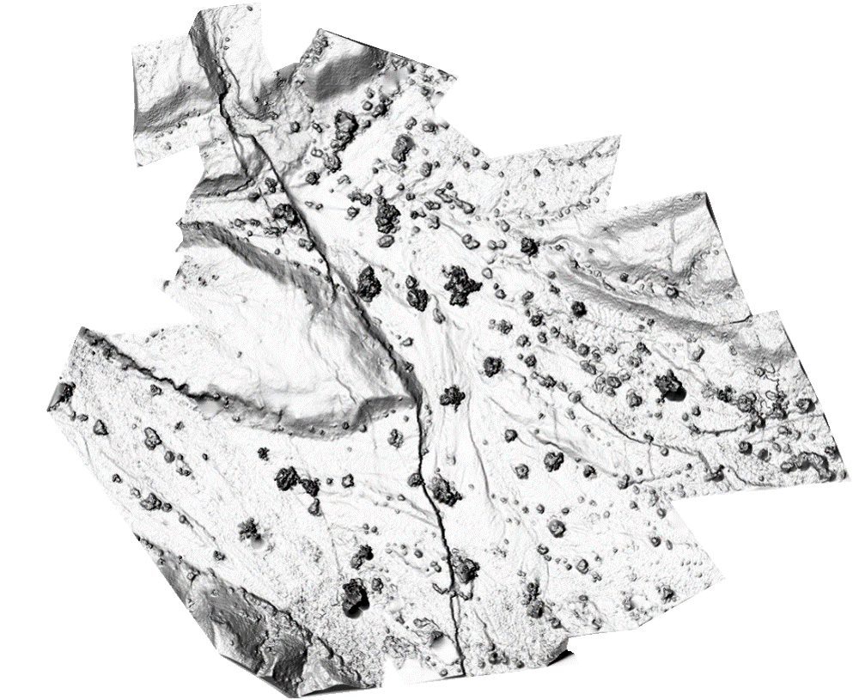
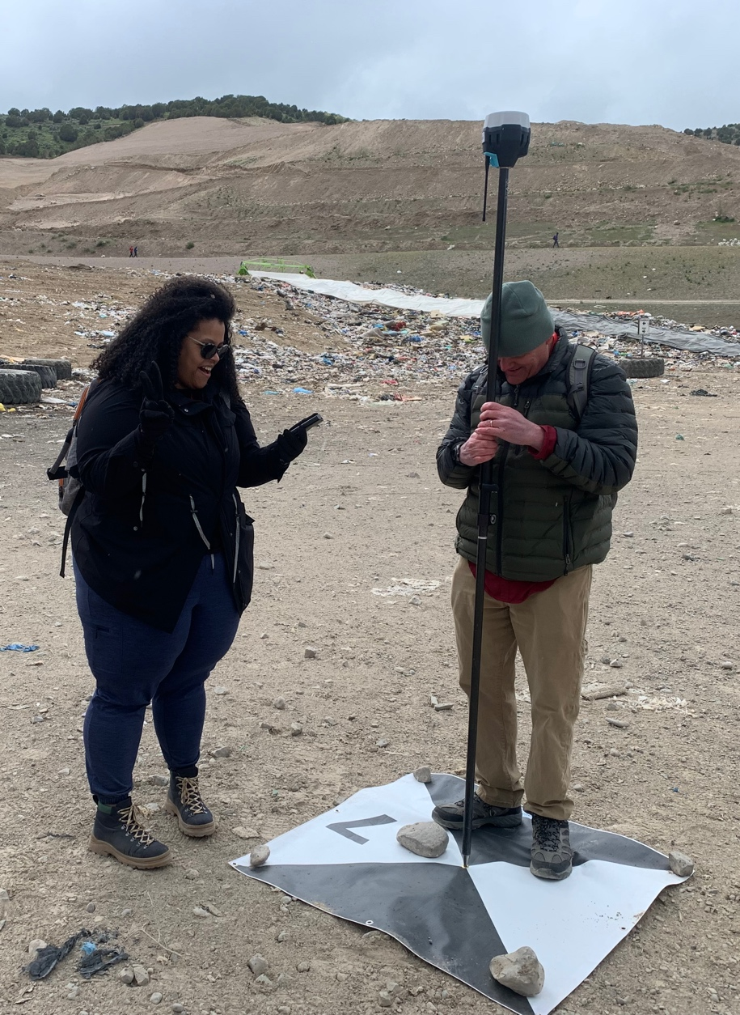
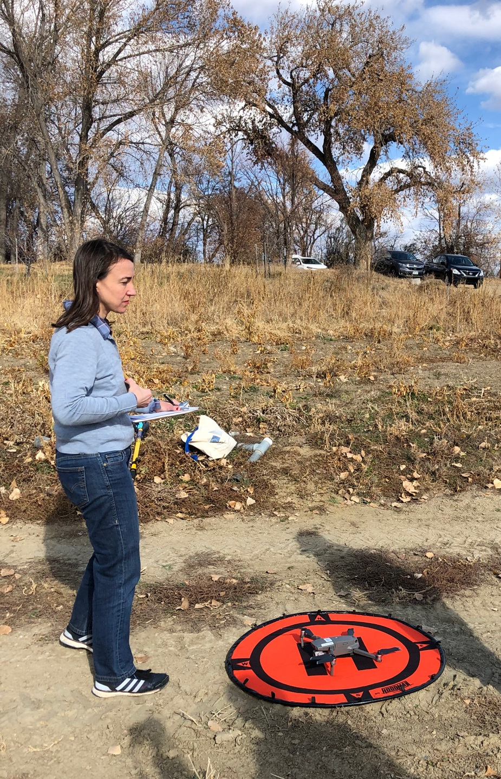
Georeferencing other projects
Drone or pole-based photogrammetry survey to define topography
Notes:
Photo: Beth Pratt-Sitaula, EarthScope
Map: Ed Nisson

Slide 19
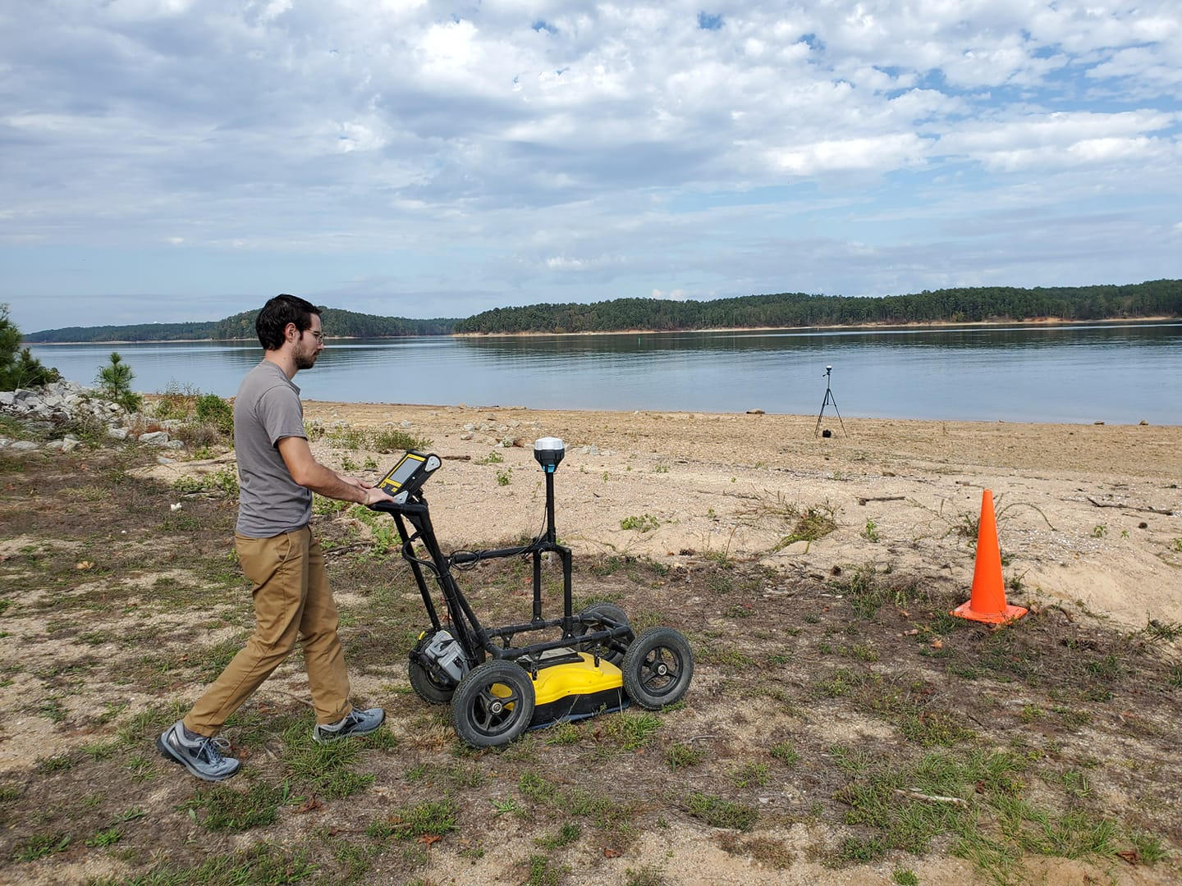
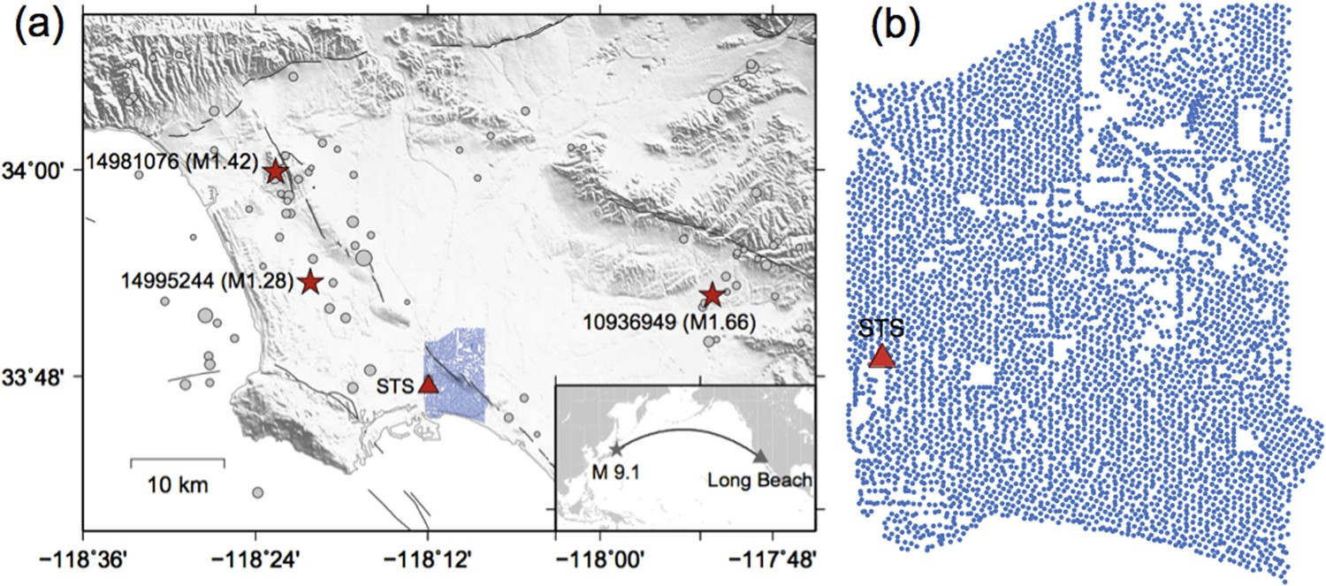
Georeferencing other projects
Other surveys – ex. GPR
Nodal array deployments
Notes:
Image right: https://www.nature.com/articles/s41598-018-19728-w/figures/1 (do not further disseminate; not CC)
Image left: Bigman Geophysical (do not further disseminate; not CC)

Slide 20
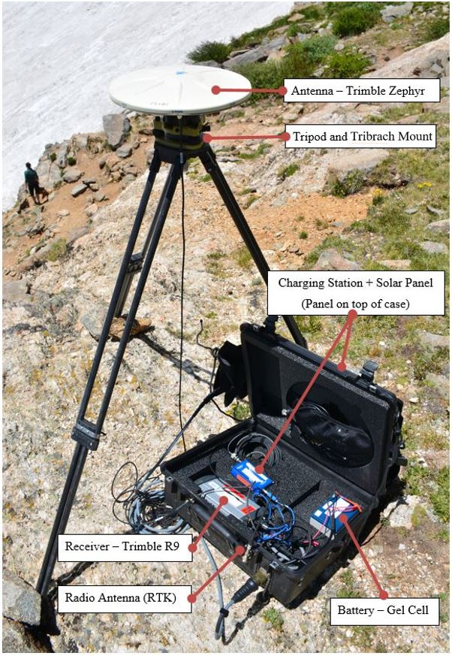
Kinematic components
GNSS Antenna
Radio
Antenna
GNSS
Receiver
Base Station and Radio
Rover Antennas and Receiver
(Images: Ian Lauer, Ben Crosby)

Slide 21
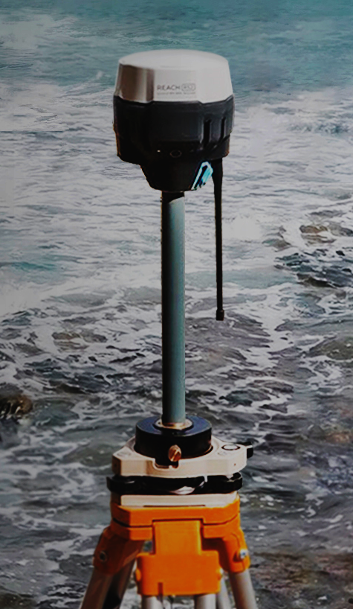
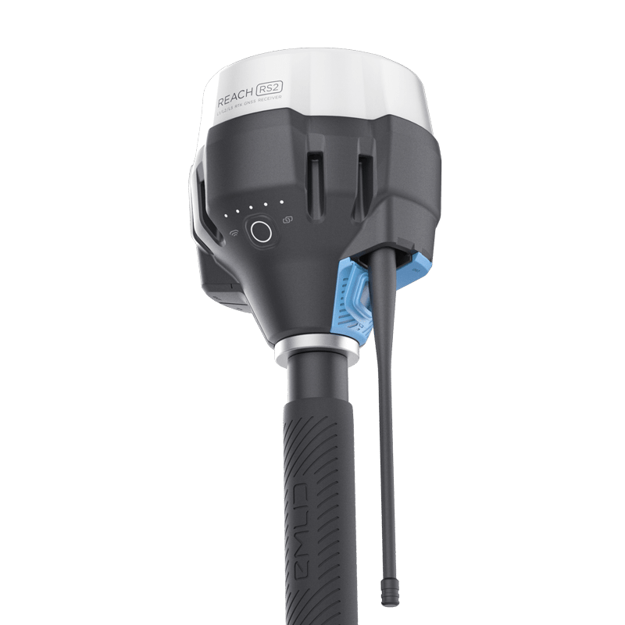
Kinematic components
Base Station and Radio
Rover and Radio
(Images: Emlid)

Slide 22
Kinematic systems
Base station antenna receives data from satellites.
The position drifts over time relative to the known, stable location of the antenna. This offset is communicated to the rover as a correction.
At the same time, rover antenna also receives position data from satellites.
Rover also receives a position correction from the base, in real time for RTK.
Base
Rover
(Images: Ben Crosby)

Slide 23
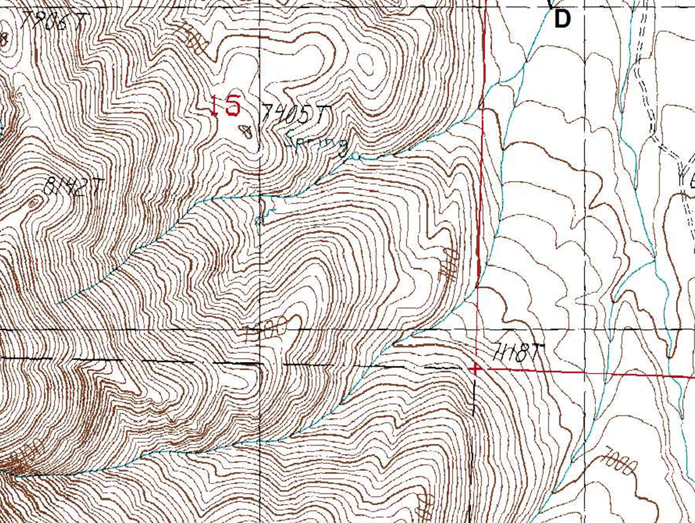
Map View of an RTK Survey
Base Station
Three Different Rover Positions
assumed ‘here’
raw base obs.
raw rover obs.
rover RTK adj.
t₁
corrected base
t₂
t₁
corrected rover
t₃
t₂
t₃

Slide 24
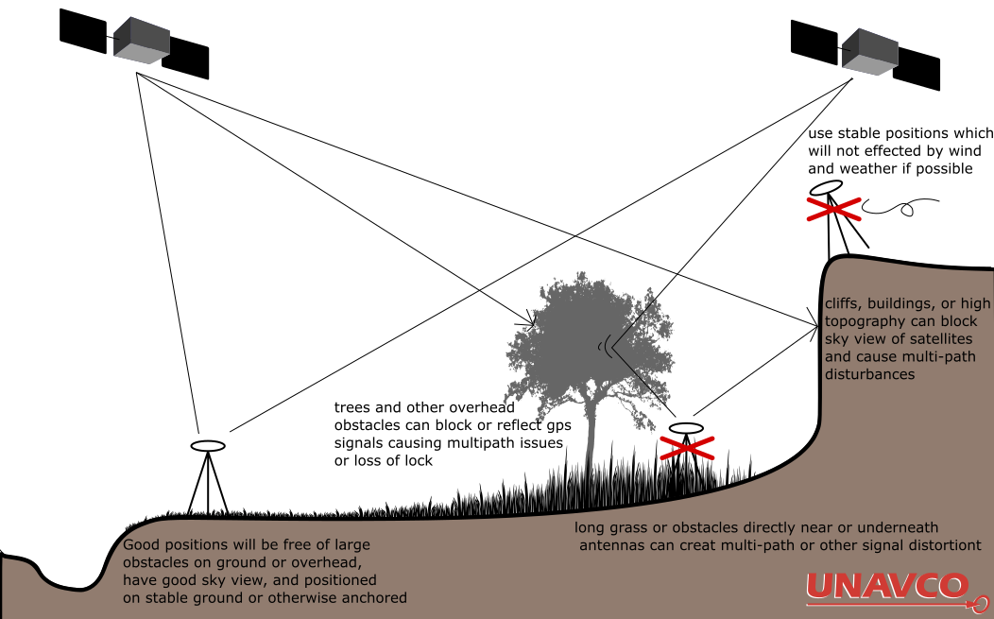
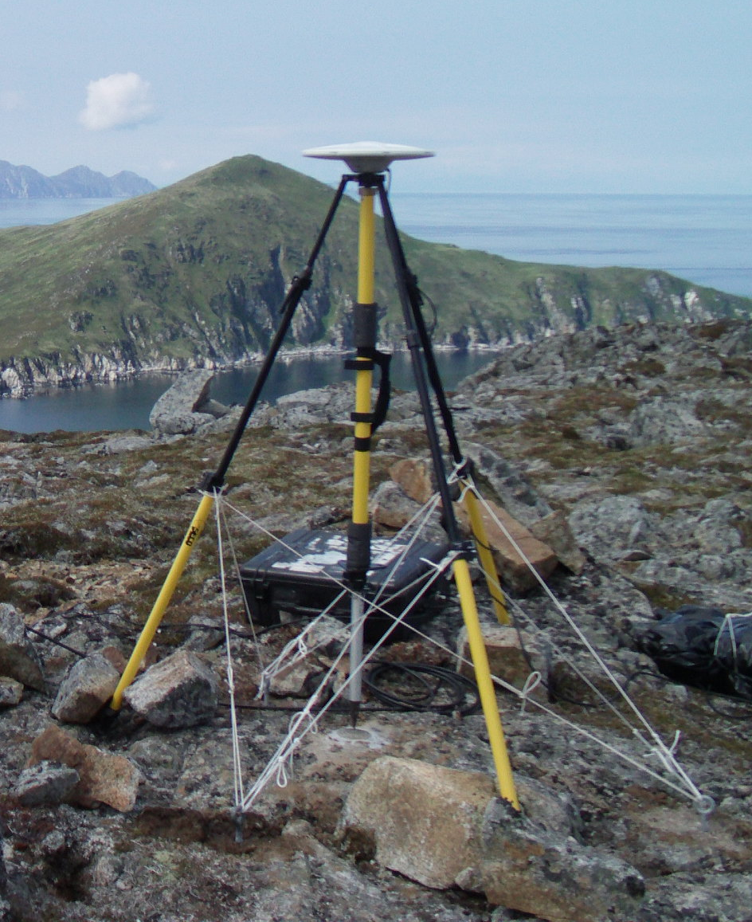
Thinking About Base Stations
Site Access
Site Permissions
Site Security
High Ground
Stable Ground
Clear sky view
Line-of-Sight and distance to Rover
Minimal multipath issues
cliffs, buildings, or high topography can block sky view of satellites and cause multi-path issues
good positions will be free of large obstacle on ground over overhead, have good sky view, and positioned on stable ground or otherwise anchored
long grass or obstacles directly near or underneath antennas can create multi-path or other signal distortions
Notes:
Images: Weston Renoud (https://www.flickr.com/photos/weston/3666328474/), EarthScope (Ian Lauer)

Slide 25
Kinematic survey design
Base Station
  Located in a stable, safe, unobstructed place
  Line of sight for radio communication to rover
  < 10 km from rover location
  Ideally set up over known monument
Rover
  Close to and in line of site with base for corrections
  Occupy points for 5–120 sec, keep pole vertical
  Name and describe each point in field book
  Avoid cover and multi-path, confirm
  corrections

Slide 26
Collecting GPS on a Landslide
Where would you put a base station in this landscape?
Notes:
This is an example from field camp. The large basin in the center of the image (with the lake) is ringed by the headscarp of an enormous landslide. If you were to collect GPS data in the image, where would you position a base station?

Slide 28
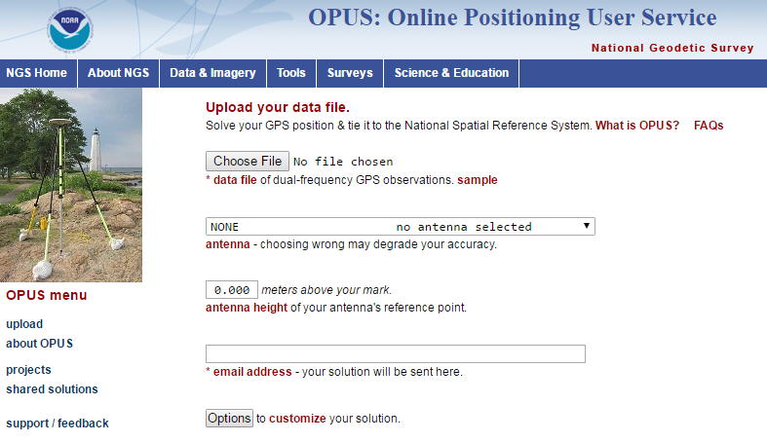
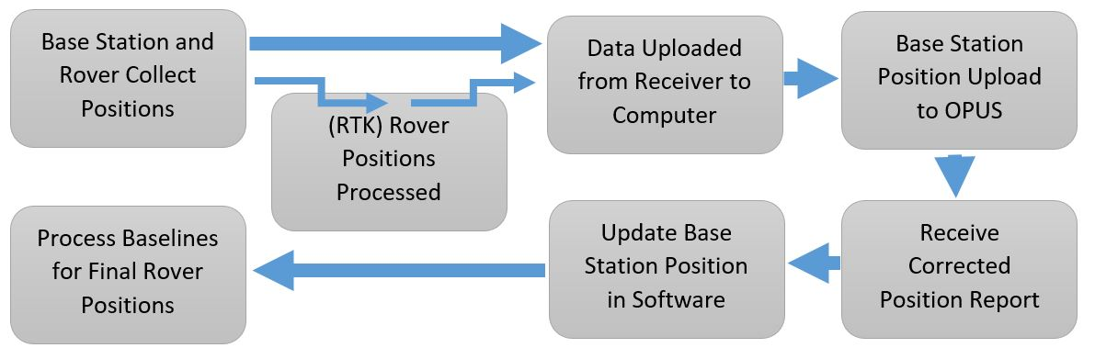
Kinematic workflow
If base is not over a known point, you must post-process to get an accurate position

Slide 29
Kinematic post-processing
Post processing is only necessary if the base was set up over an unknown point or you use a PPK system.
Download data from base to PC software for your hardware.
Export base dataset as a RINEX formatted file
Upload RINEX to OPUS or CSRS website, specifying all necessary information regarding base antenna type and height (need to wait 2+ hours after collection before uploading)
Update your base position with the new, corrected position in your PC software
Propagate the change in base to all your rover positions

Slide 30
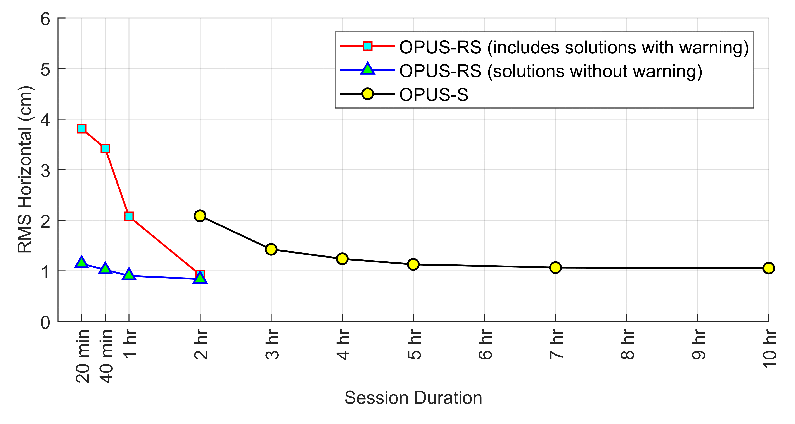
Data Collection Duration
Data Processing
NRCAN
(CSRS-PPP)
2hrs +
Ultra Rapid
Rapid
Final Orbits
2hr 24hr 14 days
Time Post-Survey
15min – 2hrs
Rapid Static
OPUS
2hrs +
Static

Slide 31
Applications of RTK GNSS
Students discuss at first:
Text here

Slide 32
Applications of RTK GNSS
Students discuss at first:
Delineating or measuring migration of a river channel with proximity to a valuable resource or infrastructure
Measuring movement on a natural hazard such as a landslide, earthflow, or slump
Delineate or measure motion of monuments on a glacier, glacial retreat or snowpack change
Measuring a scarp surface or profile to determine potential hazard to infrastructure with earthquakes
Creating topographic models of flood plains to calculate flood volume and determine potential for flood hazard at various stage levels
Create digital elevation models to determine slope stability with addition of roadcuts or other infrastructure

