Slide 1
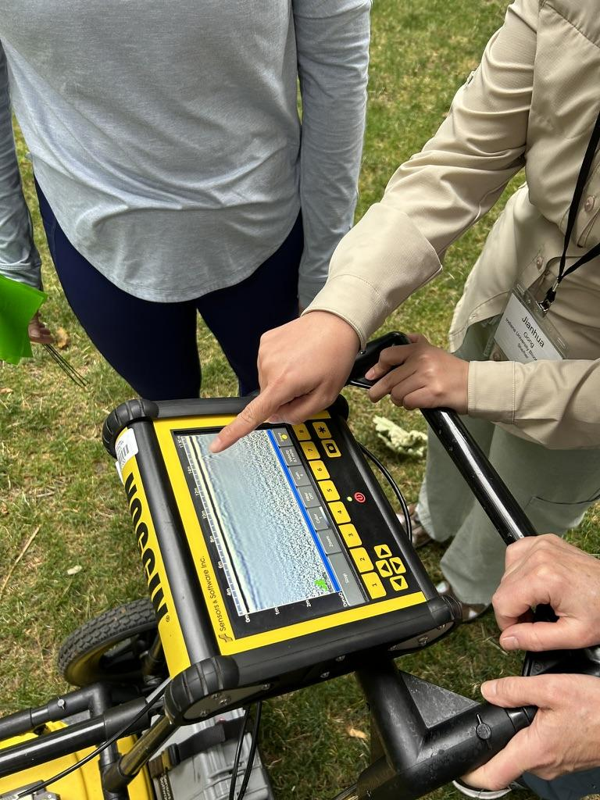
What is Ground Penetrating Radar?
2pm MTN, July 14, 2025, Online
Dr. Andy Parsekian, University of Wyoming
(based on slides prepared by S. Kruse, USF)
Notes:
Image: EarthScope Consortium (Pratt-Sitaula)

Slide 2
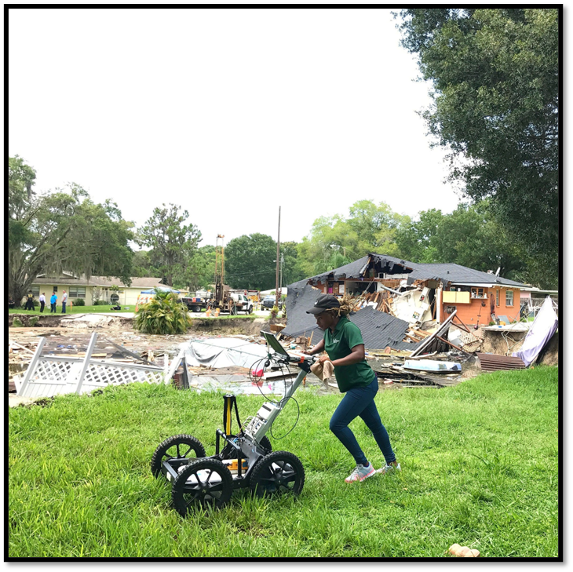
Webinar Goals
How GPR works
Typical geoscience (and commercial) applications
Survey design considerations

Slide 3
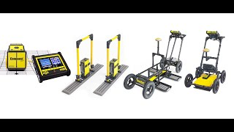

Slide 4

https://youtu.be/Jmc0n2bfrEs?list=PL2KbqZ4LoYmTcODw0R_uL1zYXMGY932pb&t=41
Notes:
This video illustrates some basics and many commercial applications; start at 0:43

Slide 5
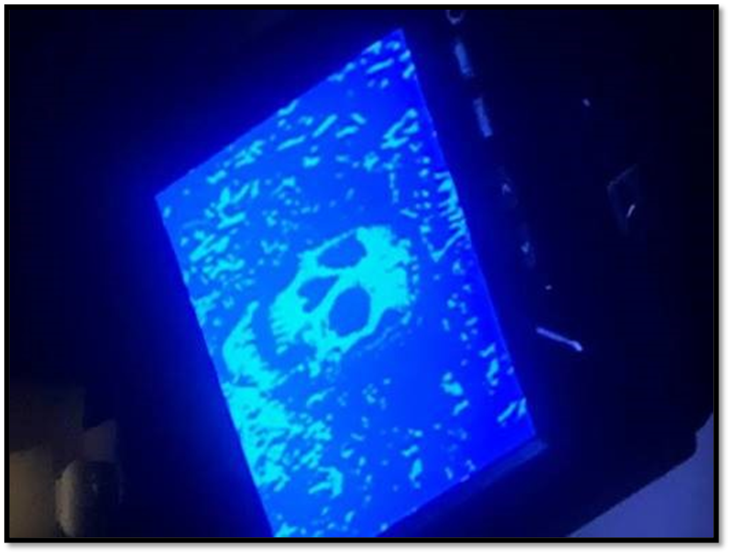

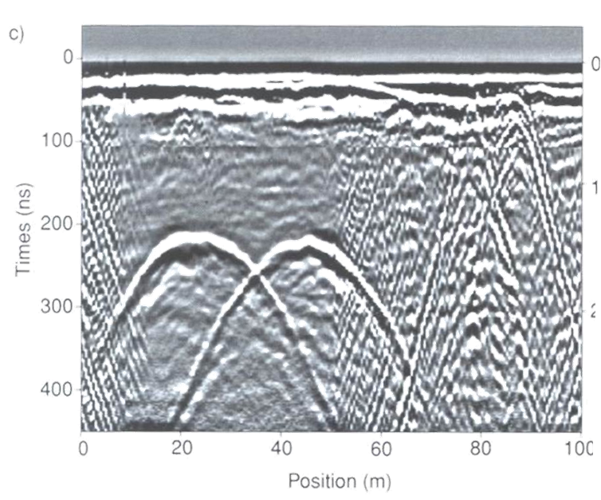
GPR images give a distorted view of the subsurface
GPR in Hollywood
GPR in real life
From Criminal Minds

Slide 6
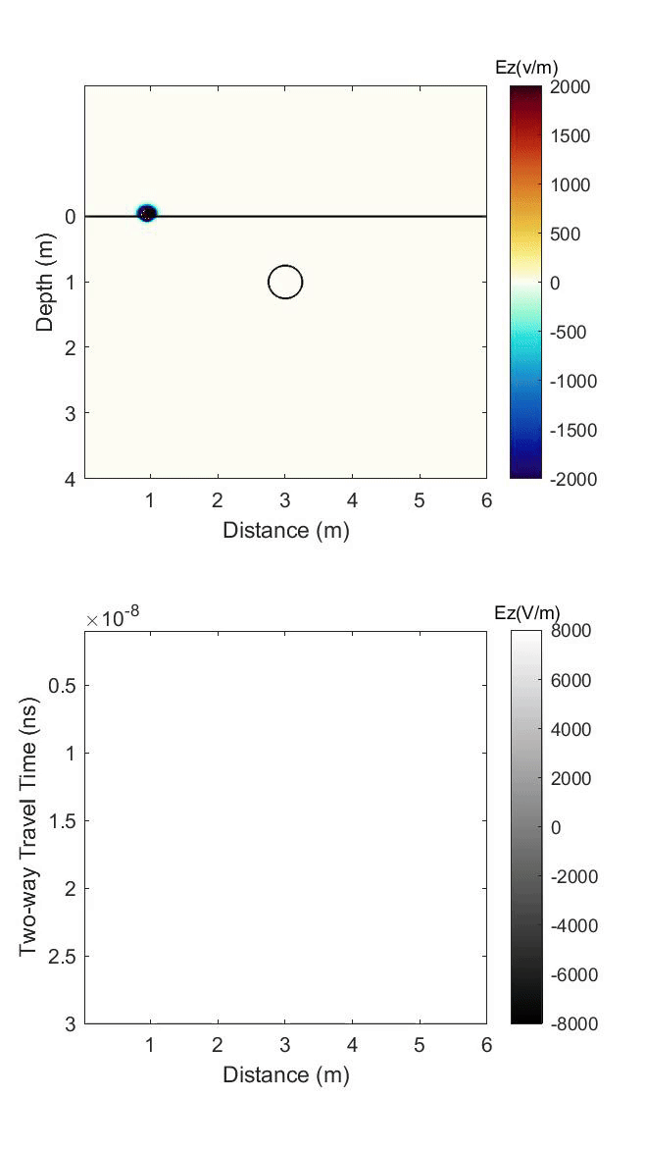
GPR Signal
Diffraction Hyperbolas from Point-like Objects
Notes:
Black box = transmitter+receiver
Receiver records arrival time for two-way travel
Plotted at location of antenna, but object is in this case not right under the antenna -> causes distortion
As antennas get closer to object, reflected signal arrives earlier ->
Note extended pulse = signal from single buried feature.

Slide 7
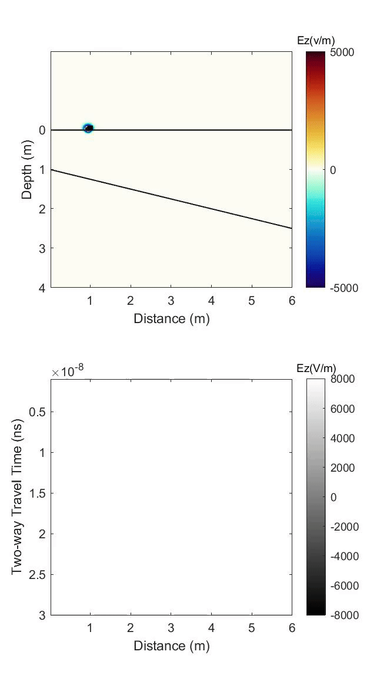
GPR Signal
Reflections from layer boundary
Notes:
Black box = transmitter+receiver
Receiver records arrival time for two-way travel
Plotted at location of antenna, but object is in this case not right under the antenna -> causes distortion
As antennas get closer to object, reflected signal arrives earlier ->
Note extended pulse = signal from single buried feature.

Slide 8
Case Study
Let’s consider a real GPR profile and explore the information it holds

Slide 9
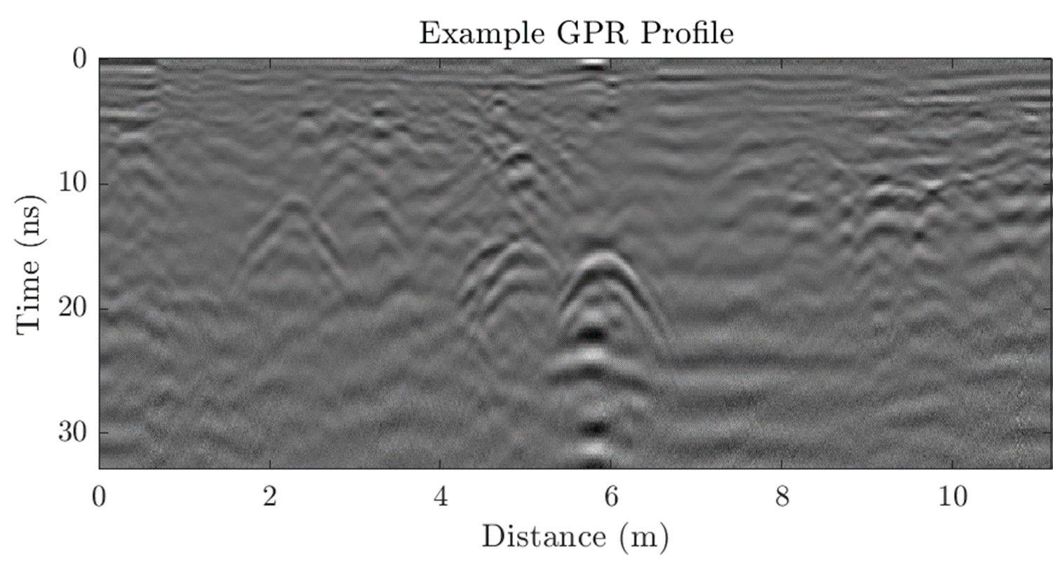
Question: Over what distance did the GPR cart travel to make this image?
Answer in the Chat

Slide 10
Question: Over what distance did the GPR cart travel to make this image?
11 meters
Answer in the Chat
Answer: the x-axis is the distance the GPR cart is pushed. In this example, the radar was pushed for

Slide 11
Question: What is the longest travel time recorded?

Slide 12
Question: What is the longest travel time recorded?
32 ns*
Answer: At each position, the y-axis is the two-way travel time.
In this example, the receiver recorded reflected signal up to
*GPR waves travel so fast that we reported them in meters per nanosecond (ns)!
(nanoseconds after the initial pulse was transmitted)

Slide 13
Question: What key features do you see?

Slide 14
Question: What key features do you see?
Answer: The upside-down ‘U’s shown here are hyperbolas.
They are indicative of features in the ground that have different properties than the ground itself.

Slide 15
Causes for GPR to Reflect
GPR is very similar to ultrasounds in that a signal is transmitted out (emitted) and the equipment records the part of the wave that is reflected.
Reflections occur when the wave encounters a change in the ground’s dielectric permittivity, which also controls the ground’s wave velocity.

Slide 16
Change in… | Examples that cause GPR wave reflection
porosity (amount of air-filled space) | Boundary between: loose sand & compacted sand sediment/rock & an air-filled cavity sediment & hard rock
water saturation | Top of the water table Encountering organic material with a higher water content (i.e. tree roots or buried remains)
composition | Boundary between: sandstone and siltstone rock layers or rock bodies
clay content | Boundary between: sand/silt with little clay and clay-rich sediments
iron content | Encountering a metallic body (GPR waves do not penetrating metal so all of the energy reflects)

Slide 17
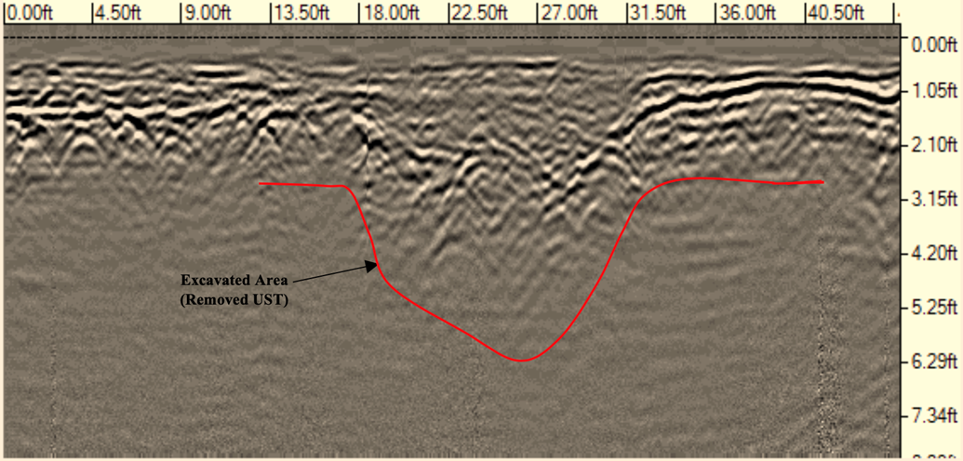
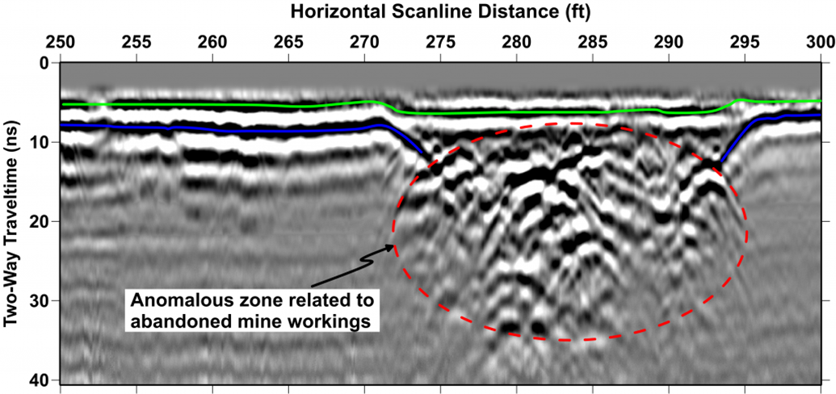
Porosity
Boundary between:
•loose sand & compacted sand
•sediment/rock & an air-filled cavity
•sediment & hard rock

Slide 18
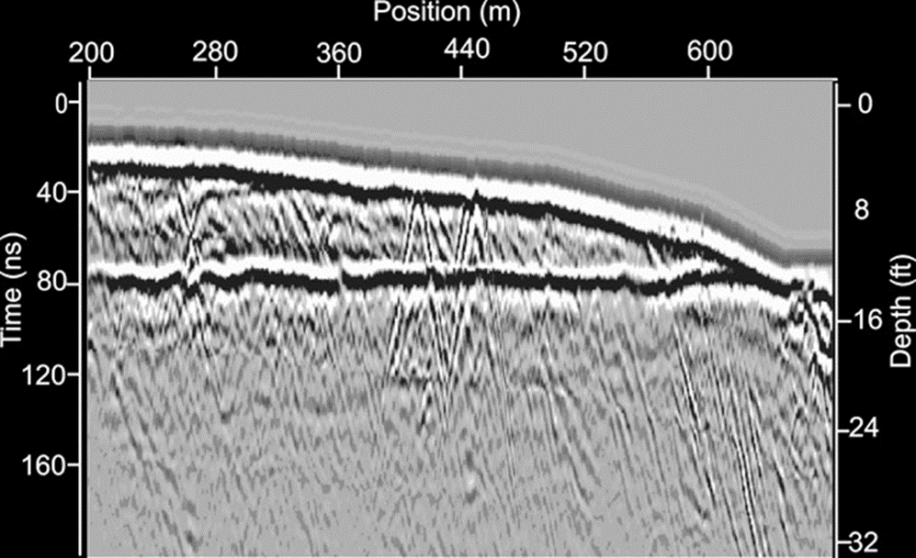
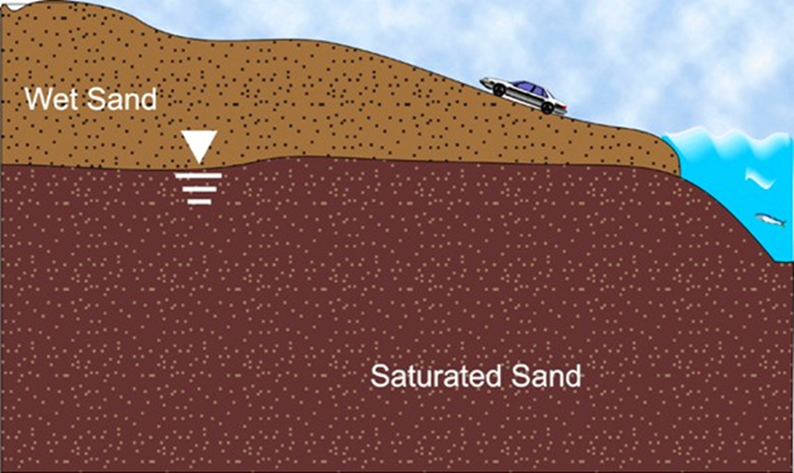
Water Saturation
•Top of the water table (sometimes!)
•Encountering organic material with a higher water content (i.e. tree roots or buried remains)

Slide 19
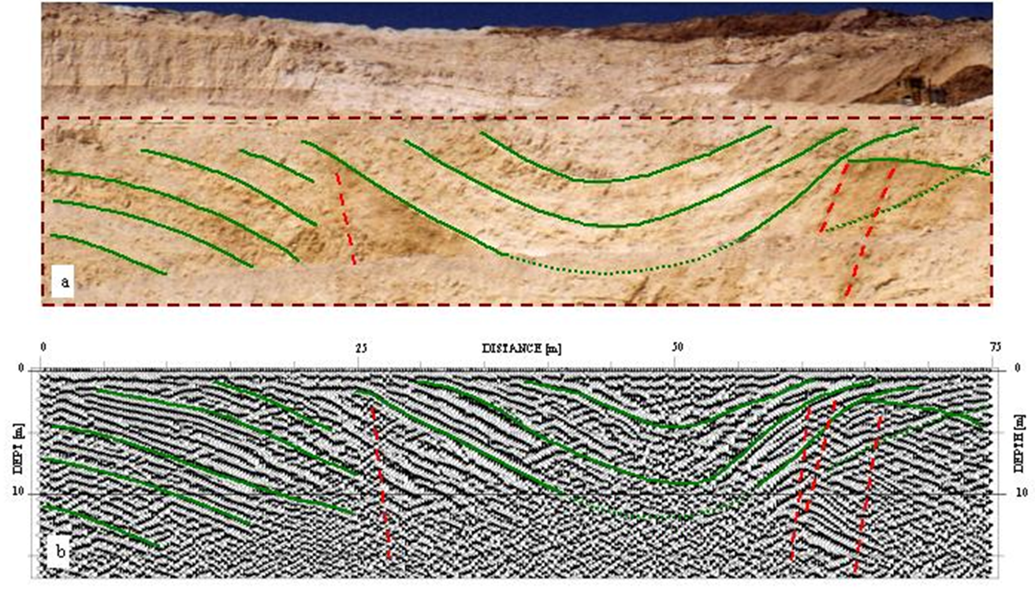
Composition
Boundary between:
•sandstone and siltstone
•rock layers or rock bodies

Slide 20
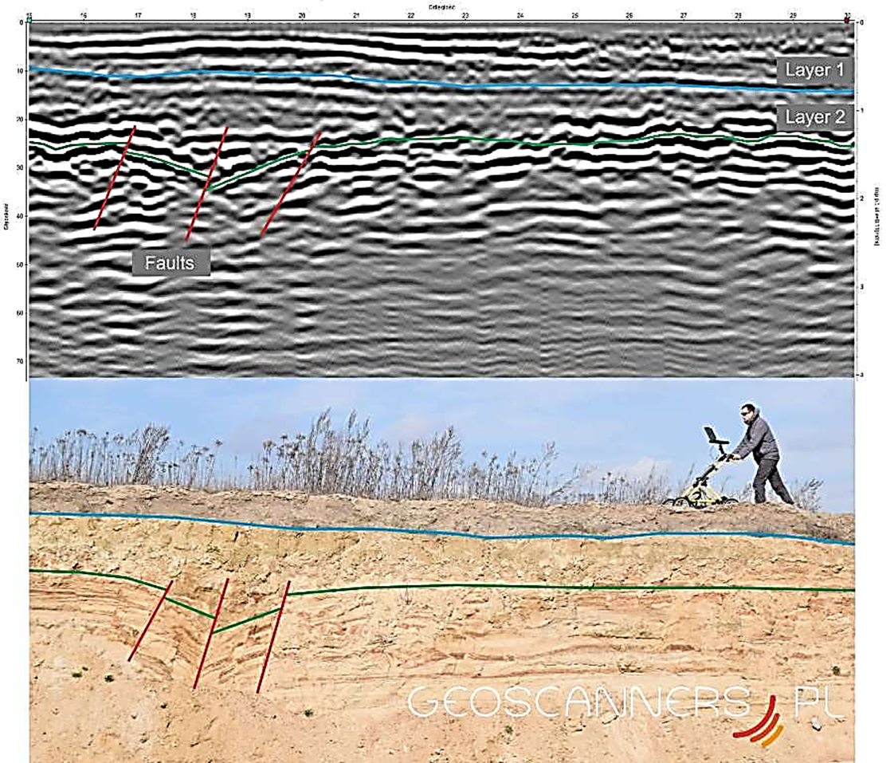
Also Composition
GPR can detect subsurface faults!

Slide 21
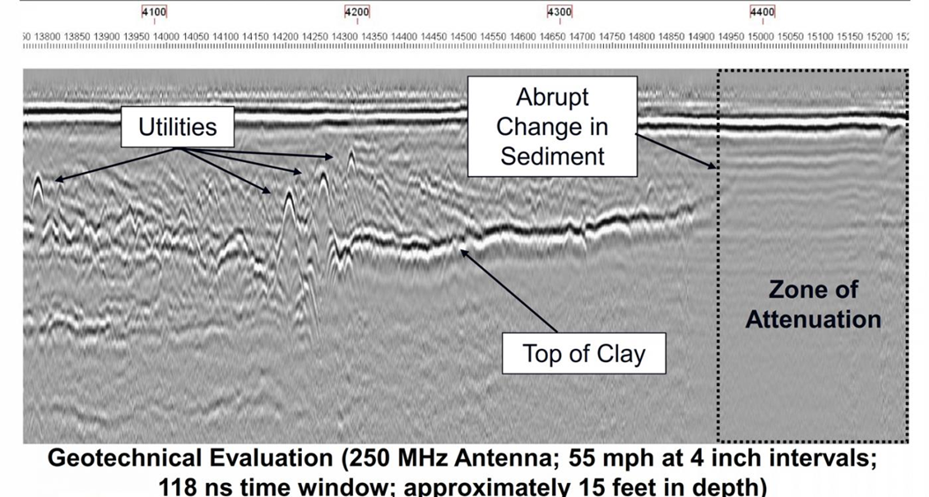
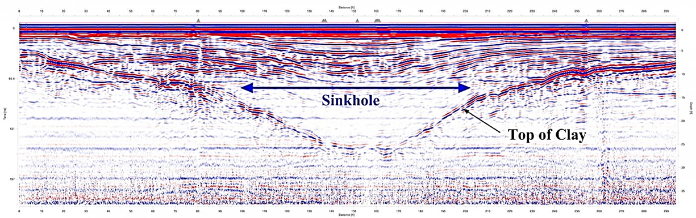
Clay Content
Boundary between:
sand/silt with little clay and clay-rich sediments
We can’t tell just from the GPR data what the layer is made of.
To confirm that it is clay, we’d have to dig or have other information.

Slide 22
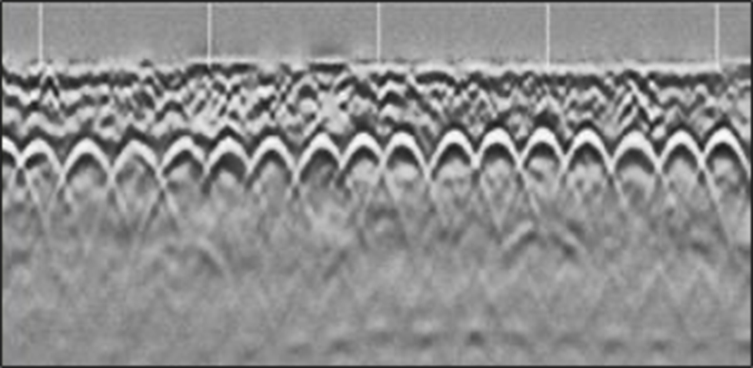
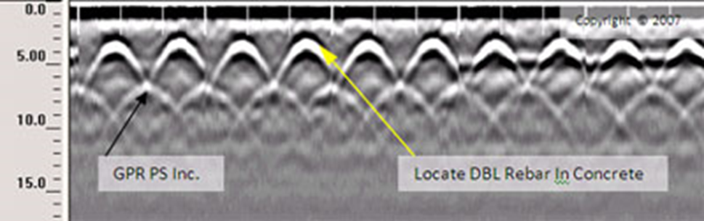
Iron Content
Encountering a metallic body (GPR waves do not penetrate metal so all of the energy reflects)

Slide 23
What could you image on or near your campus?

Slide 24
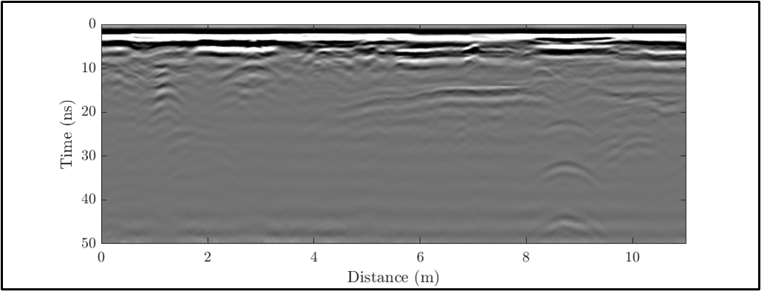
Determining Depth:
Two-Way Travel Time is not enough information
In this example, some buried object at about 8.8 meters along the profile produces a diffraction hyperbola with a peak at 31 ns TWTT.

Slide 25
Two-Way Travel Time
But if we don’t know the velocity, the same travel time could be caused by:
Measured TWTT (ns) | If the velocity were (m/ns) | Then the depth would be (m)
31 | 0.05 | 0.78
 | 0.1 | 1.55
 | 0.15 | 2.33
an object at 0.78 m depth with a wave velocity of 0.05 m/ns
an object at 2.33 m depth with a wave velocity of 0.15 m/ns
Or

Slide 26
Can use the shape of hyperbolas to determine velocity
- convert travel time to depth
https://www.iris.edu/app/gpr-fit/

Slide 27
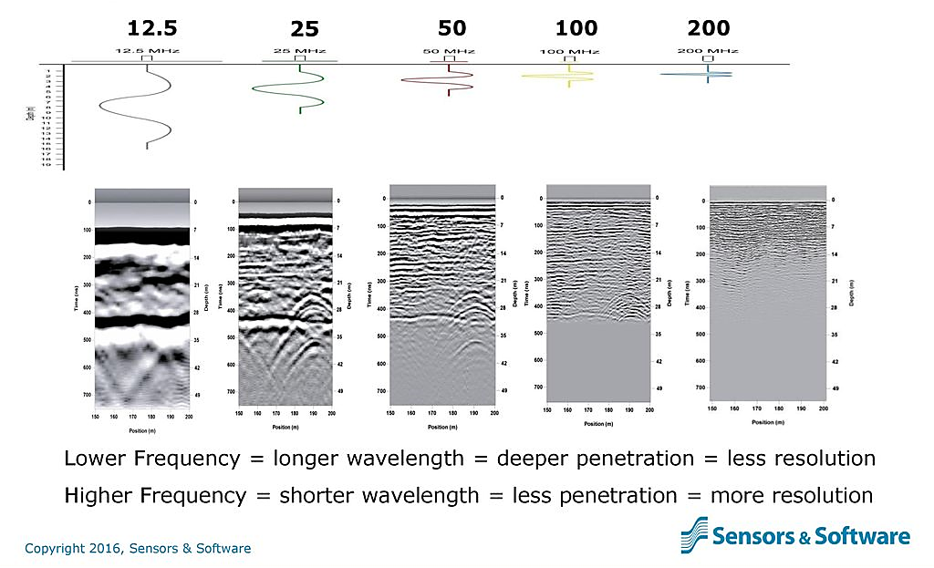
Antenna frequency tradeoffs

Slide 28
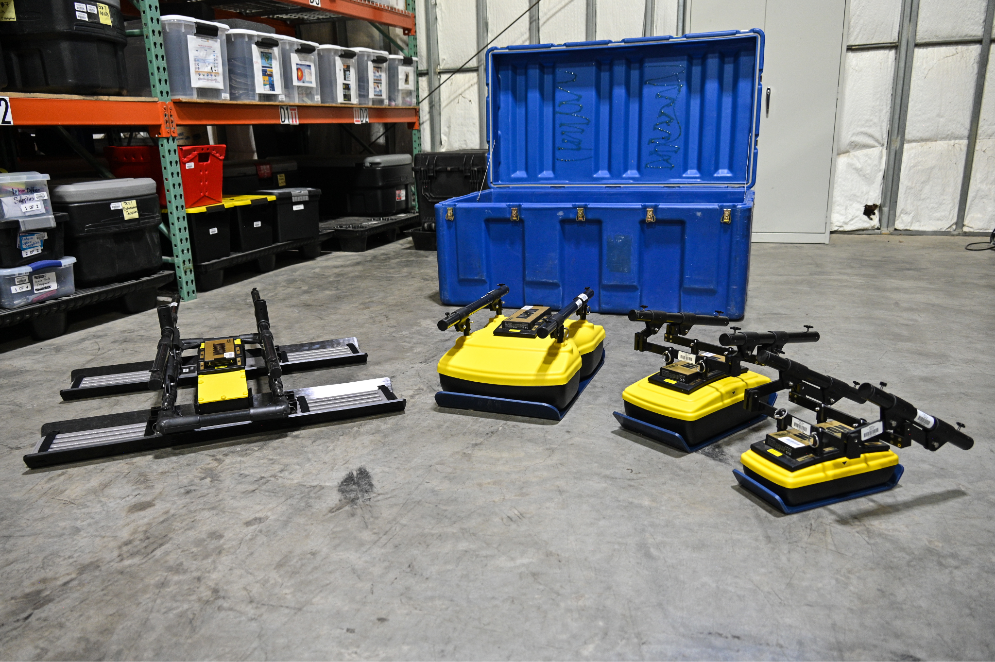

Slide 29
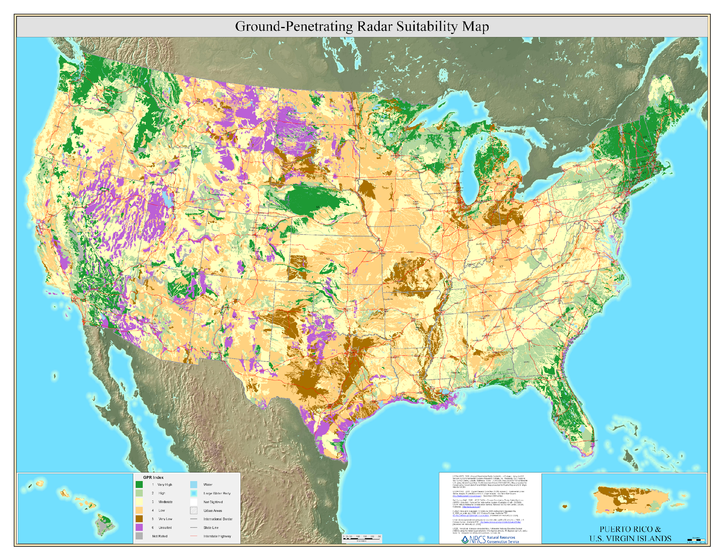
Designing surveys
Notes:
Such maps are also for individual states. USDA keeps moving these around, currently only in archives. Will try to update link as they change this.

Slide 30
Suitable soils?
-> soil/rock layers tree roots historical cemetaries buried utilities test survey with 250 MHz or 100 MHz antennas
*if see features with one antenna frequency, try with one higher. Possibly better resolution.
Notes:
Such maps are also for individual states. USDA keeps moving these around, currently only in archives. Will try to update link as they change this.

Slide 31
Less suitable soils?
-> tree roots buried utilities test survey with 250 MHz or 100 MHz antennas
*if see features with one antenna frequency, try with one higher. Possibly better resolution.
-> rebar in concrete test survey with 1000 MHz antennas
Notes:
Such maps are also for individual states. USDA keeps moving these around, currently only in archives. Will try to update link as they change this.

Slide 32
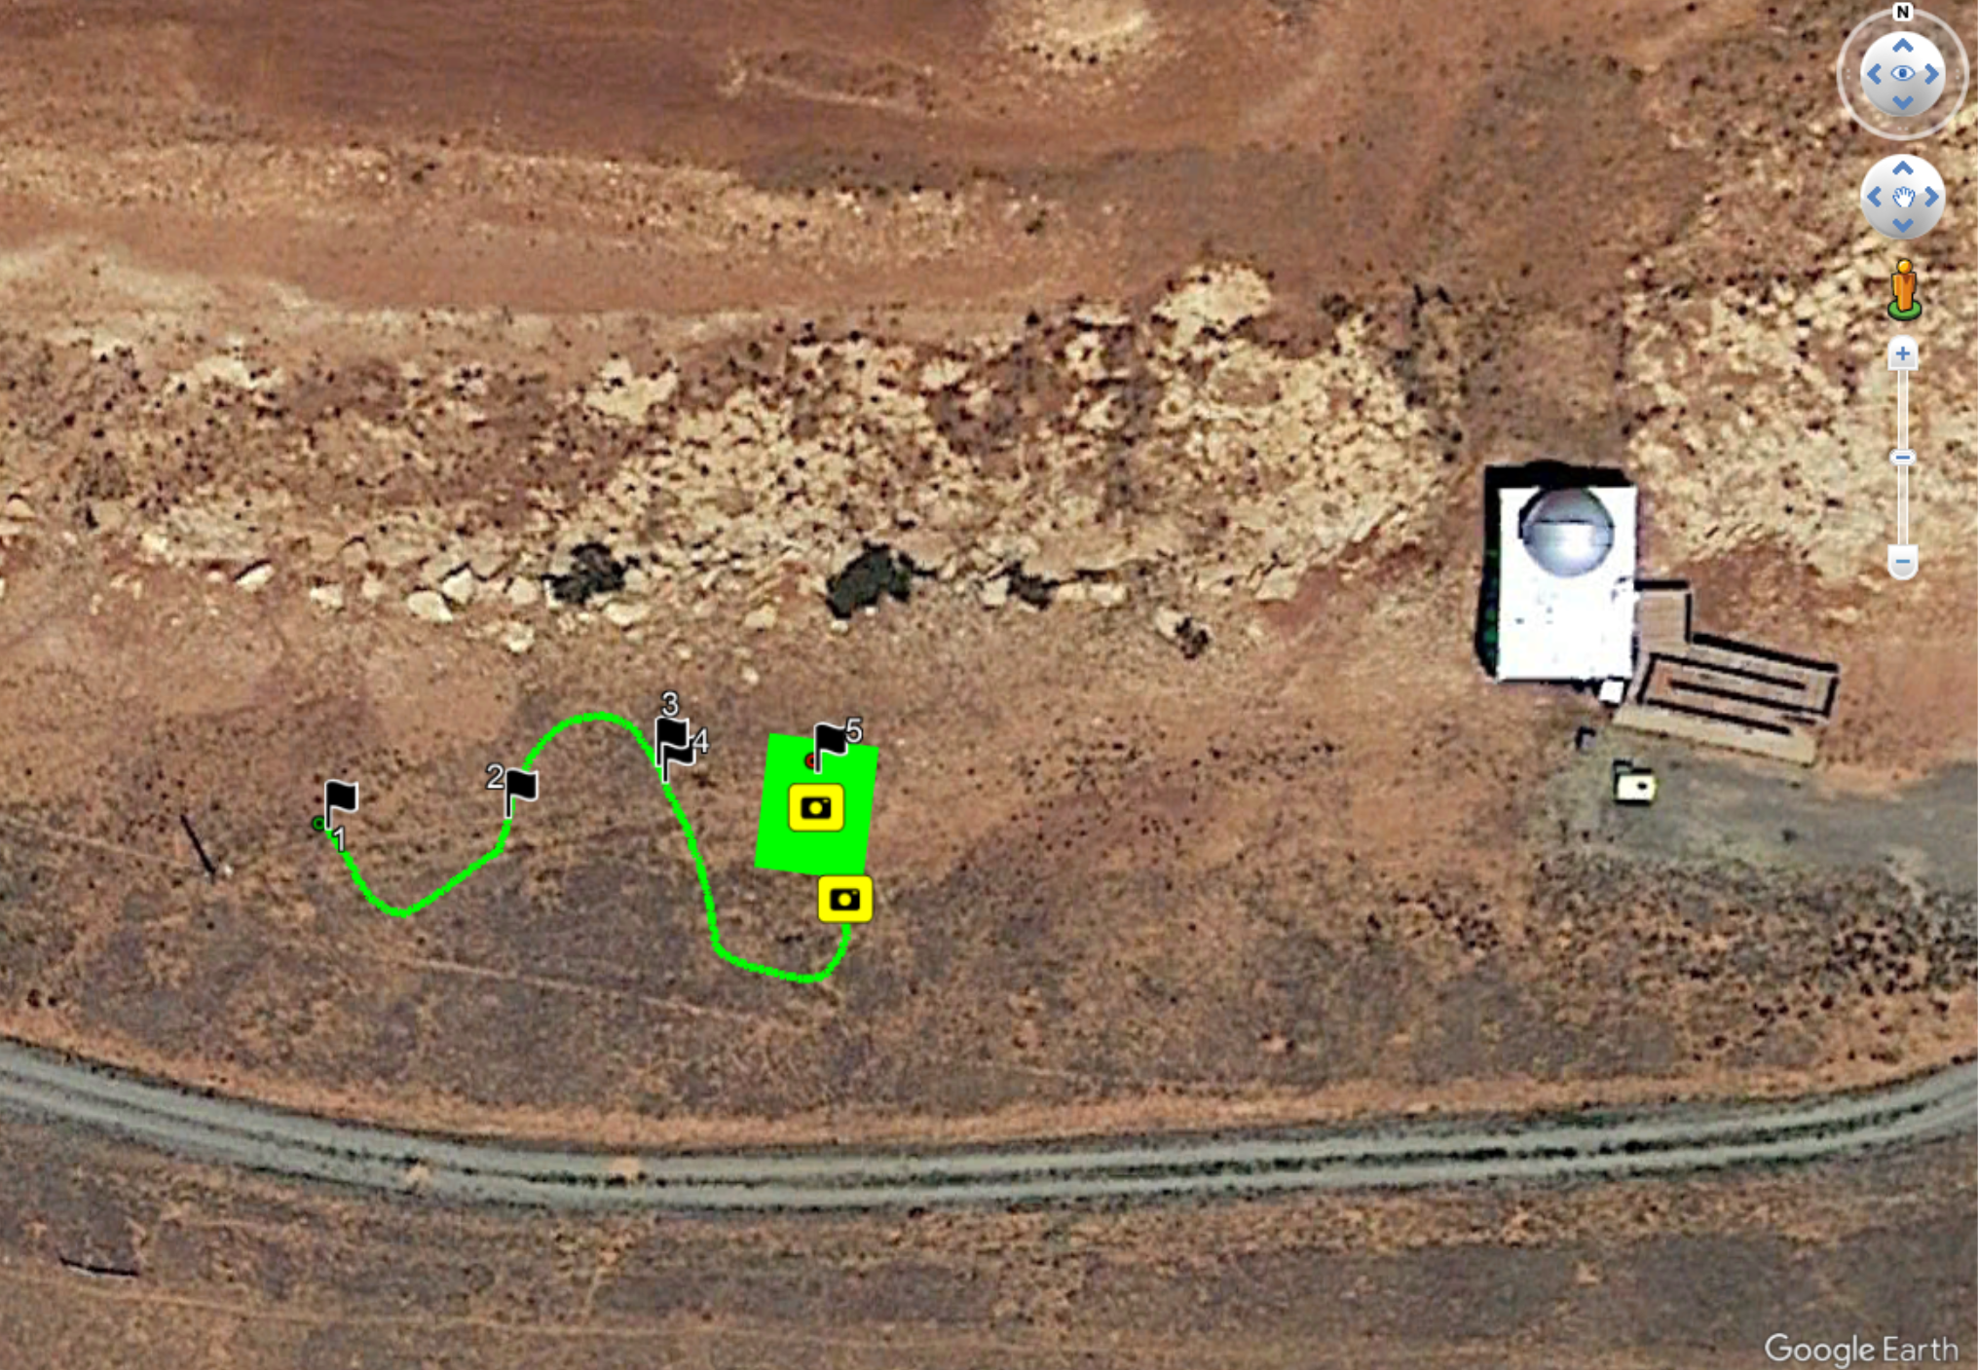
Run test lines
Mark features with flags
-in program
-on ground
Notes:
Noticed power line went underground at pole on left, assumed it ran to building on right. Noted sandstone layers outcropping in band across image.

Slide 33
Run test lines – for presence and orientation of features
For utilities-between buildings and streetlights, around buildings
For tree roots – in circle around tree – just outside canopy.
Note: both buildings and trees can degrade/block GPS signal.
For rebar in concrete - floors of most multistory buildings.
Notes:
Noticed power line went underground at pole on left, assumed it ran to building on right. Noted sandstone layers outcropping in band across image.

Slide 34
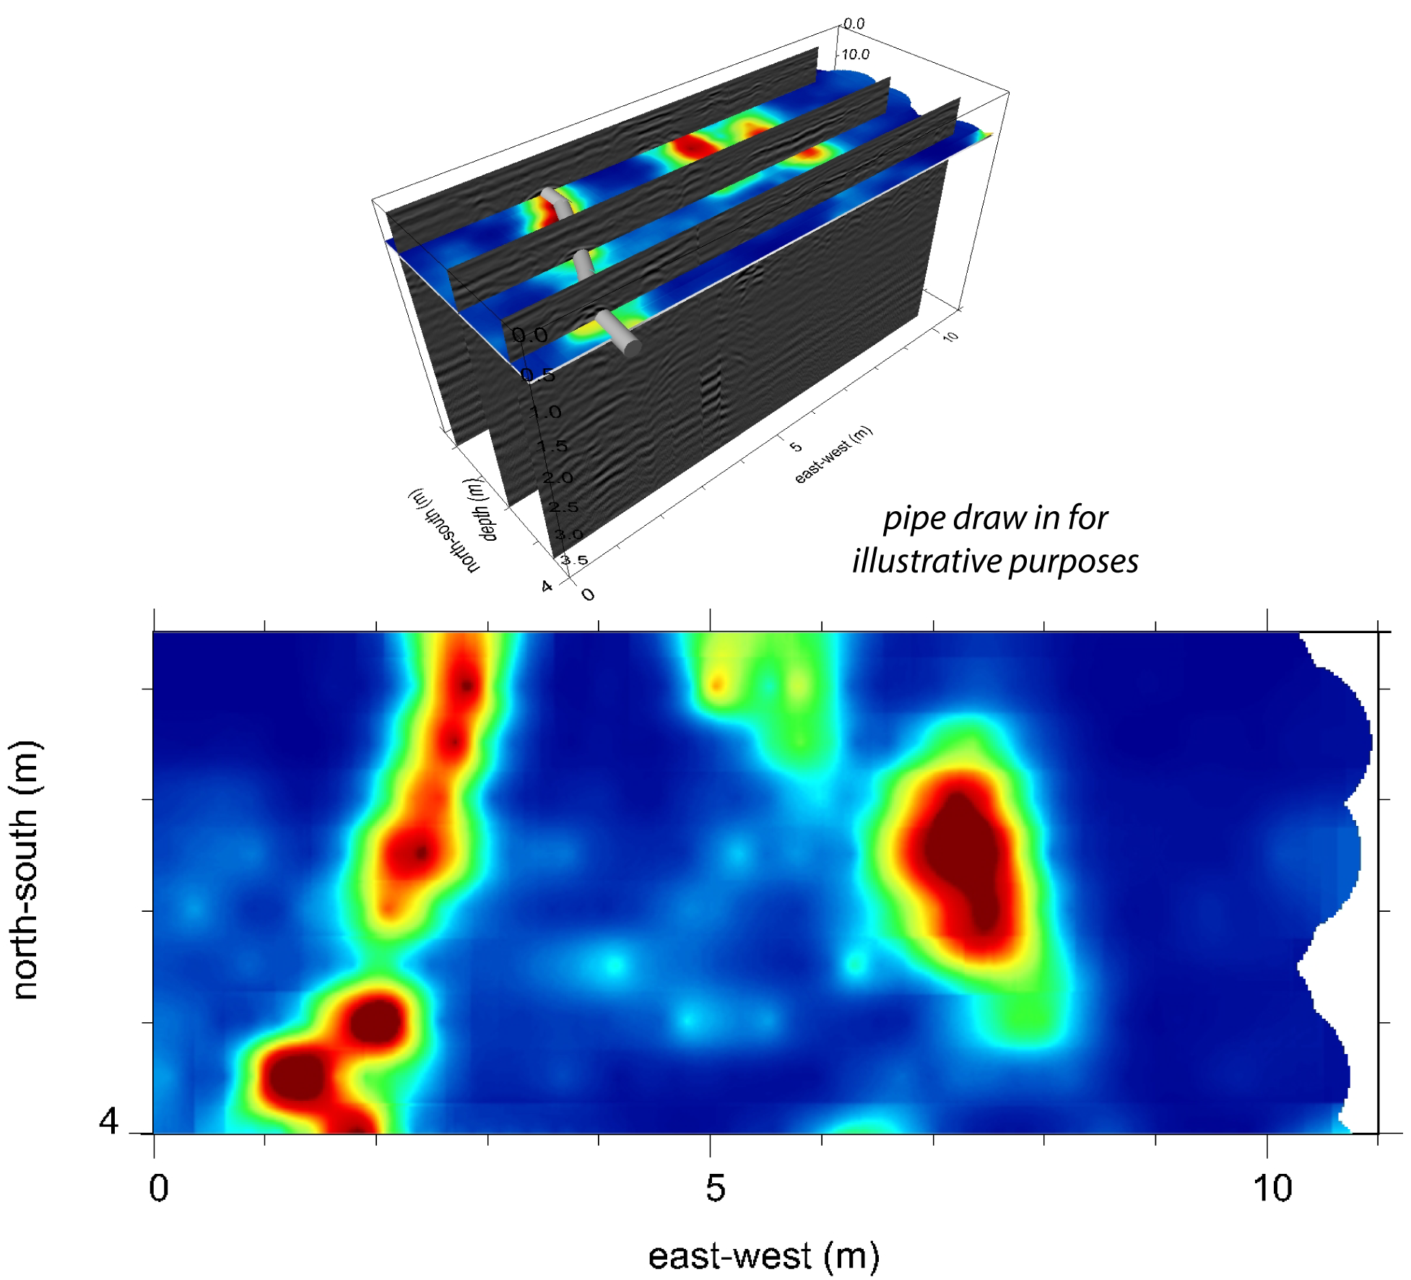
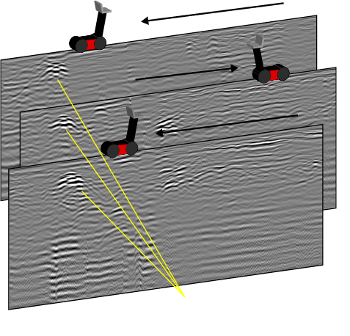
Lines vs. Grids?
Notes:
Such maps are also for individual states. USDA keeps moving these around, currently only in archives. Will try to update link as they change this.

Slide 35
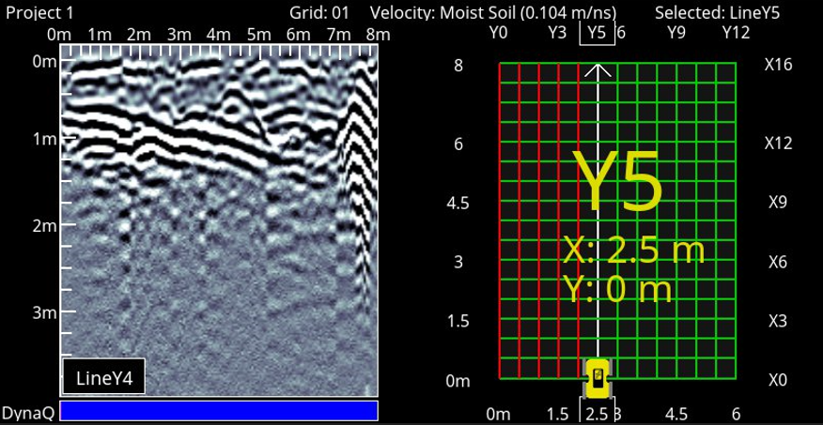
Grid: labor intensive! Do only after targets identified

Slide 36
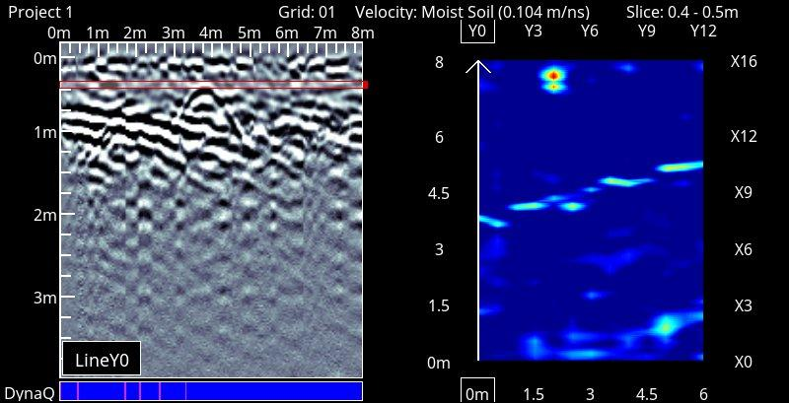
Grid: fun

Slide 37
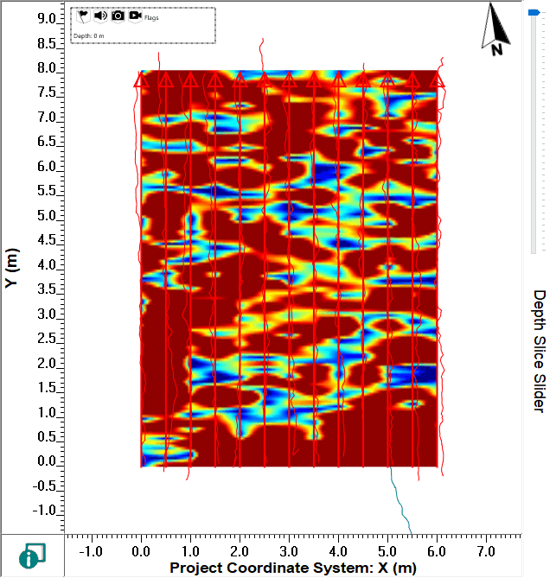
Grid: fun!

Slide 38
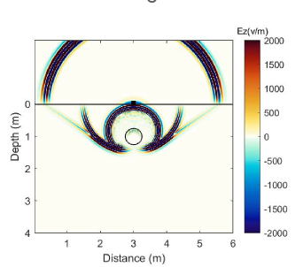
Questions?
How GPR works
Typical geoscience (and commercial) applications
Survey design considerations

Slide 39
Participant Checklist
serc.carleton.edu/getsi/workshops/Summ2025_field/participant_checklist.html
Some general tasks (complete by Friday July 25)
  Short knowledge assessment (will be emailed Tue July 15)
  Complete the field trip waiver form (will be sent via DocuSign)
  IF YOU HAVE NOT ALREADY, make the following accounts
    EarthScope instrument request system: https://epic.earthscope.org/sdb/newuser_application
    SERC: https://serc.carleton.edu/account/loginout.php
Look through teaching modules
Download software
Watch helpful videos

