Slide 1
Introduction to GPS/GNSS
Excerpts from GETSI module presentations for the 2024 Geophy Educ Workshop
Notes:
DO REMEMBER to include attribution information for all the figures you include. Even if you took the picture or made the diagram, it will make it easier later if we just have that recorded.
ALSO – it is much easier to make notes (at least preliminary ones) for each slide NOW compared to several months later. Think about the information that future instructors using this materials will need to know in order to understand what the point of the different slides are. If all the relevant text is on the slide, notes may not be necessary, BUT if there are images, most likely some notes will be needed for future users.

Slide 2
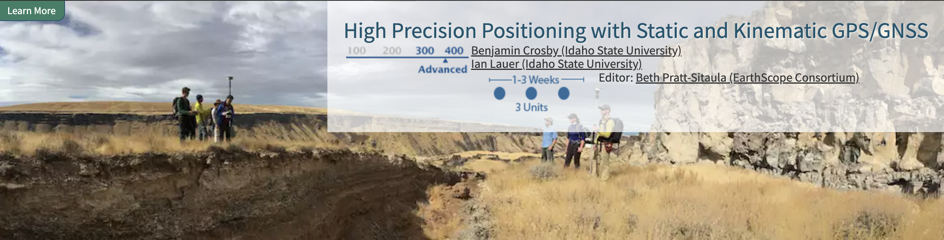
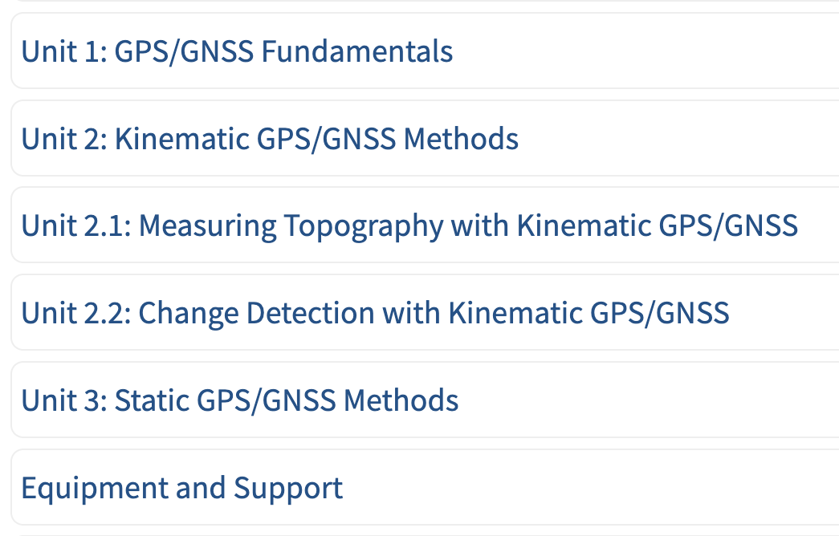
Module Goals
Design and conduct static and/or kinematic GPS/GNSS surveys to address a geologic research question.
Apply the findings of GPS/GNSS surveys to issues important to society
Justify why different high-precision positioning techniques are appropriate in different situations.
Notes:
Red shows likely units related to this workshop

Slide 3
Goals
Describe the GPS/GNSS and how it enables positioning
Distinguish different grades of GPS/GNSS receivers, their uses, and their accuracies.
Highlight applications of GPS/GNSS in the Geosciences
Get started using Emlids Reach RS2/2+/3 instruments

Slide 4
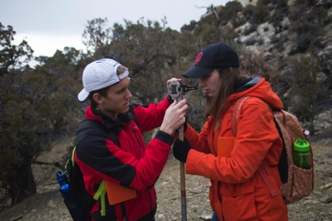
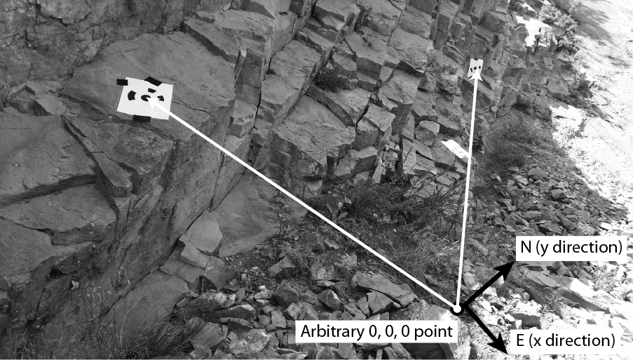
Georeferencing - Local
References to a local zero point
  Hand measuring with tape and compass
  Total station – laser for distance, inclinometer for angles
Notes:
Left image: Beth Pratt-Sitaula (EarthScope, GETSI Project)
Top right image: https://scotthuckphoto.wordpress.com/2014/03/05/geology-sed-strat-spring-break-day – used with permission
Bottom right image: https://commons.wikimedia.org/wiki/File:US_Navy_070801-F-8678B-039_Engineering_Aide_2nd_Class_Randy_Felipe_attached_to_Naval_Mobile_Construction_Battalion_(NMCB)_4,_trains_on_the_new_Trimble_5600DX_Total_Station_series,_survey_equipment.jpg

Slide 5
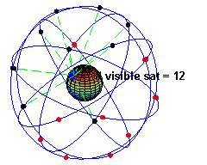
Georeferencing - Global
Typically determined with:
GNSS – Global Navigation Satellite System
  GPS: USA, global (~30 satellites)
  GLONAS: Russia, global (24 satellites)
  BeiDou: China, global
  Galileo: Europe, global
  India, France, and Japan:
  developing regional systems
Notes:
Left: Artist’s conception of a GPS Block II-F satellite in Earth orbit. (Public domain from NASA) https://en.wikipedia.org/wiki/Global_Positioning_System
Right: Bottom image: NASA (public domain) http://spaceplace.nasa.gov/gps-pizza/en/
Top image: https://en.wikipedia.org/wiki/Global_Positioning_System

Slide 6
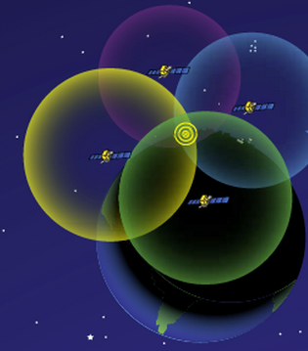
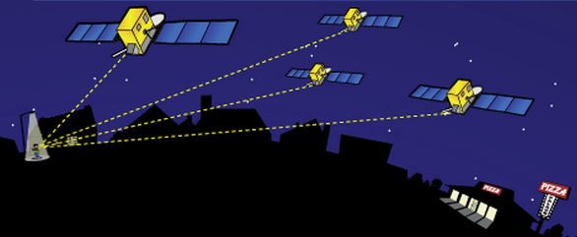
How Does GPS Work?
A receiver obtains signals from GPS/GNSS satellites
Precisely known orbits and time
A receiver needs 4 satellites to accurately determine position (+6 preferable)
→ solves for 4 variables:
x, y, z and time using trilateration
Notes:
From the user’s point of view, GPS is a passive system: you need only a low-powered receiver to obtain the signals, which contain all the information you need to determine your position. This requires that the satellites carry atomic clocks to keep accurate time and transmit to the user the position of the satellite in the sky. The orbits are computed by the Department of Defense (DoD) by tracking the satellites from ground control stations. GPS control segment consists of a global network of ground facilities that track the GPS satellites, monitor their transmissions, perform analyses, and send commands and data to the constellation. The current (as of 2015) operational control segment includes a master control station, an alternate master control station, 12 command and control antennas, and 16 monitoring sites. The ground control stations have known positions that are uploaded to the satellites, which then transmit the information continuously along with the time. With handheld receivers, it is possible to find your position to within a few meters, limited primarily by the accuracy of the broadcast orbits. As we shall see, the civilian scientific community uses more than 200 stations to determine the orbits with an accuracy of a few centimeters, allowing millimeter positioning after several hours of tracking.
Images: NASA (public domain) http://spaceplace.nasa.gov/gps-pizza/en/

Slide 7
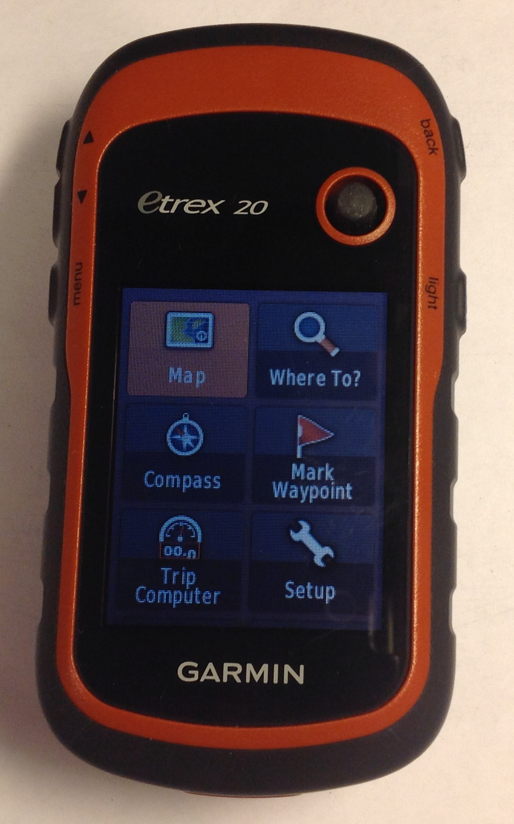
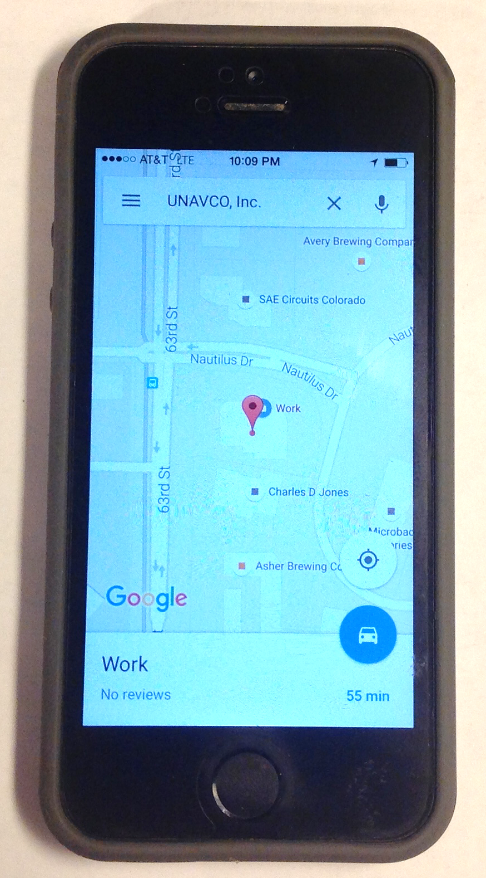
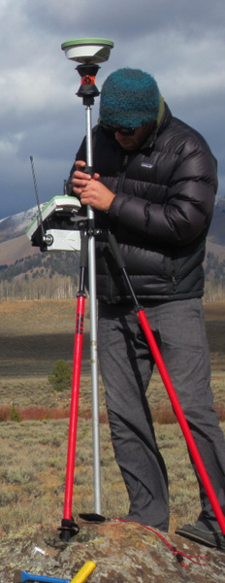
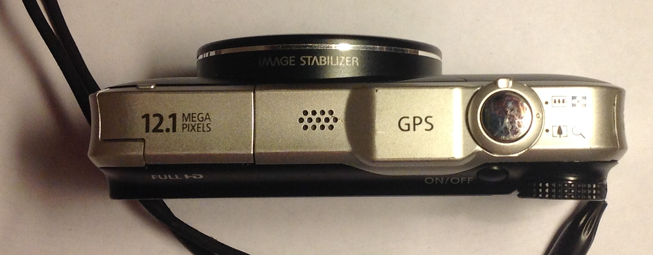
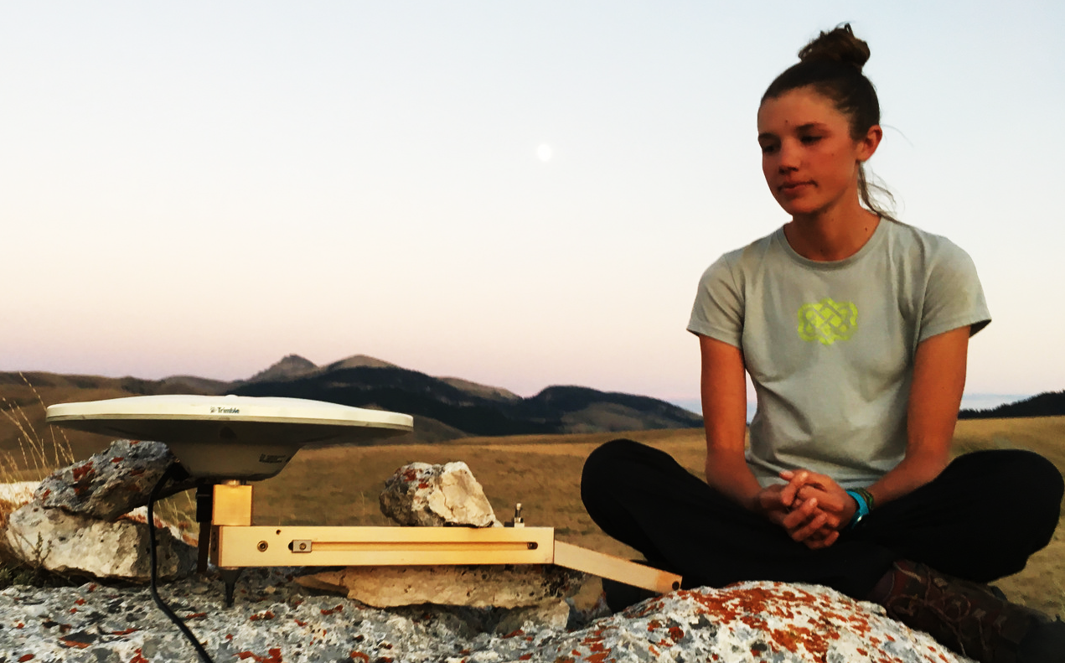
GPS receivers are all around us
Notes:
Whether they know it or not, students use GPS receivers daily in their cars, phones, cameras, and handheld recreational GPS. Most have heard the term “GPS” but few know much about how the system actually works or high precision GPS/GNSS for science and industrial use.
Left images: UNAVCO
Right field images: B. Brosby

Slide 8
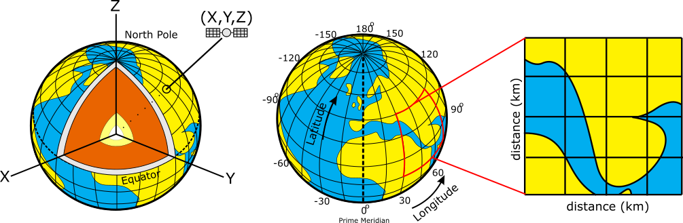
GPS provides 3D positioning
Positions on the earth can be reported using:
  Cartesian coordinates (relative to the earth’s center)
  Geographic coordinates (lat., long., elev., in deg.)
  Projected coordinates (UTM, state plane, in m or ft)
Cartesian (X,Y,Z)
Geographic System
Projected System
(Figures: Ian Lauer, modified from Common Domain)
Notes:
It is important for students to understand that position data can be reported to a user in a number of different formats.

Slide 9
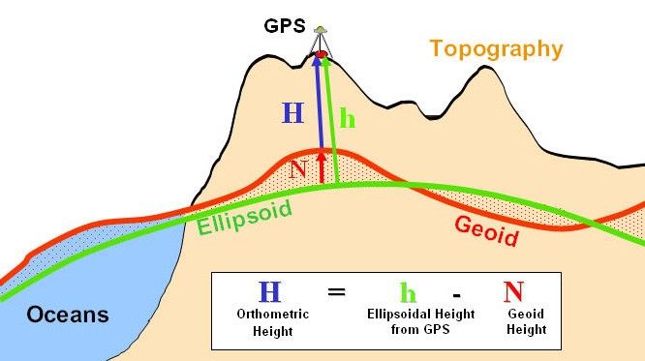
Typical GPS coordinates
Most GPS data is recorded and reported using:
  Geographic Coordinates
    World Geodetic System 1984 (WGS 84)
      A reference surface or datum composed of an ellipsoid
      A geoid model (gravitational equipotential surface, EGM96)
    Remember, elevations can be reported as ellipsoidal heights or orthometric heights

Slide 10
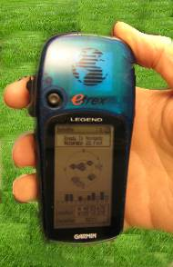
Antennas receive data streams
Works the same…
Your location is:
37º 23.323’ N
122º 02.162’ W
The time is:
11:34.9722 (UTC)
ERRORS (after 8 hrs)
Horiz: +/- 2-4 mm (~1/8 in)
Vert: +/- 10-15 mm (~1/2 in)
ERRORS
Horiz: +/- 10 m (30 ft)
Vert: +/- 15 m (45 ft)
Notes:
Since each satellite maintains time very accurately (~1 nanosecond = 30 cm), it can tag its signal with the time of transmission. This information, together with the location of the satellite, also transmitted to the receiver, is sufficient to allow the receiver to calculate the range to each satellite, provided that the receiver also knows the time. Equipping receivers with atomic clocks would be very expensive, so the receiver tags the signal with the time of its internal clock to create a “pseudorange” (range plus an unknown clock correction). The software in the receiver then uses the pseudoranges from four satellites to solve for the four unknowns: three coordinates and the receiver clock correction.
Images: Vince Cronin (Baylor University)
High precision rates taken from GAMIT/GLOBK 10.6 release notes - http://geoweb.mit.edu/gg/
After 24 hours
Horz: +/- 1-2 mm
Vert: +/- 5 mm

Slide 11
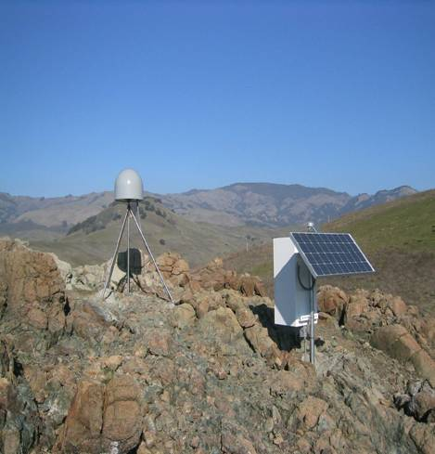
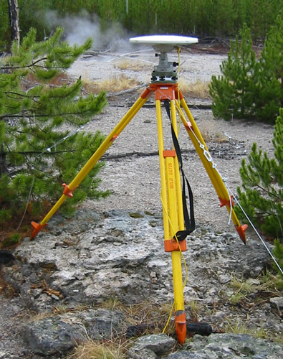
Precision depends on system
Static, Geodetic Campaign Systems
Occupation Time or Effort Required
Kinematic Systems
Easy Hard
Consumer & Mapping Systems
Survey Grade
0.5-5 m 0.01–0.03 m 0.005m
Precision of Position
(Images: Ben Crosby)
Notes:
More information at http://kb.unavco.org/kb/article/gps-data-collection-methods-70.html

Slide 12
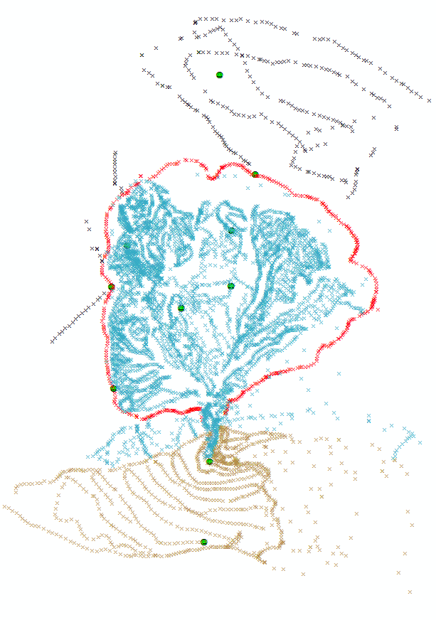
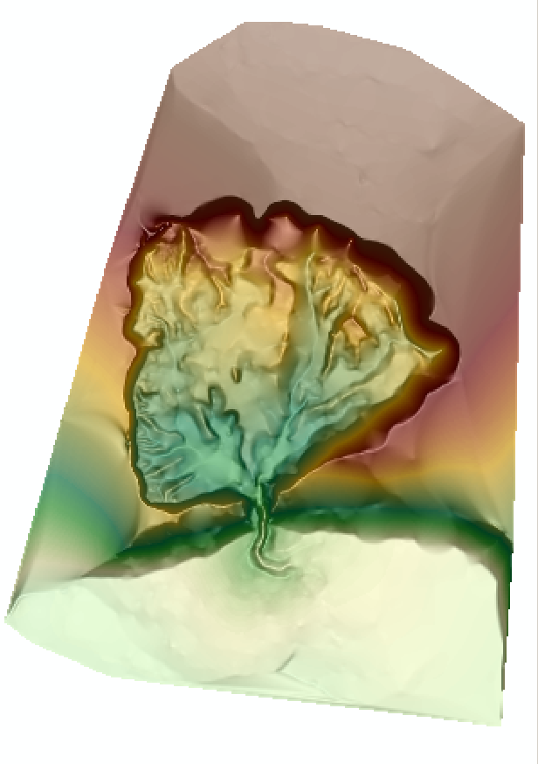
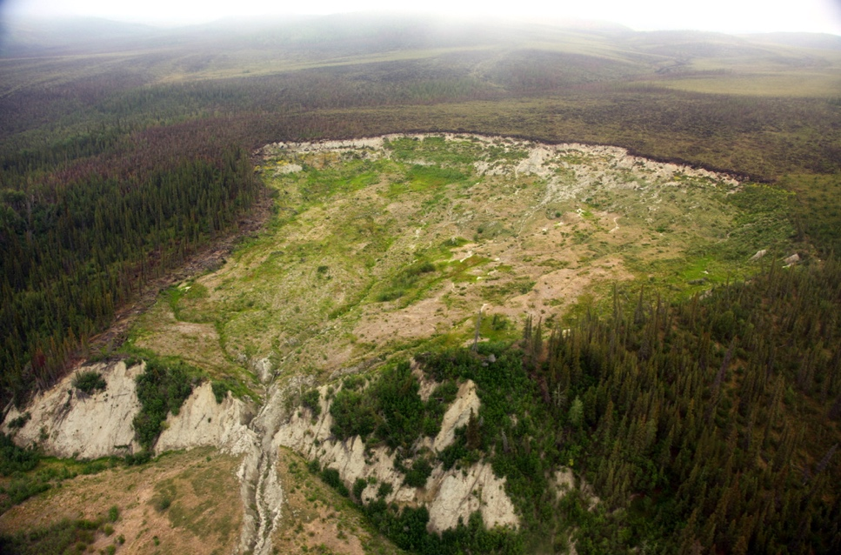
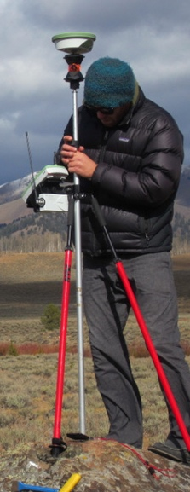
Creating Topography
Using Kinematic Systems
  Quickly measure many points with high accuracy and precision – landslides, permafrost morphology, moraines, fault scarps
From the field … … to post- … to surface generation
processed points … using GIS.
(Images: Ben Crosby)

Slide 13
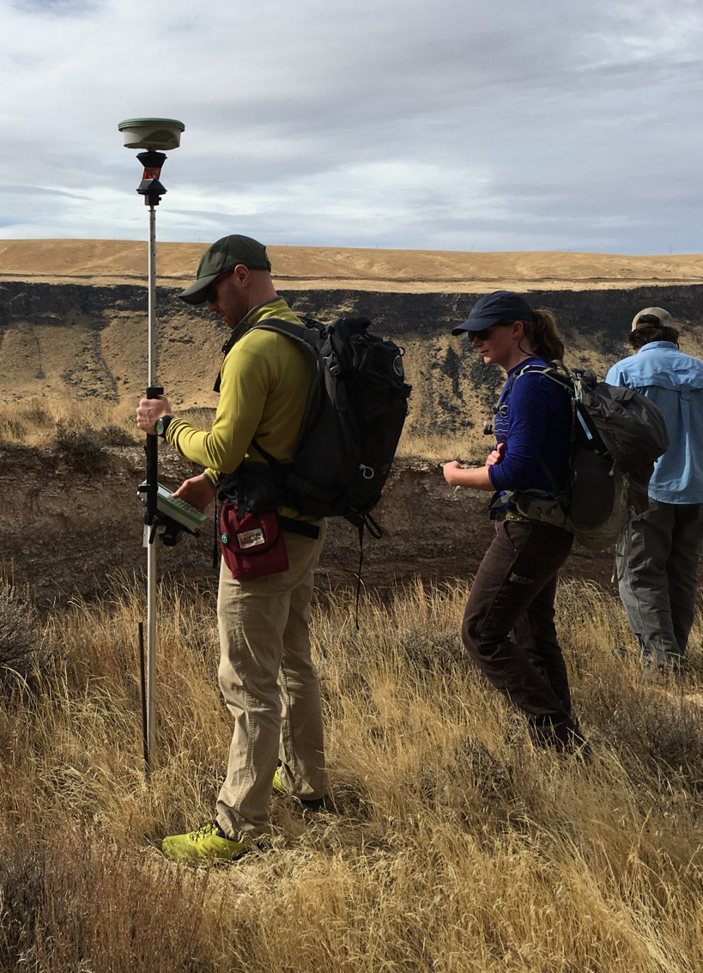
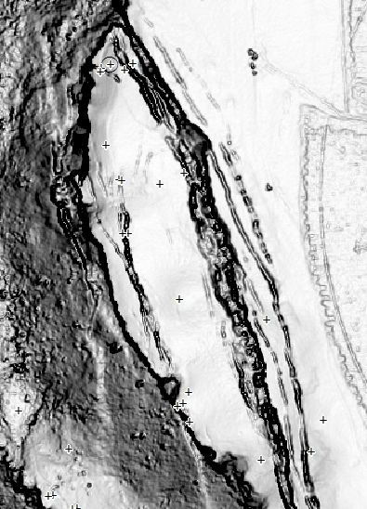
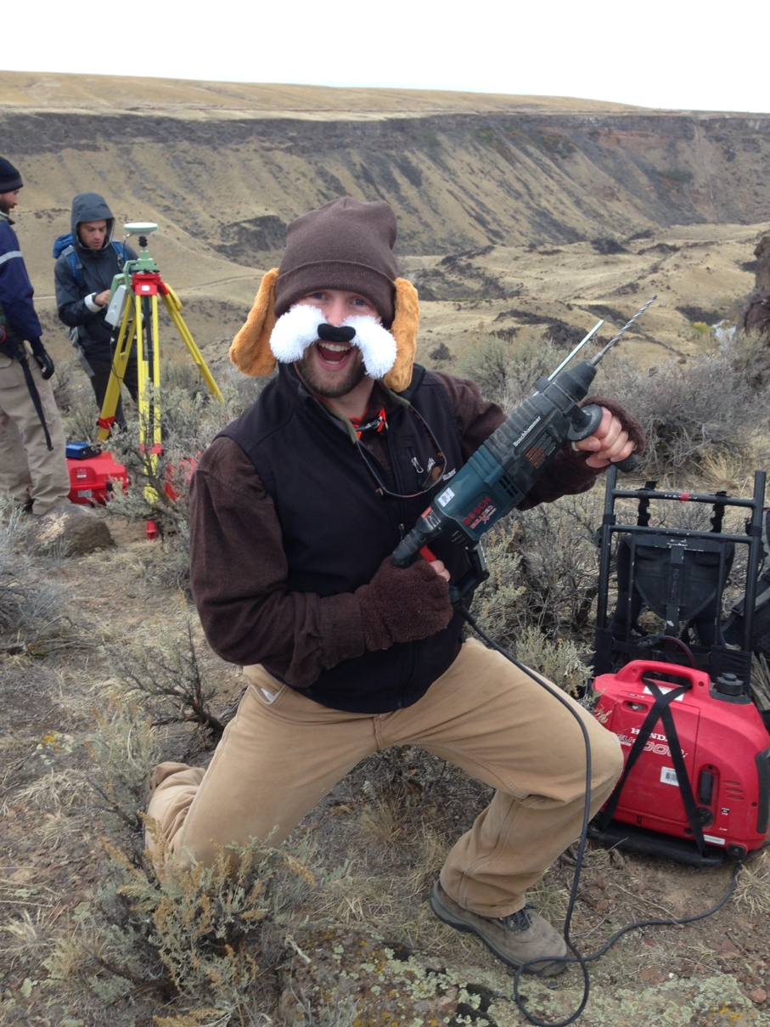
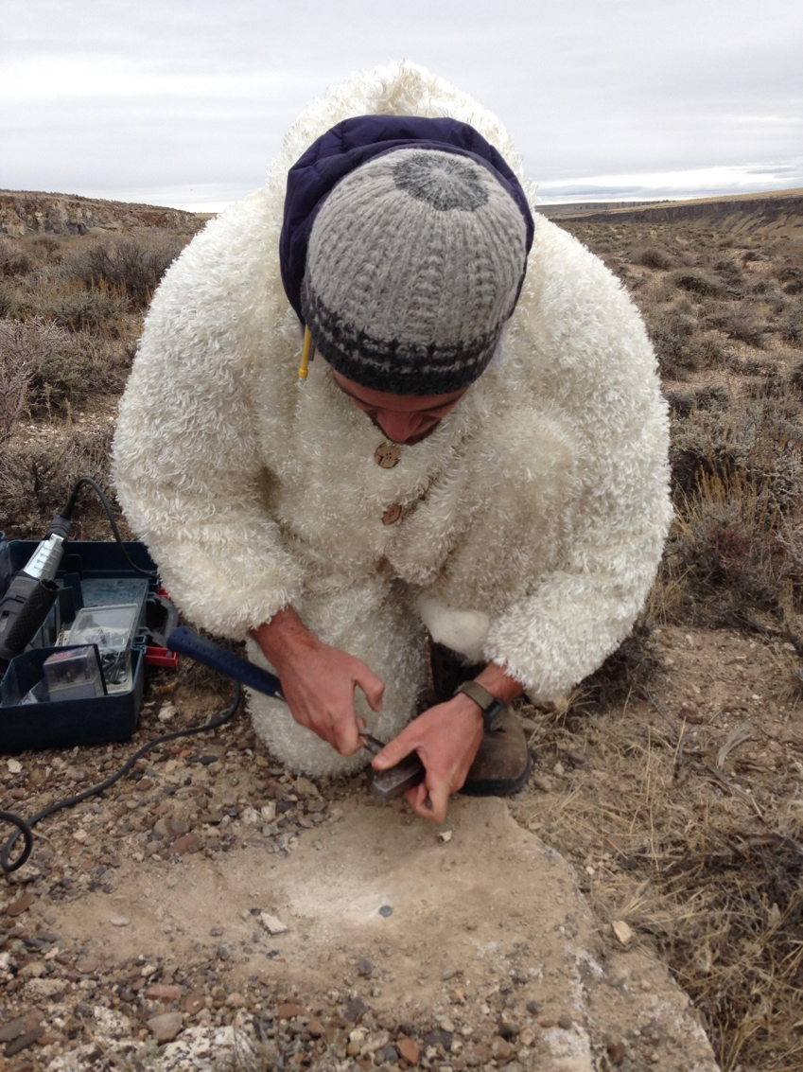
Change Detection
~85 points surveyed across slide
Some previously monumented (rebar, etc.)
Some new monuments added in rock

Slide 14
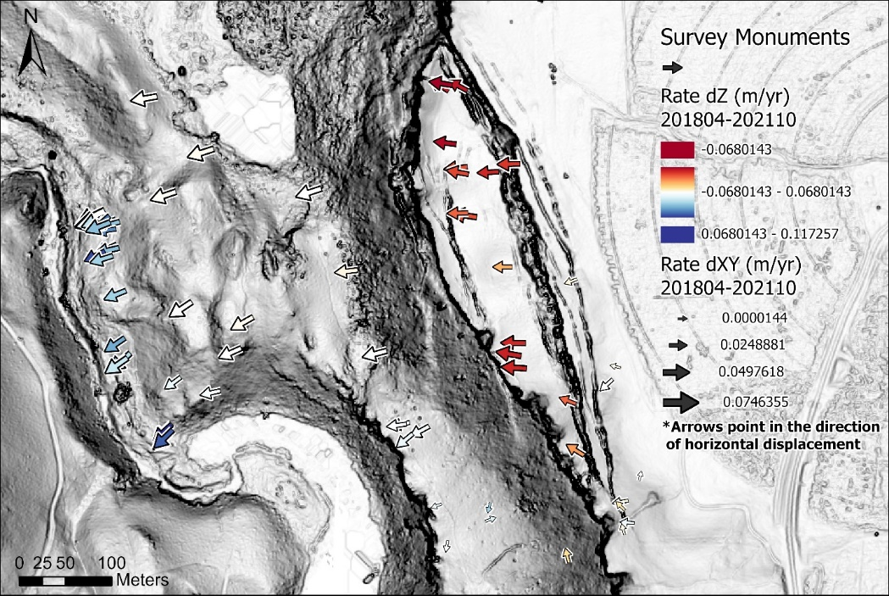
Change Detection
2018-04 → 2021-10

Slide 15
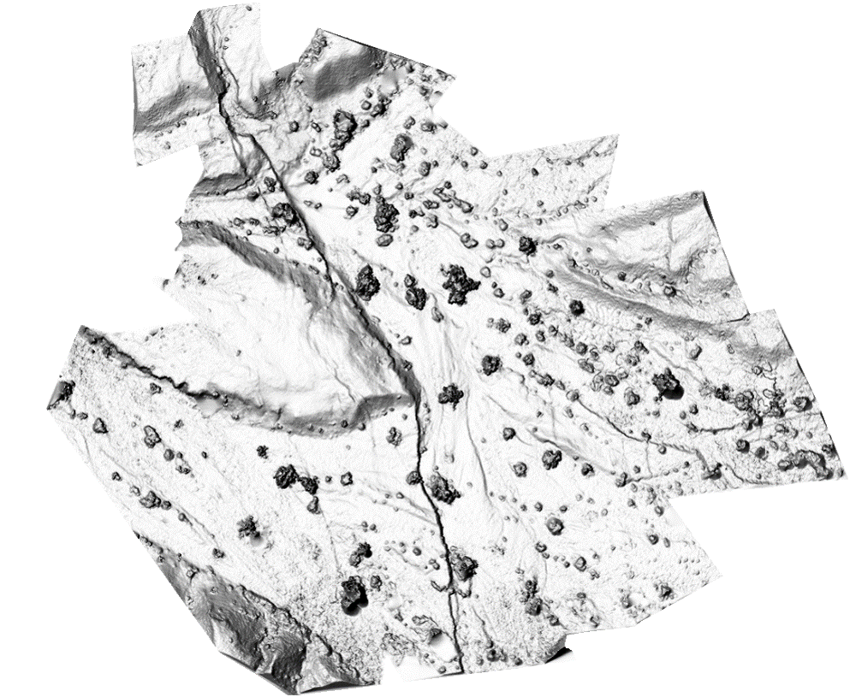
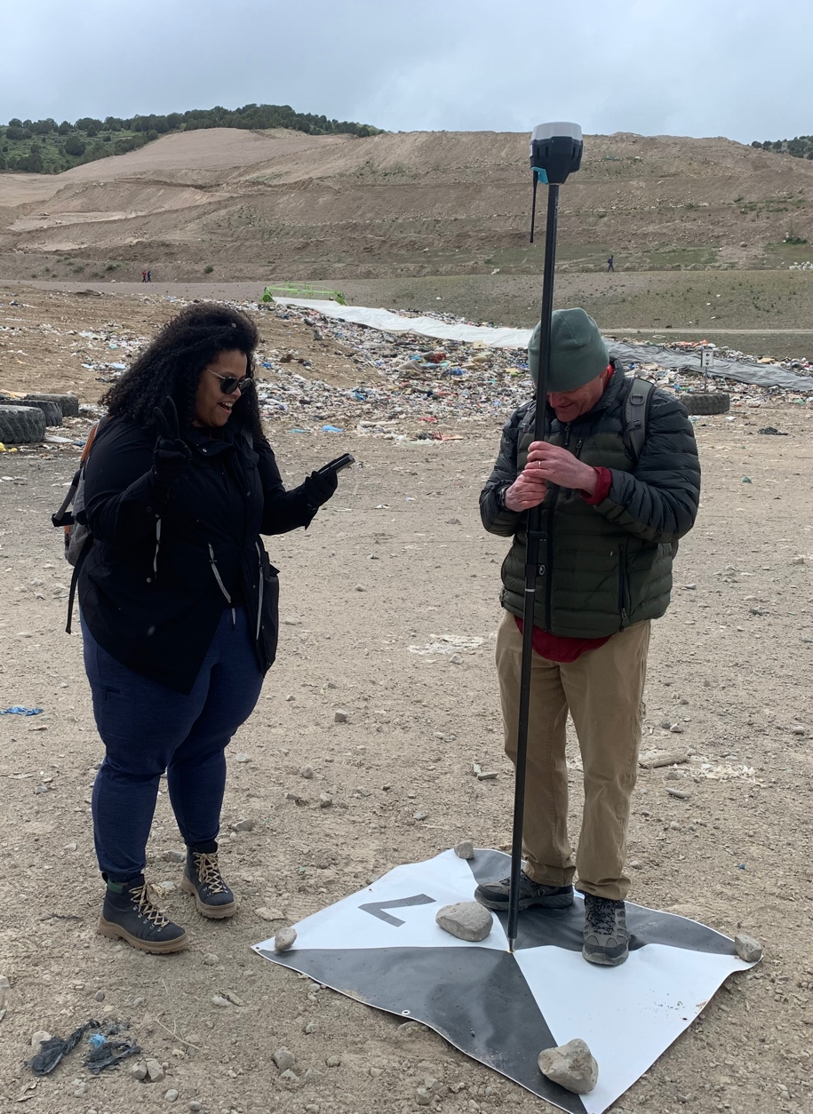
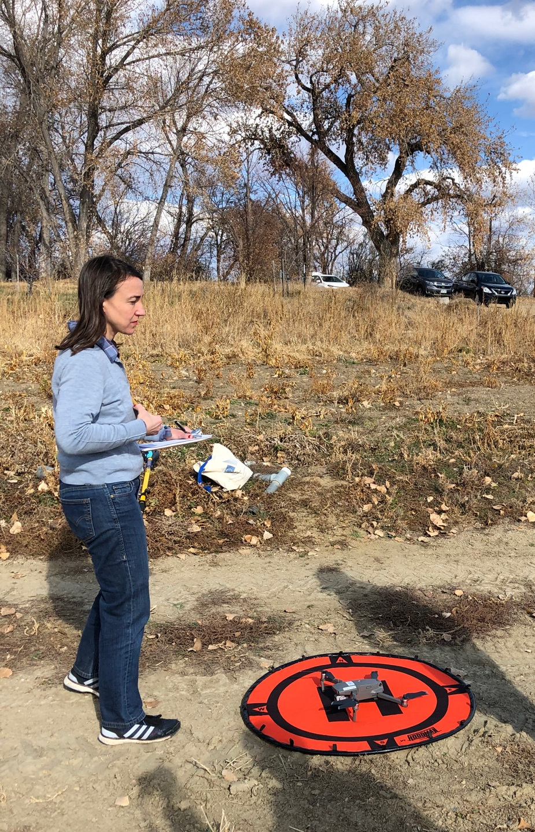
Georeferencing other projects
Drone or pole-based photogrammetry survey to define topography
Notes:
Photo: Beth Pratt-Sitaula, EarthScope
Map: Ed Nisson

Slide 16
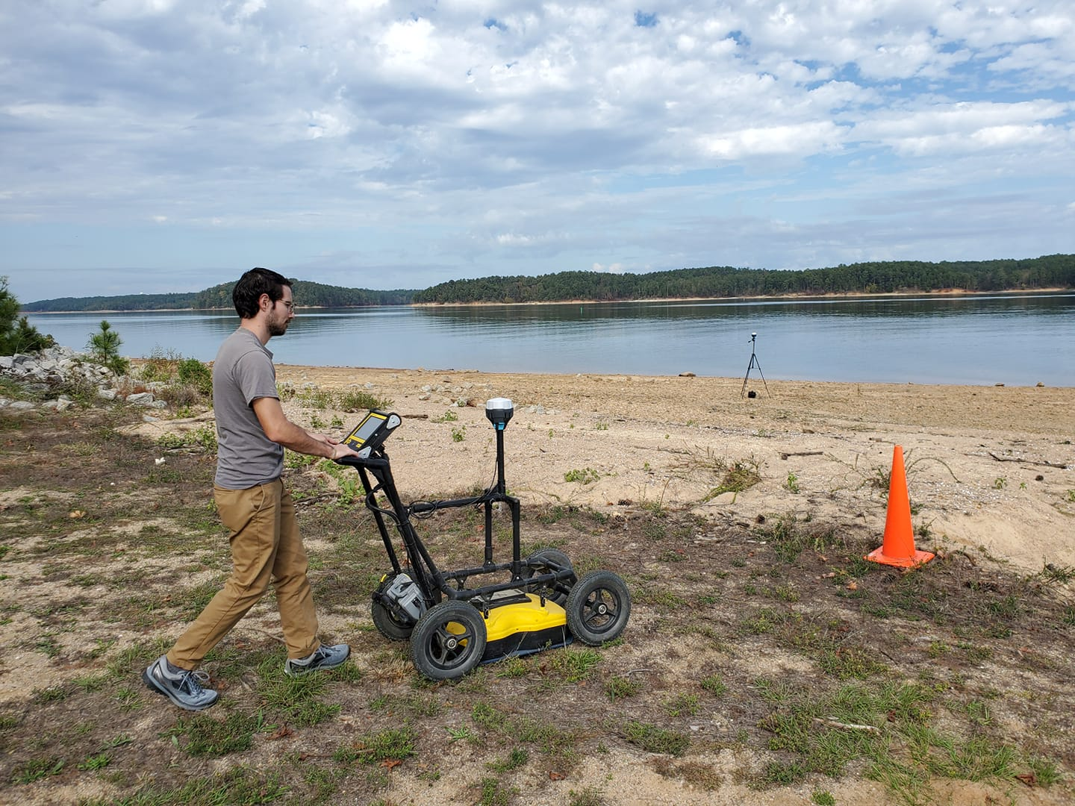
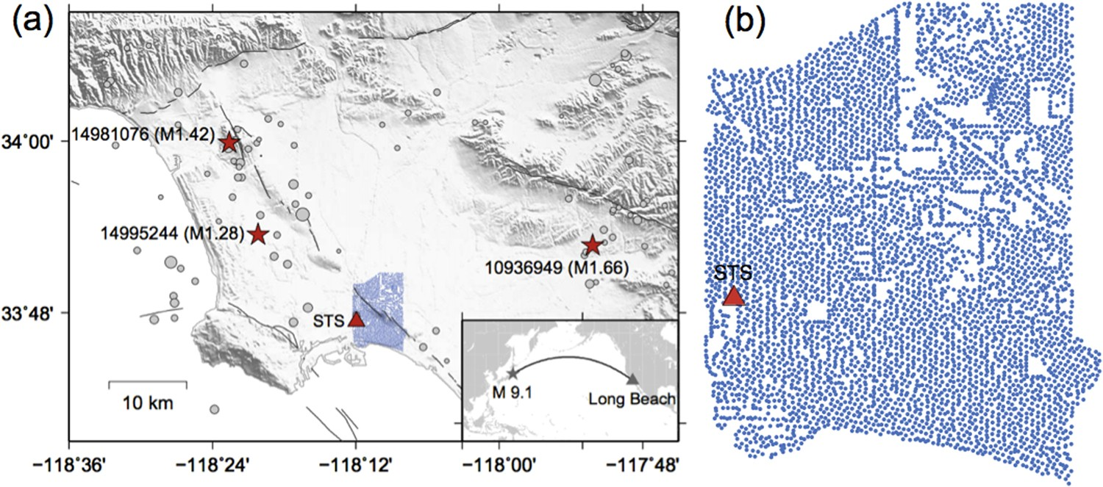
Georeferencing other projects
Other surveys – ex. GPR
Nodal array deployments
Notes:
Image right: https://www.nature.com/articles/s41598-018-19728-w/figures/1 (do not further disseminate; not CC)
Image left: Bigman Geophysical (do not further disseminate; not CC)

Slide 17
Sources of error
Some GNSS Error Sources
Satellite orbit irregularities
Satellite and receiver clock errors
Atmospheric delays – speed of light is affected by water content and other variables in the atmosphere
Multi-path – GPS signals can bounce off the ground and then enter the antenna, rather than only entering from above
Human error – Incorrect base or rover antenna heights, errors in post-processing, datum and projection errors.
Notes:
There is a complex field of engineering and science behind post-processing GPS data to reduce error sources.
In addition to those mentioned above, specific sites may measure movements not associated with the parameter the researcher wants to measure. For instance
Seasonal groundwater fluctuations may cause the ground to rise and fall annually, in a way that is not at all related to plate motion.
A site could be sliding downhill because of a creeping landslide.
A melting glacier or a falling lake level will “unweight” an area, leading to rebound and upward movement measured by the GPS.
It is best to collect multiple years of data before trying to draw conclusions.

Slide 18
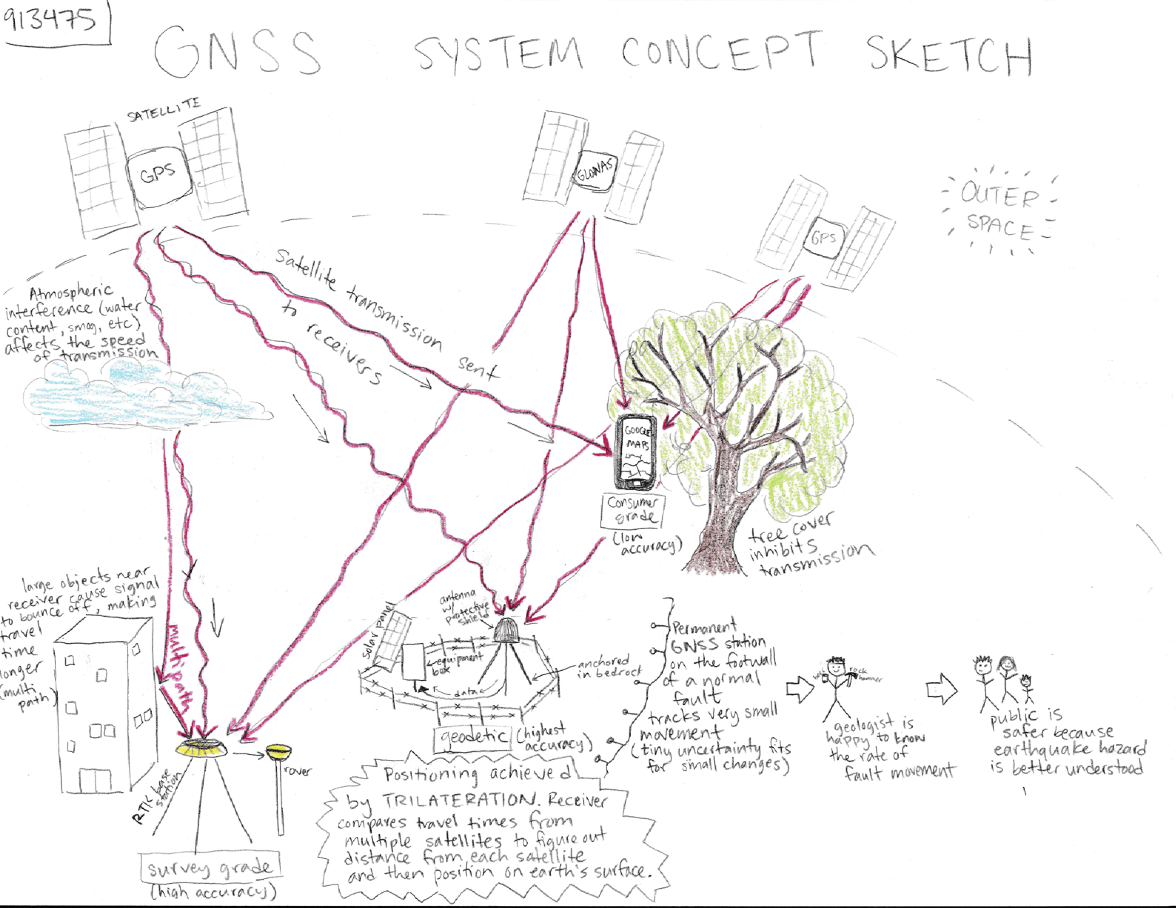

Slide 19
Motivations
Briefly describe:
  The components of a kinematic system
  The concepts behind kinematic GNSS systems
  The survey design of a kinematic system
  The data collection/post-processing workflow
2.1: Measuring Topography with Kinematic GNSS
2.2: Change Detection with Kinematic GNSS

Slide 20
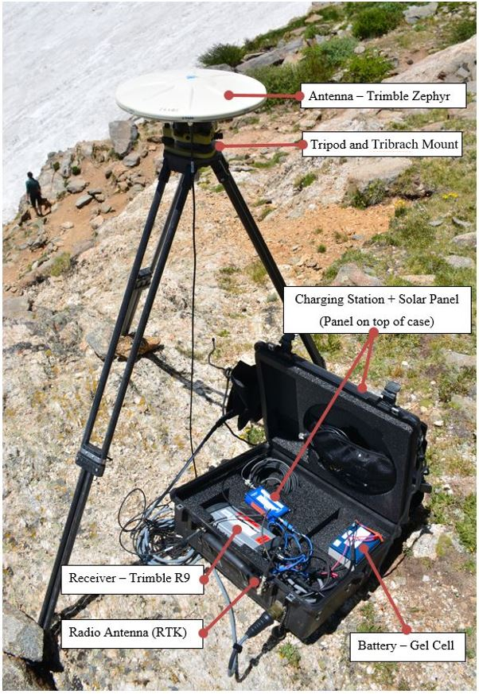
Kinematic components
GNSS Antenna
Radio
Antenna
GNSS
Receiver
Base Station and Radio
Rover Antennas and Receiver
(Images: Ian Lauer, Ben Crosby)

Slide 21
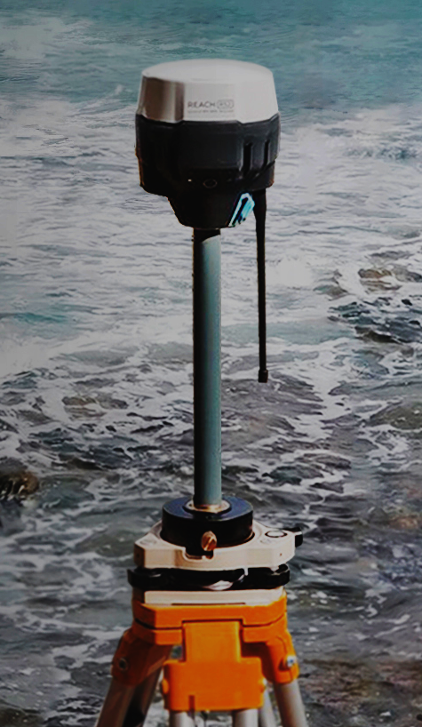
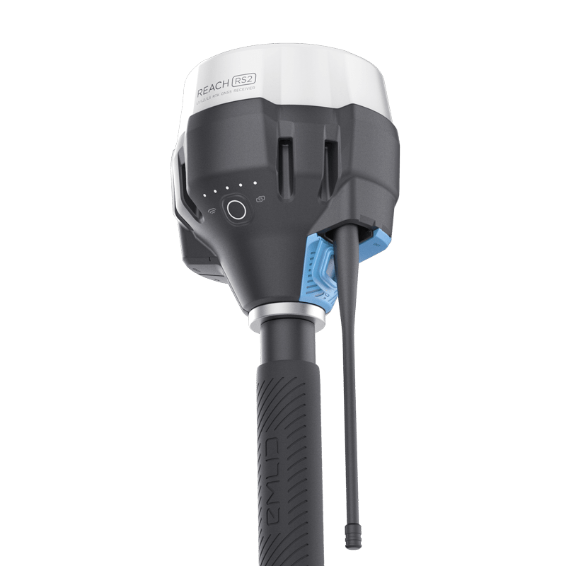
Kinematic components
Base Station and Radio
Rover and Radio
(Images: Emlid)

Slide 22
Kinematic systems
Base station antenna receives data from satellites.
The position drifts over time relative to the known, stable location of the antenna. This offset is communicated to the rover as a correction.
At the same time, rover antenna also receives position data from satellites.
Rover also receives a position correction from the base, in real time for RTK.
Base
Rover
(Images: Ben Crosby)

Slide 23
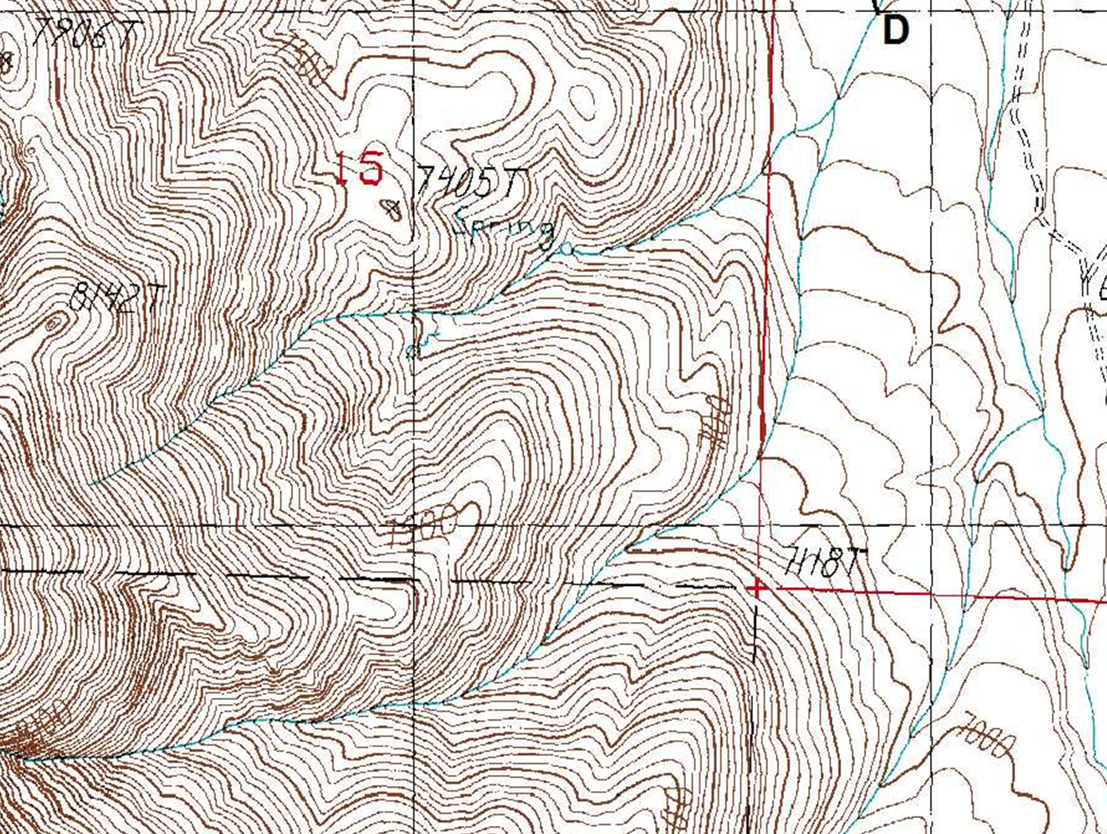
Map View of an RTK Survey
Base Station
Three Different Rover Positions
assumed ‘here’
raw base obs.
raw rover obs.
rover RTK adj.
t₁
corrected base
t₂
t₁
corrected rover
t₃
t₂
t₃

Slide 24
Kinematic survey design
Base Station
  Located in a stable, safe, unobstructed place
  Line of sight for radio communication to rover
  < 10 km from rover location
  Ideally set up over known monument
Rover
  Close to and in line of site with base for corrections
  Occupy points for 5–120 sec, keep pole vertical
  Name and describe each point in field book
  Avoid cover and multi-path, confirm corrections

Slide 25
Thinking About Base Stations
Considerations:
Site Access
Site Permissions
Site Security
Line-of-Sight to Rover
Distance to Rover
High Ground
Stable Ground for Tripod
Stable Monument
Nearby stations for correction

Slide 26
Collecting GPS on a Landslide
Where would you put a base station in this landscape?
Notes:
This is an example from field camp. The large basin in the center of the image (with the lake) is ringed by the headscarp of an enormous landslide. If you were to collect GPS data in the image, where would you position a base station?

Slide 27
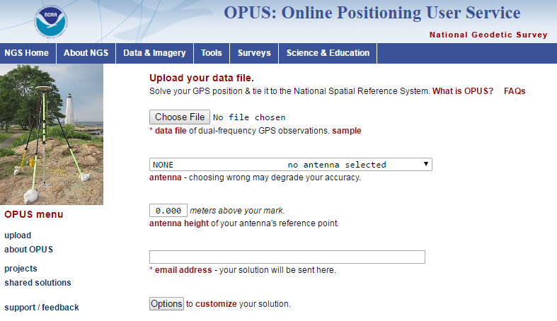
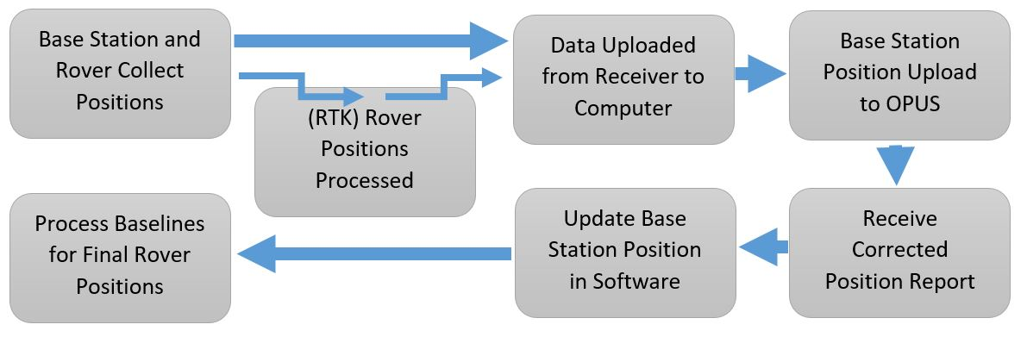
Kinematic workflow
If base is not over a known point, you must post-process to get an accurate position

Slide 28
Kinematic post-processing
Post processing is only necessary if the base was set up over an unknown point or you use a PPK system.
Download data from base to PC software for your hardware.
Export base dataset as a RINEX formatted file
Upload RINEX to OPUS or CSRS website, specifying all necessary information regarding base antenna type and height (need to wait 2+ hours after collection before uploading)
Update your base position with the new, corrected position in your PC software
Propagate the change in base to all your rover positions

Slide 29
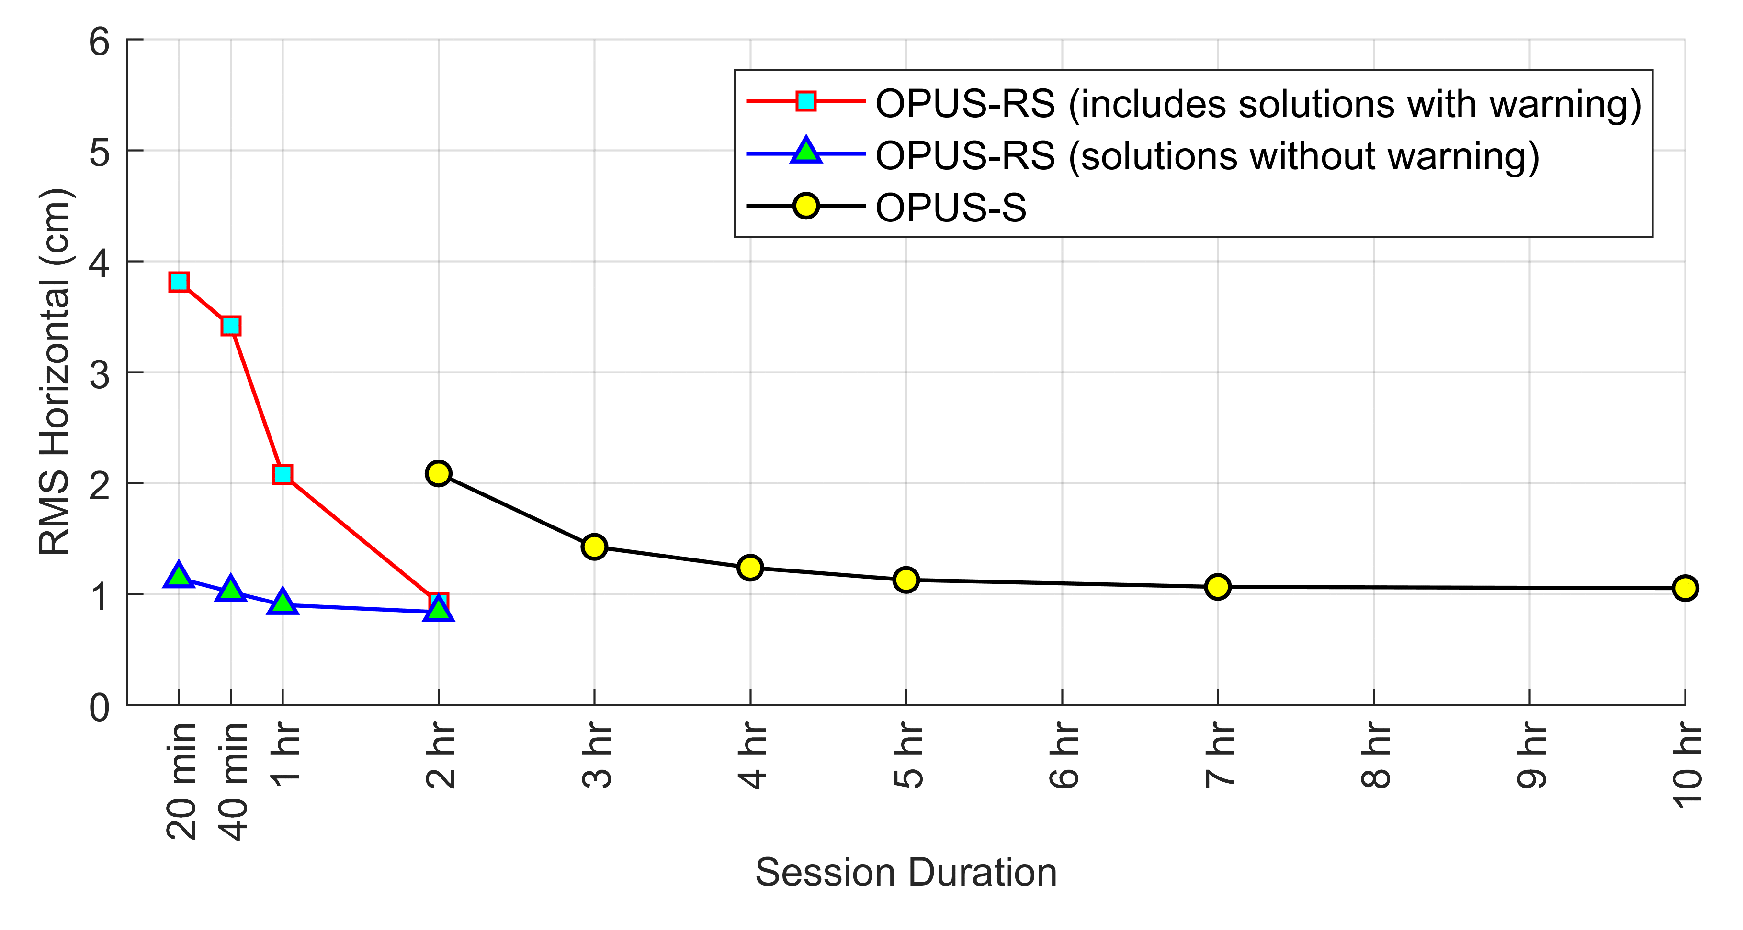
Data Collection Duration
Data Processing
NRCAN
(CSRS-PPP)
2hrs +
Ultra Rapid
Rapid
Final Orbits
2hr 24hr 14 days
Time Post-Survey
15min – 2hrs
Rapid Static
OPUS
2hrs +
Static

Slide 30
Applications of RTK GNSS
Students discuss at first:
Text here

Slide 31
Applications of RTK GNSS
Students discuss at first:
Delineating or measuring migration of a river channel with proximity to a valuable resource or infrastructure
Measuring movement on a natural hazard such as a landslide, earthflow, or slump
Delineate or measure motion of monuments on a glacier, glacial retreat or snowpack change
Measuring a scarp surface or profile to determine potential hazard to infrastructure with earthquakes
Creating topographic models of flood plains to calculate flood volume and determine potential for flood hazard at various stage levels
Create digital elevation models to determine slope stability with addition of roadcuts or other infrastructure

Slide 33
Applications of GNSS
Recreational & Mapping Systems (phones, consumer-type, mobile GIS devices)
  Inexpensive, low complexity, short occupations, rapid results, low-precision positions
Kinematic Systems (Unit 2)
  Expensive, moderate complexity, short occupations, positions can be rapid or require post-processing, high-precision positions
Static Systems (Unit 3)
  Expensive, high complexity, long occupations required, long and complex post-processing required, extremely high-precision positions.
Notes:
Images: Ben Crosby, ISU

Slide 34
Anatomy of a high-precision permanent “static” GNSS station
GNSS antenna inside of dome
Monument solidly attached into the ground with braces.
If the ground moves, the station moves.
Solar panel for power
Equipment enclosure
GNSS receiver
Power/batteries
Communications/ radio/ modem
Data storage/ memory
Notes:
Example of a typical remote GPS station. In urban areas, some are also fixed to the roof of large reinforced buildings and hooked into grid power supply with battery backup. Many stations are now being equipped with “real-time” communication to allow immediate transfer of data to researchers. In other places logistics or country-specific regulations require that data not be transmitted but is instead downloaded manually on a given schedule (monthly, quarterly, or annually, depending on the site)

Slide 35
High-precision GNSS requires…
Stable monuments
Multiple stations
Sophisticated processing
Collecting lots of data
Using the carrier phase
Dual-frequency receivers
High-precision orbital information (ephemeris)
→ with several years of data can determine velocities to 1–2 mm/yr
Notes:
The primary GPS signal is transmitted at a “carrier’ frequency of 1575 MHz (“L-band”), corresponding to a wavelength of 19 cm. As with FM radio, This signal is then modulated at a much lower frequency to each modulated to incorporate information about the time and location of the satellites. The precision of the pseudorange is limited by the modulation frequency to about 10 cm. In high-precision GPS we use the carrier phase itself to obtain a measurement precision of 10 cm
Simple GPS receivers use code-phase to determine locations to an accuracy of 3–6 meters. Essentially code-phase is bigger chunks of signal. High-precision receivers use the carrier phase of the signal. You can think of this as being able to line up smaller chucks of code between the satellite and the receiver. This leads to smaller errors and more precise locations. Trimble has a more full explanation of the difference (http://www.trimble.com/gps_tutorial/sub_phases.aspx).
Dual-frequency receivers can “tune in” to the satellite signal at more than one frequency. You can think of this as listening to more than one radio station at the same time. In the case of GPS, this can allow for reduction in error from the ionosphere delays.

