Slide 1
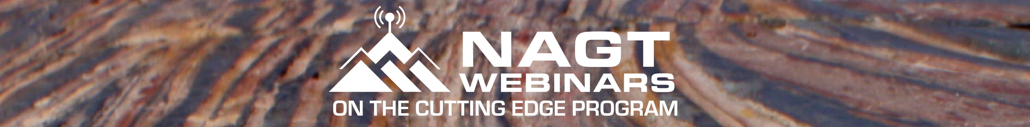
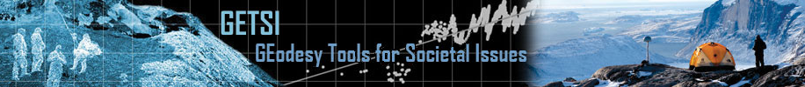



Teaching About Volcanoes with Monitoring Data and Communicating Risk
Sponsoring Project
Ask as we go along!
As you enter, please review the Zoom controls below. Leave your audio and video off, unless prompted by a host. You can post any questions in the chat box. Thank you!
Please leave your audio muted and video off (both indicated by a red slash).
Click to open the Participants box. This will allow you to give nonverbal feedback.
Click to open the Chat box. This will allow you to chat with Hosts and Participants.
Join or Renew Today!
http://nagt.org/37340
Notes:
Invite people to continue typing into the chat box about technical or specific questions about the modules and the authors will attempt to address as we go along

Slide 2

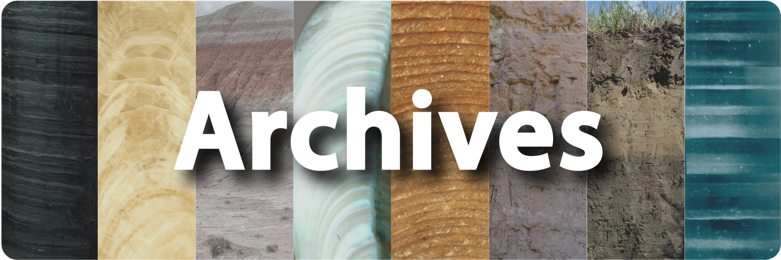


Welcome to the NAGT webinar series
Improving Earth education one hour at a time
NAGT sponsors a comprehensive webinar series that is sure to be your one-stop-shop for strengthening work in Earth education. Webinars feature novel and innovative work in Earth education research and pedagogy, new teaching materials, and classroom and professional experiences of people like you. The NAGT webinar series is free and we encourage you to invite your colleagues to attend and join the discussion.
See the full schedule and archives
at the NAGT Webinar Series Homepage
http://nagt.org/190616
Join or Renew
http://nagt.org/37340
Get Involved in NAGT
http://nagt.org/95944
Sponsoring Projects and Programs

Slide 3
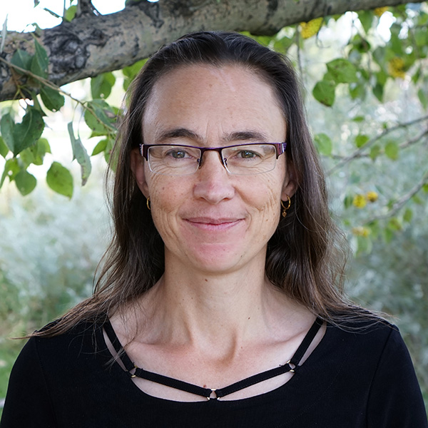

Teaching About Volcanoes with Monitoring Data and Communicating Risk
Monitoring Volcanoes and Communicating Risk module
serc.carleton.edu/getsi
Photo from Sarah Kacovich
Beth Pratt-Sitaula
UNAVCO
Kaatje Kraft
Whatcom Community College

Slide 4
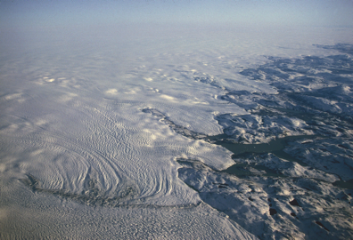
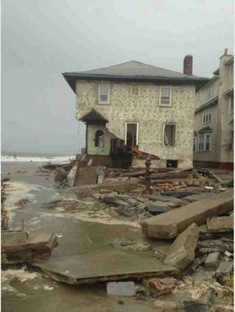
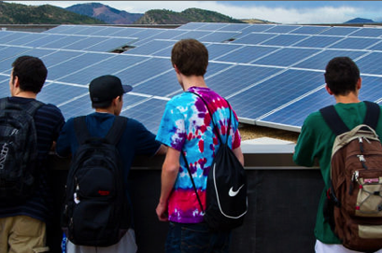
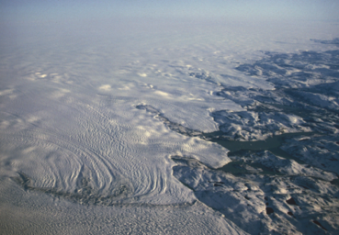
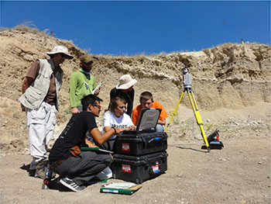
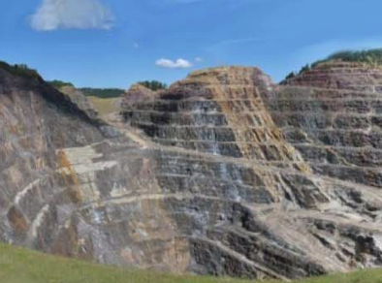

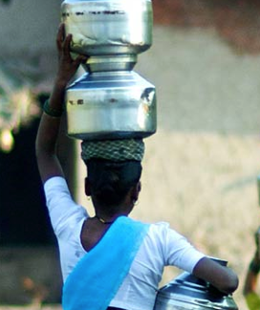
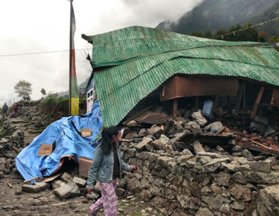
Solving societal challenges
Increasing student STEM engagement
Complementary paths to improvement
Notes:
Both projects had a shared vision of the value of putting science learning in a societal context.
Image sources: (all offered under a Creative Commons Attribution-NonCommercial-ShareAlike license)
(damaged house) https://commons.wikimedia.org/wiki/File:Damage_from_Hurricane_Sandy_to_house_in_Brooklyn,_NY.jpeg#/media/File:Damage_from_Hurricane_Sandy_to_house_in_Brooklyn,_NY.jpeg)
(Greenland ice) https://upload.wikimedia.org/wikipedia/commons/f/f9/Greenland-ice_sheet_hg.jpg
(students and solar panels) http://images.nrel.gov/viewphoto.php?&albumId=207379&imageId=6314201&...
(students at computer) https://commons.wikimedia.org/wiki/File:Wikipedians_in_Atlanta,_December_2012...
(student in the field) Bruce Douglas https://www.unavco.org/education/advancing-geodetic-skills/short-courses/2016/field-education/field-education.html
(mine) https://www.flickr.com/photos/baggis/5156621907/in/photostream/
(earthquake damage) By Sumita Roy Dutta - Own work, CC BY-SA 4.0, https://commons.wikimedia.org/w/index.php?curid=40998384
(water carrier) https://www.flickr.com/photos/danielbachhuber/3142801676

Slide 5

GETSI Project Overview
Mission: Develop and disseminate teaching and learning materials that feature geodesy data & quantitative skills applied to critical societal issues such as climate change, water resources, and natural hazards
US National Science Foundation funded (4 grants)
Developing 13 modules (~2 weeks each)
  Introductory & Majors-level
  Classroom & Field

Slide 6
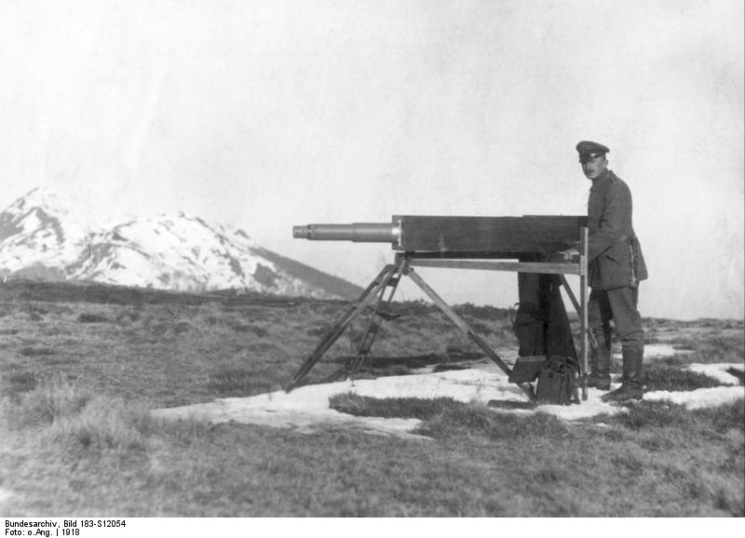

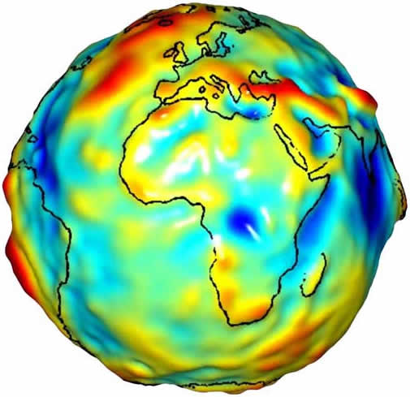
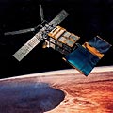
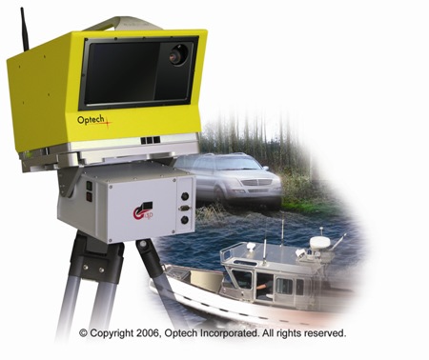

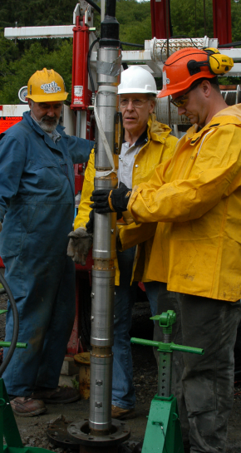
Geodesy is…
…the science of accurately measuring the Earth’s size, shape, orientation, mass distribution and the variations of these with time.
Traditional geodesy:
Precise positioning of points on the surface of the Earth
Modern geodesy:
A toolbox of techniques to better measure the Earth
wikipedia.org
JPL/NASA
6
Notes:
6
6
To make sure we are on the same page about what geodesy is…
As we got better and better at measuring points on the Earth, it evolved into being able to determine how they change.
Think of geodesy as a toolbox of ways to better measure the Earth’s size, shape…etc

Slide 7
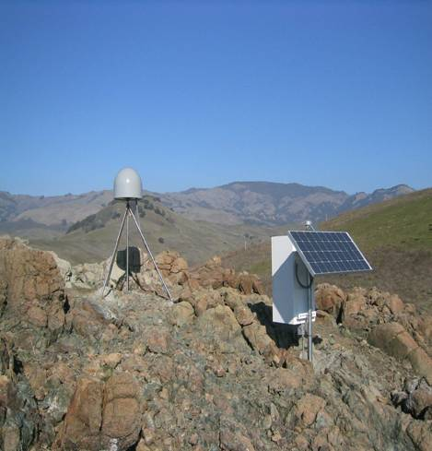
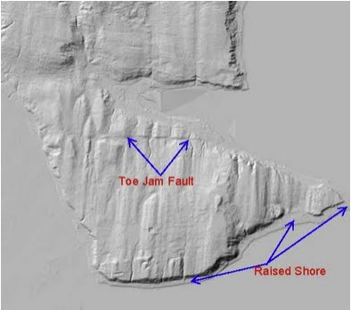
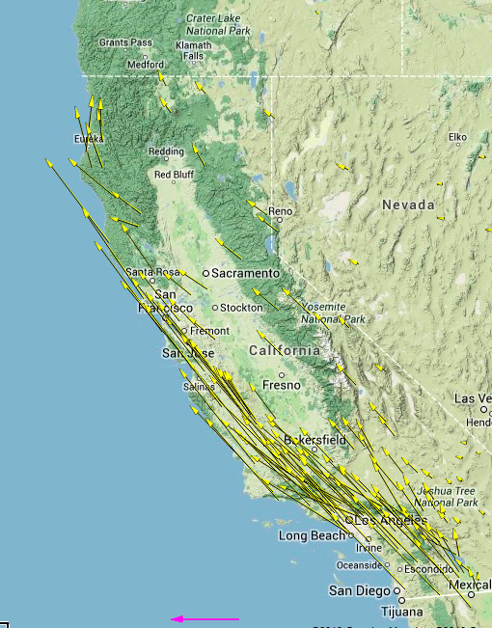
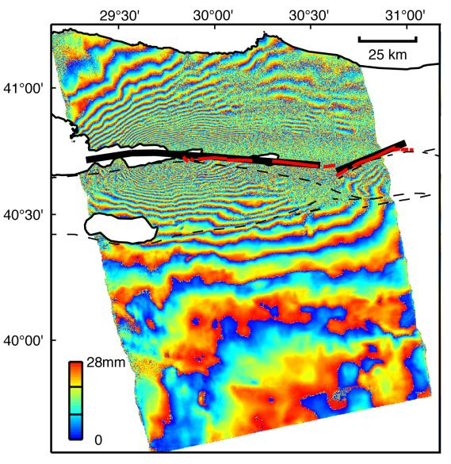
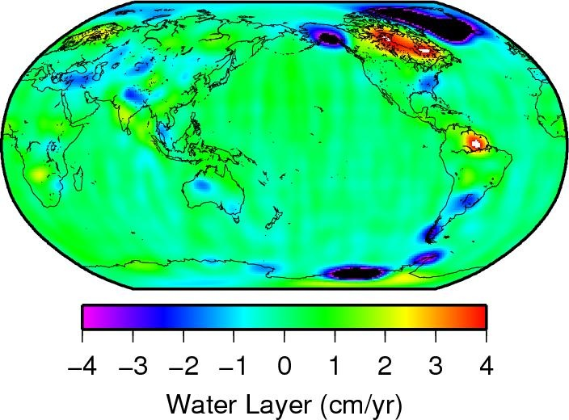
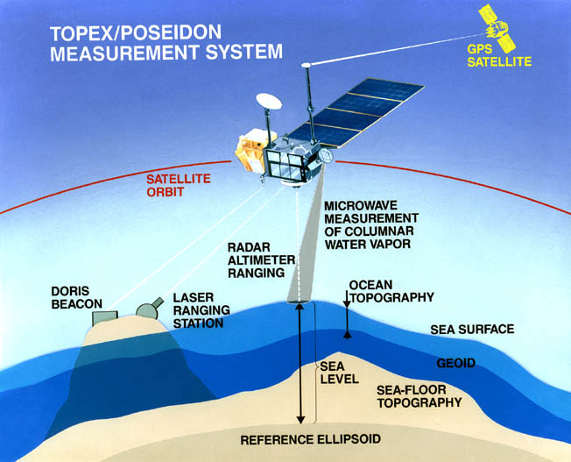
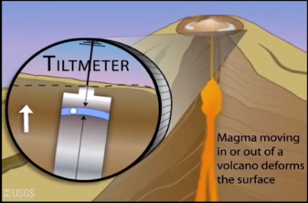
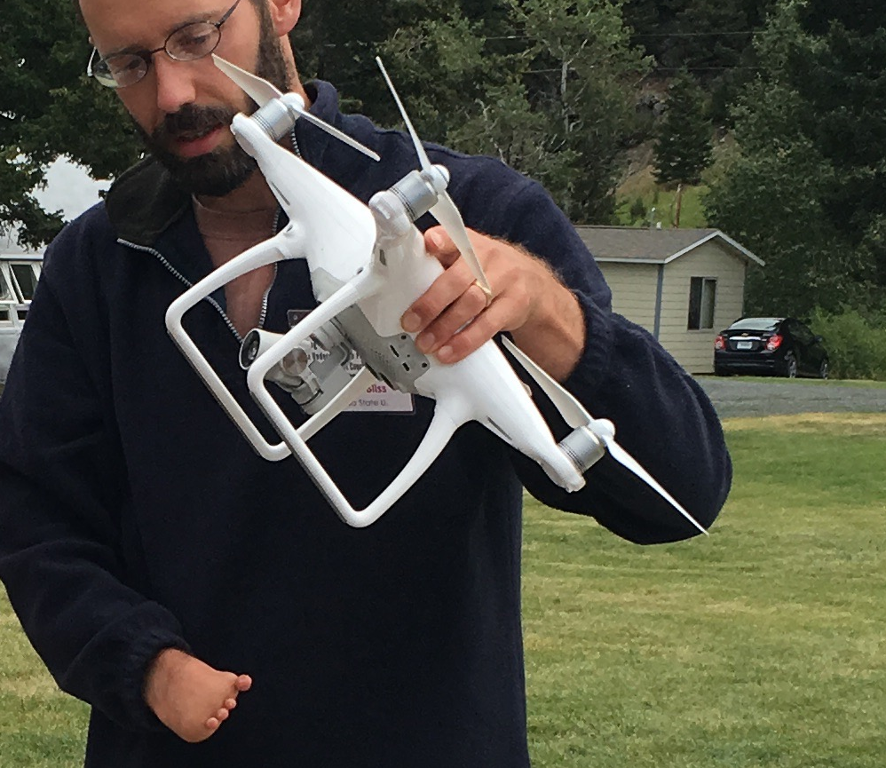
Unpacking the Geodesy Toolbox
GPS (Global Positioning System)
InSAR (Interferometric synthetic aperture radar)
LiDAR (Light detecting and ranging)
Structure from Motion
Strain meters, tiltmeters, creep meters
Gravity measurements
Sea level & ice altimetry
GPS (Global Positioning System)
InSAR (Interferometric synthetic aperture radar)
LiDAR (Light detecting and ranging)
Structure from Motion
Strain meters, tiltmeters, creep meters
Gravity measurements
Sea level & ice altimetry
usgs.gov
http://www.nasa.gov/topics/earth/features/graceImg20091214.html
www.jpl.nasa.gov
http://photojournal.jpl.nasa.gov/catalog/PIA00557
http://facility.unavco.org/data/maps/GPSVelocityViewer/GPSVelocityViewer.html
http://www.iris.edu/
Notes:
Geodetic methods include…

Slide 8
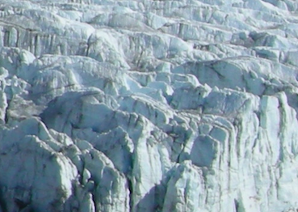
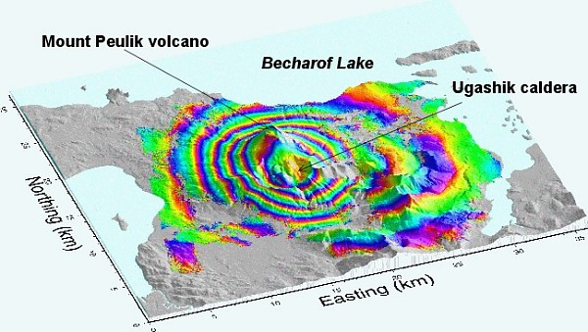
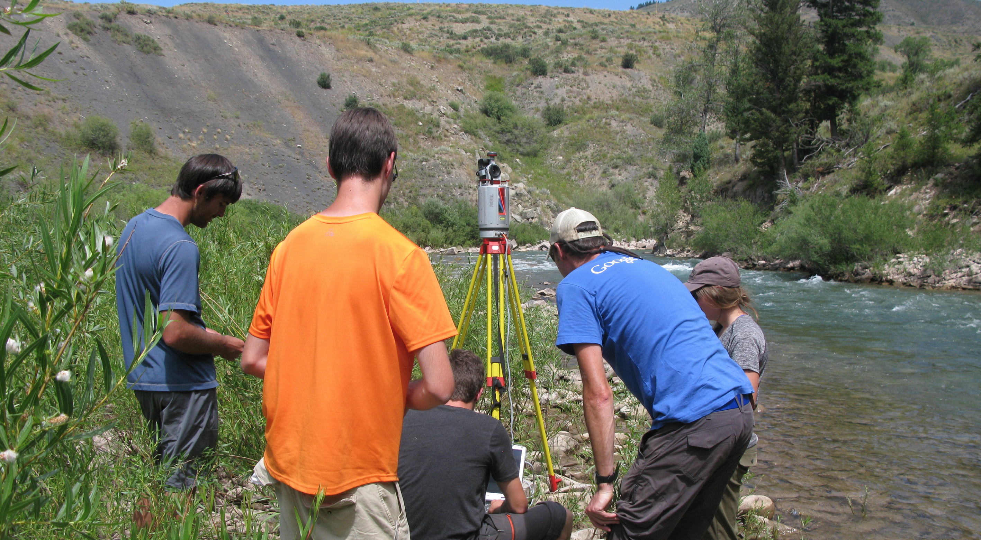
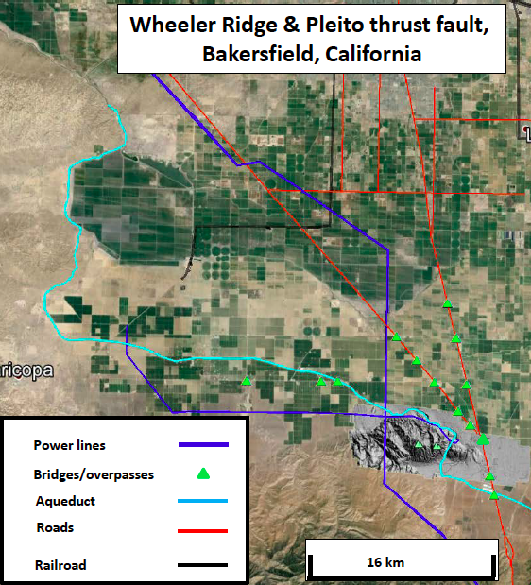
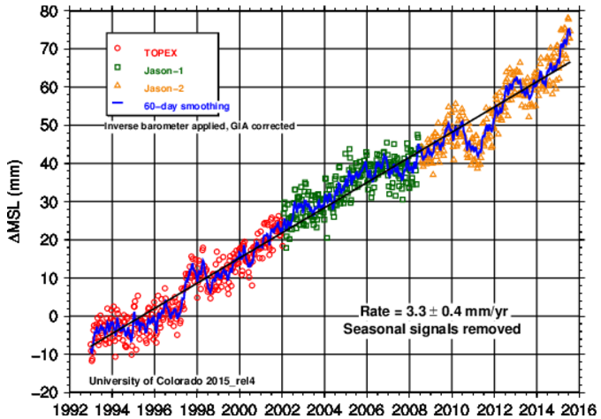
Module components & Development process
Guiding Principles
Address one or more geodesy-related grand challenges facing society
Make use of authentic and credible geodesy data
Improve student understanding of the nature and methods of geoscience
Develop student ability to address interdisciplinary problems and apply geoscience learning to social issues
Increase student capacity to apply quantitative skills to geoscience learning
Guiding Principles
Address one or more geodesy-related grand challenges facing society
Make use of authentic and credible geodesy data
Improve student understanding of the nature and methods of geoscience
Develop student ability to address interdisciplinary problems and apply geoscience learning to social issues
Increase student capacity to apply quantitative skills to geoscience learning
Images: B. Douglas, USGS, N. Niemi, GETSI, CU Sea level group

Slide 9
GETSI-InTeGrate partnership
Identify module learning goals
Identify unit learning outcomes
Determine assessment strategy
Design teaching materials to match assessment
Plan instruction strategies
Pilot Materials
Revise
Module development and assessment following model of SERC’s InTeGrate Project (NSF STEP)
serc.carleton.edu/integrate

Slide 10


Polling the group
“Raise” your hand if you already use any geodetic or seismic data in your teaching.
Now “unraise” your hand
Which of these volcanic monitoring methods do you know the least about:
  InSAR
  High precision GPS
  Lidar
  Seismic
Poll #1
Notes:
Poll#1
Which of these do you know the least about:
InSAR
High precision GPS
Lidar
Remind people to type into the chat box about technical or specific questions about the modules and the authors will attempt to address as we go along
Urge them “Write for yourself (paper or text doc) -- What course might you teach this in? -- How much time might you have available?

Slide 11
Introduction to volcanic monitoring METHODS
(mostly Geodetic)

Slide 12
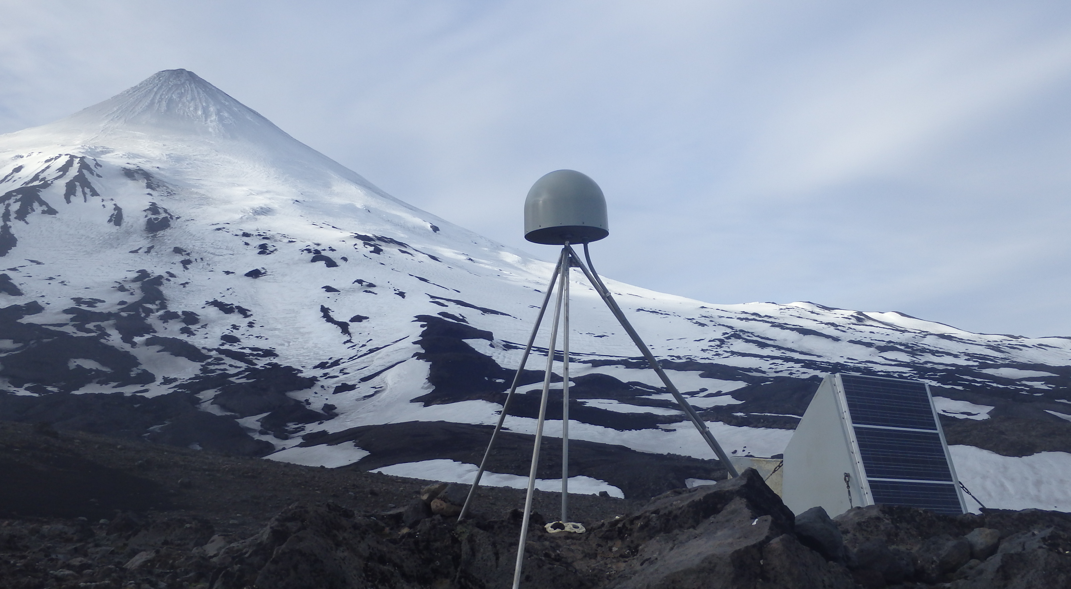
High Precision GPs
Notes:
UNAVCO (https://www.unavco.org/instrumentation/networks/status/pbo/AV37)

Slide 13
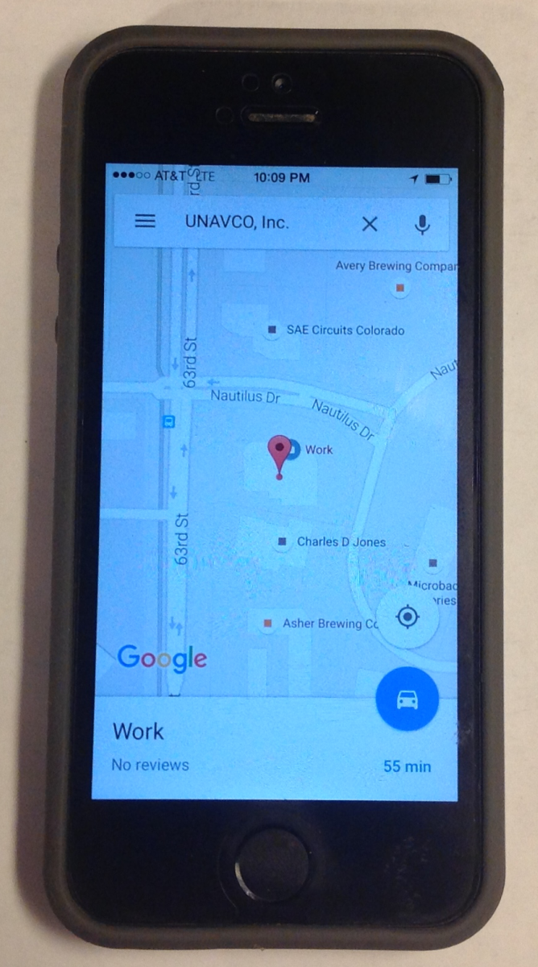
What Is GPS?
GPS receivers are in phones, cars, etc.—basically anything that tells you where you are
This is a great entry point for engaging students
Notes:
Whether they know it or not, students use GPS receivers daily in their cars, phones, cameras, and handheld recreational GPS. Most have heard the term “GPS,” but few know much about how the system actually works or high-precision GPS for science and industrial use.
Note: Although the term GPS (Global Positioning System) is more commonly used in everyday language, it officially refers only to the USA's constellation of satellites. GNSS (Global Navigation Satellite System) is a universal term that refers to all satellite navigation systems including those from the USA (GPS), Russia (GLONASS), European Union (Galileo), China (BeiDou), and others. In this module, we use the term GPS even though, technically, some of the data may be coming from satellites in other systems.
Images from UNAVCO

Slide 14
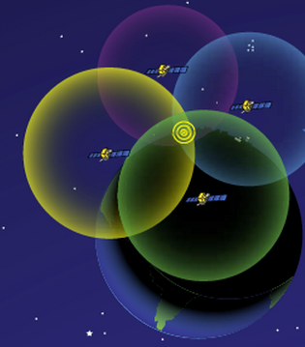
How Does GPS Work?
Receiver position is determined by calculating the distances to at least 4 satellites
Solve for the variables:
  North–South position
  East–West position
  Elevation
  Time
http://spaceplace.nasa.gov/gps-pizza/en/
Notes:
The time element is needed because of the difference between the highly accurate atomic clock on the satellites (US$100,000 each) and the much cheaper clock in the GPS receivers.
Although 4 is a technical minimum number of satellites, for geoscience research work it is highly recommended to have at least 6 satellites.
Although people will often refer to this process and “triangulation,” in fact it is “trilateration” because it depends on distances rather than angles.
For a nice explanation of trilateration versus triangulation visit https://gisgeography.com/trilateration-triangulation-gps/.
Images from NASA (public domain) http://spaceplace.nasa.gov/gps-pizza/en/

Slide 15
High-Precision Permanent GPS station
GPS antenna inside of dome
Monument solidly attached into the ground with braces.
If the ground moves, the station moves.
Solar panel for power
Equipment enclosure
GPS receiver
Power/batteries
Communications/radio/modem
Data storage/memory
Notes:
Example of a typical remote GPS station. In urban areas, some are also fixed to the roofs of large reinforced buildings and hooked into grid power supply with battery backup. Many stations are now being equipped with “real-time” communication to allow immediate transfer of data to researchers. In other places logistics or country-specific regulations require that data not be transmitted but is instead downloaded manually on a given schedule (monthly, quarterly, or annually, depending on the site).

Slide 16
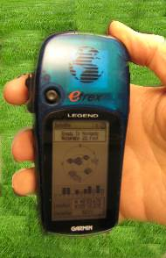
Antennas receive data streams
Works the same…
Your location is:
37º 23.323’ N
122º 02.162’ W
The time is:
11:34.9722 (UTC)
ERRORS (after 8 hrs)
Horiz: ± 2-4 mm
Vert: ± 10-15 mm
ERRORS
Horiz: ± 10 m
Vert: ± 15 m
RATES
~1 mm/year
after ~2 years
Notes:
Since each satellite maintains time very accurately (~1 nanosecond = 30 cm), it can tag its signal with the time of transmission. This information, together with the location of the satellite, also transmitted to the receiver, is sufficient to allow the receiver to calculate the range to each satellite, provided that the receiver also knows the time. Equipping receivers with atomic clocks would be very expensive, so the receiver tags the signal with the time of its internal clock to create a “pseudorange” (range plus an unknown clock correction). The software in the receiver then uses the pseudoranges from four satellites to solve for the four unknowns: three coordinates and the receiver clock correction.
Images: Vince Cronin (Baylor University)
High precision rates taken from GAMIT/GLOBK 10.6 release notes - http://geoweb.mit.edu/gg/
After 24 hours
Horz: +/- 1-2 mm
Vert: +/- 5 mm

Slide 17
Volcanic deformation with GPS and Tilt

Slide 18
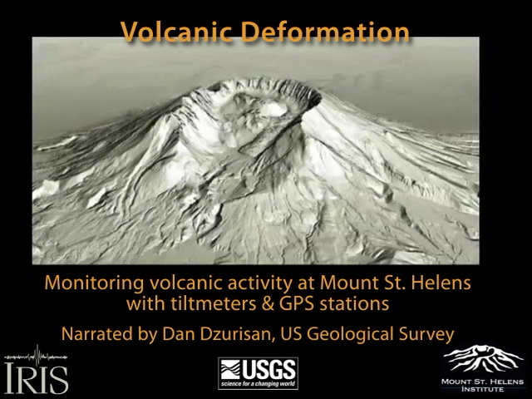

Slide 19
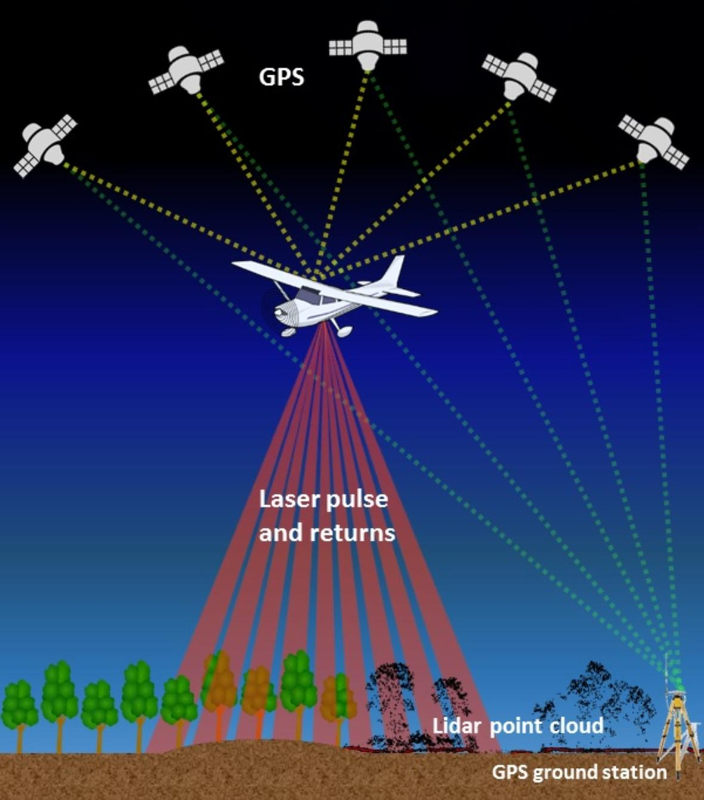
Lidar
Scanner measures the time delay between emitting laser pulse and the reflected return
(also depends on GPS)
Notes:
Image is Public Domain https://www.usgs.gov/media/images/graphic-depicting-airborne-lidar-system

Slide 20
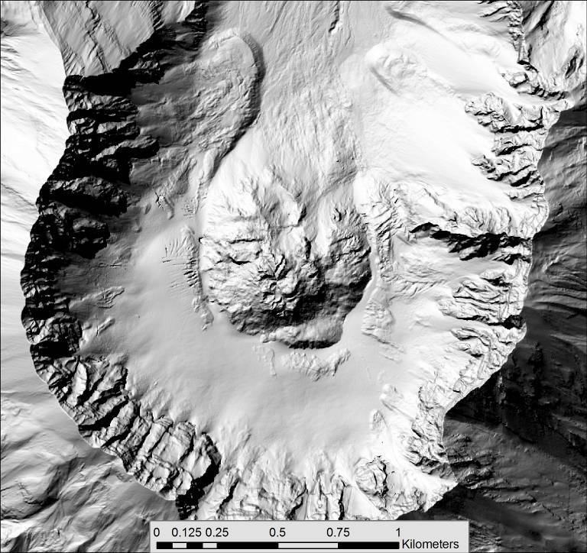
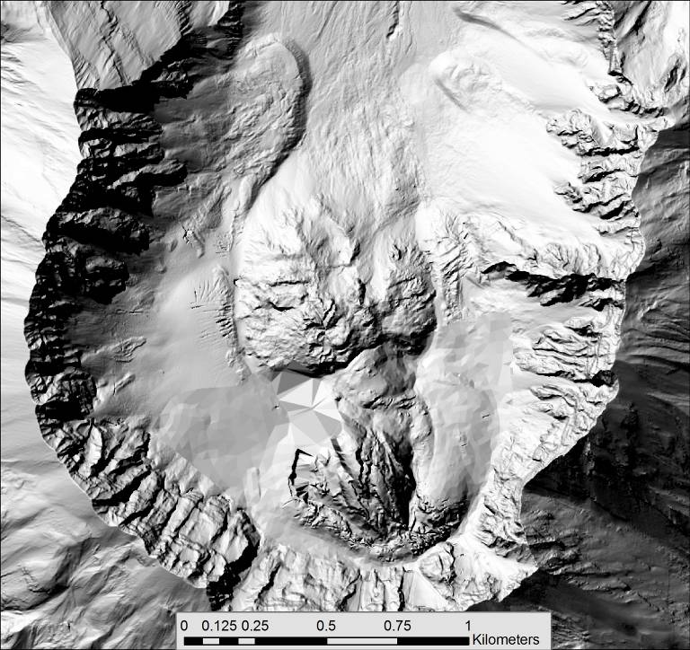
Final 2004-2008 Activity: LiDAR Images
September 2004
January 2005
Notes:
Slide shows LiDAR images that illustrate how the dome grew over the next several months. Instructors may want to show a composite video instead: https://volcanoes.usgs.gov/volcanoes/st_helens/st_helens_monitoring_109.html
And video of suite of photos collected from rim of MSH 2004-2008 (1min 27 sec) is here:
https://www.youtube.com/watch?v=h6B1myUKAS4

Slide 21
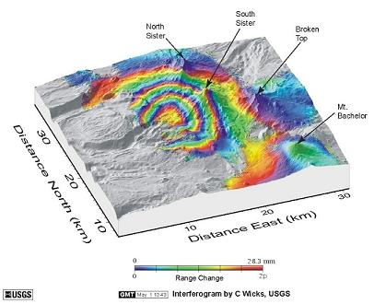
Using InSAR to Measure Volcanic Deformation

Slide 22
InSAR
Interferometric
Synthetic
Aperture
Radar
use wave interference
pretend you have a big radar antenna
emit microwaves,
measure echoes
Notes:
SAR (Synthetic Aperture Radar) is an imaging technique in its own right that uses the amplitude (intensity) of backscattered radar from the ground as a means of imaging it. A single image acquisition is all that is needed to produce a SAR image. Typically we do not use the phase of a single SAR image for imaging purposes.
On the other hand, we can use the phases of multiple SAR images. InSAR is a method that uses two or more SAR images to measure movements of Earth’s surface, by calculating the interference between the phases of the SAR images.
Elements of this InSAR presentation are taken from a presentation developed by Gareth Funning (UC Riverside) for GETSI module “Imaging Active Tectonics” Unit 3. https://serc.carleton.edu/details/files/63910.html

Slide 23
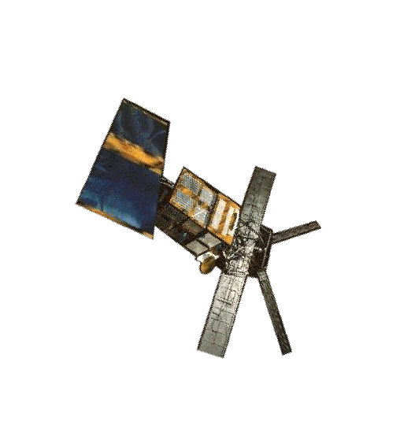
SAR: how it works
Satellite emits radar pulse
Radar is backscattered
Amplitude (intensity) and phase of echo recorded at the satellite
Notes:
The radar antenna on a satellite (shown here is ERS-1, the first long-lived orbiting SAR satellite, launched in 1991) is both an emitter of radar and a detector of radar. A pulse of microwave radiation is emitted toward the ground, and some of it is scattered back to the satellite. The antenna records both the amplitude (intensity) and phase of the backscattered radar. A typical radar satellite makes over a thousand such measurements every second (in the case of ERS-1, 1680 measurements per second).
Image from: https://nsidc.org/sites/nsidc.org/files/technical-references/GIMP-ATBD-Version2.pdf
Landsat image of the Kangerdlussuaq Glacier is used for illustration purposes.

Slide 24
Phase
Phase is a function of the distance from the satellite to the ground.
ERS-1
~6 cm
~780 km
Notes:
In this example, the ERS-1 satellite has a wavelength of ~6cm (called “C-band”), so the resolution of changes is ½ the wavelength and thus ~3cm.
Recall that one wavelength of path length is equivalent to 2π of phase. Given that radar satellites orbit at several hundred km of elevation, it is not feasible to count the number of phase cycles for a single image . . .
Image from: https://nsidc.org/sites/nsidc.org/files/technical-references/GIMP-ATBD-Version2.pdf
Landsat image of the Kangerdlussuaq Glacier for illustration purposes.

Slide 25
InSAR: No Change
Pass 1
Pass 2
Notes:
. . . So what we do is compare (difference) the phase from two different passes of the same satellite over the same point on the ground. Assuming that we can correct for the position of the satellite (and we can), then any difference in phase between the two passes must be related to a change in distance between the satellite and the ground (i.e. a movement of the ground – in this case the surface of the volcano).
In the example shown here, there is no change between the two passes (actually they are the same image), so we would determine no movement.

Slide 26
InSAR: Change in time
Pass 1
Pass 2
Phase shift due to volcano deformation (here deflation)
Notes:
In this case there is change (although to the human eye, it would be hard to detect) between the two passes, so we can detect a phase shift when we subtract the phase of the second image from the phase of the first!
It is important to note that we can only measure displacement of the ground toward or away from the satellite, in the line-of-sight direction between the two. Everything we measure is a “line-of-sight” displacement.
Sentinel-1 satellites have repeat times of 6 days. Other satellites range may only repeat every ~30–90 days

Slide 27
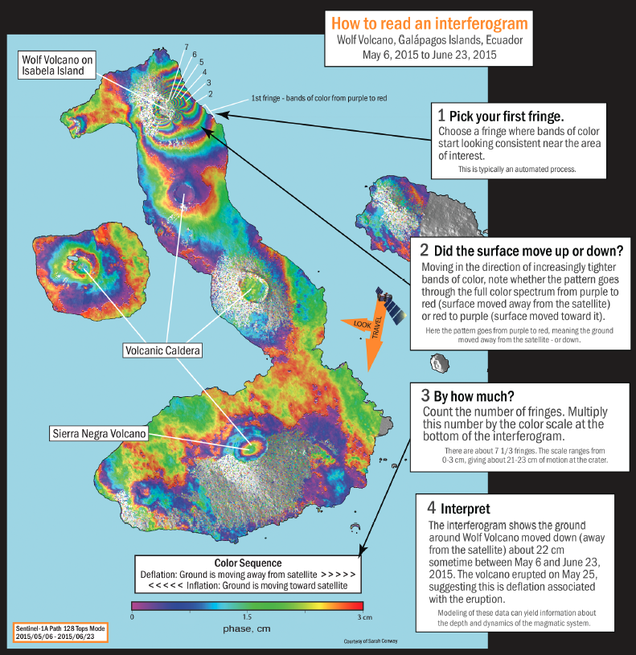

Slide 28
SEISMIC monitoring

Slide 29
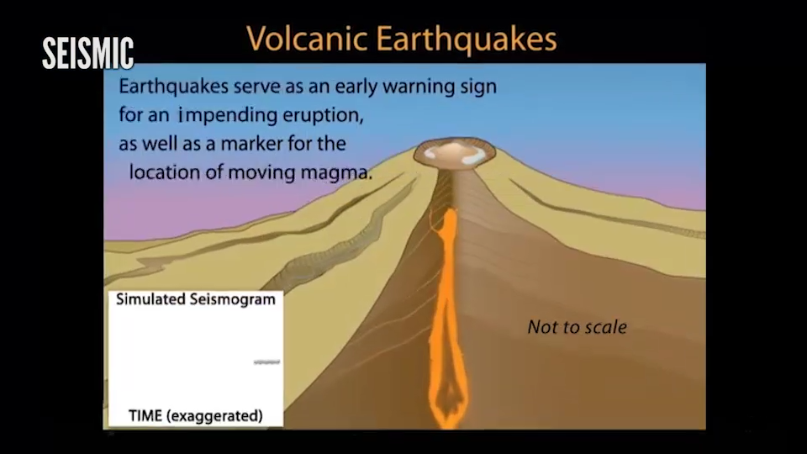

Slide 30
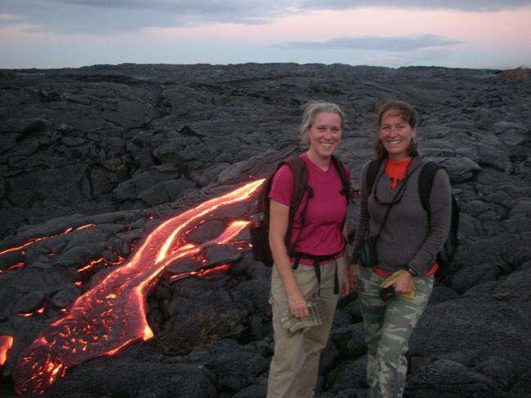
Monitoring Volcanic Hazards and Communicating Risk
By Kaatje van der Hoeven Kraft & Rachel Teasdale

Slide 31
Module Goals
Students will be able to:
Interpret geodetic data in the context of monitoring volcanoes in order to assess geologic conditions without direct observations
Use geodetic data within the constraints of realistic data sets (e.g. incomplete, seemingly contradictory results) in order to forecast volcanic activity
Identify the risks and hazards associated with volcanoes
Use evidence-based arguments to communicate that monitoring is an ongoing effort
Notes:
31

Slide 32
Monitoring Volcanoes and Communicating Risk
Unit 1 Renewed Activity at Mount St. Helens in 2004
Introduction to geodetic data and hazards from a dome/stratovolcano
Unit 2 Kilauea, Hawaii, Monday Morning Meeting at the Volcano Observatory
Students analyze data (GPS, Tilt, Seismic, and InSAR) to forecast an eruption at a shield volcano to consider hazards and cultural implications
Unit 3 Yellowstone is active but not erupting?
Students examine Seismic, GPS, and InSAR data in the context of a caldera-style volcano which indicates swarms of earthquake do not indicate an imminent eruption
Unit 4 Assessment of monitoring 3 different types of volcanoes: Mauna Loa, Fuego, & Rinjani
Students assess risks from three different volcanoes based on the risk equation = Hazard x Value x Vulnerability

Slide 33
Strengths of the Module
Flexibility
  Can be used as individual units or as a complete module
  Components can be used as homework, in class, or in lab
  Individual, small groups, and/or large-group discussions
  Large and small classes
Use real data to solve societally relevant problems
  Authentic data
  Students make data-supported recommendations about a societally relevant problem
Models scientific thought
  Guides students to approach reading data as scientists
  Students make observations to describe data both qualitatively and quantitatively, interpret what that data mean after learning the geologic processes involved, and apply what they learned to support arguments
  Strong metacognitive component
Notes:
33

Slide 34
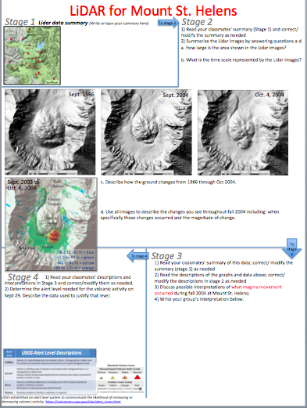
Unit 1: Renewed Energy at Mount St. Helens
[Pre-reading introduces Mount St. Helens history]
Parts A-C: Gallery Walk –exploring Seismic, GPS, and Lidar from 2004 activity;
forecasting USGS alert
Part D: Assessing possible
hazards to local populations
Part E: “Reveal” of events that
unfolded, including alert levels
*Can be completed in one 75 minute class or in two 50 minute classes
Notes:
Video reveal with Cynthia Gardner, USGS (SIC at the time of the eruptive activity)

Slide 35
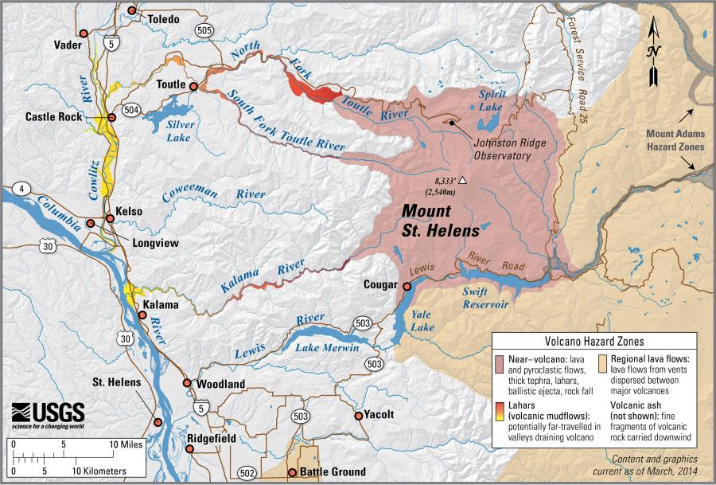
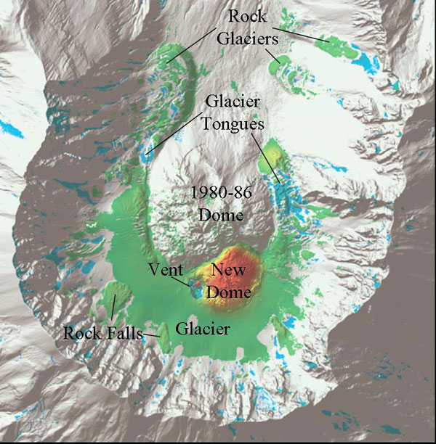
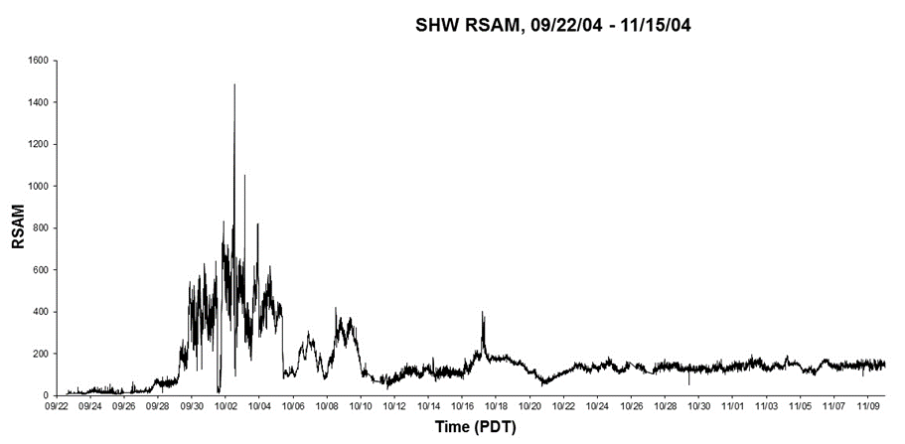
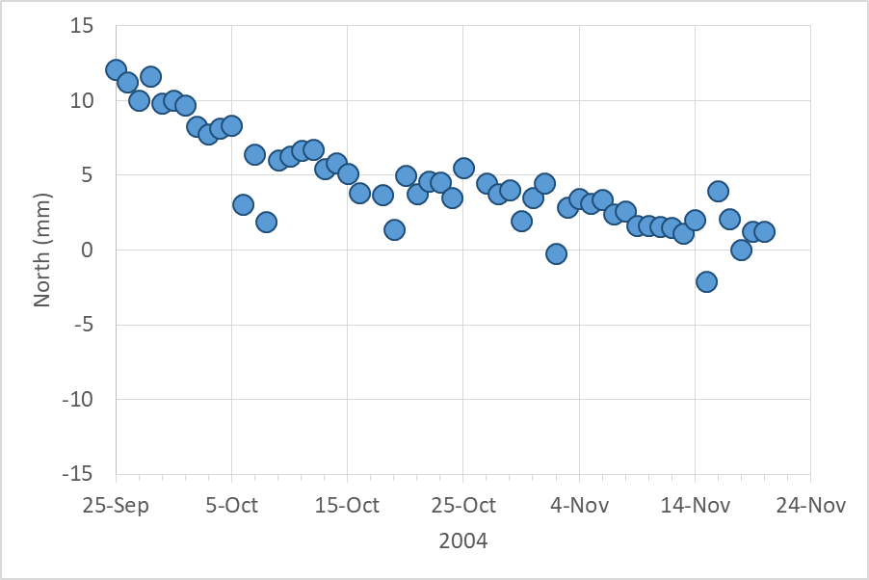
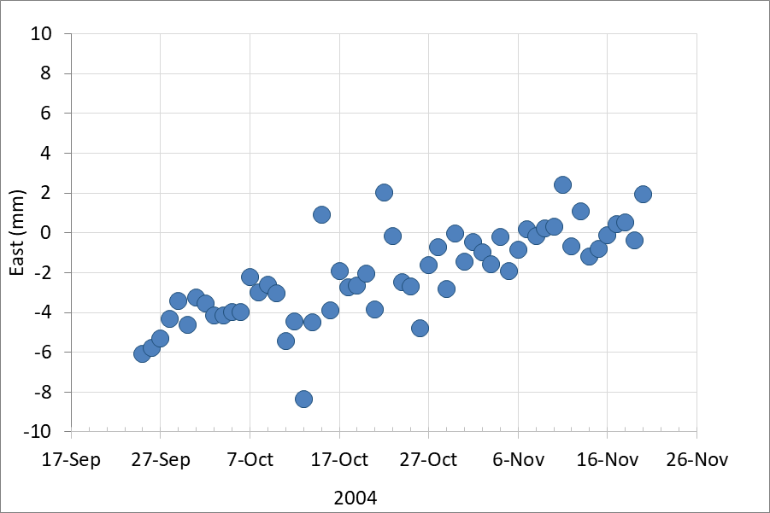
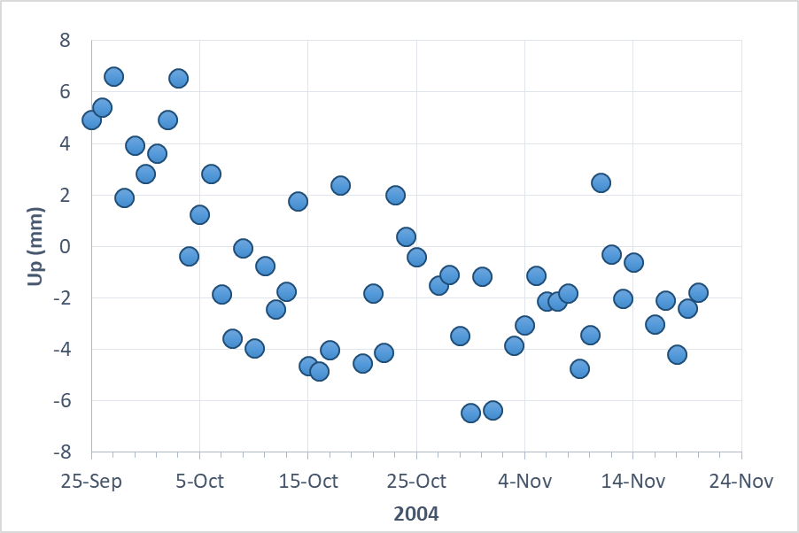
Unit 1: Monitoring Volcanic Activity at Mount St. Helens
Sept. 2003 to
Oct. 4, 2004
Seismic: Real-time Seismic Amplitude Measurement
-0.5 to -30 m = blue
+1.5 to 40 m = green
+40 to 80 m = yellow
+80 m to 120 m = orange
Lidar
GPS
Notes:
35

Slide 36


Unit 1: Monitoring Volcanic Activity at Mount St. Helens
?
Poll #2
Given the data provided, what is the maximum alert level would you recommend for the USGS and when?
USGS Alert Level Descriptions
RSAM 9/22/04 – 11/15/04
Real-time Seismic Amplitude Measurement
10/2
9/29
10/8
9/25
USGS established an alert level system to communicate the likelihood of increasing or decreasing volcanic activity. https://volcanoes.usgs.gov/vhp/alert_icons.html
Notes:
Poll #2
What is the maximum alert level would you call for?
Normal
Advisory
Watch
Warning
When would you call the alert assigned?
9/25
9/29
10/2
10/8
36

Slide 37
Societally Relevant Problems in Each Unit
Unit 1 Renewed Activity at Mount St. Helens in 2004
  Which regions are likely to be impacted by which hazards
Unit 2 Kilauea, Hawaii, Monday Morning Meeting at the Volcano Observatory
  Cultural sensitivities to proposals of lava re-routing
Unit 3 Yellowstone is active but not erupting?
  Consider how to communicate non-explosivity to a skeptic
Unit 4 Assessment of monitoring 3 different types of volcanoes: Mauna Loa, Fuego, & Rinjani
  Consider socioeconomic, infrastructure, and corruption levels in each location
Notes:
37

Slide 38


Societally Relevant Problems in Each Unit
Unit 1 Renewed Activity at Mount St. Helens in 2004
Which regions are likely to be impacted by which hazards
Unit 2 Kilauea, Hawaii, Monday Morning Meeting at the Volcano Observatory
Cultural sensitivities to proposals of lava re-routing
Unit 3 Yellowstone is active but not erupting?
Consider how to communicate non-explosivity to a skeptic
Unit 4 Assessment of monitoring 3 different types of volcanoes: Mauna Loa, Fuego, & Rinjani
Consider socioeconomic, infrastructure, and corruption levels in each location

Slide 39

Unit 2: Kilauea, Hawaii, Monday Morning Meeting at the Volcano Observatory
[Pre-reading introduces lava flow hazards]
Jigsaw analyzing data (seismic, GPS, InSAR, & Tilt) from an eruptive event in 2007
Discussion of the pros and cons of lava diversion, including cultural
sensitivities
*Two 50 minute classes or modified version for one 50-minute class

Slide 40





Unit 2: Kilauea, Hawaii, Monday Morning Meeting at the Volcano Observatory
Notes:
40

Slide 41

Unit 3: Yellowstone is active but not erupting?
[Pre-reading introduces Mean Recurrence Intervals (MRIs) and Seismic Swarms]
Seismic Swarm data by decade in small
groups with full class analysis of MRIs
Compare Swarms to GPS and
InSAR to one decade
Ask students to respond to a
friend who thinks Yellowstone
is about to erupt
*50-75 minute time period
Notes:
https://www.unavco.org/instrumentation/networks/status/nota/overview/P709

Slide 42
Unit 3: Yellowstone is active but not erupting?
?
Poll #3
How many swarms do you identify?
Notes:
Poll #3
How many swarms do you identify?
1
2
3
4
5
42

Slide 43
Unit 3: Yellowstone is active but not erupting?
?
Poll #3
How many swarms do you identify?
Notes:
Poll #3
How many swarms do you identify?
1
2
3
4
5
43

Slide 44



Unit 4: Assessment of monitoring 3 different types of volcanoes: Mauna Loa, Fuego, & Rinjani
[Pre-reading introduces VEI variation]
Mixed groups work on risk (= hazard x value x vulnerability): examining VEI, MRI, monitoring equipment, socioeconomic status, corruption index, infrastructural vulnerabilities, and population density
Re-mixed groups (or as whole class) determine highest, middle and lowest
risk volcanoes
Write a letter to a political official about the need for ongoing monitoring of volcanoes
*50-75 minute time period

Slide 45
Challenges & Solutions
Challenge #1: I can’t cover the content I need to cover
Solution: These units cover all the typical content of a volcanic unit:
  Three different types of volcanoes
  Associated hazards
Notes:
45

Slide 46




Challenges & Solutions
Challenge #2: Students can get overwhelmed
Notes:
46

Slide 47
Challenges & Solutions
Break it up
  e.g. Units 1 & 2 have options for how to modify it for different class lengths
  e.g. Unit 1 as in class activity, Unit 2 as a lab, Unit 3 in lab the next week, Unit 4 as a homework
Notes:
47

Slide 48
Challenges & Solutions
Challenge #3: Grading
Notes:
48

Slide 49

Challenges & Solutions
Exam questions can be either open ended or multiple choice
Notes:
49

Slide 50

Challenges & Solutions
Exam questions can be either open ended or multiple choice
Notes:
50

Slide 51
Challenges & Solutions
In class questions are reflective, do not require grading- but inspire class discussion
What parts of this activity were most helpful in making you confident in assigning alert levels? How can you use those learning strategies in future activities?
Notes:
51

Slide 52


Challenges & Solutions
Rubrics / checklists
provided with longer
answers and are written in a transparent framework (tilthighered.com)
Notes:
52

Slide 53
Challenges & Solutions
Challenge #4: My intro students have limited exposure to analyzing data and graphs
Solution:
  These assignments scaffold the data analysis.
  Unit 1 Gallery Walk: Questions prompt students to examine the pieces before the whole
  Unit 2: Videos and readings build on Unit 1 [InSAR, assign to group with stronger students]
  Many of the assignments are very open ended leaving freedom to multiple interpretations
Notes:
53

Slide 54
Quick look at the website elements
https://serc.carleton.edu/getsi/index.html

Slide 55
Reflection and Discussion
Questions about the teaching the module?
Questions about the methods or applications?
Take a few minutes to jot down ideas for your own teaching – What unit/s might you use?
What might you need to change?
Use the chat box to respond
Paper or file for yourself

Slide 56
Improving Earth education one hour at a time
Upcoming GETSI webinar:
Teaching About the Water Cycle with Data-rich Water Resources Activities
Thursday, February 27, 2020
Time: 9:00 am PT | 10:00 am MT | 11:00 am CT | 12:00 pm ET
Webinar Page - https://serc.carleton.edu/235032
Upcoming NAGT webinar:
On-Ramps to more effective teaching: quick-start guides to strategies for actively engaging students to improve learning
Thursday, February 6, 2020
Time: 11:00 am PT | 12:00 pm MT | 1:00 pm CT | 2:00 pm ET
Webinar Page - https://serc.carleton.edu/235061
See the full schedule and archives
at the NAGT Webinar Series Homepage
http://nagt.org/190616
Join or Renew
http://nagt.org/37340
Get Involved in NAGT
http://nagt.org/95944

