Slide 1
Unit 1. Structure From Motion:
Research Applications
Katherine Shervais
Questions, contact education-AT-earthscope.org

Slide 2
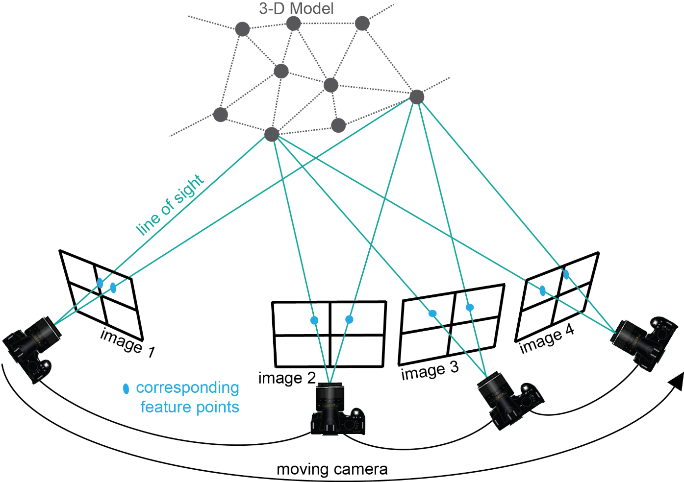
Structure From Motion?
Use the locations of the camera (motion) to interpret the geometry or 3D model (structure) of a scene
Notes:
Structure-from-Motion photogrammetry is an emerging technique used to create three-dimensional point clouds with associated color—basically a three-dimensional model of the area of interest. The key things to notice here are that the camera needs to continually be moving (no two photos taken from the same location) and the photographs need to include the same features, so that features are in multiple photographs. You can see here that many of the gray dots on the 3D model are captured by multiple images, not just one. Scientists use this for many applications, which you will learn about today. The next slide will show what Structure-from-Motion actually produces.

Slide 3
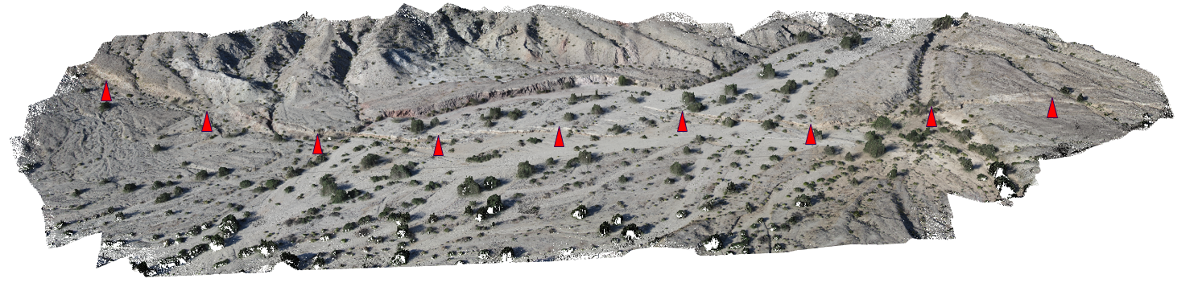
What Do You Create?
~500 points/m² colored point cloud along a ~1 km section of the 2010 El Mayor-Cucapah earthquake rupture generated from ~500 photographs captured in 2 hours from a helium blimp
Figure Ed Nissen
Notes:
The model above is a three-dimensional point cloud with associated color. This model is of a fault scarp; the red arrows point toward the location of the scarp. You will see a different view of this figure later in the presentation. Most researchers who use SfM use it to make point clouds like these: 3D models of a field area they can revisit and actually measure in the lab instead of the field. Can you think of anything to model using SfM? [Make a list on the board.] Why would SfM be a good method to use for these applications? [add to list on the board.]

Slide 4
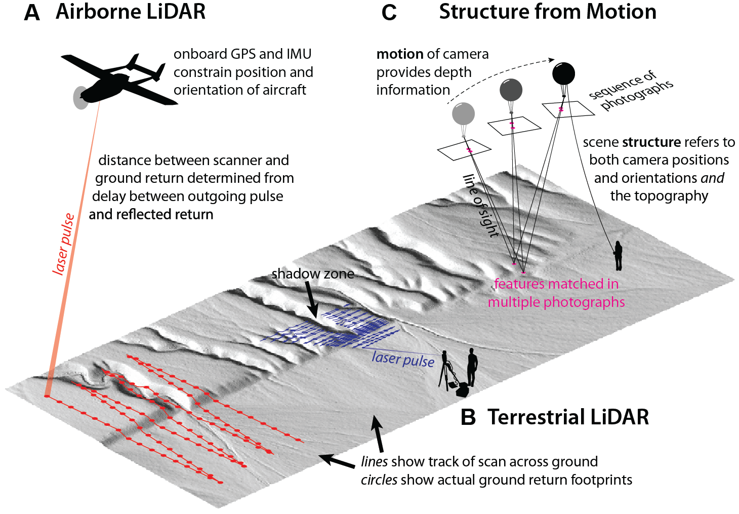
What Can We Compare SFM to?
Figure Johnson 2014
Notes:
Structure-from-Motion is not the only way to create a georeferenced point cloud like the one on the previous slide. The other option is using something called LiDAR. LiDAR laser scans an area of interest to create a 3D point cloud. Two example platforms for LiDAR are shown. You can fly a plane over an area at an altitude of roughly 1 km to get a point cloud or have a scanner on a tripod as shown in B. LiDAR can be used with many other platforms not seen here. Typically, LiDAR is how scientists are able to collect 3D point clouds for research. We will see some direct comparisons between LiDAR and SfM in later slides. (Kendra Johnson, Geosphere 2014)
Note: GSA Publications allow the reproduction of a single figure or table under without permissions. http://www.geosociety.org/pubs/copyrt.htm

Slide 5
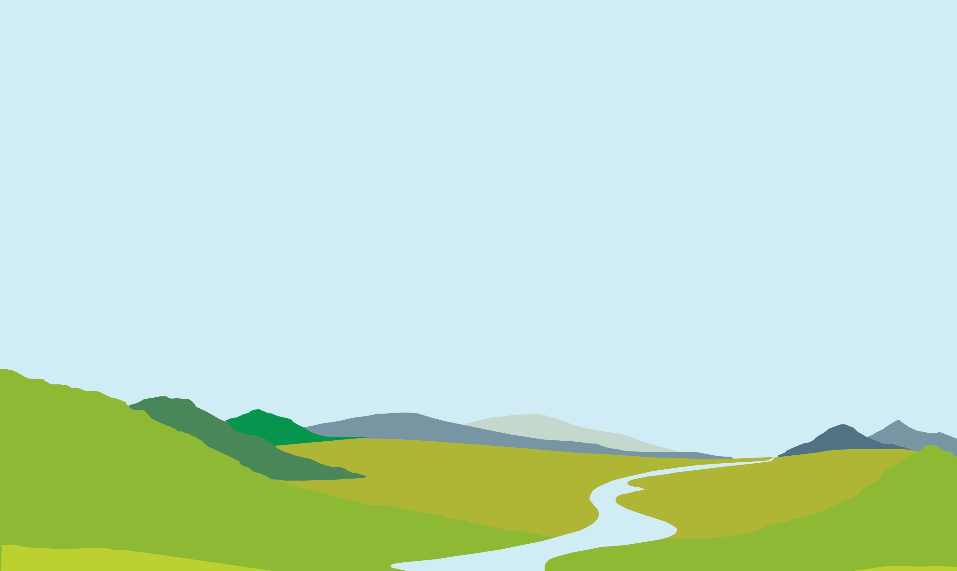
Matching Features
d
Step 1
Match corresponding features and measure distances between them on the camera image plane d, d’
The Scale-Invariant Feature Transform is key to matching corresponding features despite varying distances
d'
Figure Ed Nissen
Notes:
The first step in actually creating the product we saw on the previous slide is to find the same feature in multiple photographs. You can see [spacebar] the red and purple lines tracing the line of sight from the two camera locations to two different features on the ground. This is done using an algorithm called SIFT: Scale-Invariant Feature Transform.

Slide 6
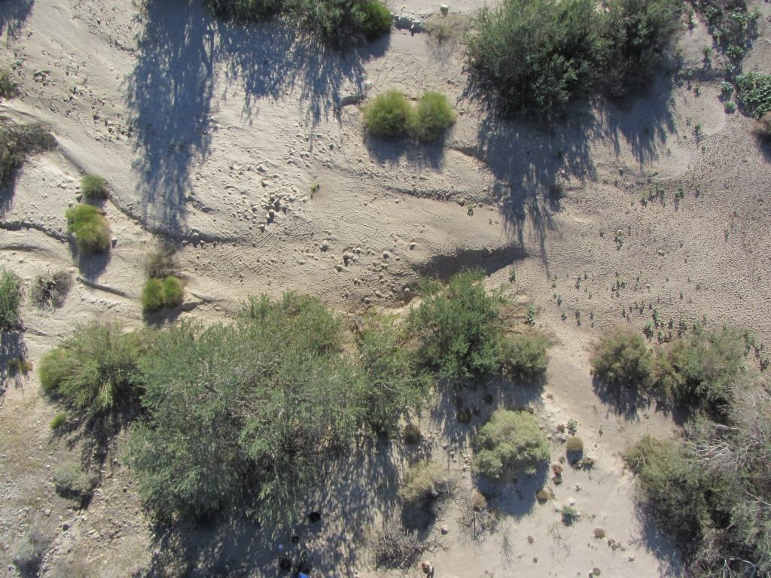
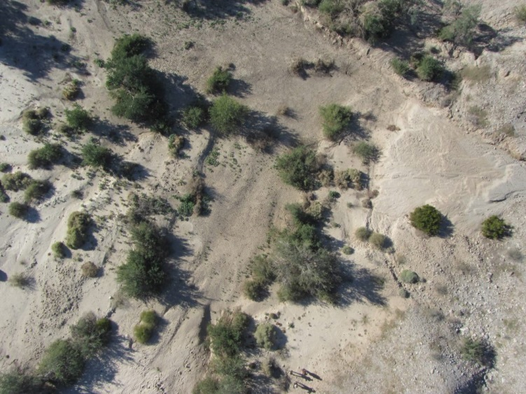
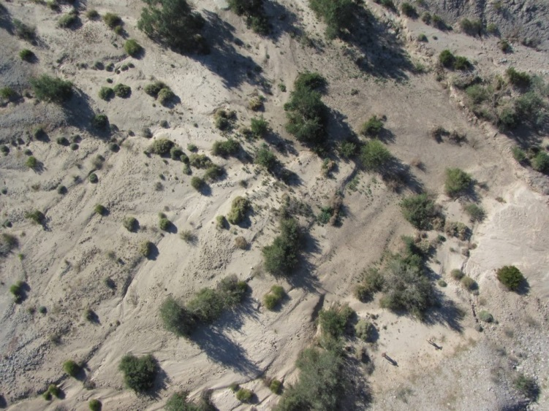
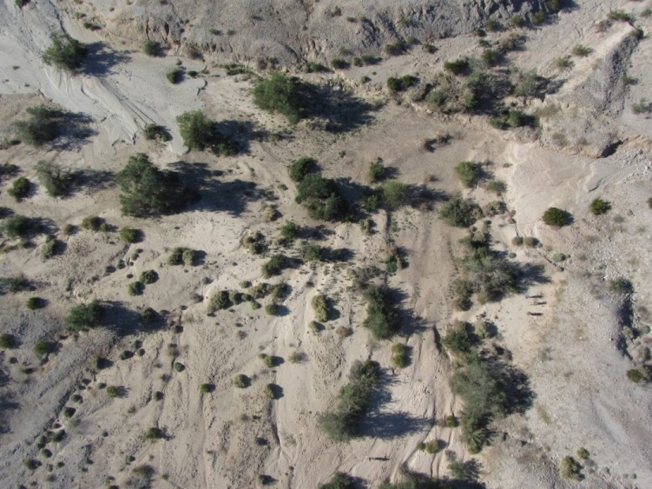
Scale-Invariant Feature Transform (SIFT)
Figure Ed Nissen
Notes:
Each red box shows the same feature in multiple photographs. The SIFT algorithm recognizes these as the same feature.

Slide 7
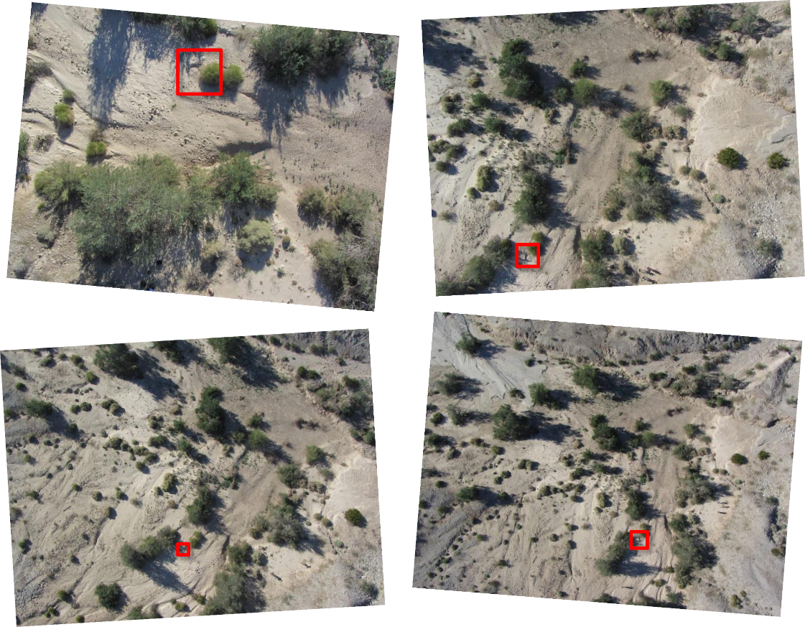
Scale-Invariant Feature Transform (SIFT)
Finds matching features in multiple photographs
Scale, perspective, and illumination of the feature in the photograph do not affect algorithm
Used as the input for calculating camera locations
Figure Ed Nissen
Notes:
[Read the slide.]
A primary pioneer for the SfM method is: Lowe, D.G., 1999. Object Recognition from Local Scale-invariant Features. International
Conference on Computer Vision, Corfu, Greece, pp. 1150–1157.

Slide 8
Find Camera Locations
d
Step 2
When we have the matching locations of multiple points on two or more photos, there is usually just one mathematical solution for where the photos were taken.
Therefore, we can calculate individual camera positions (x, y, z), (x’, y’, z’), orientations i, i’, focal lengths f, f’, and relative positions of corresponding features b, h, in a single step known as “bundle adjustment.”
f
(x, y, z)
i
f’
d'
(x’, y’, z’)
i’
h
b
Figure Ed Nissen
Notes:
When we have the matching locations of multiple points on two or more photos, there is usually just one mathematical solution for where the photos were taken. [spacebar] This step, bundle adjustment, results in the locations of the cameras and a sparse point cloud—like the one we saw on the earlier slide, but with significantly fewer points.

Slide 9
Multi-View Stereo
d
Step 3
Next, a dense point cloud and 3D surface are determined using the known camera parameters and the sparse point cloud as input.
All pixels in all images are used so the dense model is similar in resolution to the raw photographs (typically 100s–1000s point/m²). This step is called “multi-view stereo matching” (MVS).
f
(x, y, z)
i
f’
d'
(x’, y’, z’)
i’
h
b
Figure Ed Nissen
Notes:
Multi-view stereo is a process that results in the creation of a dense point cloud, like the example on the earlier slide. The MVS algorithm takes the sparse point cloud and camera locations to populate the model with more points. The resultant point cloud may have millions of points.

Slide 10
Georectification
d
Step 4
Georectification means converting the point cloud from an internal, arbitrary coordinate system into a geographical coordinate system. This can be achieved in one of two ways:
f
(x, y, z)
i
f’
d'
(x’, y’, z’)
i’
h
b
Figure Ed Nissen
Notes:
Georectification means converting the point cloud from an internal, arbitrary coordinate system into a geographical coordinate system. This step is essential; we want to be able to link the model to where it actually is in space. This results in the ability to measure features in the model, because it will be correctly scaled. [spacebar]

Slide 11
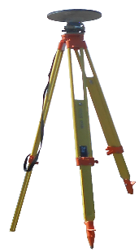
Georectification
d
Step 4
Georectification means converting the point cloud from an internal, arbitrary coordinate system into a geographical coordinate system. This can be achieved in one of two ways:
• directly, with knowledge of the camera positions and focal lengths
• indirectly, by incorporating a few ground control points (GCPs) with known coordinates. Typically these would be surveyed using differential GPS.
f
(x, y, z)
i
f’
d'
(x’, y’, z’)
i’
h
b
GPS base station
GCPs surveyed
with roving receiver
Figure Ed Nissen
Notes:
The process of georectification can be achieved in two ways: directly or indirectly. Generally, the indirect process is what scientists use. This way, the model is not only correctly scaled but also correctly located geographically. The number of ground control points varies project to project; however, a minimum of three is needed. It is recommended to use more than 10 per project. Find points that are clearly recognizable or use targets (usually the recommended option).

Slide 12
Products
d
Optional Step 5
Generate derivative products:
Digital Surface Model
Orthomosaic for texture mapping
f
(x, y, z)
i
f’
d'
(x’, y’, z’)
i’
h
b
GPS base station
GCPs surveyed
with roving receiver
Figure Ed Nissen
Notes:
The last step in the production of an SfM model is to create the final products. Generally, people use the topography (digital surface model) or the imagery (orthomosaic). The next slides show some examples.

Slide 13
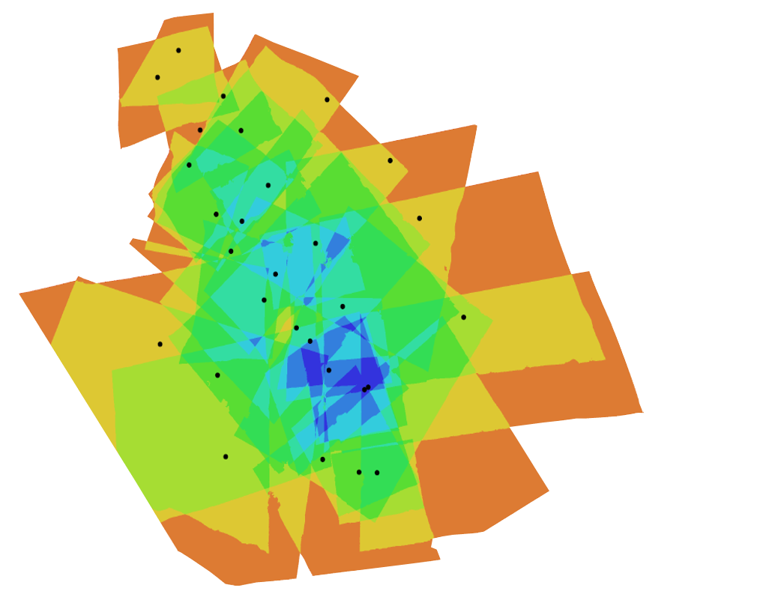
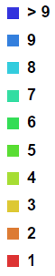
Photo Density Map
Figure Ed Nissen
Notes:
This photo density map shows the amount of overlap between the photos in a dataset. Each dot is a camera location. You can see the photos are the most dense around areas with lots of camera locations like the center, but that in this model every spot was seen by at least two photographs.

Slide 14
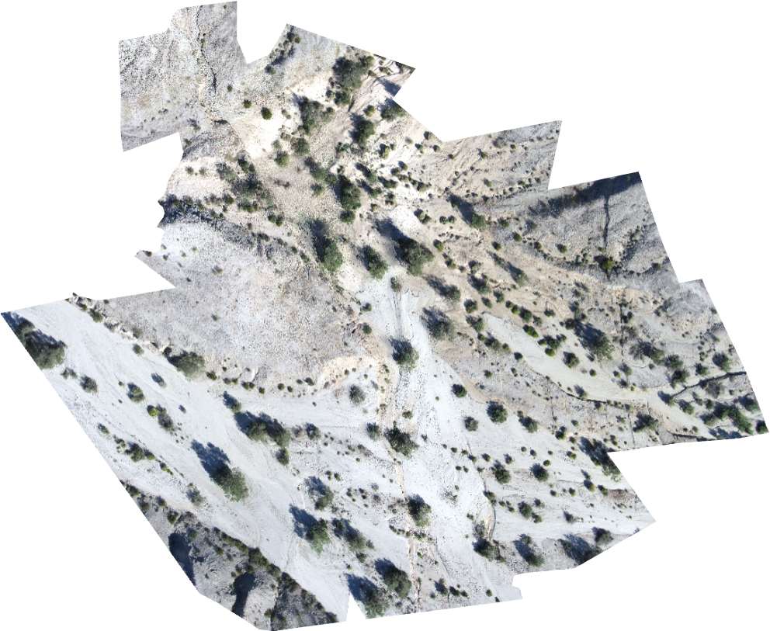
Orthomosaic
Figure Ed Nissen
Notes:
The orthomosaic is a high-resolution photograph of the area created by associating color with each point in the model. This can be used to view the features on the surface.

Slide 15
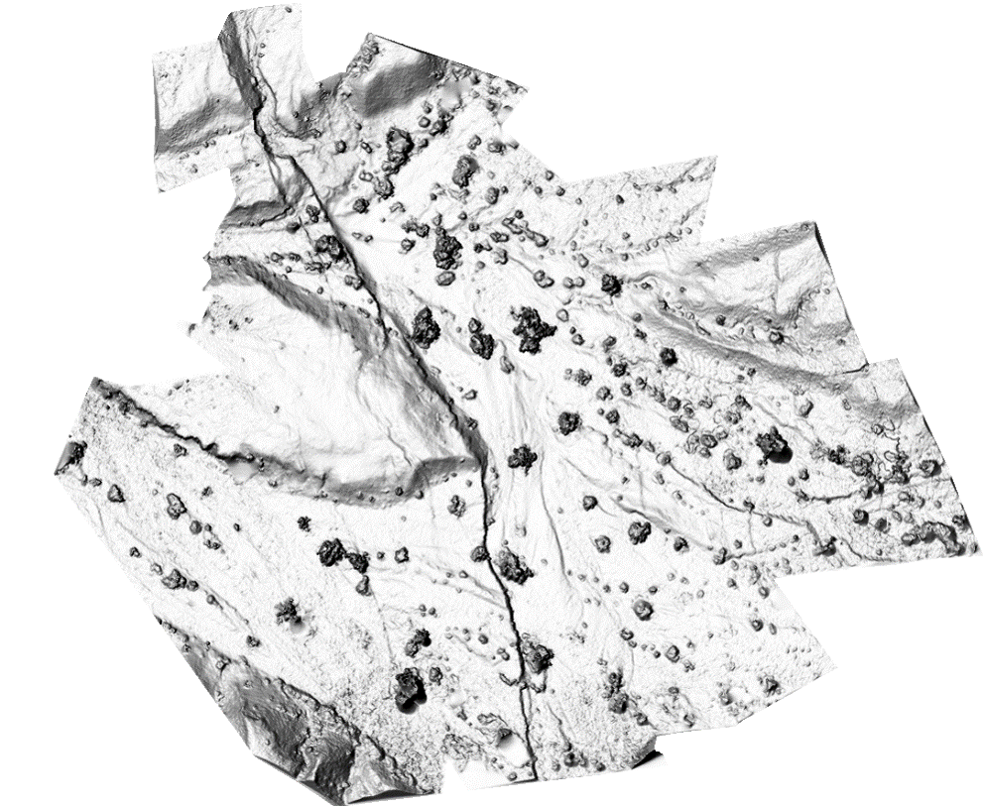
Shaded Digital Elevation Model
Figure Ed Nissen
Notes:
DEM – Digital elevation model. This one has hillshade, so it seems like the sun is shining and it is partially in shadow to show off the features. You can see that different features stand out in the DEM in comparison to the orthomosaic, so they can be used for different research applications. You can use this to measure features.

Slide 16
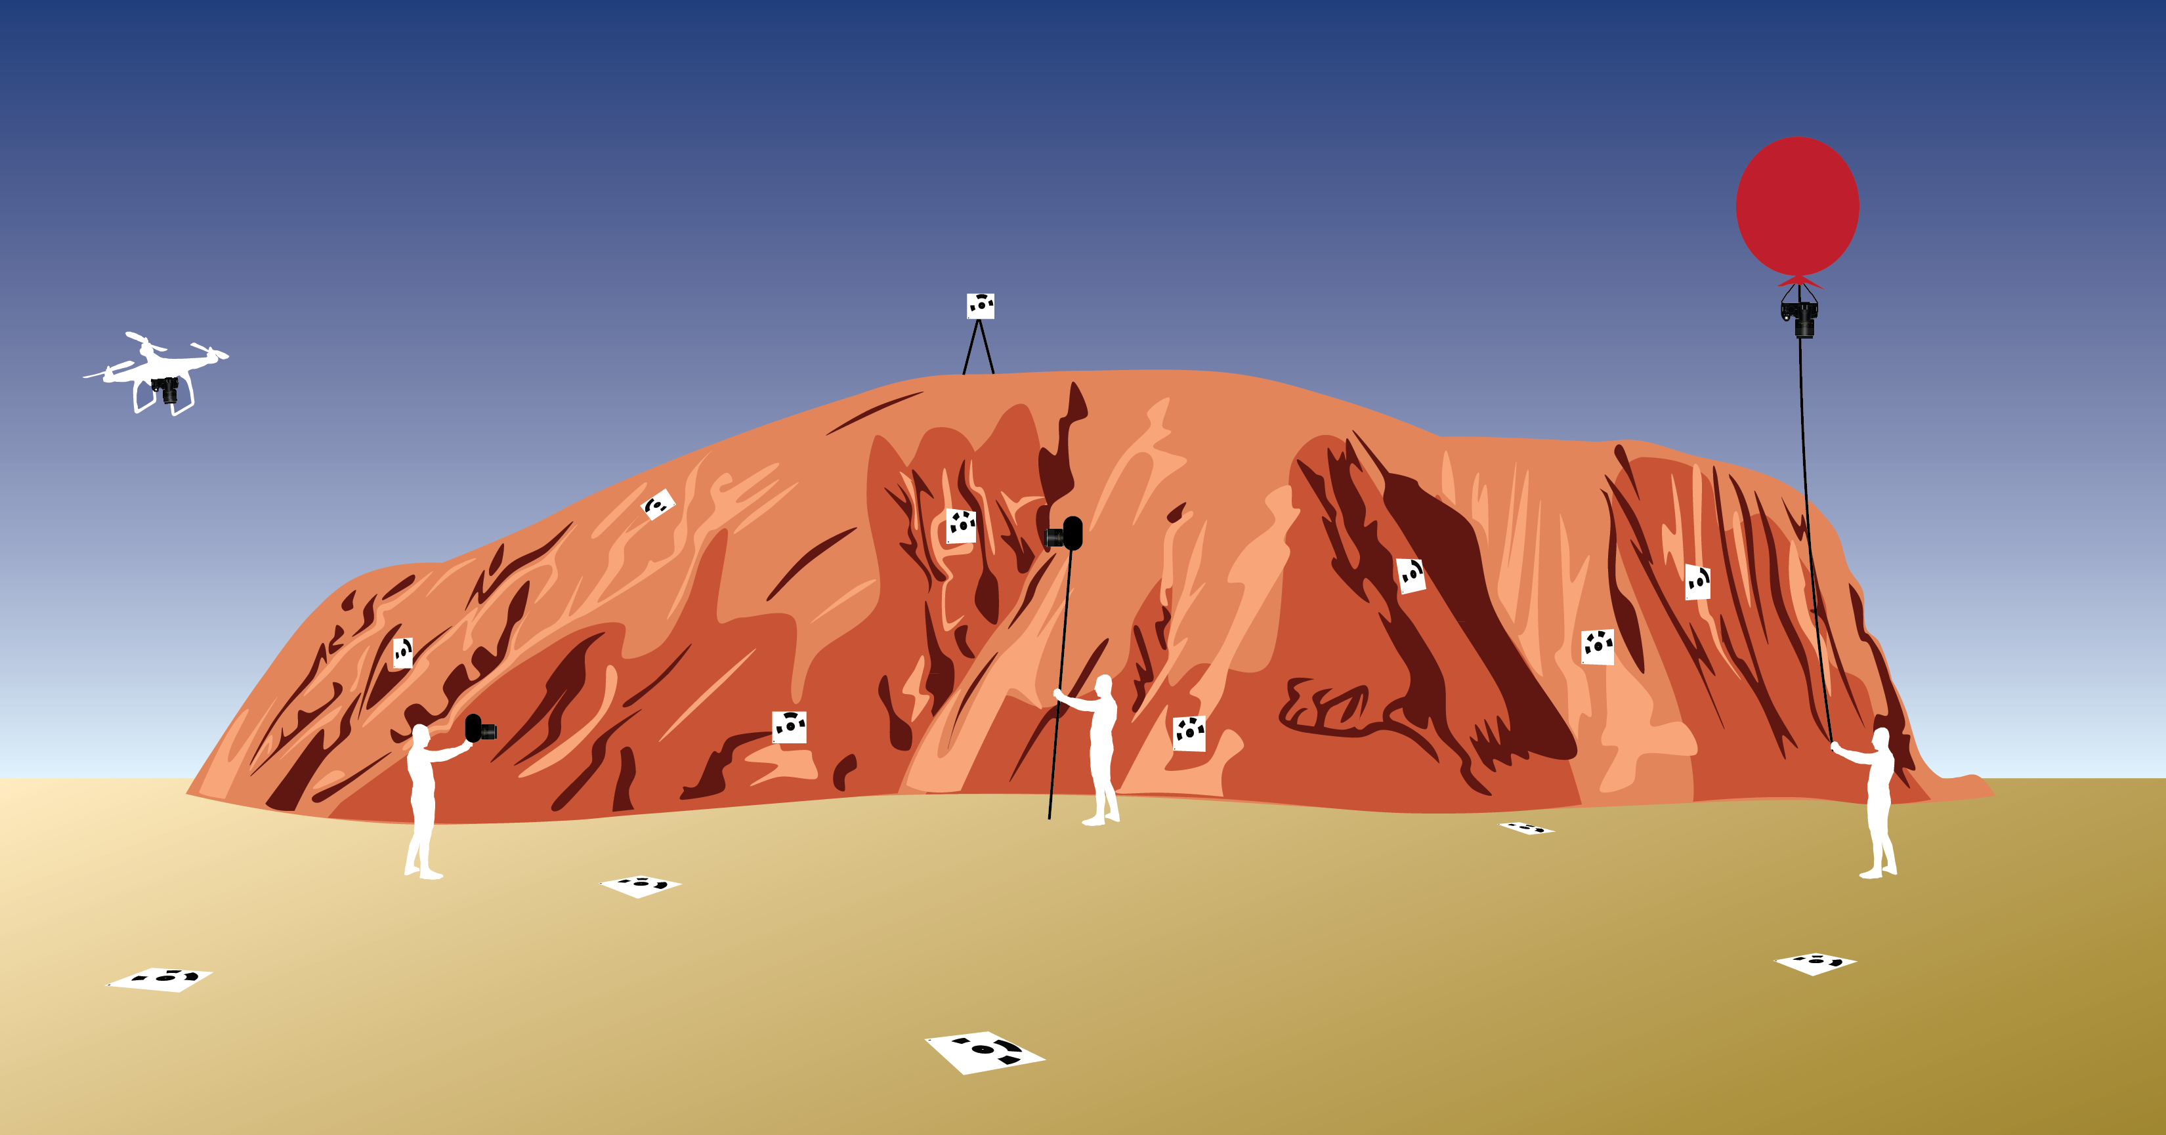
Platforms
Figure Kate Shervais
Notes:
Many platforms exist to assist in capturing SfM data. The figure above shows a range of platforms, from UAS on the far left, handheld mid-left to pole photography on the mid-right and a balloon on the far right. The squares with a black pattern are targets, places to survey in, so the model can be linked to geographic coordinates. A handheld platform is best for doing detail work and some outcrop scale work, but has limited applications and is not ideal for areas larger than 100–200 square meters. The slides following will go into the details of the other platforms.

Slide 17
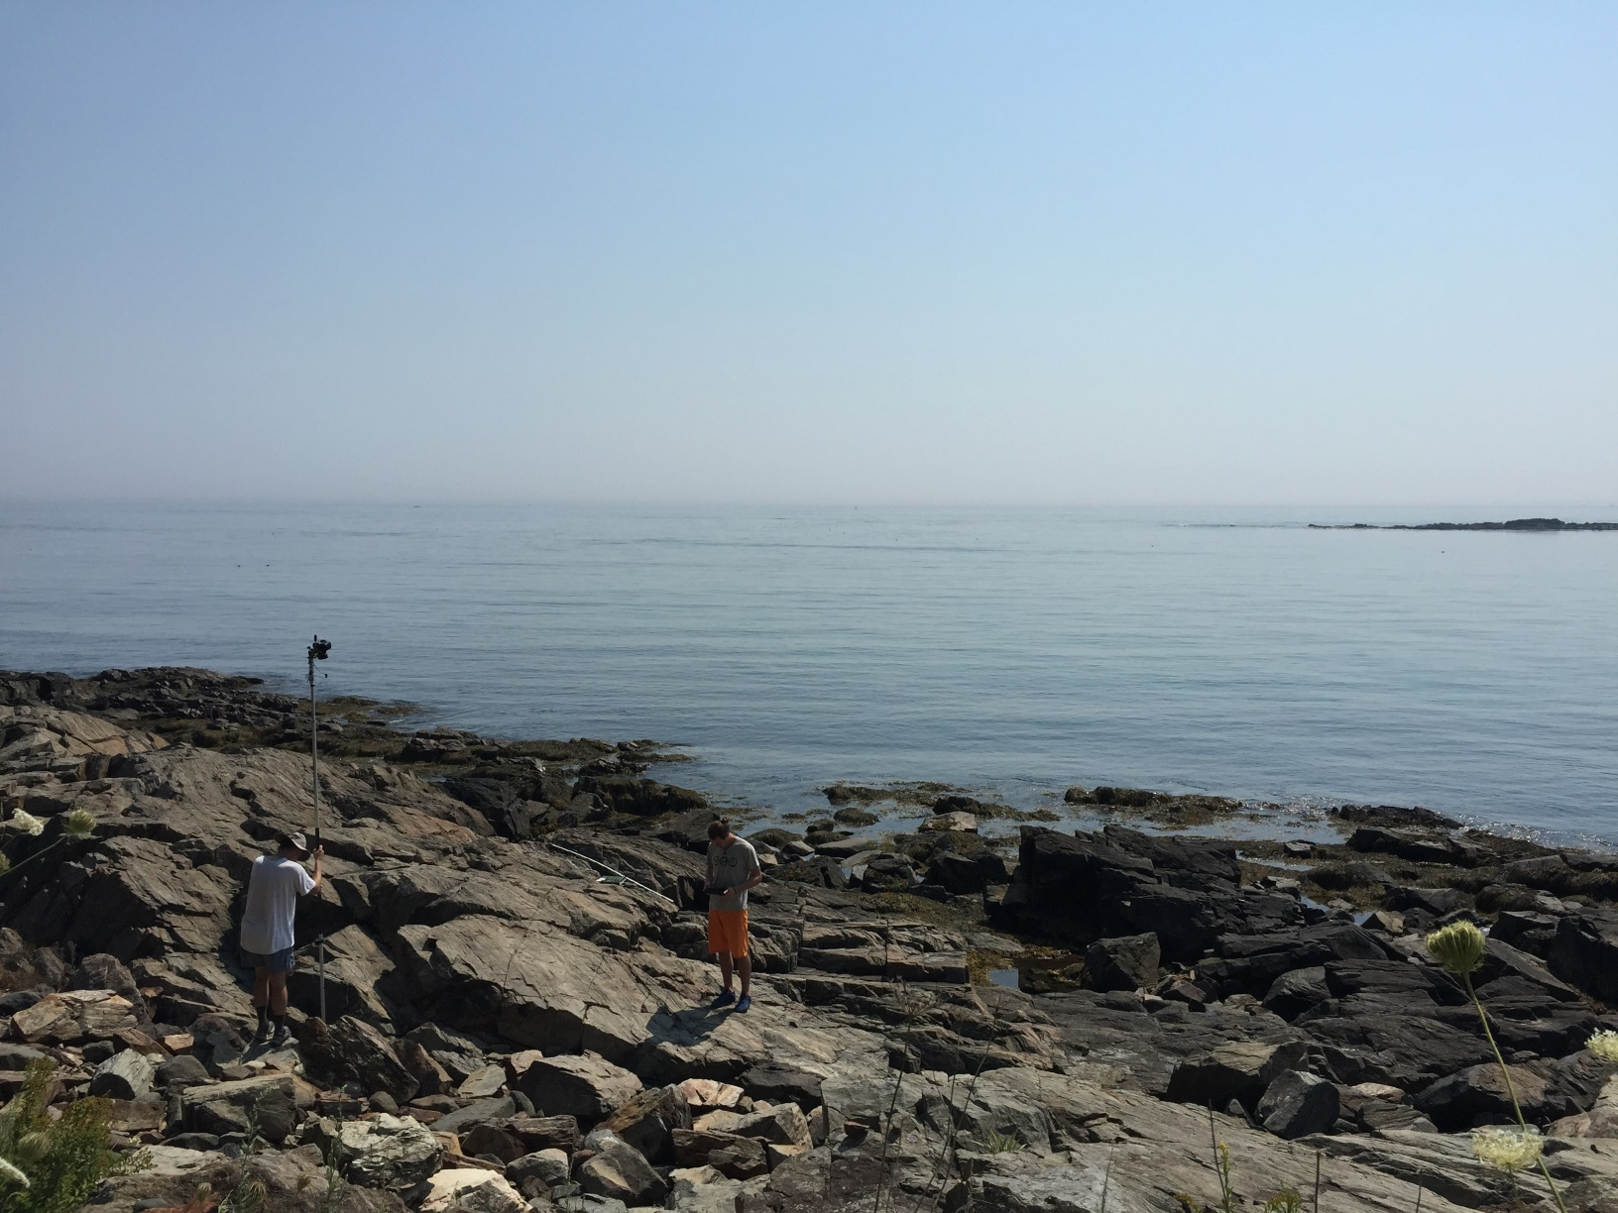
Platforms - Pole
Figure Kate Shervais
Notes:
One form of ground-based SfM is pole photography. In the photo shown, the pole is used to take photographs of the horizontal outcrop. For scale, the man holding the pole is 1.85 m tall. Poles are useful because they are inexpensive, good for photographing outcrops, easy to use, and lightweight. They can be quite high—although poles higher than around 20 feet generally need a tripod for stability. However, poles are inefficient in comparison to using an aerial system and require a mount for the camera, as most poles are intended for other applications.

Slide 18
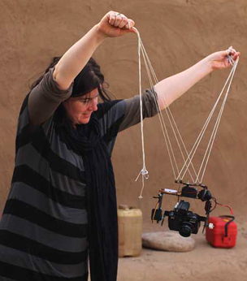
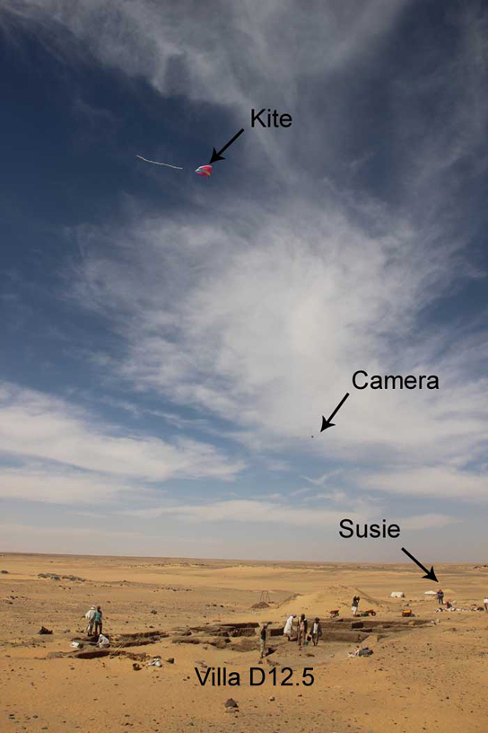
Platforms - Kite
Figure Neal Spencer
Notes:
Kites are used frequently as a platform. This example is from Amara West, an archaeological site. Kites are inexpensive, but reliant on wind. Kites also require a picavet (shown in the left photo). Kites allow photographs from a useful height for photographing topography, require no helium (unlike balloons), and have no legal complications (unlike UASs) because they use a tether.

Slide 19
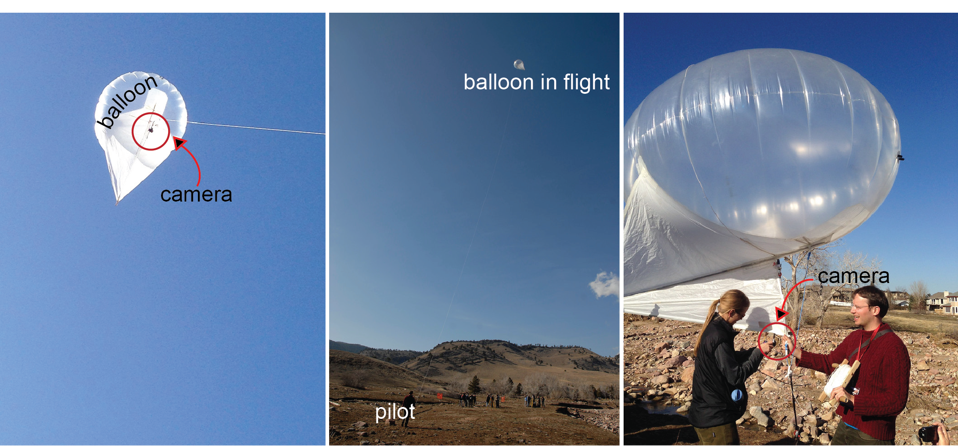
Platforms- Balloon
Figure Kate Shervais
Notes:
This is just an example of one type of balloon. This one is called a heli kite because it has a kite-like tail but is filled with helium. The heli kite carries small cameras only (other balloons may carry larger cameras). Balloons and kites having similar advantages/disadvantages, as well as similar applications. The main difference is balloons have no weather requirements, but do need helium (~$180 per canister). Figure Kate Shervais, photographs taken by UNAVCO

Slide 20
Platforms – UAV (uncrewed aerial vehicle)
Figure https://commons.wikimedia.org/wiki/File:DJI_Mavic_Pro.jpg
Notes:
UAVs are the final category of SfM platform. This had become much more common since about 2017 when FAA rules changed to give clearer guidance on UAV useThe cost is highly variable depending on type—one can spend thousands of dollars. The UAV shown in this photograph was around 1000 dollars. The height, camera position, and flightlines are easily controlled using an UAV. However, they require a skilled operator, batteries may limit the survey time (to ten minutes or less), and may require a lighter camera than a balloon. The legal landscape is also quite complex and frequently changing, so consult legal counsel before using.

Slide 21
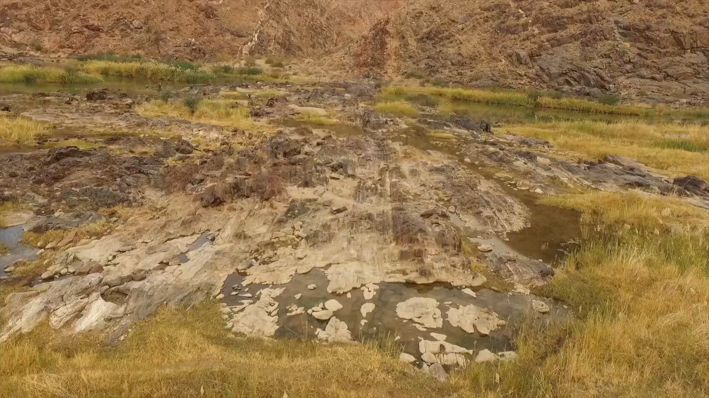
Video of UAS Flight – Pofadder Shear Zone
Video Jamie Kirkpatrick
Notes:
This video shows the view of a UAS during flight in the Pofadder shear zone between South Africa and Namibia. At the end of the video, you can see the operator on the left side of the frame wearing a baseball cap. This flight was one of many used to create a model of the outcrop.

Slide 22
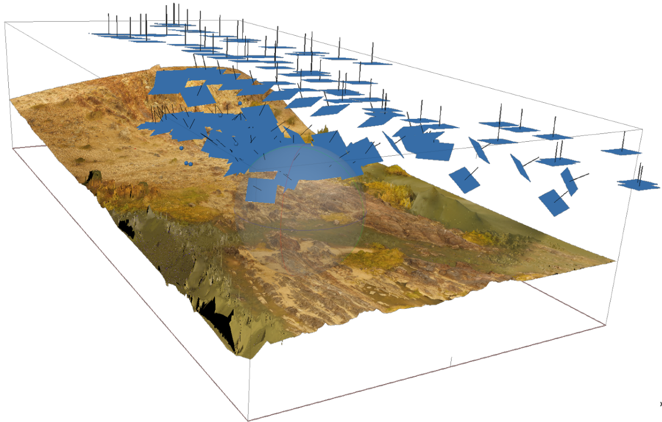
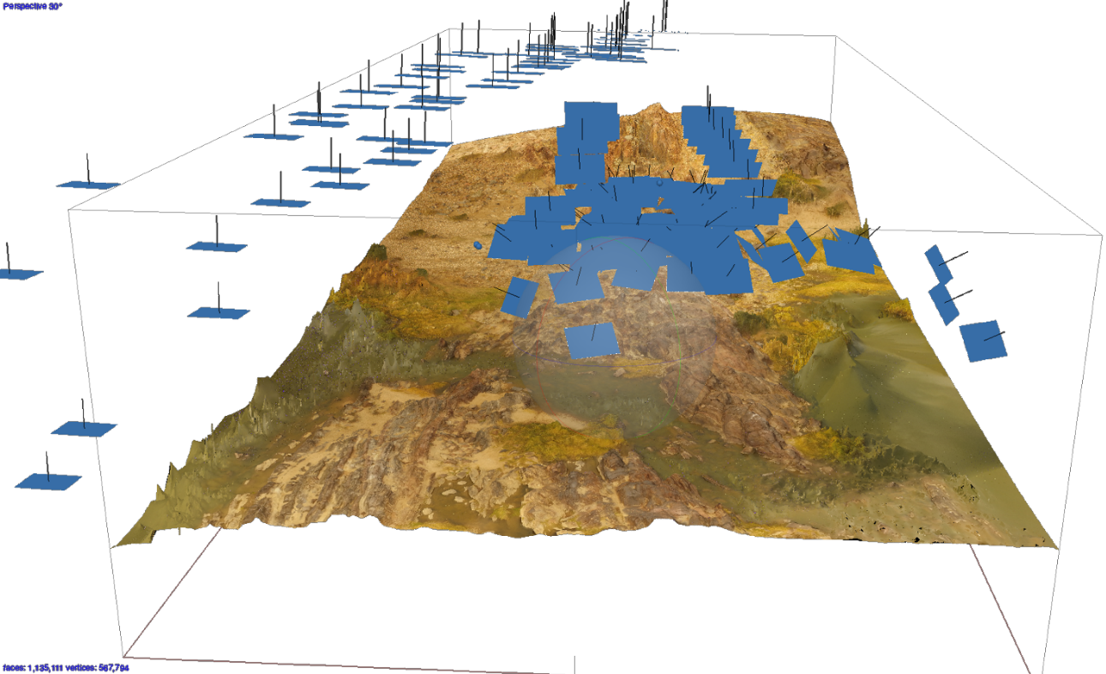
Pofadder Shear Zone Model – Photo Locations
Figure Jamie Kirkpatrick
Notes:
The blue rectangles show the camera locations for the photos used for the model. The photos line up and show the flight paths taken [spacebar]. As you can see, many flight paths were combined to create the model of the shear zone, not just the one shown in the video.

Slide 23
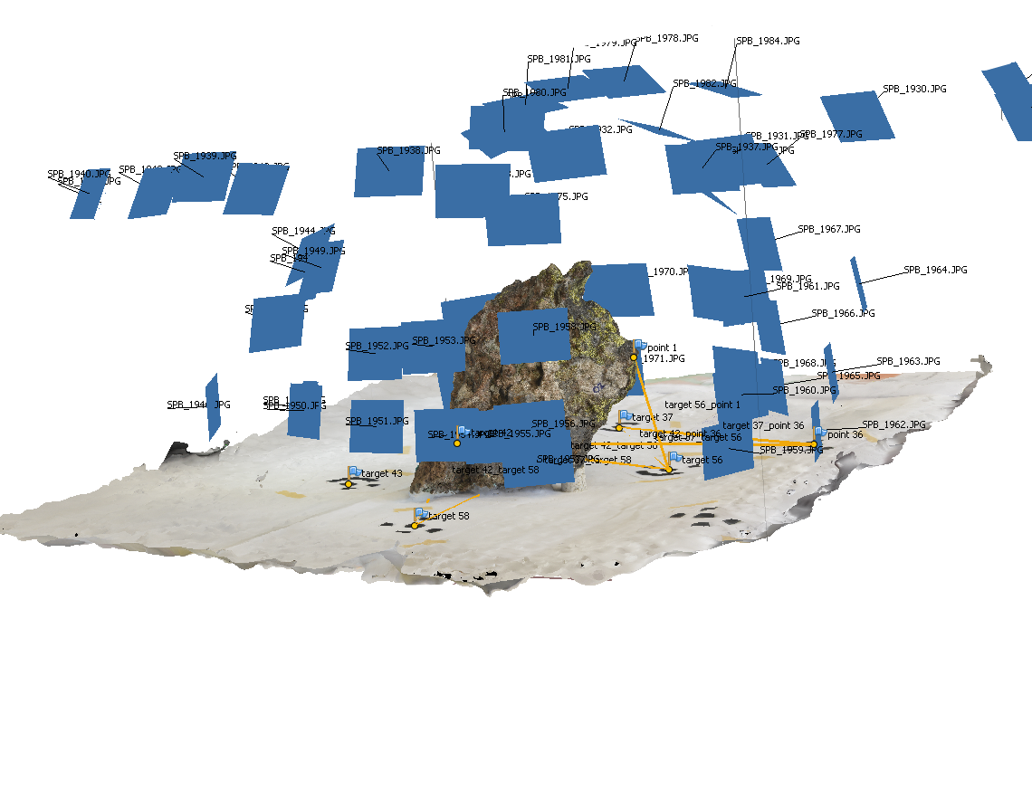
Rock Sample Model
Figure Sean Bemis
Notes:
The first example of a ground-based SfM model is this basalt sample. Photographs were taken at each of the blue rectangles (indicating the calculated camera location).

Slide 24
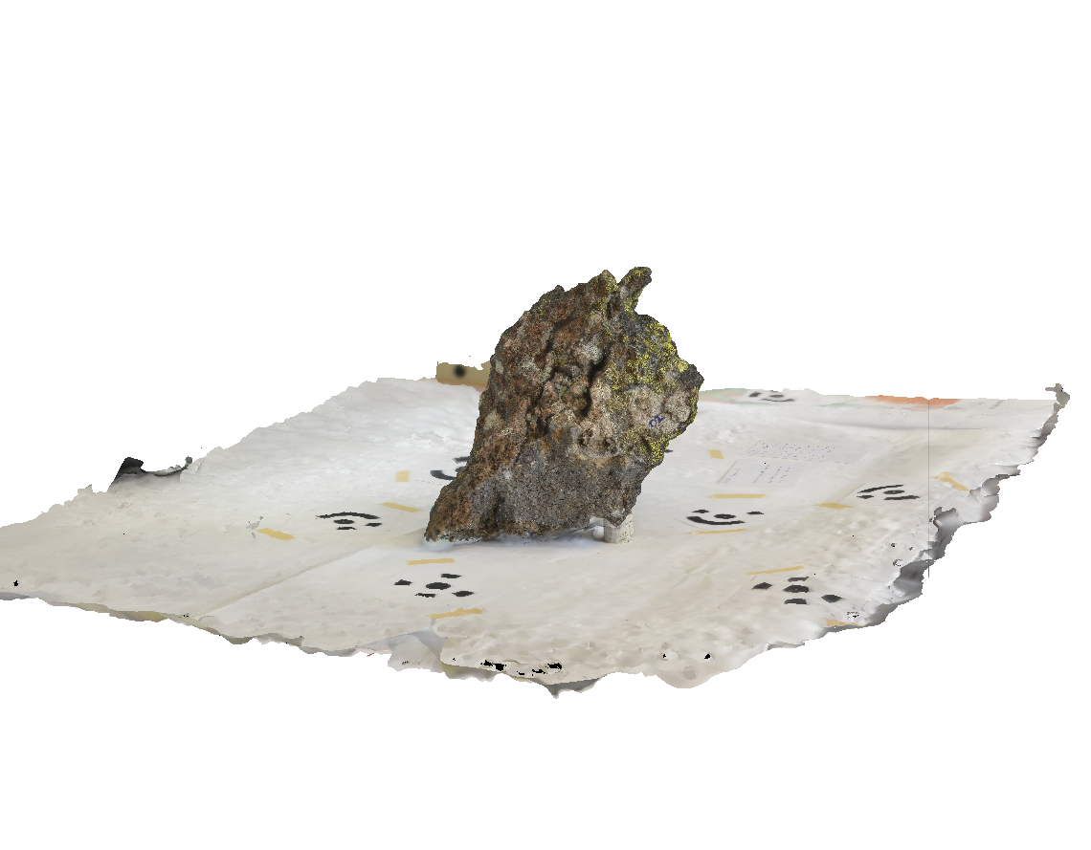
Rock Sample Model
Figure Sean Bemis
Notes:
When the camera locations are removed, you can see the sample a bit better. The black patterns on the cloth underneath the sample are used to scale the image. This model is used for students; they can look at hand samples in a digital form in addition to the hand sample in the classroom.

Slide 25
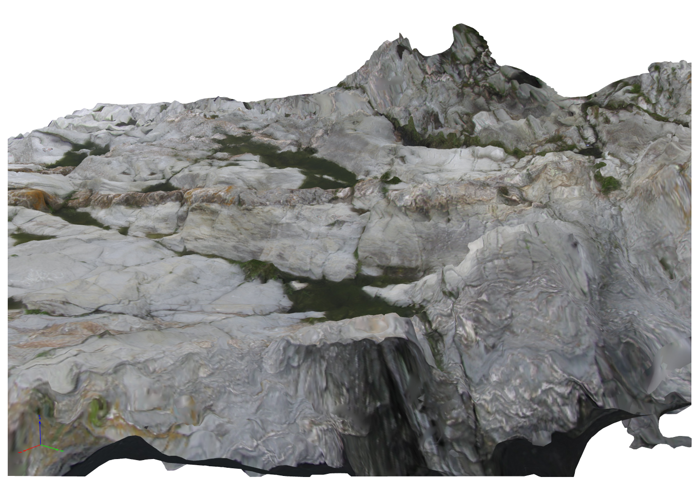
Outcrop Model – Side View
Figure Phil Resor
Notes:
This model was created to show an outcrop at Beavertail State Park in Rhode Island. The model has been used by students to map the different small-scale folds present in the outcrop. You can see in this side view that the edges of the model have been blurred; the blurring effect is due to low photo density at the edges of the model.

Slide 26
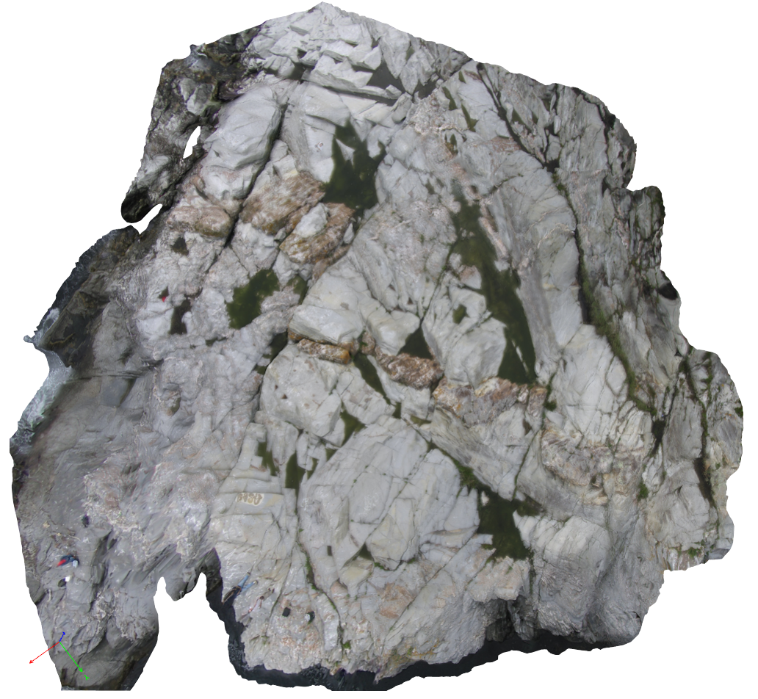
Outcrop Model – Top View
Figure Phil Resor
Notes:
Here is the top view of the Beavertail State Park outcrop model.

Slide 27
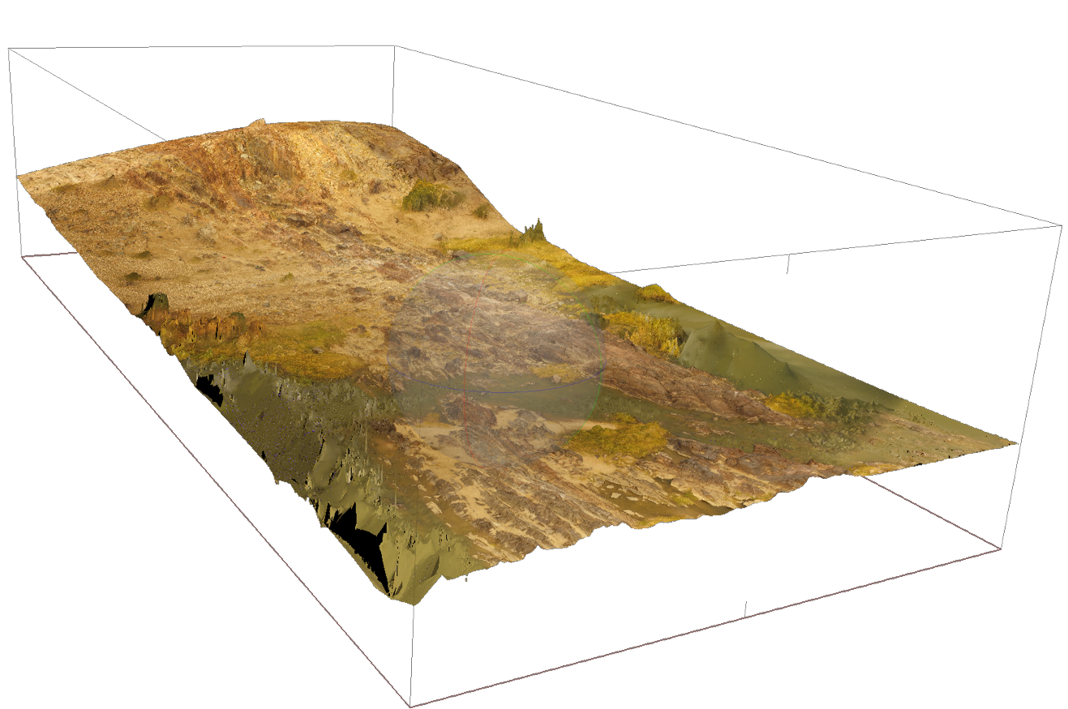
Outcrop Model – Pofadder Shear Zone
Figure Jamie Kirkpatrick
Notes:
In this view, you can see the 3D topography of the area shown in the flight video.

Slide 28
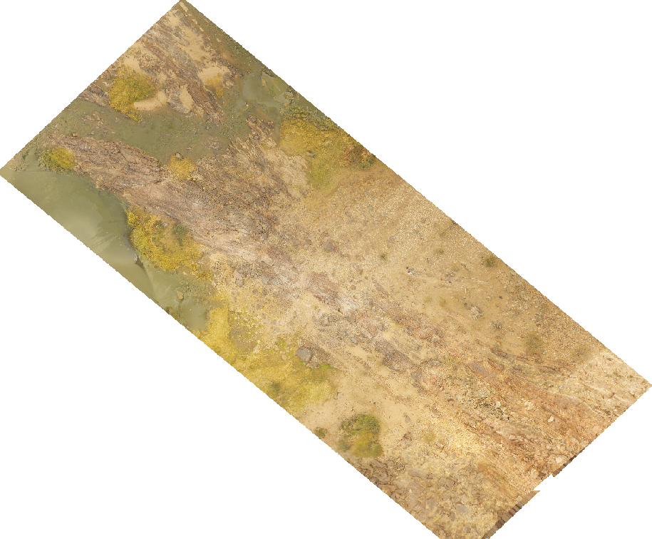
Outcrop Model – Pofadder Shear Zone
Figure Jamie Kirkpatrick
Notes:
The orthomosaic looks like this. This orthomosaic was used as the base for a geologic map.

Slide 29
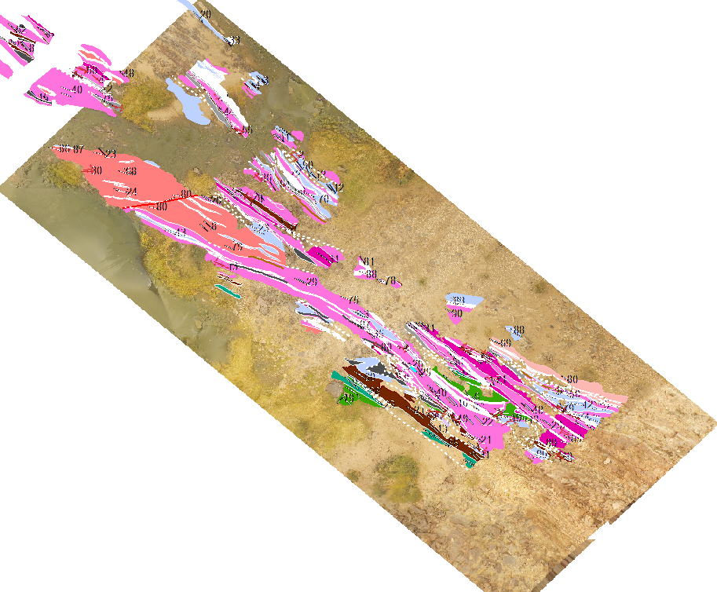
Outcrop Model – Pofadder Shear Zone
Figure Erik Young
Notes:
The map characterizes the shear zone based on rock type and orientation. Like a typical geologic map, the different colors correspond to different rock types. The white lines correspond to faults or fold axes.

Slide 30
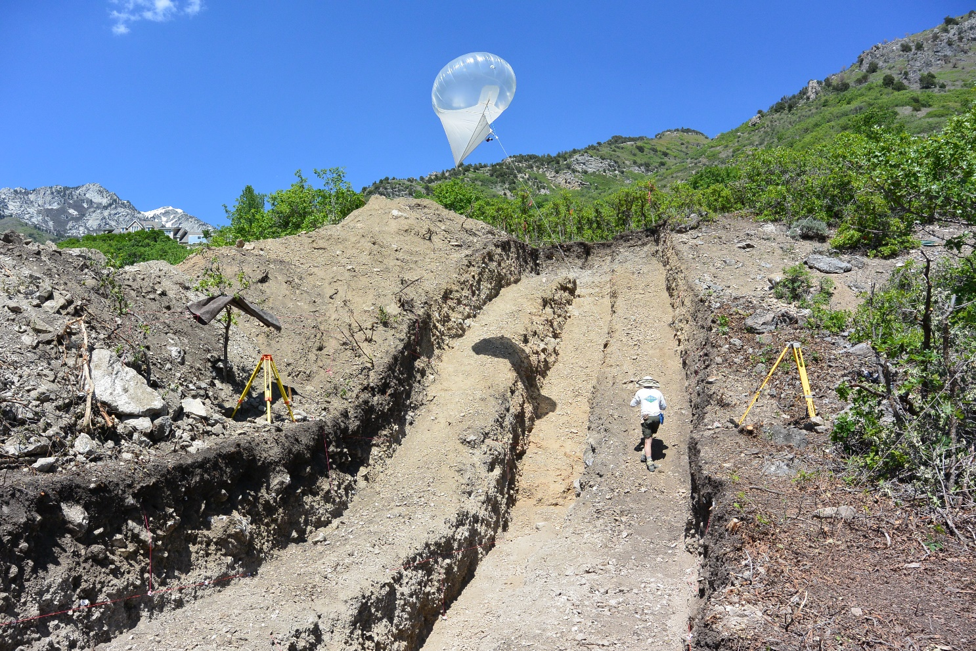
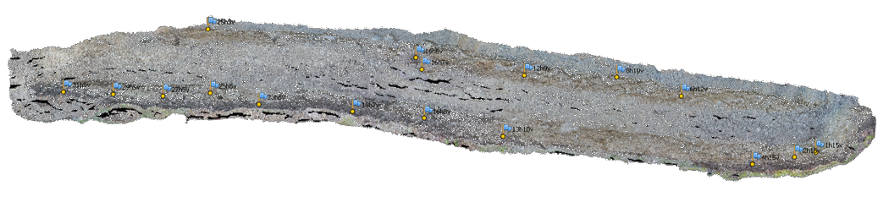
Paleoseismic Trench
Figure Nadine Reitman
Notes:
This example of a paleoseismic trench is in Alpine, Utah, and is on the Wasatch Fault. Classically, trenches are dug to show the Quaternary deformation history of a fault. The trench crosses a fault scarp, like the ones shown on earlier slides. The walls of the trench have layers of material displaced by the fault that can be dated to find the age of the slip event. In addition, the layers are mapped. These maps used to take tens of hours to generate, but using SfM, they are relatively efficient to create. However, this model shows one issue – the areas that lack enough photographs result in black areas with no data as circled here. [spacebar]
[spacebar] The photo in the top right shows a heli kite; this is not used for trench data collection but is a cool platform!

Slide 31
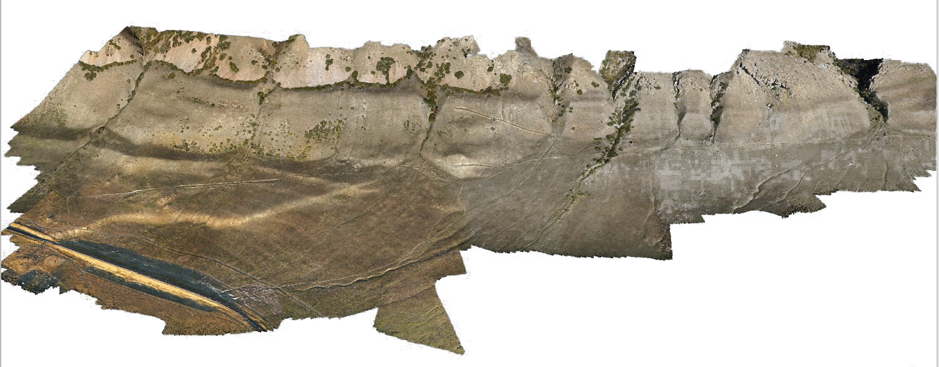
Oquirrh Fault Scarp
Figure Mike Bunds
Notes:
The Oquirrh fault scarp is located in western Utah. This fault is a normal fault, like many of the faults in Utah (Basin and Range extension). This survey was conducted using a UAS: a drone. You can clearly see the fault scarp [spacebar] as the break in slope on the hill.

Slide 32
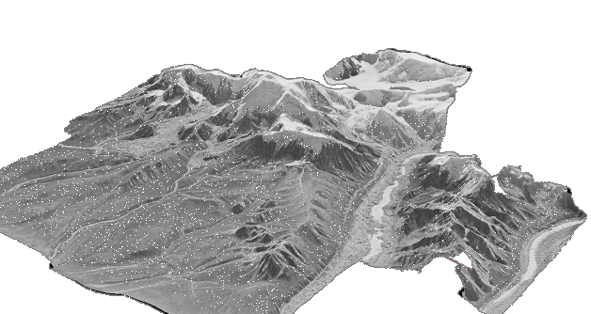
Airphoto Models
Figure Sean Bemis
Notes:
Aerial photographs have been used in the geosciences as a base for mapping and to see structures from another viewpoint. These aerial photos can also be used for SfM. This model was made from only five photographs, but the topography is very clear. These models can then be used as a base map for planning geologic research.

Slide 33
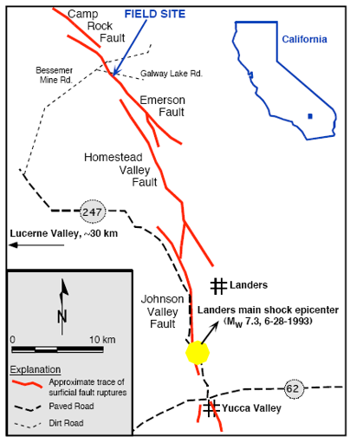
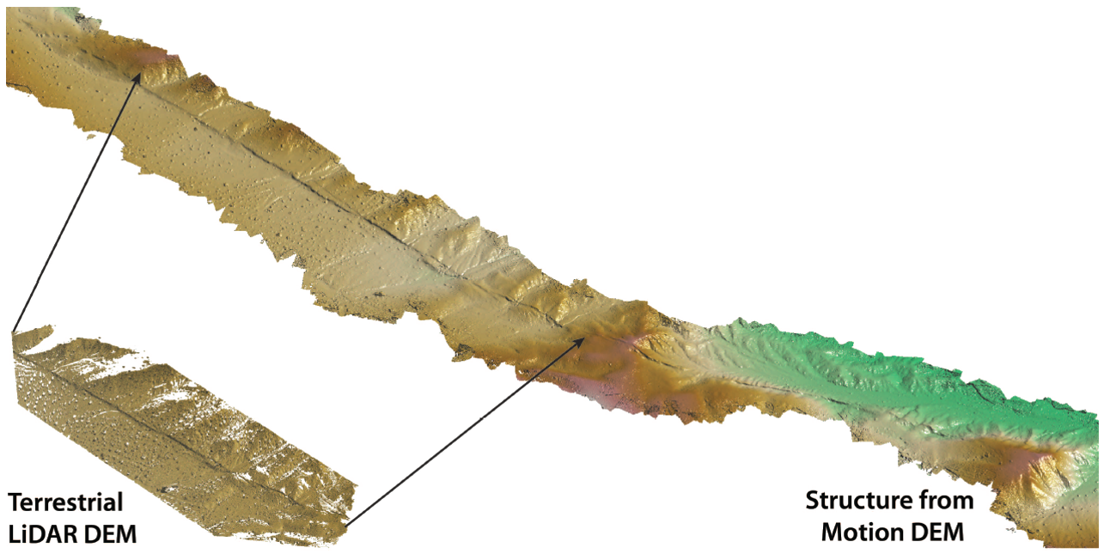
Comparison of SFM to TLS - Landers
Figure Ed Nissen, Map Ramon Arrowsmith
Notes:
This slide also shows images of a fault scarp. The Landers fault scarp, located in Southern California, resulted from a M7.3 earthquake in 1993. The image above shows examples of the SfM DEM (top) and a DEM generated using TLS (terrestrial laser scanning). TLS requires expensive equipment (hundreds of thousands of dollars) and a higher level of expertise to conduct a survey. As you can see, the point clouds are quite comparable. The TLS point cloud has a lower point density away from the fault scarp.

Slide 34
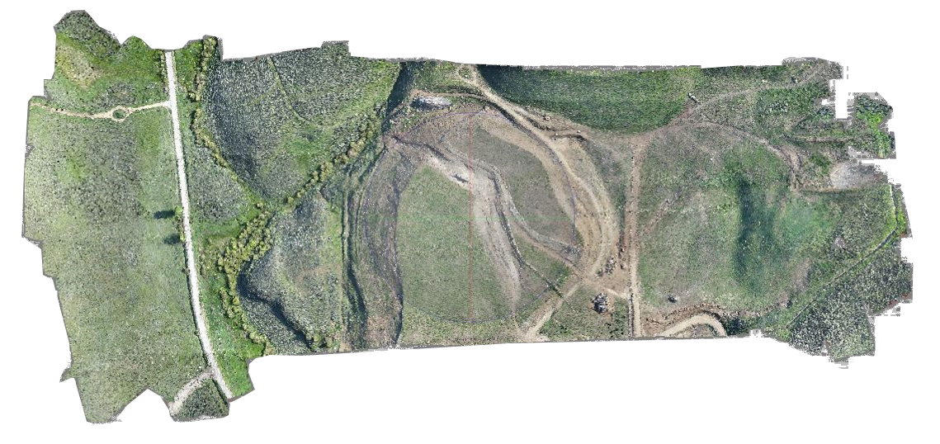
Granby Landslide
Figure Francisco Gomez
Notes:
This view is of the Granby landslide. The landslide [spacebar] circled here in red. This landslide is a slow-velocity landslide frequently monitored by researchers as it is still currently moving, from 2007 to the present. It is important to study this, as workers would like to slow the landslide until it is no longer a hazard. A different view of the landslide is here. [spacebar]

Slide 35
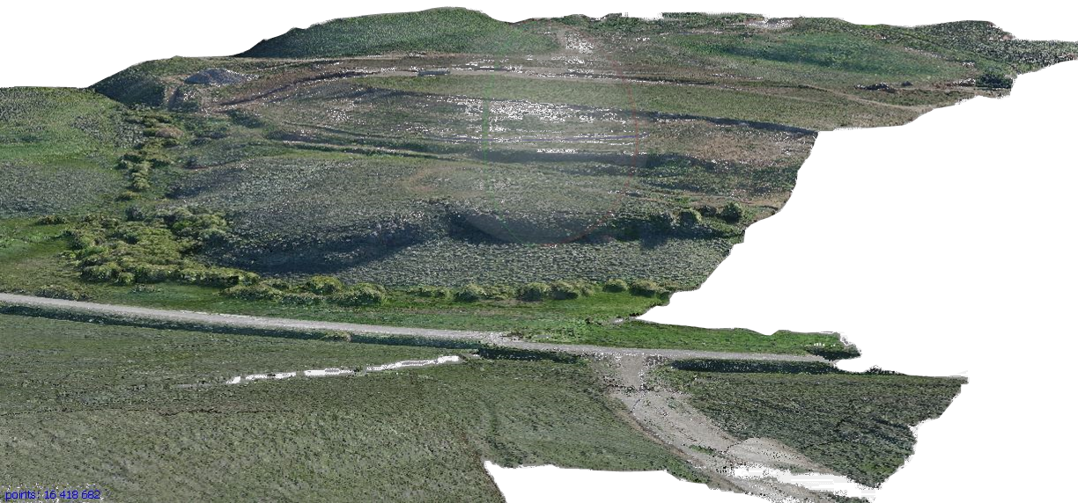
Granby Landslide
Figure Francisco Gomez
Notes:
The edge of the landslide can be seen here. [spacebar]

Slide 36
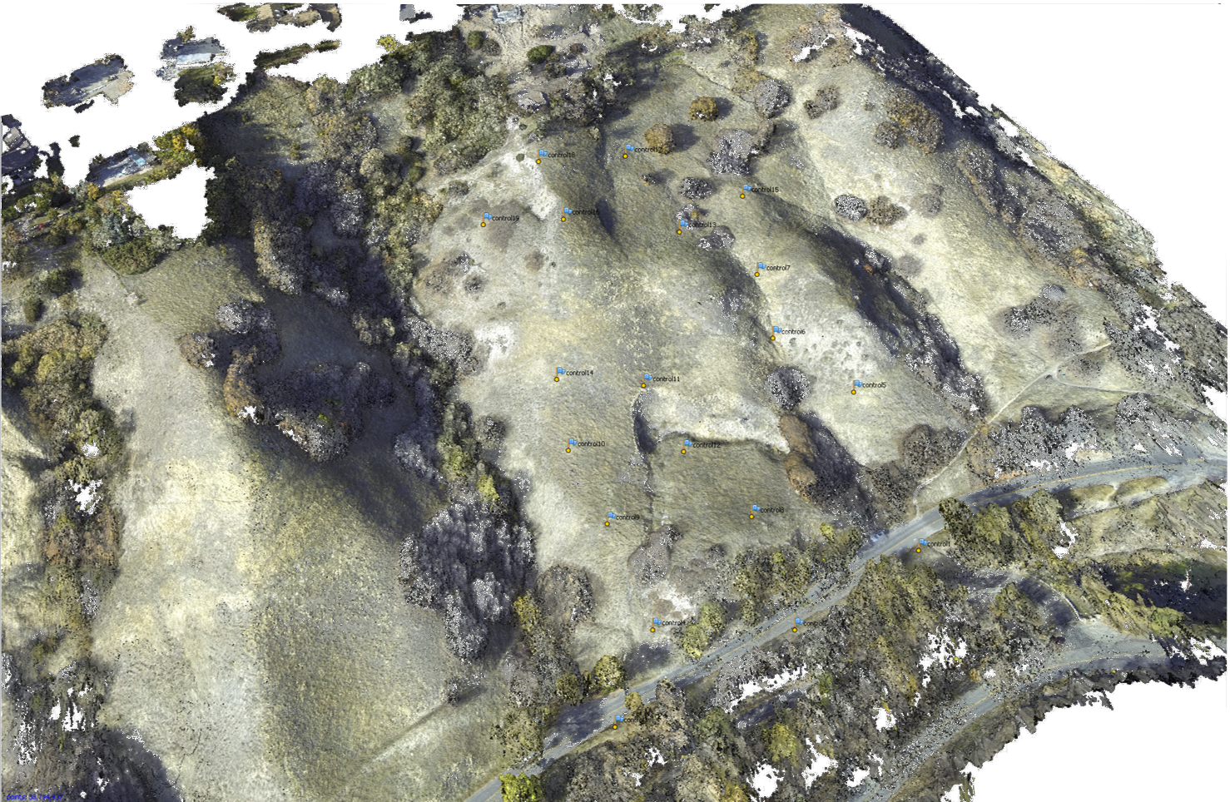
Landslide Near City Creek, UT
Figure Mike Bunds
Notes:
This landslide is in Utah, on the Wasatch front. Landslide activity in this area (around Salt Lake City) is linked to activity on the Wasatch Fault.

Slide 37
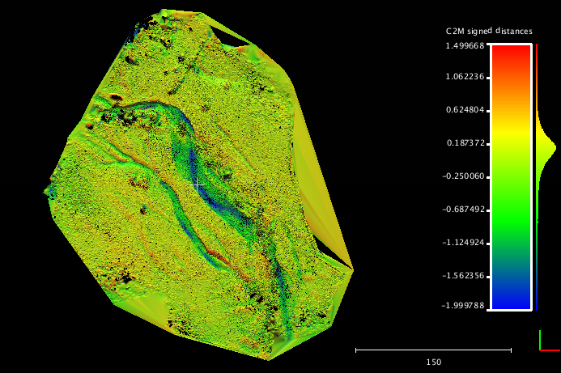
Four Mile Creek Differencing (SFM-ALS)
Figure Kendra Johnson
Notes:
Another application of SfM is looking at geomorphologic change. In 2013, a major flood occurred in Boulder, Colorado. Prior to the flood, an ALS survey was conducted of the Four Mile Creek area in North Boulder. After the flood, SfM and TLS surveys were conducted. “Change detection” is when you take a dataset from two different times and subtract them—think of it as simple math. At the point on both surfaces with the same GPS location, what’s the difference in elevation? This uses the SfM model and the ALS survey. The color corresponds to how much the elevation has changed in that place. On the next slide we will see a very similar figure produced using TLS and ALS.

Slide 38
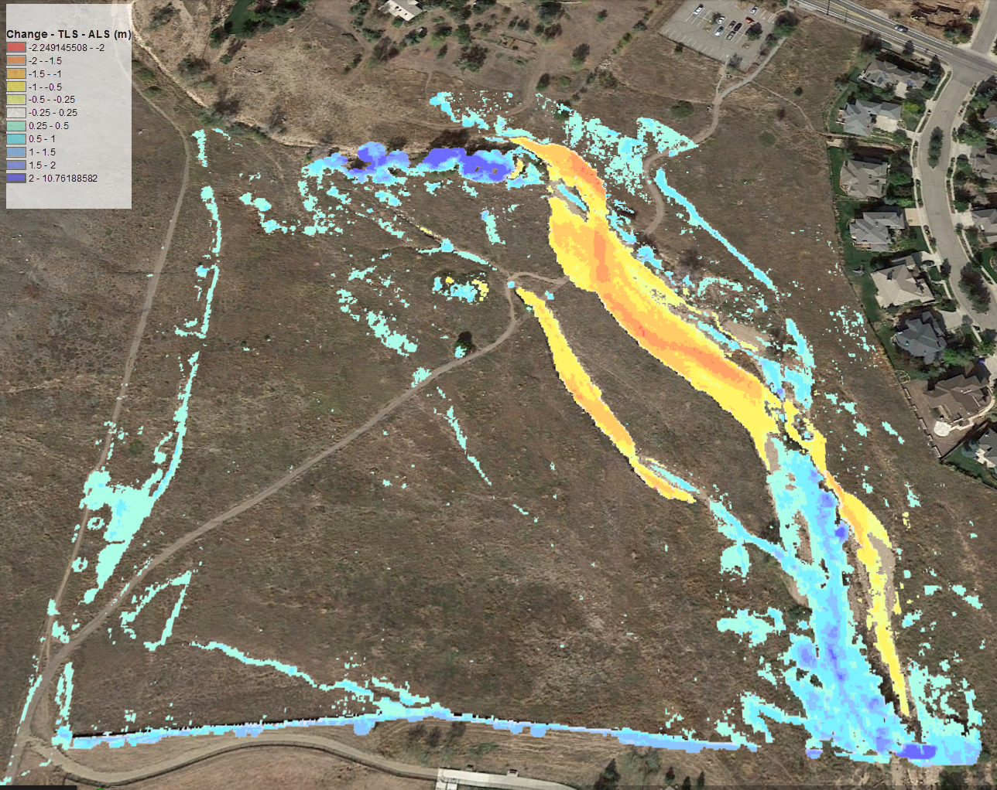
Four Mile Creek Differencing (TLS-ALS)
Figure Chris Crosby
Notes:
In this figure, we have the same view as the previous slide. The color ramp is the opposite of the previous slide (so the blue on the earlier slide is orange/red here). Both figures show the change in the channel. TLS and SfM can make very similar products.

Slide 39
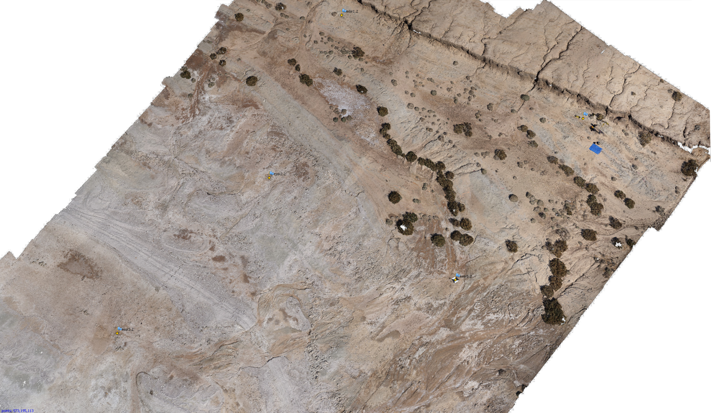
Shoreline of The Salton Sea
drainage
tarp
drainage
Figure Mike Bunds
Notes:
This survey was conducted using a UAS. The Salton Sea is located in Southern California near the Mexico border and was created when combination of bad irrigation practices and historic flooding of the Colorado River led to the Salton Sink—one of the lowest elevations in California—filling with water. This part of Southern California is a desert, so the shoreline has fluctuated with time. This survey was done to characterize the geologic evidence for the history of the Salton Sea shoreline. The ground control points used to georeference the survey are shown in the red circles [spacebar]. The oldest shoreline of the Salton Sea is shown by the red dotted line. Two drainages are here [spacebar]. Finally, you can see the tarp used to land the UAS here [spacebar].

Slide 40
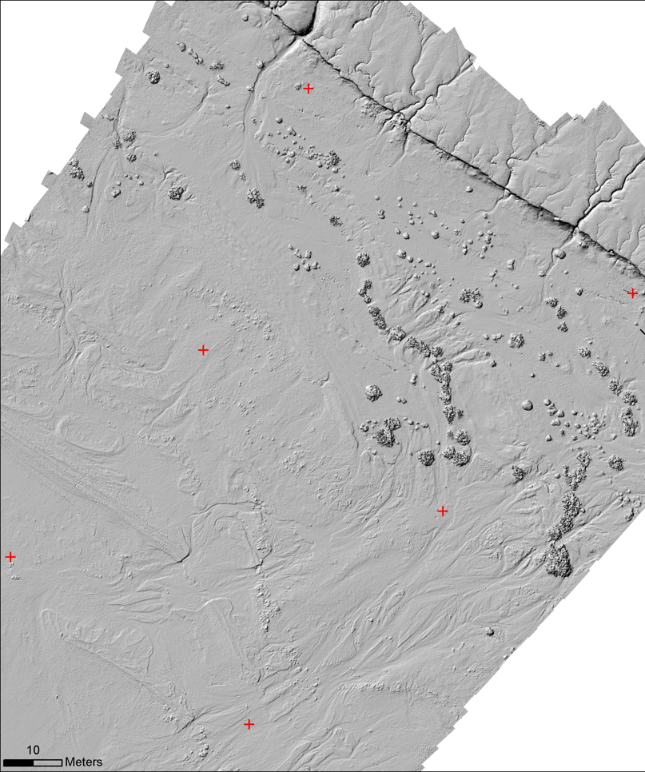
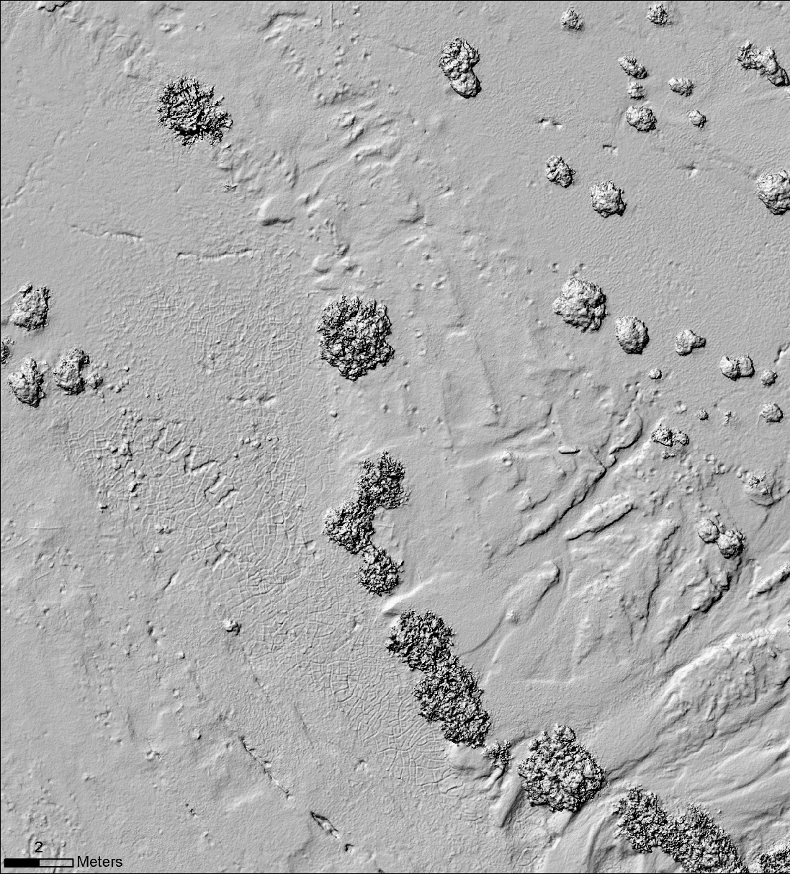
Shoreline of The Salton Sea
footprints
mudcracks
strandline
Figure Mike Bunds
Notes:
This is the DEM created from the model shown on the previous slide. In the DEM, some features appear that were difficult to see with the orthomosaic. For example, you can see mudcracks [spacebar], as well as footprints in the sand [spacebar] and strandlines (lines created by stranded fish carcasses that show the previous furthest extent of the water). [spacebar].

Slide 41

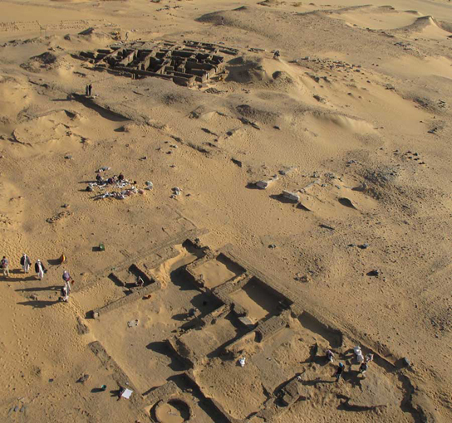
Archaeology – Amara West
Figure Neal Spencer
Notes:
Another application of SfM is archaeology. This example is from the British Museum’s Egypt department. They primarily use kite-based photogrammetry. The setup is shown in the left photo and a photograph from the camera attached to the kite on the right.

Slide 42
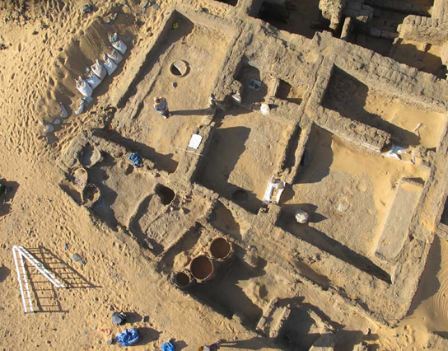
Archaeology – Amara West
Figure Neal Spencer
Notes:
Here is a portion of a model created from the kite photography.

