Slide 1
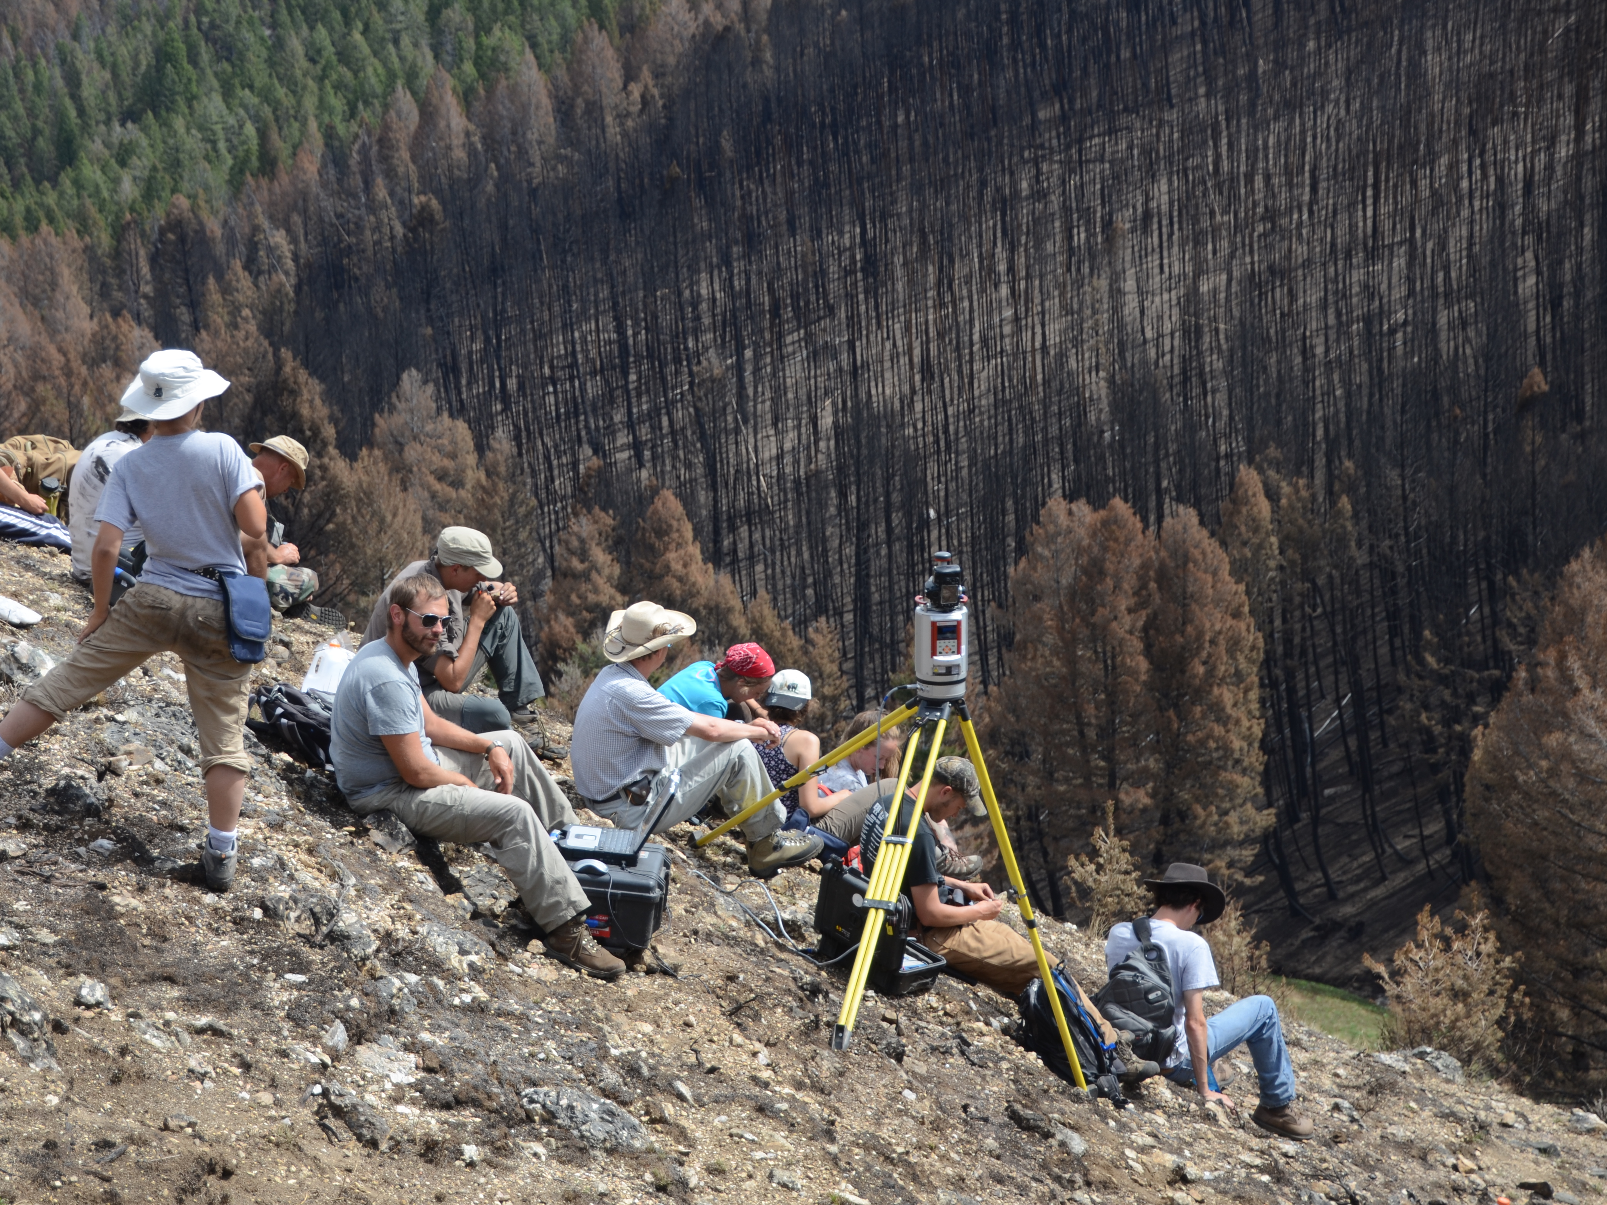
Introduction to Terrestrial Laser Scanning: Mechanisms and Research Applications
Christopher Crosby
(EarthScope)
Version: 10 , 2023
Questions, contact education-AT-earthscope.org
Notes:
Photo by Chris Crosby [EarthScope]

Slide 2
Video..
https://www.youtube.com/watch?v=yxLMk120vMU
Notes:
This video is a three- minute introduction to what UNAVCO does. Though UNAVCO has merged into EarthScope Consortium, this video still contains accurate information about geodesy and the role EarthScope plays in managing geodetic data. It is important to note that the Plate Boundary Observatory Network of GPS Stations (mentioned in the video) is now the Network of the Americas (NOTA).

Slide 3
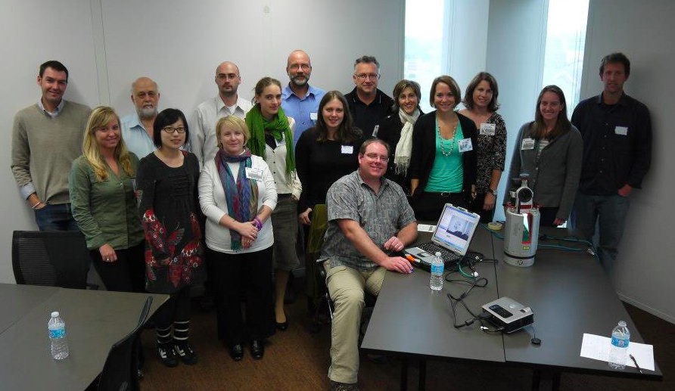
TLS Community Support
Support Resources
Instrumentation
Field Engineering
Data Processing
Training
Data Archiving & Dissemination
Community Building
Workshops
Inter-Agency Collaborations & Partnerships
Education and Outreach
Training Courses
Field Courses
GSA 2012 UNAVCO (Now EarthScope) TLS short course, Charlotte, NC
Notes:
TLS is supported by EarthScope in a variety of ways; PIs can use instrumentation, have field engineers come with them to conduct a survey, etc. EarthScope also leads workshops and short courses and participates in many collaborations with other agencies. EarthScope also has an Education and Community Engagement department for activities pertaining to geodesy education.

Slide 4
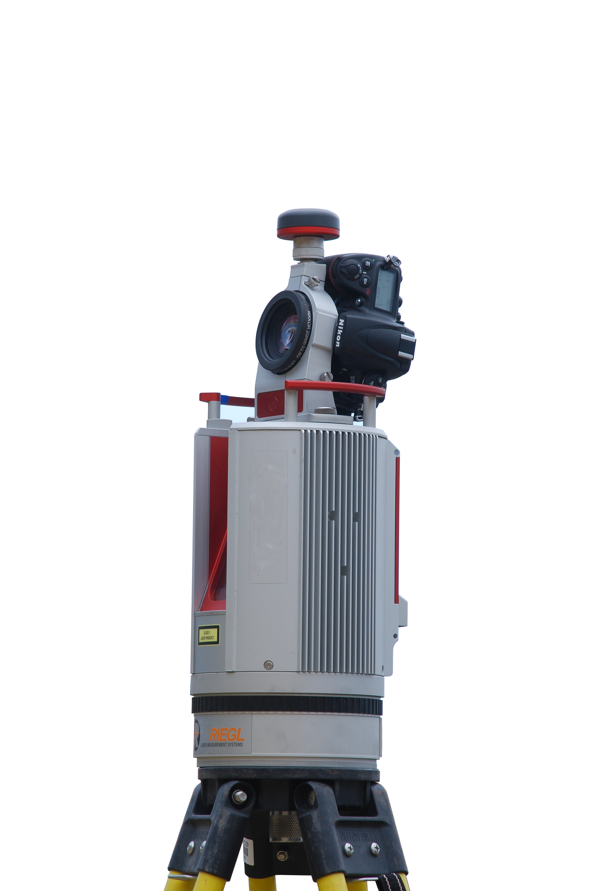


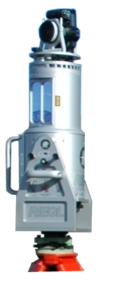
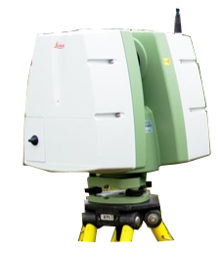
EarthScope TLS Instrument Pool
Scanners funded by the National Science Foundation
 | Riegl VZ-2000 | Riegl VZ-1000 | Riegl VZ-400 | Riegl Z620 | Leica C10
Laser wavelength | Near infrared |  |  |  | 532 nm (green)
Effective range | 2050 m | 1400 m | 500 m | 2000 m | 150 m
High-speed meas. rate | 396,000 pts/sec | 122,000 pts/sec | 125000 pts/sec | 11,000 pts/sec | 50,000 pts//sec
Precision | 5 mm | 5 mm | 5 mm | 10 mm | 4 mm
Accuracy | 8 mm | 8 mm | 5 mm | 10 mm | 6 mm
Field of view | 100°x 360° | 100°x 360° | 100°x 360° | 80°x 360° | 270°x 360°
Dimensions | 308 mm x 196 mm | 308 mm x 180 mm | 308 mm x 180 mm | 463 mm x 210 mm | 238 mm x 395 mm
Weight | 9.9 kg | 9.8 kg | 9.8 kg | 16 kg | 13 kg
Notes:
UNAVCO has seven TLS instruments. Six of them are Riegl scanners similar to the ones that you will use in this course. The seventh is a Leica scanner with a slightly smaller maximum range (distance to feature of interest). UNAVCO also has all the supporting equipment needed for a TLS survey such as GPS, tripods, etc., and also has access to a server with licenses for the software one uses to explore and process the data.

Slide 5
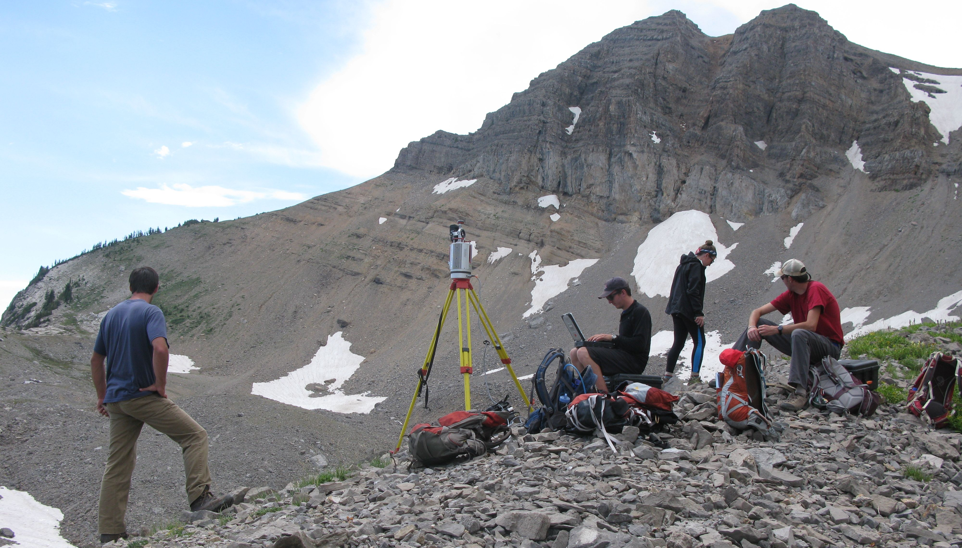
Related Resources
Campaign and RTK GPS, tripods, various power supply options
Instrument validation range
License server with access to RiScan Pro, Cyclone, Polyworks, ArcGIS, Quick Terrain Modeler, MatLab, etc
Photo Nathan Niemi

Slide 6
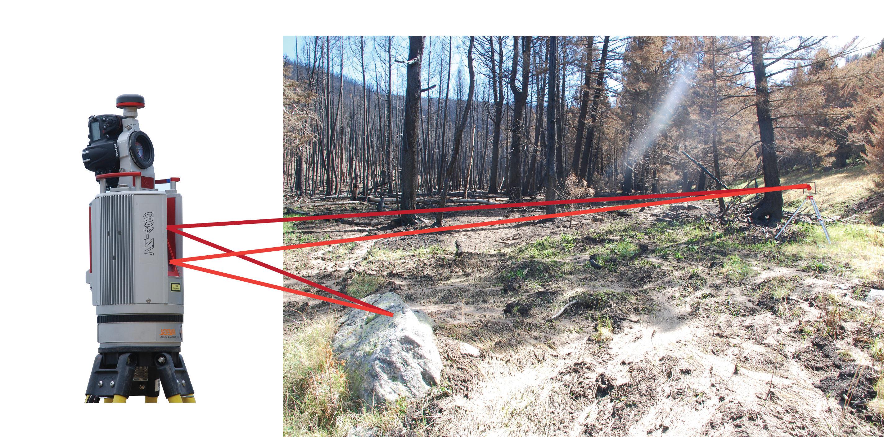
Light Detection and Ranging (LiDAR)
Accurate distance measurements with a laser rangefinder
Distance is calculated by measuring the two-way travel time of a laser pulse.
Near IR (1550nm) or green (532nm)
Photo Bruce Douglas
Notes:
Light detection and ranging or lidar works by measuring the distance between a scanner and any object in its field of view by emitting a laser pulse and measuring the time it takes to return and be recorded by a receiver.

Slide 7
How is Range Measured?
Time of flight
Time it takes for emitted pulse to reflect off object and return to scanner.
Phase shift
By measuring the phase shift of a pulse, distance is calculated along a sinusoidally modulated laser pulse.
Notes:
There are two ways that this range between the object and the scanner is measured. The first is time of flight, which is what the Riegl scanner you’ll use utilizes. the calculated time is based on the time it takes a signal to be returned. Phase shift measures the phase shift of a pulse and uses that to calculate the distance.

Slide 8
Advantages and Disadvantages
Time of flight
Range ~ 100–6000m
Accuracy ~ 1 mm
< 300,000 pts/s
Slower, larger
Phase shift
Range ~ 0–100m
Accuracy ~ 1 micron
> 1,000,000 pts/s
Noise in data
Notes:
Advantages exist for both systems. Time of flight has a larger maximum range, which means it can be used in sites where the area of interest may or may not be directly accessible. Phase shift is more accurate and can collect more points per second. Time of flight is a slower and larger system, whereas phase shift data can be noisy and only collected when one is close to the feature of interest.

Slide 9
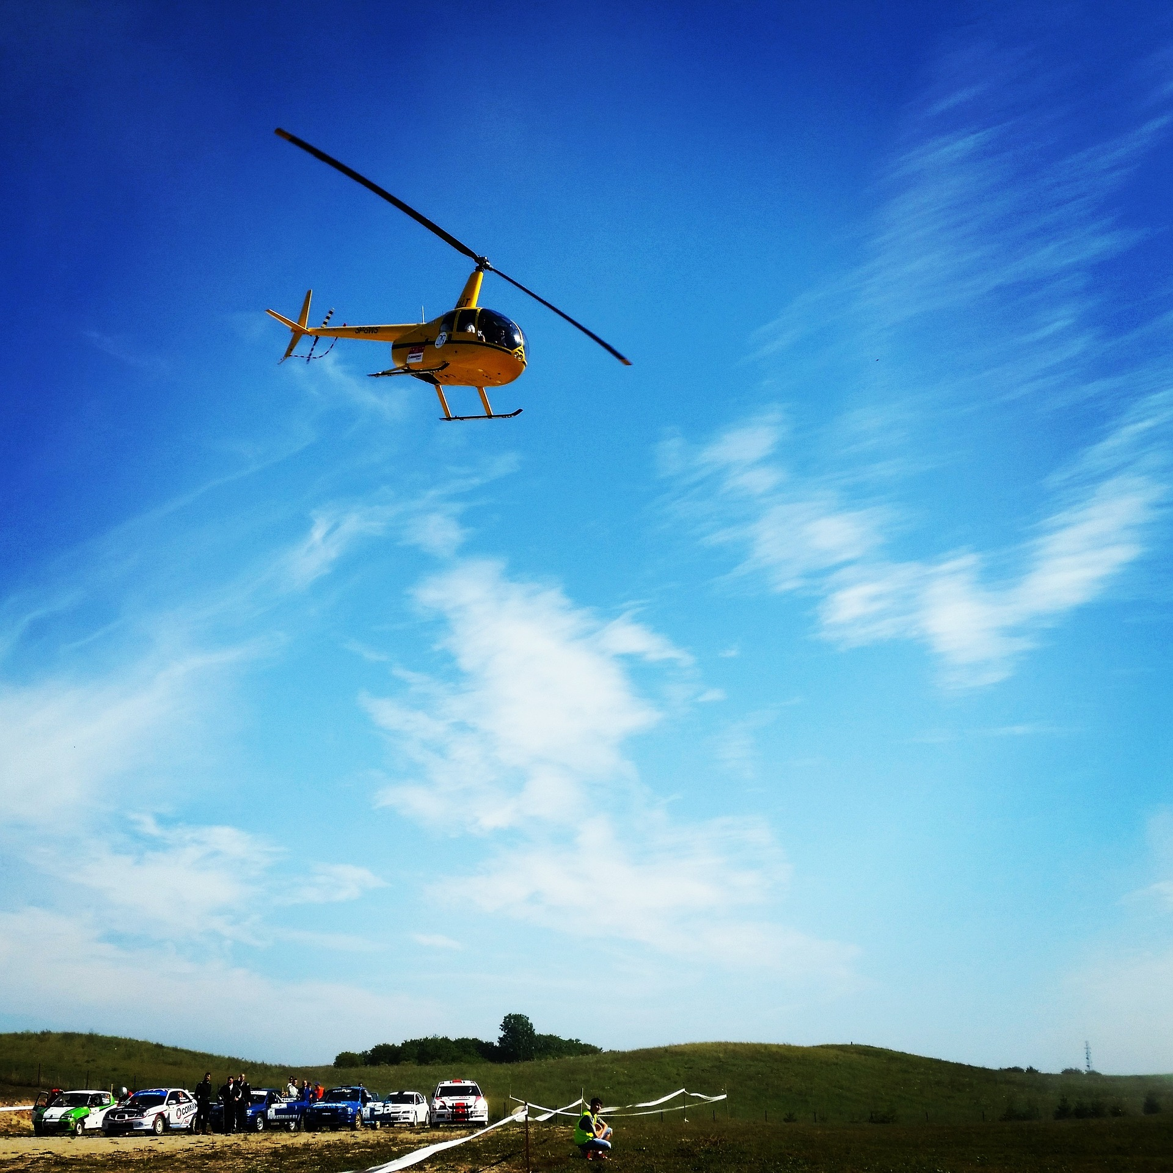
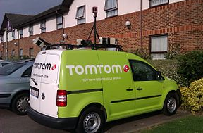
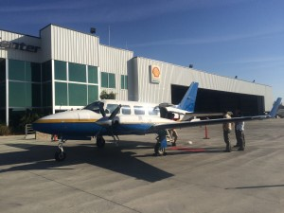
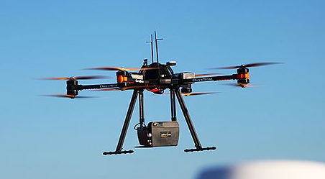
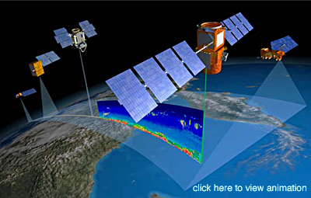
A Suite of LiDAR Platforms
Notes:
Lidar data can be collected using many platforms: tripod (what you learn in this module), drone, helicopter, airborne, satellite, and even off the top of a car.
Images (clockwise from upper left):
https://pixabay.com/static/uploads/photo/2015/11/11/23/31/sky-1039395__180.jpg (CC)
http://www.opentopography.org/blog/opentopography-rides-along-airborne-lidar-survey-ncalmhttp://www.opentopography.org/sites/opentopography.org/files/images/news_items/plane_thumb.jpg (public domain)
https://en.wikipedia.org/wiki/Lidar#/media/File:Mapping_van_tomtom_with_five_lidars.jpg (public domain)
http://www.hq.nasa.gov/office/hqlibrary/documents/o55480866.pdf (public domain)
By Cargyrak - Own work, CC BY-SA 4.0, https://commons.wikimedia.org/w/index.php?curid=48685015 (CC)

Slide 10
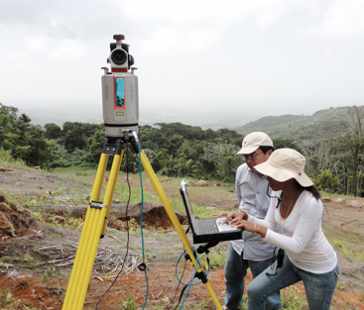
Light Detection and Ranging (LiDAR)
Similar technology, different platforms:
Terrestrial Laser Scanning (TLS)
  - Also called ground based lidar or T-lidar.
Laser scanning moving ground based platform = Mobile Laser Scanning (MLS).
Laser scanning from airborne platform = Airborne Laser Scanning (ALS).
Notes:
Read slide. Don’t need to spend a lot of time on this one!
Images: EarthScope and https://en.wikipedia.org/wiki/Lidar#/media/File:Mapping_van_tomtom_with_five_lidars.jpg

Slide 11
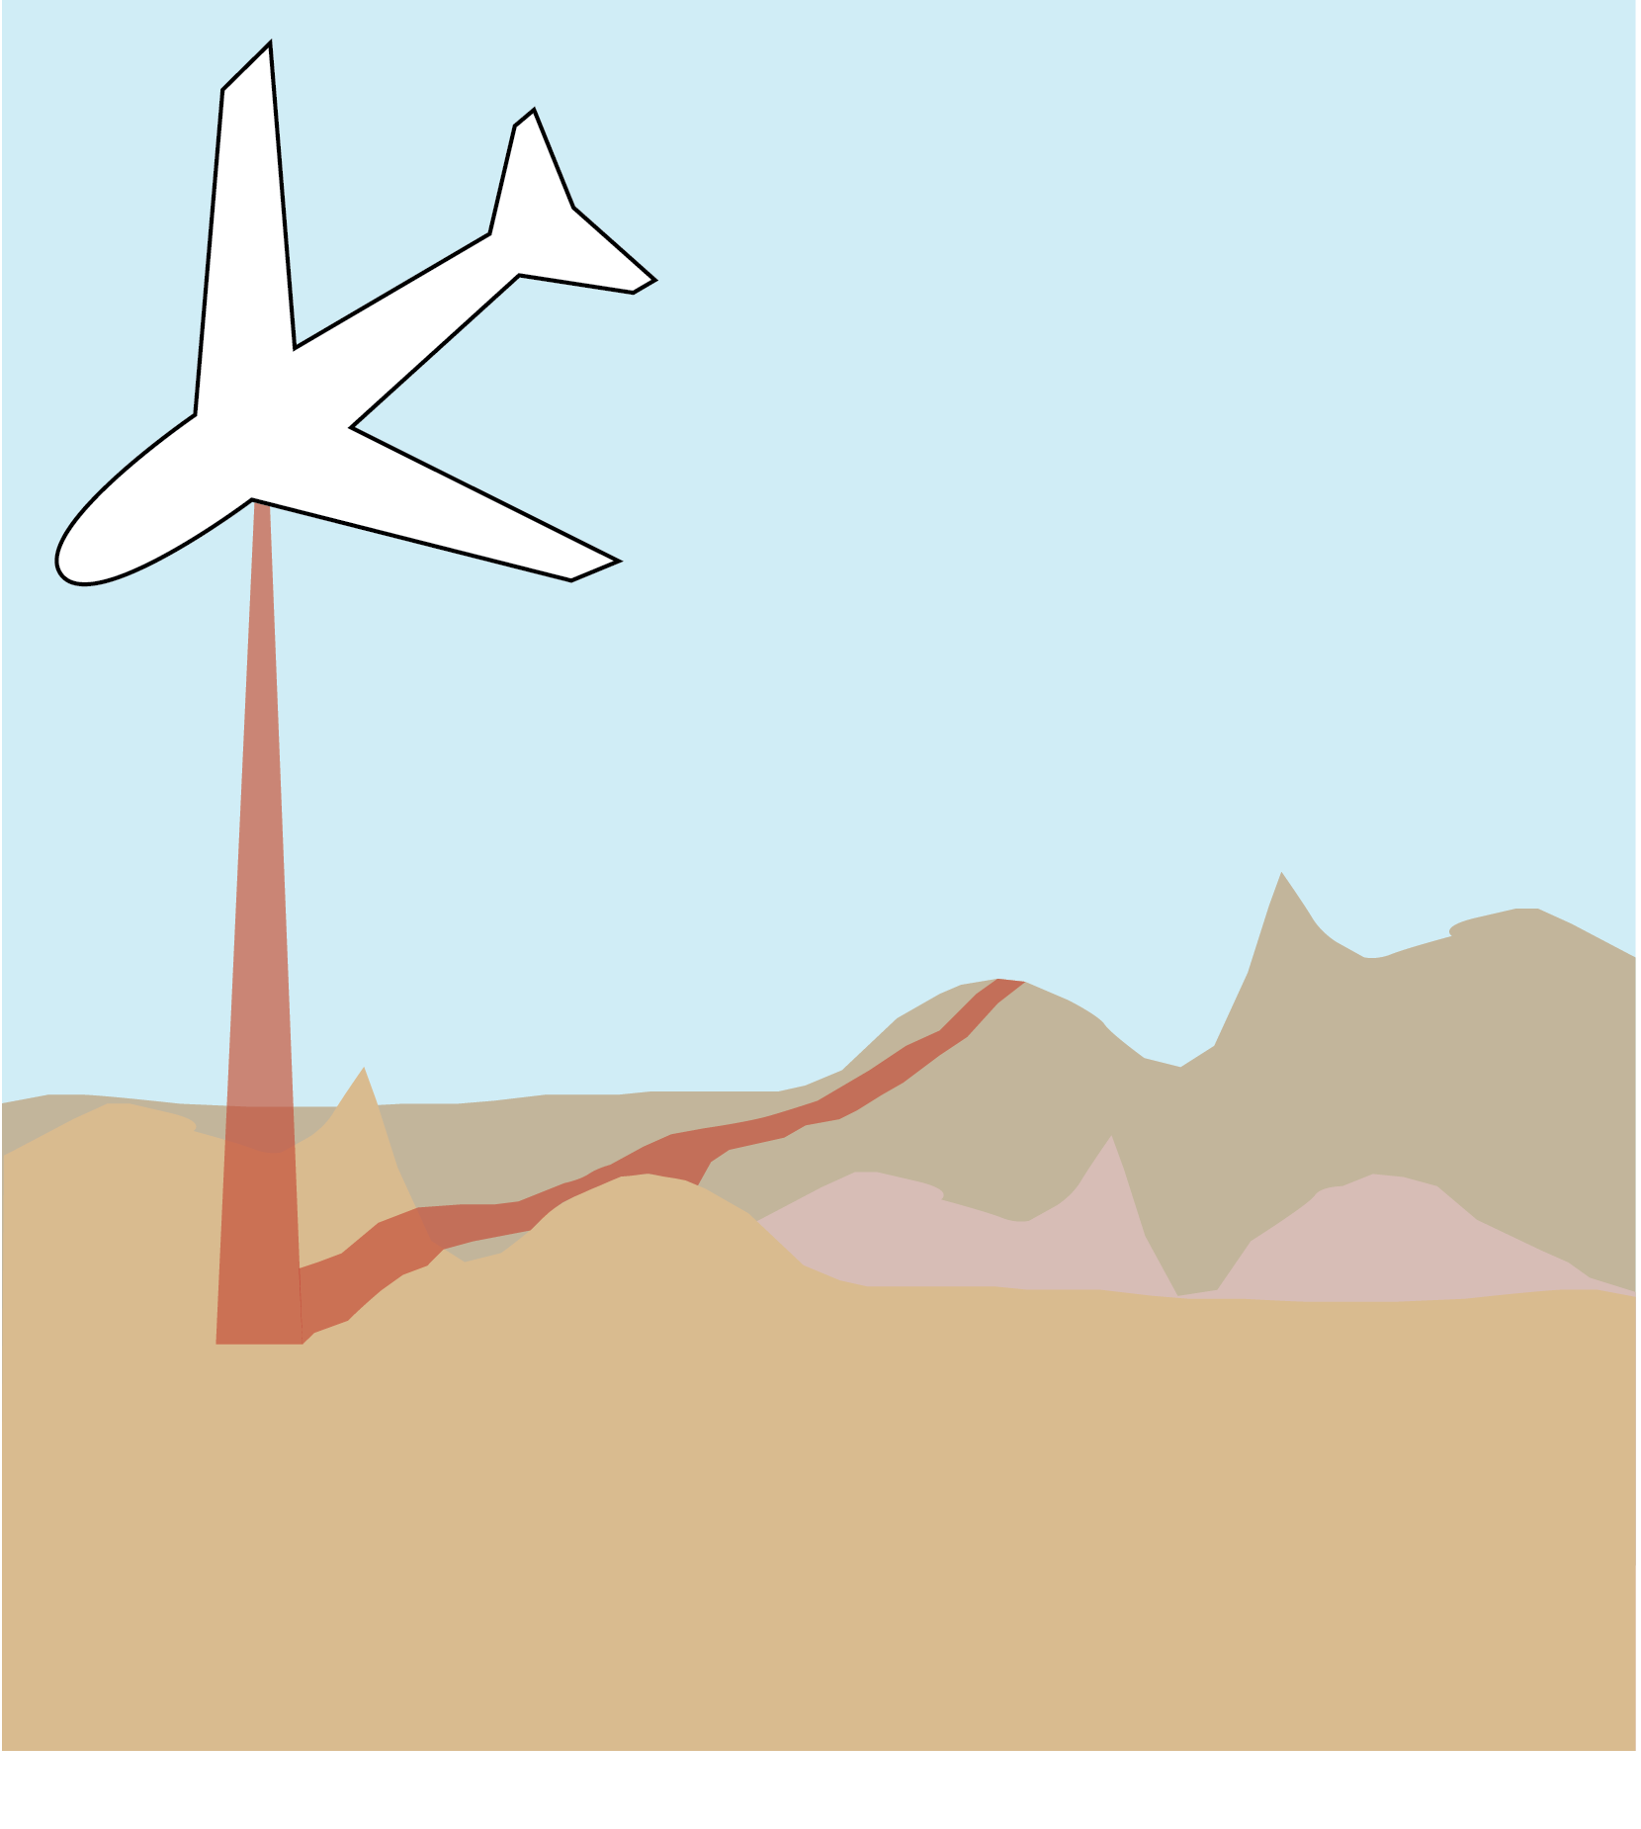
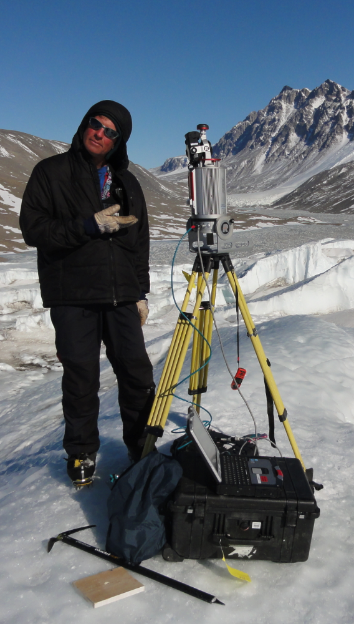
Light Detection and Ranging (LiDAR)
System: | Spaceborne (e.g. GLAS) | High Altitude (e.g. LVIS) | Airborne (ALS) | Terrestrial (TLS)
Altitude: | 600 km | 10 km | 1 km | 1 m
Footprint: | 60 m | 15 m | 25 cm | 1–10 cm
Vertical Accuracy | 15cm to 10m depends on slope | 50/100 cm bare ground/ vegetation | 20 cm | 1–10 cm Depends on range, which is few meters to 2 km or more
GLAS/ICESAT
Notes:
Because of all these different platforms, we can collect data using lidar over a huge range of scales.
Images NASA public domain

Slide 12
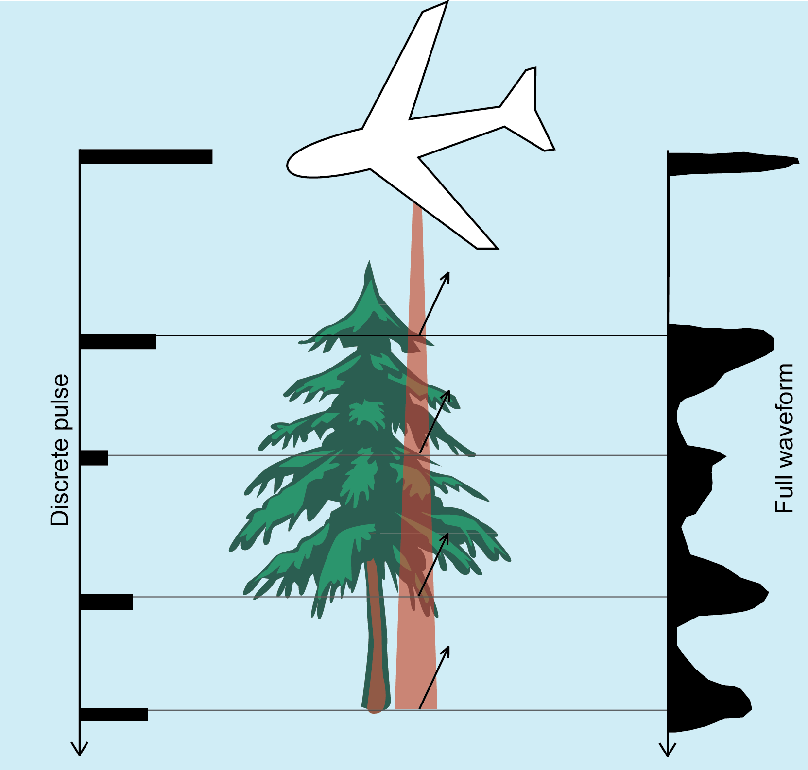
Discrete Pulse and Full Waveform
Discrete pulse = binary yes- or-no return
Full waveform = digitized backscatter waveform
Benefits of full waveform?
More resolution between pulse width ambiguity
Spectral property information
Improved fitting of geometrically defined targets.
Notes:
The vast majority of scanners are discrete pulse
Lidar can record data in one of two ways: discrete pulse or full waveform. Full waveform is preferred because it has better resolution and fits targets better, but discrete pulse can be used for a lower resolution scan. This also depends on the scanner being used.
Image: Kate Shervais

Slide 13
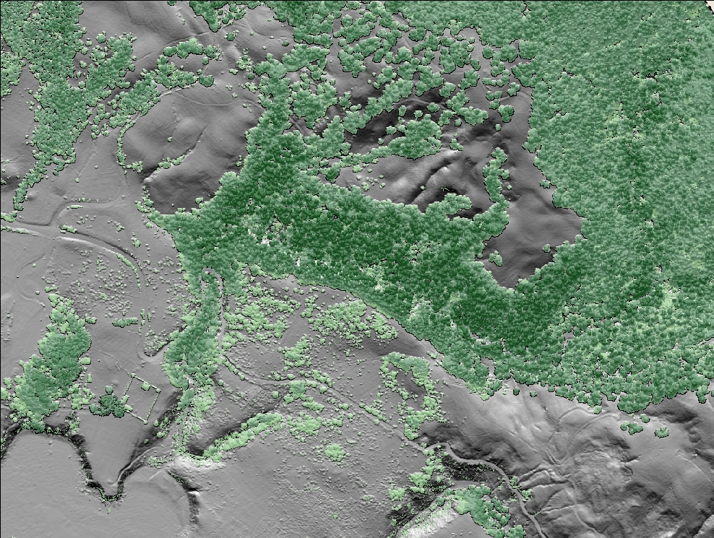
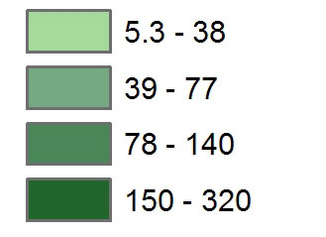
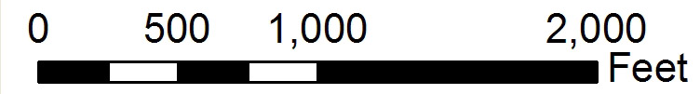
Canopy Height (ft)
Notes:
In geoscience, we are very interested in the topography of the earth but not always so interested in the vegetation. (space bar) When you use lidar in general you are able to actually de-vegetate the view because of the multiple returns we just discussed. This is Highway 1 and Fort Ross in California. Red line is the rupture of the 1906 earthquake, as mapped in the 1906 official report on the earthquake. What geologists tend to think of as noise (vegetation) may be something someone else could be very interested in. So you could also analyze the height of the vegetation (space bar).

Slide 14
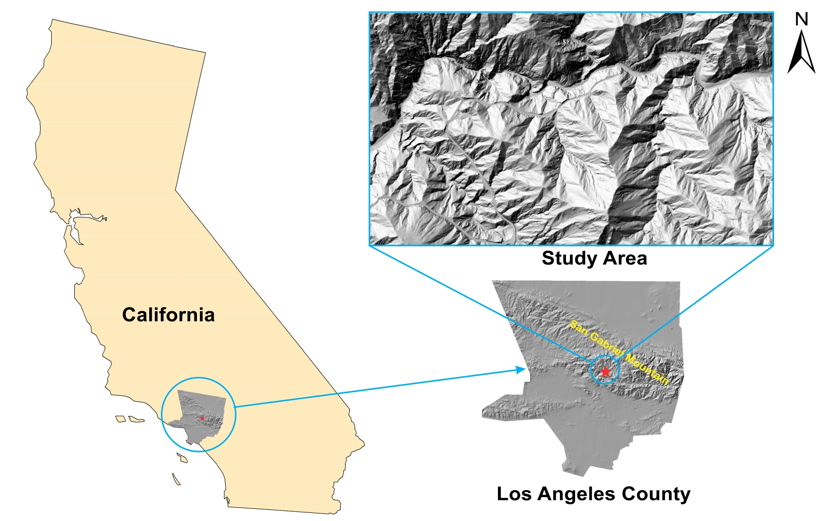
Using Terrestrial and Airborne Lidar
J. Oldow, UTD
Notes:
TLS can be used as an addition to airborne lidar (the platform used to collect the data on the previous slide) or on its own. This study area in the San Gabriel Mountains has a 1-m DEM of the study area. This study was focused on analyzing the impact of the 2009 Station Fire in the San Gabriel Mountains.

Slide 15
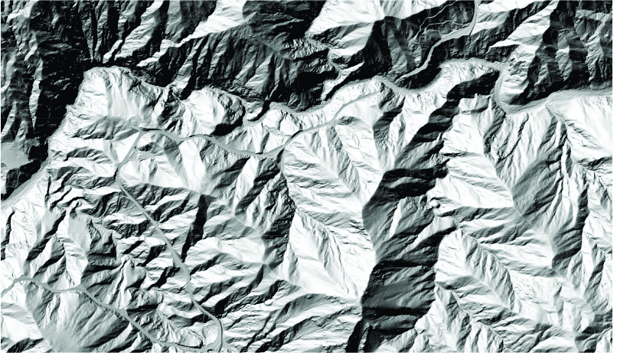
Using Terrestrial and Airborne Lidar
San Gabriel Mountain 1-m DEM from airborne lidar
J. Oldow, UTD
Notes:
It looks great/very high resolution from this view; at this scale you could do some kind of watershed analysis.

Slide 16
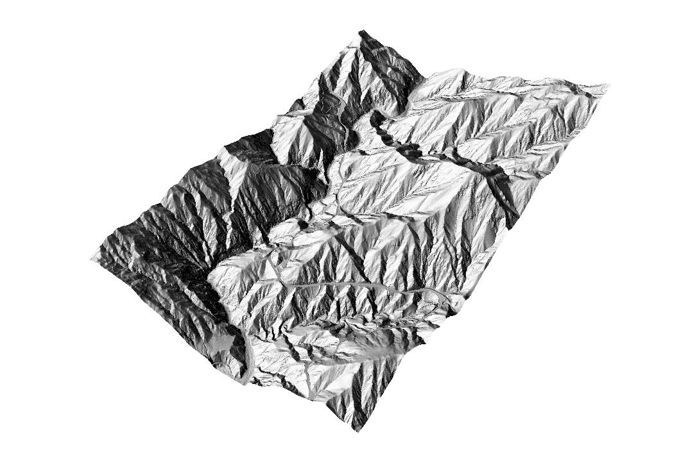
Using Terrestrial and Airborne LiDAR
J. Oldow, UTD
Notes:
To understand how it looks in 3D…

Slide 17
Using Terrestrial and Airborne LiDAR
Notes:
The research area of interest, however, is the area highlighted by the circle

Slide 18
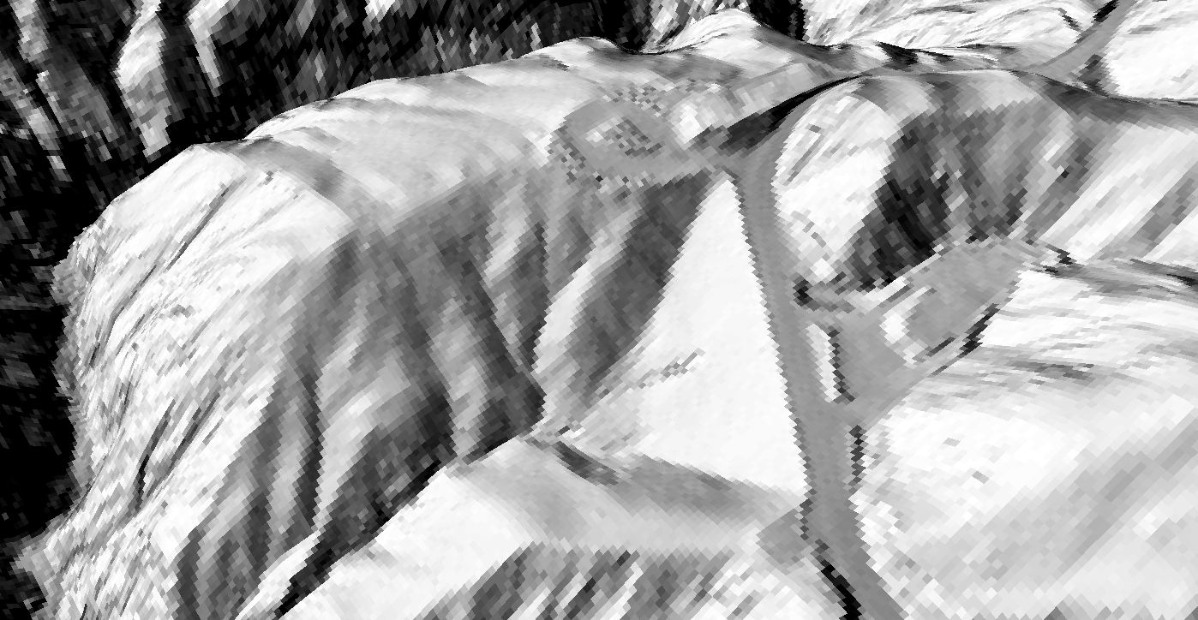
Using Terrestrial and Airborne LiDAR
J. Oldow, UTD
Notes:
If we zoom to this area, the resolution is no longer so great.

Slide 19
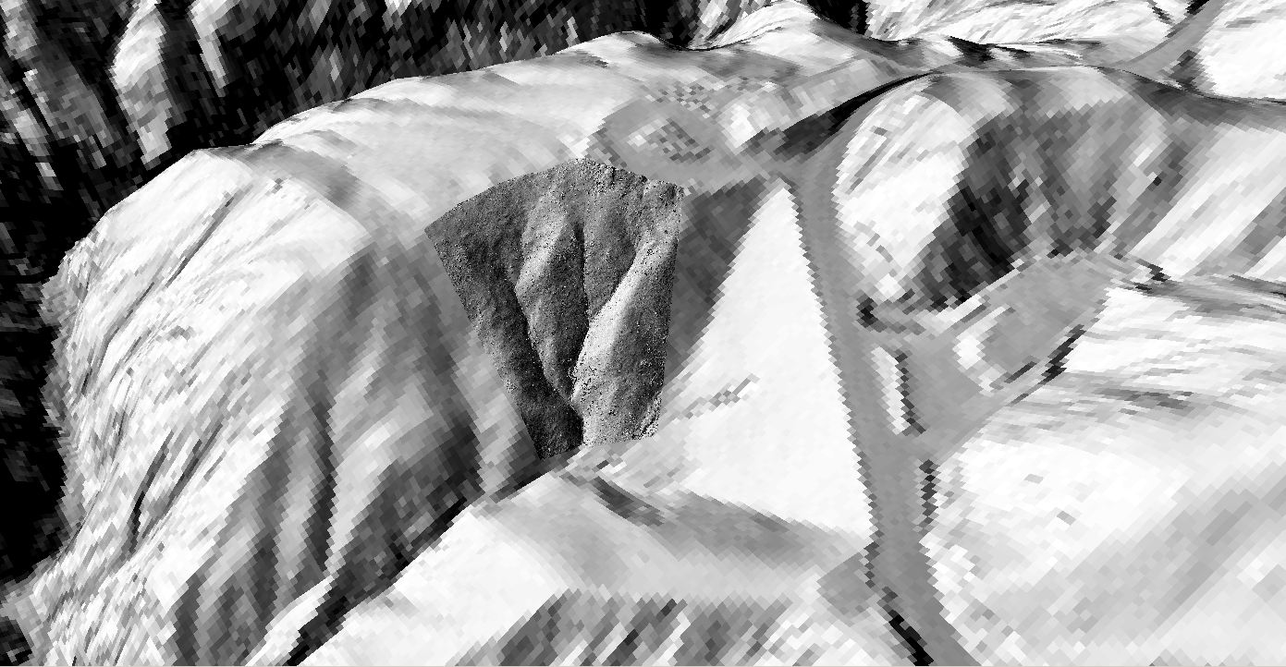
Using Terrestrial and Airborne LiDAR
J. Oldow, UTD
Notes:
However, if you’re interested in exactly how the fire has affected the slope, you may want to bring a TLS to do a detail scan like this one to show the characteristics of the slope.

Slide 20
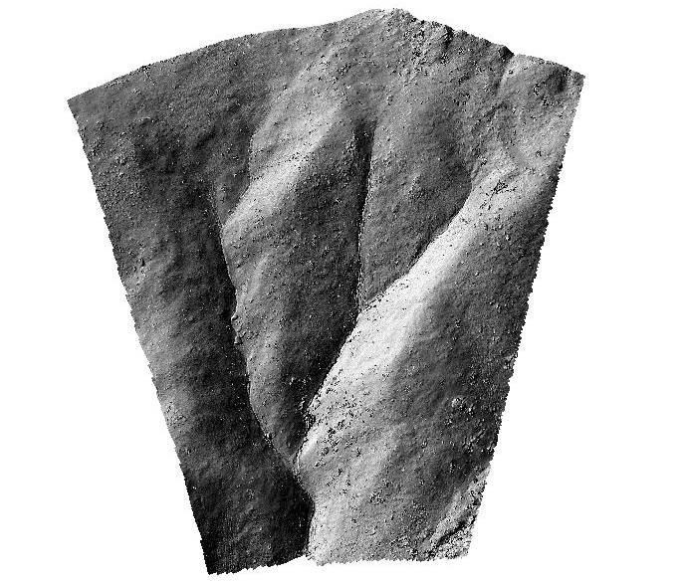
Using Terrestrial and Airborne LiDAR
J. Oldow, UTD
Notes:
All the little nubs on this slide are actually tree stumps!

Slide 21
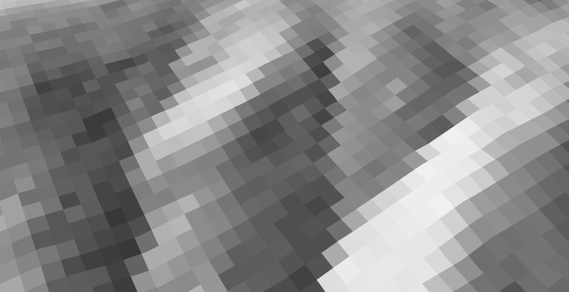
Using Terrestrial and Airborne LiDAR
J. Oldow, UTD
Notes:
Here’s the airborne lidar again

Slide 22
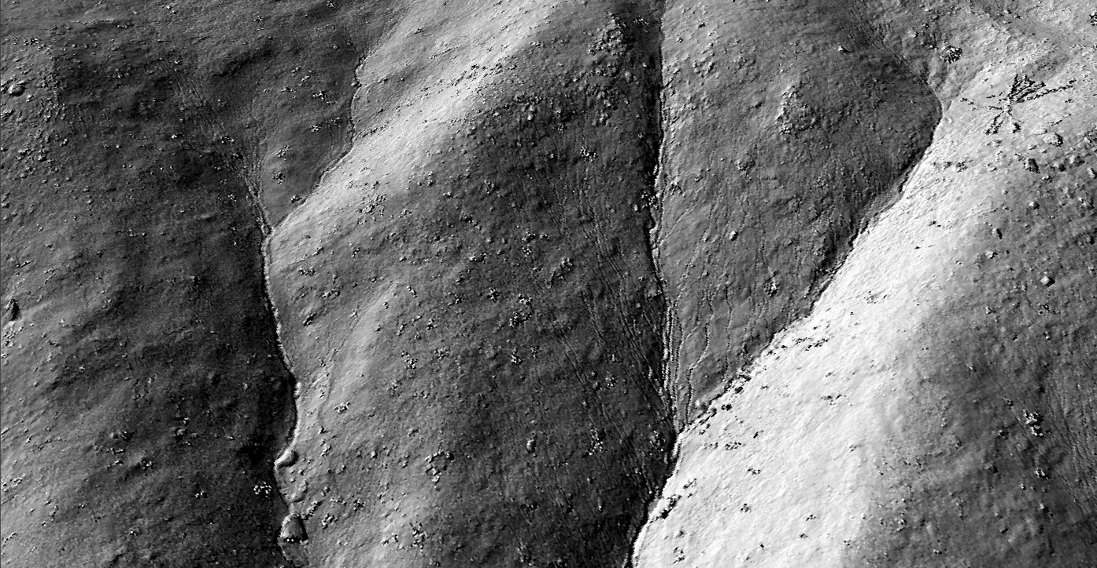
Using Terrestrial and Airborne LiDAR
J. Oldow, UTD
Notes:
Compared to this view of the TLS data. The fire de-vegetated the hillslope. TLS allows you to capture the landscape at the scale at which the process is happening. You can even see small gullies running down the side of the hill!

Slide 23
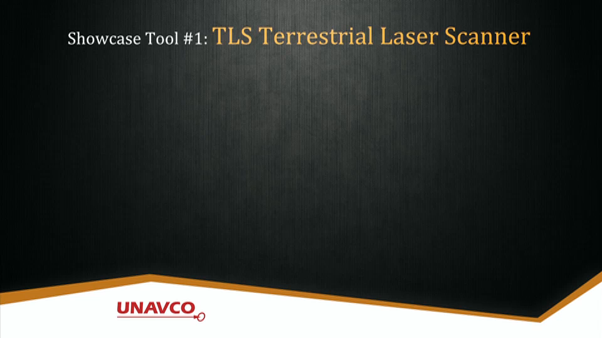
Showcase Video for TLS
Notes:
Play embedded video. This demonstrates applications of TLS for research.
Video from UNAVCO, now EarthScope

Slide 24
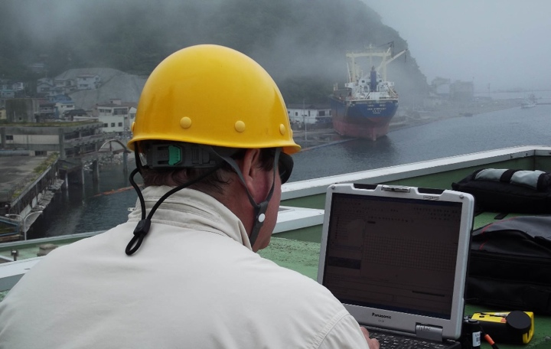
TLS Research Application
Project: 2011 Japan Tsunami measurements
PI: Hermann Fritz (Georgia Tech)
NSF RAPID project
Notes:
TLS has a number of research applications. The following slides will demonstrate the wide range of research that has been conducted using UNAVCO instrumentation and support.
Image: EarthScope

Slide 25
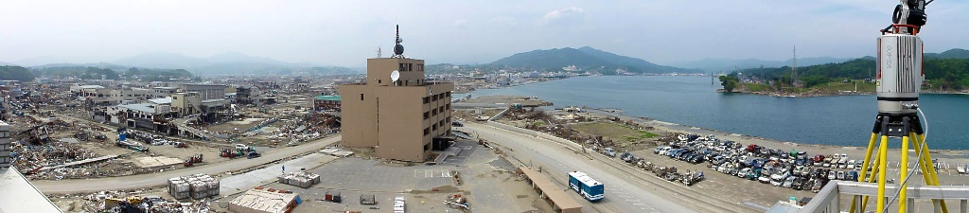
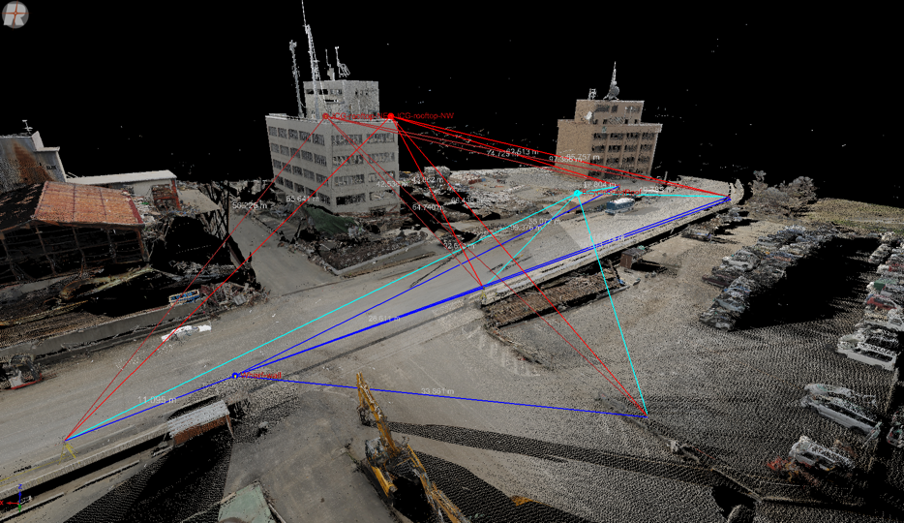
2011 Japan Tsunami
Notes:
In this project run by Georgia Tech and sponsored by NSF RAPID, PIs used TLS to document the effects of the 2011 Japan tsunami soon after it happened. This slide shows the scan positions
Images: EarthScope

Slide 26
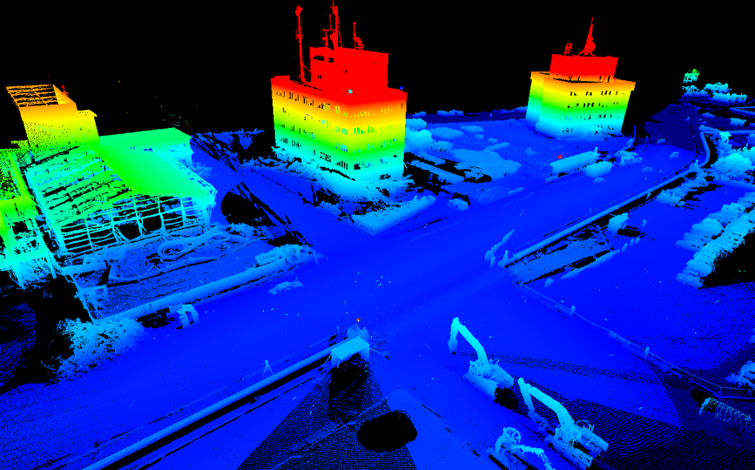
2011 Japan Tsunami
Notes:
While this slide shows the resultant scan, projected using the elevation of the data.
Images: EarthScope

Slide 27
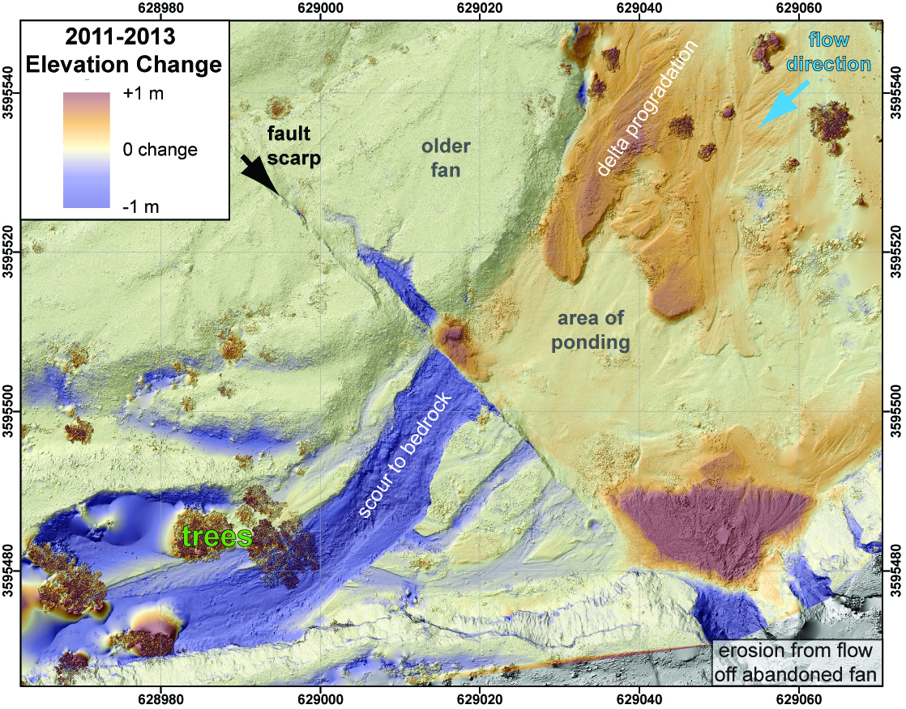
Scarp Erosion, 2010
Notes:
Fault scarps also erode with time, as shown by this study analyzing the elevation change on one fault scarp.
Image: Austin Elliot

Slide 28
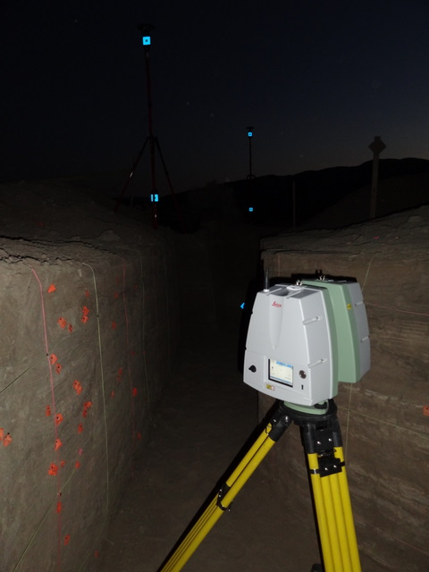
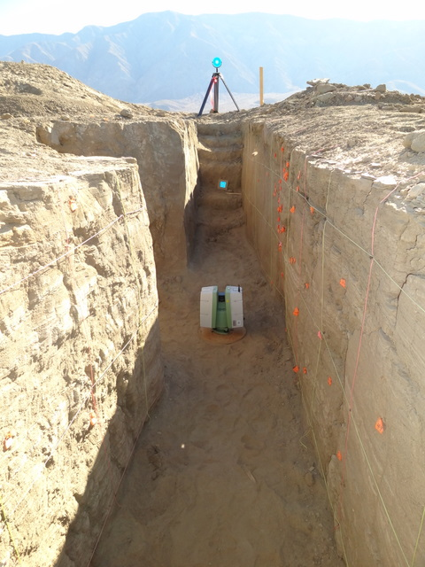
Paleoseismology
T. Rockwell, SDSU
Notes:
Paleoseismologists dig trenches into fault scarps to track the number of events that have occurred on that fault and their relative age to calculate recurrence intervals and do other analyses. TLS allows researchers to record the trench, because trenches usually stay open for a short time interval.

Slide 29
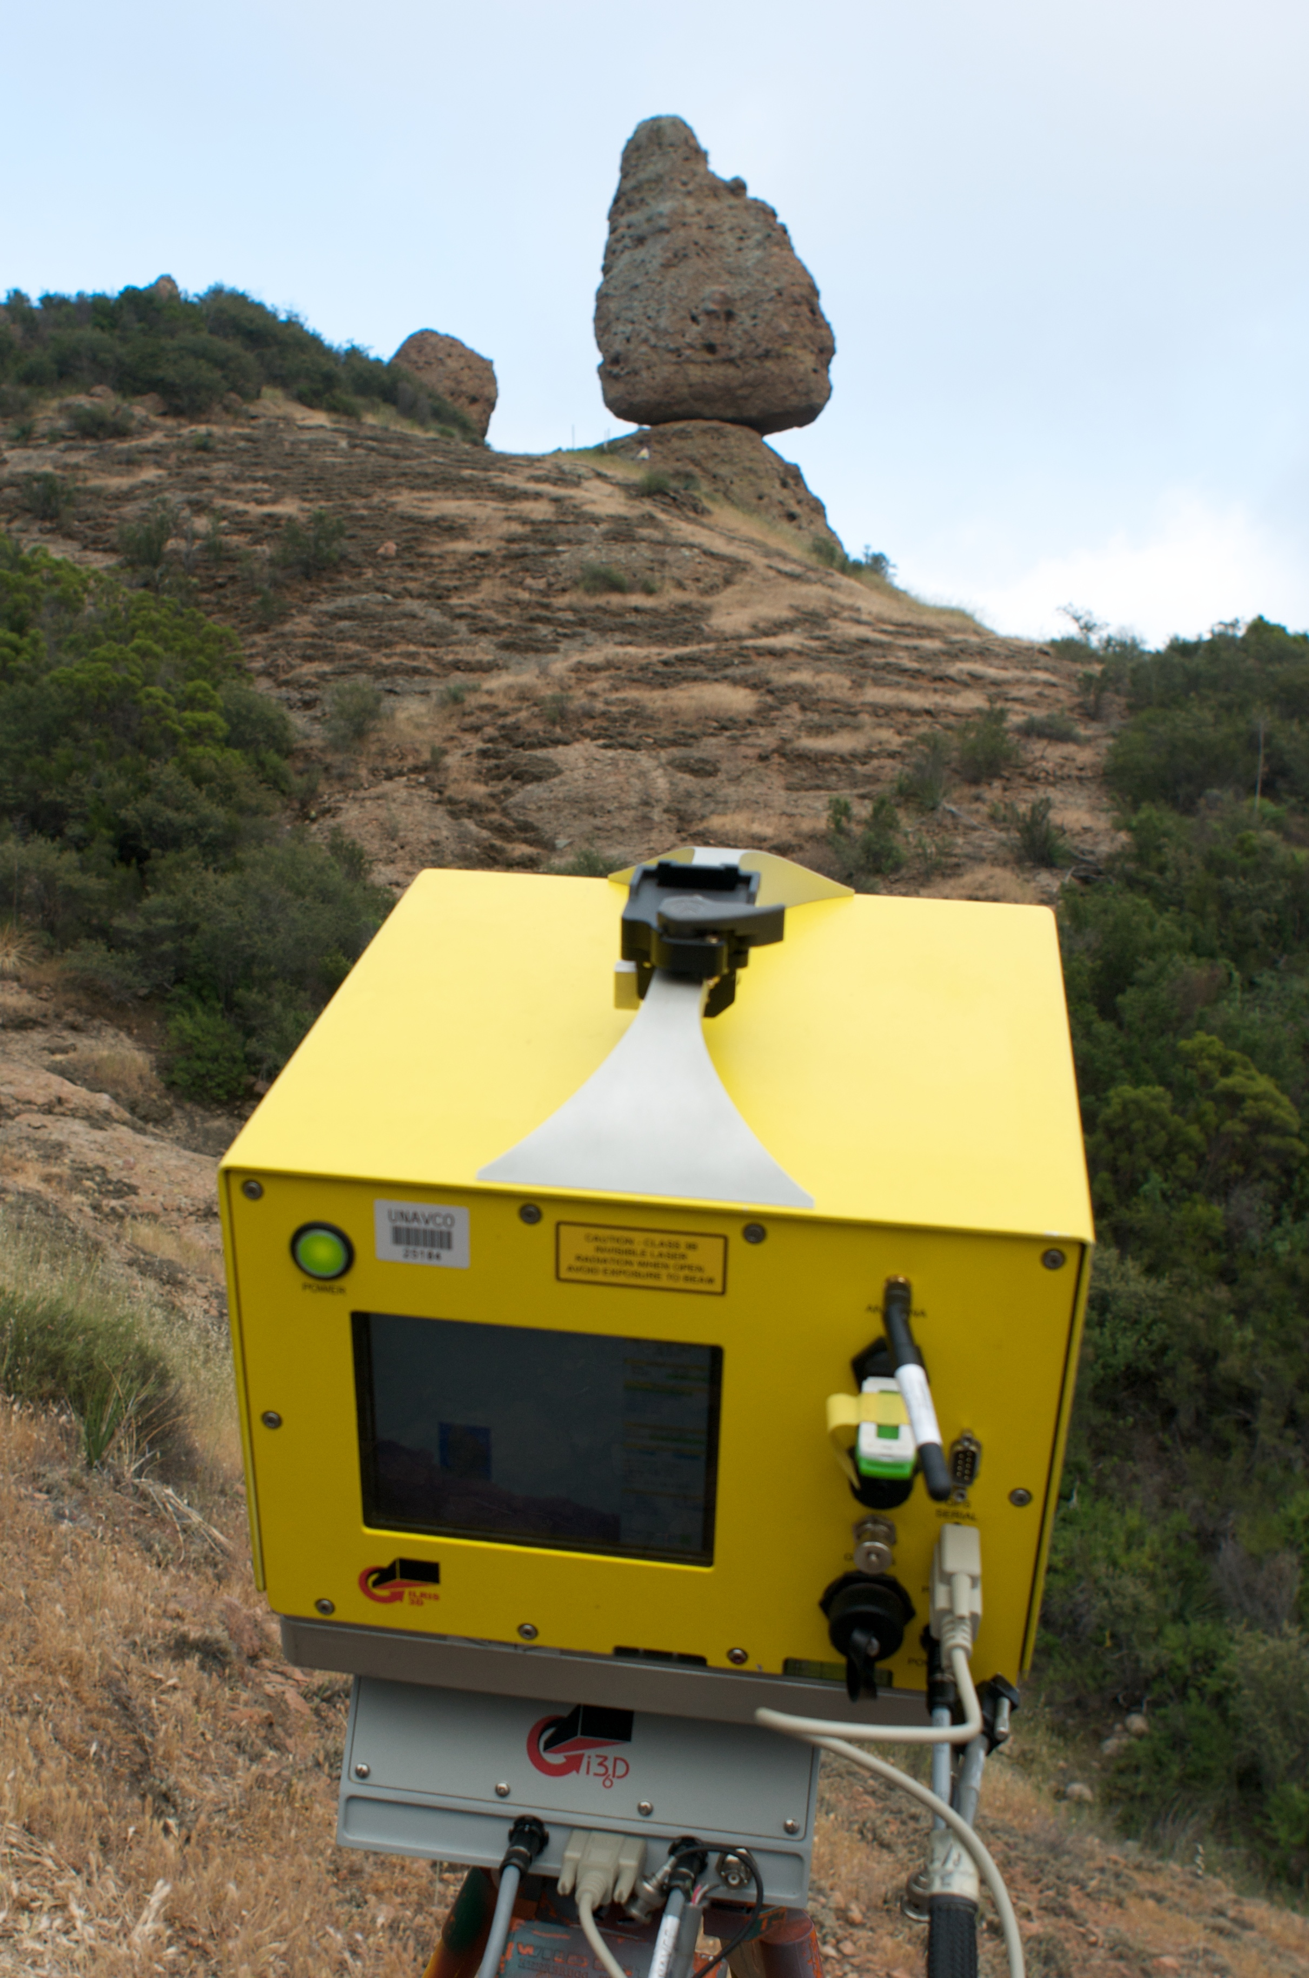
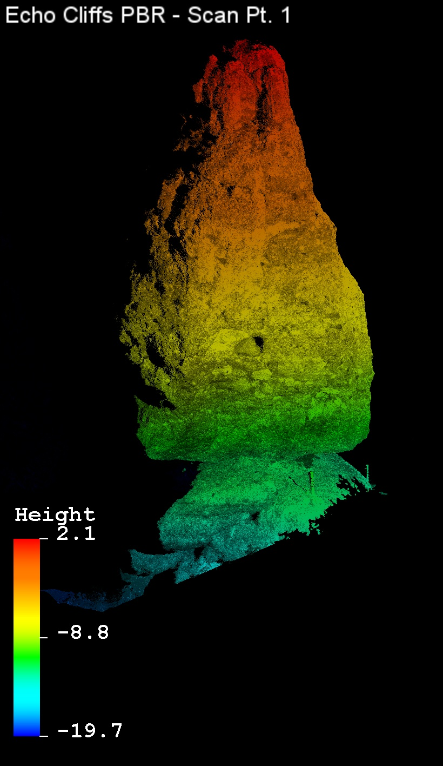
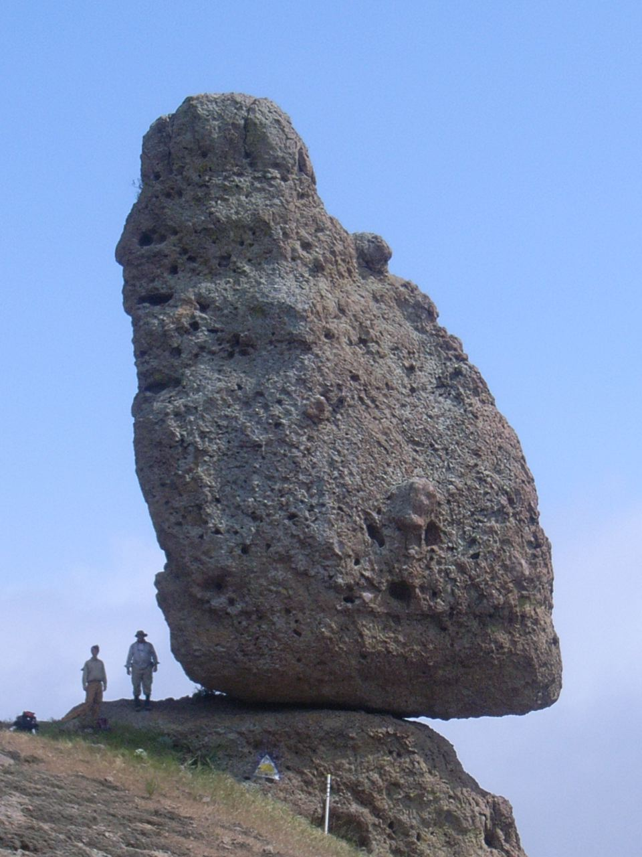
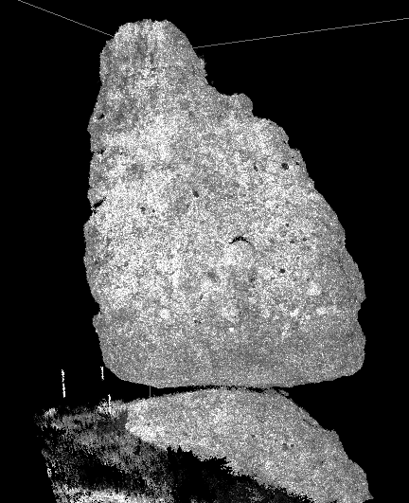
Precariously Balanced Rocks, PBRs
Project Highlight: Precariously balanced rock (PBR) near Echo Cliffs, southern California.
PI: Ken Hudnut, USGS.
Goal: generate precise 3D image of PBR in order to calculate PBR’s center of gravity for ground motion models useful for paleoseismology, urban planning, etc.
Notes:
Precariously balanced rocks are used in paleoseismology to help constrain the ground shaking during past events, as the rocks would fall if the shaking reached a certain level. TLS helps researchers create accurate models based on the 3D scan of the PBR.

Slide 30
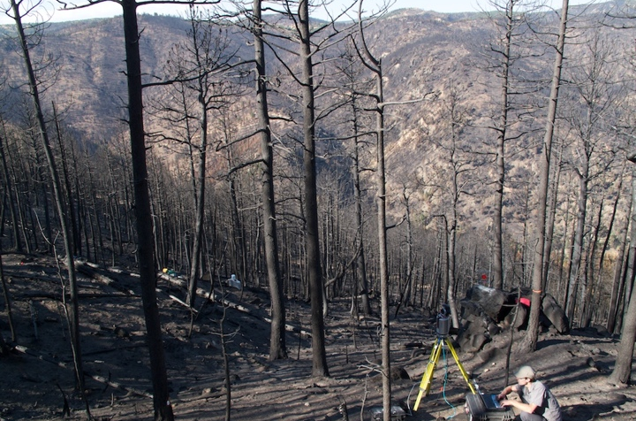
Four Mile Fire Erosion (Moody, Tucker)
Notes:
Geomorphologists also use TLS. In this example, researchers studied the erosion related to the four mile fire.
Image: EarthScope

Slide 31
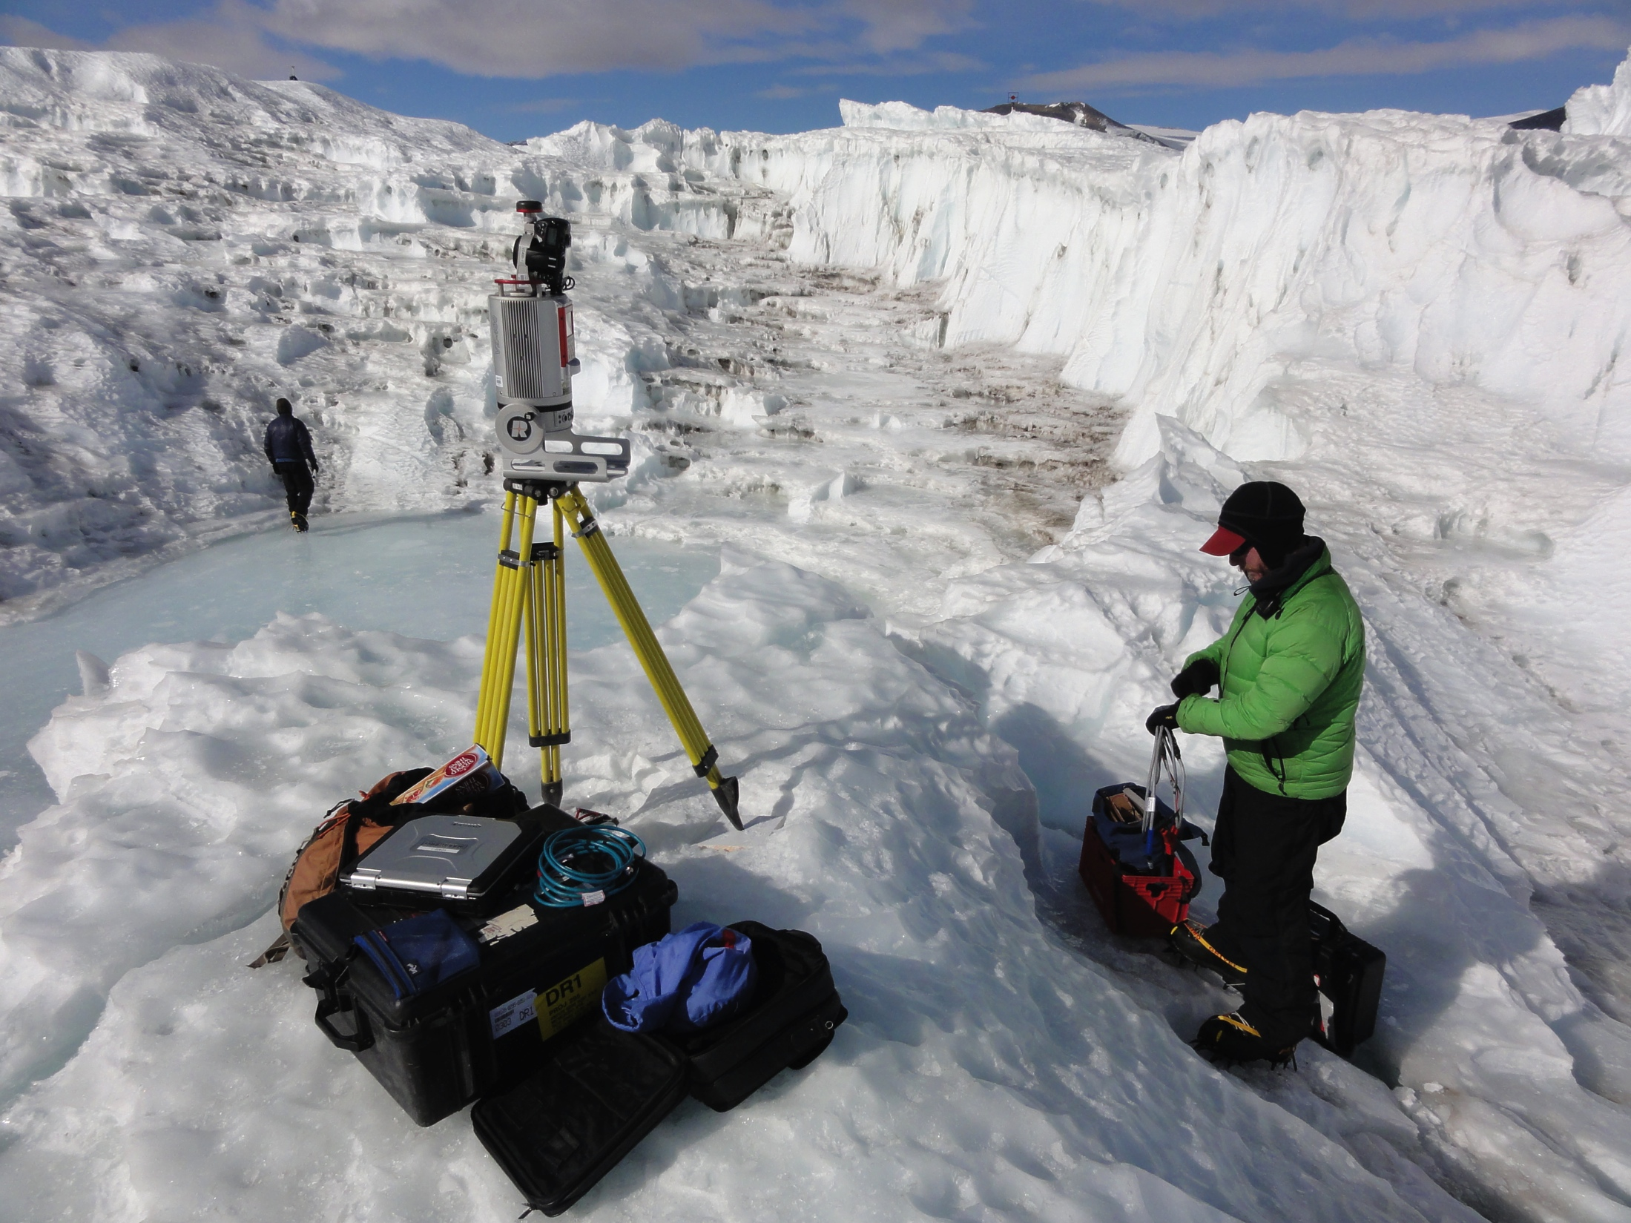
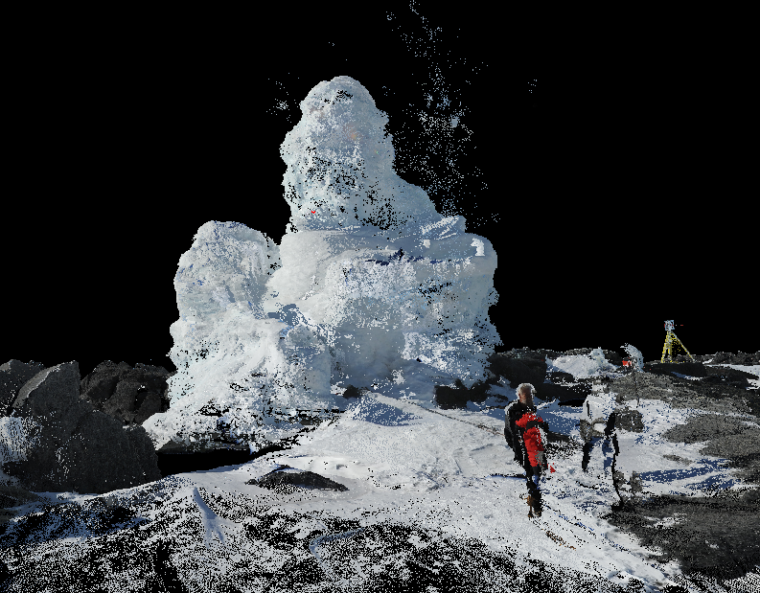
Scanning in Polar Environments
10–15 Antarctic and Arctic projects per year
Remote locations, challenging logistics (helicopter, icebreaker, backpack)
Extreme environmental conditions:
  -35C to +15C, 20–65 knot winds
Science:
Geomorphology: Frost polygons and ancient lake beds
Glaciology: Glacier melt and ablation
Biology/Ecology: Weddell Seal volume; Microtopology of tundra in Alaska
Archaeology: Human impact of climate change
Notes:
TLS is extremely useful for a variety of applications in polar research settings. UNAVCO works on 10–15 of these projects a year, and they range from geomorphology to glaciology to biology/ecology to archaeology.
Images: EarthScope

Slide 32
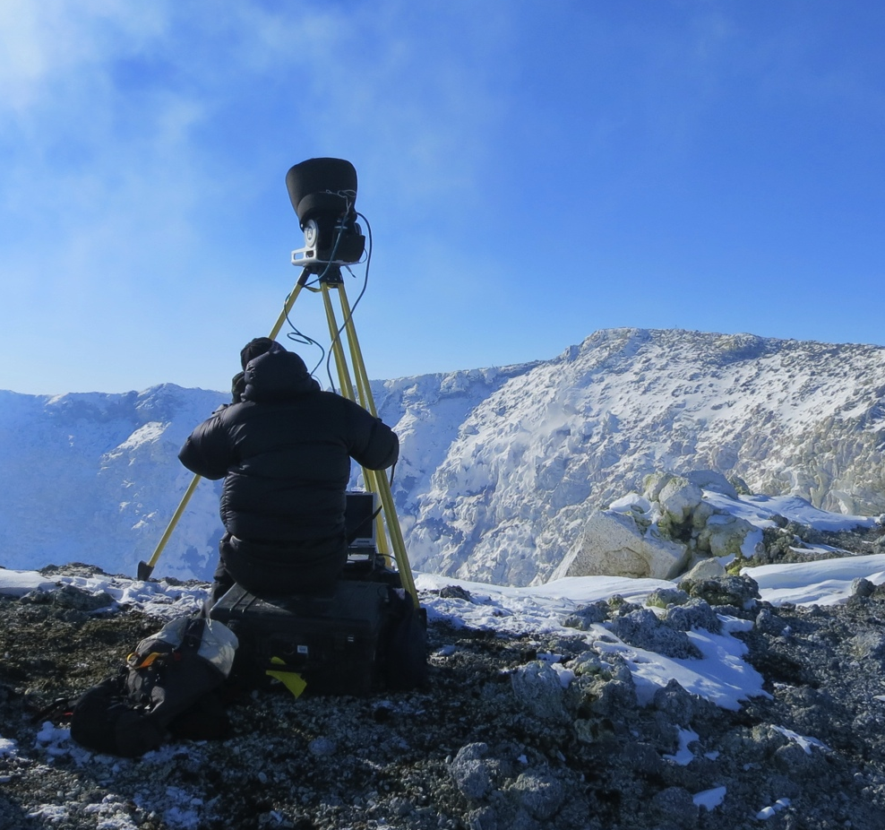
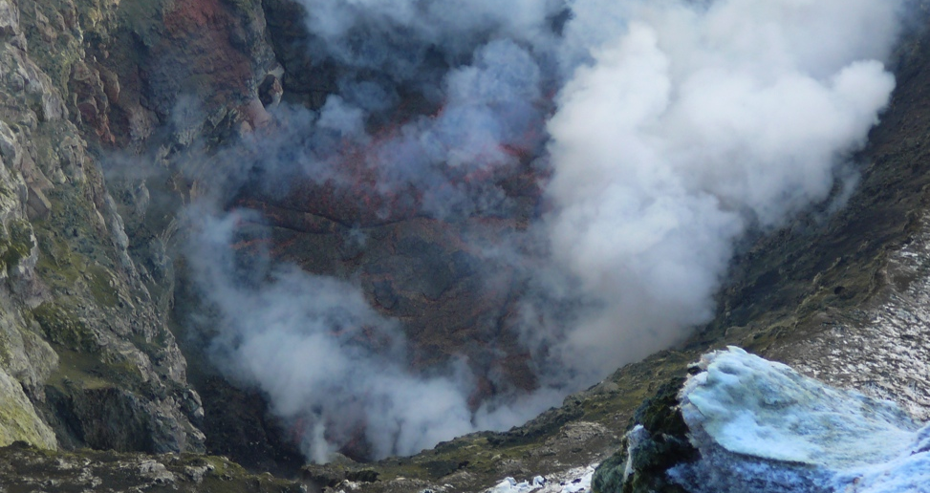
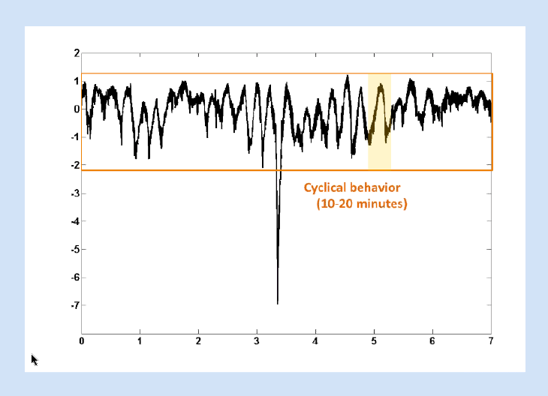
Scanning in Polar Environments
Mount Erebus, Antarctica
Lava lake scanned 2008–2013, revealing behaviors invisible to naked eye
Inner crater scan used to augment and truth 2003 aerial scans
Scans of ice caves and ice towers help determine thermal / energy budget of volcano
Lava Lake
Notes:
One example of a polar TLS project is Mount Erebus, Antarctica. Scans show the thermal and energy budget of the volcano.
Images: EarthScope

Slide 33
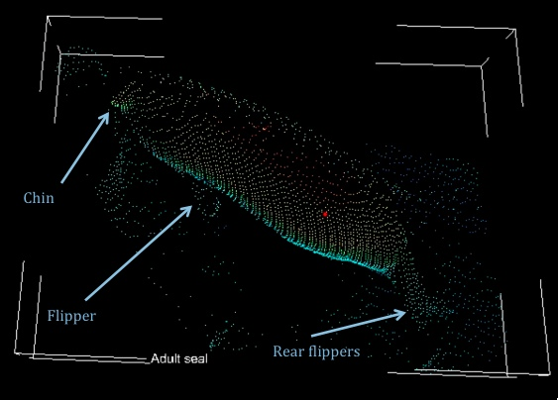
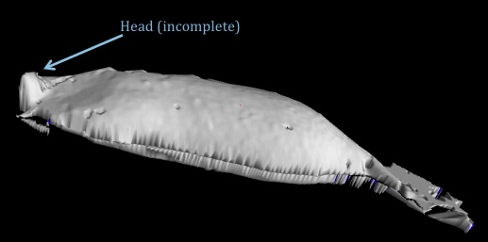
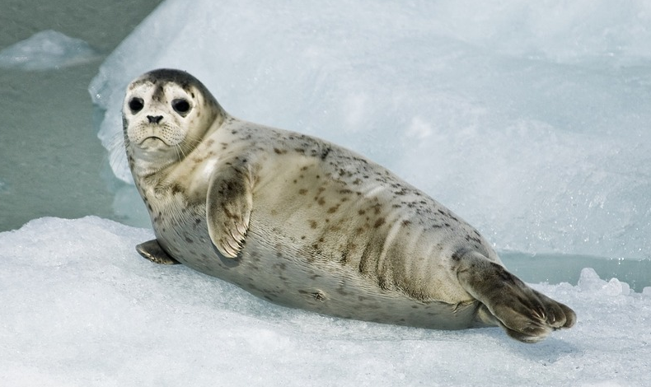
Scanning in Polar Environments
Using TLS to Obtain Volumetric Measurements of Weddell Seals in the McMurdo Sound
Seal body mass = proxy for availability of marine food resources
Notes:
Another example is seal body mass, used as an analog for availability of marine food resources. (How does the seal stay still? Is this done just on dead seals?)
Images: EarthScope

Slide 34
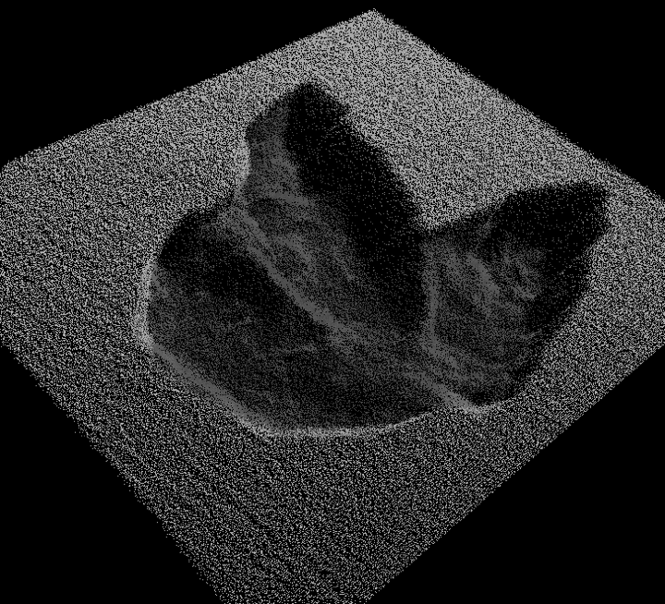
Dinosaur Trackway, Fiorello
Notes:
In non-polar settings, Lidar has been used to record dinosaur footprints.
Images: EarthScope

Slide 35
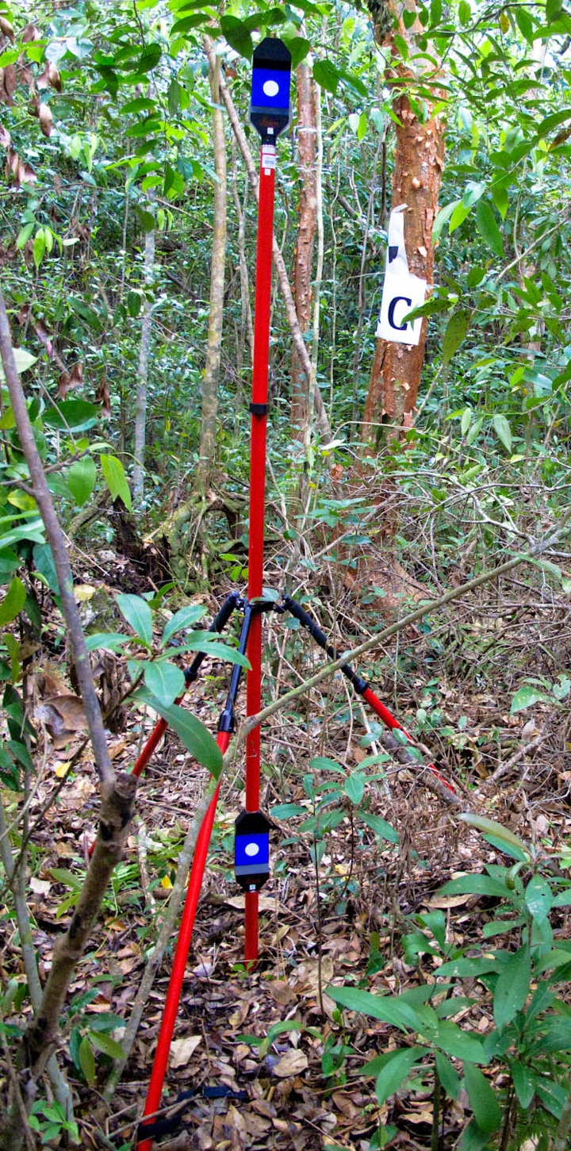

Everglades Biomass, Wdowinski
Scanning to measure biomass in Everglades National Park (PI: Wdowinski).
Notes:
Another application of TLS is outside of the field of geoscience: forestry researchers also use TLS to scan their area of interest and then measure features like the volume of the tree trunk after returning to the lab.

Slide 36




Everglades Biomass, Wdowinski
Notes:
An example of forestry work on the Everglades biomass. Emmanuel Luciano

Slide 37


TLS in Field Education
Indiana University, University of Houston, University of Michigan, UCSC
Notes:
Finally, we use TLS to teach students like you about geodesy!

Slide 38

Thanks! chris.crosby@earthscope.org https://tls.unavco.org/
Notes:
Image: EarthScope

