Slide 1
Ocean Biogeochemistry and Paleoclimate
Image: NASA
Module Originator:
Dr. Allison W. Jacobel
Notes:
Marine phytoplankton productivity off of Patagonia-photosynthesis in the surface ocean triggered by dust
NASA content - images, audio, video, and computer files used in the rendition of 3-dimensional models, such as texture maps and polygon data in any format - generally are not copyrighted. You may use this material for educational or informational purposes, including photo collections, textbooks, public exhibits, computer graphical simulations and Internet Web pages. This general permission extends to personal Web pages.

Slide 2
Outline
Carbon reservoirs
Significance of the deep ocean
Modern change
Motivation
Ocean ecosystems
Nutrients
Climate
Proxies/datasets
Notes:
Outline of module powerpoint

Slide 3
Carbon Cycle
What are the biggest reservoirs?
What is the timescale of exchange (flux) with other reservoirs?
Figure: NASA
Notes:
NASA figure – flux and reservoir based understanding of the carbon cycle
Differentiate between reservoirs and fluxes
Talk about timescales of relevance
Biggest reservoirs are rocks and deep ocean
Deep ocean has relevant timescale of exchange for control of glacial-interglacial cycles – tectonic timescales of rock record are too long for these cycles

Slide 4
Possible Changes to the C Cycle
Figure: NASA
Notes:
Process based understanding of the carbon cycle
How CAN we change the partitioning of carbon between the ocean and the atmosphere?

Slide 5
Modern Changes to the C Cycle
Figure: Global Carbon Project
Notes:
How ARE we actually changing carbon distribution today?
26% (9/34) of anthropogenic emissions (per year) are going into the ocean
Ocean is incredibly important for moderating magnitude of modern GHG-driven warming
Global Carbon Project Copyright. We use the Creative Commons license CCBY, which means that material (e.g. figures) may be freely copied and modified, and used in commercial works, as long as credit is provided as indicated for each figure. We tag each figure with the source of the data.

Slide 6
Ocean Carbon Storage
The ocean has absorbed ~30% of emitted anthropogenic carbon dioxide
– IPCC AR5
Will the oceans continue to store carbon?
What will the consequences of carbon storage be for the oceans?
Figure: Gruber, N., et al. (2009), Oceanic sources, sinks, and transport of atmospheric CO₂, Global Biogeochem. Cycles, 23, GB1005, doi:10.1029/2008GB003349.
Notes:
So far carbon has mostly gone into the upper ocean but the deep ocean stores much more carbon as DIC (dissolved inorganic carbon)
Specifically the deep pacific is a huge reservoir for dissolved carbon
AGU grants permission for individuals to use figures, tables, and short quotes from AGU journal and books for republication in academic works and to make single copies for personal use in research, study, or teaching provided full attribution is included. There is no need to request this permission from AGU.

Slide 7
Motivation – Ocean Ecosystems
Figure: US JGOFS
Notes:
Part of the motivation for this module is understanding how ocean ecosystems might respond on G-IG timescales to changing nutrients and carbon storage and to apply that knowledge of the system to future change
That is important for the organisms that call the ocean home
http://usjgofs.whoi.edu/copyright.html

Slide 8
Ocean Ecosystems => Nutrients
Where do they come from?
Aeolian dust
(particle transport)
Erosion
Photosynthesis
(organic carbon production)
River inflow
Evaporites
Hydrothermal vents
Upwelling
Authigenic mineral formation
Burial
Cartoon: Dr. Allison Jacobel
Notes:
Ocean ecosystems require nutrients to feed the base of the food chain
Need to think about the sources of those nutrients – in bold

Slide 9
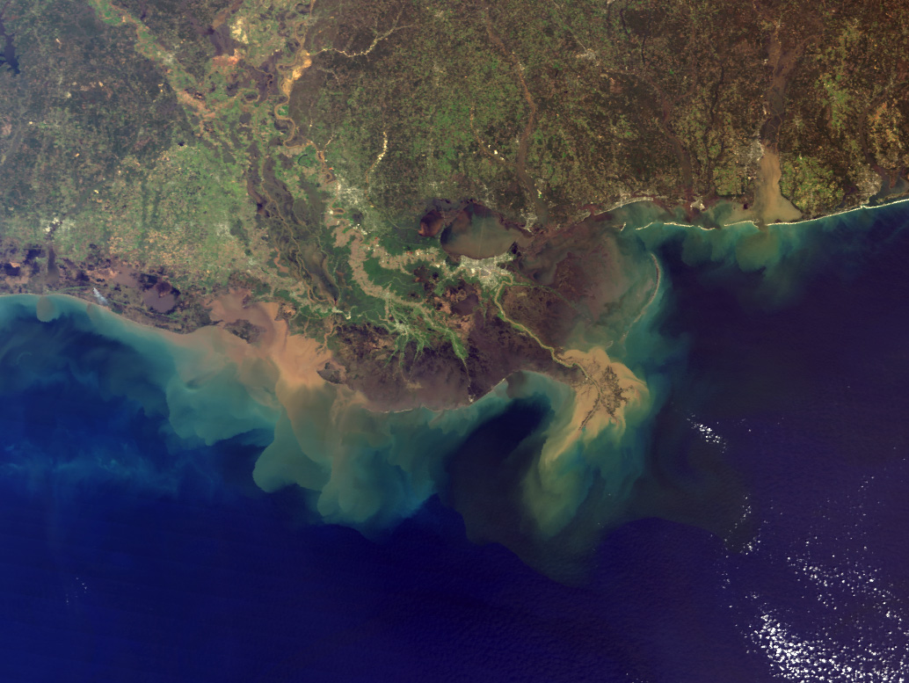
Image: NASA
Notes:
Example of river input-mississippi river delta brings salts, dom, nutrients pollutants to GOM
https://earthobservatory.nasa.gov/images/1257/mississippi-river-sediment-plume

Slide 10
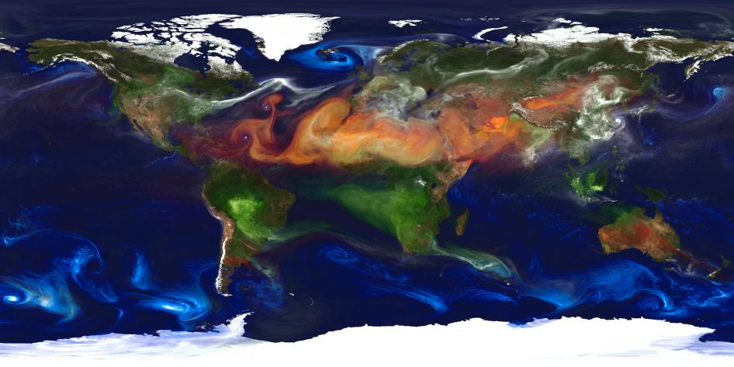
Image: NASA
Notes:
NASA portrait of global aerosols-simulated model of dust transport
Dust is an important source of micro nutrients to the ocean – especially Fe

Slide 11
Where do these components come from?
Image: NOAA
Notes:
https://www.flickr.com/photos/oceanexplorergov/27485515902
Black smoker-hydrothermal vent
Iron, hydrogen sulphate, manganese
Rare earth elements and trace metals
Note also the precipitation around the edges of smoker-removal

Slide 12
Ocean Ecosystems => Nutrients
Where do they go?
Aeolian dust
(particle transport)
Photosynthesis
(organic carbon production)
Erosion
River inflow
Evaporites
Hydrothermal vents
Upwelling
Authigenic mineral formation
Burial
Cartoon: Dr. Allison Jacobel
Notes:
Sinks for nutrients- in bold

Slide 13
Motivation - Climate
Experiments run by Earth
Figure: Modified from Thomas Blunier
Where does the carbon go?
Notes:
Second and related motiviation for the module is thinking about where carbon goes on glacial-interglacial timescales- the earth has run many carbon storage experiments in the past – what can we learn from them?
https://www.eurekalert.org/multimedia/pub/8131.php
Restrictions on reuse: none
Make sure to talk about:
Directionality of axis, what 1000s of years before present means (ka and kyr).
”Last” 100 ka/most recent 100 ka
Variations of 80-100 ppm
Where does this carbon go if it is not in the atmosphere??
Last glacial maximum -20 ka…

Slide 14
Motivation - Climate
Figure: US JGOFS
Notes:
http://www.iceandclimate.nbi.ku.dk/research/past_atmos/composition_greenhouse/
Carbon exchange with the atmosphere and carbon burial in the deep ocean (as dissolved/respired and solid organic material)

Slide 15
Ice Age Changes to the Carbon Cycle?
What changes might occur at LGM?
+
Dissolved inorganic carbon
Figure: NASA
Notes:
Where does the carbon go during glacial periods?
It isn’t in the atmosphere so it must go into one of the reservoirs we talked about.
What are the possibilities? – in boxes
In reality – ice age fewer plants, more arid, more land covered by ice… so we actually need to account for 95-115 ppm co2 change
And the most logical (and true) place where we can store LGM carbon out of the atmosphere - is in the deep ocean

Slide 16
LGM Changes to the Cycle
LGM
+ 15 ppm
(Biosphere 30% smaller)
300-700 Pg loss
+
Dissolved inorganic carbon
Figure: NASA
Notes:
In reality – ice age fewer plants, more arid, more land covered by ice… so we actually need to account for 95-115 ppm co2 change

Slide 17
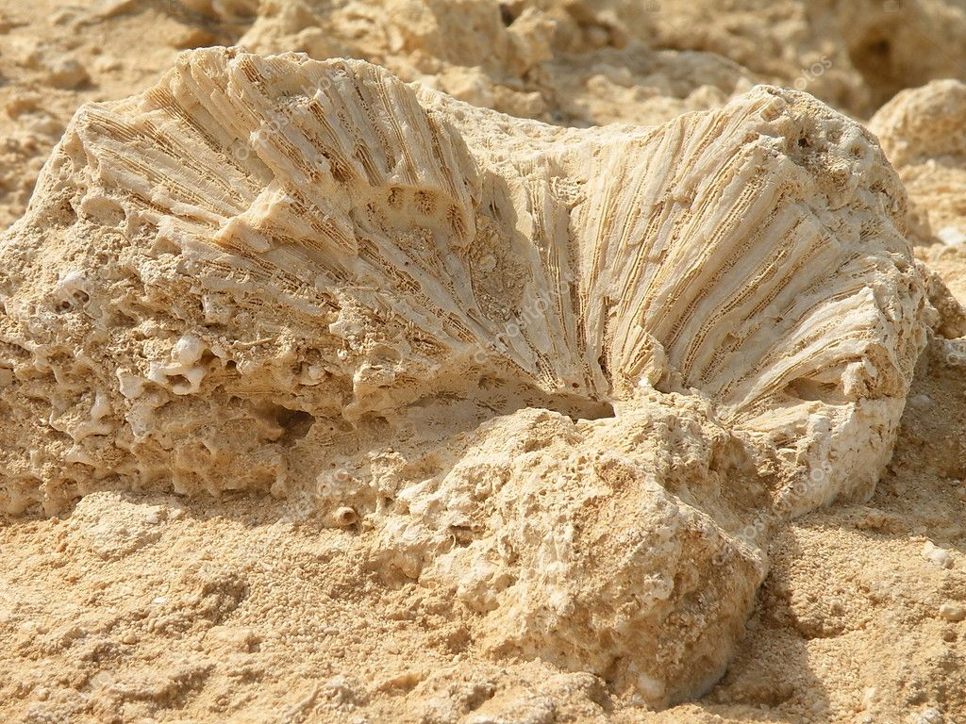
Proxies
Something that tells us about something else
Preserved physical or chemical information -> past environmental conditions
Photo: Allison Jacobel
Notes:
Umbrella photo:https://www.piqsels.com/en/public-domain-photo-scxvy
If you look outside and see people using umbrellas you know it is probably raining-without ever experiencing the rain yourself
If you find a fossilized coral you know that the location was probably a warm, shallow marine environment at some point in the past

Slide 18
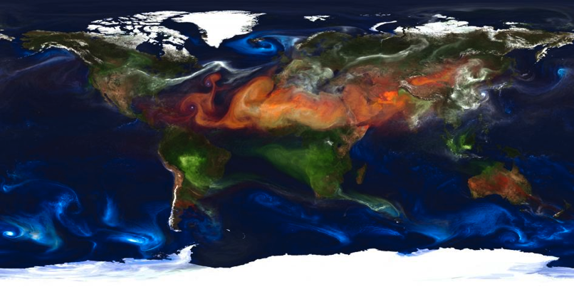
Proxies – Dust Flux
²³²Th
Proxy for aeolian dust
Known concentration in dust source areas
Long half life (14.05 Ga)
Glacial dust fluxes 2-3x higher than at present
Image: NASA
Why might glacial periods be dustier?
Notes:
Beginning of discussion of proxies that we will use in this module
Glacial dust fluxes are 2-3x higher than at present because of 1) increased thermal gradients (gustier-important for dust transport), 2) increased production of dust by glaciers, 3) increased aridity during glacial periods
Ga-opportunity to revisit timescales of relevance yrs, kyr, ga

Slide 19
Proxies – Export Productivity
1. Ba_{xs}
Non-lithogenic, excess barite
Formed during early diagenesis of organic matter in water column
2. Alkenones
Coccolithophorid algae
Primary producers
Fluxes
Not concentrations!
Constant flux proxy (²³⁰Th)
Image: Alison R. Taylor
Notes:
https://commons.wikimedia.org/wiki/File:Emiliania_huxleyi_coccolithophore_(PLoS).png
Emphasize that Baxs and alkenones do not track the same processes per se, but both are related to productivity in the surface of the ocean
May choose to emphasize that we are examining fluxes (e.g.: g/cm2/yr rather than concentrations (g/cm3) because concentrations can be changed by diluting components

Slide 20
Proxies – Antarctic pCO₂
CO₂ gas trapped in air bubbles in ice
Mini samples of paleo atmosphere
Photo: CSIRO
Photo: NASA/Ludovic Brucker
Notes:
Data in this lab come from the epica dome C ice coring project – paleo atmospheres trapped in ice can reveal past partial pressures of CO2
https://commons.wikimedia.org/wiki/File:CSIRO_ScienceImage_521_Bubbles_in_Ice.jpg
https://commons.wikimedia.org/wiki/File:An_ice_core_segment.jpg

Slide 21
Proxies – LR04 δ¹⁸O
Stack (global compilation) of benthic foraminifera oxygen isotopes
Oxygen isotope composition is a function of global ice volume, temperature, and salinity
Make sure you flip the axes
(warmer and less ice - more negative)
Cibicides wuellerstorfi by Gottschalk et al., 2016
Notes:
Proxy for global ‘climate’ = ice volume + salinity + ocean temperature at depth
Image from AGU publication
1. Gottschalk, J. et al. Carbon isotope offsets between benthic foraminifer species of the genus Cibicides (Cibicidoides) in the glacial sub‐Antarctic Atlantic. Paleoceanography 31, 1583–1602

Slide 22
Proxies – Authigenic Uranium (aU)
Sunlit surface ocean
Photosynthesis
CO₂+H₂O => CH₂O+O₂
Proxy for sedimentary anoxia (no oxygen)
Related to bottom water oxygen limitation
Oxygen is consumed during the respiration of organic carbon…
Low oxygen reflects respired carbon storage in deep ocean
Oxygen produced
Carbon export
Sunlit surface ocean & deep ocean
Respiration/oxidation of carbon
CH₂O+O₂ => CO₂+H₂O
Oxygen
consumed
Respired carbon release
Smaller organic carbon
export

Slide 23
Figure:
Dr. Allison Jacobel
Data sources cited in online module and in notes below
Notes:
May choose to hide figure from students - so that they need to collaborate with partners from other groups to complete activity C
May choose to share figure with students so that they can complete Activity C on their own outside of class without meeting with partners from other groups
d18O-Lisiecki, L. E. & Raymo, M. E. A Pliocene-Pleistocene stack of 57 globally distributed benthic δ¹⁸O records. Paleoceanography 20, (2005).
pCO2 - Lüthi, D. et al. High-resolution carbon dioxide concentration record 650,000–800,000 years before present. Nature 453, 379–382 (2008).
aU, dust, - Martínez-García, A. et al. Southern Ocean dust-climate coupling over the past four million years. Nature 476, 312–315 (2011).
Alkenones -Martínez-Garcia, A. et al. Iron Fertilization of the Subantarctic Ocean During the Last Ice Age. Nature 343, 1347-1350 (2014)

