Slide 1
Imaging the mantle structure of cratons: Implications for the formation and modification of the Wyoming lithosphere
Heather A. Ford
University of California, Riverside

Slide 2
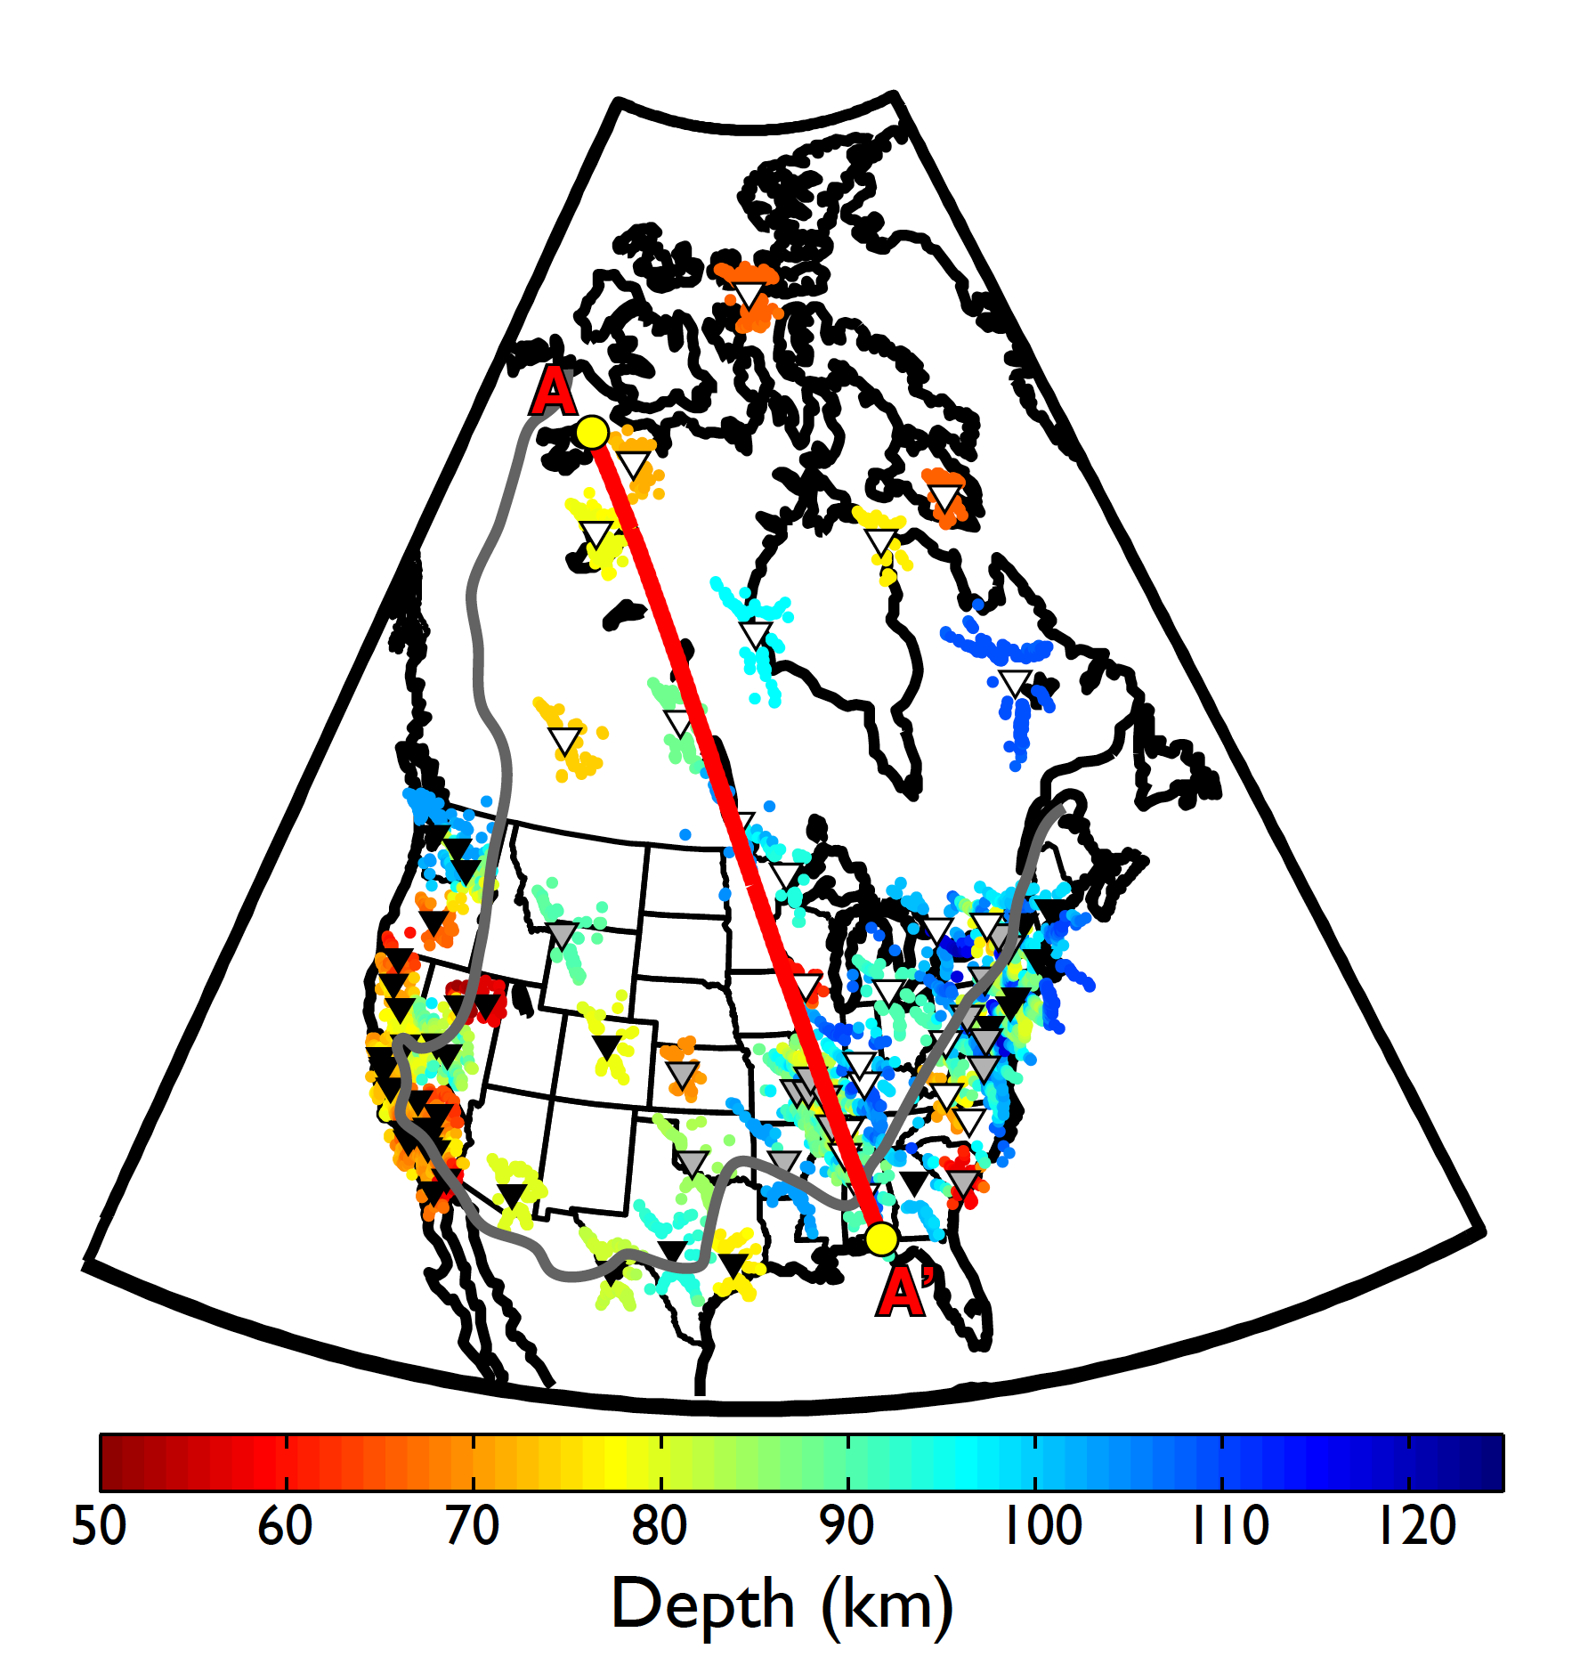
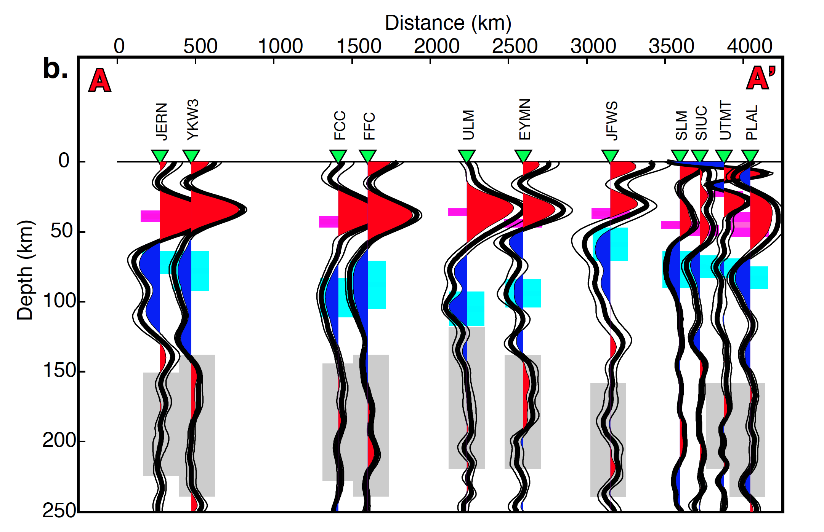
Mid-lithospheric discontinuities
Modified after Abt et al. (2010)
Modified after Abt et al. (2010)
Schaeffer and Lebedev (2014)
What we know
MLD appears as a negative phase in Ps & Sp receiver functions
Defined as one or more negative velocity gradients within the mantle lithosphere of stable continental interiors
Found at depths comparable to the LAB in other regions

Slide 3
Mid-lithospheric discontinuities
Ford et al. (2010)
Kennett et al. (2017)
Ford et al. (2010)
What we know
MLD appears as a negative phase in Ps & Sp receiver functions
Defined as one or more negative velocity gradients within the mantle lithosphere of stable continental interiors
Found at depths comparable to the LAB in other regions

Slide 4
Mid-lithospheric discontinuities
Potential MLD mechanisms (Selway et al., 2015)
Thermal
Partial melt (Kumar et al., 2012; Thybo, 2006; Thybo and Perchuc, 1997)
Small amount could produce observable change in velocities
Requires water saturation, deeper than average MLD
Magnetotelluric data does not support melt layer hypothesis
Elastically accommodated GBS (Karato et al., 2012)
Explains the “universal” presence of MLD
Key parameters still poorly constrained
Composition ( e.g., Foster et al., 2013; Sodoudi et al., 2013; Ford et al., 2010)
Change in Mg#
Change in Mg# not large enough to produce modeled velocity gradient
Hydrous Minerals
Evidence of minerals found in xenoliths
Capable of producing modeled velocity gradients
Anisotropy (Sodoudi et al., 2013; Wirth and Long, 2014; Ford and Fischer, in prep)
Prior evidence for anisotropy at similar depths
Difficult to explain as a universal feature

Slide 5
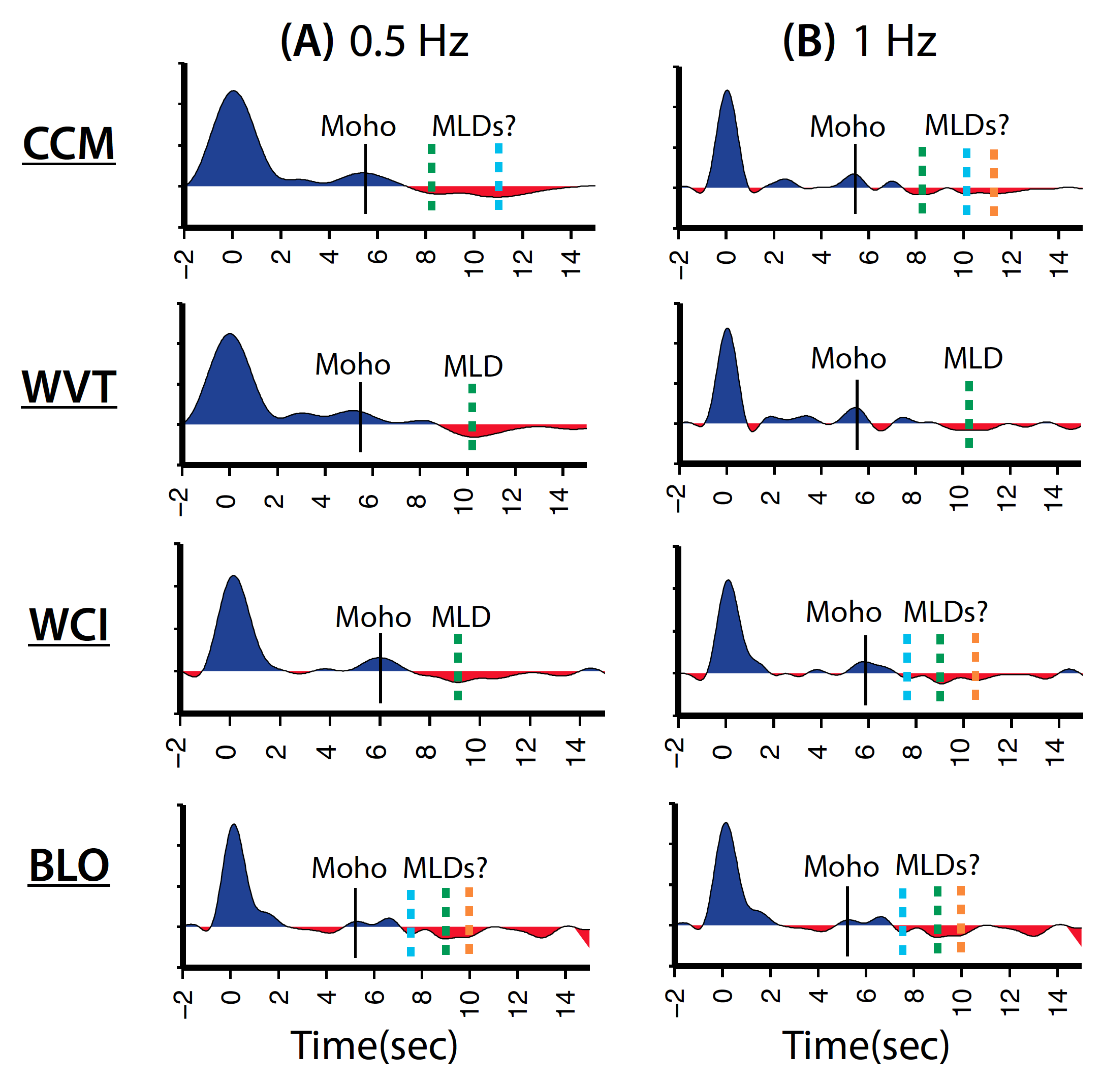
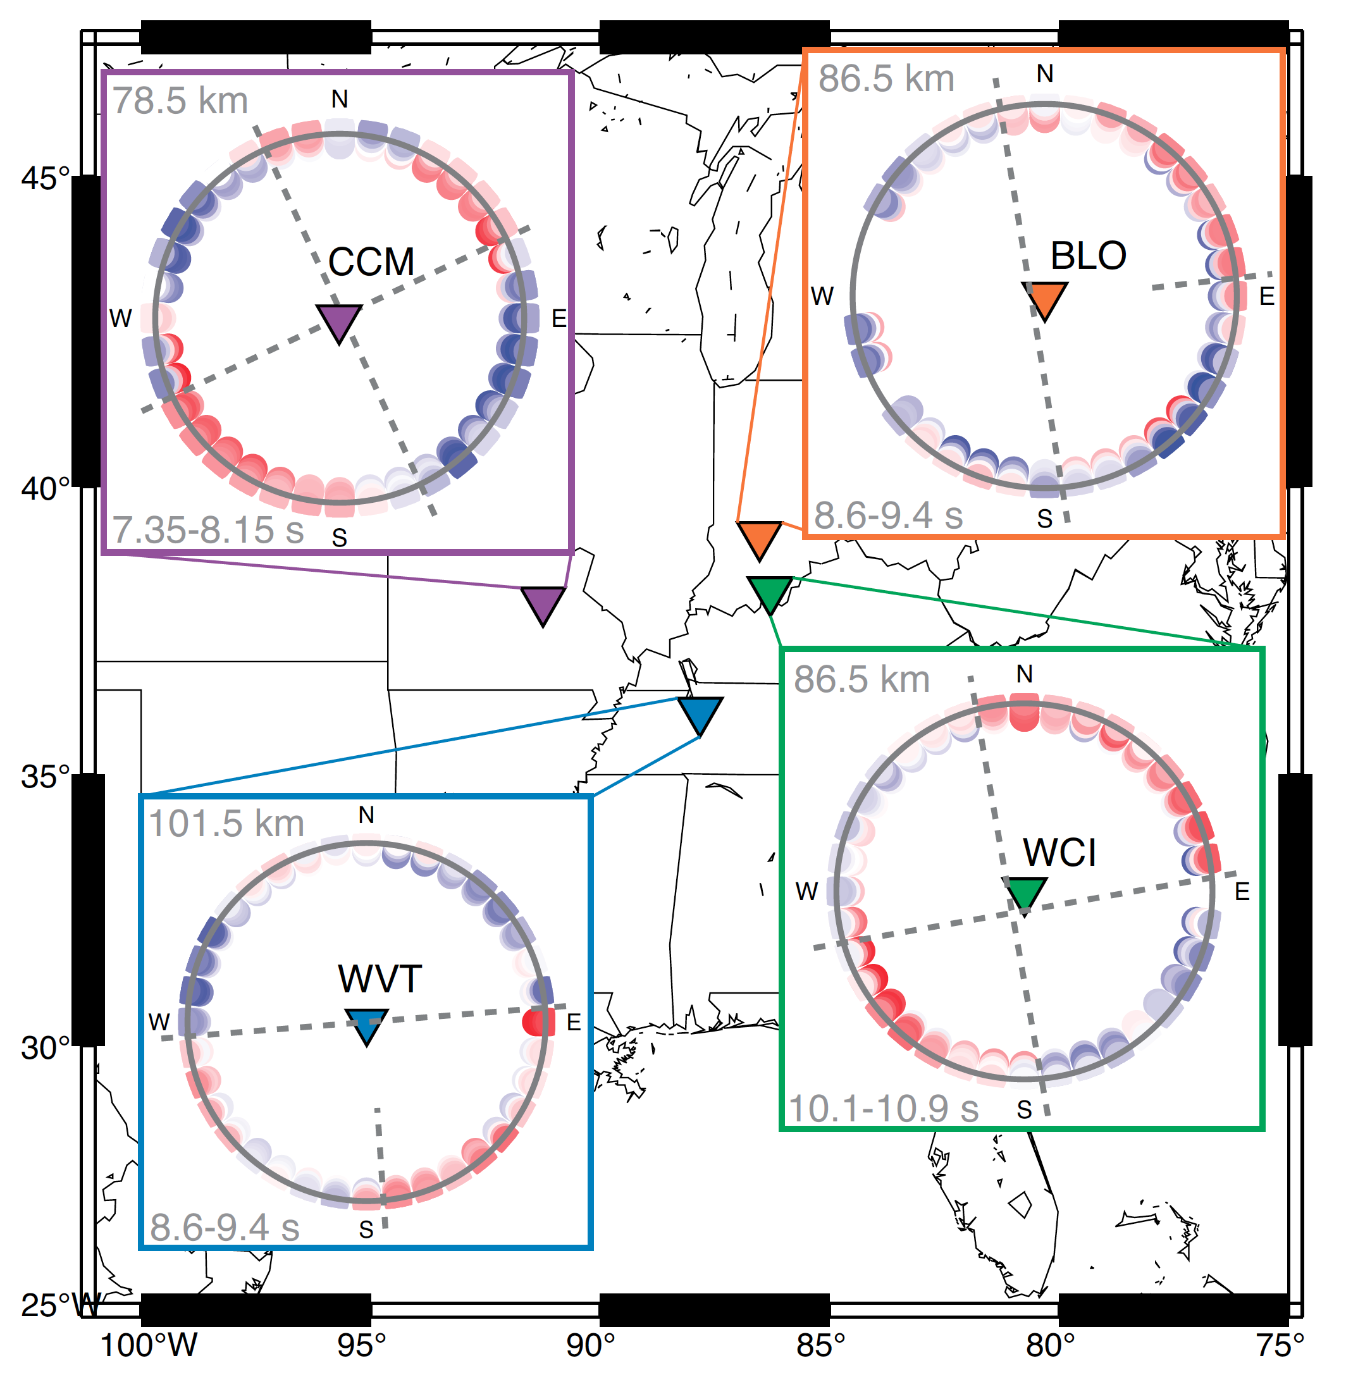
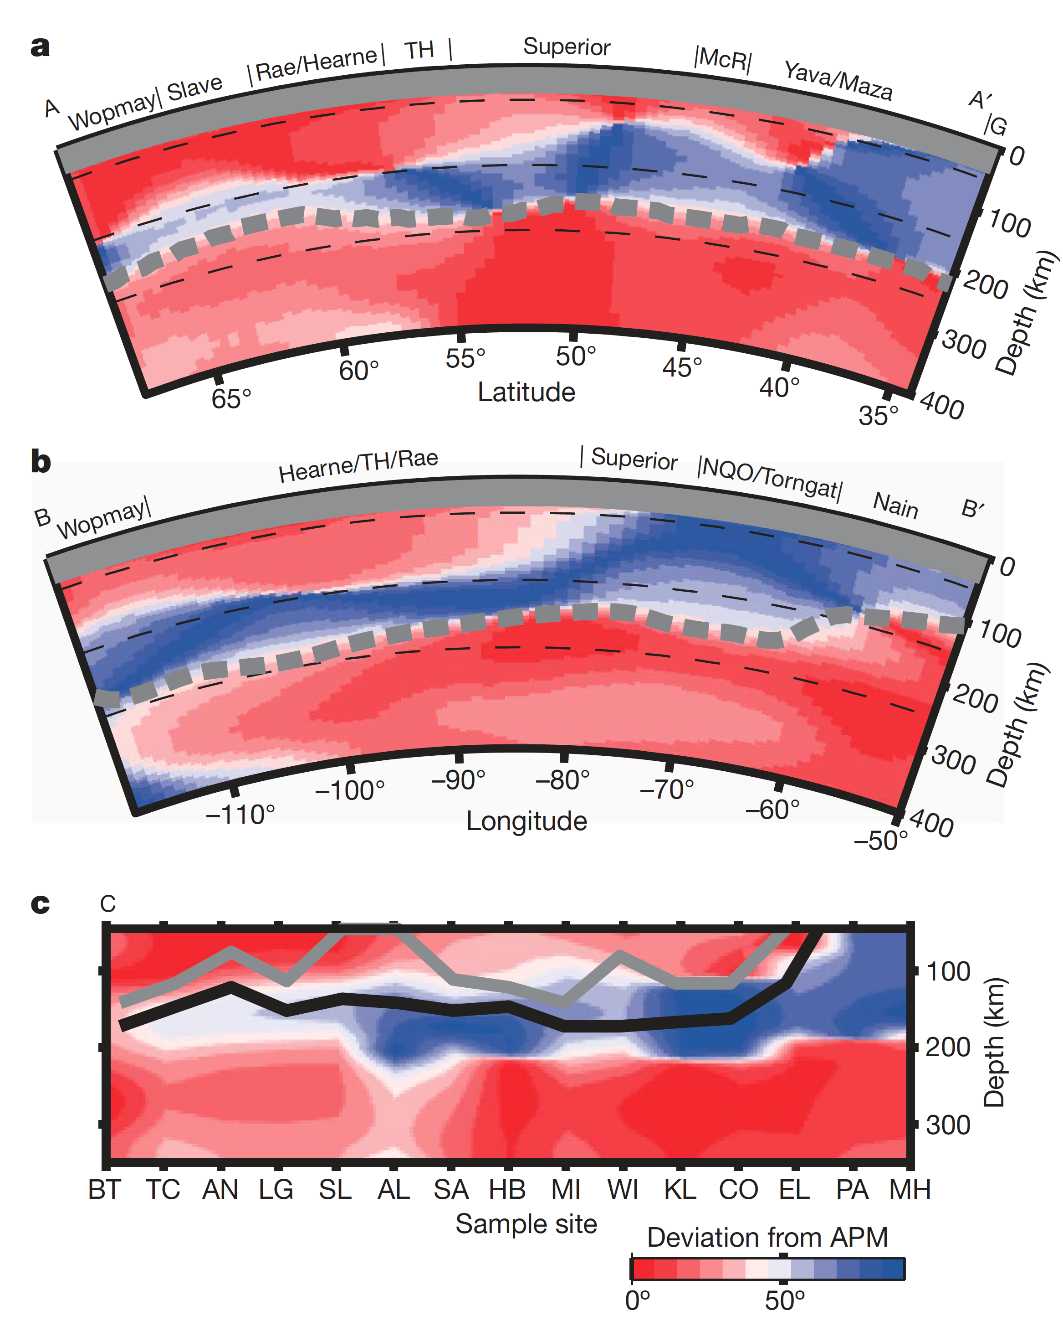
Mid-lithospheric discontinuities
Modified after Abt et al. (2010)
Yuan and Romanowicz (2010)
Wirth & Long, 2014

Slide 6
Mid-lithospheric discontinuities
Ford et al. (2016)

Slide 7
Mid-lithospheric discontinuities
Conclusions
One or more MLDs present at most stations
Anisotropy in the mantle does exist, but is not limited to MLDs
No coherent pattern exists across or within cratons
Ford et al. (2016)

Slide 8
Mid-lithospheric discontinuities
Conclusions
One or more MLDs present at most stations
Ford et al. (2016)

Slide 9
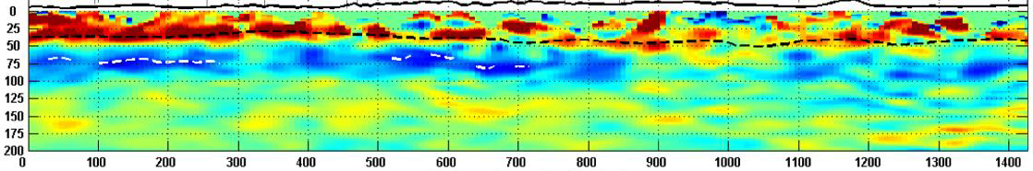


Mid-lithospheric discontinuities
Yellow-stone
Cordillera
Wyoming Craton
MLD
LAB
Hopper et al. (2014)
$$Σ$$
$$Σ$$
Hopper and Fischer (2015)

Slide 10
Mid-lithospheric discontinuities
Multiple MLDs result of several processes related to craton evolution
Hopper and Fischer (2015)

Slide 11
CIELO Seismic Experiment
Crust thickens
~16 km
CIELO in red!
What is the nature (and origin) of the high-velocity region imaged beneath NE Wyoming?
What controlled Laramide-associated deformation in the Black Hills?
40 km
56 km
100 km (approx.)
Notes:
Points to include:
General description of study area
Point out study, which is shown with red upside down triangles
Spell out what CIELO stands for
CIELO also means sky or heaven in Spanish, which we thought was particularly fitting…

