Slide 1



Paleoproterozoic metasupracrustal suites on the NW flank of the Wyoming Province: insights into an evolving continent
Julia Baldwin
Tekla Harms
Jeffrey Vervoort
Peter Baker
Sara Stotter

Slide 2
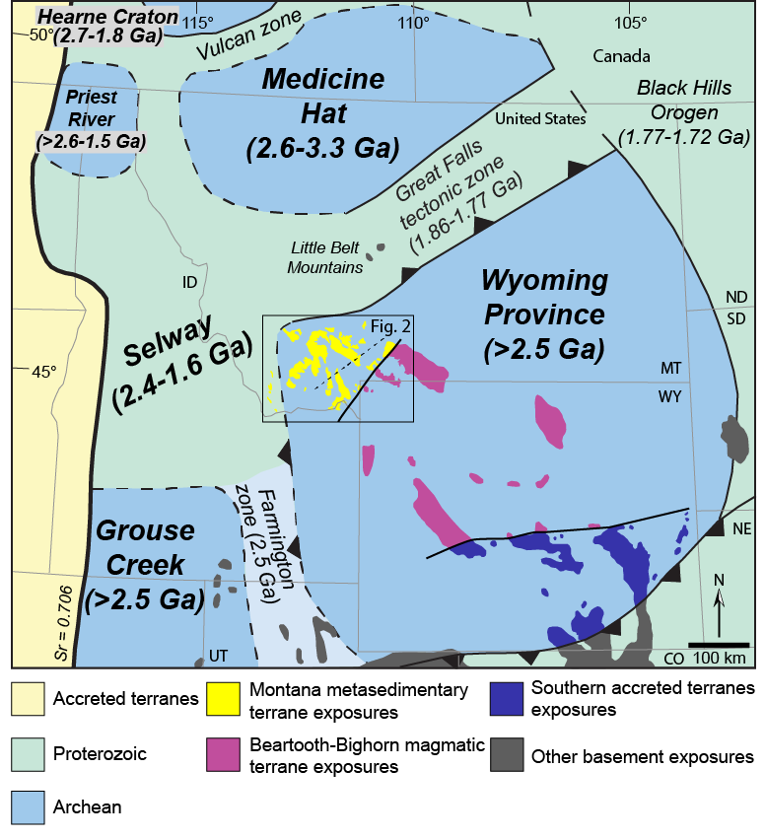
Motivation
What is the significance of Paleoproterozoic events that affected the northwest margin of the Wyoming Province?
from Foster et al. (2006)

Slide 3
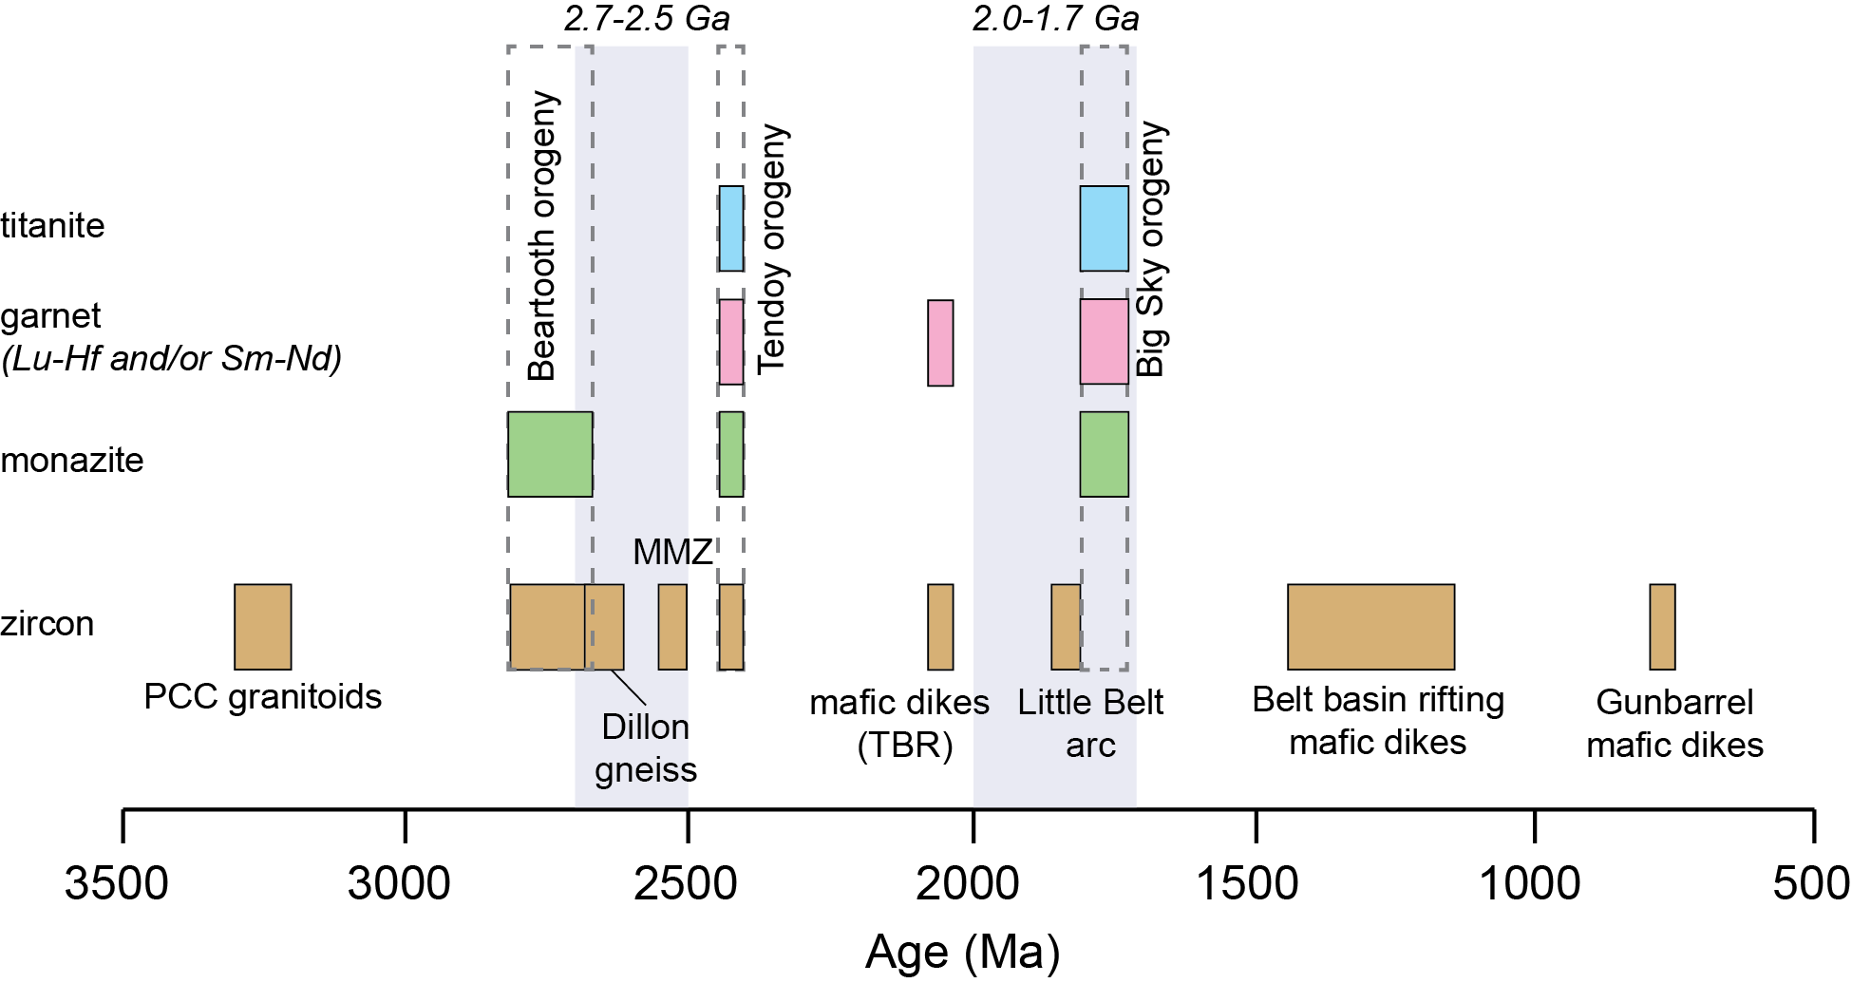
Age data from Mueller et al.,1998, 2002, 2004, 2005; Roberts et al., 2002; Cheney et al., 2004; Vogl et al., 2004; Harlan et al., 2005, 2008; Foster et al., 2006; Jones, 2008; Krogh et al., 2011.

Slide 4
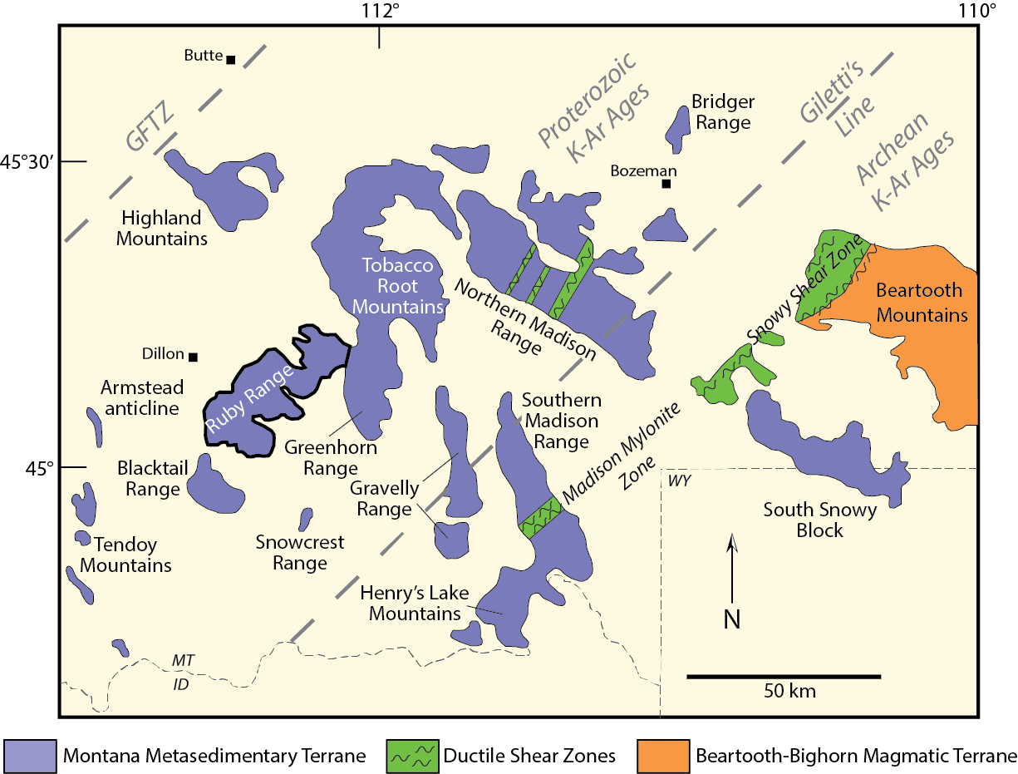
Laramide uplifts in the NW Wyoming province (after Mogk et al., 1992)

Slide 5
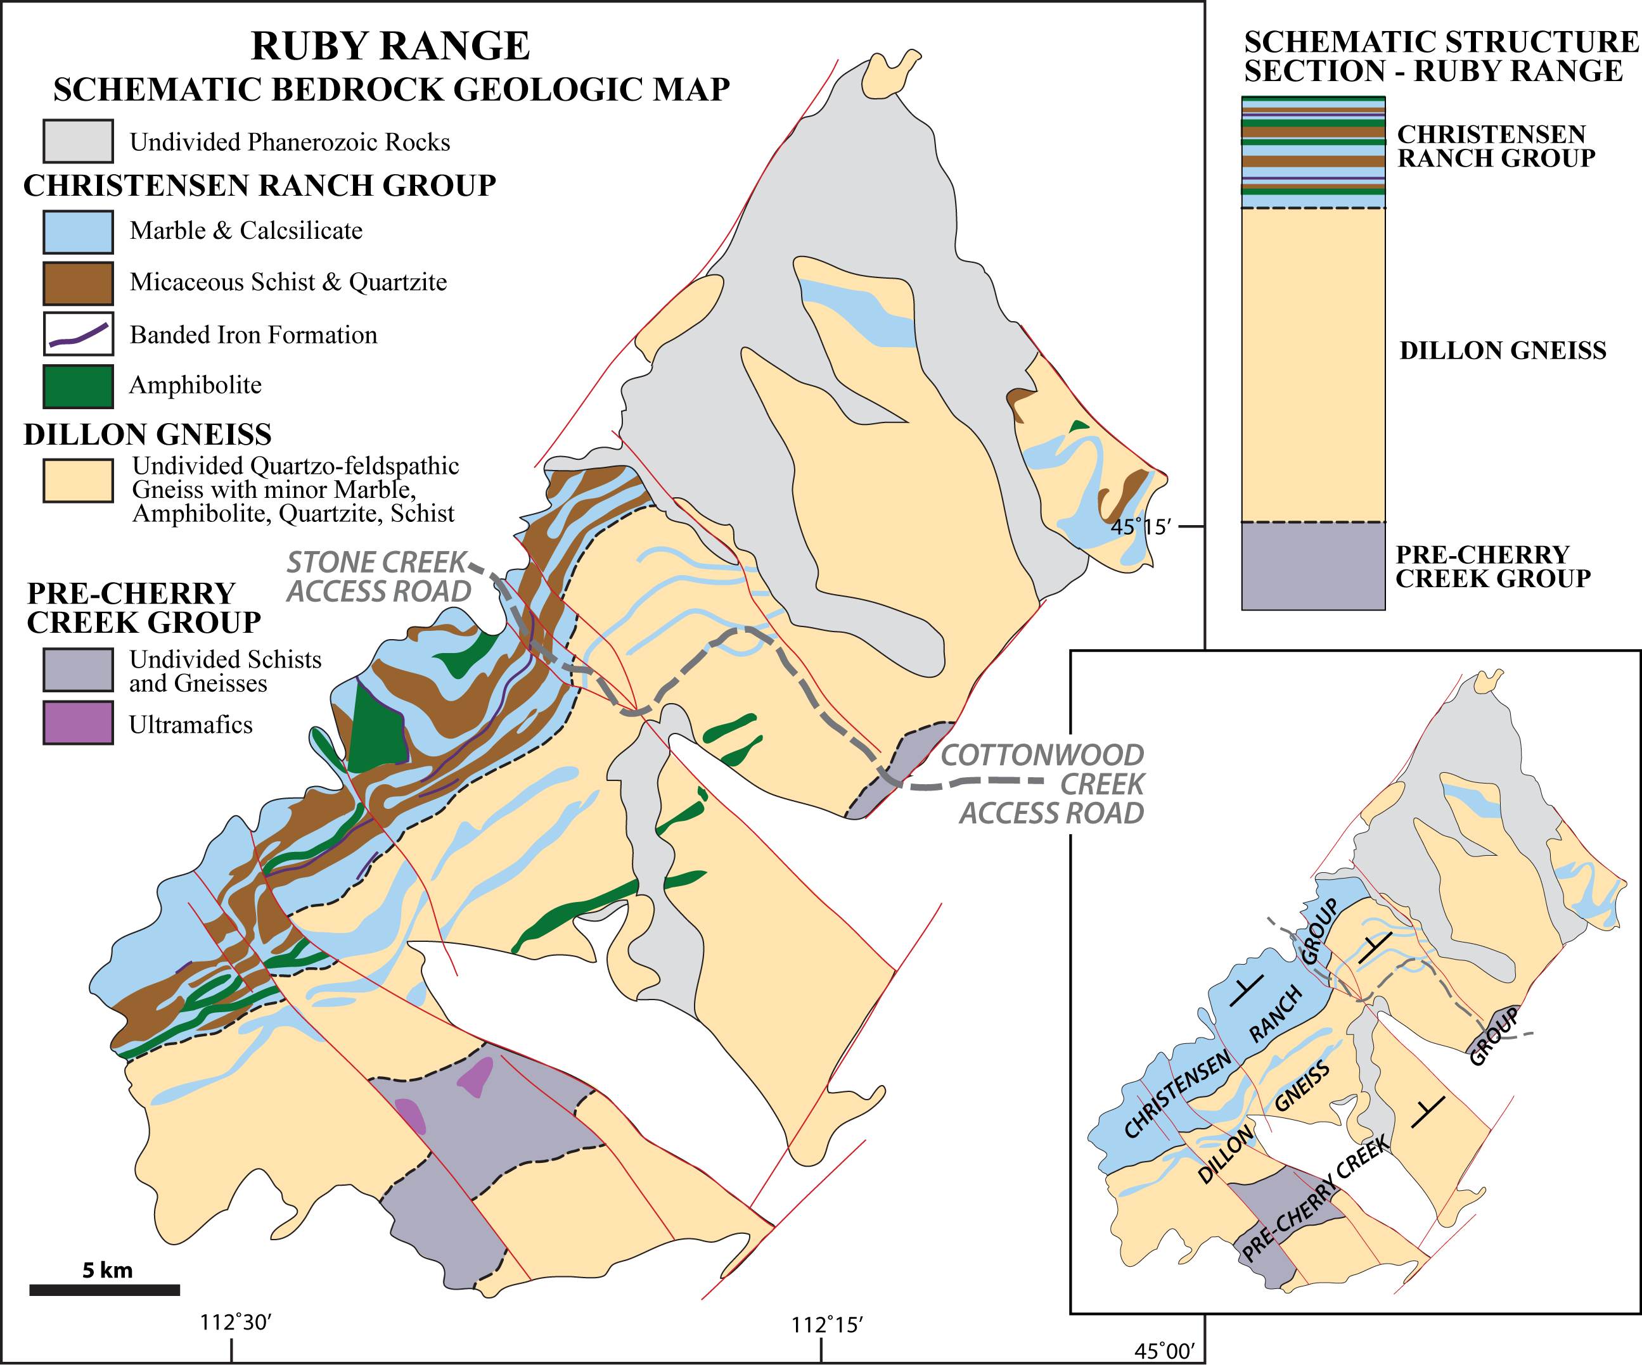

Slide 6
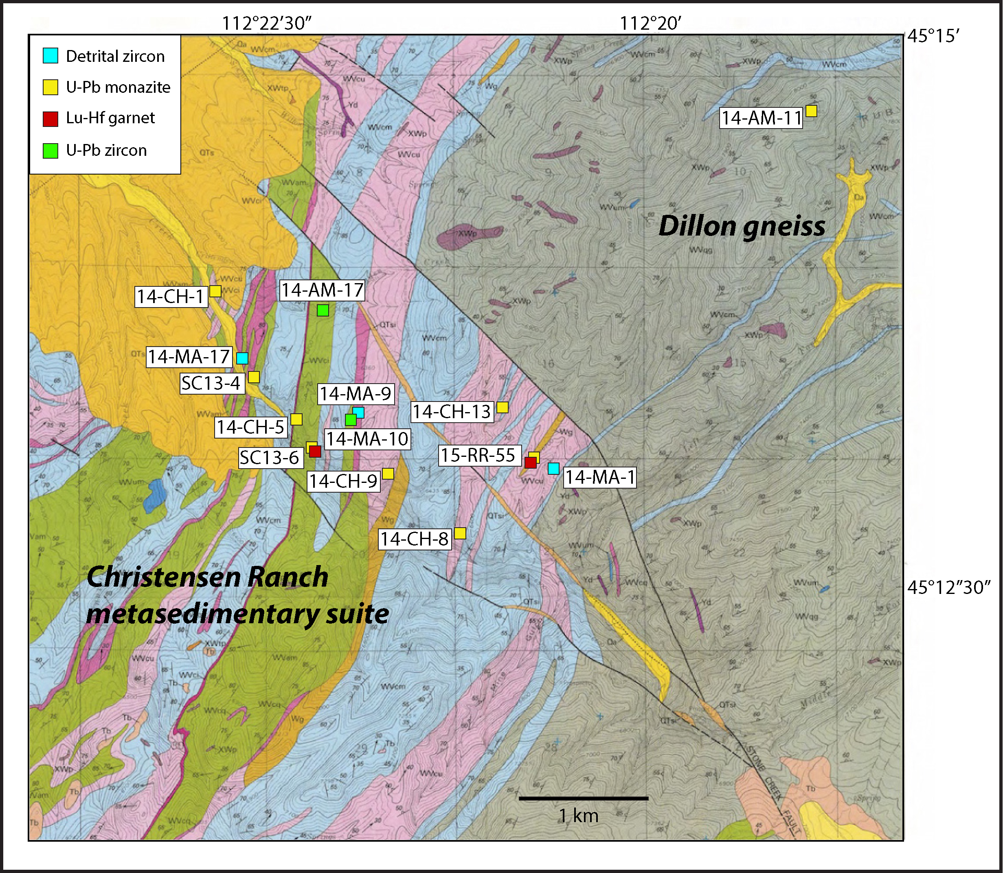
James (1990)

Slide 7
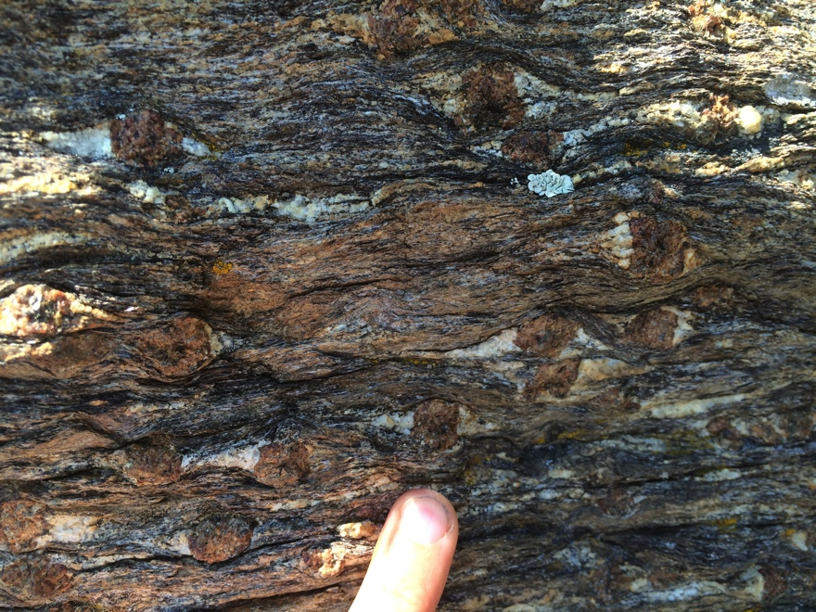
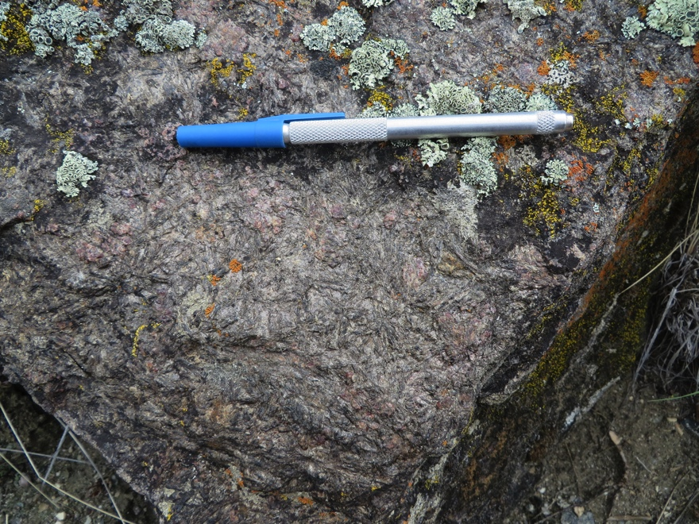
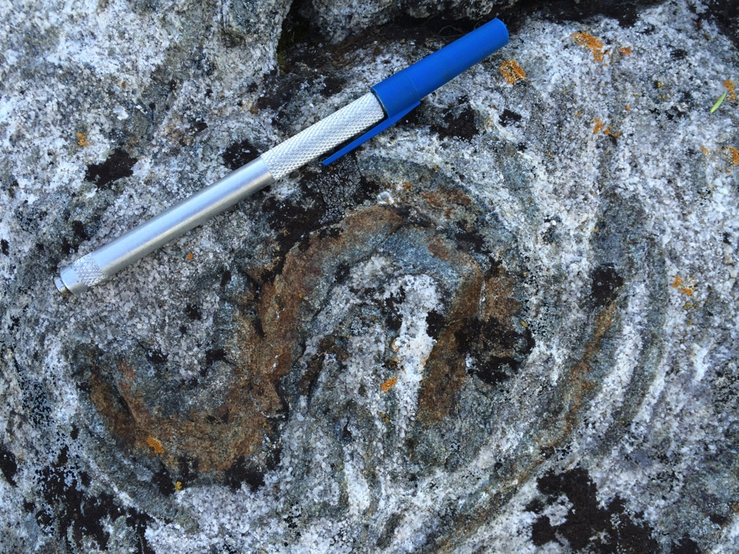
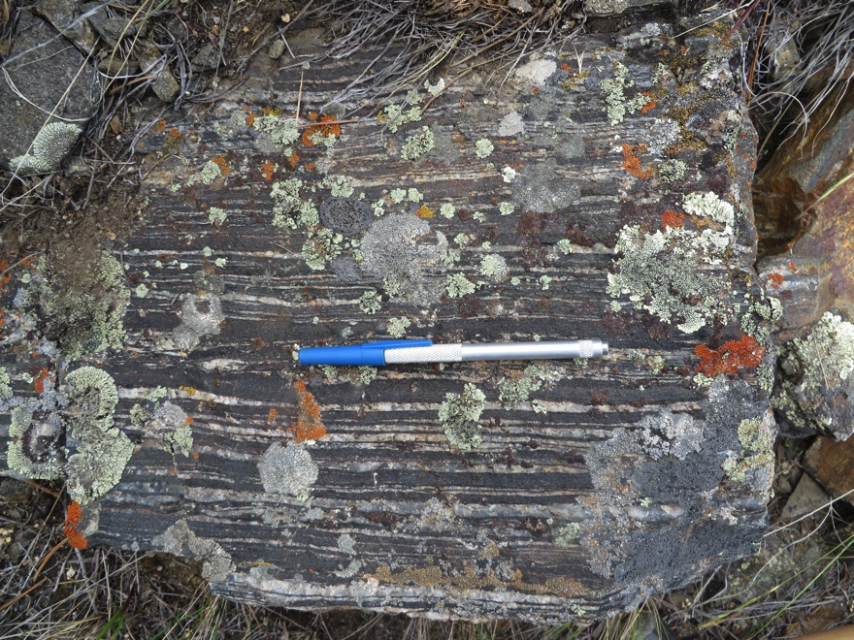
Christensen Ranch Metasedimentary Suite

Slide 8
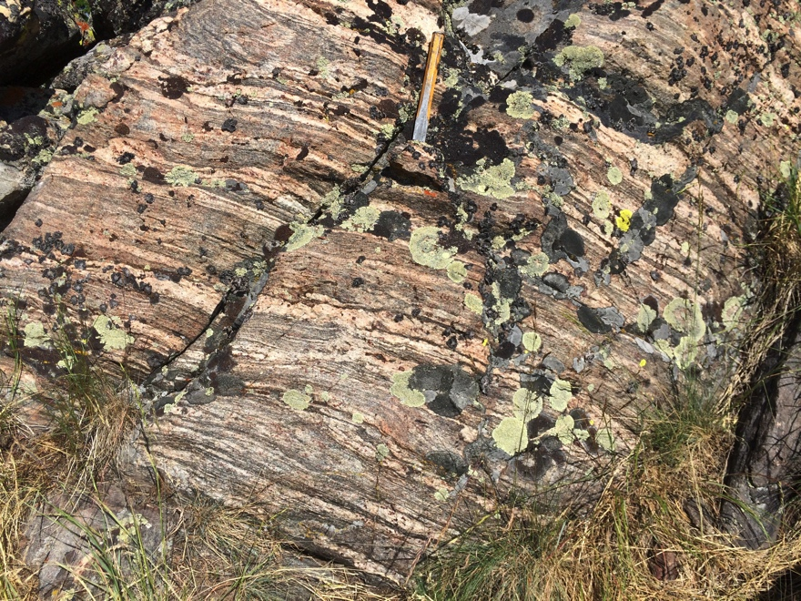
Dillon gneiss

Slide 9
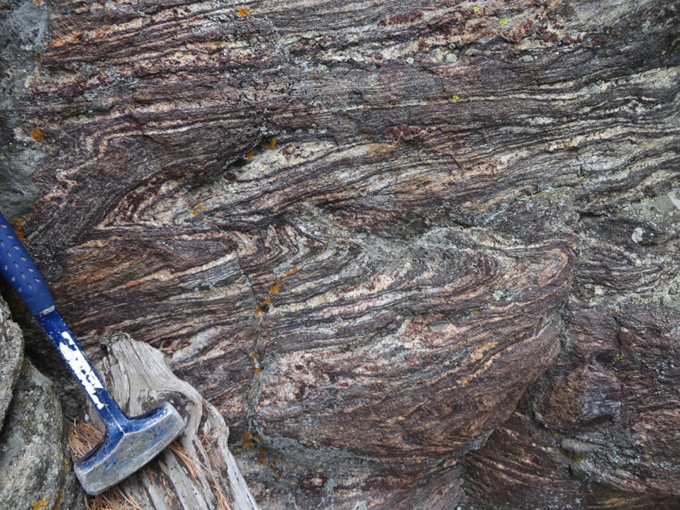
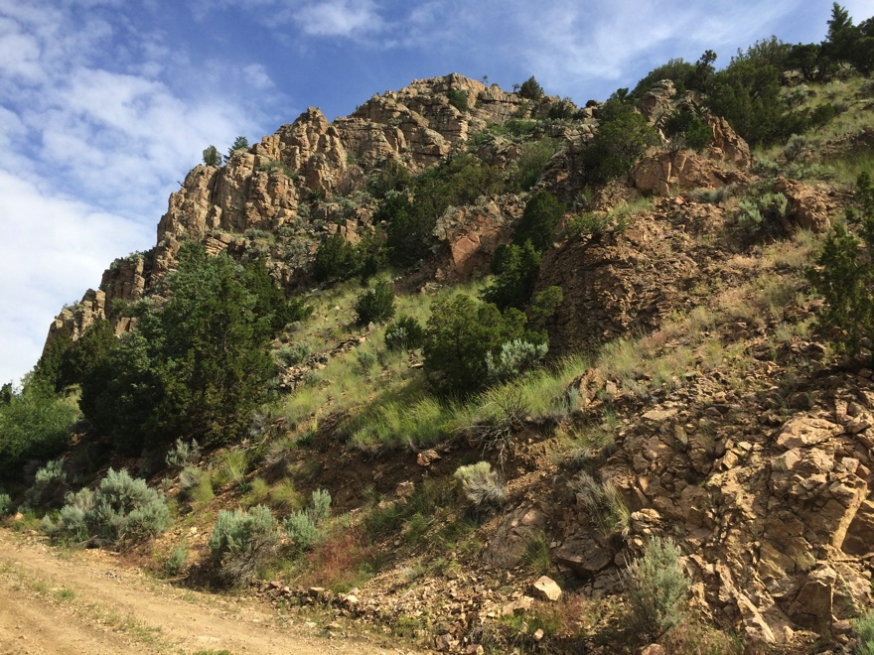
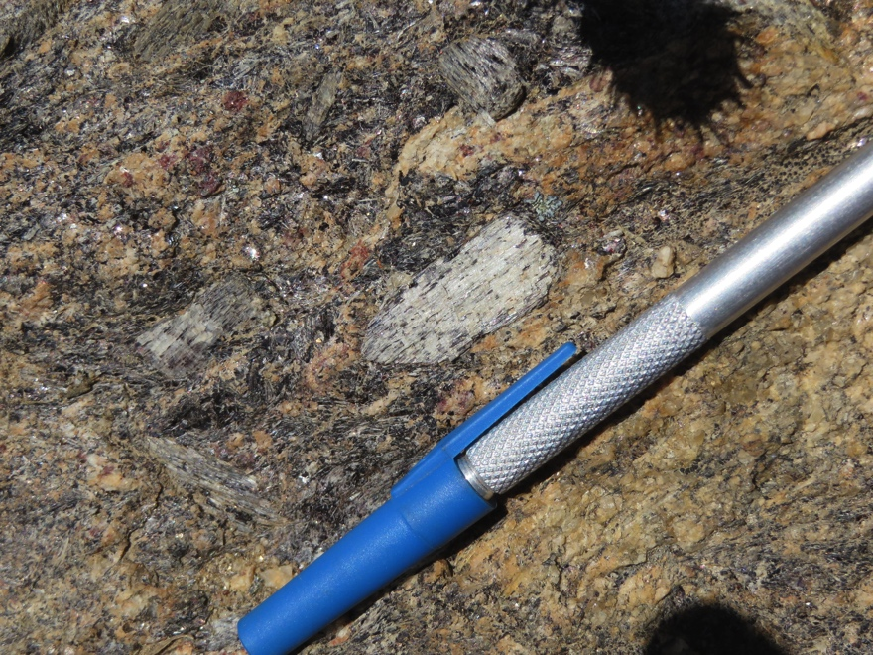
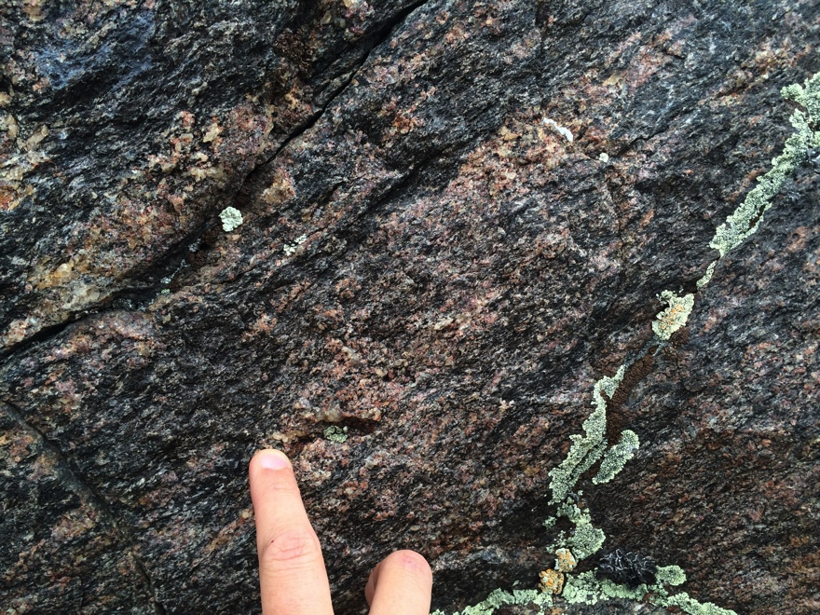
Pre-Cherry Creek gneiss

Slide 10
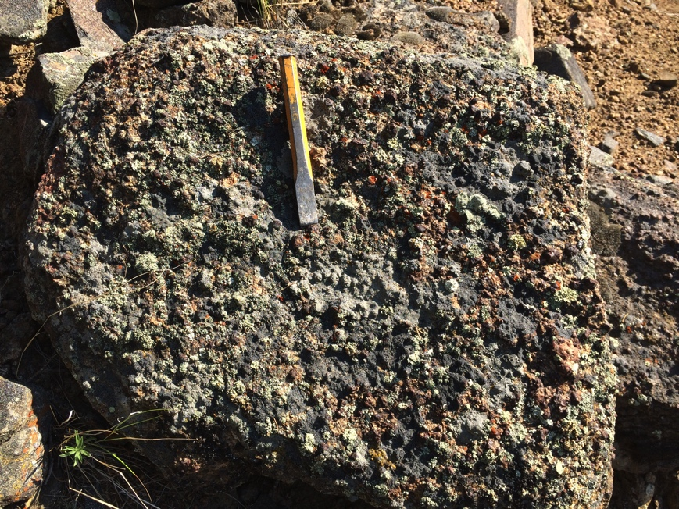
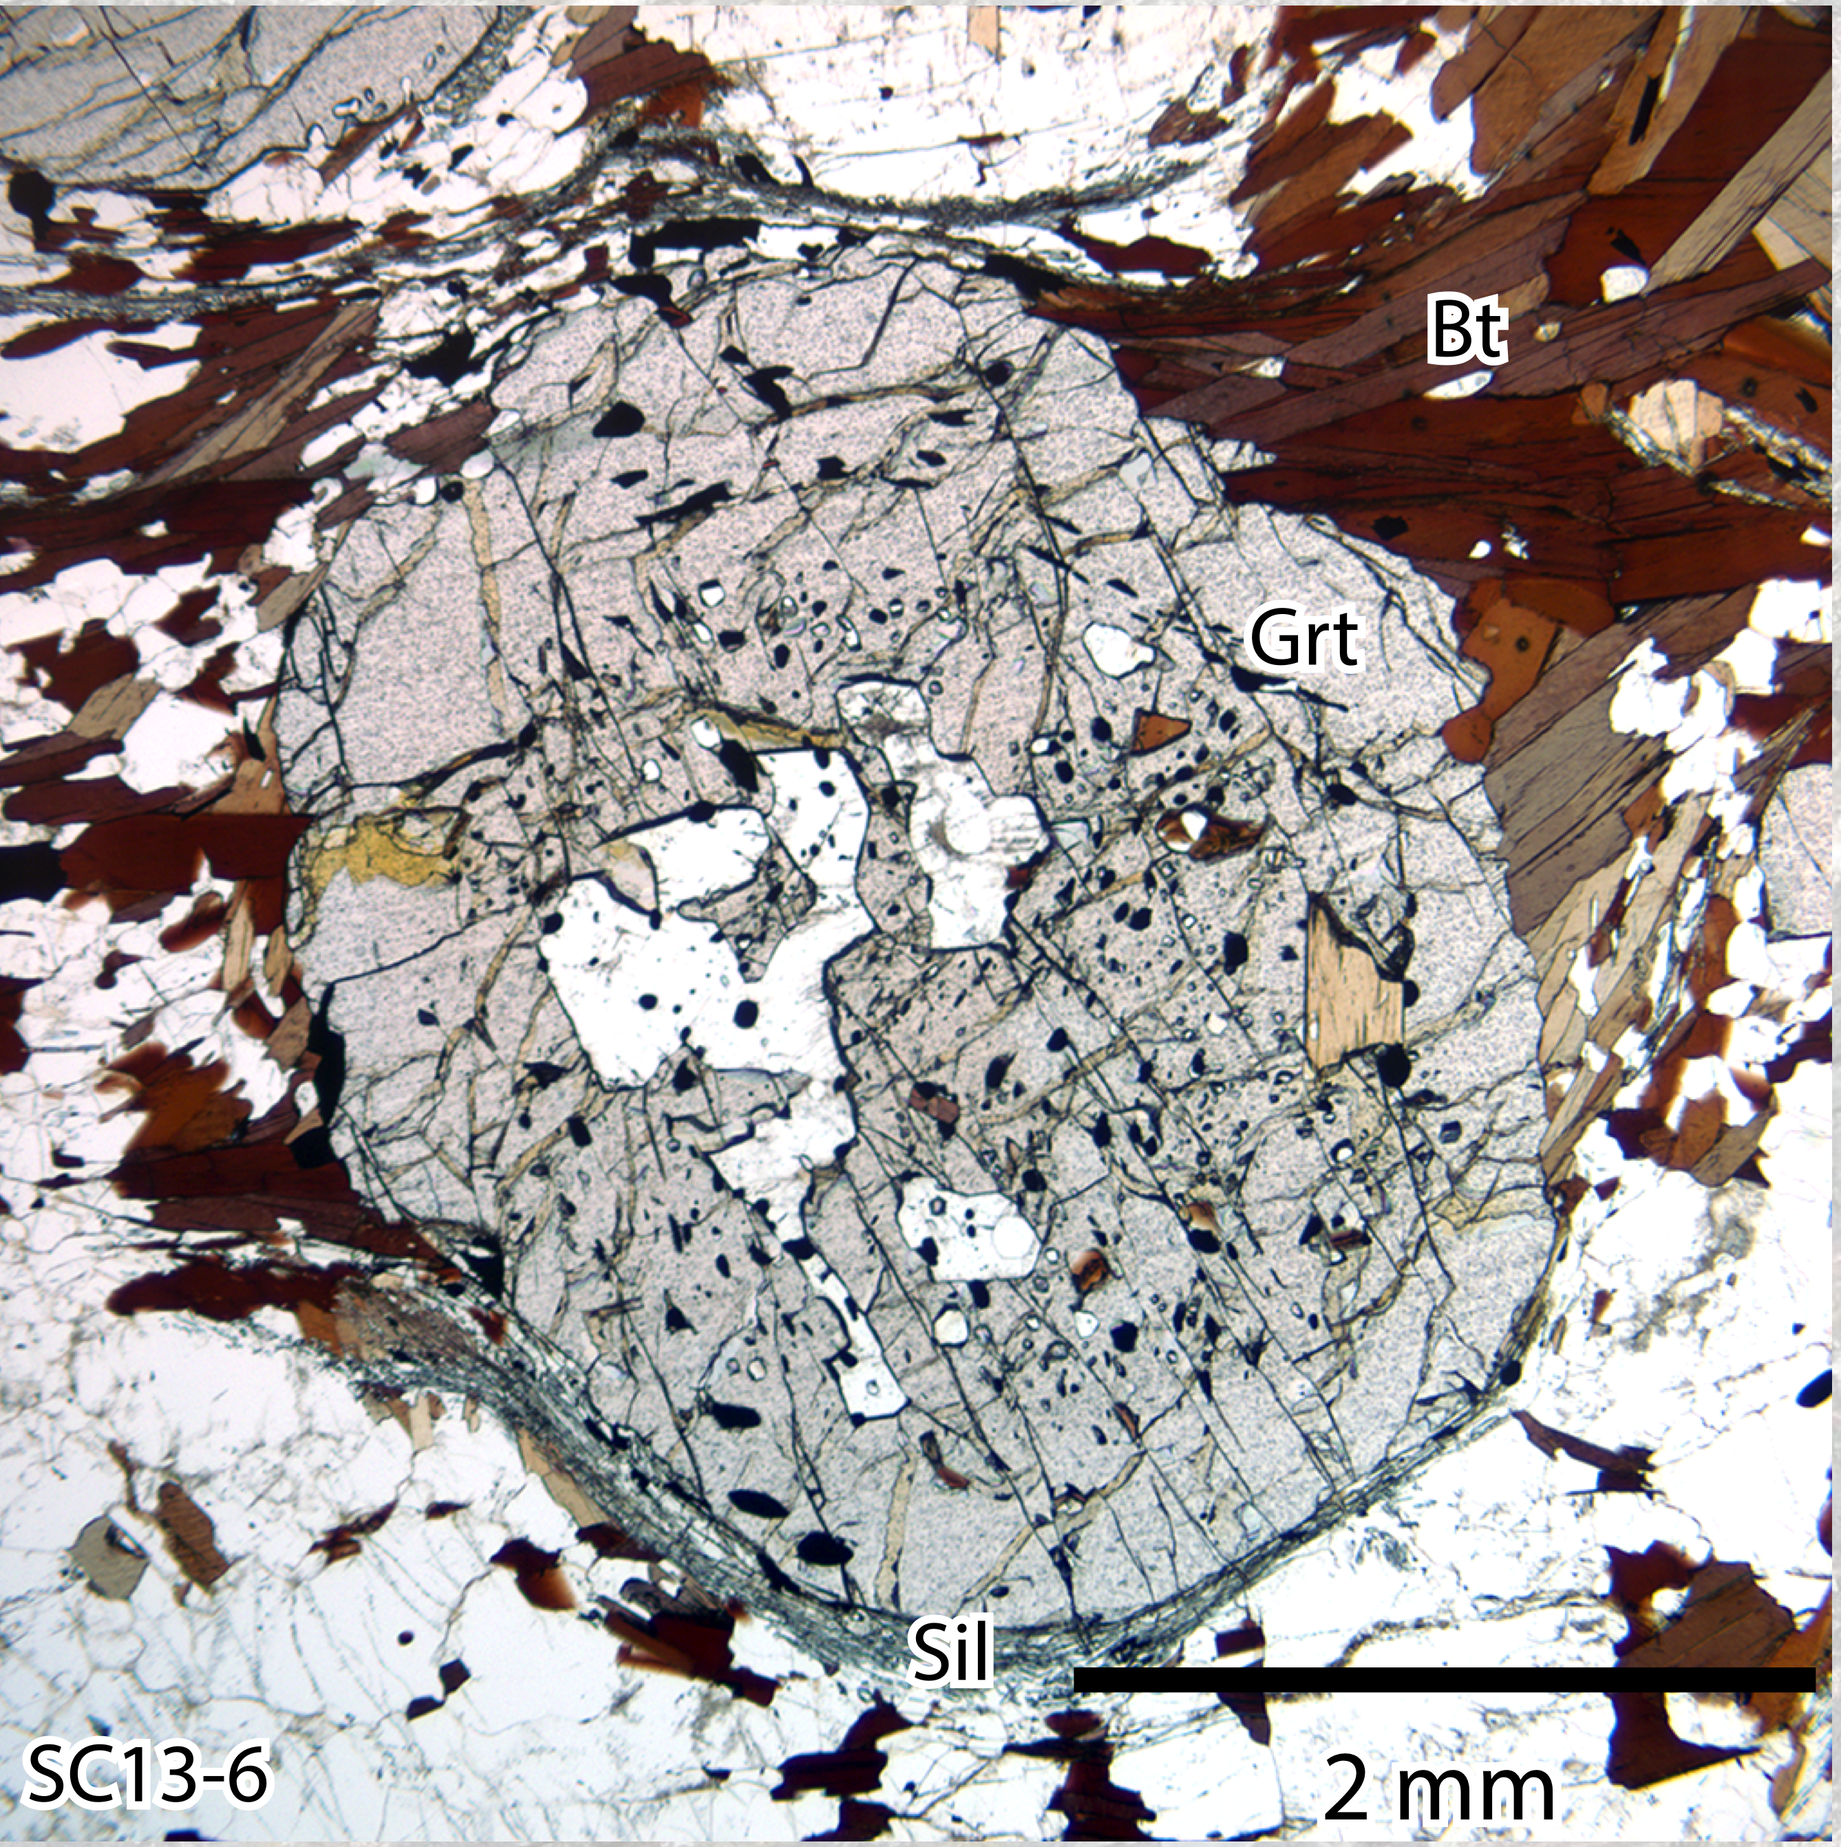
CRMS metapelite
garnet-biotite-sillimanite gneiss
Layered EDS elemental map of thin section

Slide 11
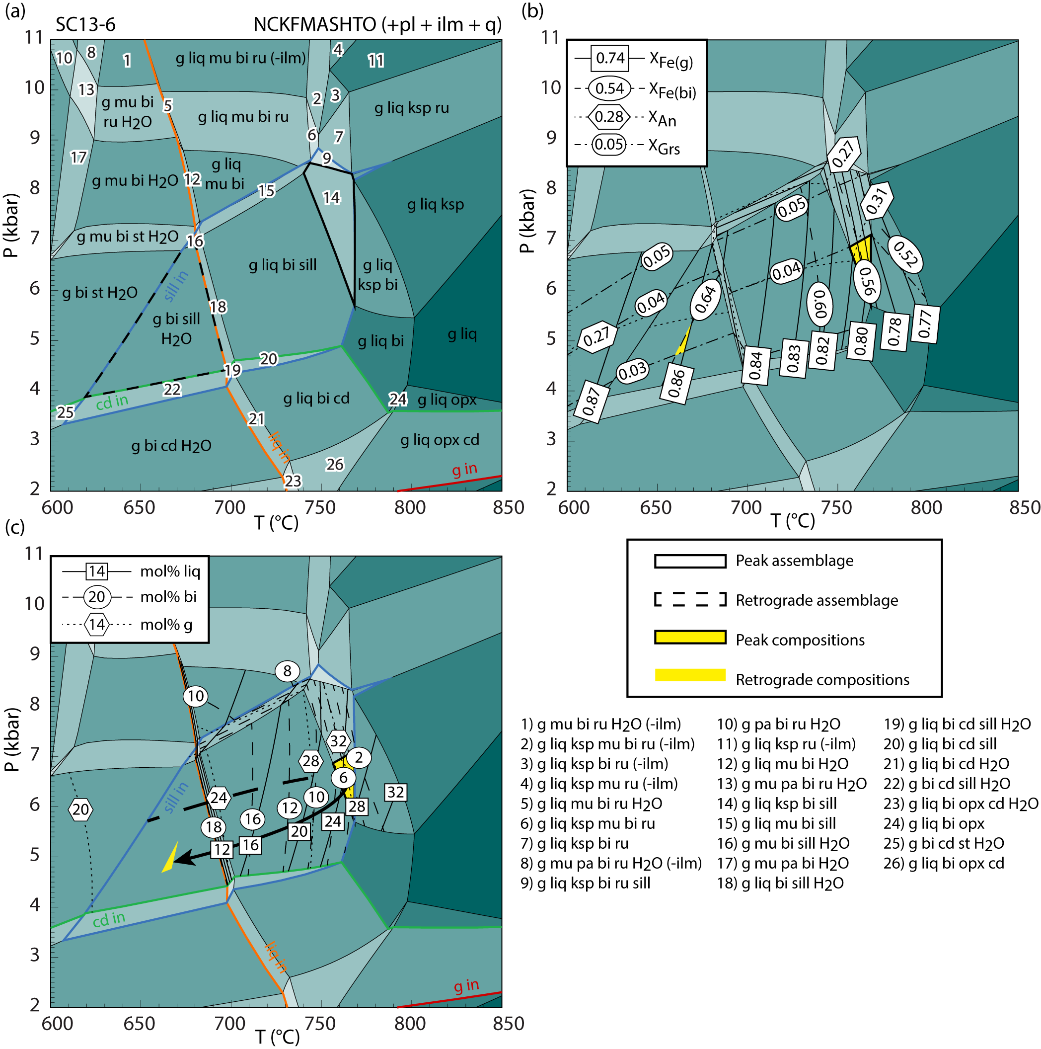
CRMS metapelite
Peak conditions of 6.5 kbar, 760°C

Slide 12
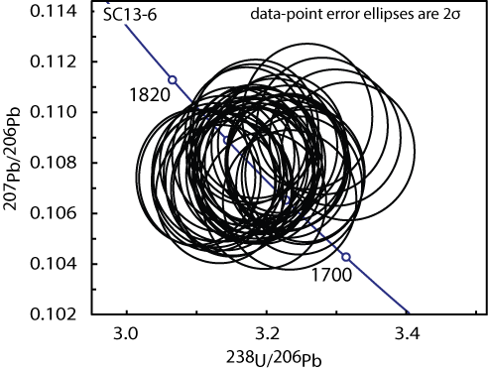
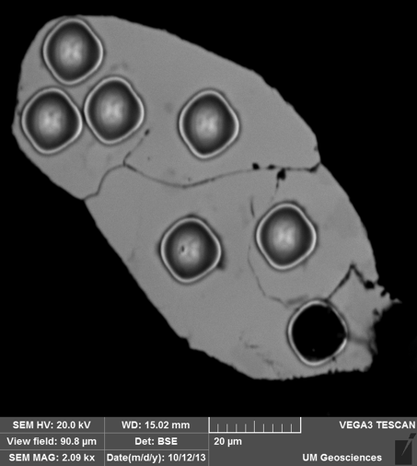
Monazite petrochronology (LASS)
All monazite data collected with a 10µm spot size at UCSB
9 grains analyzed
Range: 1790–1741 Ma
Weighted mean: 1764 ± 6 Ma
Inclusions in garnet: 1757 ± 8 Ma

Slide 13
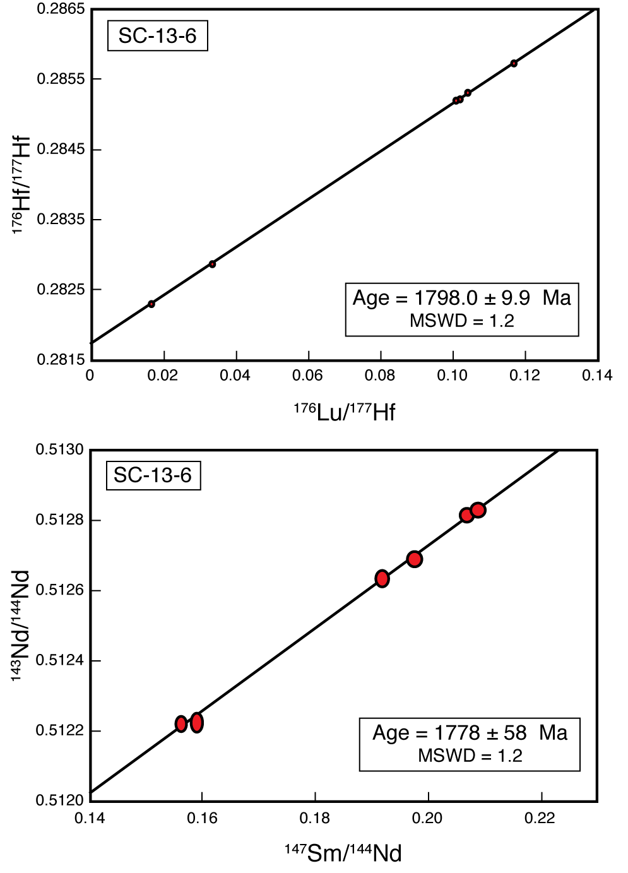
Garnet Lu-Hf and Sm-Nd geochronology

Slide 14
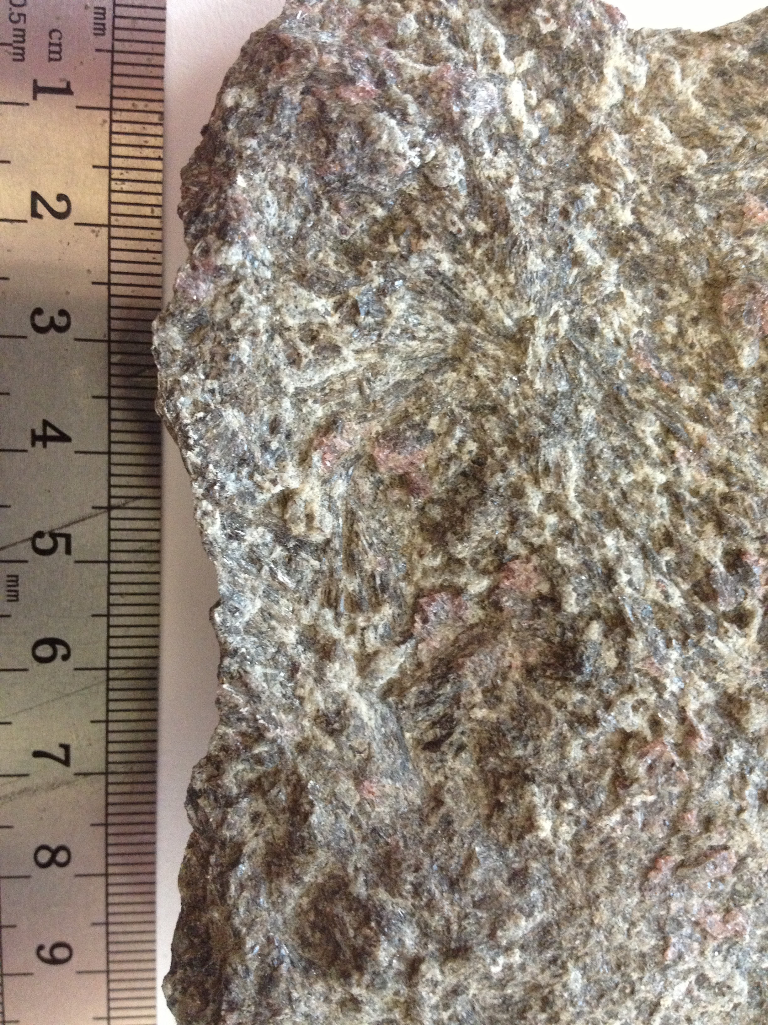
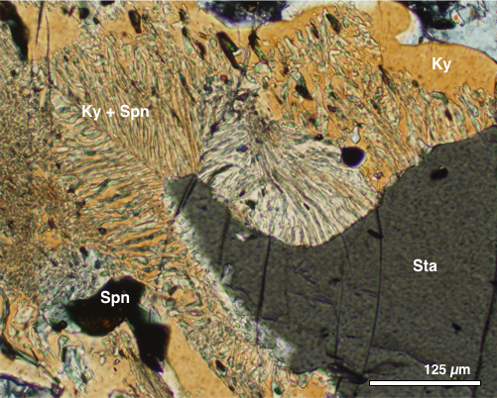
CRMS orthoamphibole schist
Oam
Pl
Grt
Grt
Crn + Crd
St
Crn + Crd
0.5 mm
Notes:
SC13-4 1723-1776 Ma

Slide 15
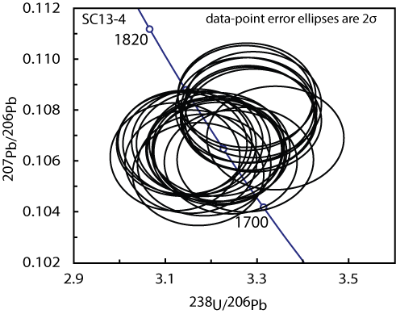
Monazite petrochronology (LASS)
1776–1723 Ma
Weighted mean: 1747 ± 6 Ma
Notes:
SC13-4 1723-1776 Ma
4 low REE analyses come from m4 – closest grain to edge of garnet.
Only 5 monazite grains in thin section.

Slide 16
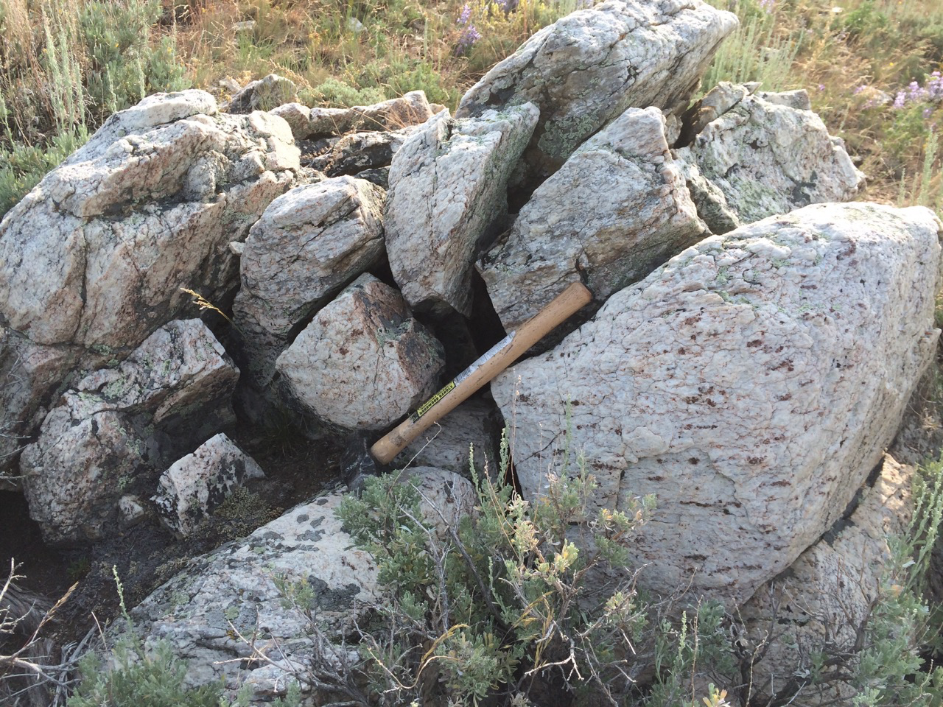
Mylonitic garnet leucogneiss (MGL)

Slide 17
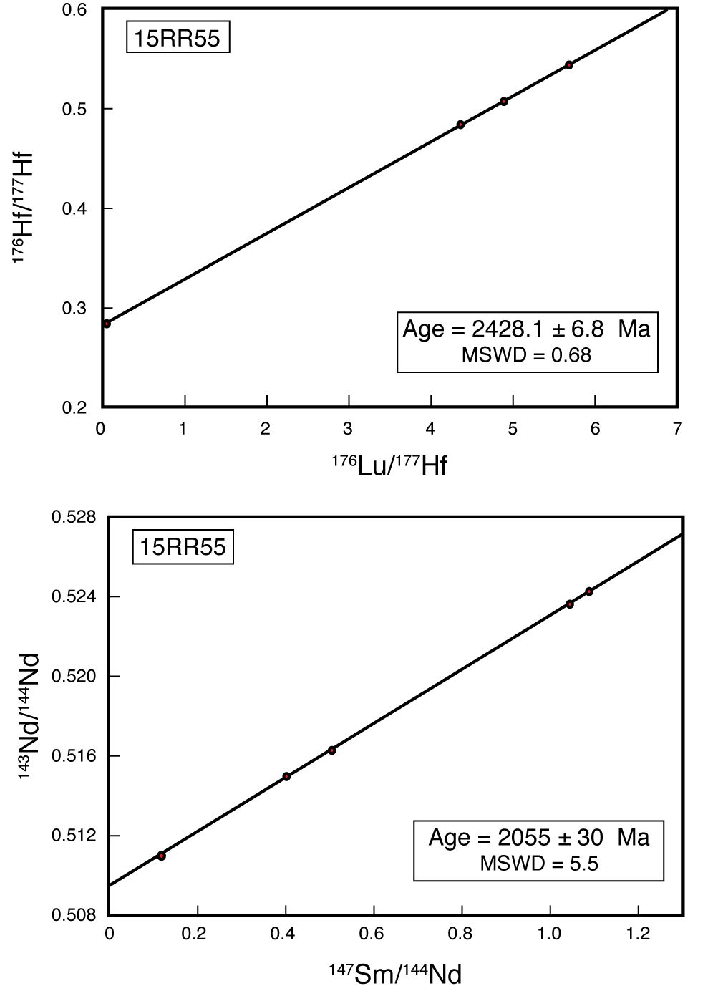
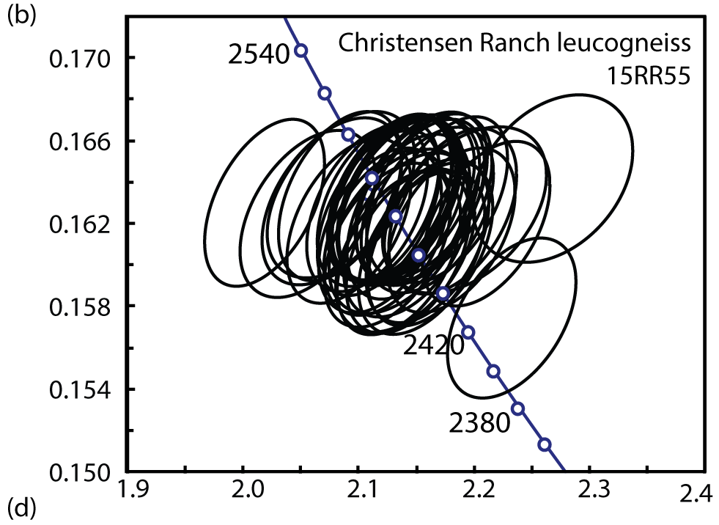
Garnet Lu-Hf and Sm-Nd geochronology
2.43 Ga zircon
2.48 Ga monazite
Sm-Nd systematics contaminated by LREE-rich inclusions?
2.06 Ga dike emplacement in the MMT (Barnhart et al. 2012, Mueller et al. 2004)

Slide 18
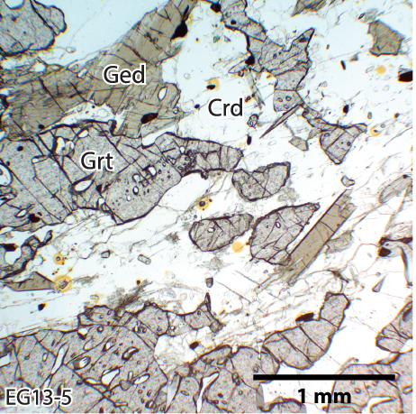
Pre-Cherry Creek orthoamphibolite
Garnet-gedrite-cordierite gneiss

Slide 19
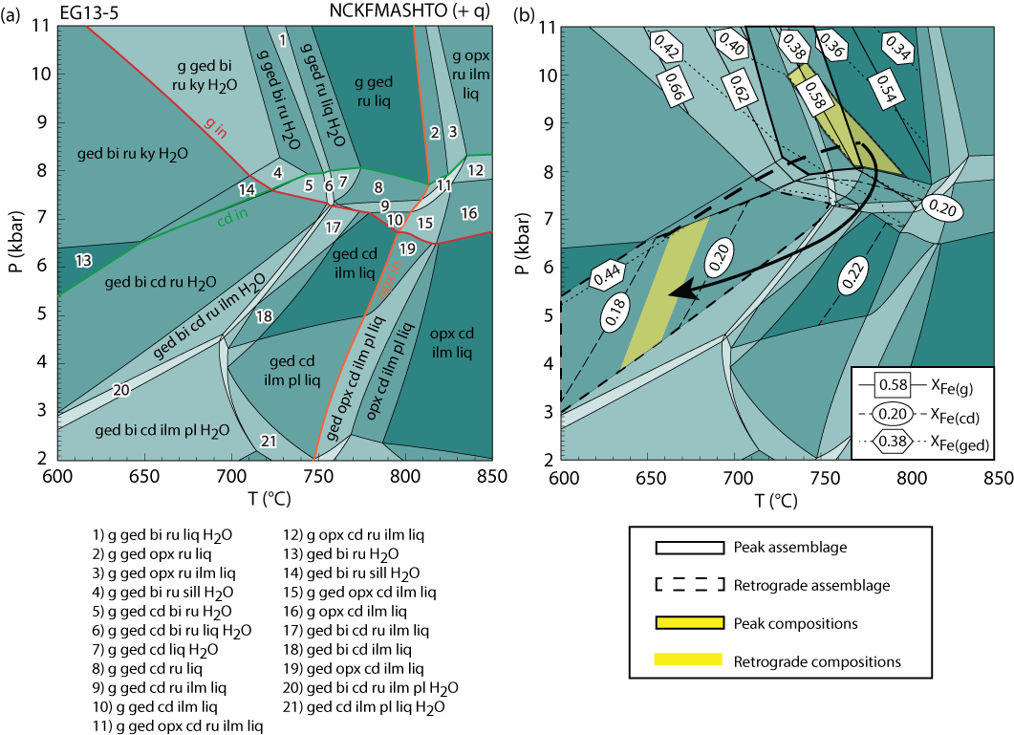
Pre-Cherry Creek orthoamphibolite
Garnet stable at P>7 kbar
Cordierite stable at P<8 kbar
Peak: 8-10.5 kbar, 730–790 °C
Retrograde: 5-7 kbar, ~660 °C

Slide 20
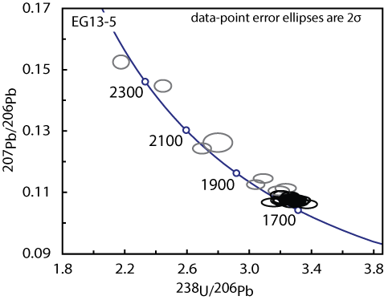
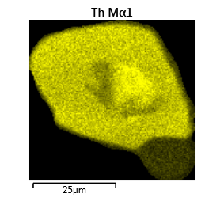
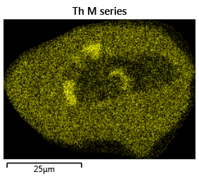
Monazite petrochronology (LASS)
13 grains analyzed
Grt inclusion
Matrix grain
1784–1733 Ma
Weighted mean: 1758 ± 4 Ma
inclusions in garnet: 1757 ± 8 Ma
Inclusions in gedrite: 1761 ± 9 Ma
Inclusions in cordierite: 1752 ± 8 Ma
Notes:
2373 Ma high Y core in grt inclusion
Grt 1754-1763
Crd 1739-1760
Ged 1752-1784
Matrix 1733-1784

Slide 21
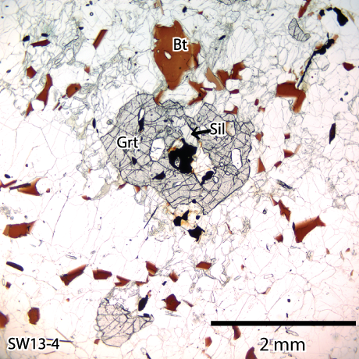
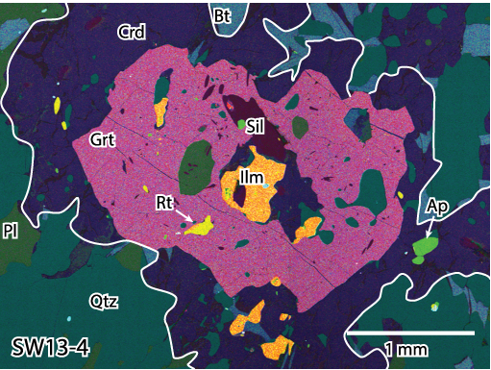
Pre-Cherry Creek metapelite

Slide 22
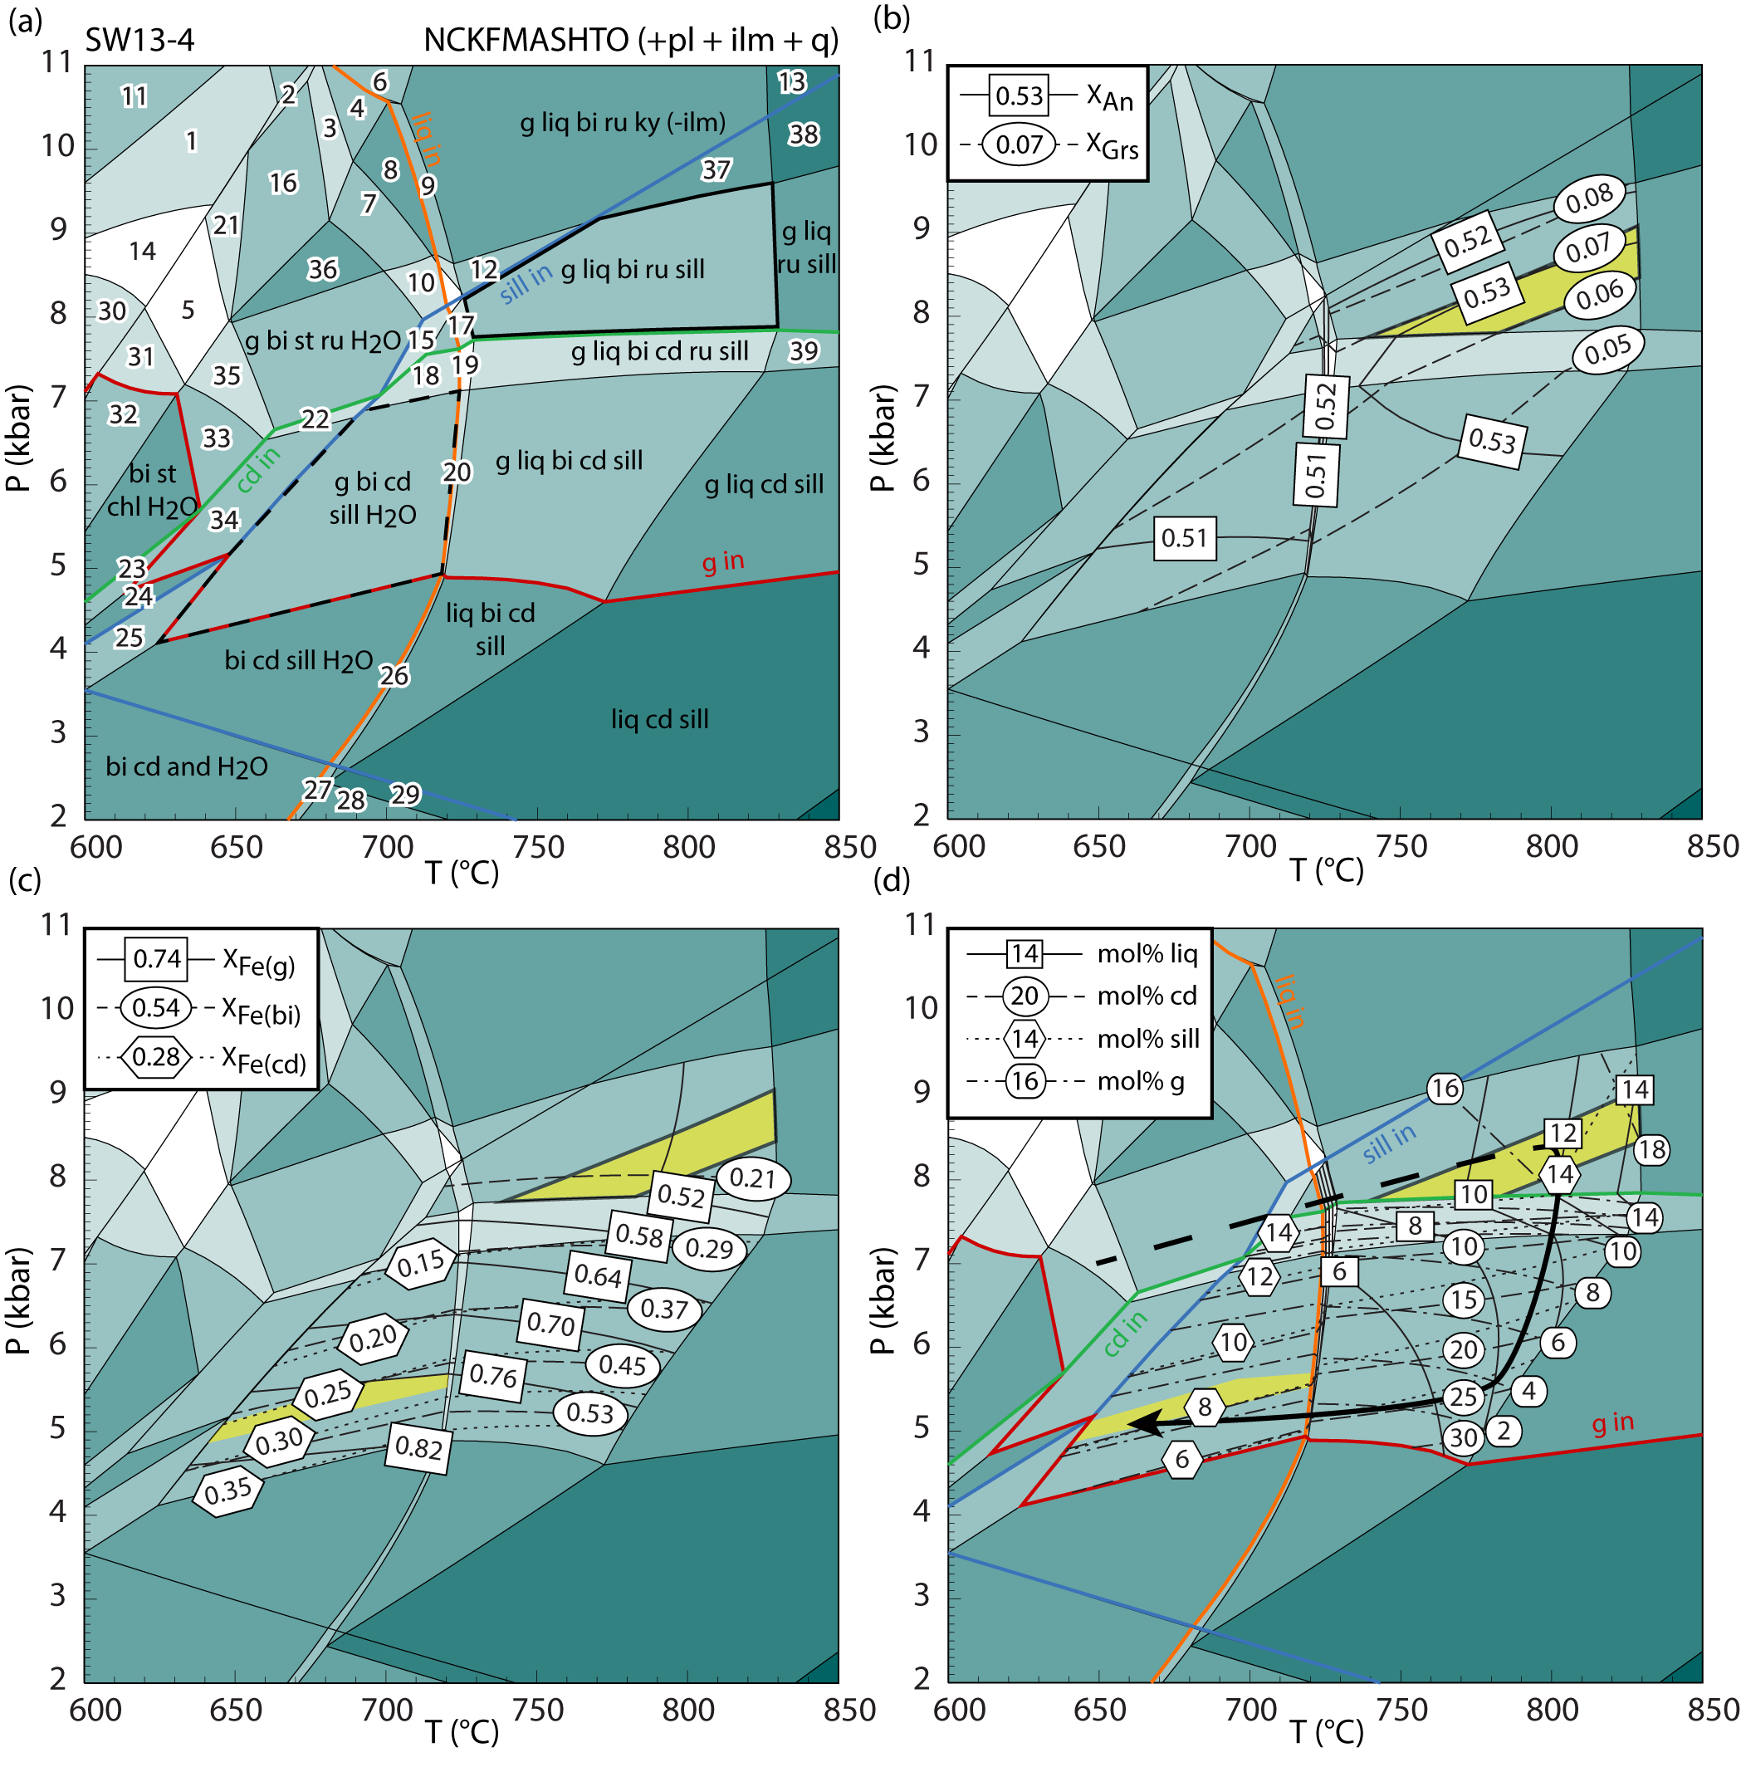
Pre-Cherry Creek metapelite
Peak conditions of 8.5 kbar, 800°C

Slide 23
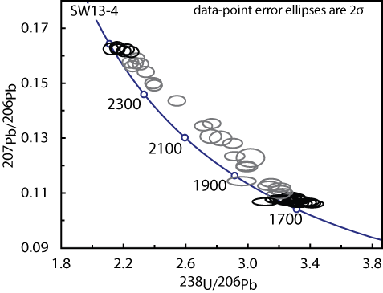
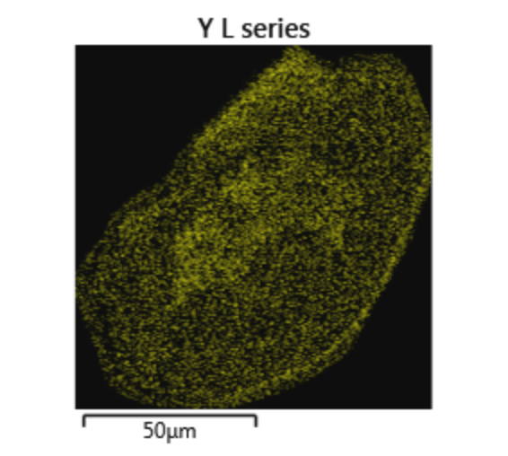
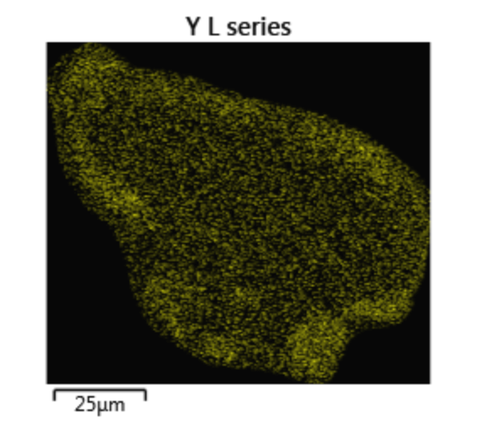
Monazite petrochronology (LASS)
8 grains analyzed
1778–1732 Ma
Weighted mean: 1752 ± 6 Ma
2470-2487 Ma cores

Slide 24
Conclusions
P–T–t paths from the CRMS and PCC suite support a collisional setting for the Ruby Range from 1.79-1.71 Ga
Prograde metamorphism occurred from 1.79–1.76 Ga, followed by near isothermal decompression and re-equilibration during post-orogenic extension at 1.76–1.71 Ga
The PCC and Dillon gneiss represent reworked Archean craton and record an early metamorphic event at ~2.45 Ga
The MGL was intruded during the 2.45 Ga event. No melt of Big Sky age has been identified yet.
Deeper rocks in the PCC suite record near-isothermal decompression that indicates 12-15 km of exhumation
Rocks throughout the range equilibrated at mid-crustal depths following post-orogenic extension

