Slide 1
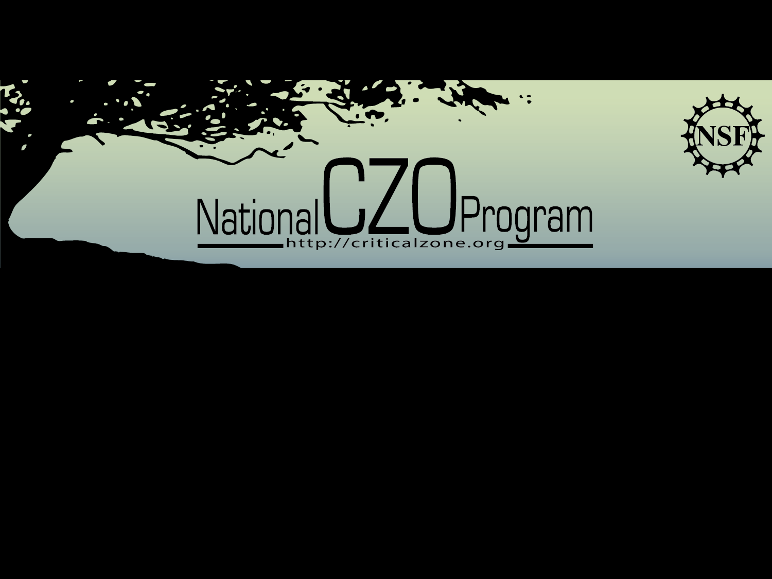
Critical Zone Observatory (CZO) program
Education (and Outreach)
Tim White
February 20, 2012
Earth Science Provider Summit
Notes:
The program began with funding of individual Pis instructed in the original RFP to propose stand-alone sites rather than a network of sites. I’m the closest thing we have to a program coordinator which is a somewhat daunting part-time task. Yet we’ve achieved remarkable progress so I will first provide a summary of some key information about the CZO program and then focus on coordination activities……..

Slide 2
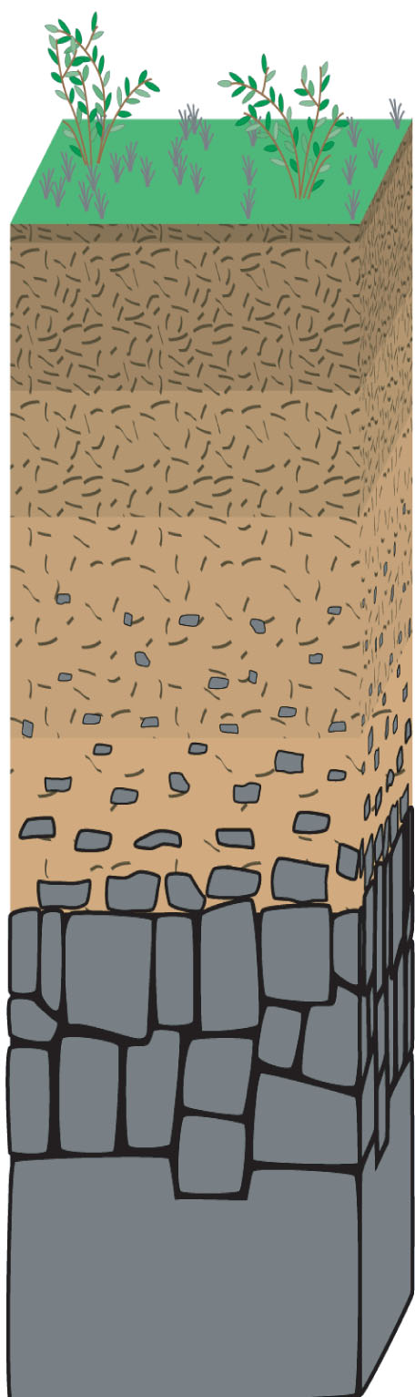
Critical Zone:
• term published by the U.S. National
Research Council in 2001 BROES report
• thin veneer at Earth’s surface spanning
from the top of vegetation canopy to deep in
the subsurface where groundwater freely circulates.

Slide 3
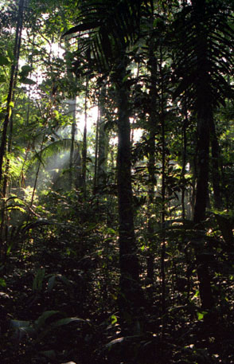
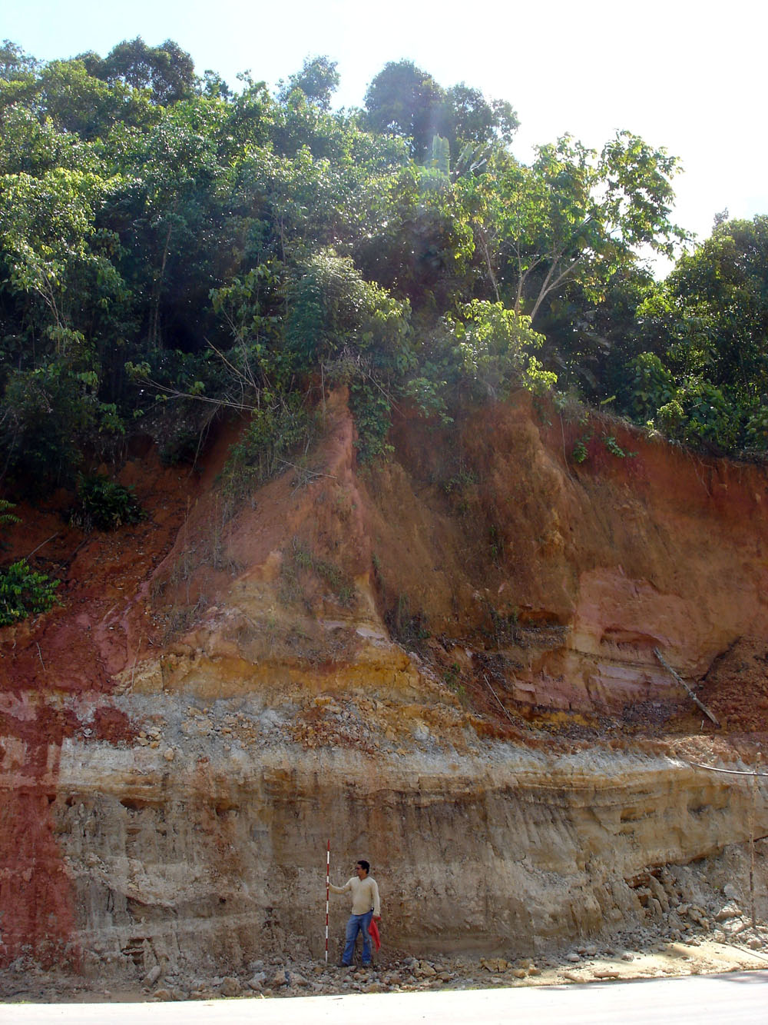
Tropical rainforest:
extensive forest canopy and
complex understory
- thick mature soils

Slide 4
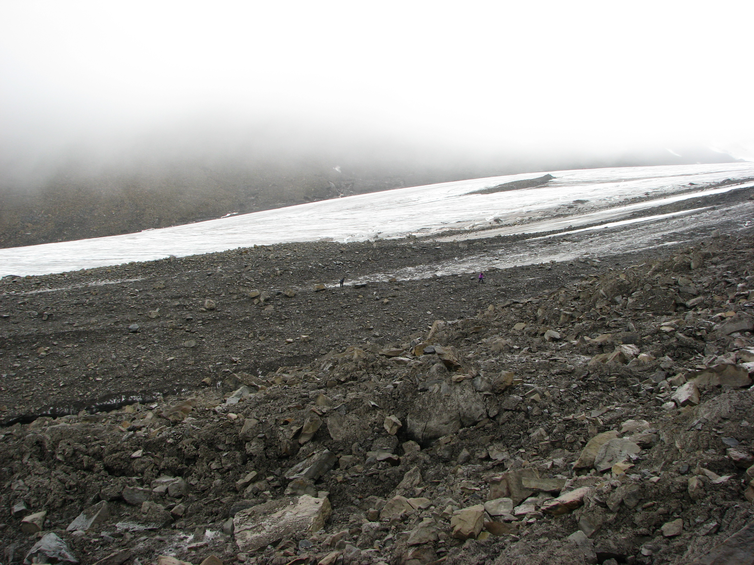
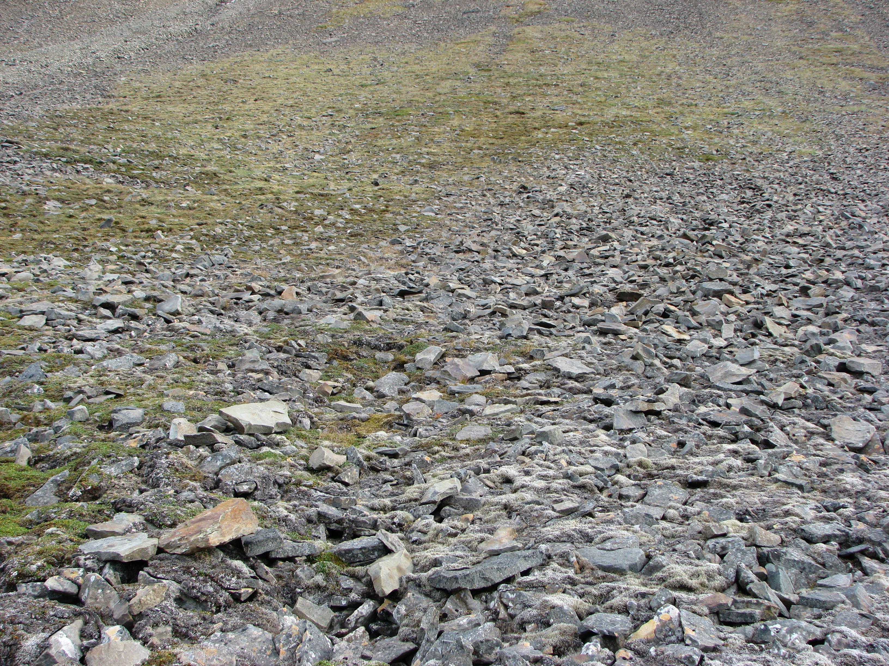
Polar realm:
- permafrost
- thin discontinuous soils
- stunted vegetation
Longyearbyen Valley,
Spitsbergen

Slide 5
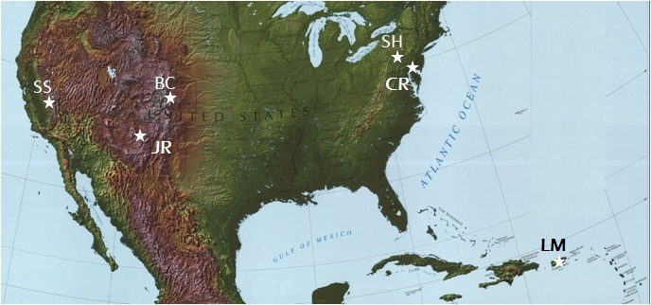
State of CZ Science: Six CZOs cover an array
of geologic, climatologic and ecologic settings in
which a variety of critical zone processes can be
studied from the vegetation canopy into bedrock.
Notes:
Maybe add some animation that points out some of the work that is beign done?
5

Slide 6
CZOs evolved from the recognition that many
similar scientific questions were being asked by
diverse groups of Earth surface scientists who
did not typically collaborate.

Slide 7
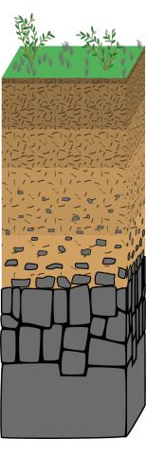
CZEN Four Driving Questions
Atmosphere
How do processes that nourish ecosystems change over human and geologic time scales?
What processes control fluxes of carbon, particulates, and reactive gases over different timescales?
Landform
Evolution
Nutrients
How do biogeochemical processes govern long-term sustainability of water and soil resources?
How do variations in and perturbation to chemical and physical weathering processes impact the Critical Zone?
Chemistry
of Water

Slide 8

CZEN Four Driving Questions
Atmosphere
How do processes that nourish ecosystems change over human and geologic time scales?
What processes control fluxes of carbon, particulates, and reactive gases over different timescales?
Landform
Evolution
Nutrients
How do biogeochemical processes govern long-term sustainability of water and soil resources?
How do variations in and perturbation to chemical and physical weathering processes impact the Critical Zone?
Chemistry
of Water

Slide 9
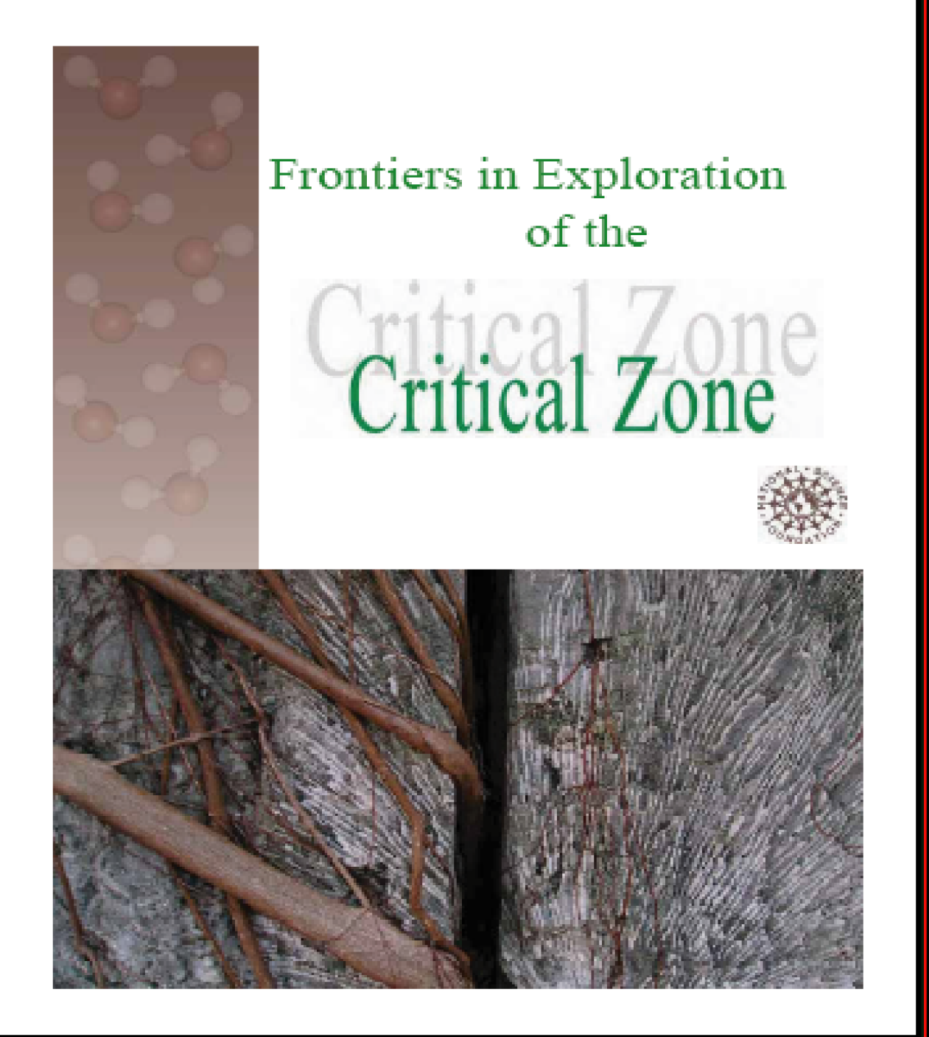
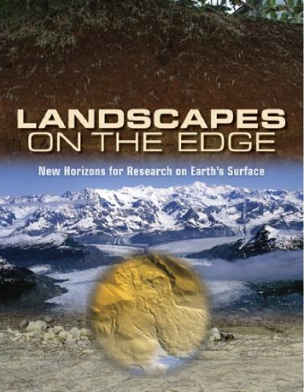
Brantley et al., 2006
Download at:
www.czen.org

Slide 10
Education
• Develop a new cadre of Critical Zone scientists who early in their career have been trained in interdisciplinary (and international) collaboration.
• Supplemental funding through International Programs has since 2007 provided opportunities in Europe for 42 U.S. graduate students to pursue field or lab activities related to and supportive of their research.

Slide 11
CZO general information: Human resources
Undergrads Grads Post-Docs Degrees
Boulder 19 (19) 19 4 9
Shale Hills 13 (24) 18 (9) 4 4
S. Sierra 12 11 4
Christina RB 7+ 9 3
JRB/SCM 8 11 3
Luquillo 7 13 3(1) 1

Slide 12
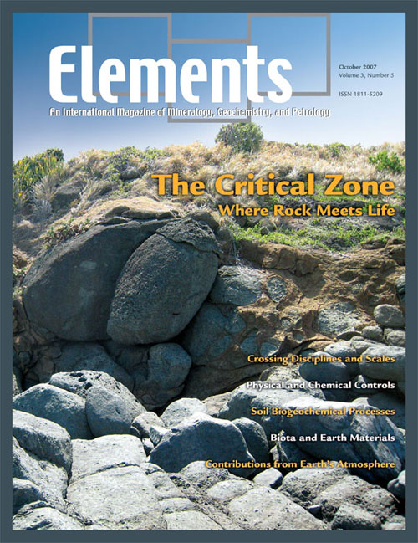
CZO general information: Human resources
• 51 scientists working at a CZO from entirely outside the CZO program and home institution (not counting LTER)
• 5 intra-network multi-PI collaborations
• Several paired CZO-CZO projects
• Special CZ sessions @ AGU, GSA,
SSSA, Goldschmidt
• Two CZO-spearheaded special issues

Slide 13
Education
• Develop a new cadre of Critical Zone scientists who early in their career have been trained in interdisciplinary (and international) collaboration.
• Supplemental funding has since 2007 provided opportunities in Europe for 43 (12 in 2011) U.S. graduate students to pursue field or lab activities related to and supportive of their research.

Slide 14
16 U.S. universities represented:
• Penn State • U. New Hampshire
• U. Arizona • Cornell
• U. Delaware • U. Georgia
• U. Pennsylvania • Arizona State
• U. Colorado-Boulder • Stanford
• Oregon • San Francisco State
• Oregon State • U. Montana
• Purdue • Duke
• (USGS Mendenhall Program)

Slide 15
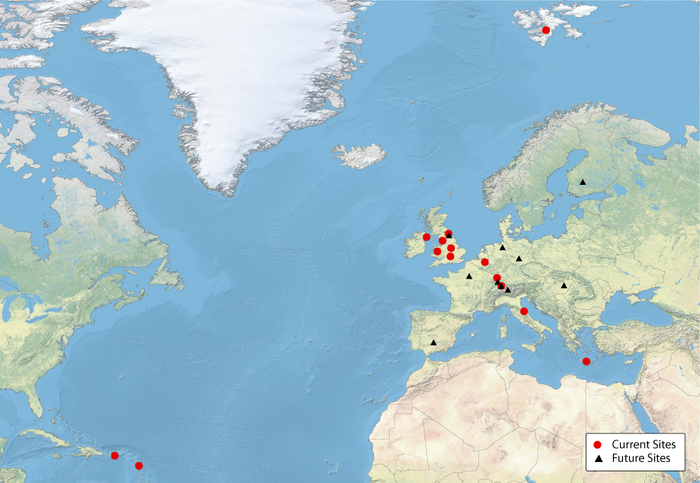
Notes:
Show map of Europe and Caribbean where students have been and highlight Crete posters and quotes and upcoming projects in 2011.

Slide 16
20 European hosts:
• U. Newcastle • U. Freiburg
• Inst Physq Globe Paris • Helmolz Centre
• Queen’s U. (Belfast) • Swiss Fed Inst Tech
• U. Hasselt (Belgium) • Max Planck Inst
• Oxford • Durham U.
• British Geol Survey • Centre Ecol Hydro
• Lancaster U. • Tech Uni Crete
• U. Sheffield • U. Strasbourg
• U. Stockholm • IAEA (Vienna)
• ETH (Zurich) • U. Helsinki

Slide 17
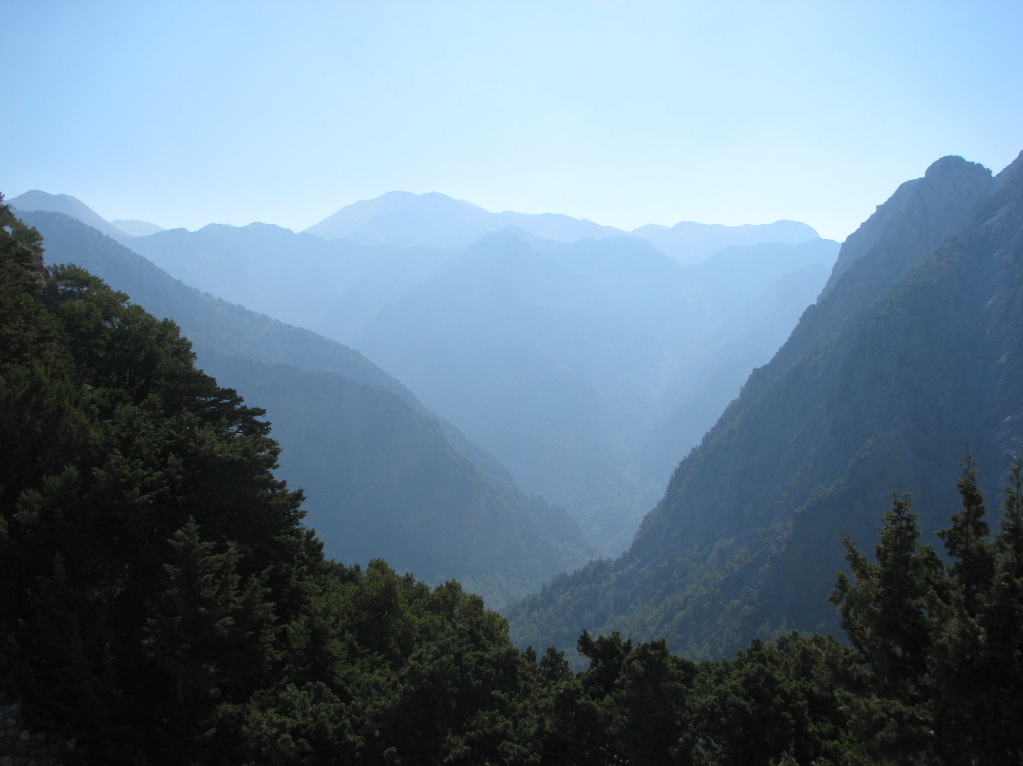
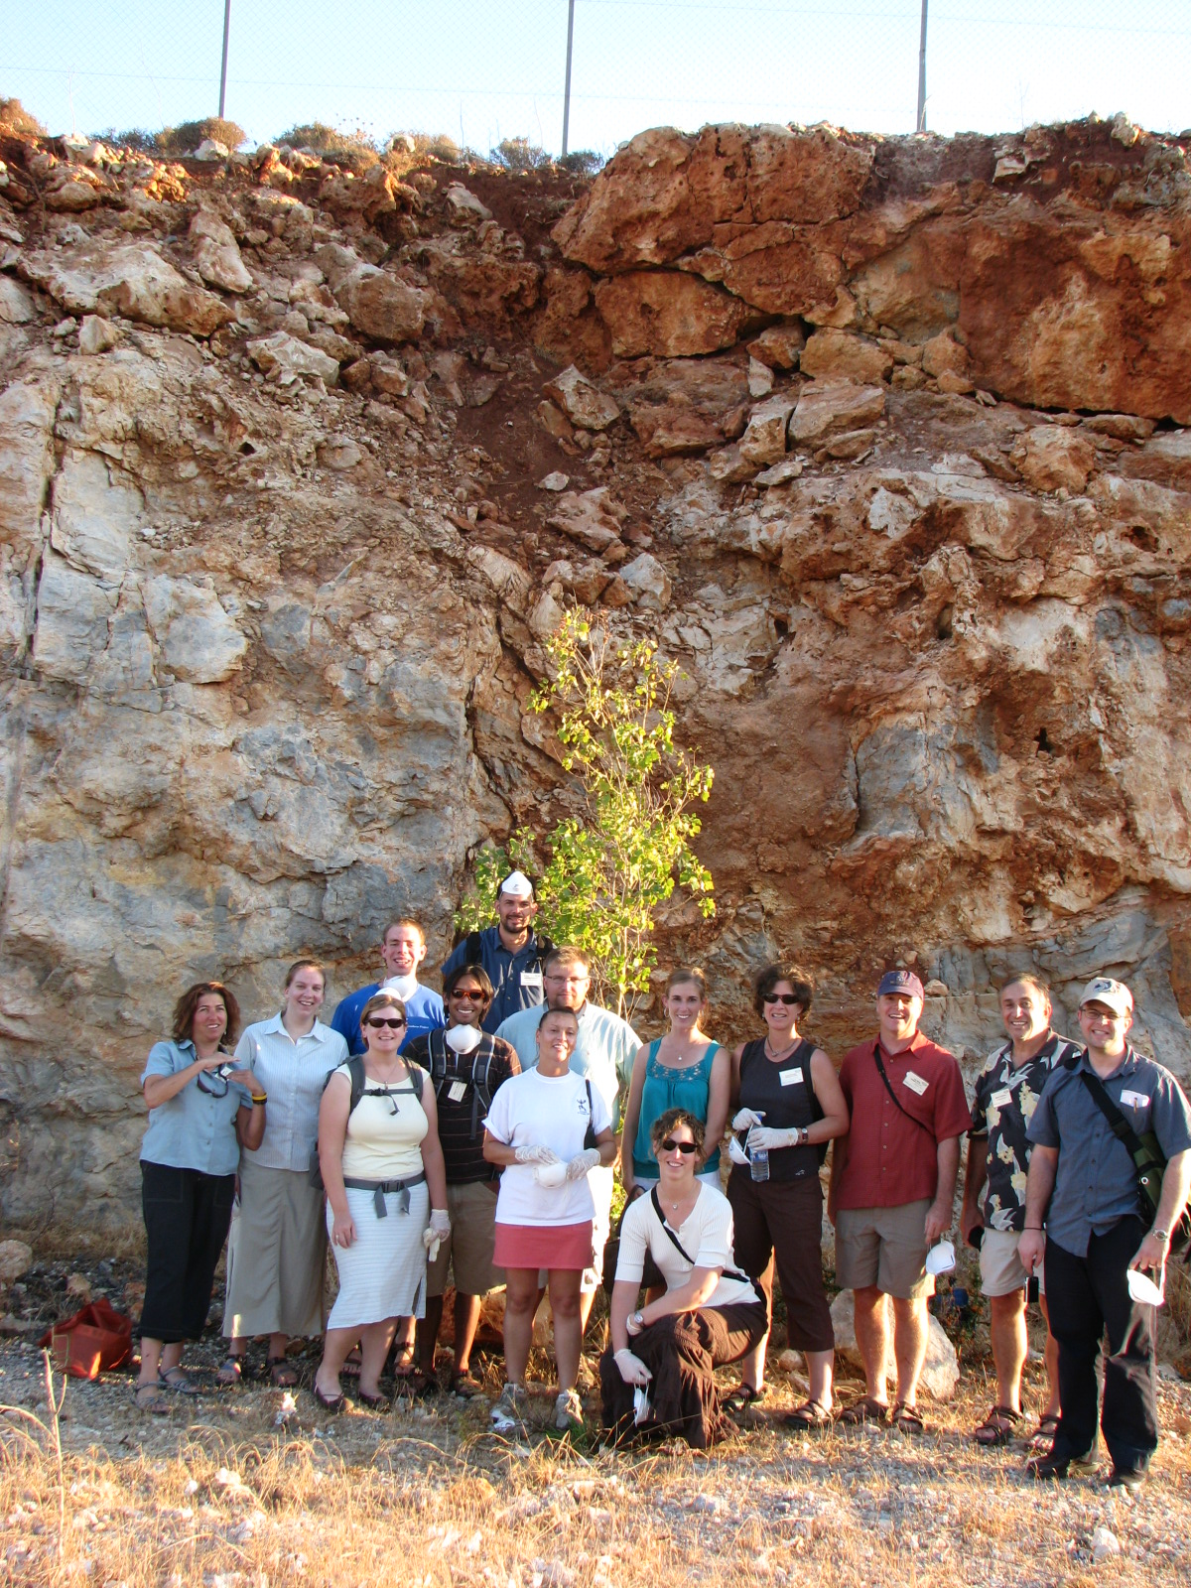
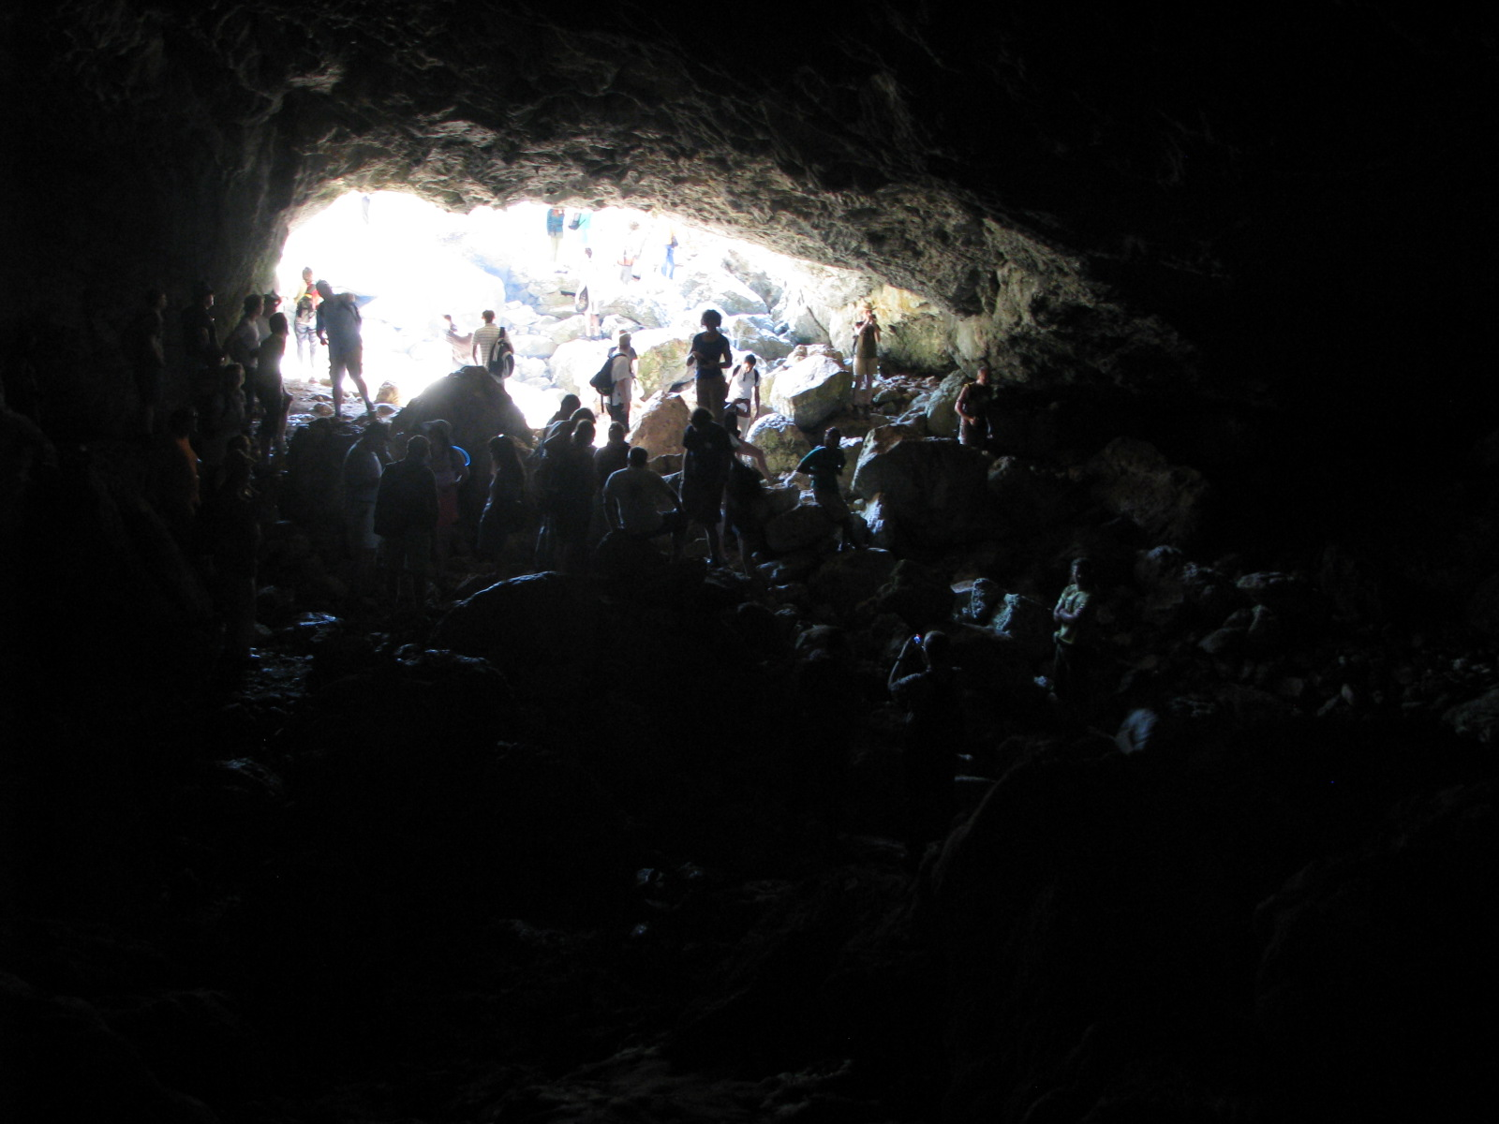
Chania, Crete Fall 2008

Slide 18
“I could not have asked for a better experience than I had at the
SoilCritZone conference in Chania, Crete. The exposure, both to the ideas of others and of others to my work, will likely be a turning point in my career.” J.A.
The opportunity to meet fellow soil scientists and interact personal basis was unparalleled, not to mention truly inspirational…… Although I am only just beginning my career as a soil scientist, I undoubtedly consider this experience a defining moment, both professionally and personally.” A.D.
“As a master’s candidate in a small department at a primarily
undergraduate non- research institute, I found myself, for the first time, surrounded by researchers who in one way or another are working on the same problem I am….the feedback exceeded my expectations; I camehome with a notebook full of ideas and suggestions.” J.M.

Slide 19
“I can say that thanks to this meeting I am currently in the process of
writing a grant in collaboration with another researcher I met in the
workshop.” S.M.
“I do not think that I have attended a scientific meeting thus far where the "early stage researchers" have been so welcomed by the "senior
researchers"; it was so easy to talk with all attendees at different stages in their careers…My hope is that meetings like this one will continue in the future, and that they will continue to include and support early stage
researchers… I returned home inspired to finish up my dissertation!” E.H.
“It was very interesting to learn more about the European perspective
on the critical zone. In the US, we seem to focus on the Critical Zone
from a pure science perspective. Europe seems to be more focused on
soil sustainability.” S.R.

Slide 20
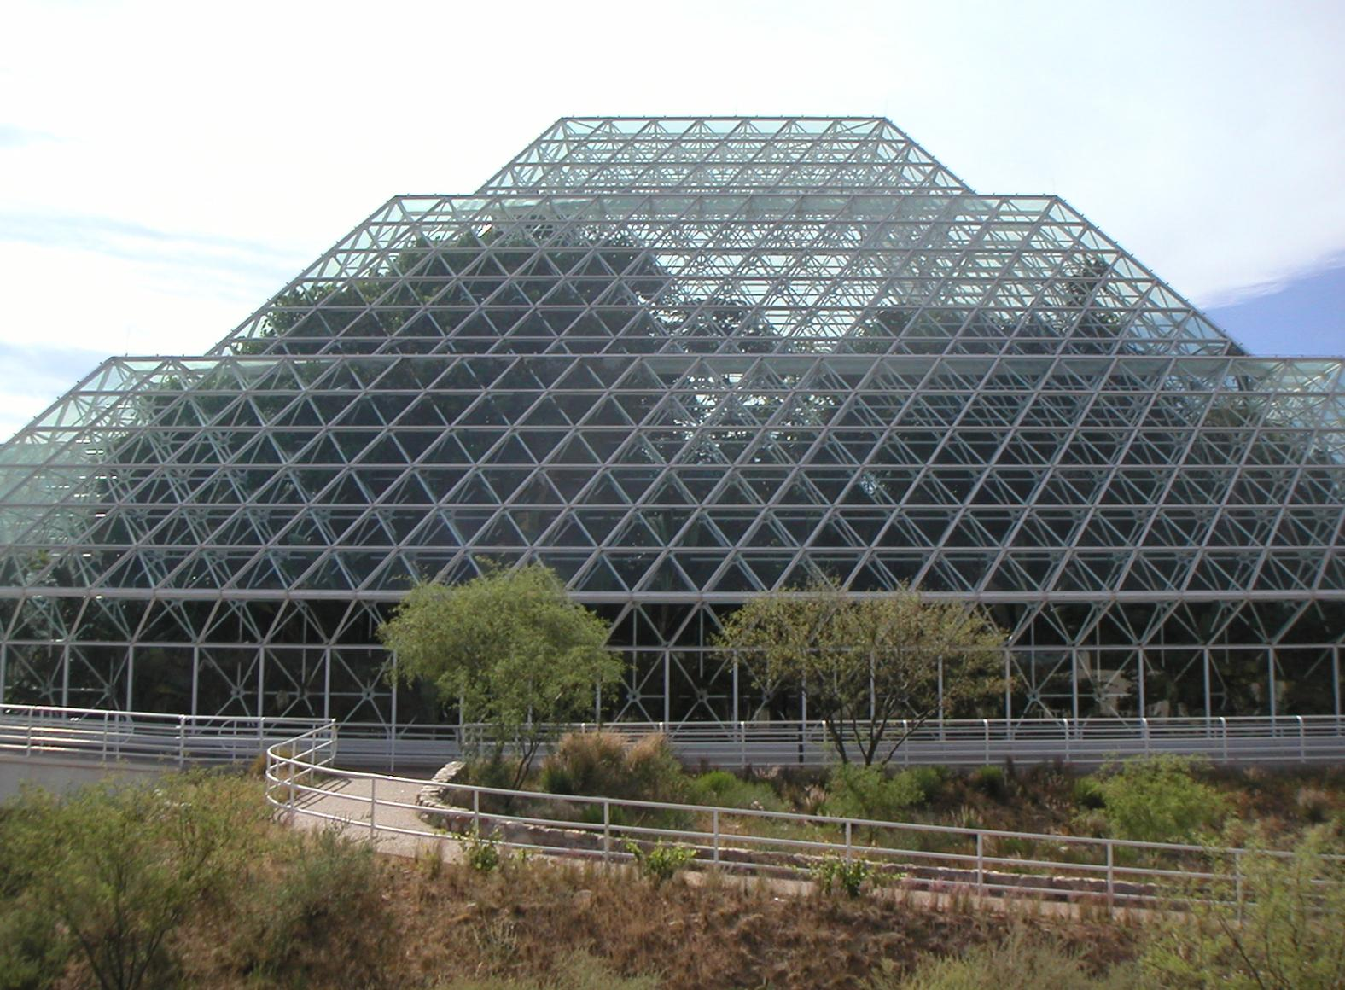
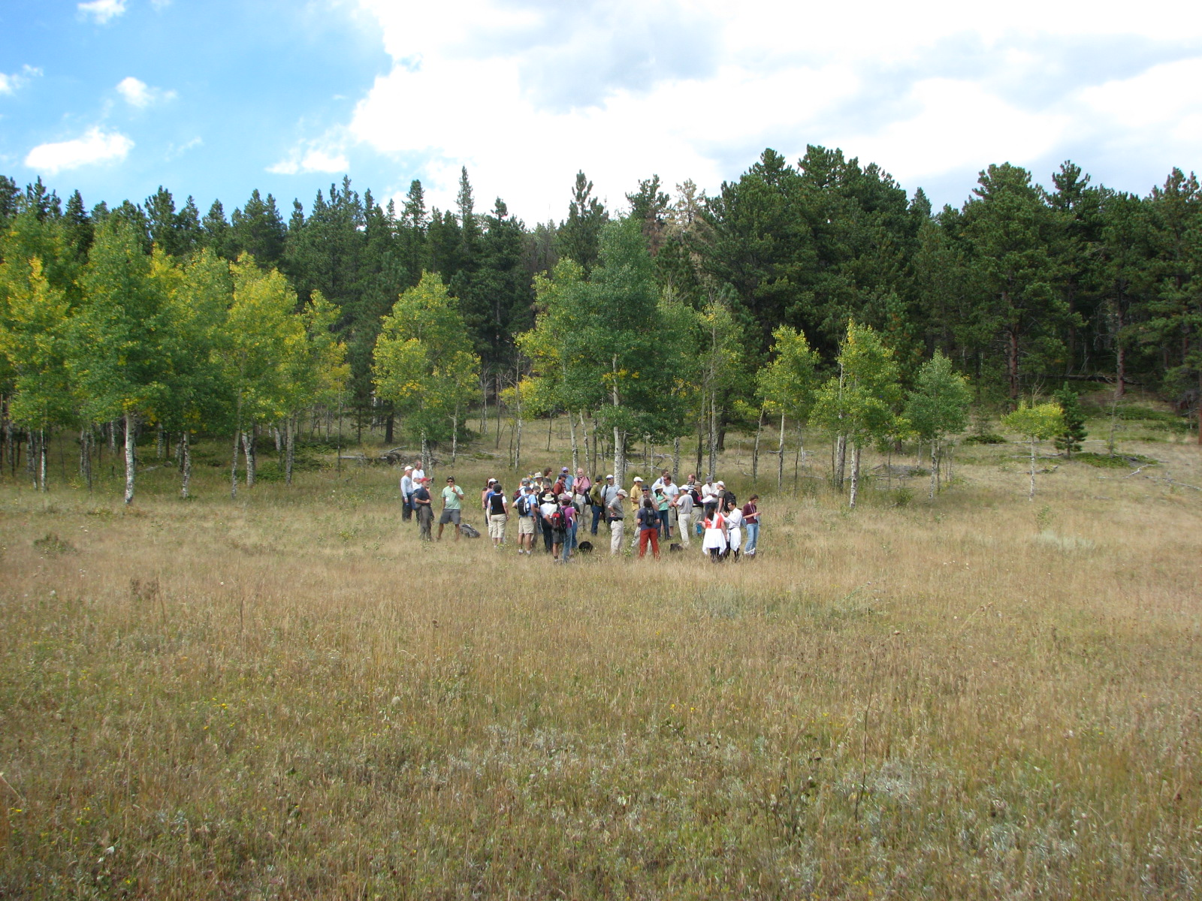
Outreach within CZO program:
• monthly telecons
• czen.org working groups
• annual meetings (All Hands every other year)

Slide 21
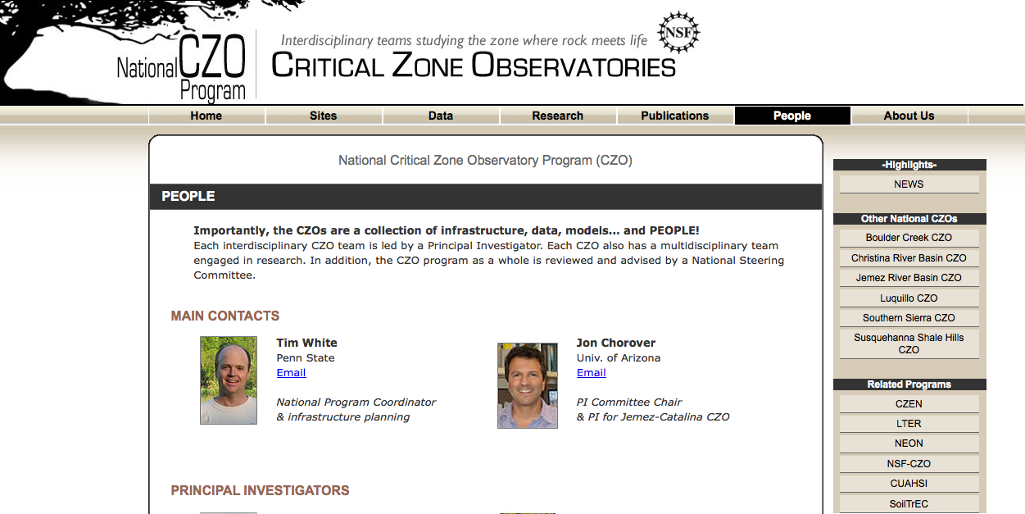
Outreach to greater CZO community:

Slide 22


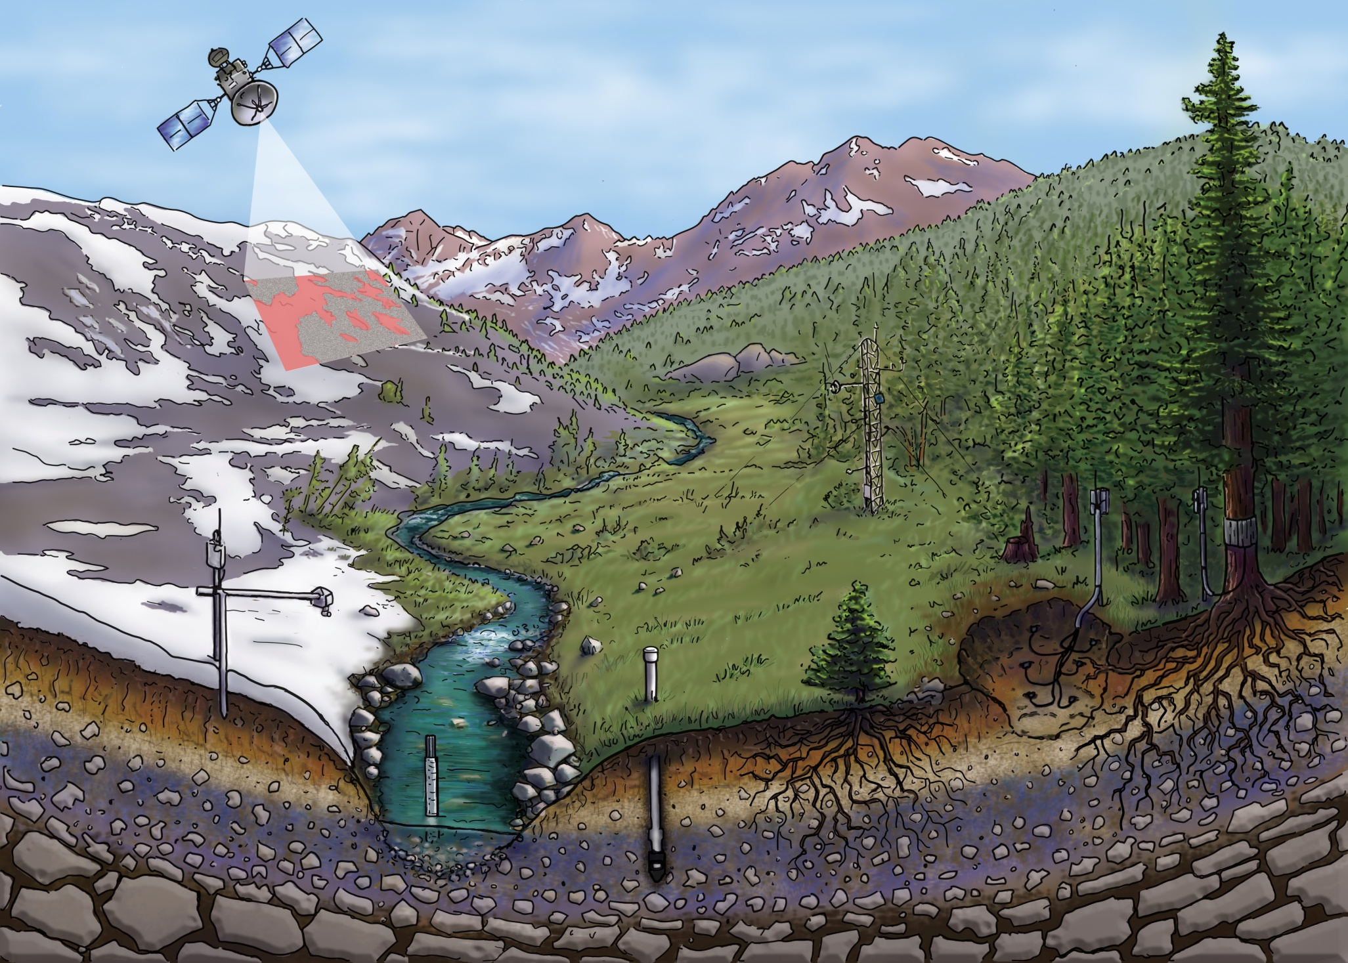

Slide 23
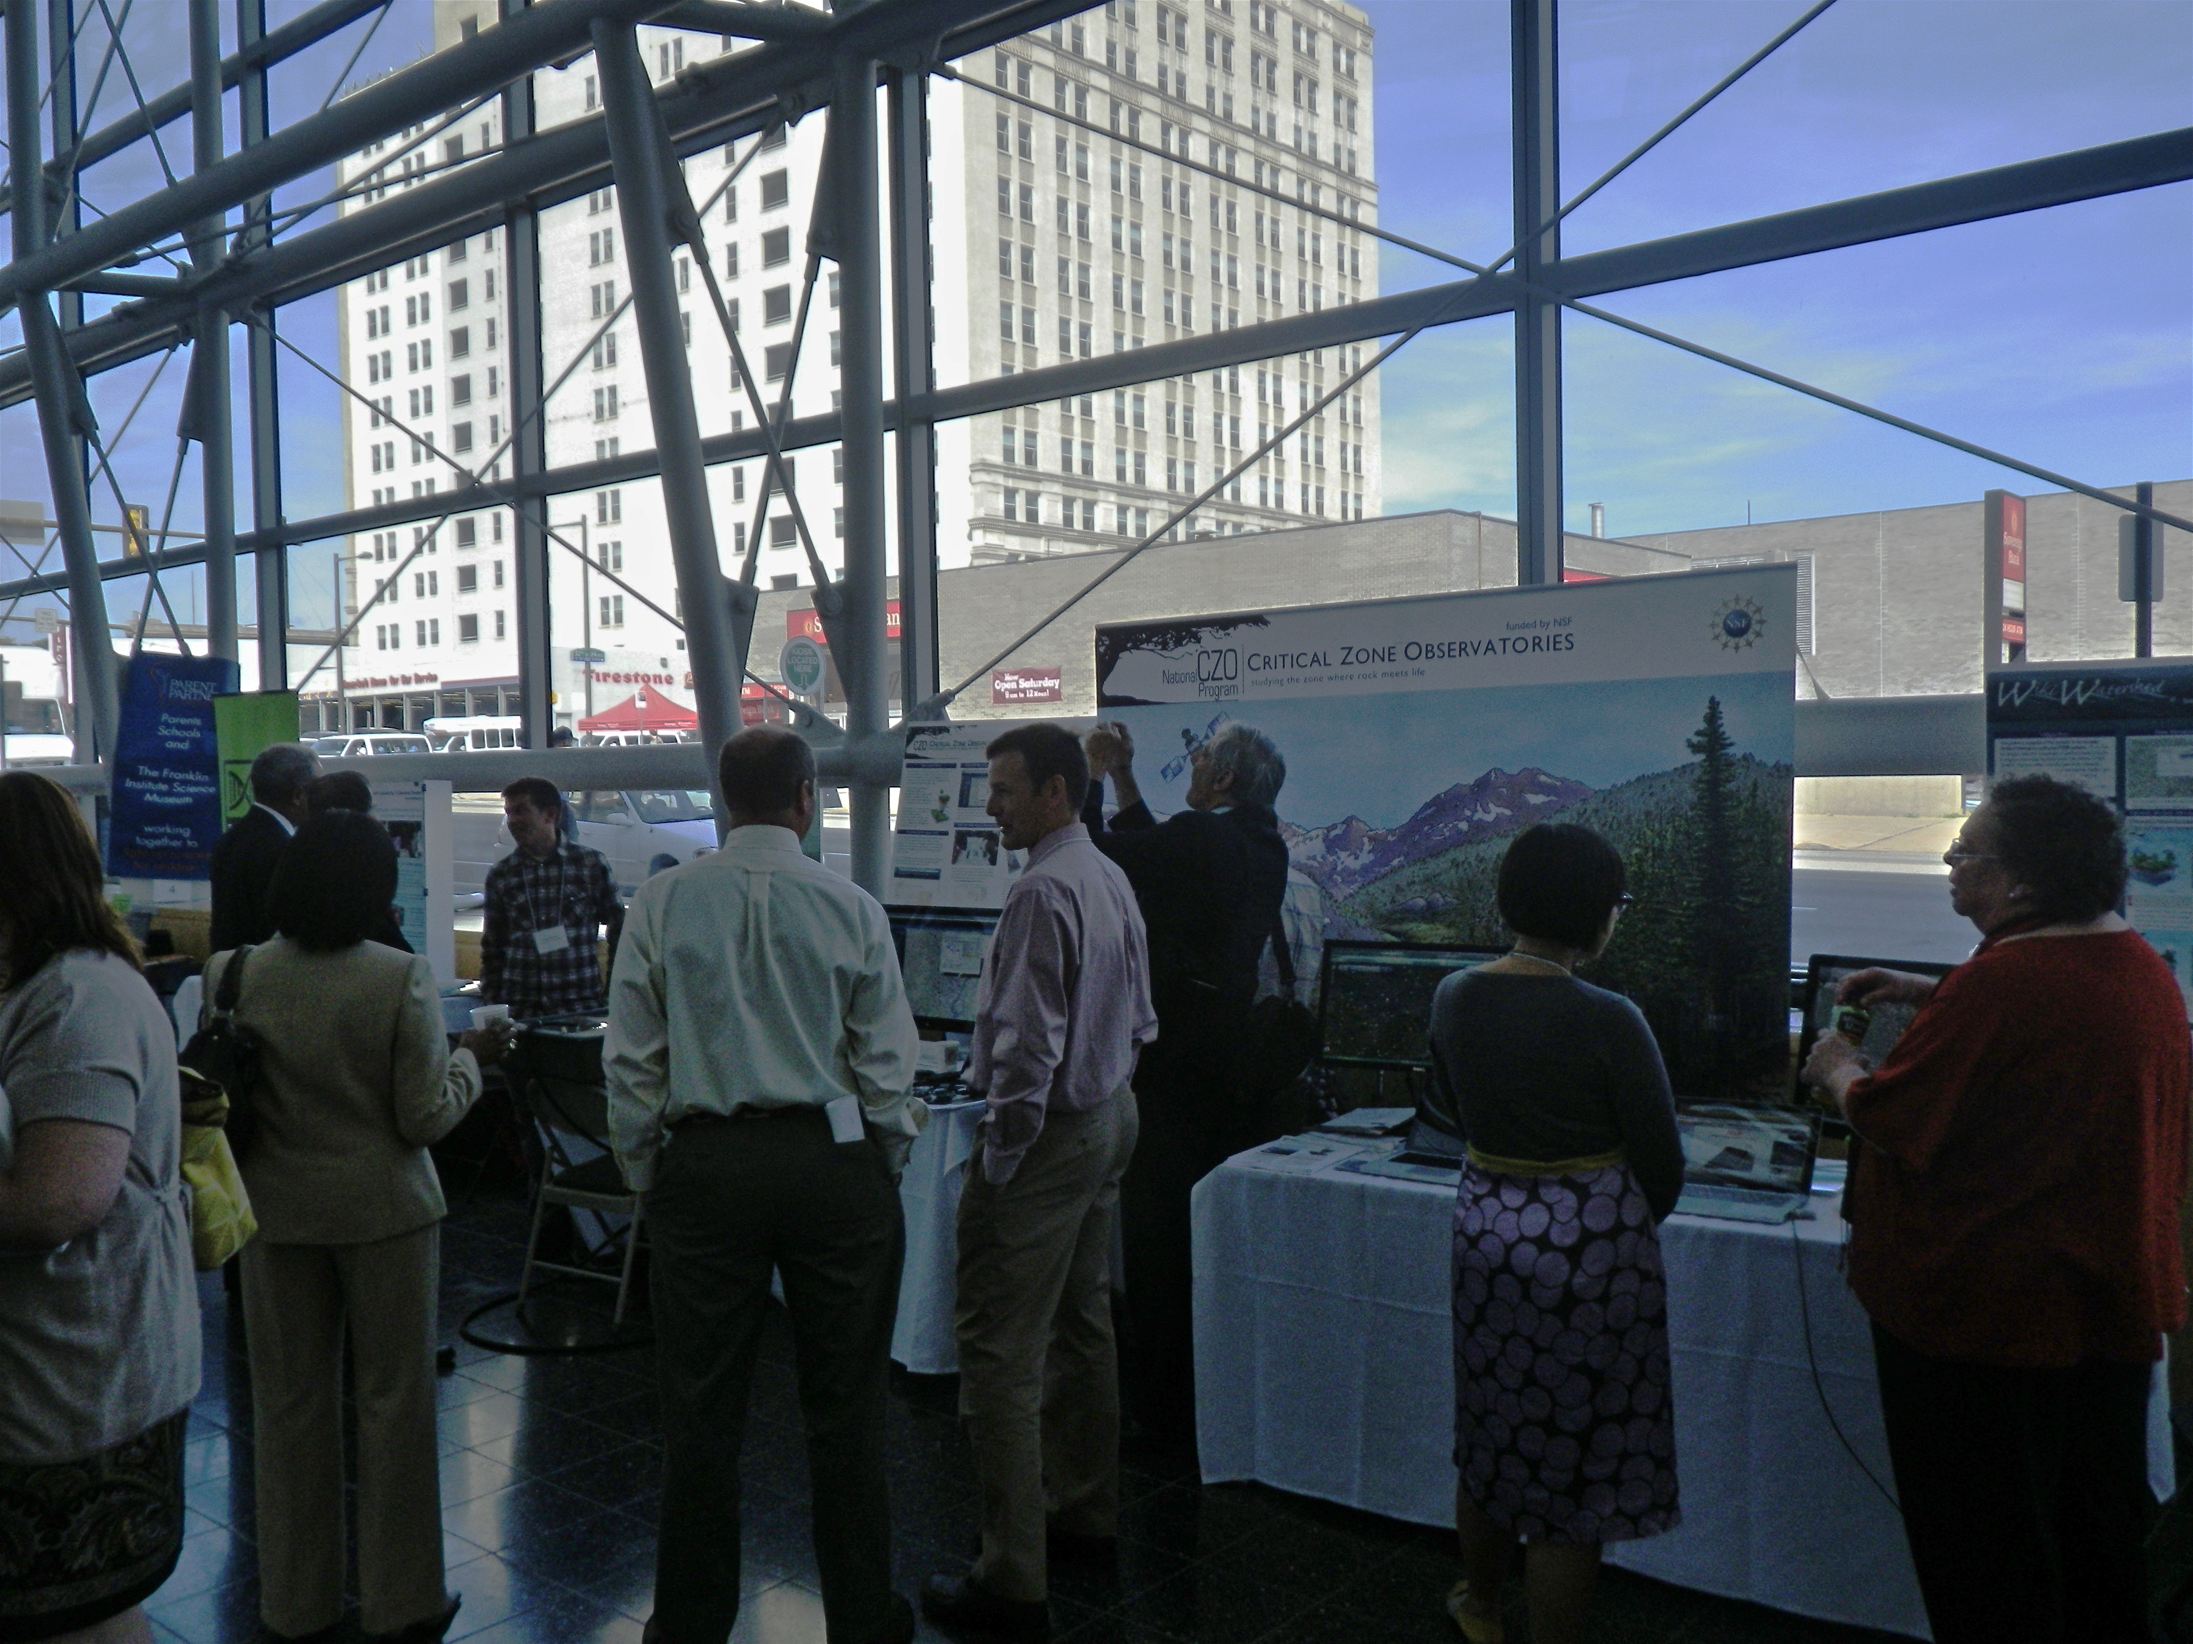
National STEM Best Practices Conference
September 16, 2011
Drexel U., Philadelphia

Slide 24
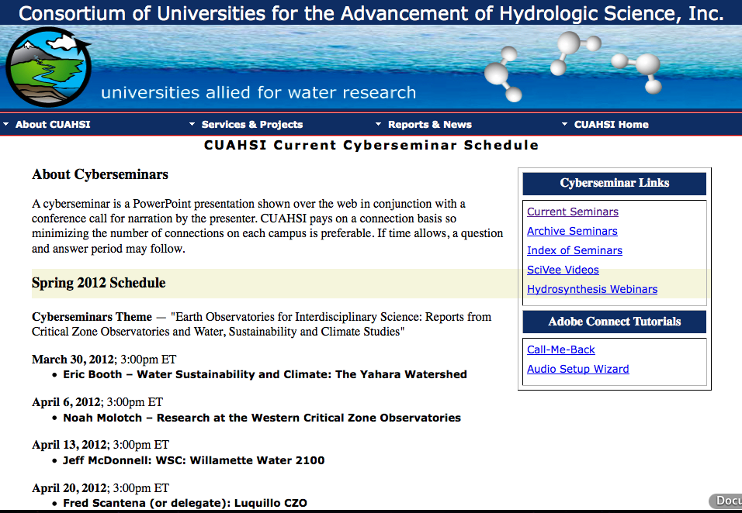
Education/outreach to greater CZ community:

Slide 25
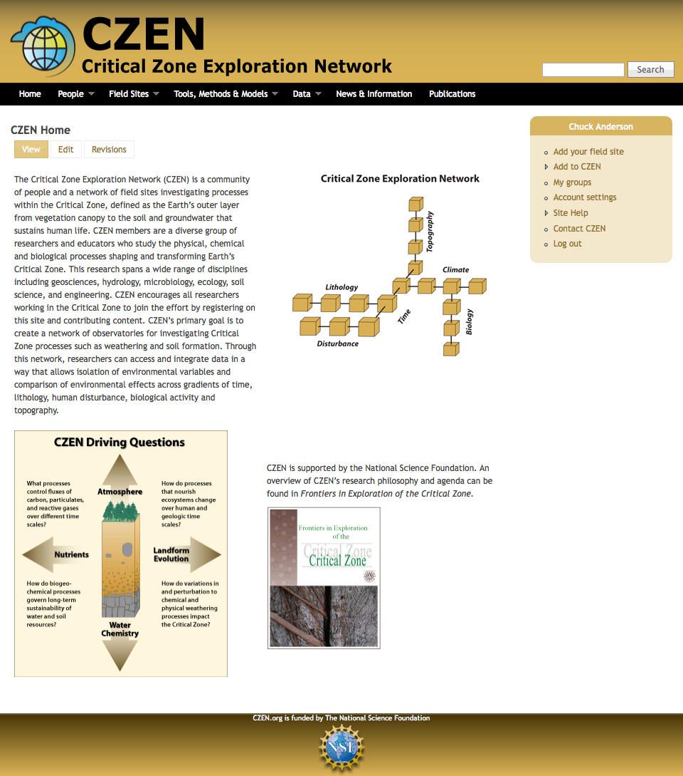
Outreach to greater CZ community:
www.czen.org
C. Anderson
>1000 members
31 working groups
1600 visits in Feb.

Slide 26

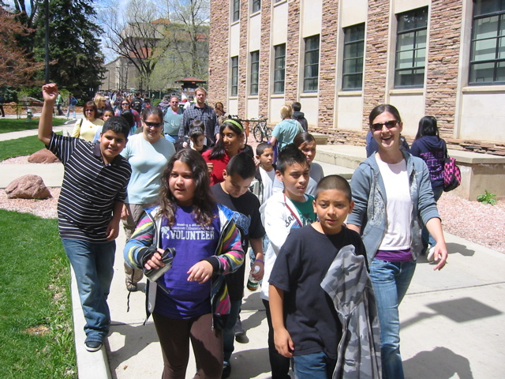
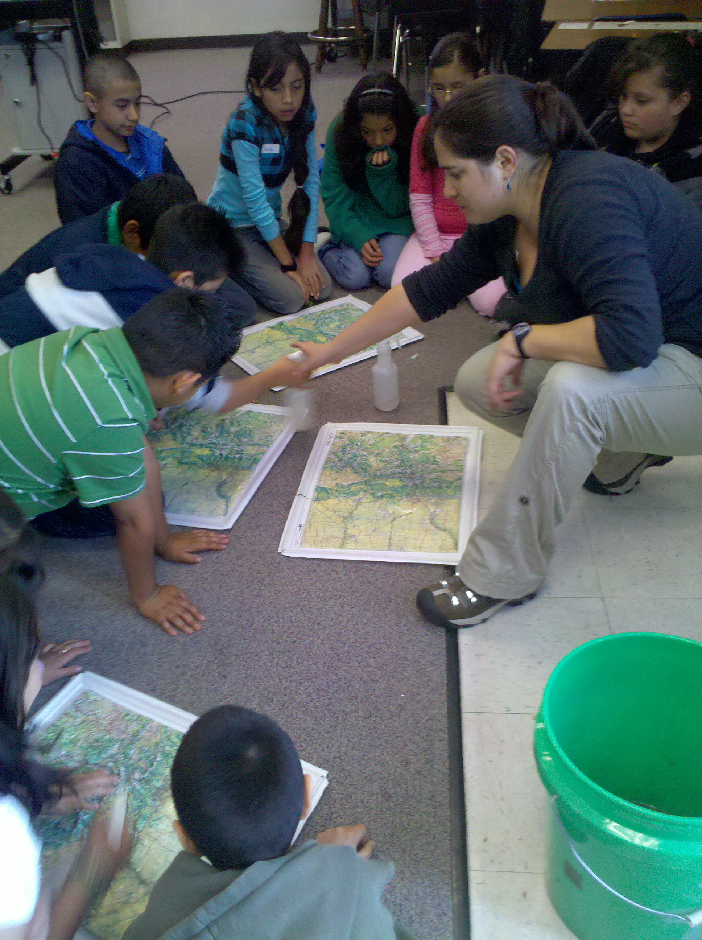
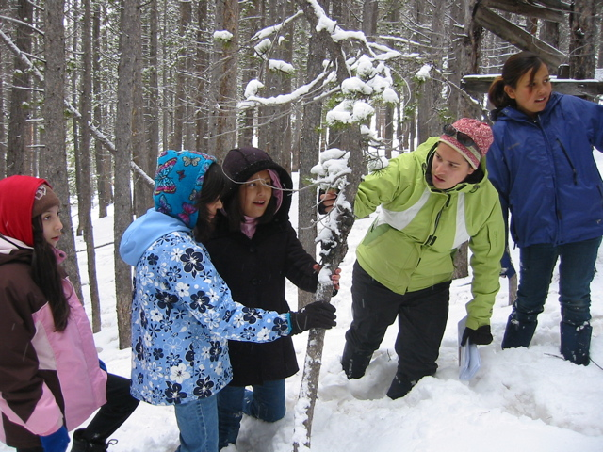
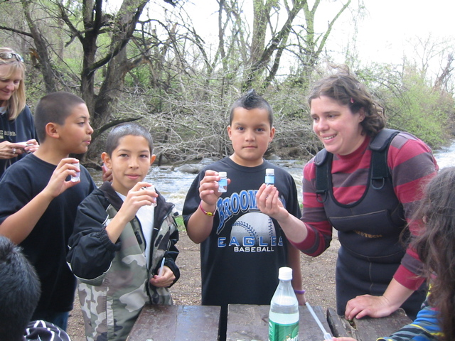
Science Discovery
~ 75 kids per year
Summer camp
5th grade Outdoor Classroom
~36 kids per year
Run by post-doc Eve Hinckley + 17 graduate students
Notes:
Our 2nd year with Science Discovery
Overnight fieldtrip and classroom visits– Outdoor classroom
Week long summer camp-

Slide 27
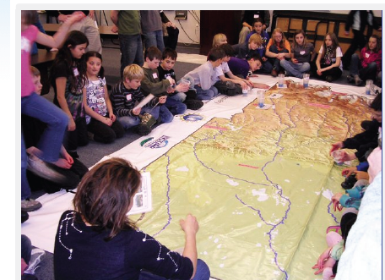


Science Discovery
Middle School
Science Explorers Workshops (2011-12)
Earth System Science: Exploring change in the Critical Zone
~150 teachers and students for full day; 10 workshops planned
Activities on water resources, fire ecology, and landscape evolution
Take-home materials, module instructions, and data
Steamboat Today headline, Jan 21, 2012
Notes:
Our 2nd year with Science Discovery
Overnight fieldtrip and classroom visits– Outdoor classroom
Week long summer camp-

Slide 28
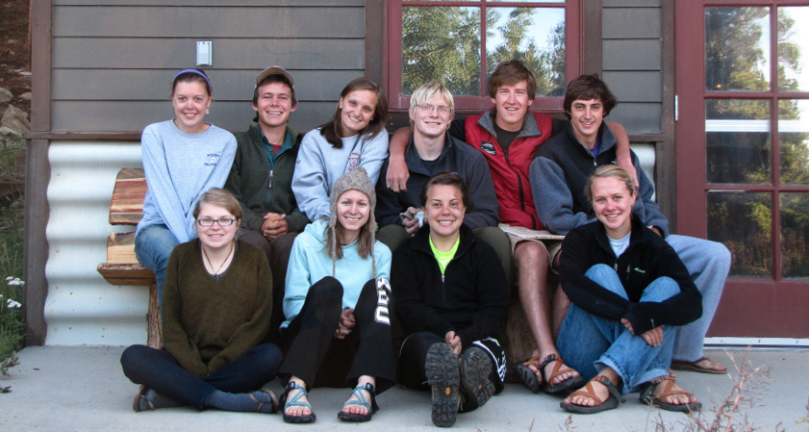
Keck Project-Colorado
Undergraduate field research
23 undergraduates since 2008
-Each completes senior thesis or project
Coordinated by David Dethier, Williams College, and Will Ouimet, Univ. of Connecticutt

Slide 29
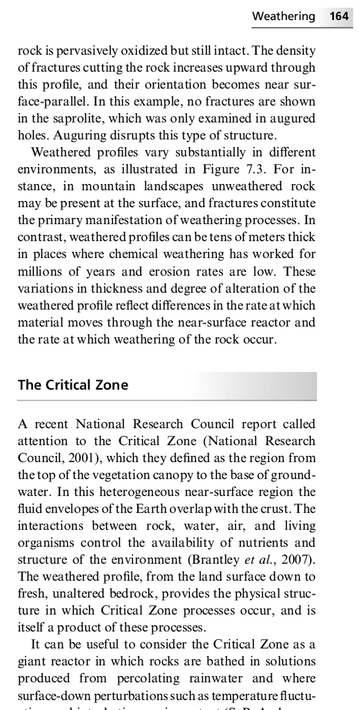
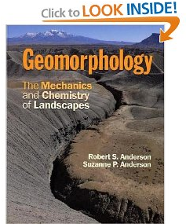
University level classes
Grad: Earth’s Critical Zone
  14 students, 5 departments
Undergrad: Earth’s Critical Zone
  23 students, 3 departments
Geomorphology
  30 students
Landscapes and
  Water
  150 students

Slide 30
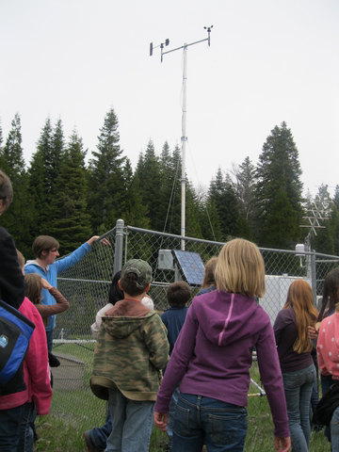
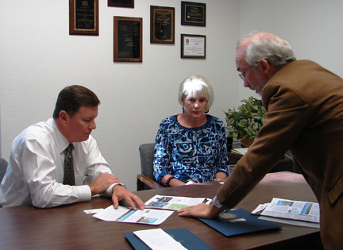
Southern Sierra CZO education & outreach activities
Present seminars and science lessons to school groups and local organizations
Work with media outlets to bring reporters to the CZO
Organize field trips
Presentations at science meetings
Briefings for elected officials, resource managers & business leaders
Use web site to promote our activities

Slide 31
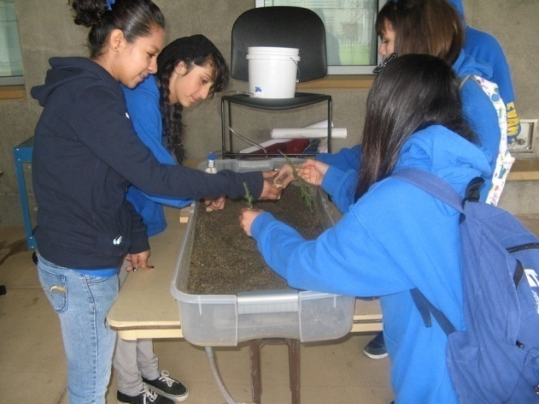
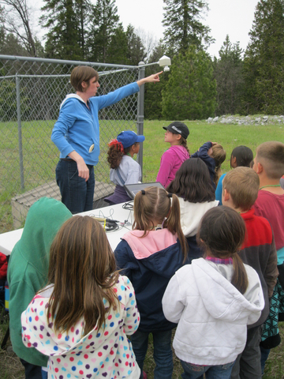
K-12 Events
Teacher trainings:
  Nature Bridge at Yosemite
  2009 AGU GIFT session
Hands-on science
  Southern CA Edison Science Days
  American Association of University Women Girls science camp
  Center for Advanced Research and Technology (CART)
Activity/curriculum development available on web site

Slide 32
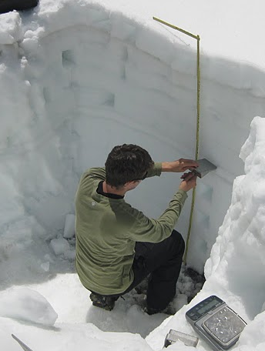
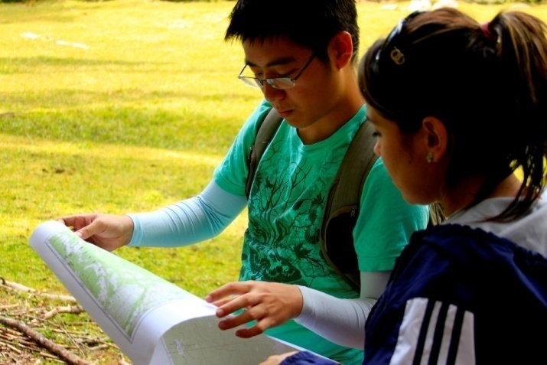
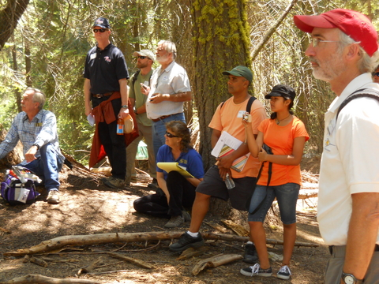
Field Trips and Conferences
UC Davis field methods class
UC Merced surface water hydrology class
Sierra Nevada Adaptive Management Project July 2011 field trip
American Geophysical Union posters and talks

Slide 33
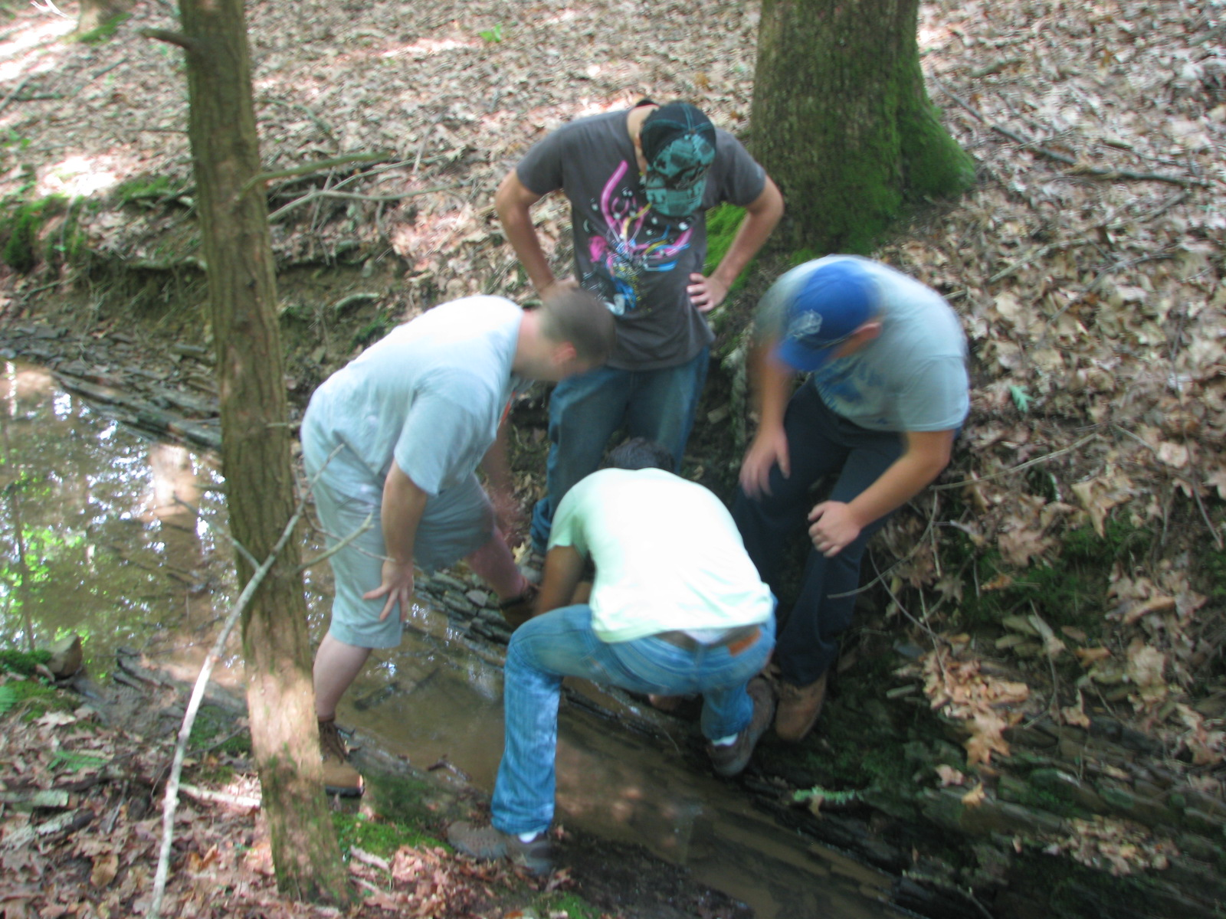
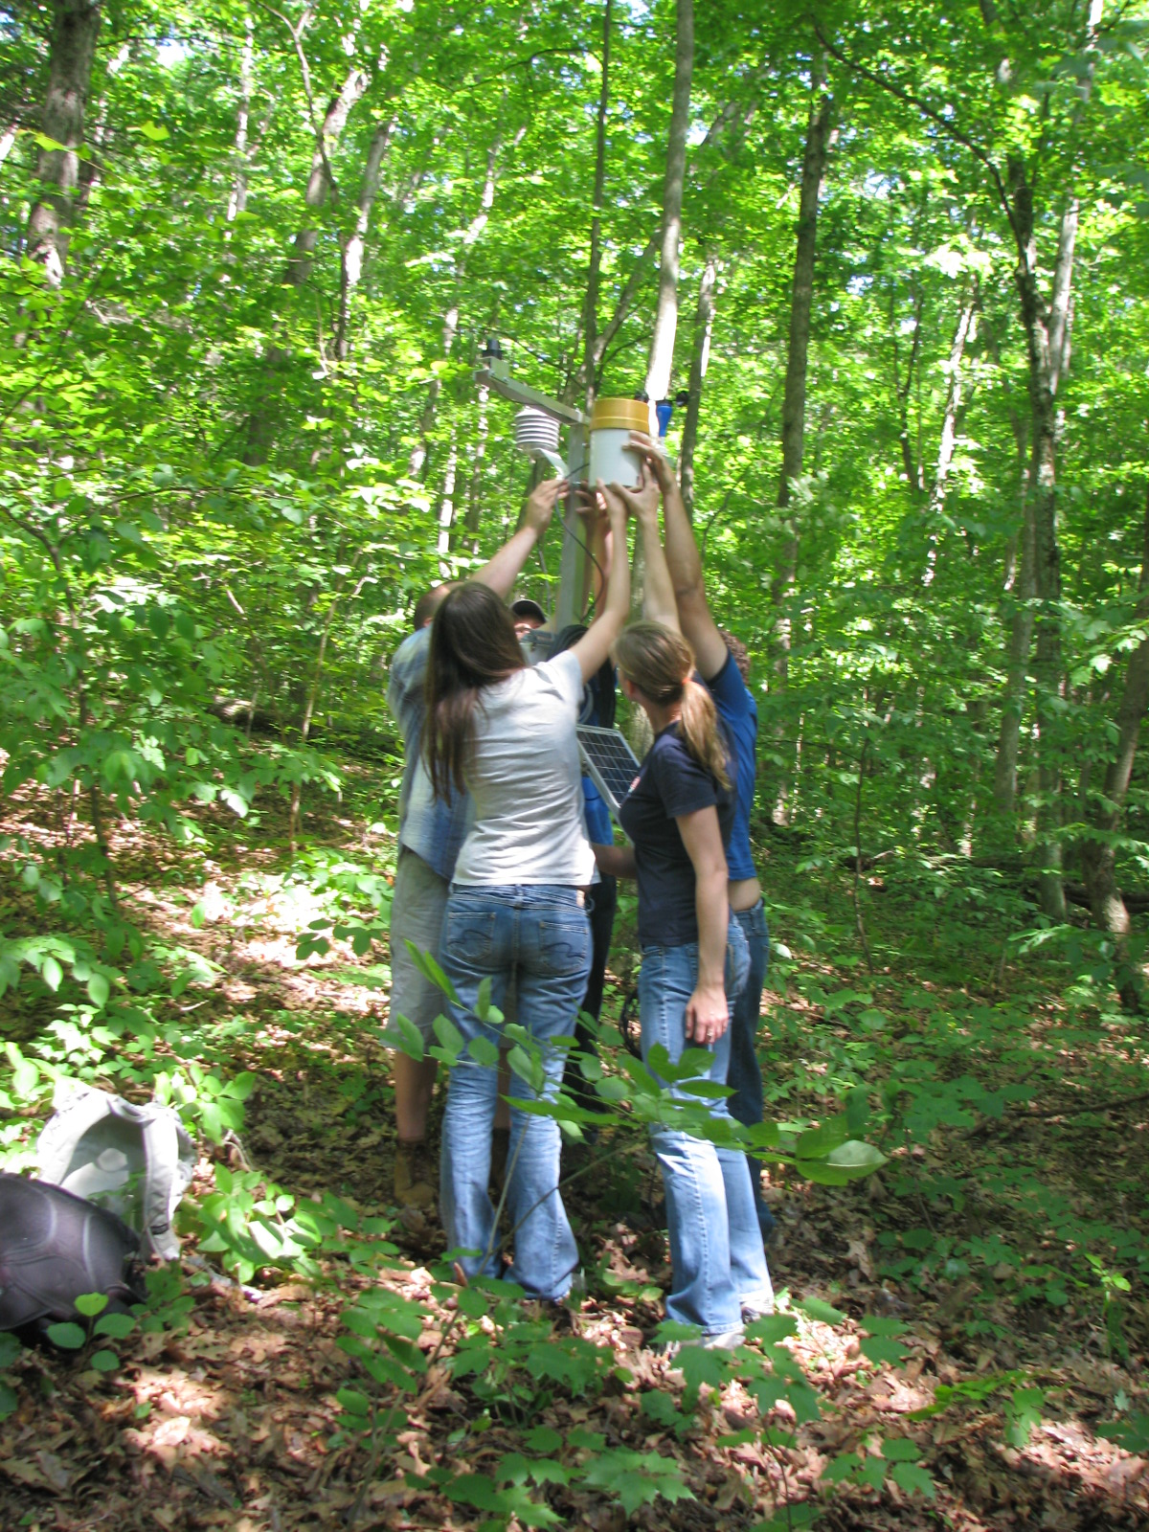
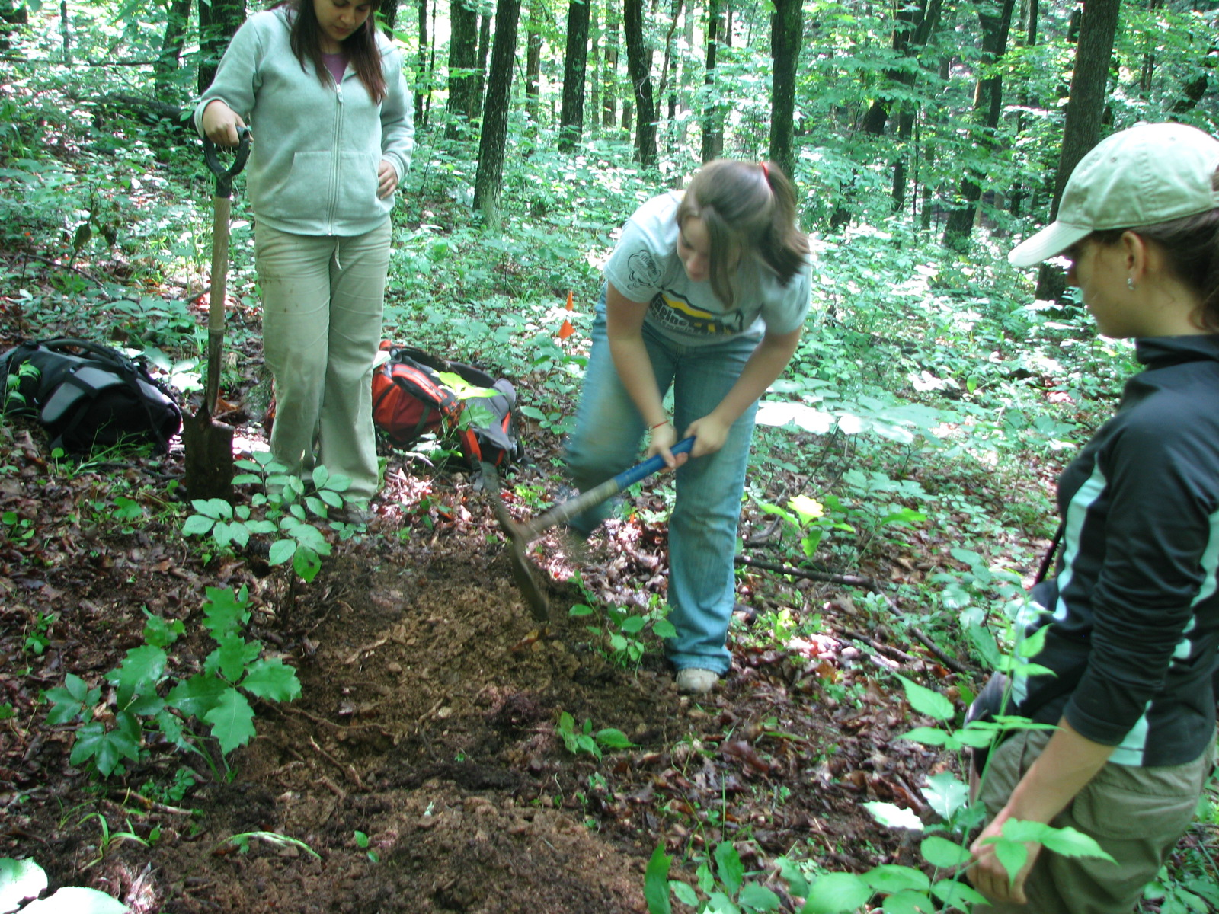
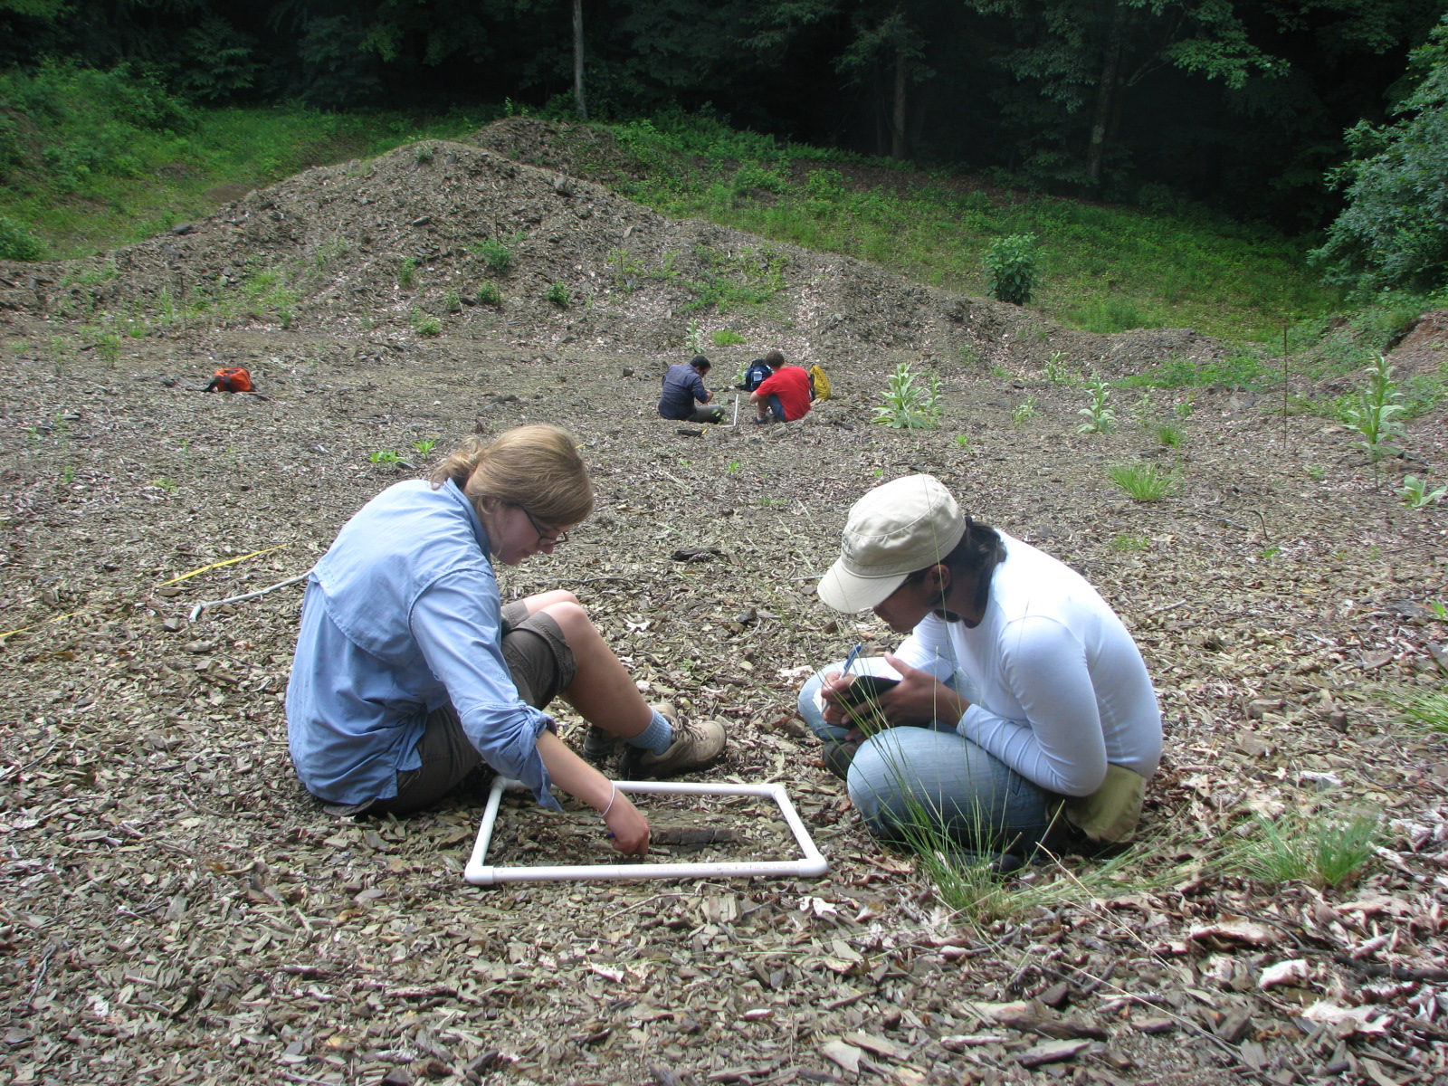
EDUCATION: 2010 SUMMER FIELD SCHOOL
- 2 week intensive; primarily field-based
• 9 U.S. undergraduates – SSHO REU
•10 European grad + postdocs – SoilTrEC
Notes:
Cretan and Bulgarian grad students working with US undergrad,

Slide 34
Critical Zone summer field school, June 1-15, 2010
• Intro and overview of SSHO
• Basic field geologic measurements
• GIS approaches to building environmental gradients
• Monitoring well drilling and construction
• GW level monitoring and sampling
• Field soil description
• Soil augering and sampling
• Lysimeter installation and sampling
• Surface water surveys and sampling
• Vegetation assays
• Study implementation

Slide 35
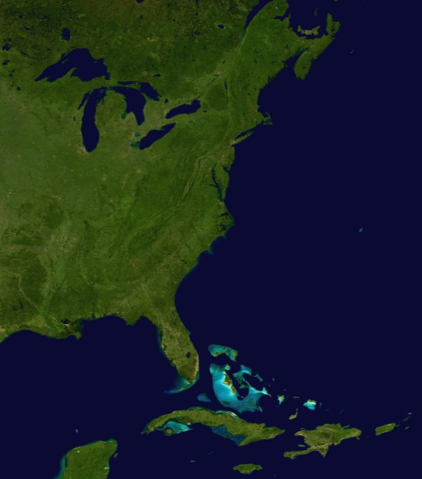
EDUCATION: 2011 SSHO REU
- 8 U.S. undergrads
- 2 week field trip
- 2 week lab
2012 CZ SUMMER FIELD SCHOOL
Rich April
Colgate U.
Chris Duffy
Penn State U.
Elizabeth Knapp
W& L U.
Larry McKay
U. Tennessee
Tom Miller
UPRM
Mezemir Wagaw
Alabama A&M U.
Notes:
Because we don’t have a stream of money from czo program to do this we haven’t been able to benefit everybody

Slide 36
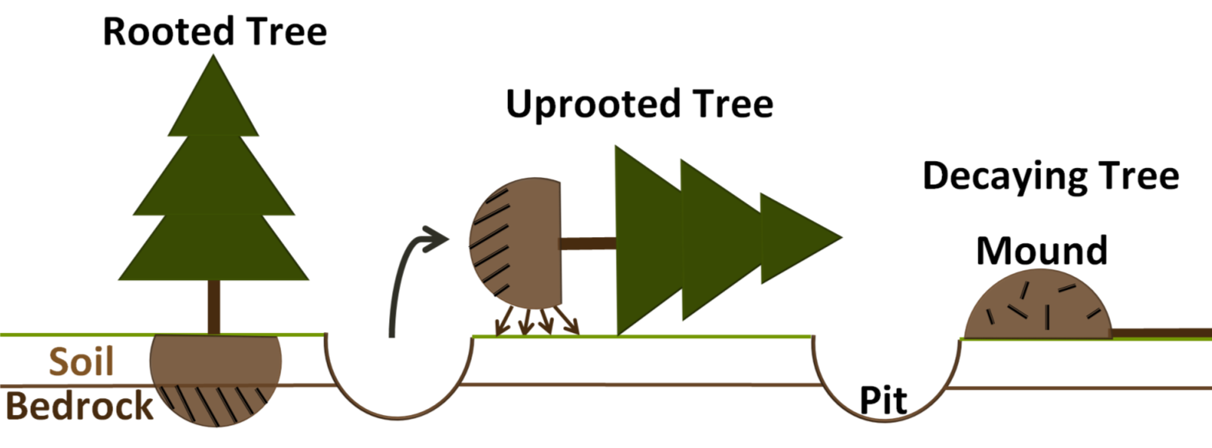
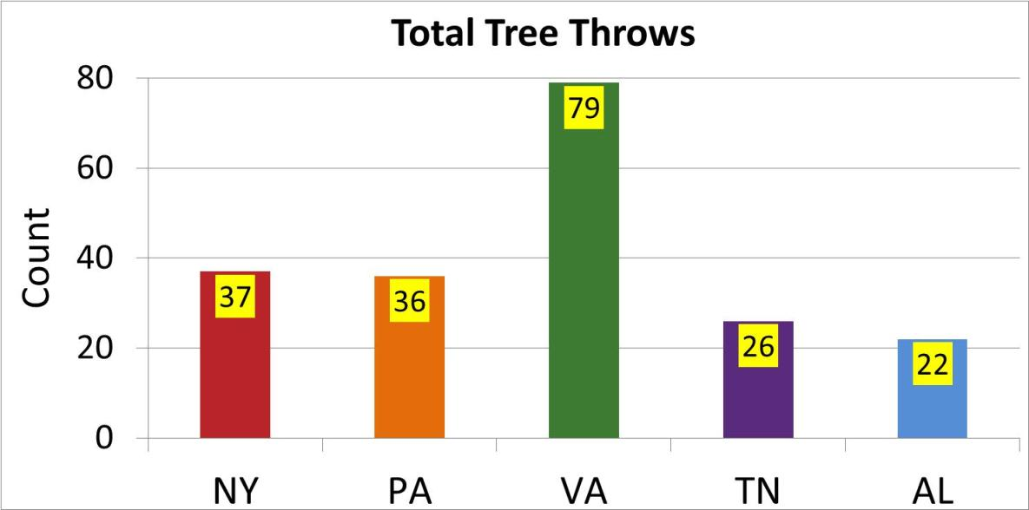
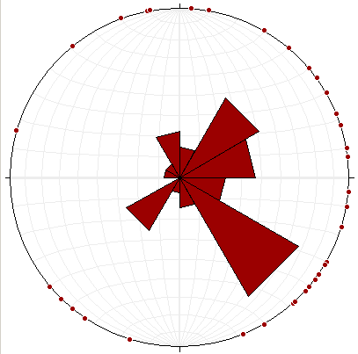
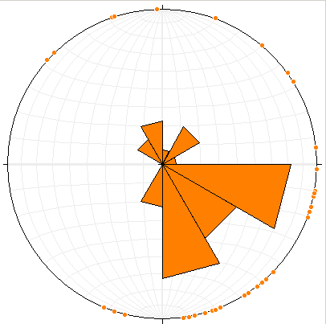
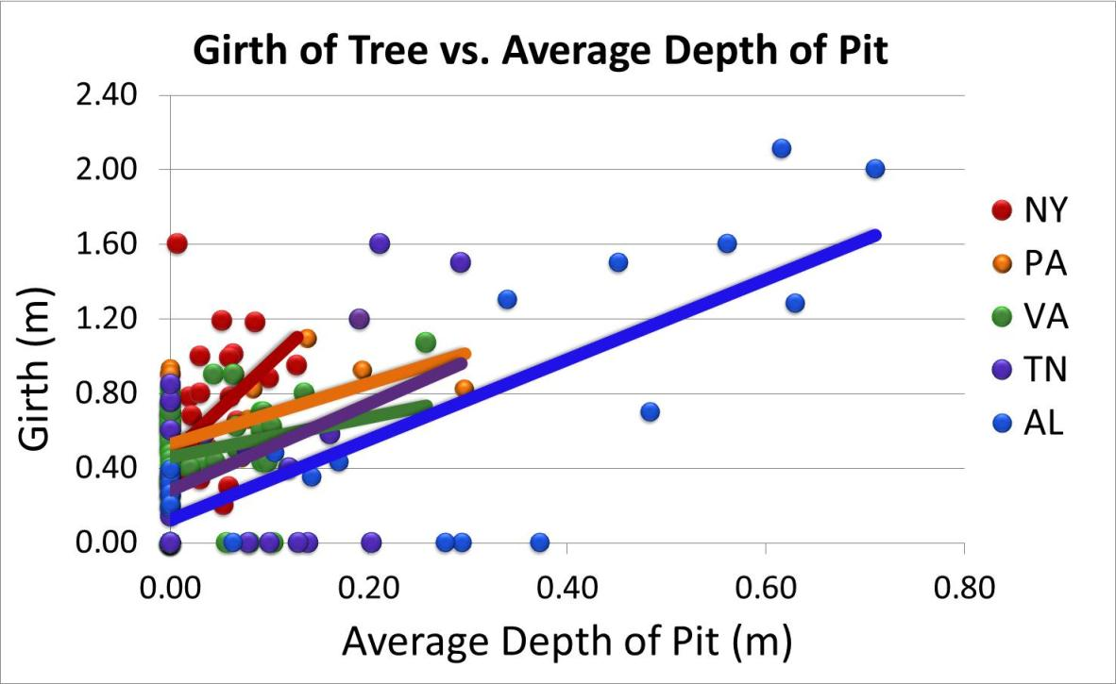
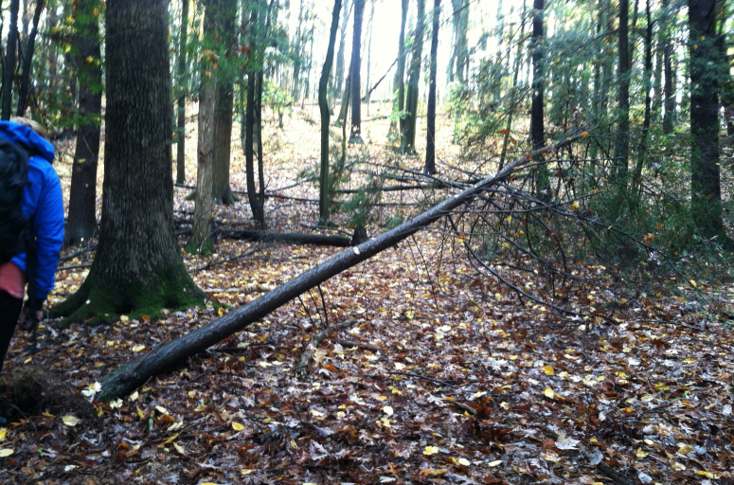
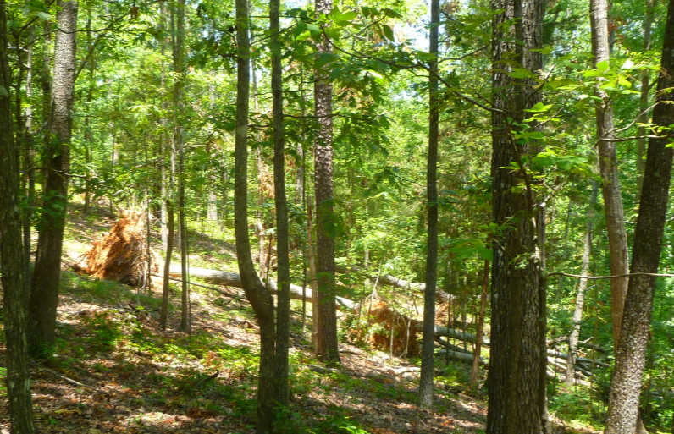
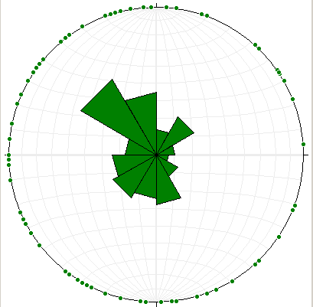










Bioturbation of Forested Shale Soils by Tree Throw in the Appalachian Mountains
Elizabeth Mann¹, Katie Downey², Ashlee Dere³, Timothy White³
¹Washington and Lee University, Lexington, VA, ²Juniata College, Huntingdon, PA. ³Department of Geosciences, Pennsylvania State University, University Park, PA
Tree Throw Processes
Abstract
Results
Figure 1. Pit and Mound Formation
Tree throw, the upheaval of bedrock and soil in the root mass of a fallen tree, has been suggested as a major process in the overturn and downslope transport of soils in mountainous regions. The process typically leads to an excavated pit, often with exposed bedrock, and a large mass of rock and soil in the exposed root mass (Figure 1). Through time, the pit fills and soil and rock from the root mass move down slope as the tree and roots decay.
Reported here is an effort to quantify the effects of tree throw along a climosequence of sites on shale in the Appalachian Mountains associated with the Susquehanna-Shale Hills Critical Zone Observatory (SSHO) (Figure 2). The study includes the following field measurements for tree throws within a 120 meter diameter search area centered on soil pits on ridge tops on the Silurian Clinton Group shale: GPS location, tree girth, tree type, dimensions of pit (Figure 3), relative tree age (Figure 4), azimuth of fall, and slope and azimuth of maximum slope.
Five sites were studied: central New York, central Pennsylvania (SSHO), west central Virginia, eastern Tennessee, and northern Alabama. A general north-to-south decreasing trend in total number of tree throws was observed excluding the Virginia site (Figure 5). In Virginia, the total number of tree throws was twice the number observed in New York, which we attribute to the higher elevation setting subjected to the steadiest winds as well as the shallowest soils. The relatively high number of throws in New York is likely tied to glacial till at the site – rooting depth appears to be limited by rock fragments, abundant clay and periodic soil saturation. Trees with the largest girths tend to excavate the largest tree throw pits, a relationship best defined in Alabama where the deepest pits were excavated by large trees that had fallen most recently (Figure 6).
Most of the observed tree throws occurred on slopes ranging from 15-31 degrees except in Alabama where tree throws fall on a range of slopes with the highest number at 45 degrees (Figure 7). No strong relationship was observed between the azimuth of fallen trees and the azimuth of maximum slopes. At the New York site, all of the tree throws fell toward the east, suggestive of control by prevailing wind direction on the direction of fall. In Virginia, most of the trees fell to the west, the prevailing slope direction of the study site, though a significant number fell to the northeast, again suggestive of influence by prevailing wind direction. In Tennessee most of the trees fell to the south-southeast, the prevailing slope direction, while in Alabama most of the trees fell to the northwest, compatible with prevailing wind directions; the broader range of azimuth of falls in Alabama is most likely due to the effect of chaotic falls associated with recent tornadoes (Figure 8).
These observations of tree throw have been made as part of a broader effort to characterize rates of erosion on shale hill slopes, information that is applicable to understanding the evolution of topography and regolith thickness on shale landscapes. Specifically, our observations are used to verify formulations of volumetric regolith flux due to tree throw.
Figure 5. North to South Decreasing Trend
Figure 8. Rose Diagrams
of Azimuth of Fallen Trees
NY
Figure 6. North to South Linear Relationship
PA
Newly Uprooted Tree (PA)
Multiple Tree Throws (AL)
VA
Exposed Root Mass (TN)
Soil and Bedrock Migration (TN)
Figure 7. Tree Throws Decrease with Increasing Inclination
TN
Methods
Figure 2. Observed Shale Sites
Figure 3. Dimensions of Pit (AL)
Pit Measurements (PA)
Figure 4. Classification for Decaying Trees
Conclusions
We consider the greater number of tree throws in the northern sites to be a function of thinner soils. Thicker soil results in less tree throw. Moving from the north to south, we see an increase in pit size relative to girth size. We attribute this relationship to be associated with soil depth as well. The thinner soils in the northern sites are not holding tree up as well as the thicker soils in the southern sites. We see this as prevailing winds more readily knock over trees in the northern sites. The dominant range of inclinations do not show a trend from north to south.
AL
Class | Definition
1 | Wood hard; all bark remaining.
2 | Wood hard; >50% of bark remaining.
3 | Wood hard; <50% of bark remaining.
4 | Wood starts to soften, texture smooth.
5 | Wood soft; small crevices and pieces lost.
6 | Wood fragments lost, so the outline of the trunk is deformed.
7 | The outer surface of the log is hard to define, possibly with a core of harder wood.
8 | Completely soft without evidence of hard wood, outline indeterminable.
Acknowledgments
Elizabeth Knapp, Washington & Lee University; Lauren Leidel, Pennsylvania State University; Erik Heider, University of Tennessee; Feron Washington, Alabama A&M University; Deborah Vazquez-Ortiz and Ricardo Ruiz, University of Puerto Rico Mayaguez
Five depth measurements along the long axis and three depth measurements along the short axis were recorded.
Each tree throw’s relative age was determined based on decay classification for the Norway spruce.

Slide 37


Slide 38


Slide 39


Critical Zone Principles and Processes go to School
4th and 5th grade students at Greenwood Elementary in Kennett Square, PA examine sediments and soil samples to understand their properties and fill out data sheets on their field observations. They also record soil profiles found in the school yard.
Funded by NSF-OCE #1034961

Slide 40

Sensors, Data and GIS in the Classroom
Middle-school students in Chester County Pennsylvania after-school programs built sensors, collected data and learned how to use GPS to locate the exact position of the the information that they collected.
Funded by NSF-OCE #1034961

Slide 41


Slide 42

Demonstrates connections between rainfall, land use and soil texture

Slide 43


Show My Watershed
Photo: Marissa Morton
Allows students to find watershed or other area and calculate the land
cover, soil and water budget for existing conditions
Notes:
43

Slide 44

Modify My Watershed
Enables students to make changes to the underlying environmental
conditions and model parameters, implement best management practices
and calculate the impact of the changes from an economic, social,
ecosystem and water quality perspective.

Slide 45



Jemez - Catalina CZO education and outreach activities
● Undergraduate, Graduate and Postdoctoral student training
● High school student participation in field campaigns for
- Snow Surveys
- LiDAR ground truthing
● Partnering with Biosphere 2 (B2):
- B2 REU in Environmental and Earth System Science
- First CZO All Hands Meeting May 2011
- Educational Displays on National CZO Program
- B2 Landscape Evolution Observatory (LEO) (focusing on coupled hydro-bio-geo processes in the CZ
-

Slide 46
By 2013:
CZO Network Coordination Office to include:
Full-time Education and Outreach staff person

Slide 47

Arizona Daily Star, November 14, 2010

Slide 48

• Graduate and undergraduate field studies
• Presentations to the NSF-REU program at El Verde Field station
in the Luquillo Mountains
• U. Penn undergraduate student "problem sets" that use LCZO data

Slide 49

Summer 2012 workshop with Puerto Rican well drillers
Joint CZO-LTER field training course the first week of every summer

Slide 50


Slide 51

Videos and Radio
Video:
UC Merced Office of Communications - Barbara Boxer visit
University of California Research Video
UC Berkeley Graduate School of Journalism CNS News - Around California
Radio:
KQED California report: Snow
Surveys of the Future
KVPR Quality of Life: End of CA
Drought

Slide 52




Other Media
Central and northern CA newspapers
On-line news outlets
Magazine articles
Portuguese Film Project on climate change in the US

