Slide 1

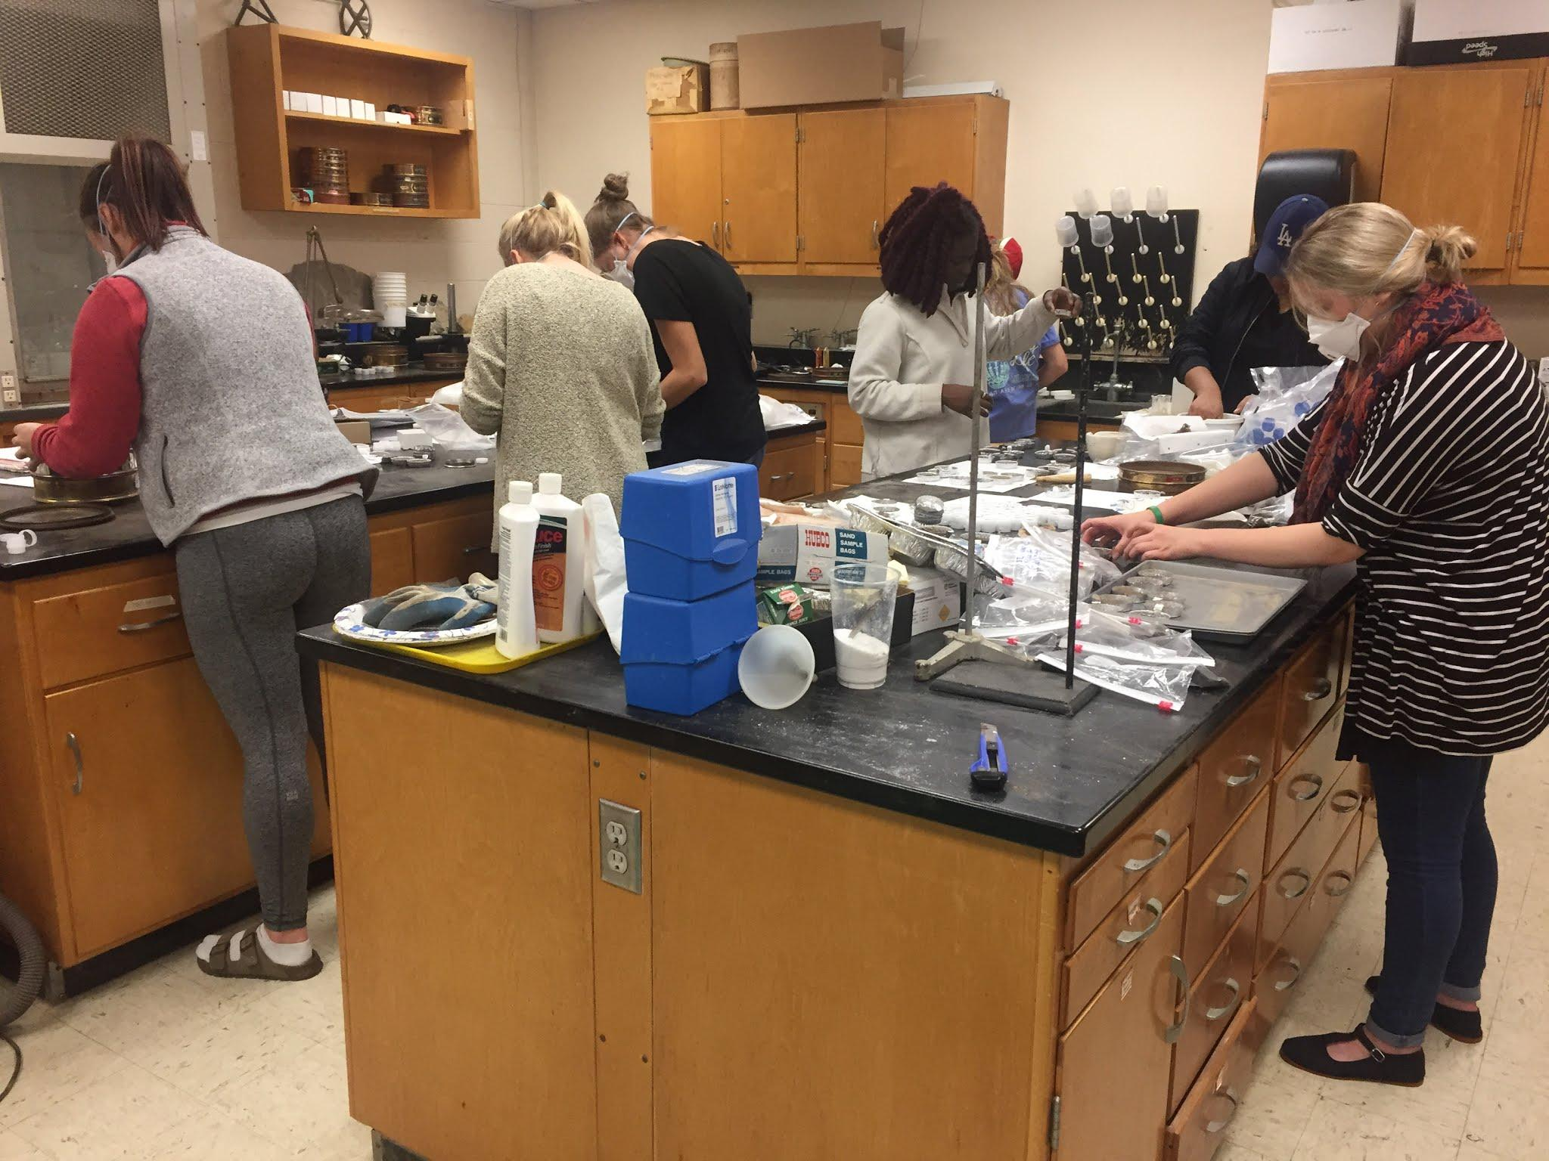
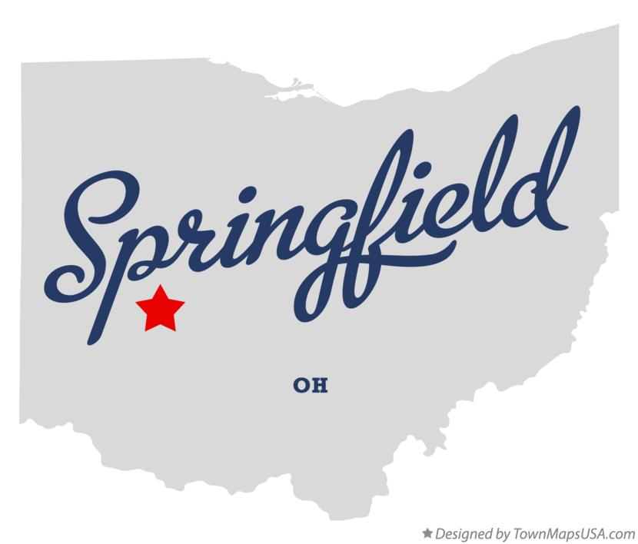


Cultivating Change Agency
through Science Curriculum
Sarah K. Fortner, Wittenberg University
NSF DUE - 1125331
Notes:
Springfield, Ohio Locator Map, designed by TownMapsUSA.com (CC 3.0)
http://townmapsusa.com/d/map-of-springfield-ohio-oh/springfield_oh

Slide 2
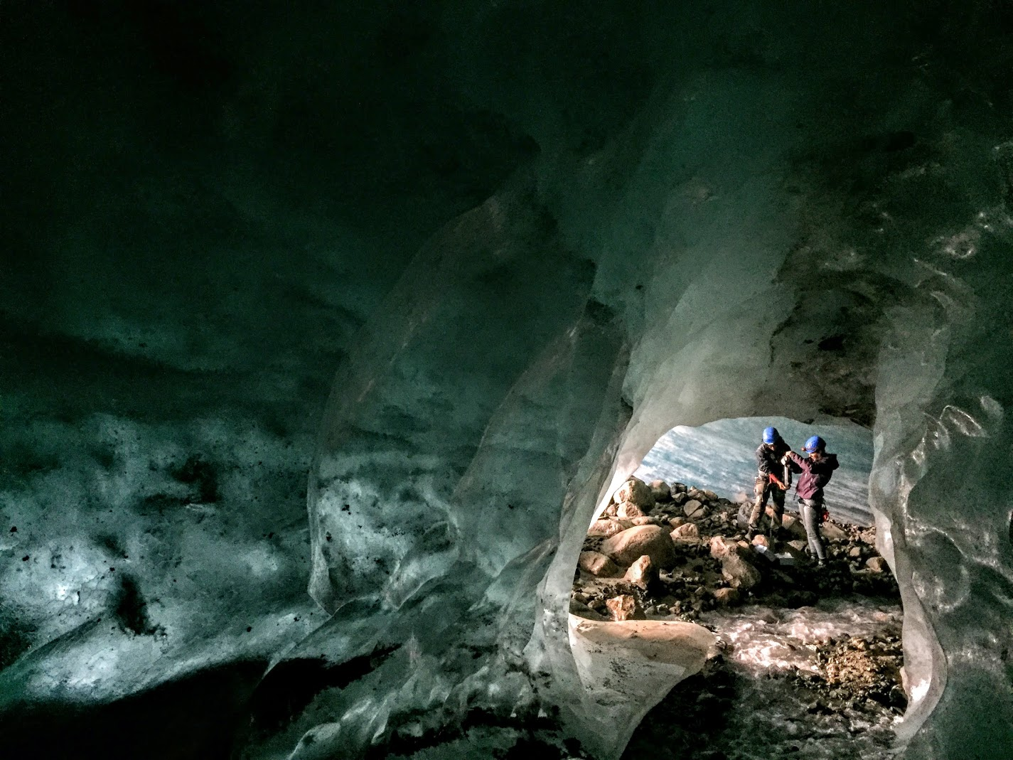
Notes:
Discovery

Slide 3
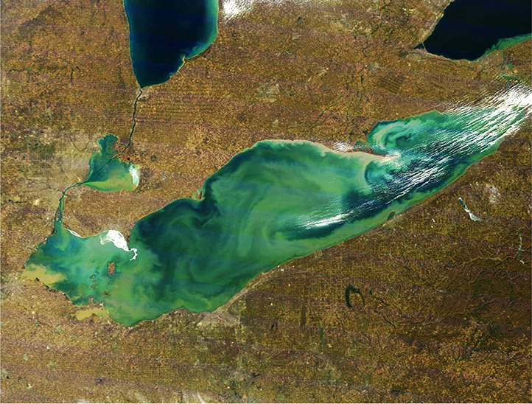
Notes:
Image: Earth Observatory
Problem solving, not always in context, simply analyzing mechanisms

Slide 4
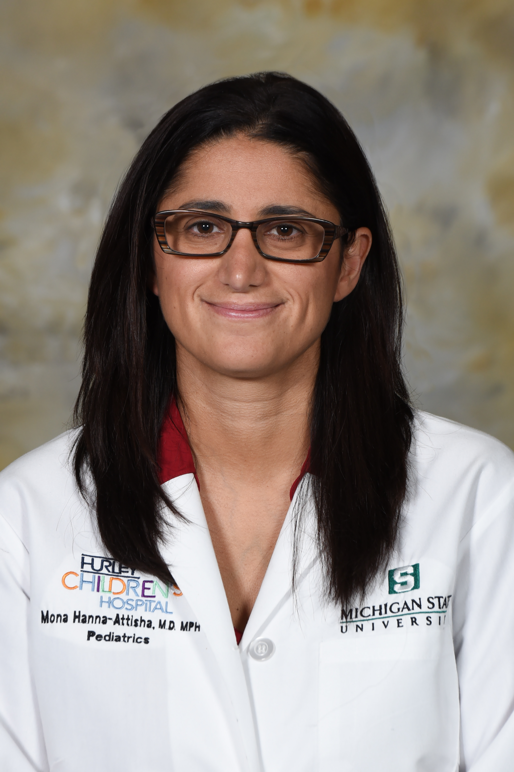
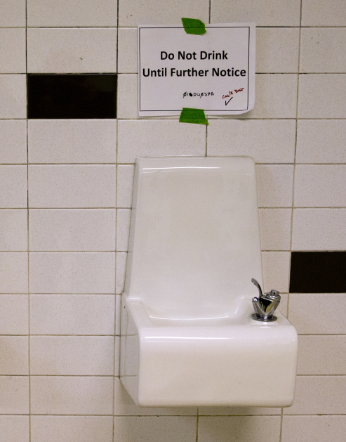
Notes:
Advocacy is another role for scientists and the community. During the Flint crisis multiple citizens, scientists, & journalists bypassed the standard process for sharing scientific information & went directly to the public. One of these heroes is Mona Hanna-Attisha who studied & shared public health issues associated with the lead in Flint’s water supply.
Mona Hanna-Attisha, https://upload.wikimedia.org/wikipedia/commons/e/ea/Dr._Mona_Hanna-Attisha_.jpg
Dr. turned advocate during the Flint crisis. She recognized the water contamination issues
Carolyn Kaster, AP Press, Drinking Fountain

Slide 5
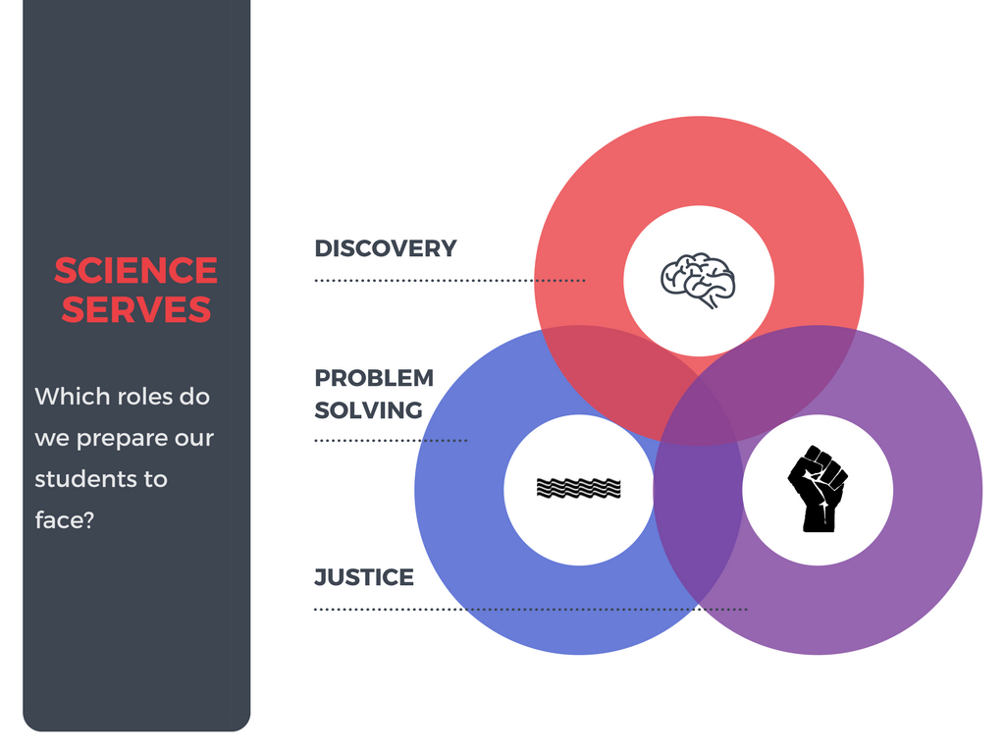

Slide 6
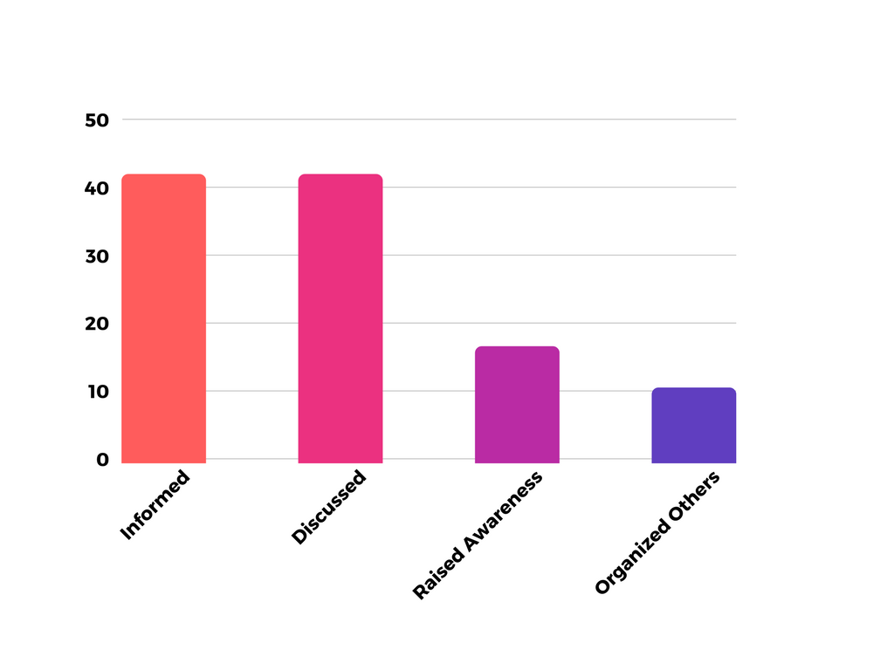
Graduating College Seniors & Local Issues
%
College Seniors responding that they often or very often are informed, have discussed, have raised awareness or have organized others around local issues (NSSE, 2016)
Notes:
Most students leave college with a larger understanding of global issues than the issues in their community. In fact, less than 45% of all students are informed or have discussed campus or community issues by the time they graduate. Even fewer take interest in engaging their peers or other community members in activities that raise issue awareness or take action through organization of events or advocacy.

Slide 7

Curriculum Design Questions
Which issues are important?
Notes:
Given the three roles of scientists, how might we design our curriculum.

Slide 8


Wicked Problems
Critical Needs:
Water
Energy
Natural Hazards
Soils
Mineral Resources
Oceans and Coasts
Climate Change
Waste Disposal
Workforce
Notes:
Guiding documents & approaches

Slide 9
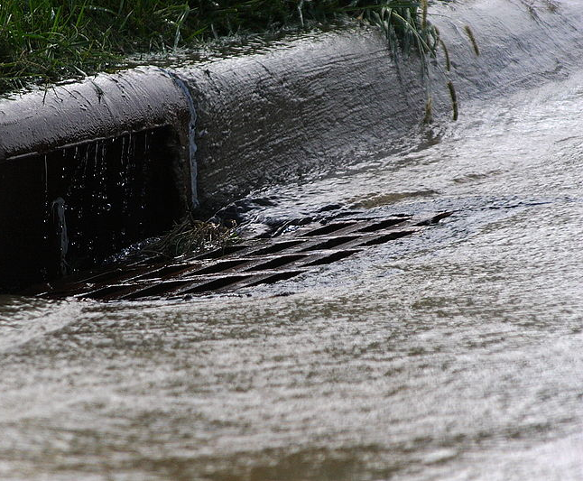
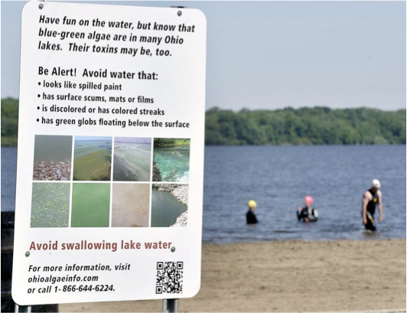
Dayton Daily News Headlines
Communities to spend $520 Million to stop sewer overflows
Lakes key to safety, economy
Algae affects home values, report says
Taxpayer- funded farm program no match for algae plague
Wetland treatment at Grand Lake Saint Marys working
Minority of farmers join anti-runoff effort as algae worsens
Notes:
Exploring issues in a local context.
Storm drain, Robert Lawton, CC 2.5:
https://commons.wikimedia.org/wiki/File:Storm_Drain.JPG
Toxic Algae, Photo Credit, Bill Lackey

Slide 10
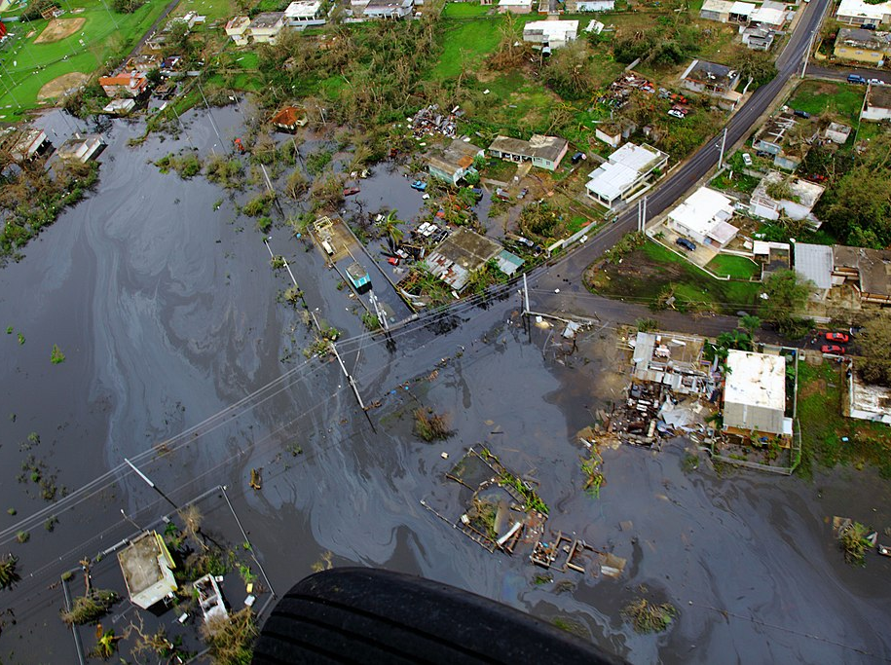
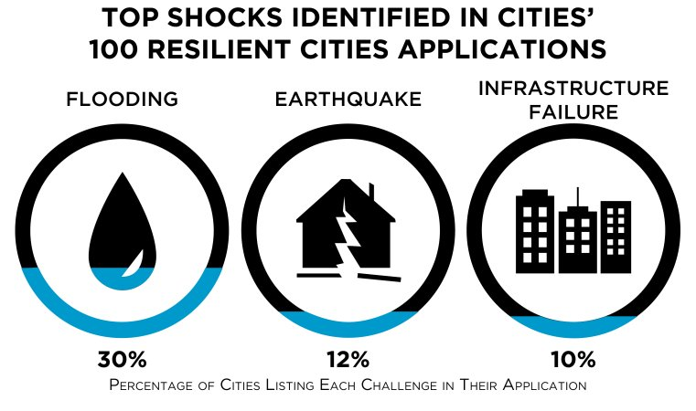
Notes:
Most of the issues our small town faces fit within the priority areas identified by ~700 city planners globally
Photo: Hurricane Maria aftermath, public domain
Rockefeller Foundation, 100 Resilient Cities

Slide 11
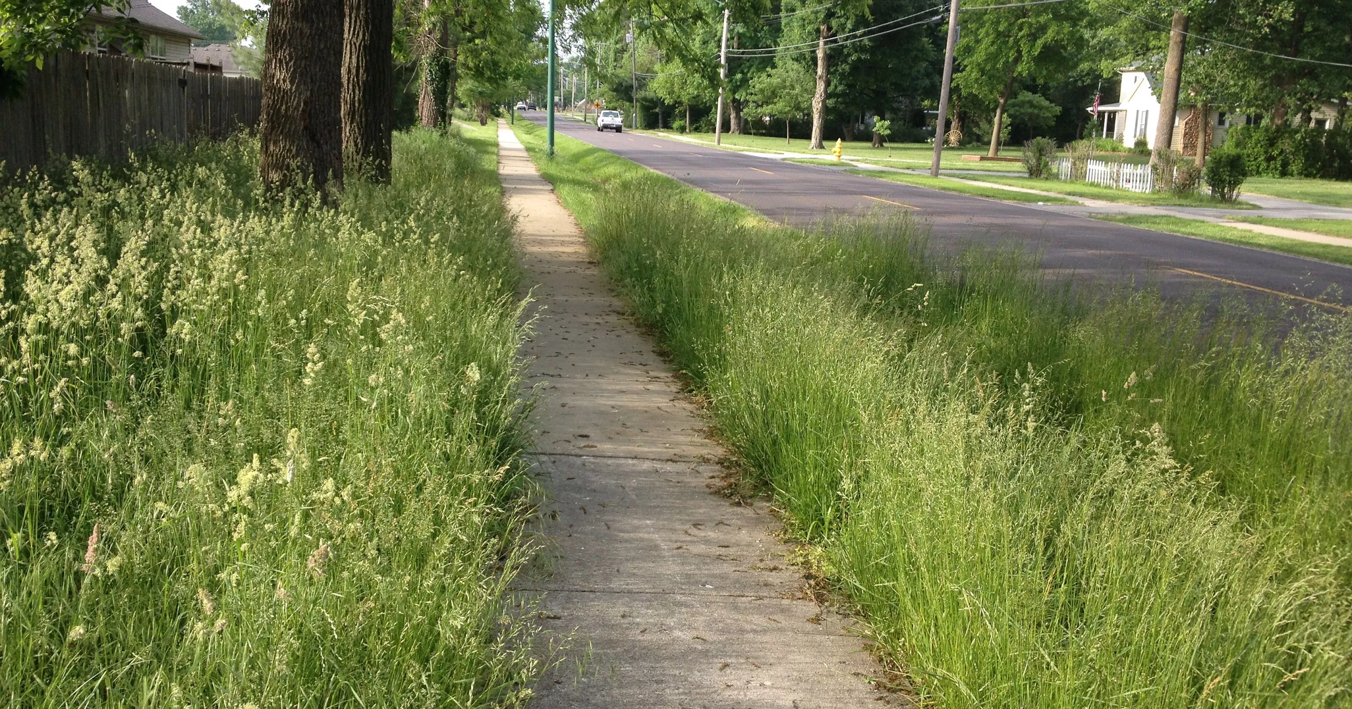
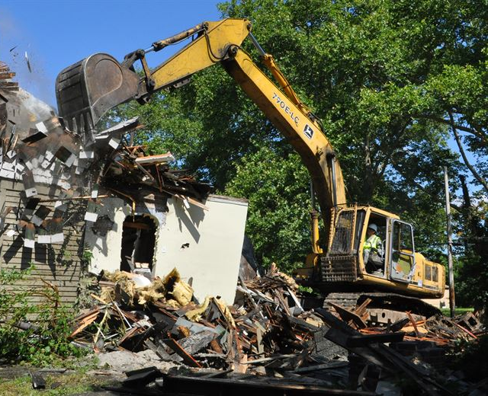
Dayton Daily News Headlines
Kids in high risk areas not being tested for lead poisoning
Lead hazards in home harm local children
Springfield could supply water to Yellow Springs
Clark county waste dump won’t likely get superfund status
2.4 M lead paint program may be revised
As homes stay vacant Dayton takes heat over housing program
Notes:
Chronic issues impact those with the least resources & disproportionately impact underrepresented groups.
No mow, David Iseman, http://www.news-leader.com/story/news/local/ozarks/2014/05/24/overgrown-weeds-grass-can-stir-city-action/9546993/
Blighted home, Youngstown CC 3.0 free for use without attribution

Slide 12
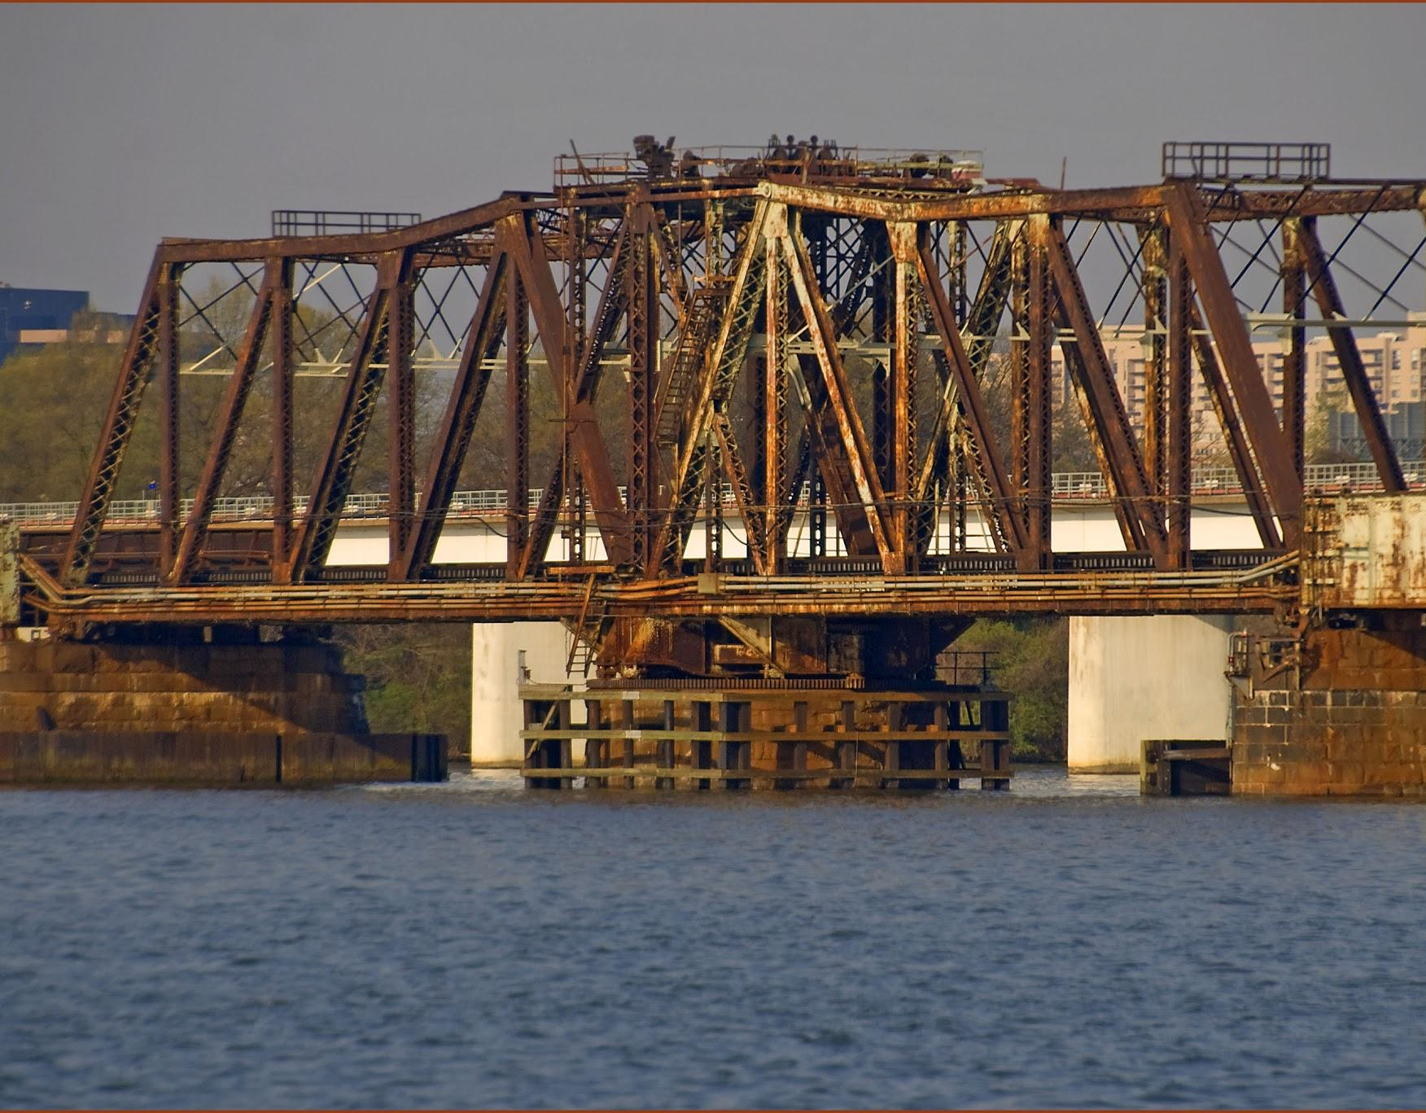
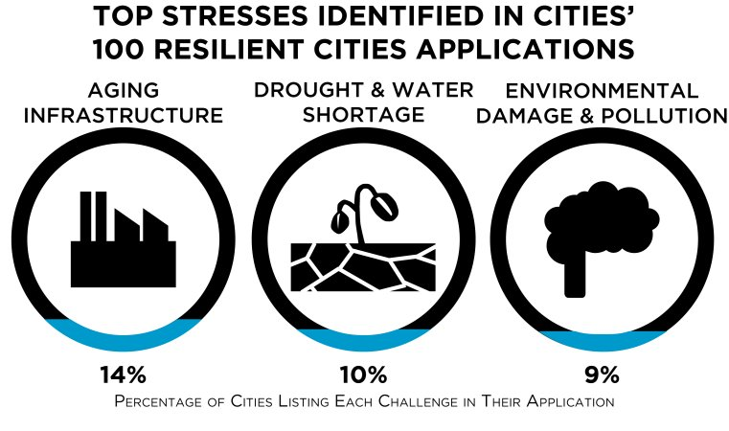
Notes:
Aging Infrastructure, Bridge over the Potomac, Ron Cogswell https://www.flickr.com/photos/22711505@N05/13940212465
100 Resilient Cities, Rockefeller Foundation

Slide 13
Central Design Questions
Which issues are important?
Are there experts, organizations, or cultural leaders that share your goals?

Slide 14
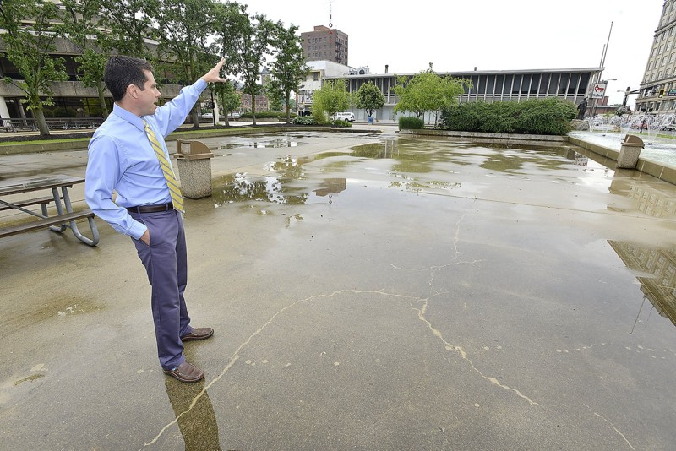
Public Education &
Resource Management
“Springfield’s stormwater utility will fund: ...wastewater infrastructure, public education on the environmental impact of stormwater, and efforts to minimize future impact....
Notes:
Partners with shared missions.

Slide 15
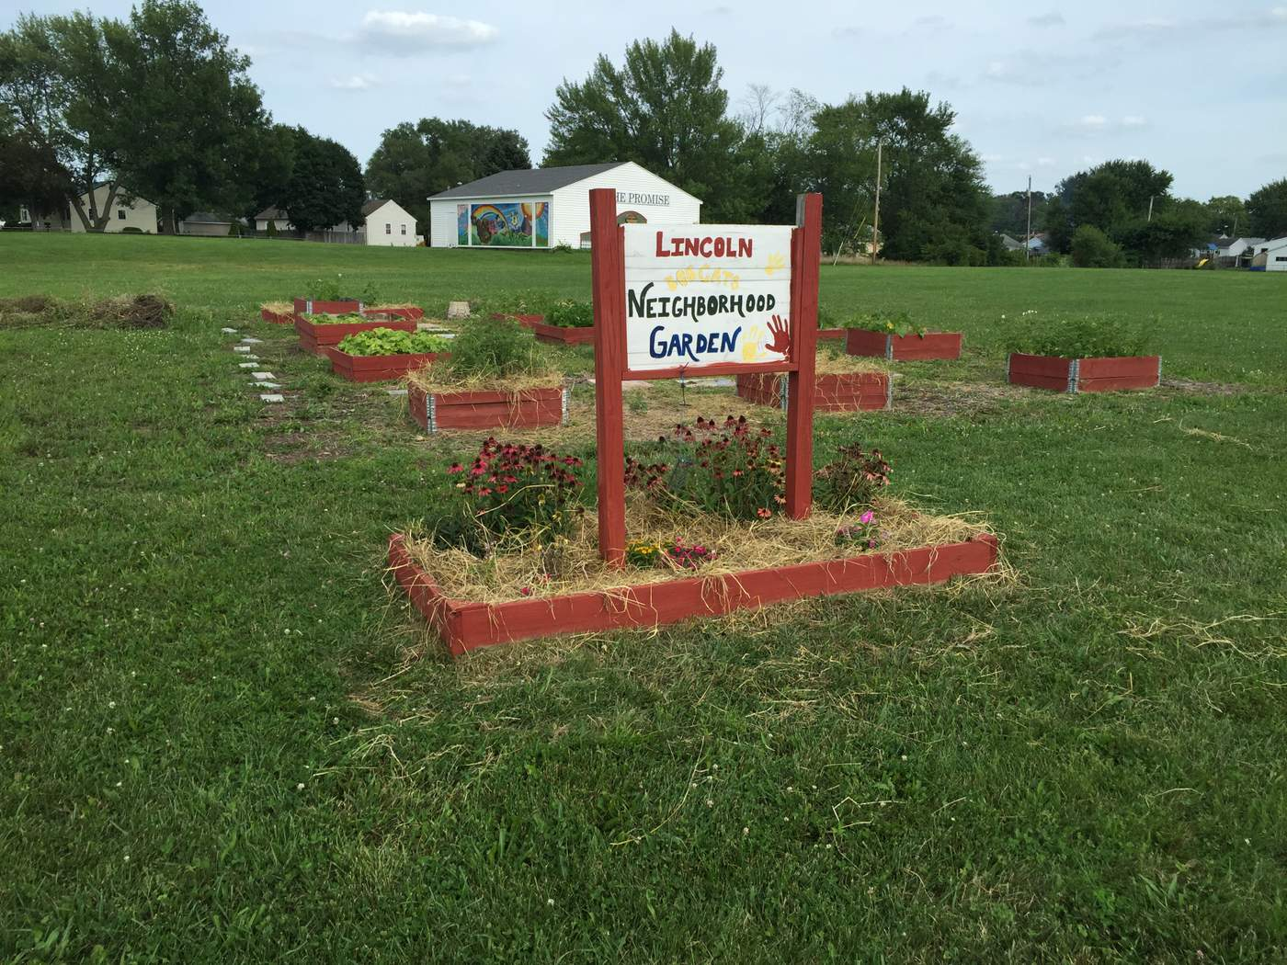

Springfield Promise Neighborhood
“placed-based and asset-based poverty alleviation project”
Justice
Notes:
Shared goals of serving underserved elementary students

Slide 16
Central Design Questions
Which issues are important?
Are there experts, organizations, or cultural leaders that share your goals?
Which skills & habits will you emphasize?

Slide 17
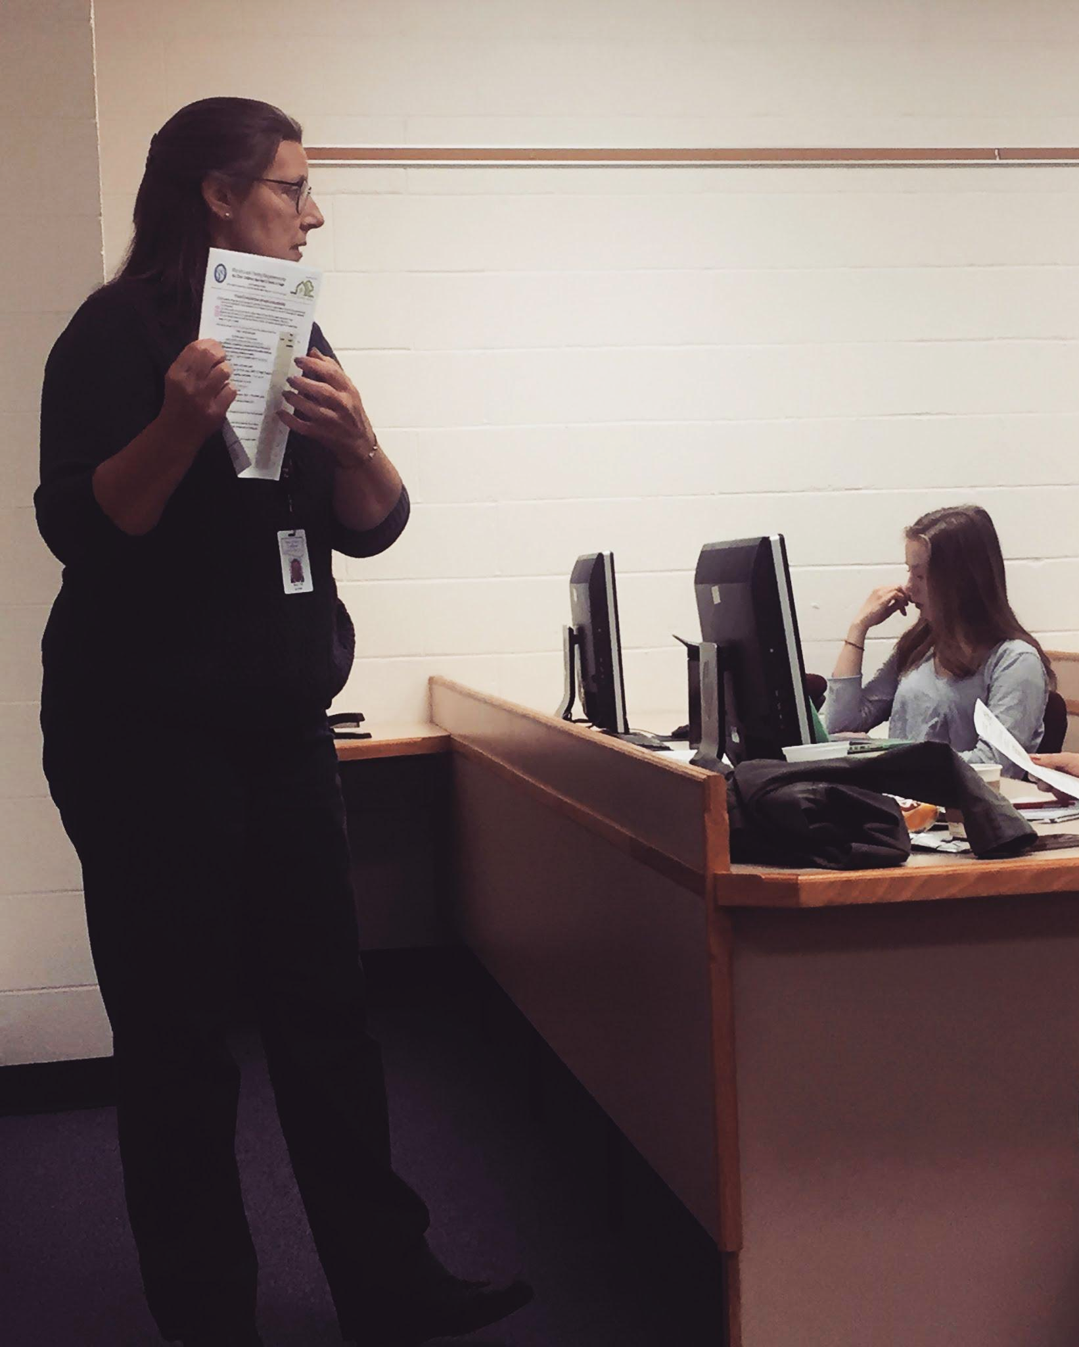
What skills & habits are important to your work?
“Ability to alter messages to new audiences”
“Allow individuals to ‘save face’ when they are proven wrong.”
“Motivating policymakers”
“Triple bottom line”
Anne Kaupp Fett shares public outreach materials from the Clark County combined Health District that inform new project design.
Notes:
We asked 7 partners from health, environmental, and community education-tied positions what skills and habits were most important to their work.

Slide 18
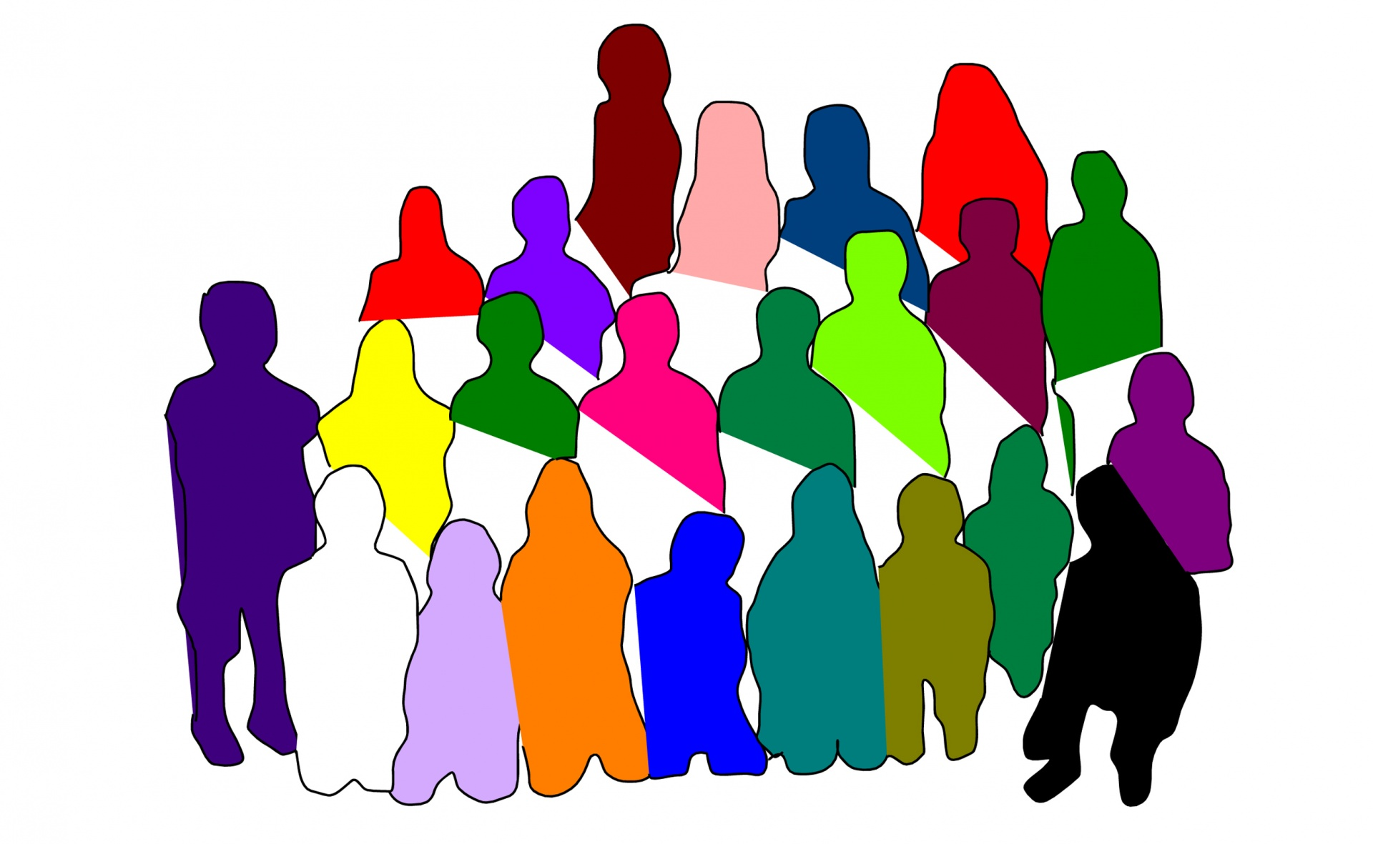
Science & Civic Learning Emphasize:
Professional Habits & Skills
Systems Thinking
Using Disciplinary Tools
Reflection
Cultural Awareness
& Inclusion
*National Task Force on Civic Learning & Democratic Engagement, 2012, A Crucible Moment: College Learning & Democracy’s Future
Notes:
Image Free For Reuse without Attribution

Slide 19
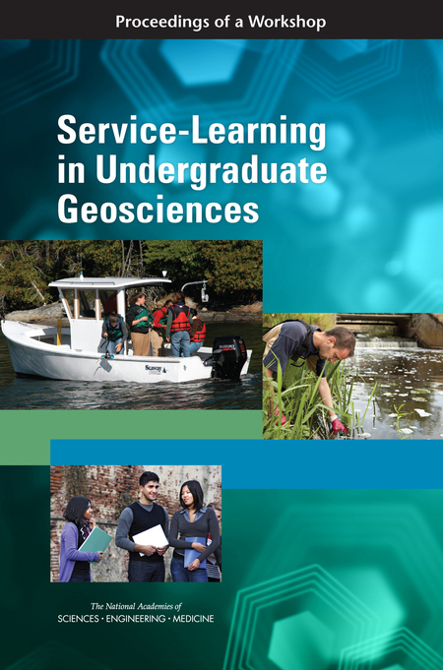
An Opportunity: Service Learning
“students use knowledge & skills... to address real needs”
Focus on: critical thinking and reflection

Slide 20
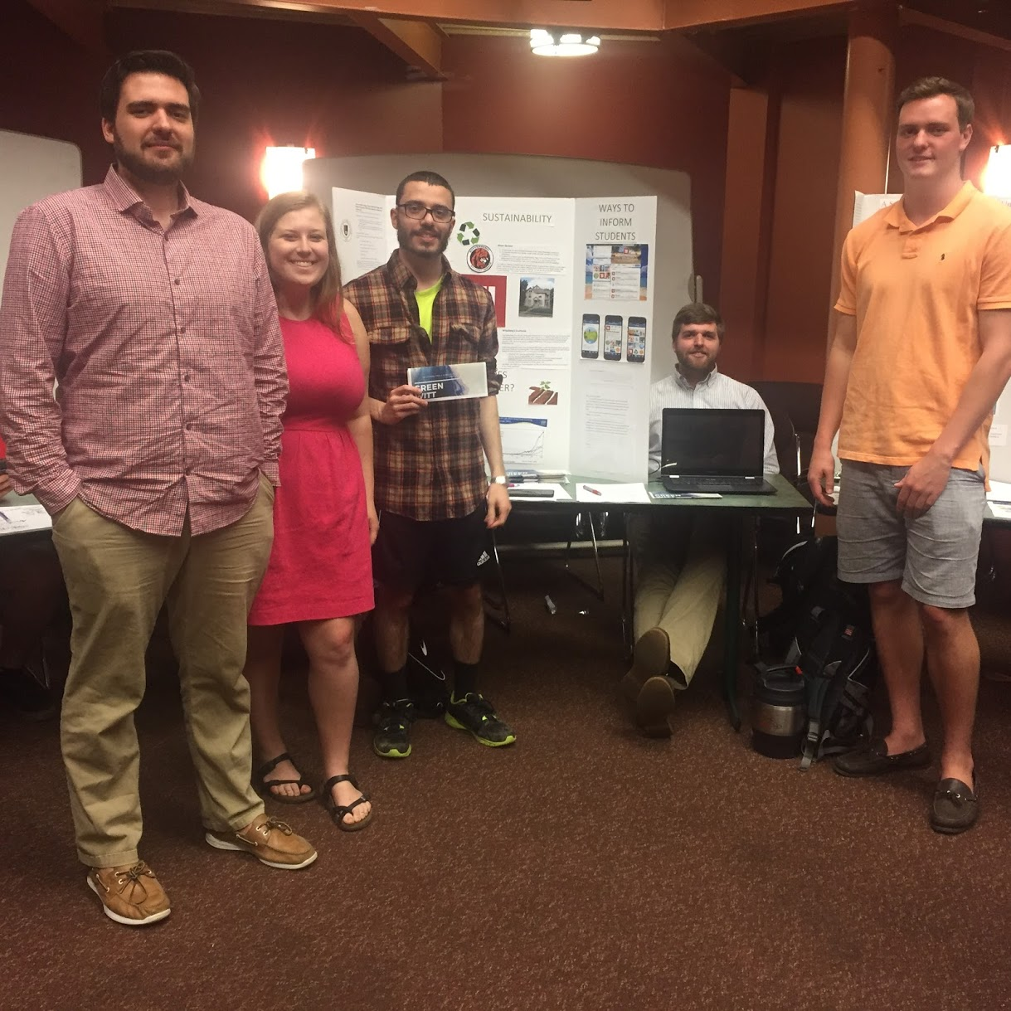
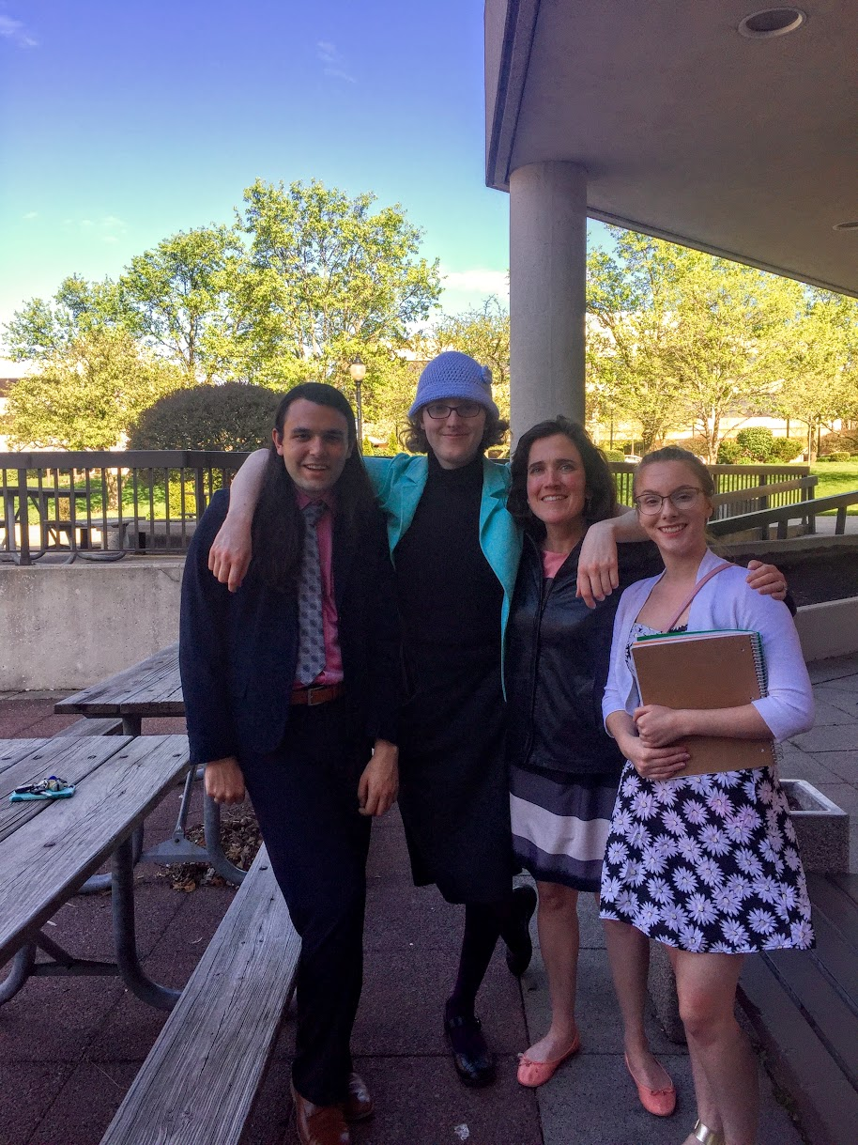
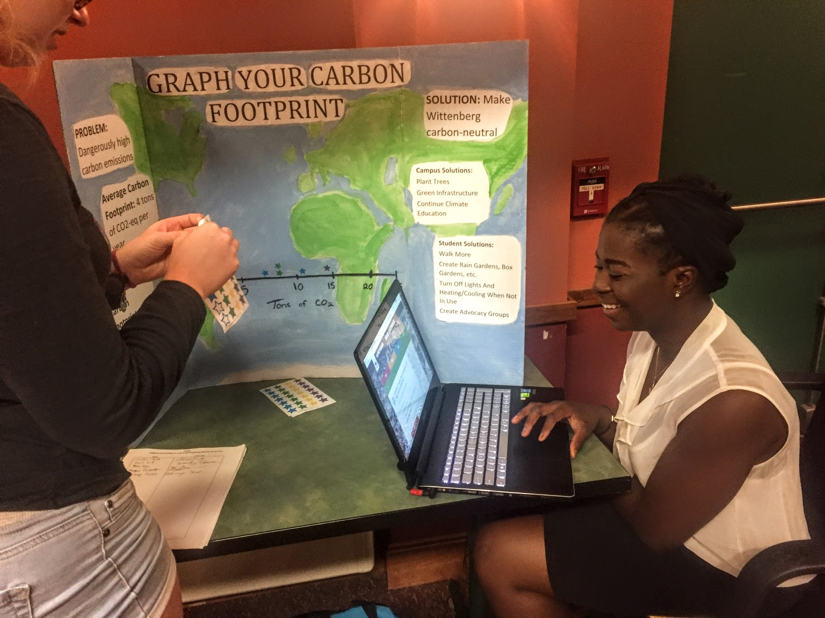
Advocacy:
Encourage action around a cause
Supported by evidence
Reflect on personal, collective, or policy opportunities
Notes:
Examples of class activities that provided professional training in a civic context.

Slide 21
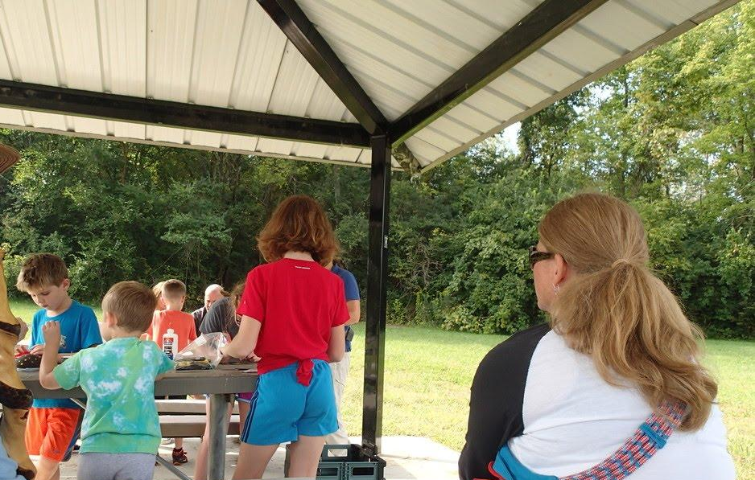
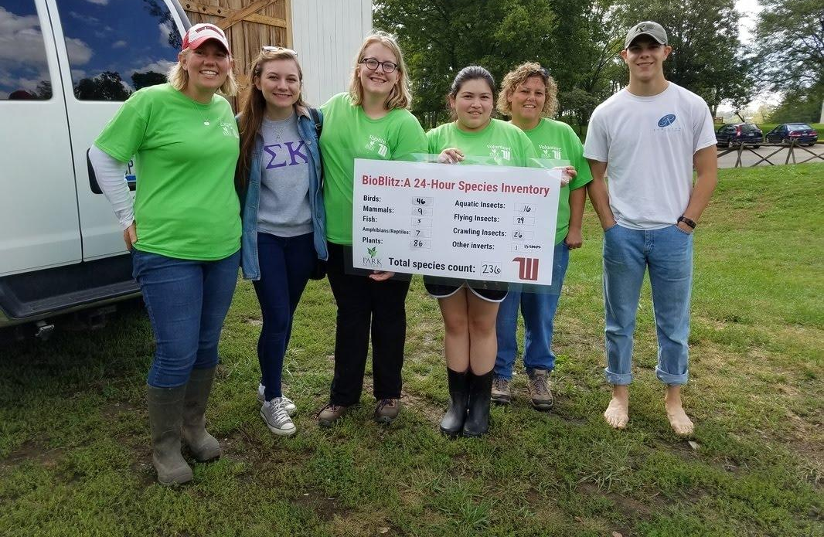
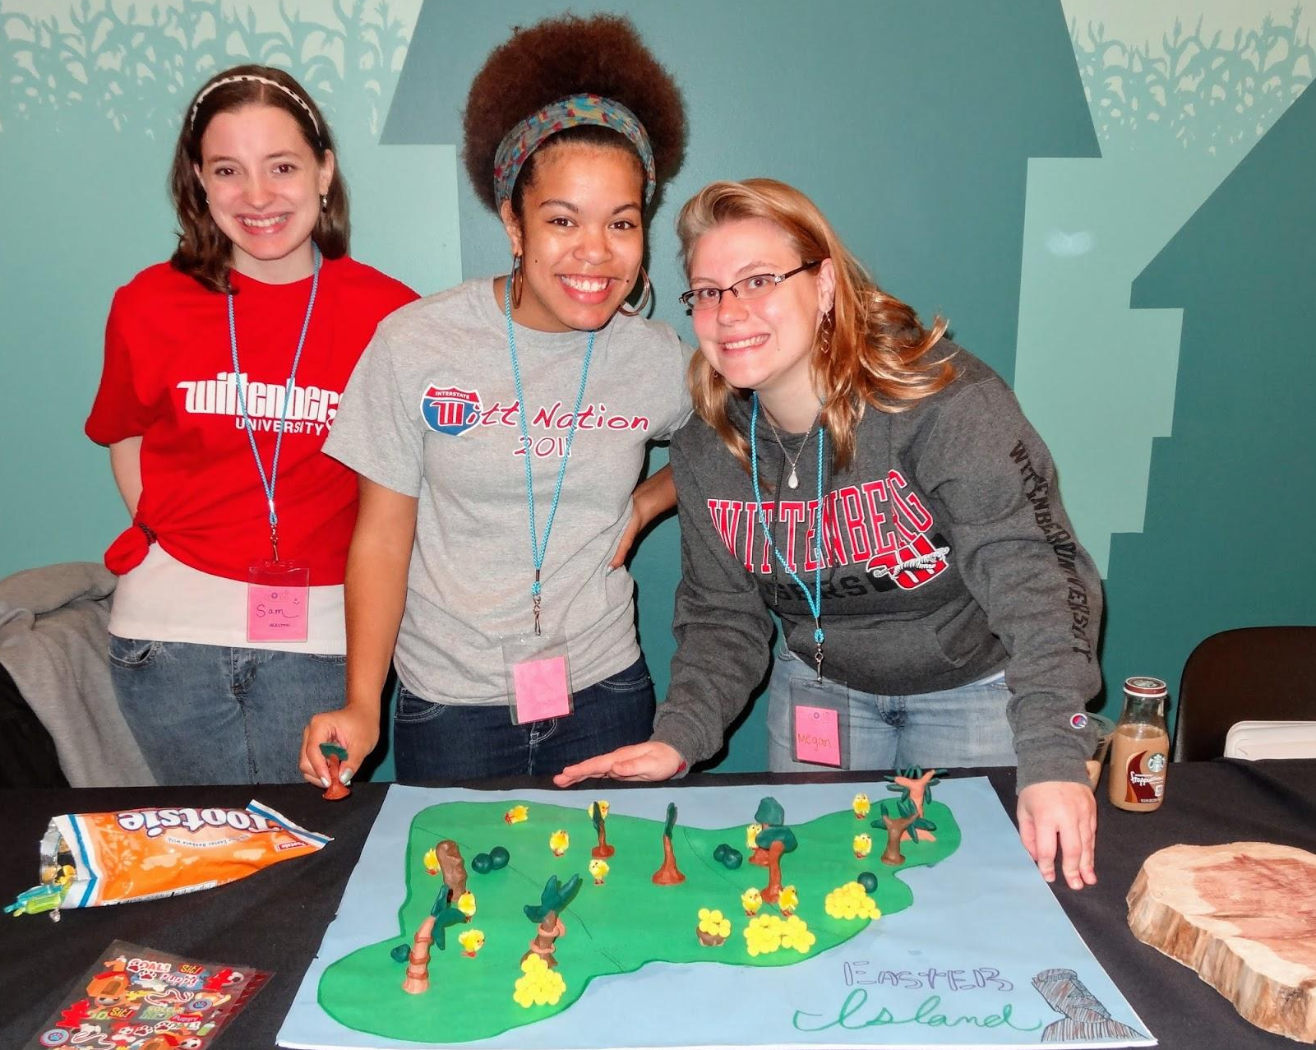
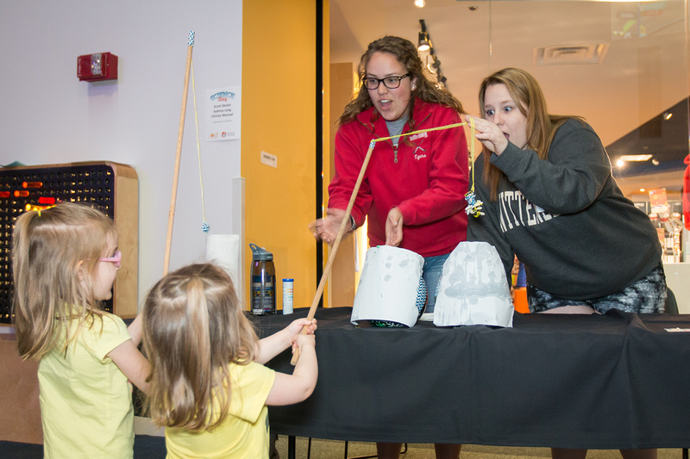
Outreach & Citizen Science:
Data informed and/or data collected
Raise literacy and/or research
participation
Notes:
Intro courses also include making literacy modules that are based on local issues &/or citizen science events. In both cases students must interpret local data to prepare for the event and/or after the event contributes data.

Slide 22
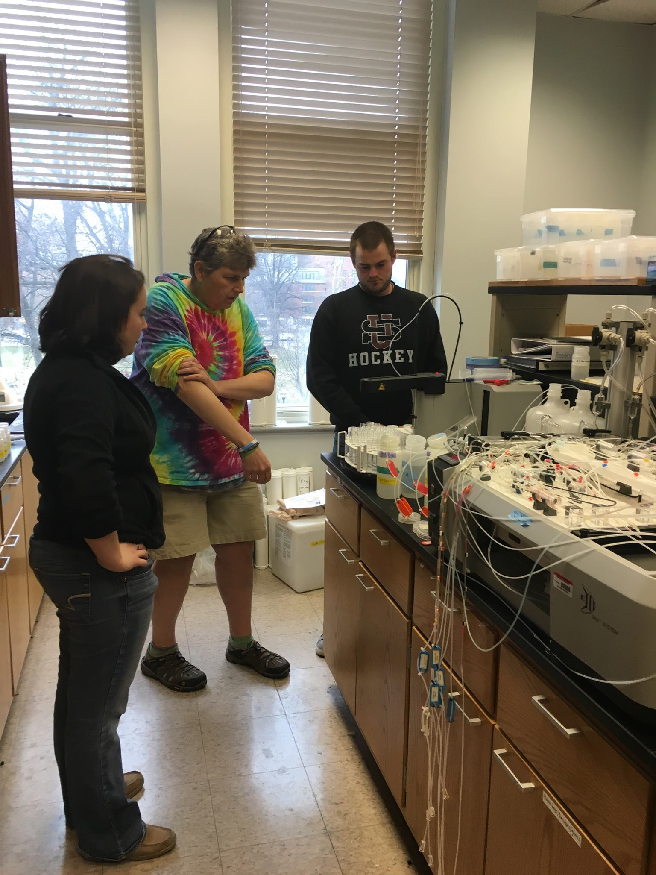
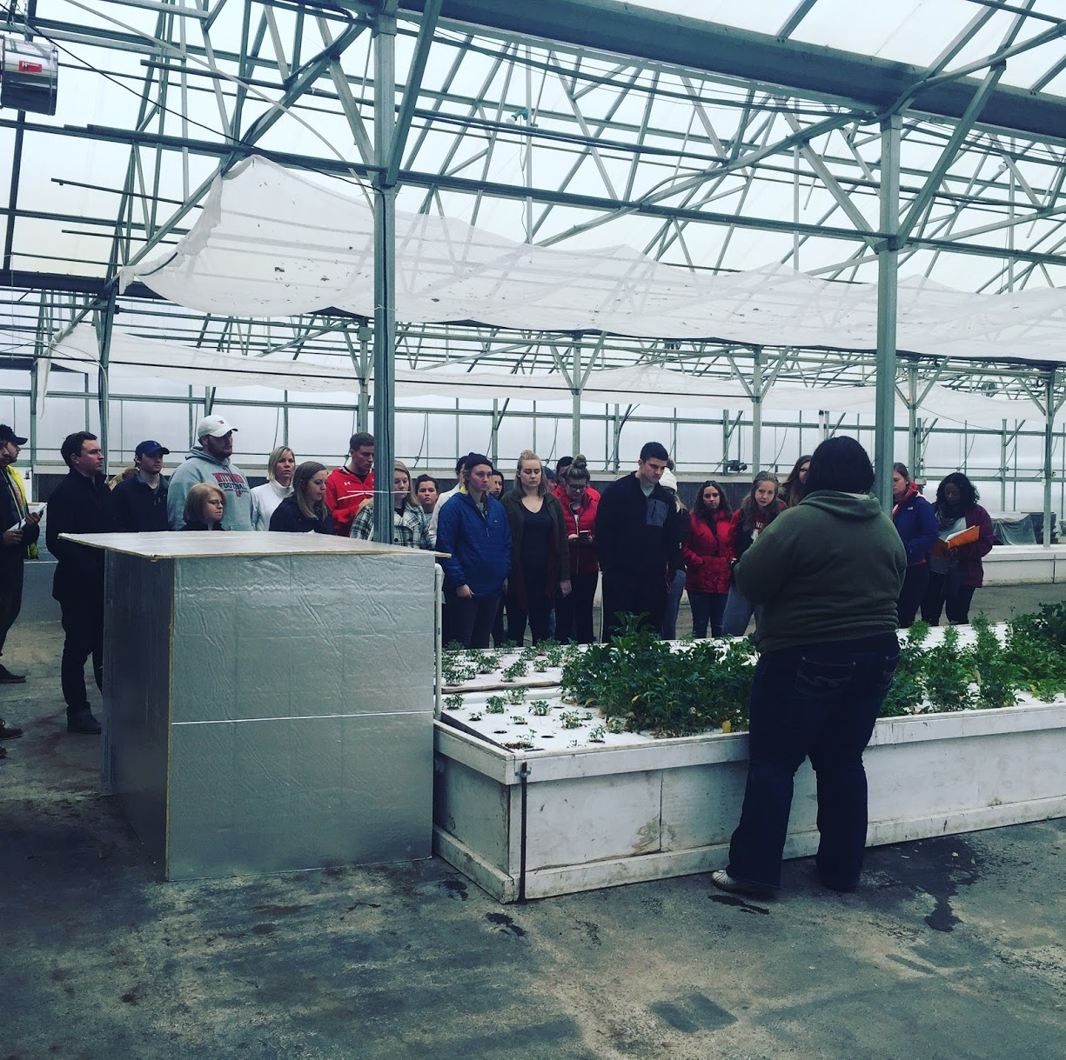
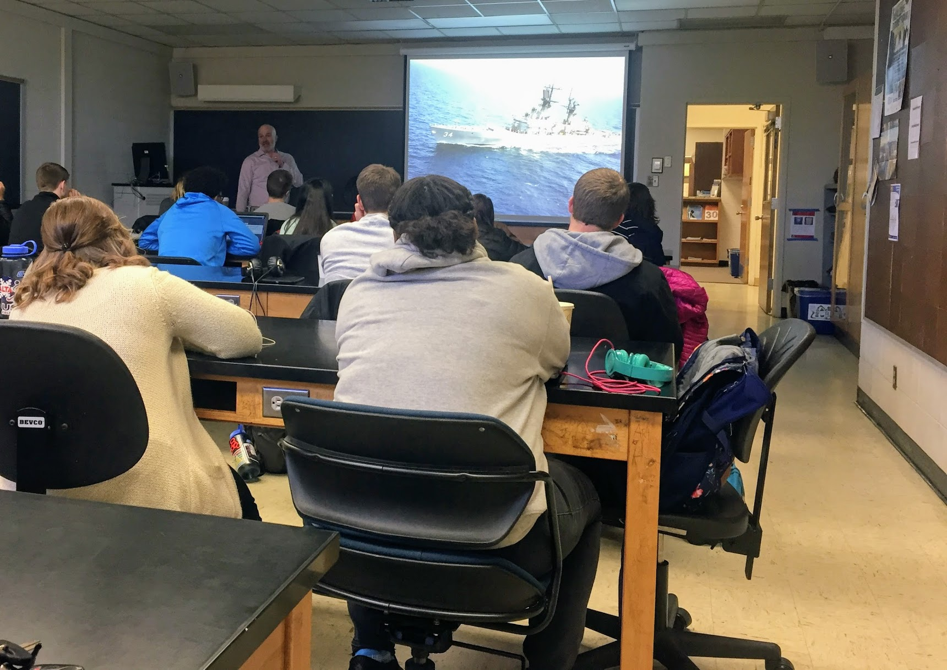
Partner Consultants:
Partners share tools &/or expertise that supports class success
Reflect on knowledge or advice
Notes:
Partners provide training and or access to resources or expertise we don’t have on campus (e.g. a hydroponic farm offers ideas for expanding practices on our campus, a research at OSU provides students with access to a nutrient analyzer, the director of sustainability for our campus food services provides his thoughts on sustainability decision making, a water treatment plant reviews local water quality issues.

Slide 23
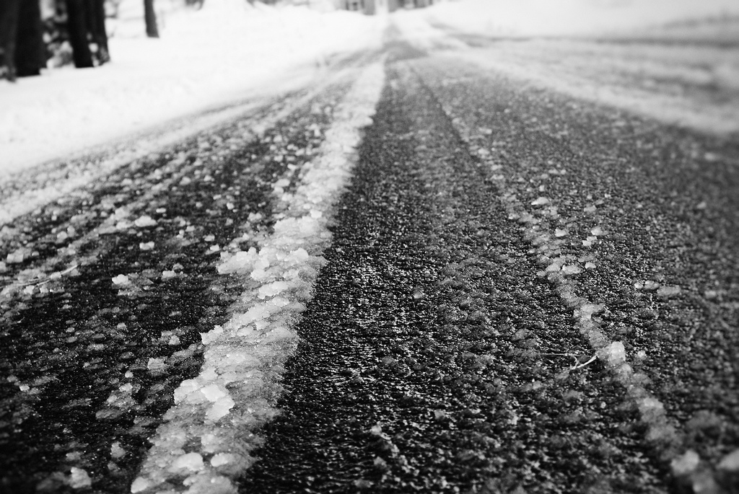
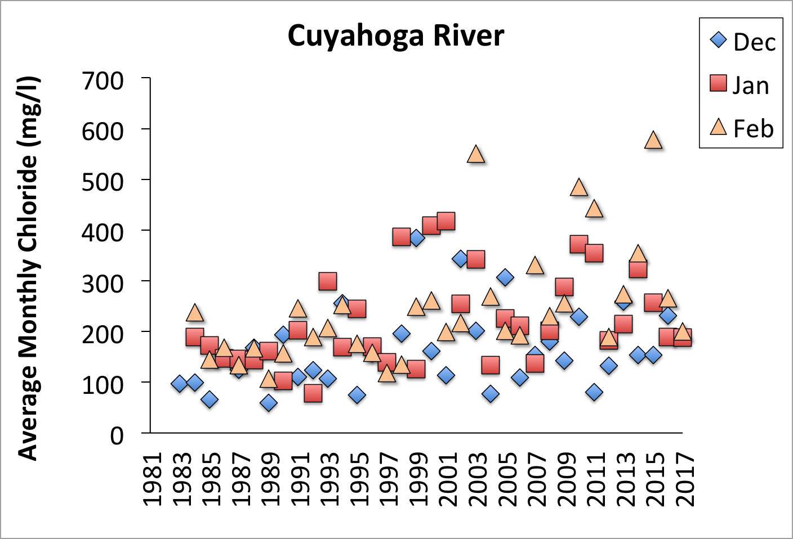
Local Research:
Apply science habits & skills
Students reflect on community needs (or co-develop)
Product creation & sharing builds communication skills
Photo Credit: Lisa Williams
Data from National Center for Water Quality Research
Notes:
CC 2.0: Lisa Williams, Icy Road, https://www.flickr.com/photos/pixellou/4199471714
Students tackled coming up with research questions that would serve the community. There are many publications on the impacts of road salt on water chemistry. However, this information doesn’t always get to decision makers.

Slide 24
Central Design Questions
Which critical issues are important to your community?
Are there experts, organizations, or cultural leaders that share your goals?
Which habits will you emphasize?
How will you evolve?

Slide 25
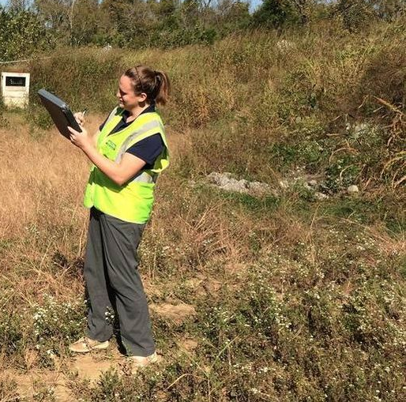
Tracking helps move efforts forward
Student learning
Civic Attitudes
Partner Provided Resources (Instruments, Land)
Service Hours
Issue Visibility (Events, Local News)
Awards for students
Number of partners
Created Internships
Careers
Products Shared
Community Gains
Beth Wilson a Wittenberg graduate is now a stormwater coordinator in Nashville.

Slide 26
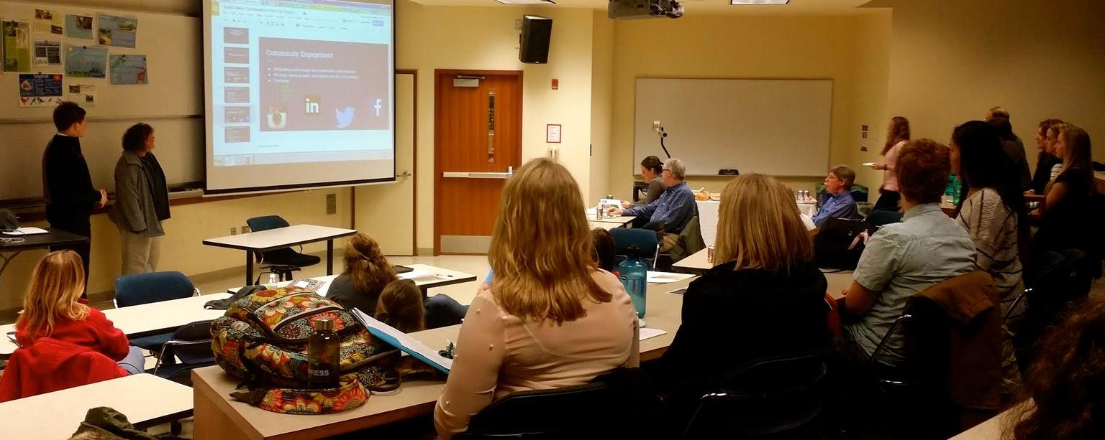
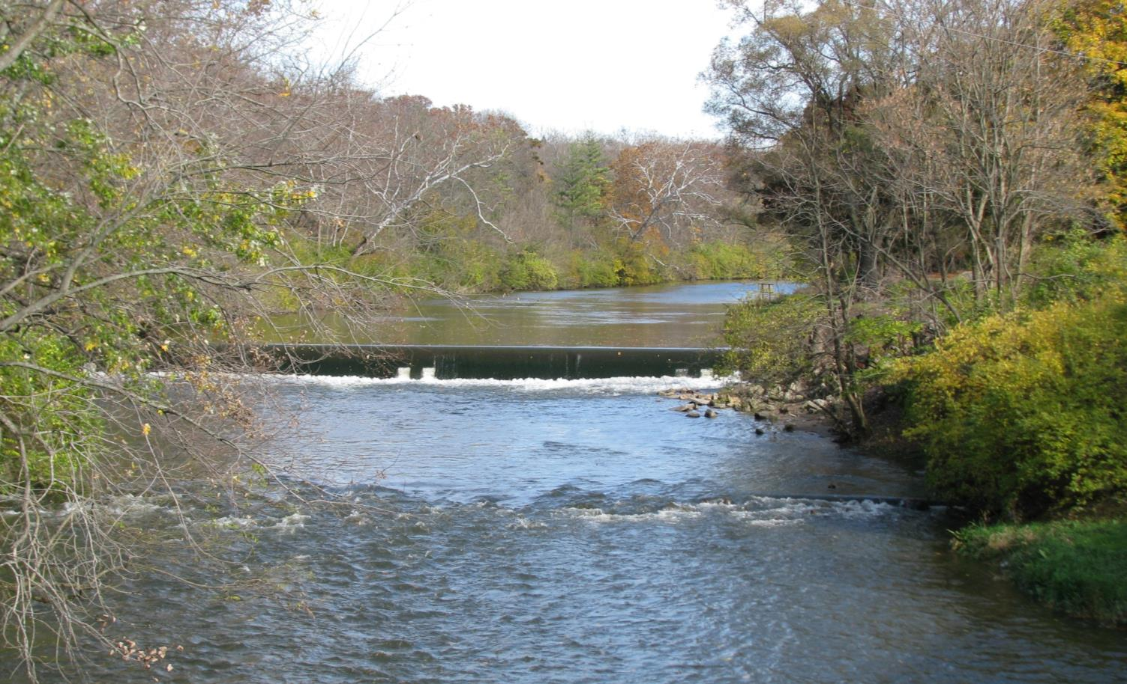
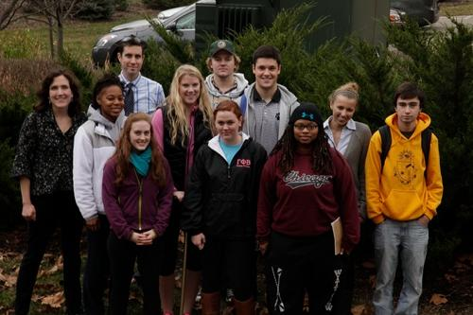
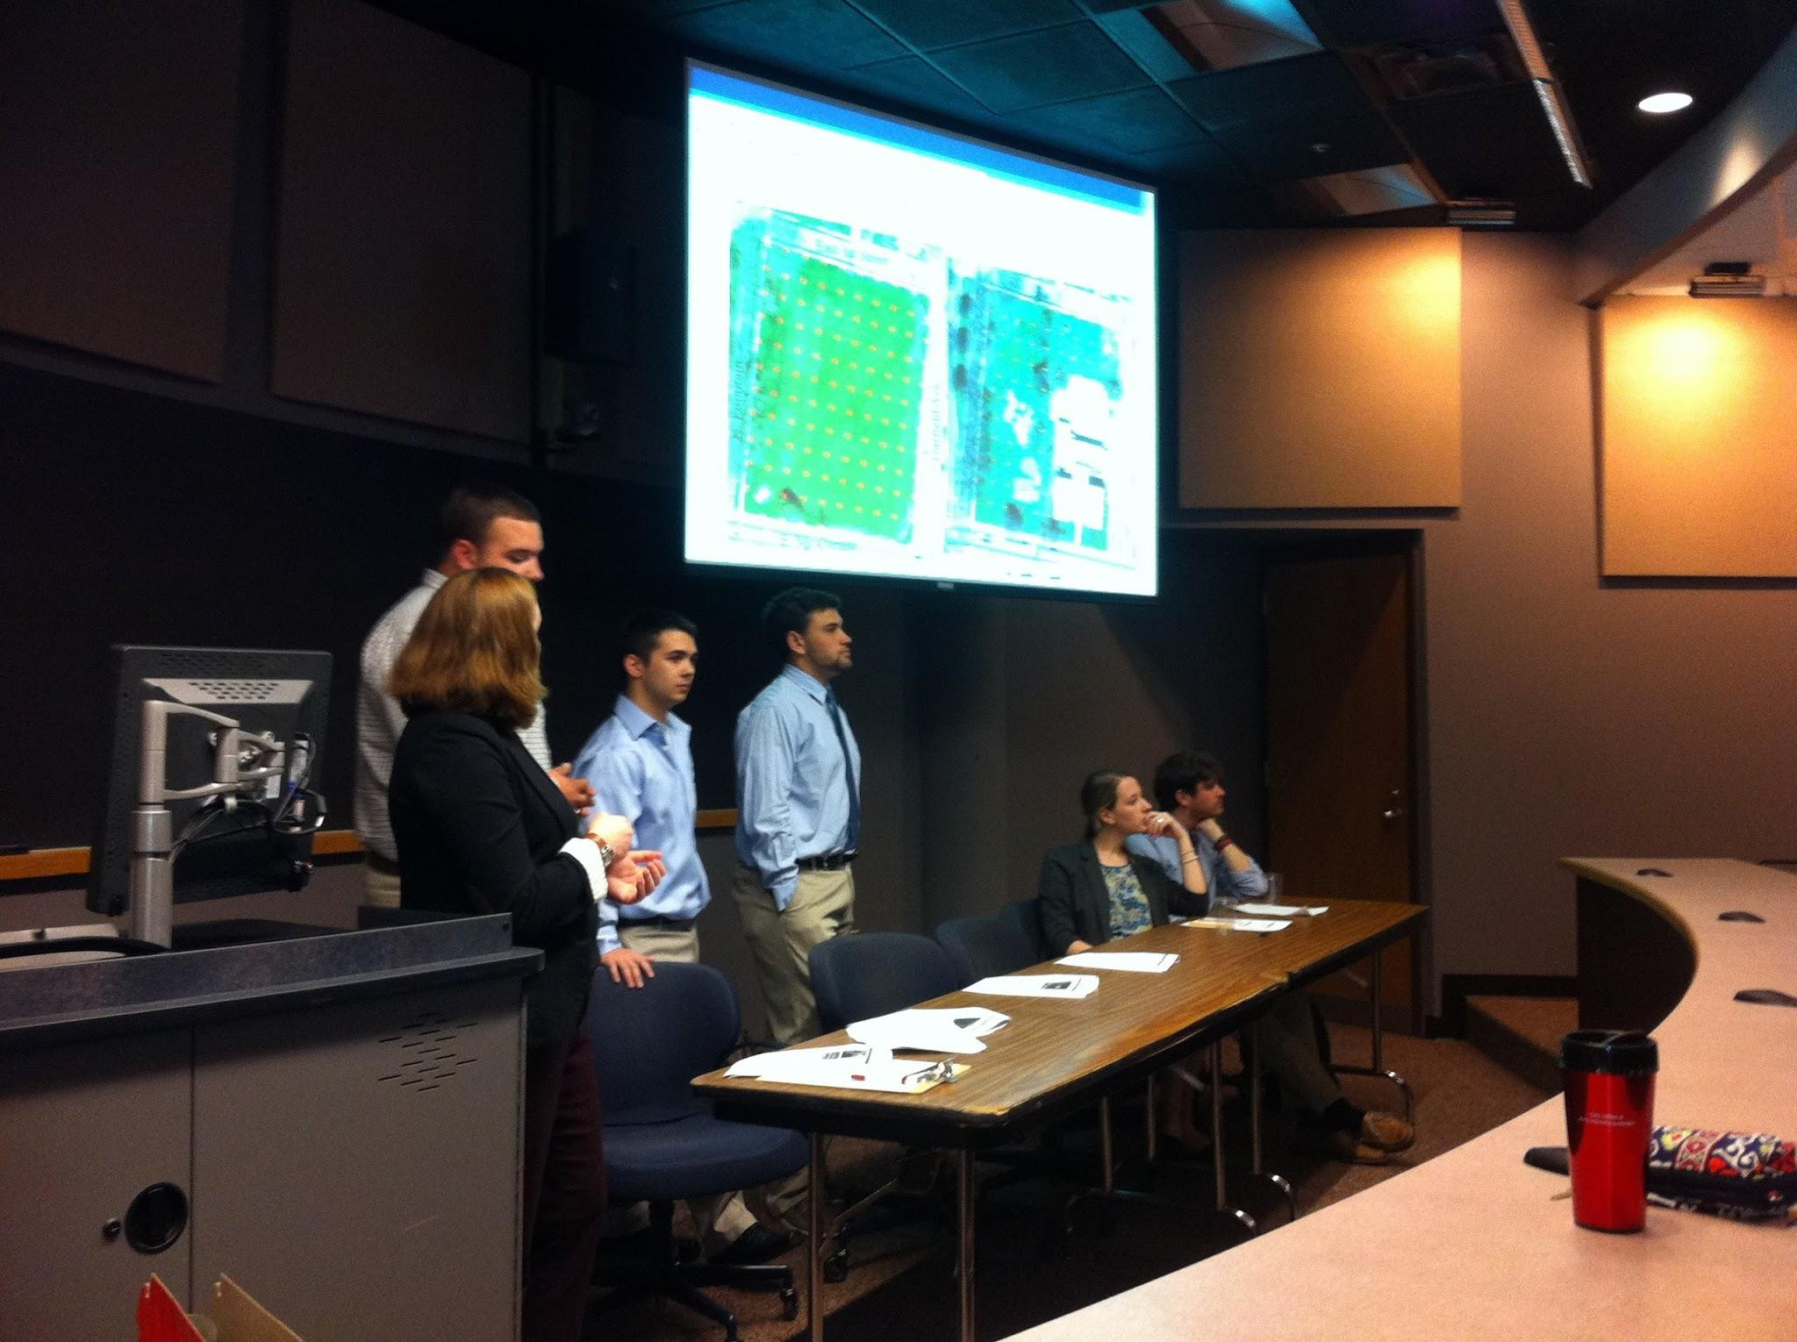
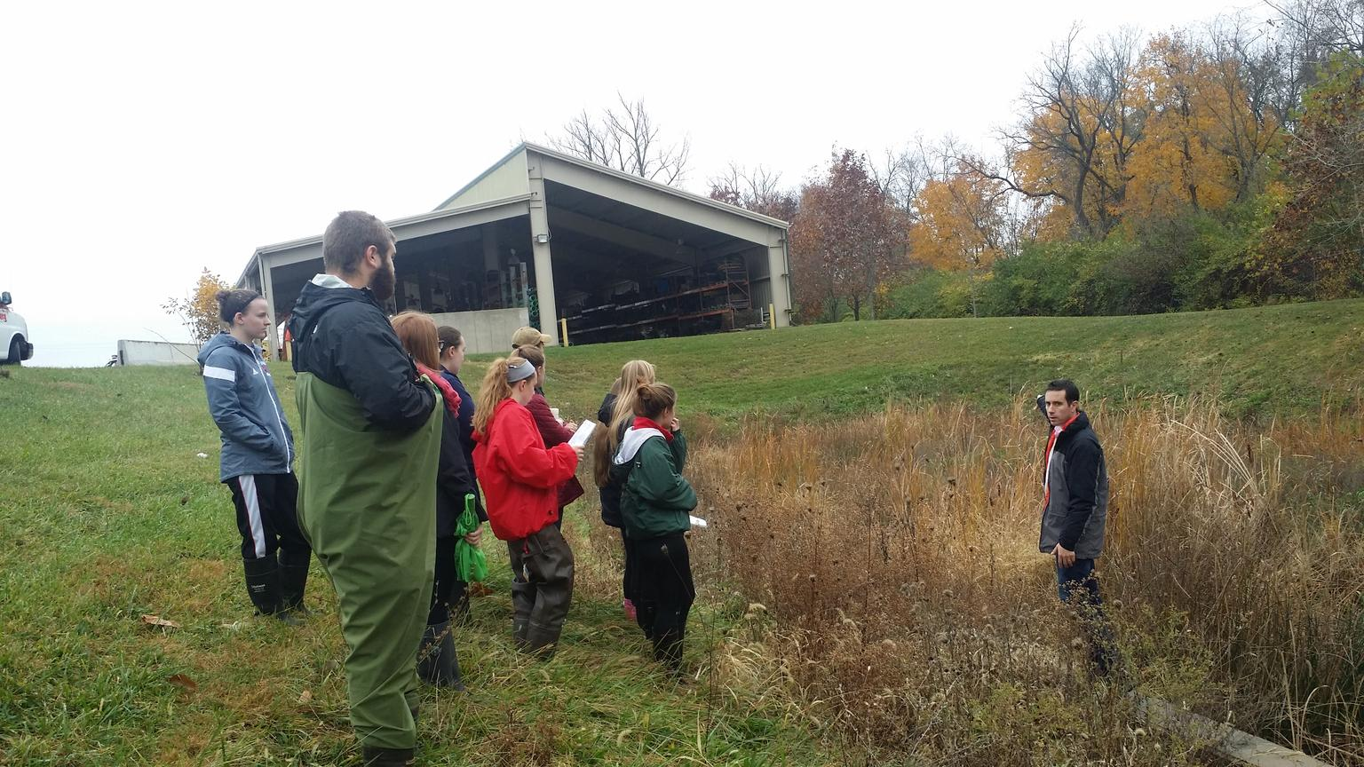
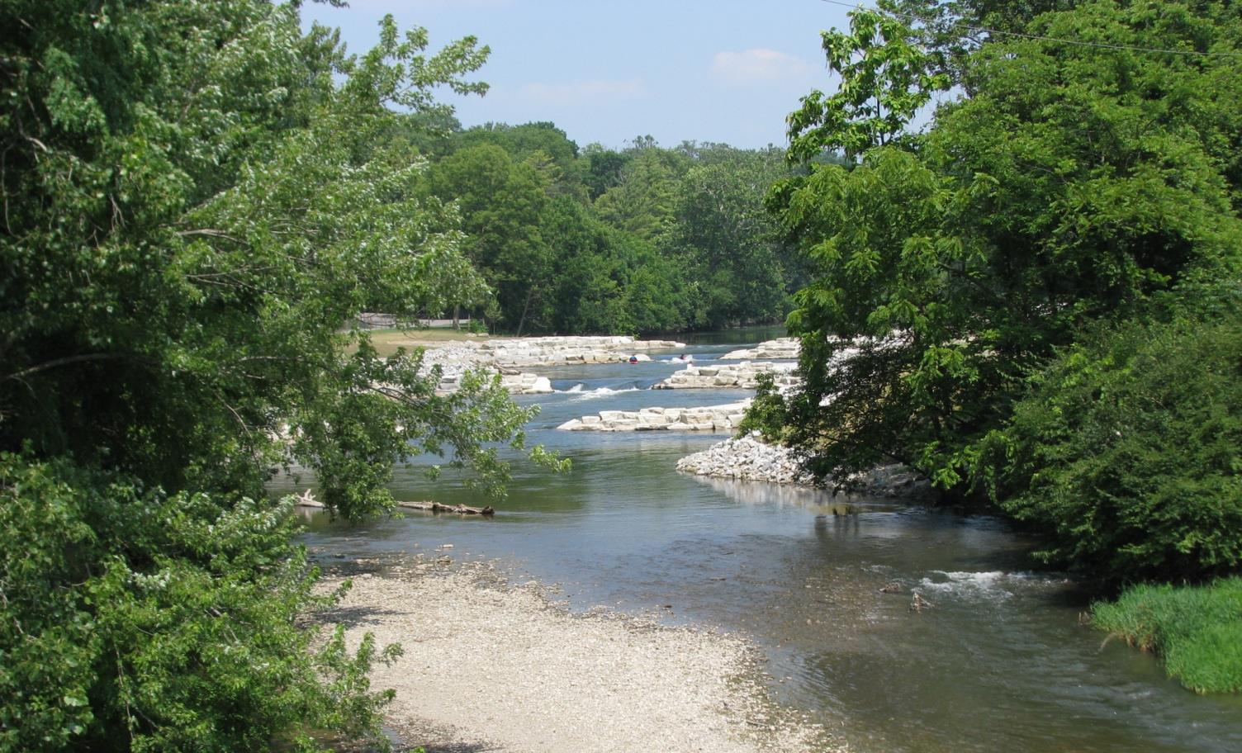
Listen, Share, & Plan Evolution
Co-development of new projects informed by earlier projects
Repetition of successful project with new audience or partners
Listening and sharing between students, partners, faculty, & community.

Slide 27
How will we build capacity?
Sarah Fortner
sfortner@wittenberg.edu
@erthsarah (Twitter)
@earthsarah (Instagram)
Check out AAC&U’s Case Studies:
Civic Learning in the Major by Design

Slide 28
EXTRA SLIDES

Slide 29
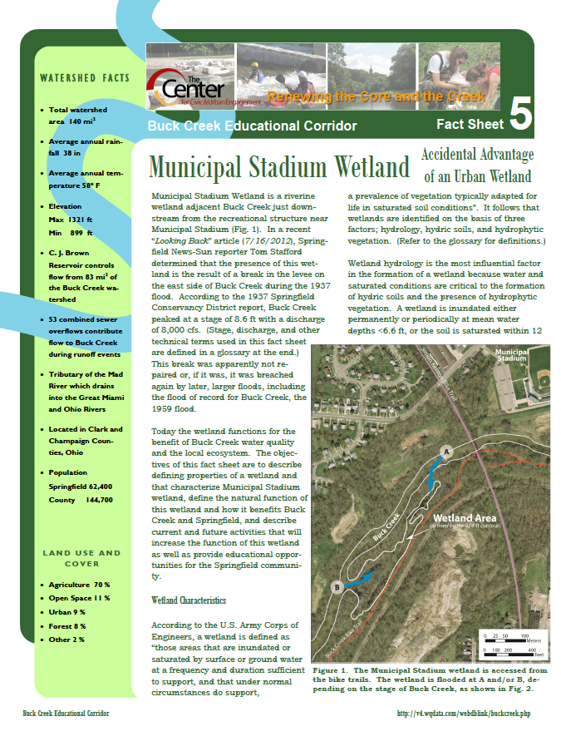
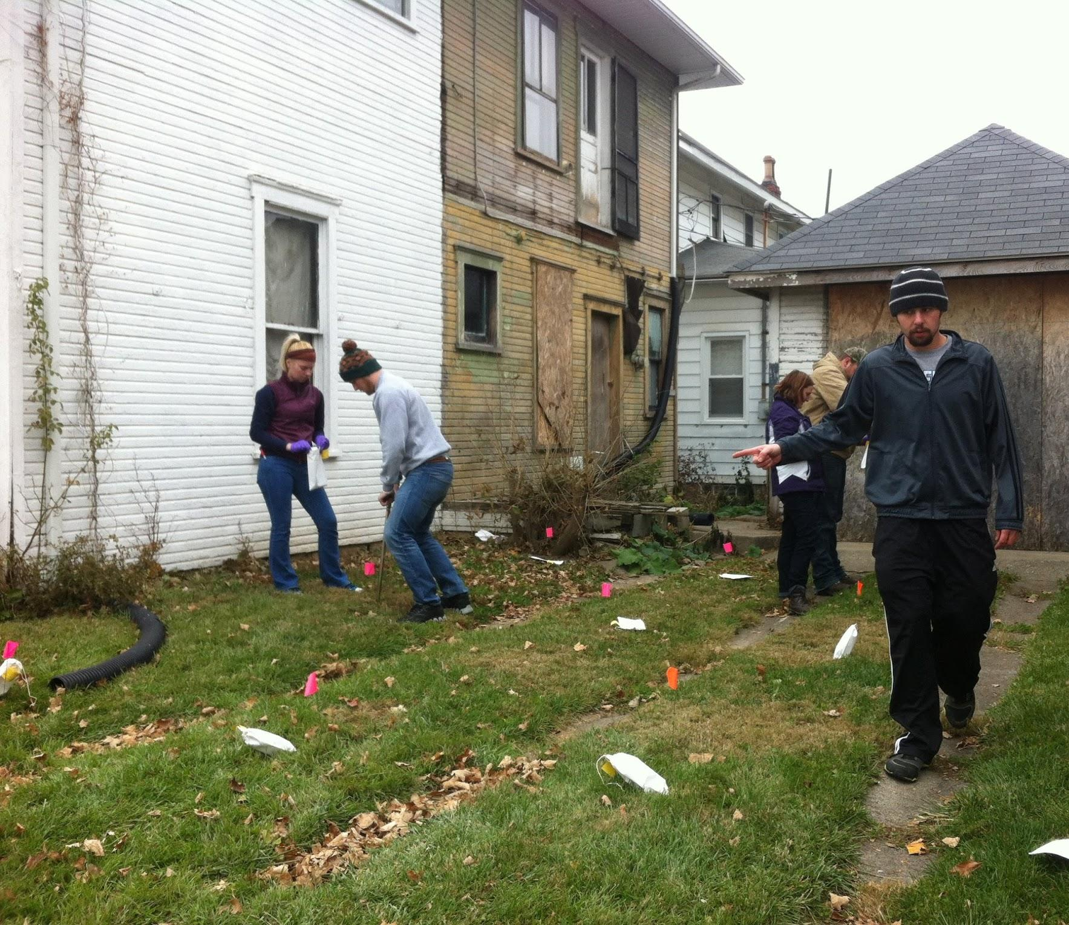
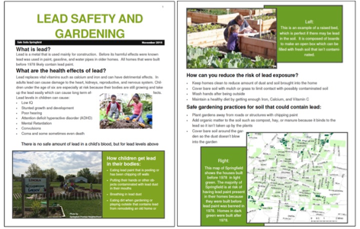
Community Interest Products
Mapping Projects
Campus Fertilizer, Campus Sustainability Assets, Soil Texture (stormwater opportunities), Surface Albedo, Surface Temperature, Carbon Sequestration, Species Inventories, Natural Hazards & Risk
Notes:
Might also mention collecting & or interpreting existing long term data & using community planning toolkits

Slide 30
Our Partners
Antioch College & The Farm
B-W Greenway Community Land Trust
Clark County Health District
Clark County Park District (multiple parks)
Clark County Soil & Water District
Clark County Solid Waste District
Clark County Citizens Climate Lobby
Cedar Bog
Center of Science & Industry
City of Springfield: Housing & Urban Development
City of Springfield Community Development
City of Springfield Stormwater
Eatin’ Park (Food Services)
Five Rivers Metro Park
Frank Lloyd Wright Westcott House & the Solar House
Freshwater Farms
Hagen Center for Civic and Urban Engagement
Miami Conservancy District
National Trails Parks & Recreation
The Ohio State University Extension
Rivers Unlimited
Springfield Chamber of Commerce
Springfield Conservancy
Springfield Public Schools
Springfield Promise Neighborhood
STRIVE at Champaign Residential Services
Tecumseh Land Trust
U.S. Army Corps of Engineers
U.S. EPA
Wittenberg’s Hagen Center for Civic & Urban Engagement
Wittenberg’s Physical Plant
Wittenberg’s Sustainability Task Force

Slide 31
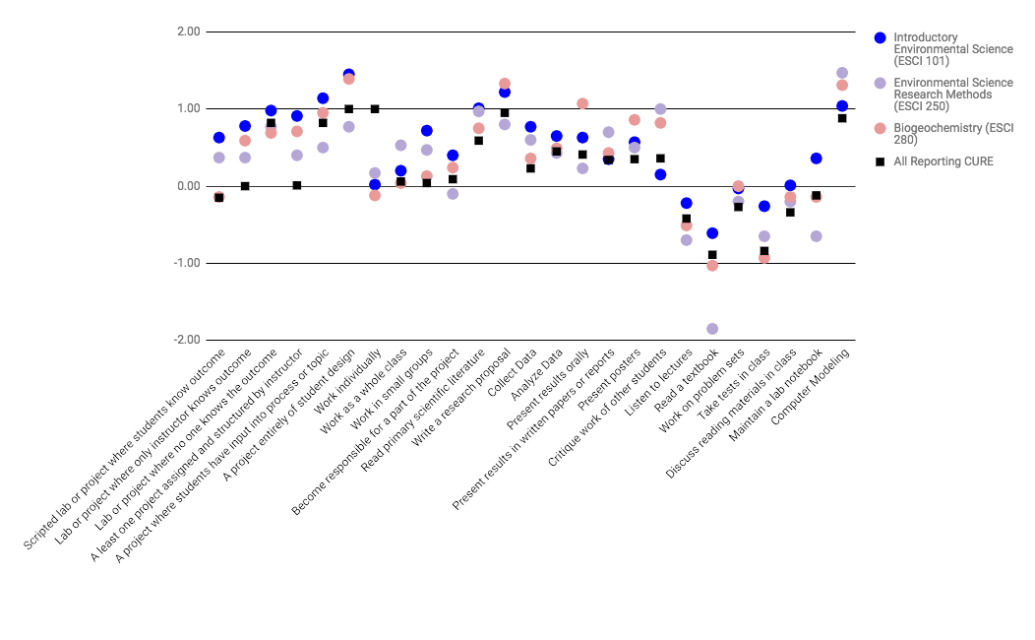
Post Course Gains (Measured with Course-based Undergraduate Research Experience, e.g. Lopatto and Tobias, 2010)
Notes:
Extra Assessment Slide, Difference between post course & pre course student reporting.

Slide 32
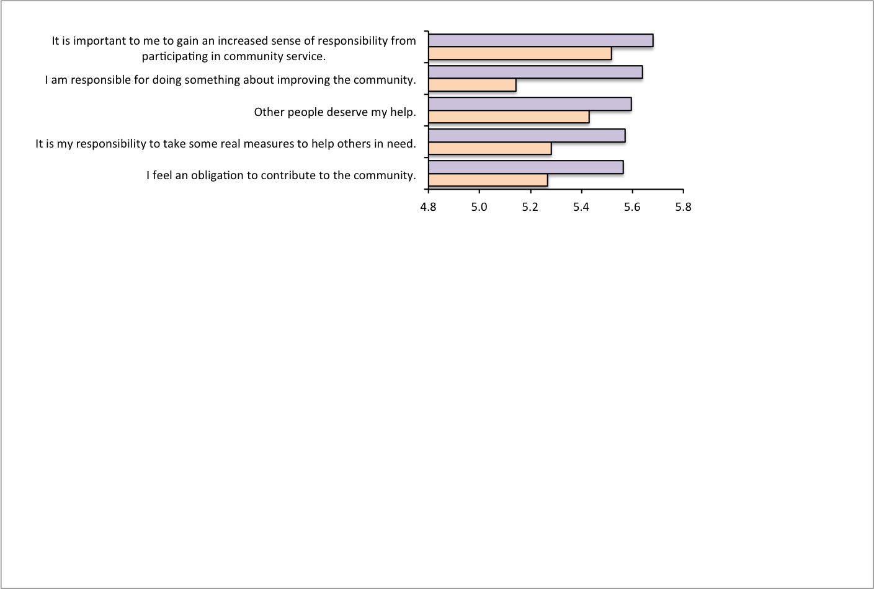
Track Learning & Attitudes
Freshmen have lower community connectedness
(Measured with Community Service Attitudes Scale, Shiarella et al., 1999)
7 Wittenberg Courses, Sophomores-Senior (purple, n=133),
Freshmen (orange, n=133)
Notes:
7 point likert scale; 7= strongly agree; 1 strongly disagree

