Slide 1
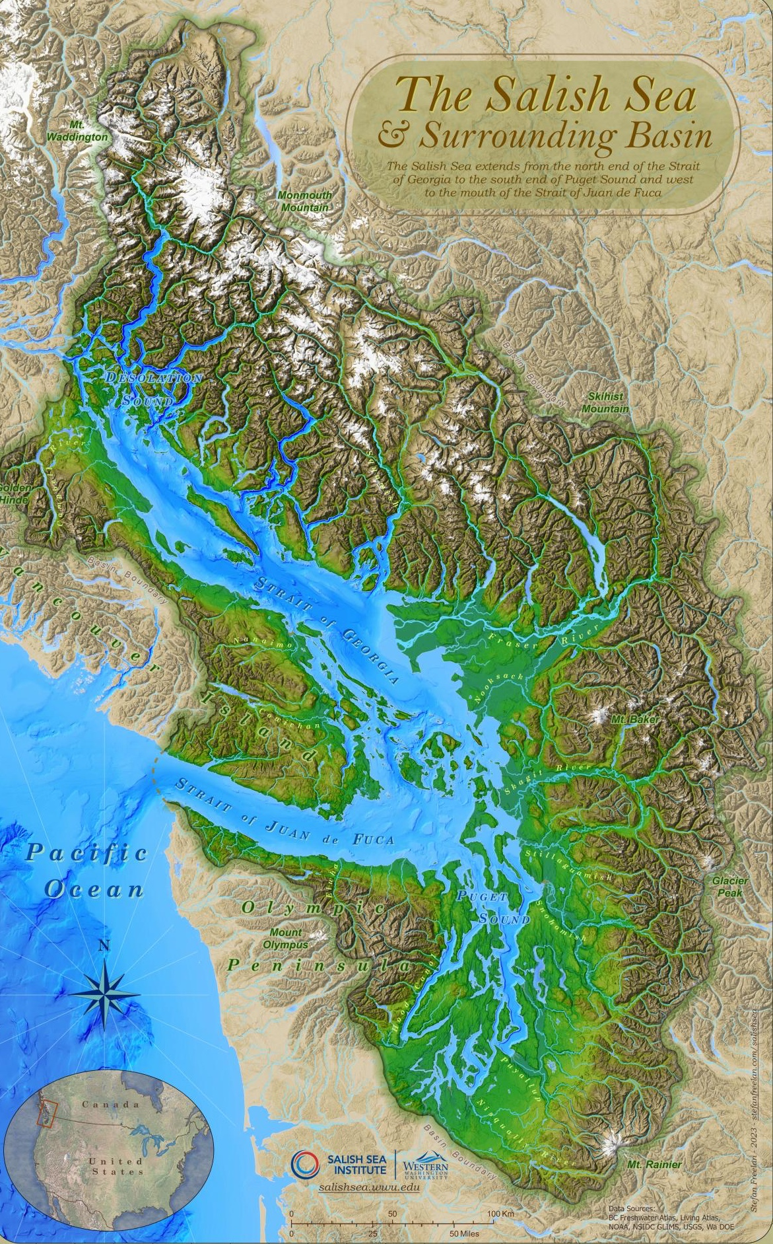
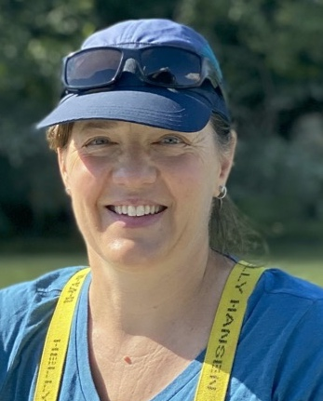
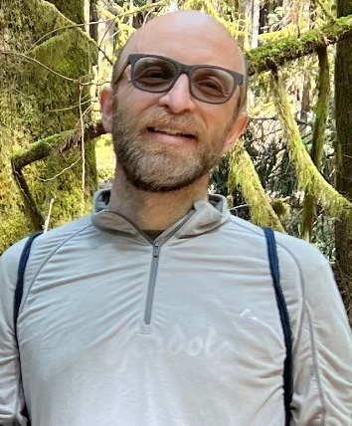



How and Why to Design a STEAMy
(Geo)science-Poetry Course
Marjorie Wonham & Curtis Wasson
Friday Harbor Labs,
U of Washington
Squamish, BC, Canada
https://salishsea.wwu.edu/salish-sea-surrounding-basin
www.native-land.ca
Notes:
Today I’m sharing with you a rationale for WHY to interweave geoscience and poetry,
and a framework for HOW to do it that you can apply at an activity, module, or course scale.
Collaborative project with my Humanities colleague Curtis Wasson.
It’s been developed in the Salish Sea region of the Pacific Northwest, an area shares a rich and complex overlap of Tribes and First Nations who have stewarded the environment since time immemorial, and whose land and waters management have influenced what we see today.
Sko-ho-mish, Tsleil-Waututh, and Musqueam FN
Samish, Swinomish, Laqhtemish, Jamestown Sklallam Tribes, Mitchell Bay Group
WSANEC, Tsou-ke FN
that spans the Canada-US border
but which geology folks will understand well shares tectonic plates, shares watersheds, and
And that incredible spatial and temporal scale of understanding that geologists have sets you up for understanding the rationale for interdisciplinary work.

Slide 2
Poetry & Geoscience?
🥳😍😀☺️🤔🙄😬🫣😱
1 2 3 4 5 6 7 8 9
Empirical Evidence
Why? (Big picture)
How? (Framework)
Outcomes
Notes:
What is your first reaction to the idea of combining poetry and geoscience?
Raise your fingers from 1 to 9 based on the faces.
Going to start with empirical evidence that it’s fun,
Talk about why this is worth doing in the big picture;
Outline how to do it with a framework for designing an activity, a module, a whole course
Offer preliminary qualitative evidence for its impact.

Slide 3
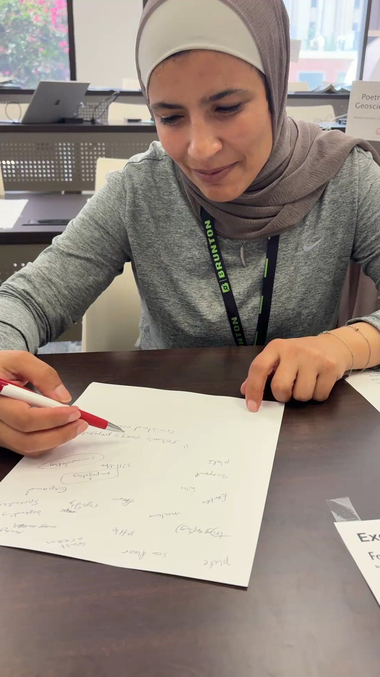
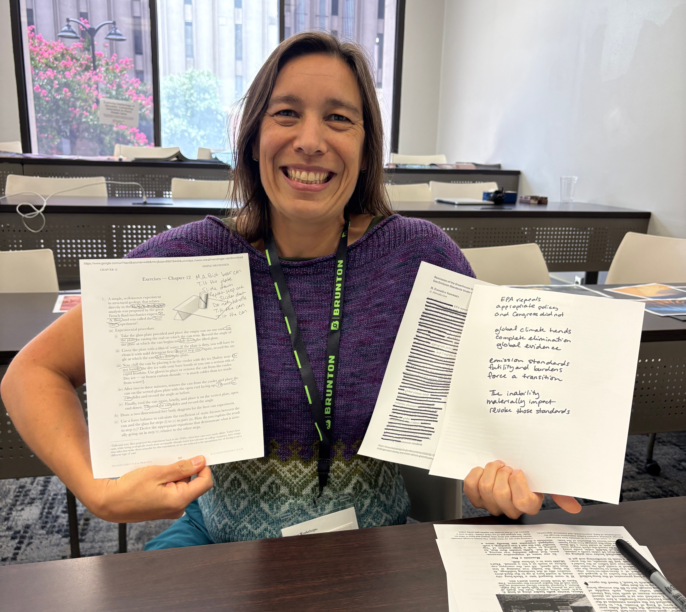
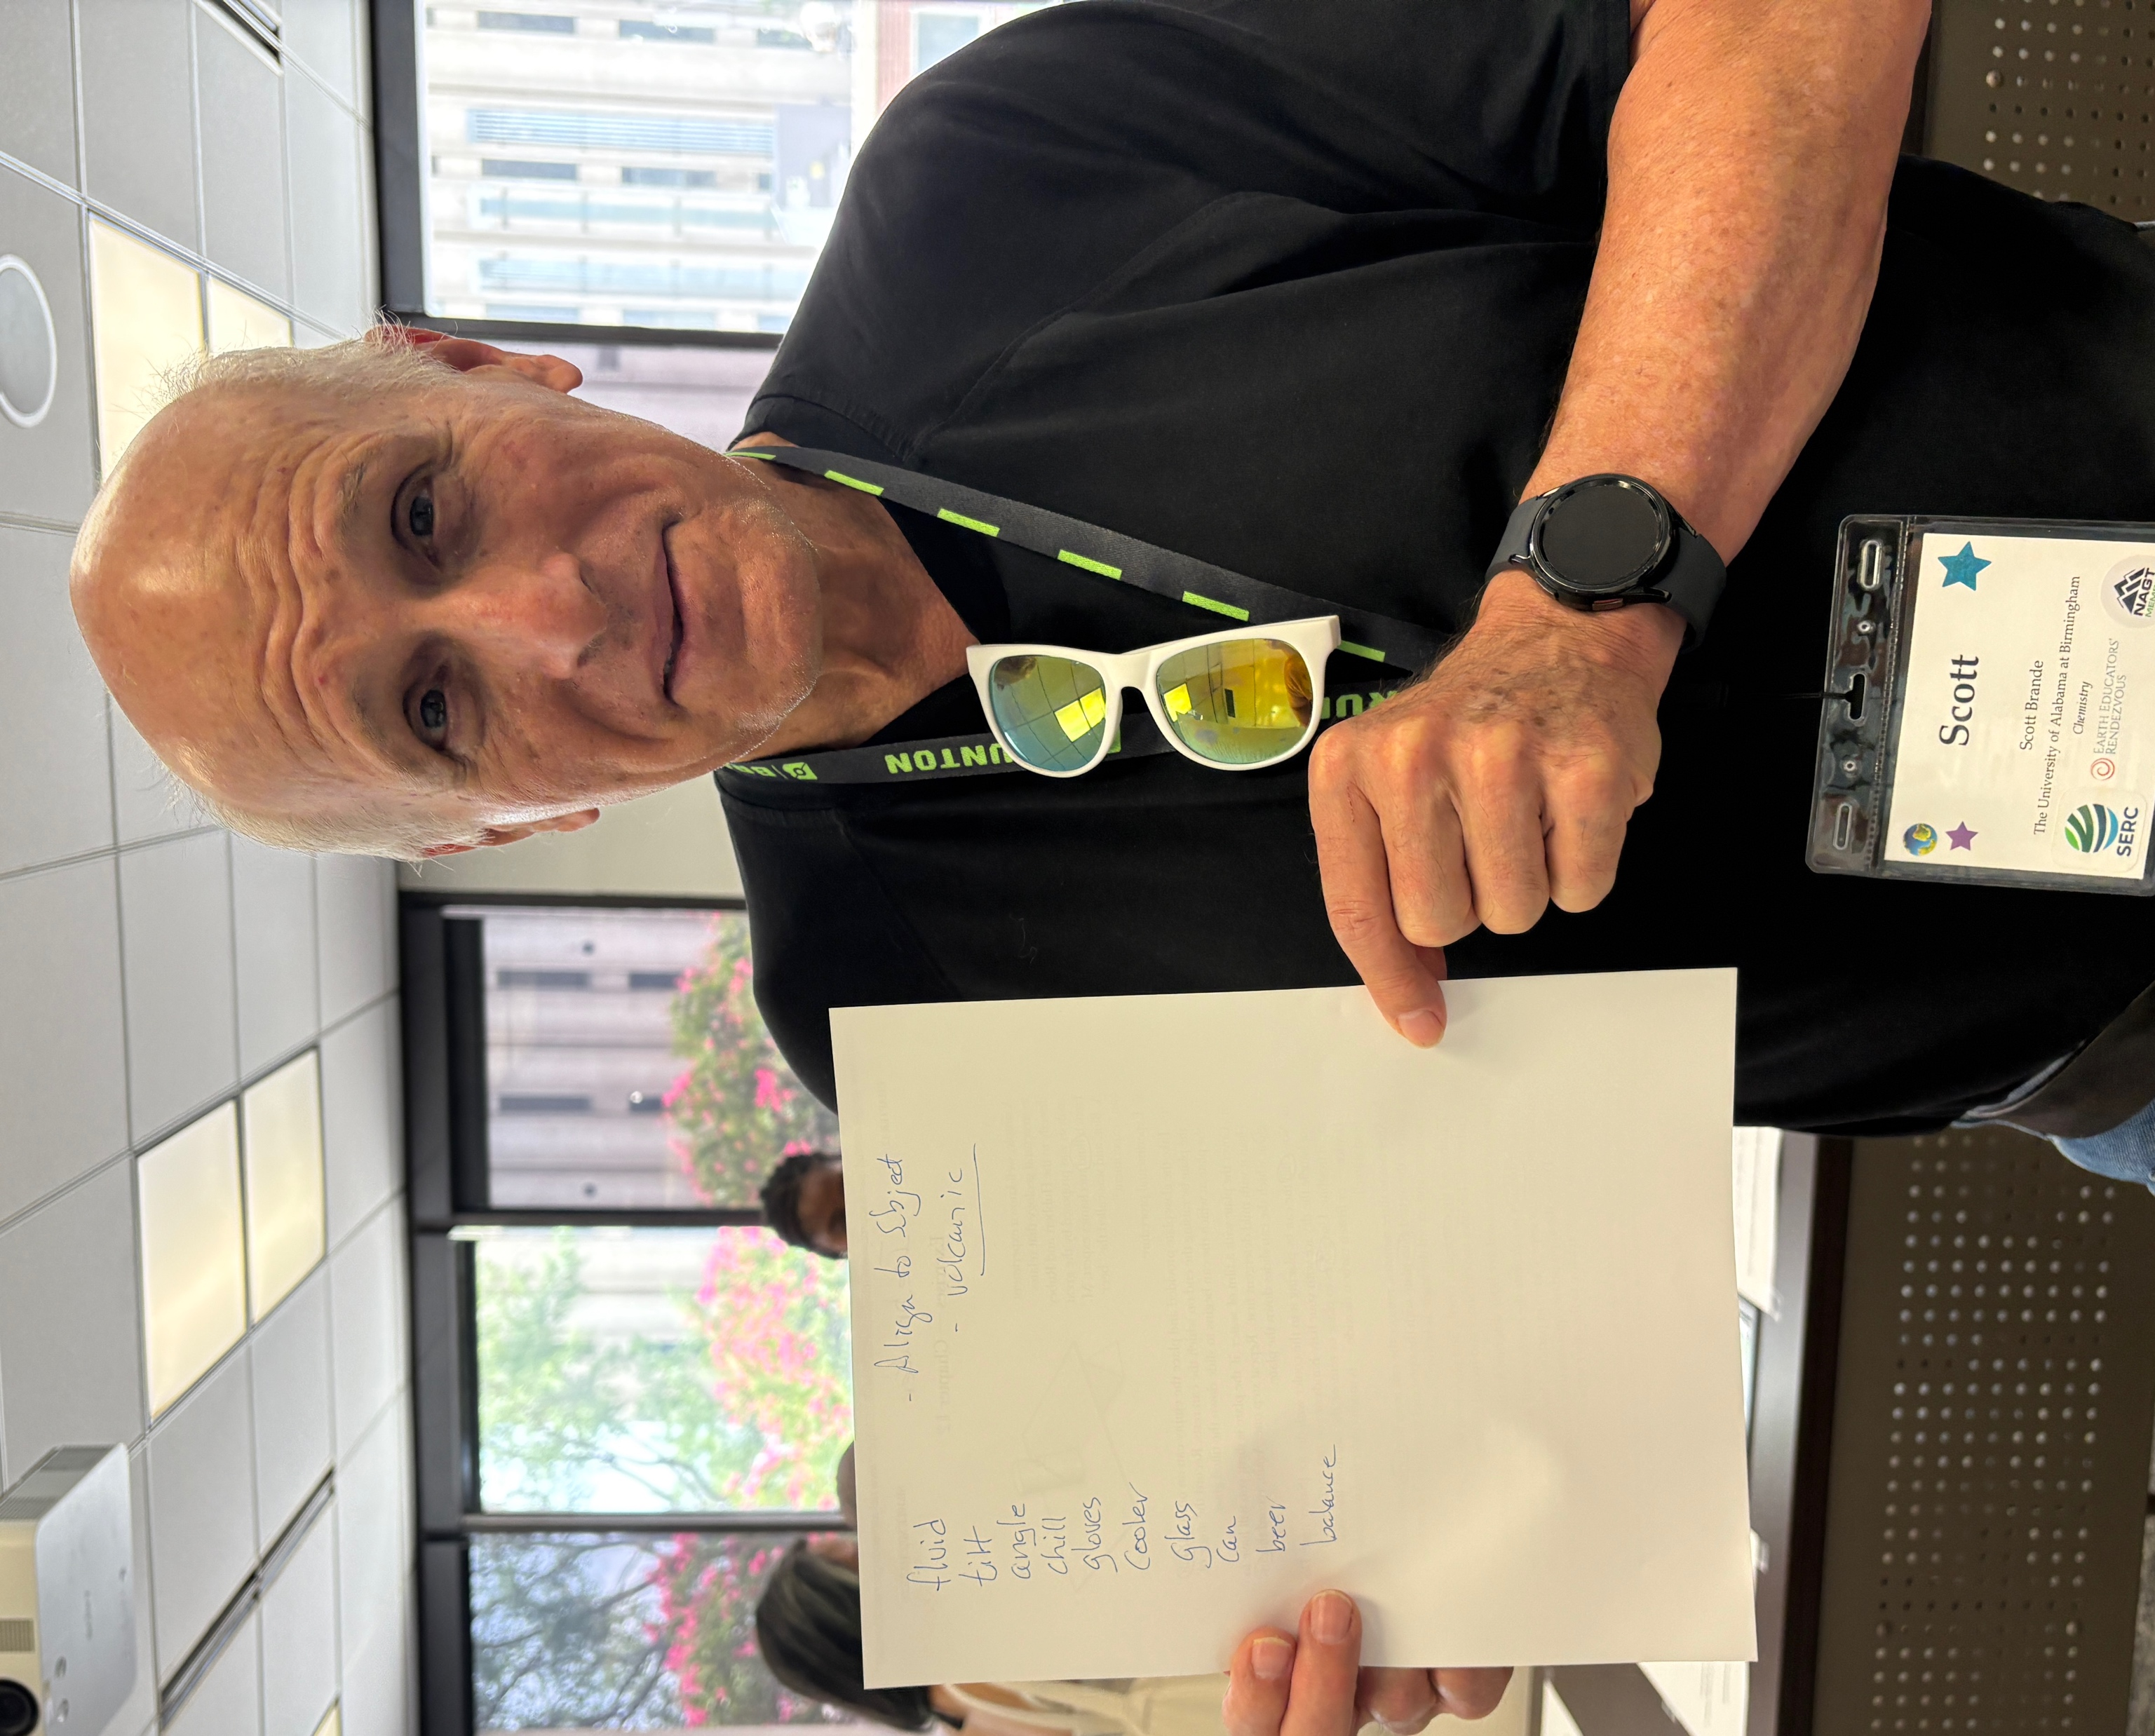
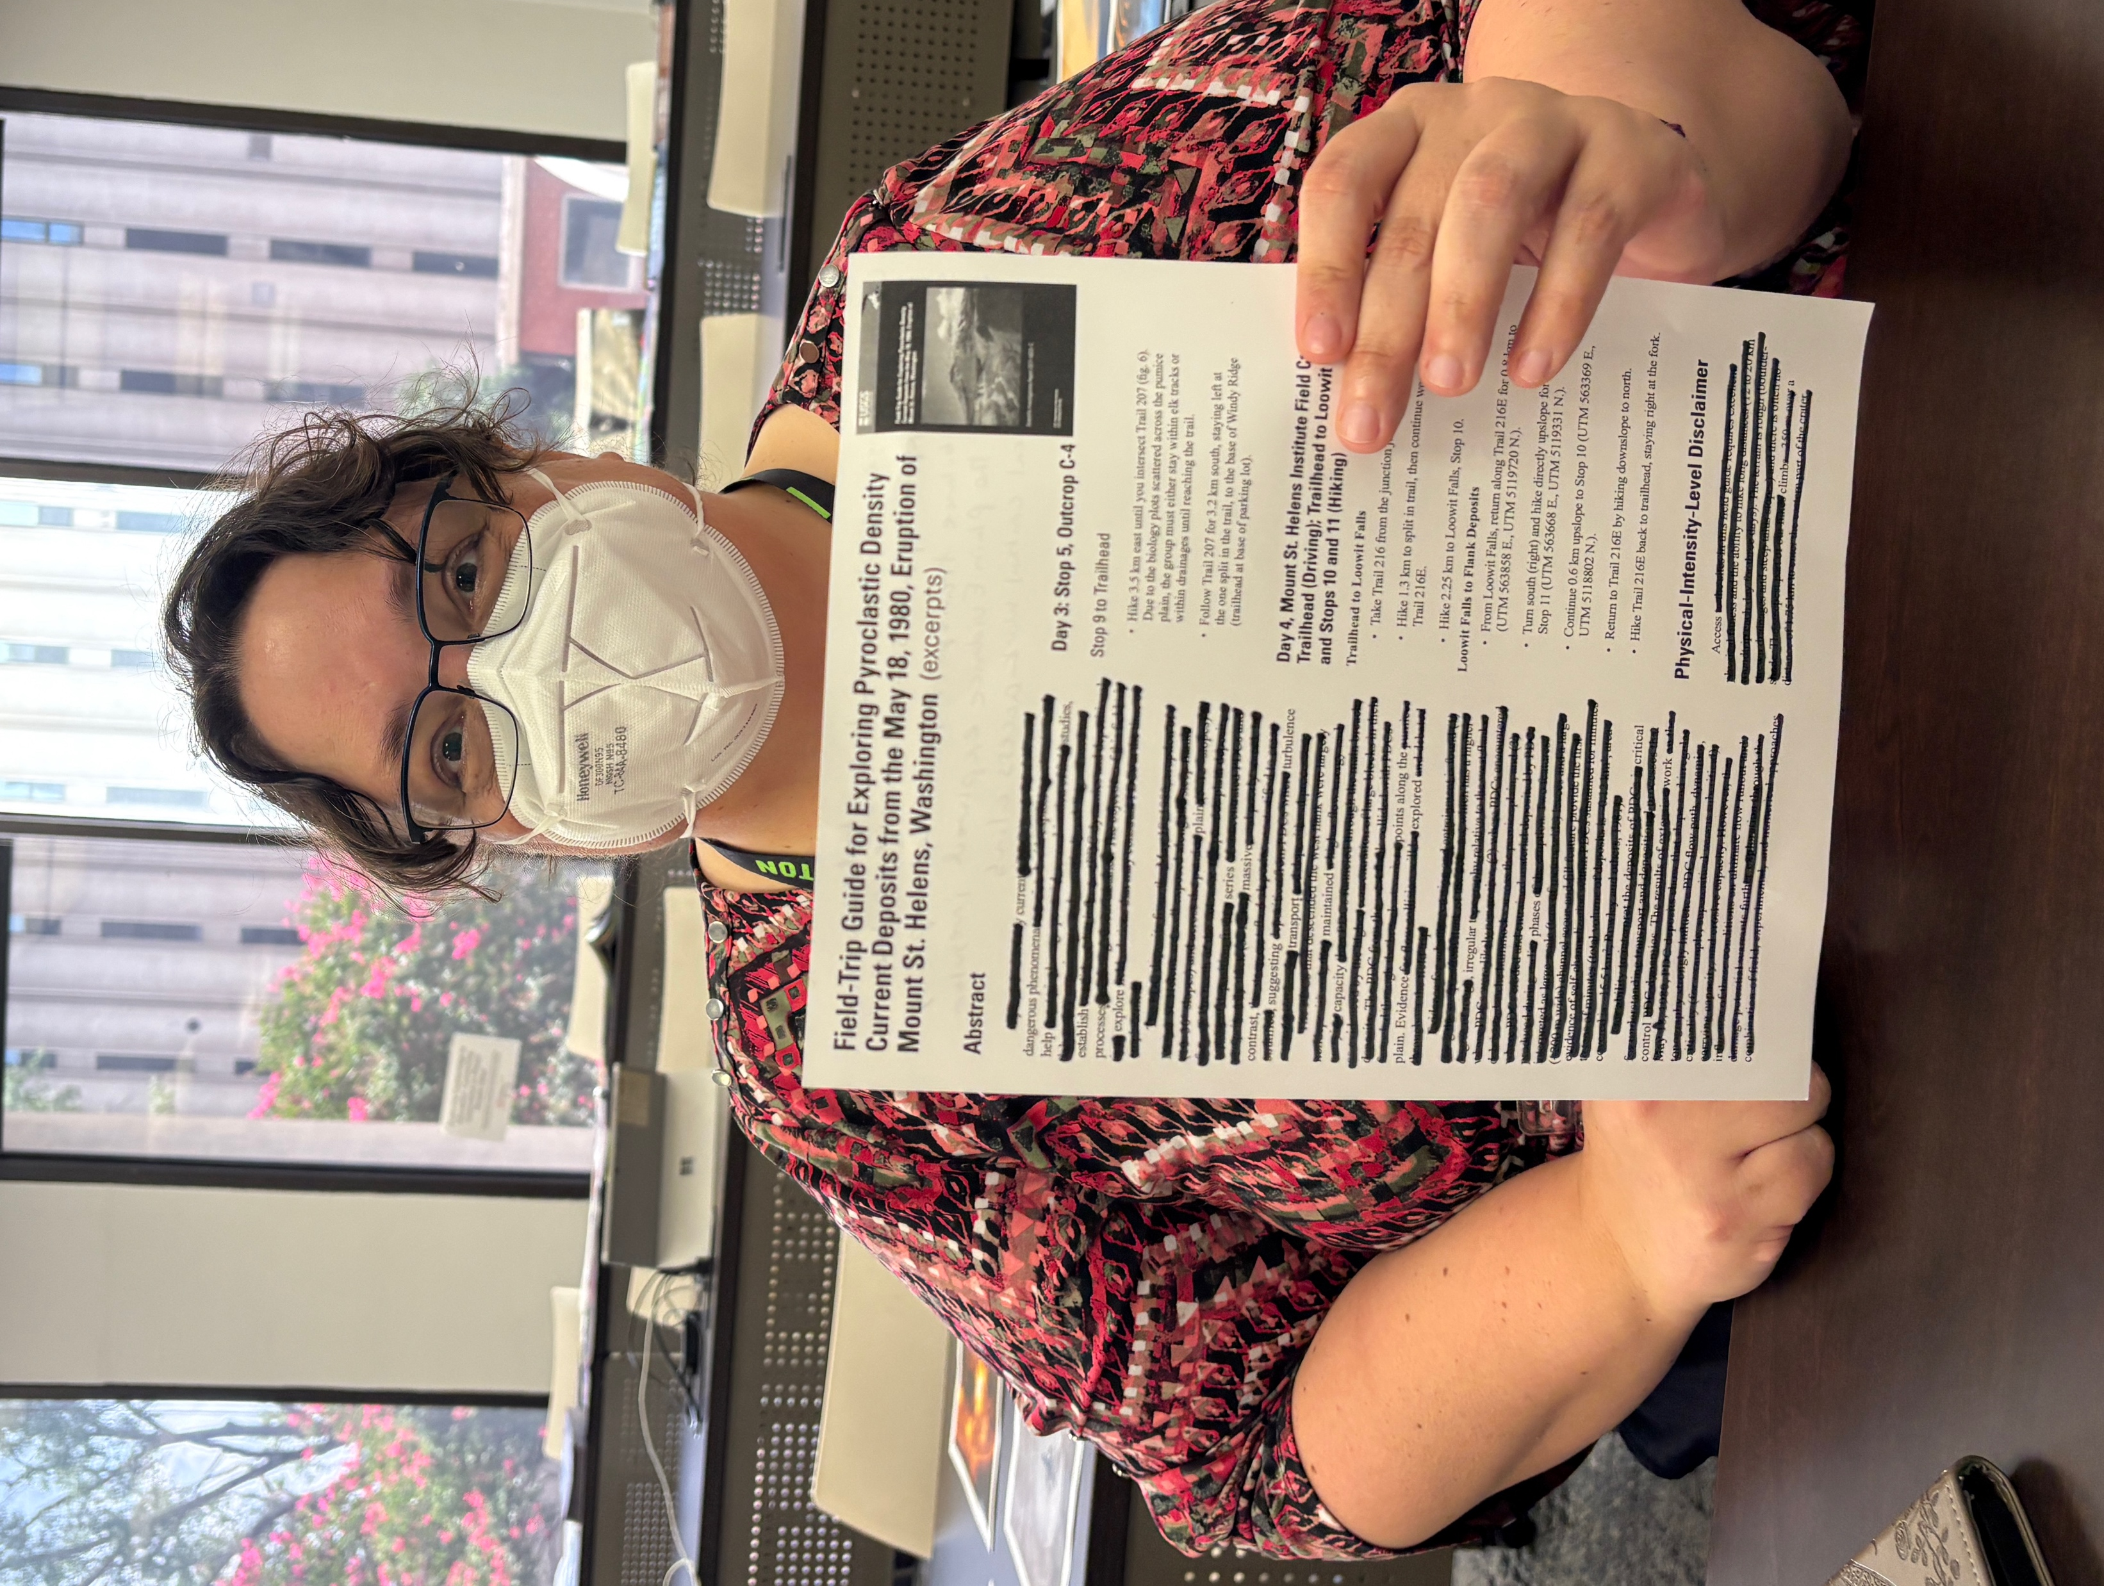
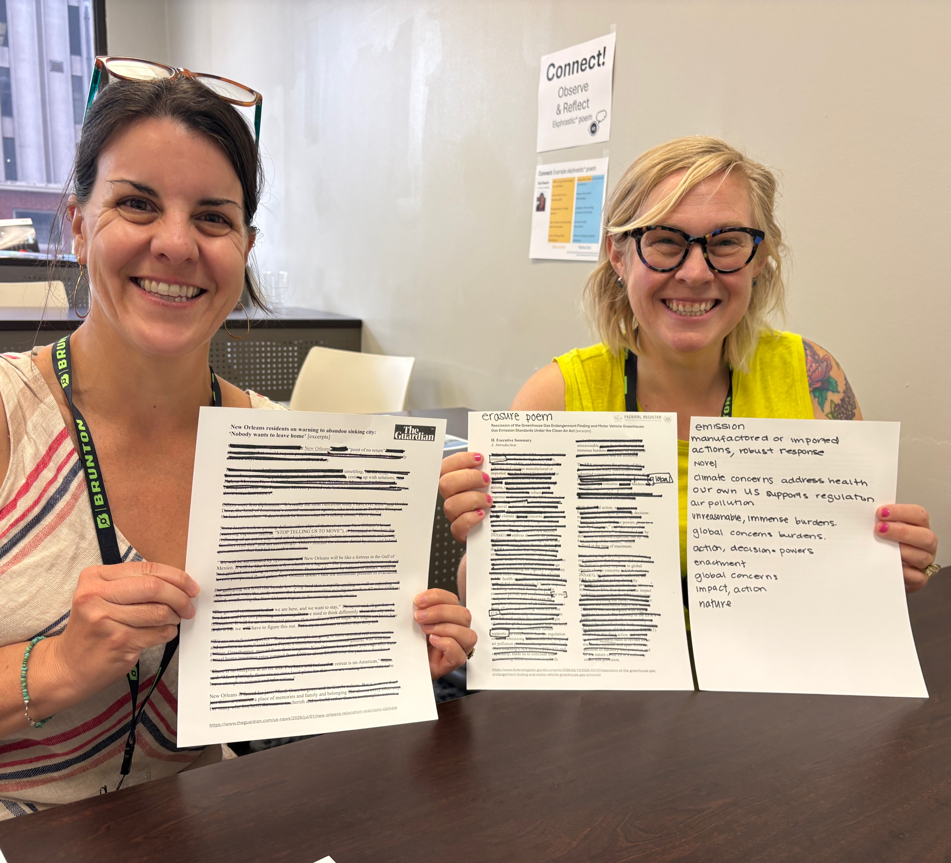
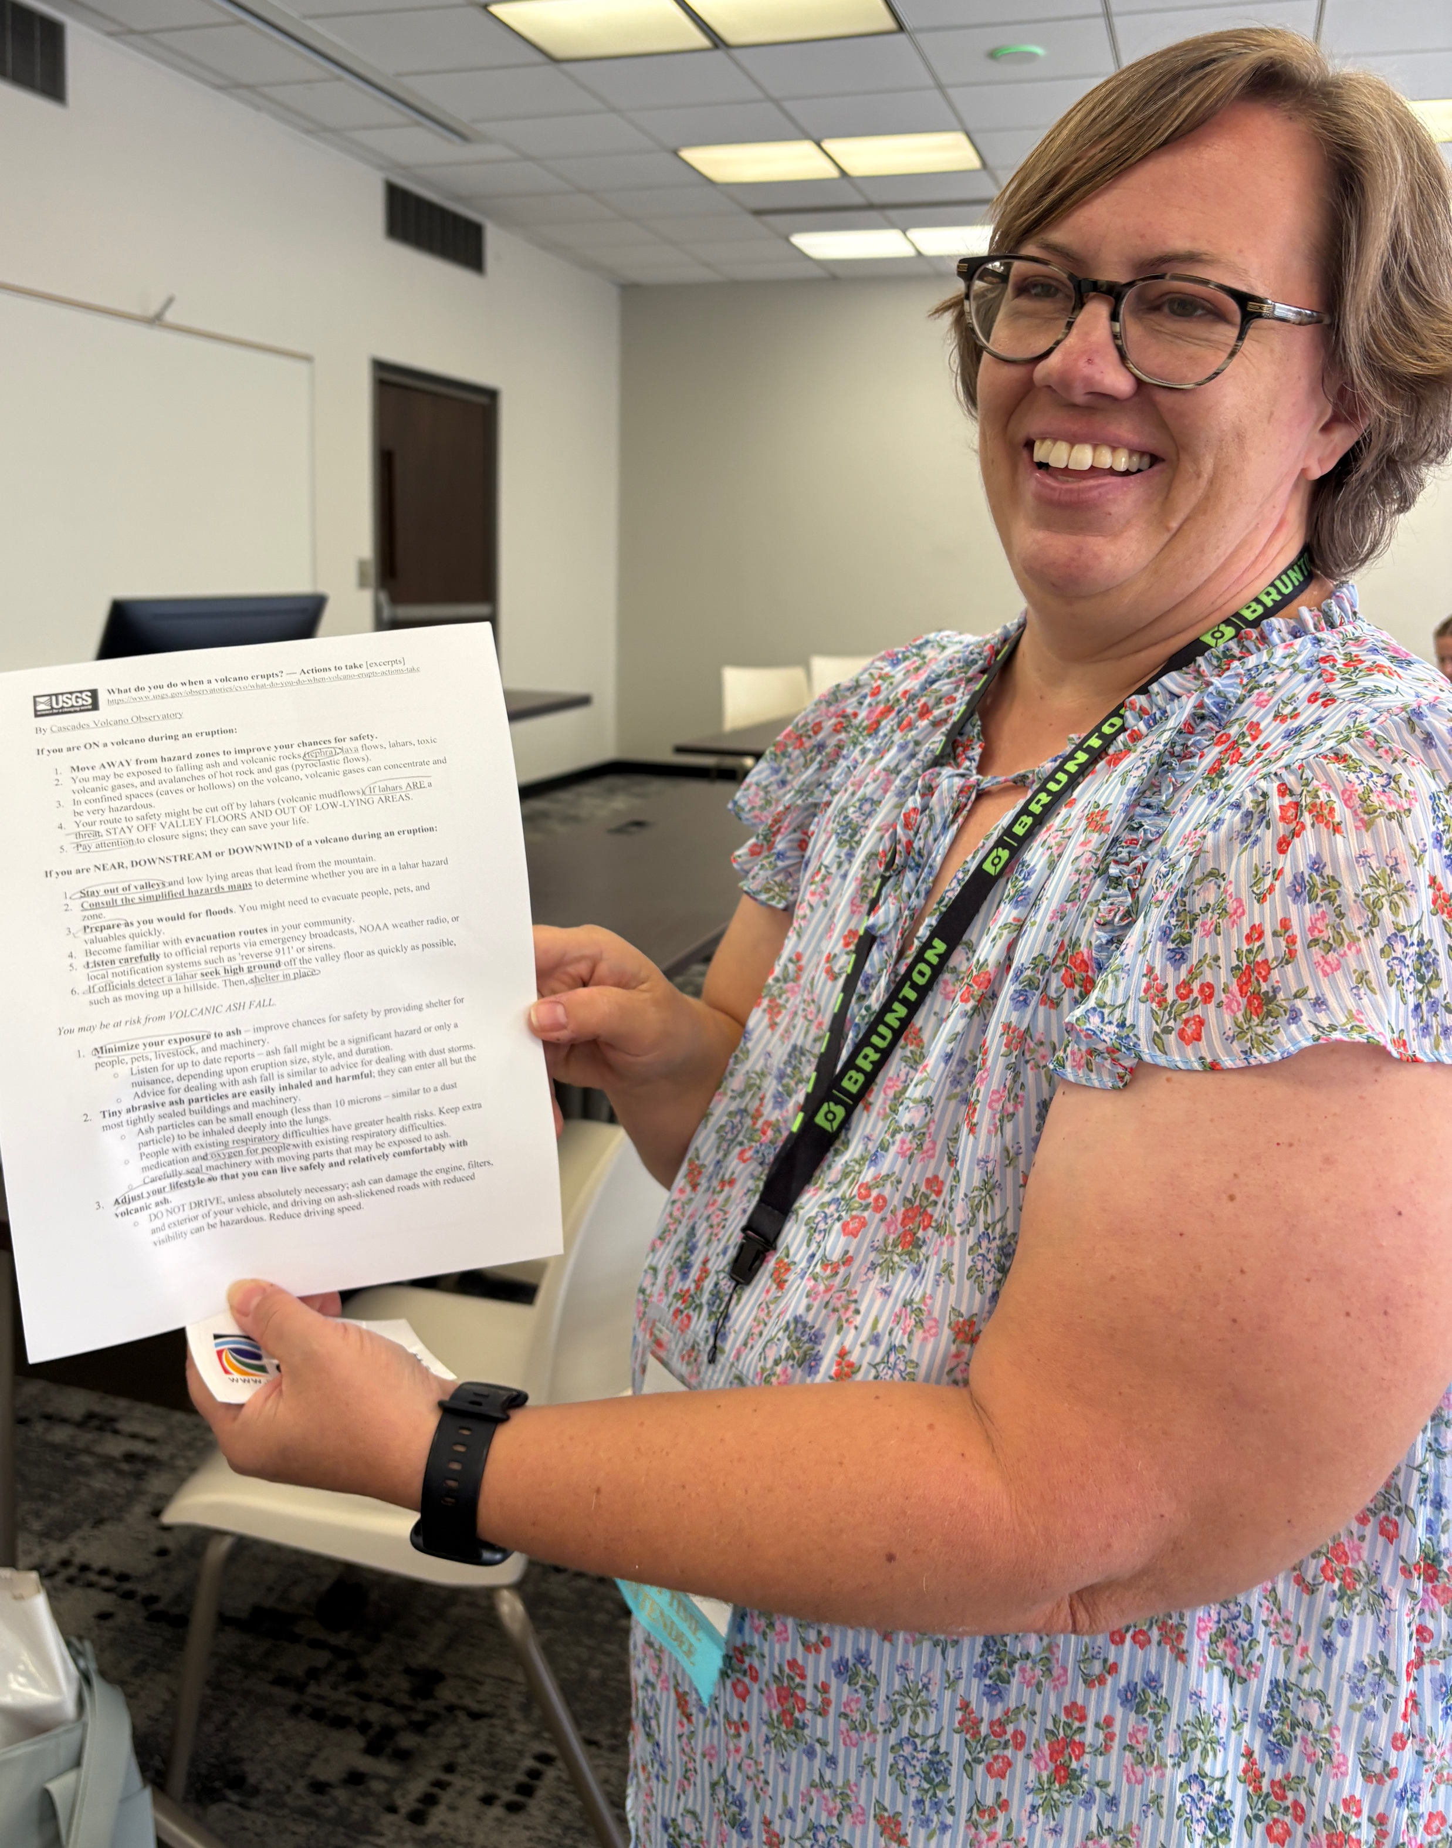
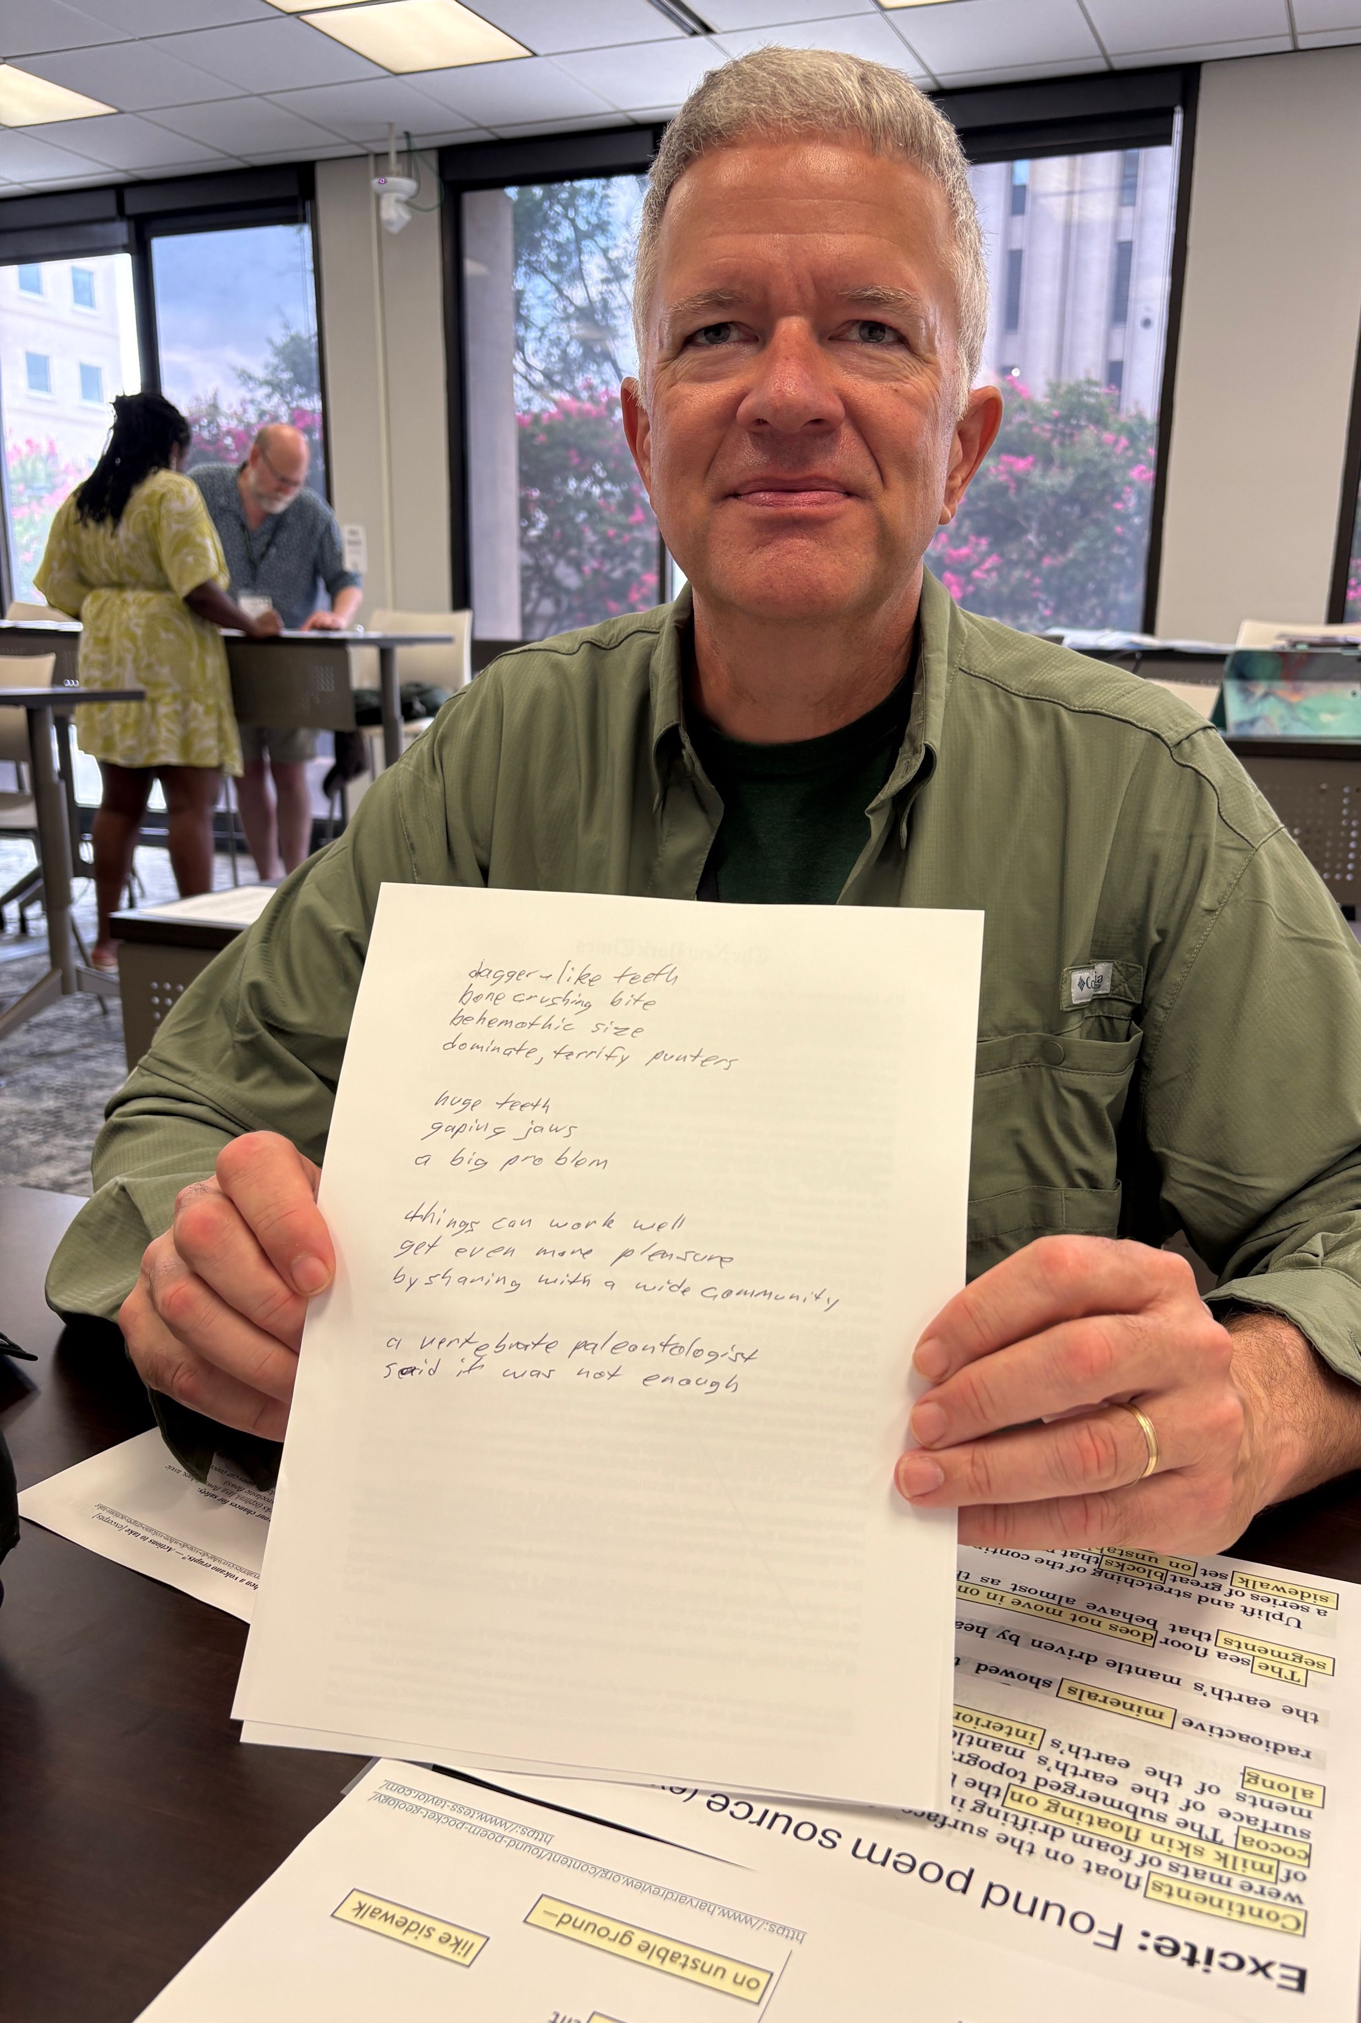
Empirically: Geopoetry is fun
Notes:
Empirical evidence: geoscientists can have fun writing geopoetry.

Slide 4
Problem: Finite planet
Climate change
Biosphere integrity
Novel entities
Land system change
Ozone depletion
Aerosol loading
Freshwater change
Ocean acidification
Biogeo-chemical flows
From Richardson et al. 2023 Earth
beyond six of nine planetary boundaries.
Notes:
Why do this?
Problem: We are exceeding our planet’s capacity.
Freshwater: green = water in soil/plants; blue = water in water bodies
Novel entities = synthetic, human-made pollutants: plastics, heavy metals, PCBs…
Aerosol loading = sulfur, dust, soot

Slide 5
Problem: Epistemology of disconnection
Distancing,
indifference
Alienation from nature
Human-nature decoupling
Biophobia
Diverging nature perception
Solastalgia
Lack of outdoor code of conduct
Philosophical
Exclusion (outsidedness)
Emotional
Sociocultural
Biocultural memory loss
Dominant norms
Epistemology of Disconnection from Nature
Epistemology of Disconnection
Danger
Individual
Ecological illiteracy
Discrimination
Societal
Cognitive
Institutional
Social extinction of species
Displacement
Injustice
Extinction of experience
Procedural inequalities
Experiential
Political
Nature deficit disorder
Distributional inequalities
Material
VR experiences
Lack of access
Zoonoses
pathogens
Telecoupling
(S-E-S)
Grey infrastructure
Food deserts
From Beery et al. 2023
Disconnection from nature:
Expanding our understanding of human–nature relations
Notes:
Why are we exceeding planetary capacity?
Thomas Beery (Sweden) & colleagues argue that the Western system of higher education perpetuates an epistemology of disconnection from nature
At individual and societal scales
In these many realms

Slide 6
Solution: Epistemology of reconnection
Epistemology of Disconnection
From Bai et al. 2013 Revisioning higher education
Expanding our understanding of human–nature relations
Notes:
Where do we look for a solution?
We find one in the educational philosophy work of Heesoon Bai, who posits that
reconnection to nature requires
reconnection to each other, which requires
reconnection to self
So, what does geoscience & poetry have to do with this?

Slide 7
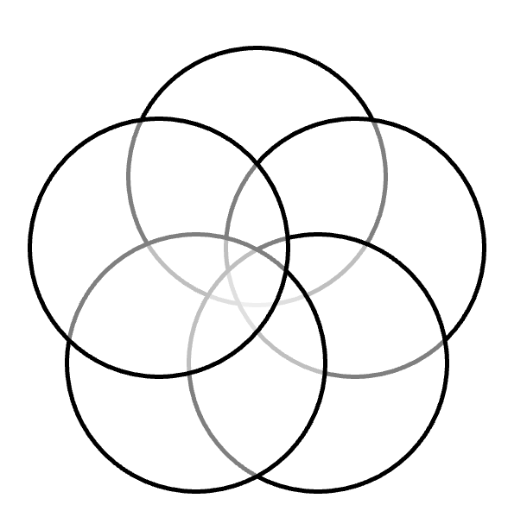

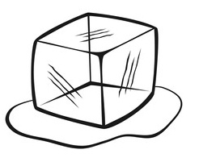
Why integrate geoscience & poetry?
Interdisciplinarity
Geosciences = inter & transdisciplinary
(e.g., Mosher & Keane 2021, Finn et al. 2022)
Inter & transdisciplinary work = hard
(e.g., Mather et al. 2023)
Interdisciplinarity ⇆ interculturality
(e.g., Islam and Stamp 2020 )
Poet diversity systemic racism in STEM
(e.g., Ali et al. 2021, Burton et al. 2026)
Interculturality
Notes:
So, what does geoscience & poetry have to do with this?
I’m going to trace three main reasons to integrate geoscience and poetry, and then connect them back to Bai’s model.
The first is that geosciences are interdisciplinary and transdisciplinary.
And that kind of work is hard, so it’s worth teaching our students how to do it.
Increasing our students’ interdisciplinary capacities also increases their intercultural capacities.
Adding poetry adds disciplinary diversity and can be used to add demographic diversity of voices,
Which can help melt the systemic racism in STEM,
And that kind of work is also hard and is also worth doing.
Mosher & Keane 2021 = Vision & change https://www.google.com/url?sa=t&source=web&rct=j&opi=89978449&url=https://www.americangeosciences.org/change/pdfs/Vision-Change-Geosciences.pdf
Finn et al. 2022. Moving from interdisciplinary to convergent research across geoscience and social sciences: challenges and strategies. Environmetal Research Letters DOI 10.1088/1748-9326/ac7409
Mather et al. 2023
Ali et al. 2021. An actionable anti-racism plan for geoscience organizations. Nature https://doi-org.offcampus.lib.washington.edu/10.1038/s41467-021-23936-w
Burton et al. 2026. Geoscience Diversity Programs: What Works and Does Not and Their Evolution Through Time. https://doi.org/10.1146/annurev-earth-040623-101222

Slide 8
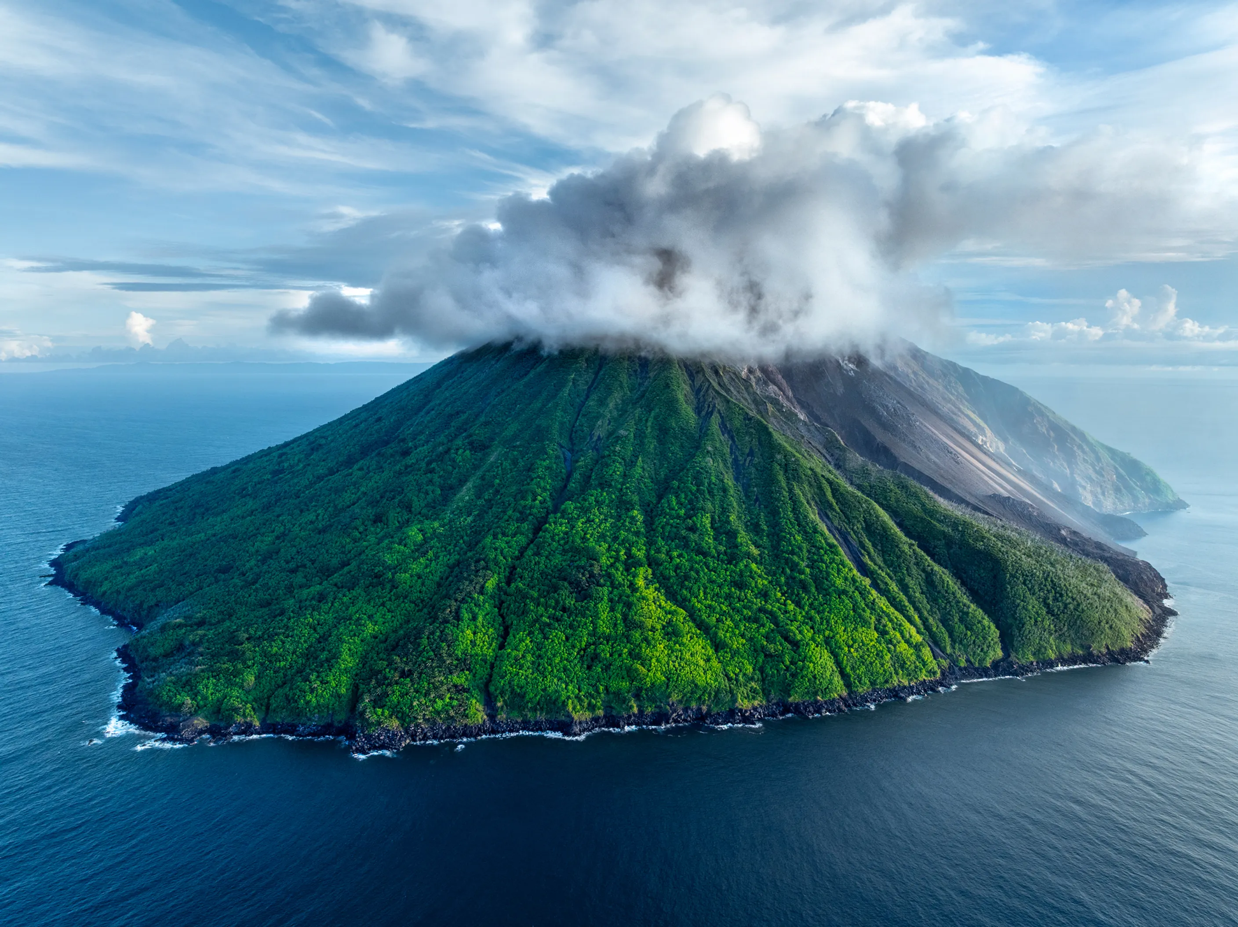

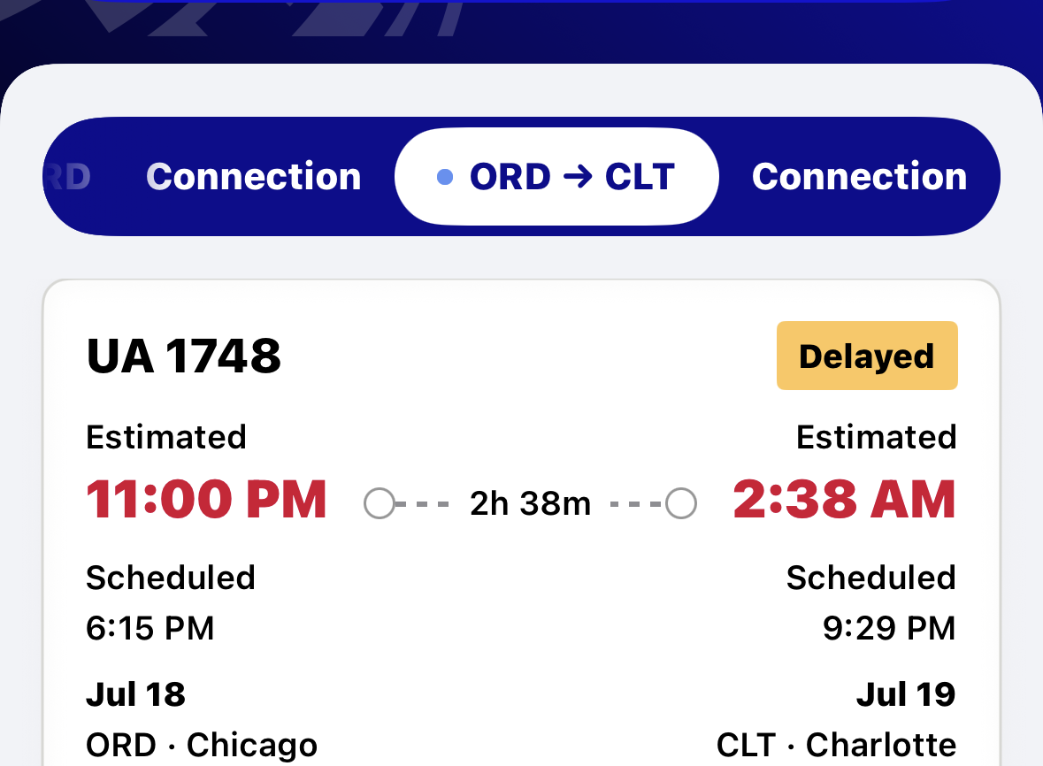



Why integrate geoscience & poetry?
Awe & dissonance
Manu San Félix
Steadfast TV
Beauty & awe → wellbeing
(e.g., Jiang et al. 2024)
Grief & anger = real
Dissonance = real
(e.g., Benham & Hoerst 2024)
Transformation
(Mezirow 2009, Kegan 2009)
Notes:
The second focuses on the transformative potential of emotional experiences
We know that experiences of beauty and awe in nature, or from a beautiful poem, can enhance wellbeing and – with reflection – can contribute to transformational learning.
We also know that experiences of shock, grief, and anger are real emotions associated with working in geosciences
And that dissonance of – for example – a delayed flight – when you realize that you are part of the wildfire and storm problem
These experiences also can contribute to transformational learning if you have a way to process them. Such as poetry.
Tinakula, Solomon Islands, Photograph by Manu San Félix, https://www.nationalgeographic.com/photography/graphics/pictures-of-the-year-2025
Deepwater Horizon: Photograph courtesy Steadfast TV https://www.nationalgeographic.com/science/article/100527-gulf-oil-spill-nation-rig-pictures
Six Maui sand grains: https://sandgrains.com/

Slide 9

Why integrate geoscience & poetry?
“Pay attention.”
– Mary Oliver
Geology students must “see for themselves”
– Kingsley (1872)
Complementary
Explain
Evoke
“The environmental crisis is, in part, a crisis of the imagination. Poems can create a new form of knowing.”
– Madhur Anand
“Science needs the intuition and metaphorical power of the arts, and the arts need the fresh blood of science.”
– E.O. Wilson
Poetry: “the best words in the best order”
– Coleridge
“Be precise and accurate. “Be clear.”
– James Levine
Skills
Notes:
The third is because they are mutually reinforcing.
Poets and scientists are really good at noticing things.
According to those who are both scientists and writers, we need each other to increase our insight, inspiration, and imagination.
And we all have to communicate effectively. Science communications texts exhort us to be precise, concise, clear – pretty much what Coleridge said poetry was all about.
Chen 2021 Integration of Creative Thinking and Critical Thinking to Improve Geosciences Education. The Geography Teacher https://doi-org.offcampus.lib.washington.edu/10.1080/19338341.2021.1875256
How to Observe https://books.google.com/books?hl=en&lr=&id=3xQ5AAAAMAAJ&oi=fnd&pg=PR1&dq=learning+to+observe+in+geology&ots=XLr8weKFPc&sig=uxnm1aBsMnJmStS5ItXYJk60Xhs#v=onepage&q&f=false
Unpacking the Complexity in Learning to Observe in Field Geology
Lauren A. Barth-Cohen
&
Sarah K. Braden
Pages 233-265 | Published online: 06 Jul 2021
Cite this article
https://doi-org.offcampus.lib.washington.edu/10.1080/07370008.2021.1934683
Geology may be defined to be that branch of natural history which investigates the successive changes that have taken place in the organic and inorganic kingdoms of nature. It is a science founded on exact observation and careful induction; it may termed the physical history of our globe; it investigates the structure of the planet on which we live and explains the character and causes of the various changes in the organic and inorganic kingdoms of nature. William Humble in: Dictionary of geology and mineralogy: comprising such terms in botany., H. Washbourne, 1843, p. 104.

Slide 10
Why integrate geoscience & poetry?
Interdisciplinarity
Awe & dissonance
Complementary
Interculturality
Transformation
Skills
Notes:
When we look at these together, we see opportunities to
Connect ourselves to each other
Connect ourselves to ourselves
Connect ourselves to nature

Slide 11
Solution: Epistemology of reconnection
Epistemology of Disconnection
From Bai et al. 2013 Revisioning higher education
Expanding our understanding of human–nature relations
Notes:
Fulfilling Bai’s imperative to change the fundamental epistemology of higher education
Ok, so, no big deal
How do we actually do that?

Slide 12
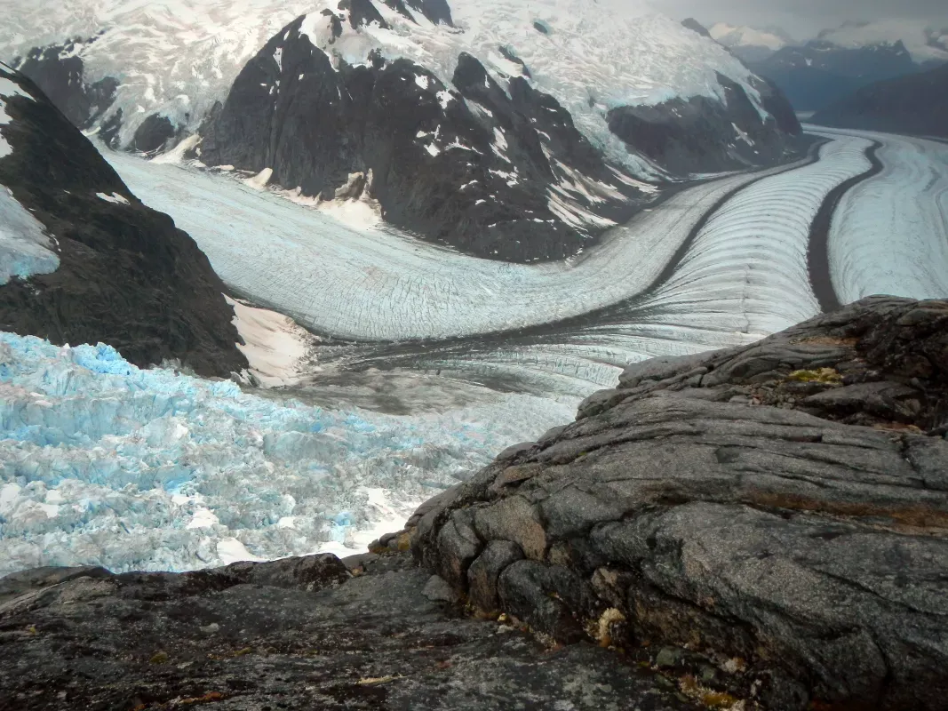
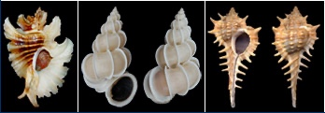
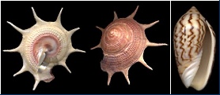
How to integrate science & poetry? Theoretical
Biogeopoetics
Functional morphology
Glacier
The miles-deep Greenland glacier’s lost its grip,
sliding nine miles a year towards the sea
on its own melt-water….....
– Gillian Clarke
ttps://nsidc.org/learn/parts-cryosphere/glaciers/science-glaciers
https://ucmp.berkeley.edu/taxa/inverts/mollusca/gastropoda.php
Notes:
I’m going to frame the key components of an integrated biology-poetry class with some adaptations for geoscientists.
First, we picked our theoretical themes.
Poetically, we focused on contemporary biogeopoetics, which means poetry in which plants, animals, water, and the landscape are not merely symbols, but have agency and opinions. Like this glacier that has “lost its grip”
Biologically, we focused on functional morphology of molluscs – and also of mushrooms
Glacier: https://nsidc.org/learn/parts-cryosphere/glaciers/science-glaciers
Glacier poem: https://www.theguardian.com/books/booksblog/2020/jun/22/poem-of-the-week-glacier-by-gillian-Clarke
Shell images:

Slide 13
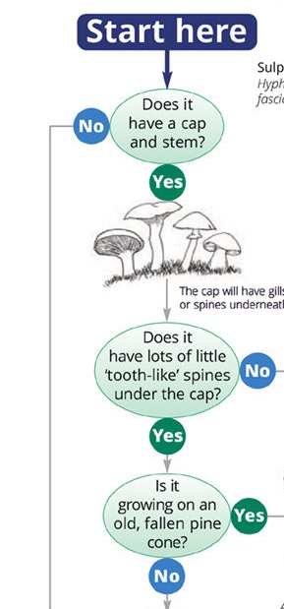
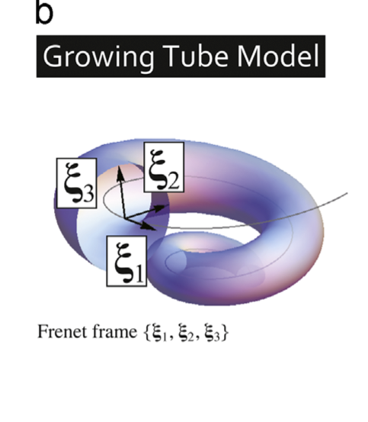
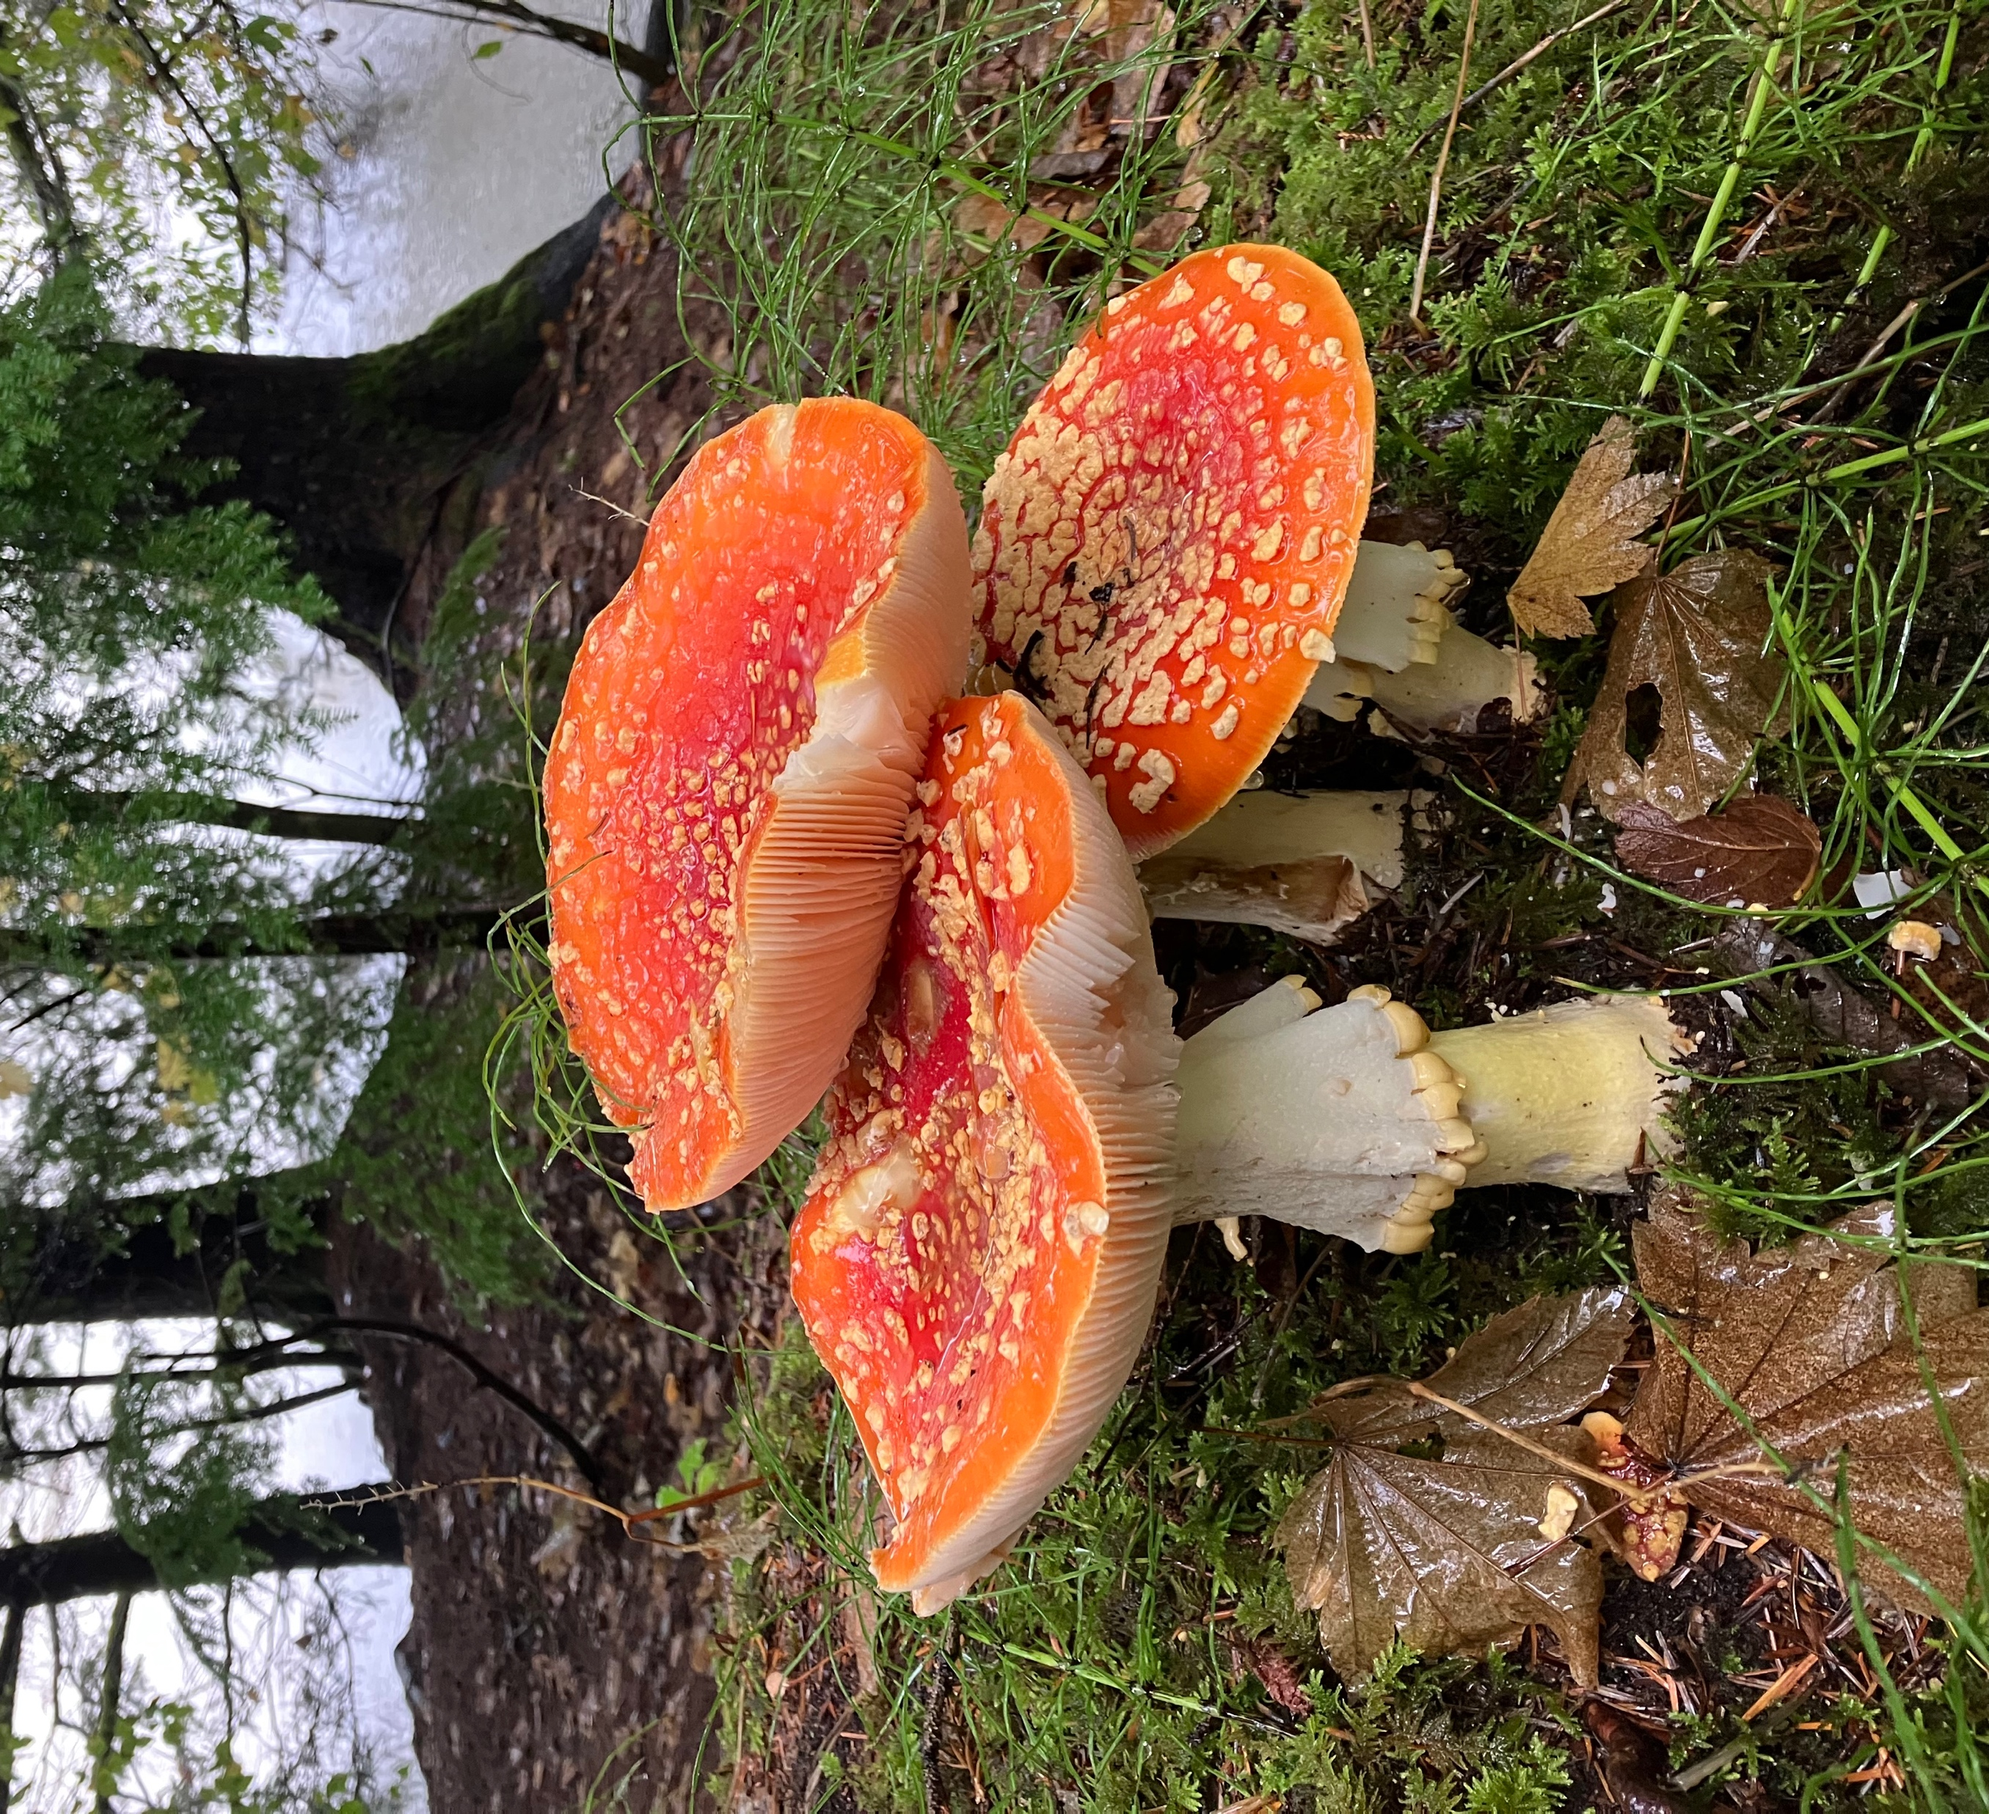
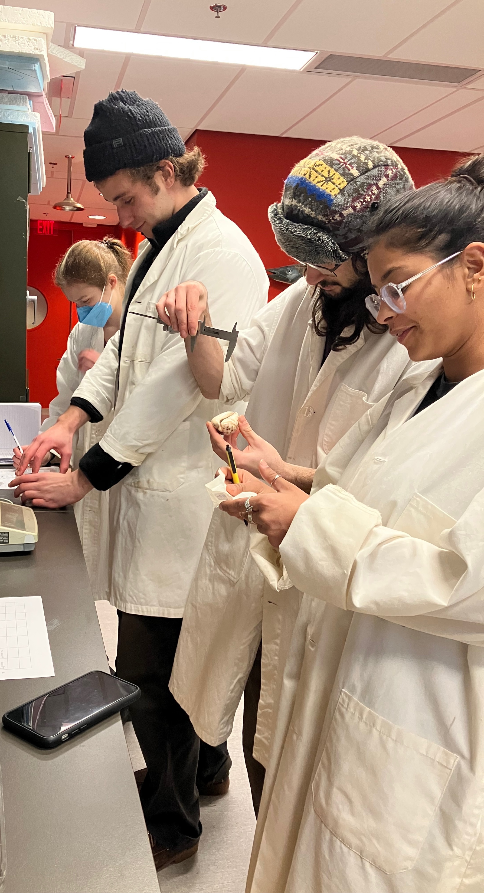
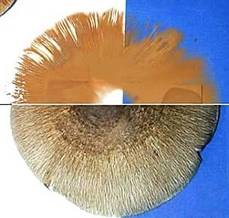
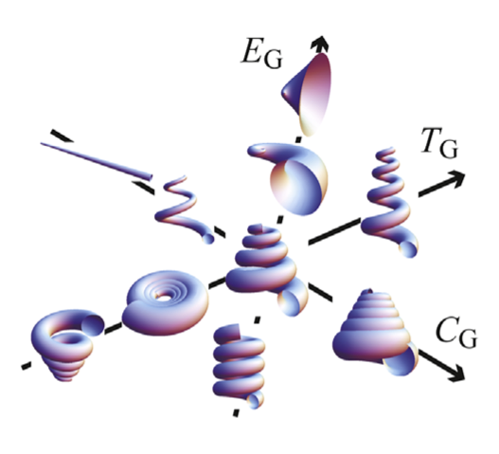
How to integrate science & poetry? Empirical
Field & Lab work
https://en.wikipedia.org/wiki/Spore_print#/media/File:Spore_print.jpg
https://meadowinmygarden.co.uk/products/fungi-name-trail
Noshita 2014
Notes:
Empirically, we focused on
Field and lab work to study these organisms through field and lab work, dichotomous keys, museum specimen work, and mathematical models
Dichotomous key: https://meadowinmygarden.co.uk/products/fungi-name-trail
Shell model: Quanti cation and geometric analysis of coiling patterns in gastropod shells based on 3D and 2D image data. Noshita 2014 http://dx.doi.org/10.1016/j.jtbi.2014.08.010
Spore print: https://en.wikipedia.org/wiki/Spore_print#/media/File:Spore_print.jpg

Slide 14
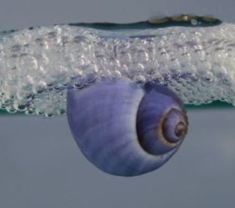
How to integrate science & poetry? Empirical
The Violet Sea Snail
…
Devour By-The-Wind-Sailors.
Feast on Bluebottle stingers.
Invert your world.
…..
Oh Purple Storm Wanderer:
begin as male & let ocean lick
you into the shape of a woman.
…
Now, crest on: leave swimming
to fins and those pink-skinned things
who collect your shell when you die.
Predation
Consonance
Orientation
Internal rhyme
Color
Alliteration
Reproduction
Caesura
Turn!
https://smbasblog.com/2025/08/09/janthina-janthina-the-violet-sea-snail-now-coming-to-a-beach-near-you/
Planktonic
End rhyme
– Scott-Patrick Mitchell
Notes:
But there’s also empirical work in studying a poem, both its content and its form
Janthina: https://smbasblog.com/2025/08/09/janthina-janthina-the-violet-sea-snail-now-coming-to-a-beach-near-you/
Greek ion ("violet") + anthos ("flower")

Slide 15
How to integrate science & poetry?
lab & field notebooks
Conceptual
Biogeopoetics
Functional morphology
Empirical
Organisms & Poems
mind maps
daily close readings
Notes:
So far we’ve covered the conceptual framework and the empirical approach to this course

Slide 16
How to integrate science & poetry?
Analytical
lab & field notebooks
Conceptual
Biogeopoetics
Functional morphology
Empirical
Organisms & Poems
mind maps
daily close readings
research papers & presentations
Analytical
Biogeopoetic poems
Notes:
The analytical component required students to write research papers comparing multiple published poems on the same biological theme, and situating them in the conceptual context

Slide 17

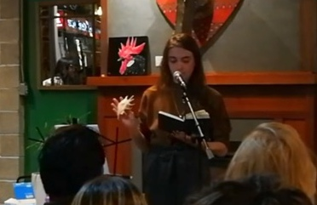
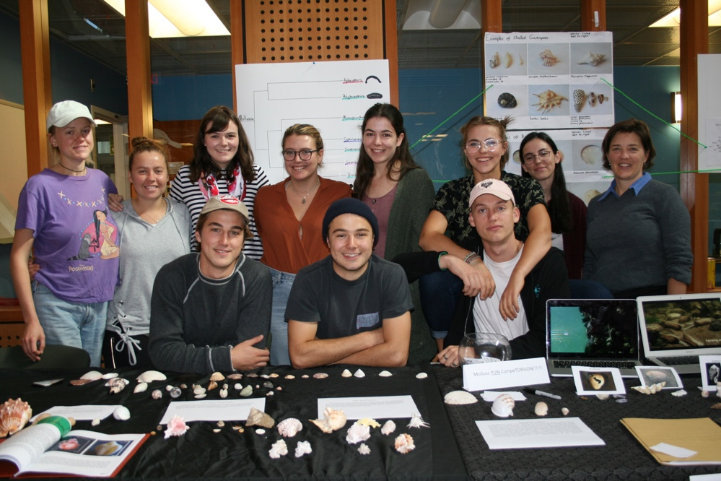
How to integrate science & poetry?
Portfolios
Zine
Display & Open mic
https://www.youtube.com/watch?v=0woDZBZjlSc
Notes:
The creative component included producing a portfolio of their own revised poems, along with an explanatory commentary;
A class zine of selected and edited poems
A public-library display in town of their poems and shells
And performing at an open-mic night that we took over in a local café.
Portfolio notebook: https://goldspot.com/products/clairefontaine-notebook-age-bag-6x8-1-4-60-sheets-lined-green?srsltid=AfmBOoqOaHEayqZBAx-gyTOv2cPKeNKhYP6f_tS1L01A_xULe7d8m1Vo
Zine
Display
Open mic

Slide 18
How to integrate science & poetry? Creative
peer-reviewed zine
Creative
Poems & commentaries
public-library display
individual portfolio
open-mic performance
lab & field notebooks
Conceptual
Biogeopoetics
Functional morphology
Empirical
Organisms & Poems
mind maps
daily close readings
research papers & presentations
Analytical
Poems & Science
Notes:
So here’s the whole shape of the course.
And what happened?

Slide 19
Outcomes? Student experience
I was apprehensive…about poetry.
I originally was very nervous…about science.
I have never felt so seen in a university class.
I can be a scientist and also a poet. I can be a scientific poet!
[A] joyous adventure…
I loved seeing my writing evolving…
[It] transformed the way [I] knew what scientific knowledge "is" ….
I…merged personal struggles, social ecological issues, and scientific story
[It] has influenced the way that I walk through the world every day.
Notes:
Student comments reported early fears about poetry or about science
Joy and satisfaction
Reflections on how they did their work
Identity shifts
Epistemological shifts

Slide 20
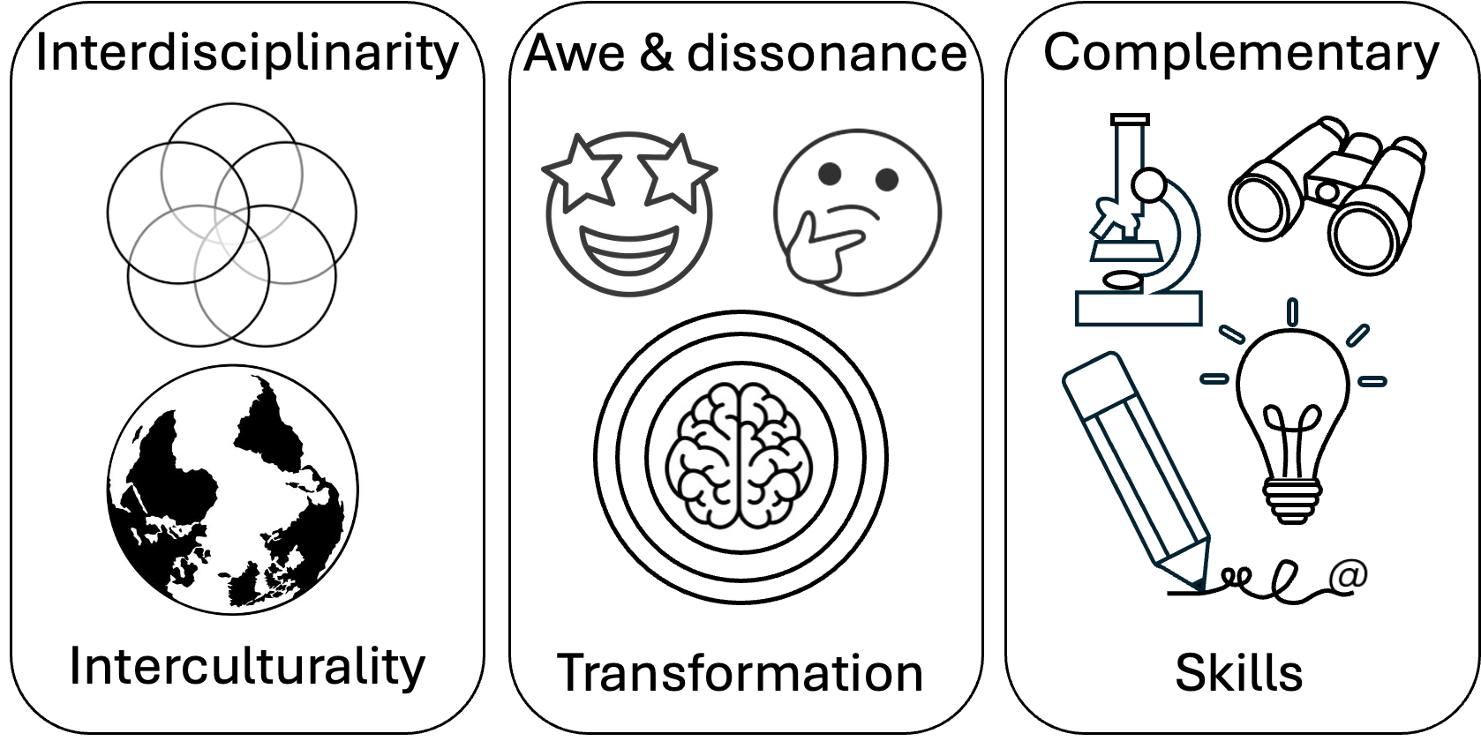
Outcomes? Faculty experience
Scary
Bemusing
Exciting
Surprising
Joyful
Easy-ish
Liberating
Generative
Humbling
Inspiring
Connecting
Notes:
Our faculty experience included learning in all these areas - with and from our students and from each other.

Slide 21
Problem: Epistemology of disconnection
Distancing,
indifference
Alienation from nature
Human-nature decoupling
Biophobia
Diverging nature perception
Solastalgia
Lack of outdoor code of conduct
Philosophical
Exclusion (outsidedness)
Emotional
Sociocultural
Biocultural memory loss
Dominant norms
Epistemology of Disconnection from Nature
Epistemology of Disconnection
Danger
Individual
Ecological illiteracy
Discrimination
Societal
Cognitive
Institutional
Social extinction of species
Displacement
Injustice
Extinction of experience
Procedural inequalities
Experiential
Political
Nature deficit disorder
Distributional inequalities
Material
VR experiences
Lack of access
Zoonoses
pathogens
Telecoupling
(S-E-S)
Grey infrastructure
Food deserts
From Beery et al. 2023
Disconnection from nature:
Expanding our understanding of human–nature relations
Notes:
Mapped onto this framework, overall, we found that we and our students were getting at these areas and manifestations of disconnect

Slide 22
Solution: Epistemology of reconnection
Epistemology of Disconnection
From Bai et al. 2013 Revisioning higher education
Expanding our understanding of human–nature relations
Notes:
And mapped onto this framework, were gaining insights into relationships with ourselves, with each other, and with nature
So, bottom line, poetry and geoscience can pretty much save the world.
Or at least, you can have a lot of fun doing your small part.

Slide 23
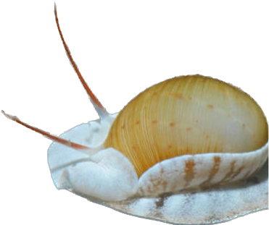
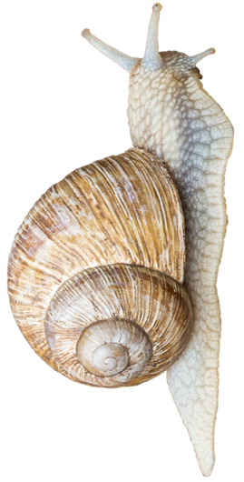
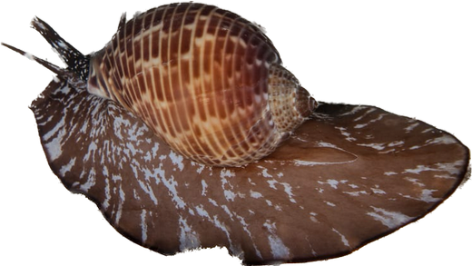
Gastropoda
Some people may find it heinous
that your head be so close to your anus¹,
yet your design is a treasure
to conceal your pleasure
from the crabs and fishes that eat you².
From high in the mountains
to volcanic fountains³
you’ve diversified your form⁴.
With ridges and furls
and spiraling whirls
like galaxies being born.
Though your foot may be slimy
and your radula spiny⁵
your shell is a beauty that nature has made.
So don’t always judge
a snail by its lair,
for beauty can lie
just about anywhere.
– Jake Linnon
Sao Mai (2014):
¹ torsion (lines 1-3)
² predation (lines 4-5)
³ habitat diversity (lines 6-7)
⁴ adaptive radiation (8-11)
⁵ foot and radula (lines 12-13)
Notes:
A whimsical account of gastropod diversification with line-by-line references to the scientific content

Slide 24
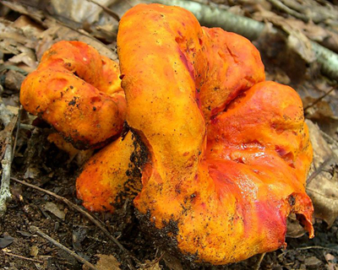
I Breathe in Spite of You
Slap me silly in my microhabitat You’re why I prefer the red room now Or is it orange?
And why do you care
About the mold in my hair
That recently murdered my mind
You have altered me
Changed my chemical composition Dark void
Destroyed
Taken pieces of my sanity
My clarity
I breathe in spite
Of who you are.
Knocked senseless from my senses Ignorance is a bliss, in an essence One I never knew.
https://www.wildernesscollege.com/lobster-mushroom.html
You intruded upon my gills Catastrophic artist
You lurk beneath the surface Mycotrophic parasite
Why am I worthless
Hypomyces lactifluorum
I breathe in spite of you.
– Kenzi Kamei
Notes:
I want first to share with you a poem written by one of our biology-poetry students: I Breathe in Spite of You.
So far, so dark.
And here’s the turn:

Slide 25

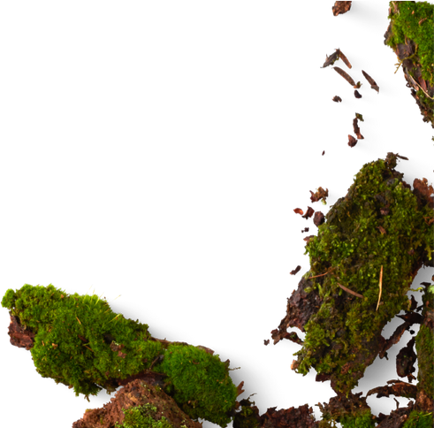
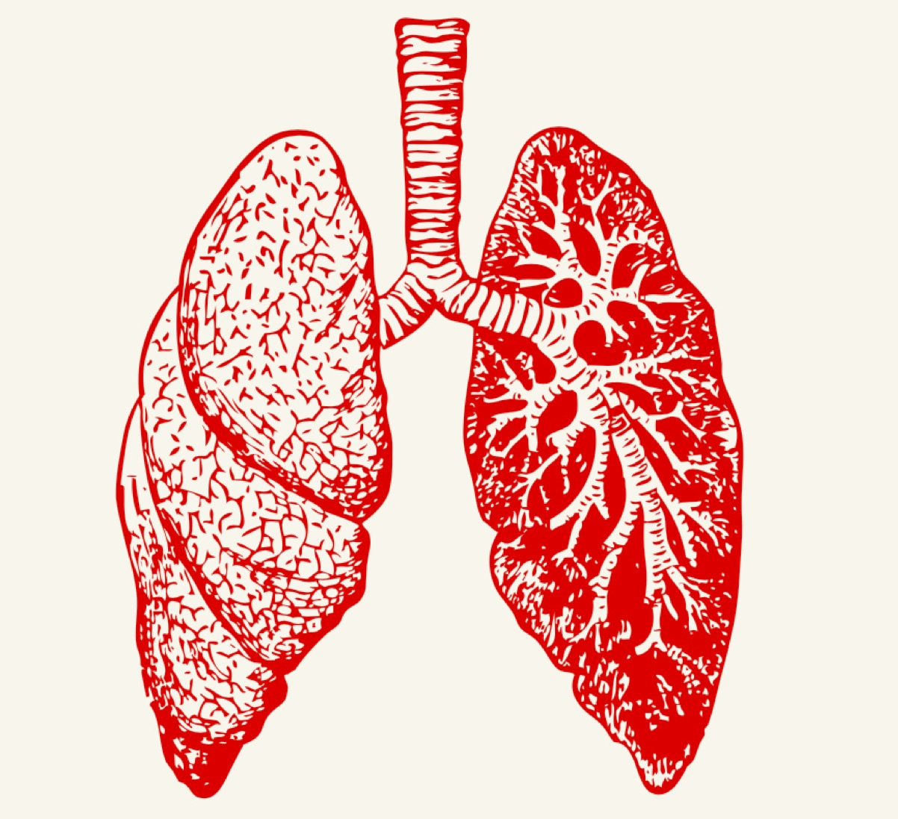
I Breathe in Spite of You
“Lobster mushroom parasites (Hypomyces lactifluorum ) form a hard red-orange shell over the host mushroom’s surface, subsume its gills and alter its consistency, flavor, shape and even DNA.
Although this poem is from the perspective of the host Russula, it also could be anyone speaking to any ‘demon’ that they have.”
Notes:
This excerpt from the scientific commentary & illustration accompanying this poem gives you more idea what she is working from: the orange lobster mushrooms that parasitize and change the white host Russula, changing their texture and composition and making them delicious.

Slide 26
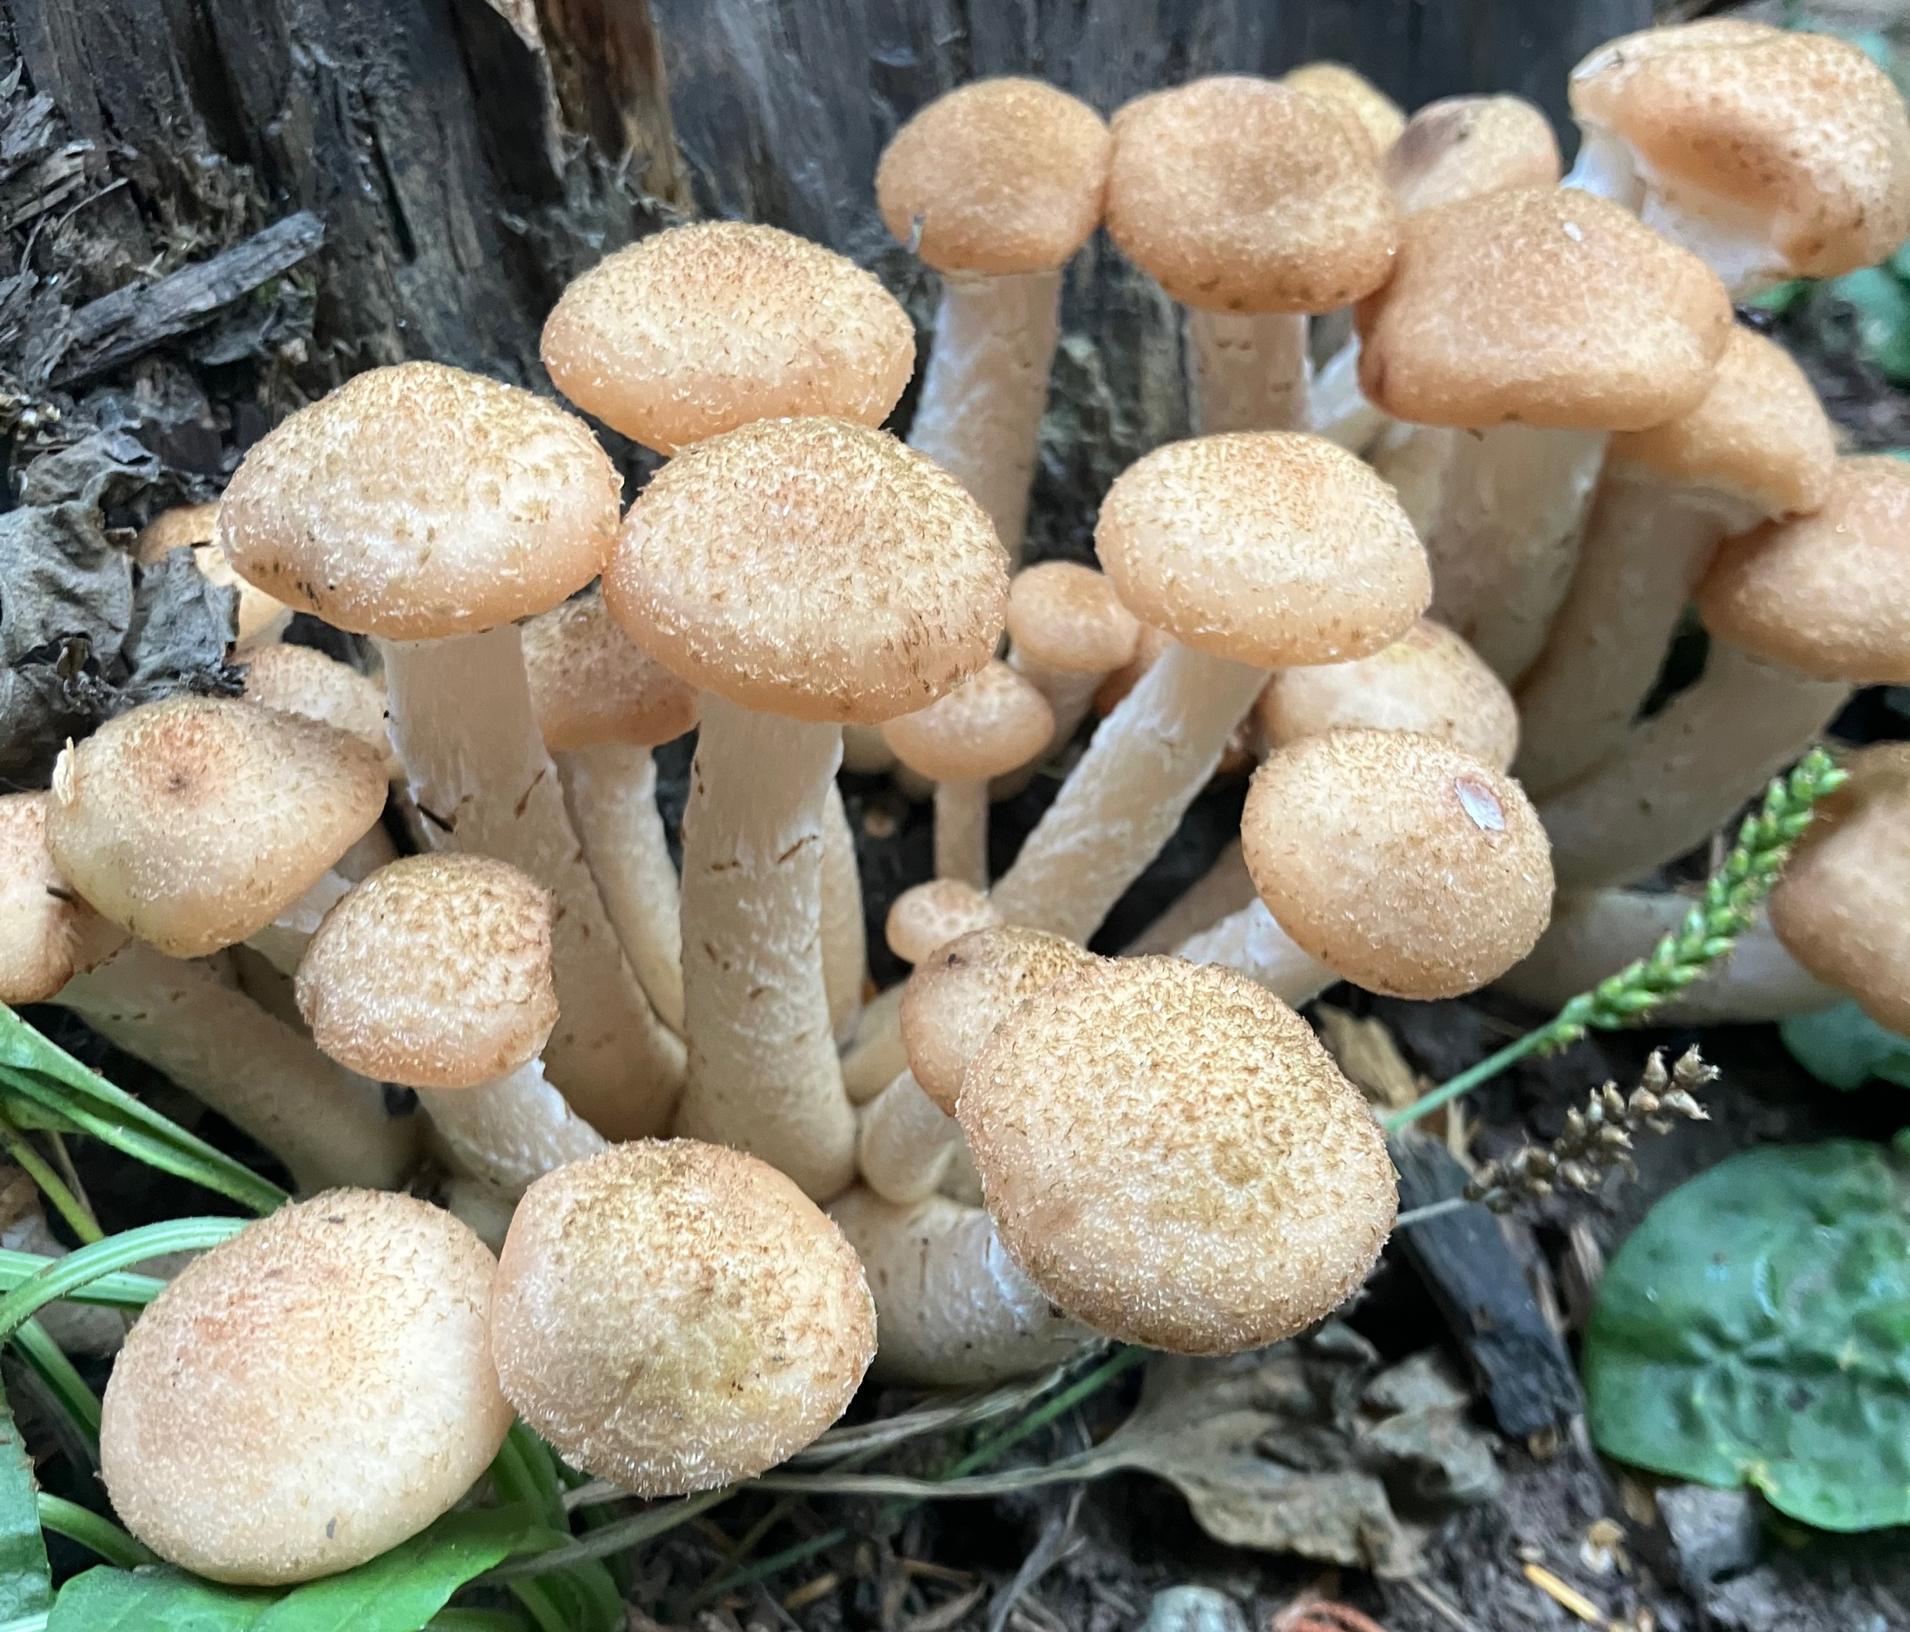
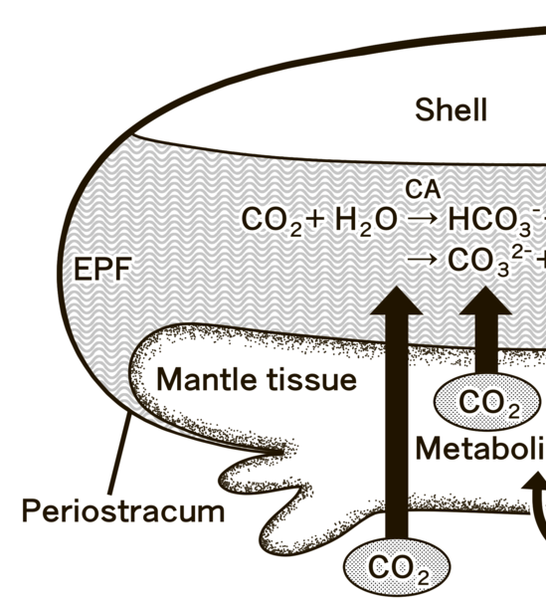
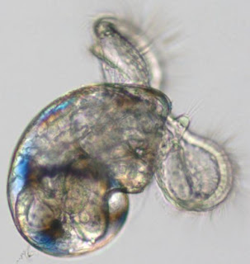
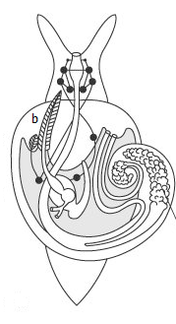
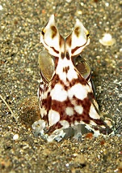
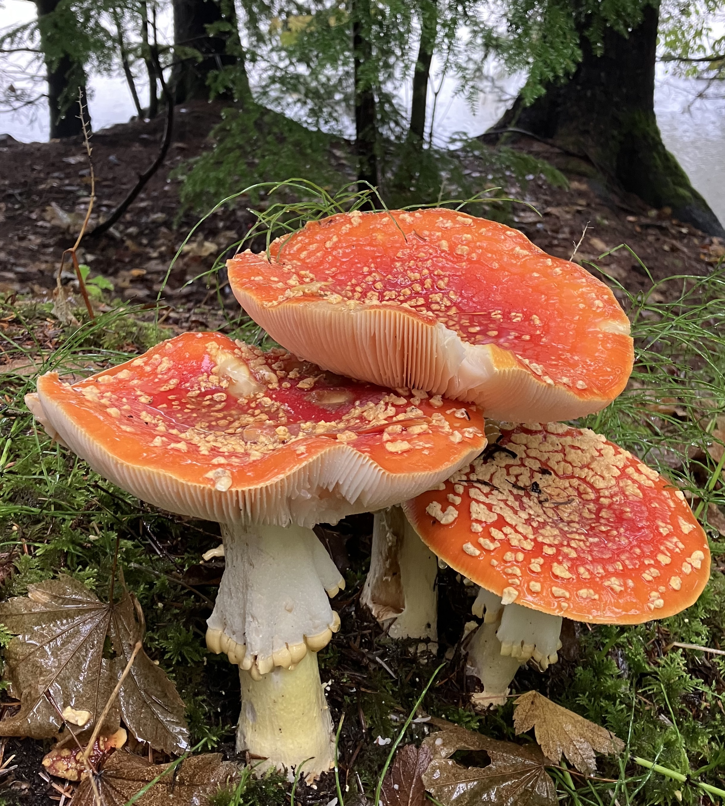
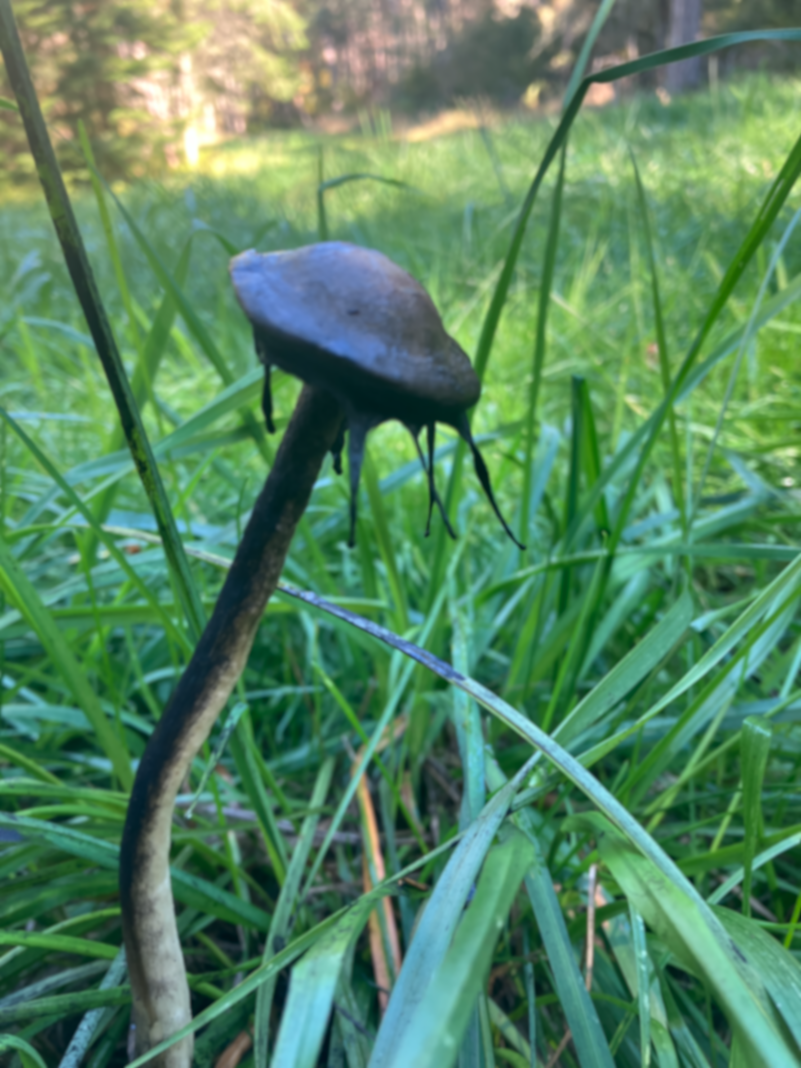
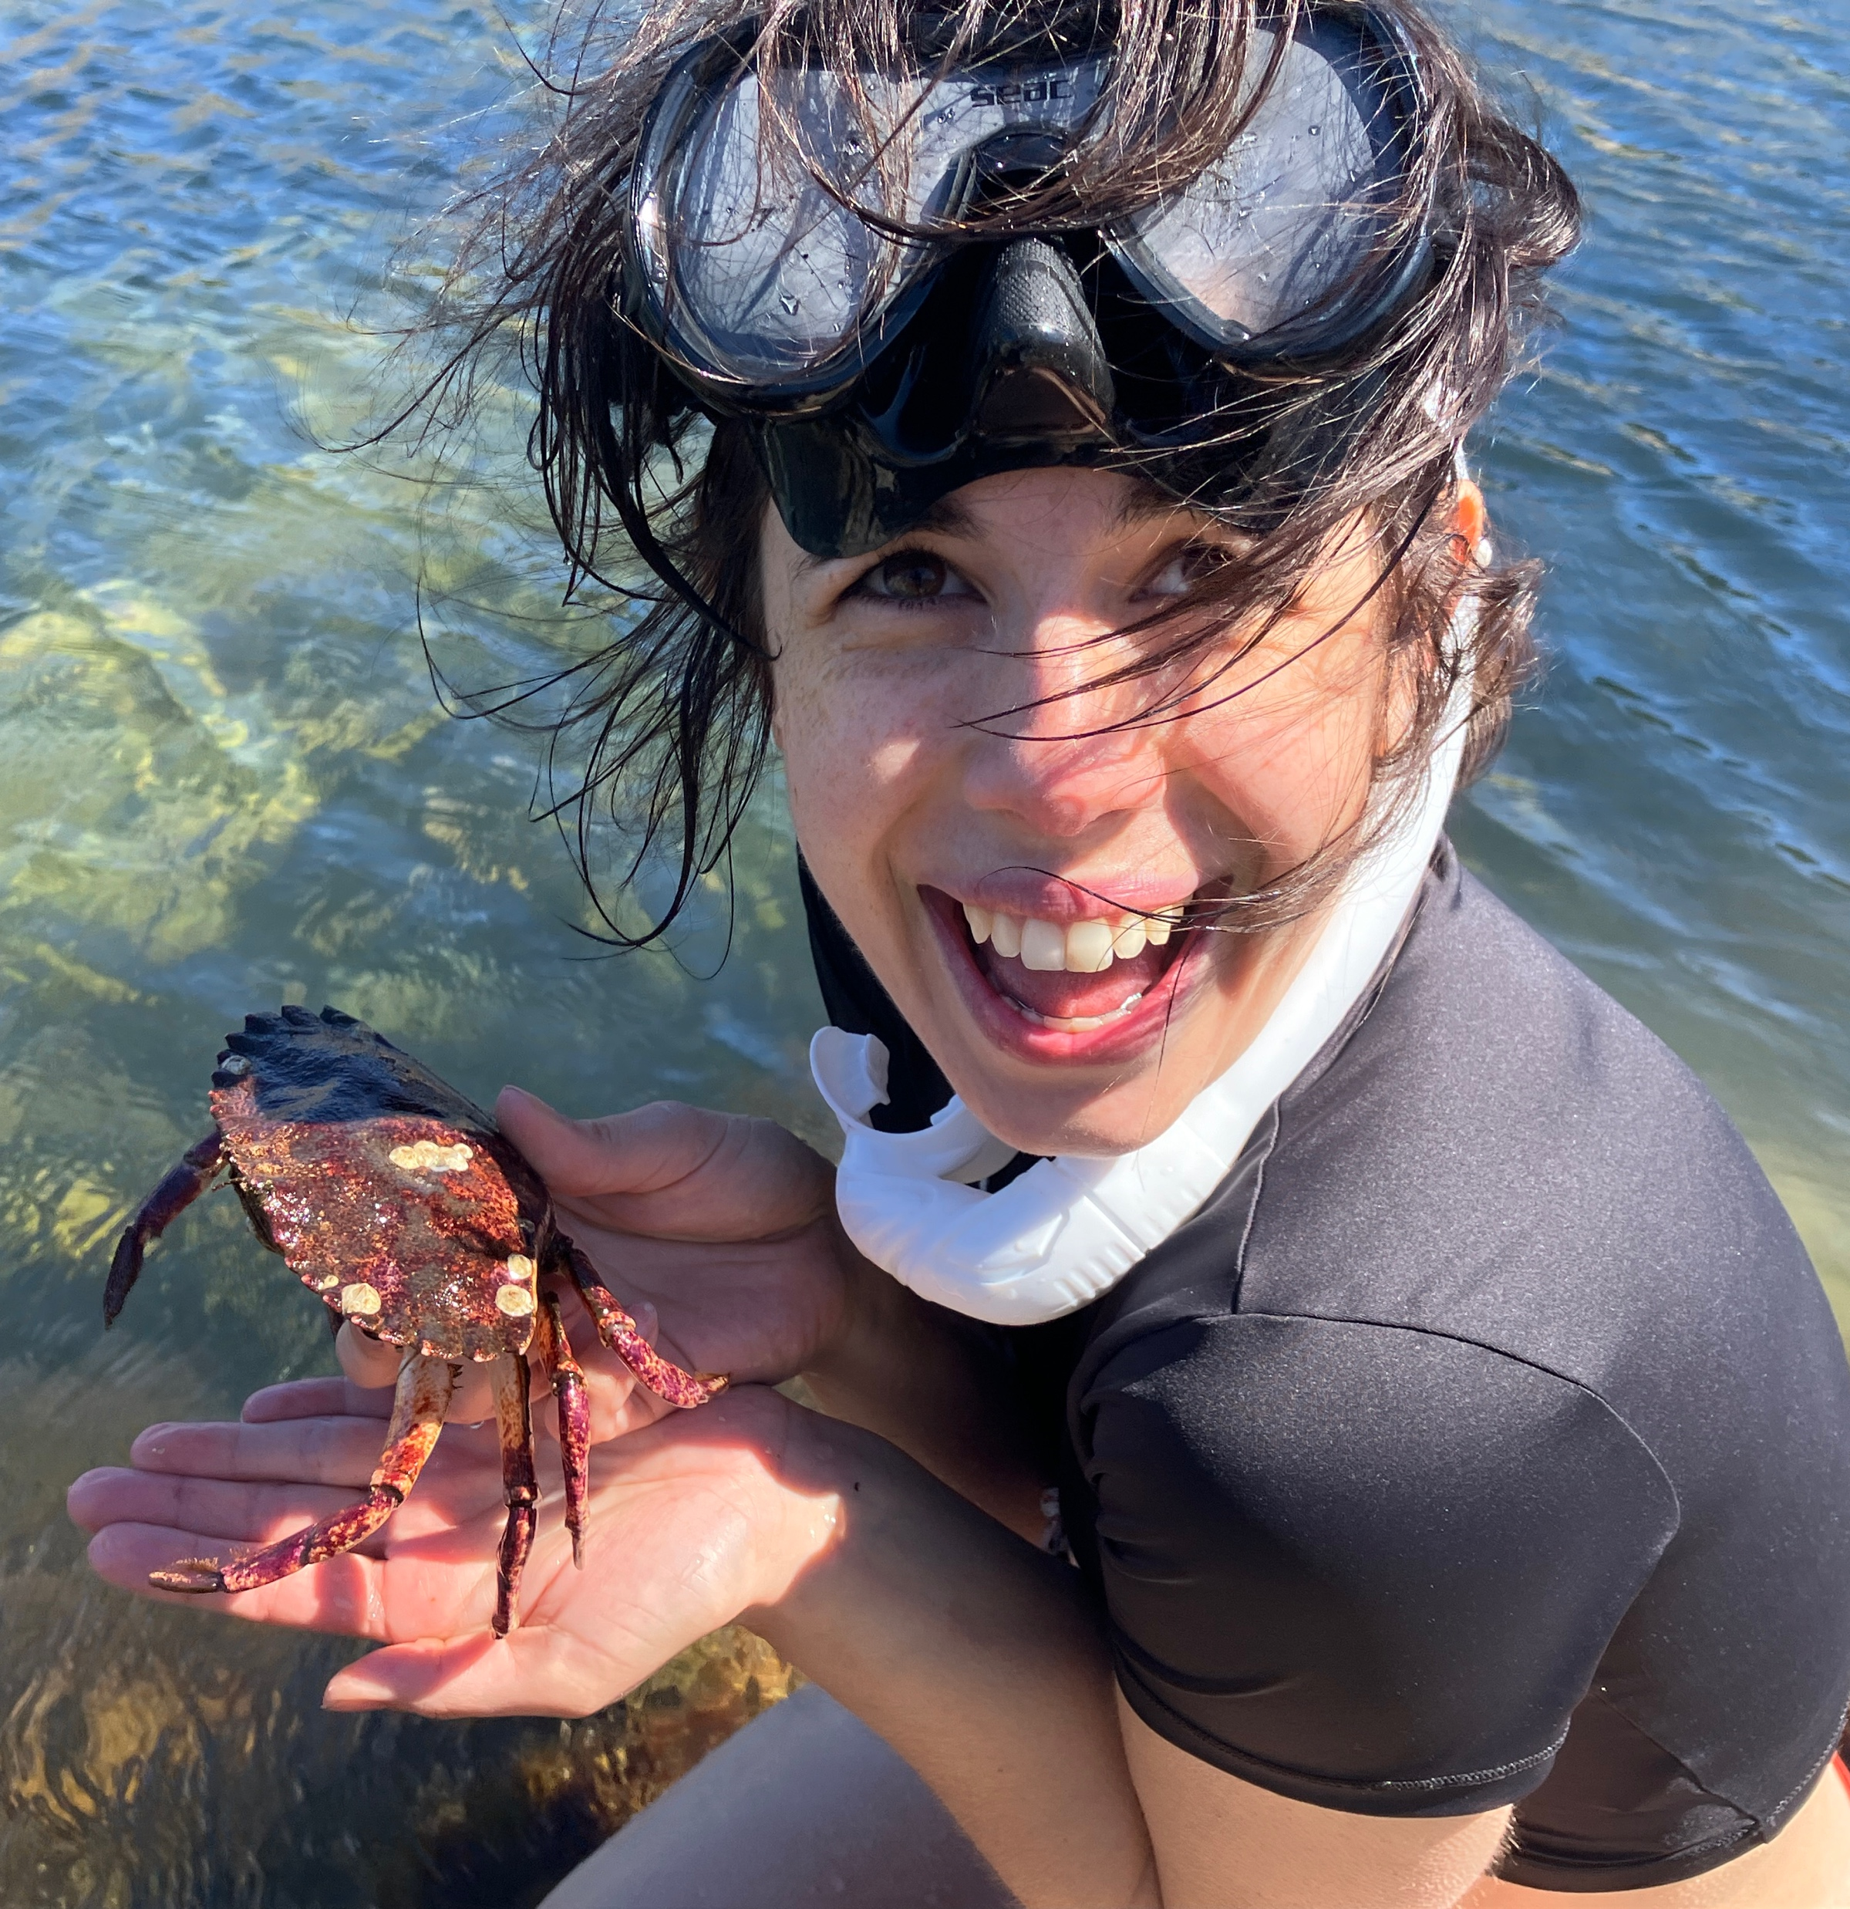
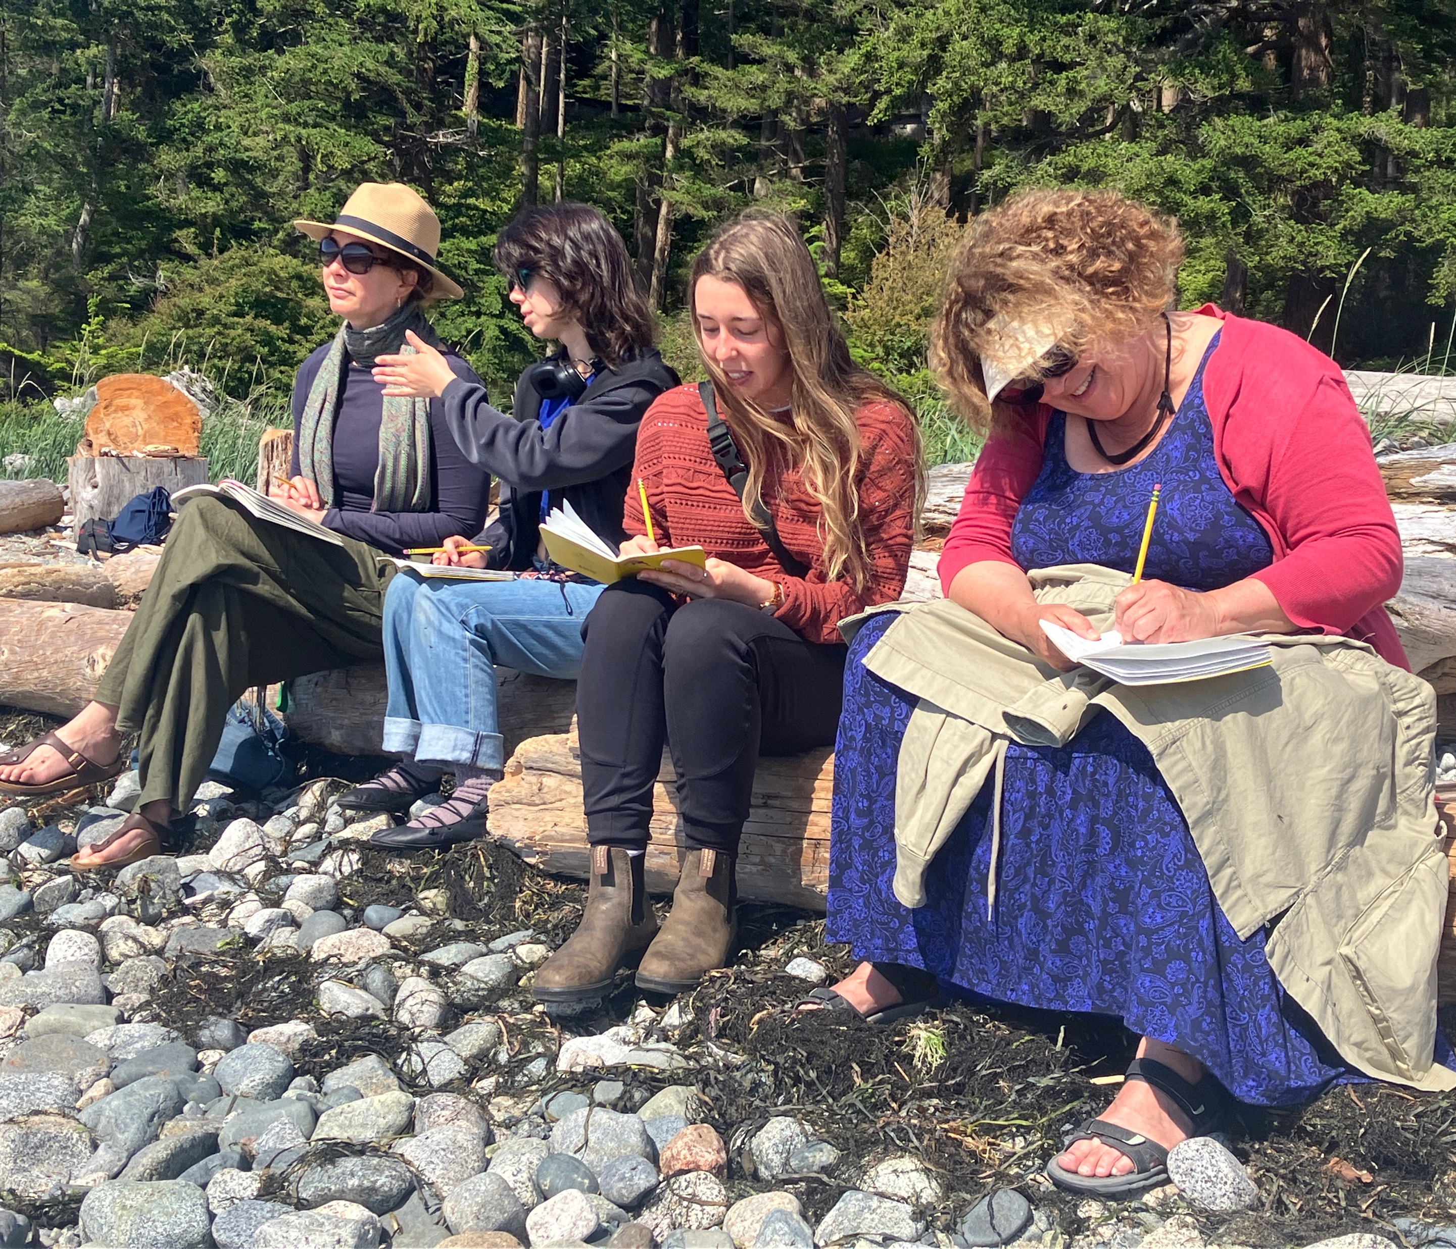
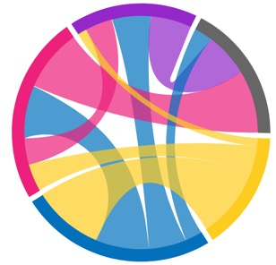
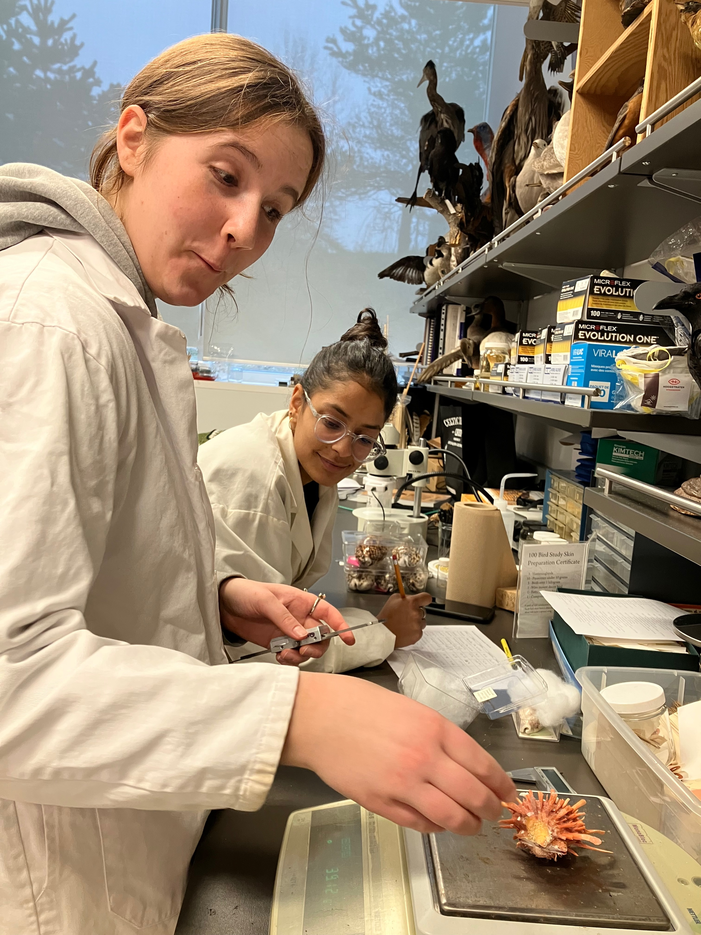
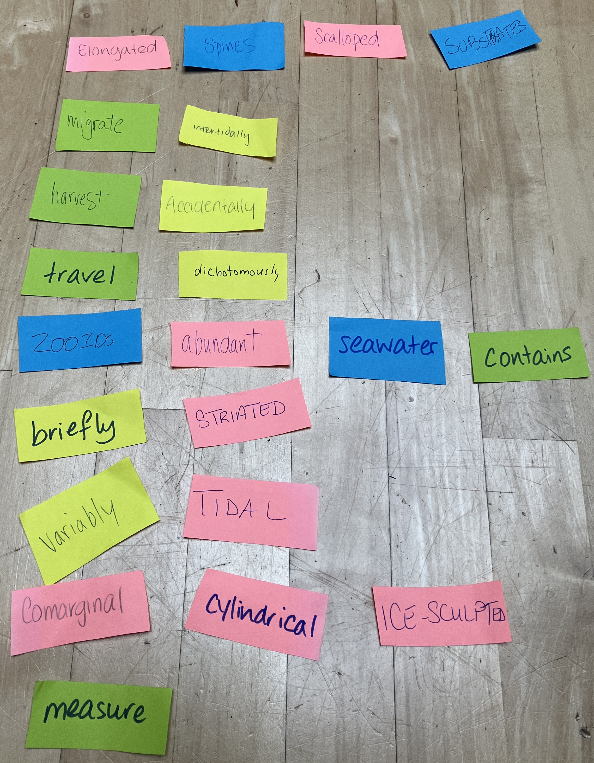
Transformation in/through eco-poetry
Mushrooms
Molluscs
nutrients, hosts, bodies
ions, metamorphosis, torsion, mimicry
y
People
Poems
Academy
identities, ideas
twists & turns
disciplinary
multi
inter
trans
trans
Nishida 2020; http://invert-embryo.blogspot.com/2011/05/veliger-larvae-of-molluscs.html; https://en.wikipedia.org/wiki/Mimic_octopus; https://www.molluscs.at/gastropoda/index.html?/gastropoda/morphology/torsion.html
https://datavizcatalogue.com/methods/chord_diagram.html
Notes:
So that’s one example of how these things all connect through transformation.
The second example is a research project.

