Slide 1
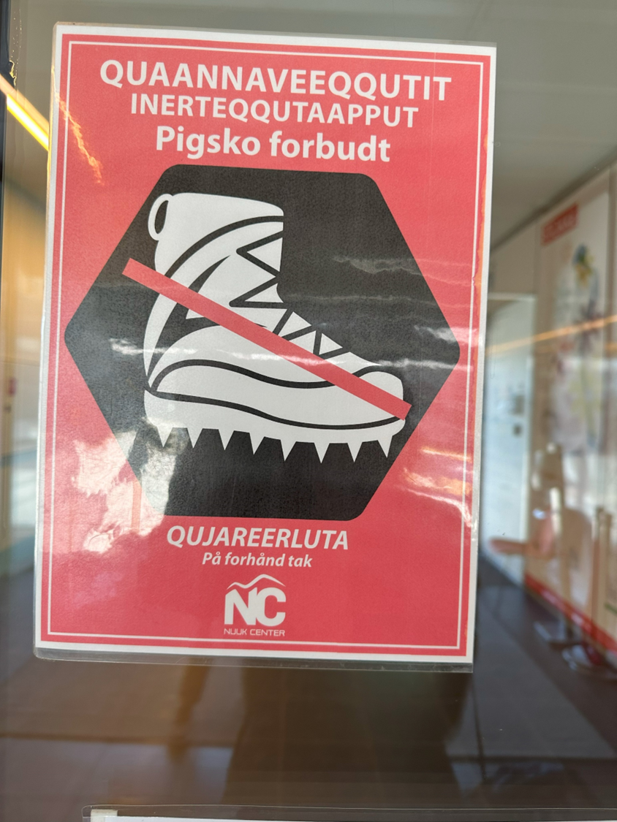
Grounding the Outreach:
Lessons from
Pre-Expedition Engagement in Greenland
Beth Doyle
Northern Virginia Community College
July 15, 2024
Earth Educators’ Rendezvous
Philadelphia, PA

Slide 2
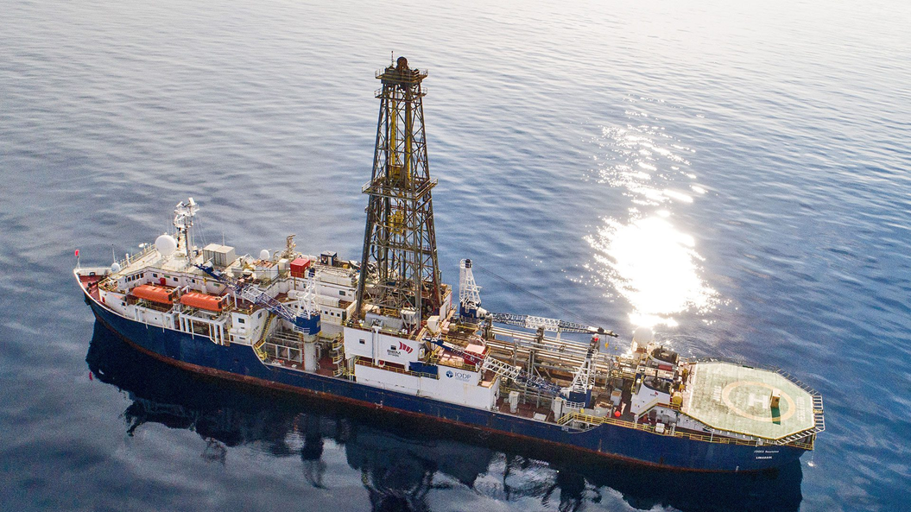
I.O.D.P.
International Ocean Discovery Program
The JOIDES Resolution
J.O.I.D.E.S.
Joint Oceanographic Institutions
for Deep Earth Sampling
Credit: IODP

Slide 3
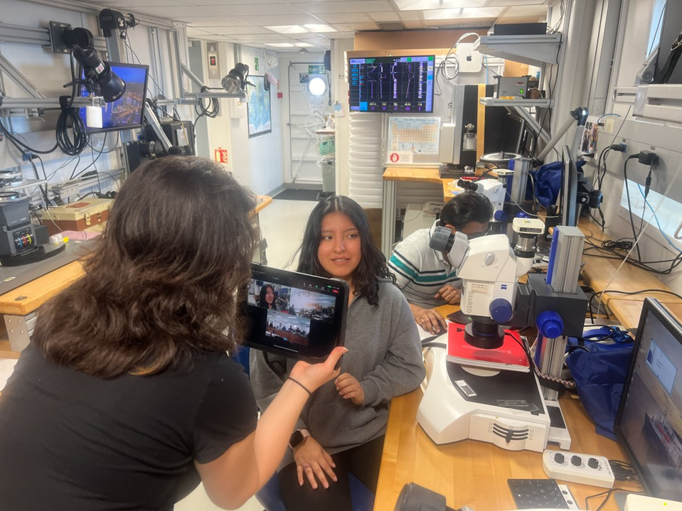
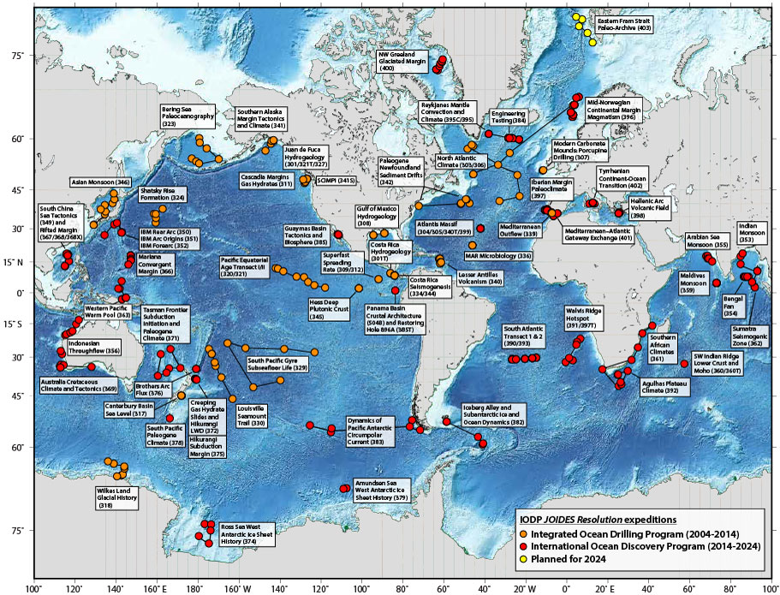
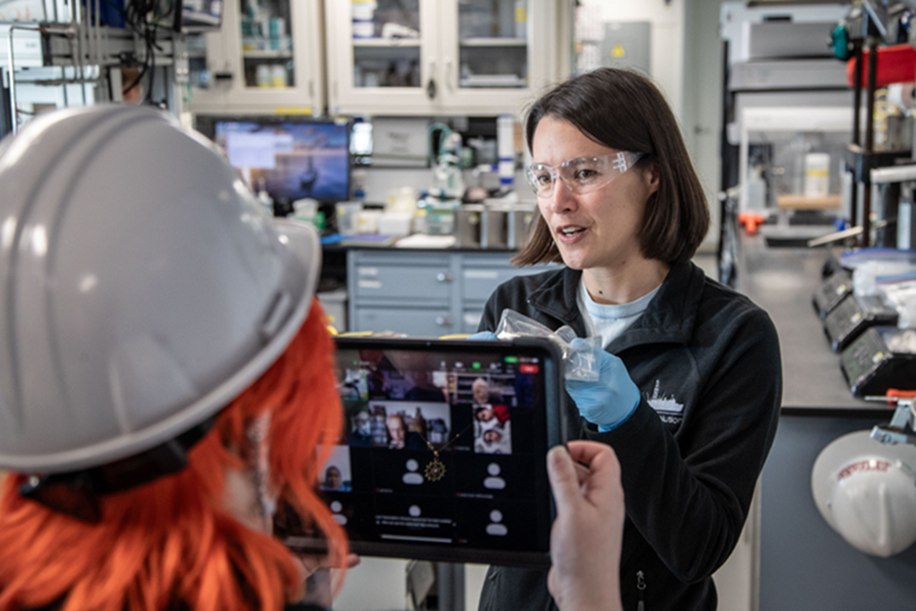

Credit: IODP

Slide 4
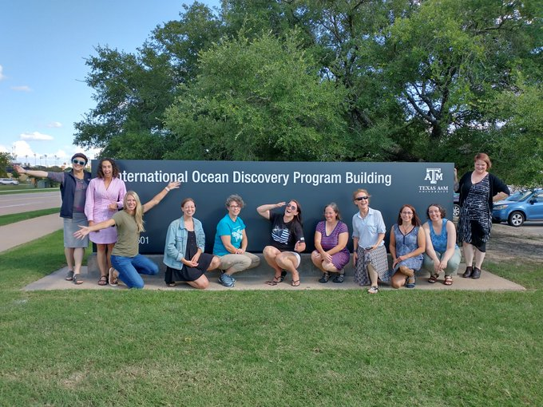
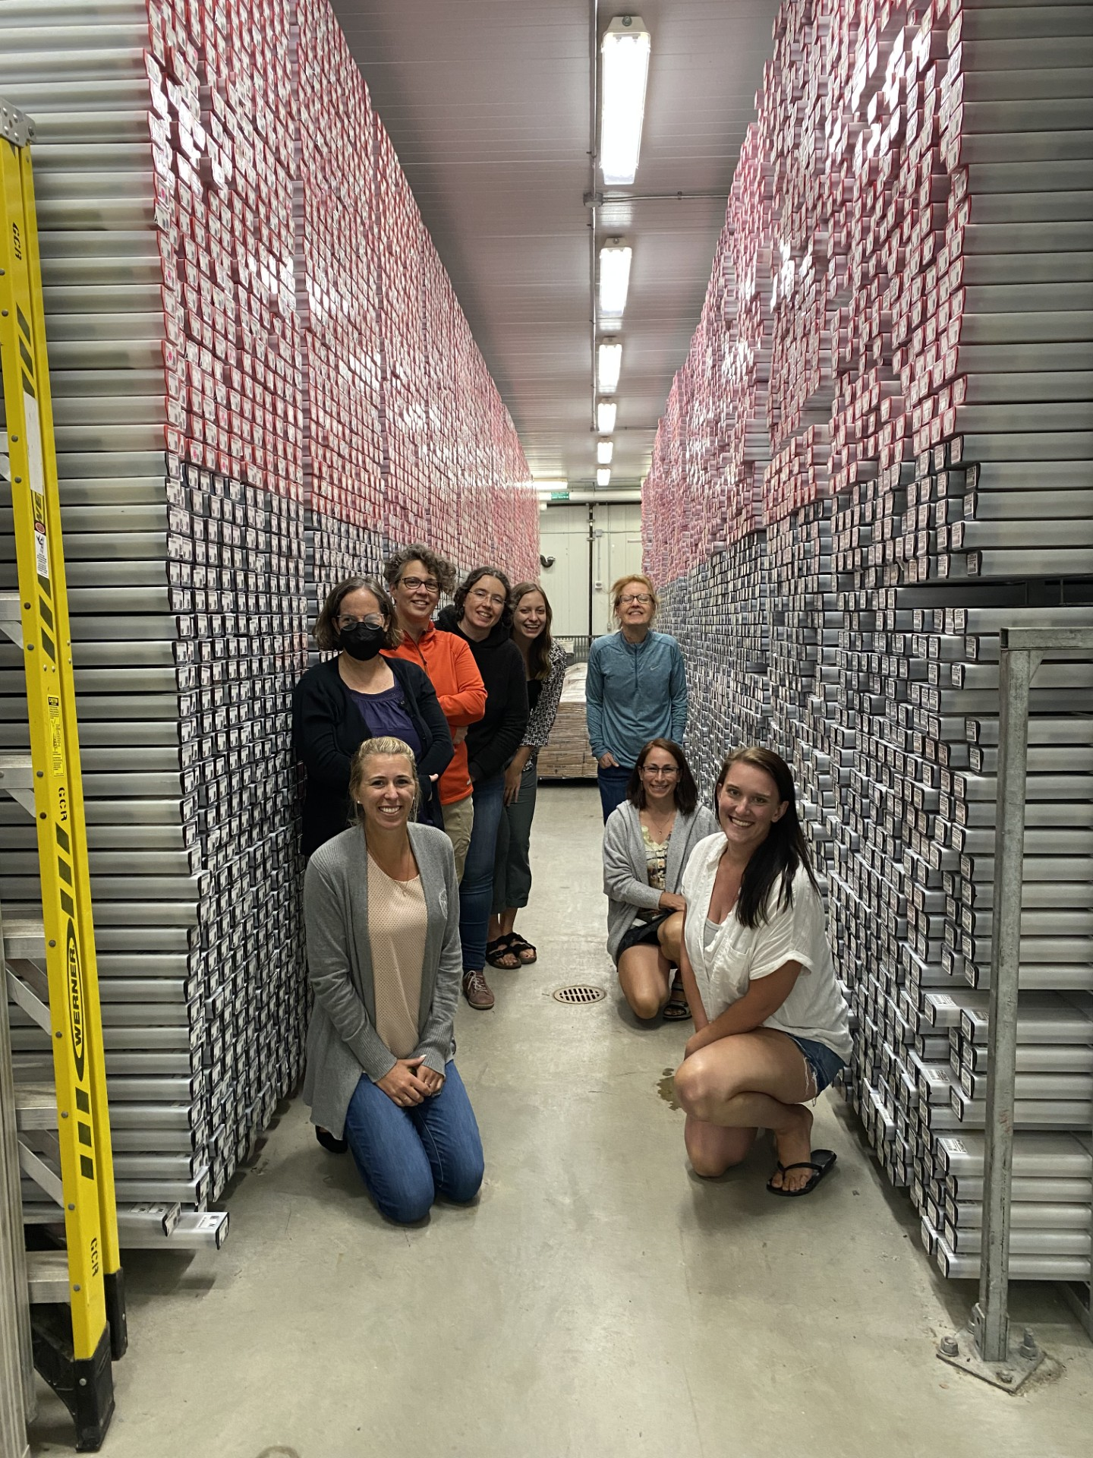
Onboard Outreach Officer: Share the science through virtual tours,
blogs, and social media posts
Onshore Outreach Officer: Generate an audience nearshore
to the expedition
Credit: IODP

Slide 5

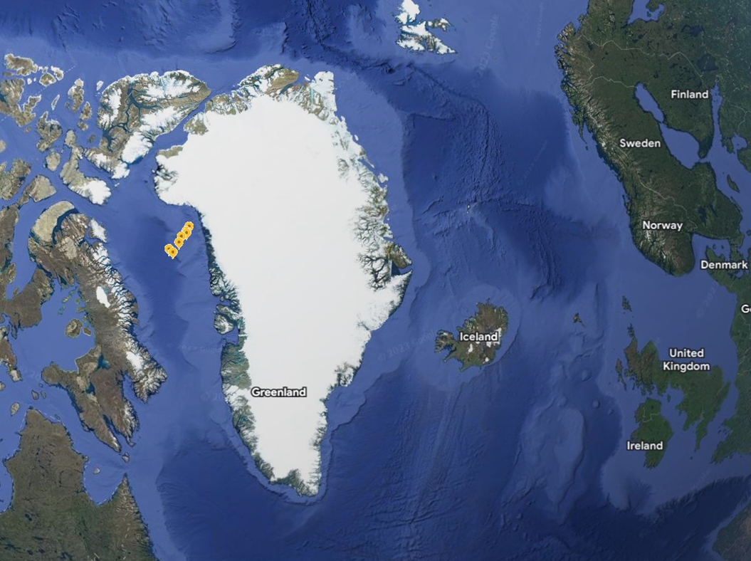
IODP Expedition 400
August 12- October 12, 2023
Credits:
IODP
Google Maps

Slide 6

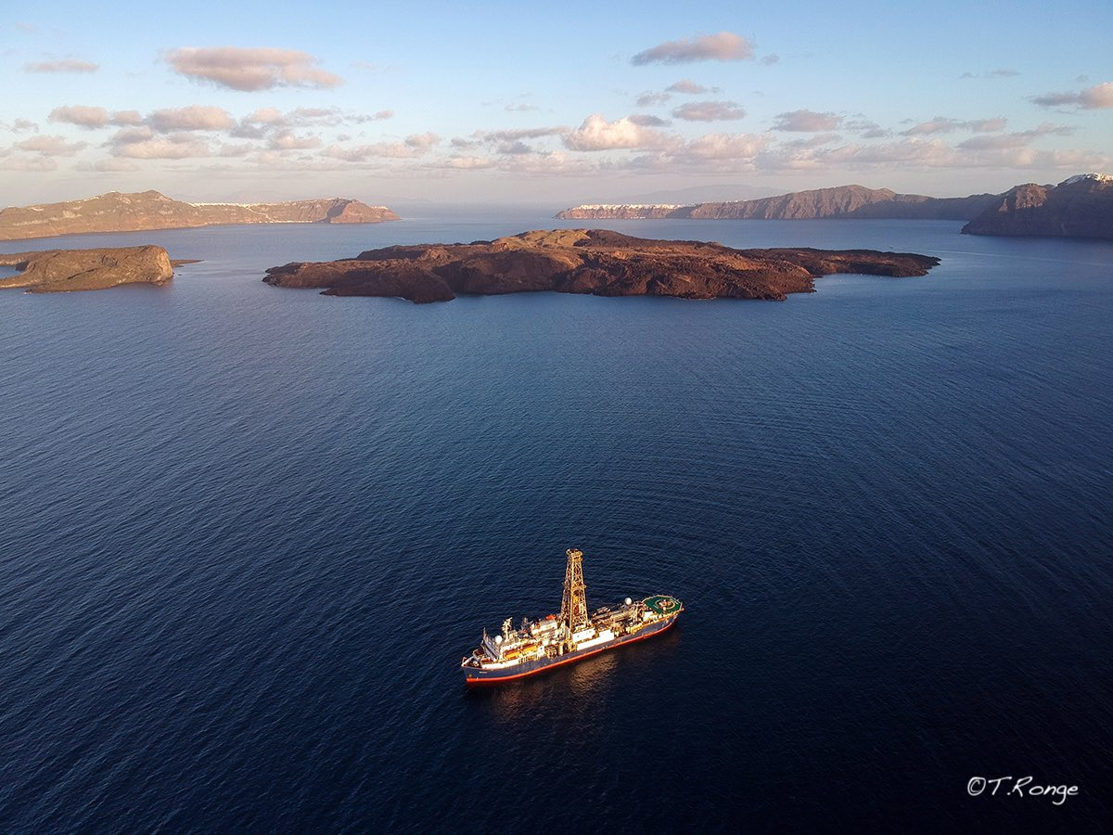
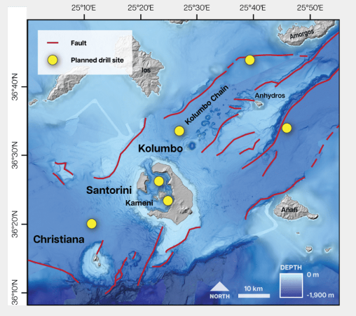
Credits:
Thomas Ronge, IODP
Expedition 398, Scientific Prospectus, IODP

Slide 7
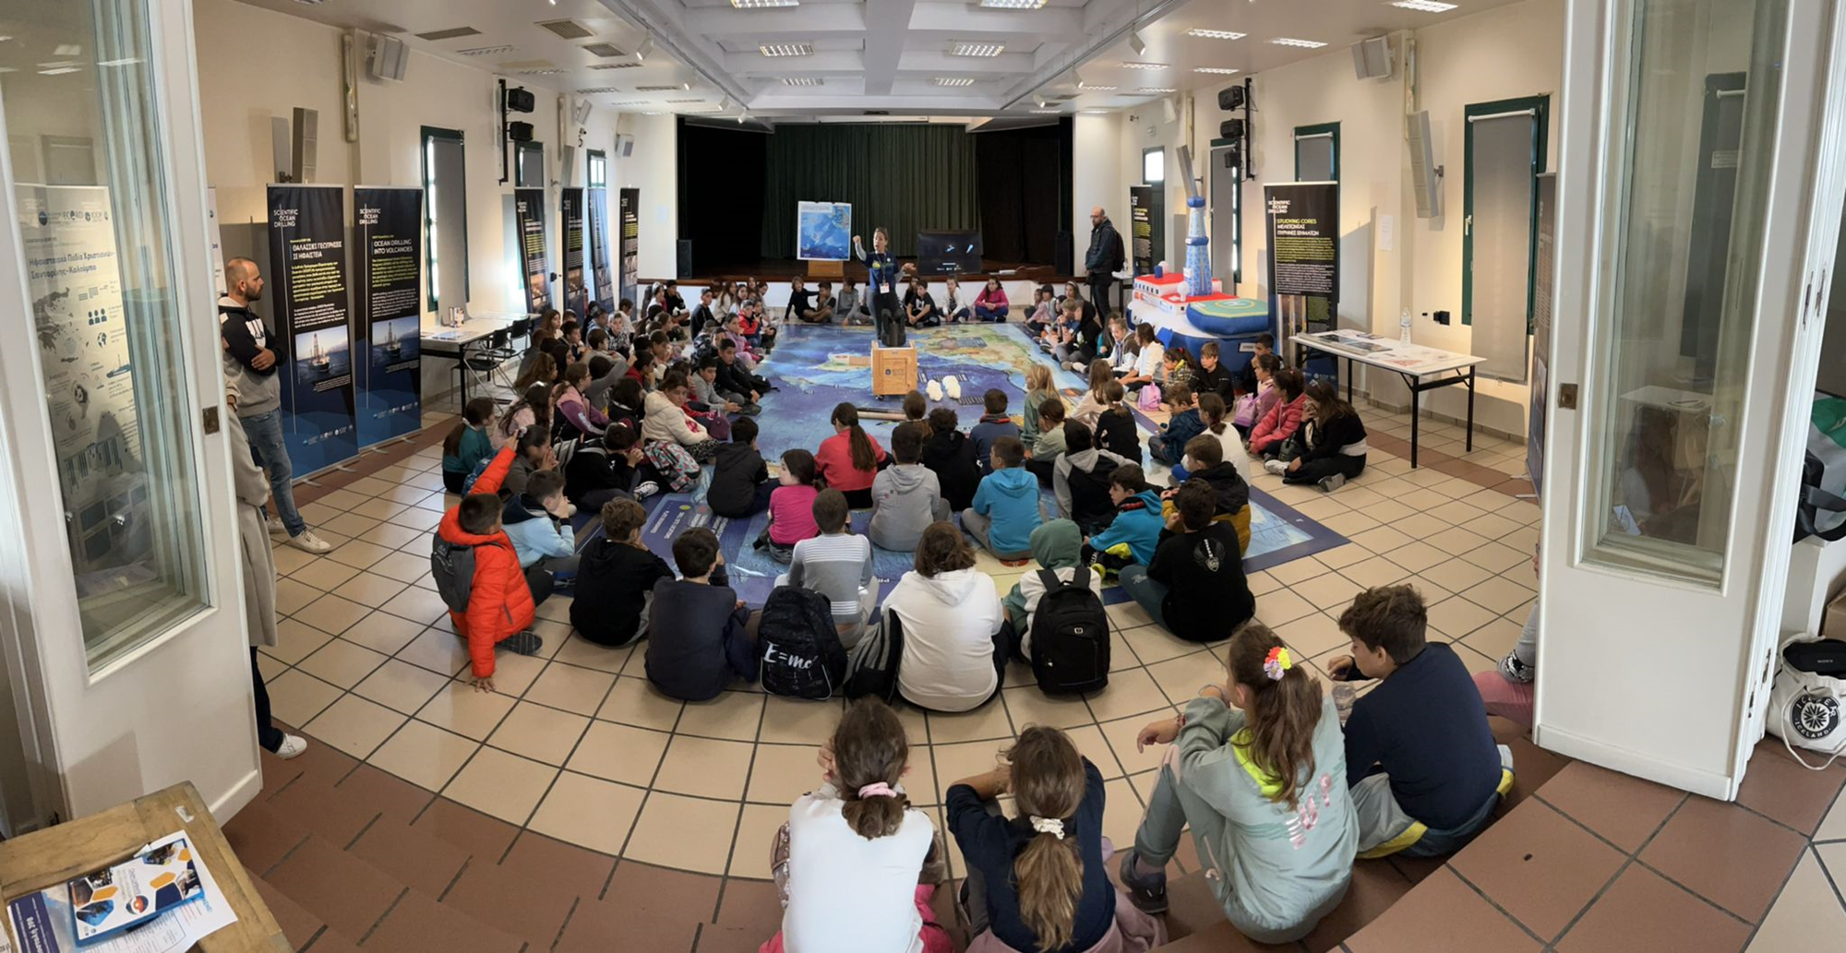
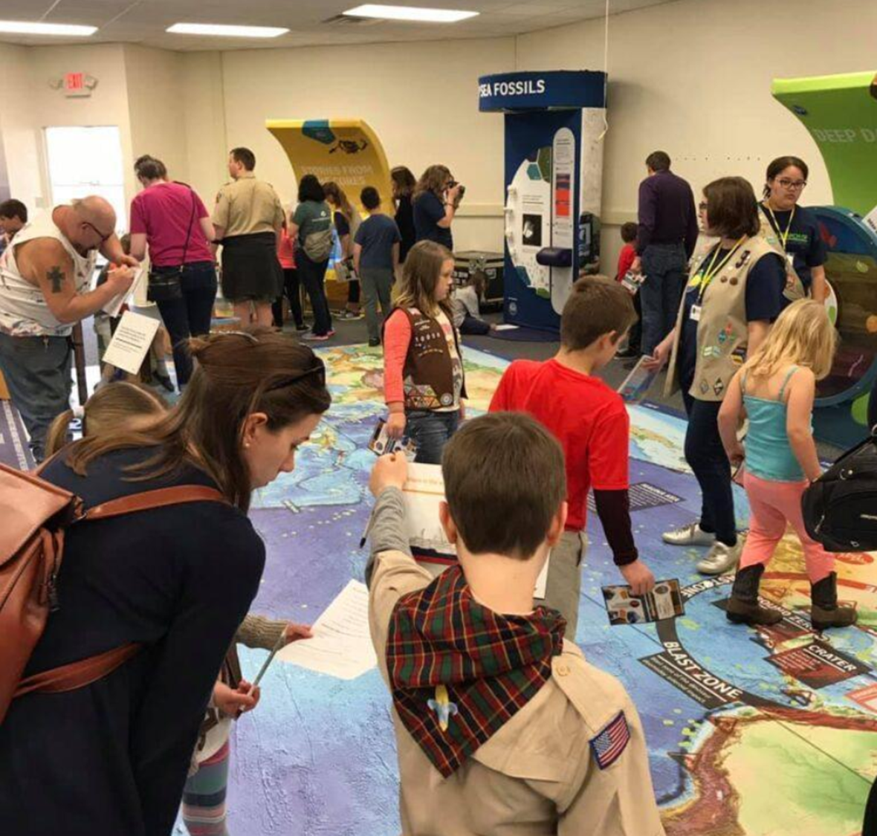
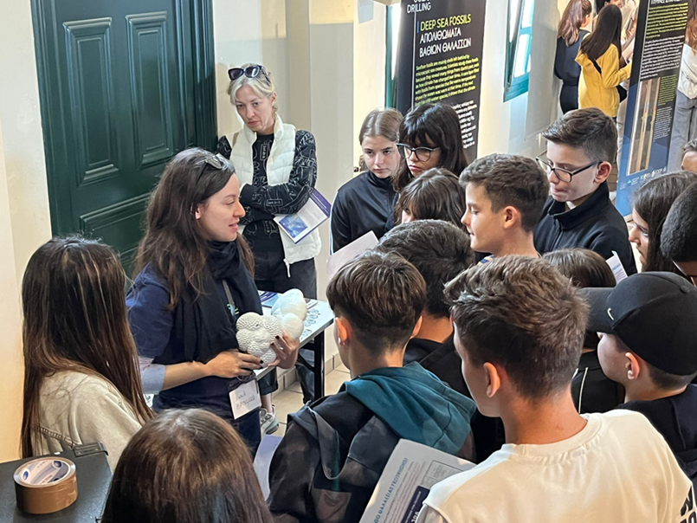
Credits:
Tim Druitt, IODP
Susan Schnur, IODP
Sarah Whitlock, IODP

Slide 8
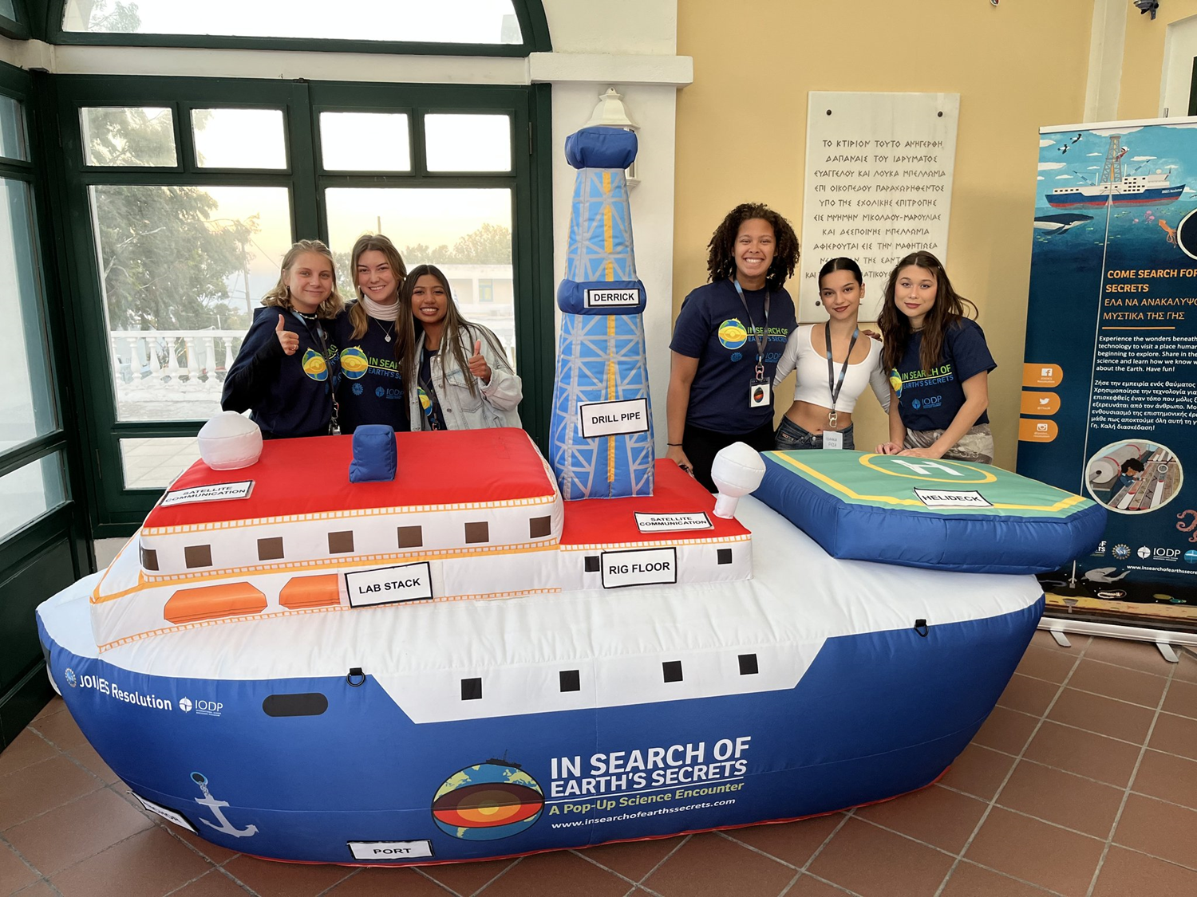
Credit:
Tim Druitt, IODP

Slide 9
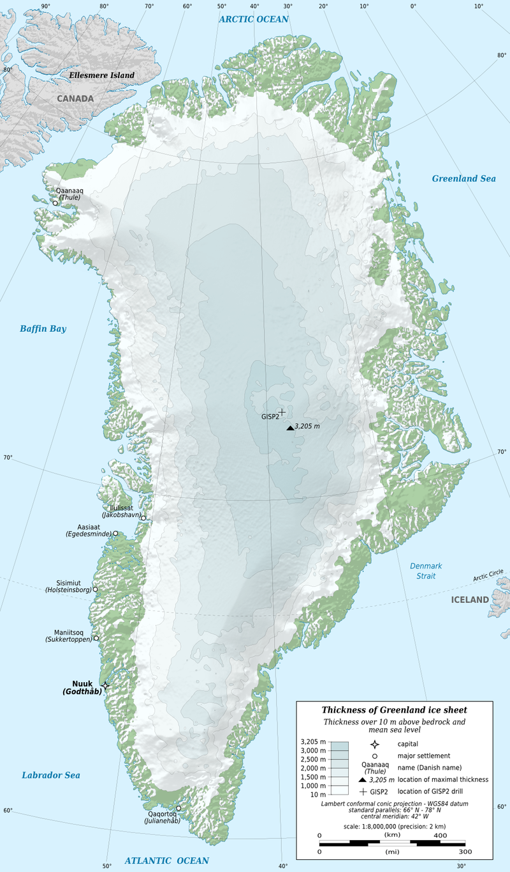
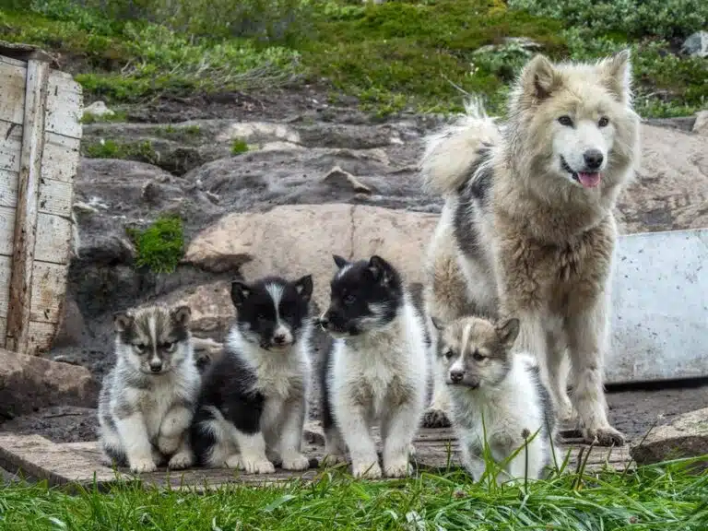


Lesson 1:
Get ready to ante up
Greenland
Population: 56,000
Ilulissat
Pop 4,500
Kangerlussuaq
Arctic Circle
Capital-Nuuk
Pop. 19,000
Credits:
Map- Eric Gaba, Wikimedia commons user: Sting
Dogs- https://guidetogreenland.com/book-trips-holiday/
the-sled-dog-experience-ilulissat-disko-bay/

Slide 10
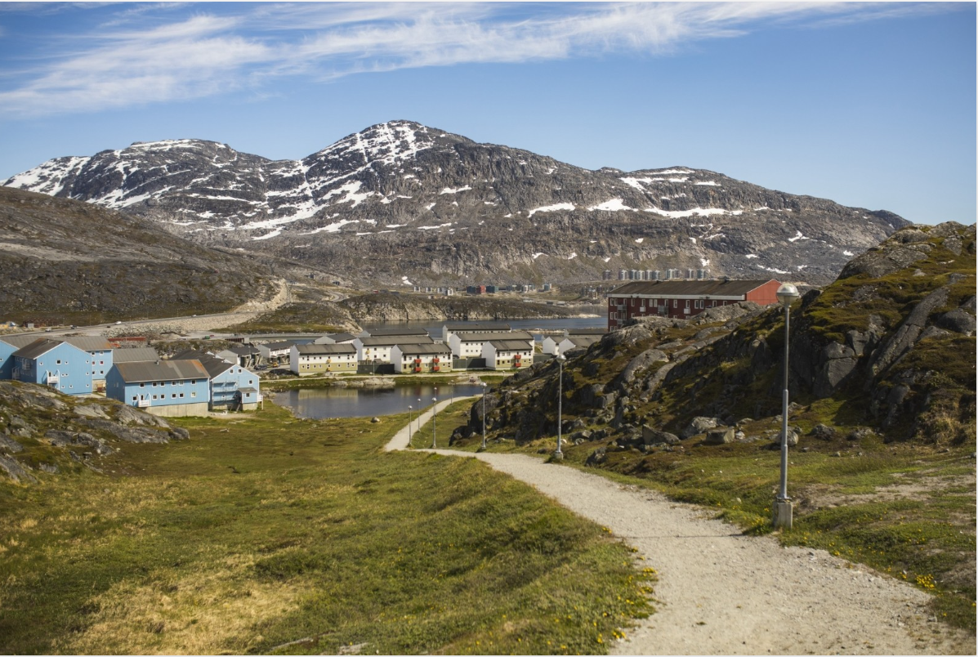
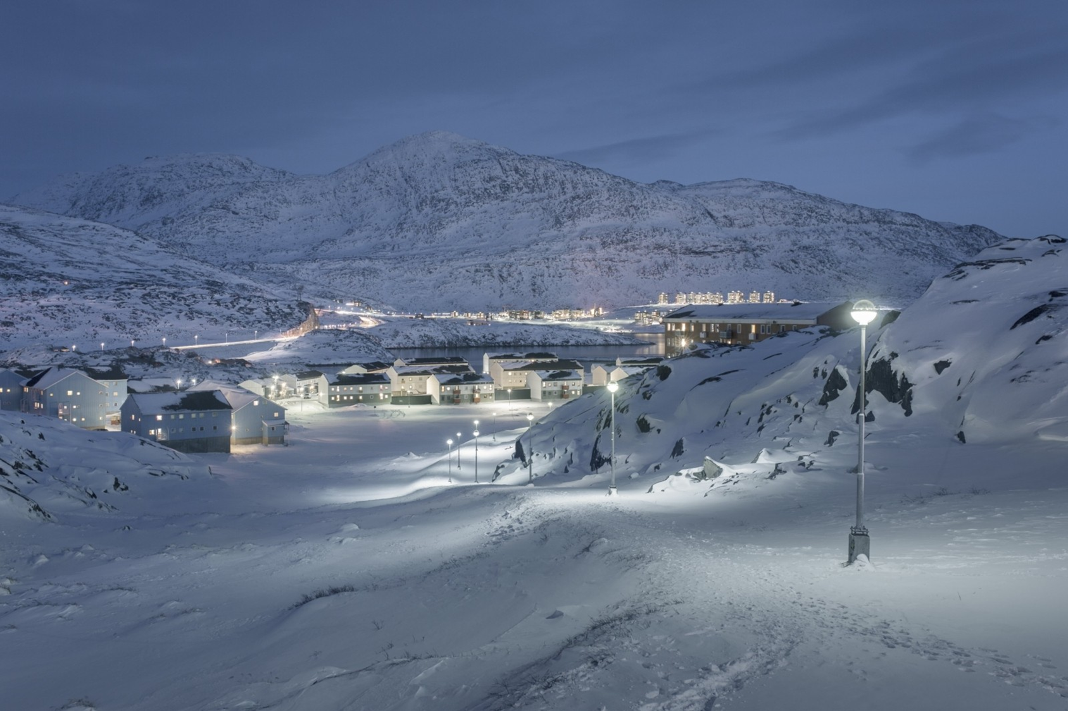
Photo by Rebecca Gustafsson (Left) & Aningaaq R Carlsen (Right) – Visit Greenland.
Credits:
Rebecca Gustafsson (Winter)
Aningaaq R Carlsen (Summer)
https://visitgreenland.com/articles/nuuk-winter-vs-summer/

Slide 11
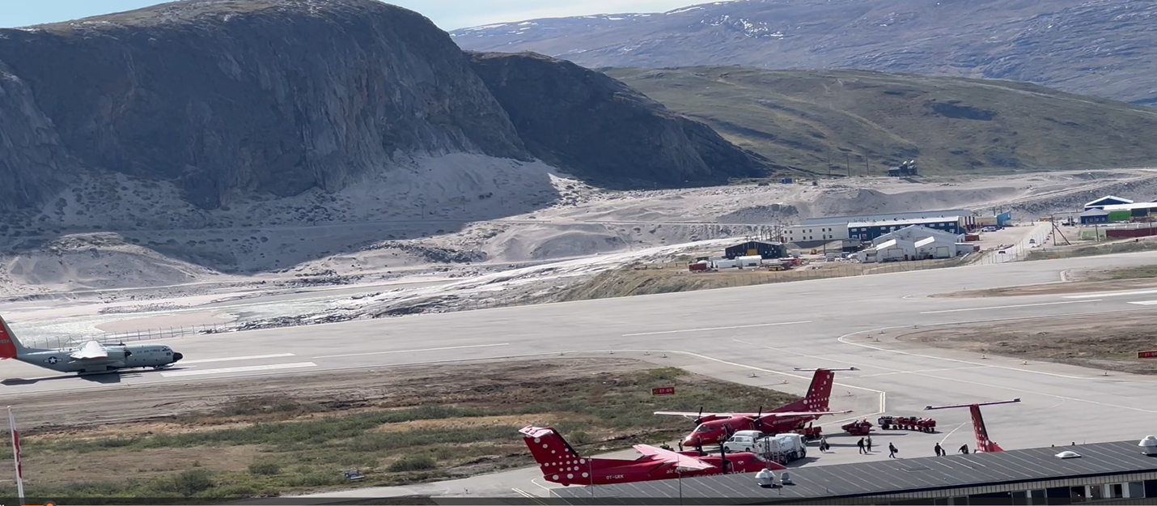
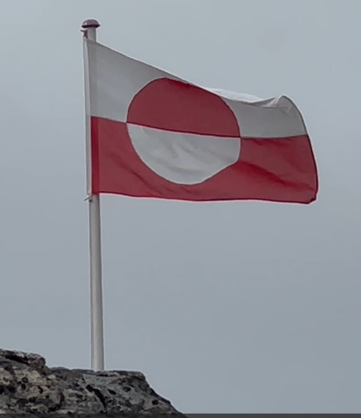
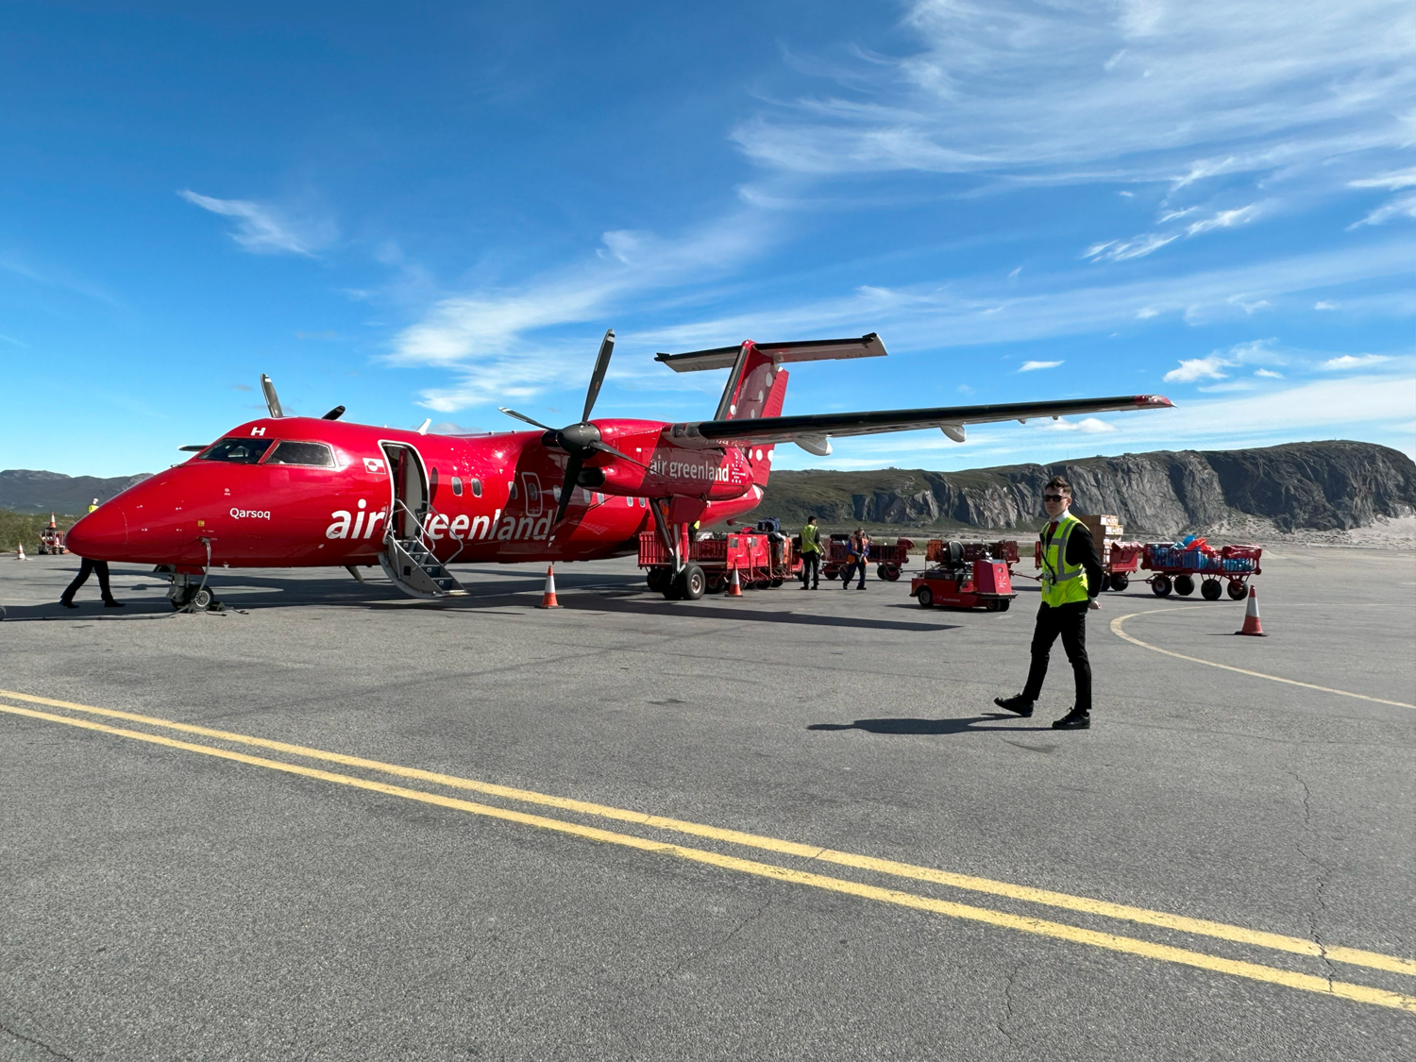
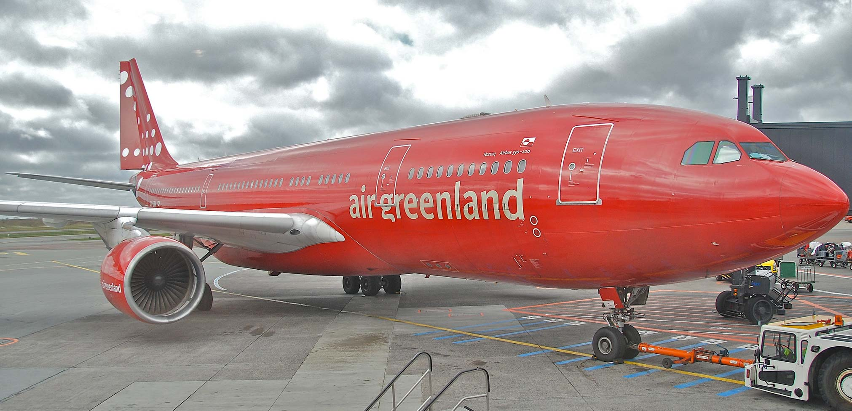
Credit: https://www.airgreenland.com/

Slide 12
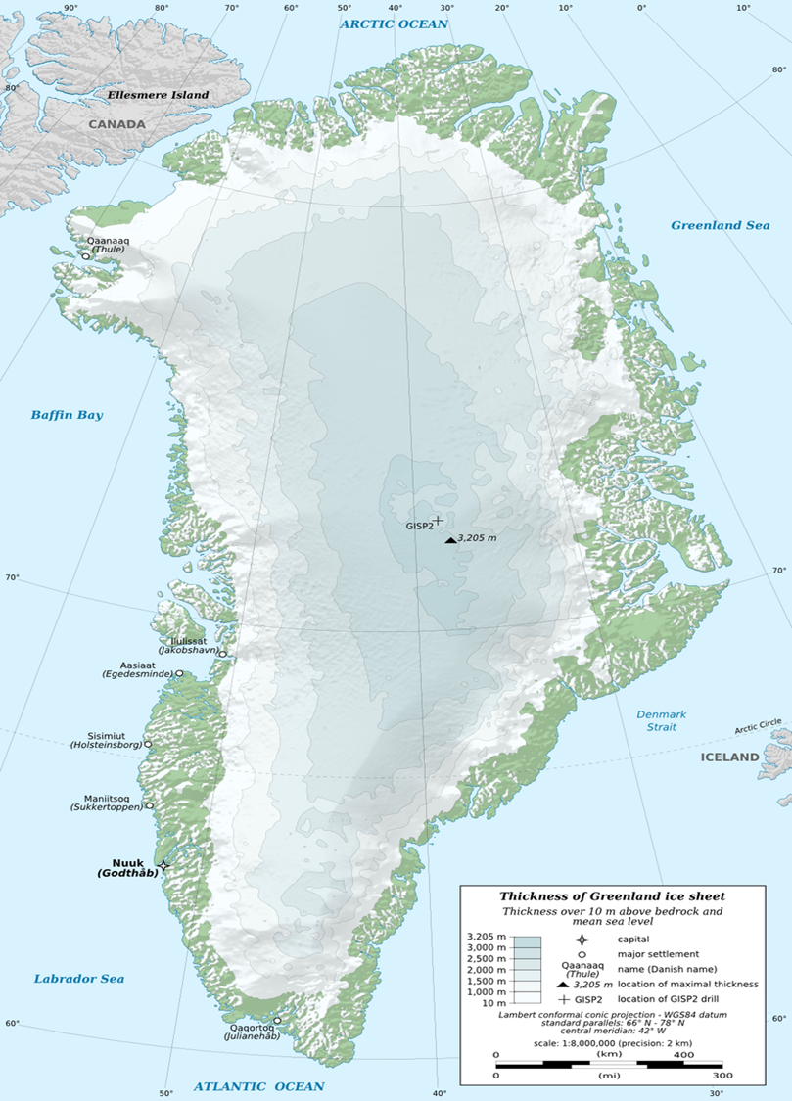
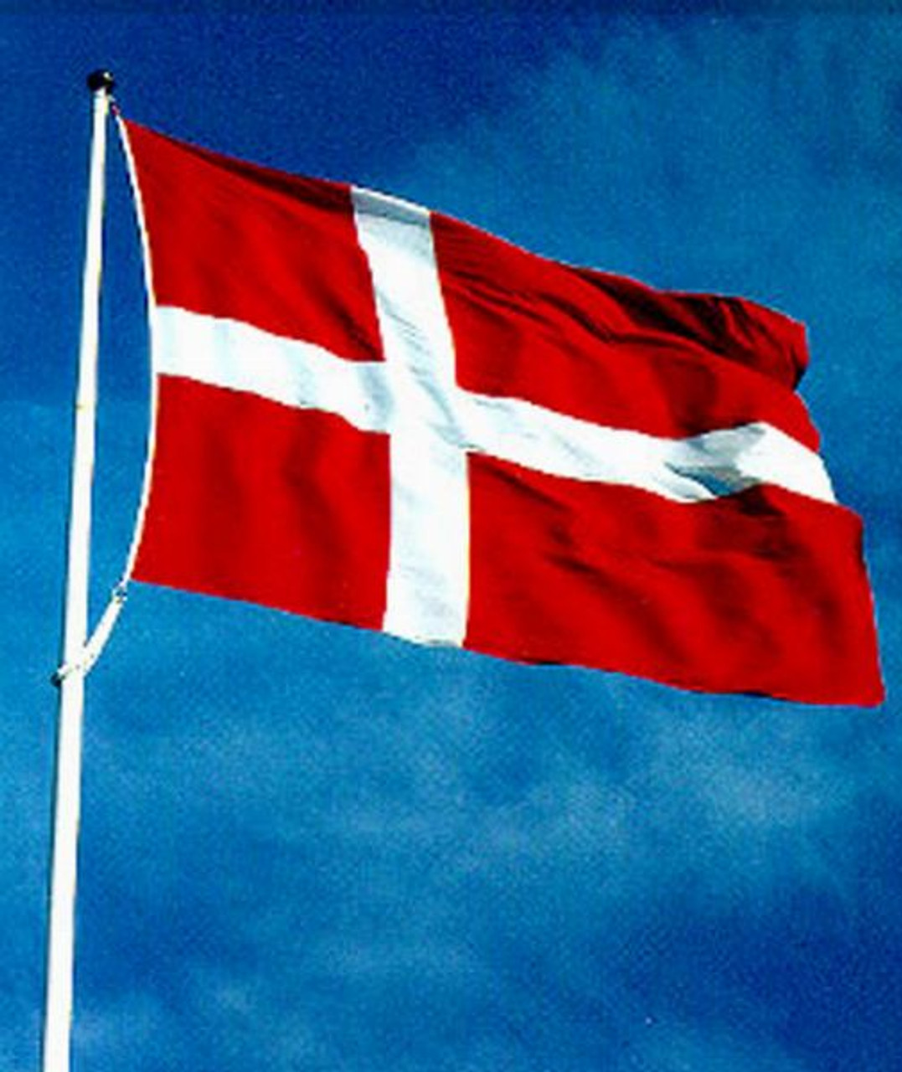
Ilulissat
Ilulissat Icefjord Centre
Disko Bay
UNESCO World Heritage site
Lesson 2:
Plan fully, then adapt
Kangerlussuaq
U.S. Science Support Station
Hub for GRIS: Greenland Ice Sheet Summit Station
Nuuk
Greenland Institute of Natural Resources
U.S. Consulate
Arctic Hub
National Museum of Greenland
6 Flights
12 Legs
Ilulissat
Kangerlussuaq
Nuuk
Denmark
GEUS-Geol. Survey of Denmark & Greenland
U.S. Embassy,
Copenhagen
U.S.

Slide 13
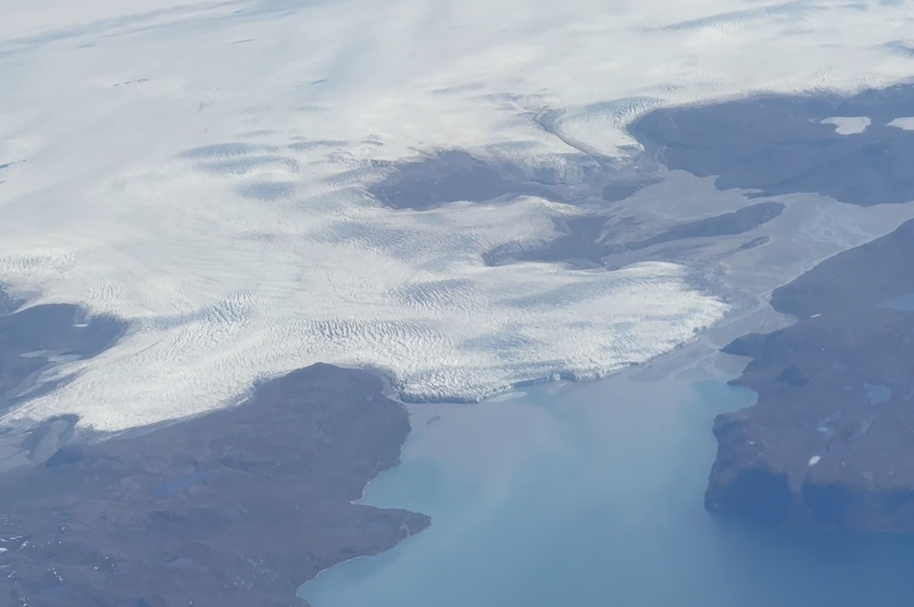
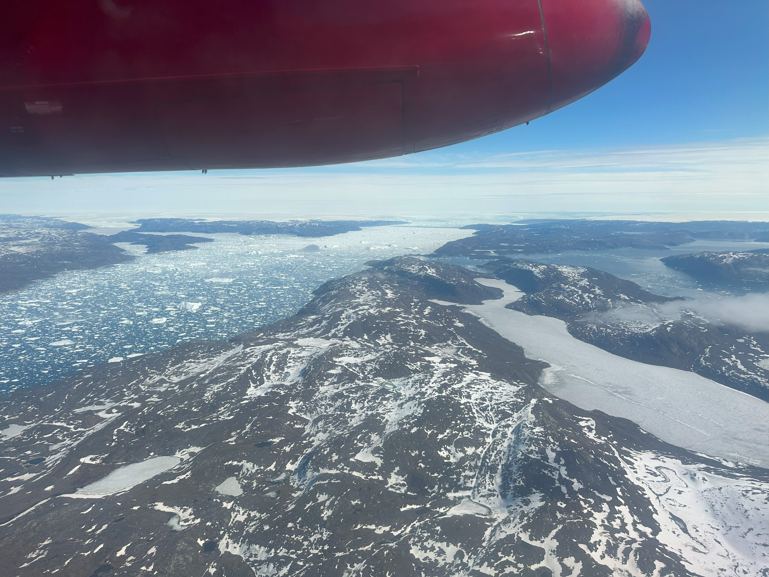

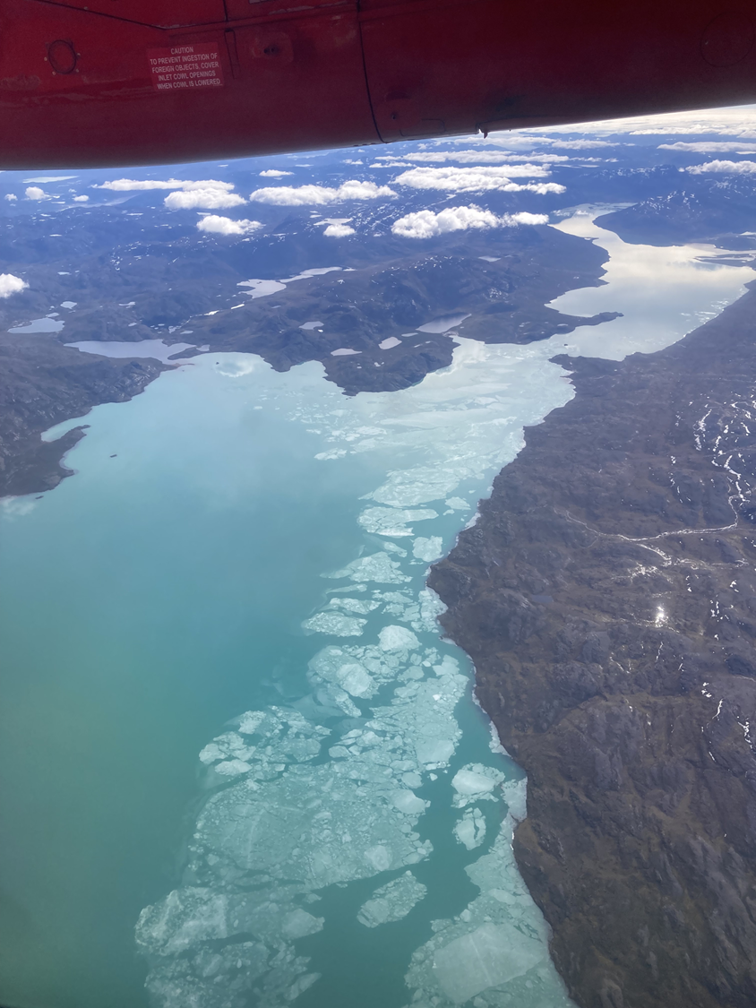
CREDIT

Slide 14
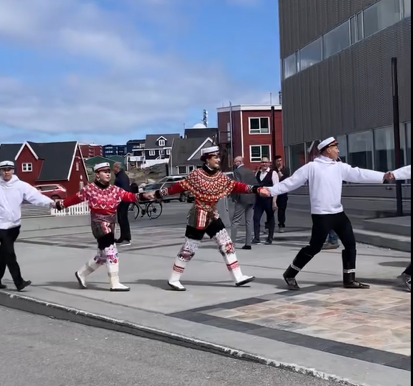
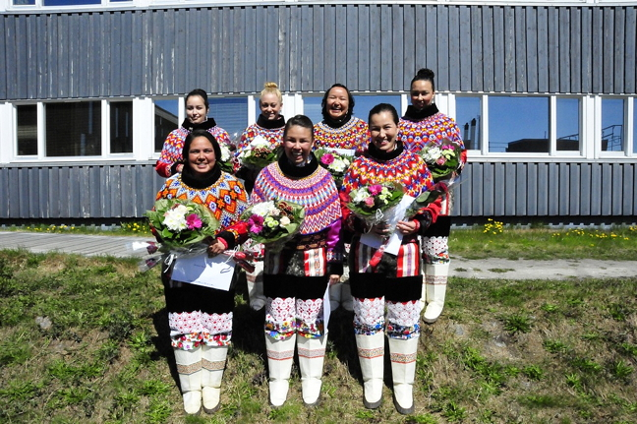
CREDIT
High School Graduation Day
Necessity yields unexpected treasure

Slide 15
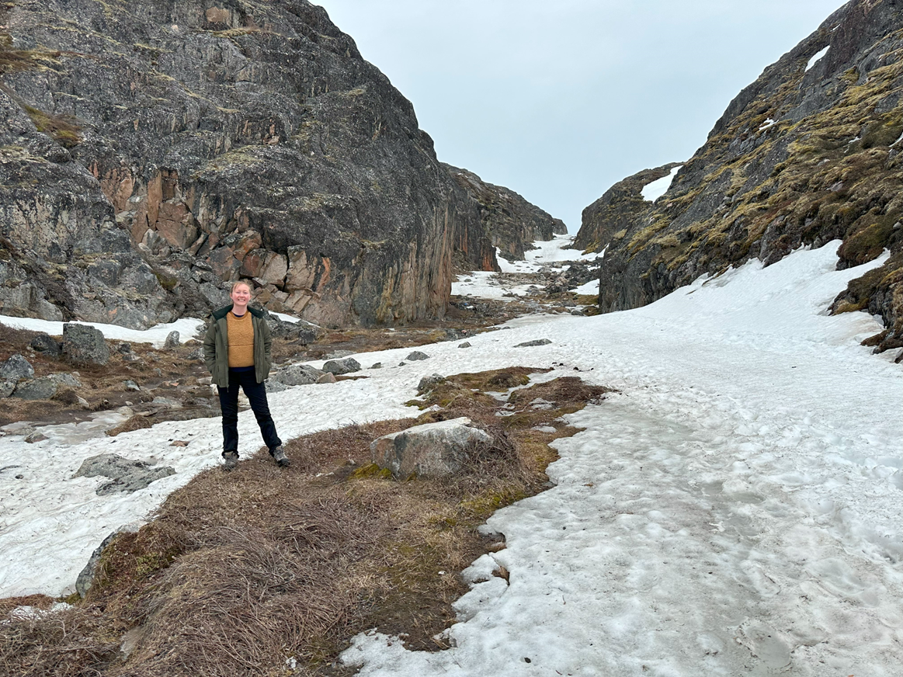
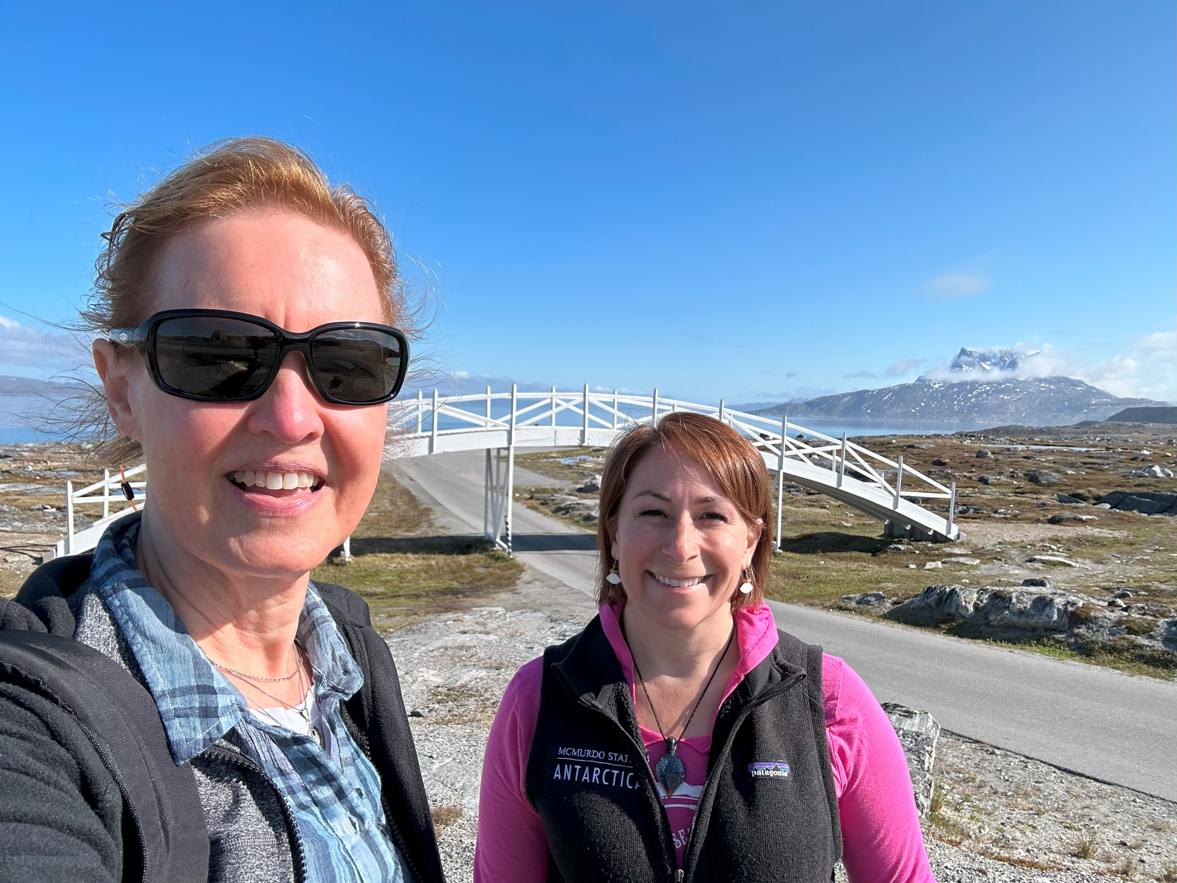
Lesson 4:
Experienced travel partners make the difference

Slide 16
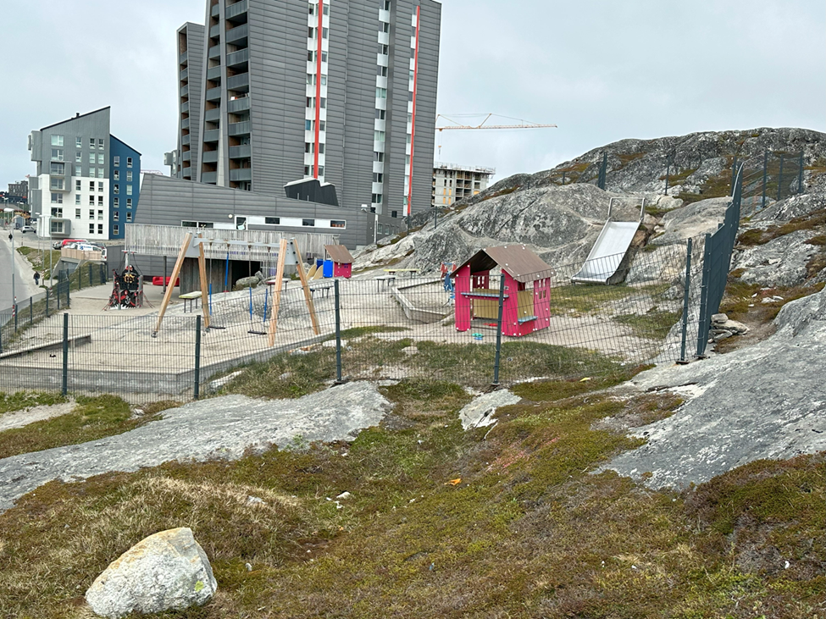
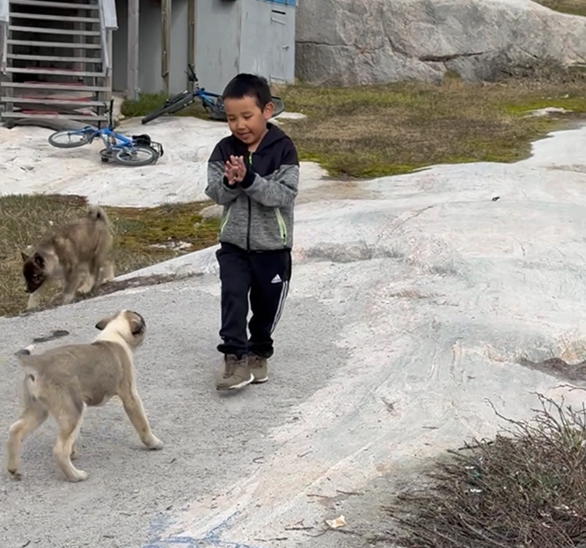

Lesson 5:
Get your boots
on the ground!

