Slide 1
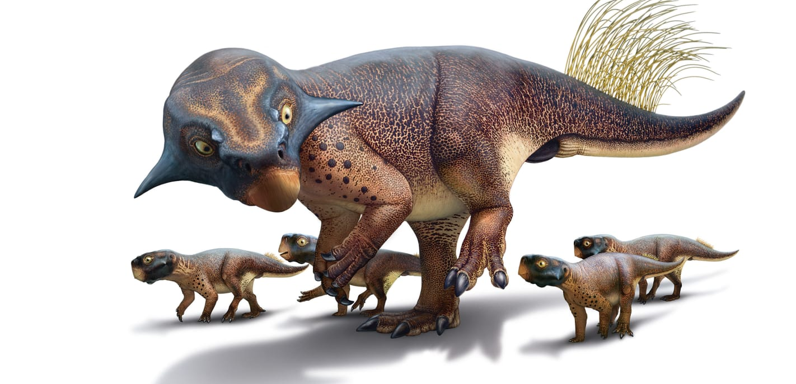
Paleontologists for a Day
Image Credit: Bob Nicholls
Activity, Models, and Slides developed by Mattea Horne;
based on undergraduate thesis research by Augustine Lodise (2022)
Notes:
https://www.cnn.com/style/article/dinosaurs-paleoart-michael-benton-culture-queue-scn/index.html

Slide 2
What does the activity cover?
Paleoclimate (ancient climate)
Evolution and natural selection
Functional morphology
Deep time (AKA the universal or geologic time scale)
The scientific process (how, and why, science happens!)

Slide 3
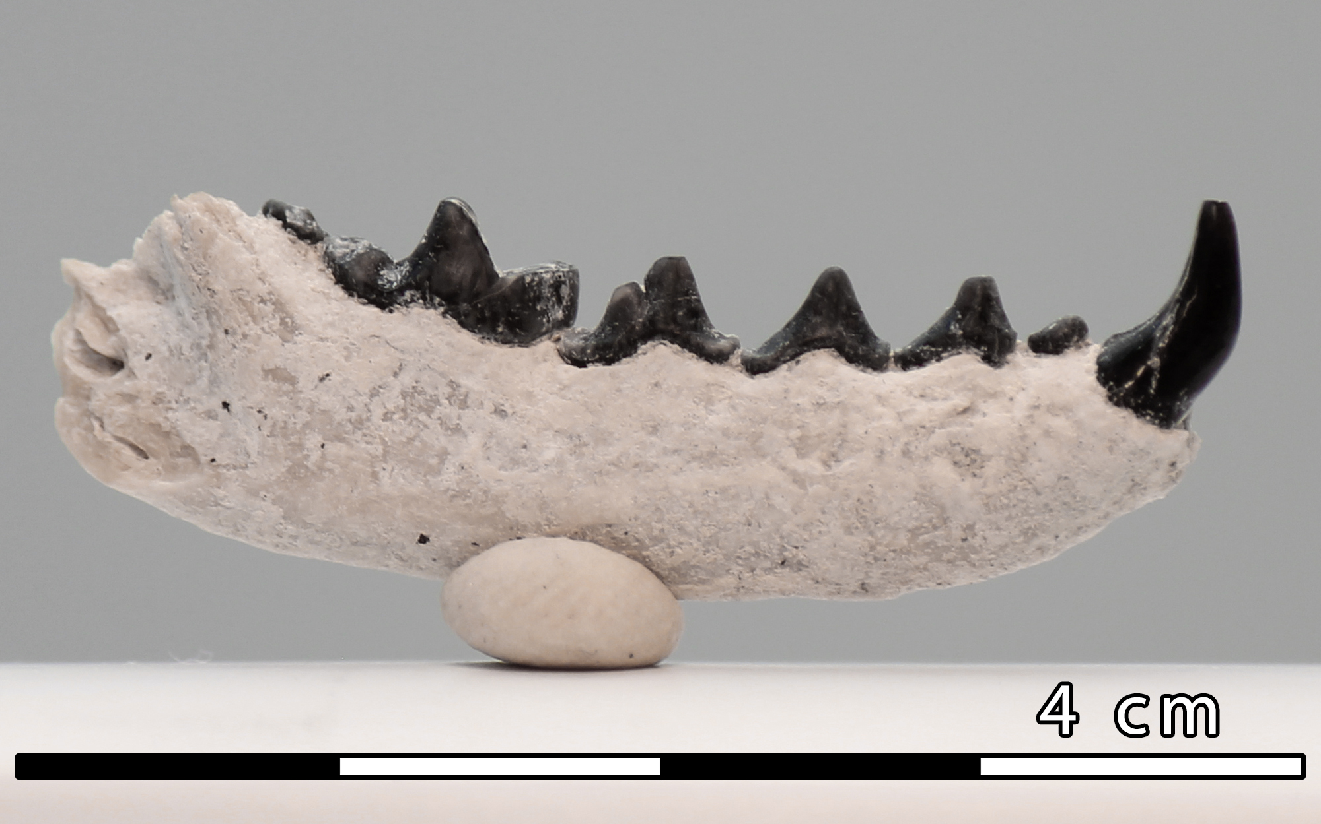
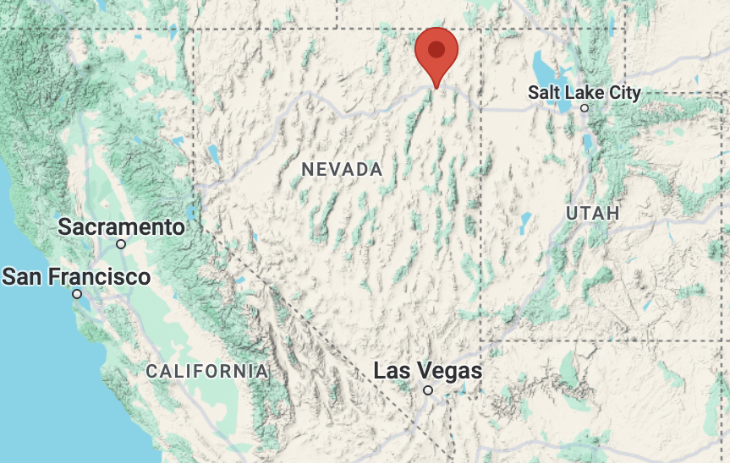
Image credit: Augustine Lodise, 2022
Time for a (quick) field trip!
This activity is meant to integrate “real” science – both field- and lab-work – into the classroom.
The premise:
  A paleontology class takes a field trip to Wells, NV.
  A tiny fossil jaw is found exposed on the soil.
  It’s likely a new species – what (and how) can we learn about it?

Slide 4
Learning Objectives
Students will be able to…
  Identify and describe differences and similarities between each fossil.
  Explain how those characteristics can help scientists hypothesize about ancient animals’ diets.
  Generate their own hypotheses about the diets of each of these ancient animals using evidence from their observations.
  Describe how fossils can help us understand regional and global climate and environment changes over long periods of time.
  Explain how paleontology can help us predict how today’s animals and environments might change in the future.
  Define terms like deep time, natural selection, evolution, functional morphology, and extinction

Slide 5
To The Lab!
In your lab, your working group will figure out more about this animal by comparing it to three known specimens from your institution’s collection.
The new lab tech volunteered to get the specimens from storage. As you’re gathering your research supplies, you hear a crash from the stairwell. The ID cards got all mixed up! Looks like this might be a little more complicated than we thought…
REMEMBER: this is cutting-edge science!
  Collaboration and questions are necessary!
  Mistakes are essential to the scientific process. If scientists never made mistakes, we’d already know everything there is to know about the universe. Wouldn’t that be boring?

Slide 6
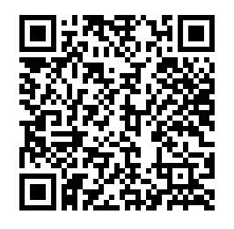
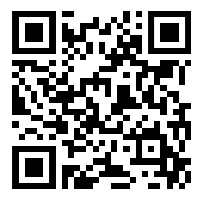

No paper copy?
View a PDF version of today’s activity here!
View my website (and all other versions of the activity) here!
View the virtual 3D models here!

Slide 7
What’s the big idea?
The animals shown in the three numbered models (Aenocyon dirus, Ursus spelaeus, and Merychippus calamarius) are all identified correctly… right?
Aenocyon dirus was known as Canis dirus until 2021, when a genetic study confirmed that dire wolves are not as closely related to living gray wolves as we once thought (Perri et al.)!
Scientists are also questioning whether all Ursus spelaeus (cave bear) specimens belong to the same species. There may have been enough variation between regional population groups to distinguish them as different species!
The history of Merychippus calamarius (an ancestor of the modern horse) is even more complicated. The fossil you studied, plus a few others from the same collection, are the only existing fossils of that species, and it is highly likely that they belong to a different Merychippus – and were simply misidentified.

Slide 8
Other questions to consider…
Based on your work today, how difficult do you think it might be to go about identifying a new species? What challenges might you encounter?
What about the New Species? Is it really “new,” or was it a test of our paleontological skills? Well… both!
  This model is extremely special. This fossil could be an entirely new species of mustelid (e.g. weasel or marten)! It was hypercarnivorous – meaning it ate only meat (Taxonomy and Paleoecology of a Late Miocene Locality near Wells, Nevada (Lodise et al., 2022).
How would YOU determine if this fossil represents a new species? What question(s) would you want to ask and what data would you want to gather to present a strong argument?
Notes:
Small group or full-class discussion:
Based on your work today, how difficult do you think it might be to go about identifying a new species? What challenges might you encounter?
(Hint: think about differences that we can observe in animals alive today. Do all people look the same? What about all dogs or cats? Remember, wolves and coyotes count as dogs and tigers and lions count as cats, too!)
We have to think about individual variation (e.g. not all people are the same height),
Genetic mutation (e.g. individuals with dwarfism have different proportions than people without the condition, which can be seen in their skeletons),
Sexual dimorphism (e.g. in some animals, females are much larger than males, and vice versa)
Age (babies are definitely not the same size as adults!), and more!

Slide 9
SO WHAT?
Remember that scientists look at fossils to better understand how environments and organisms have changed over time.
One big example of this kind of change is mass extinctions, where over half of the existing species on Earth get wiped out. This can happen because of catastrophic events, like sudden changes in the global climate, large volcanic eruptions, or asteroid impacts.
The fossils you looked at today are from extinct animals, but none of those animals disappeared in a mass extinction event.
  Why and how might this “smaller” type of extinction happen?
  What does this tell you about how paleontology can help us predict the future?
Notes:
The fossils you looked at today are from extinct animals, but none of those animals disappeared in a mass extinction event.
Why and how might this “smaller” type of extinction happen?
Diseases
Loss of habitat/food sources
Overhunting (e.g. passenger pigeon, dodo)
What does this tell you about how paleontology can help us predict the future?
Climate is changing – in the past, some organisms have been able to adapt/evolve quickly enough to survive, but many went extinct.
Change is occurring much more quickly than ‘usual’ – many organisms will not have the capacity to adapt/evolve quickly enough to match how much the climate (and environment) is changing, and may go extinct

Slide 10
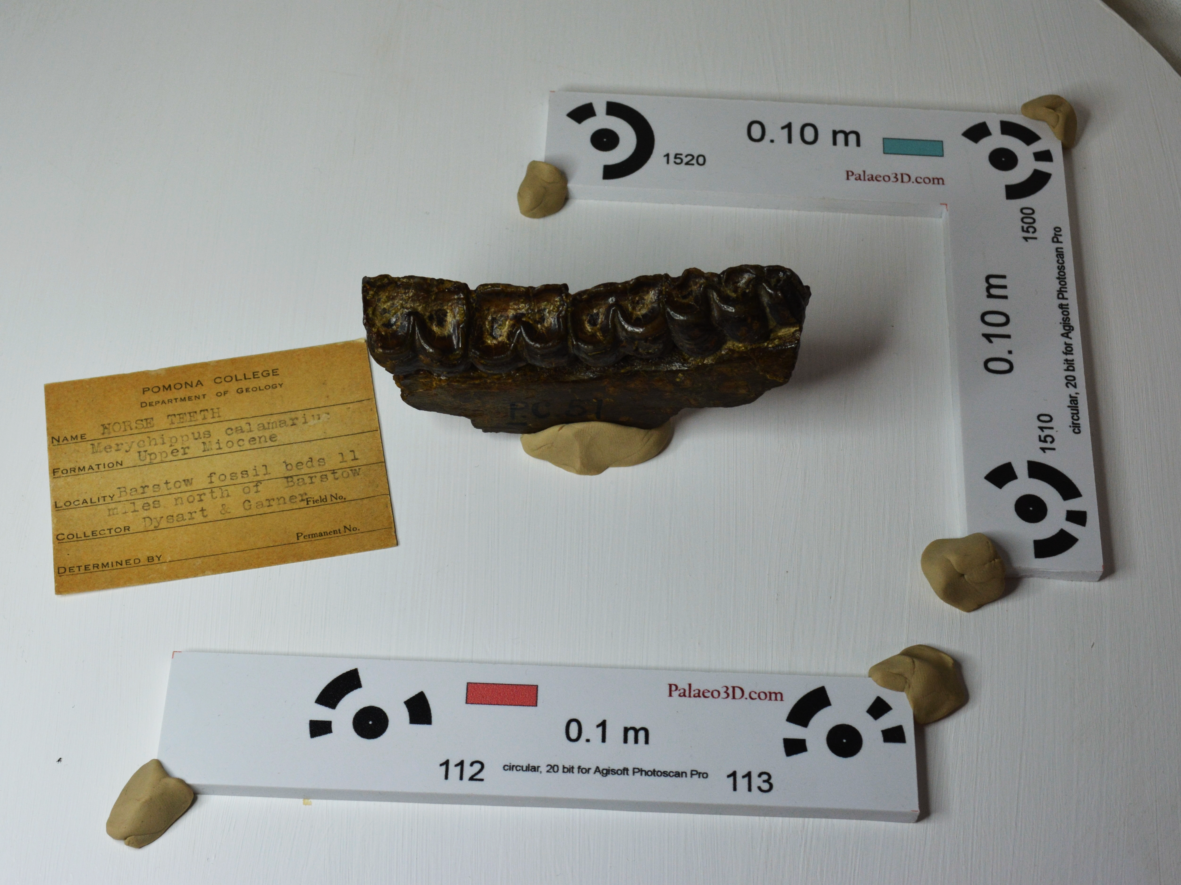
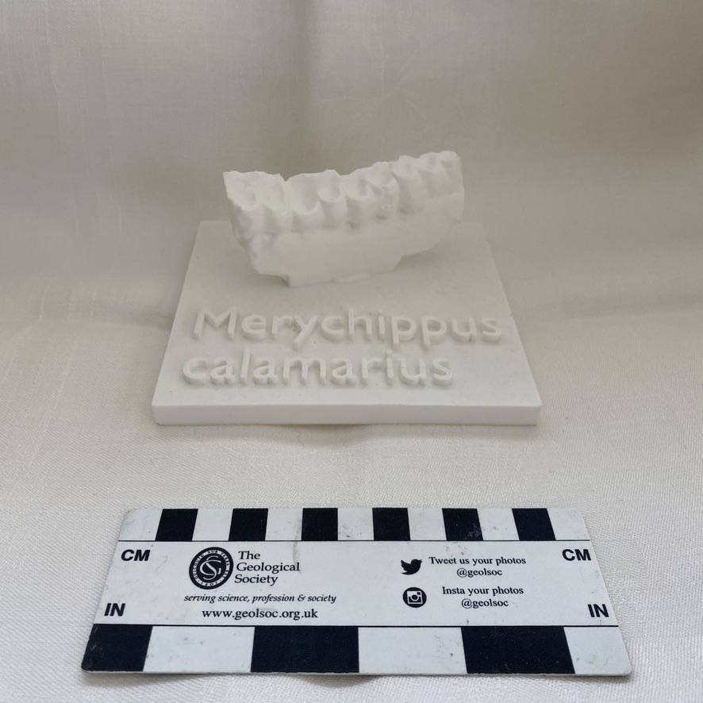
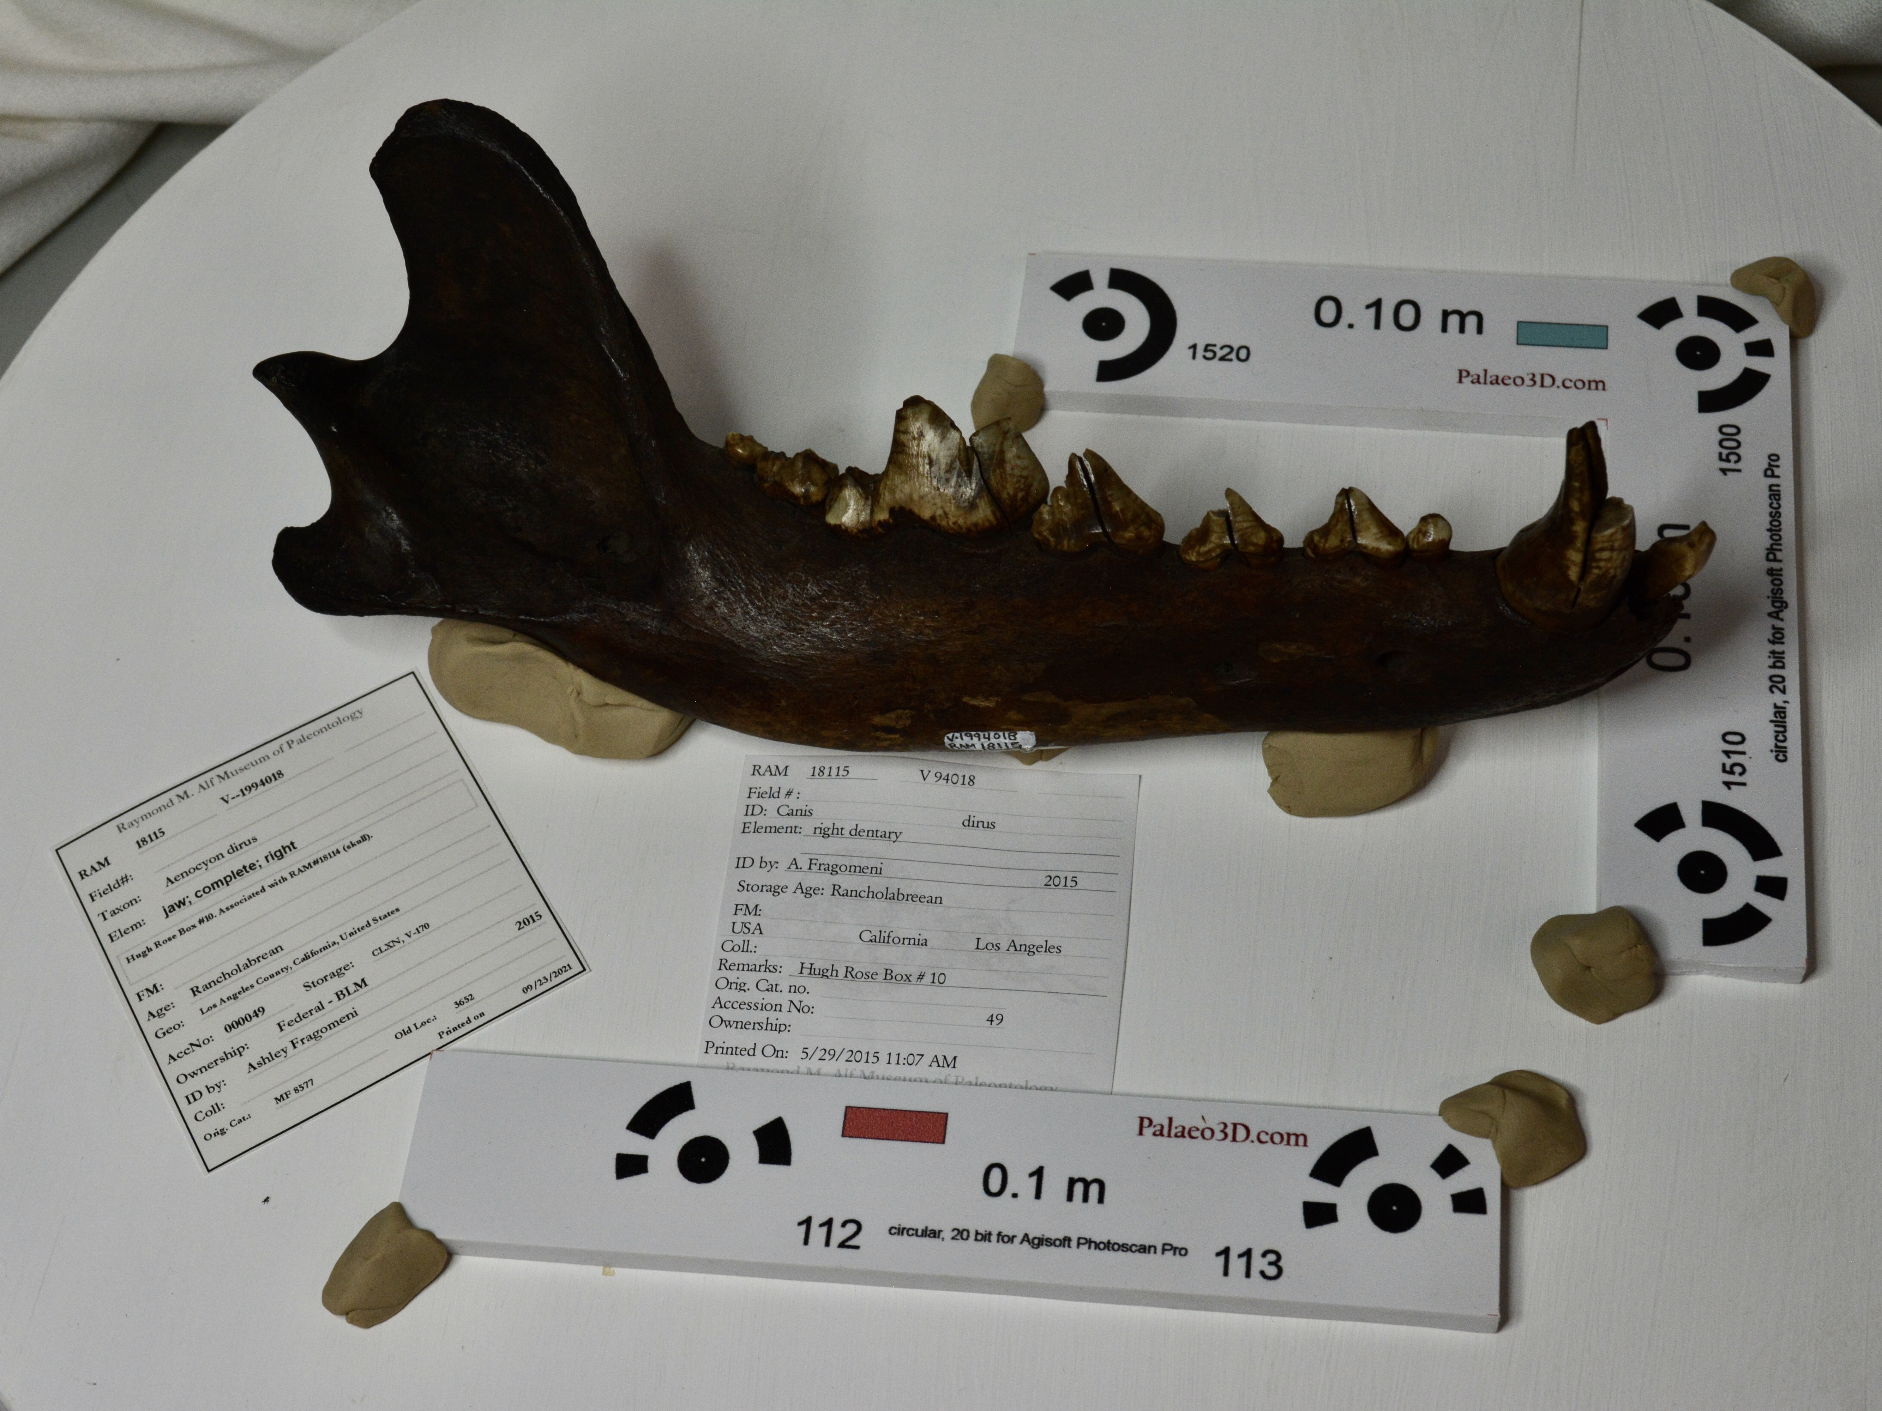
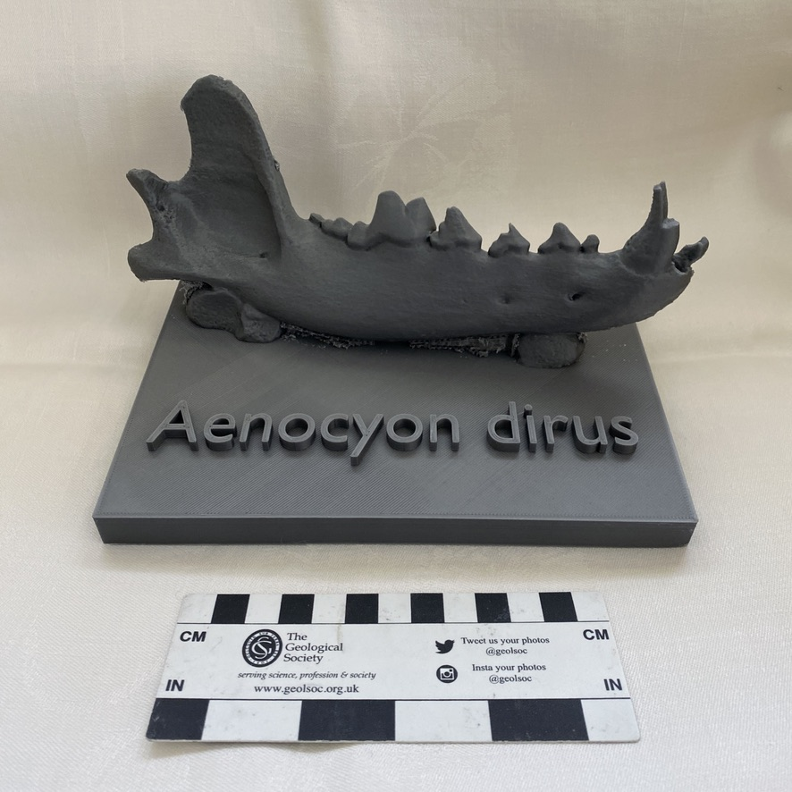
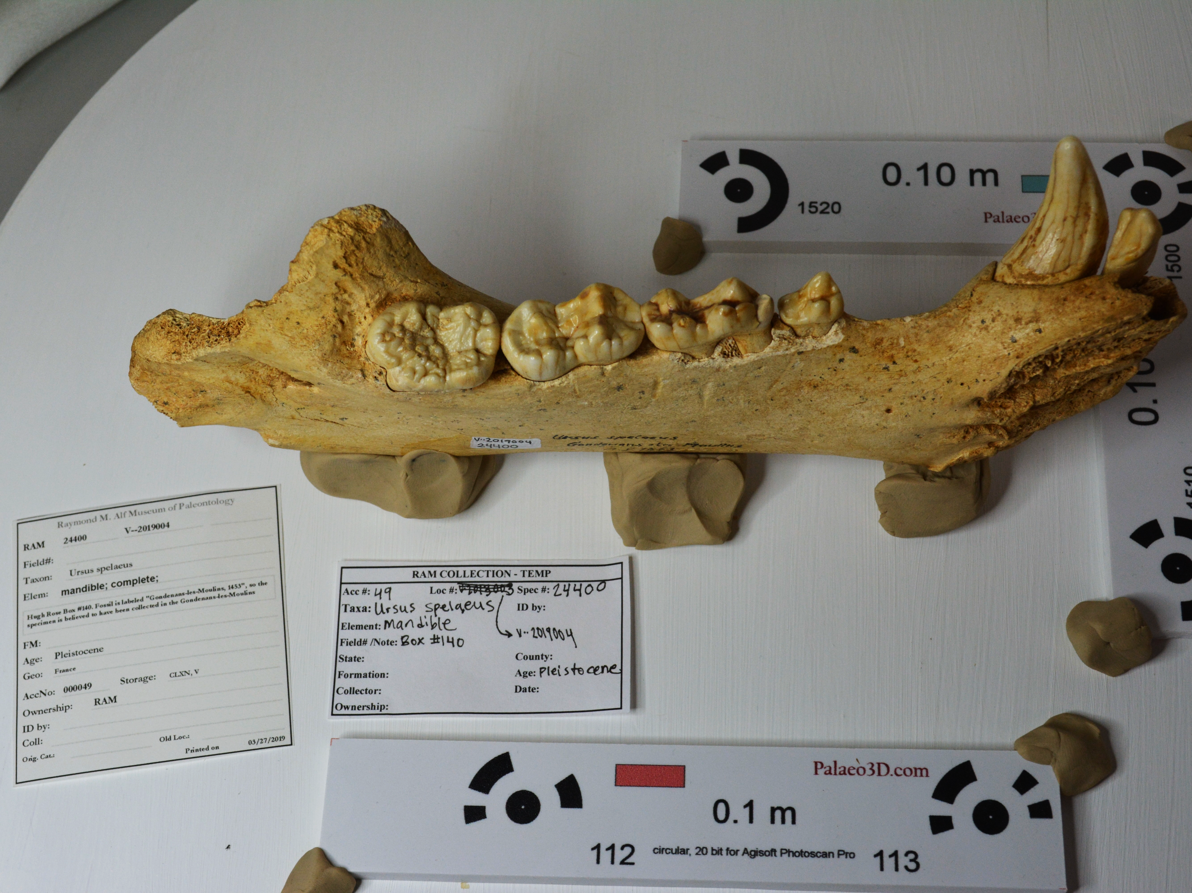
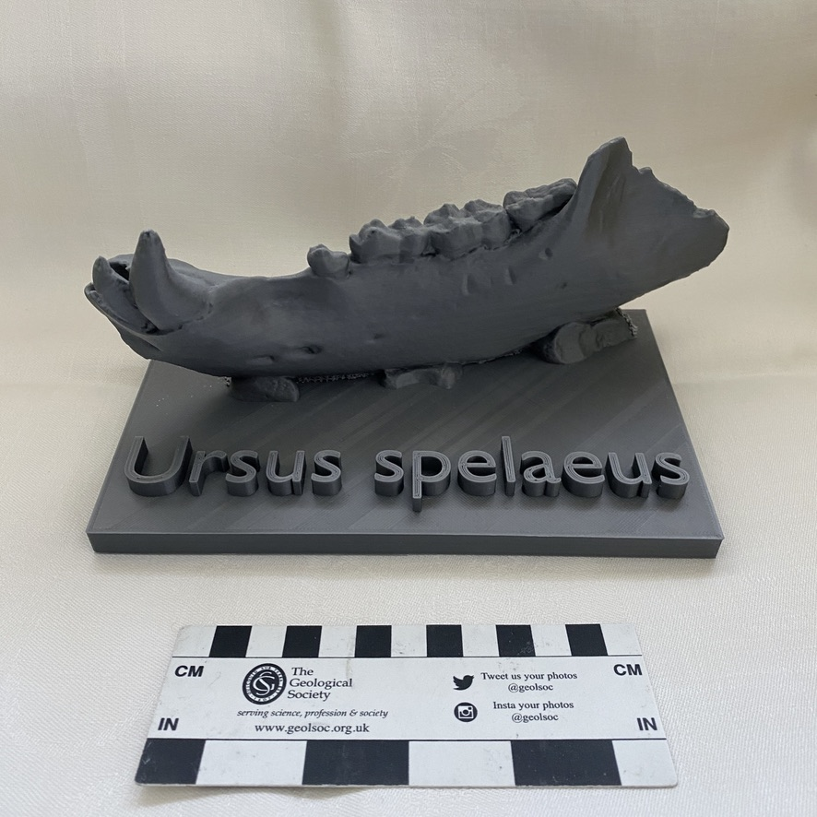
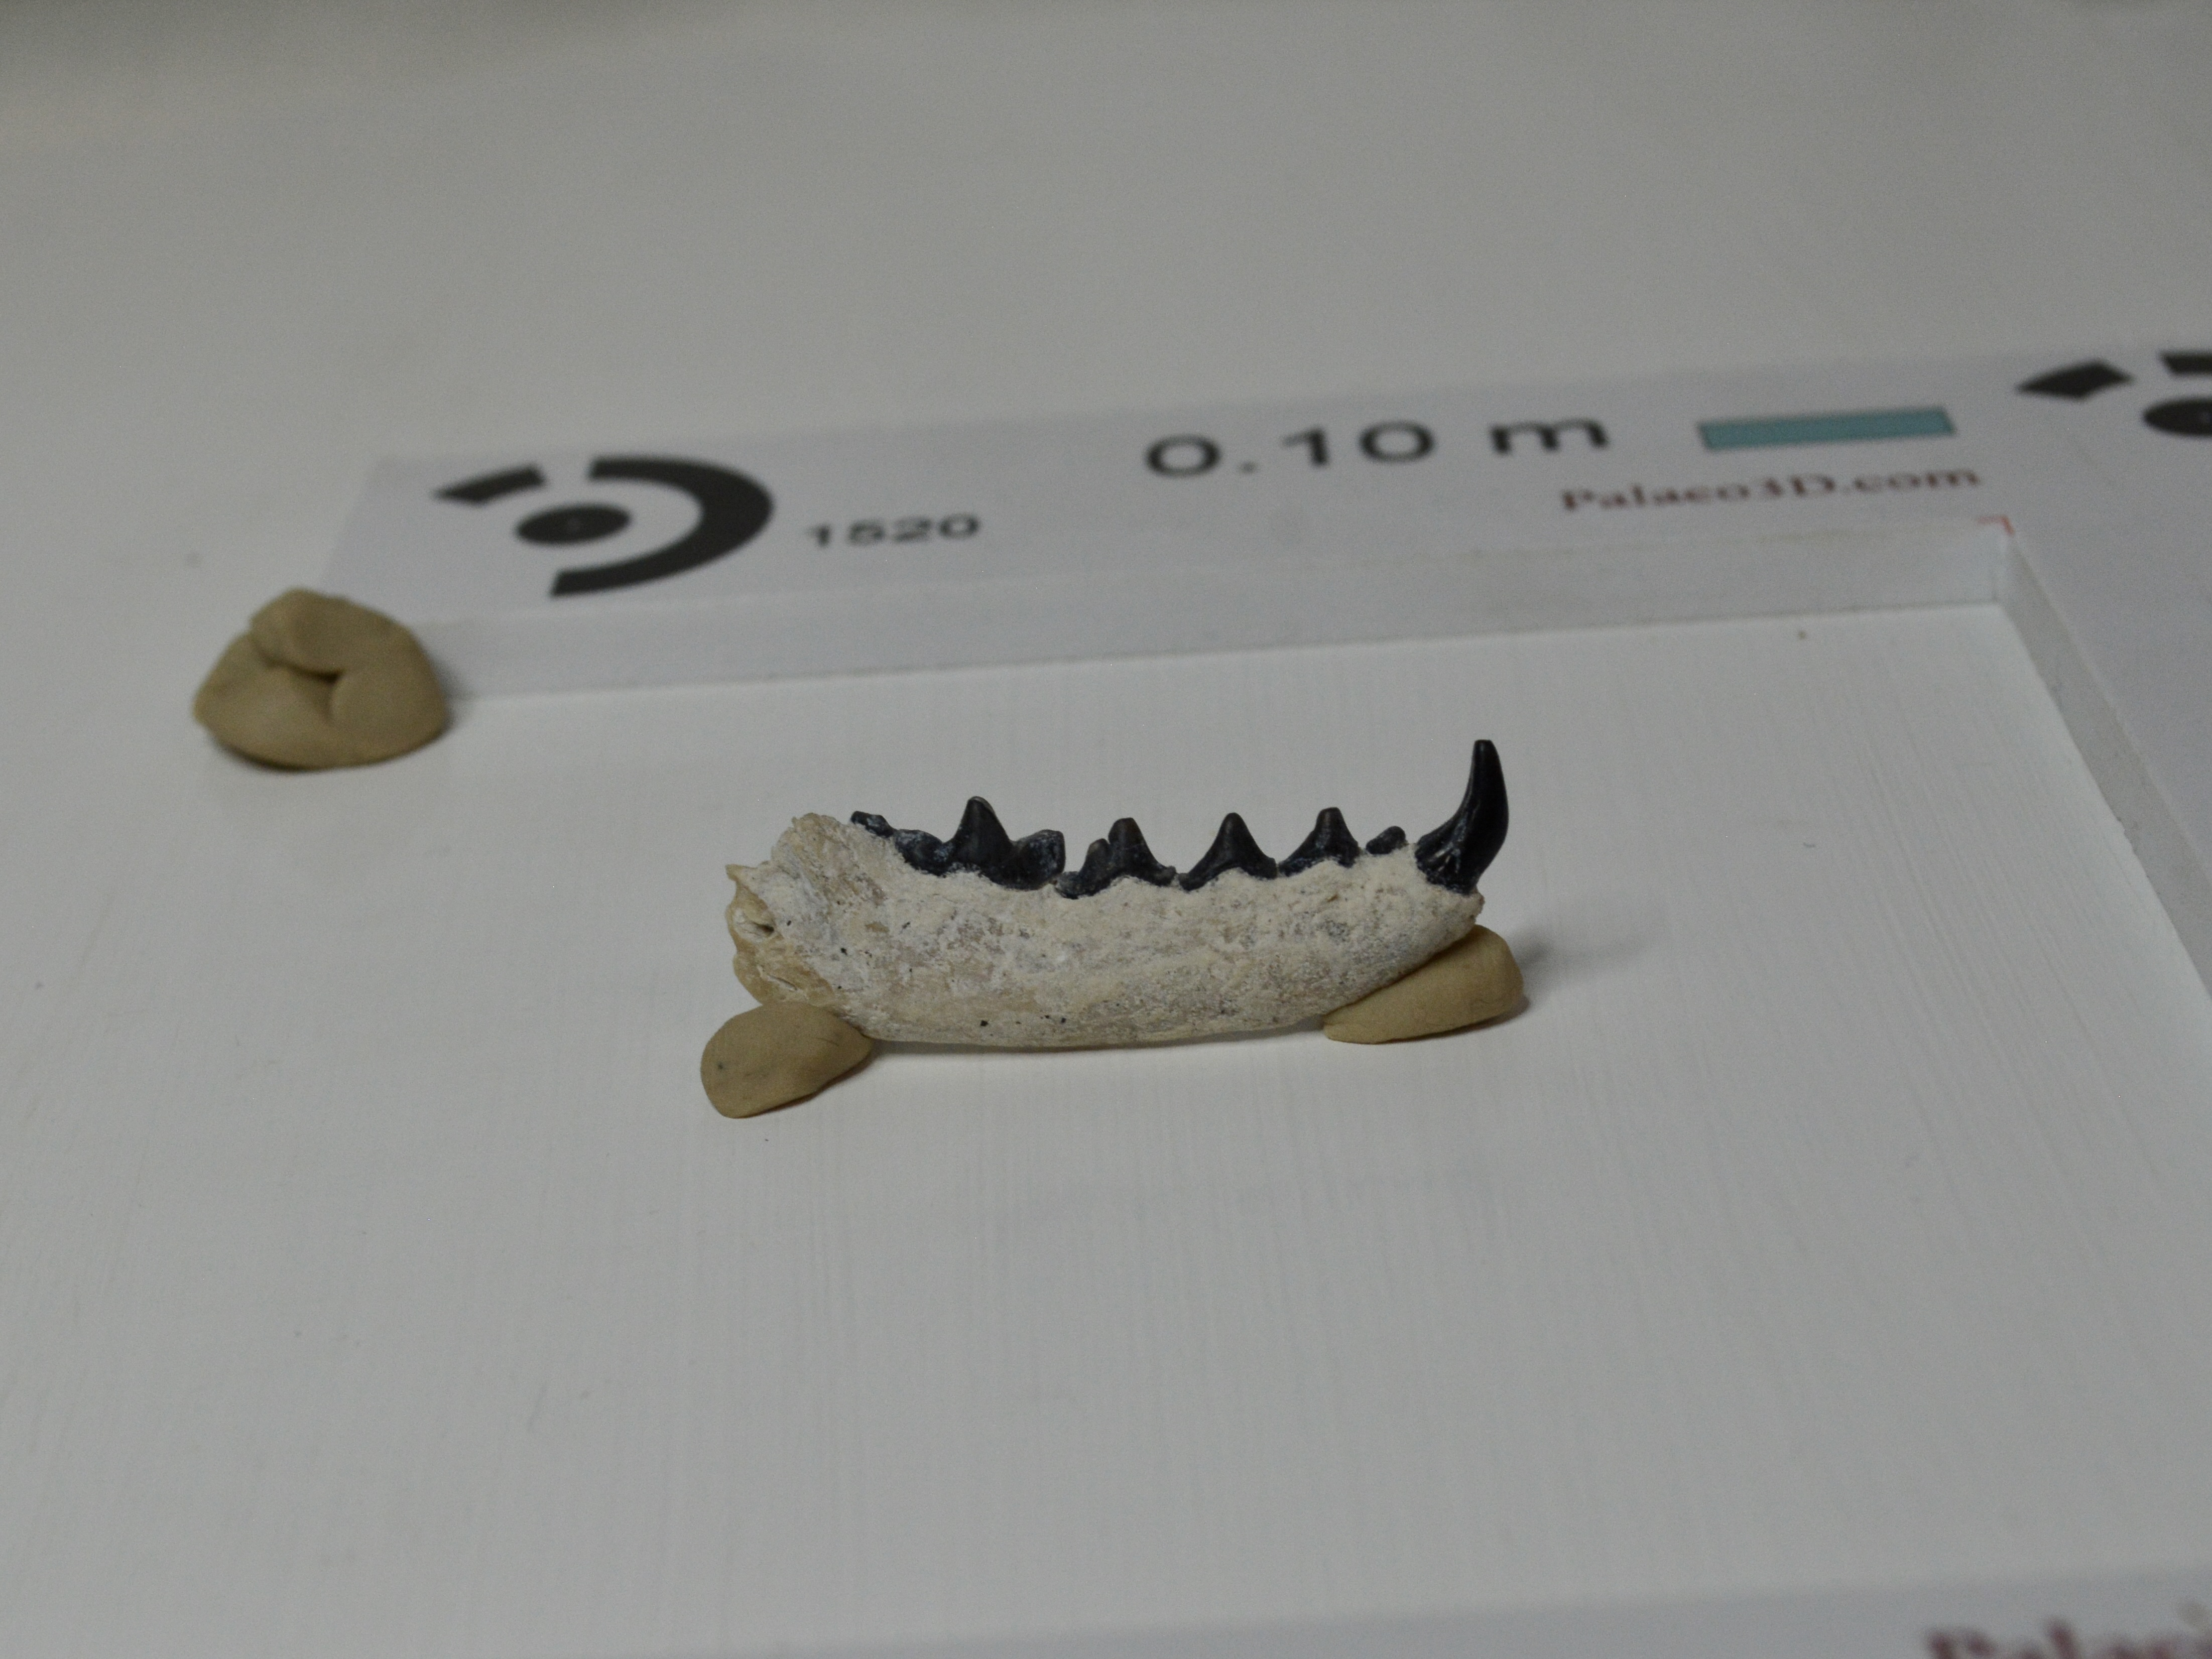
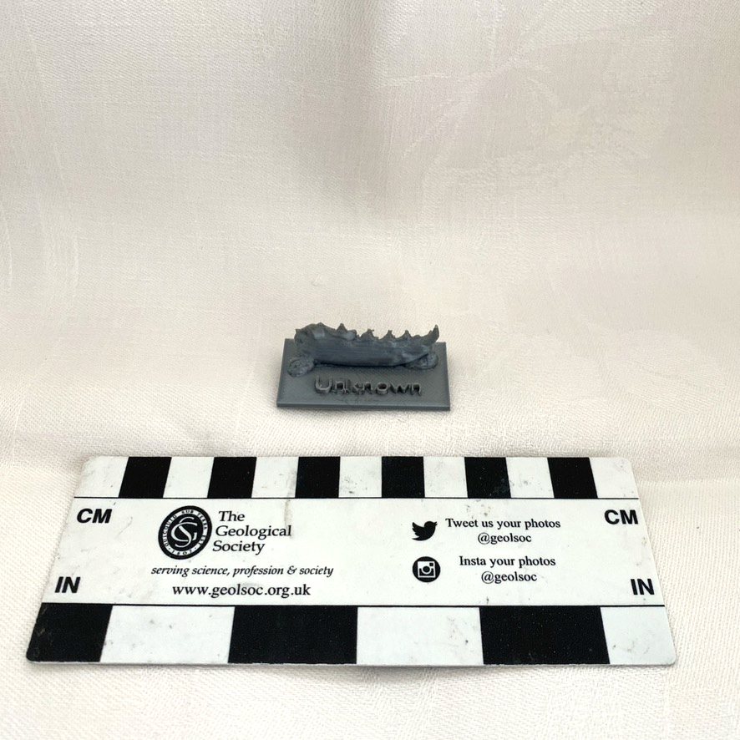
Comparing the models to the originals:
1A
1B
3A
3B
2A
2B
4A
4B
Notes:
If any students are interested in seeing the comparisons of the original specimens to the 3D prints, you can put this slide up.
This is also a great spot to talk about the advantages of 3D models as compared to “real” fossils – accessibility, reproducibility, durability… the list goes on. If you want to impress upon students how durable the models are, you can perform a “drop test” (I’ve done it before, and the models survived!).

Slide 11
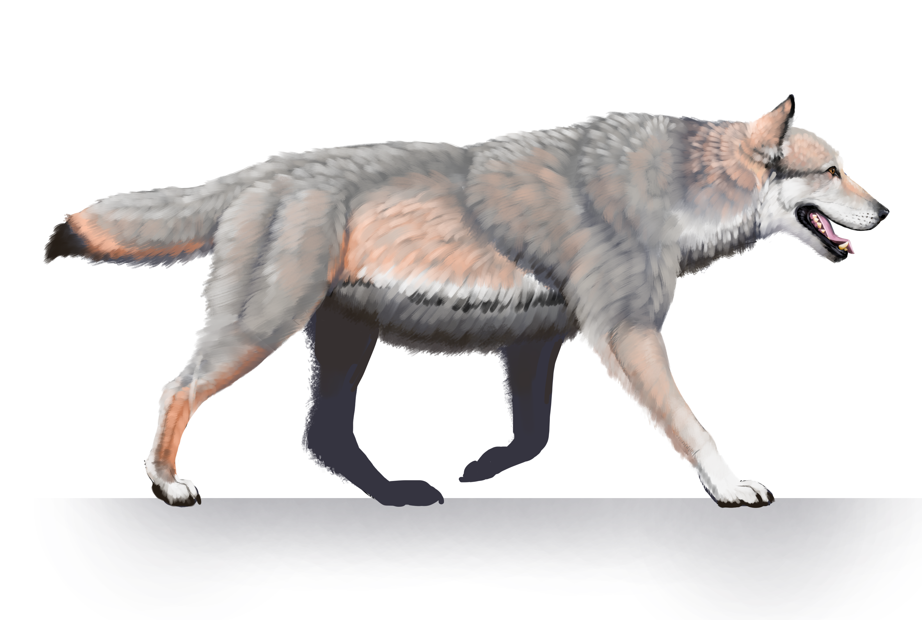
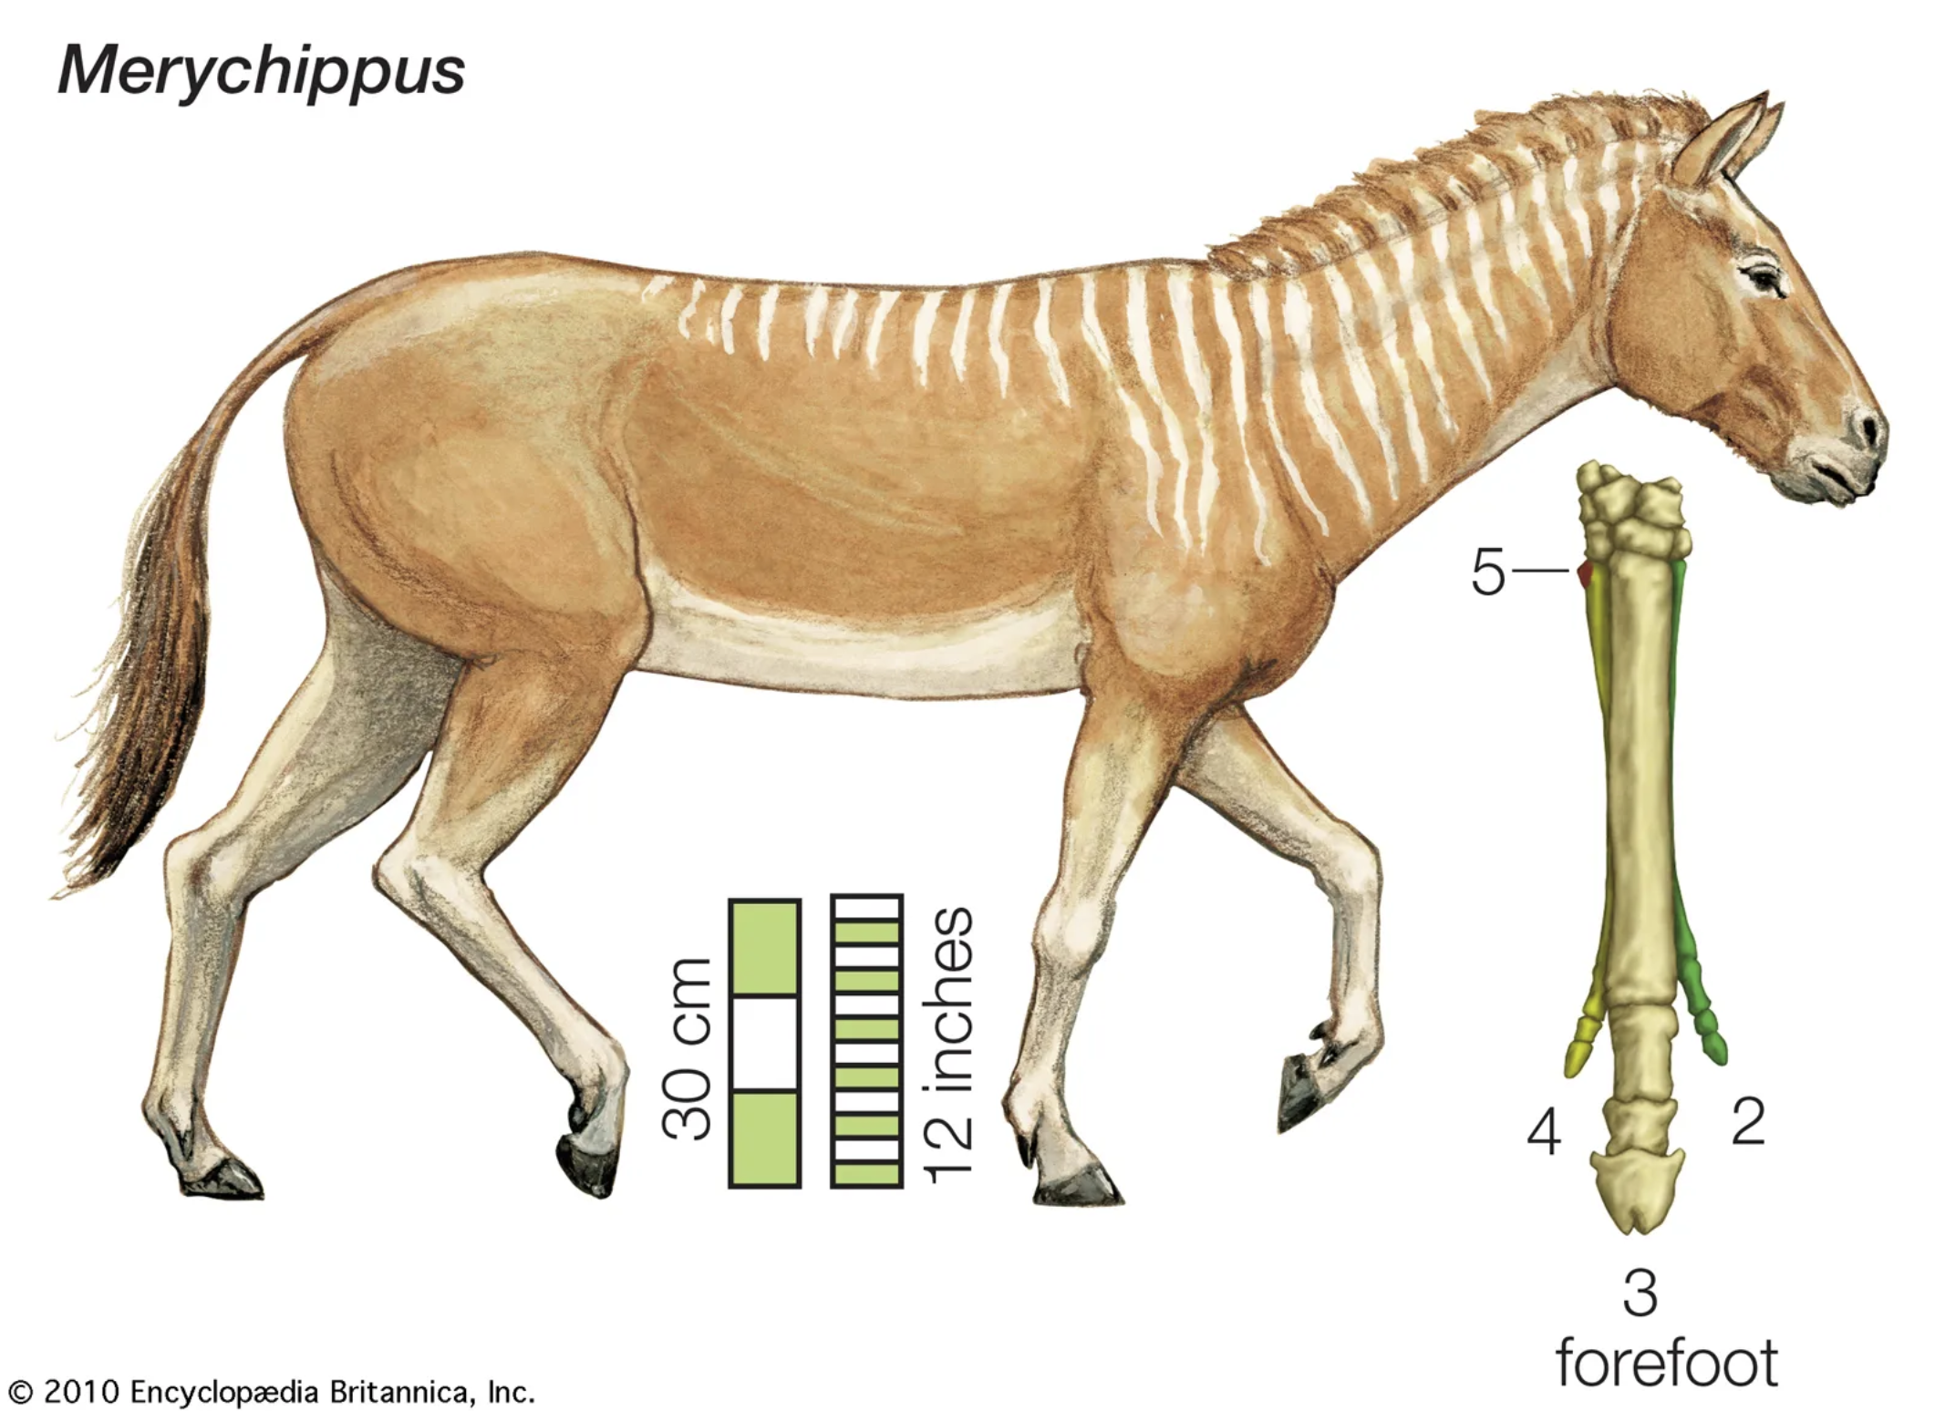
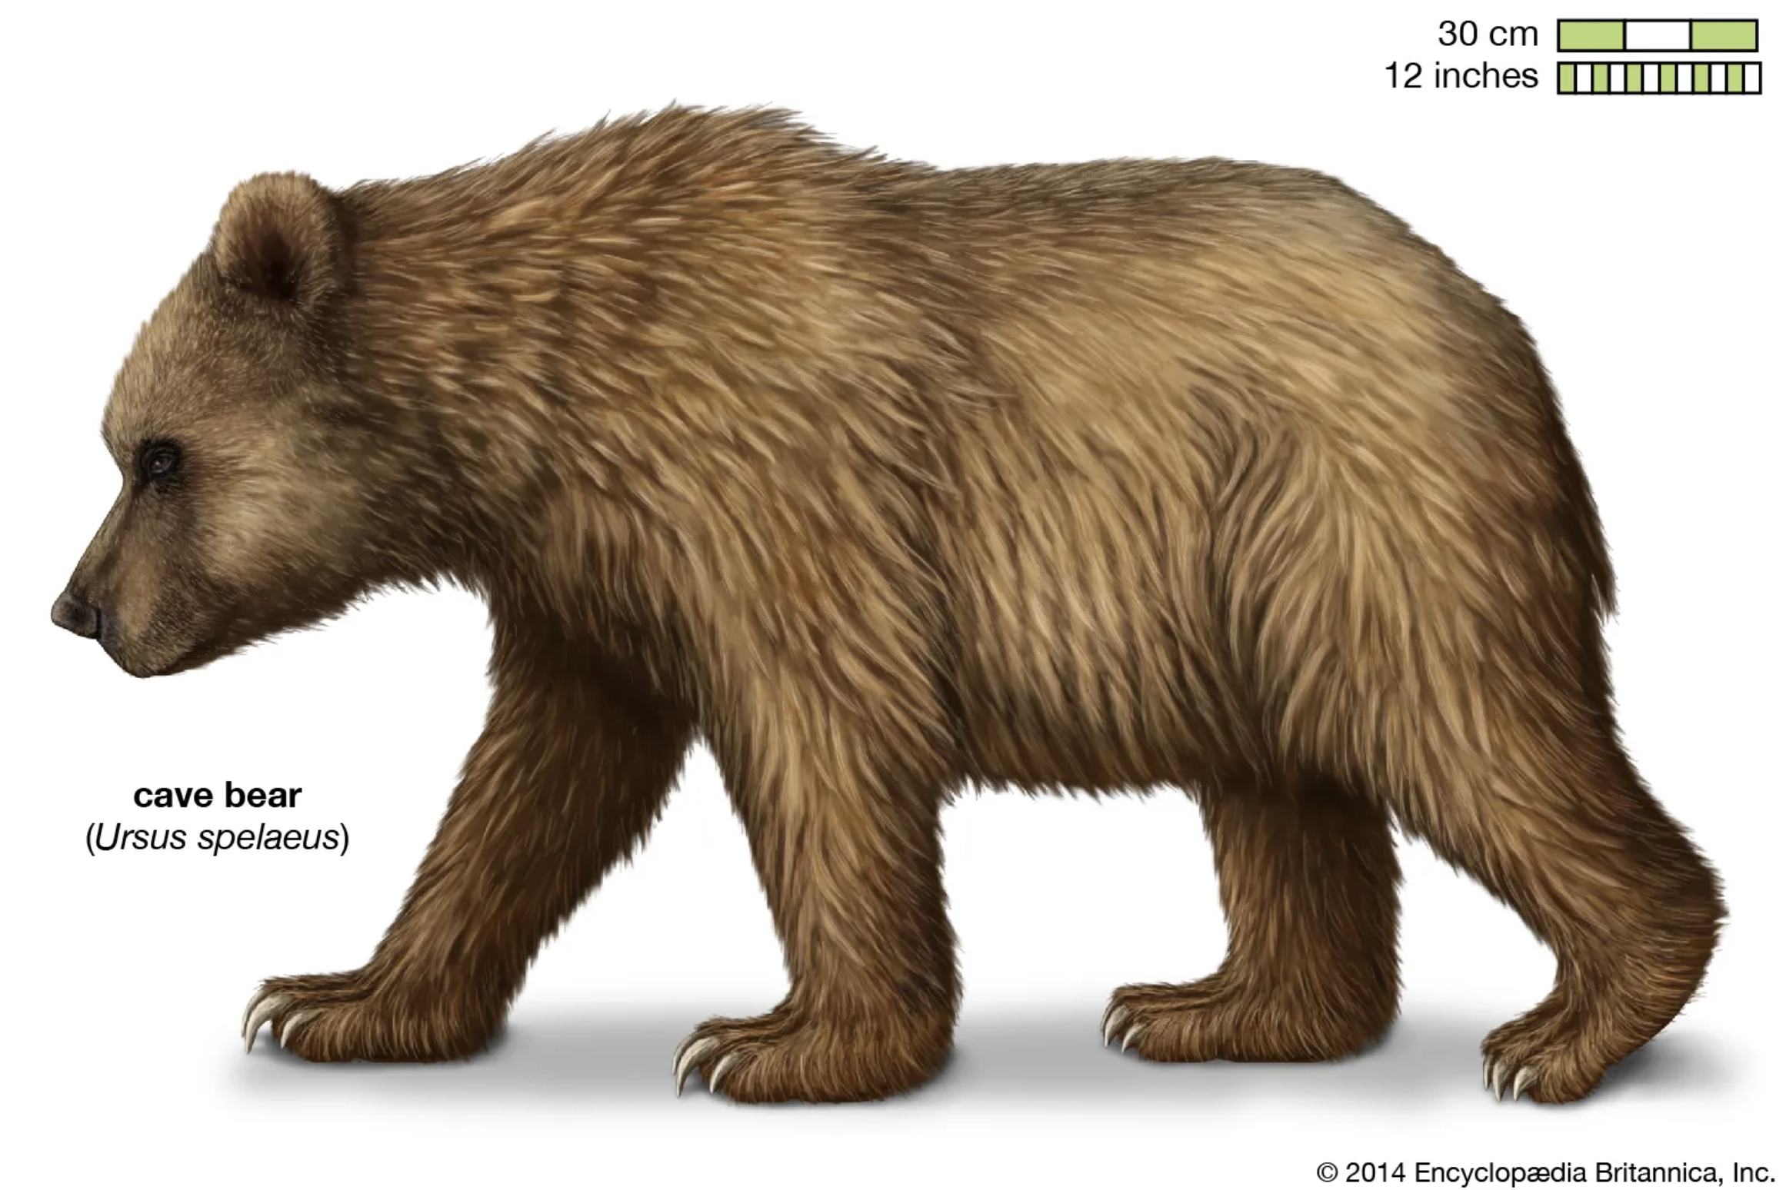
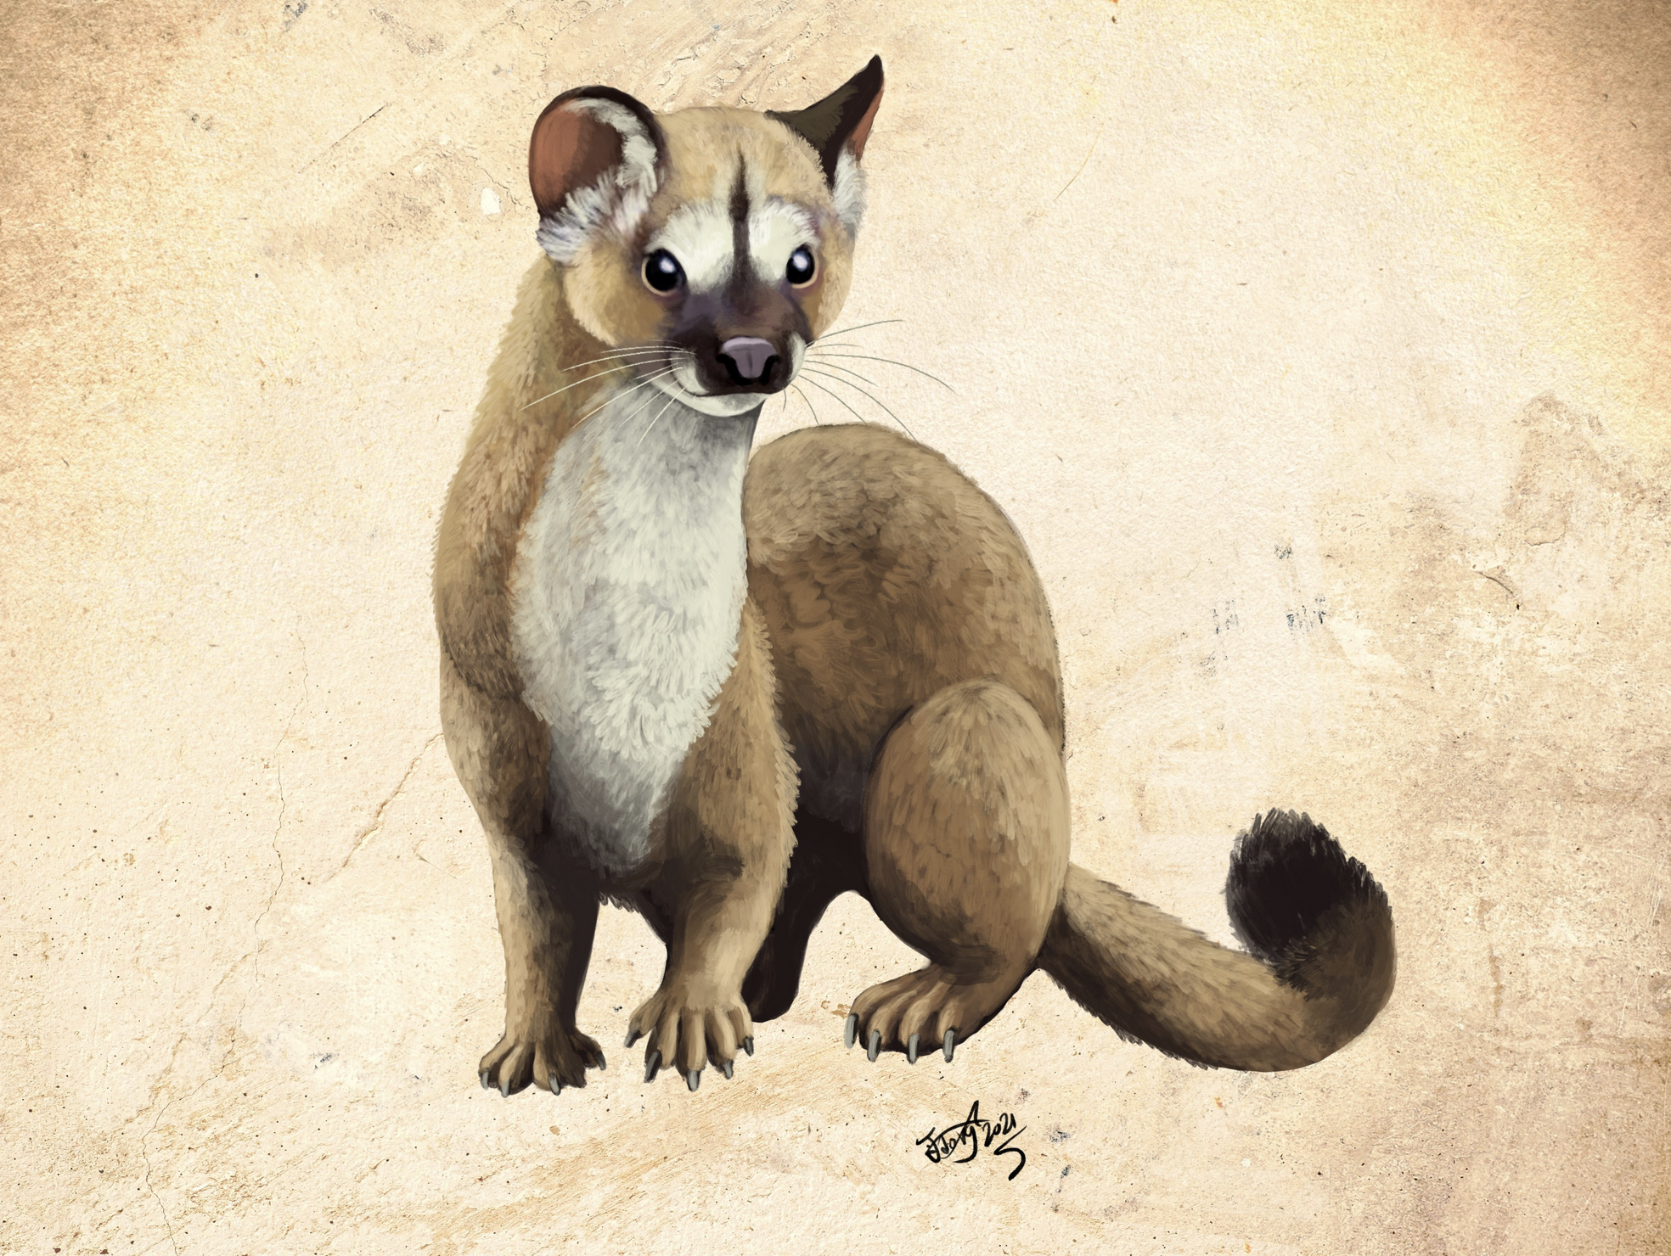
What did these animals (maybe) look like?
12 inches
Aenocyon dirus (Dire Wolf); credit: Benji Paysnoe
Merychippus (horse ancestor)
Ursus spelaeus (Cave Bear)
Unknown mustelid; credit: Hodari Nundu
5 inches
Notes:
While we will probably never know exactly what these animals looked like (unless someone invents time travel, of course), artists can draw inspiration from these animals’ modern relatives that are still alive today. The people who create this art are called paleo-artists.
Clockwise from top left:
Merychippus – an ancestor of the modern horse; notice how much smaller it is! https://www.britannica.com/animal/Merychippus
Aenocyon dirus – dire wolf (bigger than modern wolves by a fair margin) https://www.nps.gov/articles/000/dire-wolf.htm
Unknown mustelid – while no paleo-art of this specimen (new species) exists yet, here’s a drawing of another ancient mustelid (creature like a weasel or ferret). https://twitter.com/HodariNundu/status/1369930424621752329 (prolific paleoartist). VERY SMALL – note the difference in scale!
Ursus spelaeus – cave bear (close to the size of a polar bear). https://www.britannica.com/animal/cave-bear

