Slide 1

Unearth Your Future:
An online module about geoscience careers using DEI by Design
Danielle F. Sumy and Heather R. Houlton
(Videos by Joyce Smith and David McConnell)

Slide 2
Preview: Discussion
How do you see engaging (or how do you already engage with) students about geoscience career topics?
How do you engage with students to overcome potential roadblocks, setbacks, or barriers in their careers?

Slide 3
What is the Careers Module?
Free, asynchronous, online course for undergraduates
Takes 3-5 hours to complete
Extra Credit (rather than integration into your curriculum)
Main Goals:
  Introduce Geoscience and Geophysics
  Workforce Data and Skills
  Diversify Geophysics, by addressing potentially uncomfortable topics:
    Privilege
    Authenticity
    Active bystander intervention training
    Impostor Syndrome
Notes:
This module:
Is an asynchronous, 3-5 hour course about the geosciences, and specifically geophysics, for first and second-year undergraduate students.
Asynchronous means that you can go through the module at your own pace.
It discusses a brief overview of geoscience and geophysics technical concepts,
what careers are available in the profession,
how to pursue a career that combines your unique skills, interests and passions, and
does this all this using Diversity, Equity and Inclusion (DEI) by design.
How is this being developed?
This module is part of the broader impacts of EarthScope to raise awareness of our discipline and reduce the barriers to participation for people of all backgrounds and social identities.
It is in partnership with the American Geosciences Institute – we’re using their Geoscience Online Learning Initiative (GOLI) platform
We’ve had several collaborators over the years, including:
David McConnell’s Geoscience Education Research group – North Carolina State University
Joyce Smith, PhD candidate is doing all the geo videos.
Science Education Resource Center (SERC) to help us build the evaluation for the module.

Slide 4
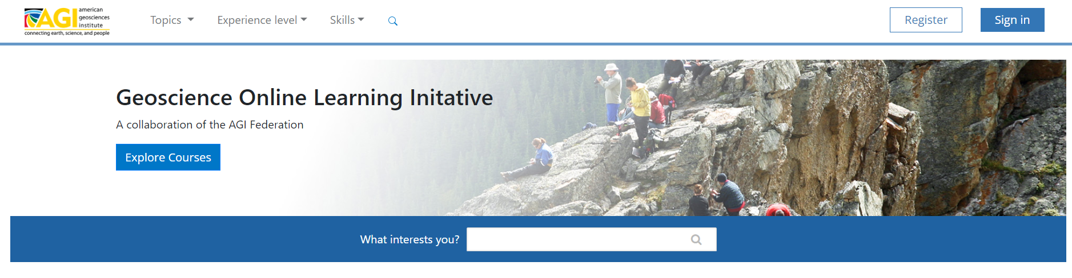
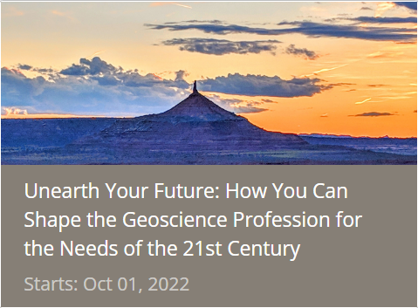
Sign up!
Step 1: Go to https://learning.americangeosciences.org/
Step 2:
Step 3: Make a profile
Step 4: Enroll in “Unearth Your Future”
Notes:
Before we dive into the details,
I want to give you a chance to sign up for the course so you can follow along, if you wish!
First, go to: https://learning.americangeosciences.org – I’ll also put this in the chat.
Once you’re there: [click] click the Register button near the top right corner of the screen.
It’ll direct you on how to make a profile. I’ll give us a few moments to do that now.
Once your profile is created, in the course list, find the Unearth Your Future module – the course thumbnail looks like this. [click]

Slide 5
Roadmap
Main Topic
Content/Information
Practical Applications
1
What is Geoscience and Geophysics?
What is Geoscience?
Relating Your Interests and Passions
What is Geophysics?
2
What Opportunities Await in a Geo Profession?
Geo Workforce Data
Skills needed to be Successful
Geoscience Salaries
3
How can You Build a Career that’s Suited for You?
Career Trajectories
Overcoming Challenges during Your Career
Authenticity
4
What are Strategies to Land Your Dream Job?
Advanced Job Searching Resources
Application Process
Notes:
This module:
Is an asynchronous course about the geosciences, and specifically geophysics, for first and second-year undergraduate students.
It discusses a brief overview of geoscience and geophysics technical concepts,
what careers are available in the profession,
how to pursue a career that combines your unique skills, interests and passions, and
does this all this using Diversity, Equity and Inclusion (DEI) by design.
Overview of Module:
5 formal learning objectives; by the end of the module students should be able to:
summarize select technical geoscience and geophysics concepts
demonstrate how geoscience/geophysics impacts society
highlight a wide variety of careers in the geosciences (and geophysics)
describe skills needed for geoscience careers AND
connect careers with students’ diverse identities
To meet these objectives, there are 4 main sections as outlined here in the course roadmap
The first provides technical content of our discipline
The second section highlights WF data, and explains skills needed in the profession
The third demonstrates how to integrate your own passions and social identities to build a unique career in the geosciences
And the last one has information about the job search
Each of the 4 main sections have pages with practical applications of this content so students can apply what they’re learning to build their own career paths.
How is this being developed?
This module is part of the broader impacts of the SAGE facilities for Education and Public Outreach (EPO) at IRIS to raise awareness of our discipline and reduce the barriers to participation for people of all backgrounds and social identities.
It is in partnership with AGI – using their Geoscience Online Learning Initiative (GOLI) platform, which uses the Open edX LMS
Additional collaborators for design and content include:
Joyce Smith who is part of David McConnell’s Geoscience Education Research group – North Carolina State University
Carol Ormand from the Science Education Resource Center (SERC).
Wendi Williams from the IAGD to ensure the course is accessible to those with disabilities

Slide 6
Discussion Break
How do you see engaging
(or how do you already engage with)
students about geoscience career topics?
Notes:
Now that you’ve seen the topics and roadmap that we use, what are some ways that you engage or do you see yourself engaging students with some of these topics in the classroom?

Slide 7
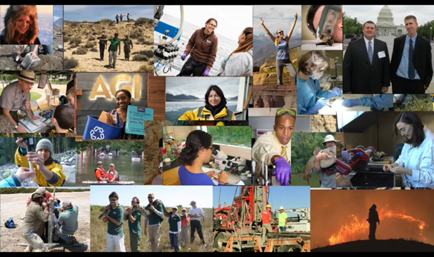
Geoscience Careers
Notes:
Now I want to highlight something from the first section of the course:
Here is an example of an animation we’ve developed.
[Heather, play starting at: 0:31 seconds, make sure it’s muted]
At the end of the geophysics technical content section,
We introduce the concept of how students can relate their own interests and passions to the geosciences
In order to build a career that’s uniquely suited for the individual.
The animation uses AGI’s Geoscience Careers Infographic:
That discusses the different sectors of the geoscience workforce as well as examples of real occupations.
We designed the animation to highlight a variety of geoscience career paths,
Including occupations that have field, lab, and/or computing components,
Those in policy, education, business, federal/state/local/tribal governments, or even medicine!
Also depicted are real geoscientists with different social identities to provide examples of role models from across our scientific community.

Slide 8
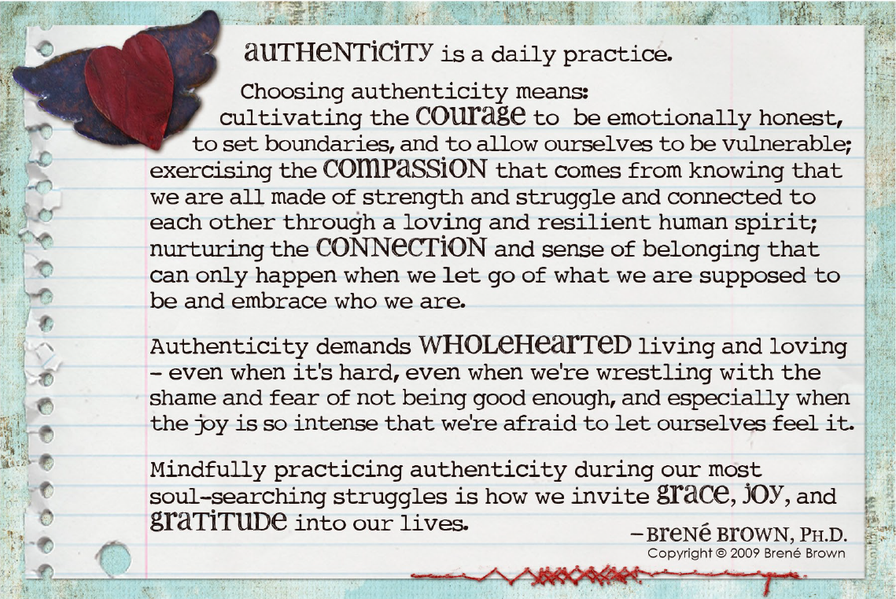
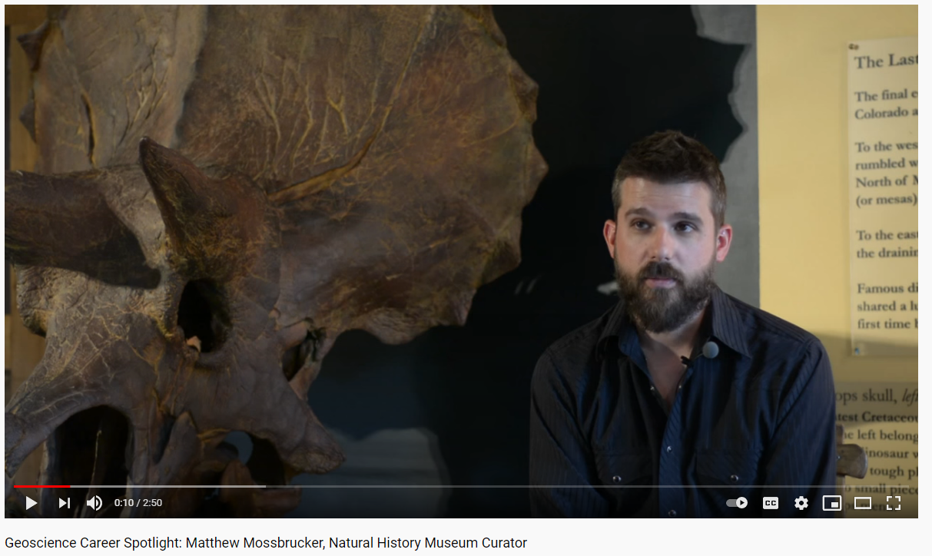
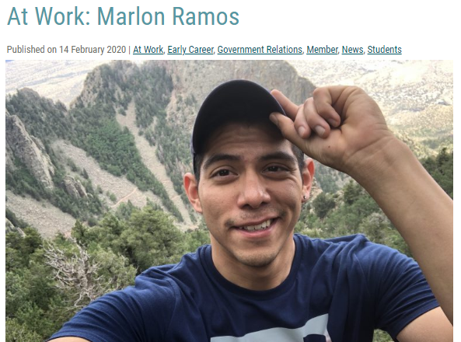
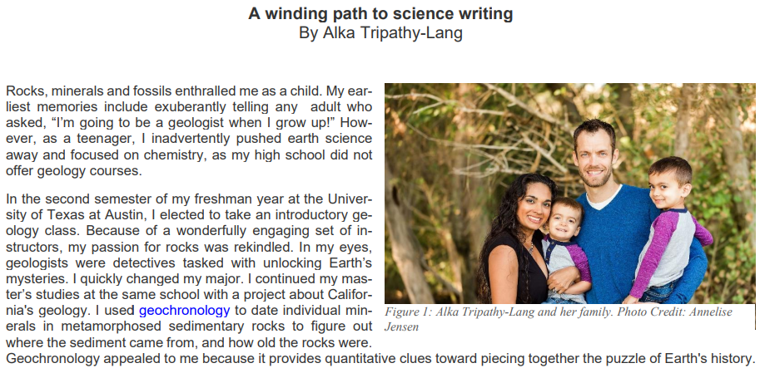
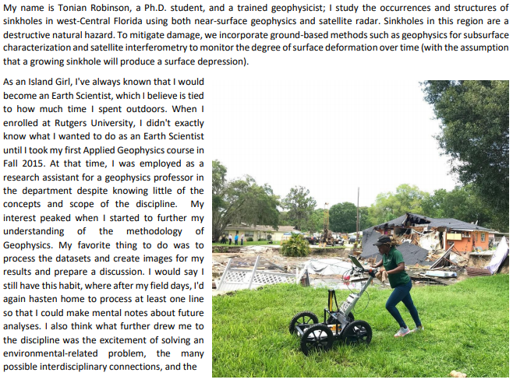
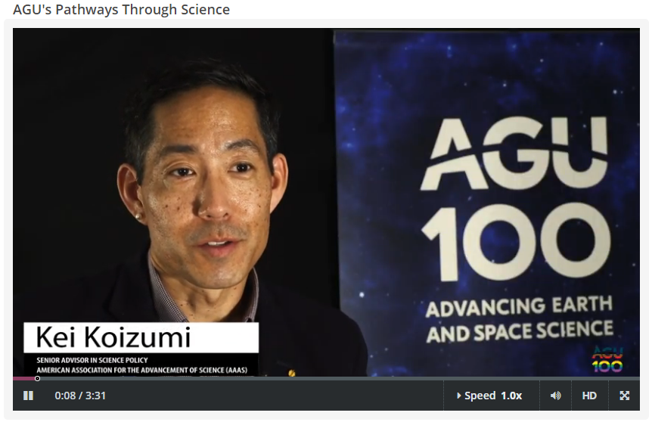
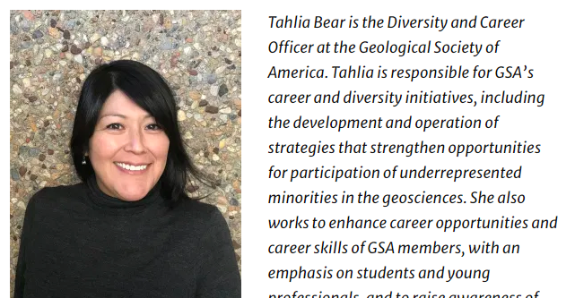
Diversity, Equity and Inclusion by Design
Notes:
How are we using DEI by design?
This course is aimed to be inclusive of all identities as best we can.
Want to stay away from geoscience stereotypes that can be off-putting.
Also want to broaden the types of geoscience/geophysics examples of careers highlighted,
how and where work is conducted (not just in the field), and its applications to society.
Applications to society and demonstrating how our work really makes a difference to local communities is a key feature of the module.
To be inclusive of all identities, we:
Are intentional with who is represented in our pictures, videos, voice actors for animations and in examples of professionals (as shown here)
We explicitly discuss DEI concepts and how they inherently play a role in STEM. These concepts include:
Social identities
Privilege
Implicit Bias
Microaggressions
Authenticity
Importance of mentoring/role models
We not only interweave these concepts in with scientific and careers content, but we also provide learning and development around overcoming challenges and barriers.

Slide 9
Demonstration!
We’re going to explore:
Geophysics Videos (created by NCSU)
Workforce Data and Skills
Identifying and Overcoming Challenges
Tips for Landing Dream Job
Let’s go!
Notes:
Now let’s jump into the live demo!
For this, I’ll share my screen and we’ll go through one main component of each of the four sections of the course.

Slide 10
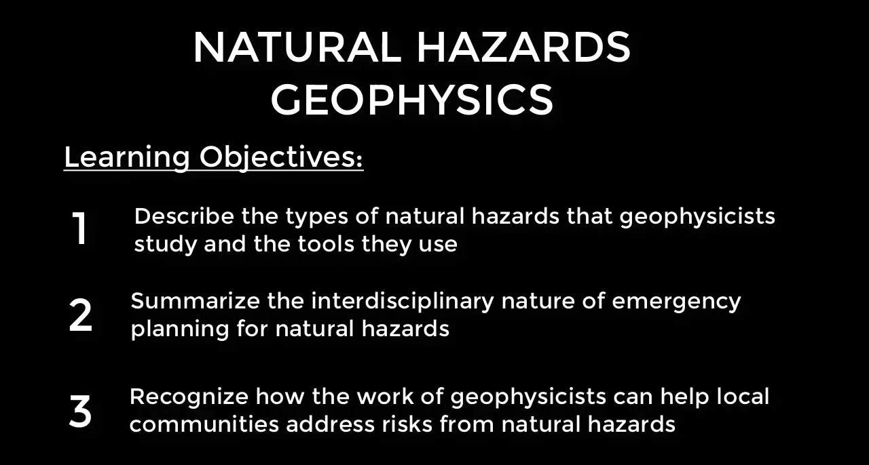

Slide 11
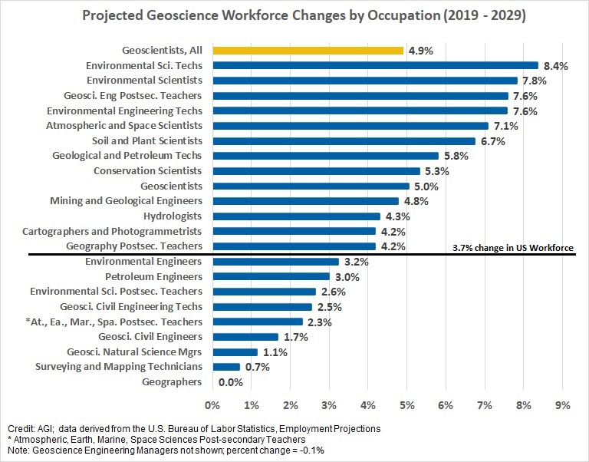
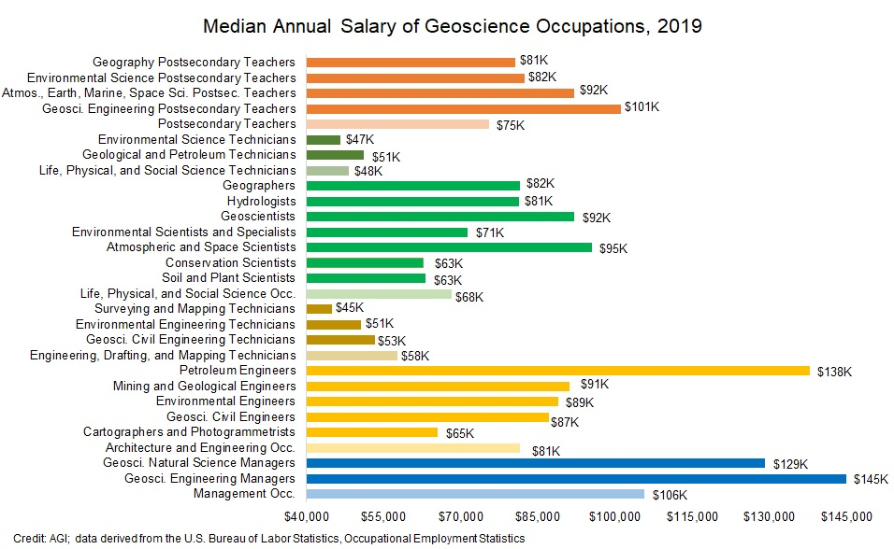
Workforce Data and Skills
Notes:
The module also includes information about the geoscience workforce.
We are collaborating with AGI to integrate workforce data into the module that tells the story of supply and demand of geoscientists.
Here we see some projections of geoscience occupation growth in the next 10 years and data about median annual salaries of mid-career geoscientists.
[fly in next graphs]
We also provide transparency about who traditionally participates in the geosciences and how that has (or has not) changed over time.
The idea is to demonstrate how much opportunity there is in our profession,
both by the growth projections and salaries, and
by including new scientists from backgrounds that traditionally haven’t been fully welcomed into our community.
This is an important component of DEI by design because
it shows the acute need for broader representation (and that it’s something we’re actively addressing) AND
that the profession’s economic outlook is strong so that there will be many opportunities to build a career and make a difference.

Slide 12
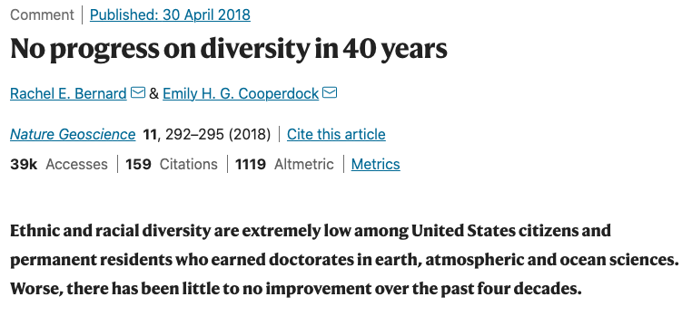
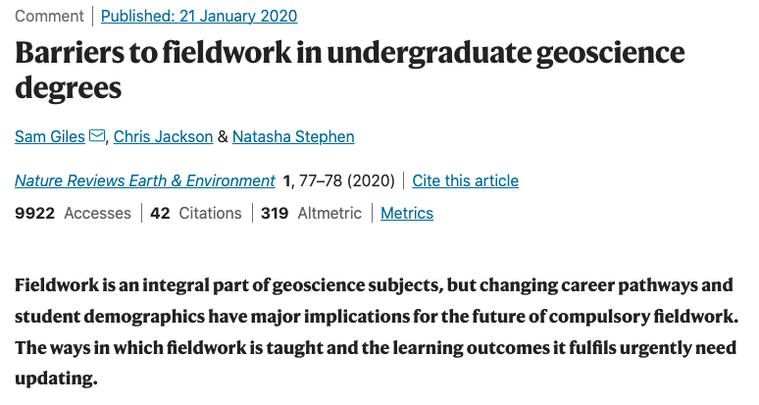
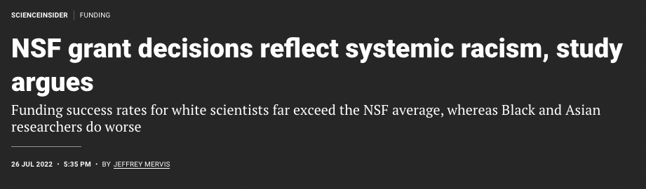
Notes:
Now we will discuss reducing barriers to participation of racial and ethnic underrepresented groups (URGs) in the geosciences and how we can leverage diversity and inclusion best practices to allow all populations into our profession. This has the potential to decrease the talent deficit and advance our science, but more importantly, it is a moral imperative to ensure anyone who wants to be a geoscientist can be a geoscientist, no matter their heritage or identity. As the geosciences increase its diversity and representation, the quality of our science will improve as will our ability to have positive impact on the communities we serve.

Slide 13
Discussion Break
How do you engage with students to
overcome potential roadblocks, setbacks, or barriers
in their careers?

Slide 14
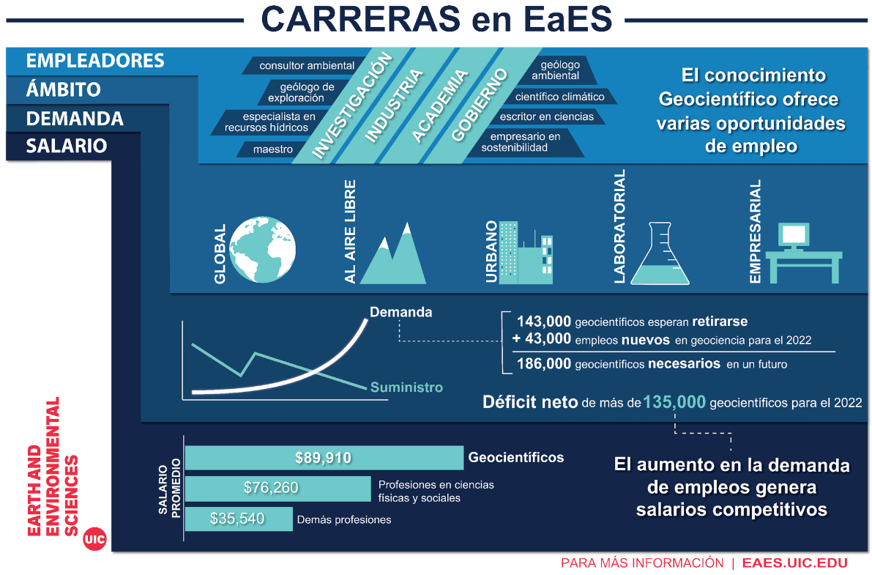
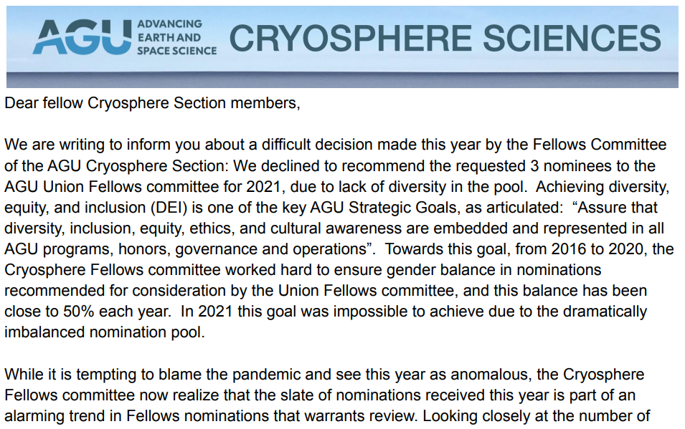
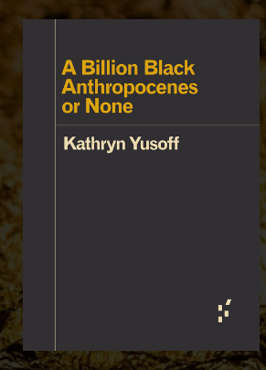
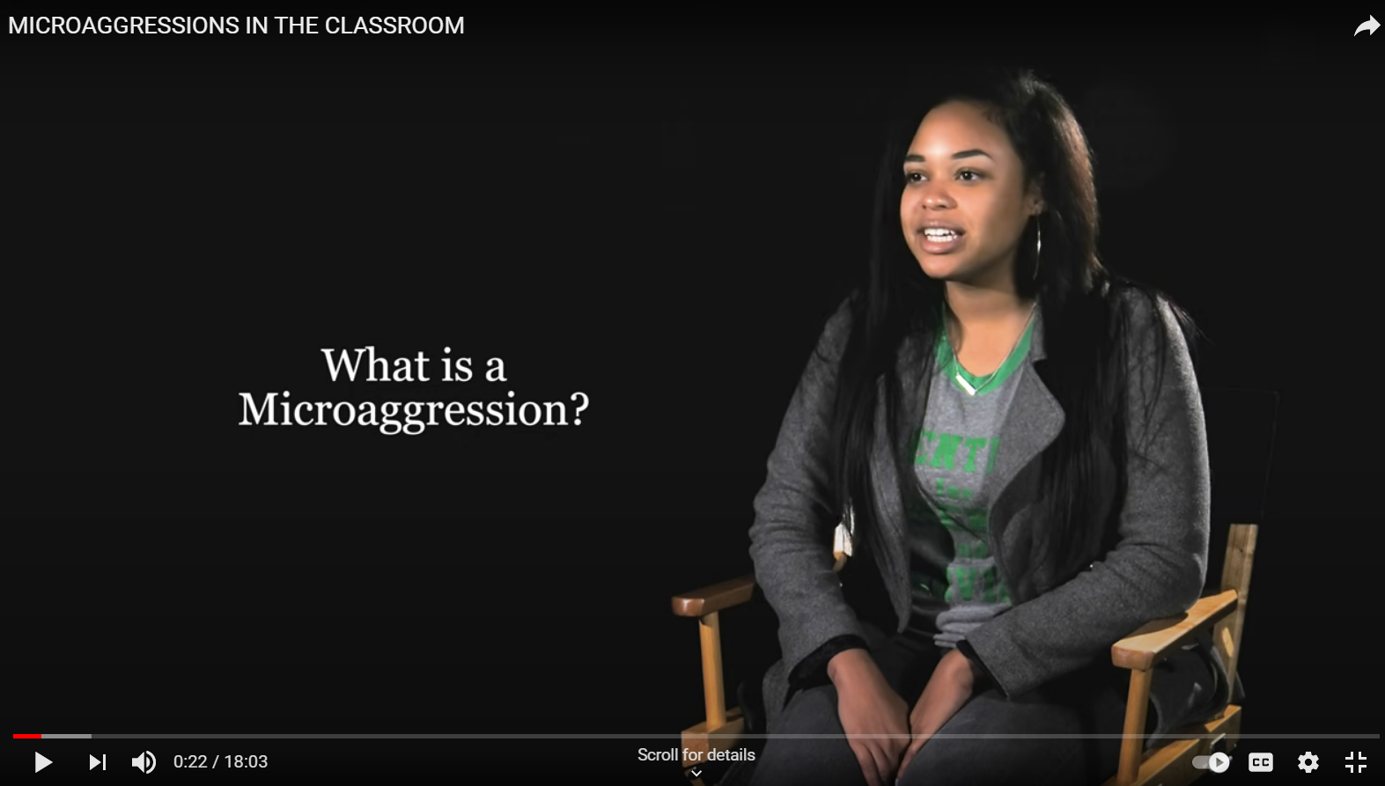
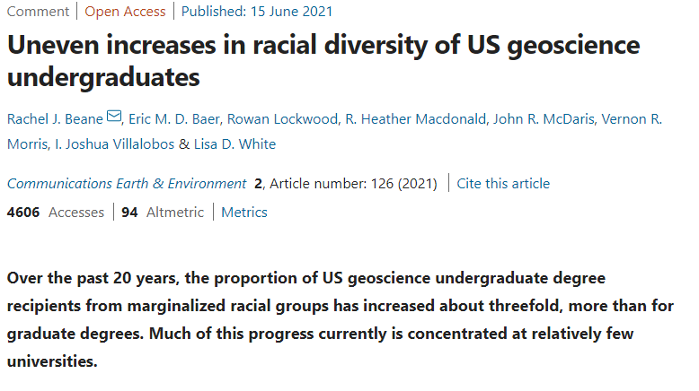
Preparing Faculty
Notes:
Since the module covers
sensitive topics and
interweaves DEI concepts into geoscience career information,
We want
faculty to be aware of current practices in DEI STEM work so they can be better equipped to foster a safe and inclusive learning environment for students.
And it’s important that they be prepared to facilitate sensitive and tough conversations.
To do this, give them course packets with:
geoscience/STEM DEI peer reviewed articles,
Suggestions of educational videos about DEI topics,
Access to AGI workforce data in Spanish for Spanish-speaking students and families
Optional books to read
Examples of current activities and actions by the geoscience community
Information on how to learn more and how to get involved in this work
Conclusion:
Finishing up module for an expected launch early 2022
There are a few items we’re finishing up, which include:
Making course content accessible for screen readers and learners with low vision
Finishing making geophysics content videos with Joyce Smith at NCSU
Crafting course assessments and module evaluation with Carol Ormand from SERC
And finishing up those final details!

Slide 15
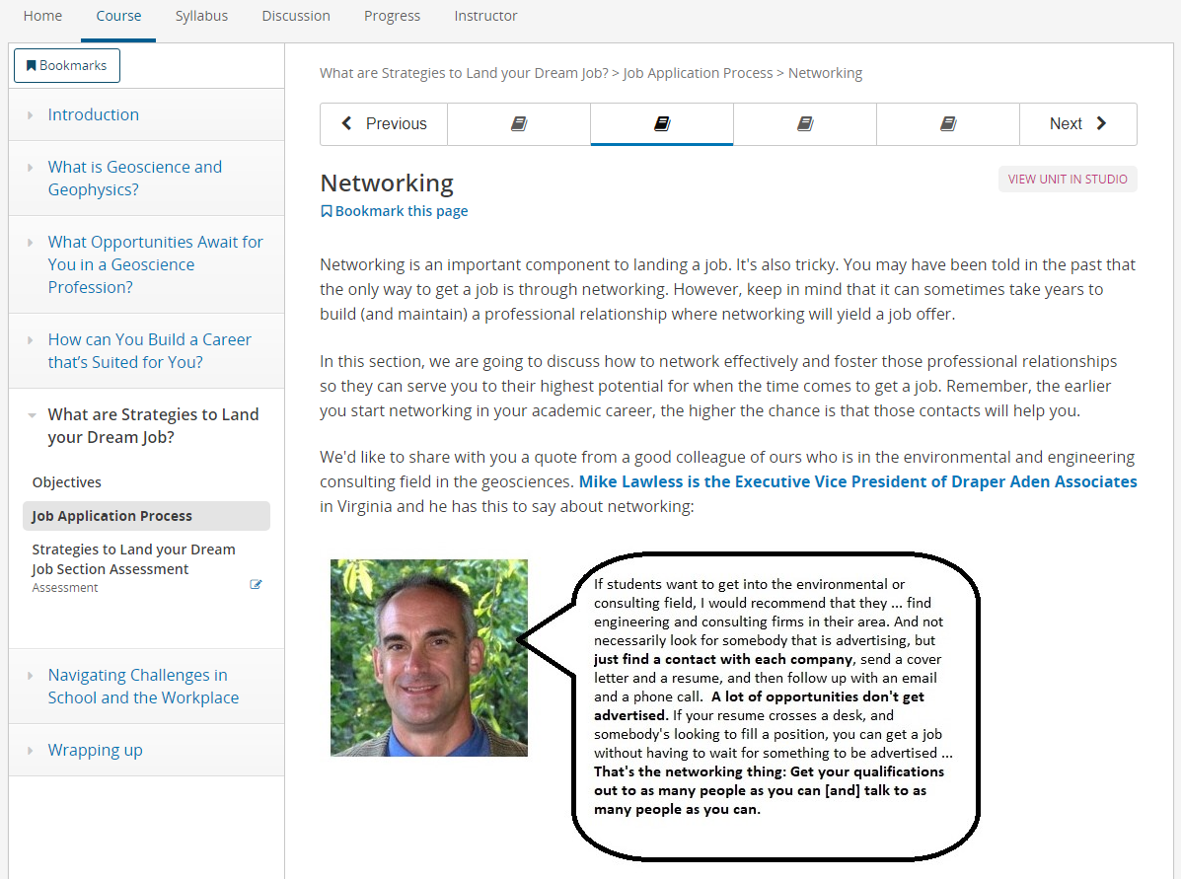
Tips for Landing Dream Job
Notes:
The last section of the course is to introduce students to the processes and logistics of how to land that first job or internship.
We discuss:
The importance of internships
Networking strategies
The differences between a resume and CV
Informational interviews
and how to prepare an elevator speech
Even though our target audience is early-career undergraduates,
it’s never too early to start thinking about and preparing for the job search.
And they can start practicing early with internships, which will ultimately make them more competitive for a full offer down the road.

Slide 16
Roadmap
Main Topic
Content/Information
Practical Applications
1
What is Geoscience and Geophysics?
What is Geoscience?
Relating Your Interests and Passions
What is Geophysics?
2
What Opportunities Await in a Geo Profession?
Geo Workforce Data
Skills needed to be Successful
Geoscience Salaries
3
How can You Build a Career that’s Suited for You?
Career Trajectories
Overcoming Challenges during Your Career
Authenticity
4
What are Strategies to Land Your Dream Job?
Advanced Job Searching Resources
Application Process
Notes:
This module:
Is an asynchronous course about the geosciences, and specifically geophysics, for first and second-year undergraduate students.
It discusses a brief overview of geoscience and geophysics technical concepts,
what careers are available in the profession,
how to pursue a career that combines your unique skills, interests and passions, and
does this all this using Diversity, Equity and Inclusion (DEI) by design.
Overview of Module:
5 formal learning objectives; by the end of the module students should be able to:
summarize select technical geoscience and geophysics concepts
demonstrate how geoscience/geophysics impacts society
highlight a wide variety of careers in the geosciences (and geophysics)
describe skills needed for geoscience careers AND
connect careers with students’ diverse identities
To meet these objectives, there are 4 main sections as outlined here in the course roadmap
The first provides technical content of our discipline
The second section highlights WF data, and explains skills needed in the profession
The third demonstrates how to integrate your own passions and social identities to build a unique career in the geosciences
And the last one has information about the job search
Each of the 4 main sections have pages with practical applications of this content so students can apply what they’re learning to build their own career paths.
How is this being developed?
This module is part of the broader impacts of the SAGE facilities for Education and Public Outreach (EPO) at IRIS to raise awareness of our discipline and reduce the barriers to participation for people of all backgrounds and social identities.
It is in partnership with AGI – using their Geoscience Online Learning Initiative (GOLI) platform, which uses the Open edX LMS
Additional collaborators for design and content include:
Joyce Smith who is part of David McConnell’s Geoscience Education Research group – North Carolina State University
Carol Ormand from the Science Education Resource Center (SERC).
Wendi Williams from the IAGD to ensure the course is accessible to those with disabilities

Slide 17
Student Thoughts
“The biggest thing I learned was how to
properly handle and deescalate a situation.
I also enjoyed the many different
career paths and salaries offered for the
course. I did not know geoscientists could
be educators and engineers.”
“My favorite part of the module would be the mentions of diversity as well as women’s equality. A community that celebrates
diversity and equality can properly express creativity and knowledge.”
“The biggest thing I learned in this course was how much geoscience was integrated into everyday topics. My passion is medicine and I learned in this course that I could still have a medical path within geoscience. Now I want to minor geoscience.”
“It wasn’t until I started studying geology that I truly realized how much of a role geosciences can have in our lives. Learning about the subsurface geology in my area; how subsidence can affect home values; infrastructure. I also learned a bit of the methods that are used to combat these problems. Geoscience topics (besides climate change talk) are not a topic that often appears in the news, but it is interesting to know that there many professions that apply geoscience knowledge on a regular basis.”
Notes:
The module has been up and running since October of 2022 – so a few months now. But,
Prior to the module’s launch,
We conducted two different pilots to find out what was working and what wasn’t.
Here are some of the comments from students:
[click] The biggest thing I learned was how to properly handle and deescalate a situation. I also enjoyed the many different career paths and salaries offered for the course. I did not know geoscientists could be educators and engineers.
[click] The biggest thing I learned in this course was how much geoscience was integrated into everyday topics. My passion is medicine and I learned in this course that I could still have a medical path within geoscience. Now I want to minor in geoscience.
[click] My favorite part of the module would be the mentions of diversity as well as women’s equality. A community that celebrates diversity and equality can properly express creativity and knowledge.

Slide 18
Thank you!
www.learning.americangeosciences.org
‘Unearth Your Future: How You Can Shape the
Geoscience Profession for the Needs of the 21st century’
Danielle Sumy
danielle.sumy@earthscope.org
Heather Houlton
heather.houlton@gmail.com
Notes:
If you’re interested in supplementing your existing curriculum with this module,
Please contact me!
If there are any questions about the module or our approach, please don’t hesitate ask.

