Slide 1

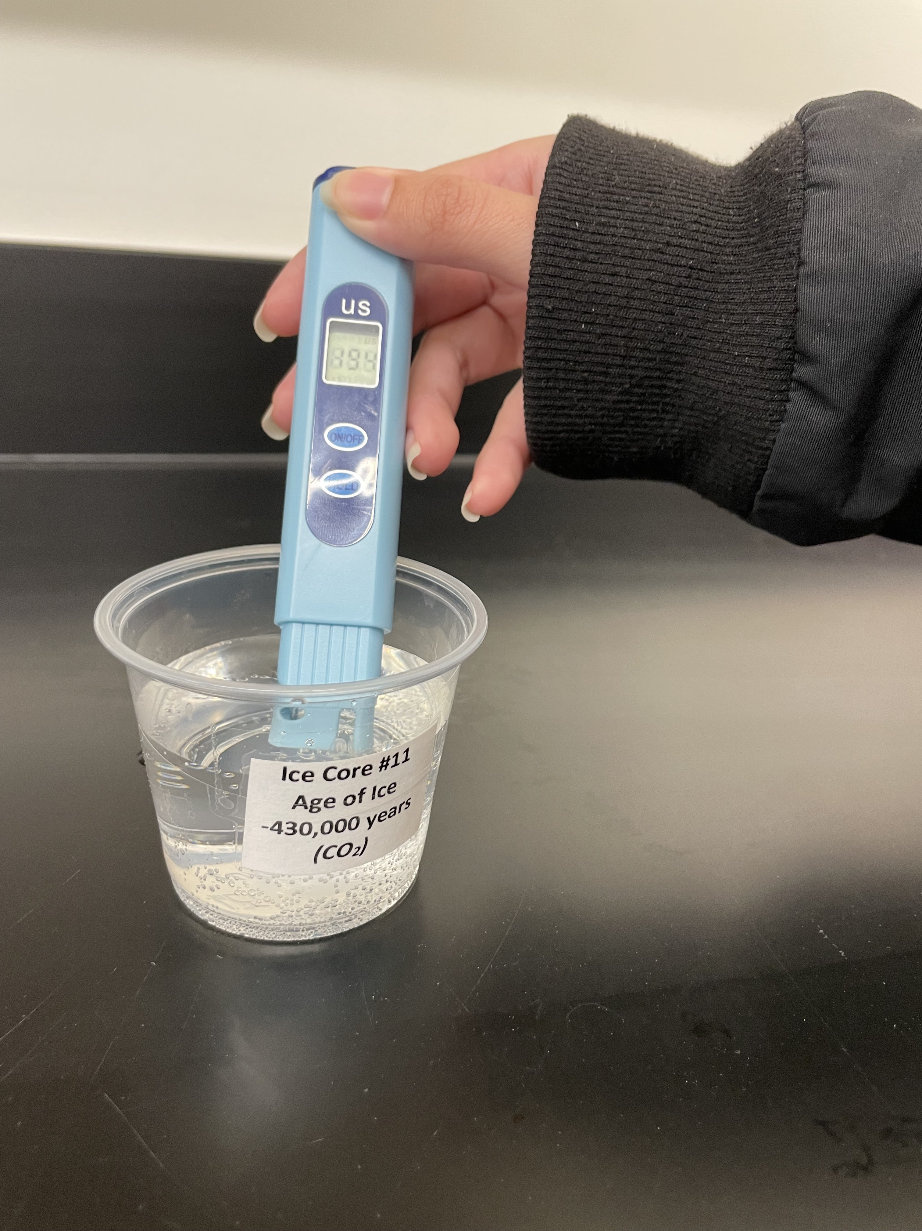
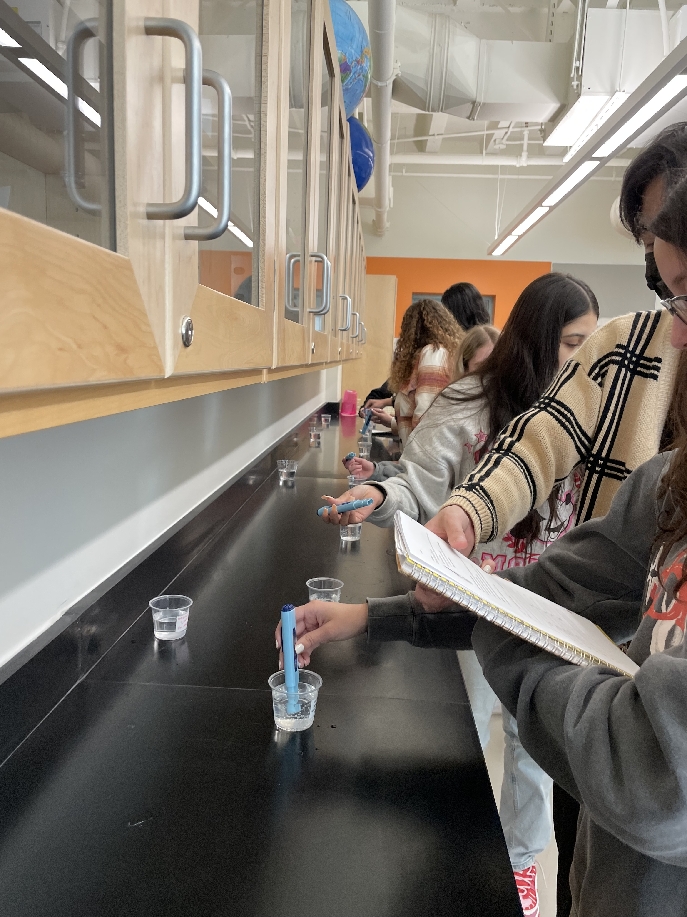


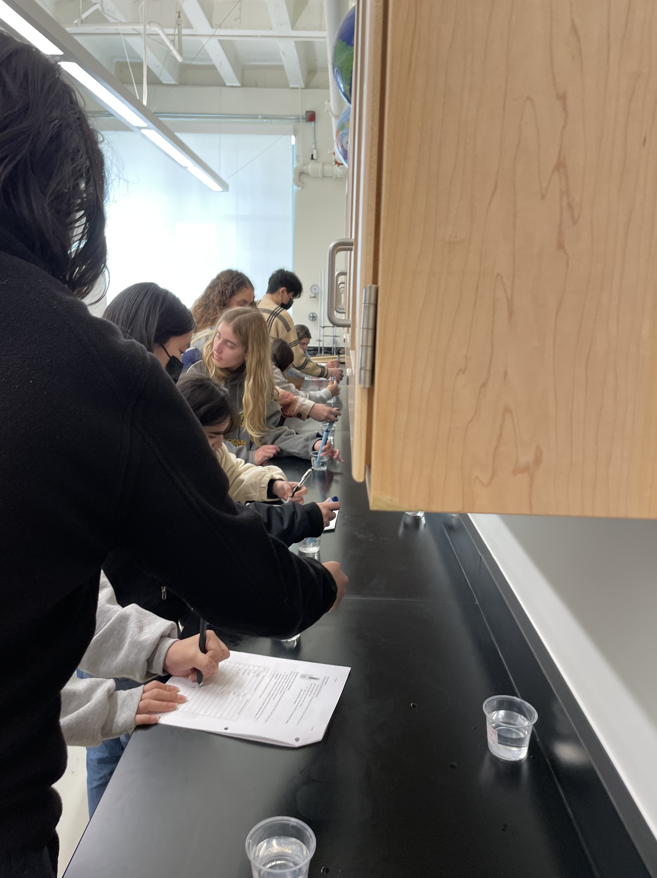
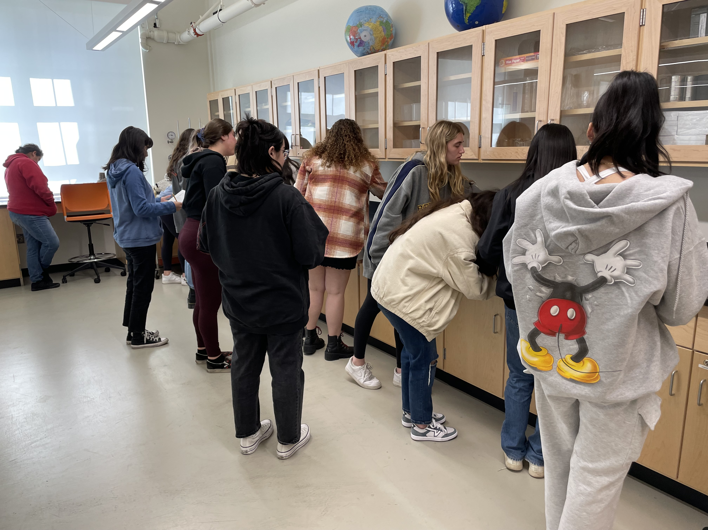
ICE CORE SCIENCE
Earth Educators’ Rendezvous 2023
Elizabeth Nagy, Pasadena City College
Louise Huffman, Dartmouth College
Bill Grosser, U.S. Ice Drilling Program

Slide 2


Overview
Activity Setting
Lead-in Activity (comparing the Arctic and Antarctic)
Decoding Ice Cores: Atmospheric Analysis
Resources and tips for instructors

Slide 3
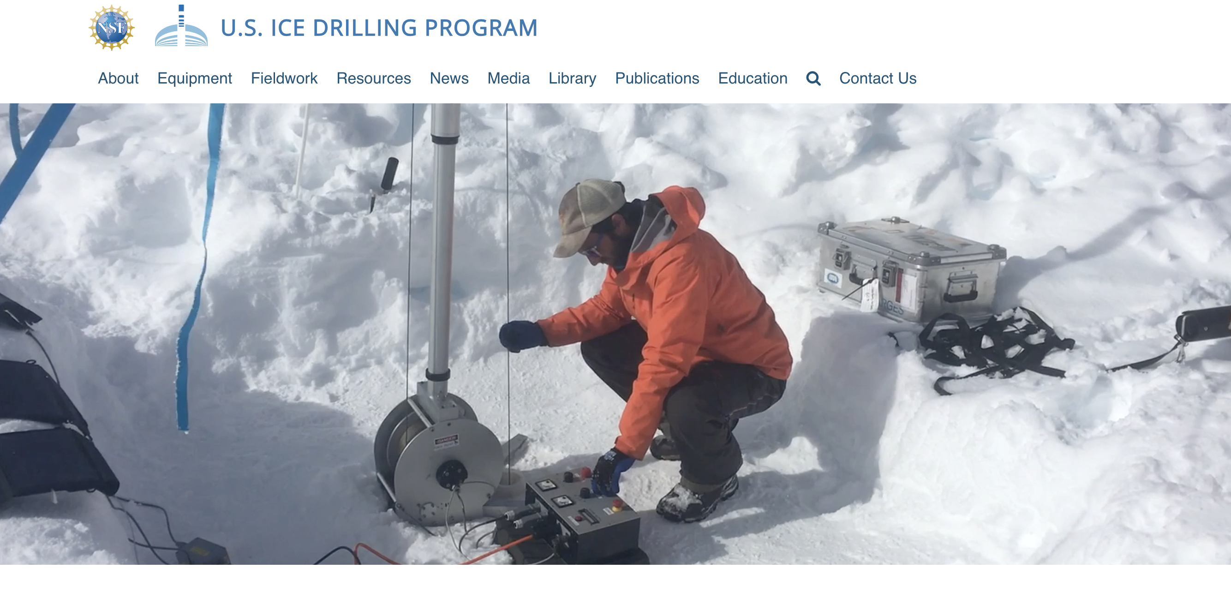
icedrill.org
Notes:
The U.S. Ice Drilling Program (IDP) was established by the National Science Foundation (NSF) to lead integrated planning for ice coring and drilling and provision of drills and drilling services.

Slide 4
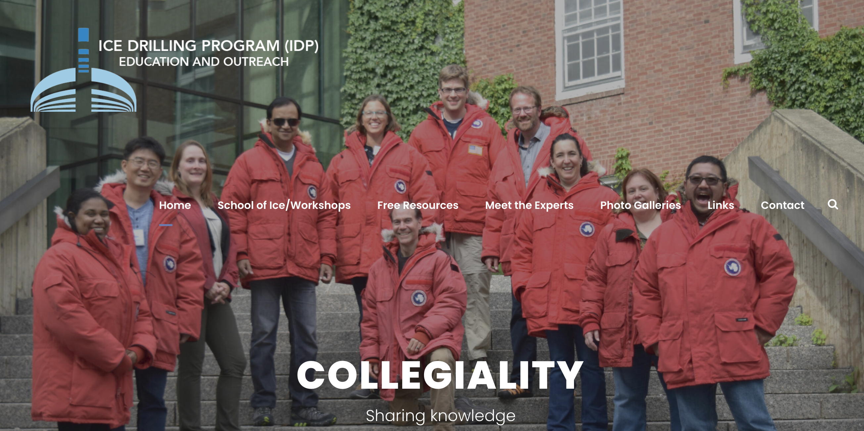
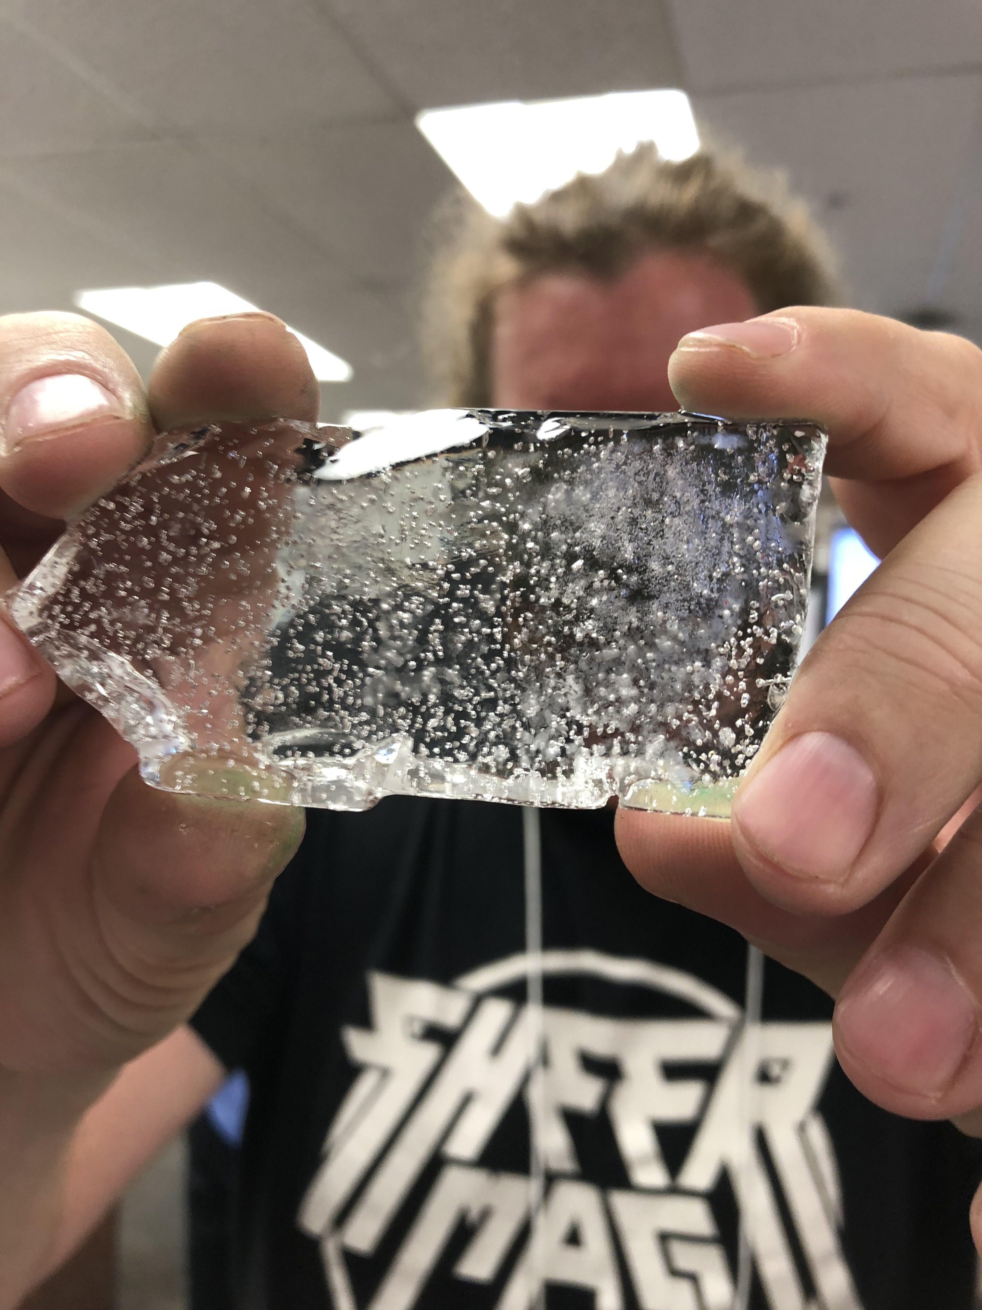
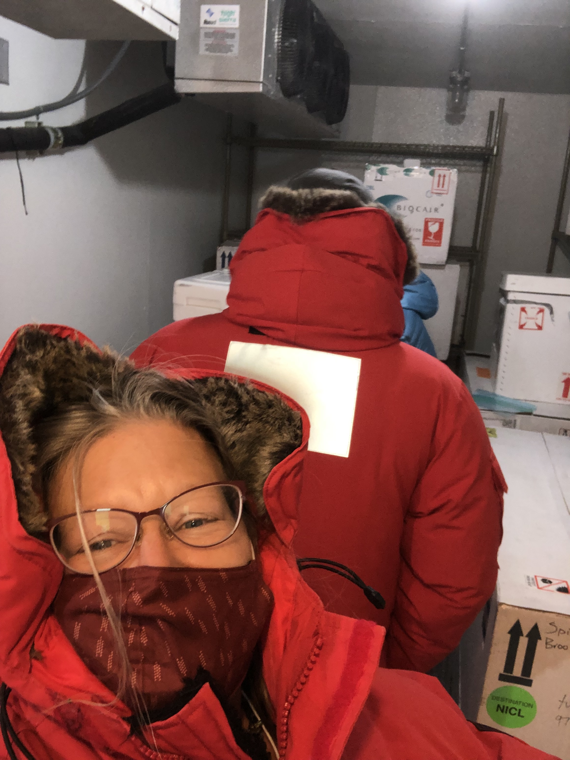
icedrill-education.org
Notes:
Providing participants the opportunity to expand their knowledge of Earth’s climate record through analysis of paleo-climate records in ice cores collected by the U.S. Ice Drilling Program.

Slide 5
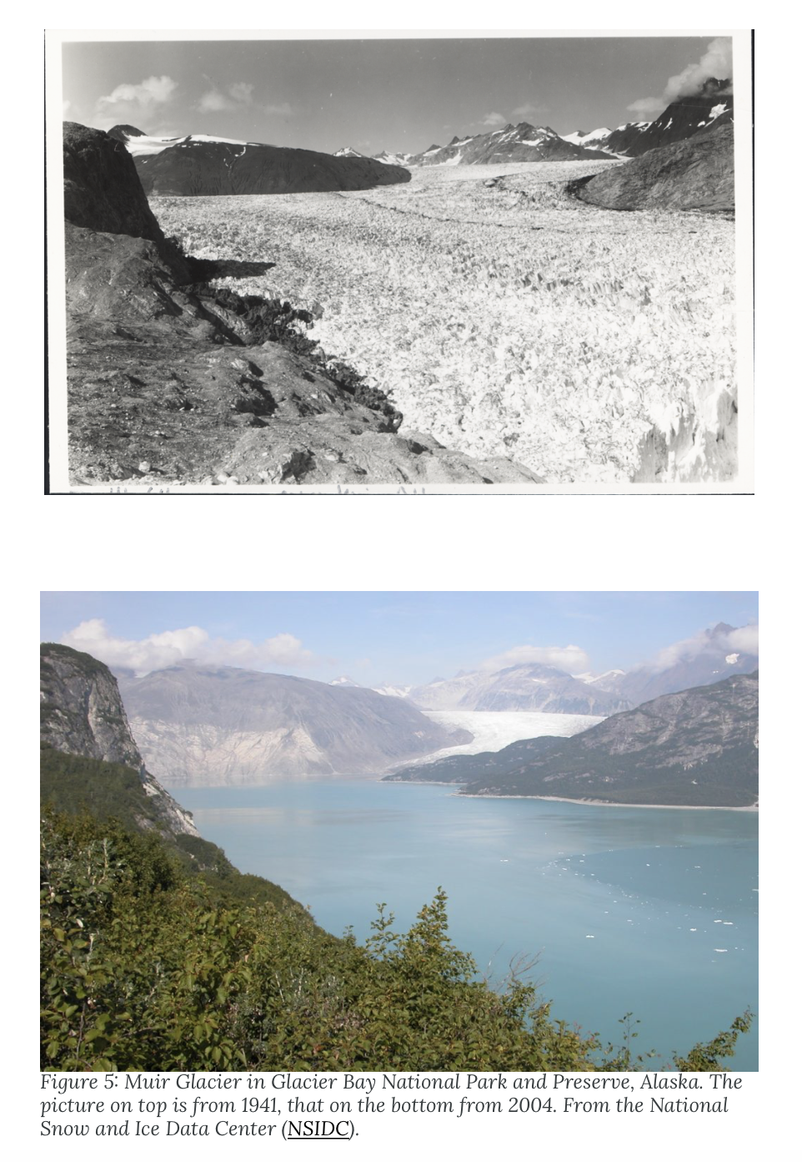
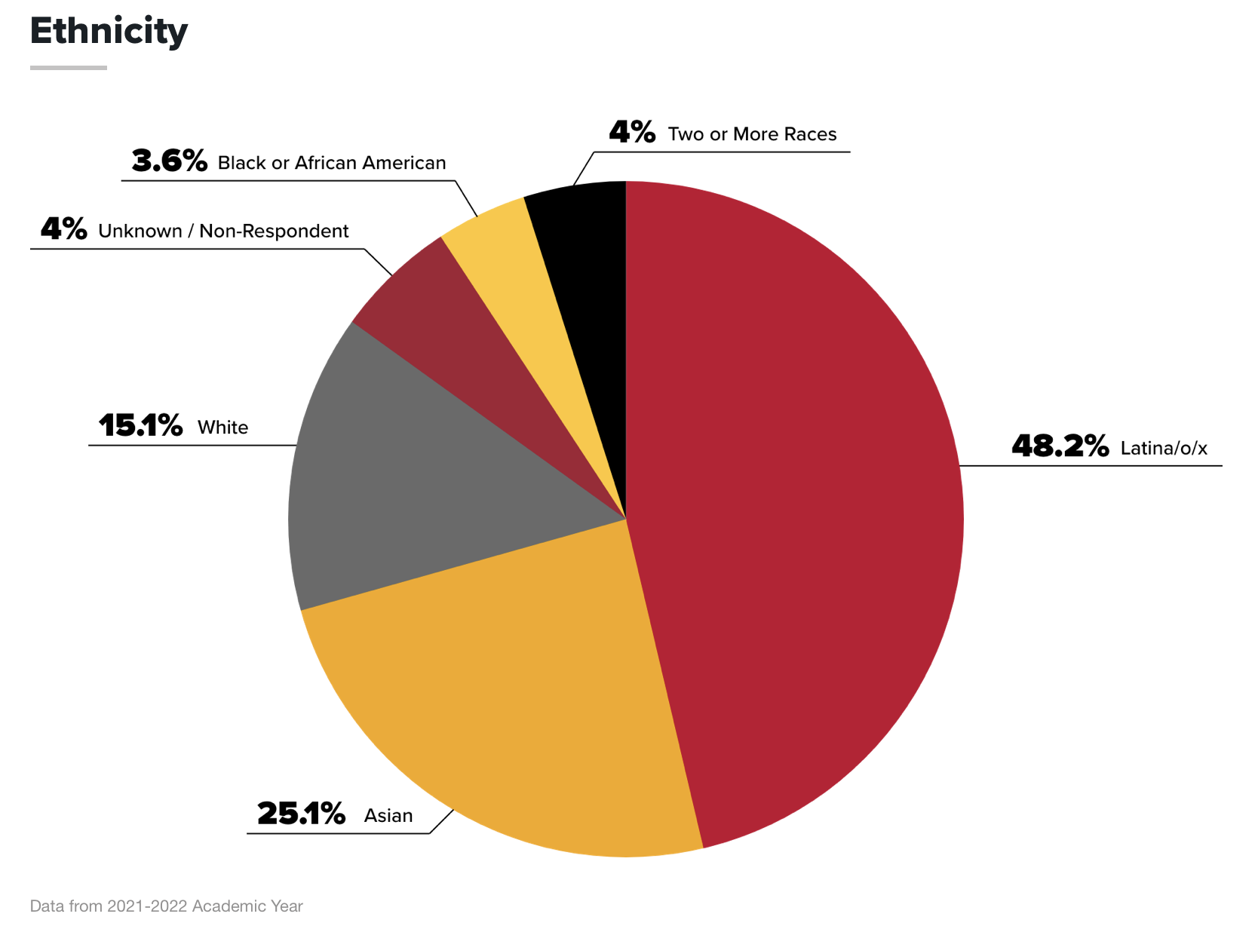
Activity Setting
Pasadena City College
Muir Glacier
1941
2004
Notes:
Photo from the National Snow and Ice Data Center (NSIDC)
Muir Glacier in Alaska
1941, 2004 (63 years)
Penn State geologist Richard Alley

Slide 6
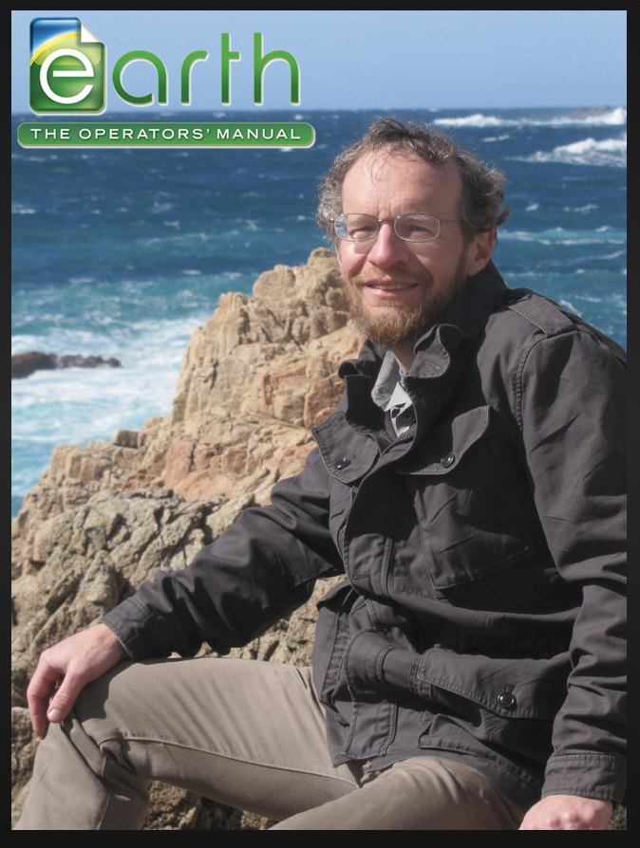
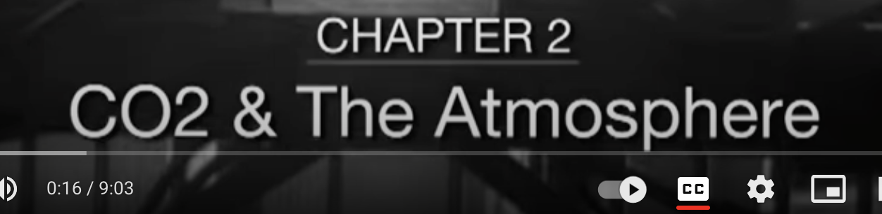
Activity Setting
Introductory-level (non-majors) Earth and Space Science course at a two-year college
Last day of Oceanography unit, focus on cryosphere
Prior knowledge: atmospheric CO₂ levels, global warming, graphing, watched 12-min lecture on types of ice, gas trapped in ice
Muir Glacier
1941
2004
Notes:
Photo from the National Snow and Ice Data Center (NSIDC)
Muir Glacier in Alaska
1941, 2004 (63 years)
Penn State geologist Richard Alley
https://youtu.be/E9eGzPxA1Dg

Slide 7
To the Ends of the Earth: Comparing the Arctic and Antarctic
This activity engages students in sorting picture cards comparing similarities and differences between the Polar Regions in a table-sized Venn Diagram.
icedrill-education.org

Slide 8
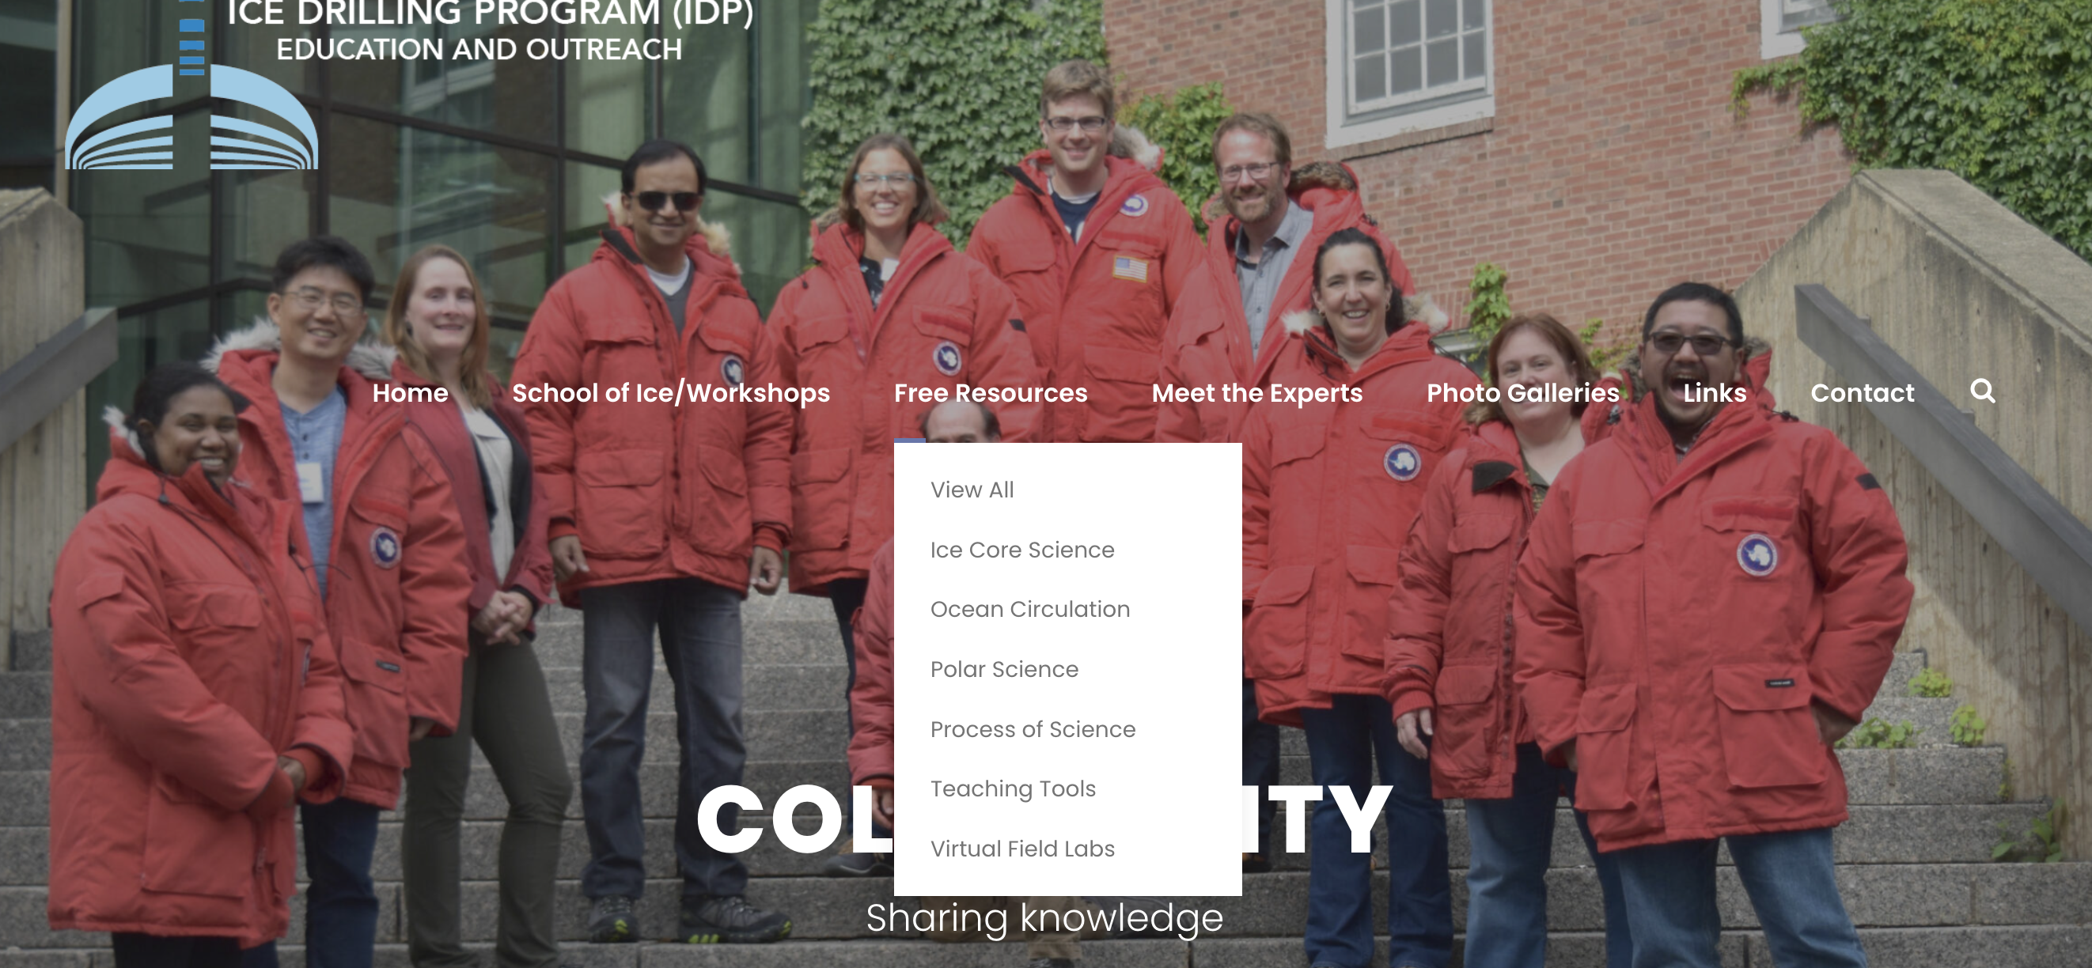

icedrill-education.org

Slide 9
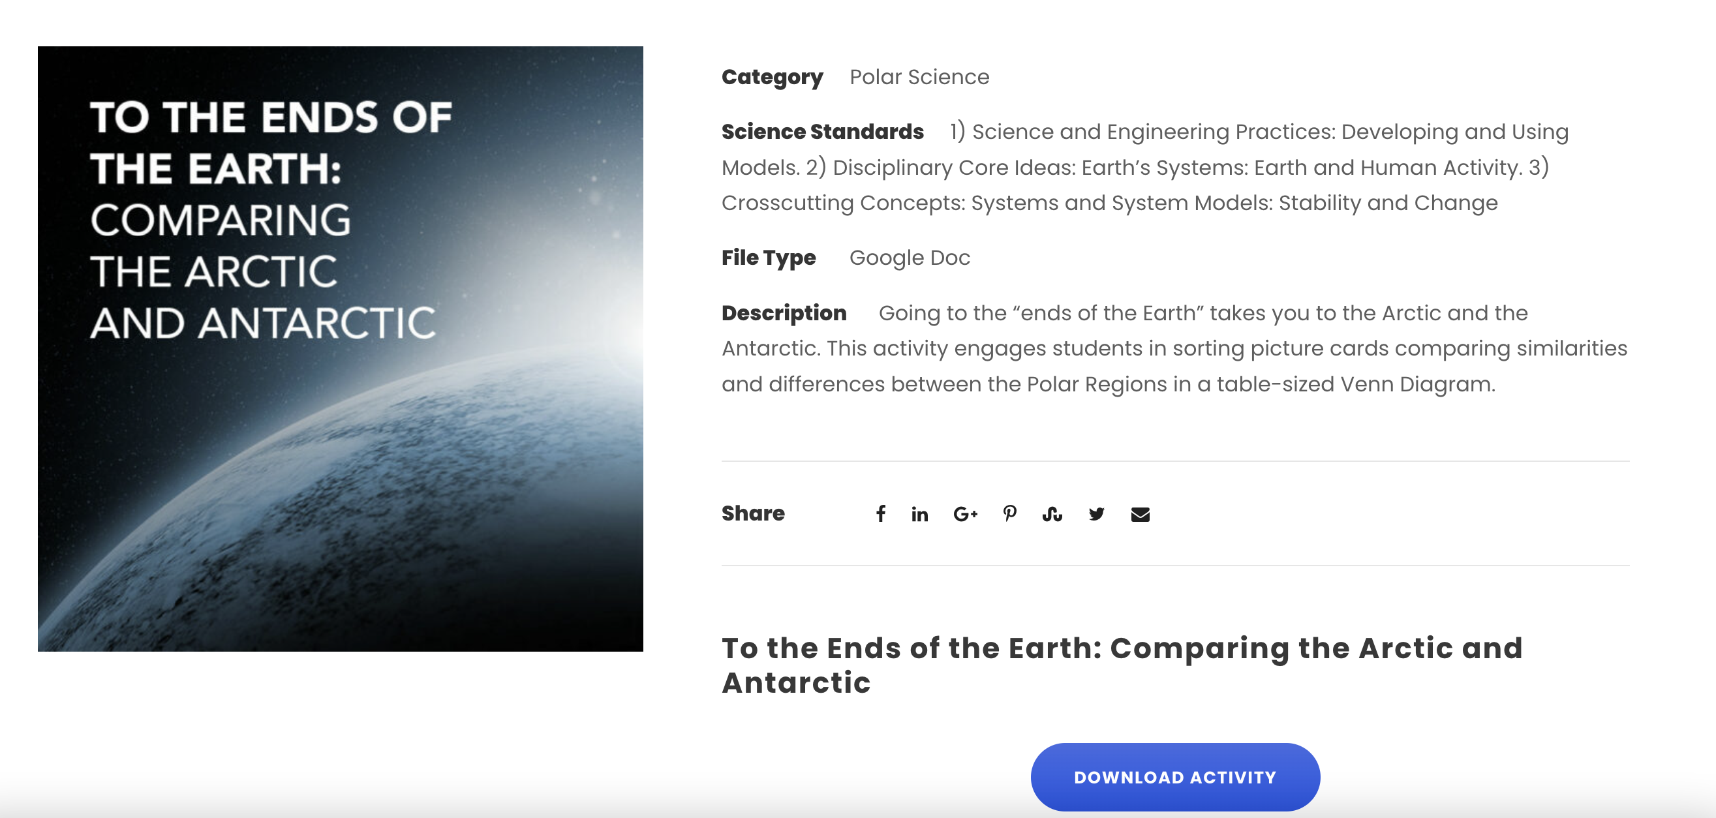

Slide 10
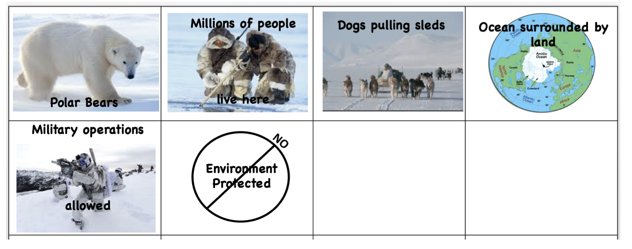
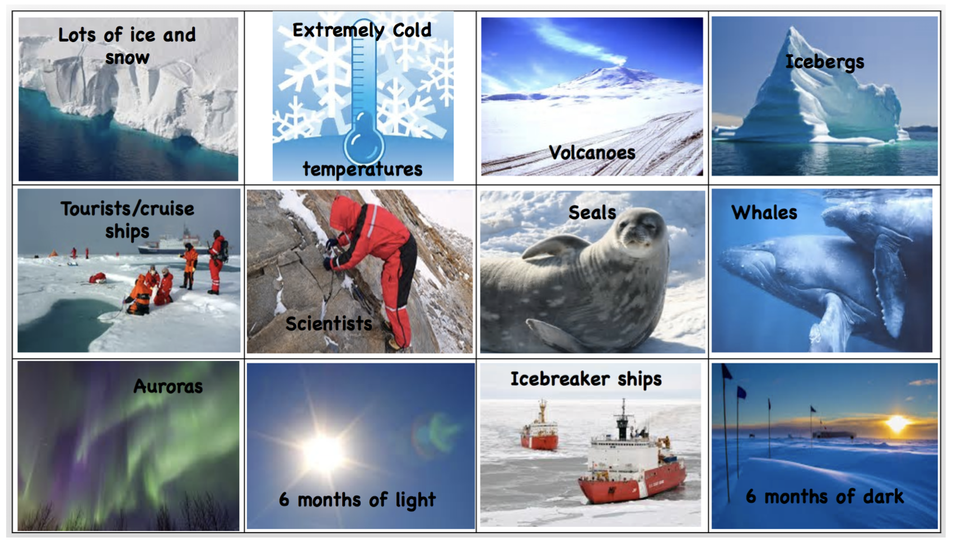
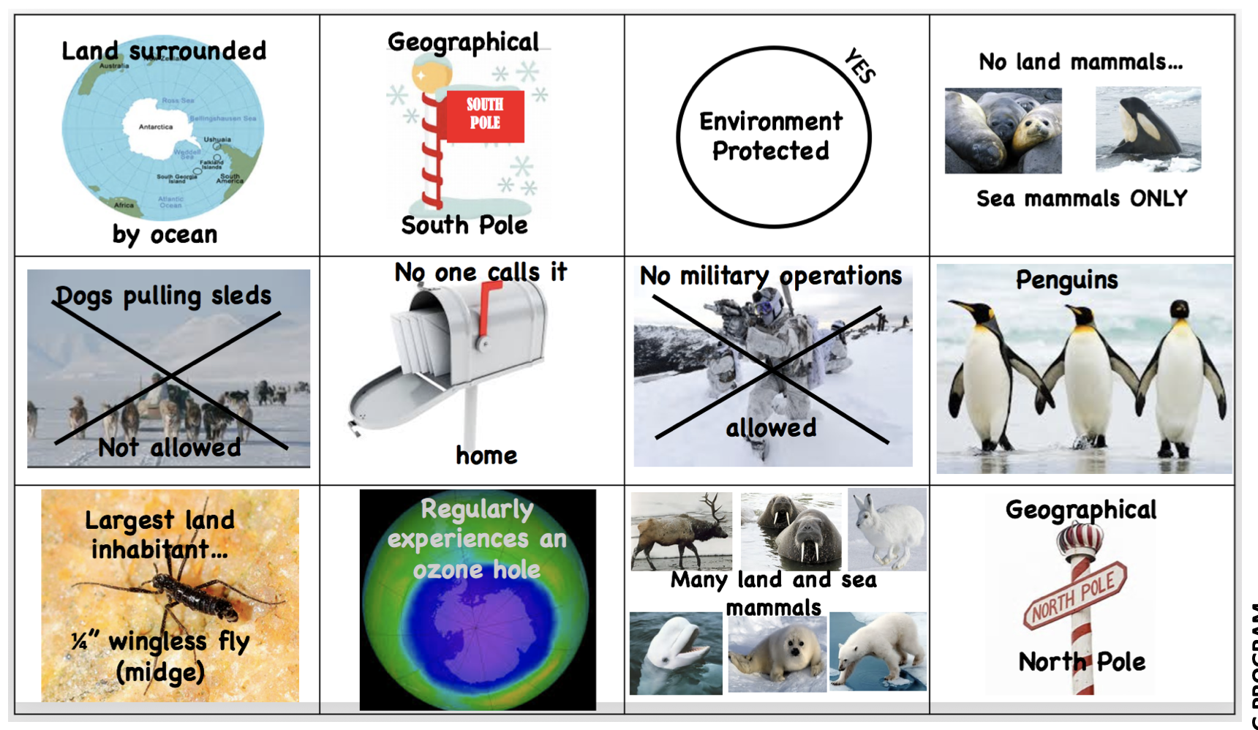
Arctic
Both
Antarctic

Slide 11
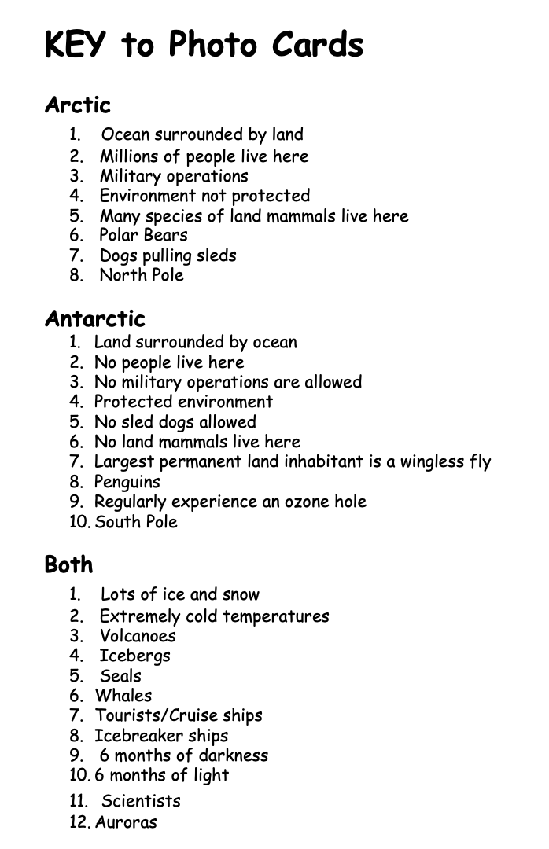
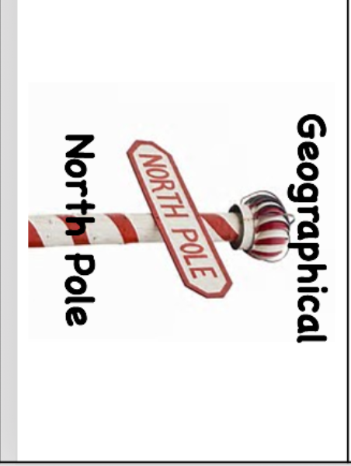
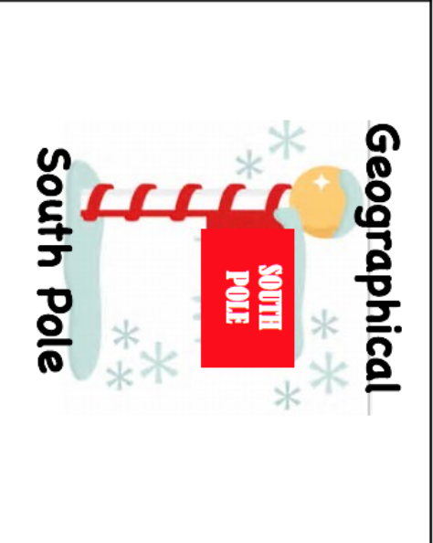
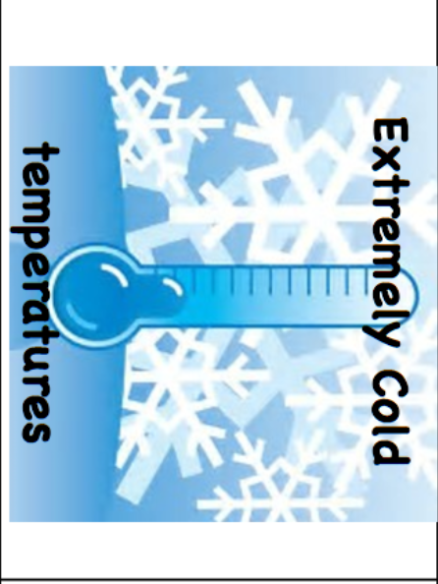




Slide 12
Decoding Ice Cores:
Atmospheric Analysis
In this lab, the relative amount of CO₂ in melted "ice core samples" will be determined using a conductivity meter. Then students will graph their results and compare to the 800,000 ice core record.
icedrill-education.org

Slide 13

icedrill-education.org

Slide 14
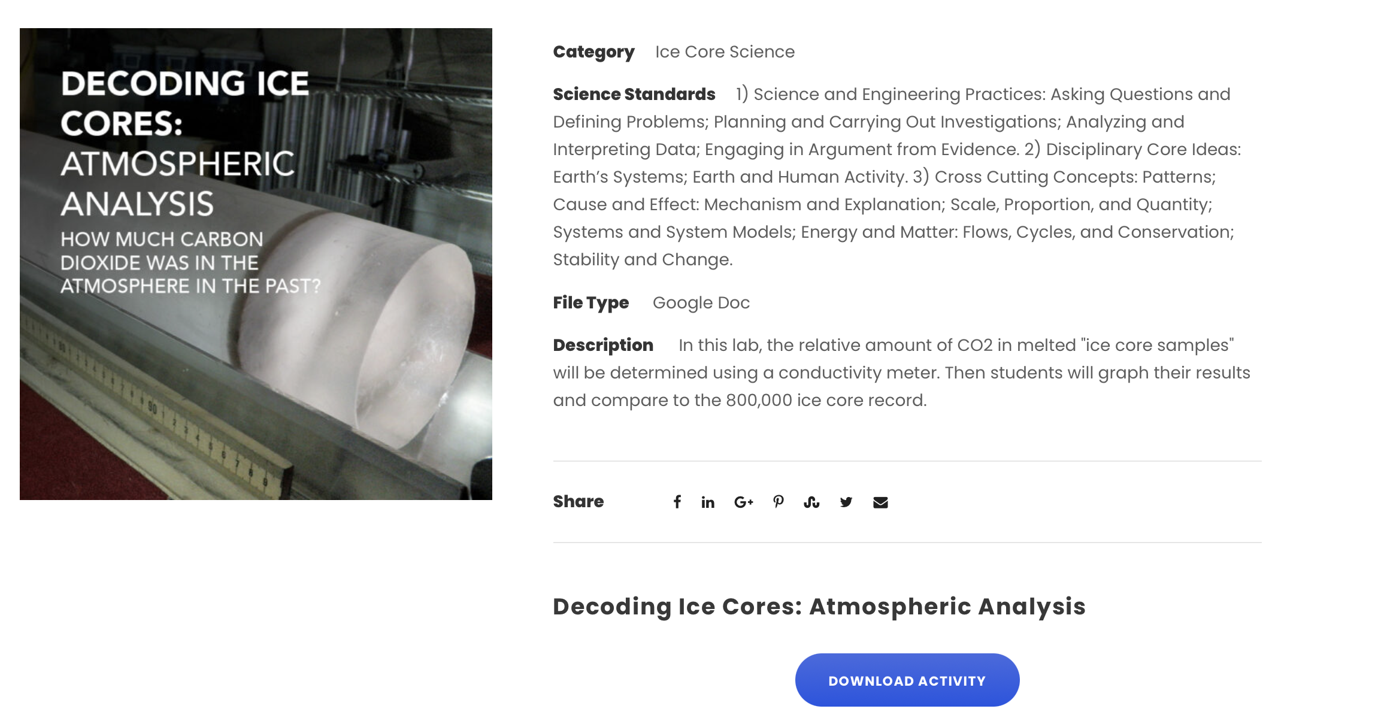

Slide 15
Let’s measure!
Follow instructions on page 4 of handout.
WAIT!
icedrill-education.org

Slide 16
Before measuring….
Discuss conductivity and carbon dioxide
Determine dependent and independent variables (pre-lab questions)
Practice using conductivity meters
icedrill-education.org

Slide 17
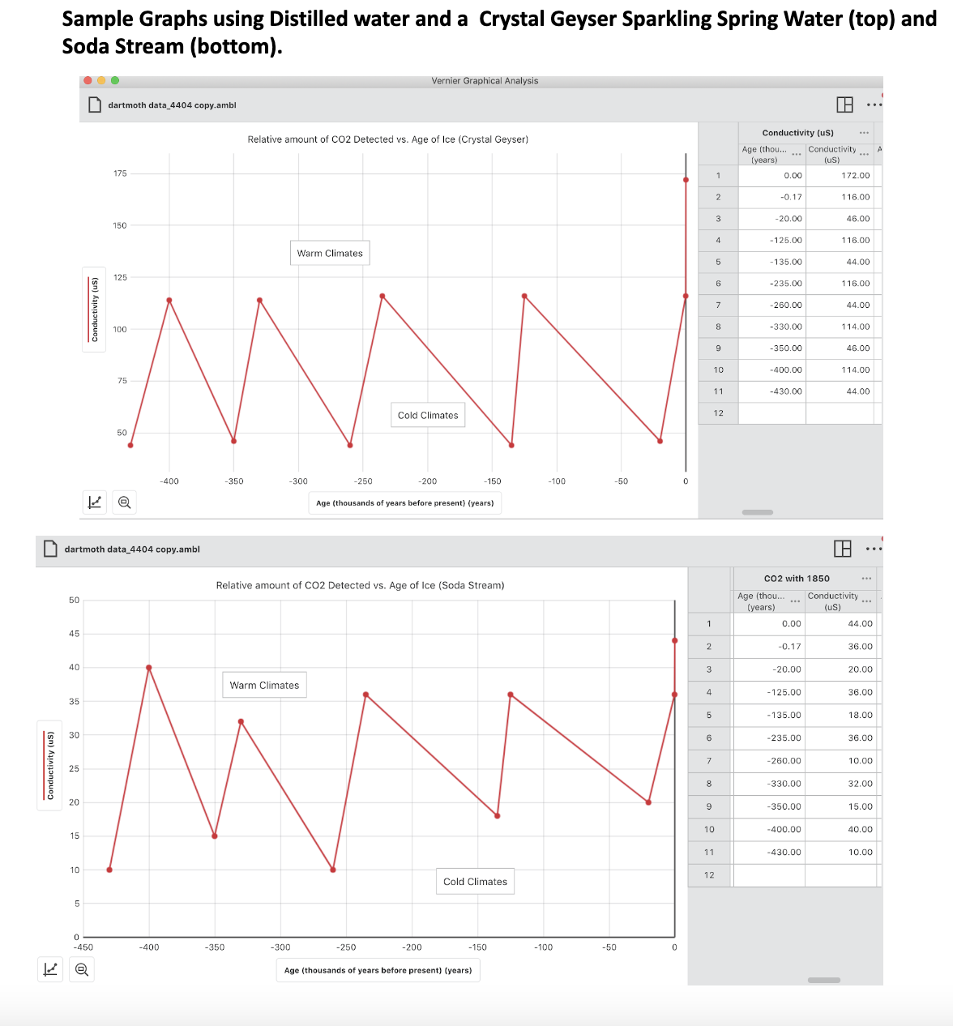
icedrill-education.org

Slide 18
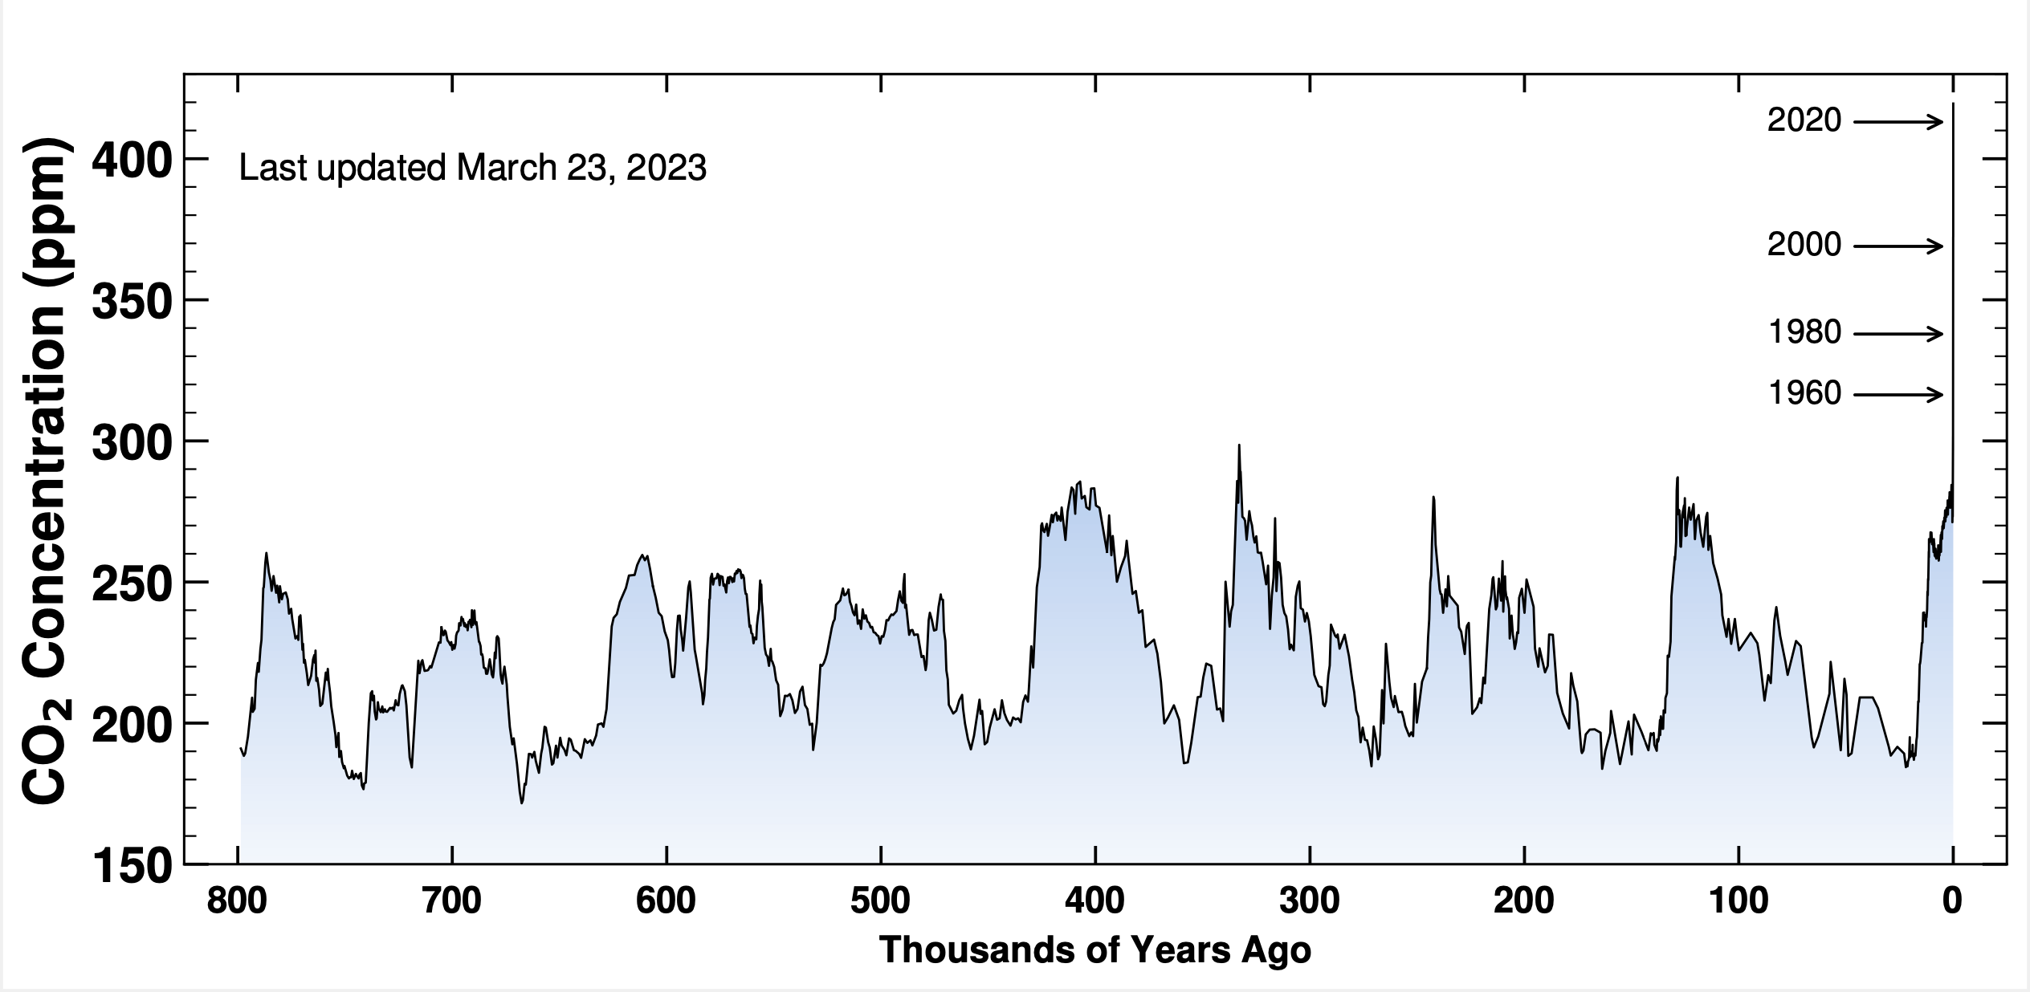
The Ancient Record in Ice
Carbon Dioxide Concentration over the past 800,000 years
icedrill-education.org

Slide 19
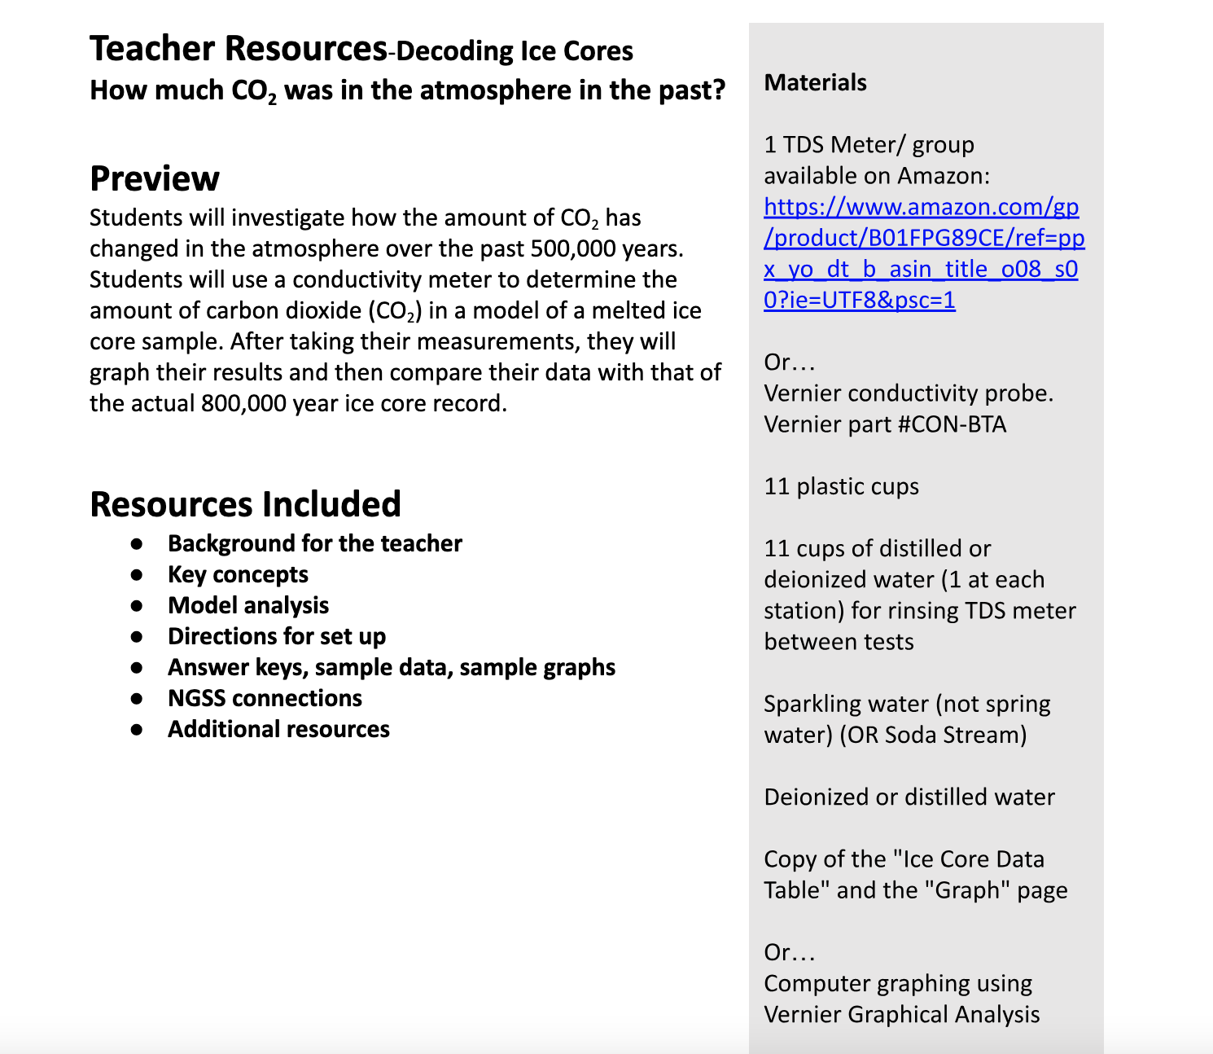
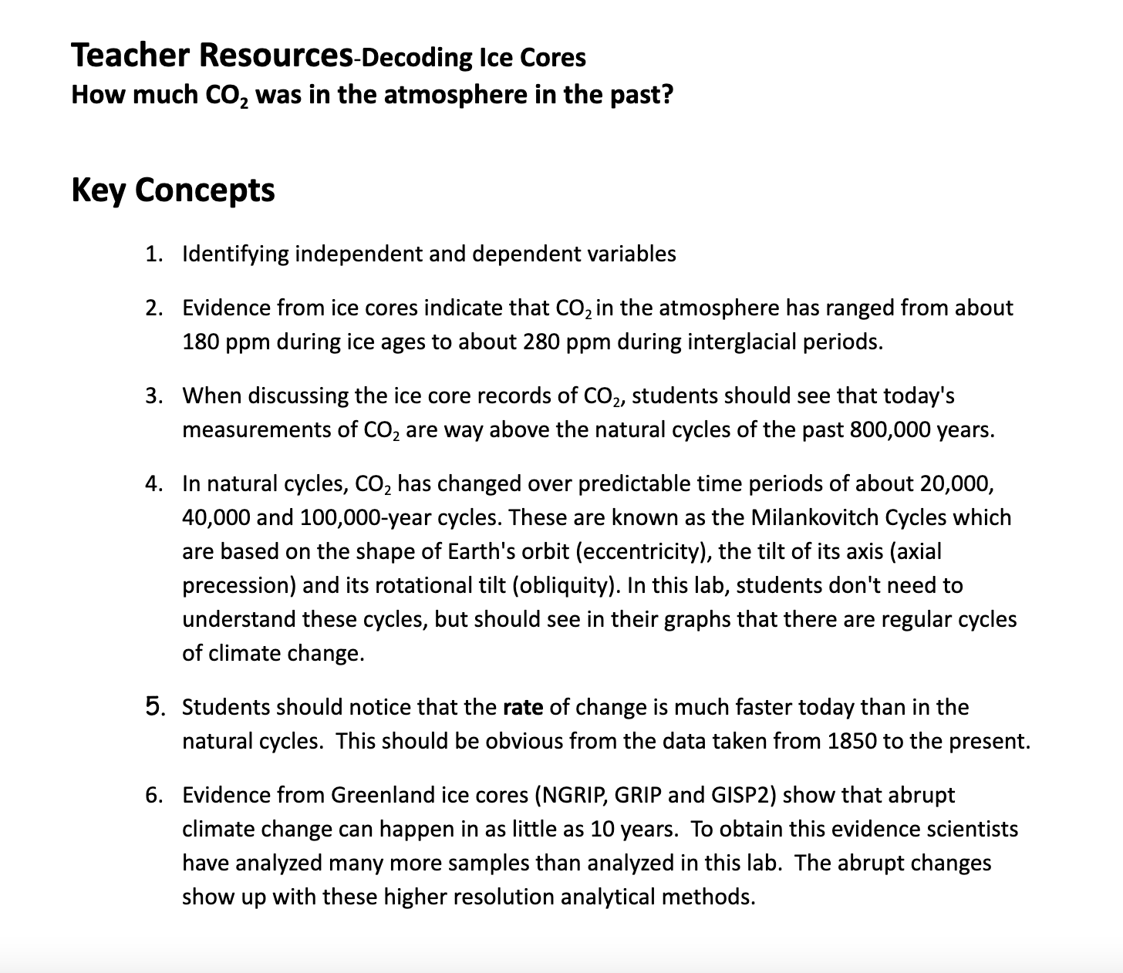
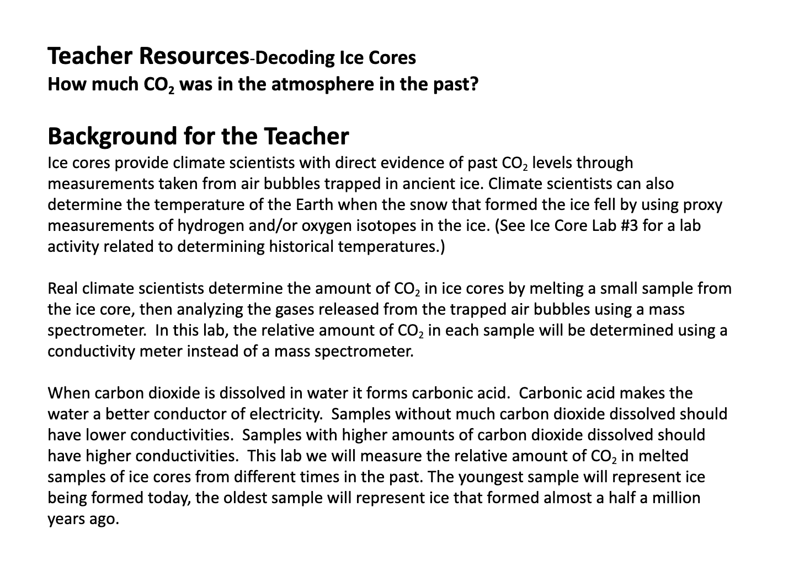
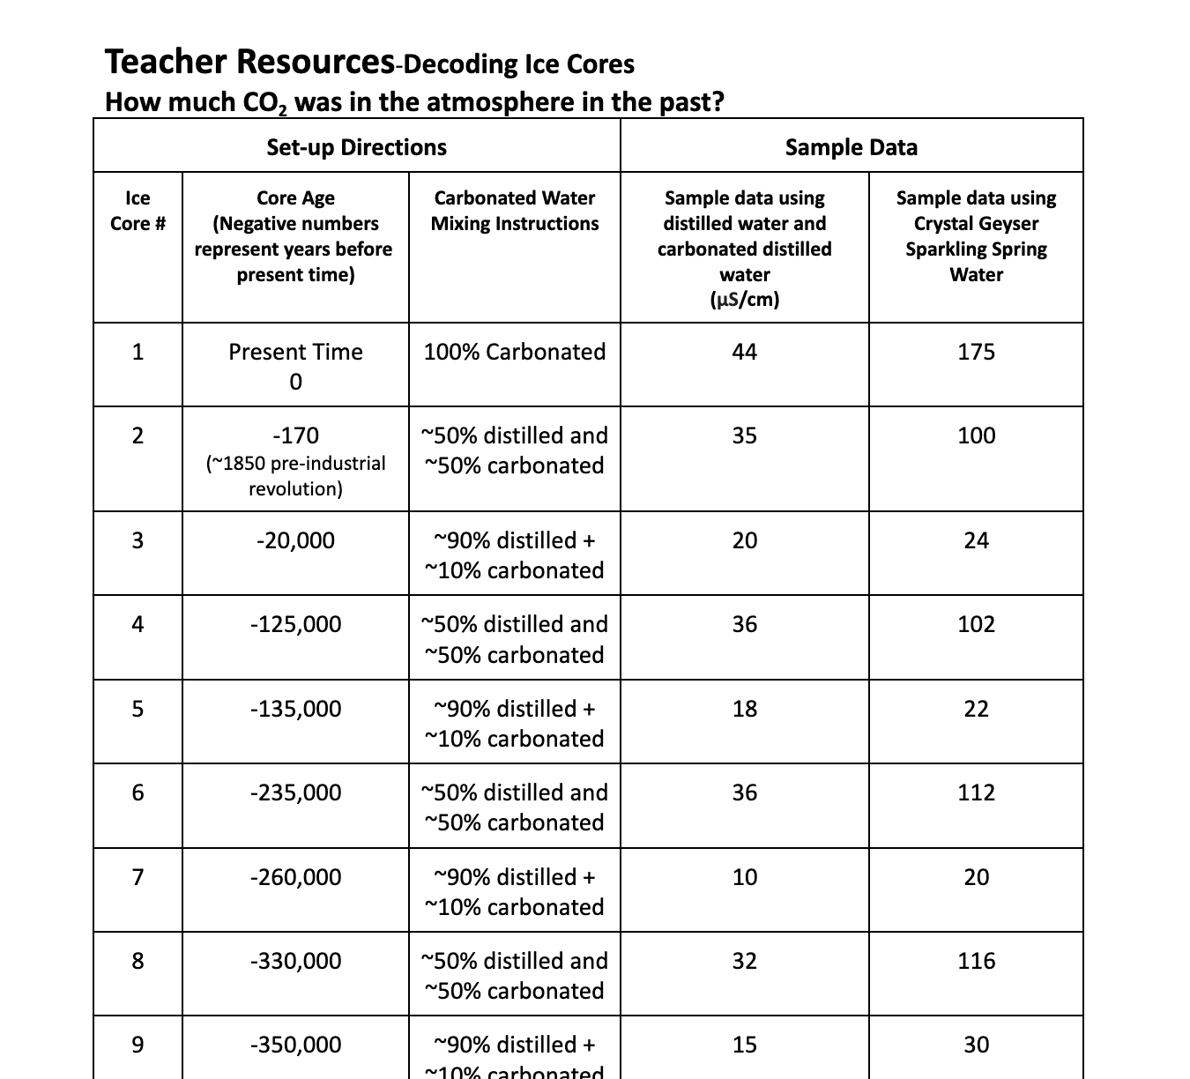

Slide 20
Decoding Ice Cores:
Atmospheric Analysis
SET-UP TIPS:
Use deionized or distilled water and
Use sparkling soda (not spring water) or a Soda Stream
  Avoid sparkling water with a lot of dissolved minerals (i.e., Perrier) – affects conductivity reading
  Try Crystal Geyser
icedrill-education.org

Slide 21
ICE CORE SCIENCE
Earth Educators’ Rendezvous 2023
QUESTIONS?
Elizabeth Nagy, Pasadena City College
Louise Huffman, Dartmouth College
Bill Grosser, U.S. Ice Drilling Program

