Slide 1


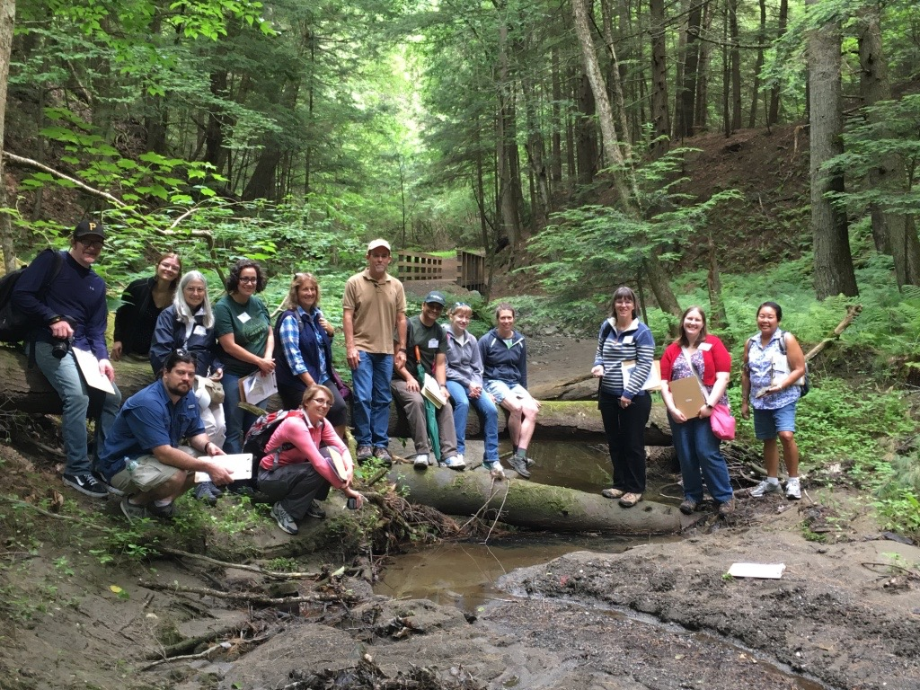
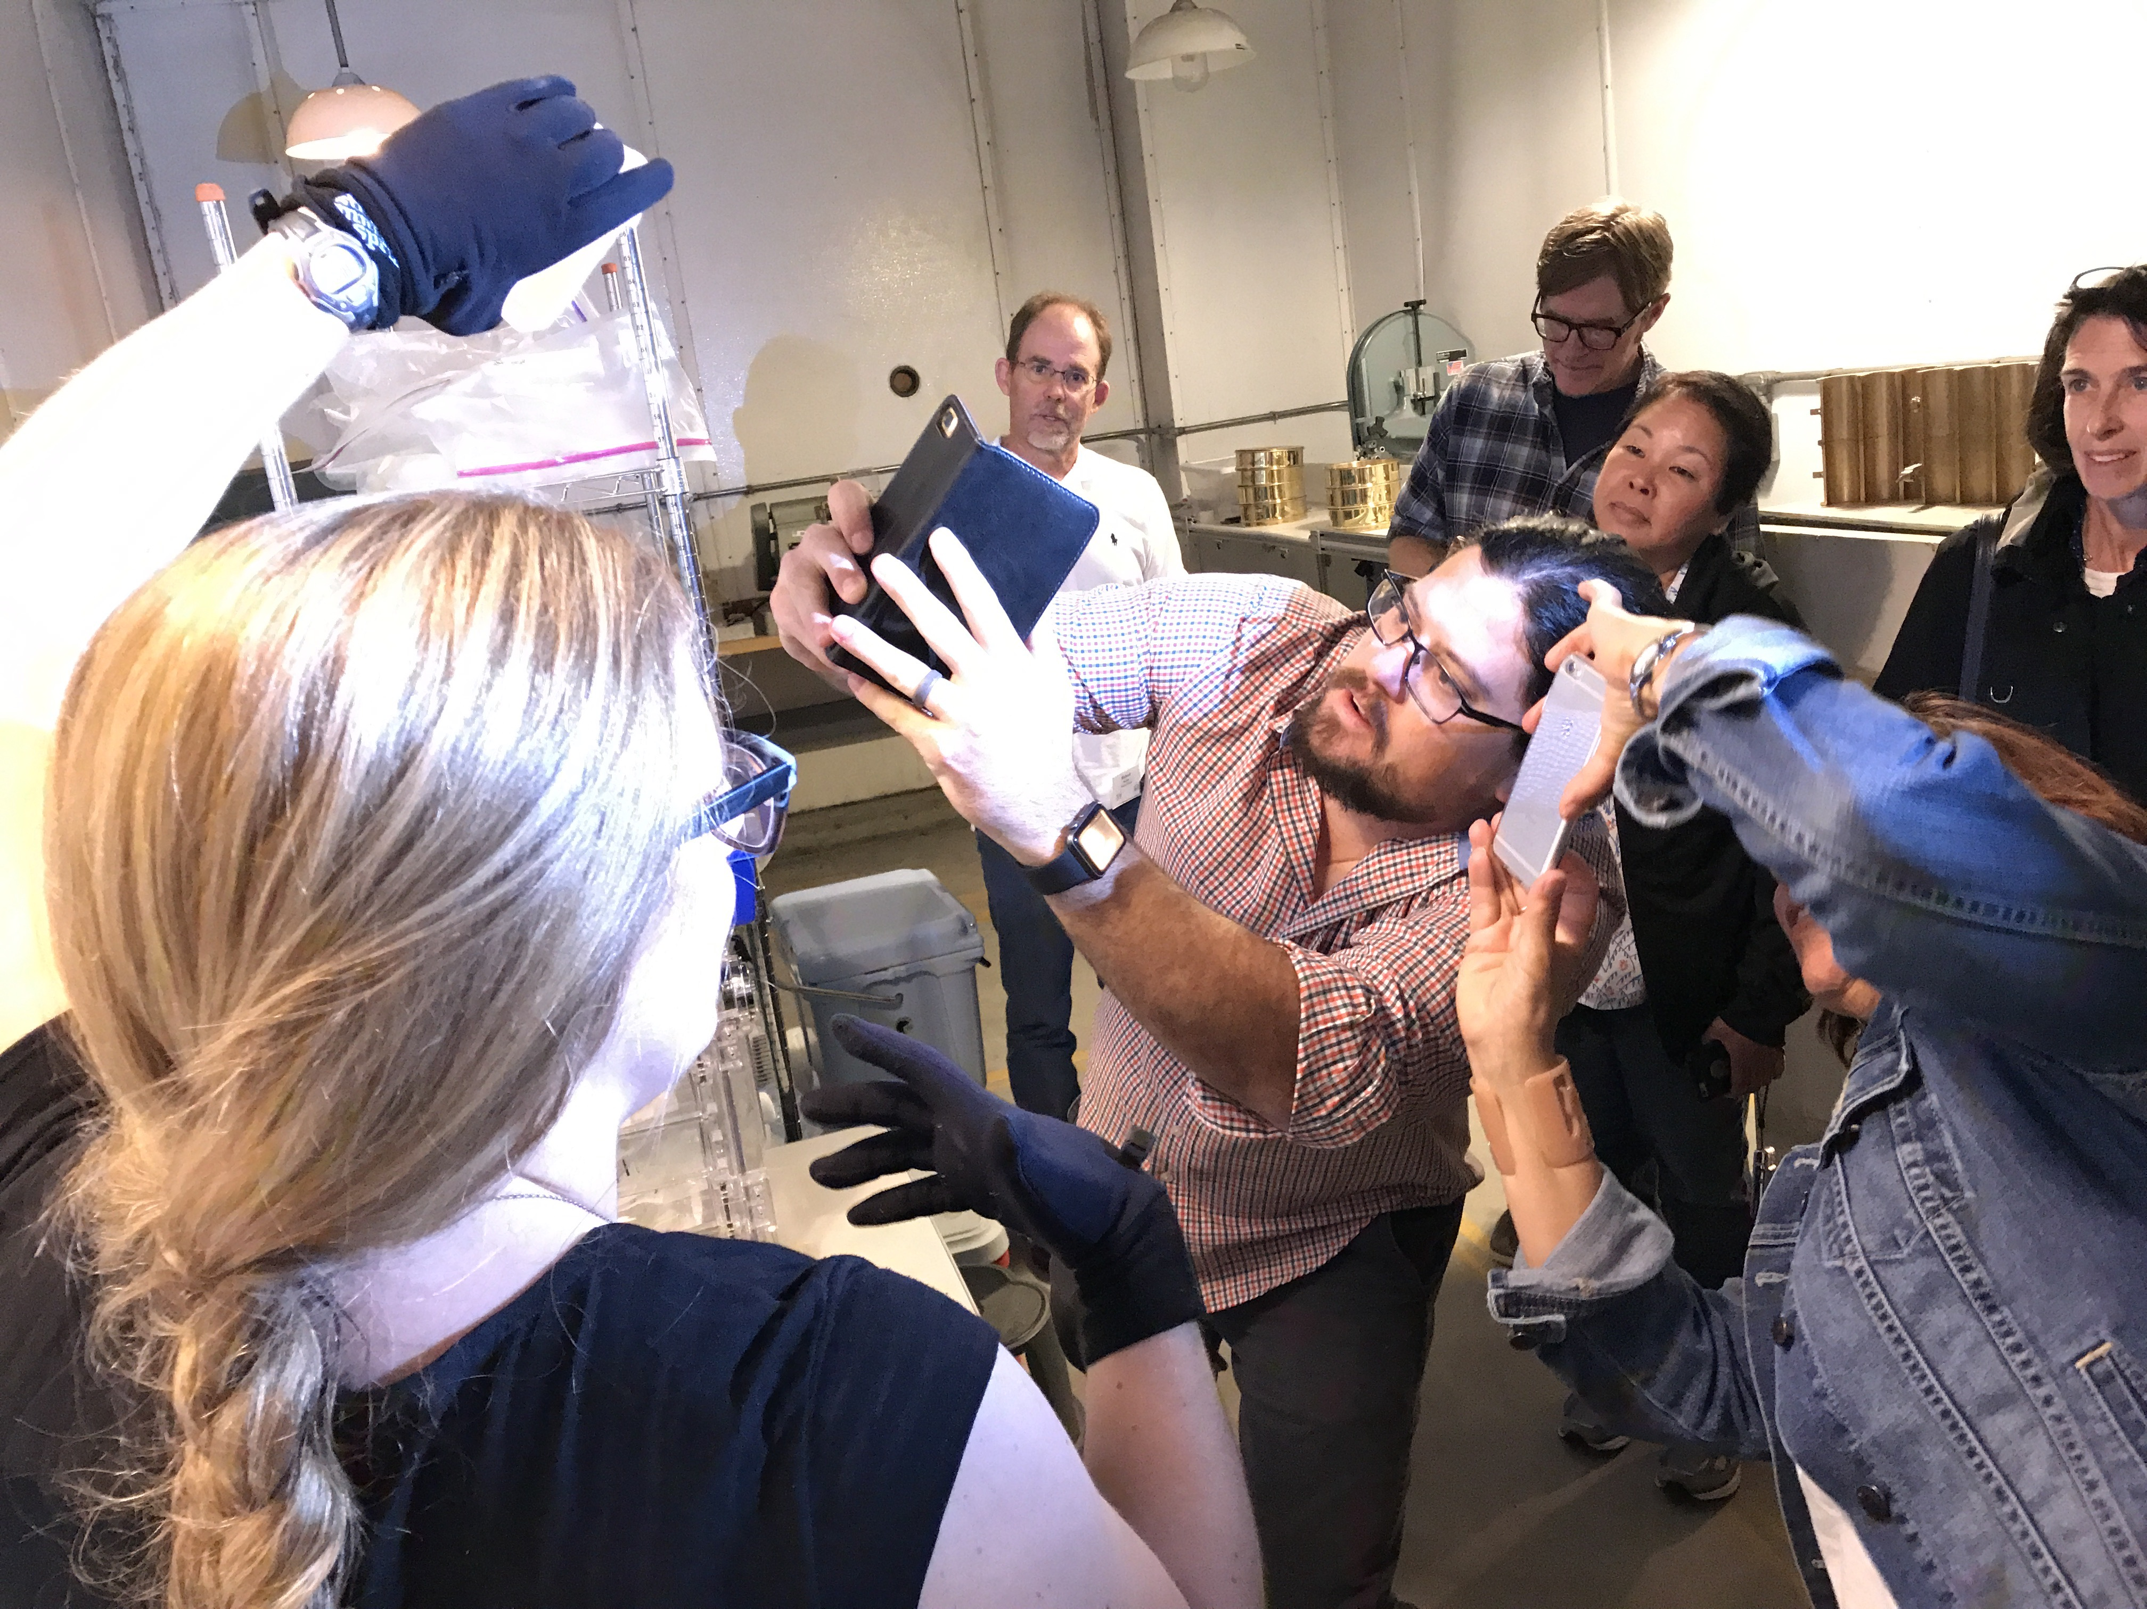
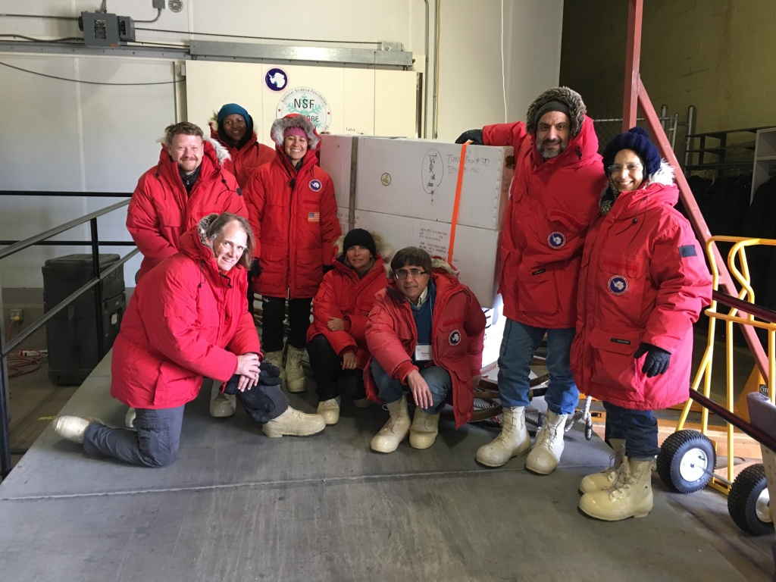
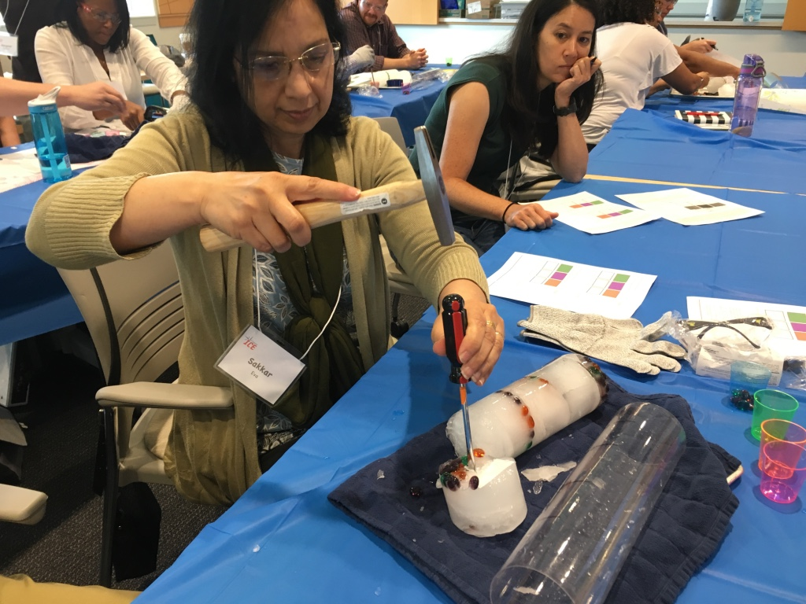
School of Ice: A Model for Advanced Professional Development for Geoscience Faculty at Minority –Serving Institutions with Applications to other 2- and 4-year Colleges
Louise T. Huffman
Director of Education and Outreach
US Ice Drilling Program (IDP)
Dartmouth College, Hanover, NH
louise.t.huffman@dartmouth.edu icedrill-education.org
US Ice Drilling Program icedrill.org icedrill-education.org

Slide 2
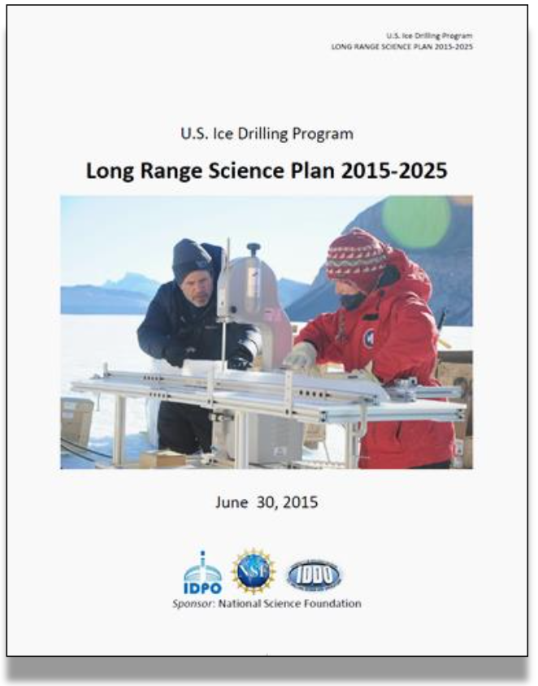
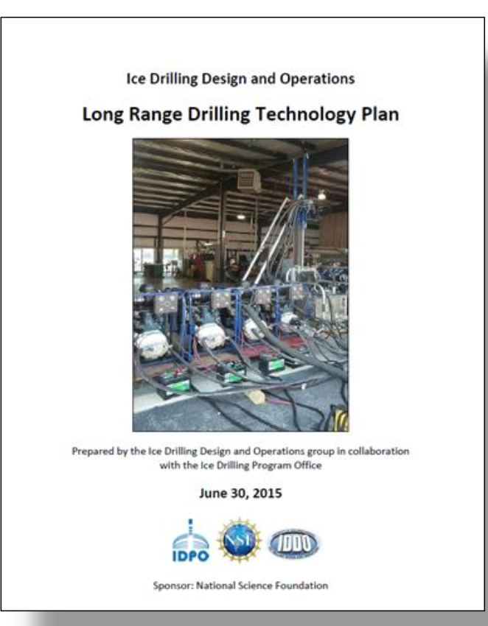
Ice Drilling Program (IDP)
Provides ice core community
leadership
Coordinates development of
Long Range Science Plan
and
Long Range Drilling Technology Plan
US Ice Drilling Program icedrill.org icedrill-education.org

Slide 3
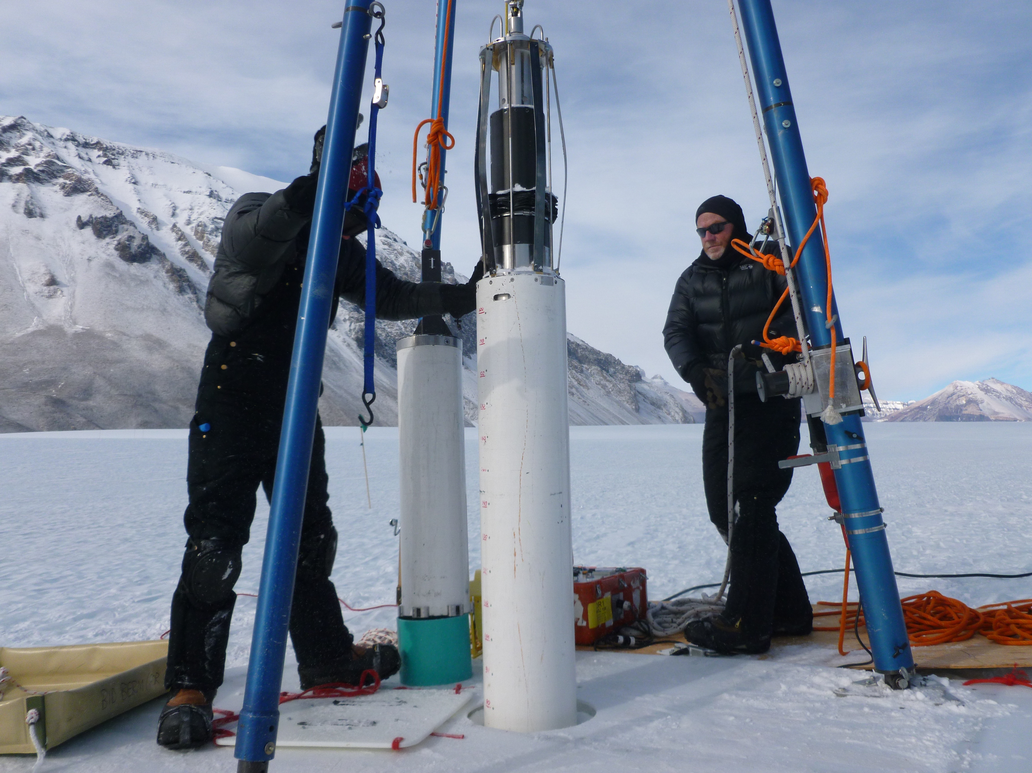
IDP Long Range Plans
Past climate through ice cores
Ice dynamics and glacial history
Subglacial geology, sediments and ecosystems
Ice as a scientific observatory
Integrated science and technology planning:
Allows science to drive technology development of new drills and capabilities
US Ice Drilling Program icedrill.org icedrill-education.org
Notes:
This presentation isn’t about the science of IDP, but rather the ed. and outreach. NGSS now require educators to integrate engineering into their science curriculum—for most teachers this is not something they had been doing—because ice core science requires great engineers to develop the technology needed by the scientists to core ice and to gain subglacial access, we have a great opportunity to bring current, real science into classrooms. That’s where my job comes in.

Slide 4
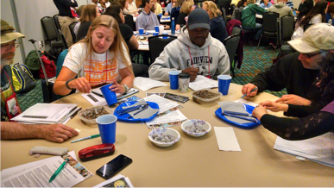
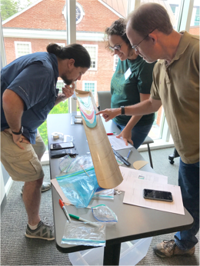
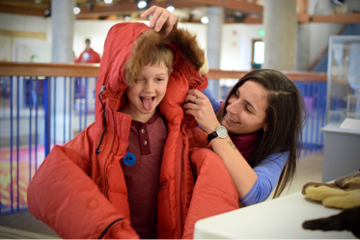
Overview of IDP EPO Program
Vision
To enable public and educator understanding of scientific and engineering discoveries from evidence in glaciers and ice sheets.
Middle school and high school hands-on teachers’
workshops at NSTA.
Graduate students engage
the public in polar science explorations during museum events.
During School of Ice workshops, college faculty experience labs for transferring ice core science to their students.
US Ice Drilling Program icedrill.org icedrill-education.org
Notes:
Early career scientists bring energy and are usually quite open to outreach opportunities—especially when their supervisors are supportive and encouraging

Slide 5
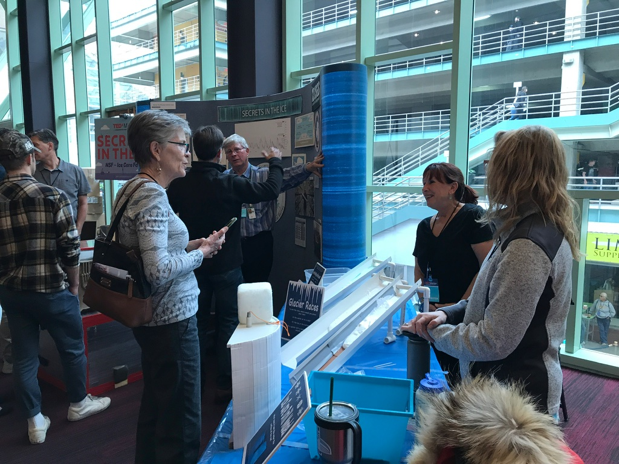
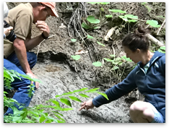
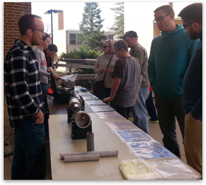
Overview of IDP EPO Program
Mission
The mission of the IDP Education and Public Outreach (EPO) Program is to conduct activities with educators and the public featuring scientists and engineers from the ice core research community, to communicate their scientific discoveries and excitement about science and engineering.
School of Ice, IDP scientists share their expertise with participants.
IDD UW-Madison --Engineers demonstrate drills to the public
Public audience at TedX, Denver in collaboration with the NSF Ice Core Facility
US Ice Drilling Program icedrill.org icedrill-education.org
Notes:
IDD UW-Madison --Engineers demonstrate drills to the public at and incorporate hands-on activities from the EO program.

Slide 6
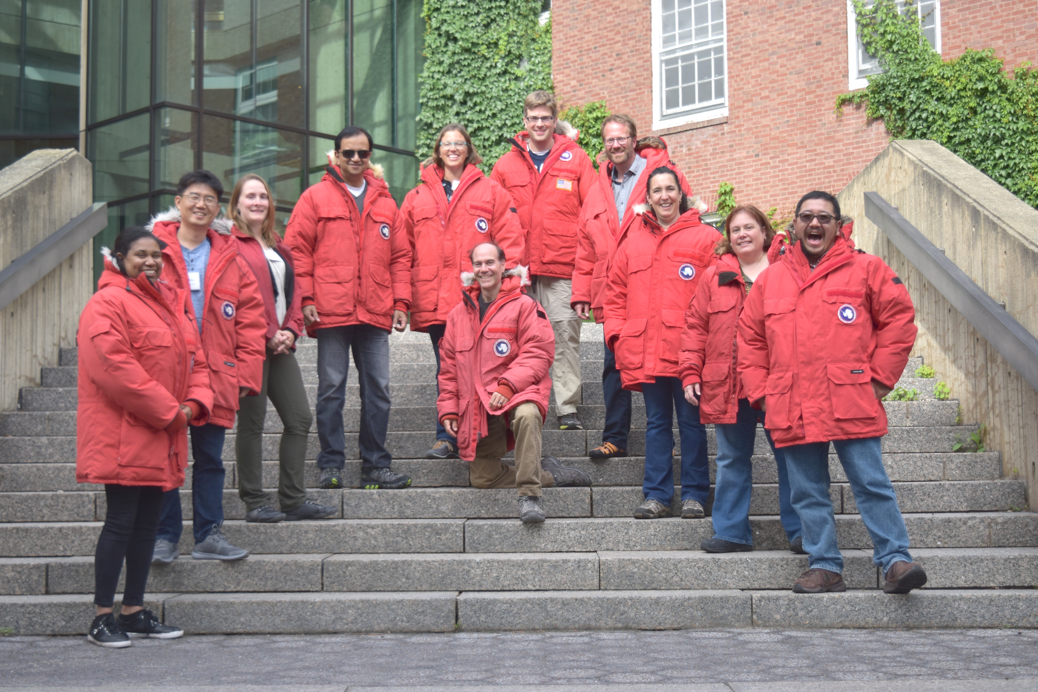
School of Ice (SOI): Advanced Professional Development Program for Faculty at Minority Serving Institutions
WHY
Our nation faces a serious challenge in attracting young people to science and its related careers. This is particularly true for members or groups under-represented in STEM and for minority college students majoring in geosciences.
US Ice Drilling Program icedrill.org icedrill-education.org
Notes:
Brochures

Slide 7
School of Ice (SOI): Advanced Professional Development Program for Faculty at Minority Serving Institutions
WHO:
Faculty teaching at minority serving institutions
…including Historically Black Colleges and Universities, Tribal Colleges, Hispanic Serving Institutions, and Alaska Native and Native Hawaiian Serving Institutions, or institutions with minority enrollments of 25% or more
2019—added a pilot with high school/community college teaching pairs to explore how to bridge the gap from high school to college for underserved minority students in STEM fields
US Ice Drilling Program icedrill.org icedrill-education.org
Notes:
Brochures

Slide 8
School of Ice (SOI): Advanced Professional Development Program for Faculty at Minority Serving Institutions
WHERE:
Dartmouth College and the Cold Regions Research and Engineering Laboratory, NH
OR
NSF Ice Core Facility in Denver, INSTAAR (Institute for Alpine and Arctic Research) in Boulder, and Antarctic Support Contract, Centennial
OR
Oregon State University—ice core and sediment core facilities
US Ice Drilling Program icedrill.org icedrill-education.org
Notes:
Brochures

Slide 9
School of Ice (SOI): Advanced Professional Development Program for Faculty at Minority Serving Institutions
WHEN:
2015-16 Denver/CU-Boulder
2017 and 2018 Dartmouth
2019 Denver/CU-Boulder
2020 Dartmouth
2021 Oregon State
(2020 applications available in Dec. at icedrill-education.org)
US Ice Drilling Program icedrill.org icedrill-education.org
Notes:
Brochures

Slide 10
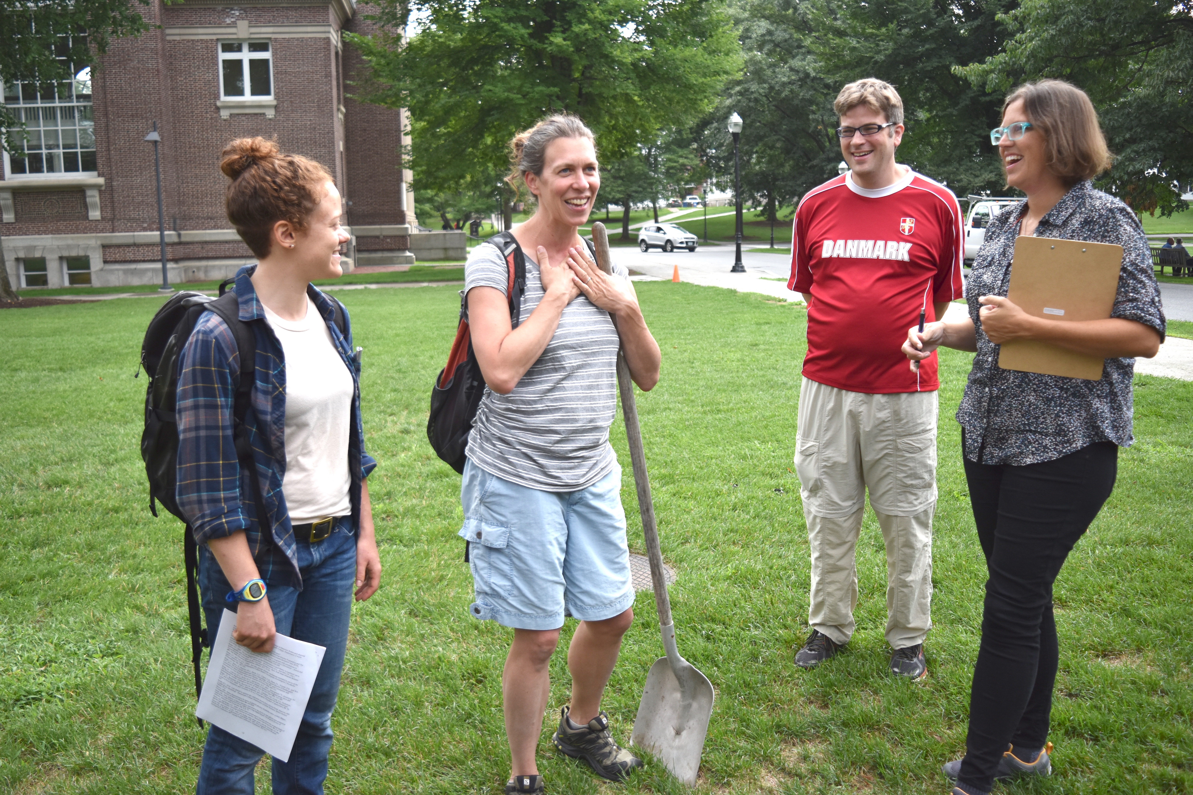
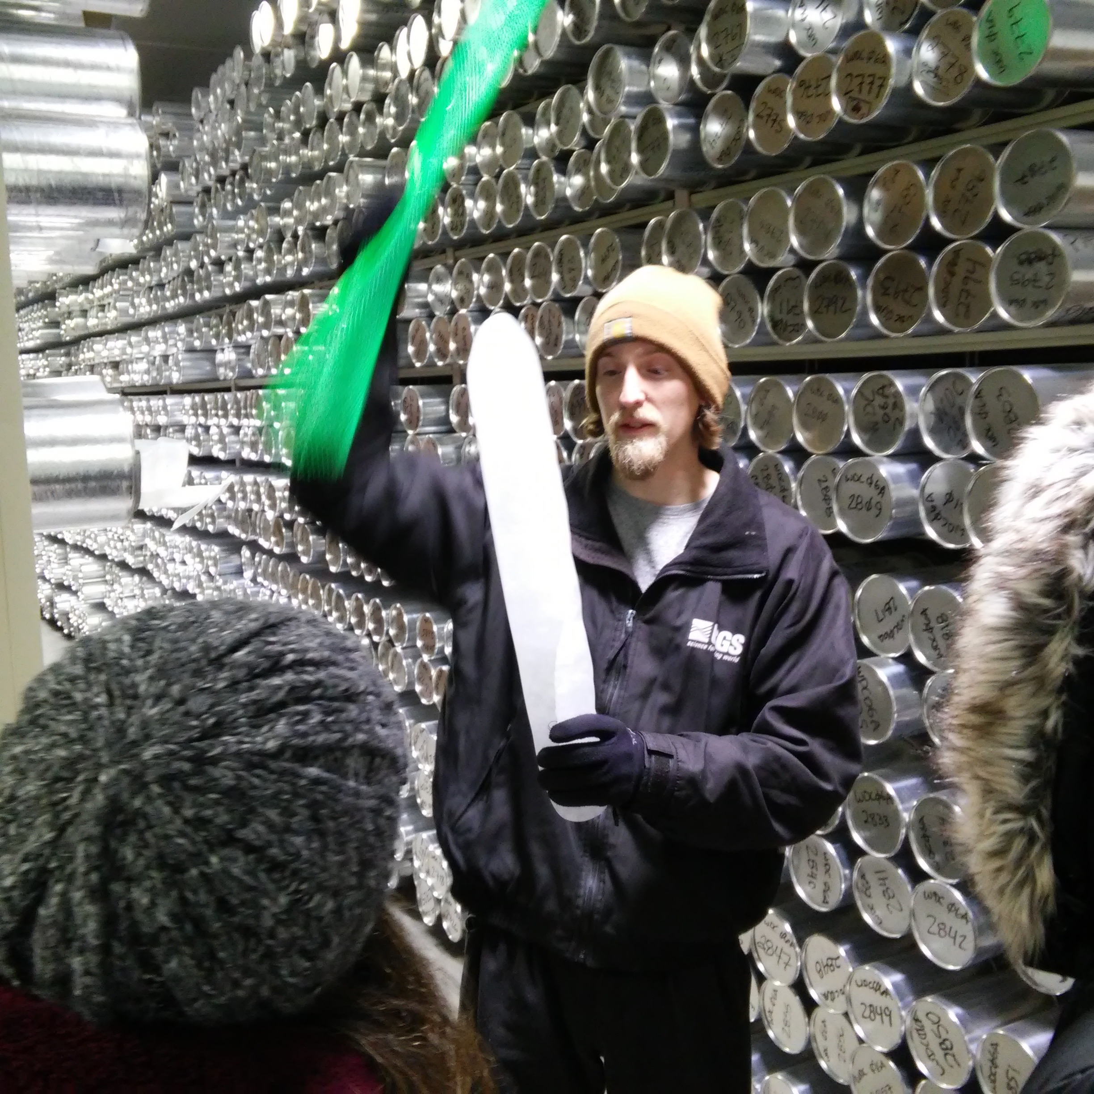
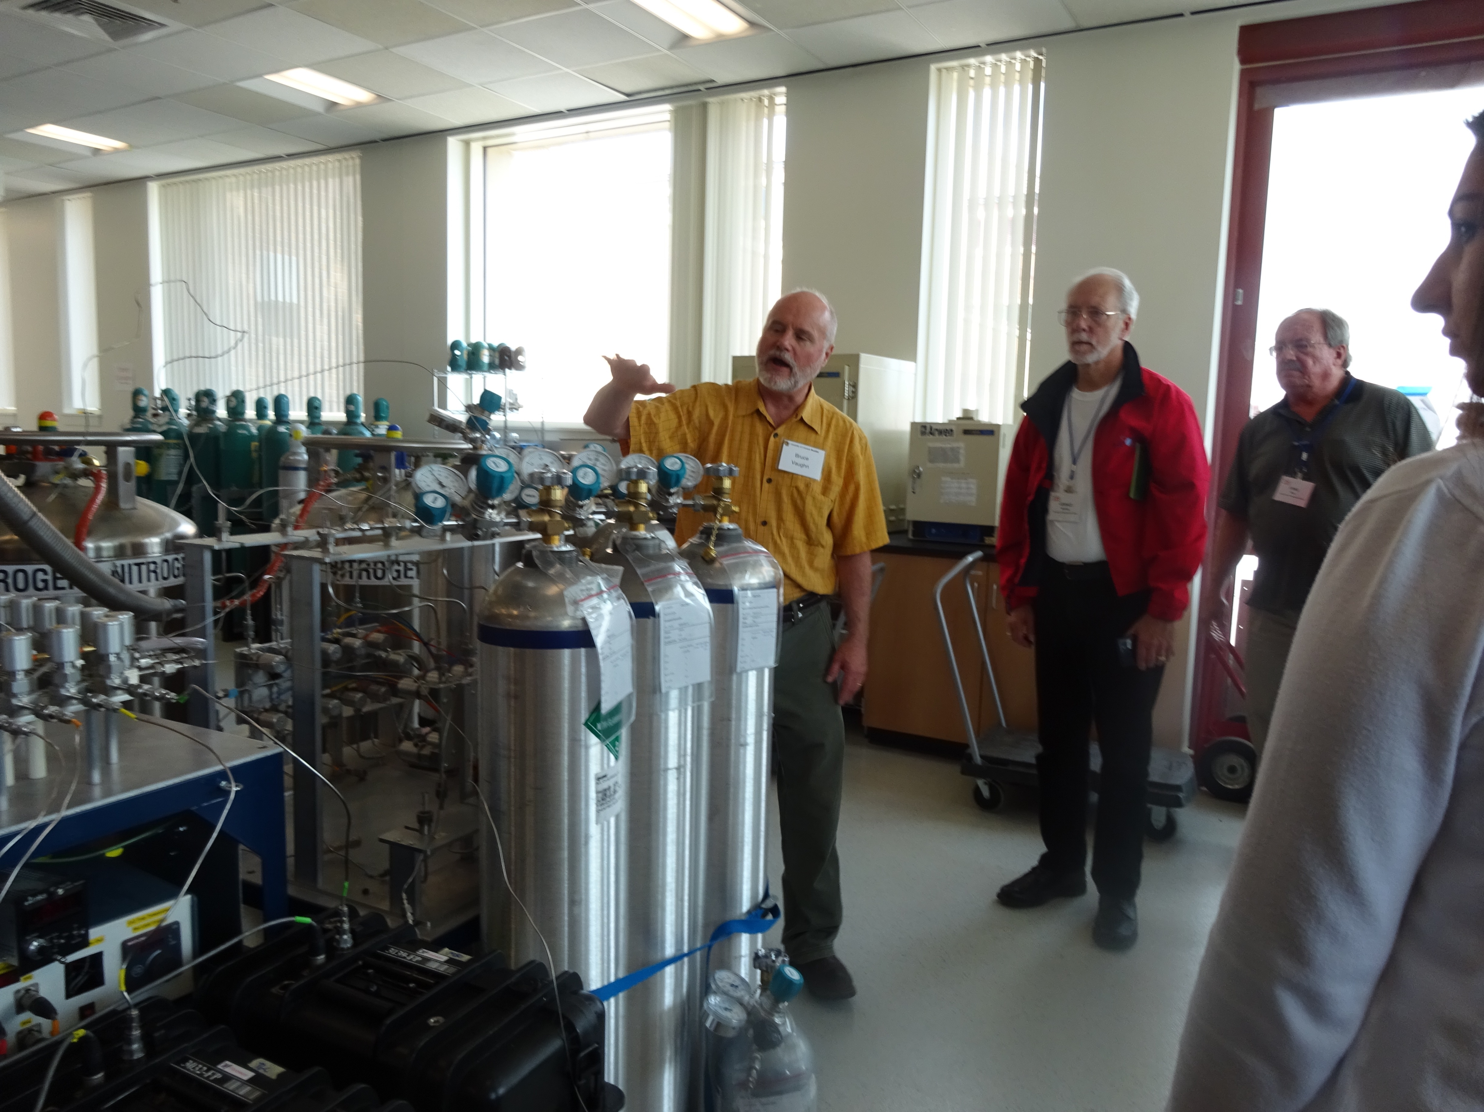
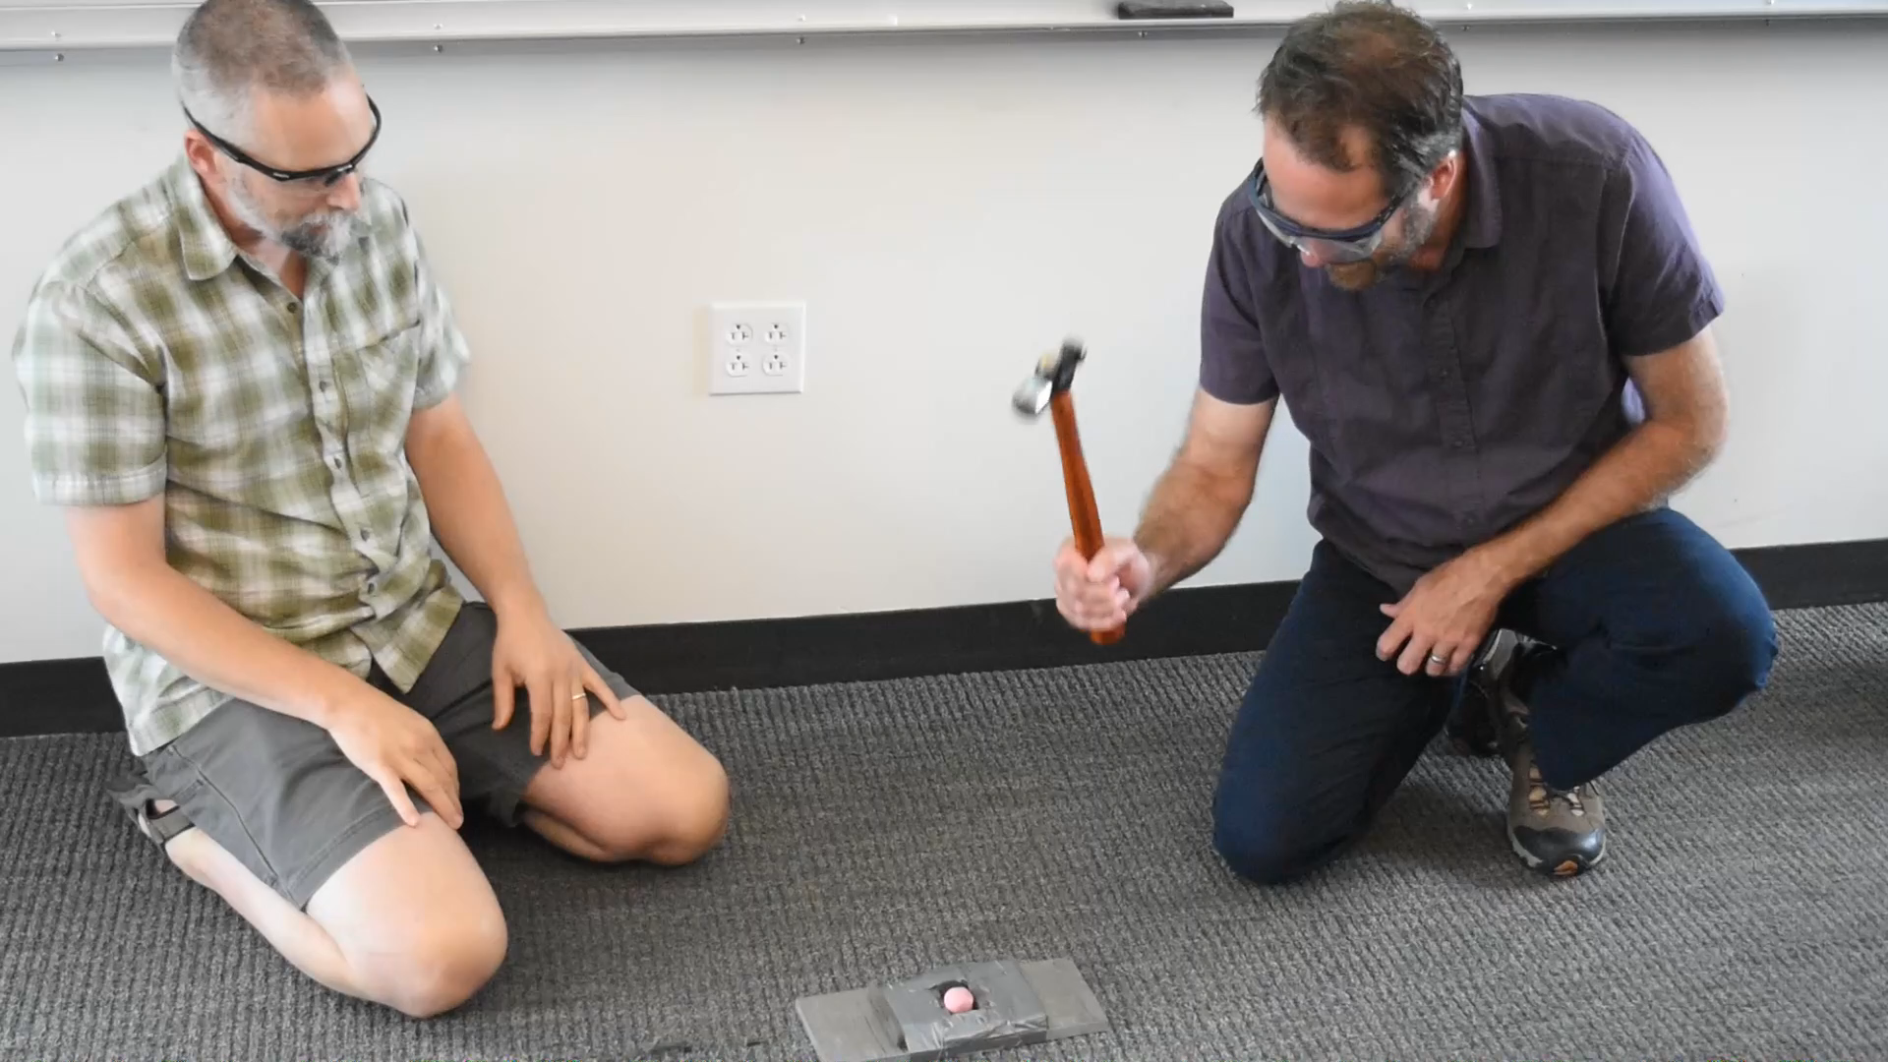
SOI-Scientists Play Key Role
Scientists share their knowledge through:
Field trips
Hands-on demos & activities
Lab visits
Lectures
US Ice Drilling Program icedrill.org icedrill-education.org
Notes:
Scientists share freely of their time and knowledge—couldn’t do SOI without their self-less dedication to education.

Slide 11
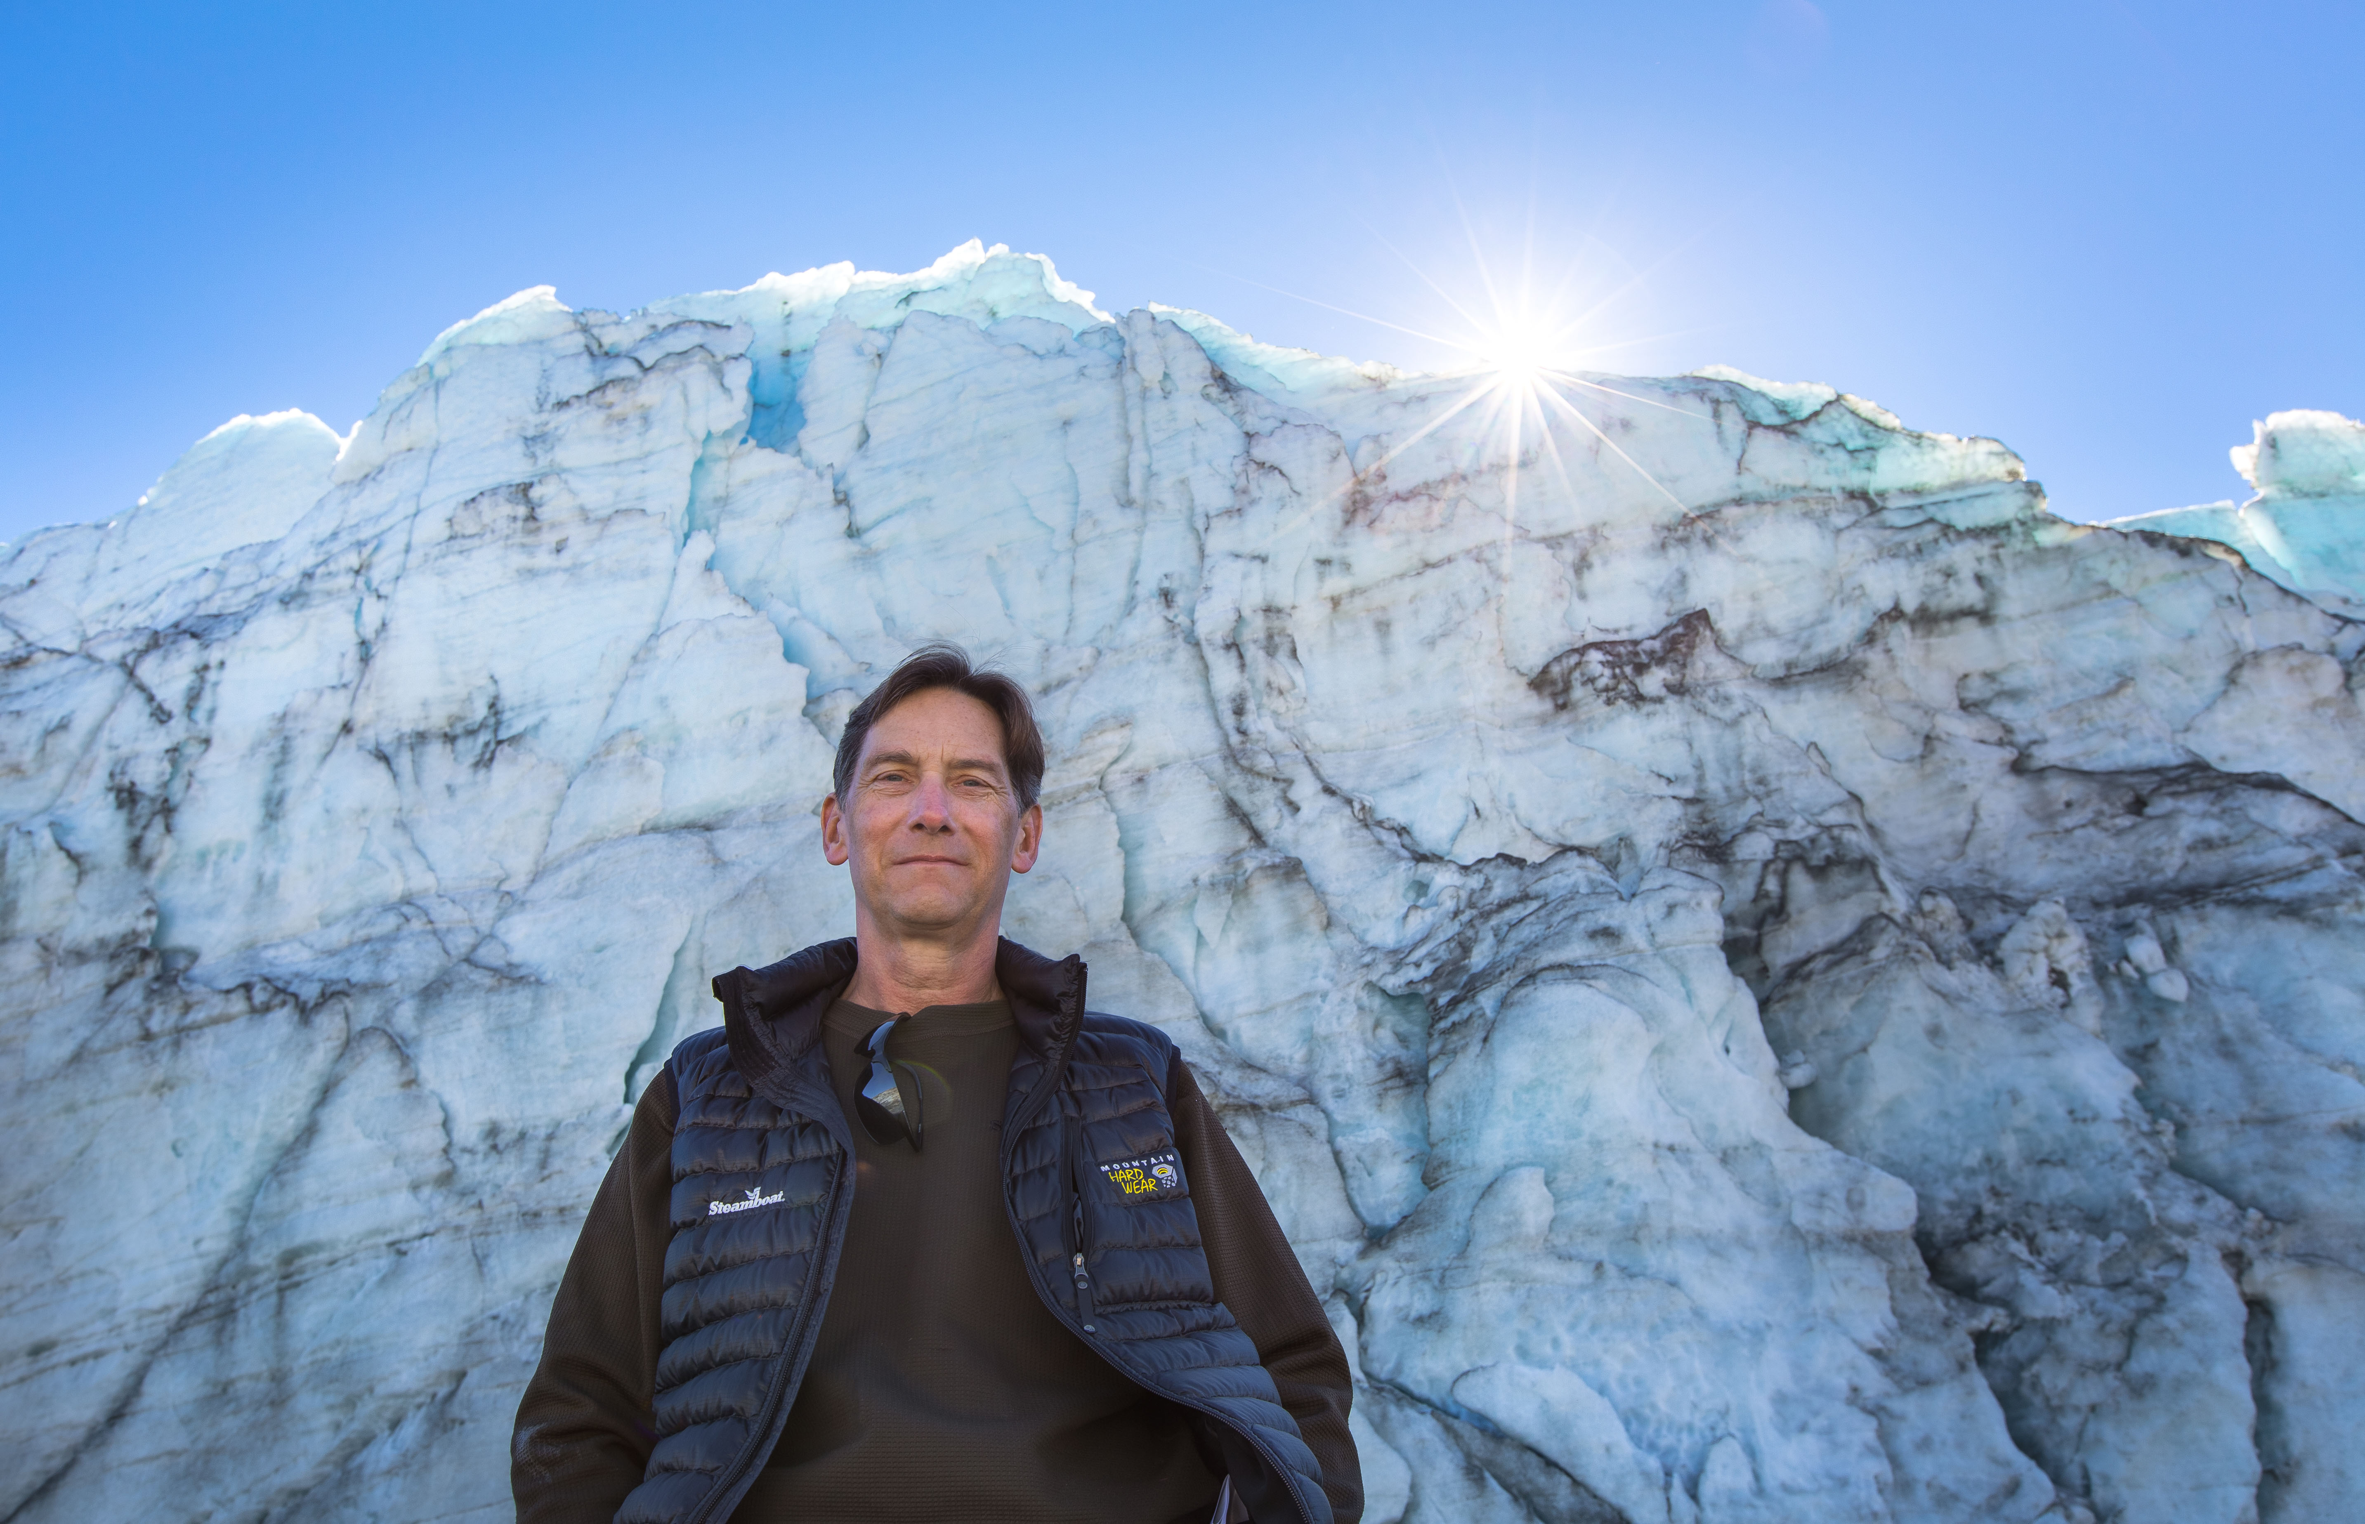
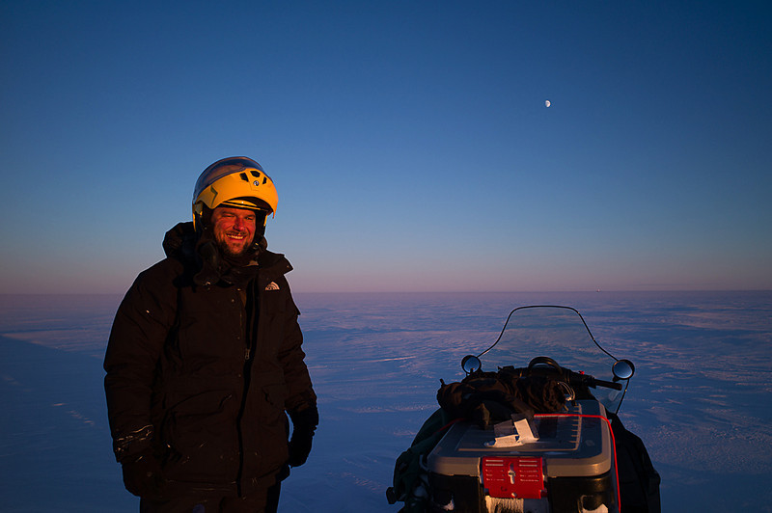
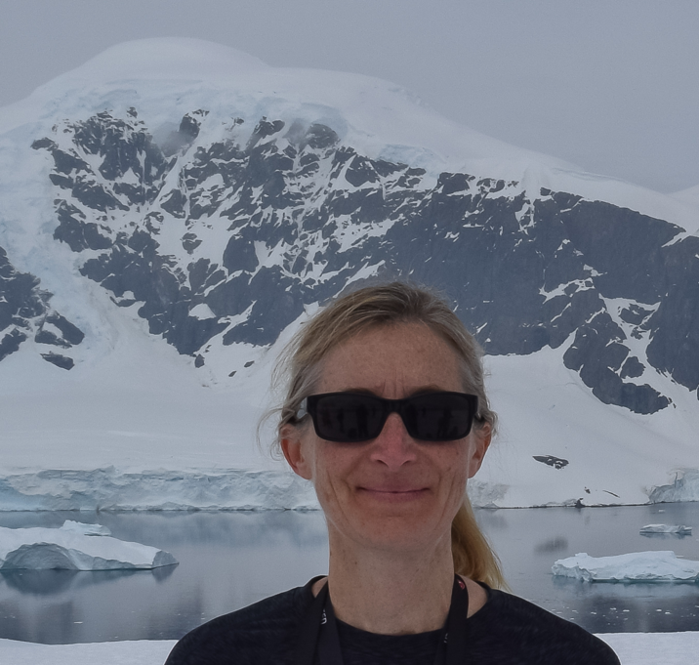
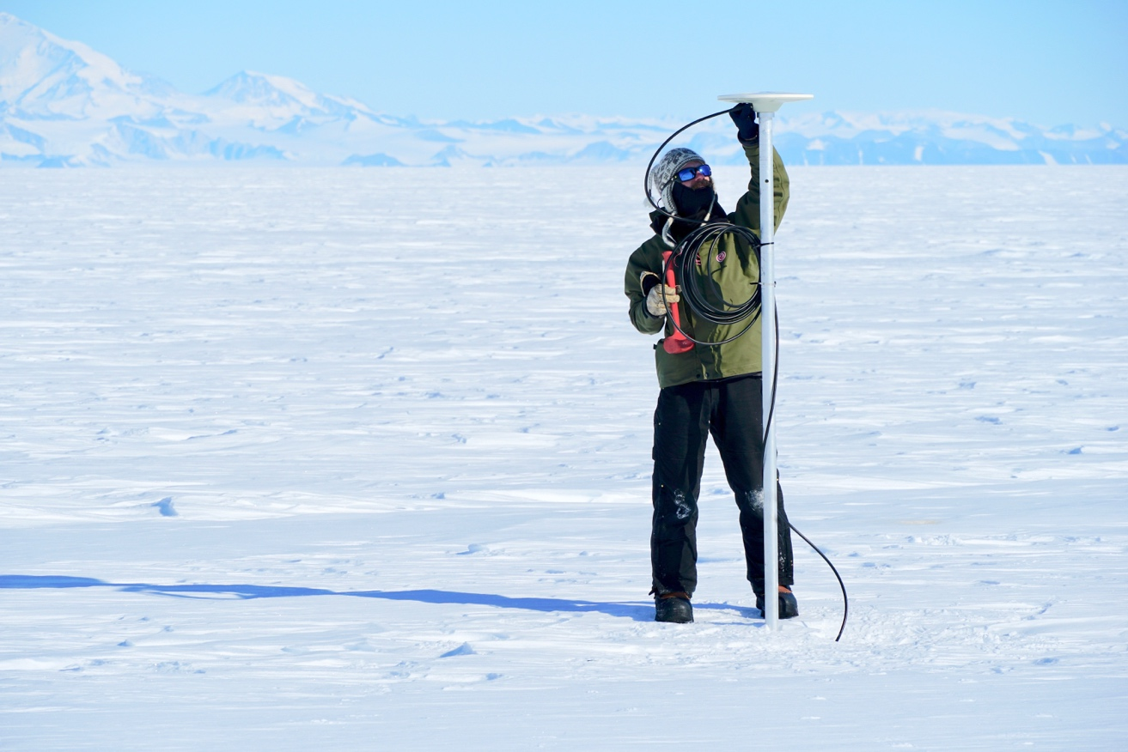

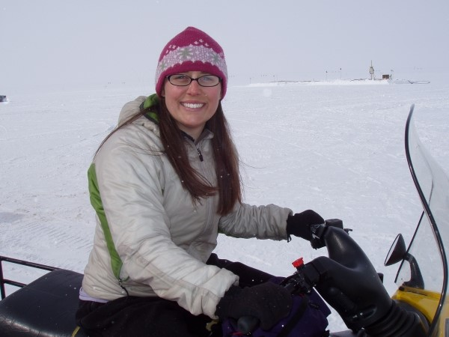
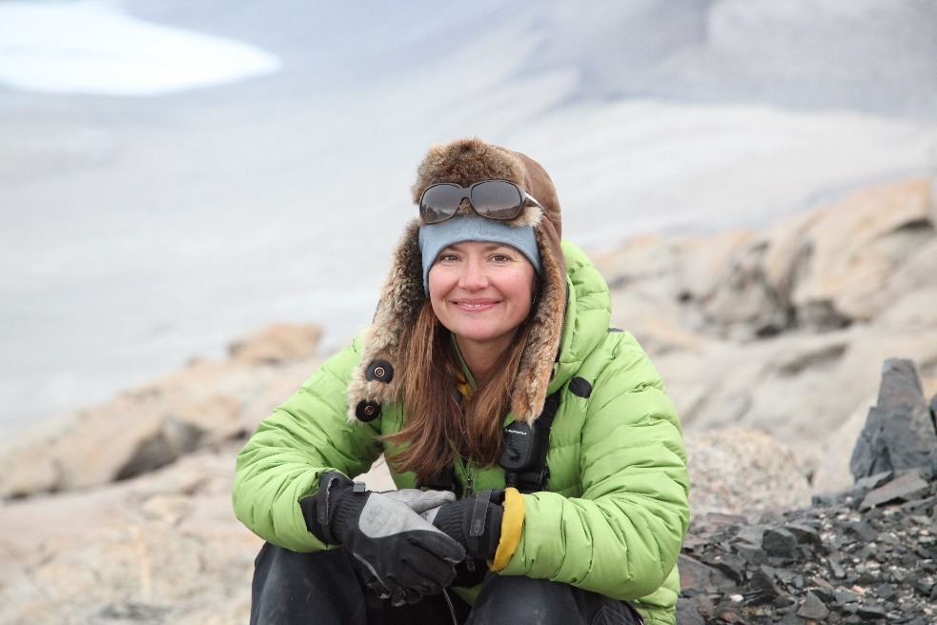
Scientists/Presenters at SOI 2019
Anderson, Bob | University of CO-Boulder
Clow, Gary | University of CO-Boulder
Hargreaves, Geoff | Ice Core Facility
Holland, Marika | UCAR
Hood, Elaine | Antarctic Support Contract
Hottel, Kory | Antarctic Support Contract
Jenkins, Jessy | Polar Field Services, Inc.
Juniel, Troy | Antarctic Support Contract
Koenig, Lora | Natl Snow & Ice Data Center
MacFerrin, Mike | Colorado School of Mines
Oliver, Matt | University of Delaware
Powers, Lindsay | US Geological Survey
Rom, Lisa | National Science Foundation
Siegfried, Matt | Colorado School of Mines
Vaughn, Bruce | INSTAAR
White, Jim | University of CO-Boulder
US Ice Drilling Program icedrill.org icedrill-education.org
Notes:
A stellar list of speakers each year—high caliber of speakeres

Slide 12
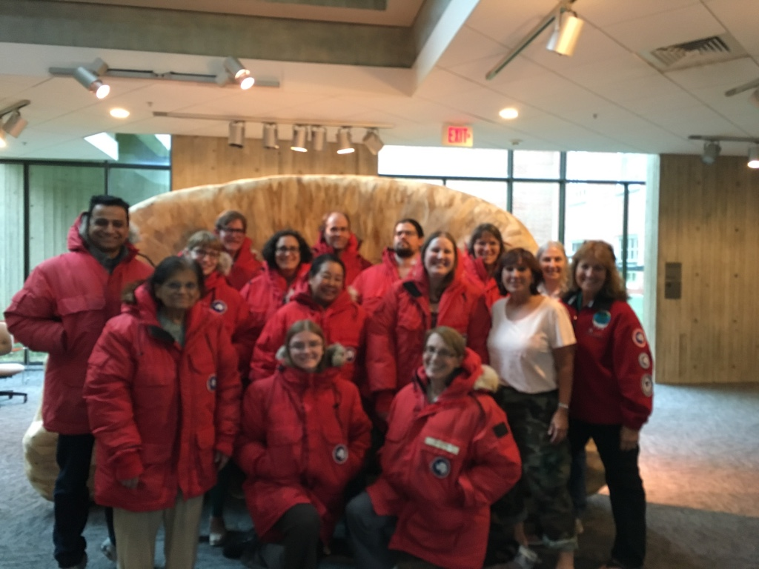
School of Ice: A Powerful Model Lessons Learned
Presenter teams include researchers and educators
Engaging, hands-on, thought-provoking activities for both the faculty and their students
Data driven resources
Capitalize on inherent interest in living and working in the extremes of the Polar Regions
Activities aligned with NGSS standards
Ice drilling technologies demonstrate science and engineering practices in the real world
US Ice Drilling Program icedrill.org icedrill-education.org
Notes:
Early career scientists bring energy and are usually quite open to outreach opportunities—especially when their supervisors are supportive and encouraging

Slide 13
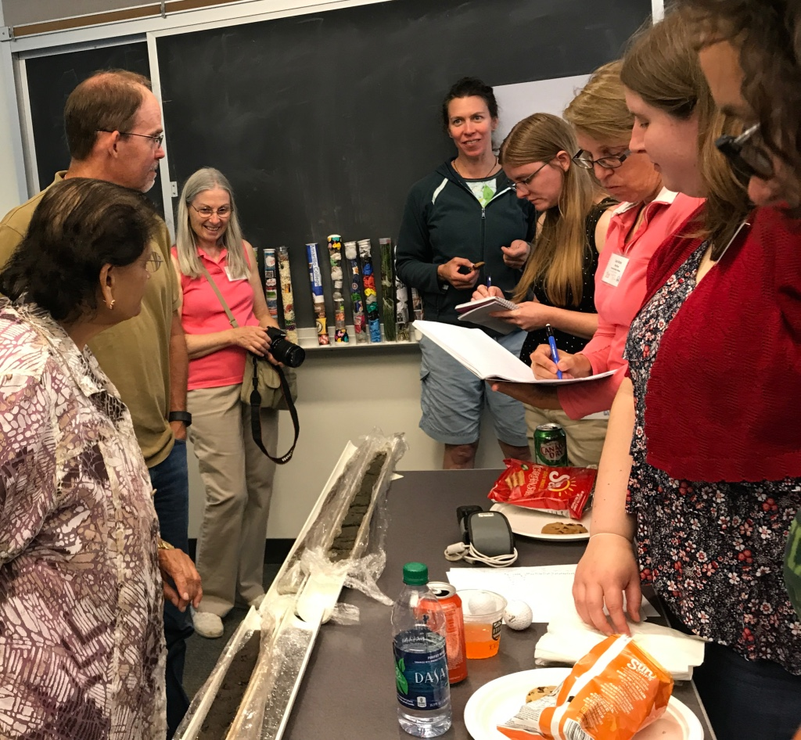
Lessons Learned
Researcher/educator co-presenters—
Researchers…
provide cutting-edge research and data
provide a deep understanding of and passion for the science
build participants’ background knowledge and increase confidence in their ability to teach paleoclimate concepts
hold a place of high value when working with community and educator audiences, especially when the participants have the opportunity to interact on a personal level and to ask questions of the expert
students are introduced to science as a career possibility—especially if the scientist looks like them
Educators…
provide scientists with knowledge of appropriate standards, context for concepts
provide communication strategies for a variety of audiences
create activities and labs for transferring science concepts to students and other non-science audiences
demonstrate how ice core and climate content can be taught within and connected to existing curriculum
US Ice Drilling Program icedrill.org icedrill-education.org

Slide 14
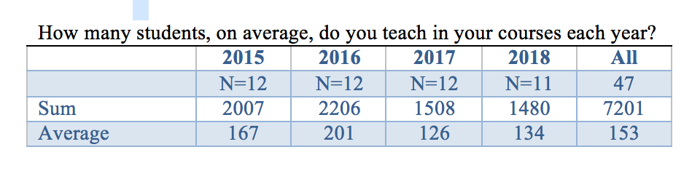
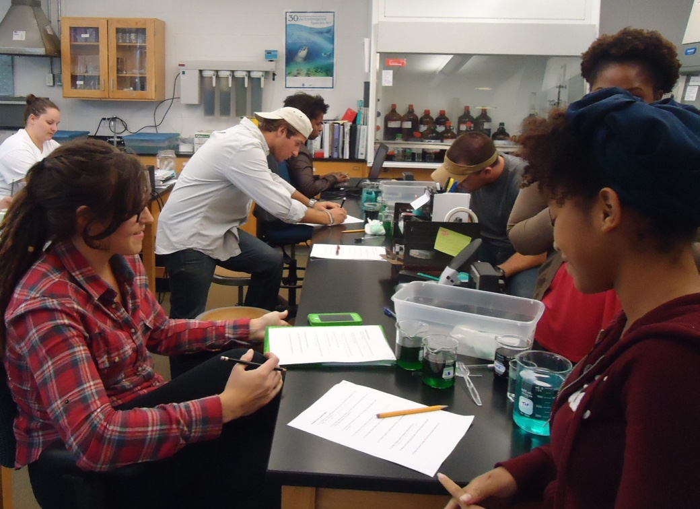
Students Affected by SOI Faculty
If the SOI participants continue to reach the average number of students each year that they reported in the survey, then they have taught collectively almost 30,000 students since 2015.
US Ice Drilling Program icedrill.org icedrill-education.org

Slide 15
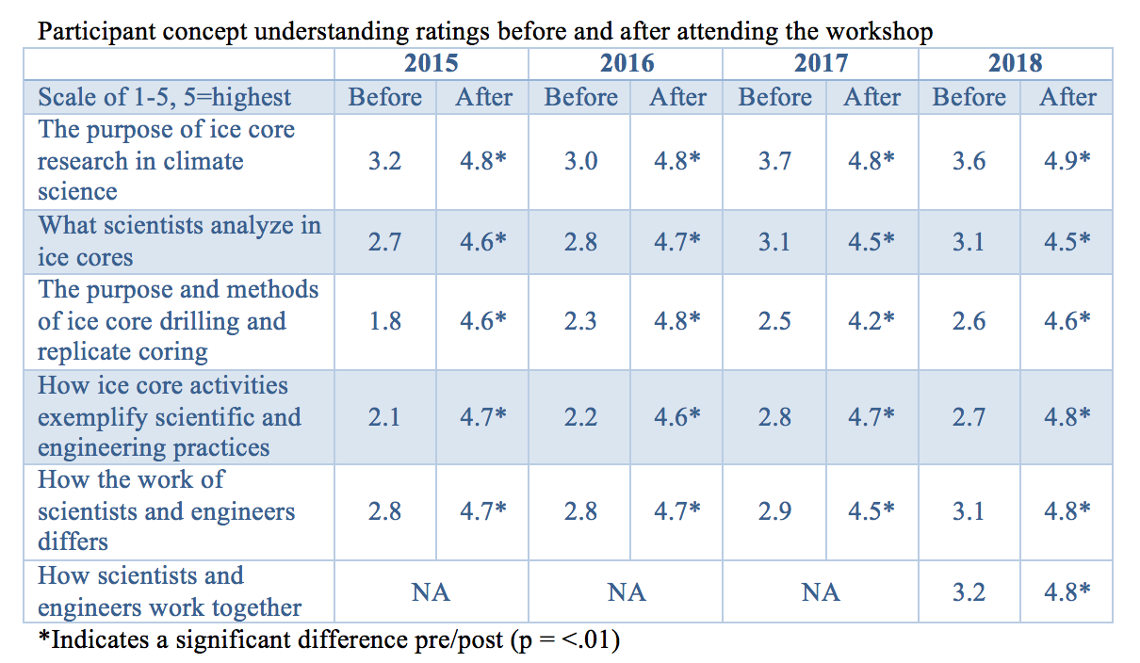
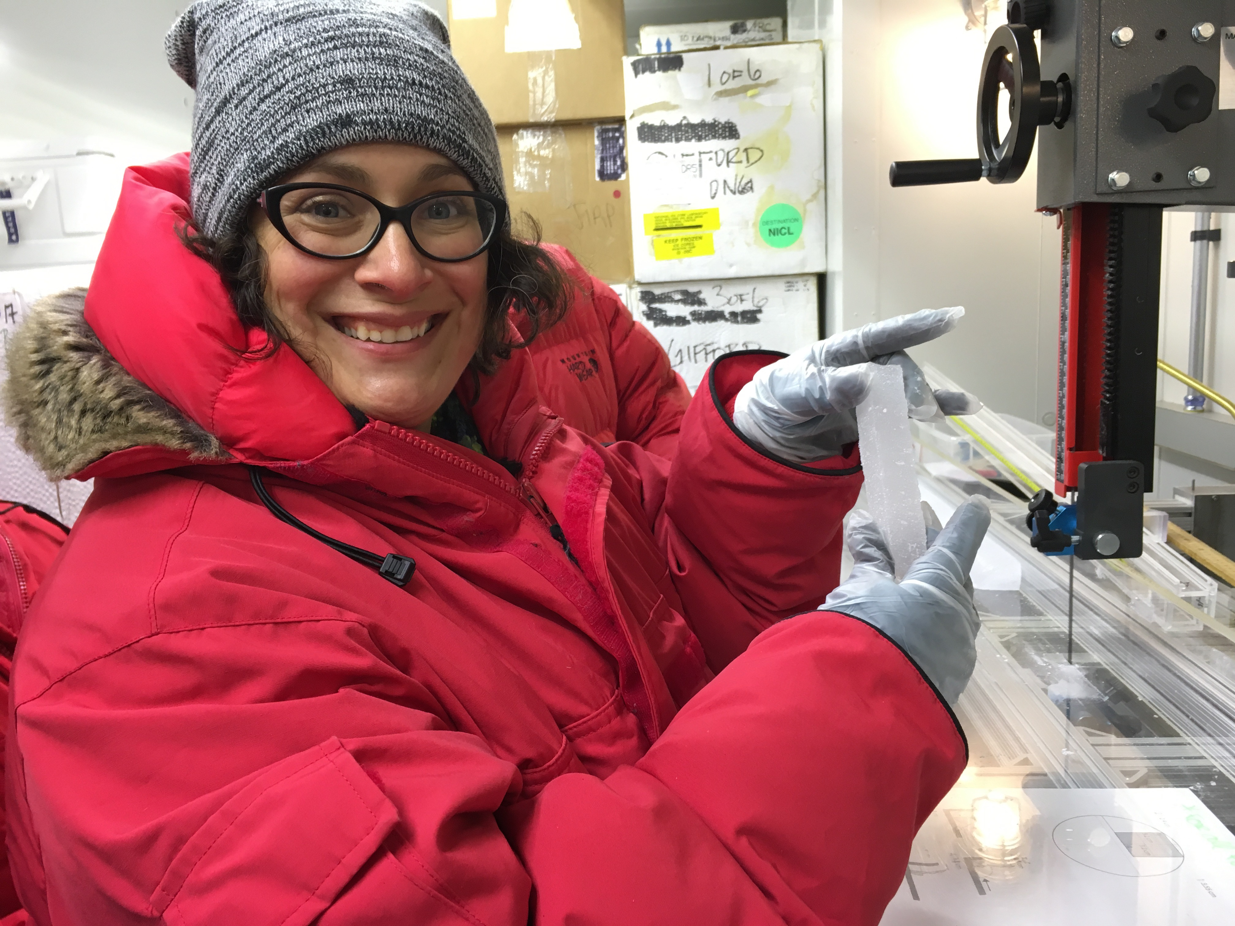
Participant Concept Understanding
US Ice Drilling Program icedrill.org icedrill-education.org

Slide 16
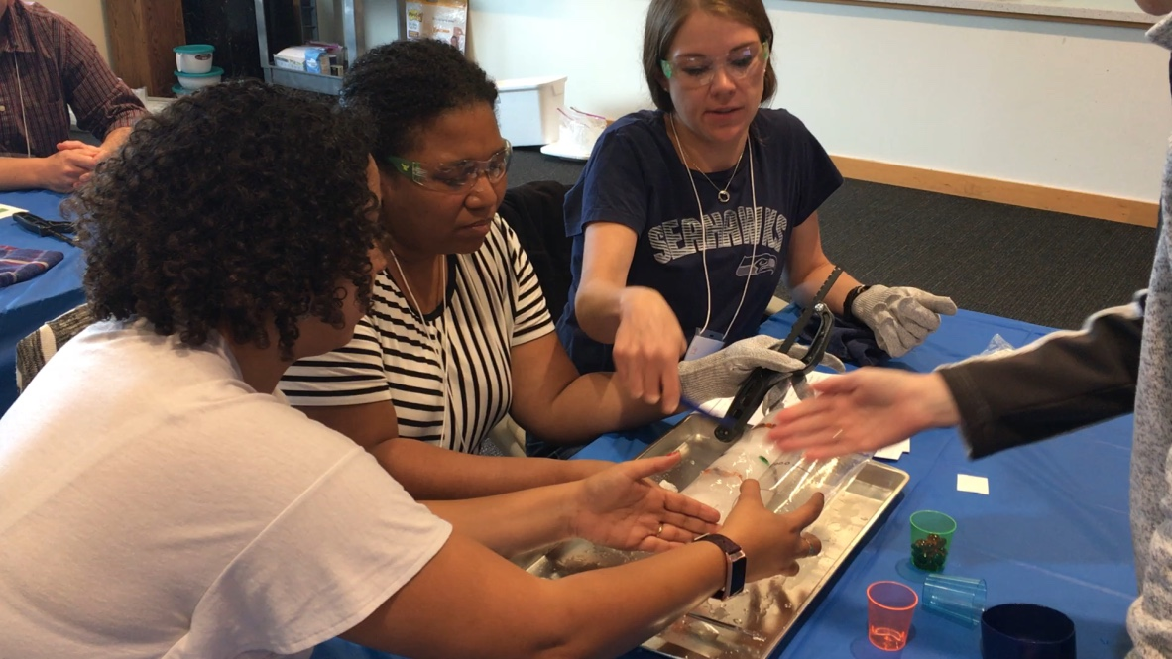
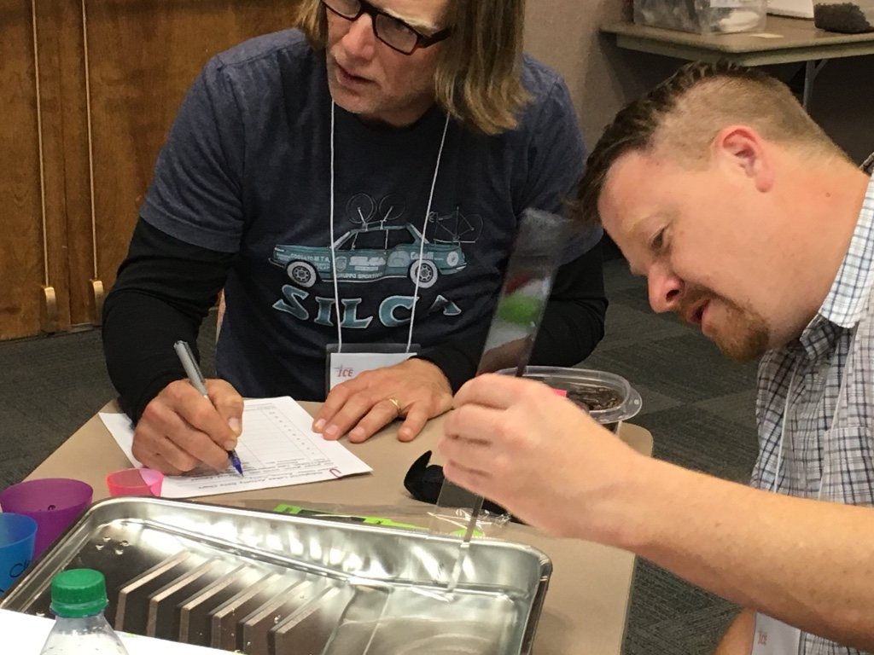
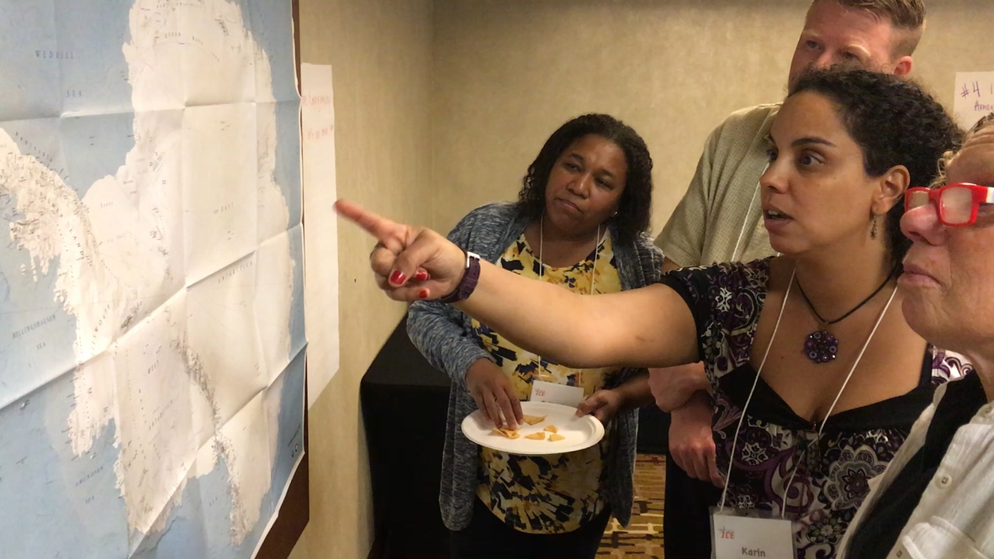
Participant Concept Understanding Quotes from 2019
“I have a new found awareness of ice studies programs and my understanding translates to a sense of authority, of gravitas within the classroom. Without the School of Ice, the exposure I give my students to ice studies would have remained vague to the point of embarrassing if not inaccurate.” Walker, 2019
“This workshop significantly increased my overall understanding of polar research and engineering accomplishments and methods. I feel that I can expand the scope and increase the depth of the kinds of information I include in my geoscience courses.” Castagna, 2019
US Ice Drilling Program icedrill.org icedrill-education.org
Notes:
Evaluations from June 2019 being correlated now. Quotes from Reflections recd July 12th.

Slide 17
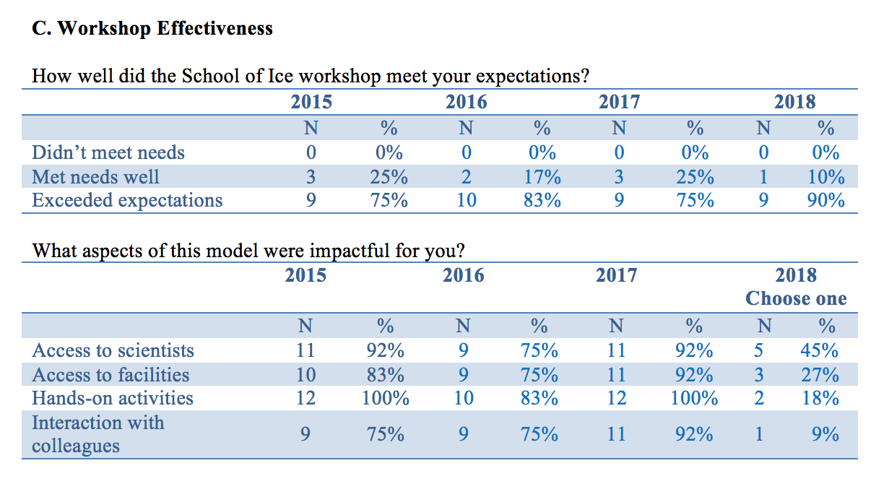
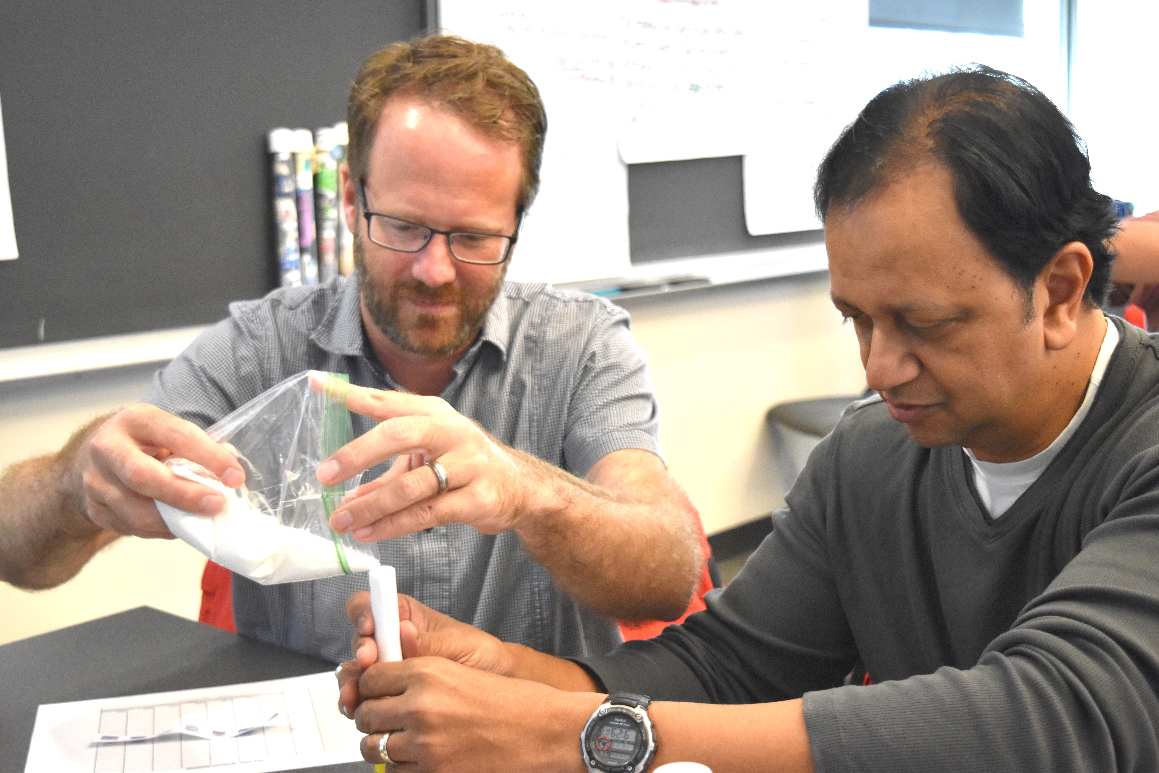
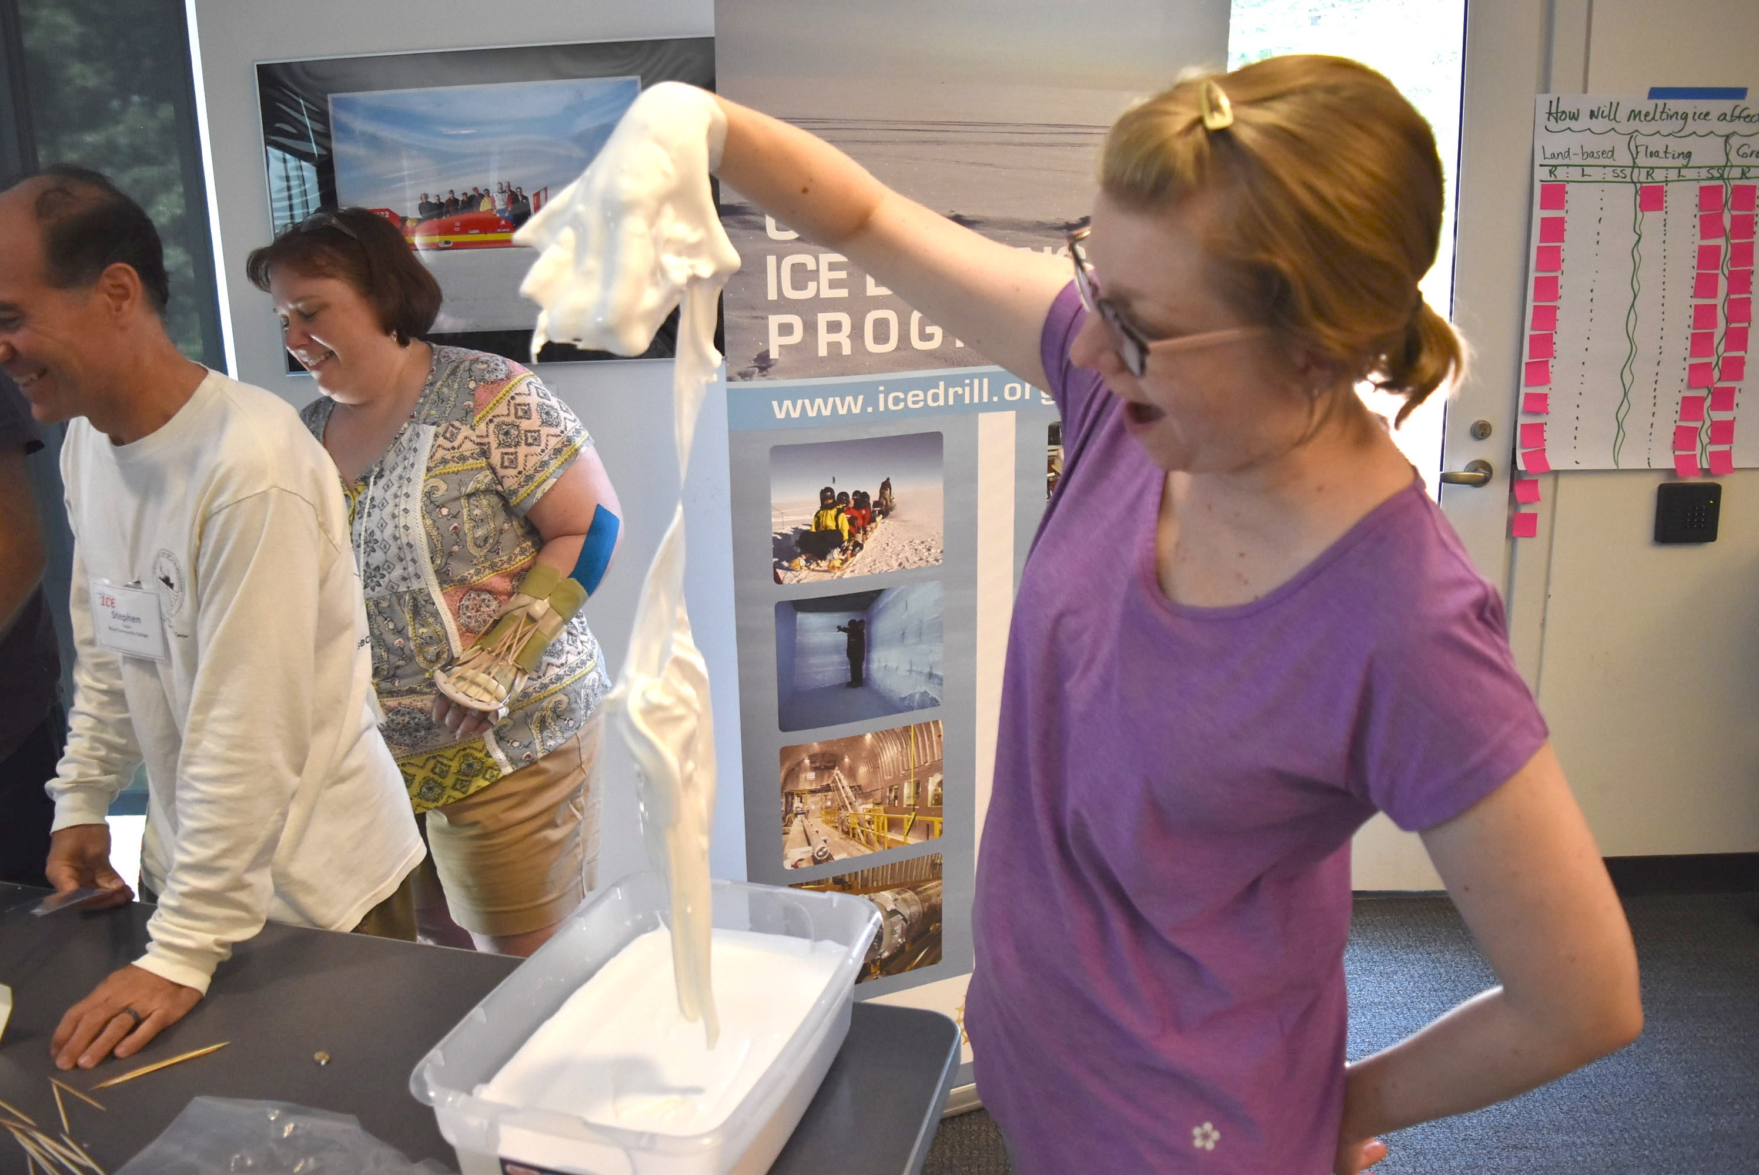
Workshop Effectiveness
*2019—100% met or exceeded expectations.
US Ice Drilling Program icedrill.org icedrill-education.org

Slide 18
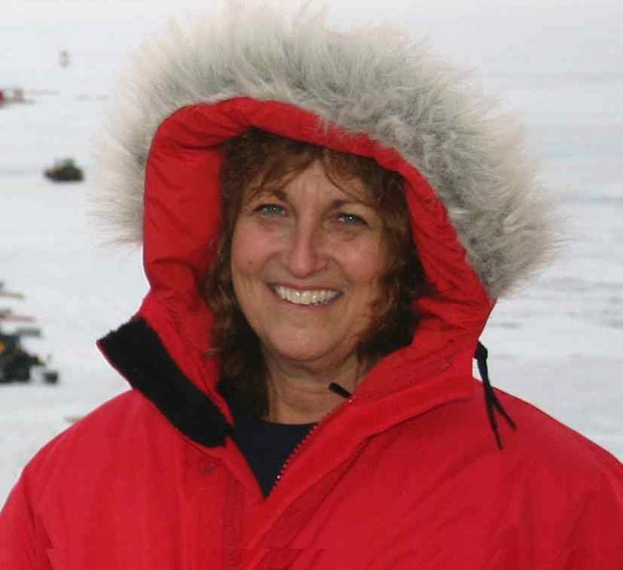
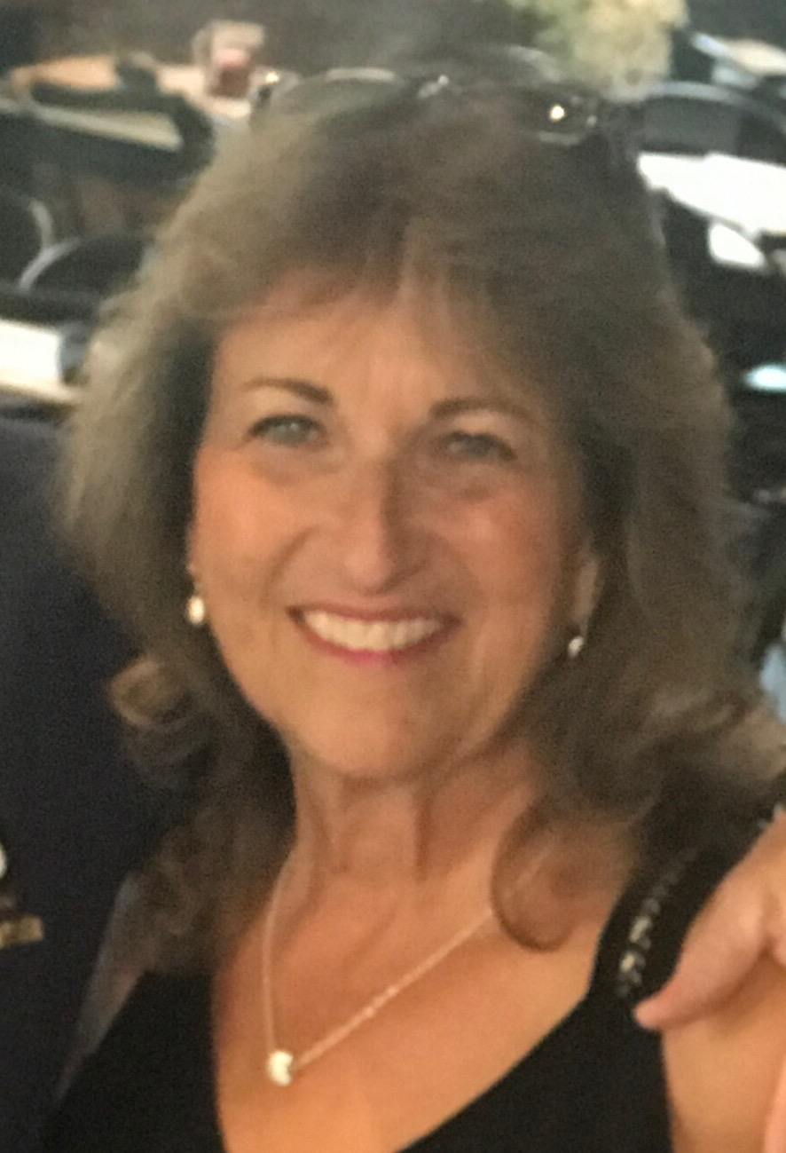
Questions?
Louise T. Huffman
Director of Education and Outreach
Ice Drilling Program (IDP)
Dartmouth College, Hanover, NH
louise.t.huffman@dartmouth.edu
icedrill-education.org
US Ice Drilling Program icedrill.org icedrill-education.org

Slide 19
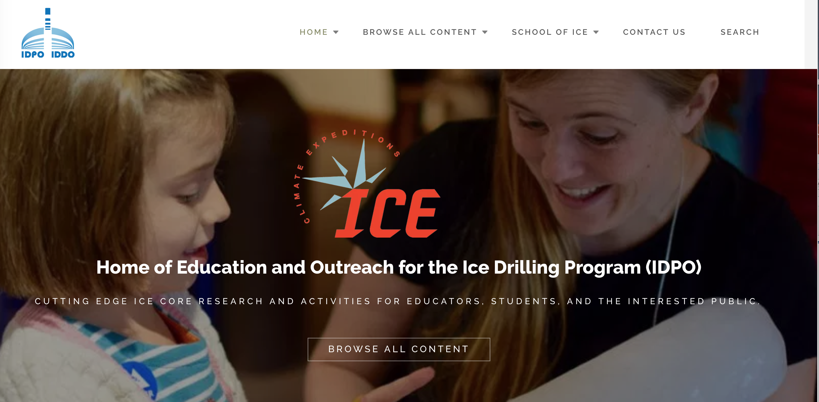
EO Website: icedrill-education.org
US Ice Drilling Program icedrill.org icedrill-education.org

