Slide 1


Utilizing InTeGrate’s “Systems Thinking” across multiple student audiences
Jessica Martin
Instructor of Biology
University of Providence

Slide 2
Background
University of Providence (Great Falls, MT)
Little to no traditional geosciences
Wanted to develop better earth and systems thinking skills in students

Slide 3
Courses – Spring 2018
BIO 152L – General Biology II Lab
31 students ; Biology majors (+ few psychology, exercise science and forensics)
BIO 110ASY – The Living Environment (online)
17 students ; non-Biology majors (part of core curriculum)
GSC 121 – Earth and Space Science
10 students ; Education majors

Slide 4
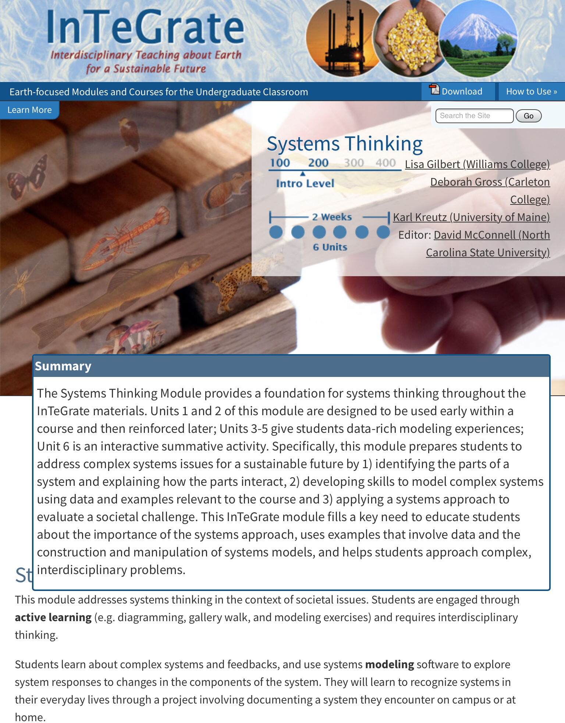
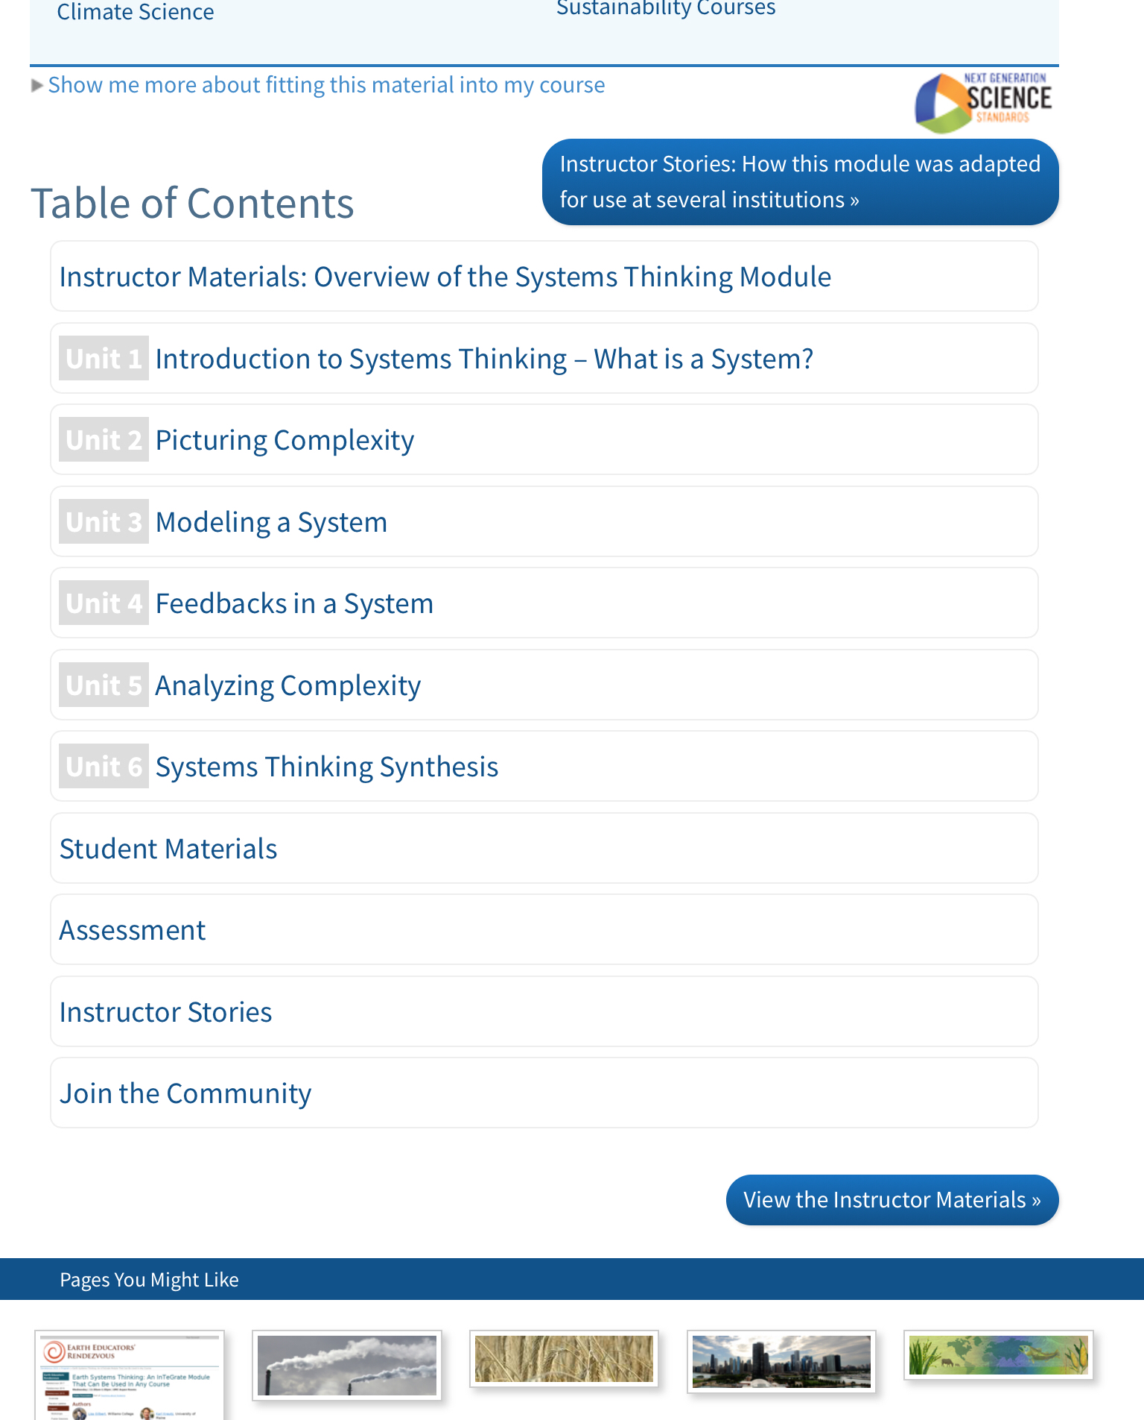
‘Systems Thinking’ Module
https://serc.carleton.edu/integrate/teaching_materials/syst_thinking/index.html

Slide 5
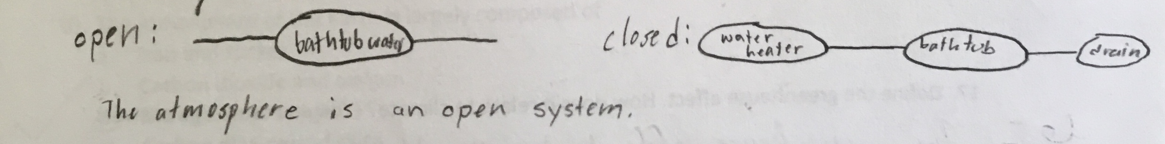
Results – Unit 1
Unit 1 = foundation to systems thinking (“What is a system?)
MN Wildfire podcast
Assessment = Pre/post survey
No changes/adjustments

Slide 6
Results – Units 2 & 3
Prompted different systems to model based on course topic
BIO152L = aquaponics
BIO110ASY = human influences on living world
GSC121 = weather and water cycle
Other adjustments made
Mainly removed quantitative portion (STELLA)
BIO152L only group asked to actually build system

Slide 7
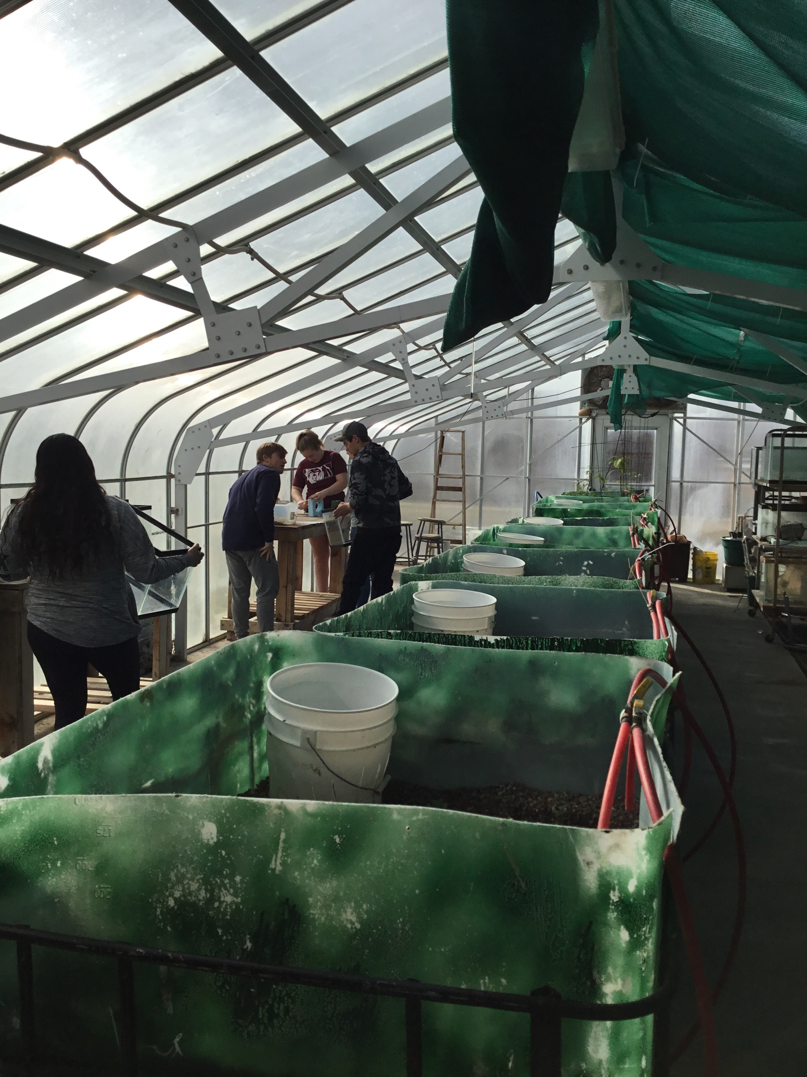
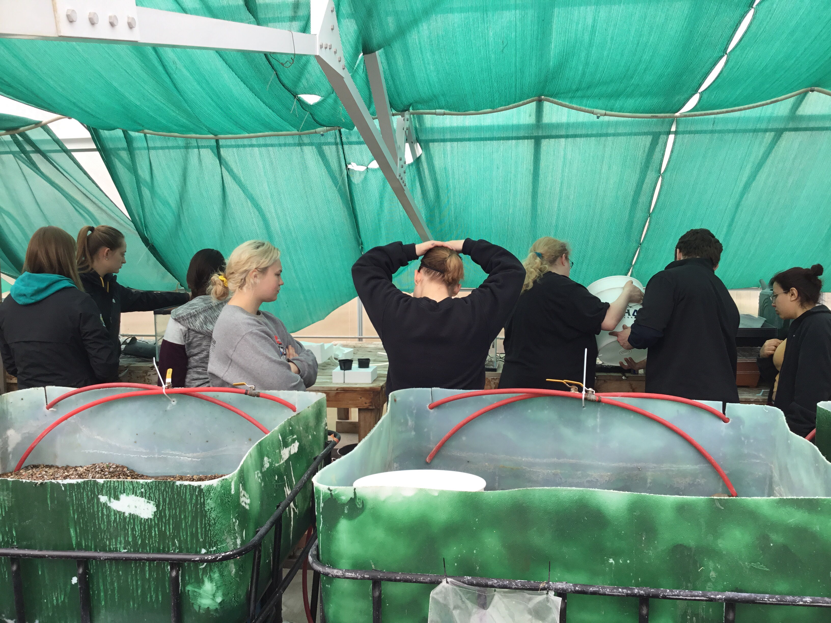

Slide 8
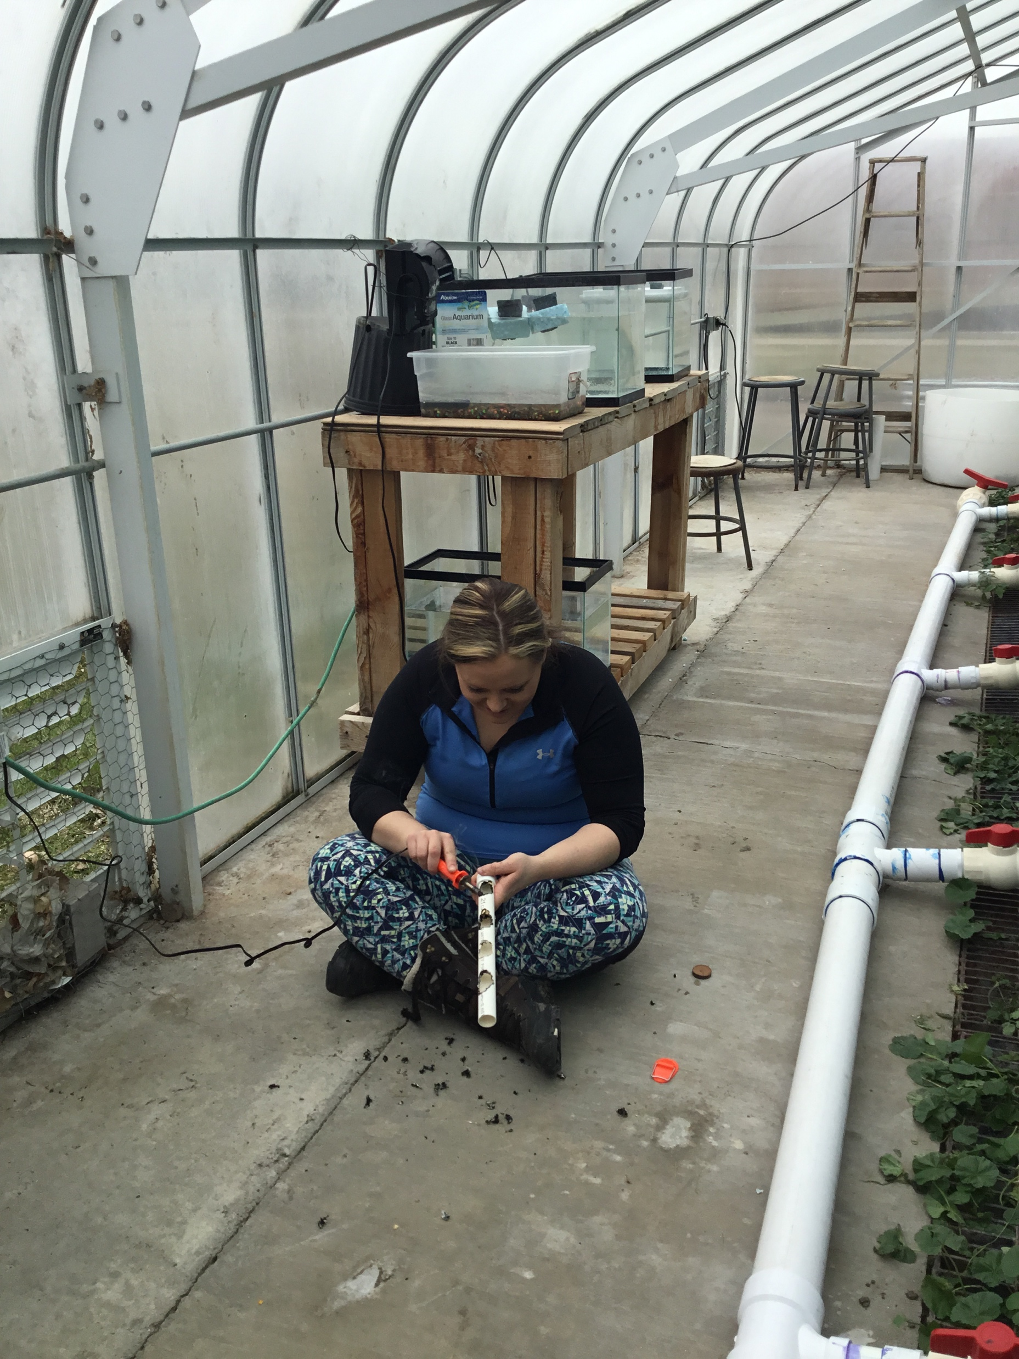
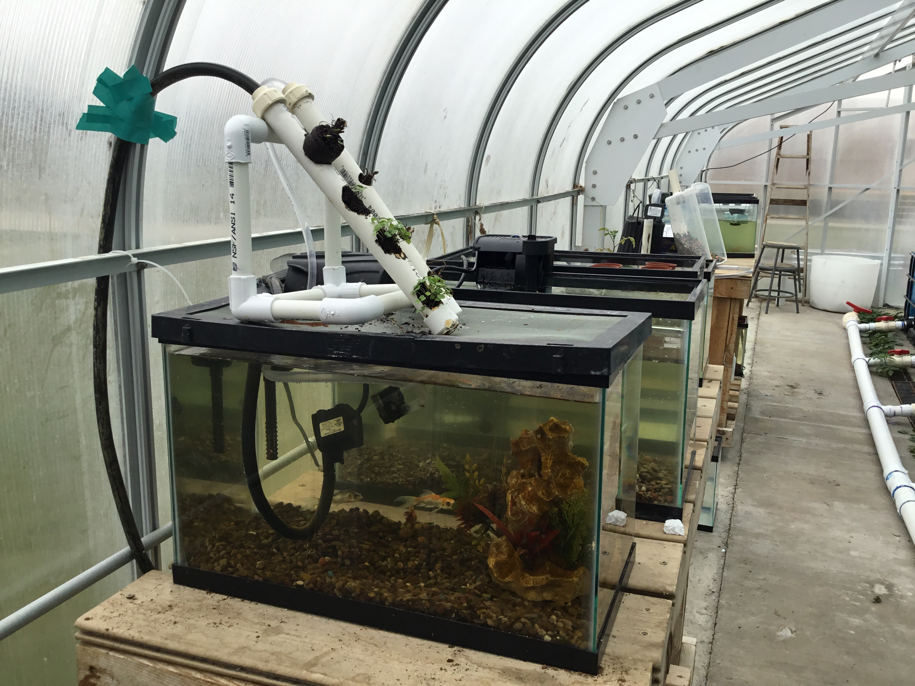

Slide 9
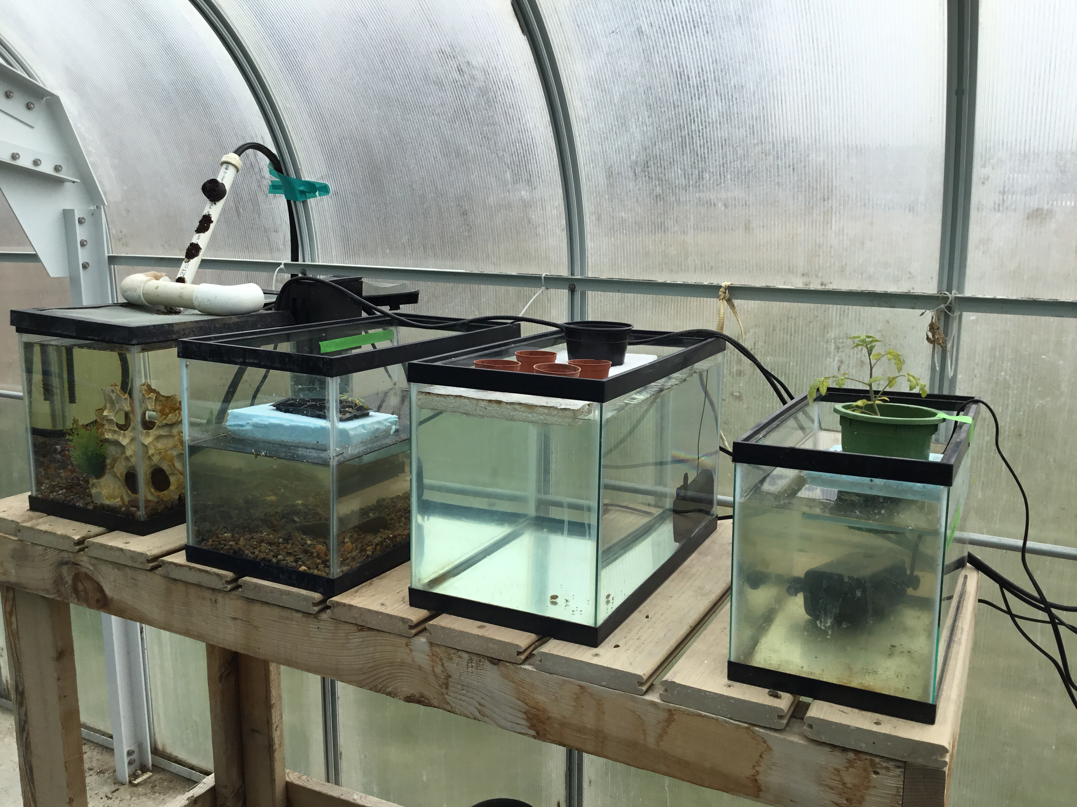
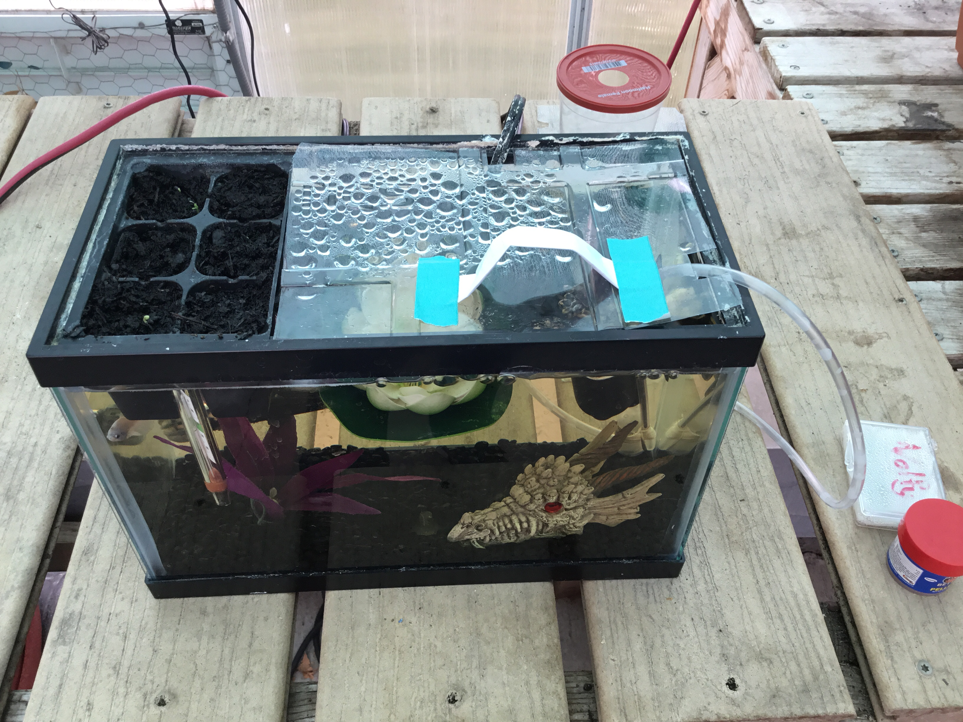

Slide 10
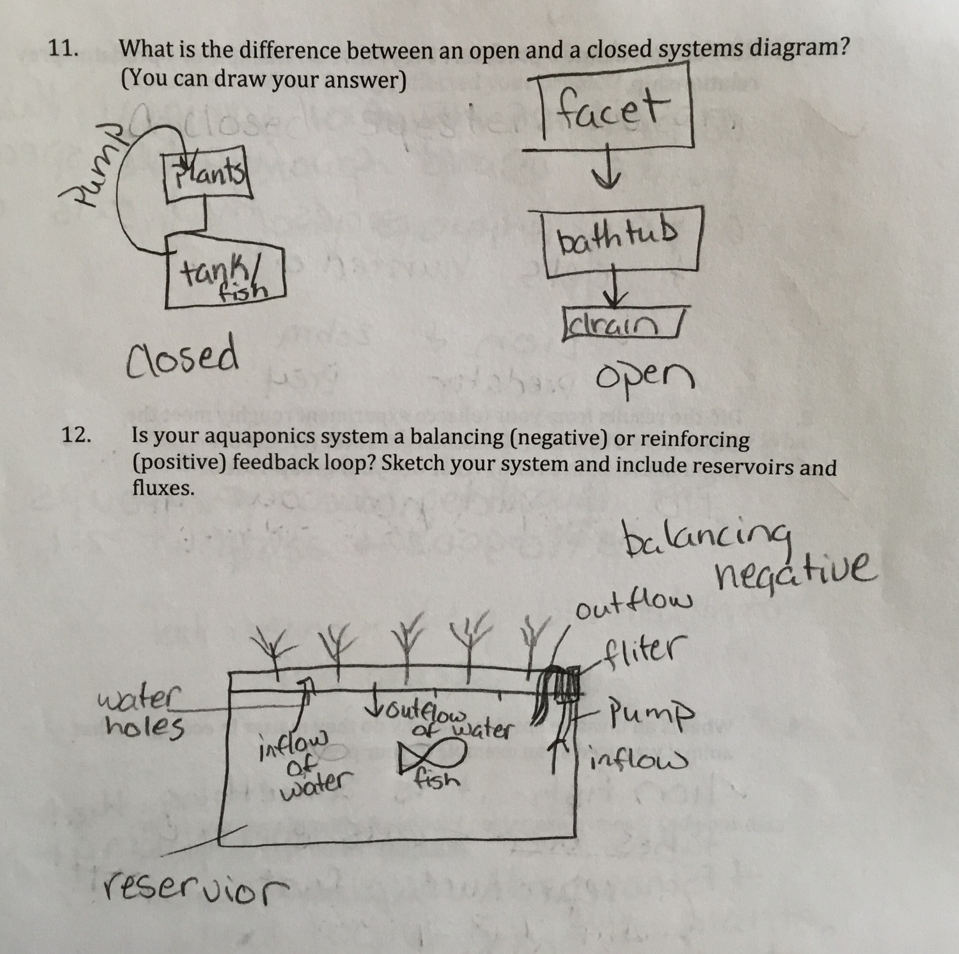
Results – Exams (BIO152L)

Slide 11
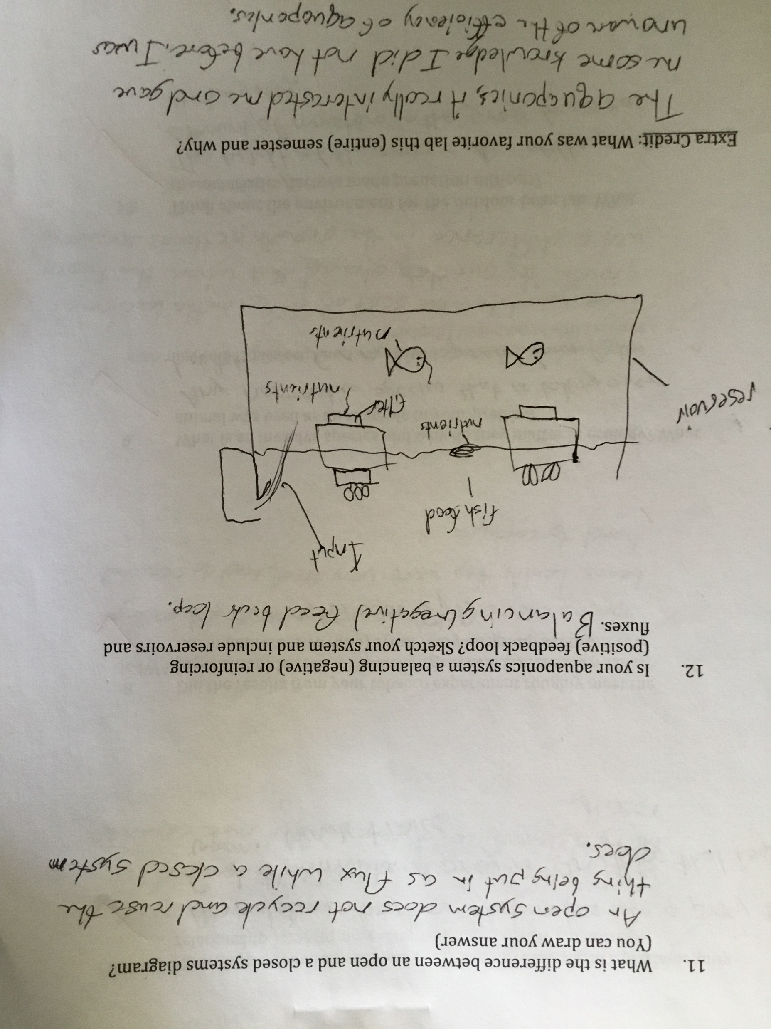
Results – Exams (BIO152L)

Slide 12
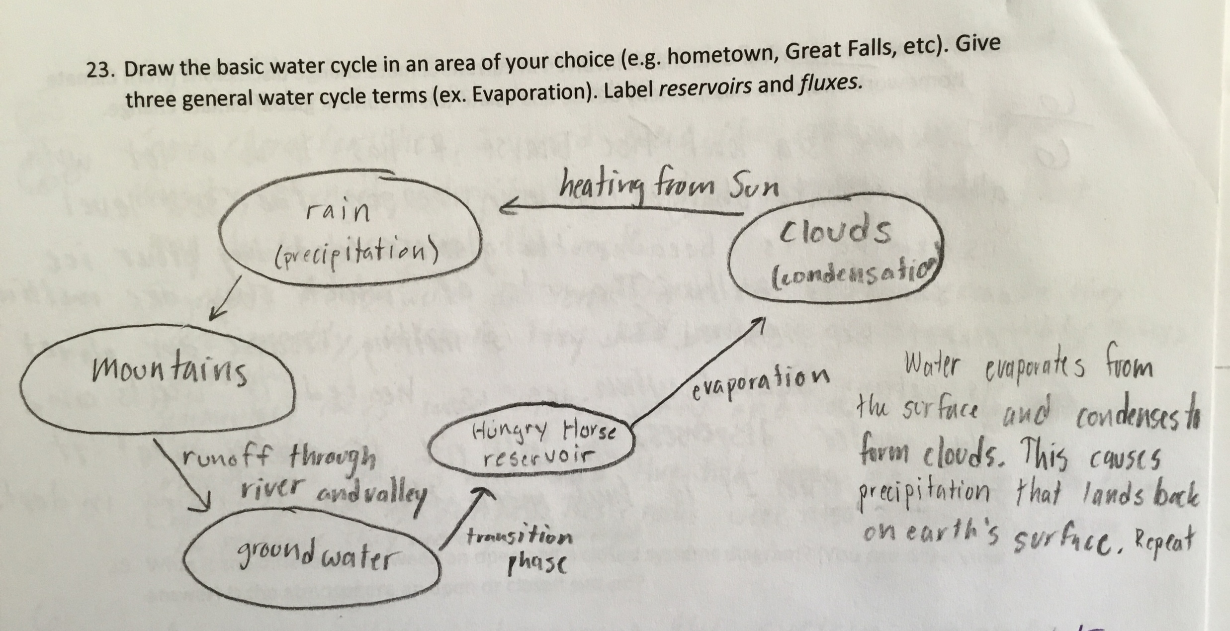
Results – Exams (GSC121)

Slide 13
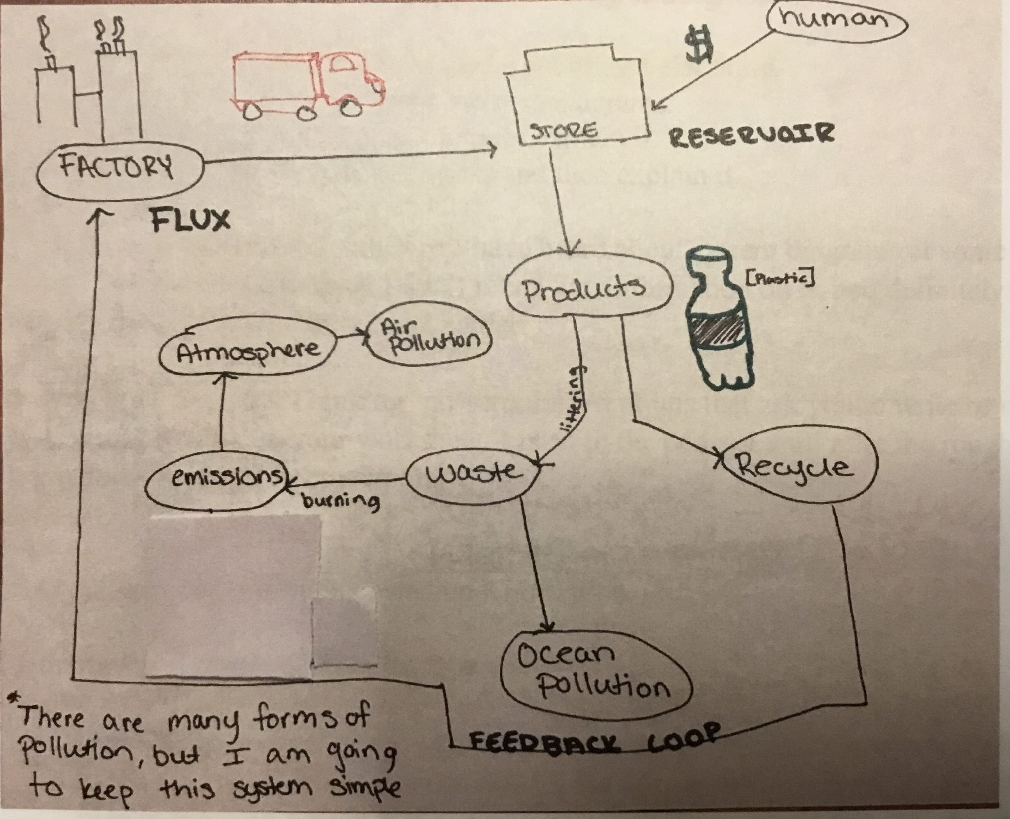
Results – BIO110ASY

Slide 14

InTeGrate FMN 2018
Assessment topics (Objectives & outcomes)
Community!
Thanks to FMN group (TJ, Stephanie, Ellen and Mike)

Slide 15
Final Thoughts
Integrate more quantitative analysis in future
Aquaponics lab activity beyond GenBio
Systems thinking and sustainability across the curriculum

Slide 16
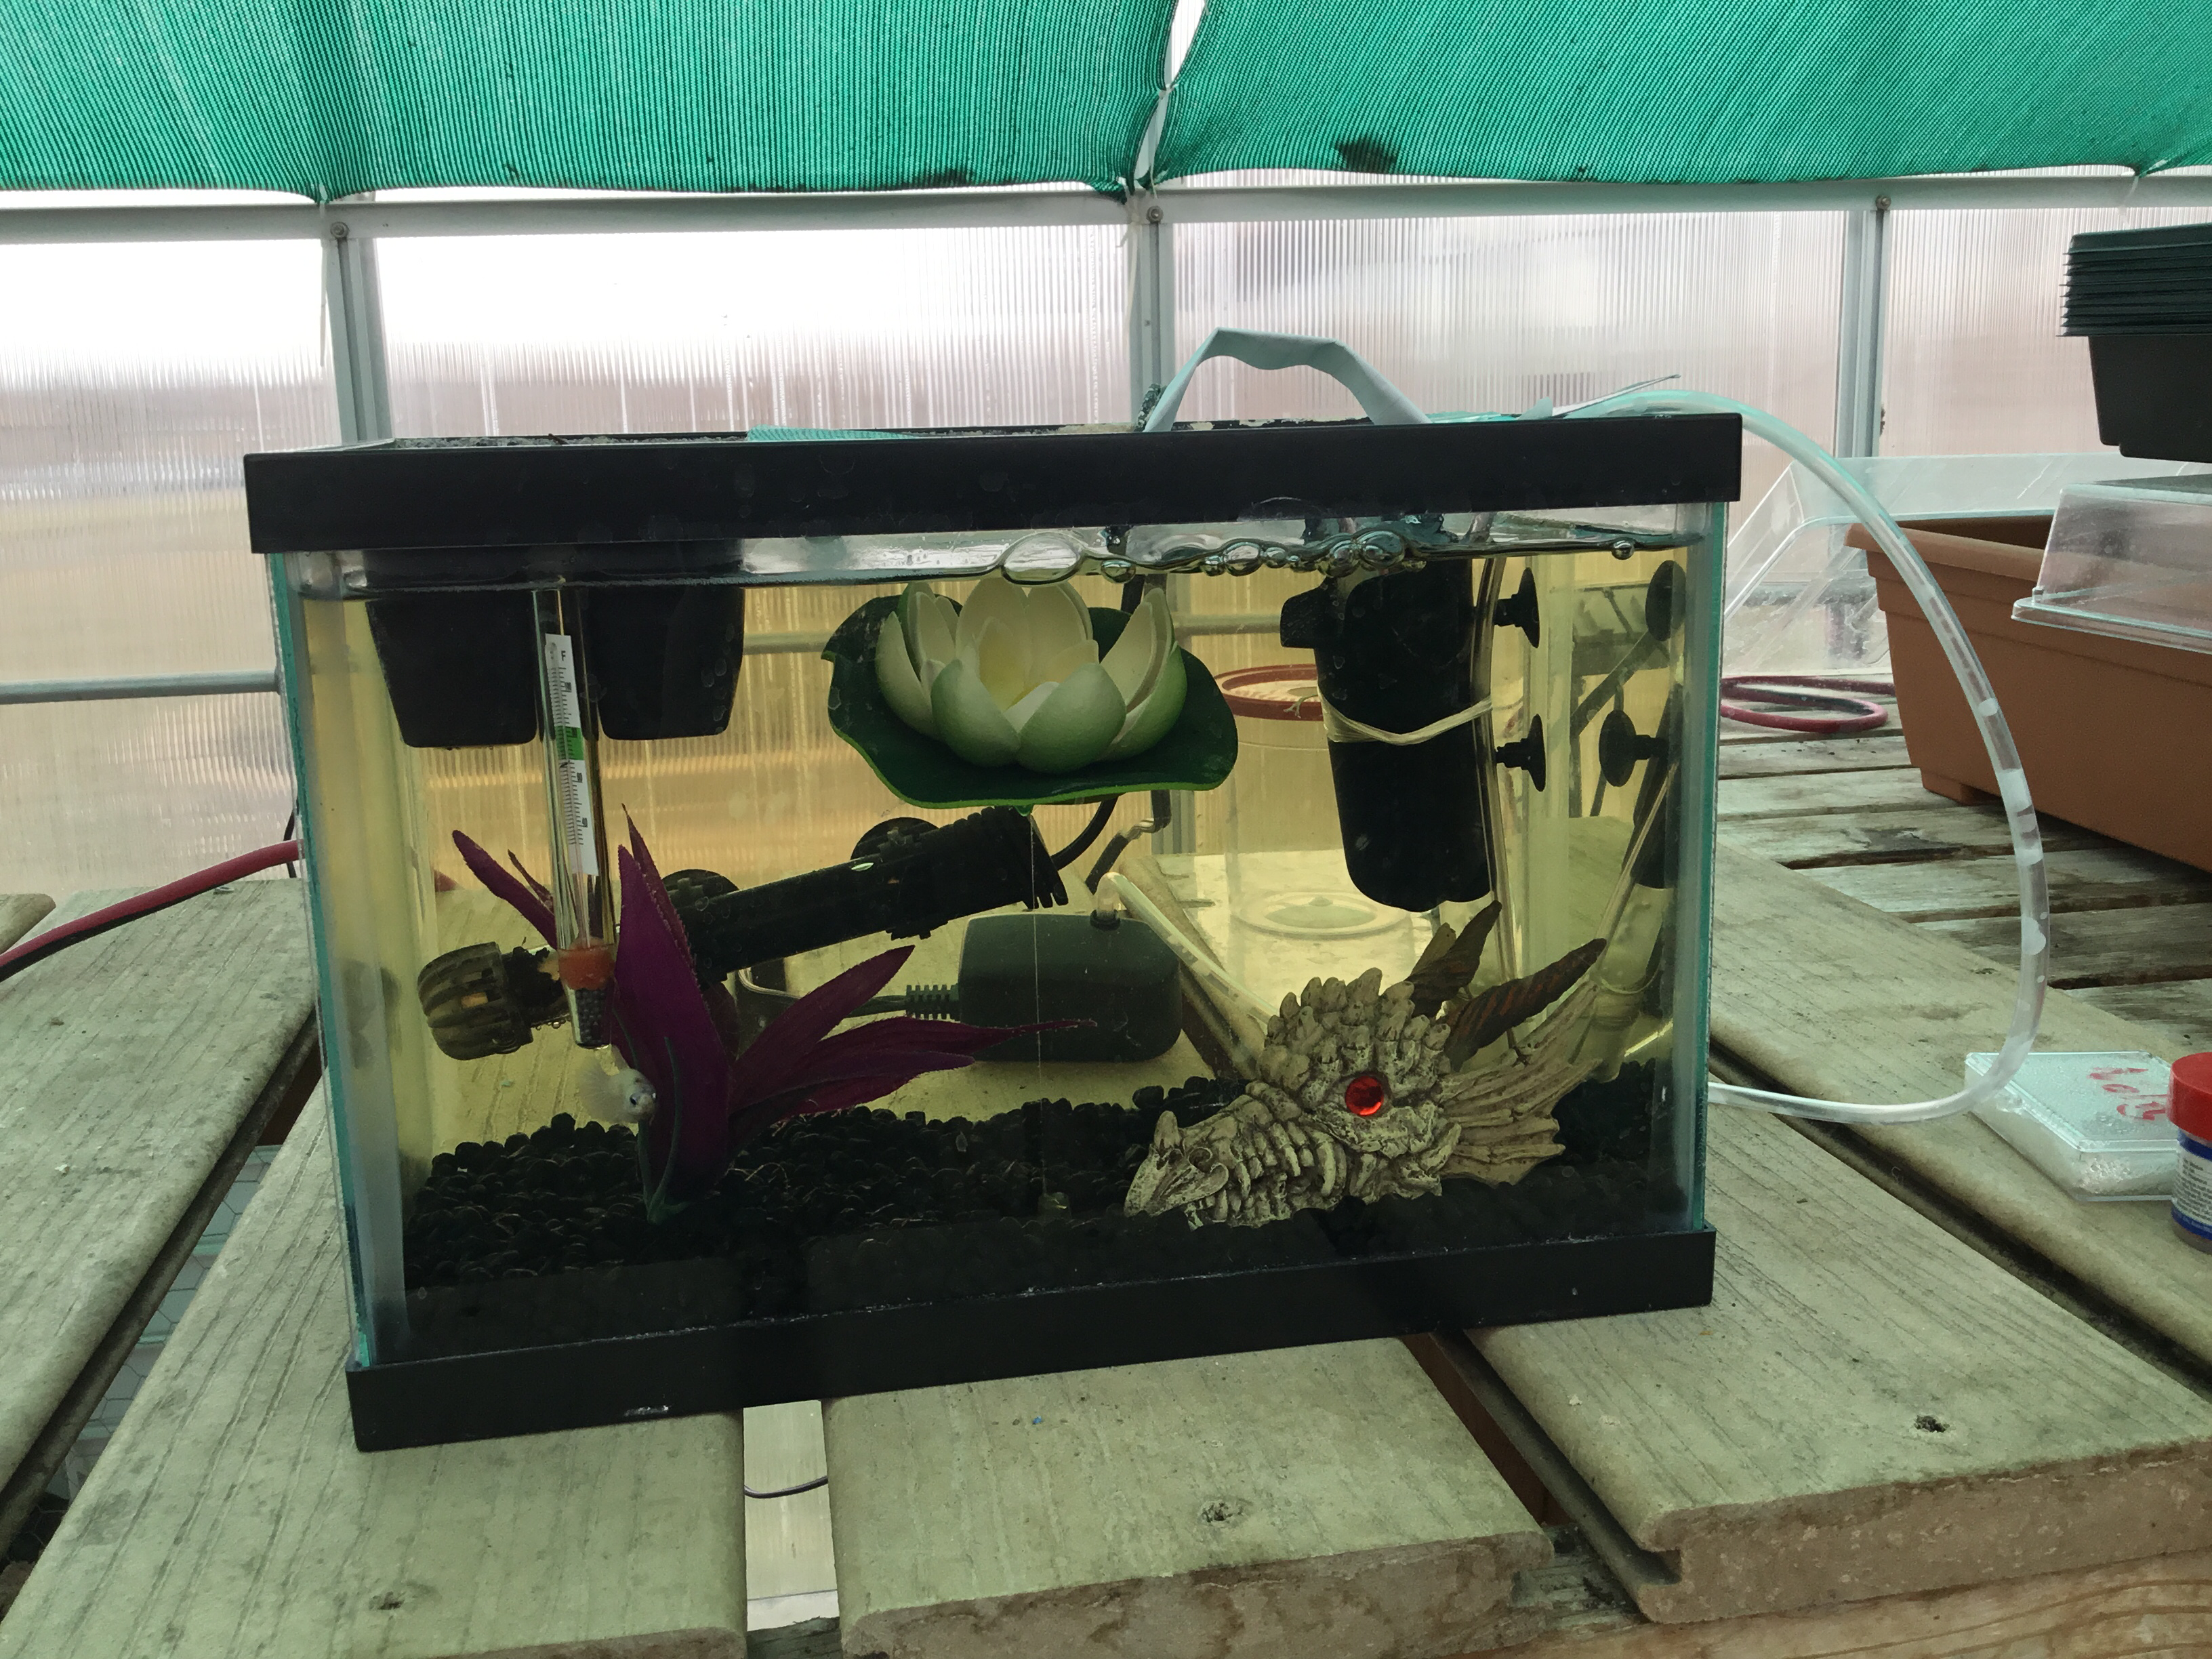
Thank you!
University of Providence
InTeGrate and QUBES
FMN 2018 team
Earth Educators Rendezvous

