Slide 1
Transforming Earth Education A Look Backward and Forward
Cathryn A Manduca
NAGT Executive Director
SERC Director

Slide 2
Sankofa. The need to look back, in order to go forward. One must look to the past, where society or one has come from, in order to know the trajectory and determine where we should go for the future.
Pan-African Approaches to Teaching Geoscience
InTeGrate HBCU Working Group Workshop
May 2017, Morehouse College, Atlanta
Notes:
A Backward and Forward – this is a form of learning that is important in traditional African culture and was identified as an important practice in Pan-African pedagogy at a workshop this year. This talk is going to look back into our history as a geoscience education community, think about how things were, and how that is different than where we are now, and use that to look forward and think about what might be important.

Slide 3
Notes:
Why do this now? I think this is an important moment in our history. The CE project which started in 2002 and of which the Rendezvous is a part has finished an important transtion. What started as a 5 year grant from the NSF to 4 Pis has fully become a community program managed by NAGT and its members and sustained through the contributions of participants, departments, professional societies and sponsors. That in my mind is a pretty big deal and a moment worthy of a look back to see where we have come and where we might be going.

Slide 4
Looking Back What was it like?
1994
2017

Slide 5
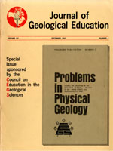
The Earth Education Community in 1967
2200 NAGT members: K-12 outnumbers undergraduate
11 active sections
JGE 6 issues, 216 pages
Descriptions of field courses including discussion of criteria for excellence in instruction and learning outcomes
Effects of environment on the learning process – interview of case study isolates 4 environmental criteria supporting learning Immersion, isolation, instructor example, training by discovery.
Scientific review articles to update content
Proptopy instructional materials using problem-oriented approaches- users asked to evaluate for quality and usefullnes, community testing in classrooms
Buying list for geology books to teachers and libraries
Strong collaborations with AAPG and AGI
1994
2017
Notes:
Community is not new – 1938 JGE, 1951
Earth Education Community is not new
Its strength and impact waxes and wanes – my understanding is the the 60s were a time of strong community work.
2200 NAGT members k-12 outnumbers undergraduate
11 active sections
JGE 6 issues, 216 pages
Descriptive field courses including discussion of criteria for excellence in instruction and learning otcomes
Effects of environment on the learning process – interview of case study isolates 4 environmental criteria supporting learning Immersion, isolation, instructor example, training by discovery.
Scientific review articles to update content
Community constructed instructional materials using problem-oriented approaches- users asked to evaluate for quality and usefullnes, community testing in classrooms
Buying list for geology books to teachers and libraries
Strong collaborations with AAPG and AGI

Slide 6
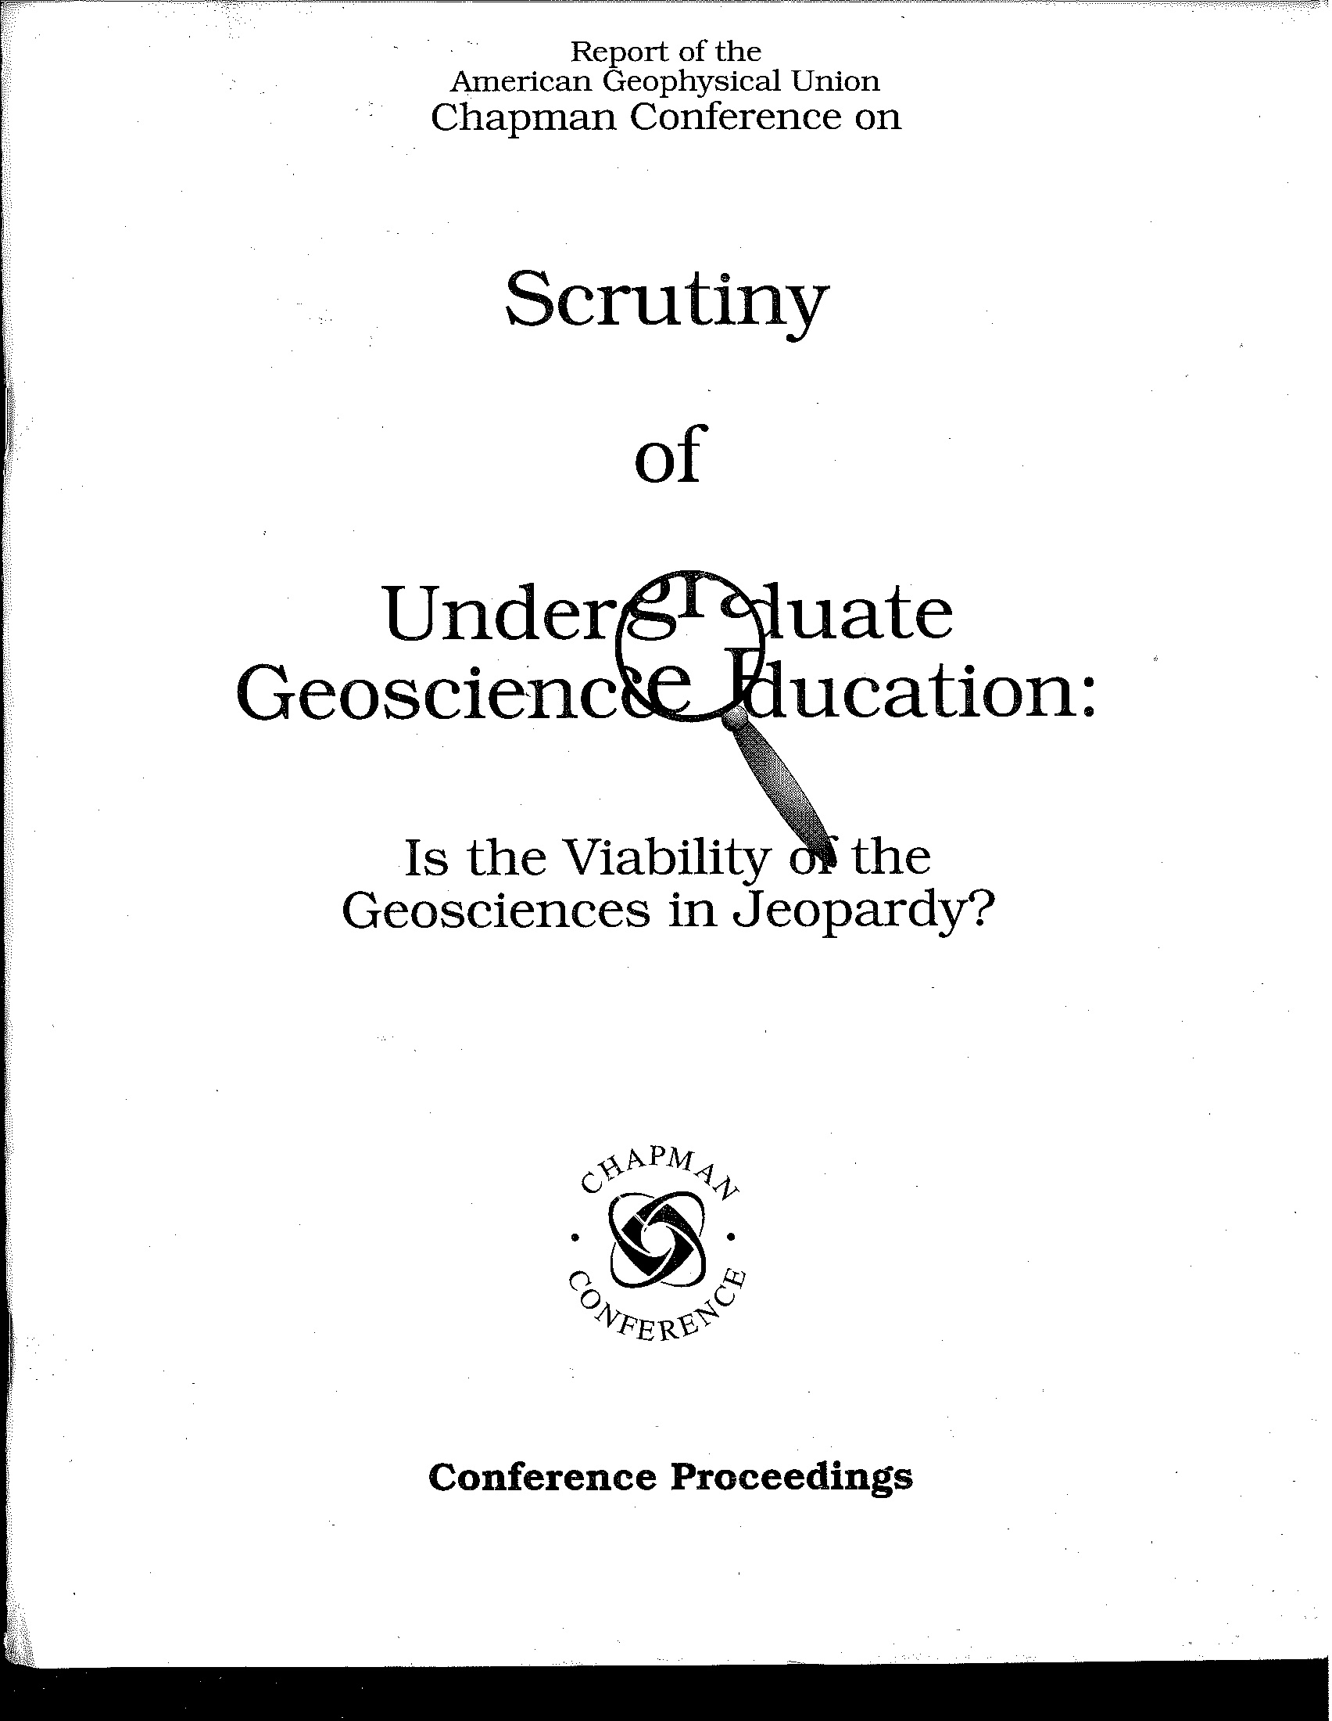
The Modern Era: 1994
Moving beyond traditional jobs (to environmental jobs)
Searching for the ultimate core curriculum
Scientific literacy for all (terminal courses)
Move beyond rote memorization
Make use of the internet
1994
2017
Notes:
130 participants - Convened by Dotty Stout, Gene Bierly and John Snow; no one on steering committee here . . .but Heather presented on career joices, and Steve Semken presented on teaching Navajo students, and Barb T presented on teaching about the geology of Africa
Moving beyond traditional jobs into environmental issues (hydrology and meteorology as practical societally relevant courses
Search for new assessments
Substantial community then – 130 participants;

Slide 7
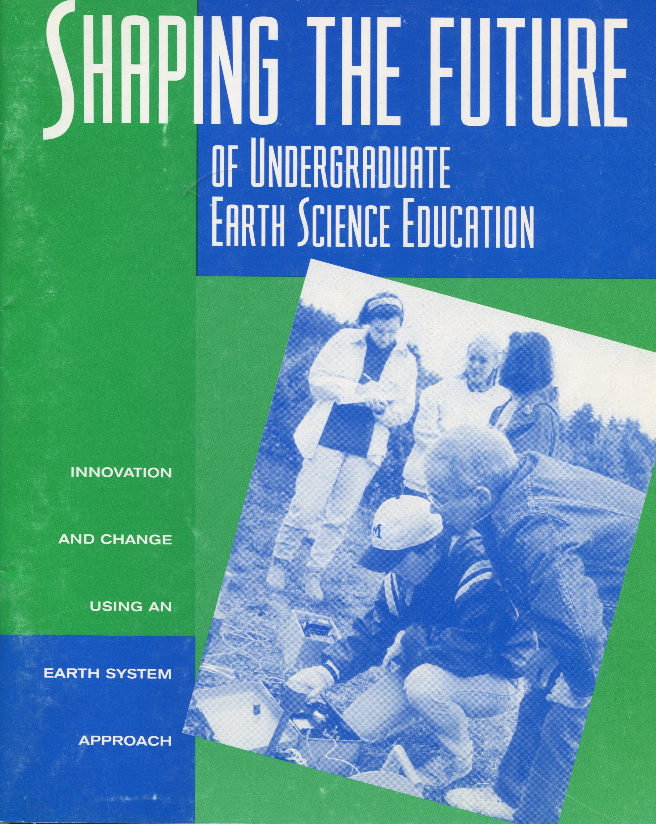
Innovation and Change Using an Earth System Approach
Coherent Earth education encompassing all disciplines
For the purpose of a scientifically literate society
Using best teaching practices based on research
1994
2017
Notes:
1996 Frank Ireton, Cathy Manduca, Dave Mogk
All of humanity impacts and is impacted by the earth system – all people have a fundamental understanding of the Earth system
Other notable events in

Slide 8
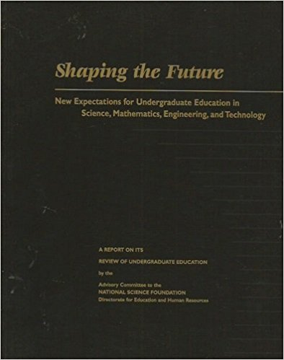


1996- A Very Big Year
Notes:
Science for all students
Earth science in the NSES -

Slide 9
As a Community What have we accomplished?
1994
2017
Notes:
These are examples

Slide 10

An Earth System Approach: From Coherent Earth Education to The Earth as a System (with people)
At the Rendezvous
Wednesday B: Conceptual Frameworks of Earth Systems: A Synthesis of Literature Addressing Student Learning of Complex Earth Systems
Wednesday A: The Wicked Problem of Food Security: Modules that Promote Interdisciplinary and Systems Thinking Using AGO
Friday Posters: Student Learning of Complex Earth Systems: A Model to Guide Development of Student Expertise in Problem Solving
Monday A: Teaching with Societally-relevant Curriculum
Theme: Implementing InTeGrate
Analyze geoscience data to make the claim that one change to Earth's surface can create feedbacks that cause changes to other Earth systems.
1994
2017
Notes:
NSES – contain Earth, Atmosphere and Ocean, cycles are studied in high school
NGSS – bio-earth system interactions in K-3, cycling and energy are in middle school and feedbacks in high school
In NGSS – Earth system is a header, and Earth and Human Activity are a separate header

Slide 11
Science for All Students
Engaged pedagogy supports better learning for most students especially students from underrepresented groups
Societally relevant framing increases enrollment and motivation to learn
Greater then 20% Classtime on student activities, questions, and discussions
Active Learning teaching strategy emphasizing small group discussion or think pair share, whole group discussion and in classe activities
Manduca et al., 2017. Improving undergraduate STEM education: The efficacy of discipline-based professional development. Science Advances
1994
2017
Notes:
Most important improvement is better pedagogy
Second is making it relevant
What is trend? ~30 years to 100%

Slide 12
Welcoming and Supporting All
2004: ~8%
2012: ~11%
Data from: http://www.nsf.gov/statistics/2015/nsf15311/start.cfm
Compiled by Susanne O’Connell (2016) for NAS Service-Learning in Undergraduate Geosciences Workshop
http://sites.nationalacademies.org/cs/groups/dbassesite/documents/webpage/dbasse
1994
2017
Notes:
50 years to 50 percent

Slide 13
Strengthening Geoscience Programs
Building Strong Departments Visioning Workshops (2004-2008
First Heads and Chairs Meeting at AGU (1997)
Traveling Workshop Program Initiated (2009)
AGU-AGI Heads and Chairs Webinars (2012)
Summit Activities Begin (2014)
InTeGrate Models Published(2017)
1994
2017
Notes:
Summit results?

Slide 14
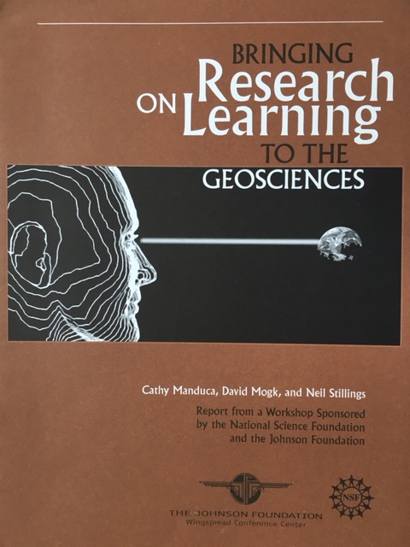
Geoscience Education Research Understanding What is Working (or Not)
29 Papers in Past Year
4 Papers in 1994
1 Paper in 1967
1994
1994
2017
Notes:
Add books, GER most recent report, JGE? Division?

Slide 15
As a Community What have we accoplished? Has the community been important?
1994
2017
Notes:
These are examples

Slide 16
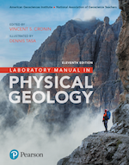
The Power of Working Together
Is Not New
Notes:
Not new – should have Integrate out here but hard to photograph

Slide 17
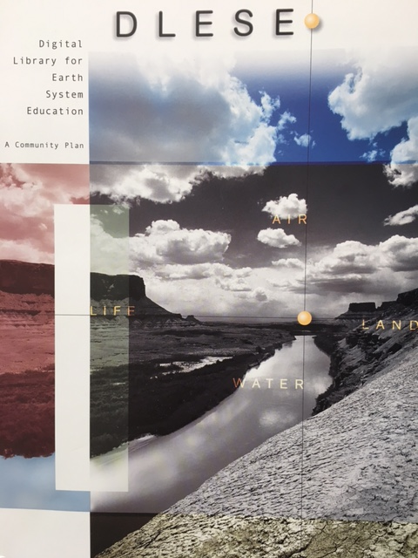
Building Together
A shared community vision for a virtual community center spanning k-12, higher ed and informal
Distributed network built as a community effort
An active outreach effort to engage the broadest participation in building and using
1994
2017

Slide 19
A Community Supporting Improved Teaching
Improved Teaching
A geoscience education community that learns from one another and from experts
Faculty make an informed responses to specific teaching circumstances
Sharing of Innovation
1994
2017
Notes:
What supports improvements in teaching?

Slide 20
Improving Teaching
Observations and Analysis by Cutting Edge Classroom Observation Project
Manduca et al., 2017. Improving undergraduate STEM education: The efficacy of discipline-based professional development. Science Advances

Slide 21
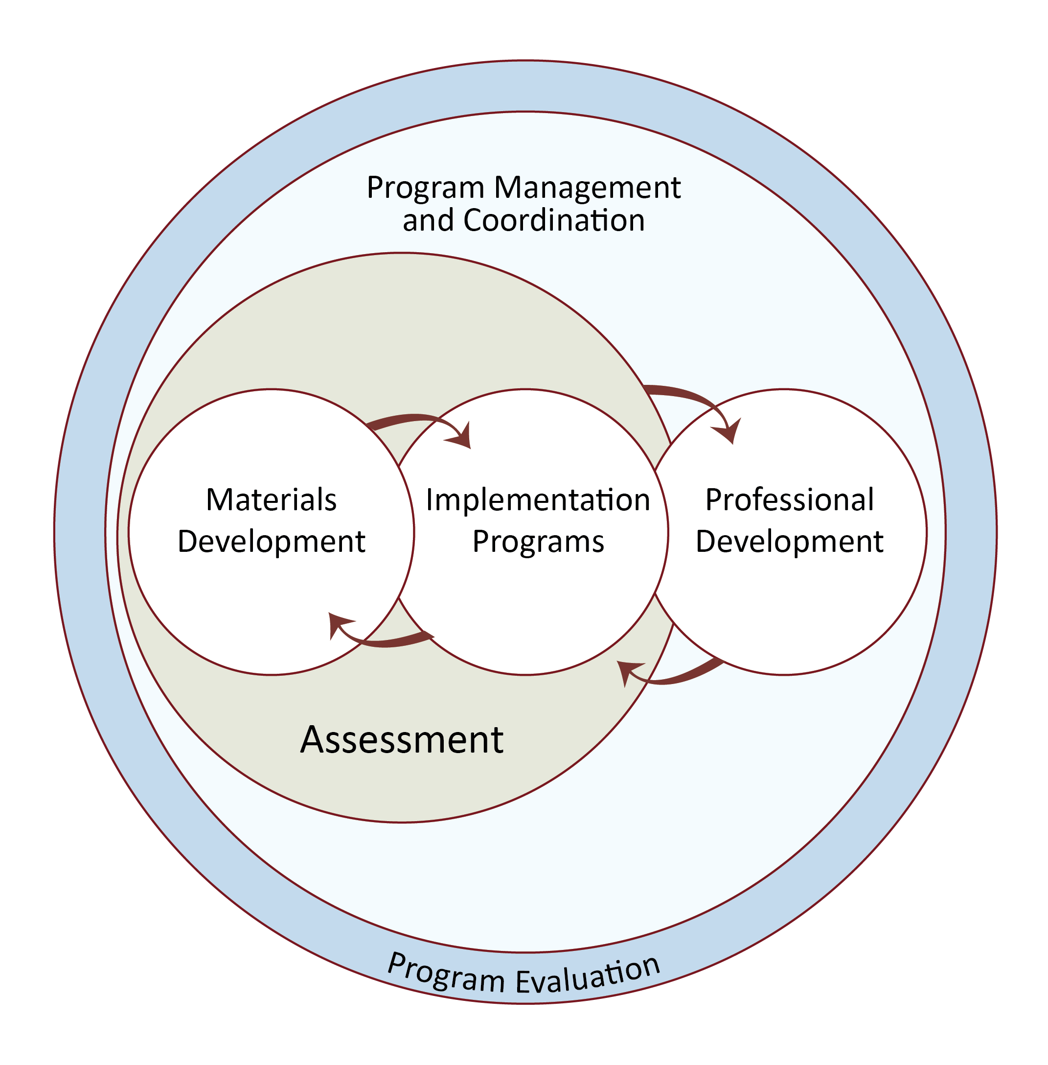
A Systems Approach
Developing and testing Materials together
Courses
Programs/
Institutions
Community/
Network
1994
2017
Notes:
How many of you are familiar with InTeGrate? (skim if lots)
The InTeGrate project is an NSF STEP Center [STEM Talent Expansion Program] that supports the teaching of geoscience in the context of societal issues both within geoscience courses and across the undergraduate curriculum. The program itself operates at a number of interacting scales with flows and interdependencies, like a system. Describe circle diagram.
Today I’m going to be talking about this middle piece here – the implementation programs.

Slide 22
Systems thinking is improving via InTeGrate
Control group (N=173)demonstrates SIGNIFICANTLY LESS systems thinking than predicted by their post-instruction GLE score
InTeGrate students (N=360)are demonstrating systems thinking in proportion to their post-instruction GLE score
Lisa Gilbert in prep
Based on Integrate student data collection effort

Slide 24
Is the Earth Education Community Thriving?
1994
2017
Notes:
These are examples

Slide 25
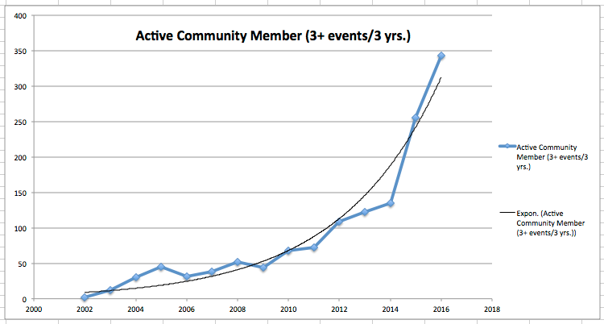
An Exponentially Growing Community
Kastens and Manduca, submitted, Leveraging the power of Community of Practice
to Improve Teaching and Learning about the Earth, Change.

Slide 26
Community Owned and Operated –
Comprehensive Geoscience Faculty Development
Notes:
Unique Across Disciplines Comprehensive PD program
Comprehensive
Designed and managed to serve community in its entiretly -- NAGT

Slide 27
What makes our community work?
– in my humble opinion
Valuable outcomes for individual and community
Open to all - participation by application
Learning together – respect for what everyone brings, model of peer interaction/instruction
Respectful of time – not skipping meetings, turning up on time, designed to make maximum progress, coming prepared
Building together- products that help the individual and the collective (new ideas, new skills, new opportunities for leadership, research, publication)
Fun!!- field trips, lunches and dinners, dancing
Drawing powerful people and ideas – from inside and out, success breeds success
Strong infrastructure and funding

Slide 28
Transforming Earth Education A Look Backward
An Earth System Approach
Improved Pedagogy
More Inclusive
Community has been Important
1994
2017
Notes:
These are examples

Slide 29
Transforming Earth Education A Look Forward
1994
2017
Notes:
These are examples

Slide 30
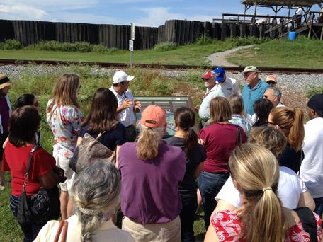
Caring for Our Community is important
It has to be tended to stay inclusive and productive
Notes:
Inclusive
Productive
It has waxed and waned

Slide 31
Transforming Earth Education A Look Forward What makes our work important?
Education is the foundation of democracy
(and geoscience workforce)
1994
2017
Notes:
Provocative ☺ Something to talk about at dinner.

Slide 33
Earth Education Must be Inclusive and Equitable
High Impact Practices/Engaged Pedagogy
Mentoring/Advising/Signposting
Sense of Belonging
Free from Favoritism
Of Obvious and Immediate Value to Student
Notes:
58 percent of respondents believe colleges put their own long-term interests first instead of those of their students.

Slide 34
What makes our work important?
Living successfully and sustainably on the Earth
1994
2017
Notes:
Successful
Building roads that don’t flood when it rains
Not building in high risk areas

Slide 35

Living Successfully Requires both Science and Community Literacy
USGS Landslide Hazard Fact Sheet

Slide 36
From Educating to Helping Our Communities Solve Problems
Civic Engagement
1994
2017

Slide 37
From Educating to Helping Our Communities Solve Problems
Engaging in community problem solving through class and research
Connecting across multiple levels

Slide 38
Transforming Earth Education A Look Backward and Forward
1994
2017
Notes:
Part of a long and proud history of Earth education
Long and productive tradition of working as a community
Provocative thoughts about what is needed to keep that community productive and growing
And some ideas on the importance of the work you are engaged in, its urgency, and some things to think about regarding what is important in the years ahead

