Slide 1
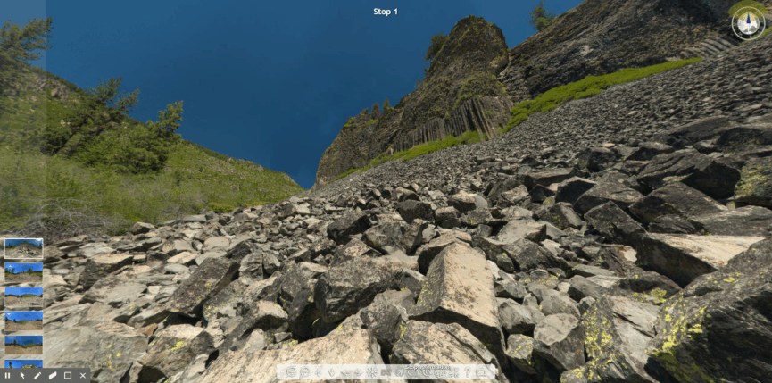
Ryan J Hollister Turlock High Geoscience & AP EnviroSci Science Friday Educator Collaborator
Embark on a 360-Degree Immersive Virtual Field Experience

Slide 2
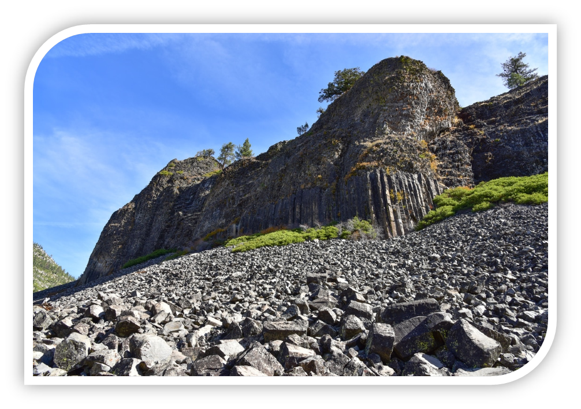
Session Overview
5 Minutes
Intro/What/Why/How of an Immersive Virtual Field Experience
10 Minutes
Playing Around Experiential Learning with IVFE at the Columns of the Giants.
5 Minutes
Student Results
Participant Reactions/ Takeaways.

Slide 3
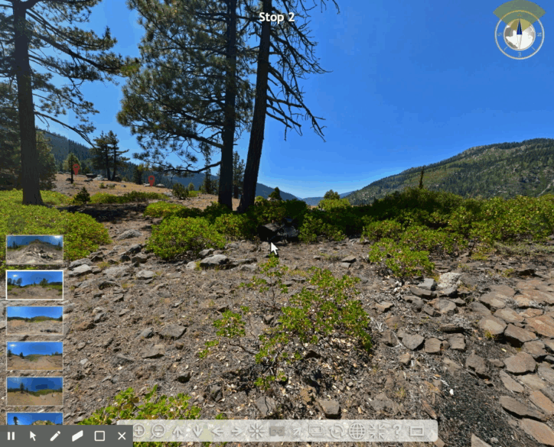
What is an IVFE ? (Immersive Virtual Field Experience)
IVFE is my attempt at creating an authentic field experience using high resolution 360-degree photospheres and photogrammetric 3D models of rock samples. (See postscript for more details)
High resolution and VR capability allows for authentic student discovery and field sketches.
Students have ultra-zoom capability in photospheres and the ability to “pick-up” and manipulate rock samples from the field.
IVFE Questions are designed to facilitate discovery while pointing students to resources that can answer their questions.

Slide 4
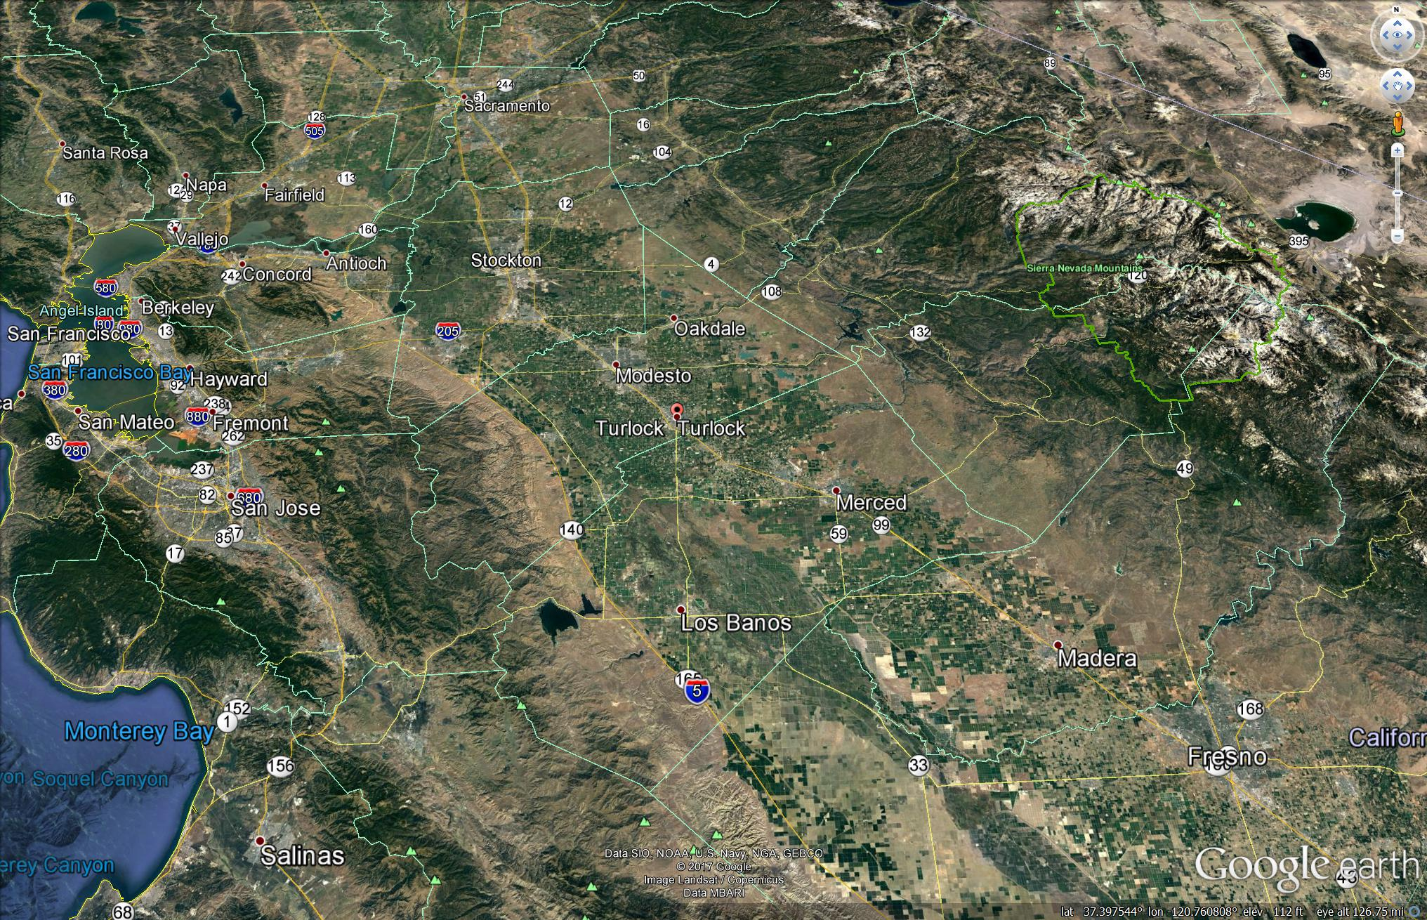
Why an IVFE ?
Students need relevant, place-based experiences to make their learning meaningful.
Many of my students have never been to the Sierras or the Pacific.
Field Experiences are financially and logistically impractical for large high school classes.
IVFE allows students of all physical abilities and demographics to experience authentic scientific field work.
2hr Driving Distance from Turlock

Slide 5
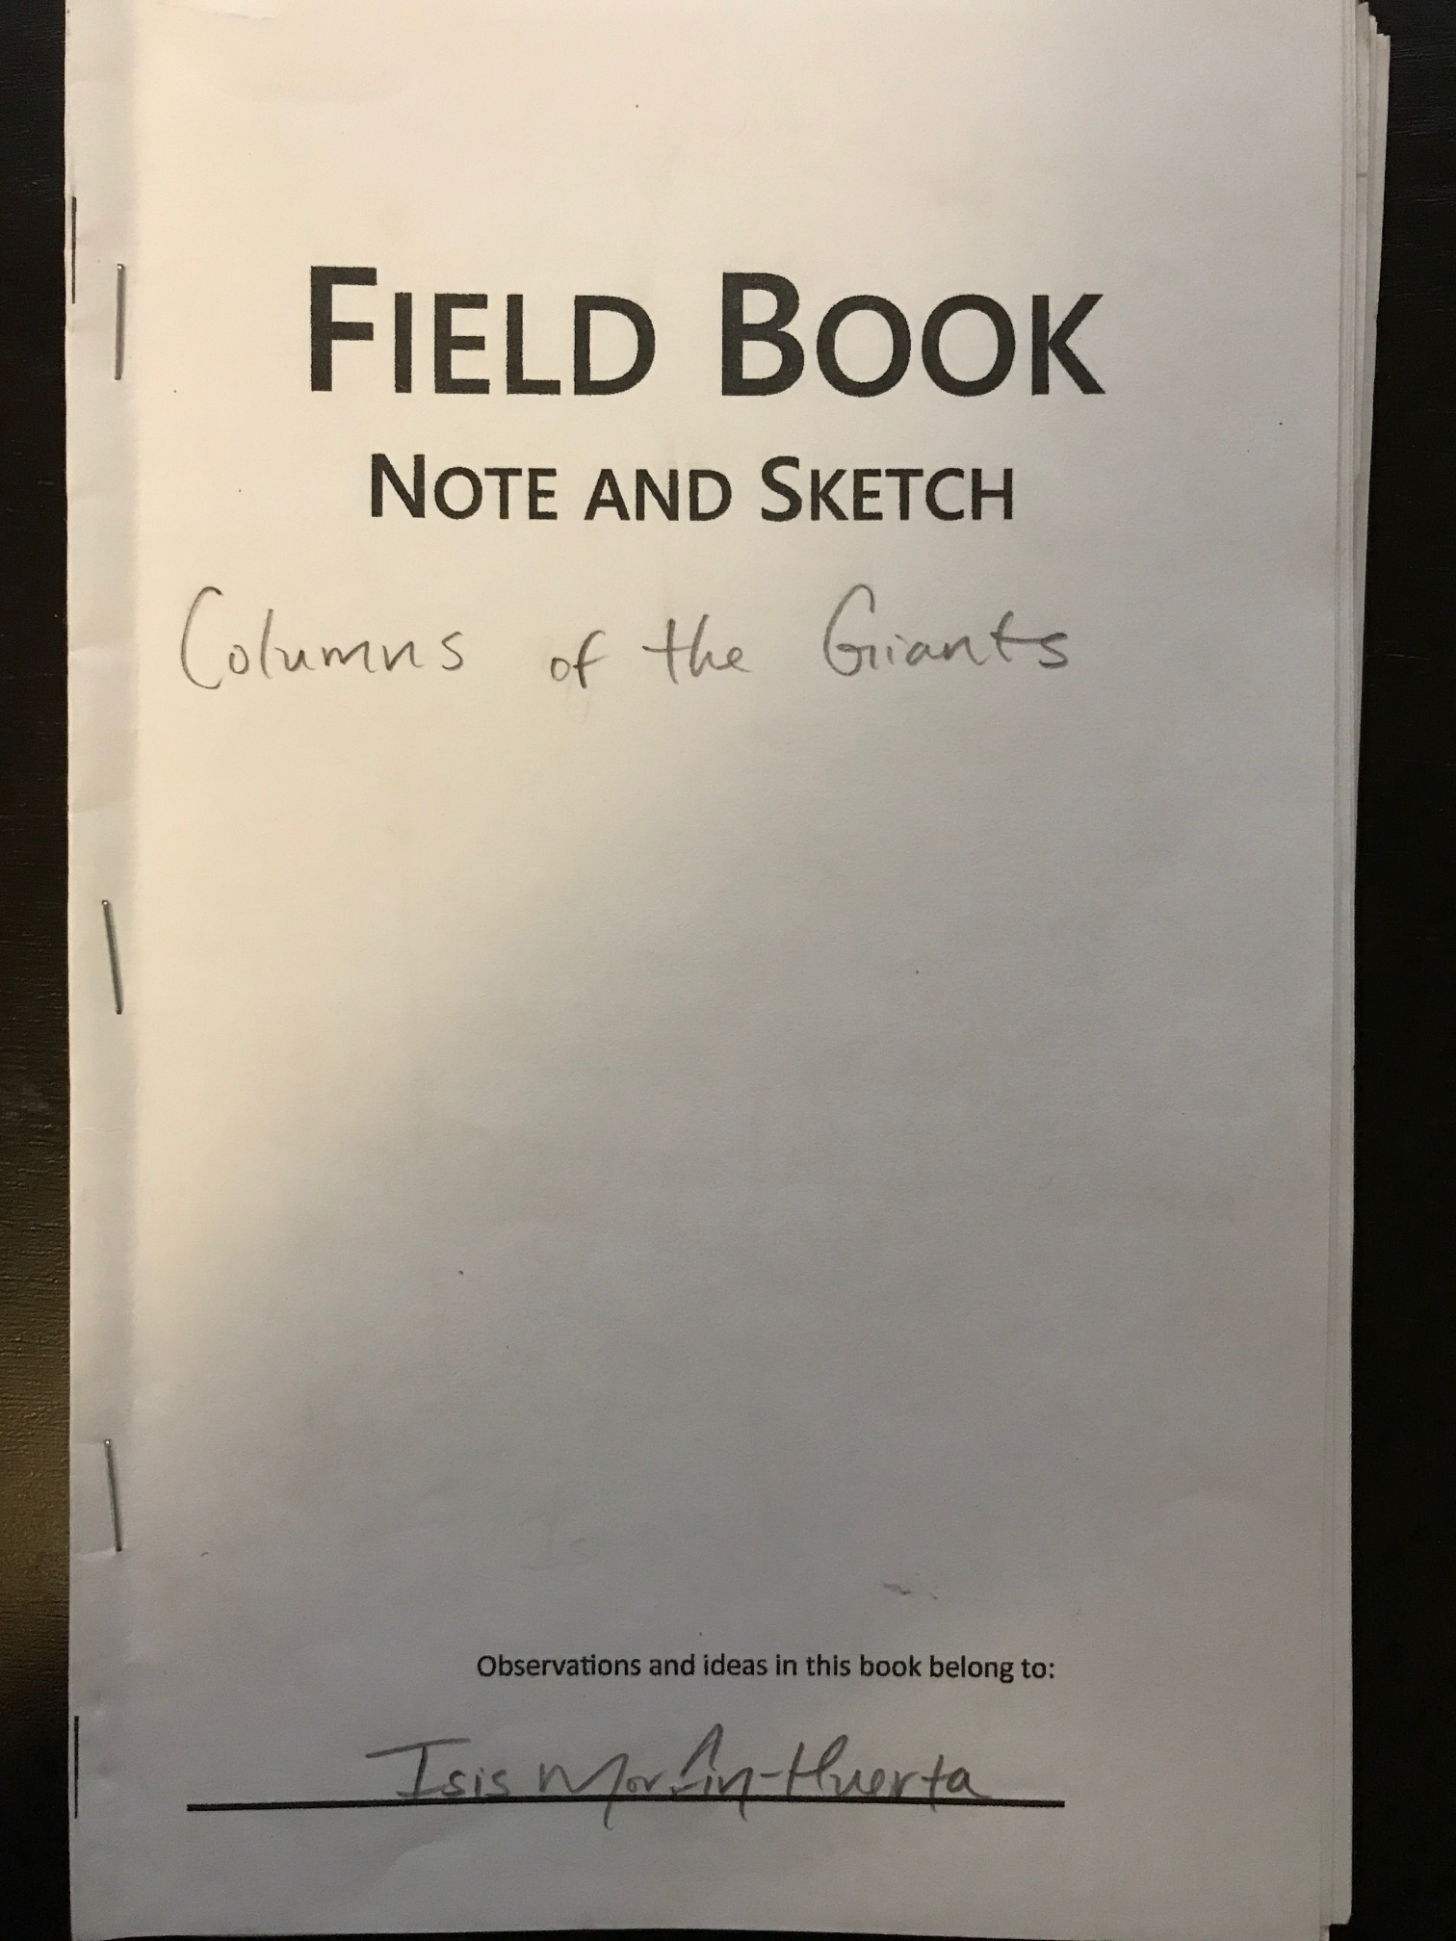

The Student Task (Completed over five, 54-minute periods)
Students will explore the six nonannotated “Stops” to make sketches and note observations they think are geologically interesting or useful.
Students will partake in small group and large group scientific discourse to make claims using evidence and reasoning.
Students will use their data to synthesize a geologic story that explains the formation of the Columns of the Giants.
Students will apply their new geology skills and knowledge to interpret the origins of landscapes across the world (and perhaps even out of this world).

Slide 6
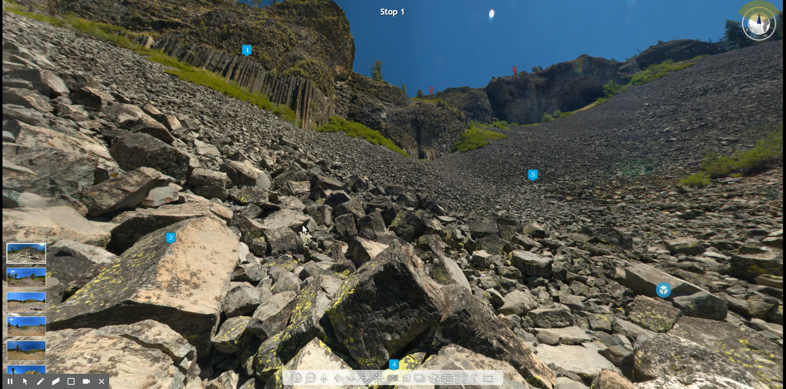
How to Navigate my IVFE

Slide 7
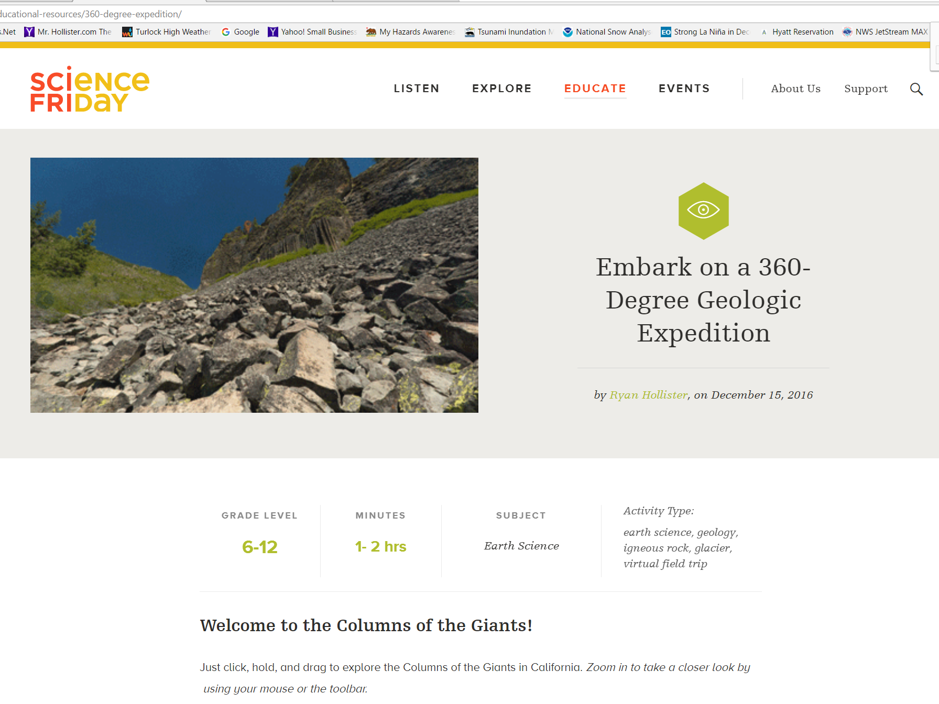
10 Minutes for Experiential Learning (Take it for a test-drive!)
http://www.sciencefriday.com/photosphere

Slide 8
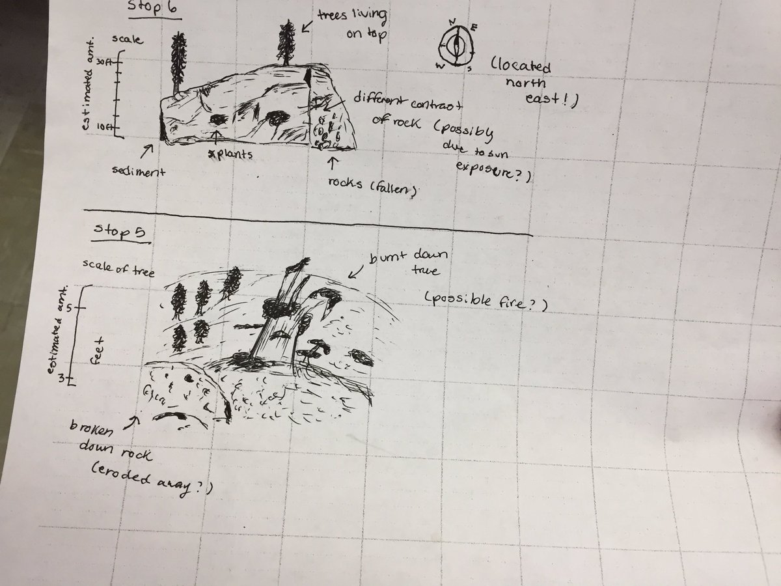
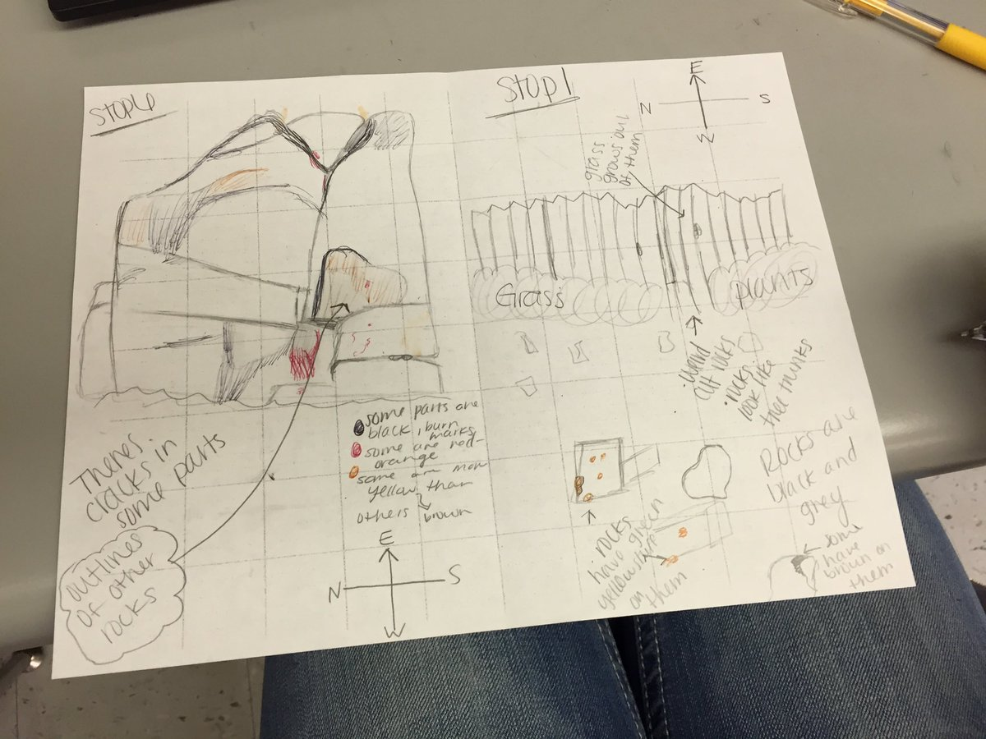
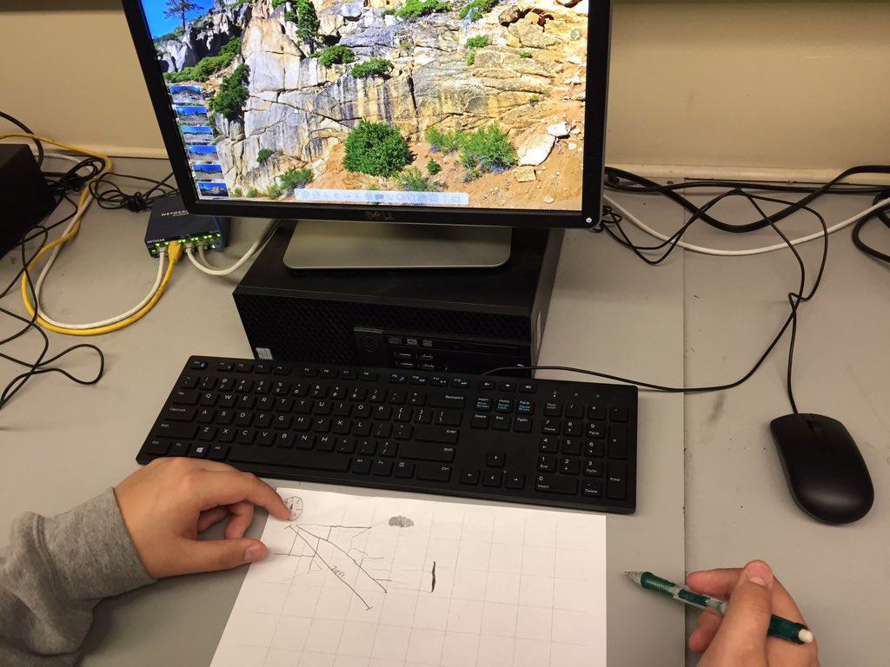
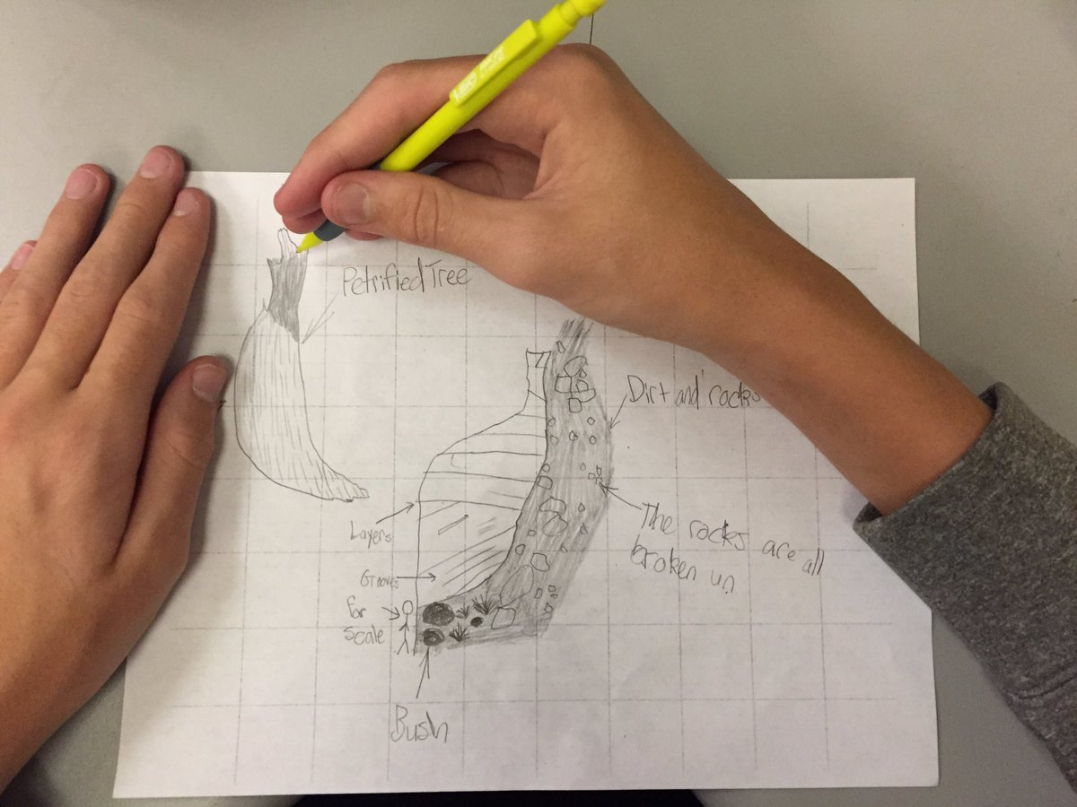
Educational Outcomes

Slide 9
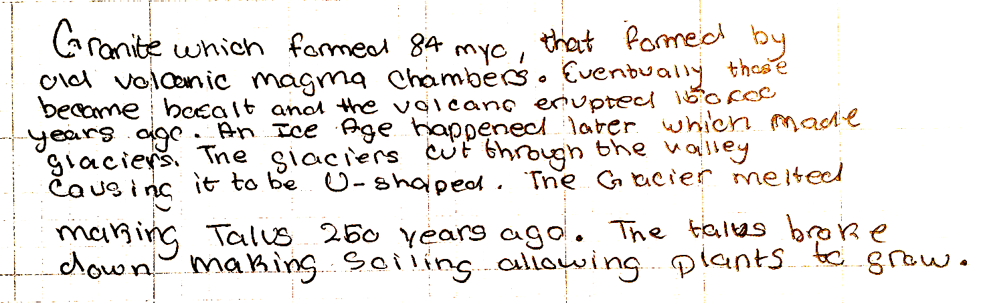
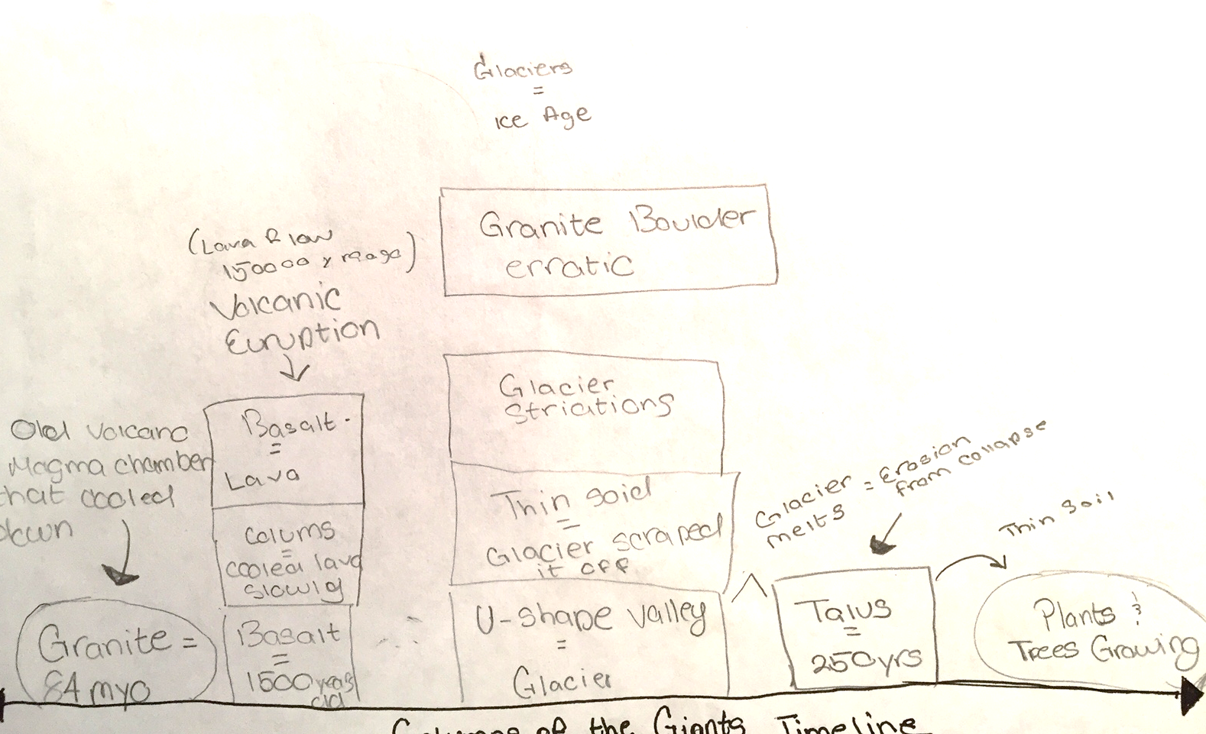
Educational Outcomes

Slide 10
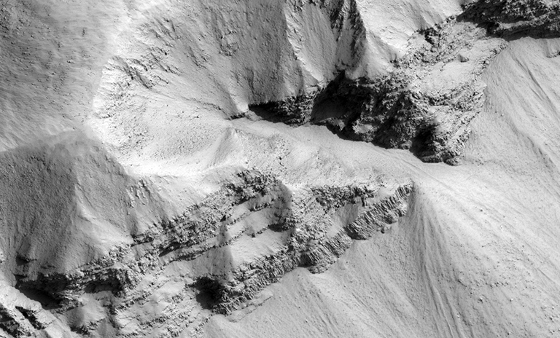
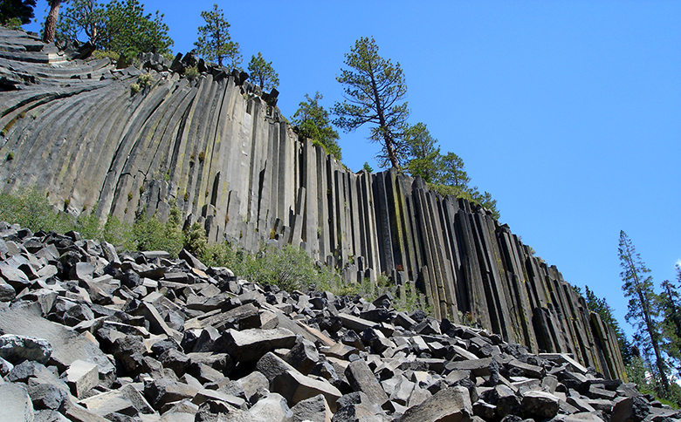
Application of New Knowledge

Slide 11
Questions?
?

