Slide 1
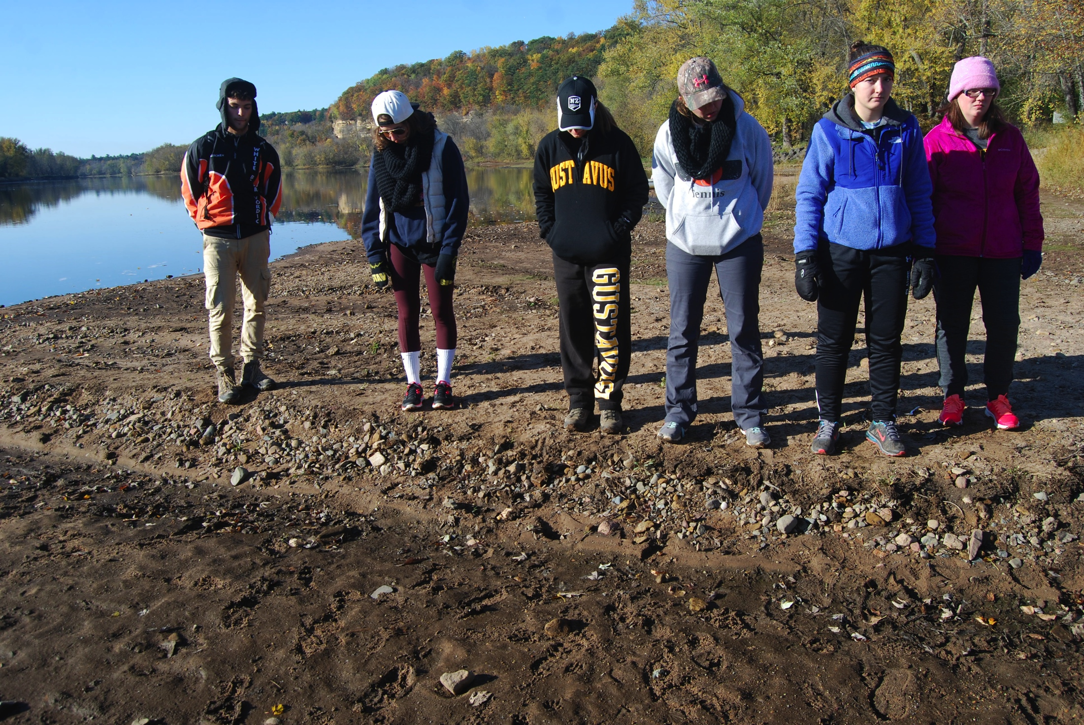
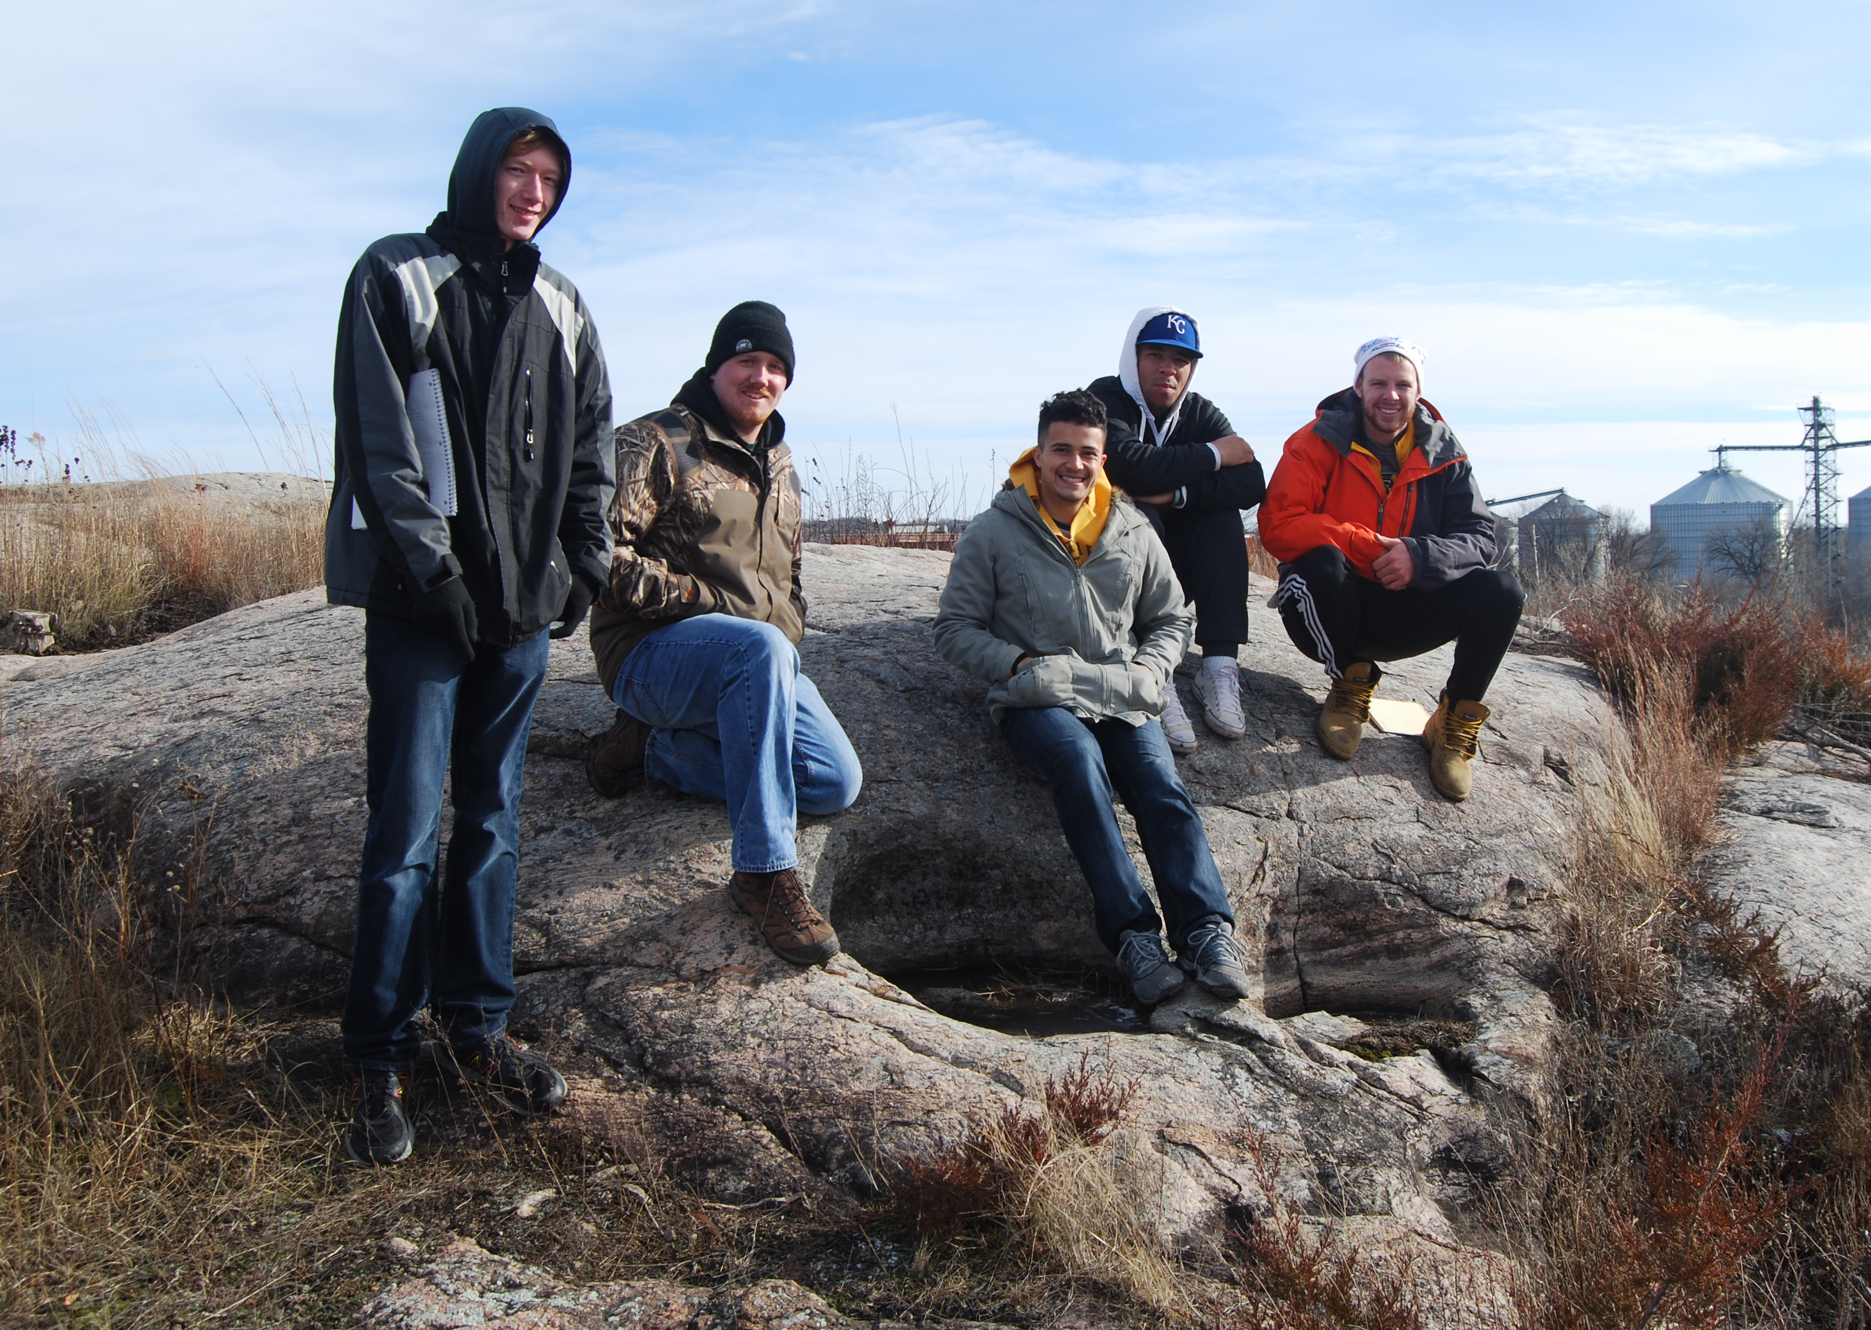



Empowering the Student Voice in Place-Based Geoscience Education: From Field Trips to Case Studies
Sadredin Moosavi, Gustavus Adolphus College, RCTC
Sherry Oaks, University of Colorado
Julie Bartley, Gustavus Adolphus College

Slide 2
“I have a Dream Today…” Imagine the Perfect World for Geoscience Learning

Slide 3
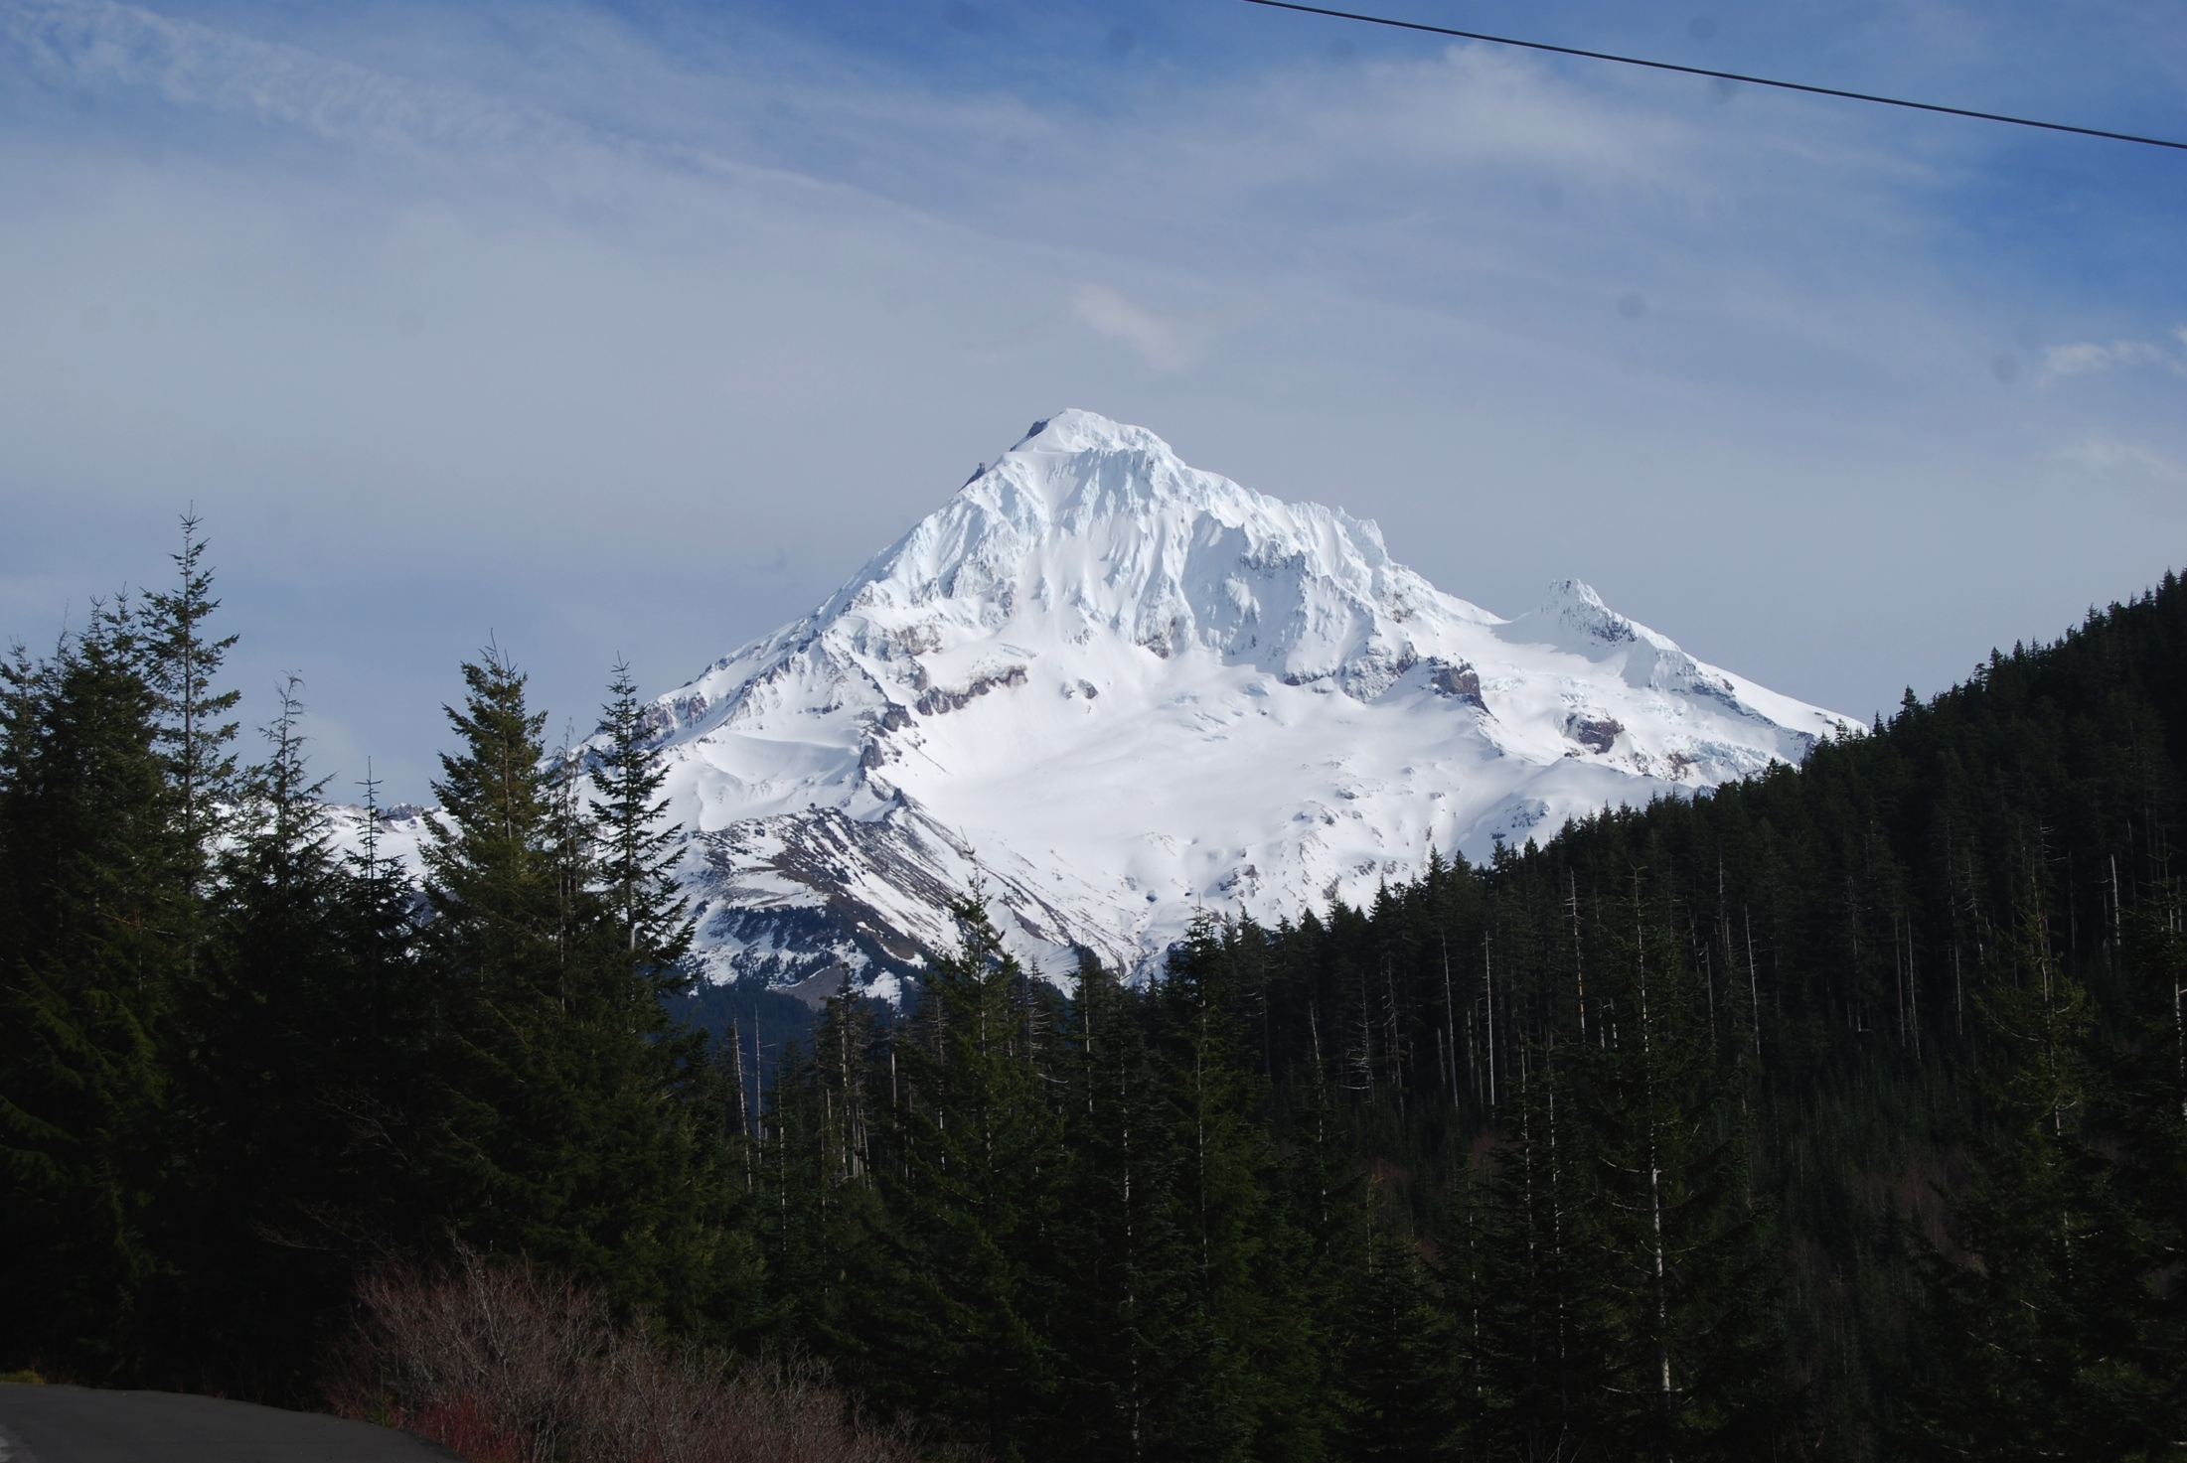
“I have a Dream Today…” Imagine the Perfect World for Geoscience Learning
Accessible Geologically Interesting Places

Slide 4

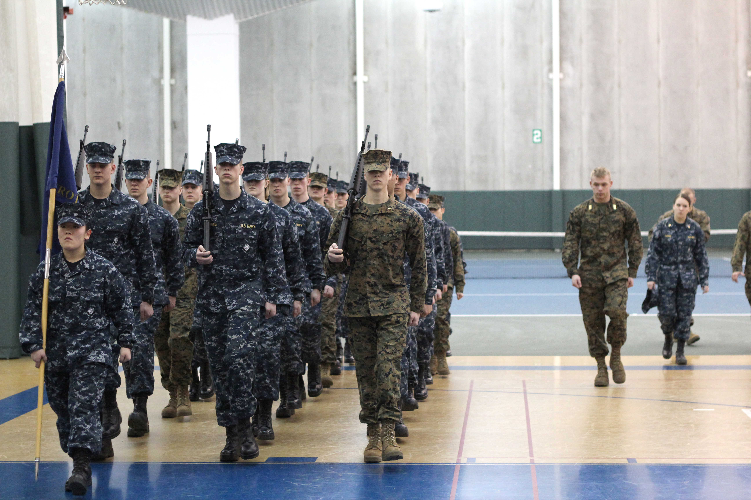


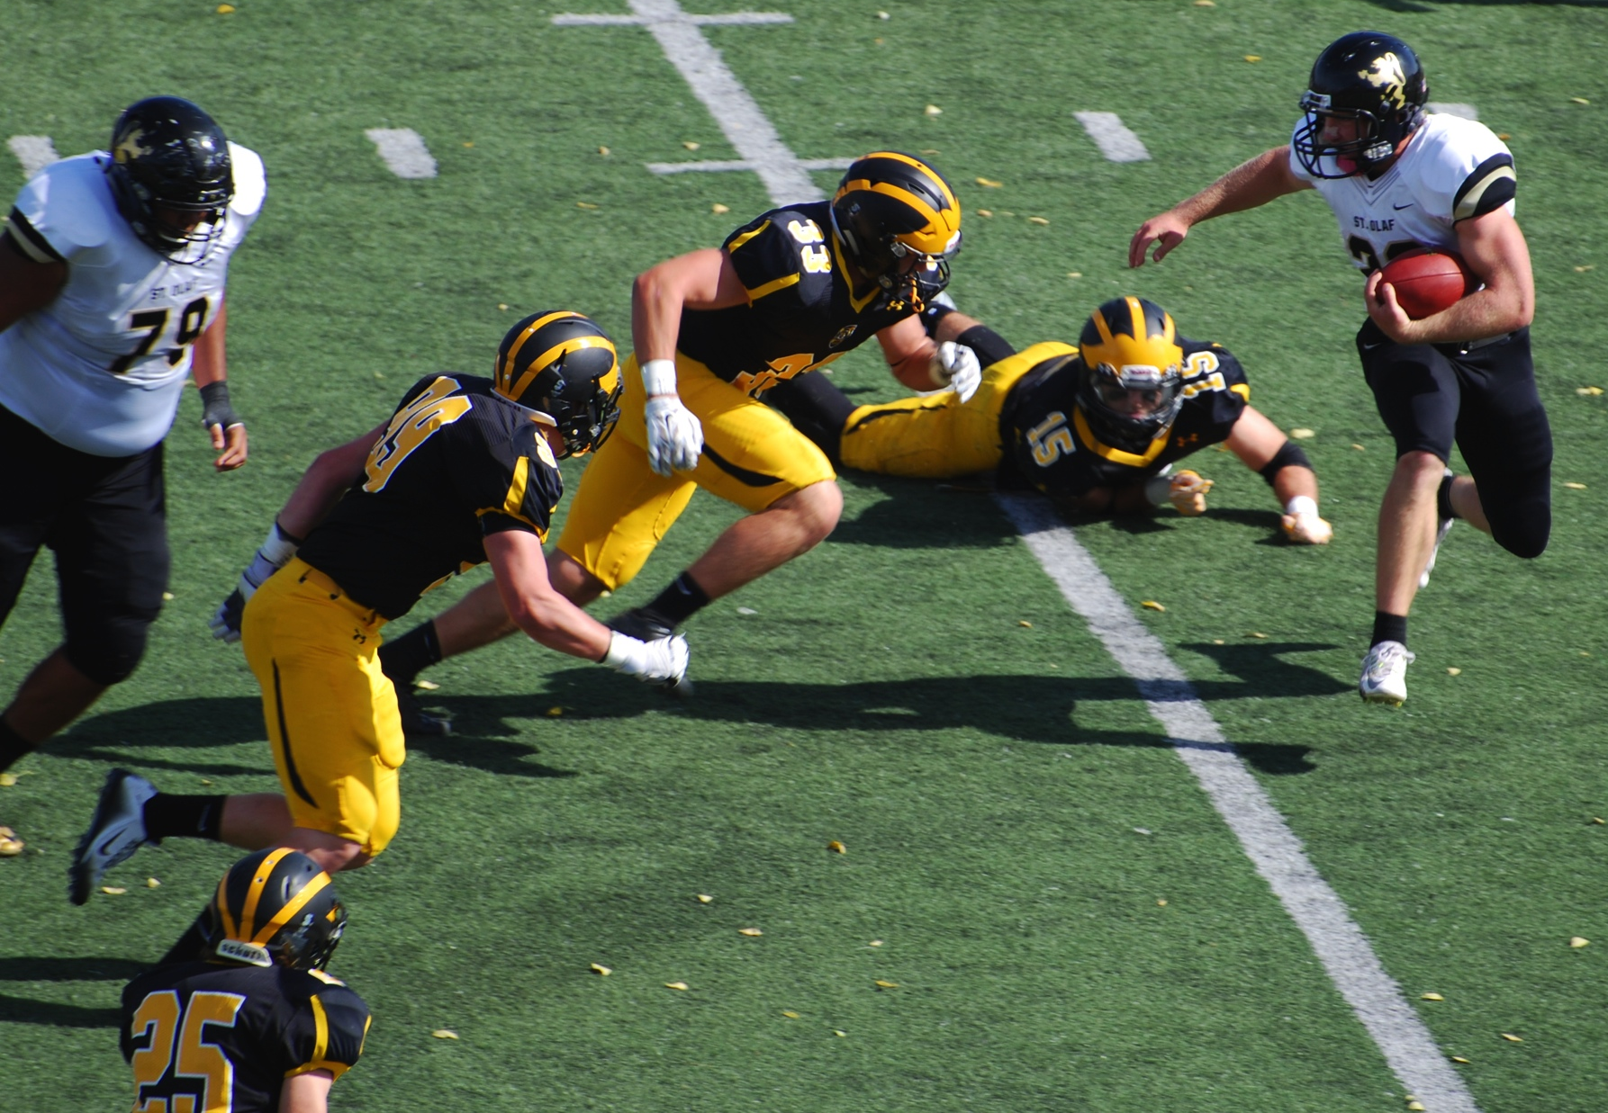
“I have a Dream Today…” Imagine the Perfect World for Geoscience Learning
Geologically Interesting Places
No Scheduling Conflicts

Slide 5
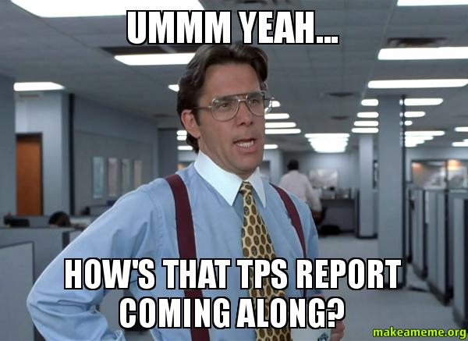
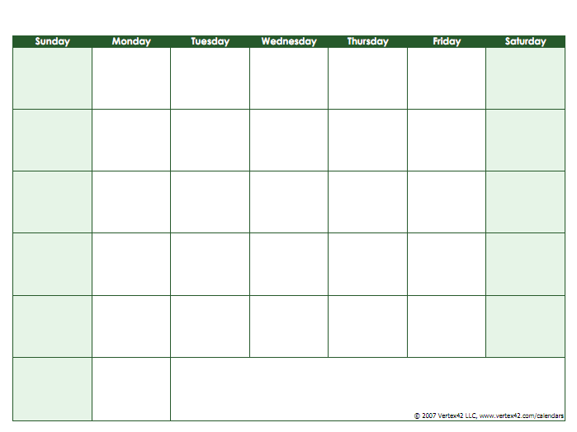
“I have a Dream Today…” Imagine the Perfect World for Geoscience Learning
Geologically Interesting Places
No Scheduling Conflicts
Sufficient Time
GEO 100
GEO 100
GEO 100
GEO 100
GEO 100

Slide 6
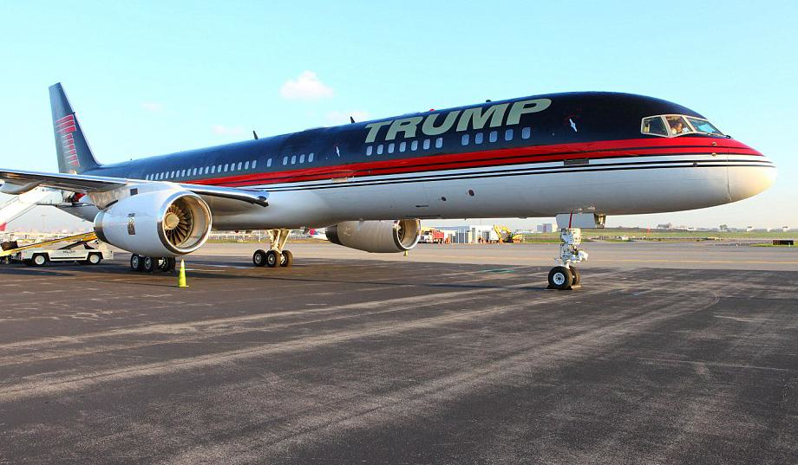
“I have a Dream Today…” Imagine the Perfect World for Geoscience Learning
Geologically Interesting Places
No Scheduling Conflicts
Sufficient Time
Adequate Resources
Field Force 1

Slide 7
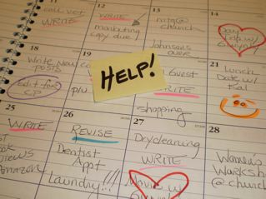
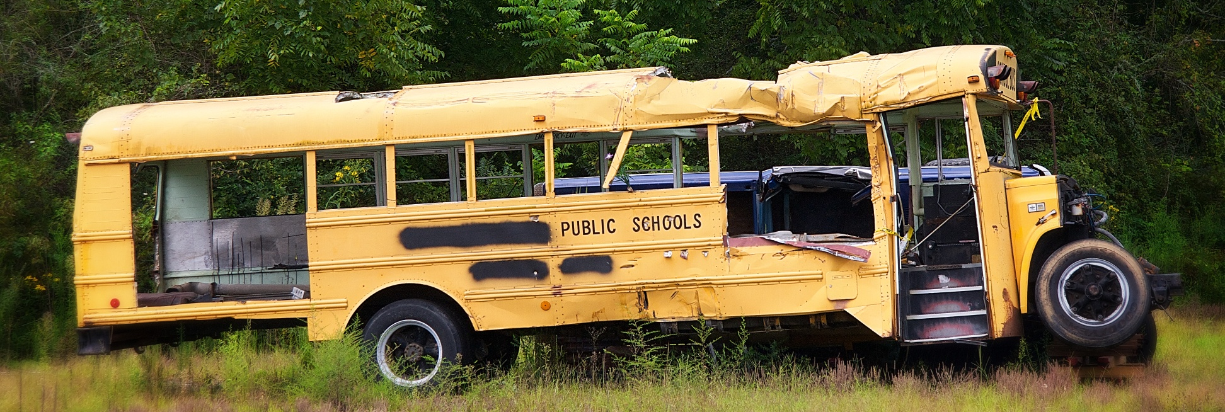
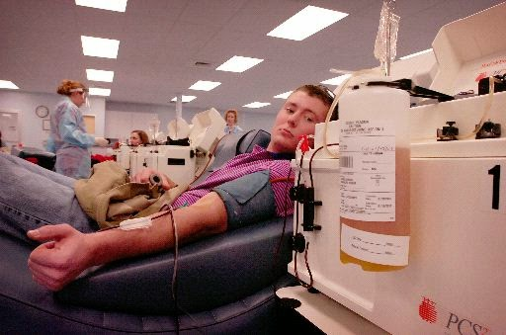
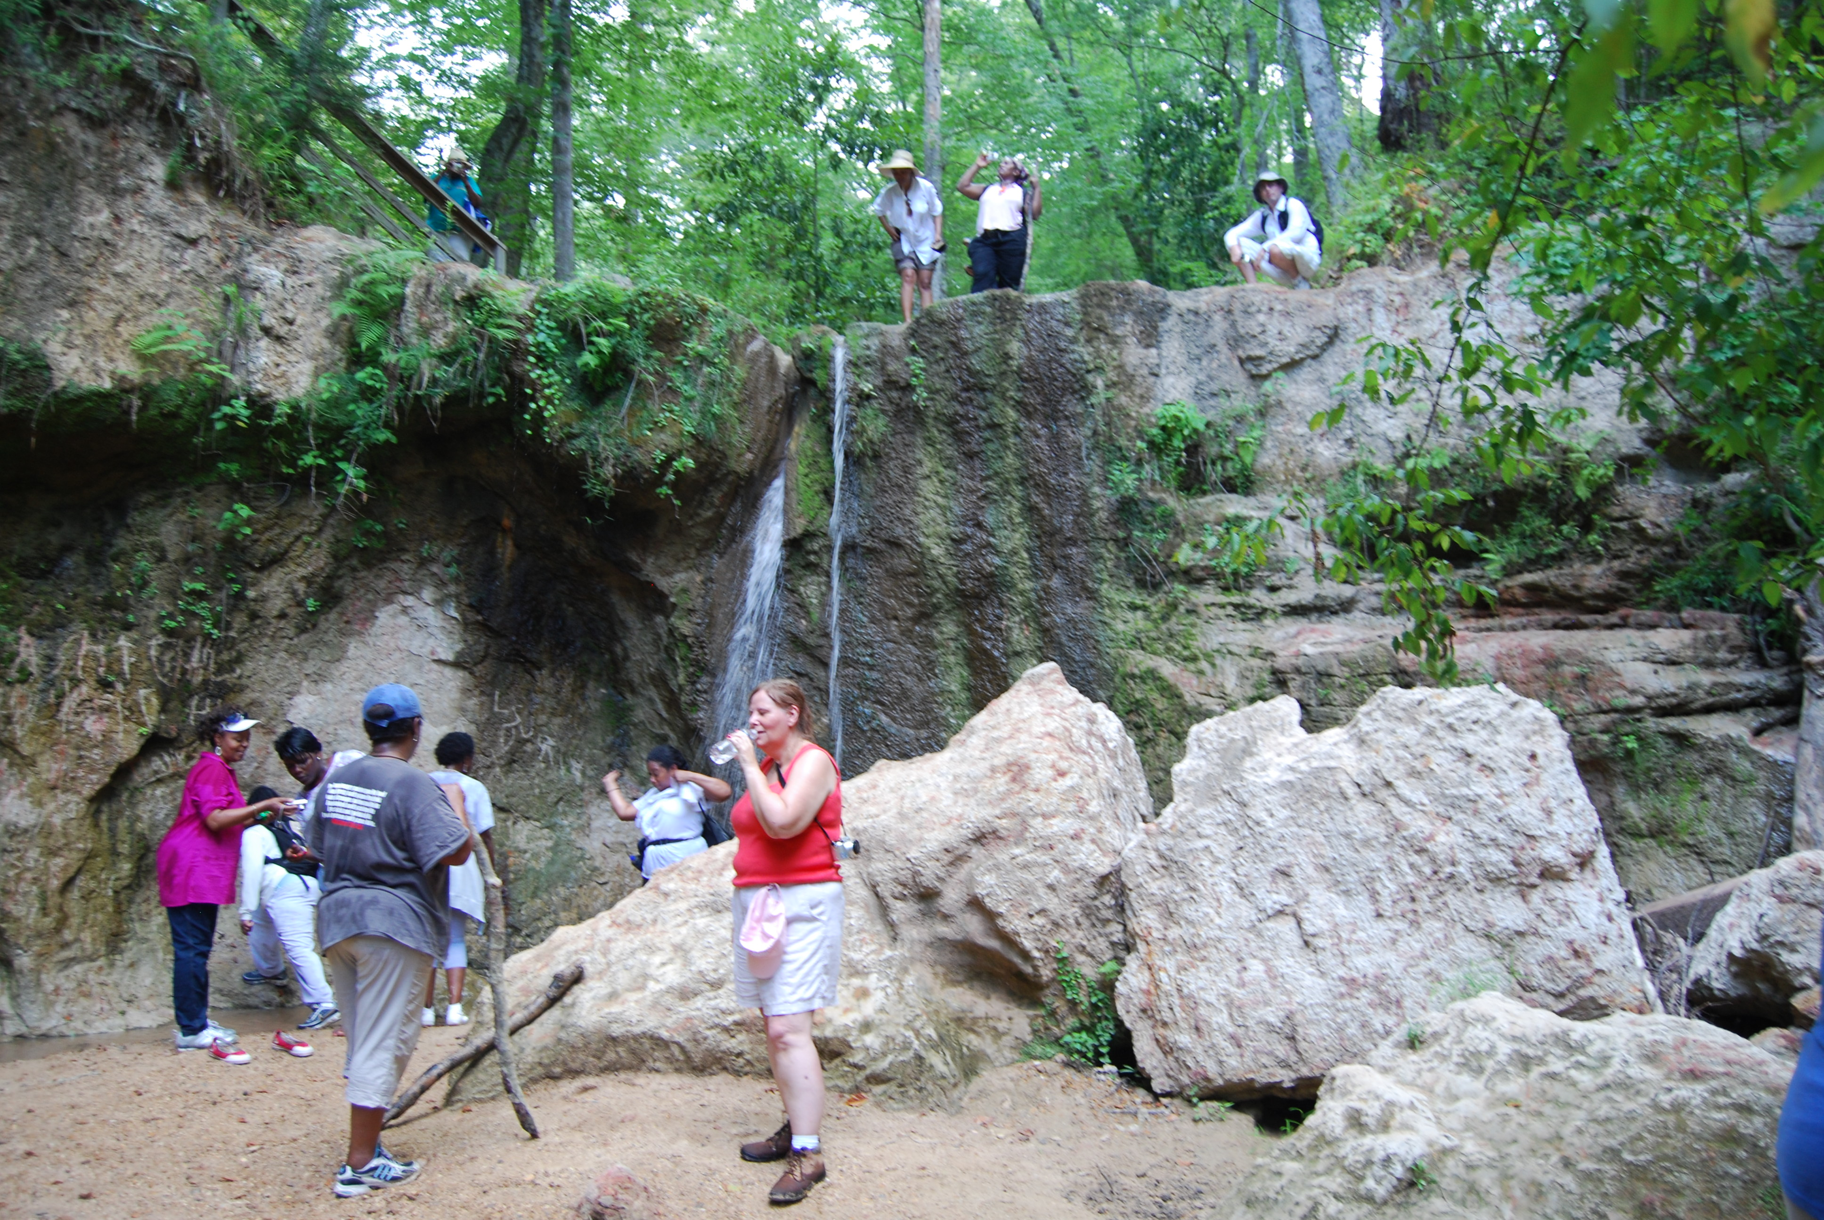
The Reality Schedules/Time/Resources & Access Limiting to Most Students
Geologically Interesting Places
No Scheduling Conflicts
Sufficient Time
Adequate Resources
Just 4 more liters to pay for that field trip!
Governor Walker’s
Cost-Saving Fixer-Upper
New Orleans Teachers
Seeing their First Rock
Outcrops….EVER…
in Mississippi Post Katrina!

Slide 8
So How Do We Tap into the Strengths of Active Learning & Place-Based Education given this reality?
Geologically Interesting Places
No Scheduling Conflicts
Sufficient Time
Adequate Resources
Just 4 more liters to pay for that field trip!
Governor Walker’s
Cost-Saving Fixer-Upper
New Orleans Teachers
Seeing their First Rock
Outcrops….EVER…
in Mississippi Post Katrina!

Slide 9
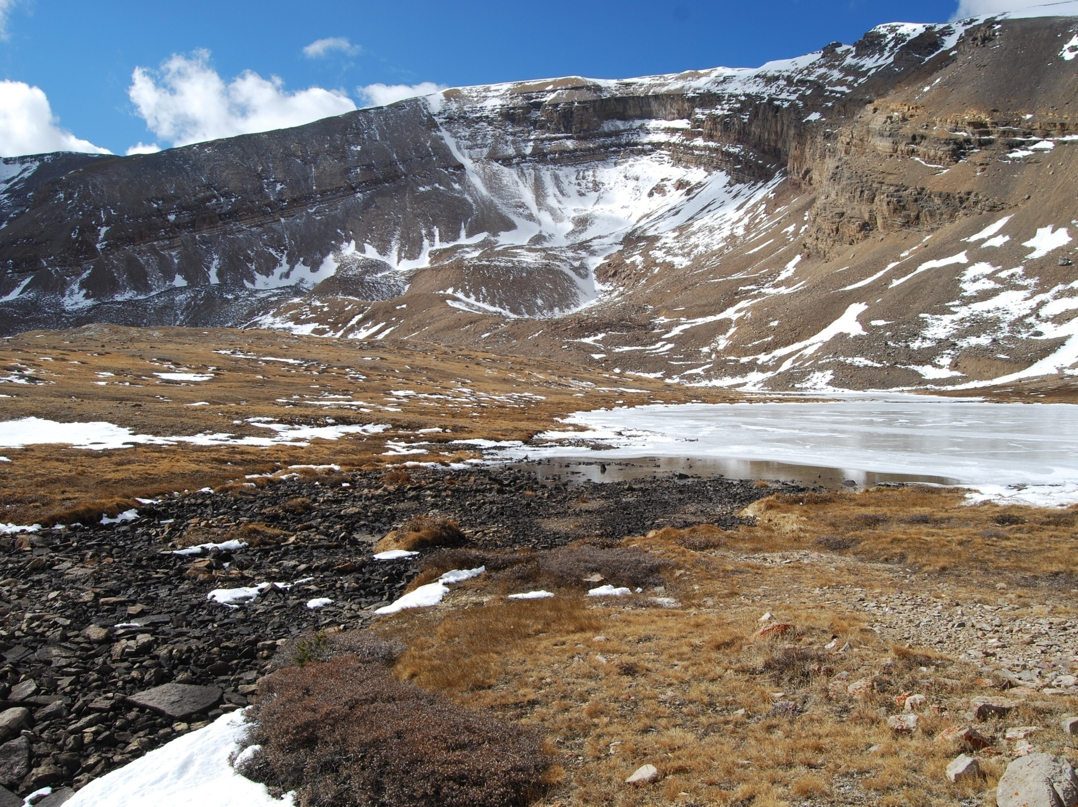
1. Faculty Guided Place-Based Case Studies
Semester-long Instructor lead virtual field trip to geologically interesting place provides “class” case study as example for student studies => Faculty Voice

Slide 10
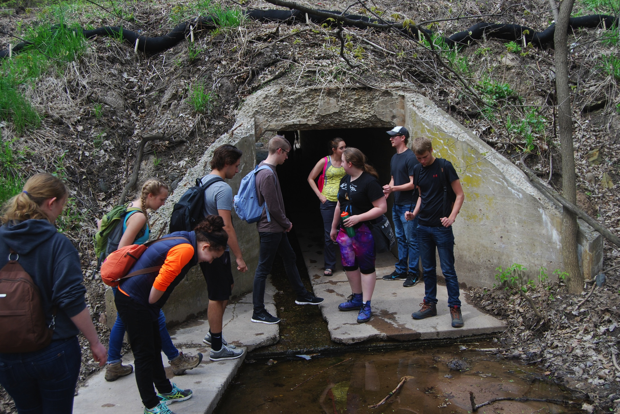
I’ve never even BEEN to Colorado!
Sure you’re not leading us down a dark hole?

Slide 11
South Tilted Layers
Appear Sedimentary
What’s Under Here?
Granite & Quartzite Boulders
Sedimentary Bedrock at Base
Students use geology content to explore formation of site:
What is the origin of the scoop like structure
in Horseshoe Mountain, CO?

Slide 12
Tilted Sedimentary Layers
Quartzite Layer
Buried
Granite
Student interpretations of the geology of Horseshoe Lake
Pit Produced Via Mining - Possible
Volcanic Cone - Less Possible
Asteroid Impact Crater - Possible
Glaciers - Possible
Laccolith - Favored Theory

Slide 13
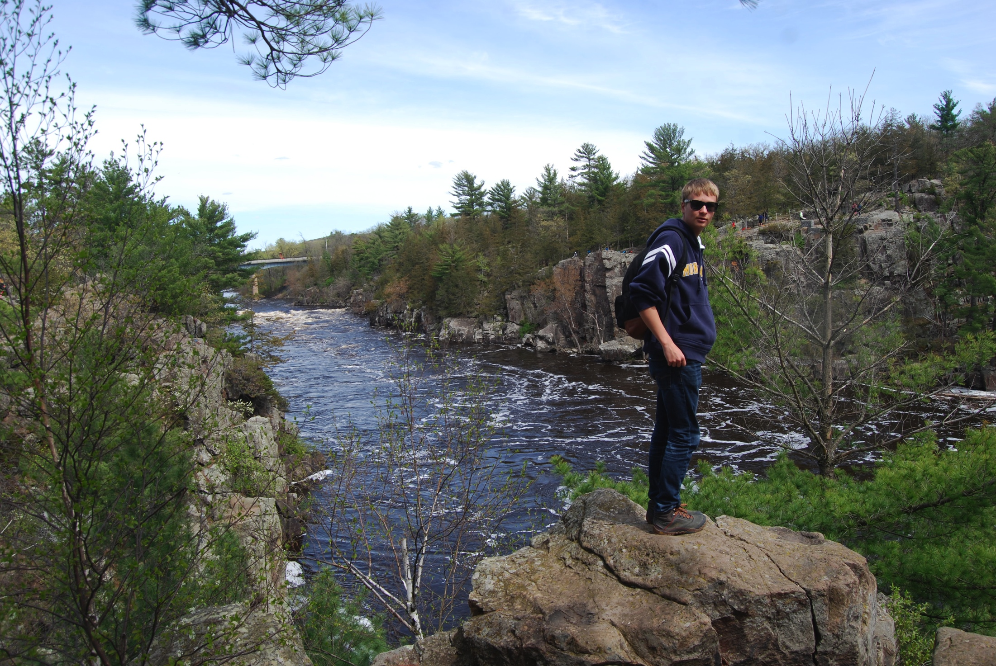
2. Student Driven Place-Based Case Studies
But what about places we know like the MN North Shore?

Slide 14
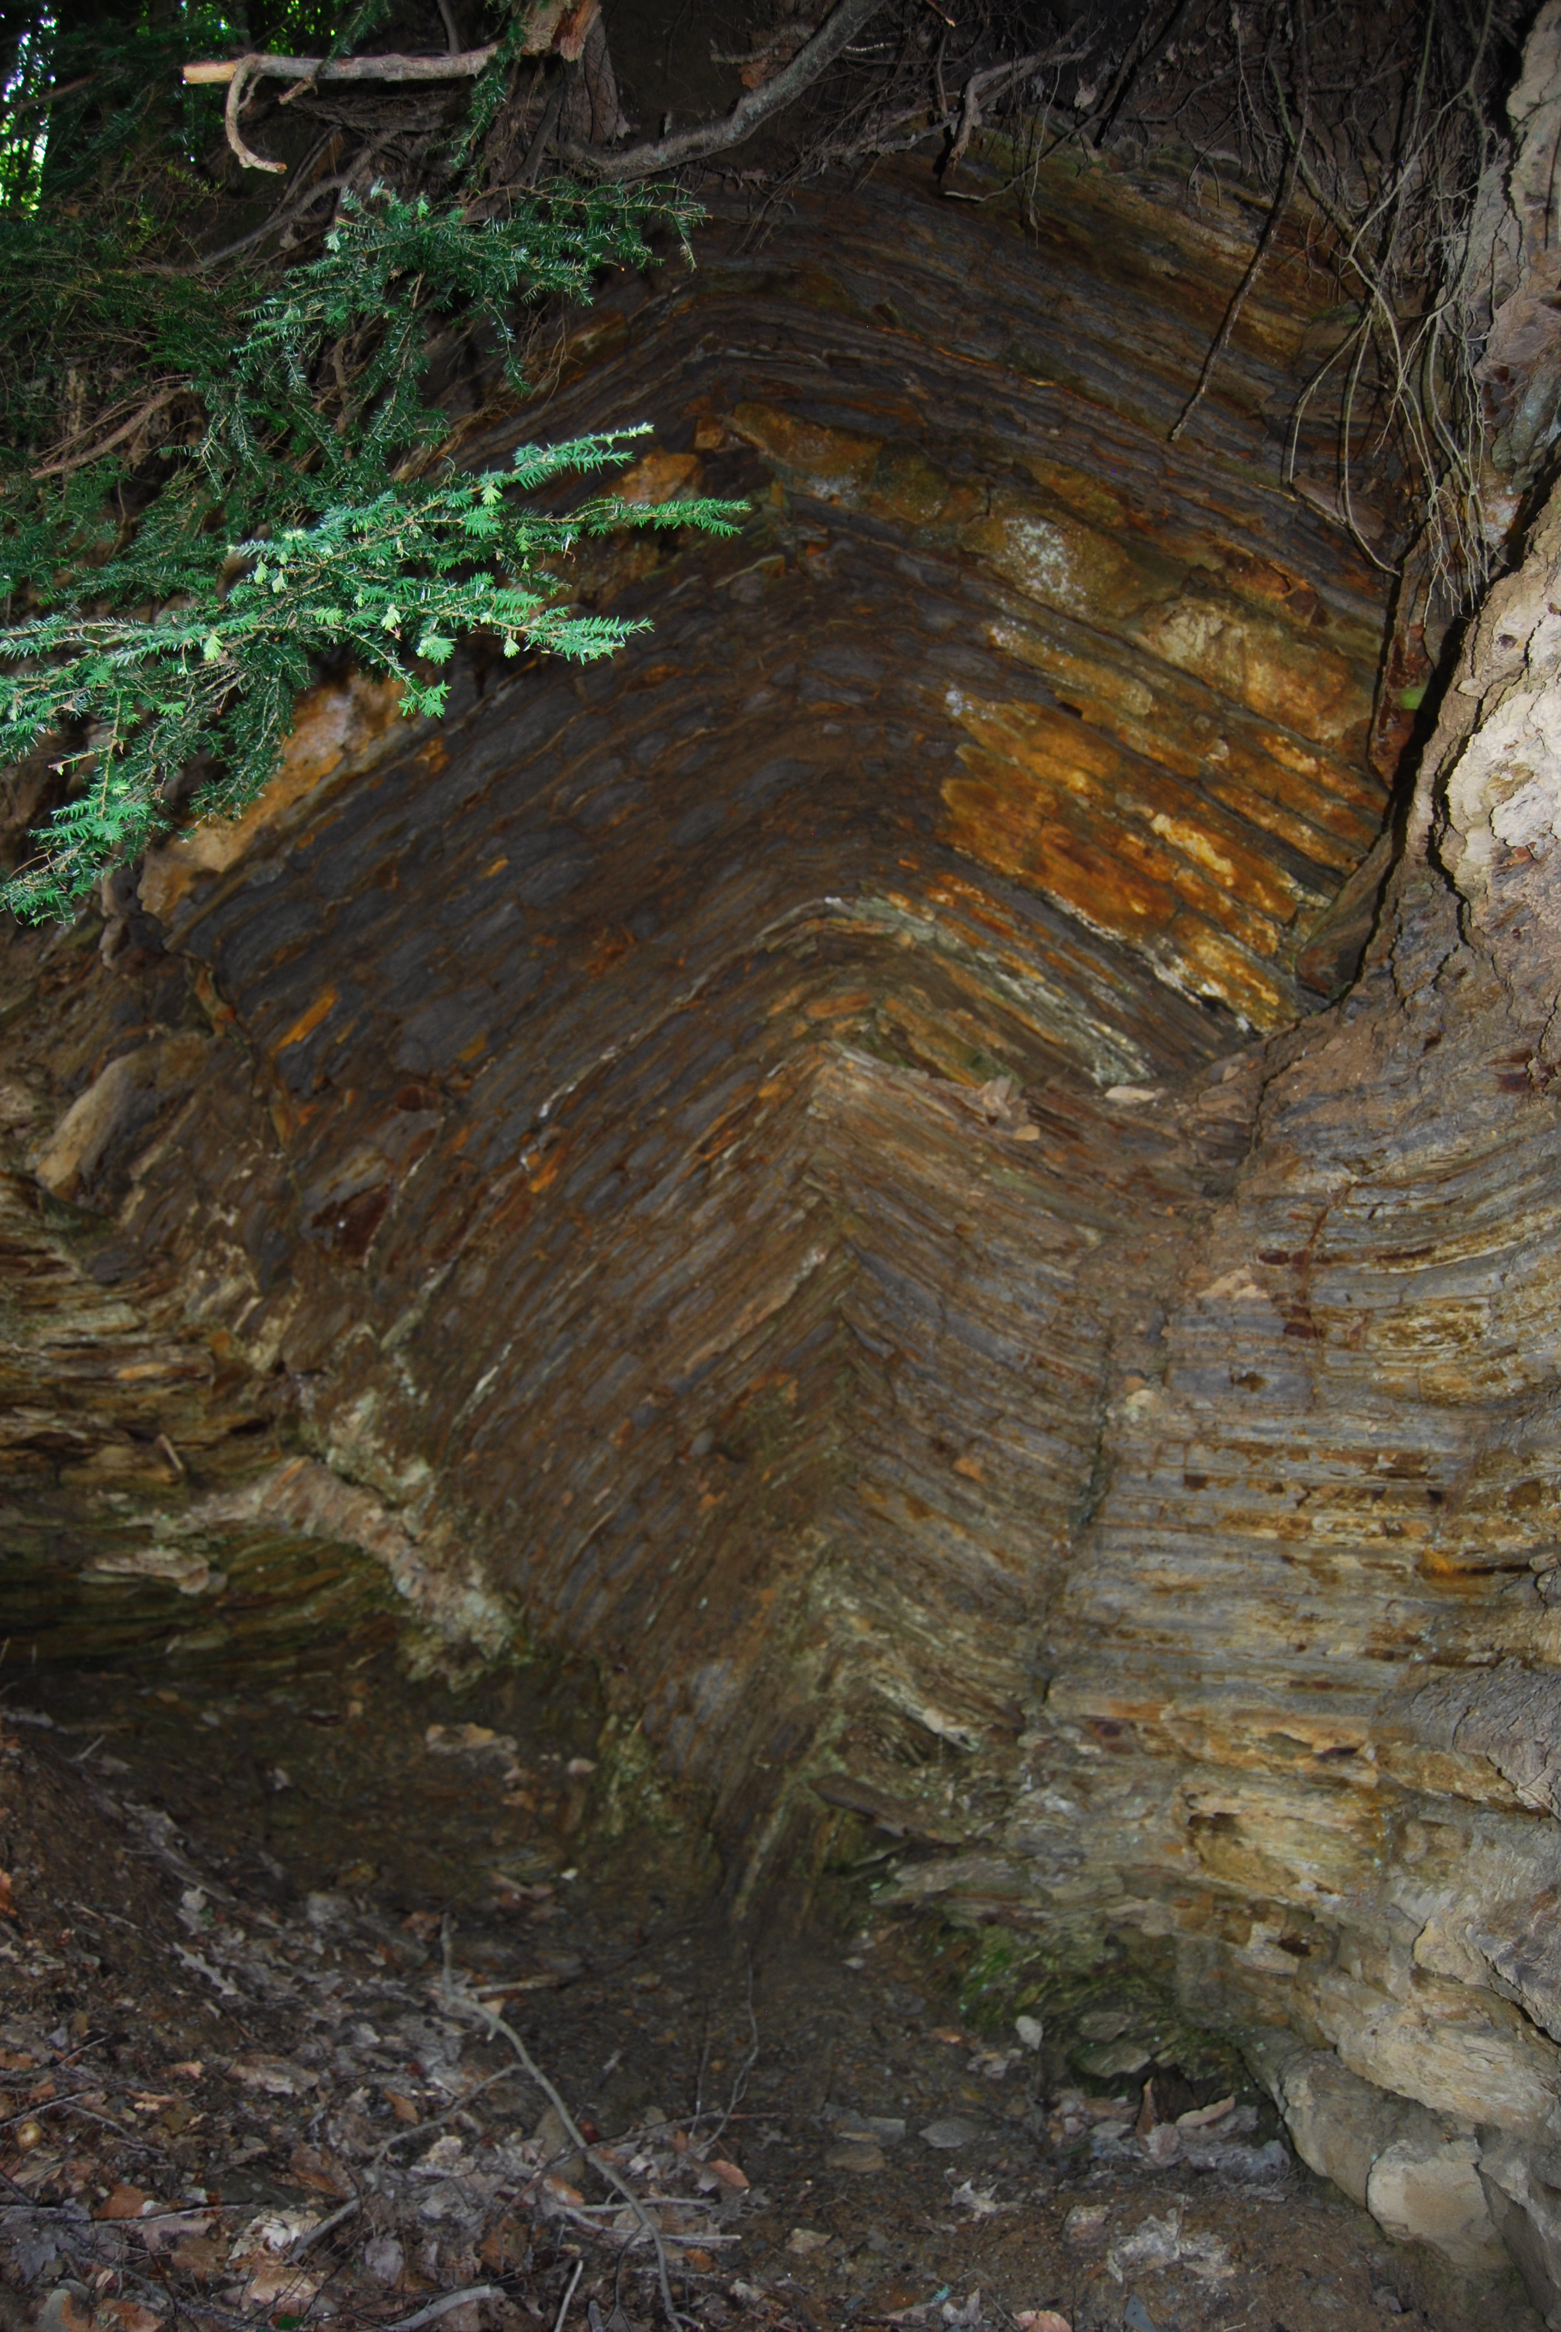
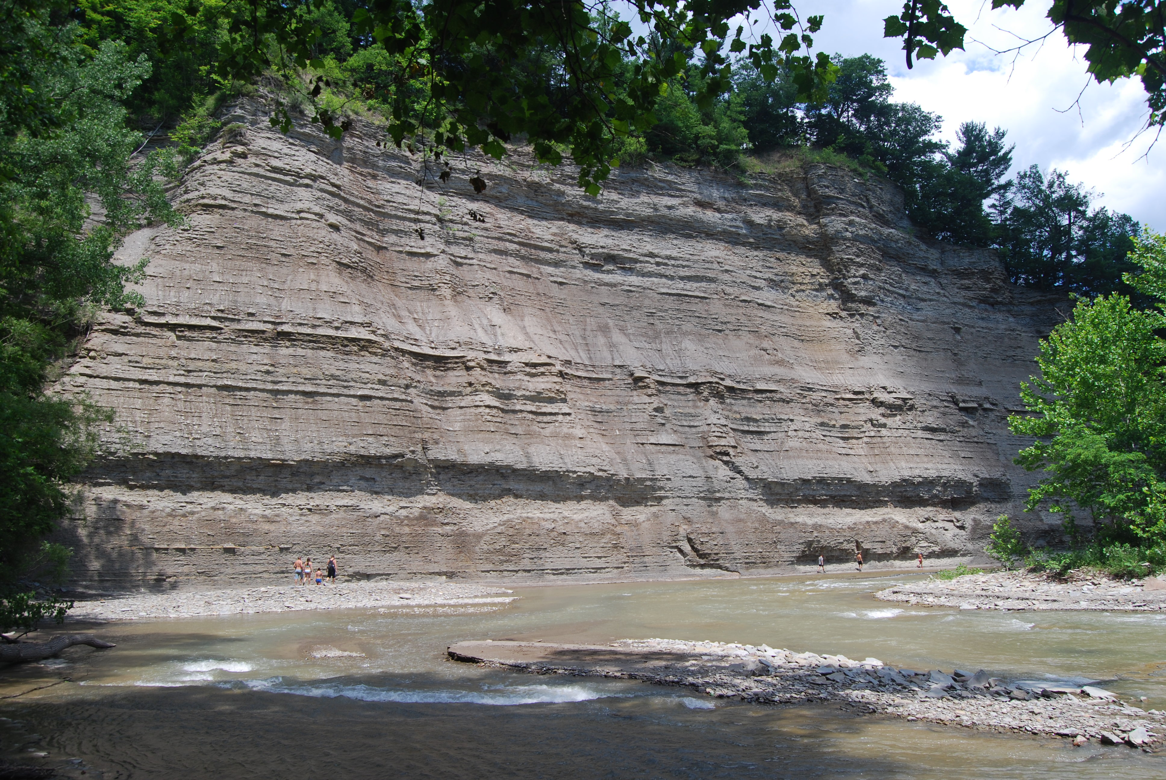
Initial Essay => Background Knowledge & Hypotheses About Place Formation
Students Select their Own Place for Case Study
Site Description & Importance
Location
Topography, Rock Exposures
Flora & Fauna
Climate
Site Importance
Site Evolution (Initial Thoughts)
Geological & ecological site formation processes
Site before the last Ice Age & glacial effects
NATURAL forces continuing to shape site
Site use today
Anthropogenic forces at work
How site might change in future

Slide 15
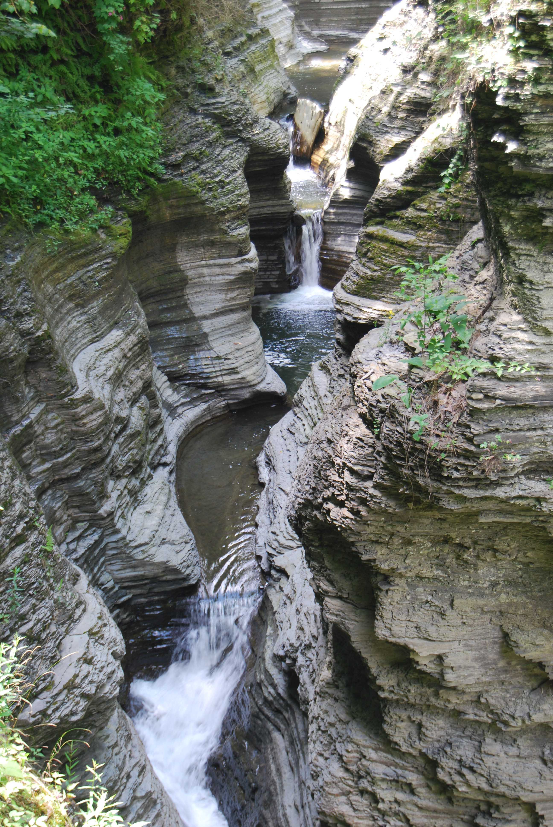
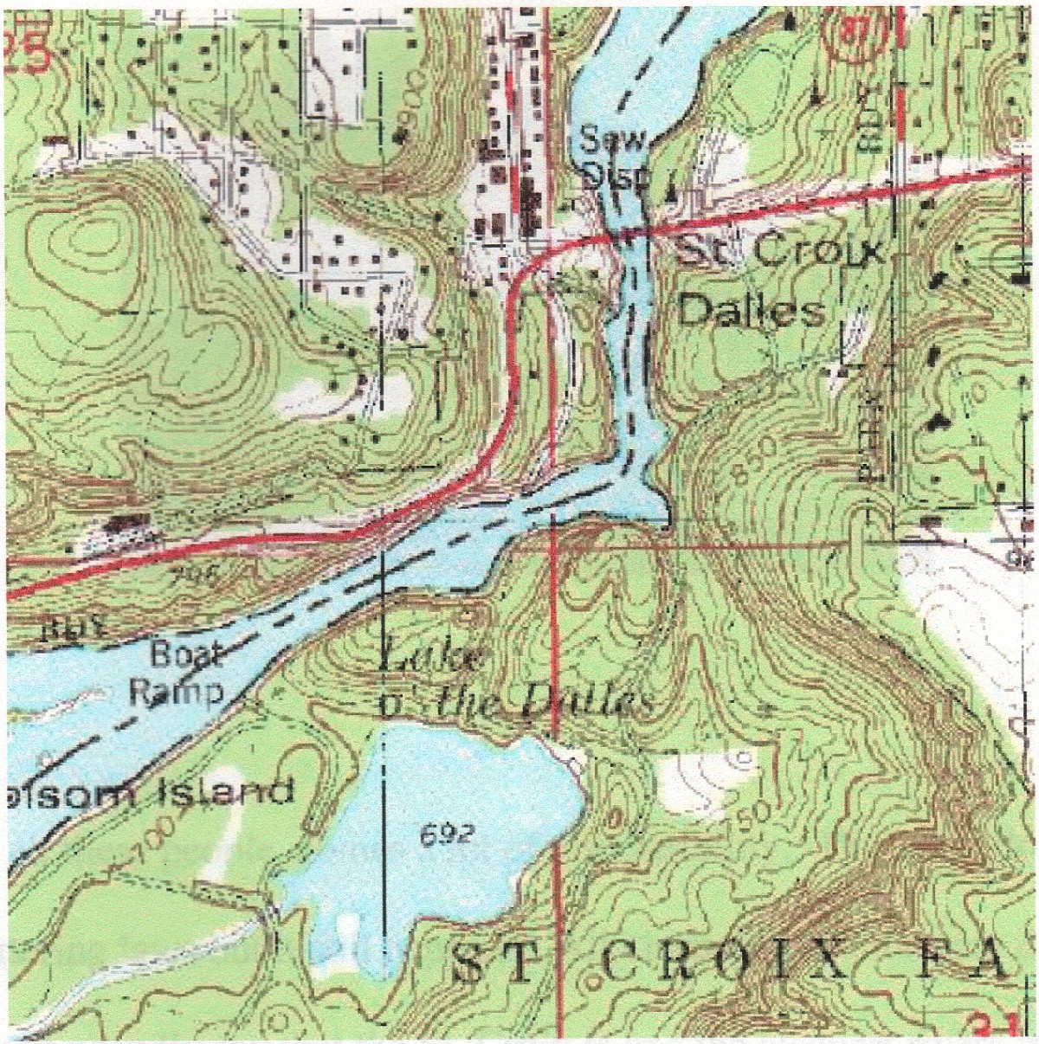
End of Semester: Land Revisited Essay
Students Explore Their Special Places In Parallel to “Class” Place Each Week
Receive Feedback from Peers in Writing Groups
Site Evolution (Revised Thoughts)
Geological & ecological site formation processes
Site before the last Ice Age & how glaciation affected it
NATURAL forces continuing to shape site
Site use today
Anthropogenic forces at work
How site might change in future
Effect of global warming of 3^{O}C in 50 yrs
Social Responsibility
Who is responsible for the future of your special place?
What role will YOU play in the future of your special place?
STUDENT
VOICE

Slide 16
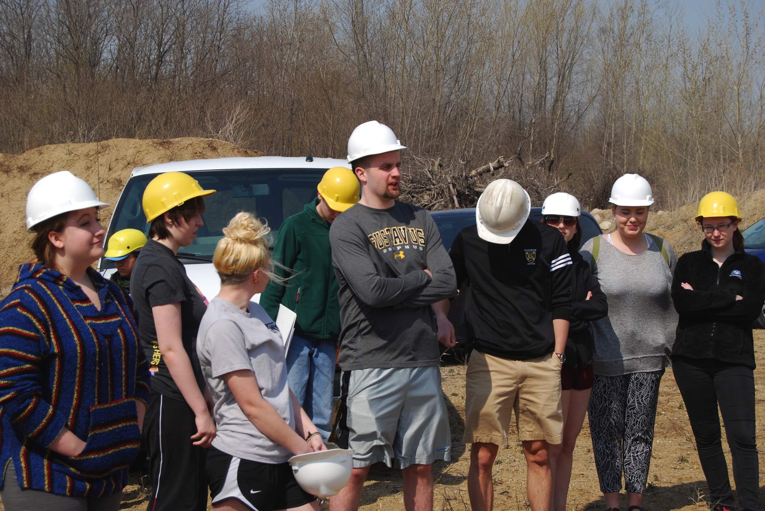
2. Student Driven Place-Based Case Studies
But we learn better by actually going places. Can’t we go on a field trip?

Slide 17
3. Faculty Guided Field Trips
Yay!!!…we get to go to the North Shore!
Weekend Field Trip Requires Vans & Budget for Camping & Food

Slide 18
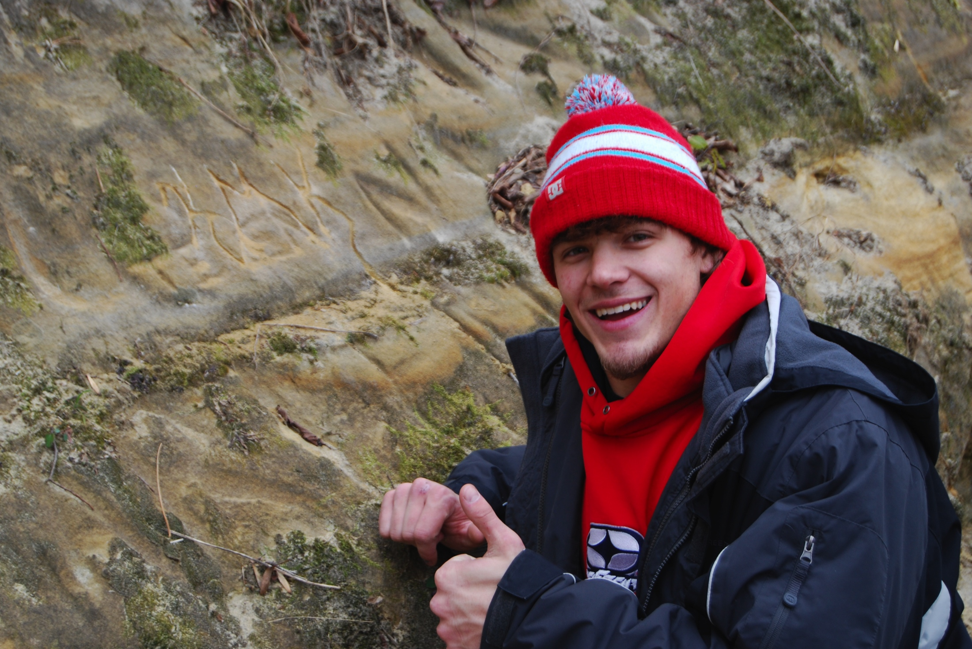
3. Faculty Guided Live Field Trips
But…but…
Here at the CC we can’t afford more than a day trip

Slide 19
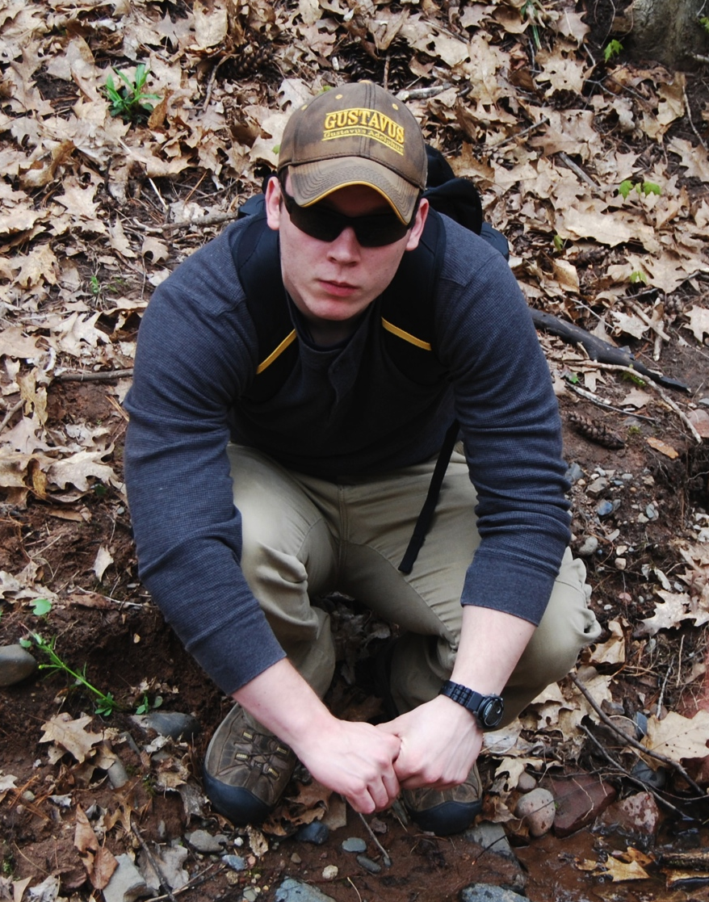
3. Faculty Guided Live Field Trips
So we can’t go either?
I can’t go…I have work

Slide 20
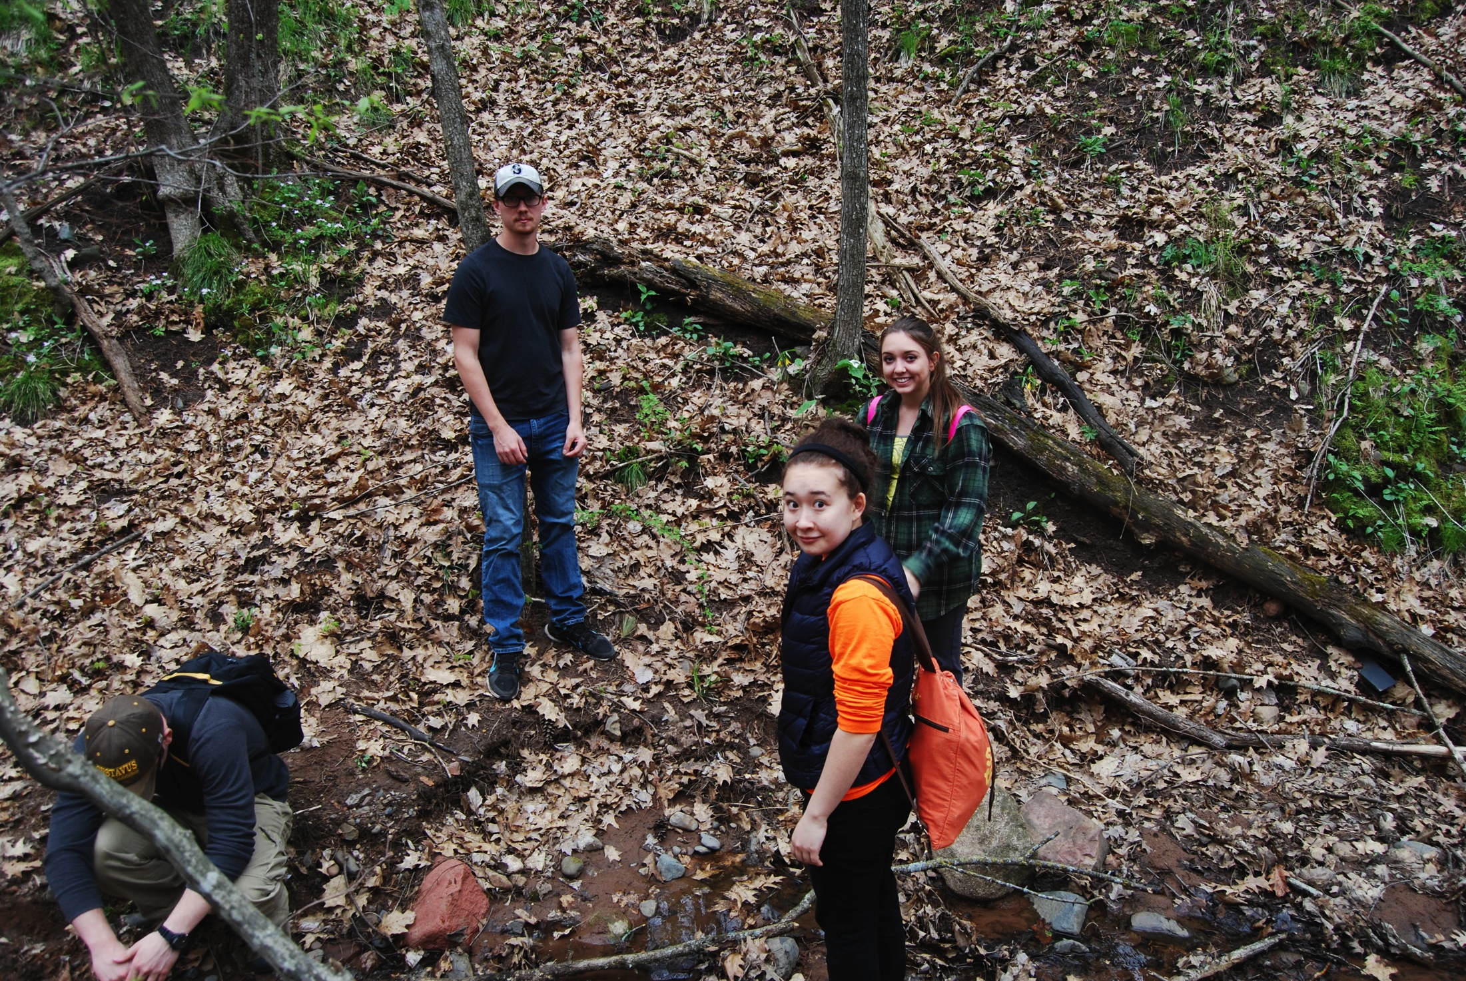
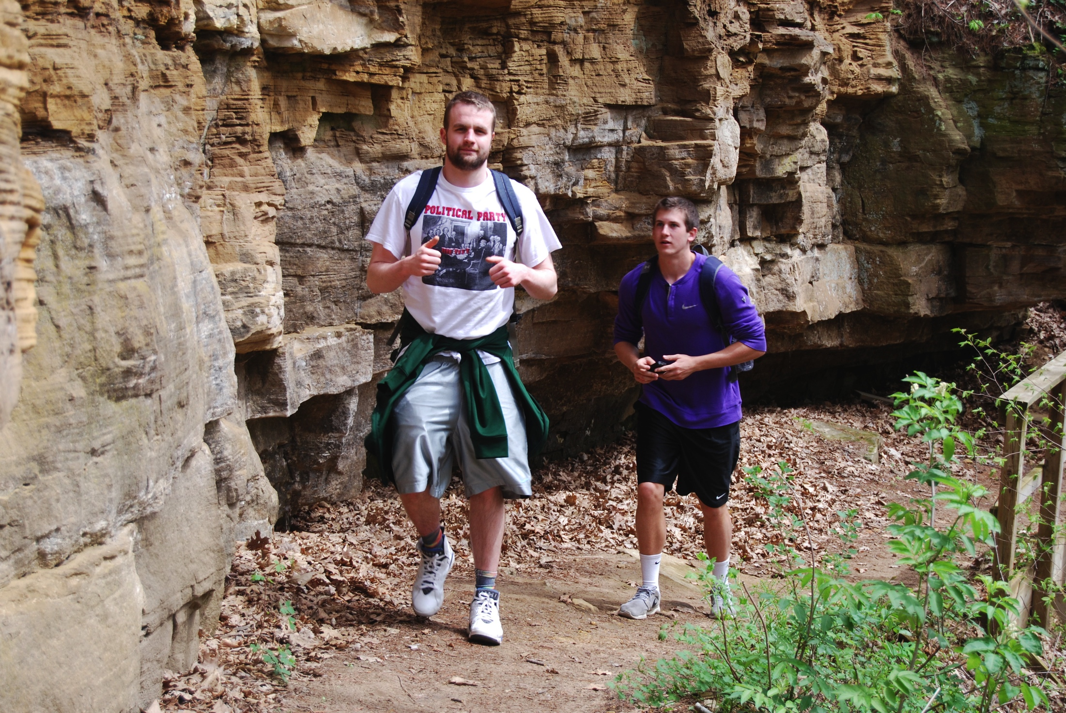
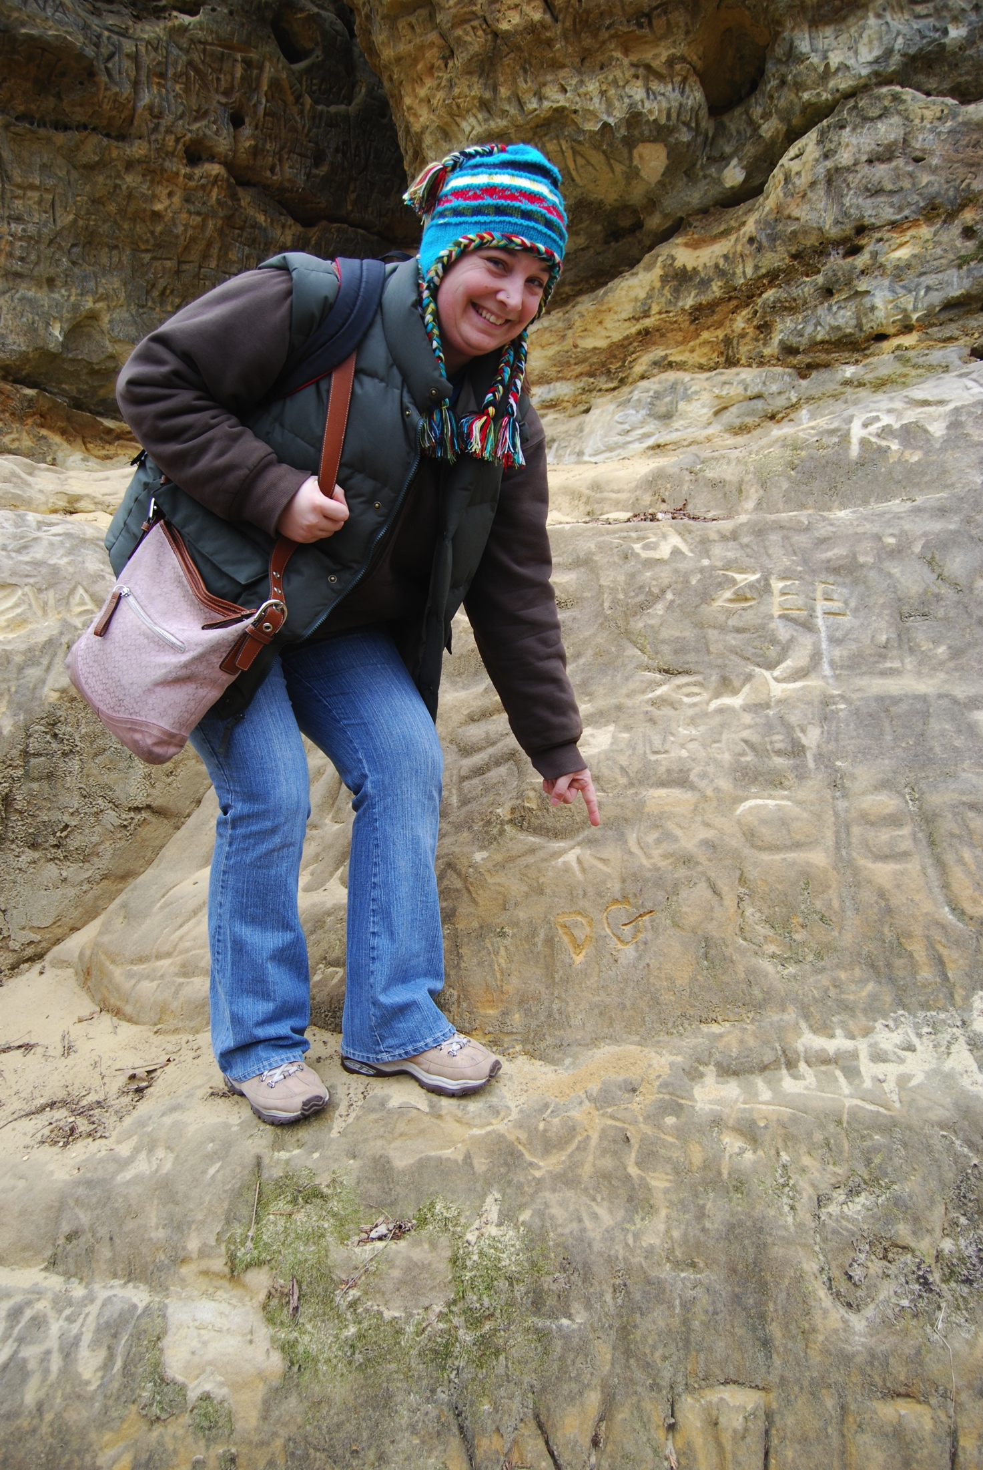
4. Student Guided Virtual Field Trips
Faculty Provide Guidance in Setting Up Local Field Trips
Students:
Conduct Local Field Trips
Develop Materials Describing Geology of Particular Sites in their Own Words Using the Special Place Case Study model
Student Developed Materials Used with Peers as a Virtual Field Trip
Works for US!

Slide 21
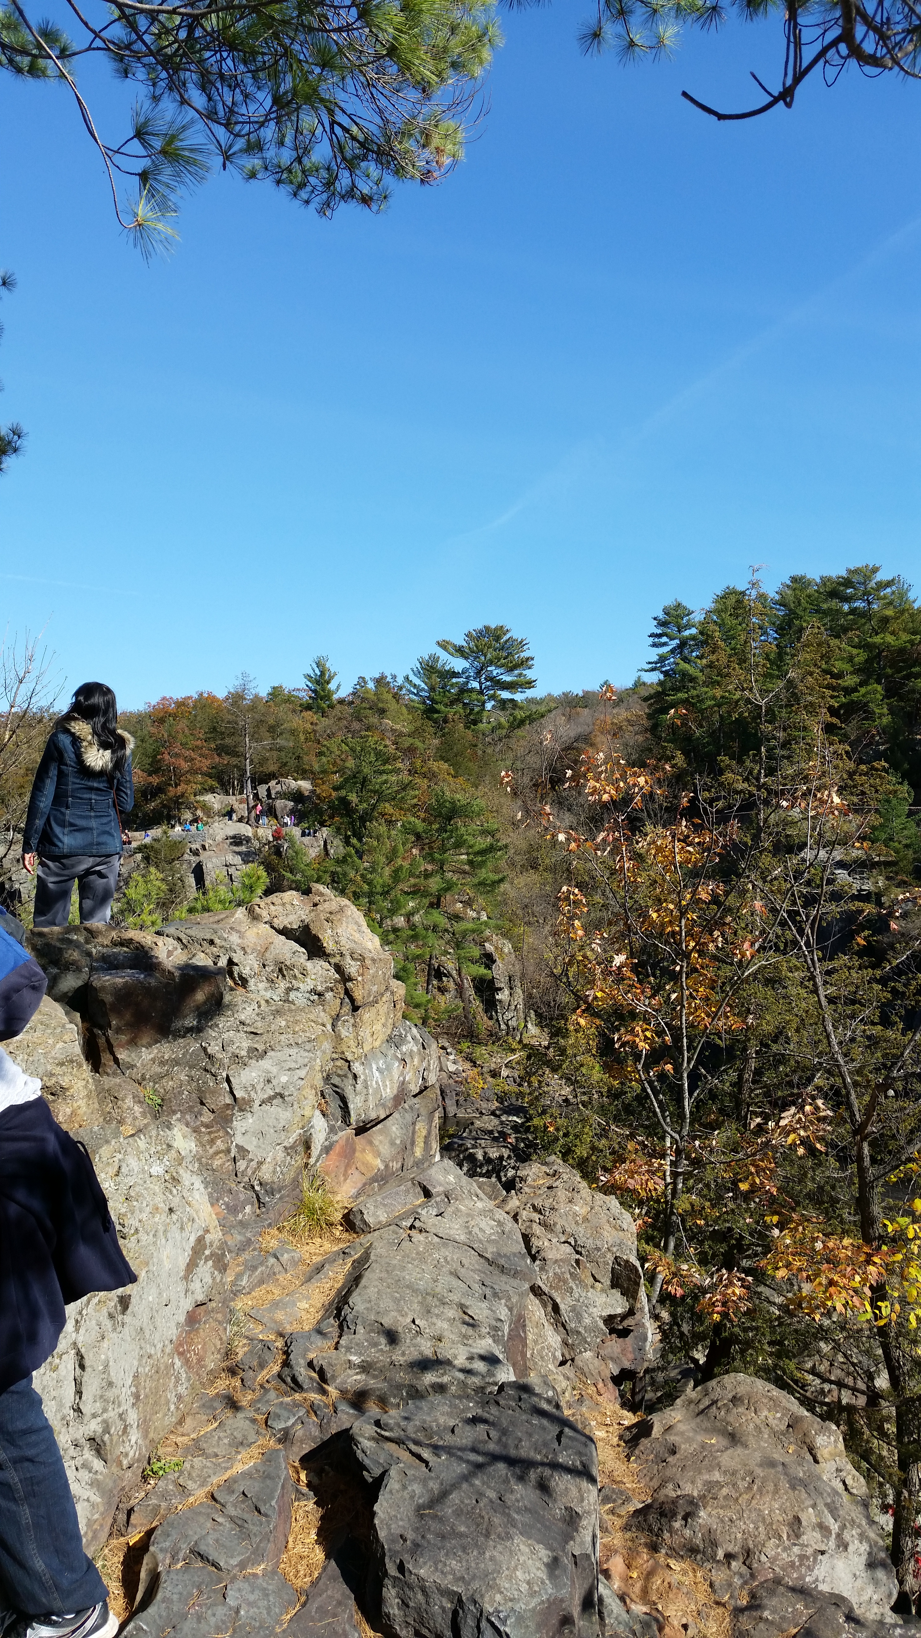
Materials Present on Site
FROM STUDENT 1
Basalt cliffs, resistant to weathering, stand tall on both sides of the St. Croix River
These cliffs are evidence of volcanic flows from the midcontinental rift

Slide 22
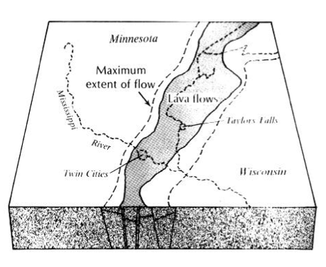
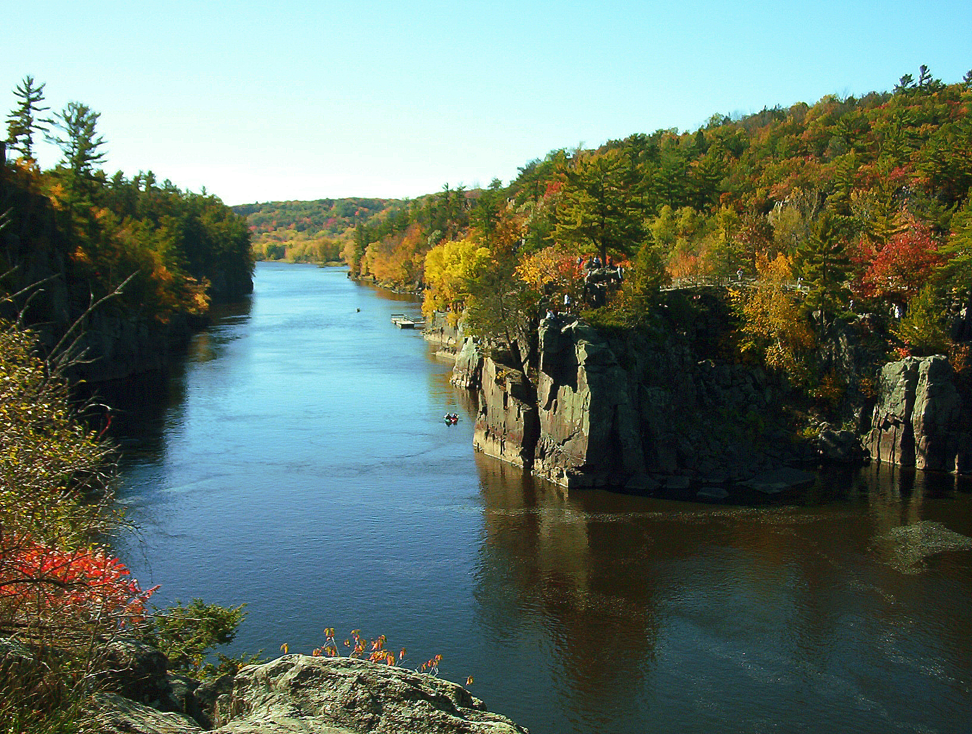
Midcontinental Rift
FROM STUDENT 1
Formed 1,100 million years ago
Extended from present day Lake Superior down to Iowa
http://files.dnr.state.mn.us/destinations/state_parks/interstate/interstate_geology.pdf
https://upload.wikimedia.org/wikipedia/commons/4/4a/Dalles_Of_St_Croix.jpg

Slide 23
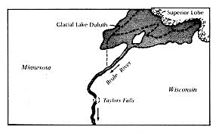
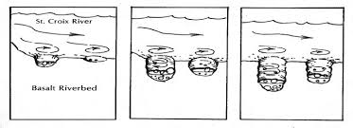
Wisconsin Glaciation
FROM STUDENT 1
Last glacial advance into Minnesota
Glacial Lake Duluth forced to drain south following present day St. Croix River valley
Force of glacial water carved out potholes with sediment
http://files.dnr.state.mn.us/destinations/state_parks/interstate/interstate_geology.pdf
http://files.dnr.state.mn.us/destinations/state_parks/interstate/interstate_geology.pdf

Slide 24
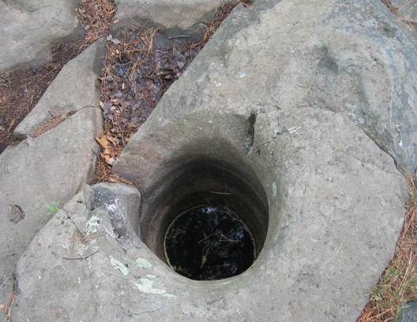
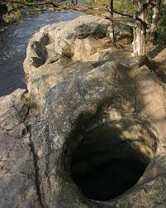
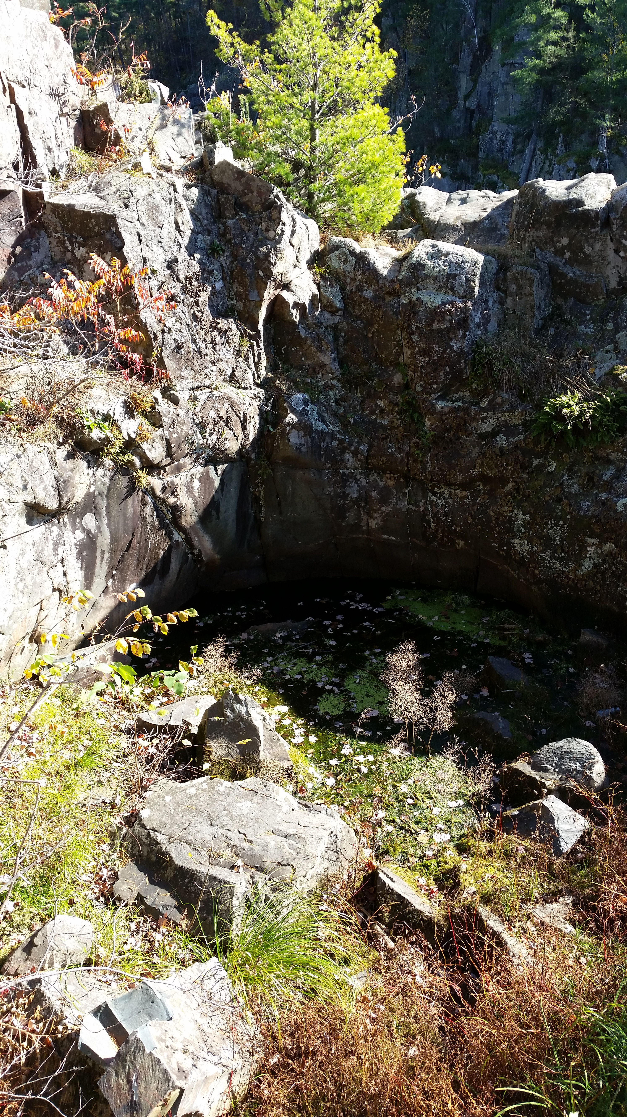
Potholes
FROM STUDENT 1
Began as eddies and enlarged as more silt and sediment became trapped
Scattered throughout the park
Often contain rounded boulders, similar to canon balls, were used to carve
http://files.dnr.state.mn.us/destinations/state_parks/interstate/interstate_geology.pdf

Slide 25
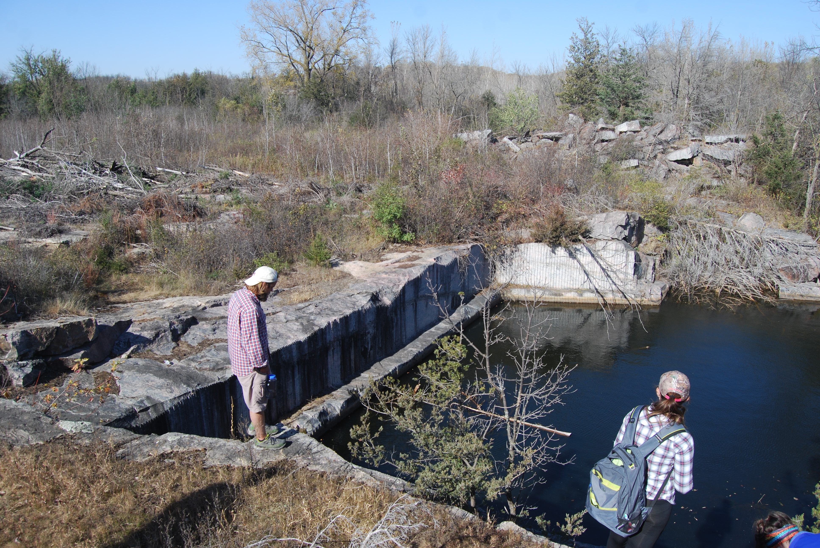
Morton
FROM STUDENT 2
Cambrian sedimentary events
MN under shallow sea
Sandstone bedrock sits on top of some of gneiss formation
Some shale
Uplift: 100 mya
Pleistocene glacial events
Large layers of till

Slide 26
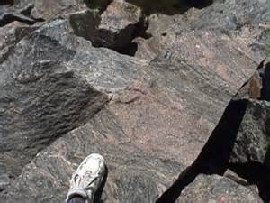
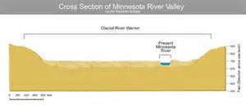
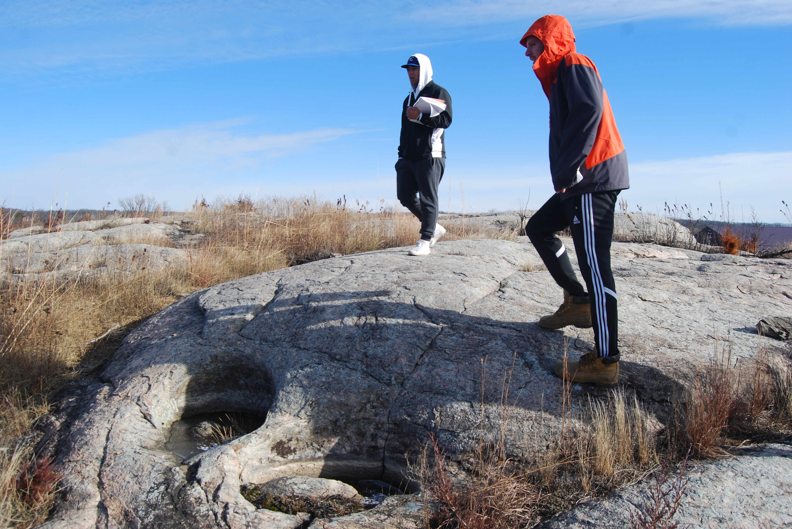
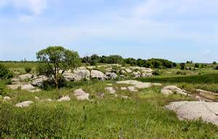
Exposure
FROM STUDENT 2
Glacial River Warren
11-9 thousand years ago
Erosion of glacial till

Slide 27
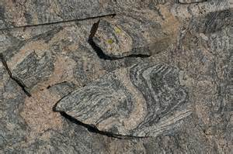
Mineralogy
FROM STUDENT 2
High heat and pressure <= 10 miles deep
Tonalitic to granodioritic gneiss and amphibolites
Older rocks: biotite-quartz-oligoclase gneiss
Igneous precursors
Theleiitic to basaltic komatiite parentage

Slide 28
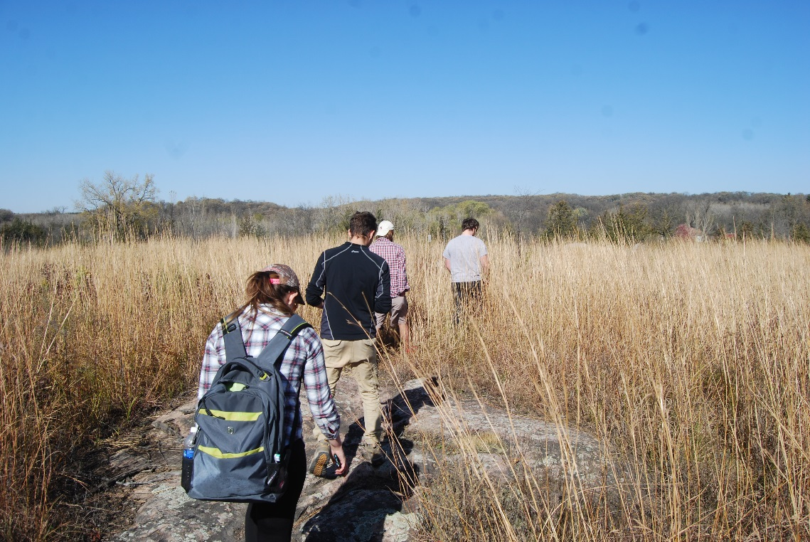
Ecology
FROM STUDENT 2
Morton has a unique ecology that survives in a relatively harsh environment with little to no sediment and intensly warm daytime temperatures
Fosters unique plant community, particularly cacti, which exist essentially nowhere else in MN.

Slide 29
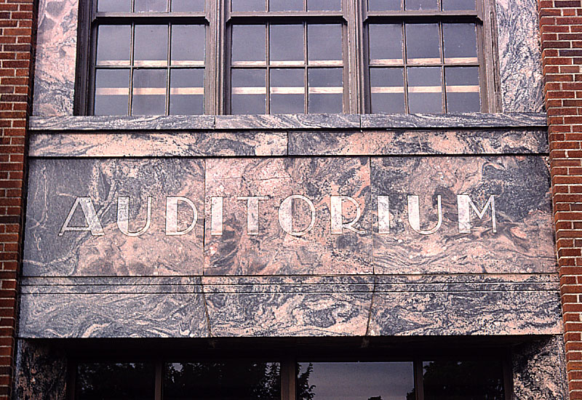
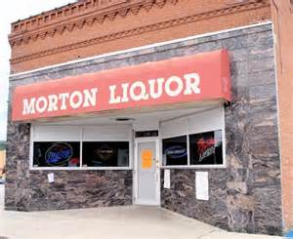
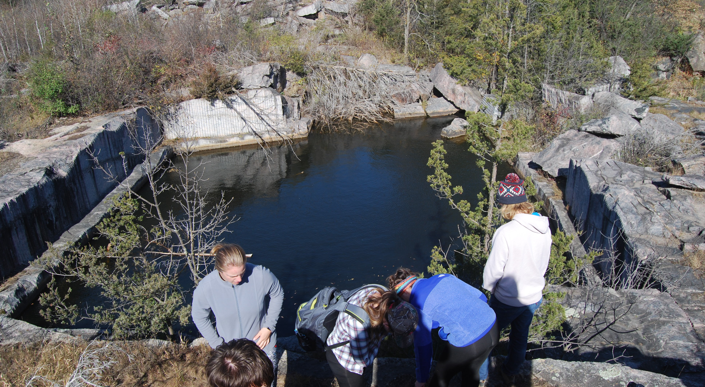
Quarried
FROM STUDENT 2
Late 1800s-mid 1900s
Rainbow Granite

Slide 30
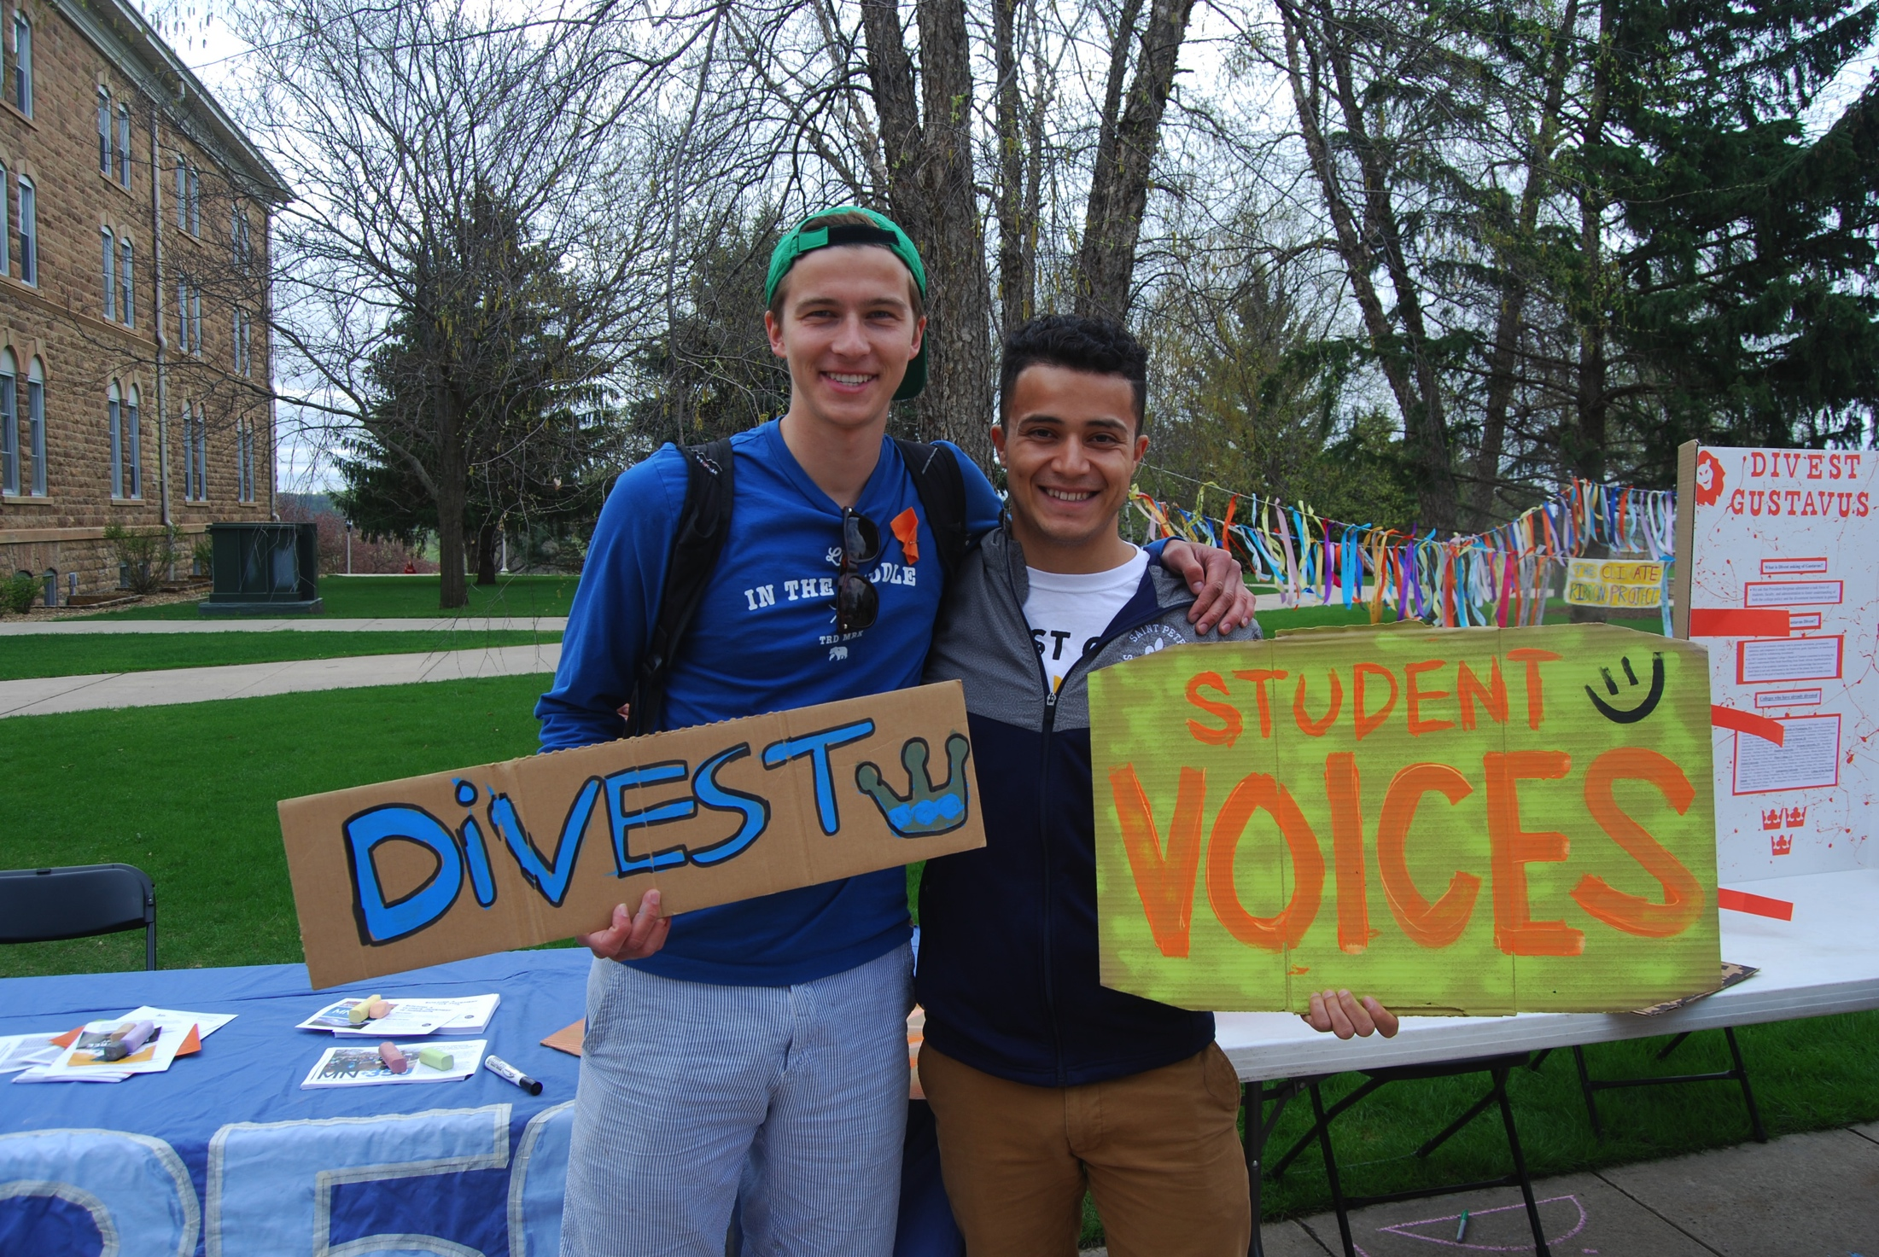
Now that’s Our Story in Our OWN Voice!

Slide 31
Empowering the Student Voice in Place-Based Geoscience Education: From Field Trips to Case Studies
Look for detailed results in Sherry Oaks talk at GSA in Denver!
Thanks to the students of Environmental Geology (RCTC) and Geomorphology & Our Planet (Gustavus Adolphus College) for Inspiring this Approach to Tying Field Trips & Case Studies Together

