Slide 1
Igneous Cooling Rates, Crystal Size, and
NOT Getting the Right
Experimental Results
Mary Colson and Russ Colson
Earth Educators Rendezvous, July 21, 2016.
Madison, Wisconsin

Slide 2
The most exciting phrase to hear in science, the one that heralds new discoveries, is not ‘Eureka!’ (I’ve found it!’) but “that’s funny …’
Isaac Asimov

Slide 3
That’s funny…when it doesn’t work is the start of true investigation
Real science involves observation of puzzling phenomena that require arguing from evidence, model creation and revision, and often new experimental designs to test developing ideas.
Real classroom science gives students and teacher the chance to work together in a collaborative environment.

Slide 4
Mary’s story – key turning points
Grain size as key idea in stories igneous rocks tell.
Developed thymol activity to reinforce this idea with memorable and stinky lab
Problems with it not working – I’d see a lot of crystallized thymol so I’d tell kids well it works sometimes, just believe me.

Slide 5
Russ’s story – key turning points
I wanted a demonstration I could do in class to show that fast cooling produced smaller crystals
Students couldn’t see the difference in crystal size and neither could I--unless we pretended.
I gave up on the demonstration for some 20 years until I decided that the whole point of an investigation is to understand what doesn’t make sense.

Slide 6
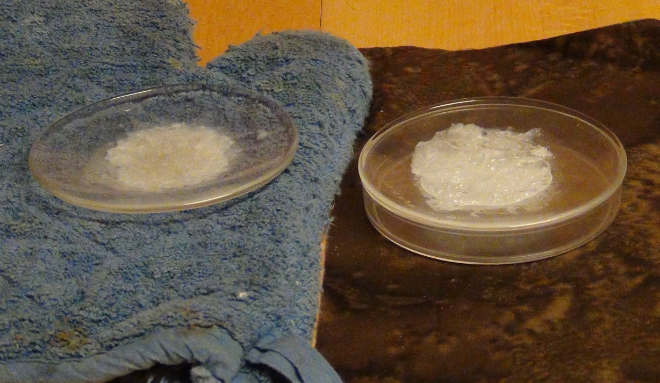
Example Investigation-First experiments
Watch Glass
Thymol
Watch Glass
Thymol
Insulating pad
Petri dish with ice water
Slow-Cooled Experiment
Fast-Cooled Experiment

Slide 7
Did we confirm the textbook answer?
Which one cooled faster? What’s the evidence?
In the classroom, we know the ‘right’ answer which can bias our interpretation.

Slide 8
Did we confirm the textbook answer?
Which one cooled faster?
One cooled in water—faster cooling
Biggest crystals, but variable size
Milky appearance
Cooled on hot pad—slower cooling
Feathery crystals
Some areas not as milky

Slide 9
Did we confirm the textbook answer?
Which one cooled faster?
One cooled in water—faster cooling
Cooled on hot pad—slower cooling
That’s funny…
These results definitely wouldn’t convince me. What’s going on?

Slide 10
Which cooled faster?
The unexpected is the launching place for true investigation.
Why did we get what we got?
We need to investigate further!

Slide 11

What’s going on? --- After investigation, possible interpretations

Slide 12
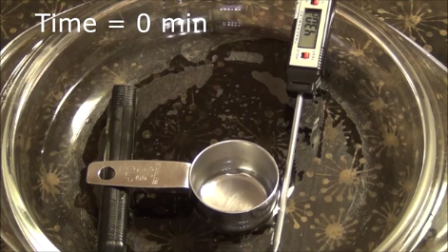
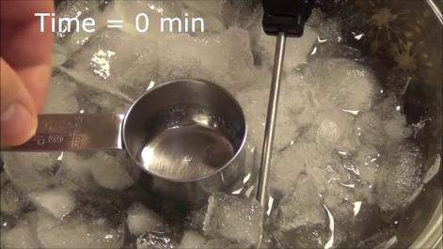
Second experiments
warm water bath
ice+ saltwater bath

Slide 13
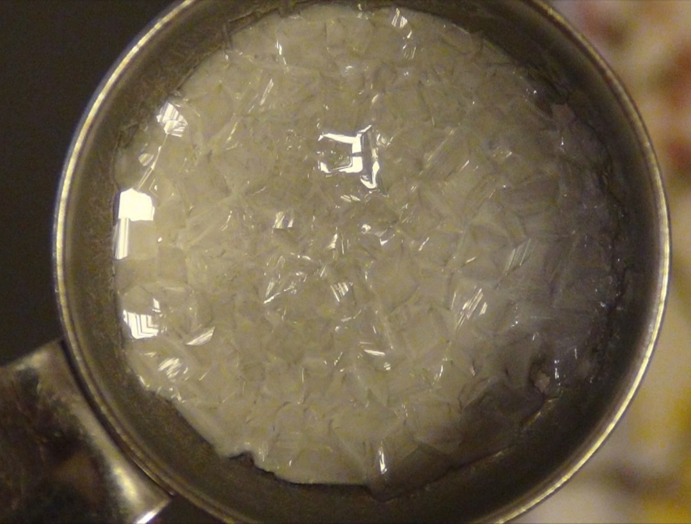
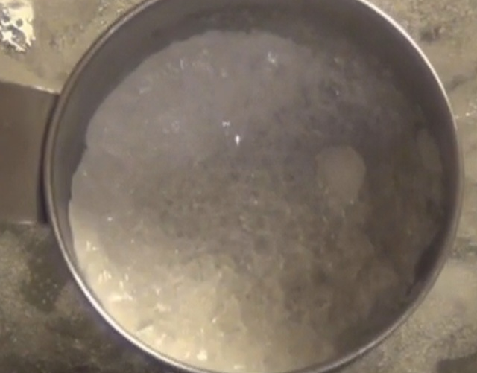
Can we design a different experiment that controls variables better?
Which one cooled faster? What caused difference?
In the classroom, interpreting what caused the difference in the different types of experiments is important in making sense of the results.

Slide 14

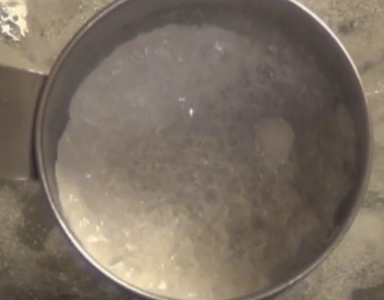
Can we design a different experiment that controls variables better?
Which one cooled faster? What caused difference?
cooled in warm water—slower cooling
Uniformly larger crystals
Less milky appearance
No feathery crystals
cooled in ice water—faster cooling
Uniformly smaller crystals
Milky appearance
Hey, maybe I’m starting to be convinced!
But, can we repeat it?
And why the different result?

Slide 15
Can we design a different experiment that controls variables better?
Which one cooled faster? What caused difference?
cooled in warm water—slower cooling
cooled in ice water—faster cooling
Different result possibly due to:
Bigger difference in water temperature creates bigger difference in cooling rates, making it easier to see size differences
Metal container conducts temperature faster and more uniformly
Depth of the thymol melt is more uniform, getting rid of the ‘crystallization from the outside in’ effect.

Slide 16
2nd investigation details

Slide 17
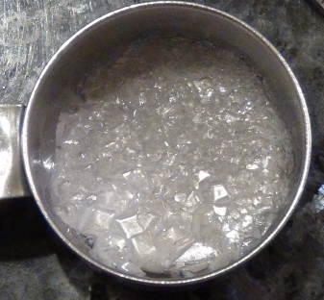
What Else Can We Do?
What can you see in these results, and what might have caused them?
The fun of an investigation in the classroom is found in striking off into the unknown where the textbook doesn’t guide us!

Slide 18
What Else Can We Do?
Smaller crystals
Smaller crystals
Larger crystals
Larger crystals
A bag of ice was held against one side of the measuring cup as the thymol cooled in air.
Many ‘seed’ crystals were added to the top side, none to the bottom side, as the thymol cooled in a warm water bath.

Slide 19
Conclusions
The purpose of classroom investigation is not to confirm the textbook information—rather the purpose to is learn how to investigate.
Real investigation—and classroom fun—begins when you pursue the unexpected.

Slide 20
Mary’s contact info
mcolson@moorheadschools.org
@MnMColson
Russ’s contact info
colson@mnstate.edu
Links Page for this investigation
http://web.mnstate.edu/colson/D2L-unlinked/Experimental_Igneous_Petrology_with_Thymol_Link.htm.

