Slide 1



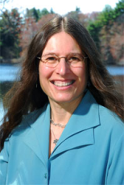


Climate Literacy and Energy Awareness Network (CLEAN)
Overview and Services
Presenter: Tamara Shapiro Ledley, TERC, CLEAN PI
(Presentation January 31, 2012 at 1 pm ET)
Presentation of slides and chat opportunity via Blackboard Collaborate© , audio via teleconference line: 702-589-8300 (code 7705706#)

Slide 2
Purpose of CLEAN Presentation
CLEAN project has developed a number of services that can be leveraged by climate change education projects and proposals
Overview of these services
  CLEAN Review Process to vet climate change education resources
  CLEAN Widget to bring resources to your web site
  CLEAN Virtual Professional Development mechanisms
  CLEAN Community

Slide 3
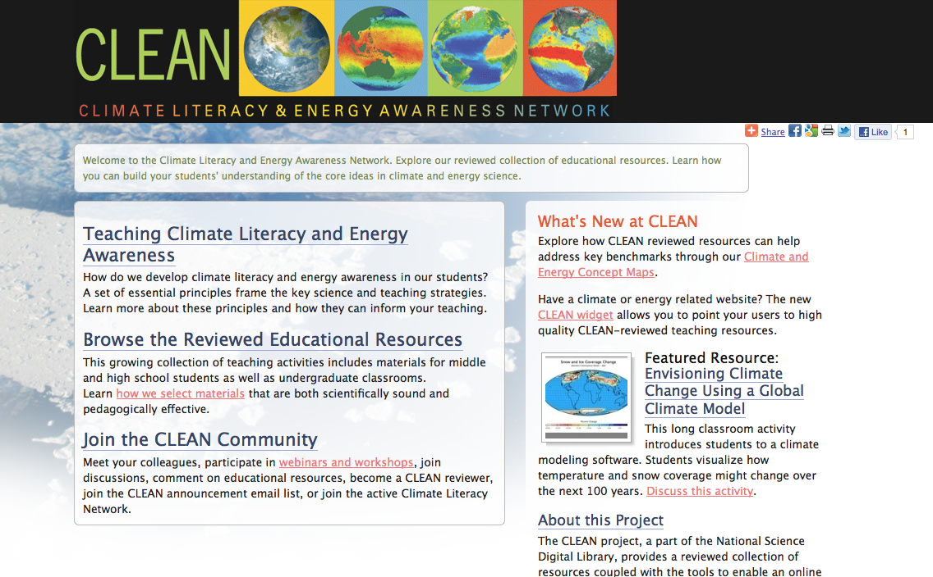
The CLEAN Portal http://cleanet.org

Slide 4
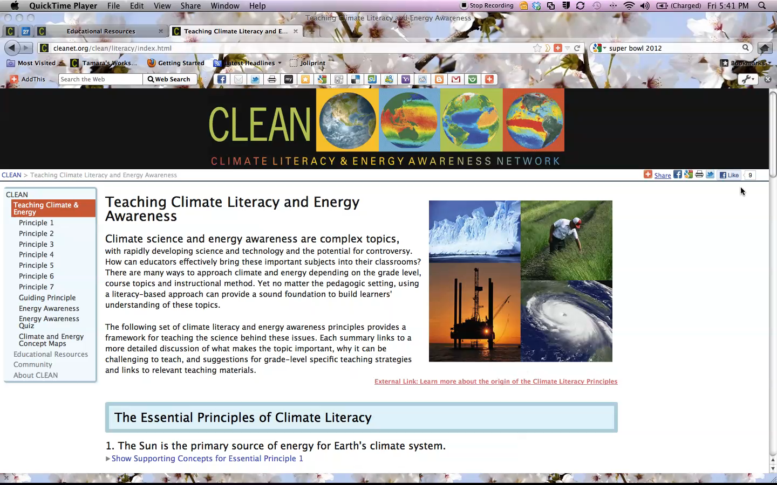
Guidance for Understanding and Teaching About Climate and Energy
Screencast
Hit Play
Button

Slide 5
The CLEAN Portal http://cleanet.org

Slide 6
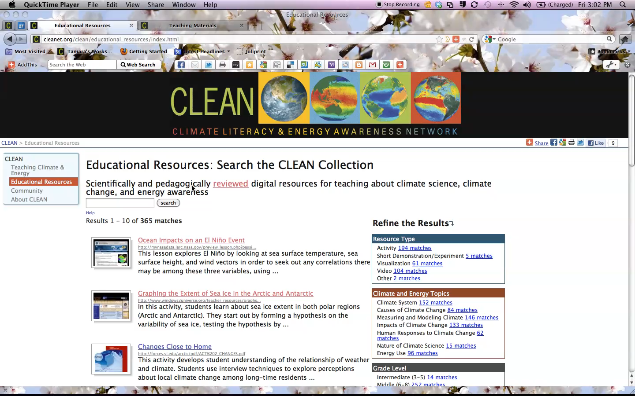
The CLEAN Collection http://cleanet.org/clean/educational_resources/index.html
Screencast
Hit Play
Button

Slide 7
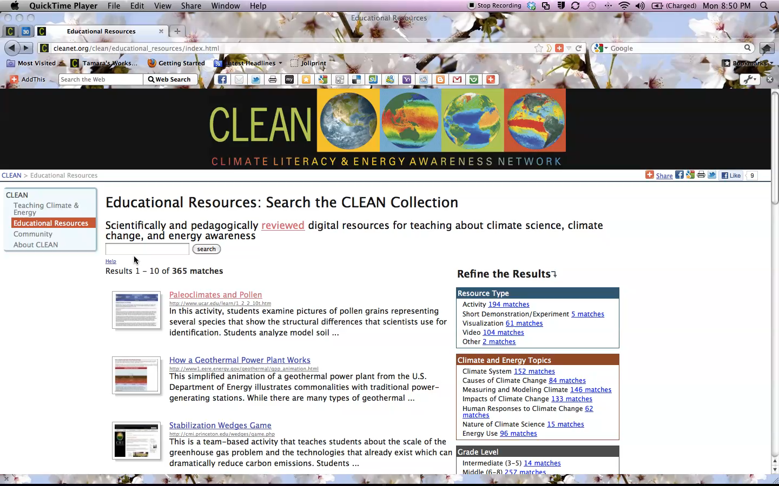
A CLEAN Resource
Screencast
Hit Play
Button

Slide 8
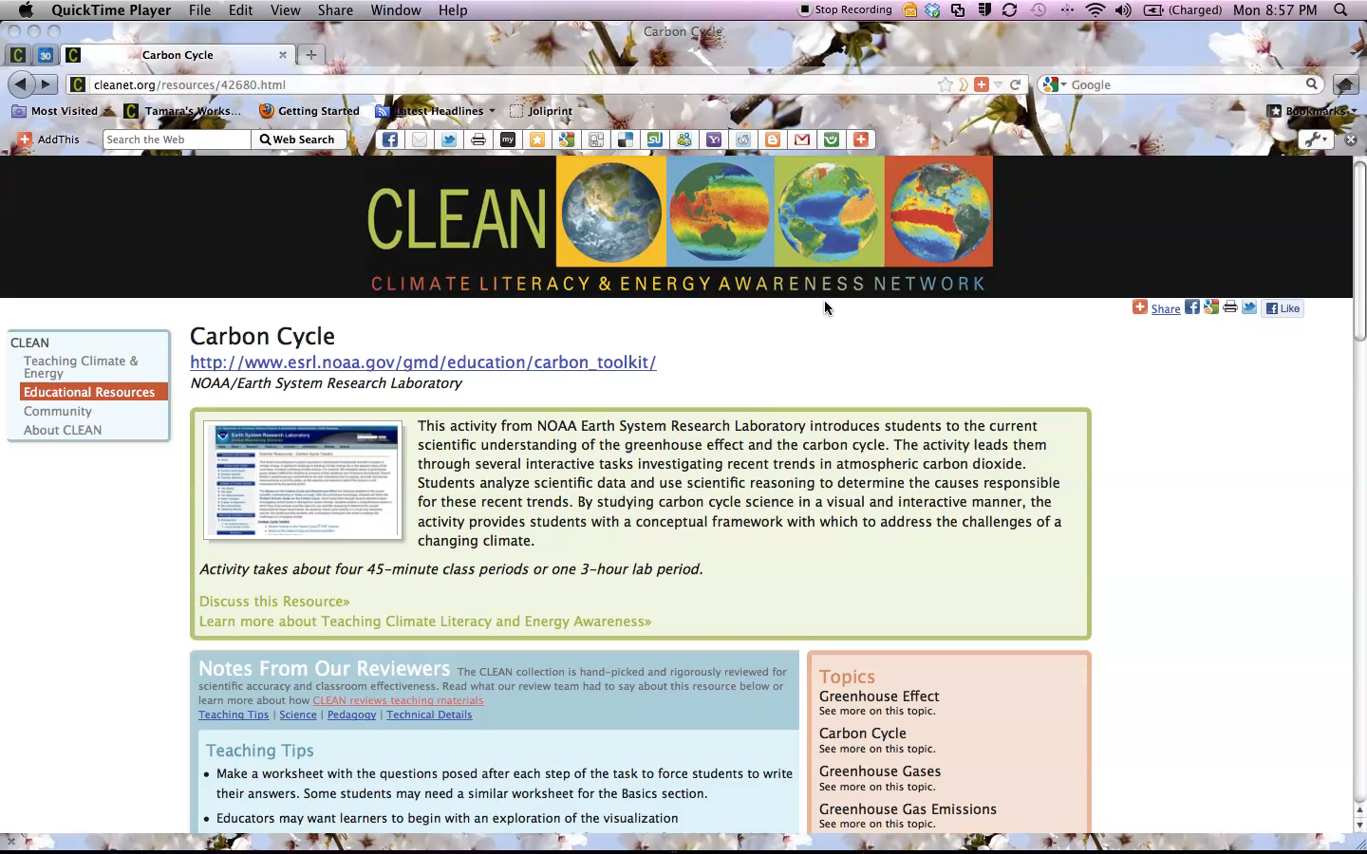
CLEAN Concept Map – Resources Alignment
Screencast
Hit Play
Button

Slide 9
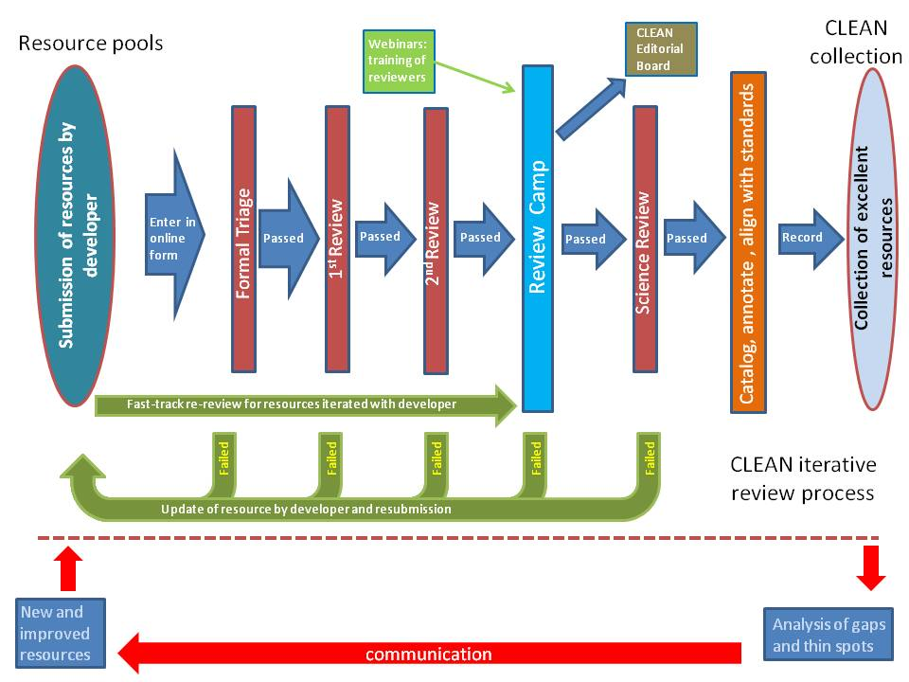
CLEAN Review Process

Slide 10
CLEAN Review Criteria
 | Learning Activity | Visualization | Video | Short Demo/ Experiment
 | Learning Activity | Visualization | Video | Short Demo/ Experiment
Scientific Accuracy (eg. attribution, scientific process, scientific validity, orginal data sources, valid concepts, misconceptions, avoiding bias, references) | 7 questions | 5 questions | 6 questions | 6 questions
Pedagogic Effectiveness (eg. learning objectives, learning styles, diverse audience, prerequisite skills, assessment, inquiry, engaging & motivating) | 10 questions | 6 questions | 5 questions | 7 questions
Usability and Technical Quality (eg. advertisements, materials, support required, teacher guide, design, access, size ) | 7 questions | 6 questions | 5 questions | 4 questions

Slide 11
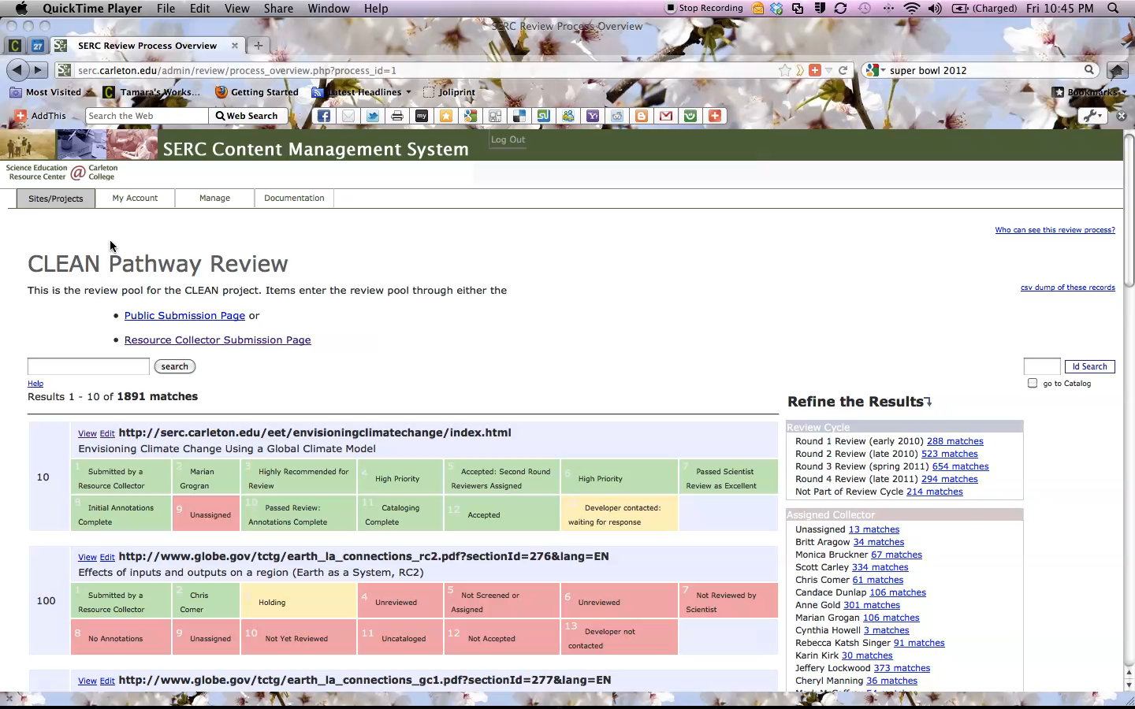
CLEAN Review Tool
Screencast
Hit Play
Button

Slide 12
CLEAN Review Services
Review of existing resources in your inventory
  Existing process and review criteria
Customization of review criteria as appropriate for your collection
Peer-review iterative process
  Work with curriculum developers in your partnership to assure resources are accepted into the CLEAN collection

Slide 13
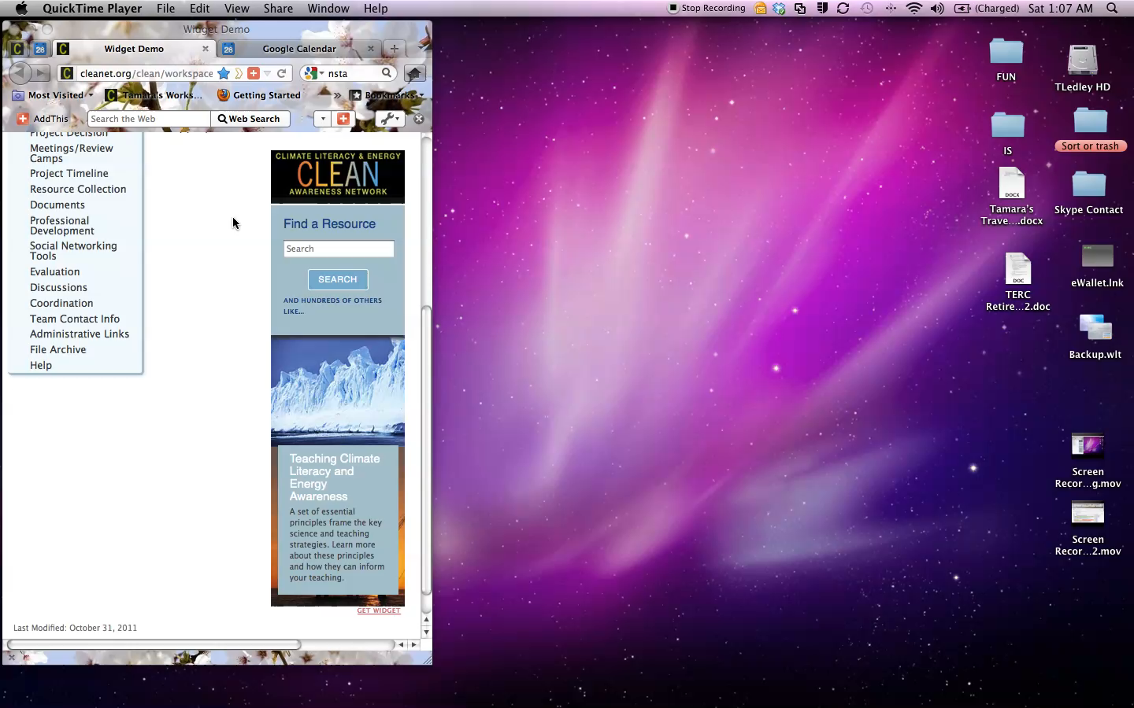
The CLEAN Widget http://cleanet.org/clean/about/widget.html
Make CLEAN resources visible from your website
Screencast
Hit Play
Button

Slide 14
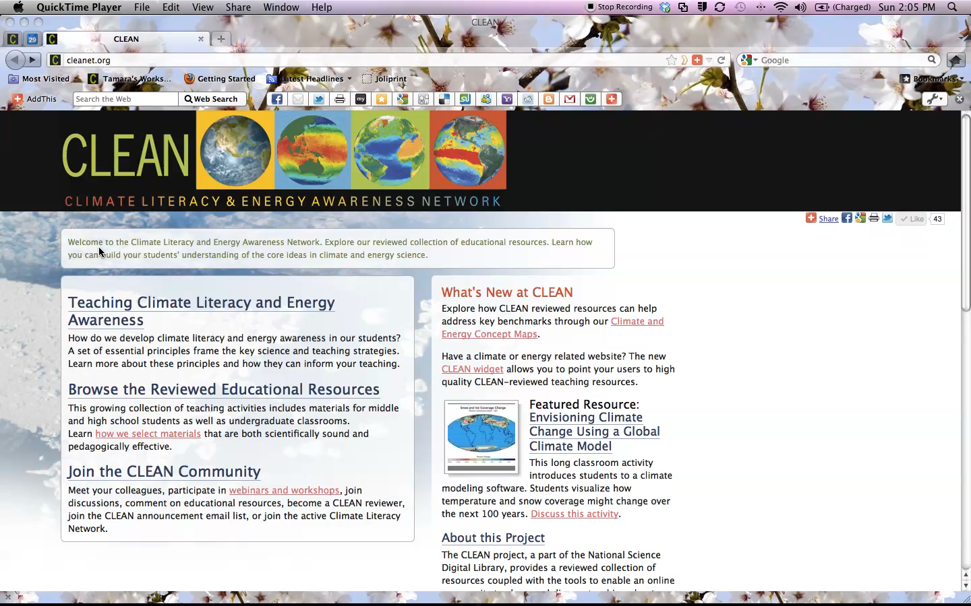
CLEAN Professional Development
Screencast
Hit Play
Button

Slide 15
CLEAN Community
Climate Literacy Network
CLEAN Announcements listserv
CLEAN Facebook page
Materials and guidance for Resource Developers
Collection of active climate change education projects
Avenue to feature and provide avenues for CCEP-II and others to communicate and leverage each other’s efforts

Slide 16
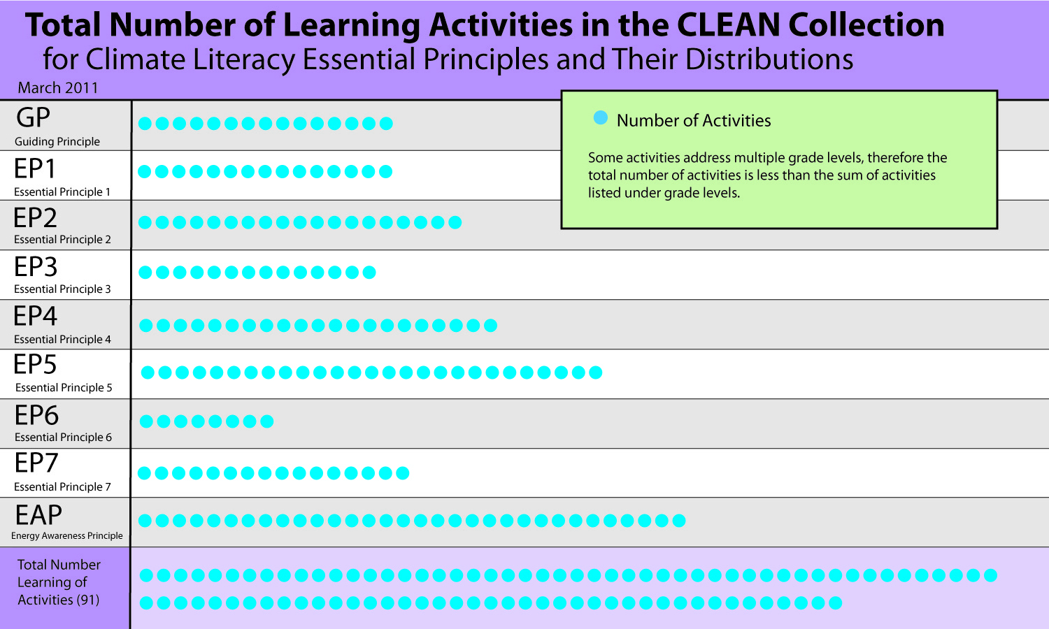
CLEAN Gap Analysis http://cleanet.org/clean/community/gap_analysis

Slide 17
CLEAN Services - Summary
The CLEAN Portal: http://cleanet.org,
  Screencast overview http://cleanet.org/clean/community/webinars/screencast
CLEAN Collection
  http://cleanet.org/clean/educational_resources/index.html
Review Process & Review Criteria
  http://cleanet.org/clean/about/review.html
CLEAN Widget: http://cleanet.org/clean/about/widget.html
CLEAN Professional Development
  http://cleanet.org/clean/community/index.html#events
CLEAN Community: http://cleanet.org/community/index.html
  Climate Literacy Network: http://cleanet.org/cln
  Climate Change Education project descriptions: http://cleanet.org/cln/ccep.html - evolve to feature and provide mechanisms to communicate and leverage efforts
  CLEAN Announcements: http://cleanet.org/clean/community/email_list.html
  CLEAN Facebook page: http://www.facebook.com/CLEANET
CLEAN Collection Gap Analysis: http://cleanet.org/clean/community/gap_analysis

Slide 18
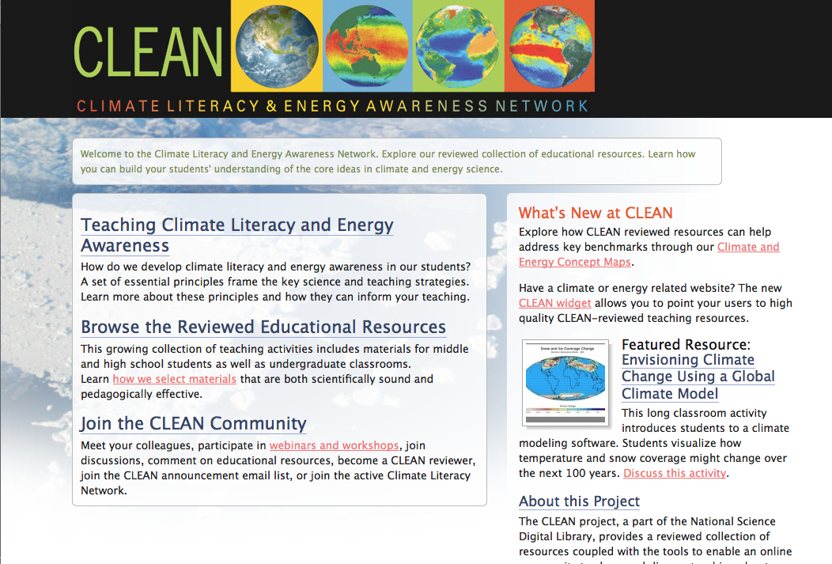
CLEAN Pathway Portal
  http://cleanet.org
Contact: Tamara Shapiro Ledley
      Tamara_Ledley@terc.edu 617-873-9658

