Slide 1
Notes:
Thanks for opportunity.
Example place-based nonprofit organization working across multiple sectors with measureable impact. Our approach is to work synergistically.
There’s a lot of impressive work happening in the climate change education community and we’re honored to be a part of it.
Introduce the short video.

Slide 2
Advancing Climate Action through Education, Public Engagement and Youth Leadership
Kristen Poppleton, Director of Programs
Climate Generation: A Will Steger Legacy
AGU: December 14, 2017

Slide 3

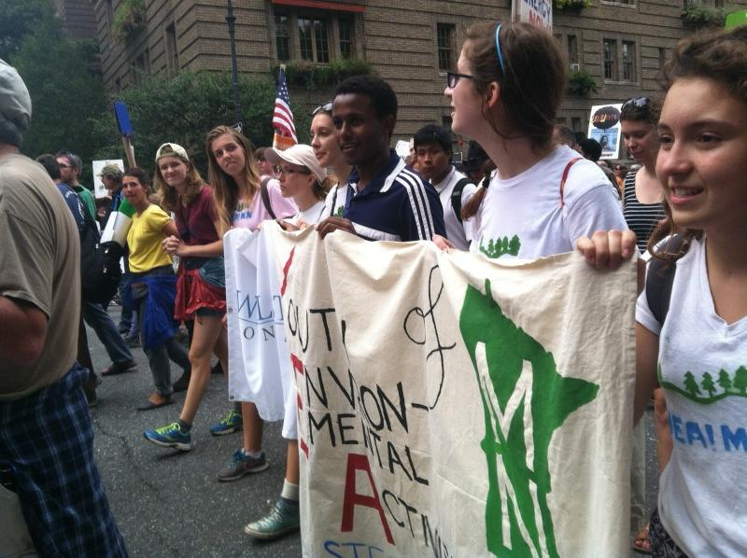
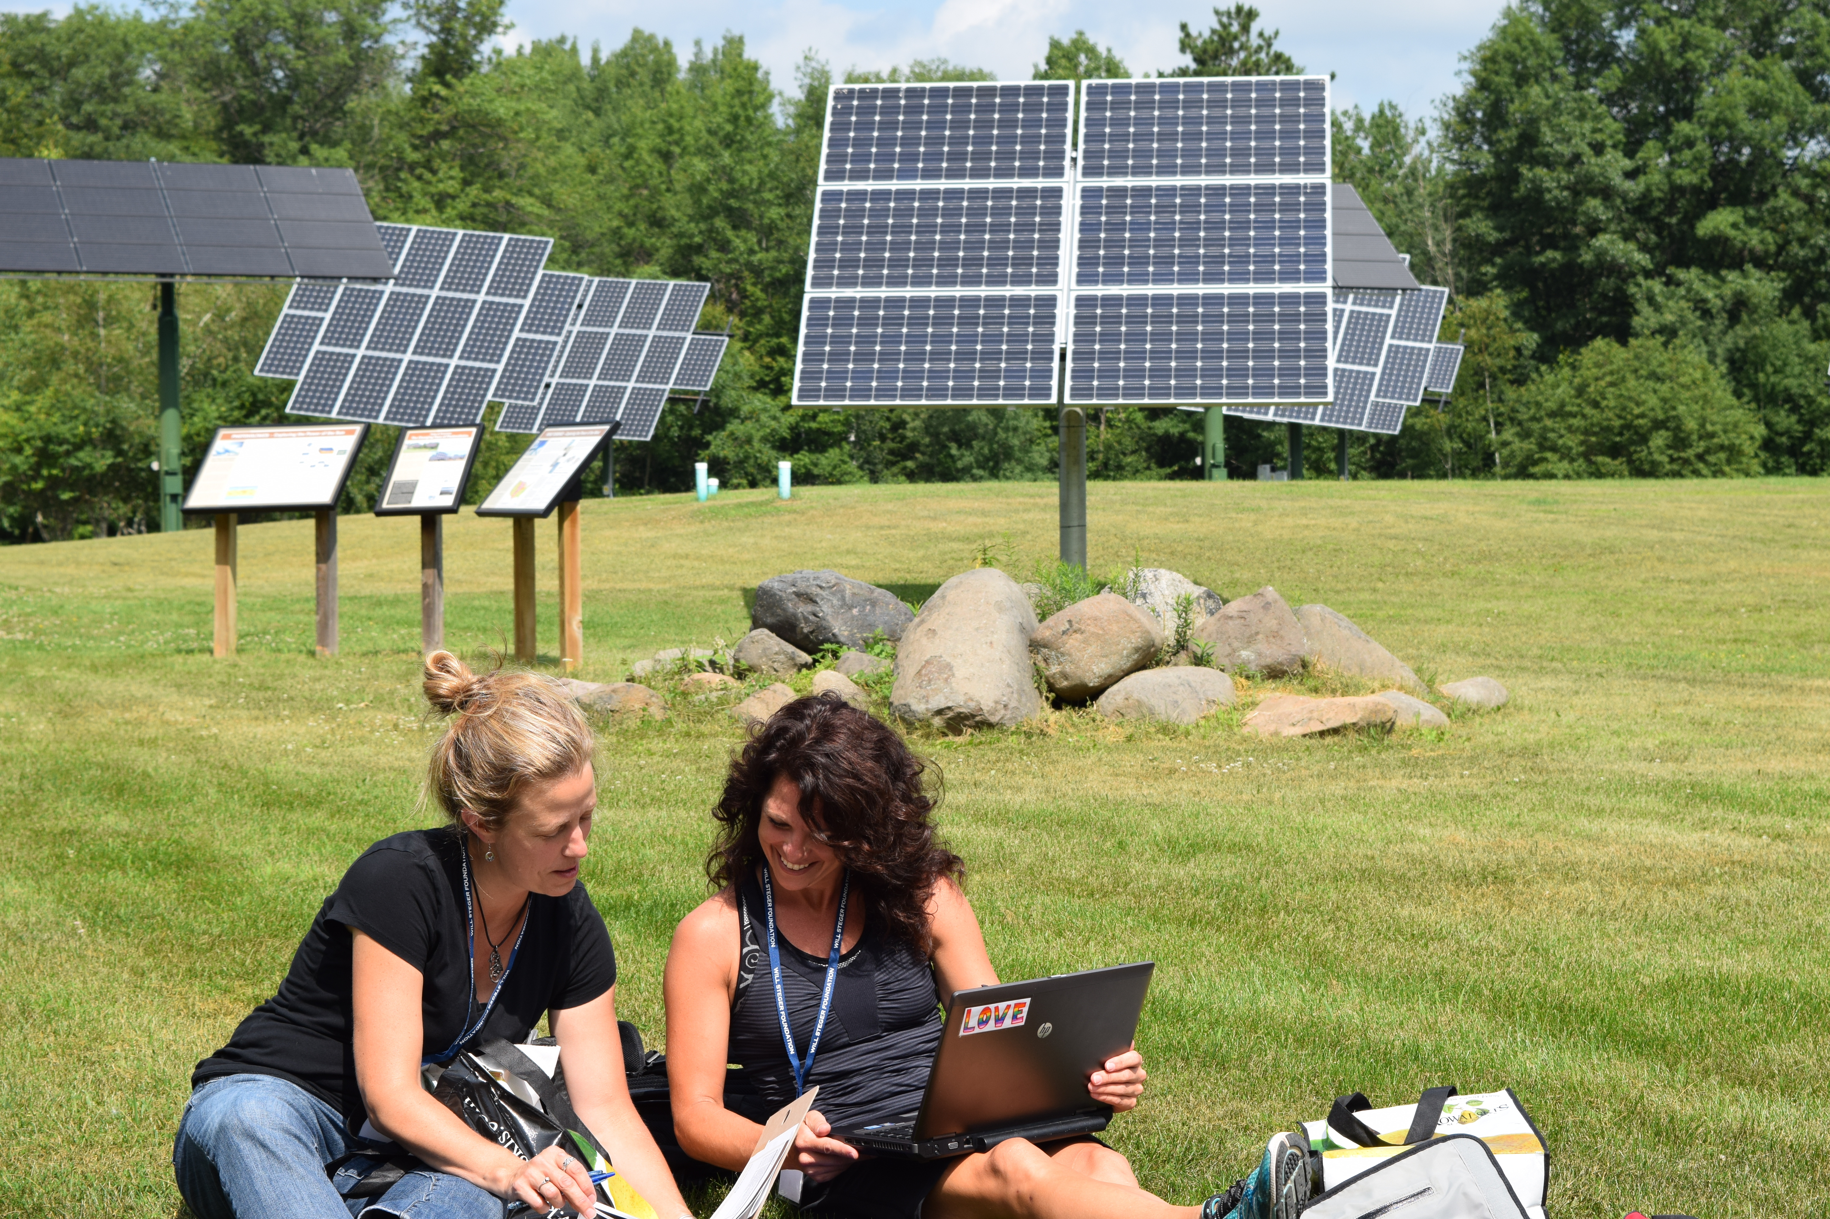
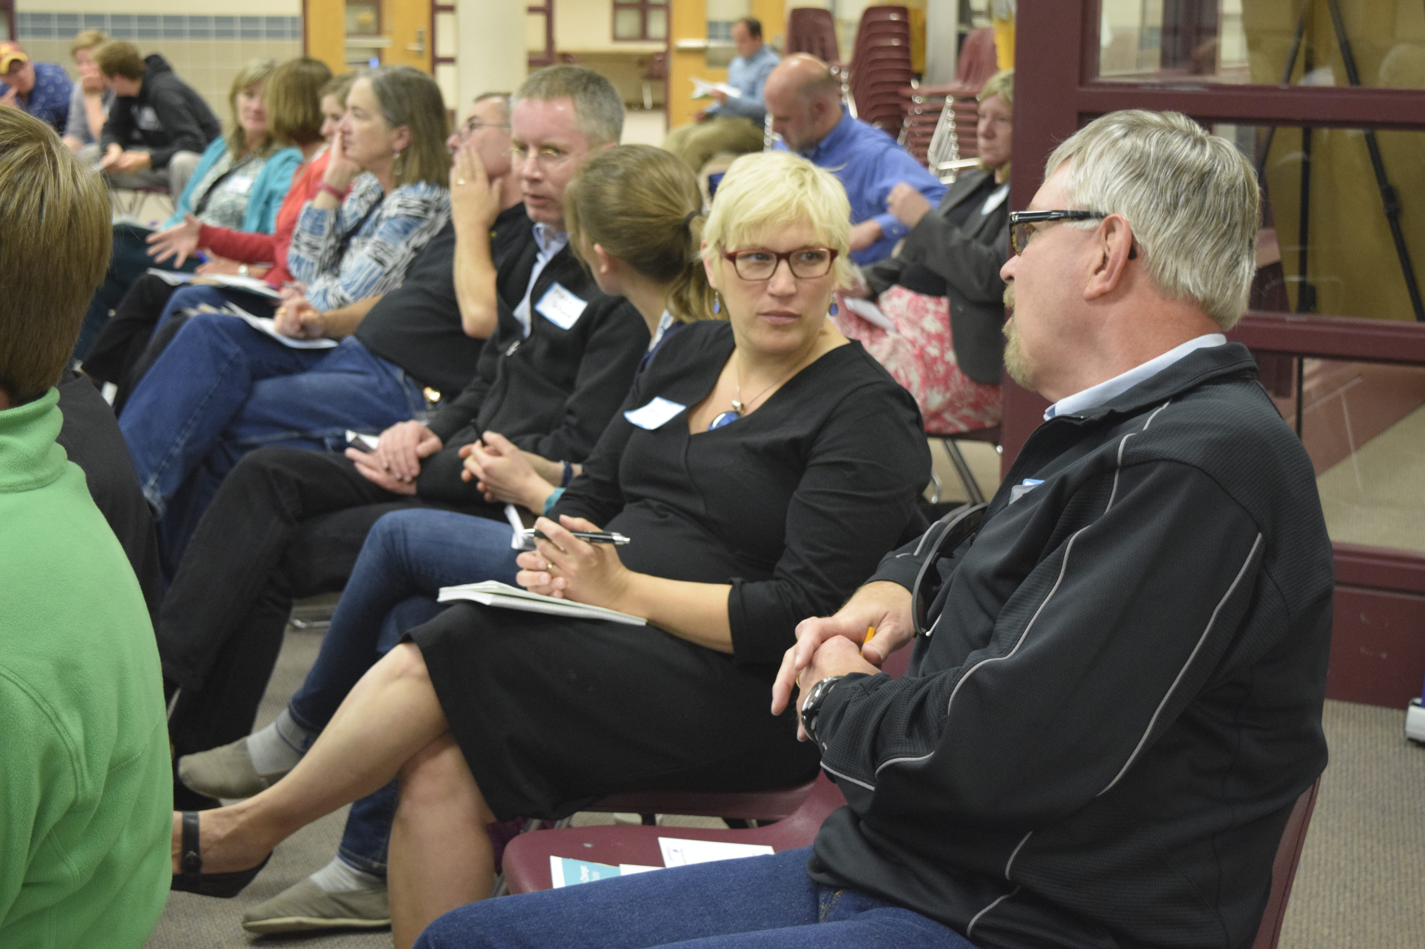
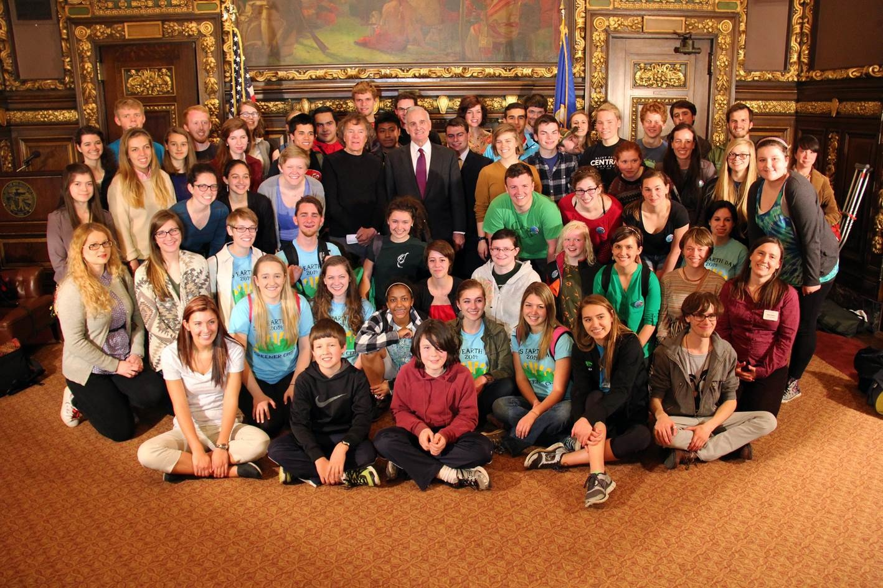
Climate Generation: A Will Steger Legacy inspires individuals and their communities to engage in solutions to climate change
Youth | Educators | Public | Influentials

Slide 4
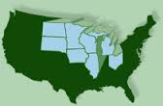
Strategic Geographic Focus
Midwest:
  Heavy reliance on coal; industry & manufacturing; with strong renewable energy potential
  Politically centrist – drives national policy
Minnesota:
  Many Fortune 500 companies based in MN
  Only Midwest state in US Climate Alliance
Notes:
This is why it’s important that we are located here; but our programs have national and international reach.

Slide 5
Mainstream climate change education
Normalize conversations about climate change impacts and solutions
Elevate the moral imperative and a future built on innovation through youth voices
Embolden leadership of decision makers and businesses to act on climate
Educators
Public
Youth
Influentials

Slide 6
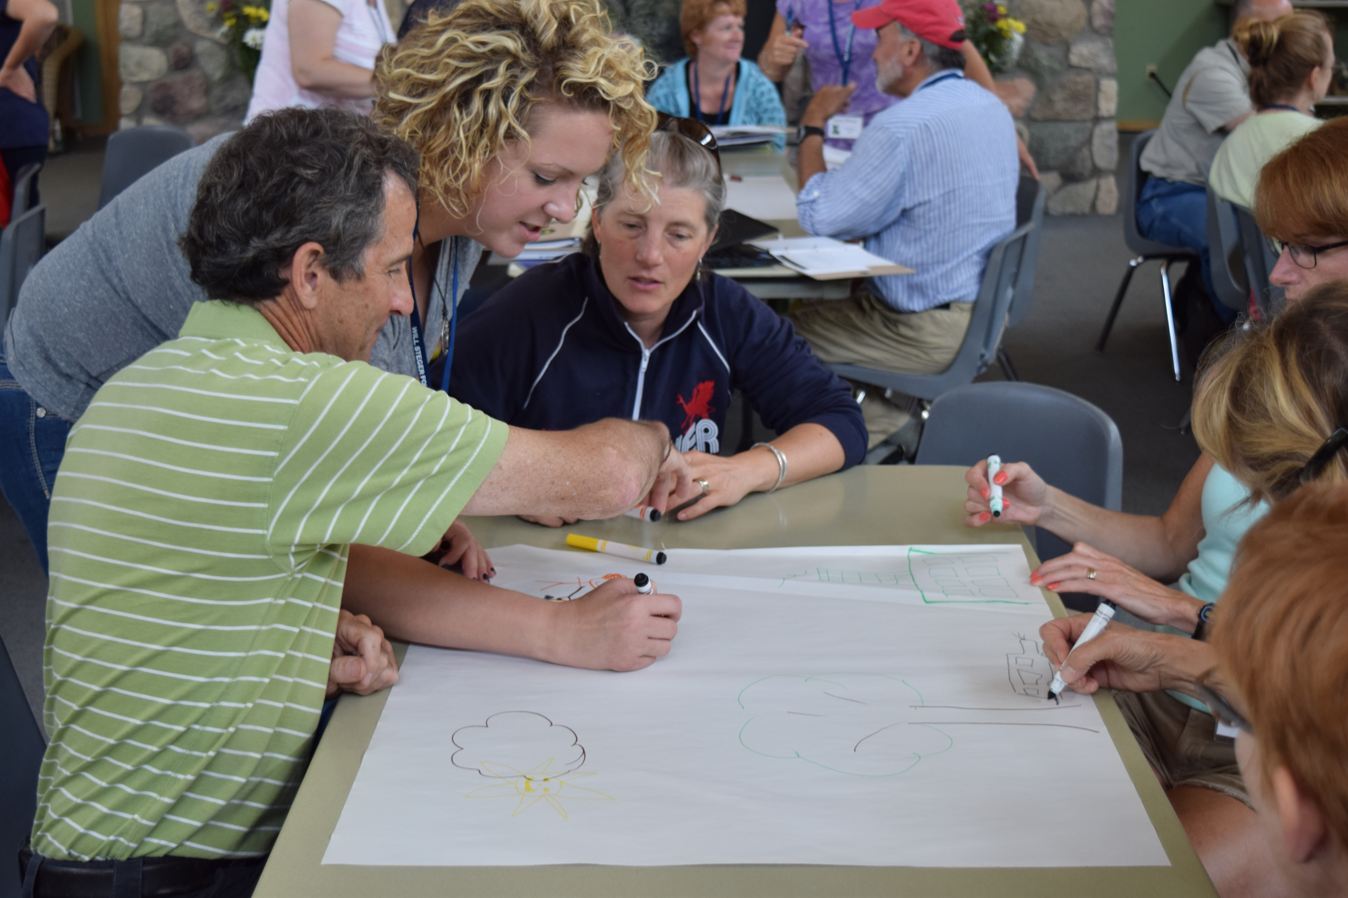
Educators
Professional Development
Curricula Resources
National teacher network
Come to our 2018 Summer Institute for Climate Change Education!

Slide 7
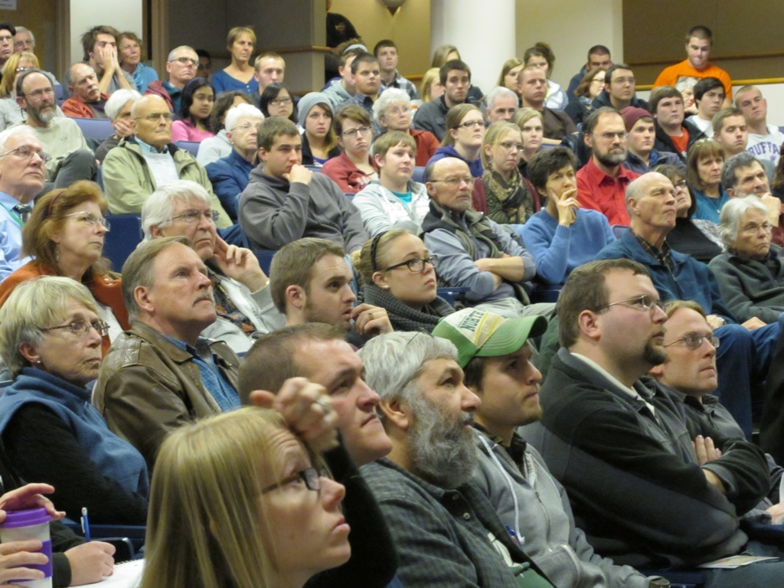
Public
Nationally recognized model of convening
Sharing of personal climate stories
Climate context
Engagement events with arts, business, communities
Come to our 2018 Talk Climate Institute!

Slide 8
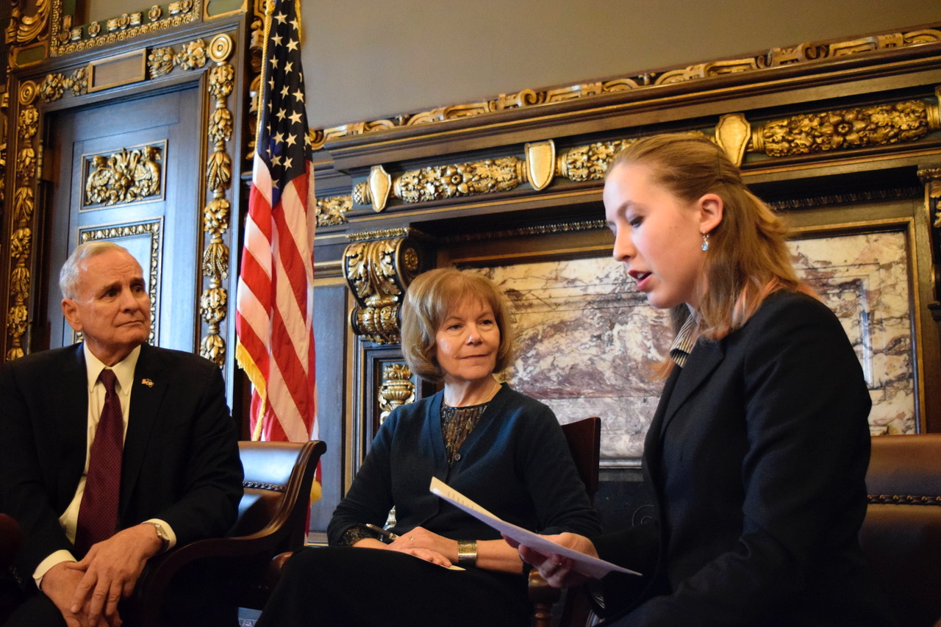
Youth
Network of high school leaders
Middle school Green careers fair, curricula, training
Energy Engagement Internship in partnership with State Energy Office

Slide 9
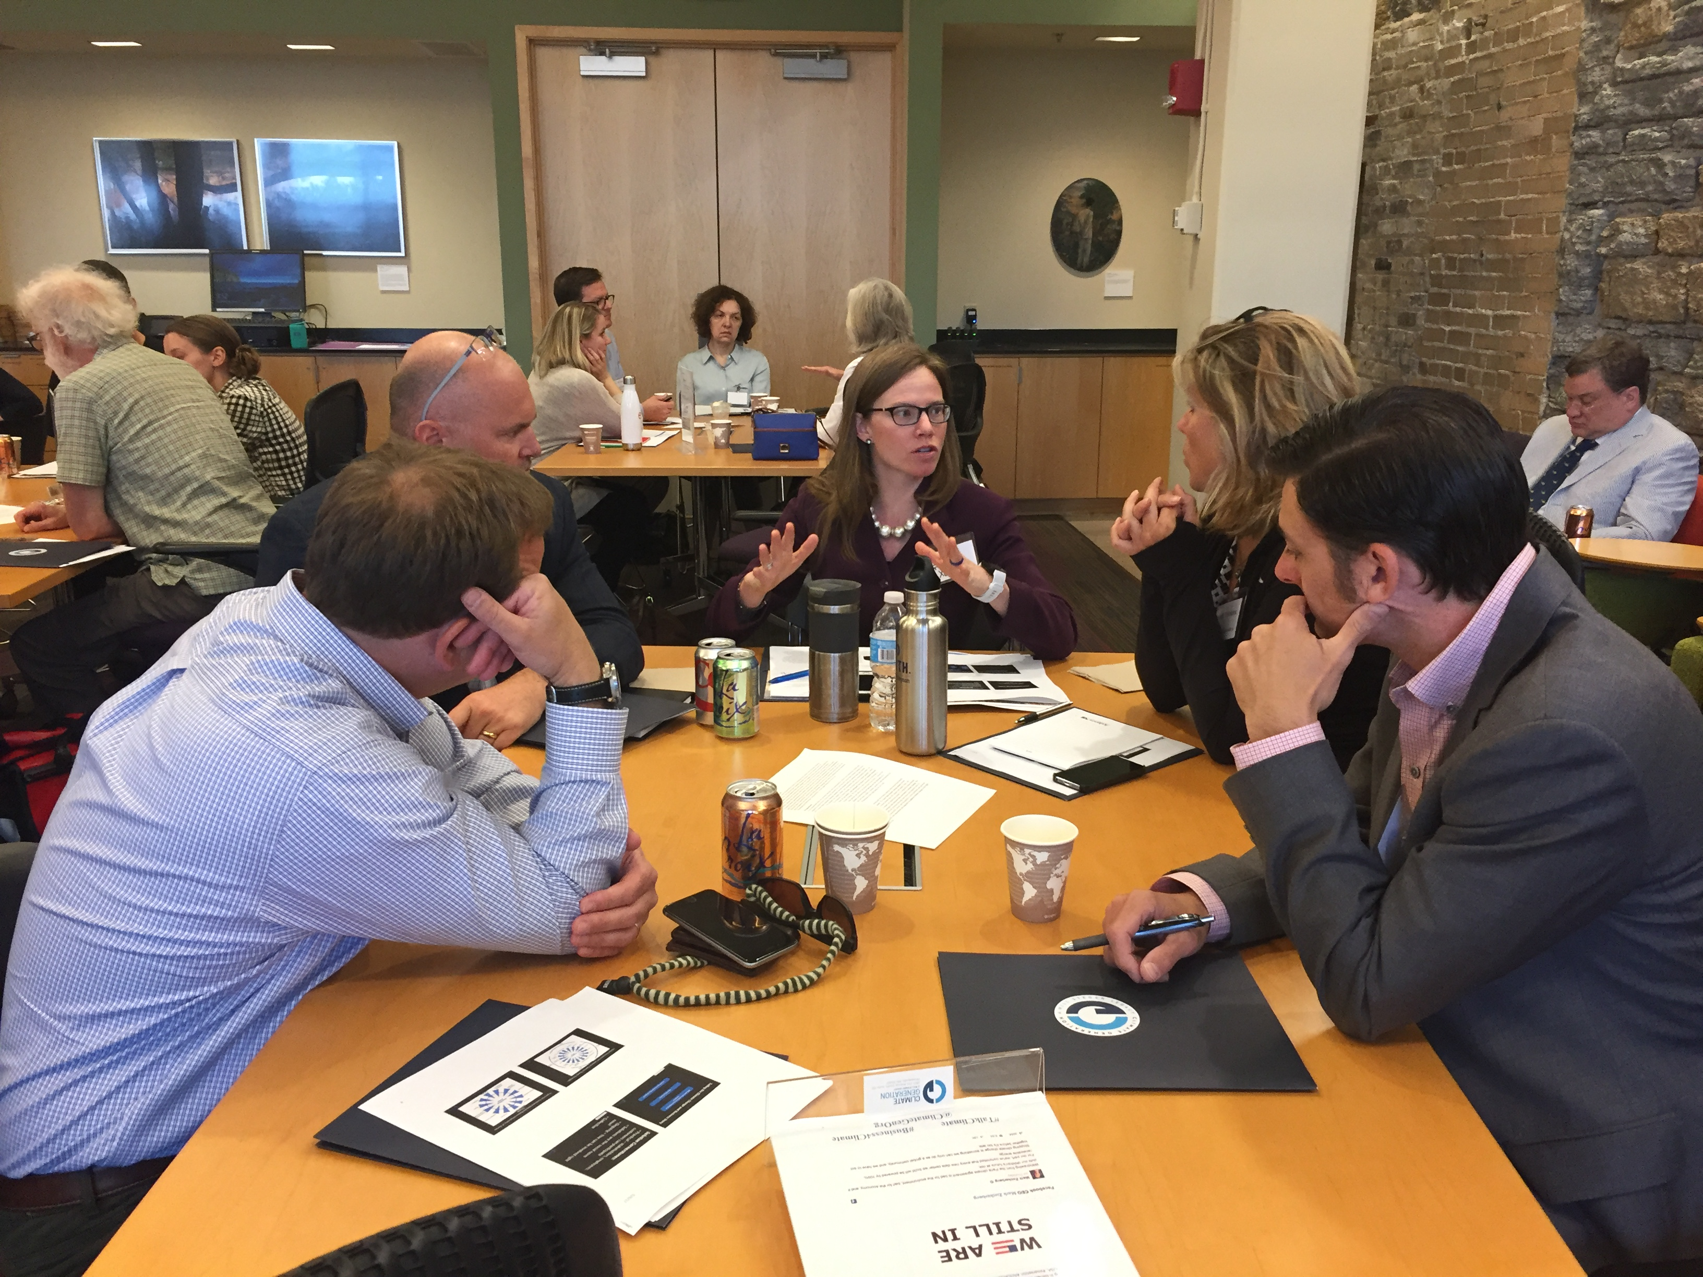
Influentials
Climate Communications for Business Workshops
Convening partnership events
Member of statewide policy coalitions and conversations pushing just, equitable clean energy policy

Slide 10
How do we accelerate action?
Mainstream climate change education across subjects
Normalize conversations about climate change impacts and solutions
Elevate the moral imperative and a future built on innovation through youth voices
Embolden leadership of decision makers and businesses to act on climate
Educators
Public
Youth
Influentials

Slide 11
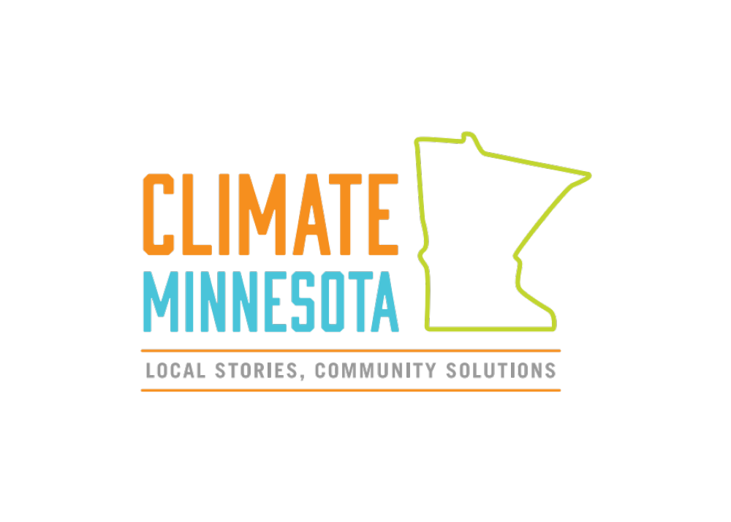
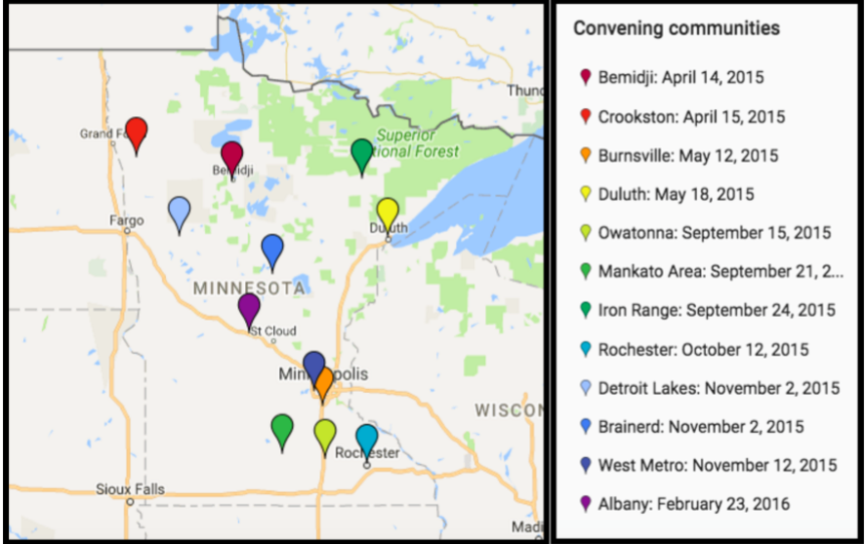
www.climateminnesota.org
Notes:
Slide: Climate Minnesota Logo, goals and activities
Climate Minnesota: Local Stories, Community Solutions project.
12 public Convenings on climate change,
online storytelling collection for personal climate stories;
and co-produced a Twin Cities PBS film, Minnesota Stories in a Changing Climate.

Slide 12
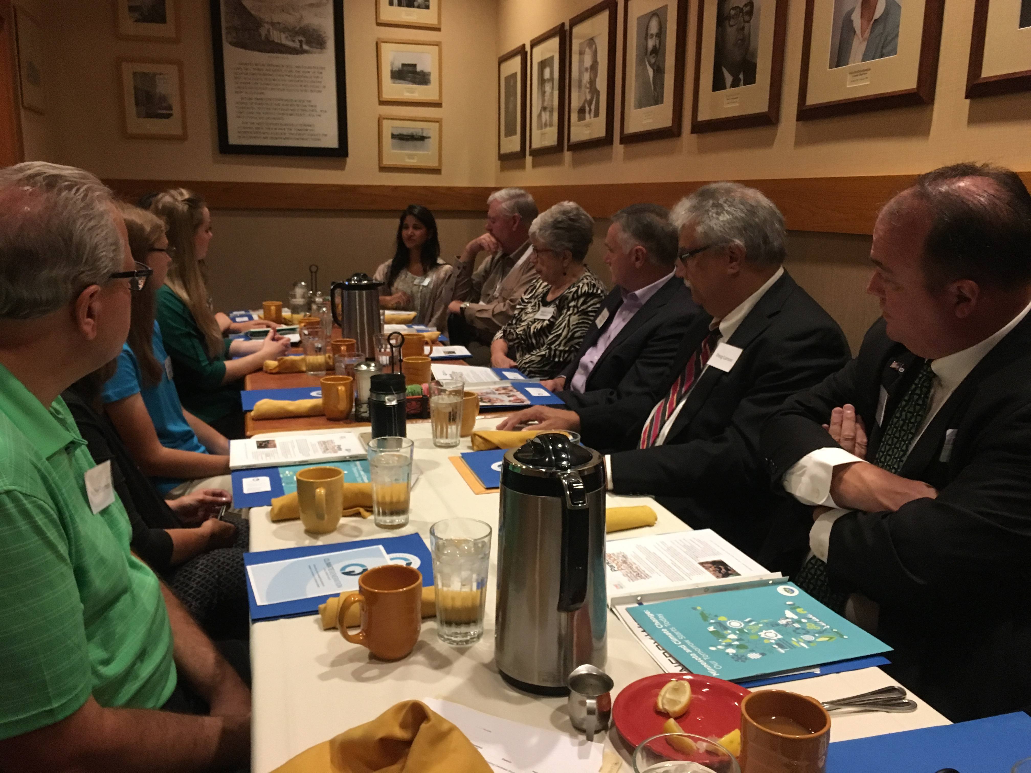
Legislative Breakfasts
I did not make the connection until now that stories could be an important way to move the needle on climate change, it reminds me of the successful campaign for the marriage equality movement!
-Duluth legislator

Slide 13

5 Greater MN Communities
School Assemblies
Ongoing mentorship
Youth led Community Convening
Legislative follow-up

Slide 14
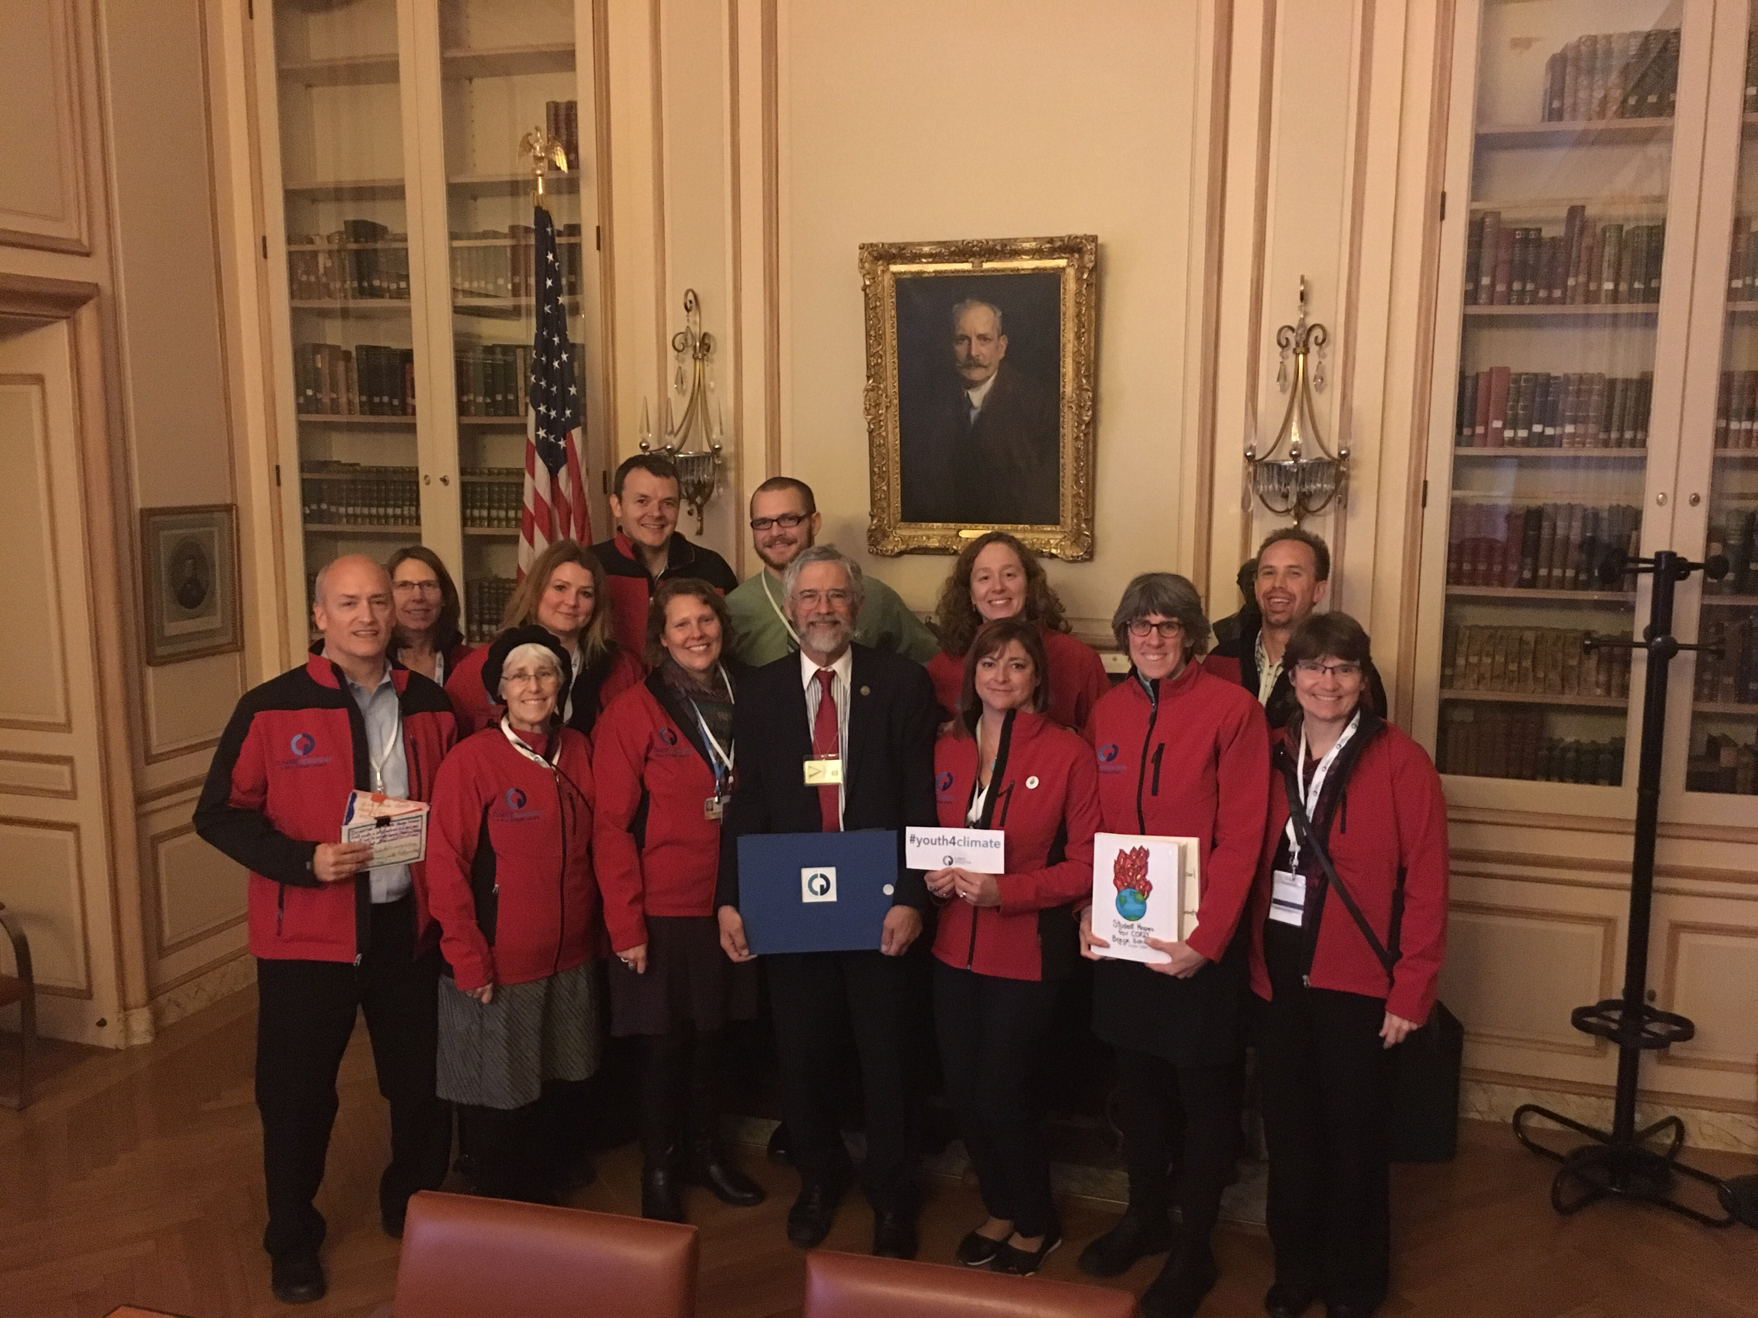
Windows into UNFCCC:
COP15-COP23
Elevate important multi-sector voices at the international level
For delegates, we want to build climate champions, build empathy and awareness for countries experiencing climate change impacts most seriously
For followers, we want to tell a story that is unique, accessible and brings COP to life.

Slide 15
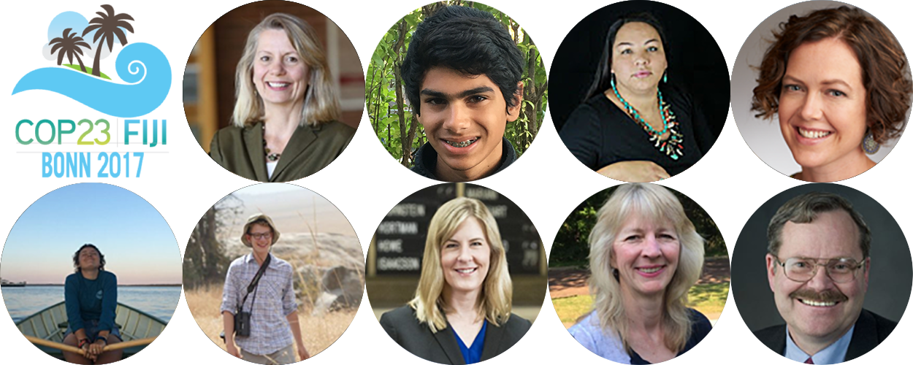

Slide 16
Effective multi-sector work is...
Mission-based
Recognizes that the climate context is critical
Depth and breadth of partnerships- with a network of partners in multiple sectors (business, equity arts, education, policy, renewables)
Positive and solutions focused
Nimble, responsive
Programs based in current research and best practice

Slide 17
Challenges
Equity
Capacity
Policy- overt or concealed?
Funding

Slide 18
As a teacher with 16 years of experience in the classroom and after attending many professional development opportunities over the years, I can say without hesitation that the Climate Generation Summer Institutes consistently have been among the best professional development I have attended locally or nationally.
Heidi Ferris, 2016 Summer Institute 2016

Slide 19
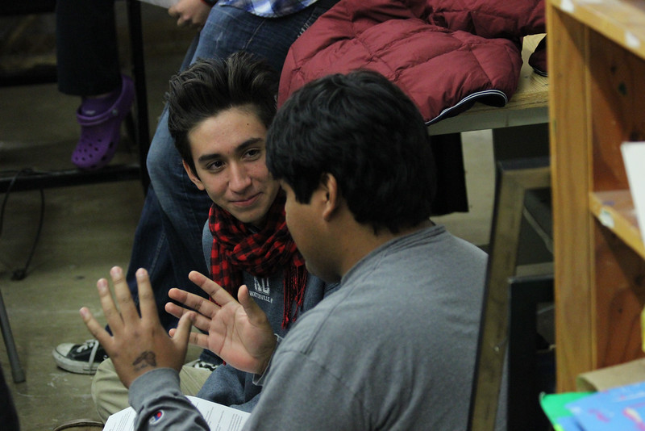
I recognize the important role that Climate Generation has played in building climate literacy and connecting communities in rural Minnesota... they empowered individuals of all ages from Crookston to Mankato to engage and formulate innovative solutions to climate change in their own communities. I particularly enjoyed and saw the importance of the stories shared by community members, especially those from young people.
Mark Seeley, Minnesota State Climatologist
Source: NASA

Slide 20
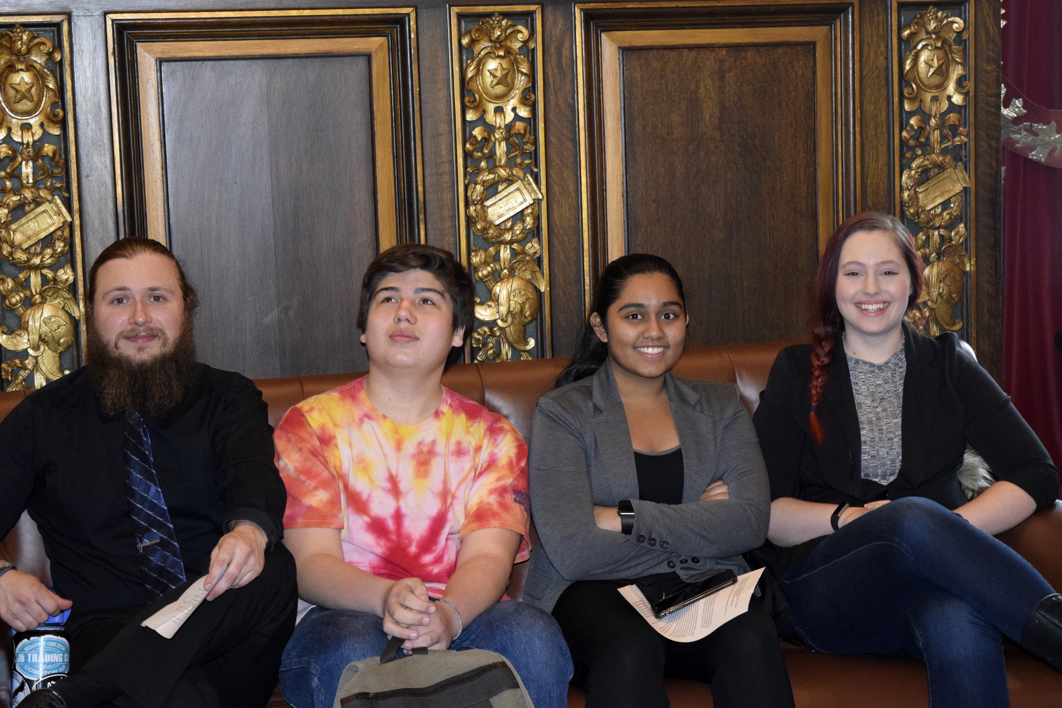
Through Climate Generation’s YEA! MN network, I’ve learned how organizations function, and about different ways to create change through policy, community, and in school. The experience has helped me think about how I can most effectively work on environmental issues after YEA! MN.
Shira Breen, Minneapolis South High School ‘14
YEA! MN Co-Chair 2013-2014

Slide 21

No one can endure the severe droughts or floods of recent years or our milder snow-scarce winters without being greatly alarmed. Just talk with my good friend and world- premier polar explorer, Will Steger, about the drastic climate changes he has witnessed. Even more alarming is that our state and our nation are still not doing enough to reverse this path towards global catastrophe, before it is too late. We’ve made real progress with clean, renewable energy, instead of polluting fossil fuels…but are we progressing fast enough?
Governor Mark Dayton, State of the State

Slide 22
Questions?
Kristen Poppleton
Director of Programs
Climate Generation: A Will Steger Legacy
www.climategen.org
kristen@climategen.org
Follow us on Facebook
Twitter @ClimateGenOrg
Instagram @ClimateGenOrg

Slide 23

https://www.youtube.com/watch?time_continue=40&v=tpQCZ1BvI8E
Notes:
Play Ten Year Video

