Slide 1
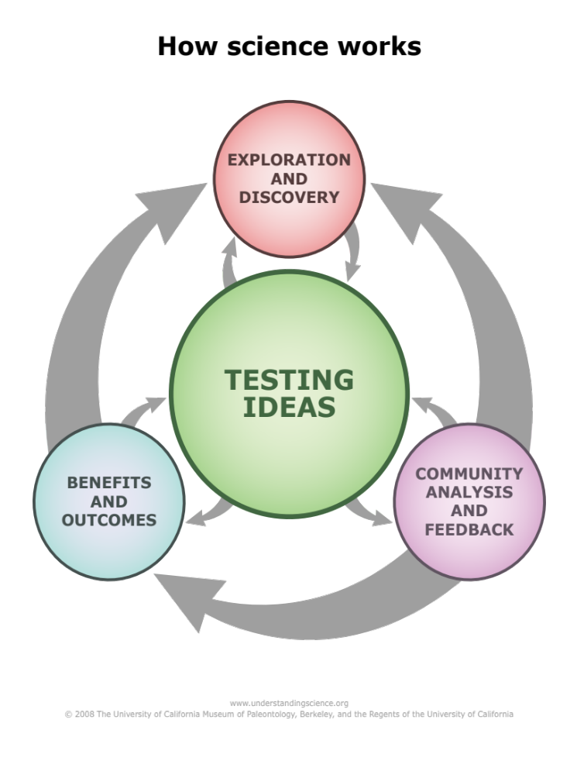
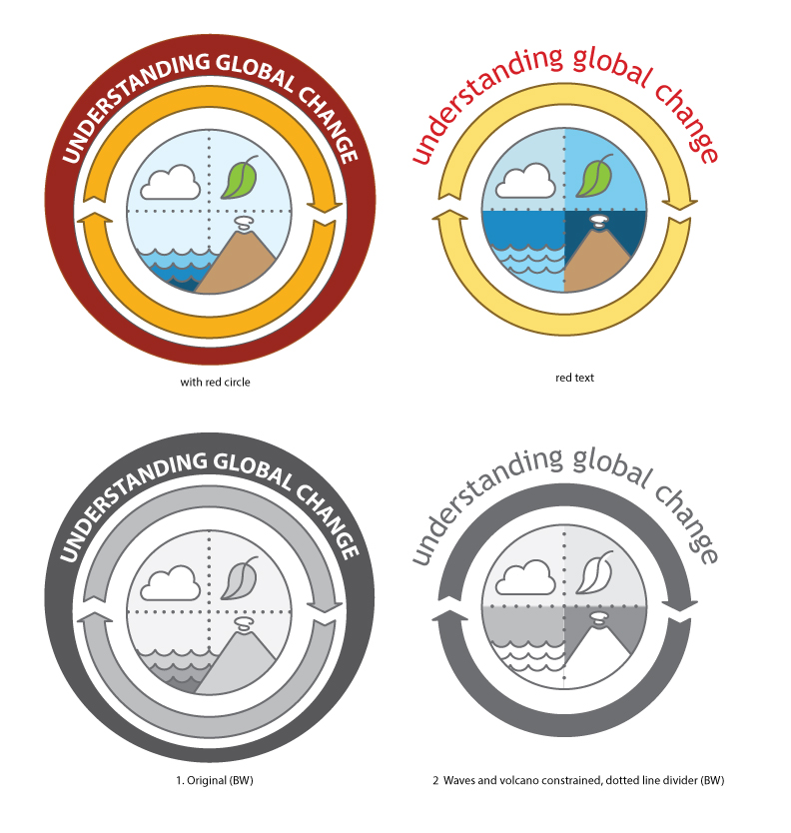

Teaching Earth Systems and Global Change:
New Tools for Scientists and Educators
Jessica R. Bean & Aleeza Oshry
University of California, Berkeley
Museum of Paleontology

Slide 2
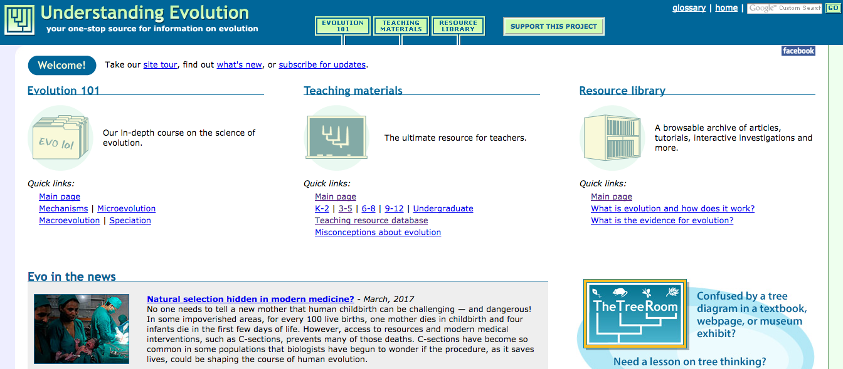

Slide 3

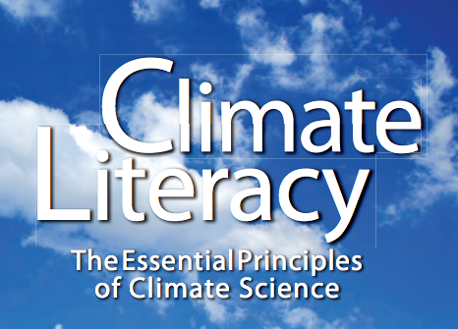










Slide 4


Slide 5
Communication Challenges for
Scientists and Educators

Slide 6
Communication Challenges for
Scientists and Educators
How we know what we know; describing and experiencing science

Slide 7
Communication Challenges for
Scientists and Educators
How we know what we know; describing and experiencing science
The interrelationships and feedbacks among components of the Earth system

Slide 8

Communication Challenges for
Scientists and Educators
How we know what we know; describing and experiencing science
The interrelationships and feedbacks among components of the Earth system

Slide 9
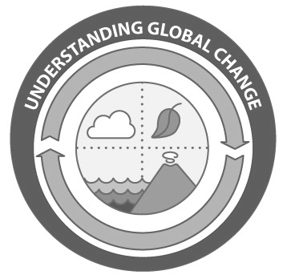
Communication Challenges for
Scientists and Educators
How we know what we know; describing and experiencing science
The interrelationships and feedbacks among components of the Earth system

Slide 10
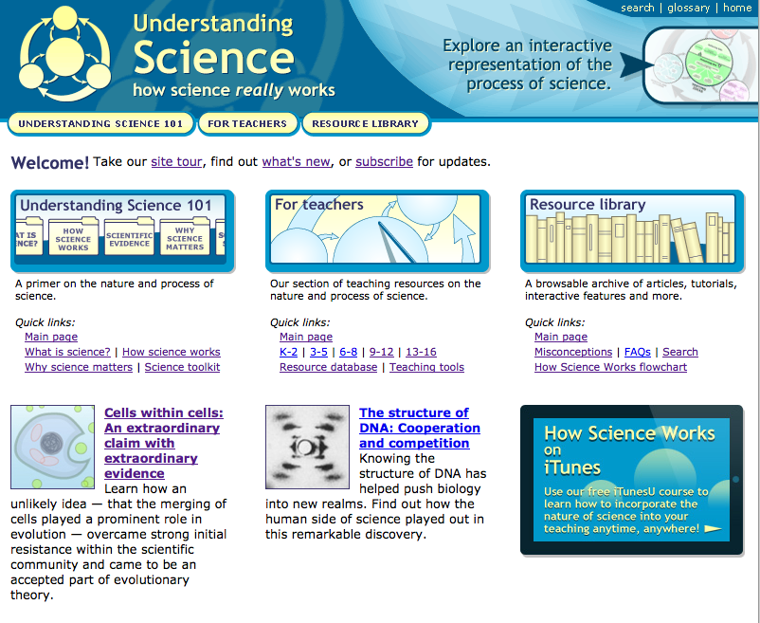
http://undsci.berkeley.edu/
Notes:
These sites receive millions of hits a year, and have been translated into multiple languages. The component of this site that is widely used, and that I have personally used in activities with middle, high school, undergraduates, and graduate students, is the understanding science flowchart

Slide 11
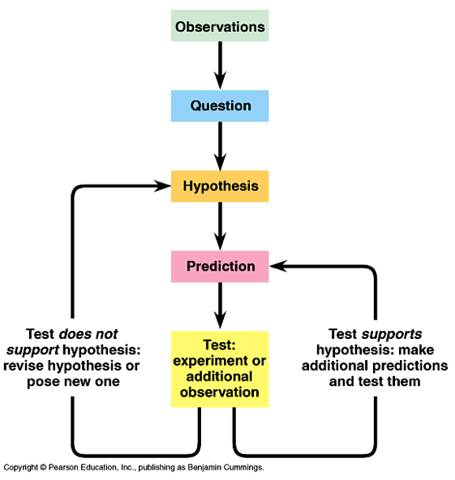

Slide 13
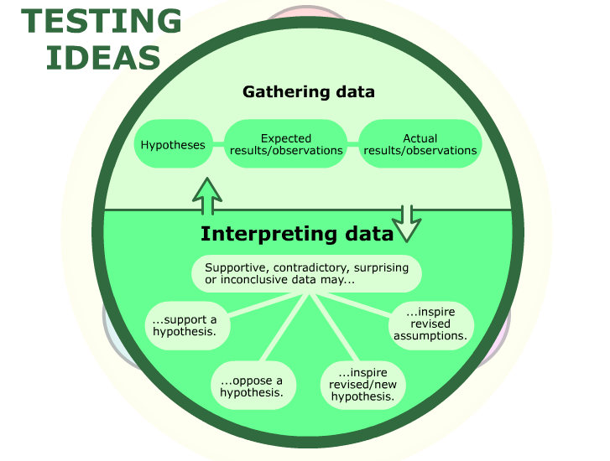

Slide 14
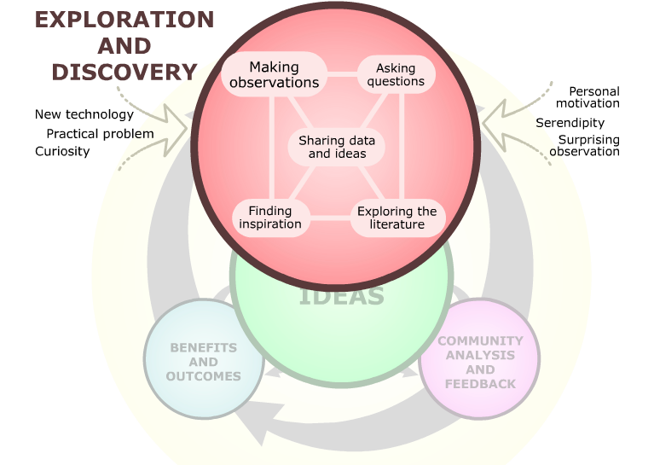

Slide 15
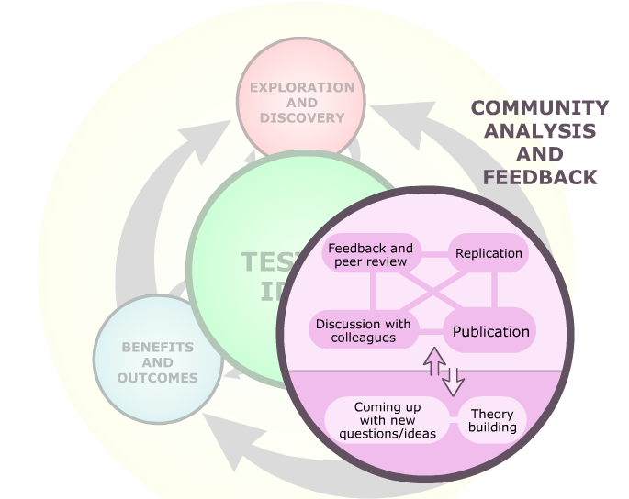

Slide 16
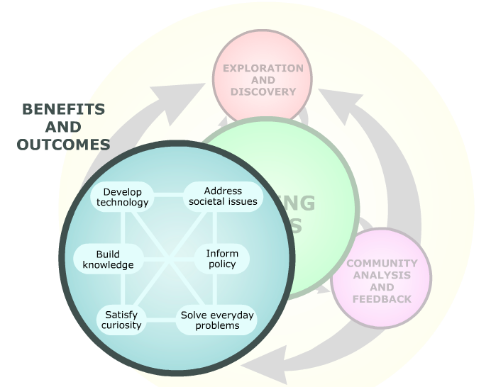

Slide 17
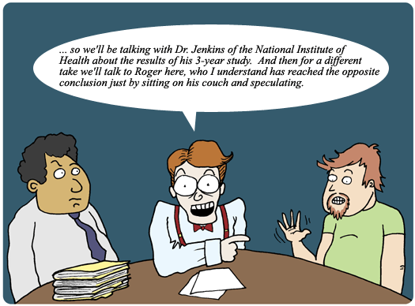

Slide 18
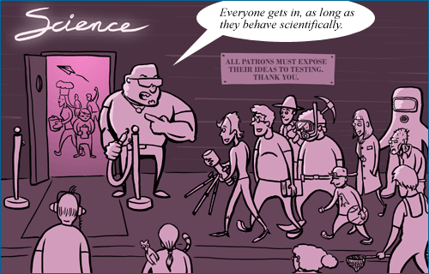

Slide 20
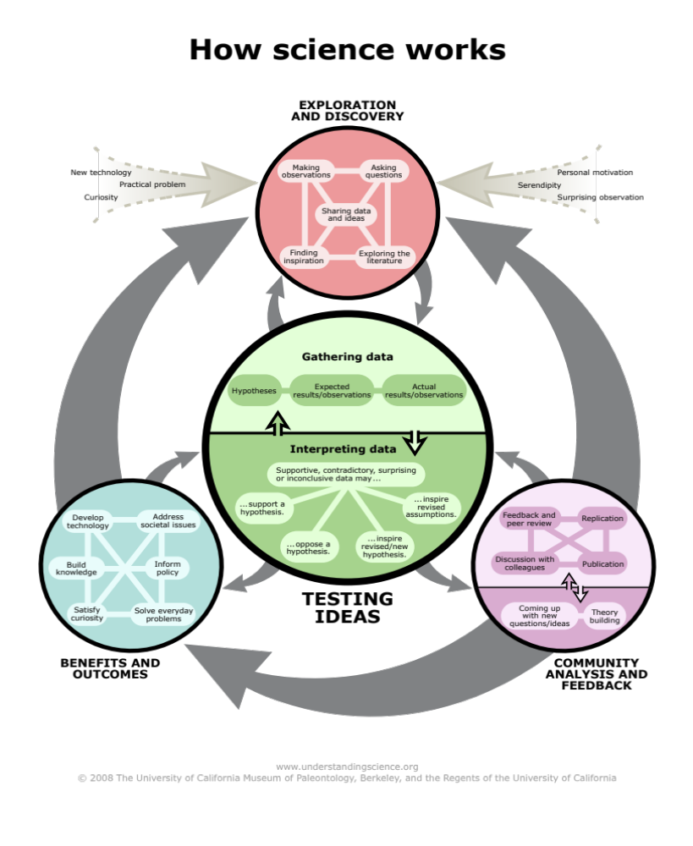
http://undsci.berkeley.edu

Slide 21
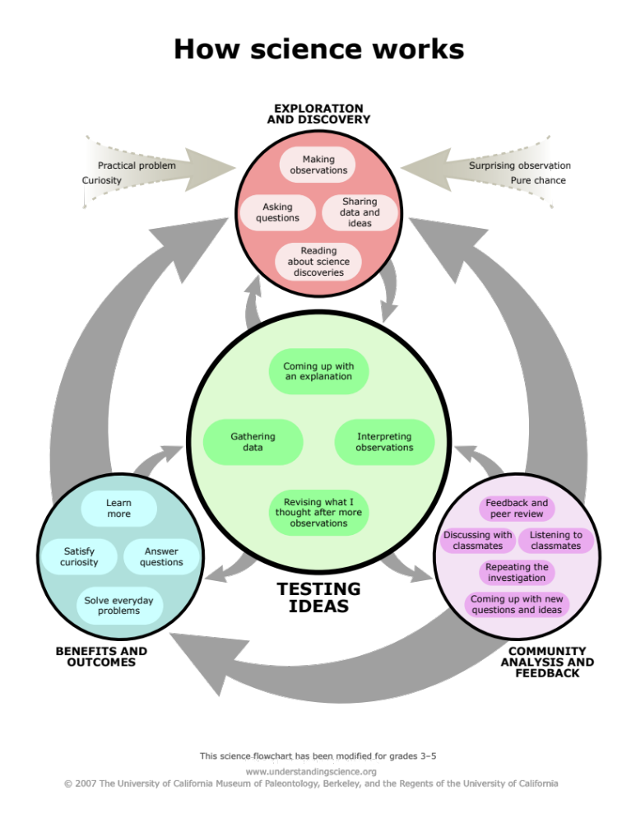

Slide 22
NGSS Science and Engineering Practices
Asking questions and defining problems
Developing and using models
Planning and carrying out investigations
Analyzing and interpreting data
Using mathematics and computational thinking
Constructing explanations and designing solutions
7. Engaging in argument from evidence
Obtaining, evaluating and communicating information
Notes:
Maybe cut

Slide 23
Can you map your scientific process?
What parts of this process are explained in scientific publications? Which parts are missing?
http://undsci.berkeley.edu
Notes:
Here you can see the various components of each of these categories, which provides a detailed template for the processes of science. This includes making observations, gathering data, feedback and peer review, etc.

Slide 24
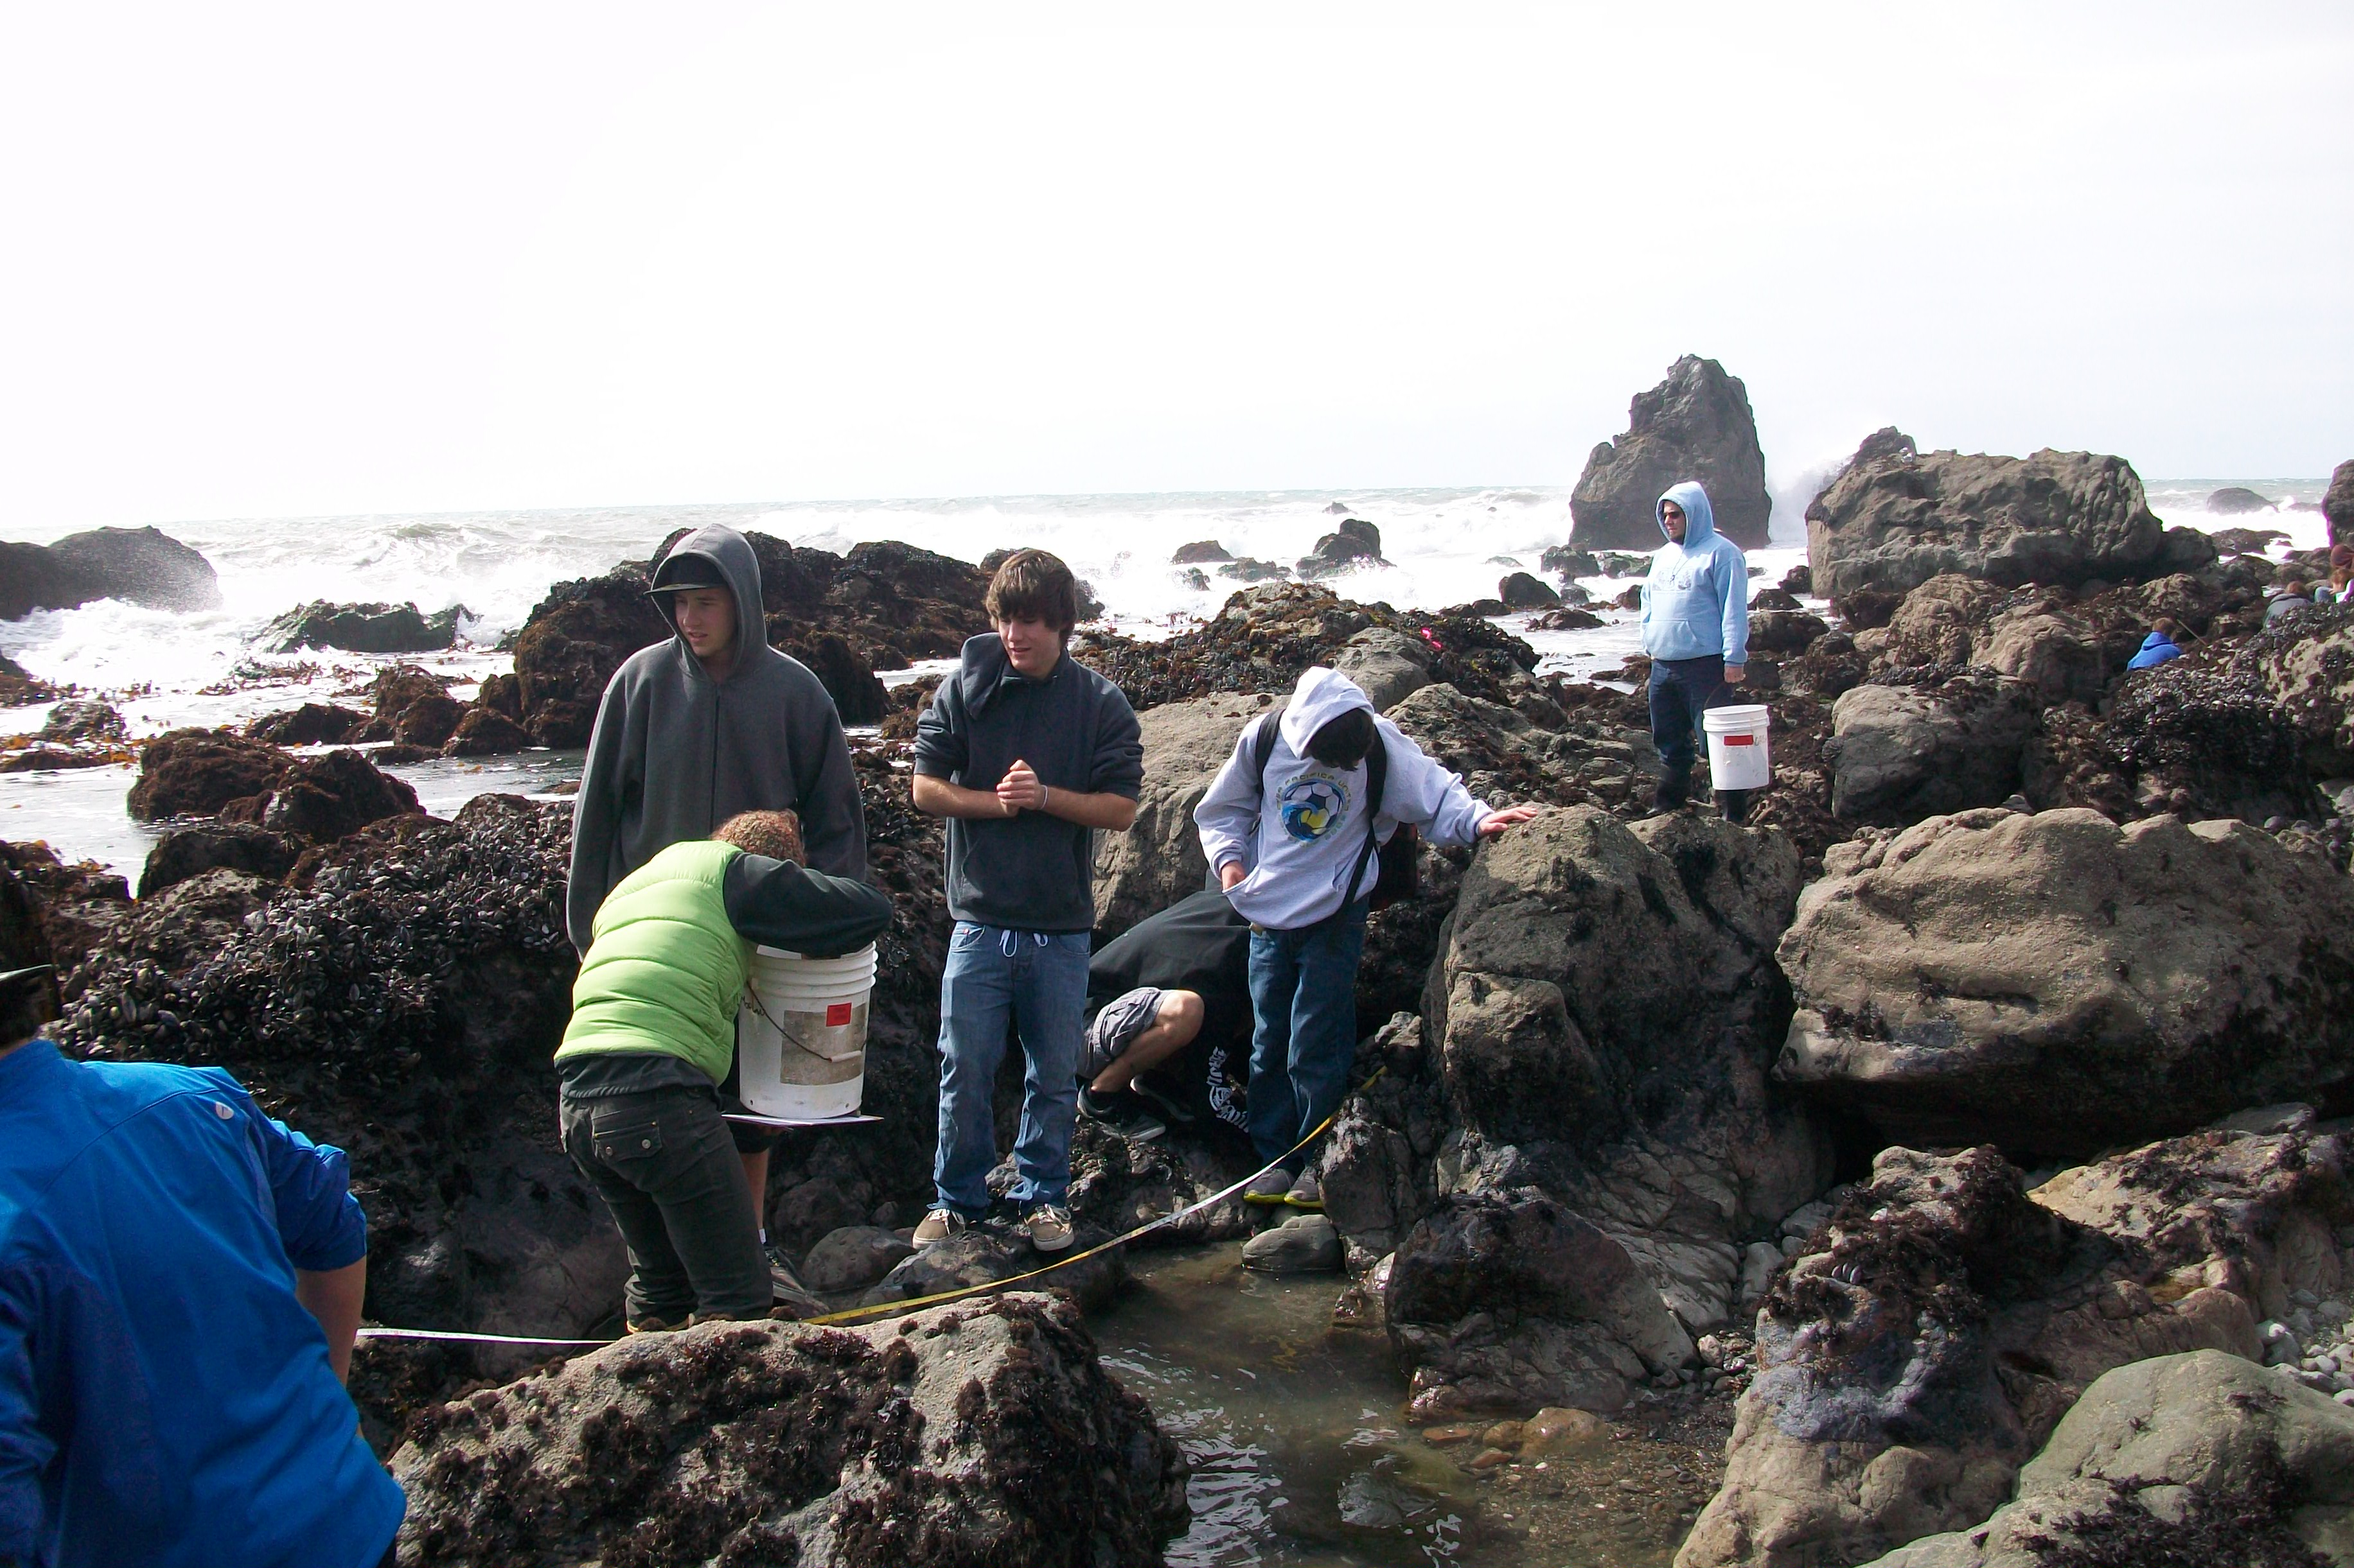
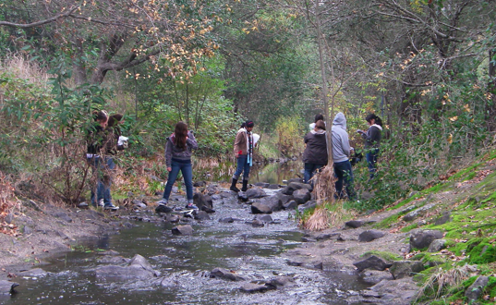
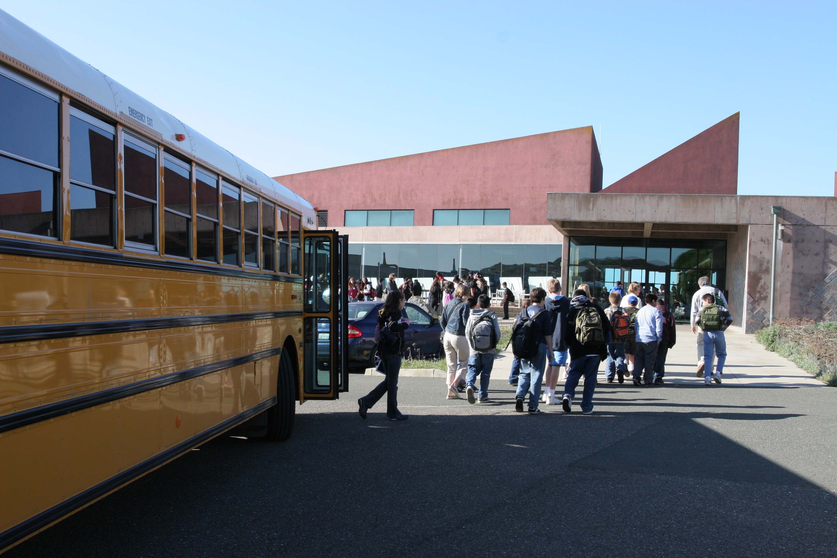
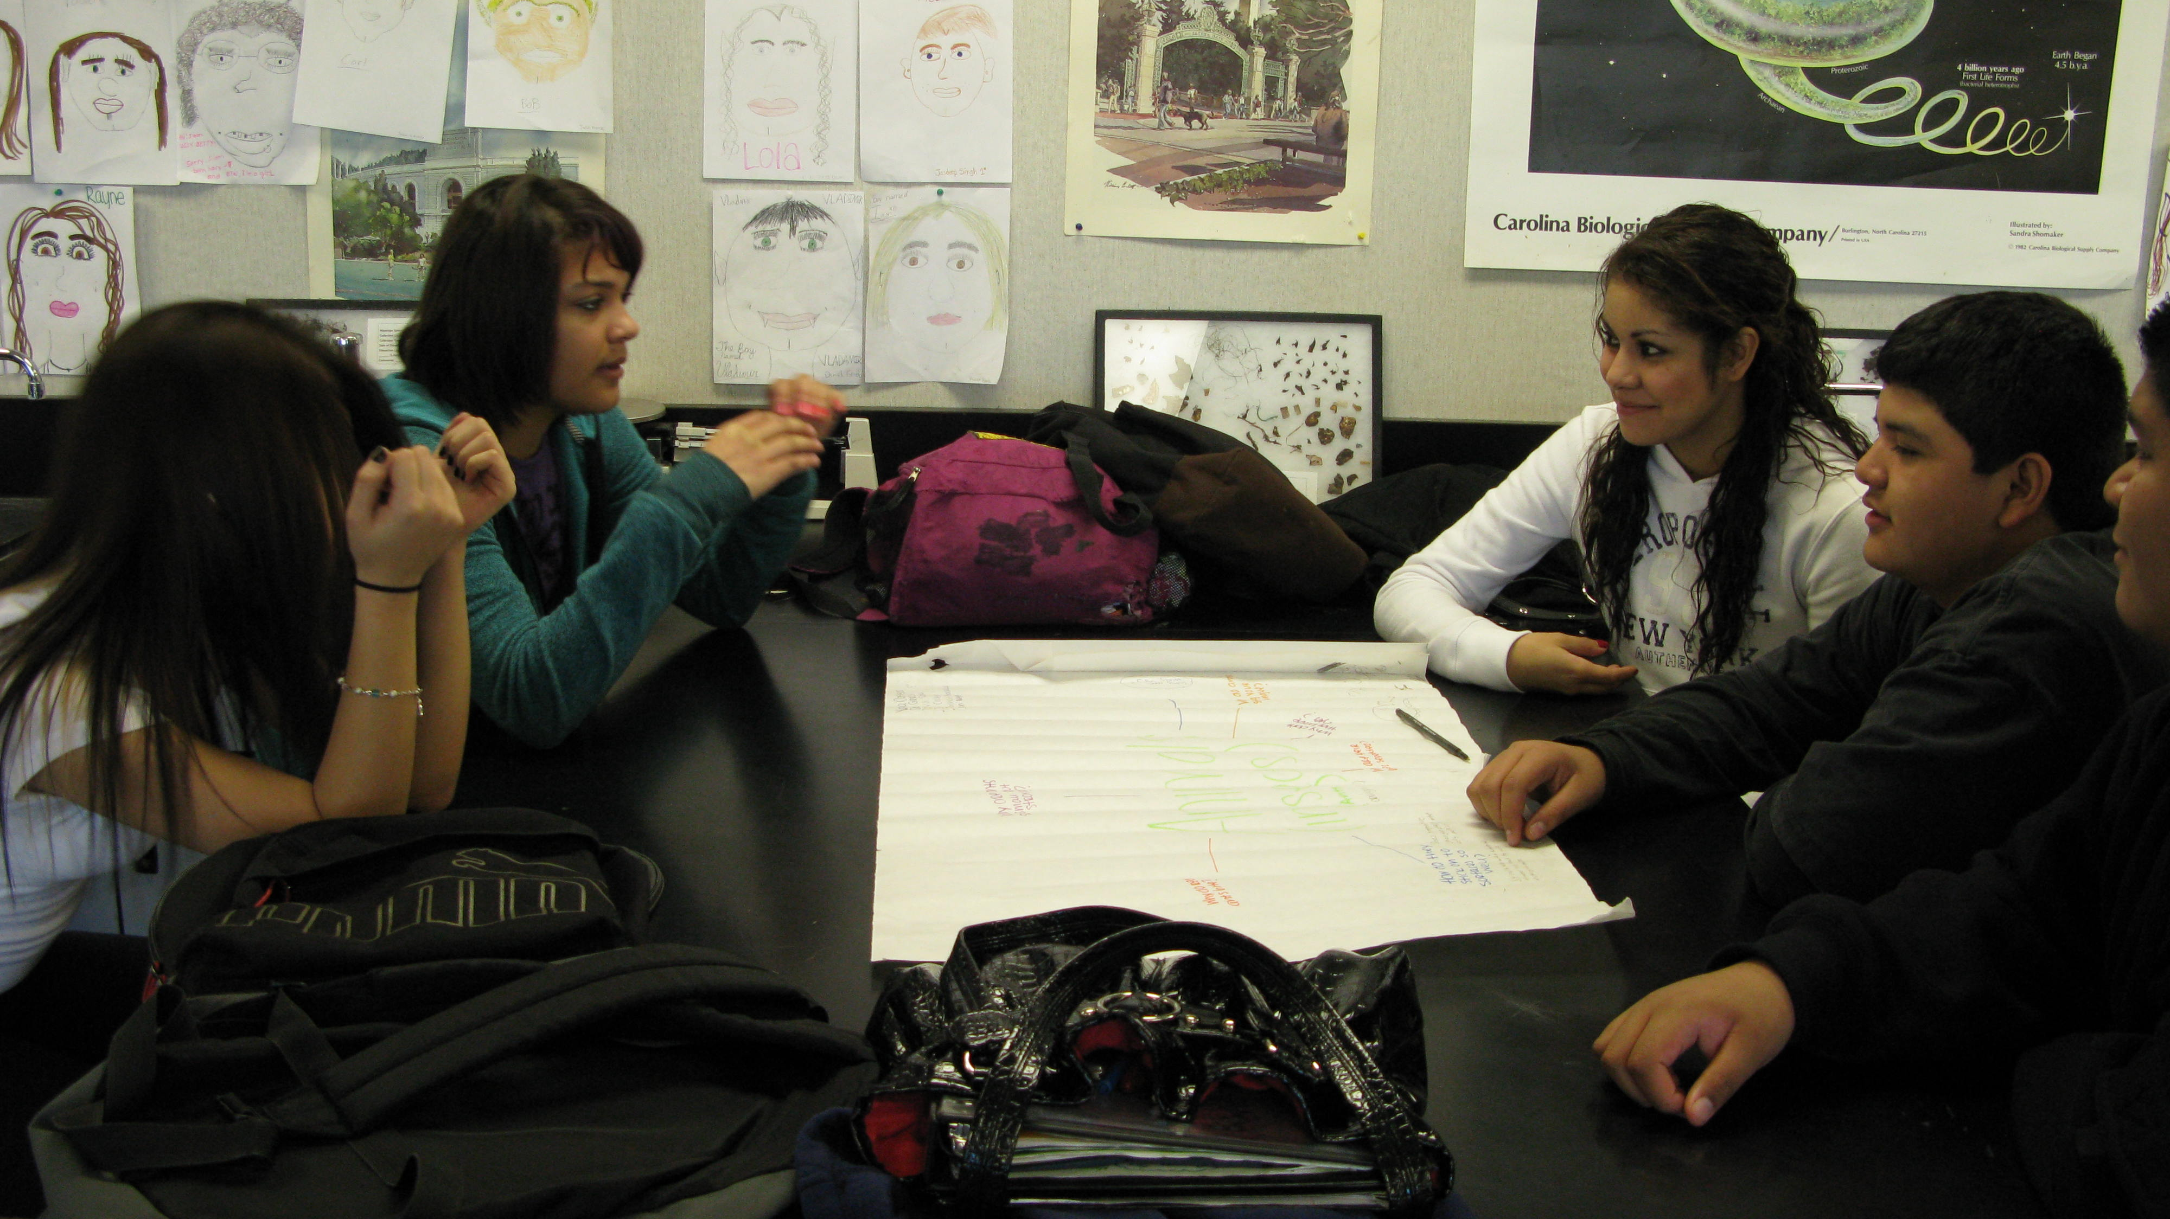
Students collect and analyze data
Students explore and make observations
Students discuss their research with scientists and peers at Bodega Marine Laboratory
Students revise study methods after receiving feedback from fellows and peers
Notes:
Problem: we have this very complex process, not all students experience the same sequence of steps

Slide 25
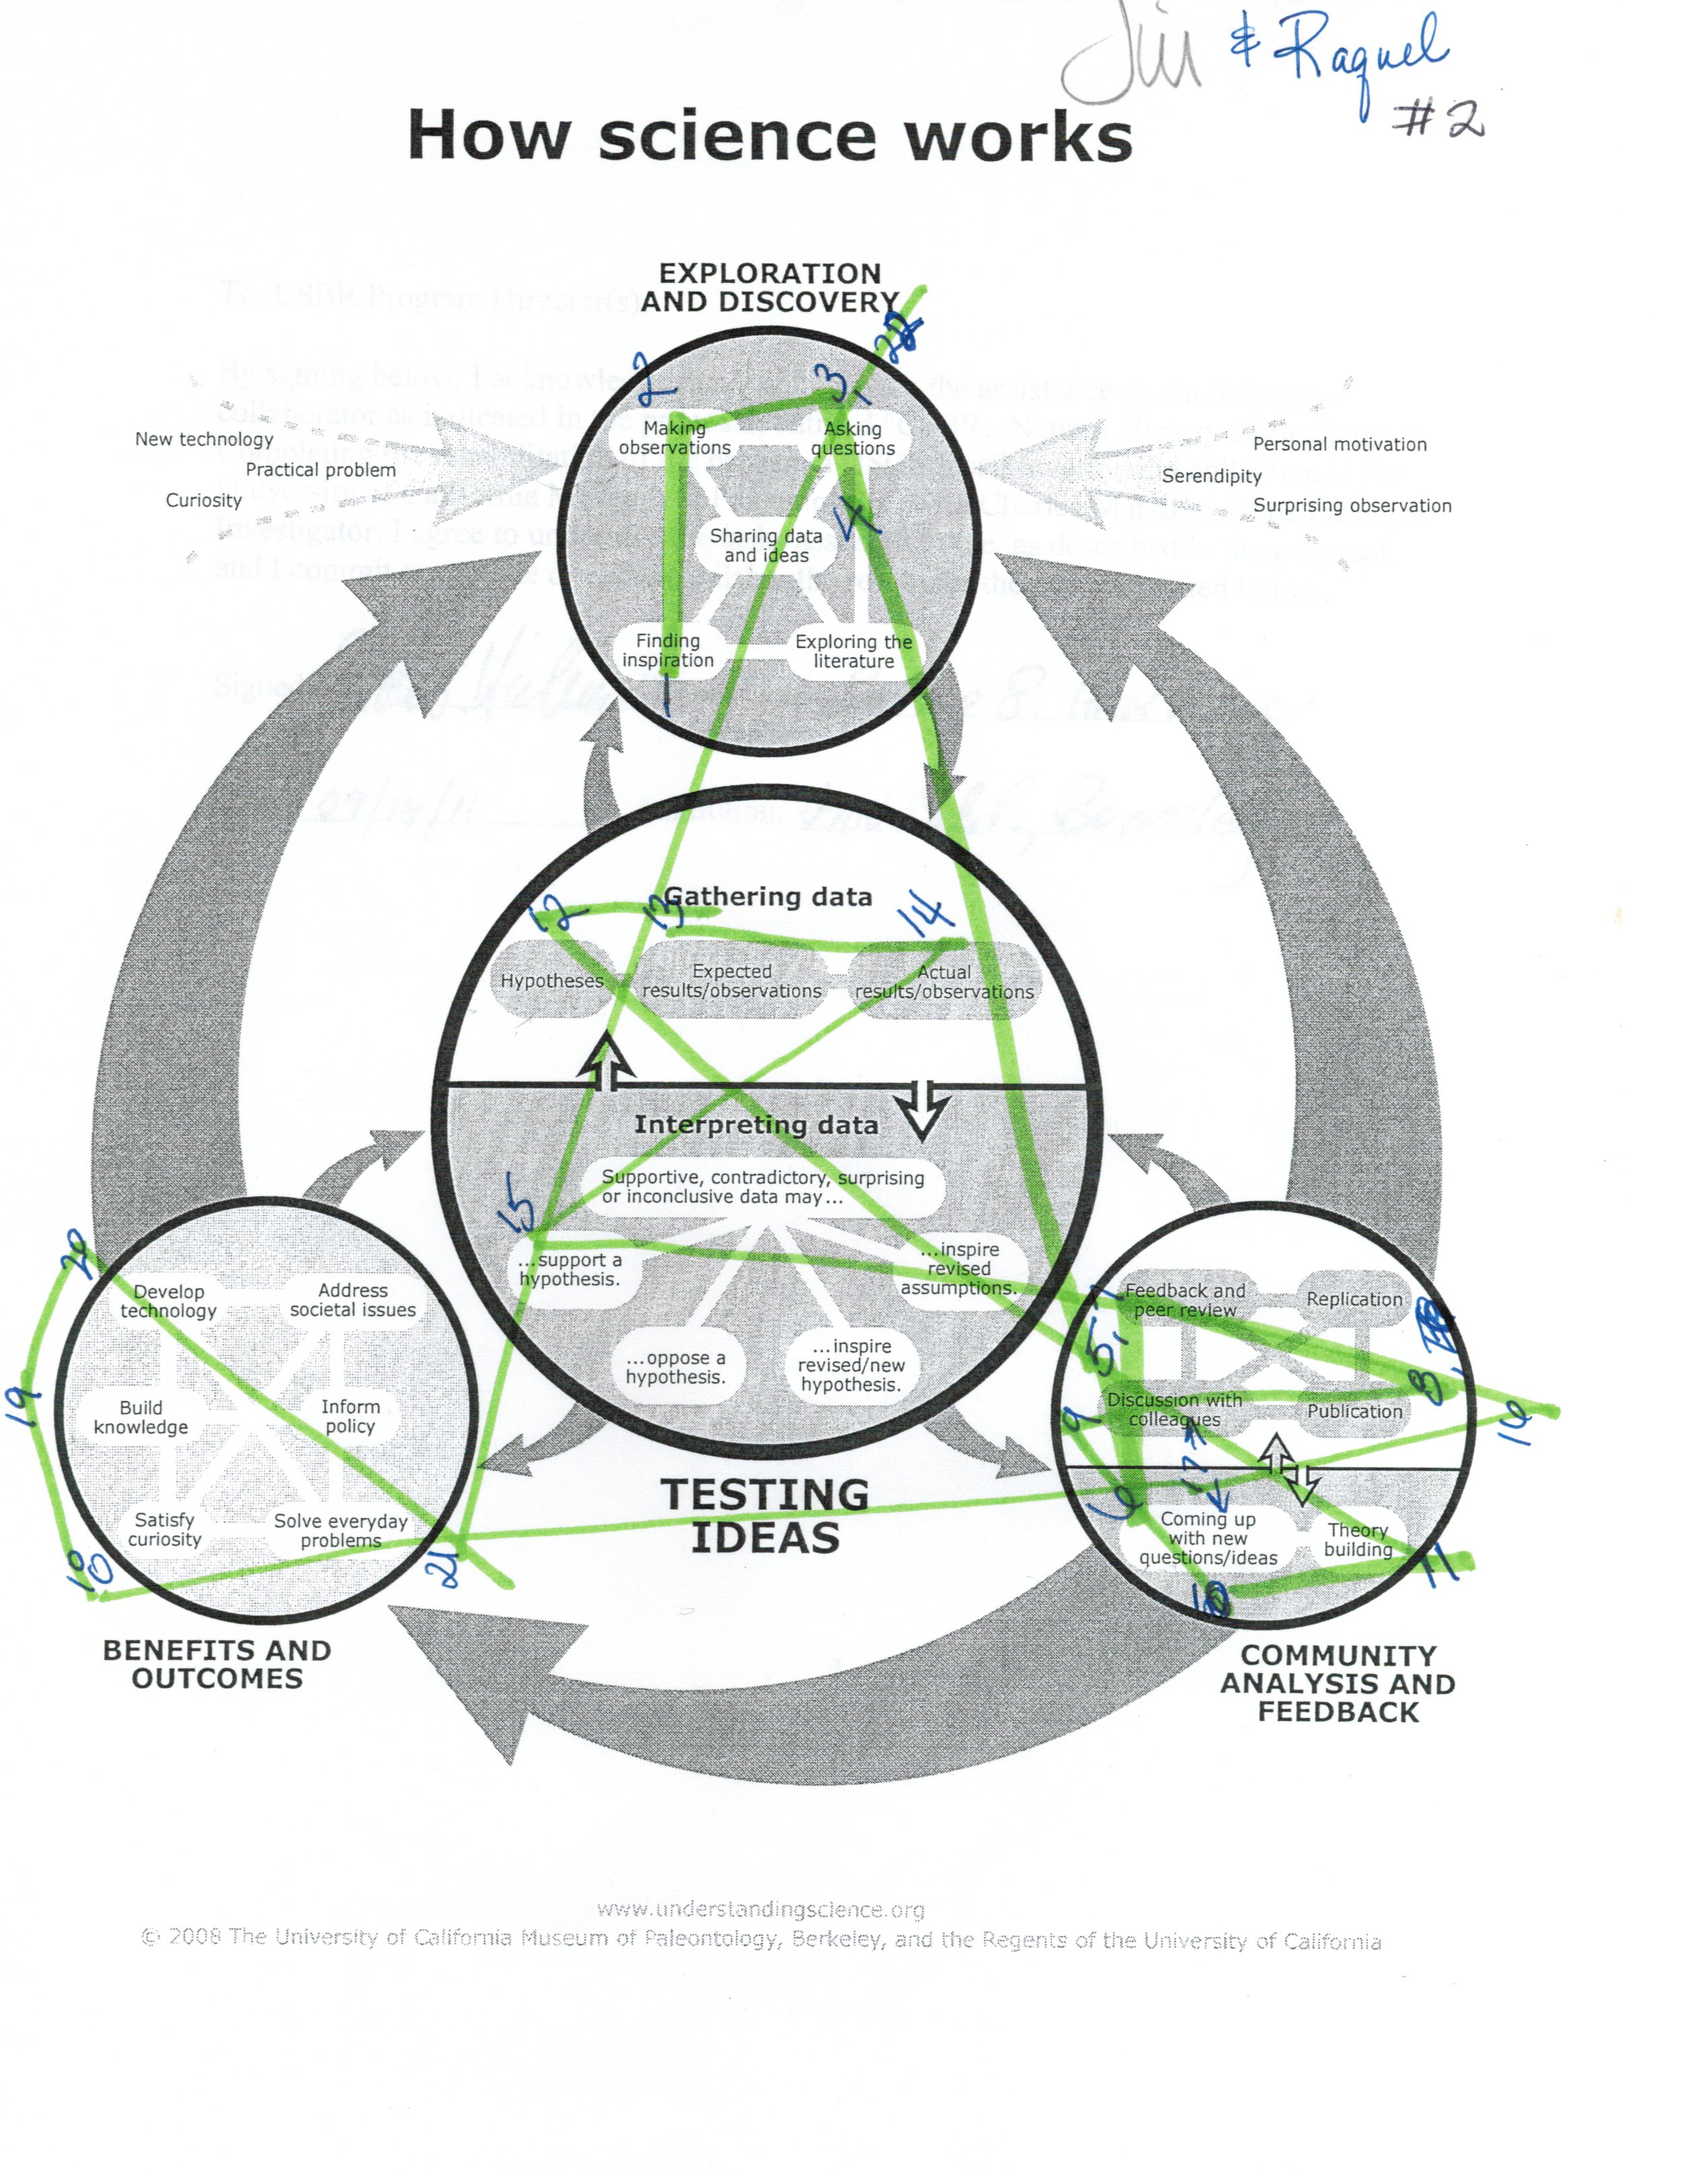
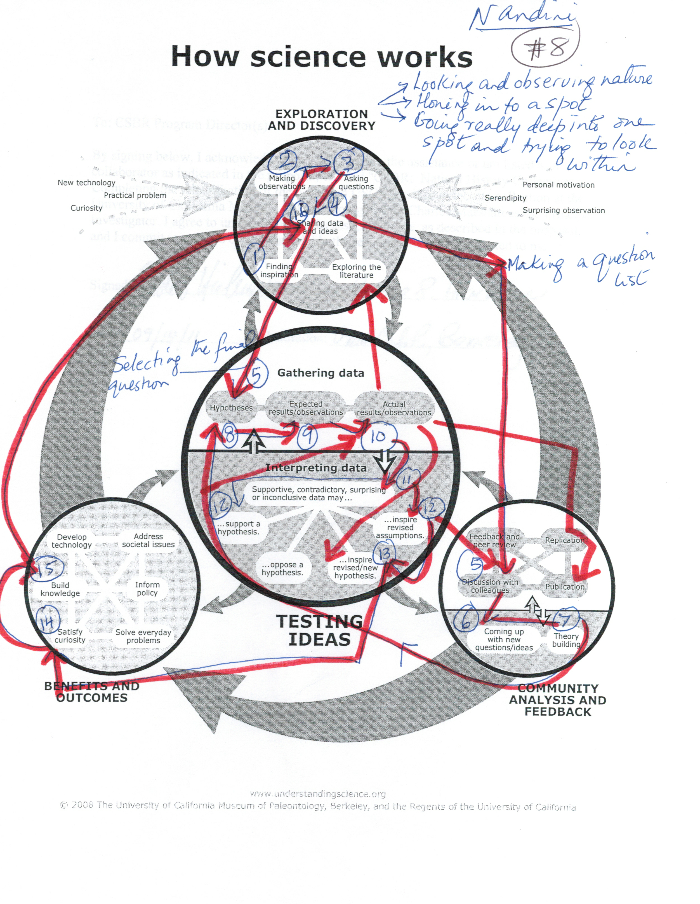
Mapping the scientific process
Notes:
And here are examples of how we have used this inforgraphic as a template to students, or in this case, teachers, to document their own experiences conducting research. These figures are journals of authentic research experiences that show unique paths through the scientific process.

Slide 26
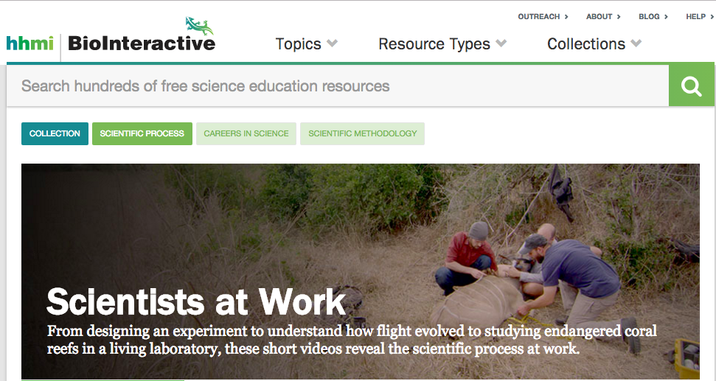
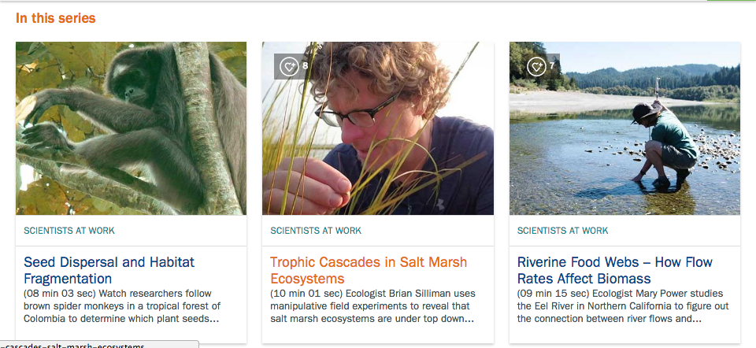

Slide 27
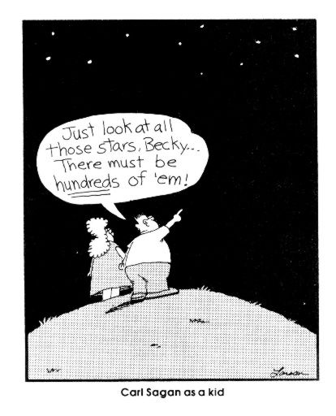
“…students cannot fully understand scientific and engineering ideas without engaging in the practices of inquiry…”
2012 A Framework for K-12 Science Education, The National Academies, Washington, D.C.
Notes:
A guide for integrating resources into a learning progression that explicitly builds the conceptual links between topics so students develop a deeper, more comprehensive understanding of our planet's systems and processes, enables students to use these activities to develop evidence-based explanations of the natural world.

Slide 28
“…students cannot fully understand scientific and engineering ideas without engaging in the practices of inquiry…”
Support exploration of the big ideas
Engaging tasks
Constructing knowledge and refining ideas through group work and discussions
2012 A Framework for K-12 Science Education, The National Academies, Washington, D.C.
Notes:
A guide for integrating resources into a learning progression that explicitly builds the conceptual links between topics so students develop a deeper, more comprehensive understanding of our planet's systems and processes, enables students to use these activities to develop evidence-based explanations of the natural world.

Slide 29
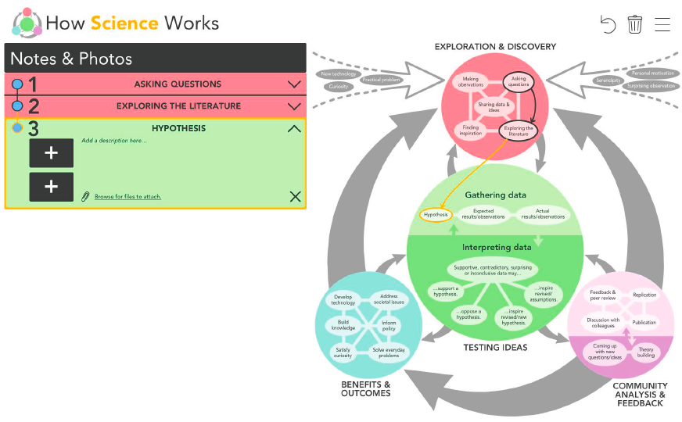

Slide 30
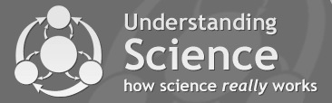
Communication Challenges for
Scientists and Educators
How we know what we know; describing and experiencing science
The interrelationships and feedbacks among components of the Earth system
(physical, chemical, biological)

Slide 31
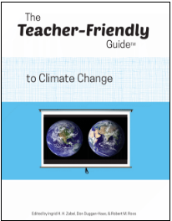


Slide 32
Next Generation Science Standards
Earth Systems Performance Expectations
5-ESS2-1. Develop a model using an example to describe ways the geosphere, biosphere, hydrosphere, and/or atmosphere interact.
HS-ESS2-2. Analyze geoscience data to make the claim that one change to Earth’s surface can create feedbacks that cause changes to other Earth systems.

Slide 33
Next Generation Science Standards
Earth Systems Performance Expectations
Science and Engineering Practice
(Developing and using models)
5-ESS2-1. Develop a model using an example to describe ways
the geosphere, biosphere, hydrosphere, and/or atmosphere interact.
HS-ESS2-2. Analyze geoscience data to make the claim that one change to Earth’s surface can create feedbacks that cause changes to other Earth systems.
Crosscutting Concept
(Systems and system models)
Science and Engineering Practice
(Analyzing and interpreting data)
Crosscutting Concept
(Stability and change)

Slide 34
Cross Cutting Concepts
Patterns
Cause and effect
Scale, proportion, and quantity
Systems and system models
Energy and matter
Structure and function
Stability and change
Notes:
Patterns, Cause and Effect, Scale, proportion, quantity, all these concepts are very necessary to Understanding Global Change processes through time and space.

Slide 35

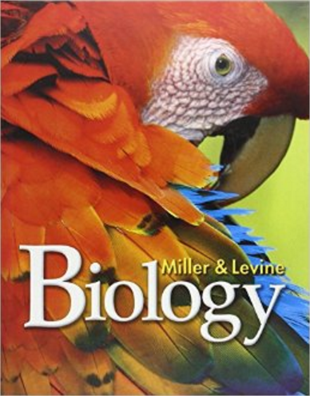



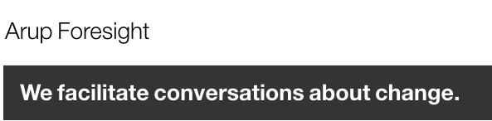
Notes:
Also, since the early 2000’s, the term environmental literacy has become more prolific - We see it incorporated into and referenced in education publications and organizations – such as the small selection shown here.
It is significant to note that environmental literacy is widely recognized as an important and integral part of academic learning.

Slide 36
Understanding Global Change
A guide to the complexity of how human and non-human processes interact to change the Earth’s environment and its habitability.

Slide 37
Understanding Global Change
This resource for teachers, students, scientists,
and the public provides:

Slide 38
Understanding Global Change
This resource for teachers, students, scientists,
and the public provides:
A framework for teaching global change topics

Slide 39
Understanding Global Change
This resource for teachers, students, scientists,
and the public provides:
A framework for teaching global change topics
Conceptual models for visualizing interrelationships and feedbacks in the Earth system

Slide 40
Understanding Global Change
This resource for teachers, students, scientists,
and the public provides:
A framework for teaching global change topics
Conceptual models for visualizing interrelationships and feedbacks in the Earth system
Curricular planning guide and examples of learning progressions for formal and informal instruction

Slide 41
Understanding Global Change
This resource for teachers, students, scientists,
and the public provides:
A framework for teaching global change topics
Conceptual models for visualizing interrelationships and feedbacks in the Earth system
Curricular planning guide and examples of learning progressions for formal and informal instruction

Slide 42
Understanding Global Change Framework
Topics are organized by:
Notes:
Read text

Slide 43
Understanding Global Change Framework
Topics are organized by:
Earth system (e.g. ocean circulation, greenhouse effect)
Notes:
Read text

Slide 44
Understanding Global Change Framework
Topics are organized by:
Earth system (e.g. ocean circulation, greenhouse effect)
Measurable changes that occur within the Earth system (e.g., temperature, extinction/ diversification)
Notes:
Read text

Slide 45
Understanding Global Change Framework
Topics are organized by:
Earth system (e.g. ocean circulation, greenhouse effect)
Measurable changes that occur within the Earth system (e.g., temperature, extinction/ diversification)
Causes of change in the system (e.g., burning of fossil fuels, volcanism)
Notes:
Read text

Slide 46
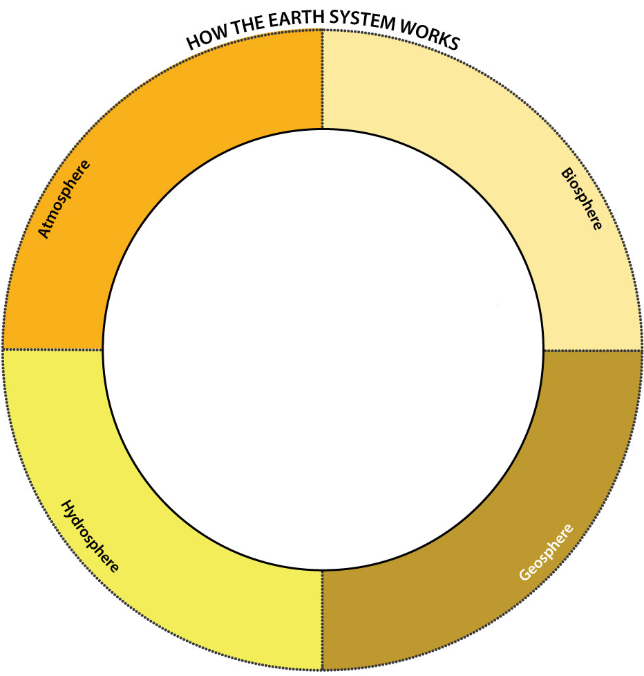

Slide 47
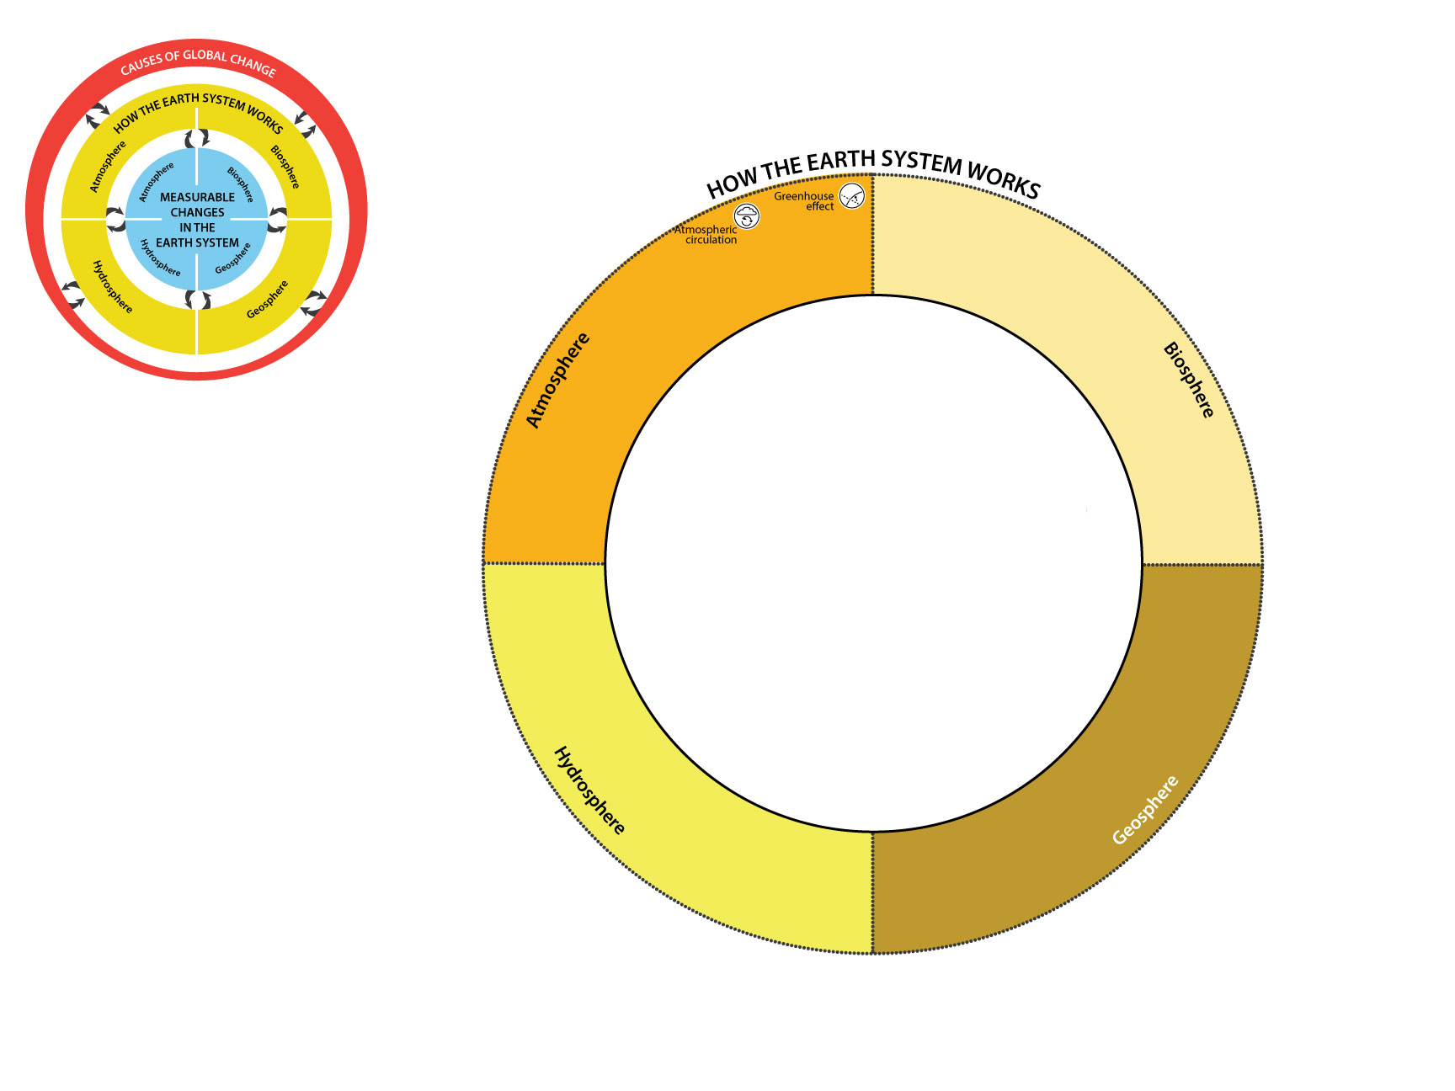

Slide 49


Slide 51


Slide 53


Slide 55
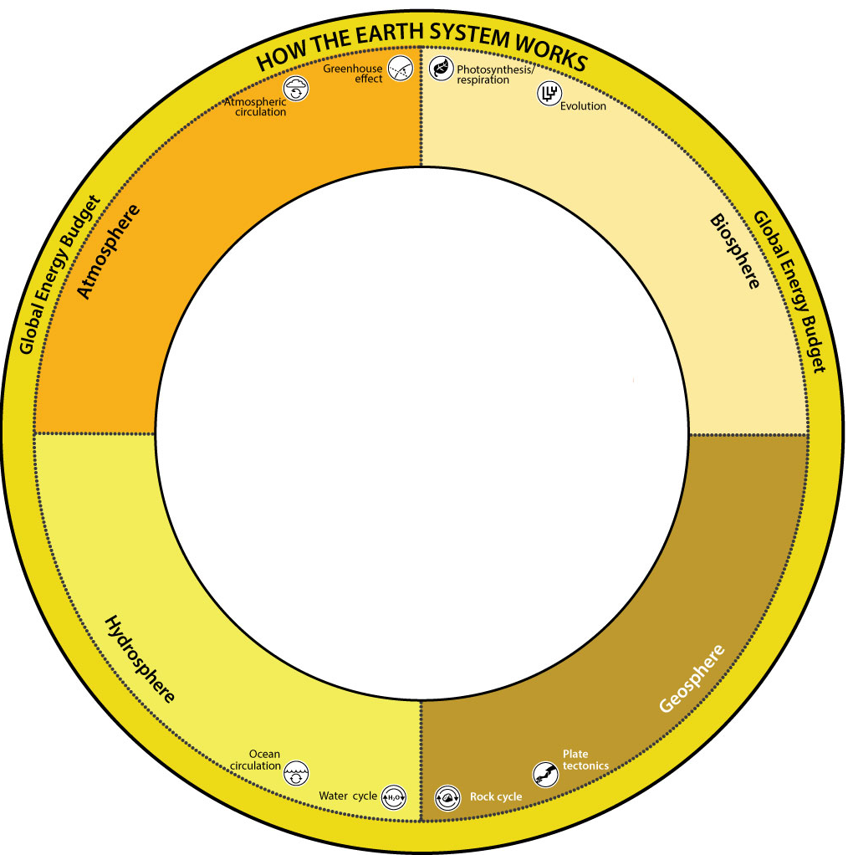

Slide 56


Slide 59
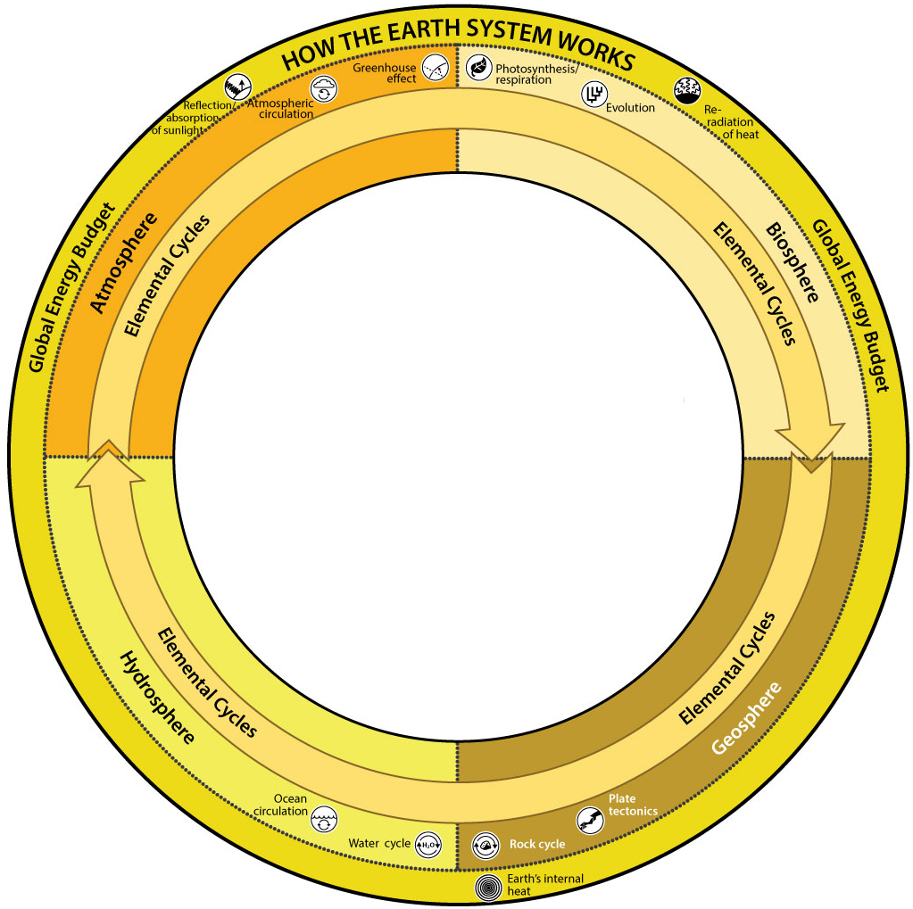

Slide 60
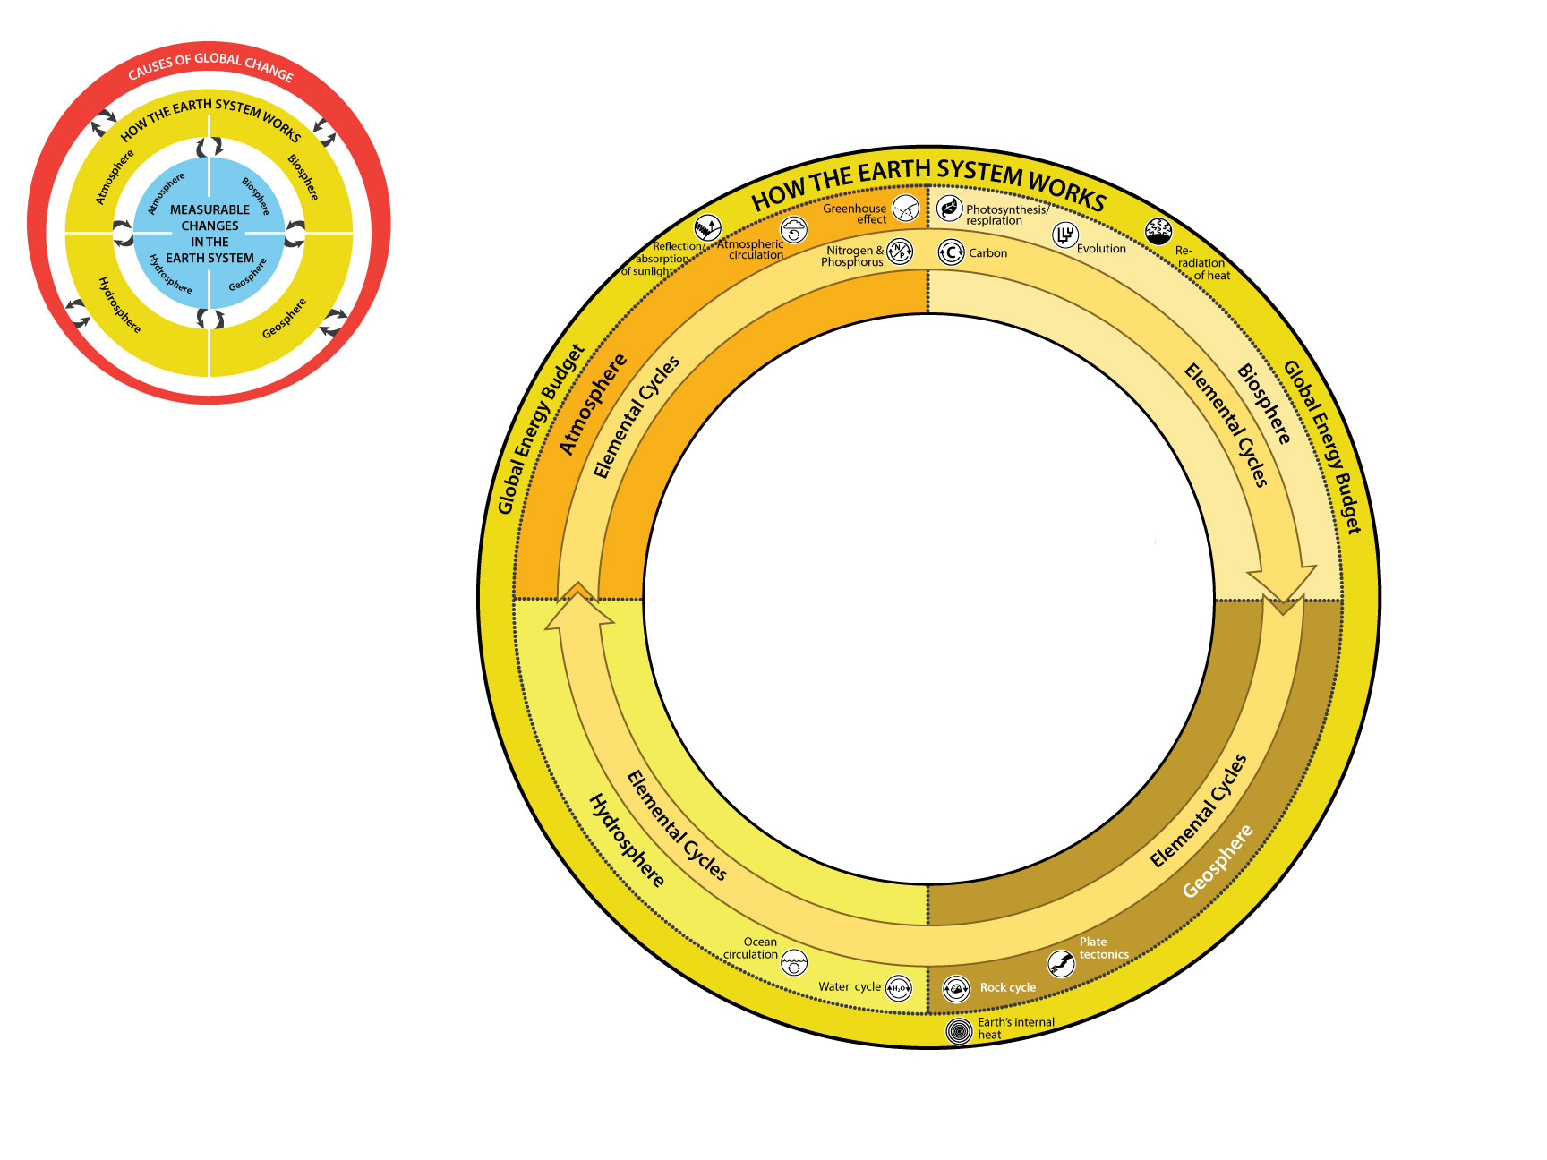

Slide 62
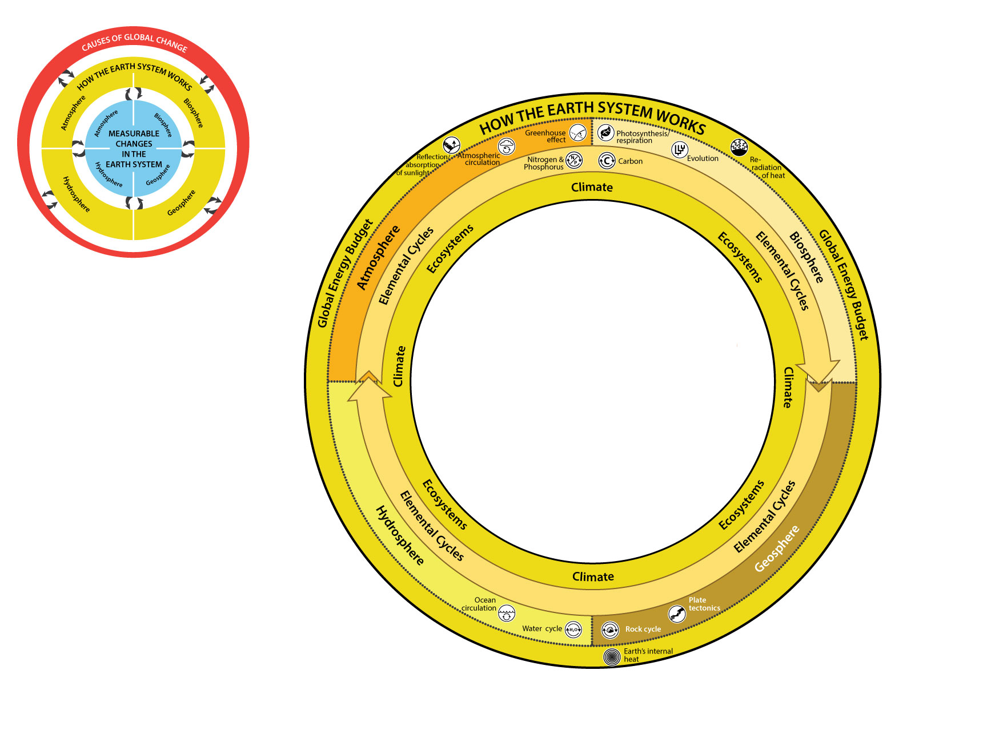

Slide 64
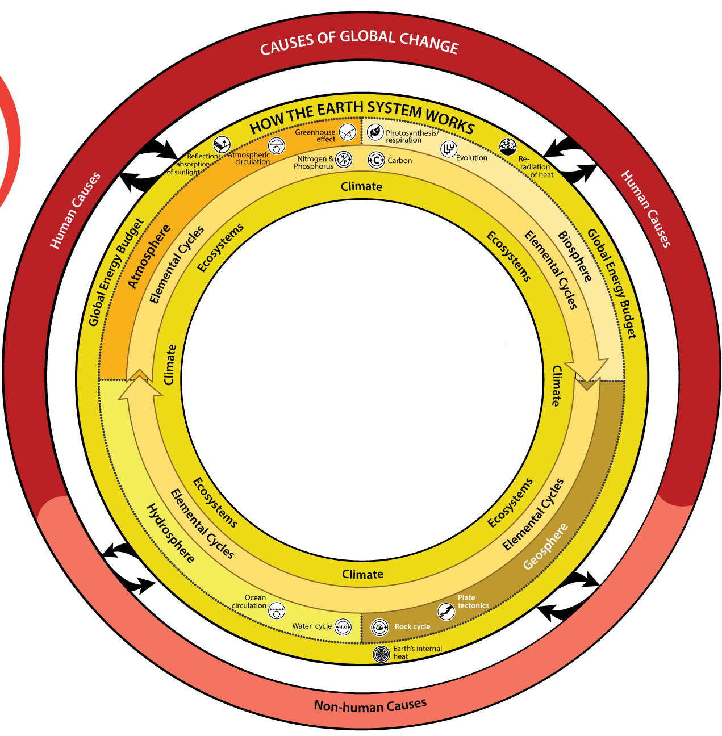


Slide 65
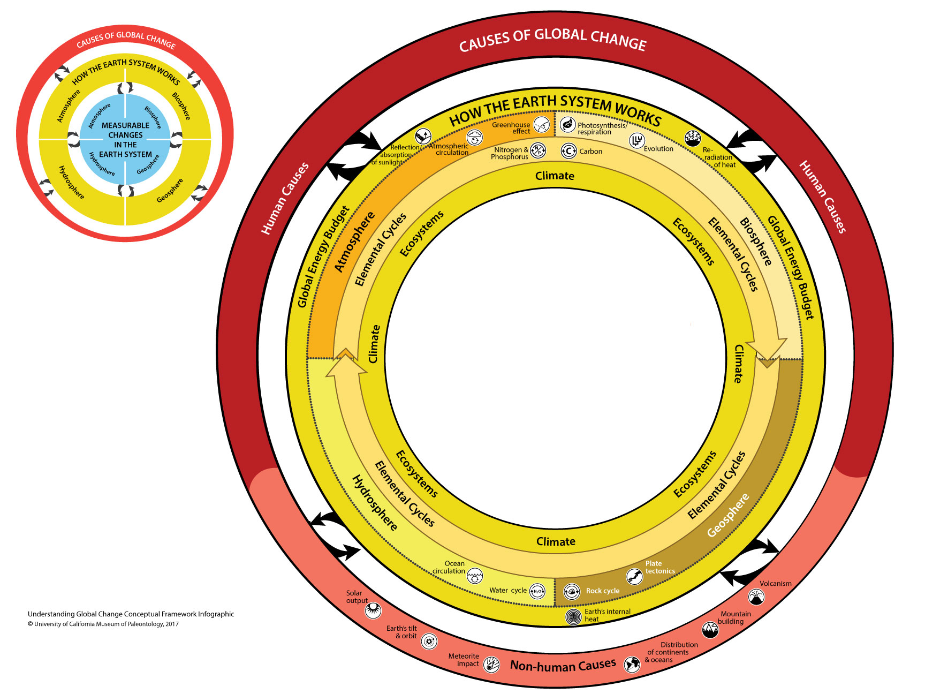

Slide 67
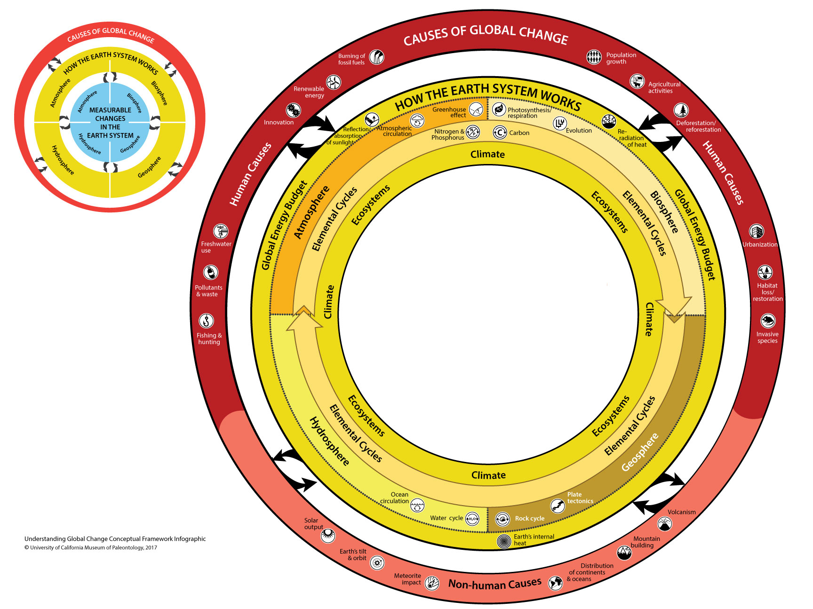

Slide 69
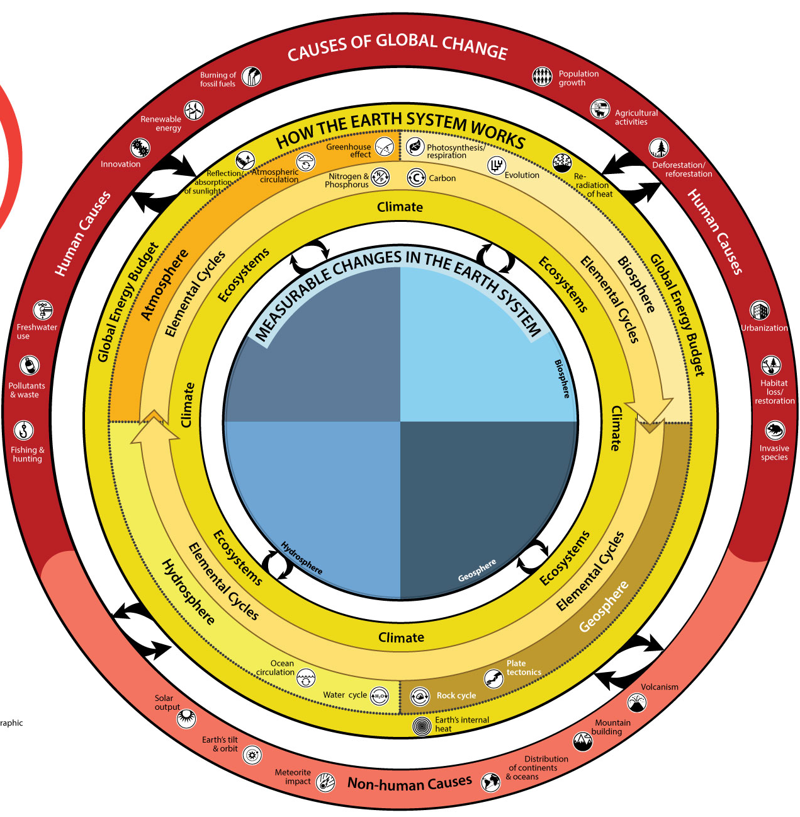

Slide 70
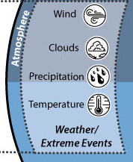

Slide 71
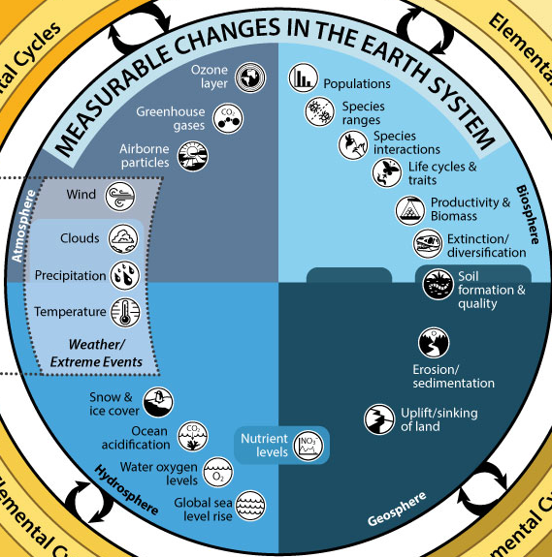


Slide 72
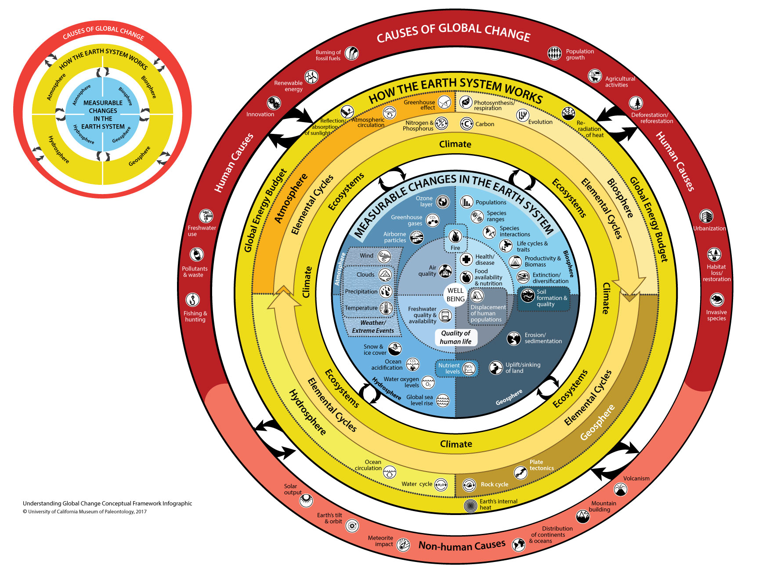

Slide 74
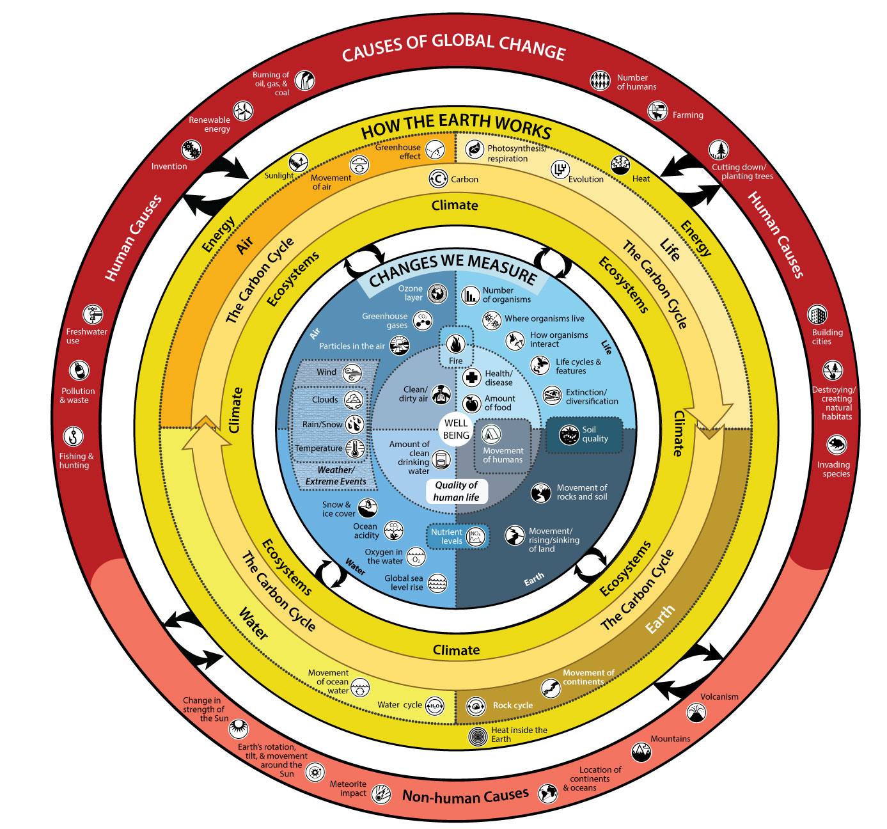
Grades 3-5

Slide 75
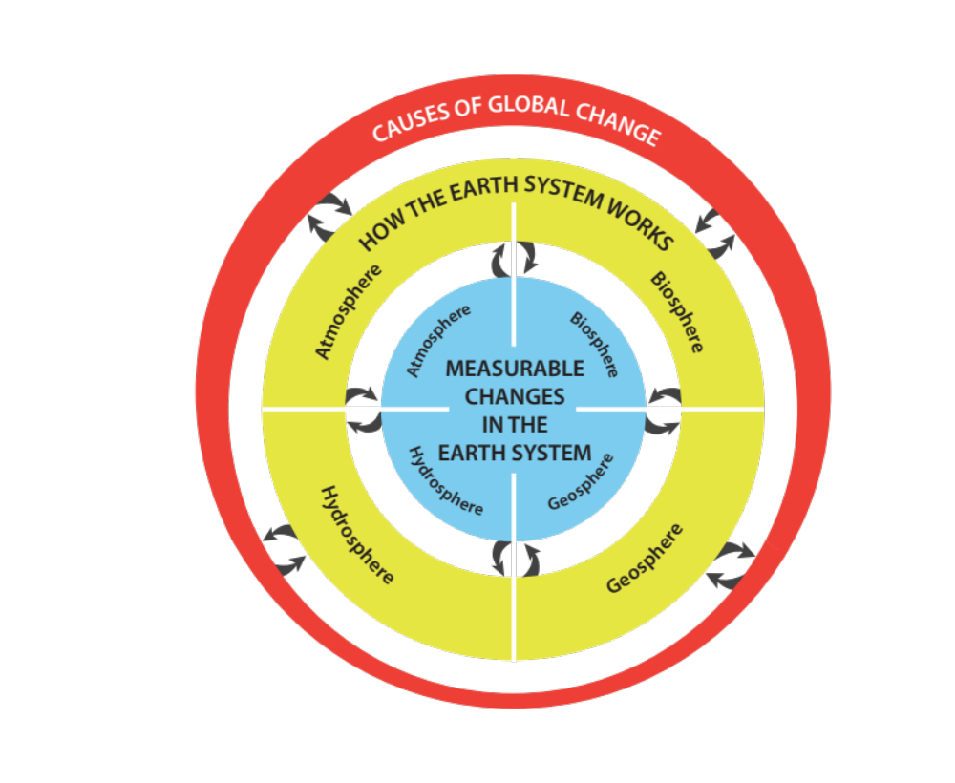

Slide 76
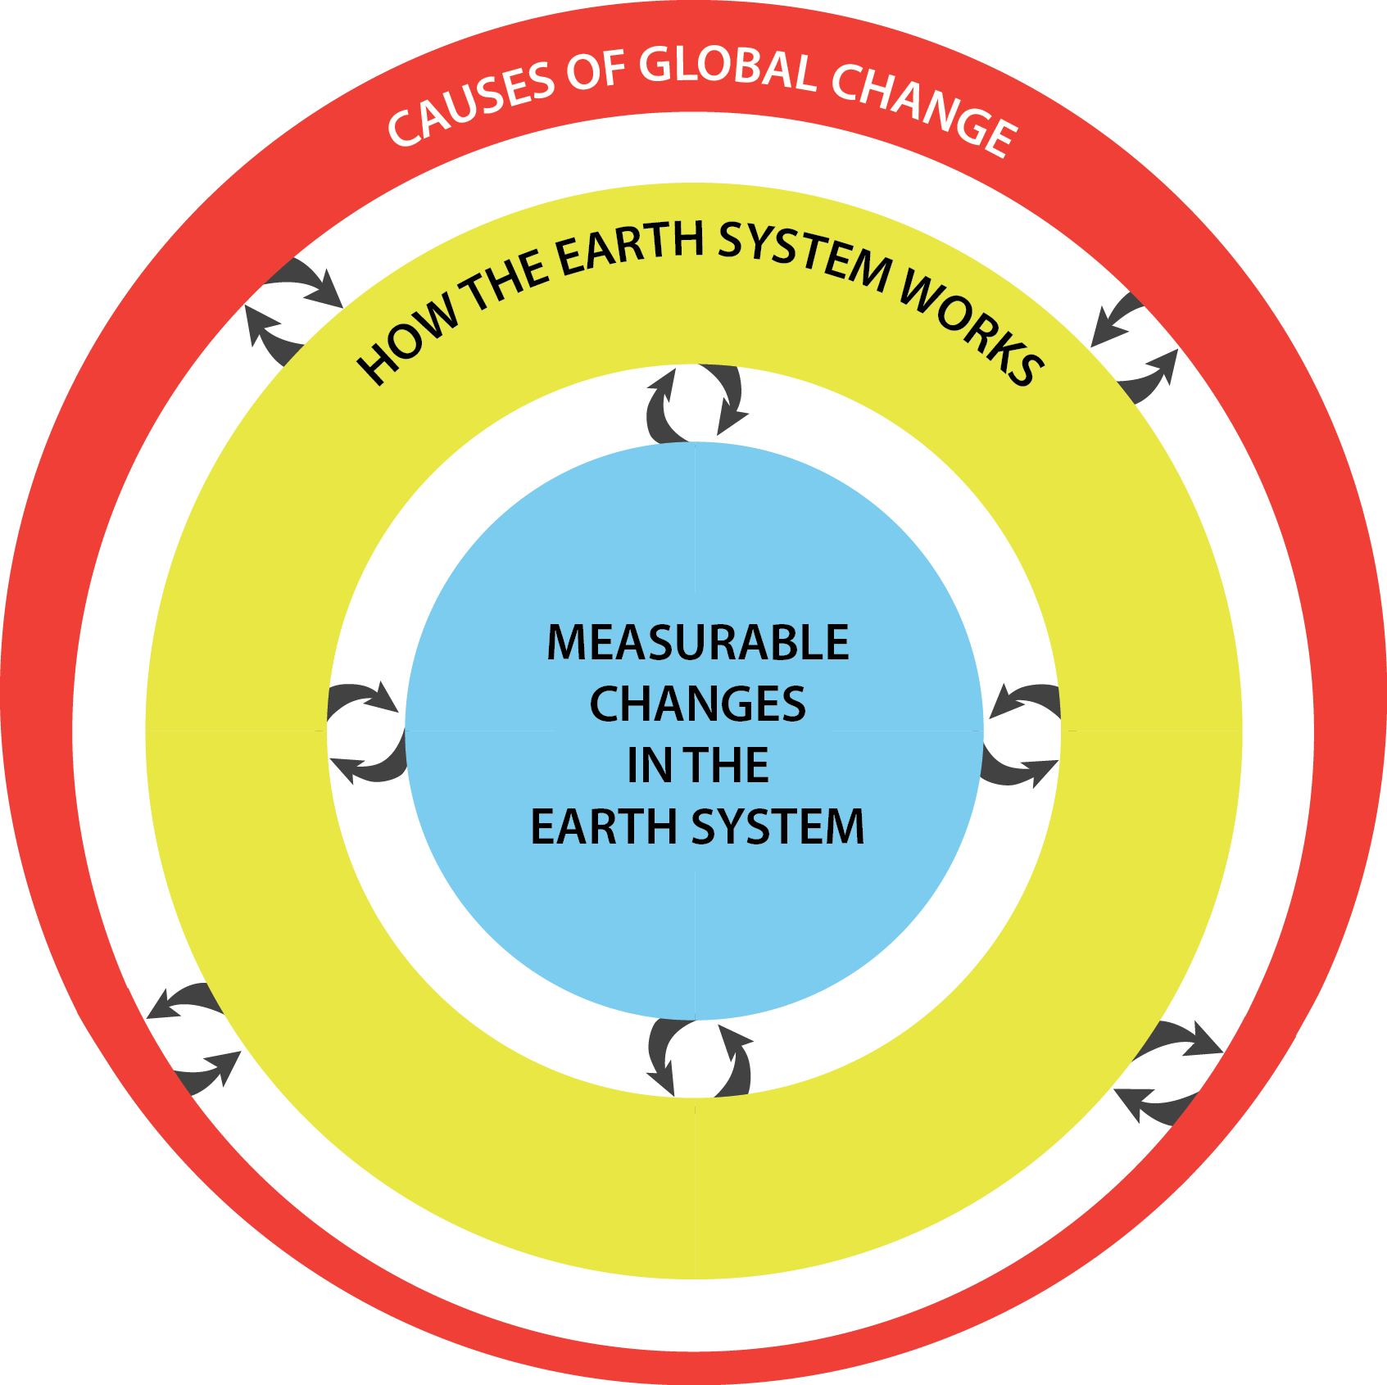

Slide 77

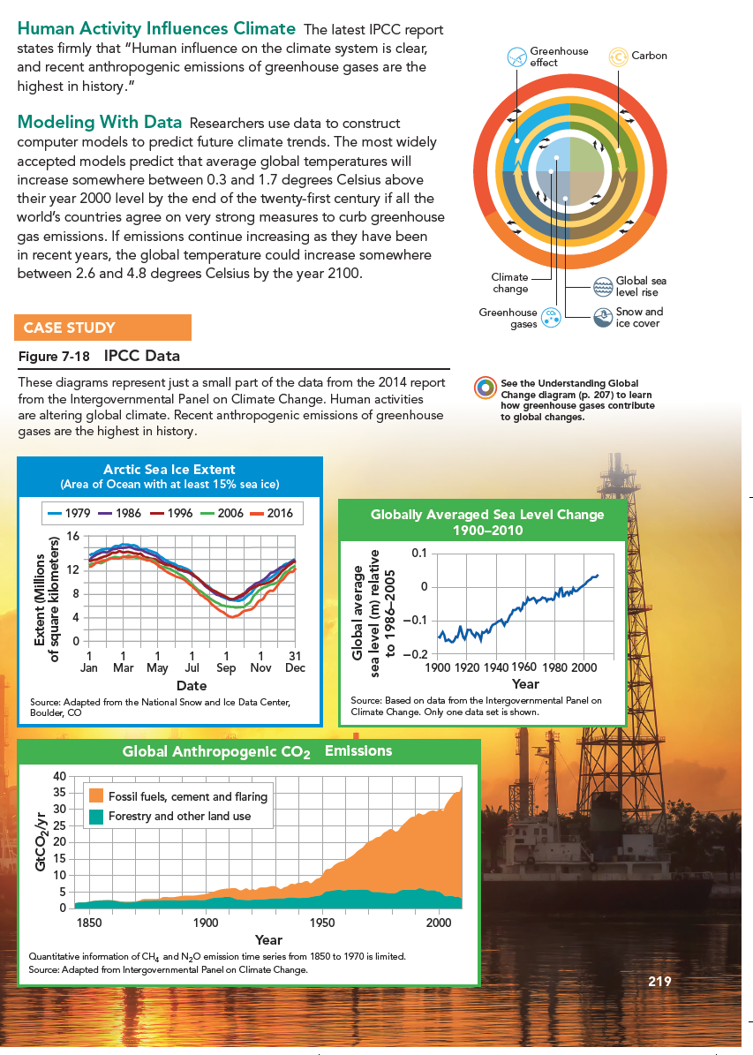
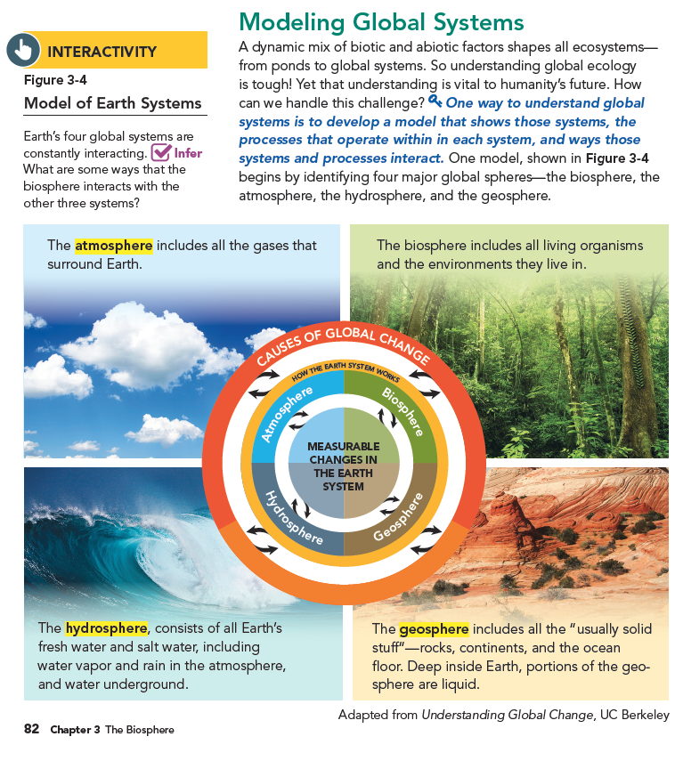

Slide 79
Understanding Global Change
This resource for teachers, students, scientists,
and the public provides:
A framework for teaching global change topics
Conceptual models for visualizing interrelationships and feedbacks in the Earth system
Curricular planning guide and examples of learning progressions for formal and informal instruction

Slide 80
How can we, as scientists and educators, be explicit about the concepts we want students and the public to understand?
How do we help students connect ideas, build knowledge, and communicate what they learn?

Slide 81
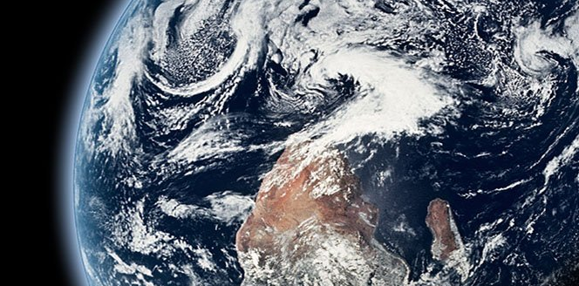
Systems and System Models
A group of interacting or interdependent parts
The Earth is a complex system of interacting physical, chemical, and biological processes

Slide 82
Cross Cutting Concepts
Patterns
Cause and effect
Scale, proportion, and quantity
Systems and system models
Energy and matter
Structure and function
Stability and change
Notes:
Patterns, Cause and Effect, Scale, proportion, quantity, all these concepts are very necessary to Understanding Global Change processes through time and space.

Slide 83
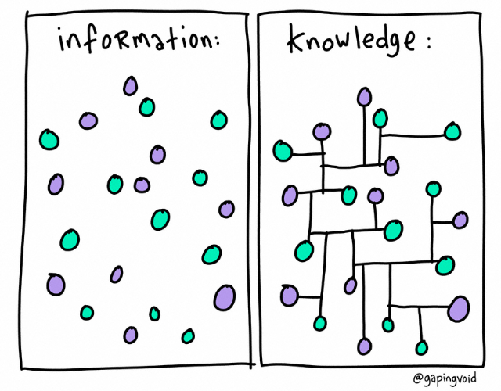

Slide 84









Slide 86
Cognitive Processes
The student should learn/ be able to…
Remember | Understand | Apply | Analyze | Evaluate | Create
Recognize, recall | Interpret, exemplify, classify, summarize, infer, compare, explain | Execute, implement | Differentiate, organize | Checking, critiquing | Generate, plan, produce
Retention Transfer

Slide 87
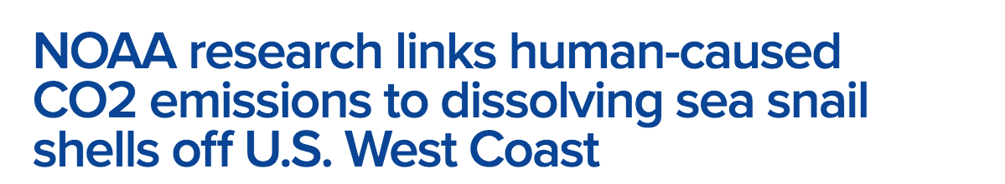






Slide 88


Slide 89


Slide 93


Slide 94


Slide 95


Slide 96


Slide 97


Slide 98


Slide 99

Exploring Connections:
Randomly select a concept (icon) from the stack.
Turn to a person next to you and discuss how your topics are related.

Slide 100



Slide 101


Slide 103


Slide 104


https://news.nationalgeographic.com/2017/09/hurricane-irma-harvey-season-climate-change-weather/

Slide 105




https://www.scientificamerican.com/article/heres-what-we-know-about-wildfires-and-climate-change/

Slide 106
Understanding Global Change
This resource for teachers, students, and the public provides:
A framework for teaching global change topics
Conceptual models for visualizing interrelationships and feedbacks in the Earth system
Curricular planning guide and examples of learning progressions for formal and informal instruction

Slide 107




Integrating Activities,
Investigations
& Datasets

Slide 108
Establishing a Cohesive Progression of Learning
Integration of resources and activities into curricula is important for establishing the interconnectedness of content, deeper understanding and proficiency - replacing stand-alone experiences.
Notes:
And to circle back again to the importance of integration: the integration of these experiences is essential to support development of proficiency and deeper understanding in place of discrete activities that are not explicitly connected. You might be familiar with some of the examples listed here of resources that support this integration.

Slide 109
Notes:
So rather than information being dispelled through individual activities, relying on students to make the connections…
If we are intentional and explicit about those connections, we can foster deeper understanding and build the conceptual links between these topics which results in fundamental knowledge about how earth systems work.

Slide 110

Integrating Activities,
Investigations
& Datasets
Global Change

Slide 111
Integrating Activities,
Investigations
& Datasets
Global Change

Slide 112

Integrating Activities,
Investigations
& Datasets
Global Change

Slide 113




Slide 115
Sequencing: How do we know what we know?
Making sense of complex phenomena can happen through sequencing of activities to build knowledge through evidence-based reasoning.
Application of the information, developing a claim and designing a solution, happen after investigation of the phenomena and can establish local context and relevancy.

Slide 116


Unit Question:
Will parts of the San Francisco Bay Area be under water in the next 100 years?
Molly Stuhlsatz
Zoe Buck Bracey
Jeffrey Snowden

Slide 117
Northern California Pilot Study Data
Teachers from 11 rural, suburban, and urban school districts
To date, 1050 middle and high school students participated in classroom activities
706 students participated in the research study
59% of students on free or reduced lunch
24% English was not their first language

Slide 118



Linking
Resources
Notes:
A variety of resources were used to develop this unit

Slide 119


Slide 120


Quick write analyses

Slide 121
Mini Experiment:
Are you a part of the Earth system? On your Earth scene, draw yourself where you think you affect or are affected by different parts of the Earth.
On a separate piece of paper, briefly explain why you drew yourself in each spot.

Slide 122


Slide 123
Communication Challenges for
Scientists and Educators
How we know what we know; describing and experiencing science
The interrelationships and feedbacks among components of the Earth system

Slide 124
Launching in Fall 2018
Development of instructional units using CLEAN resources
1. Sea level rise
2. Phenology
3. Food, energy, and water systems
Updated curricular planning guide and supporting resources
Interactive apps developed with HHMI BioInteractive
Drivers of Change resource to facilitate discussions about the social, economic, and environmental implications of global change

Slide 125


www.driversofchange.com

Slide 126


www.driversofchange.com

Slide 127


www.driversofchange.com

Slide 128
Upcoming Workshops
June 13: Boise State University
July 8-15: California Institute for Biodiversity, Yosemite National Park
July 23: Bay Area Schools Workshop
September 28-29: Arizona State University
October & November: UC Berkeley
November 8-11: National Association of Biology Teachers Annual Meeting, San Diego, CA

Slide 129
Thank you!
UCMP
Charles Marshall
Kristen Mitchell
Kathy Zoehfeld
Trish Roque
Helina Chin
Josh Frankel
Lisa White
Advisory Board
David Ackerly
Joe Levine
David Lindberg
Richard Norris
Jeff Kiehl
Ivano Aiello
Contact: Jessica Bean - jrbean@berkeley.edu
Aleeza Oshry - oshrya@hhmi.org
The Understanding Global Change project is supported by a grant to the Gordon and Betty Moore (#3416) and the Novim Foundation to C.R. Marshall and J.R. Bean.

