Slide 1
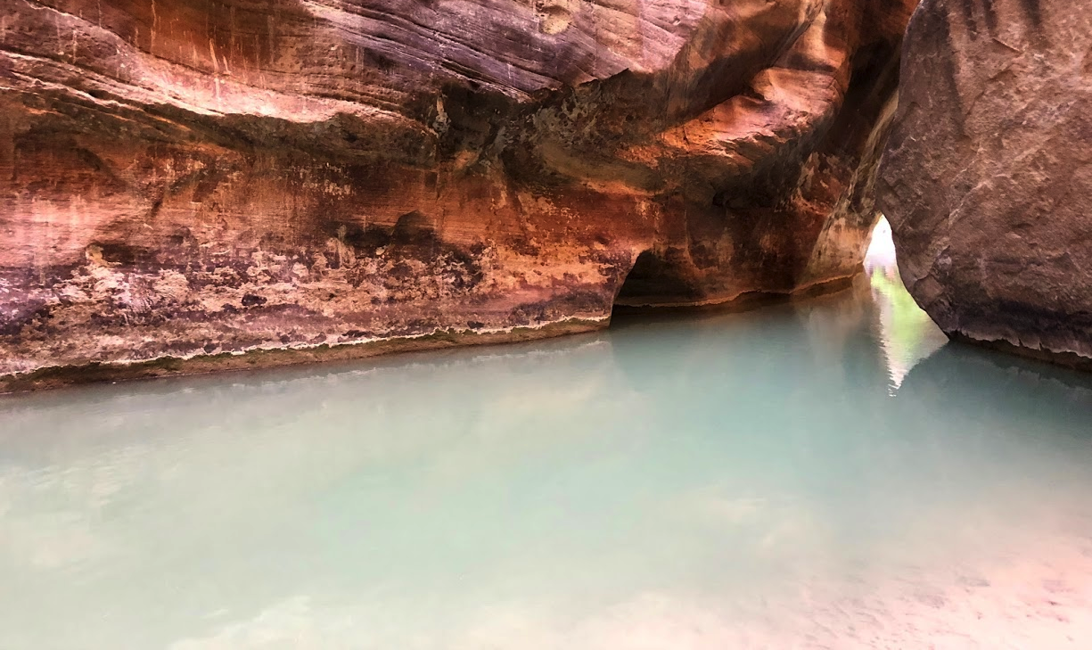
Personal Temperature Experiences in the National Parks

Slide 2
Quick notes
Photos are released by Sarah Fortner for educational use.
Graphs were generated using a PocketLab™ Weather

Slide 3
Activity 1 Directions
Break into pairs or small groups and explore examples from 3 National Parks
Identify the environmental condition (e.g. landscape, vegetation, or other conditions that would impact personal temperature experience).
Reflect on how hiker age, health, or experience might influence whether the hike is enjoyable.
As a group: list the factors and write a synthesis statement describing conditions that influence temperatures experience.
As a group: write a synthesis statement describing why understanding diverse experiences in the environment is important to planning parks or other community land use planning.
Bonus question for fast groups:
How does access or lack of access to parks influence the human experience? Does everyone have the same access to nature?
How do lessons learned from this activity translate to planning in the built environment? Are there inequities in building conditions that make temperatures more or less pleasant?

Slide 4
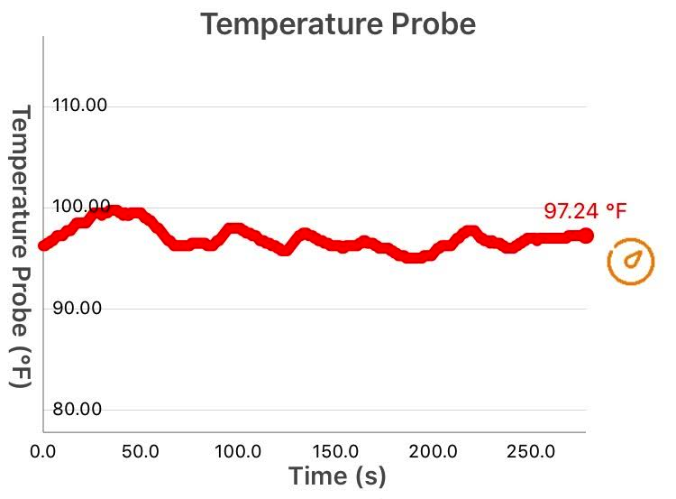
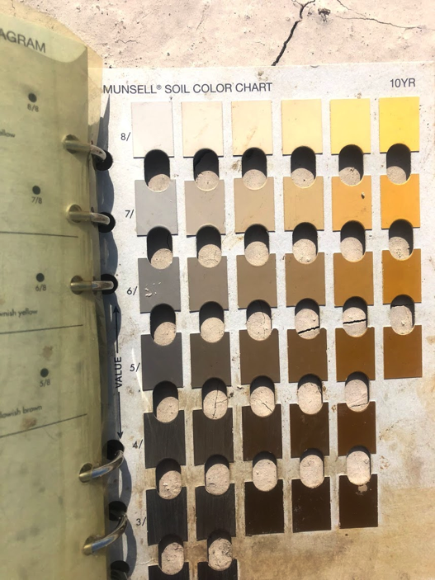
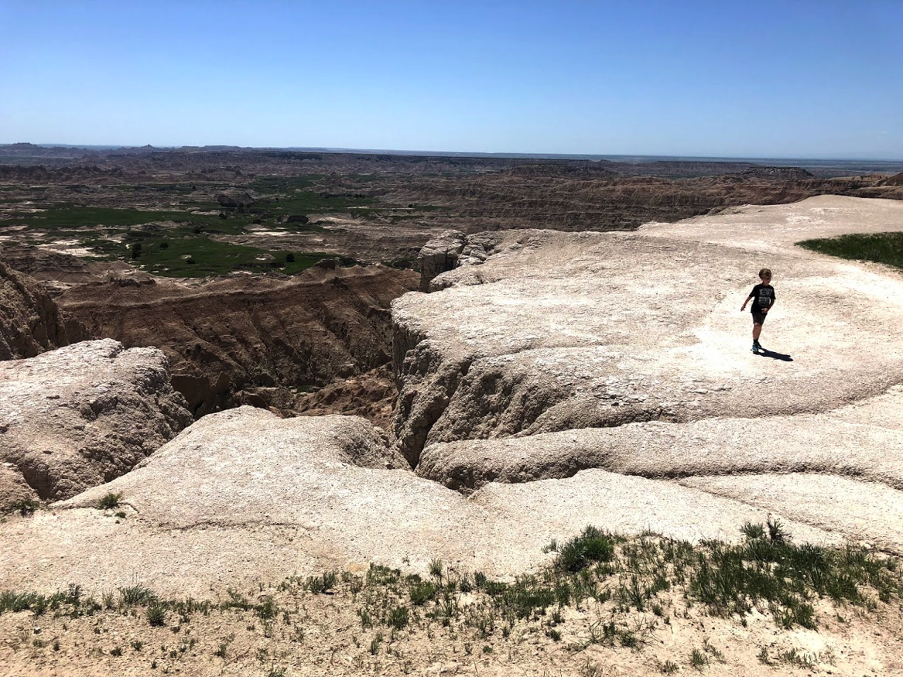
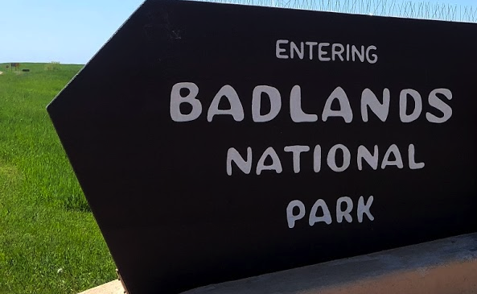

Slide 5
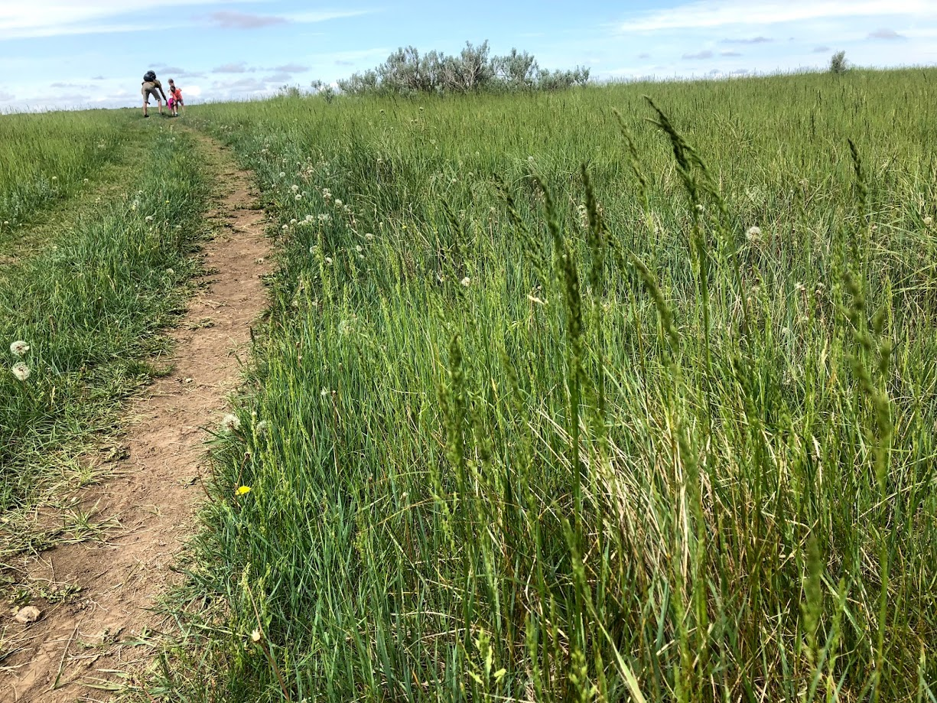
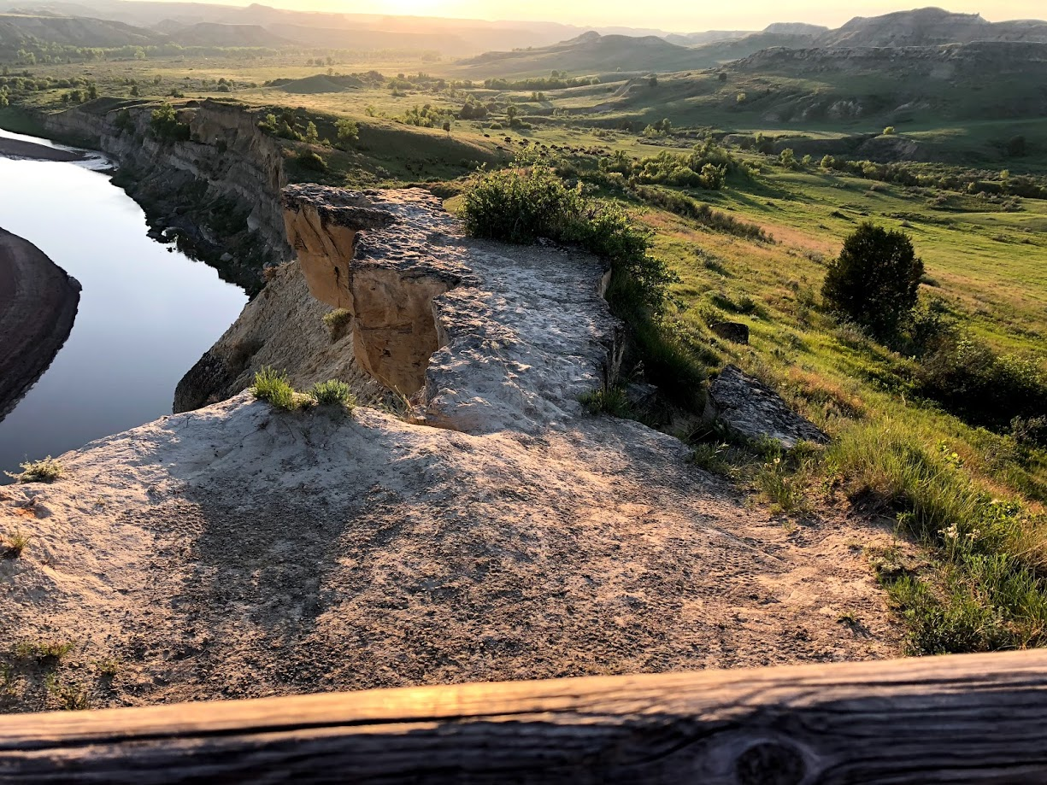
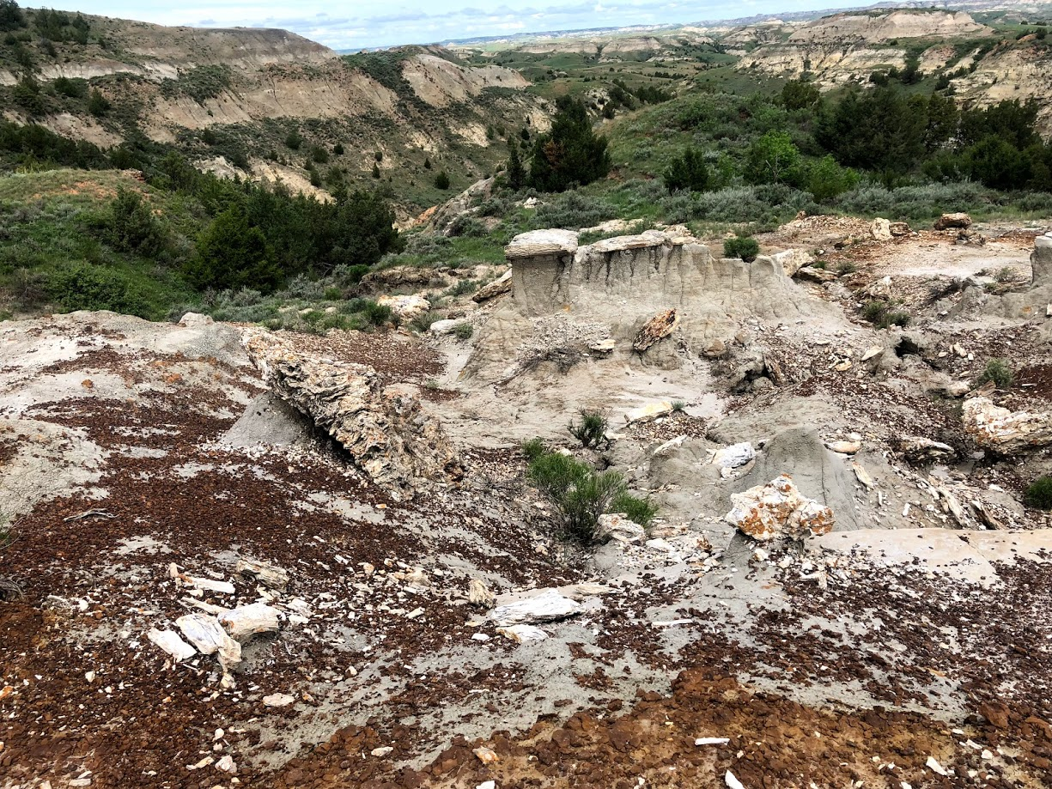
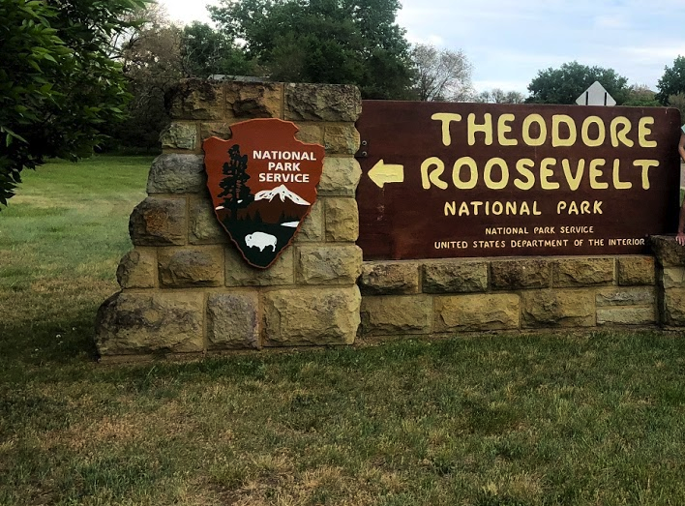

Slide 6
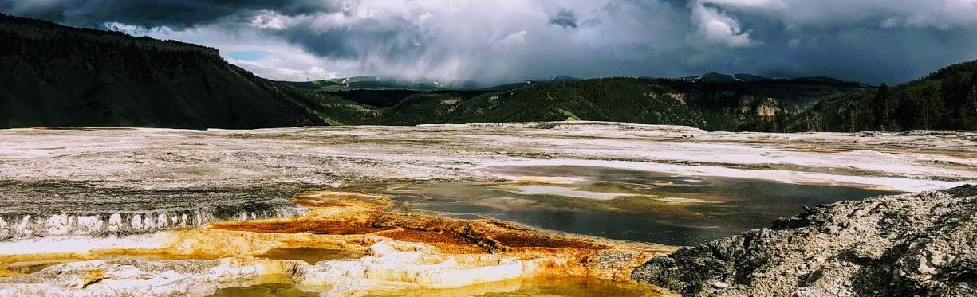
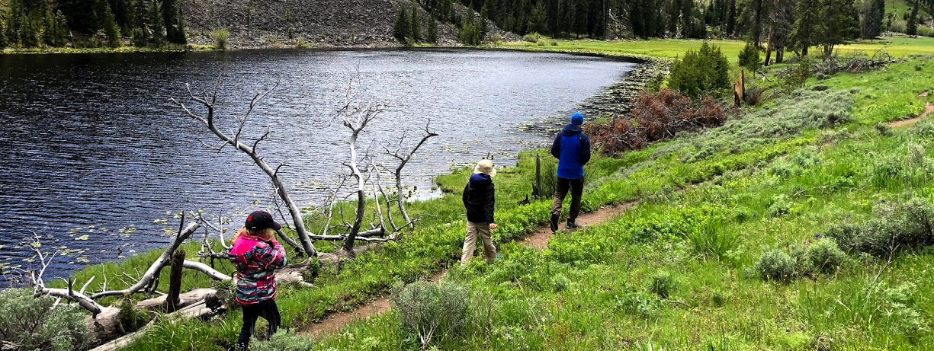
Yellowstone

Slide 7
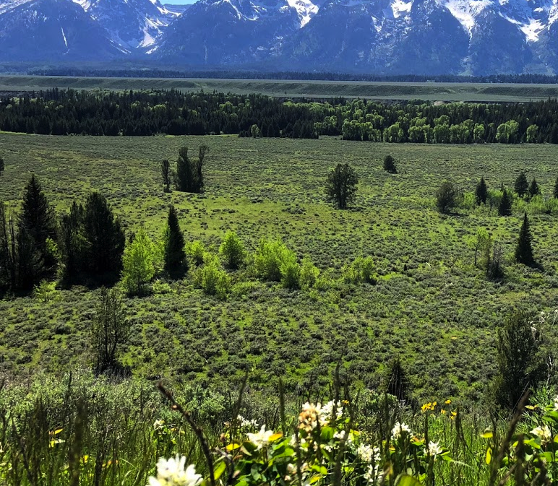
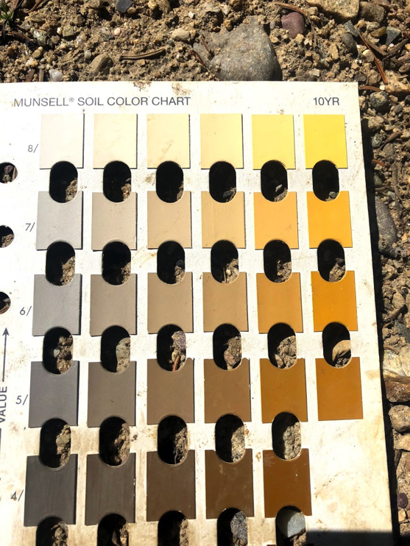
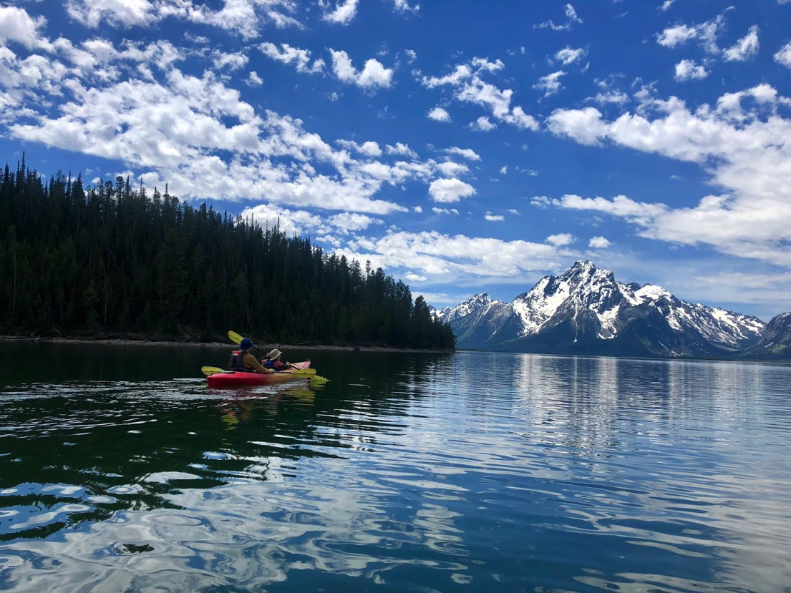
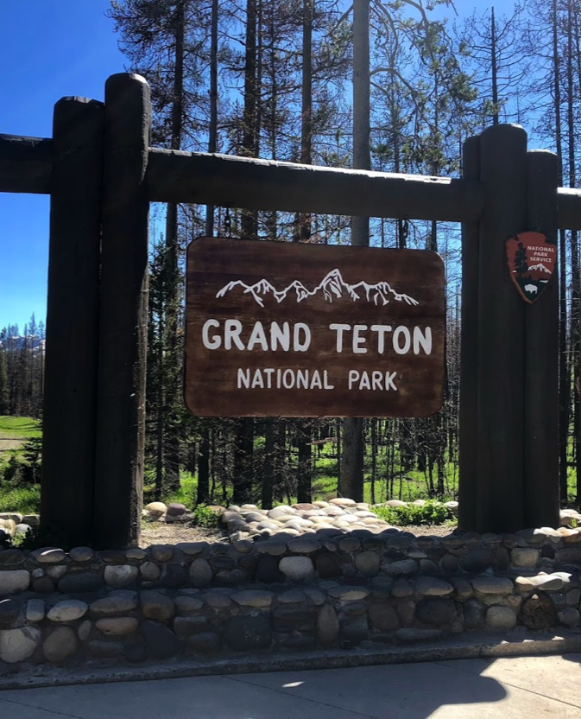

Slide 8
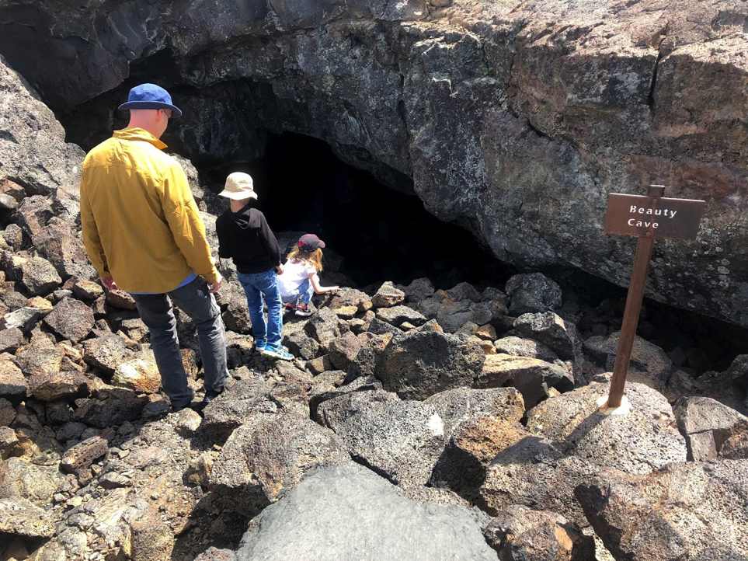
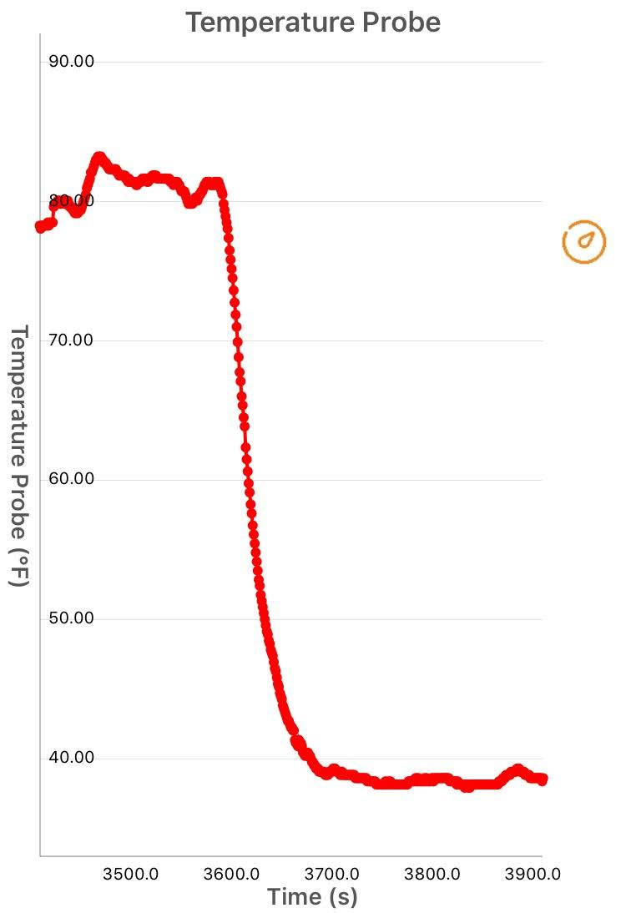
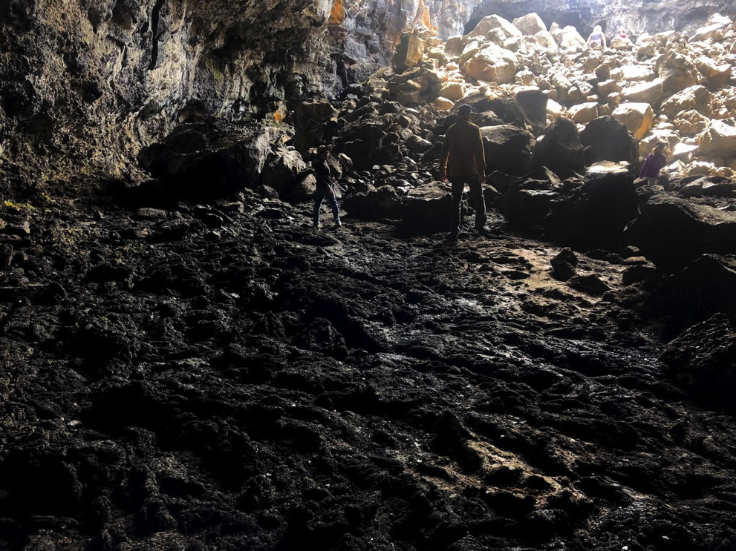
Craters of the Moon (Outside & inside cave)

Slide 9
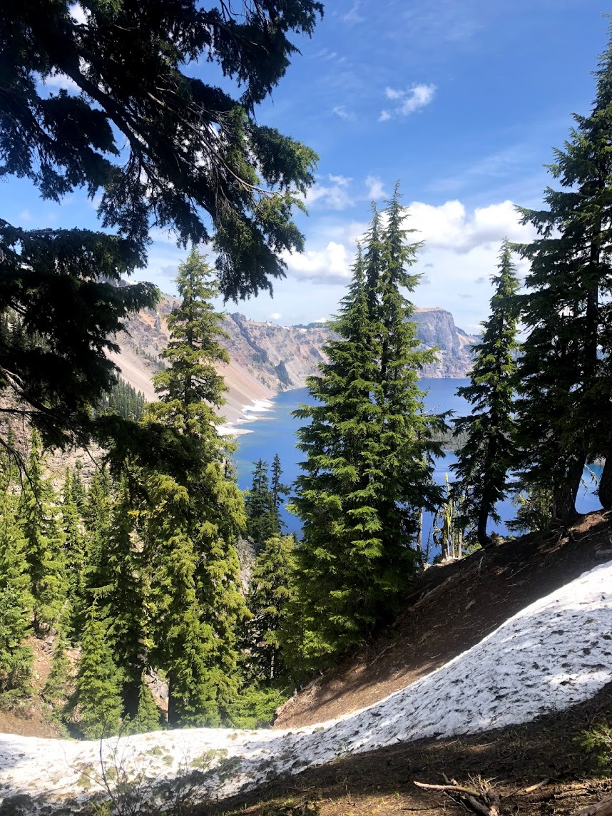
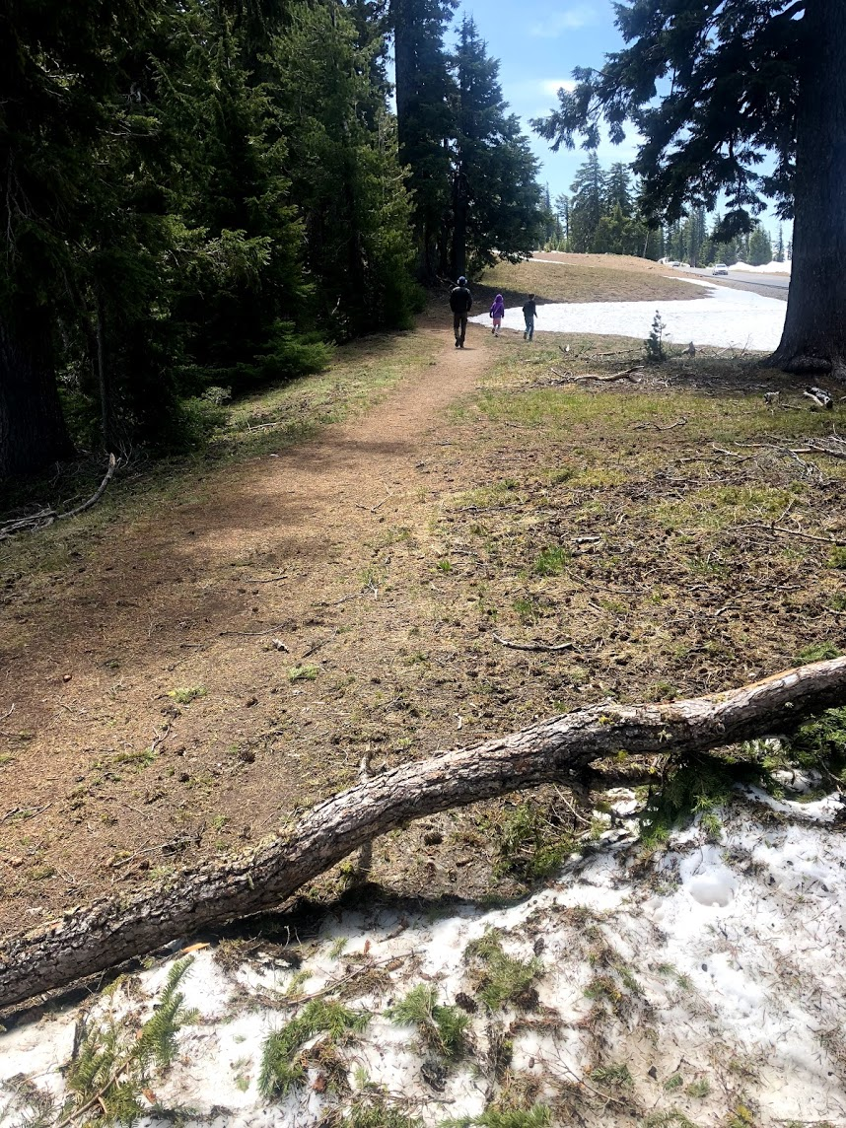
Crater Lake

Slide 10
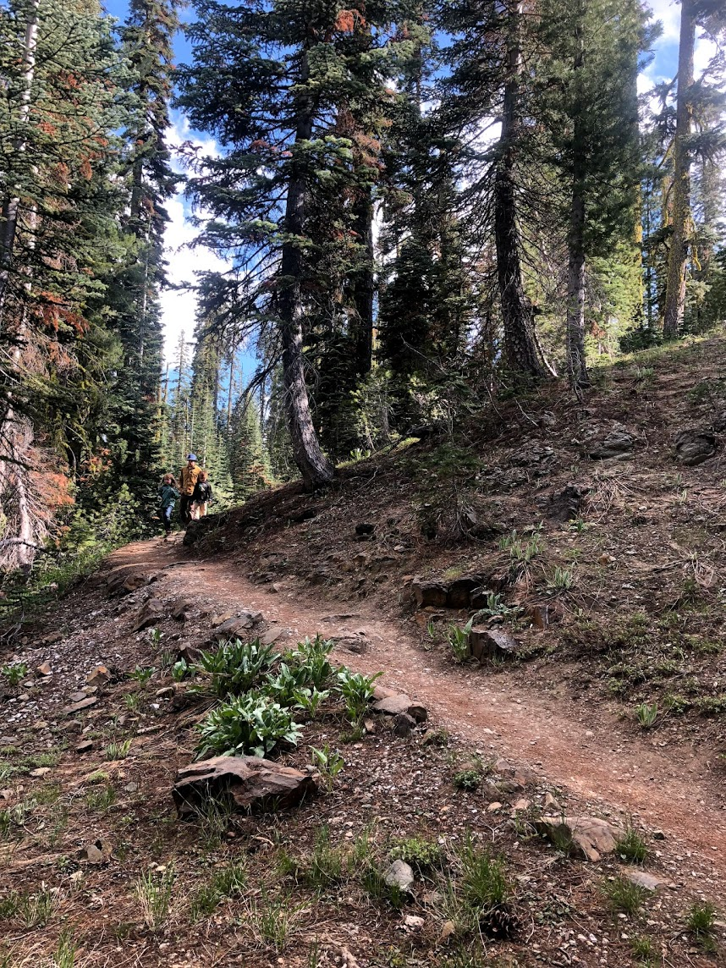
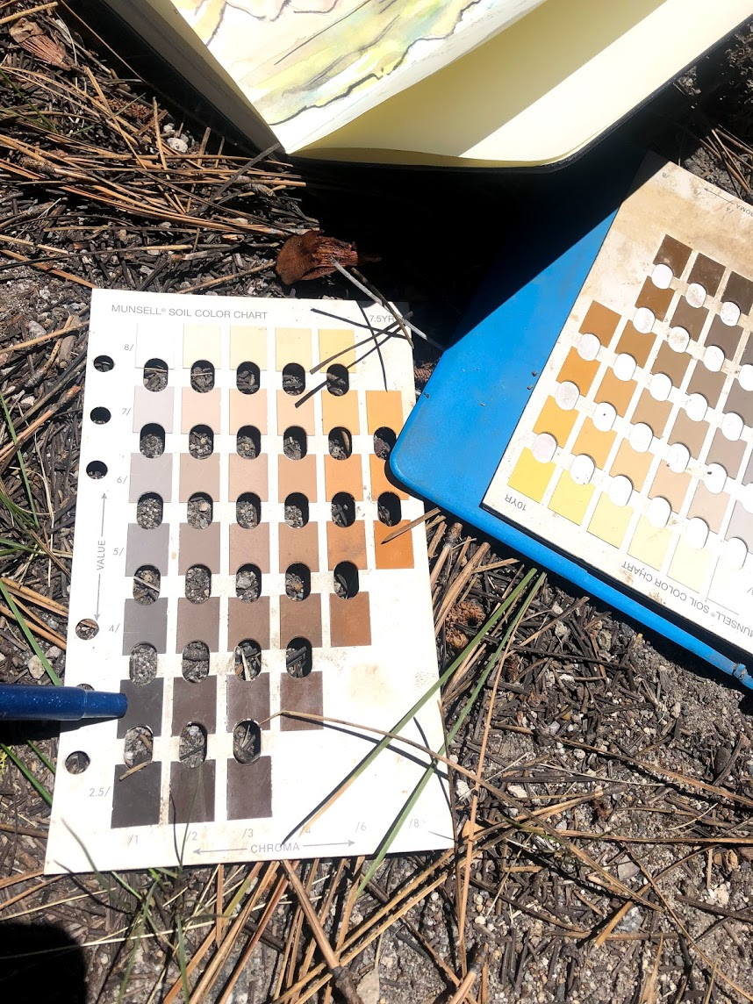
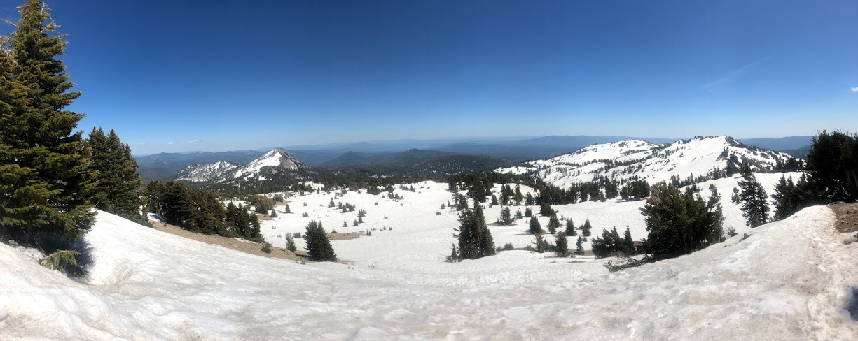
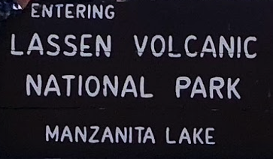

Slide 11
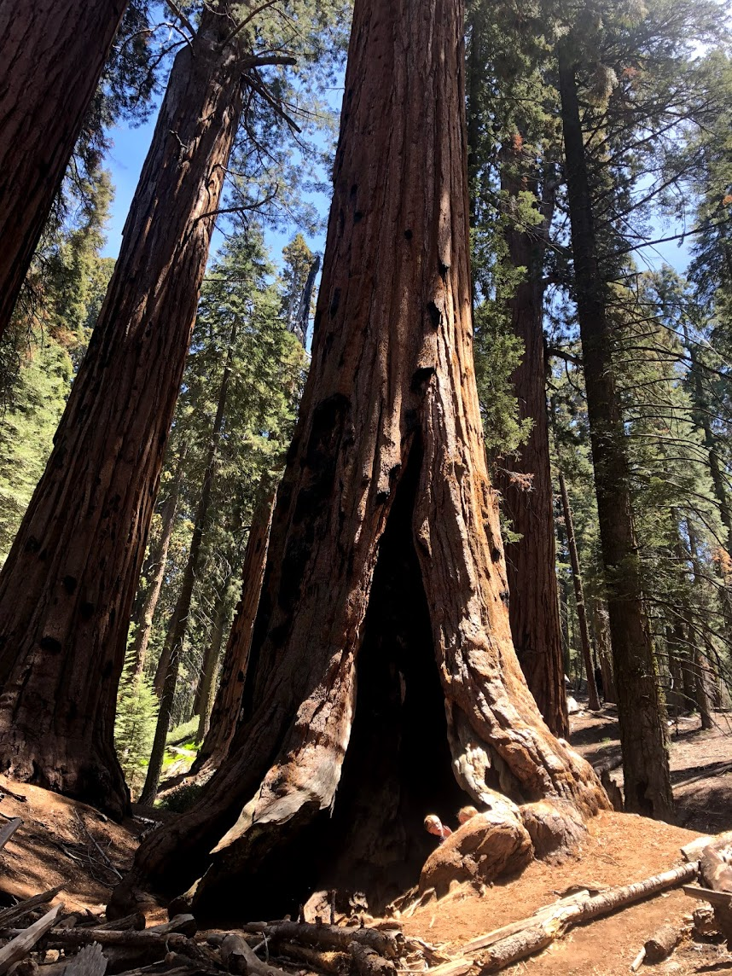
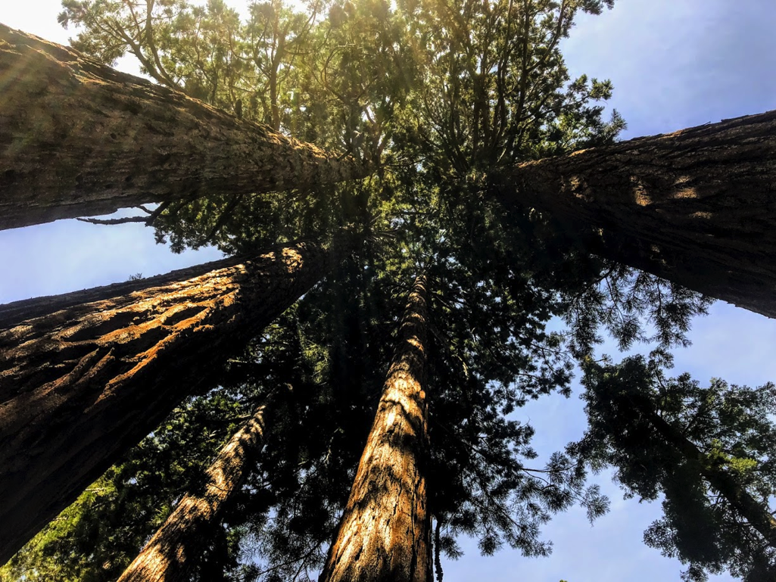
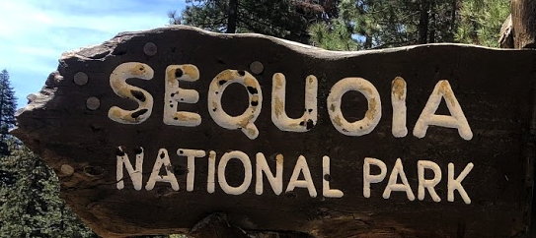
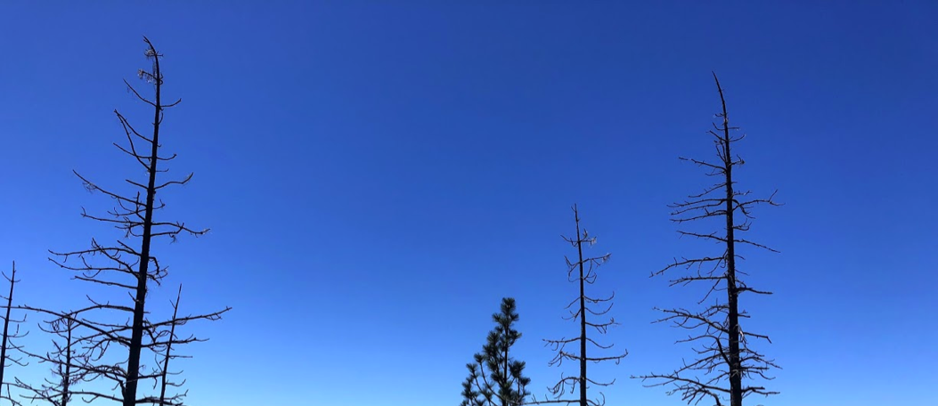

Slide 12
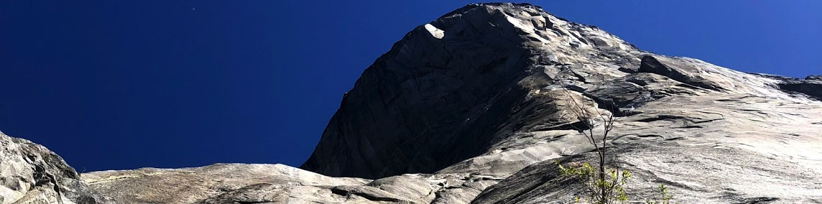
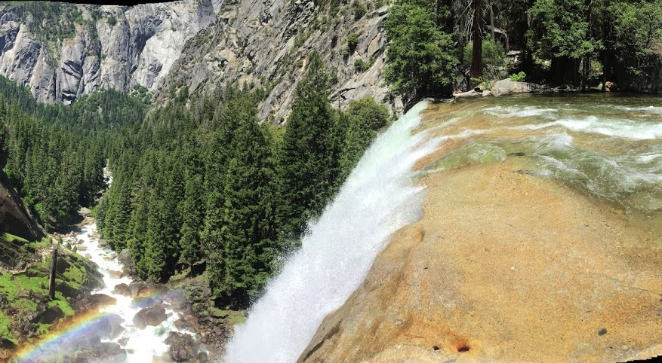
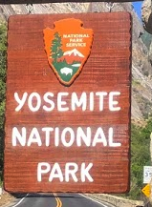

Slide 13
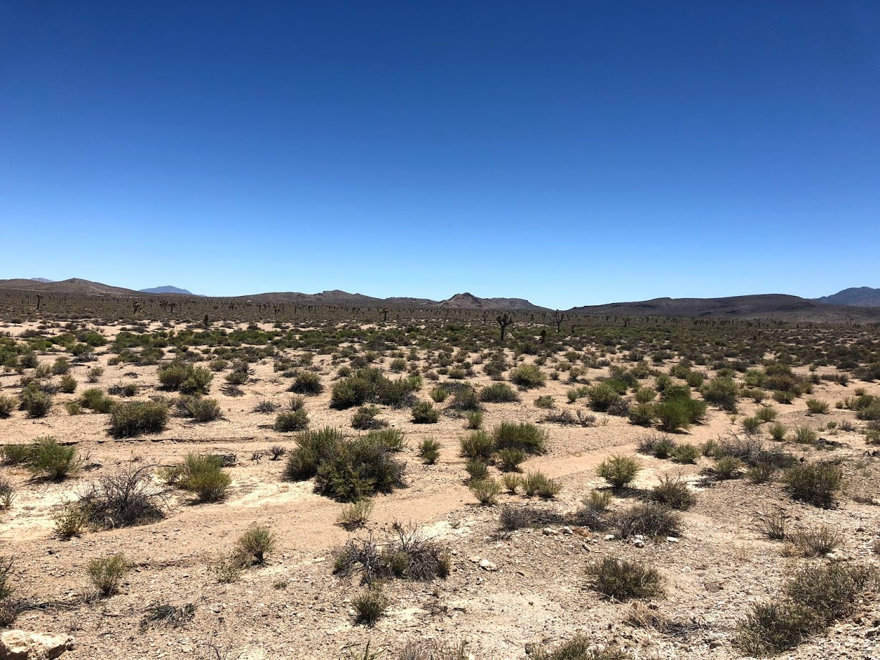
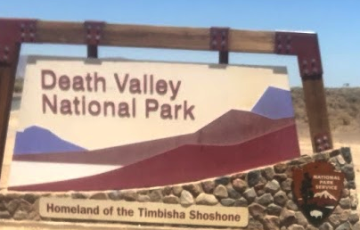

Slide 14
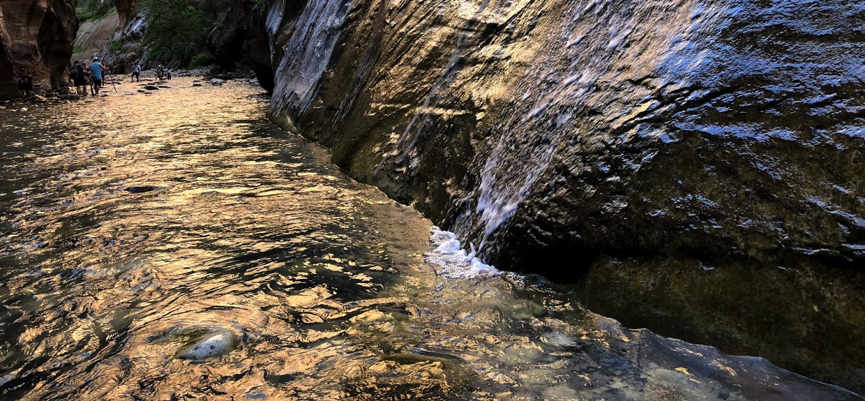
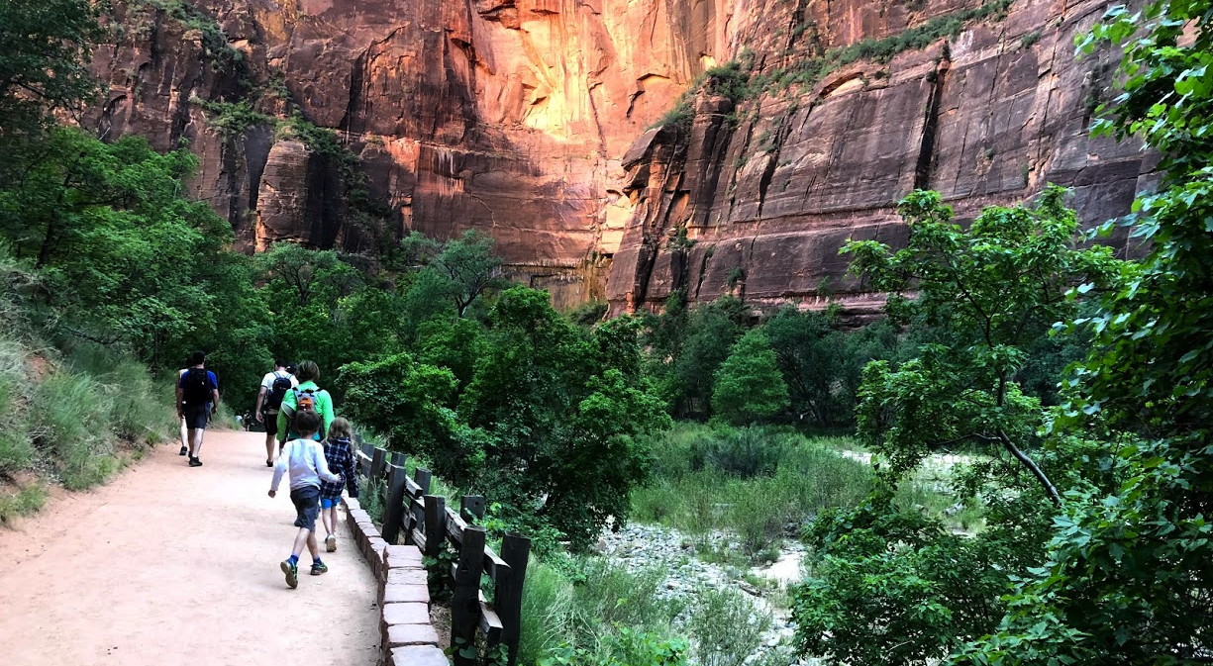
Zion

Slide 15
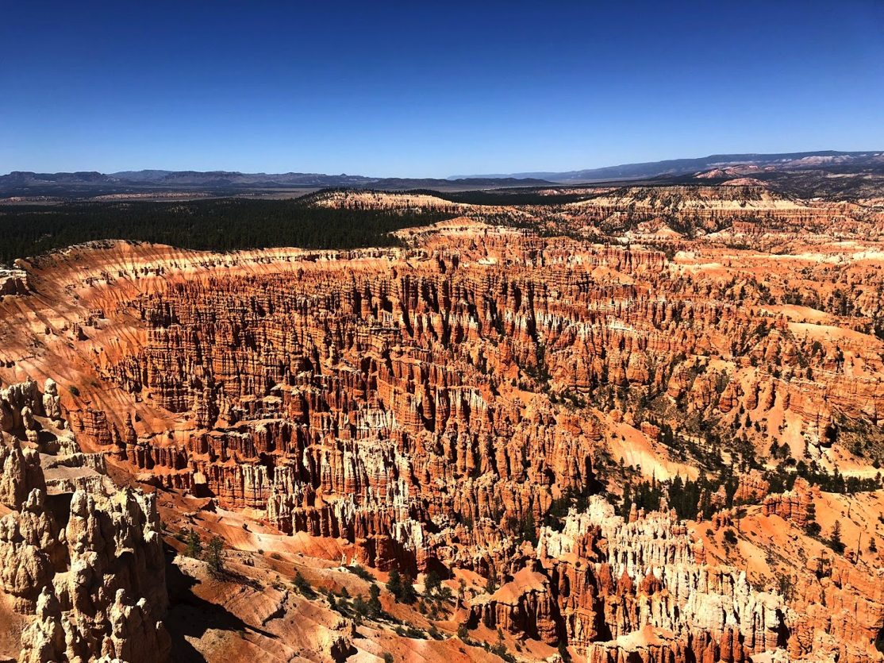
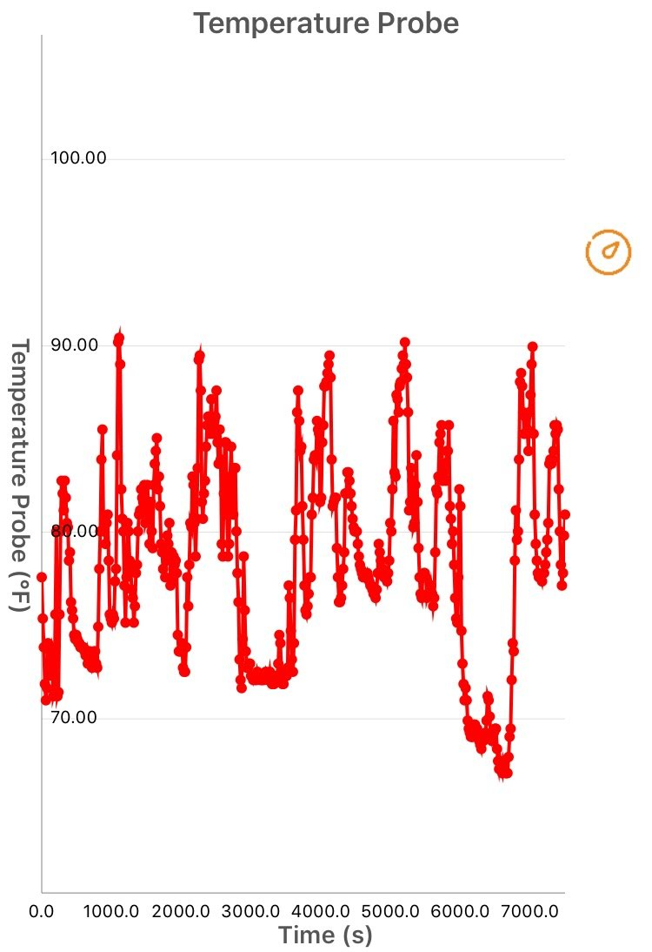
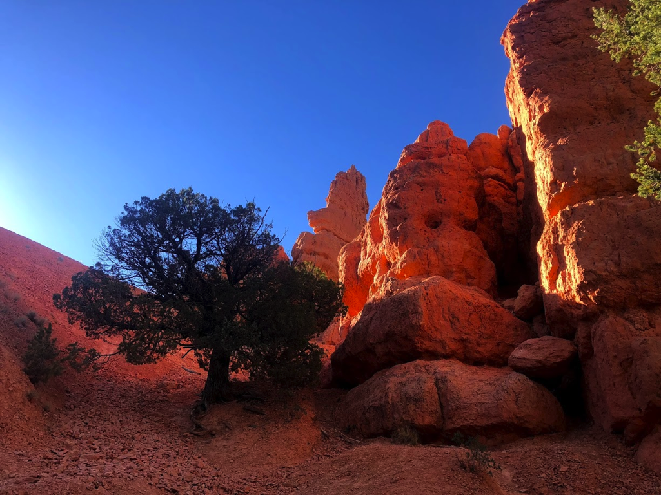
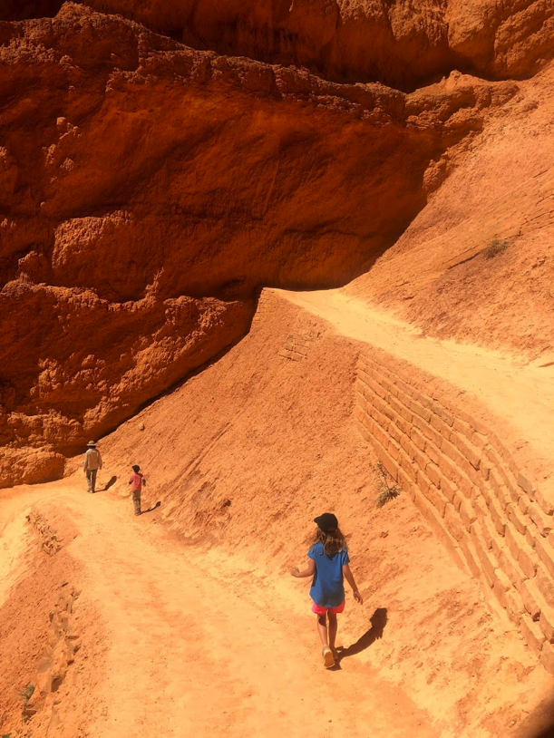
Bryce Canyon

Slide 16
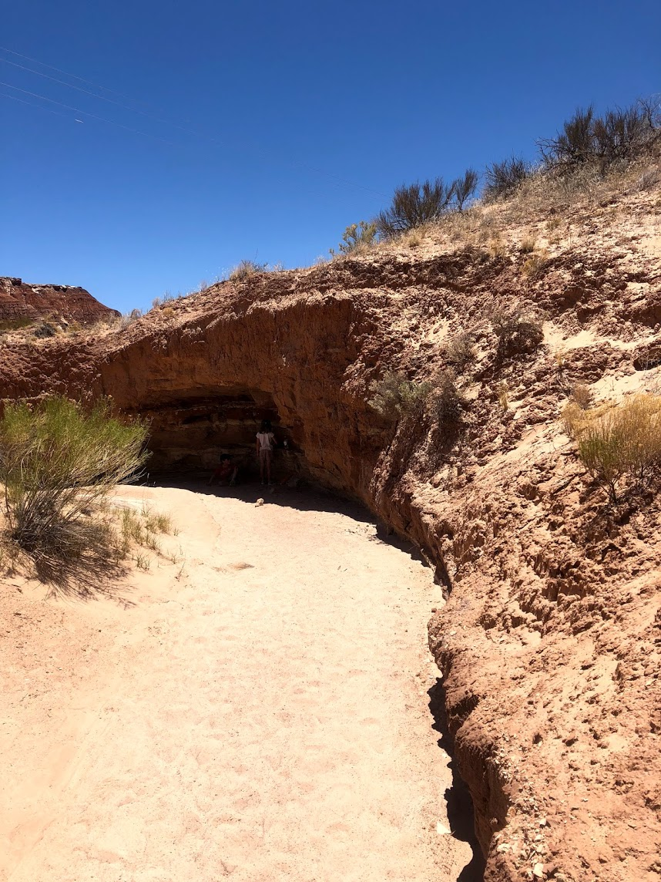
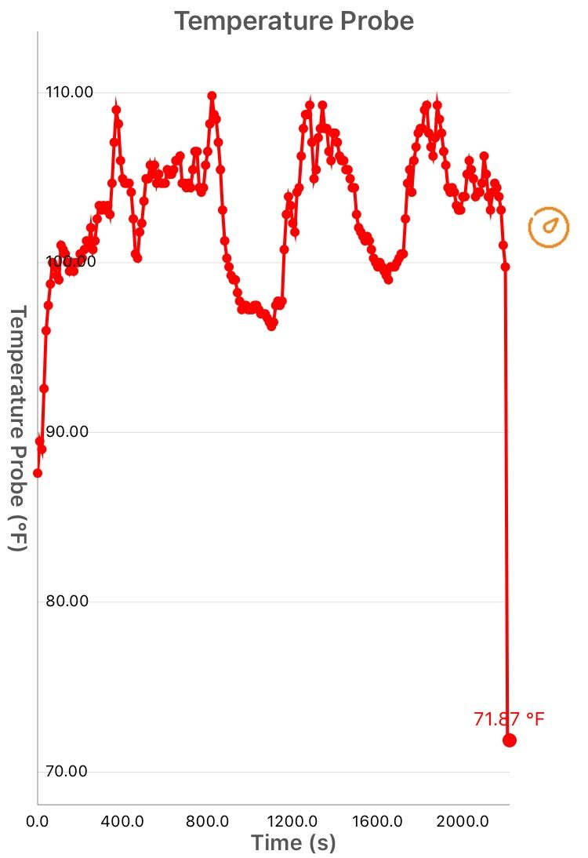
Grand Staircase Escalante
(inside & outside of cut bank shelter

Slide 17
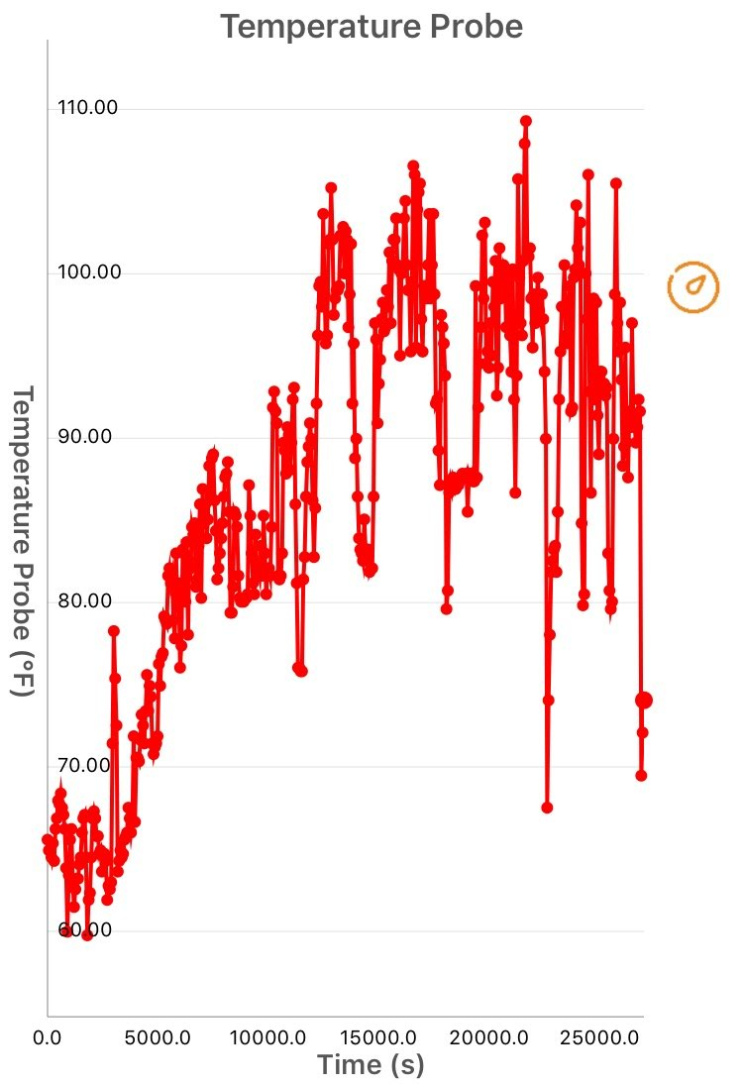
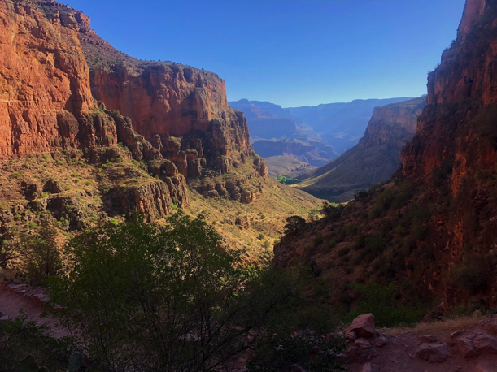
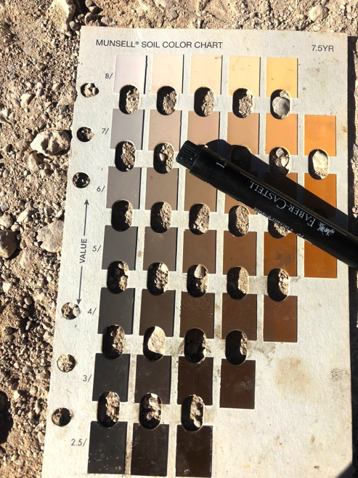
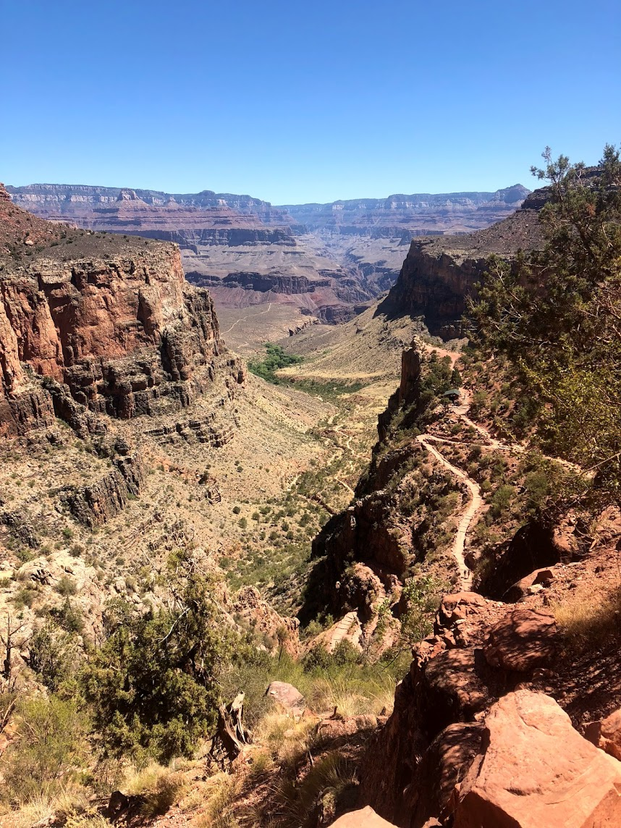
Grand Canyon

Slide 18
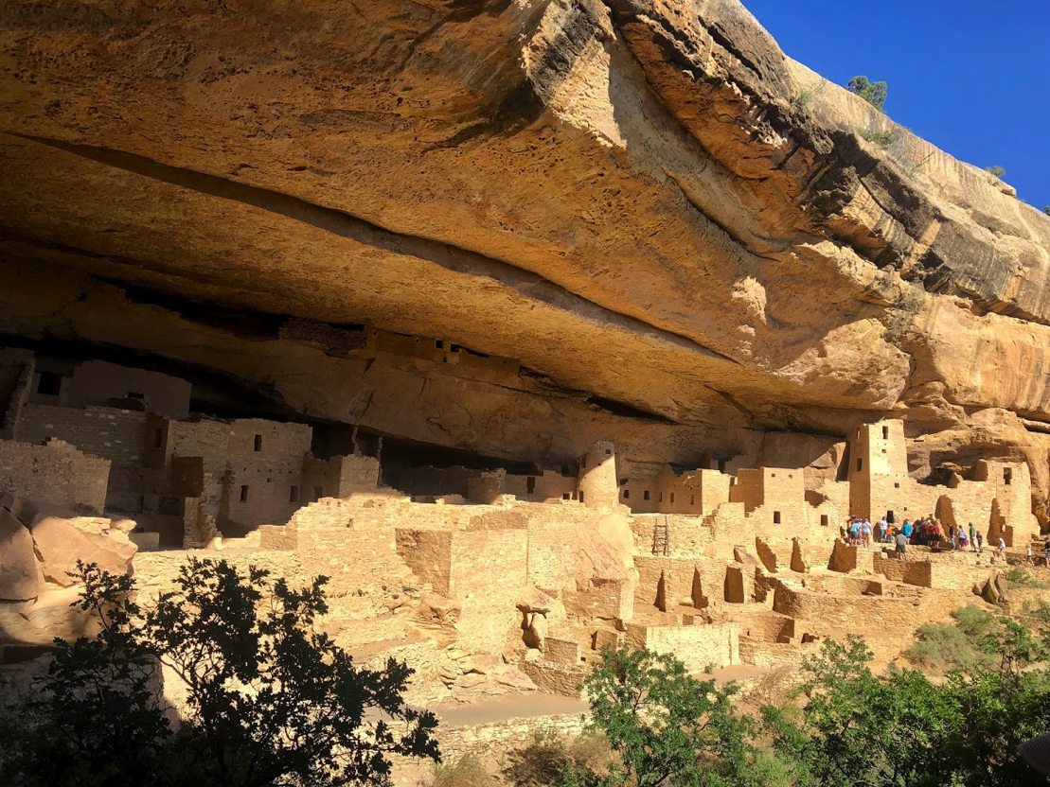
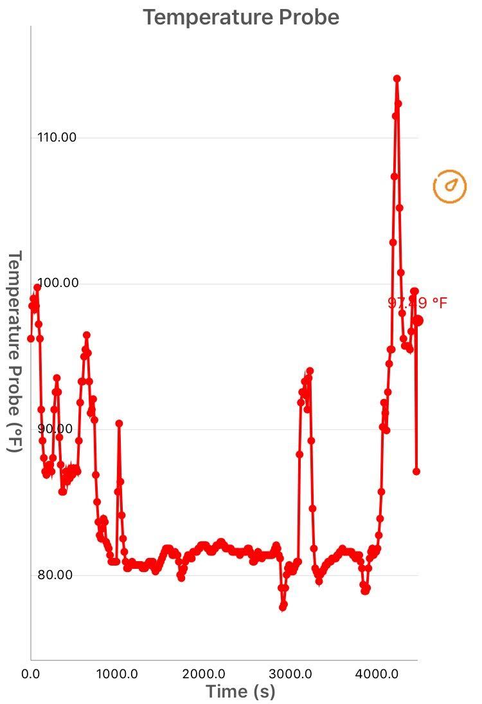
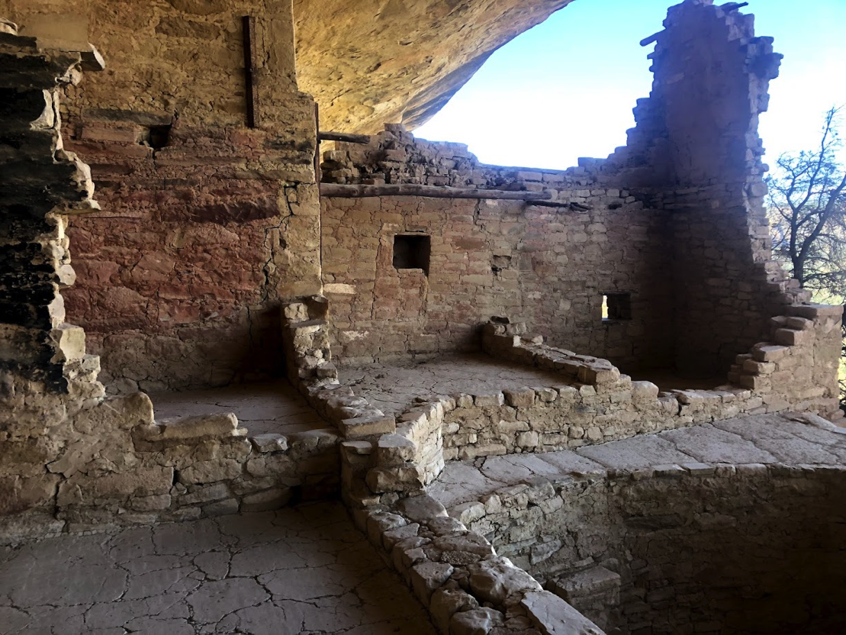
Mesa Verde

Slide 19
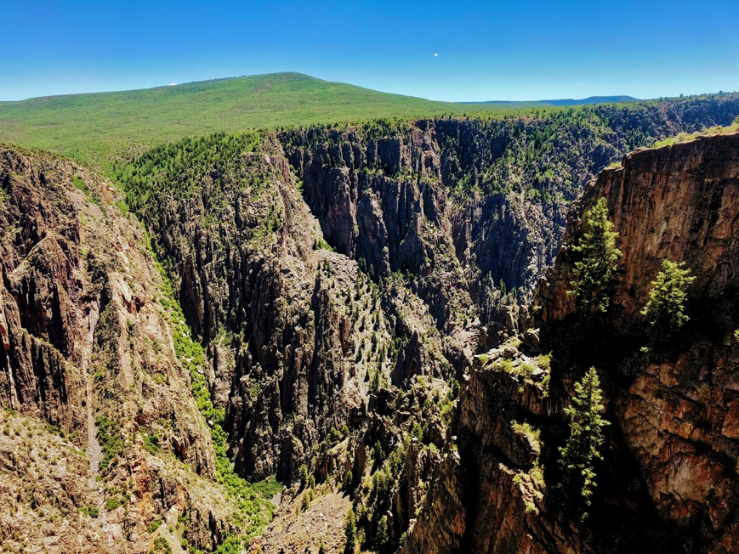
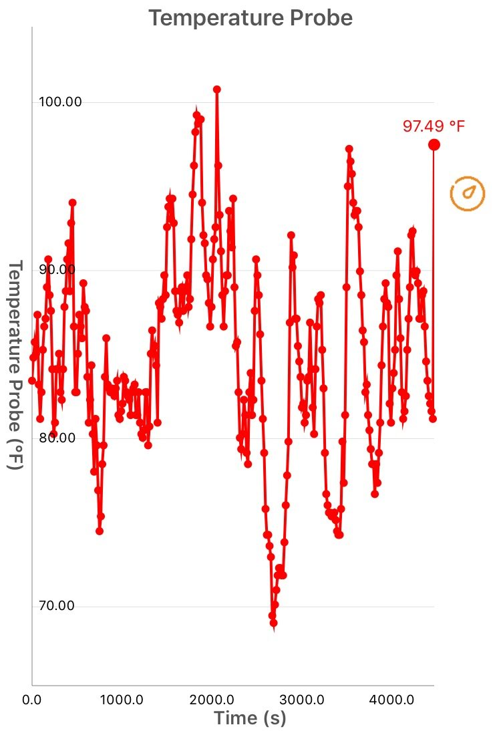

Black Canyon of the Gunnison

Slide 20




Rocky Mountain

Slide 21
Share out
Each group should share one environmental or personal factor important to temperature experience during a hike
Share out why understanding diverse environmental or built environment experiences is important to community planning.

Slide 22
Activity Two
The following shows the high temperature measured during a single hike using a PocketLab Weather™ compared with high temperatures from the day of the hike and historical daily high temperatures from Weather.com & changes in the ratio of daily record high and low temperatures from Menne et al., 2012.
Questions:
How did high temperatures from a single hike compare to daily high temperatures?
Were most of the met station daily highs higher or lower than the long term (30+ year) average?
Is that consistent with long term trends in daily high temperatures?
Reflecting on the trends you see, why might it be hard for people to understand climate change over longer time periods when they think about their own temperature experiences.

Slide 23

Temperature (F)

Slide 24

Menne et al., 2012: an overview of the global historical climatology network-daily database. Journal of Atmospheric and Oceanic Technology, 29, 897-910
https://science2017.globalchange.gov/chapter/executive-summary/

Slide 25
Activity Two
Questions:
How did high temperatures from a single hike compare to daily high temperatures?
Only 3 hikes had lower high temperatures than the high temperatures measured at the met station.
2) Were most of the met station daily highs higher or lower than the long term (30+ year) average?
Only 2 of the met station daily highs were lower than the long term average.
3) Is that consistent with long term trends in daily high temperatures?
Yes, daily temperatures are more likely to be higher than long term averages than lower.
4) Reflecting on the trends you see, why might it be hard for people to understand climate change over longer time periods when they think about their own temperature experiences.
Our personal temperature experiences aren’t at all the same as those that are reported by meteorological stations. People who live in the same place may have a good sense of relative trends if they have similar day-to-day environmental experiences throughout their lives, but this may not be the case for most people.

Slide 26
Optional Follow-up
The National Center for Science Education Recommends that Climate Educators:
Make it local
Make it human
Make it pervasive (i.e. connective outside of classroom learning)
Make it hopeful.
Why might local parks be a good place for climate education, citizen science, or community development planning to address climate change. What personal temperature monitoring activity would you do with what audiences to achieve all 4 goals?
https://ncse.com/library-resource/teaching-climate-change-best-practices

Slide 27
Optional Follow-up
Data collected during hikes at each National Park has been provided for your analyses.
Which hike had the greatest temperature range?
Calculate and graph the average temperature for 3 hikes and compare it to the high temperature for 3 hikes.
What are some of the ways climate change is monitored and planned for in the National Parks?
https://www.nps.gov/subjects/climatechange/effectsinparks.htm

