Slide 1
Introduction to structure-from-motion
Katherine Shervais modified by Beth Pratt-Sitaula

Slide 2
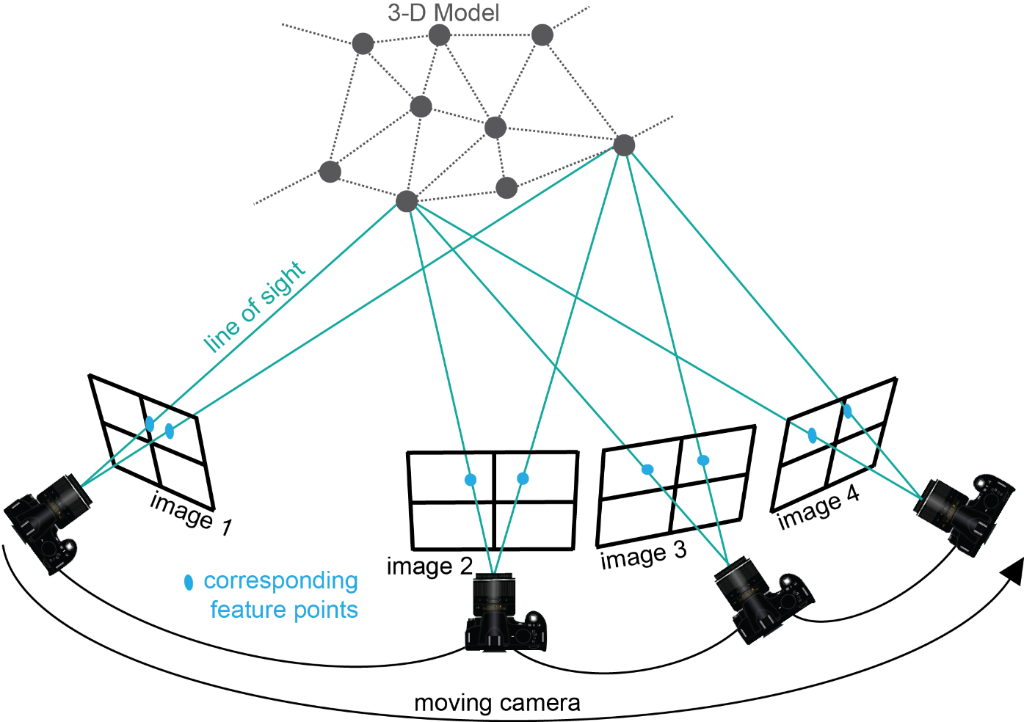
Structure-from-motion?
Use the locations of the camera (motion) to interpret the geometry or 3D model (structure) of a scene
Figure Kate Shervais
Notes:
Structure-from-Motion photogrammetry is an emerging technique used to create three-dimensional point clouds with associated color—basically a three-dimensional model of the area of interest. The key things to notice here are that the camera needs to continually be moving (no two photos taken from the same location) and the photographs need to include the same features, so that features are in multiple photographs. You can see here that many of the gray dots on the 3D model are captured by multiple images, not just one. Scientists use this for many applications, which you will learn about today. The next slide will show what Structure-from-Motion actually produces.

Slide 3
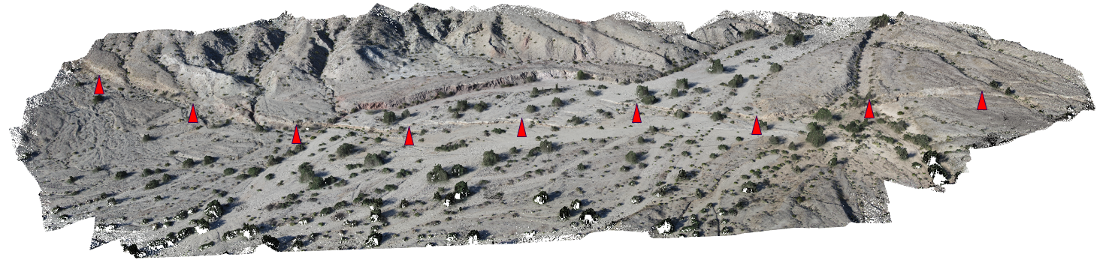
What do you create?
~500 points/m² colored point cloud along a ~1 km section of the 2010 El Mayor-Cucapah earthquake rupture generated from ~500 photographs captured in 2 hours from a helium blimp
Figure Ed Nissen
Notes:
The model above is a three-dimensional point cloud with associated color. This model is of a fault scarp; the red arrows point toward the location of the scarp. You will see a different view of this figure later in the presentation. Most researchers who use SfM use it to make point clouds like these: 3D models of a field area they can revisit and actually measure in the lab instead of the field. Can you think of anything to model using SfM? [Make a list on the board.] Why would SfM be a good method to use for these applications? [add to list on the board.]

Slide 4
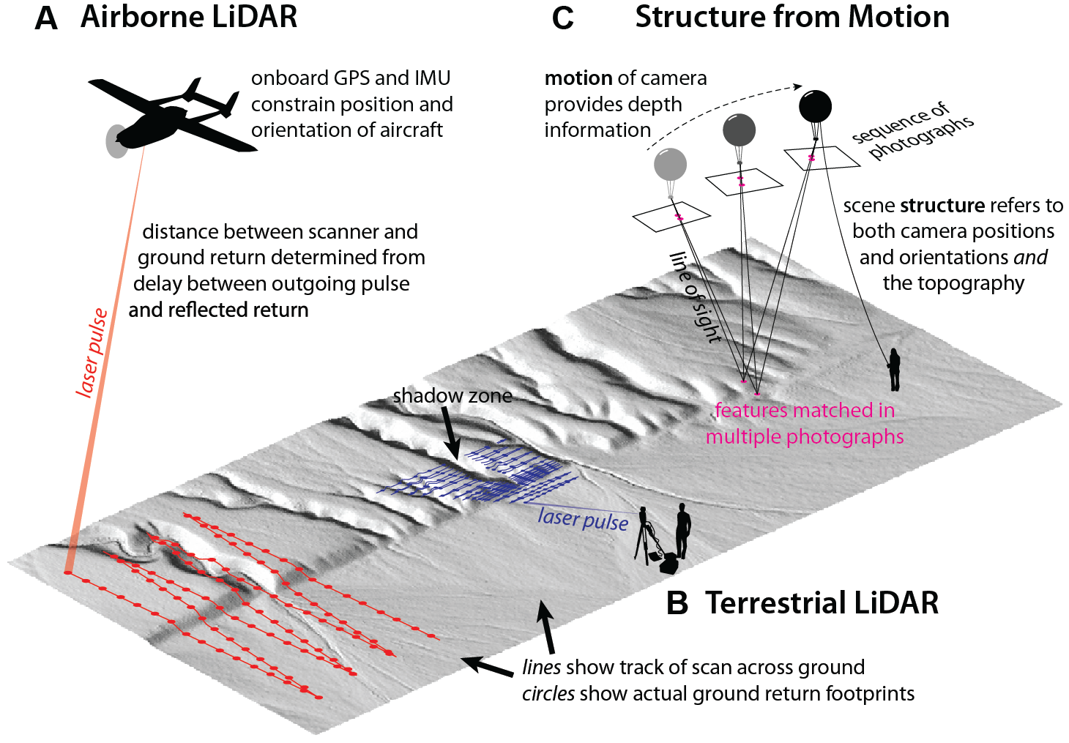
What can we compare sfm to?
Figure Johnson 2014
Notes:
Structure-from-Motion is not the only way to create a georeferenced point cloud like the one on the previous slide. The other option is using something called LiDAR. LiDAR laser scans an area of interest to create a 3D point cloud. Two example platforms for LiDAR are shown. You can fly a plane over an area at an altitude of roughly 1 km to get a point cloud or have a scanner on a tripod as shown in B. LiDAR can be used with many other platforms not seen here. Typically, LiDAR is how scientists are able to collect 3D point clouds for research. We will see some direct comparisons between LiDAR and SfM in later slides. (Kendra Johnson, Geosphere 2014)
Note: GSA Publications allow the reproduction of a single figure or table under without permissions. http://www.geosociety.org/pubs/copyrt.htm

Slide 5
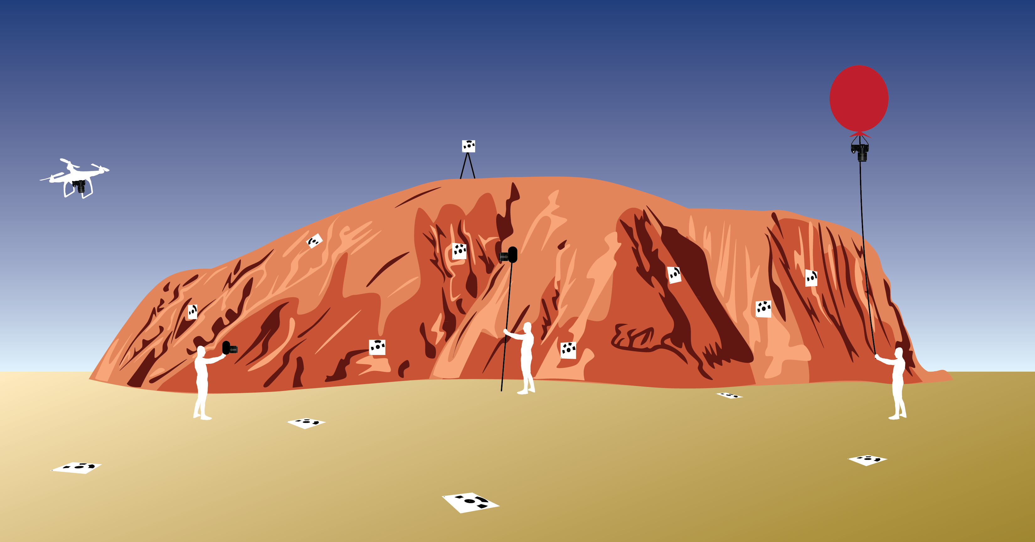
platforms
Figure Kate Shervais
Notes:
Many platforms exist to assist in capturing SfM data. The figure above shows a range of platforms, from UAV on the far left, handheld mid-left to pole photography on the mid-right and a balloon on the far right. The squares with a black pattern are targets, places to survey in, so the model can be linked to geographic coordinates. A handheld platform is best for doing detail work and some outcrop scale work, but has limited applications and is not ideal for areas larger than 100–200 square meters. The slides following will go into the details of the other platforms.

Slide 6
Applications of Sfm
Notes:
Can be fun to stop at this point and ask the students to give ideas on what applications they imagine high rez 3D models/topography.

Slide 7
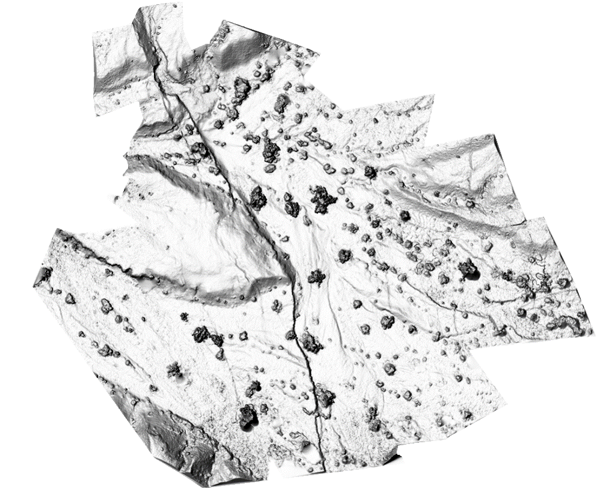
Shaded digital elevation model
Figure Ed Nissen
Notes:
DEM – Digital elevation model. This one has hillshade, so it seems like the sun is shining and it is partially in shadow to show off the features. You can see that different features stand out in the DEM in comparison to the orthomosaic, so they can be used for different research applications. You can use this to measure features.

Slide 8
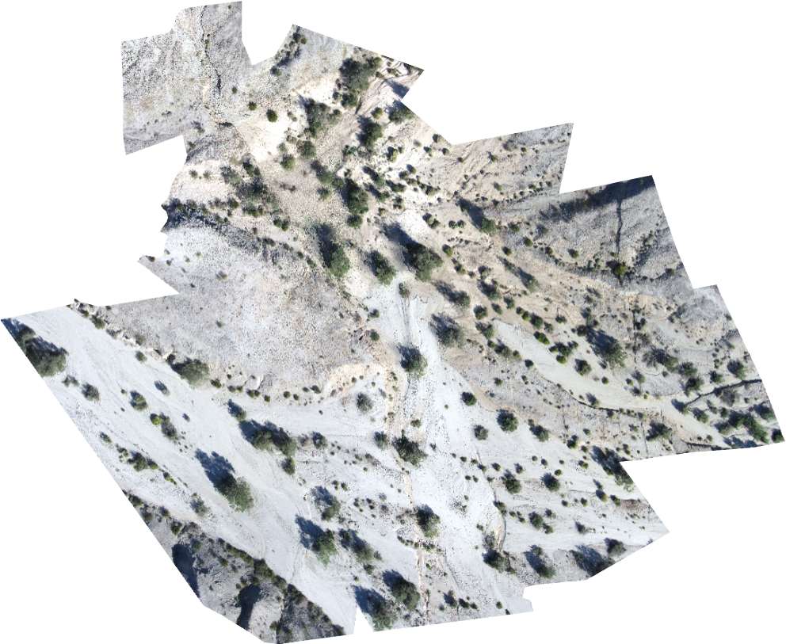
orthomosaic
Figure Ed Nissen
Notes:
The orthomosaic is a high-resolution photograph of the area created by associating color with each point in the model. This can be used to view the features on the surface.

Slide 9
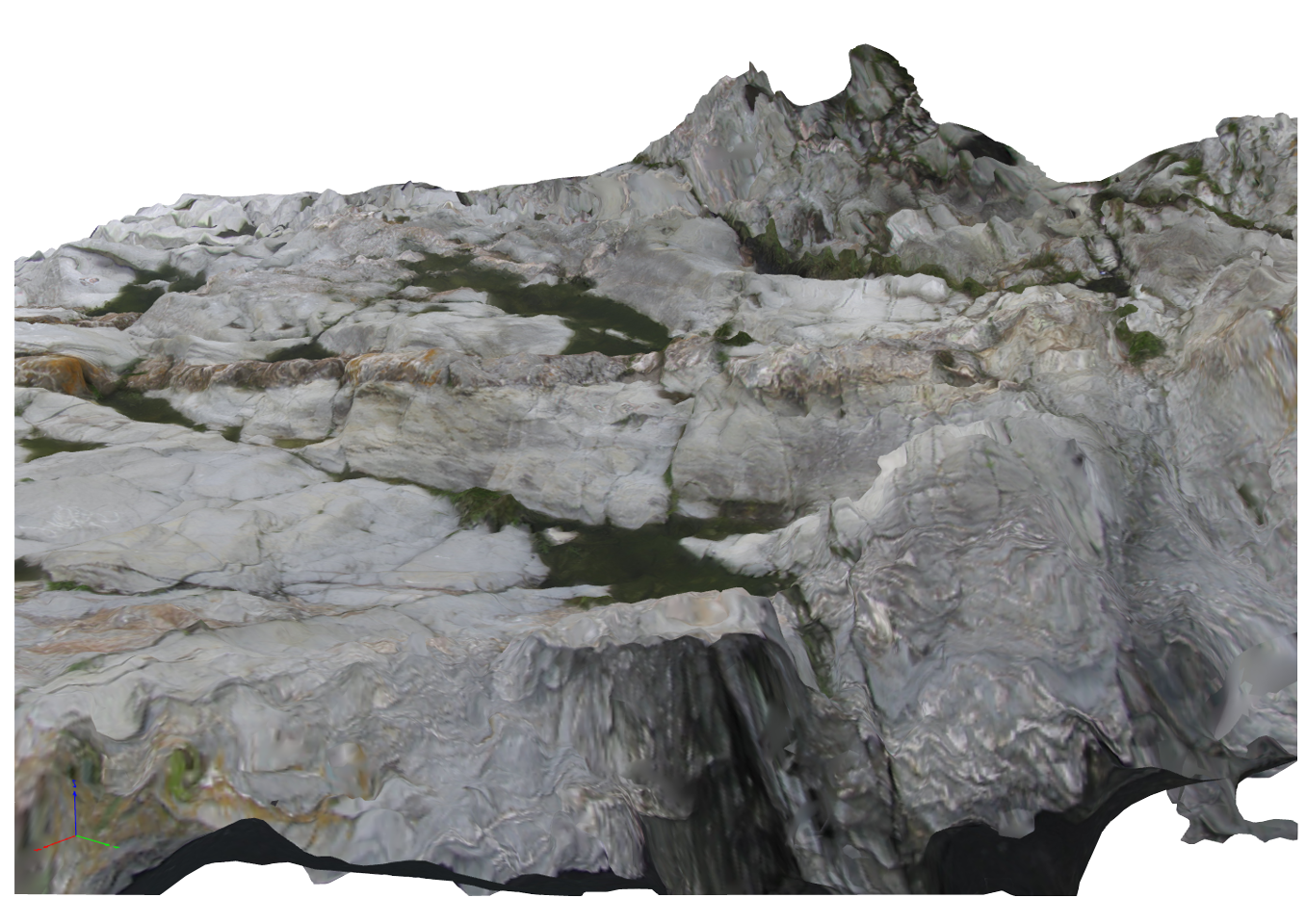
Outcrop model – side view
Figure Phil Resor
Notes:
This model was created to show an outcrop at Beavertail State Park in Rhode Island. The model has been used by students to map the different small-scale folds present in the outcrop. You can see in this side view that the edges of the model have been blurred; the blurring effect is due to low photo density at the edges of the model.

Slide 10
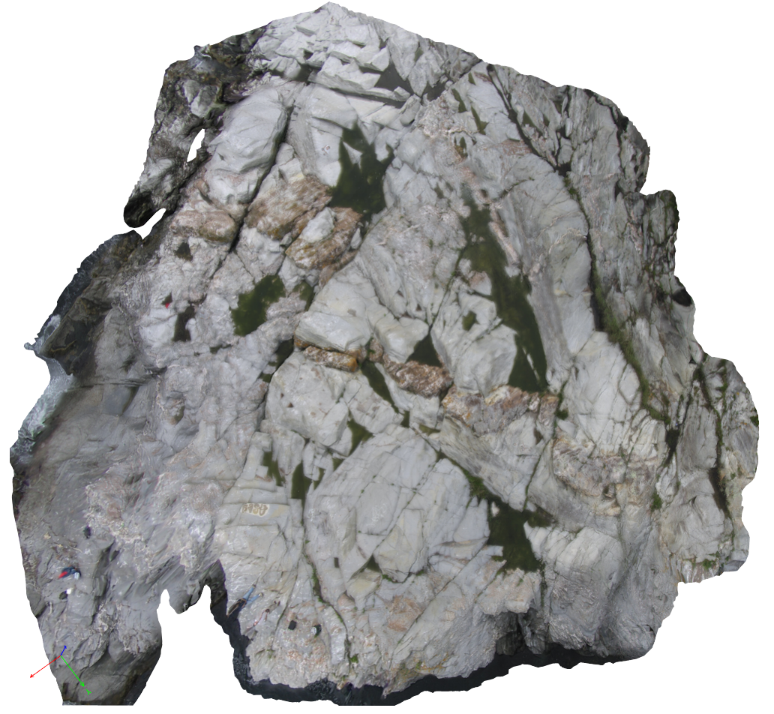
Outcrop model – top view
Figure Phil Resor
Notes:
Here is the top view of the Beavertail State Park outcrop model.

Slide 11
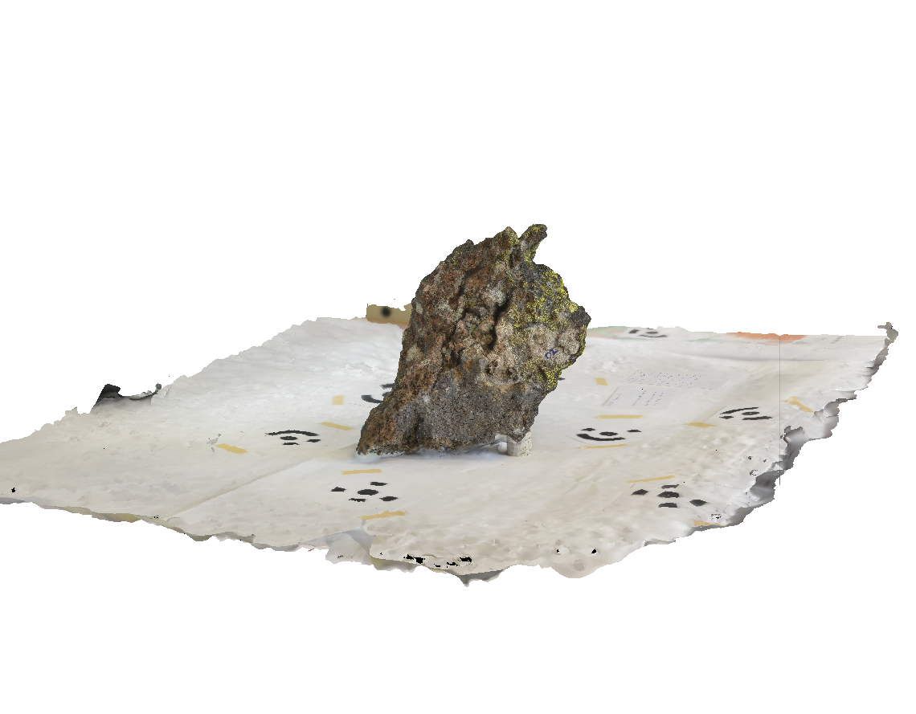
Rock sample model
Figure Sean Bemis
Notes:
This model of a handspeciman is used for students; they can look at hand samples in a digital form in addition to (or during remote learning) instead of the hand sample in the classroom.

Slide 12
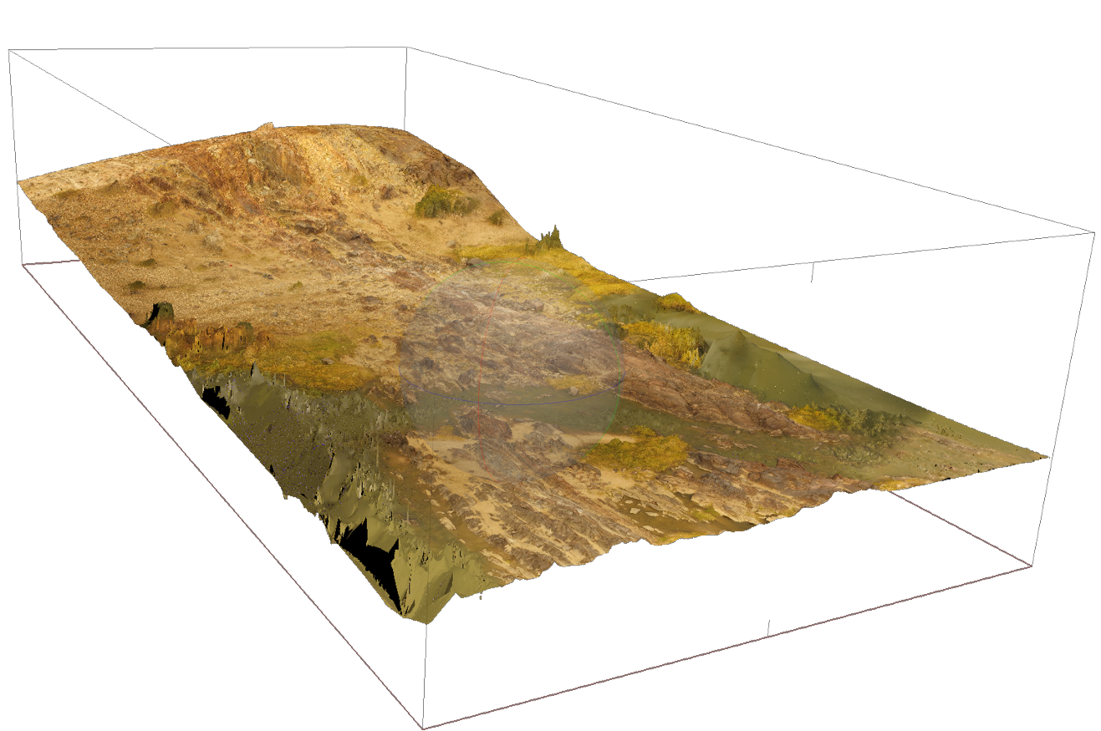
Outcrop model – pofadder shear zone
Figure Jamie Kirkpatrick
Notes:
In this view, you can see the 3D topography of the area shown in the flight video.

Slide 13
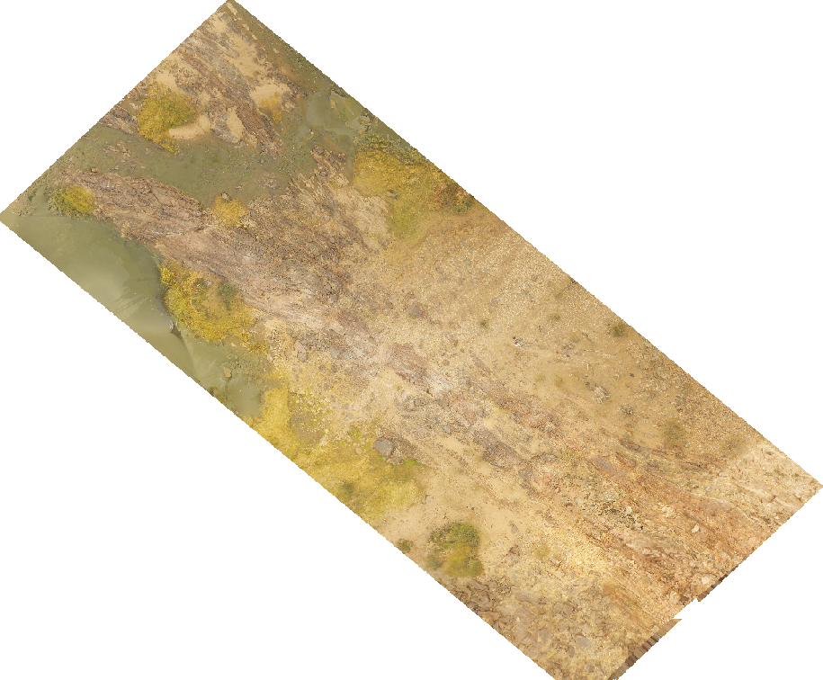
Outcrop model – pofadder shear zone
Figure Jamie Kirkpatrick
Notes:
The orthomosaic looks like this. This orthomosaic was used as the base for a geologic map.

Slide 14
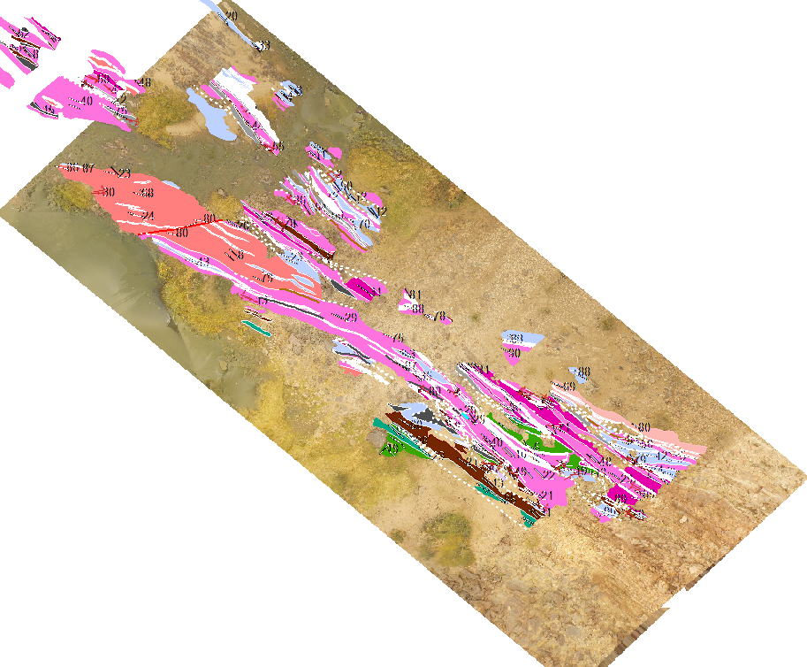
Outcrop model – pofadder shear zone
Figure Erik Young
Notes:
The map characterizes the shear zone based on rock type and orientation. Like a typical geologic map, the different colors correspond to different rock types. The white lines correspond to faults or fold axes.

Slide 15
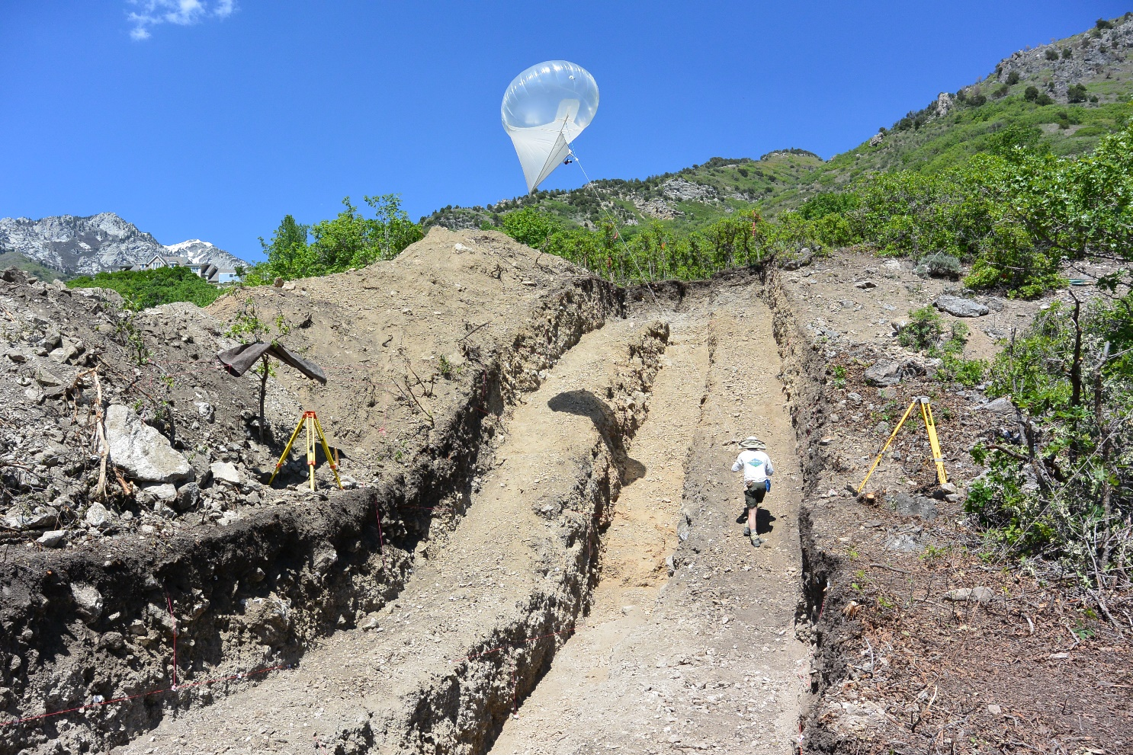
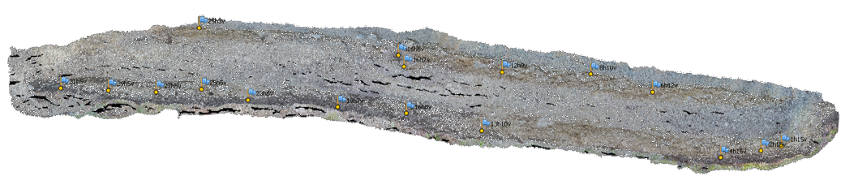
Paleoseismic trench
Figure Nadine Reitman
Notes:
This example of a paleoseismic trench is in Alpine, Utah, and is on the Wasatch Fault. Classically, trenches are dug to show the Quaternary deformation history of a fault. The trench crosses a fault scarp, like the ones shown on earlier slides. The walls of the trench have layers of material displaced by the fault that can be dated to find the age of the slip event. In addition, the layers are mapped. These maps used to take tens of hours to generate, but using SfM, they are relatively efficient to create. However, this model shows one issue – the areas that lack enough photographs result in black areas with no data as circled here. [spacebar]
[spacebar] The photo in the top right shows a heli kite; this is not used for trench data collection but is a cool platform!

Slide 16
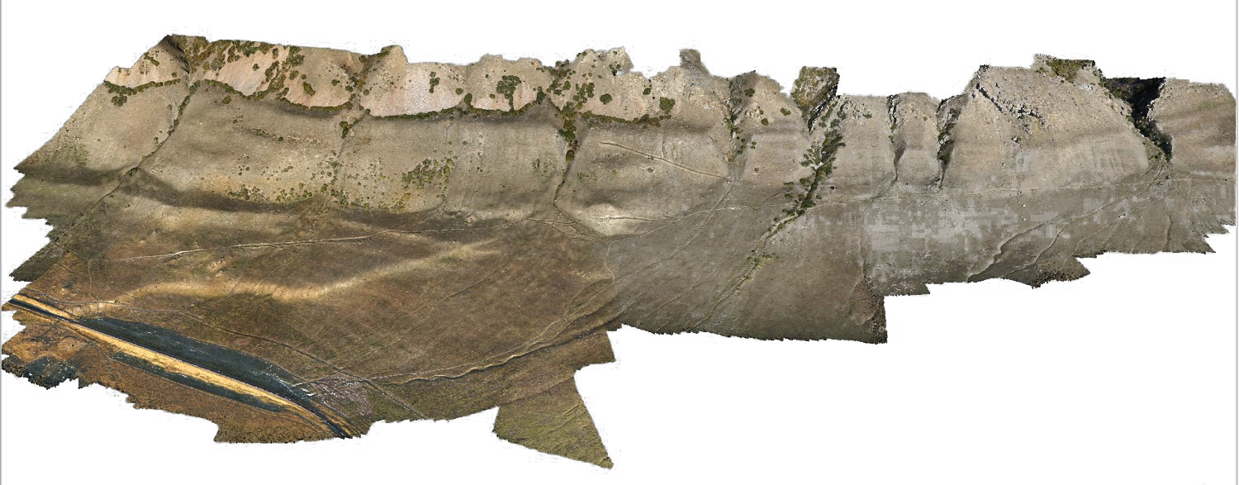
Oquirrh fault scarp
Figure Mike Bunds
Notes:
The Oquirrh fault scarp is located in western Utah. This fault is a normal fault, like many of the faults in Utah (Basin and Range extension). This survey was conducted using a UAS: a drone. You can clearly see the fault scarp [spacebar] as the break in slope on the hill.

Slide 17
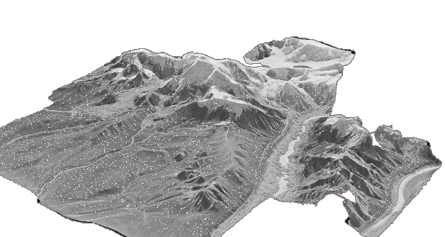
Airphoto models
Figure Sean Bemis
Notes:
Aerial photographs have been used in the geosciences as a base for mapping and to see structures from another viewpoint. These aerial photos can also be used for SfM. This model was made from only five photographs, but the topography is very clear. These models can then be used as a base map for planning geologic research.

Slide 18
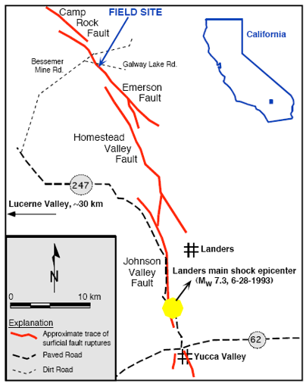
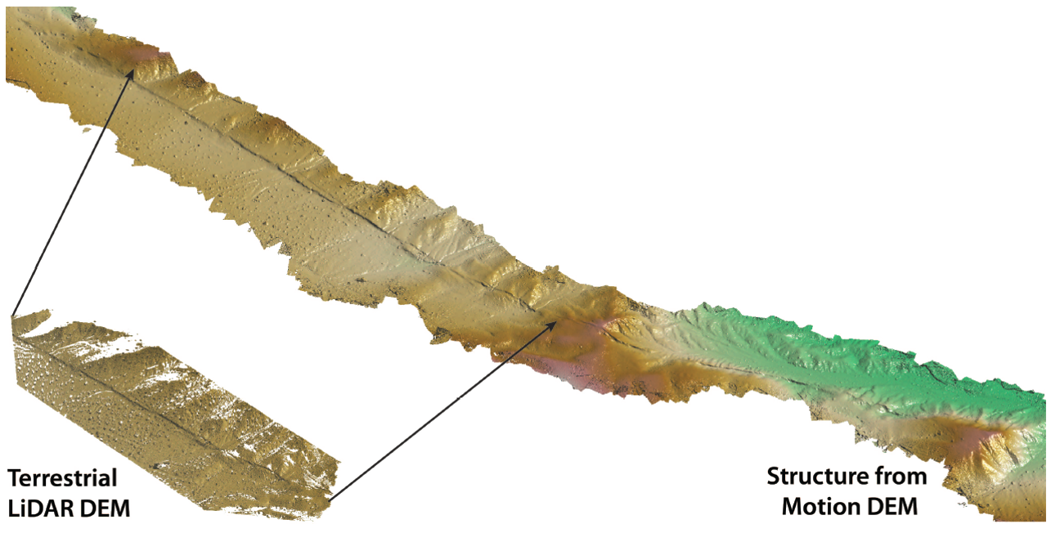
Comparison of sfm to tls - landers
Figure Ed Nissen, Map Ramon Arrowsmith
Notes:
This slide also shows images of a fault scarp. The Landers fault scarp, located in Southern California, resulted from a M7.3 earthquake in 1993. The image above shows examples of the SfM DEM (top) and a DEM generated using TLS (terrestrial laser scanning). TLS requires expensive equipment (hundreds of thousands of dollars) and a higher level of expertise to conduct a survey. As you can see, the point clouds are quite comparable. The TLS point cloud has a lower point density away from the fault scarp.

Slide 19
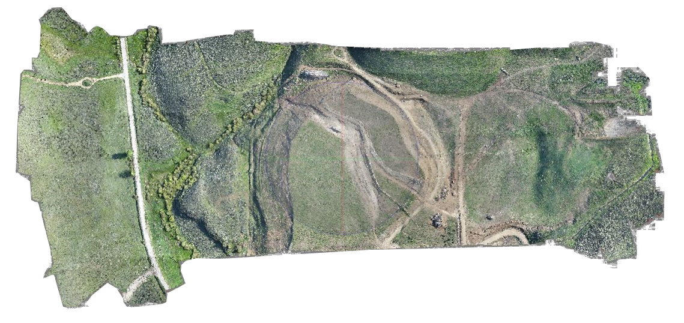
Granby landslide
Figure Francisco Gomez
Notes:
This view is of the Granby landslide. The landslide [spacebar] circled here in red. This landslide is a slow-velocity landslide frequently monitored by researchers as it is still currently moving, from 2007 to the present. It is important to study this, as workers would like to slow the landslide until it is no longer a hazard. A different view of the landslide is here. [spacebar]

Slide 20
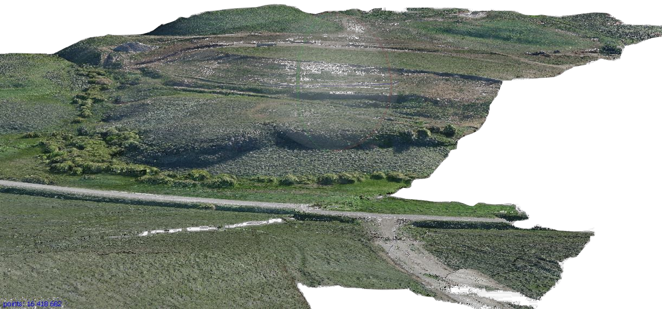
Granby landslide
Figure Francisco Gomez
Notes:
The edge of the landslide can be seen here. [spacebar]

Slide 21
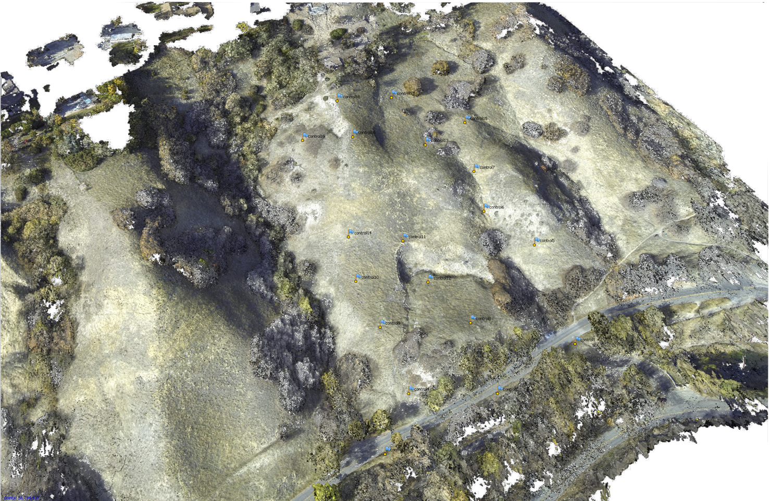
Landslide near city creek, ut
Figure Mike Bunds
Notes:
This landslide is in Utah, on the Wasatch front. Landslide activity in this area (around Salt Lake City) is linked to activity on the Wasatch Fault.

Slide 22
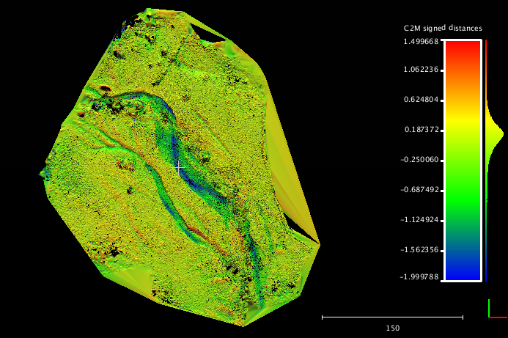
Four mile creek differencing (sfm-als)
Figure Kendra Johnson
Notes:
Another application of SfM is looking at geomorphologic change. In 2013, a major flood occurred in Boulder, Colorado. Prior to the flood, an ALS survey was conducted of the Four Mile Creek area in North Boulder. After the flood, SfM and TLS surveys were conducted. “Change detection” is when you take a dataset from two different times and subtract them—think of it as simple math. At the point on both surfaces with the same GPS location, what’s the difference in elevation? This uses the SfM model and the ALS survey. The color corresponds to how much the elevation has changed in that place. On the next slide we will see a very similar figure produced using TLS and ALS.

Slide 23
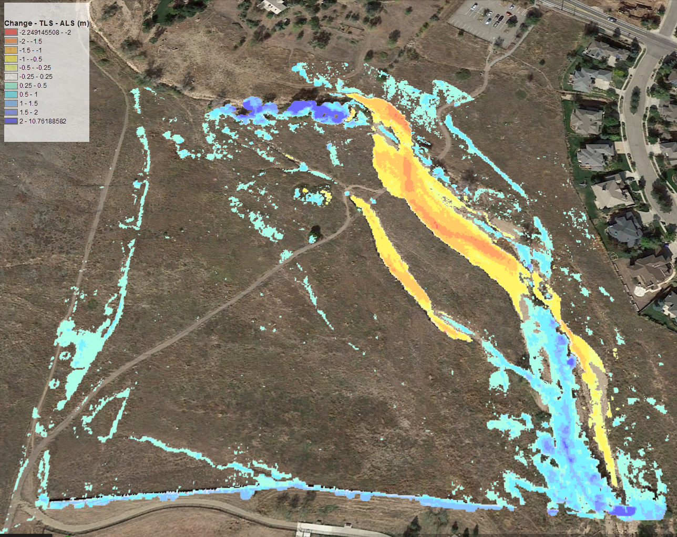
Four mile creek differencing (tls-Als)
Figure Chris Crosby
Notes:
In this figure, we have the same view as the previous slide. The color ramp is the opposite of the previous slide (so the blue on the earlier slide is orange/red here). Both figures show the change in the channel. TLS and SfM can make very similar products.

Slide 24
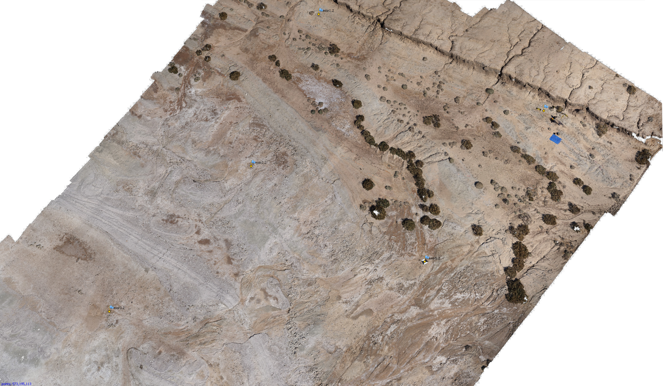
Shoreline of the salton sea
drainage
tarp
drainage
Figure Mike Bunds
Notes:
This survey was conducted using a UAS. The Salton Sea is located in Southern California near the Mexico border and was created when combination of bad irrigation practices and historic flooding of the Colorado River led to the Salton Sink—one of the lowest elevations in California—filling with water. This part of Southern California is a desert, so the shoreline has fluctuated with time. This survey was done to characterize the geologic evidence for the history of the Salton Sea shoreline. The ground control points used to georeference the survey are shown in the red circles [spacebar]. The oldest shoreline of the Salton Sea is shown by the red dotted line. Two drainages are here [spacebar]. Finally, you can see the tarp used to land the UAV here [spacebar].

Slide 25
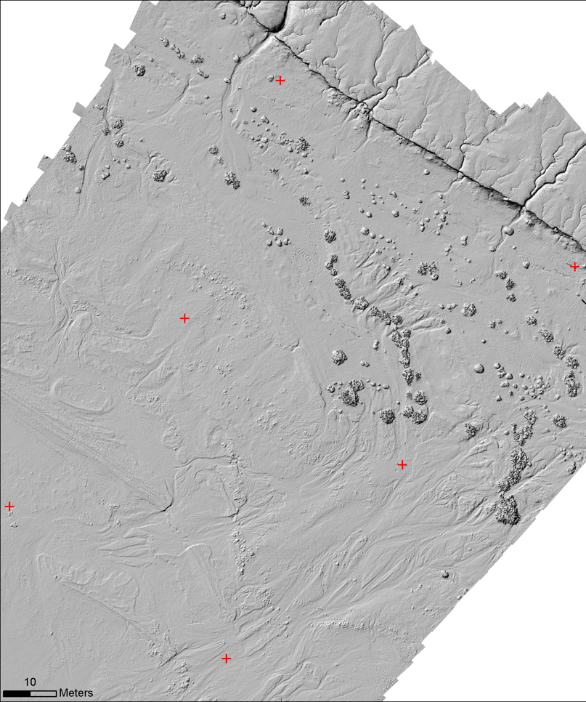
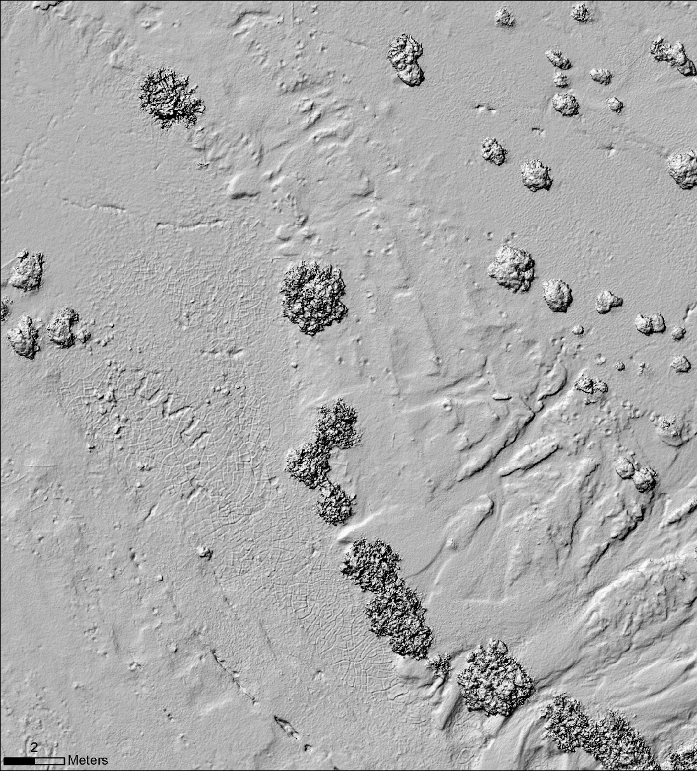
Shoreline of the salton sea
footprints
mudcracks
strandline
Figure Mike Bunds
Notes:
This is the DEM created from the model shown on the previous slide. In the DEM, some features appear that were difficult to see with the orthomosaic. For example, you can see mudcracks [spacebar], as well as footprints in the sand [spacebar] and strandlines (lines created by stranded fish carcasses that show the previous furthest extent of the water). [spacebar].

Slide 26
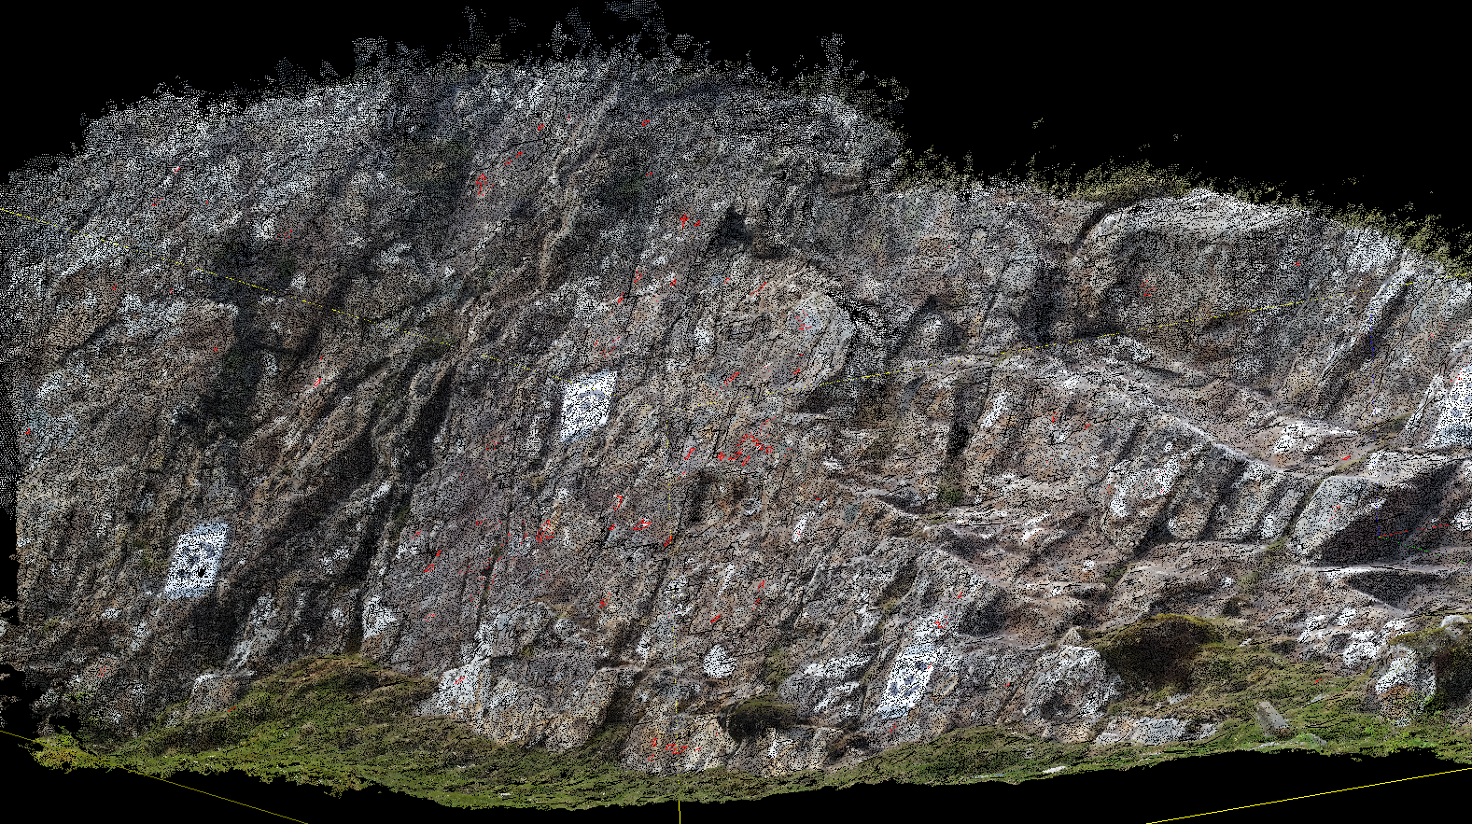
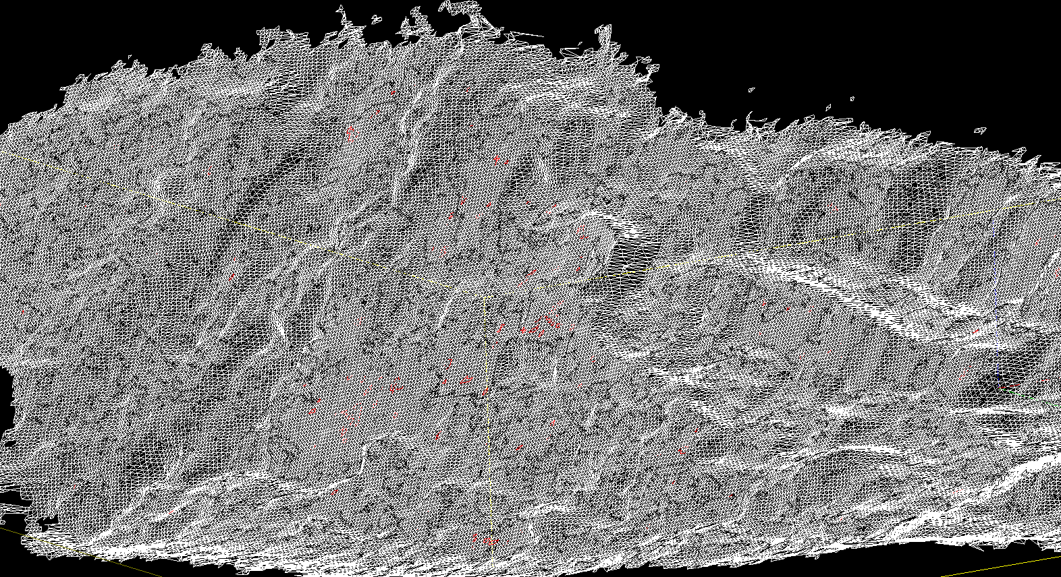
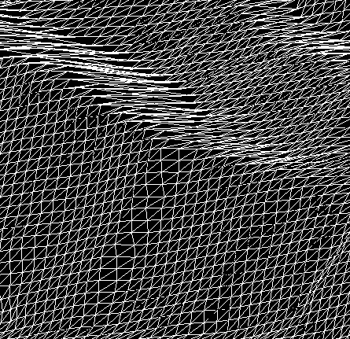
Point Cloud to Discontinuities
1) Point Cloud from SfM
2) Mesh surface from point cloud
3) Patches of relatively little change are identified by SplitFX software
these define joints and bedding where rocks are most likely to fail
4) Design safer cut slope (like road cut)
Notes:
1) Point cloud can be created from either TLS or SfM.
2) Mesh will then be created using SplitFx software.
3) Discontinuities will be identified as smooth surfaces with relatively little angle change over a region. Patches in the mesh are defined using SplitFX.

Slide 27
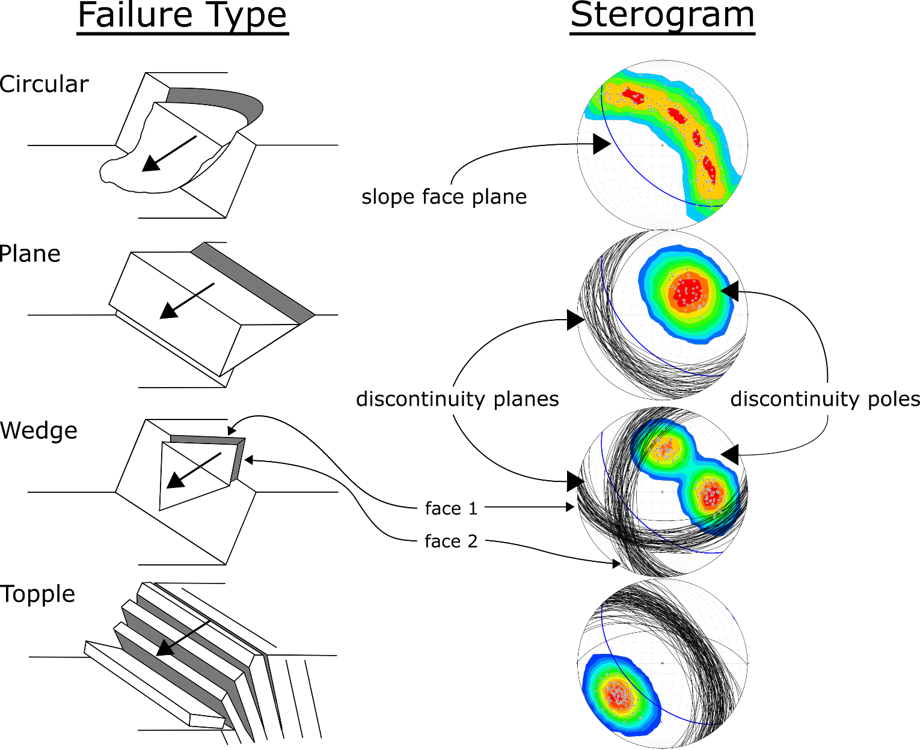
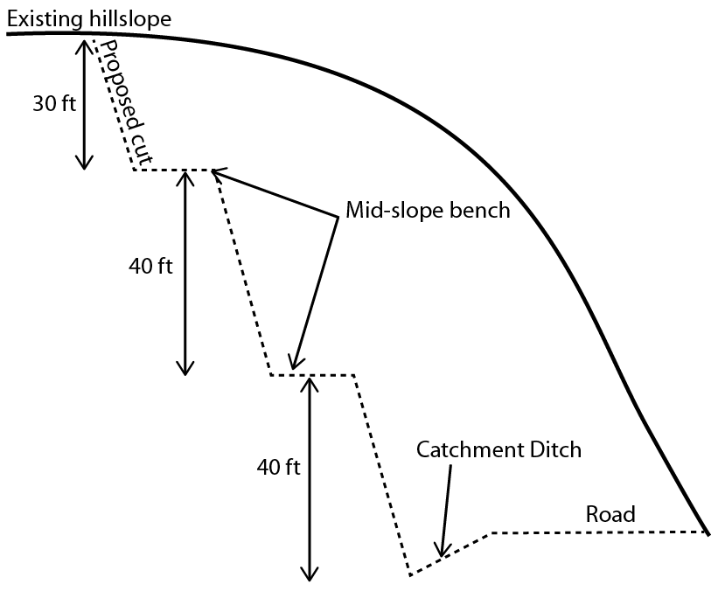
Cut slope design
Notes:
Slope angles are designed based on kinematic analysis of discontinuities plotted on stereonets.
Different types of failures show diagnostic patterns on sterograms.
Right drawings modified from Hoek & Bray 1981 by Ian Lauer (UNAVCO and Idaho State University)

Slide 28
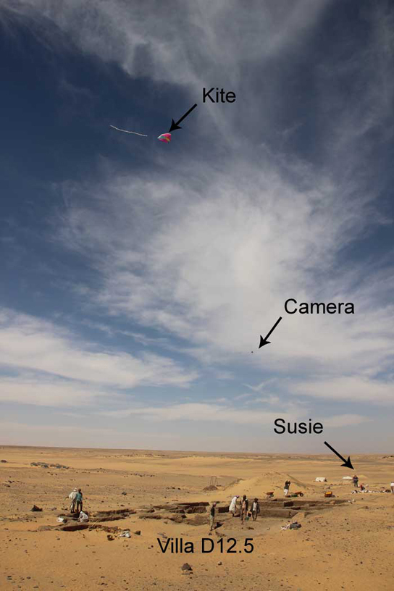
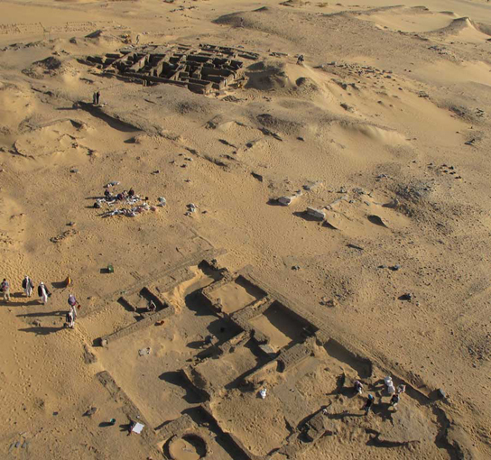
Archaeology – amara west
Figure Neal Spencer
Notes:
Another application of SfM is archaeology. This example is from the British Museum’s Egypt department. They primarily use kite-based photogrammetry. The setup is shown in the left photo and a photograph from the camera attached to the kite on the right.

Slide 29
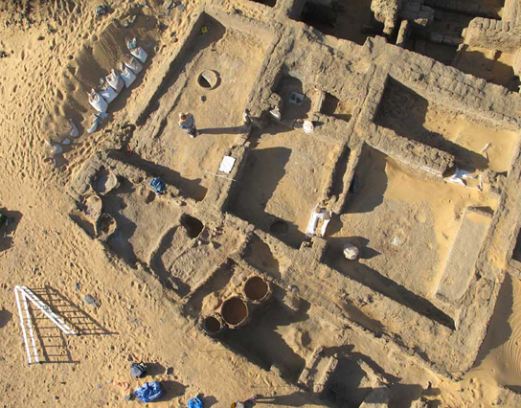
Archaeology – amara west
Figure Neal Spencer
Notes:
Here is a portion of a model created from the kite photography.

Slide 30
HOW SfM works

Slide 31
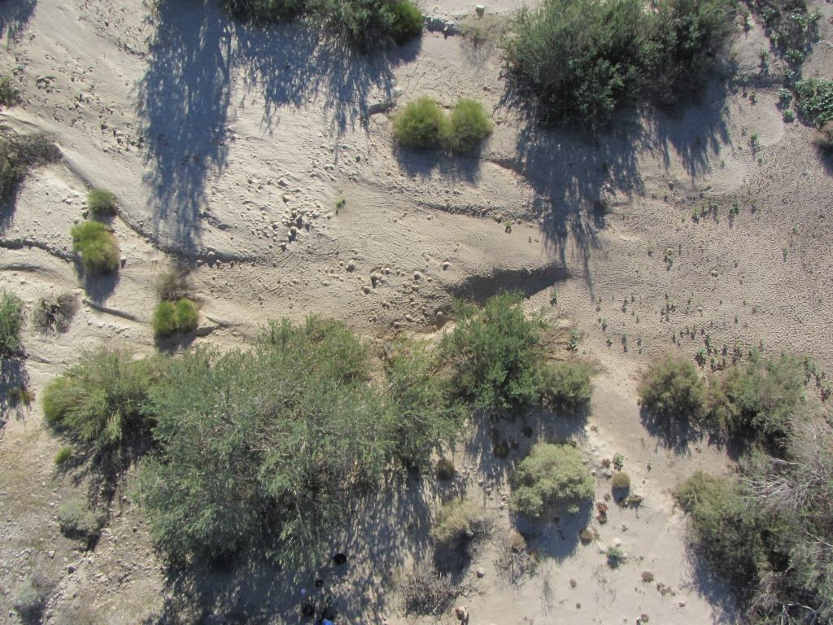
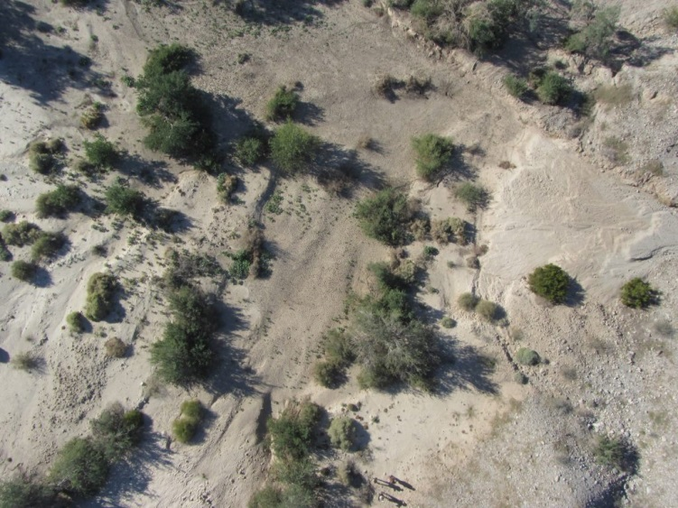
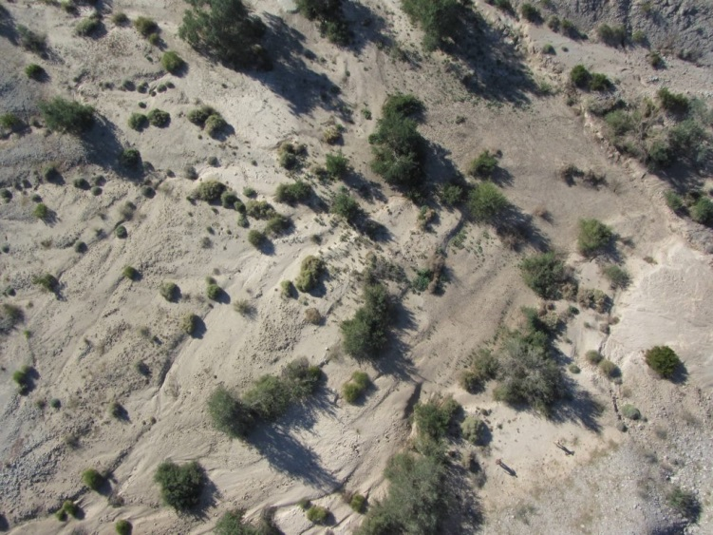
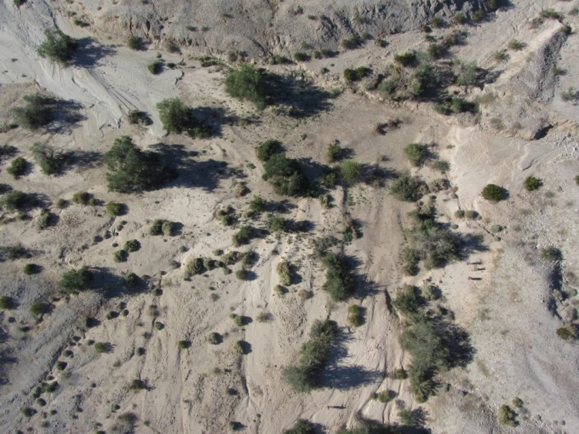
Scale-invariant feature transform (SIFT)
Figure Ed Nissen
Notes:
Each red box shows the same feature in multiple photographs. The SIFT algorithm recognizes these as the same feature.

Slide 32
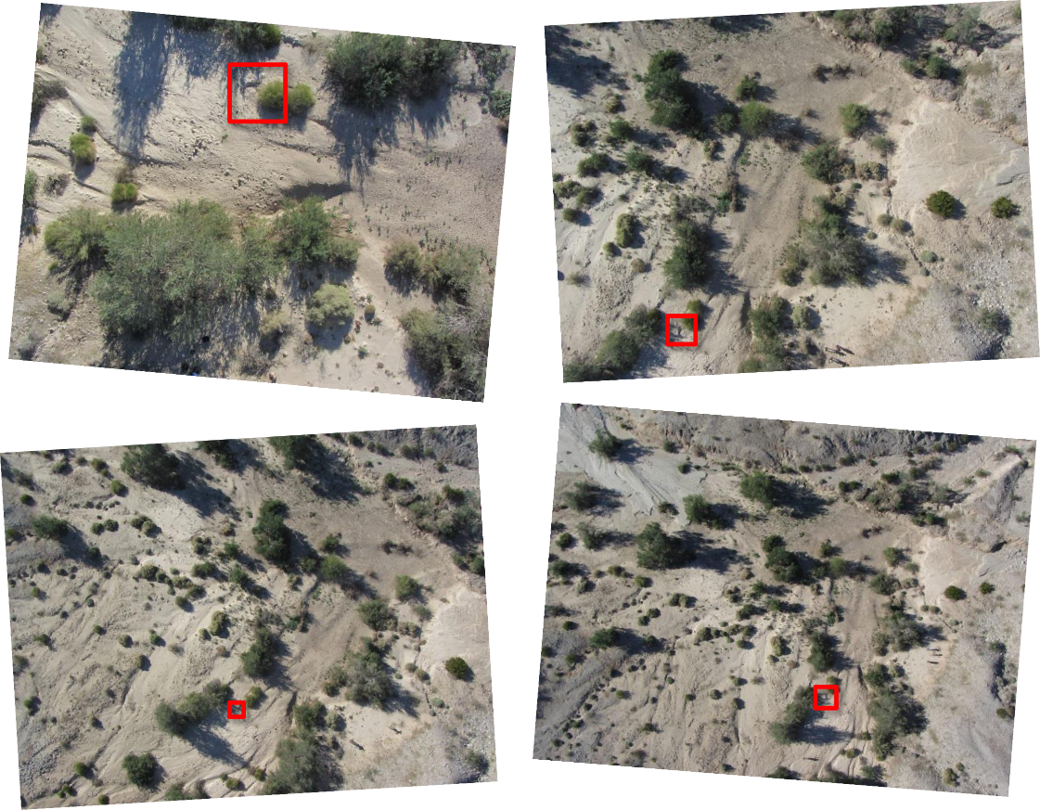
Scale-invariant feature transform (sift)
Finds matching features in multiple photographs
Scale, perspective, and illumination of the feature in the photograph do not affect algorithm
Used as the input for calculating camera locations
Figure Ed Nissen
Notes:
[Read the slide.]
A primary pioneer for the SfM method is: Lowe, D.G., 1999. Object Recognition from Local Scale-invariant Features. International
Conference on Computer Vision, Corfu, Greece, pp. 1150–1157.

Slide 33
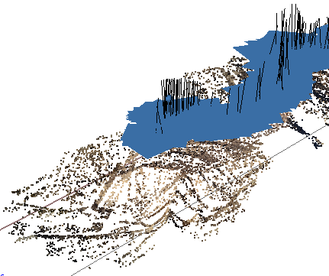
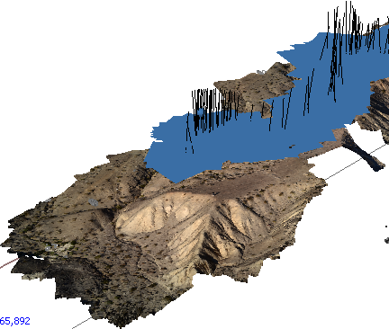
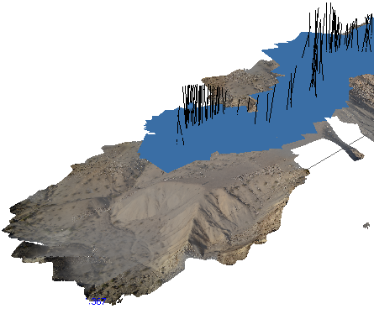
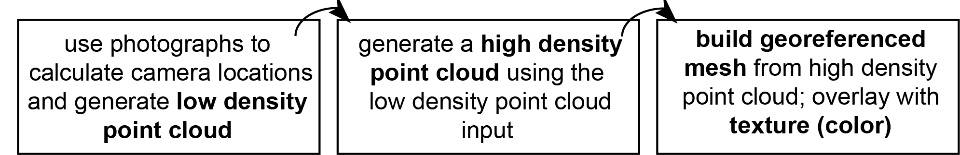
Software workflow
Notes:
The photographs, after a quality check, will be aligned. This means the matching features are found, generating a sparse point cloud and the camera locations. The next step is to generate the high density point cloud. This is one of the products you may end up using; millions of points will be in the point cloud, creating a very realistic model of the feature. This point cloud can be used to calculate a mesh. The “mesh” uses the points to create a surface composed of thousands of triangles. This mesh can be draped with the texture atlas, like draping a photograph.
Image: UNAVCO

Slide 34
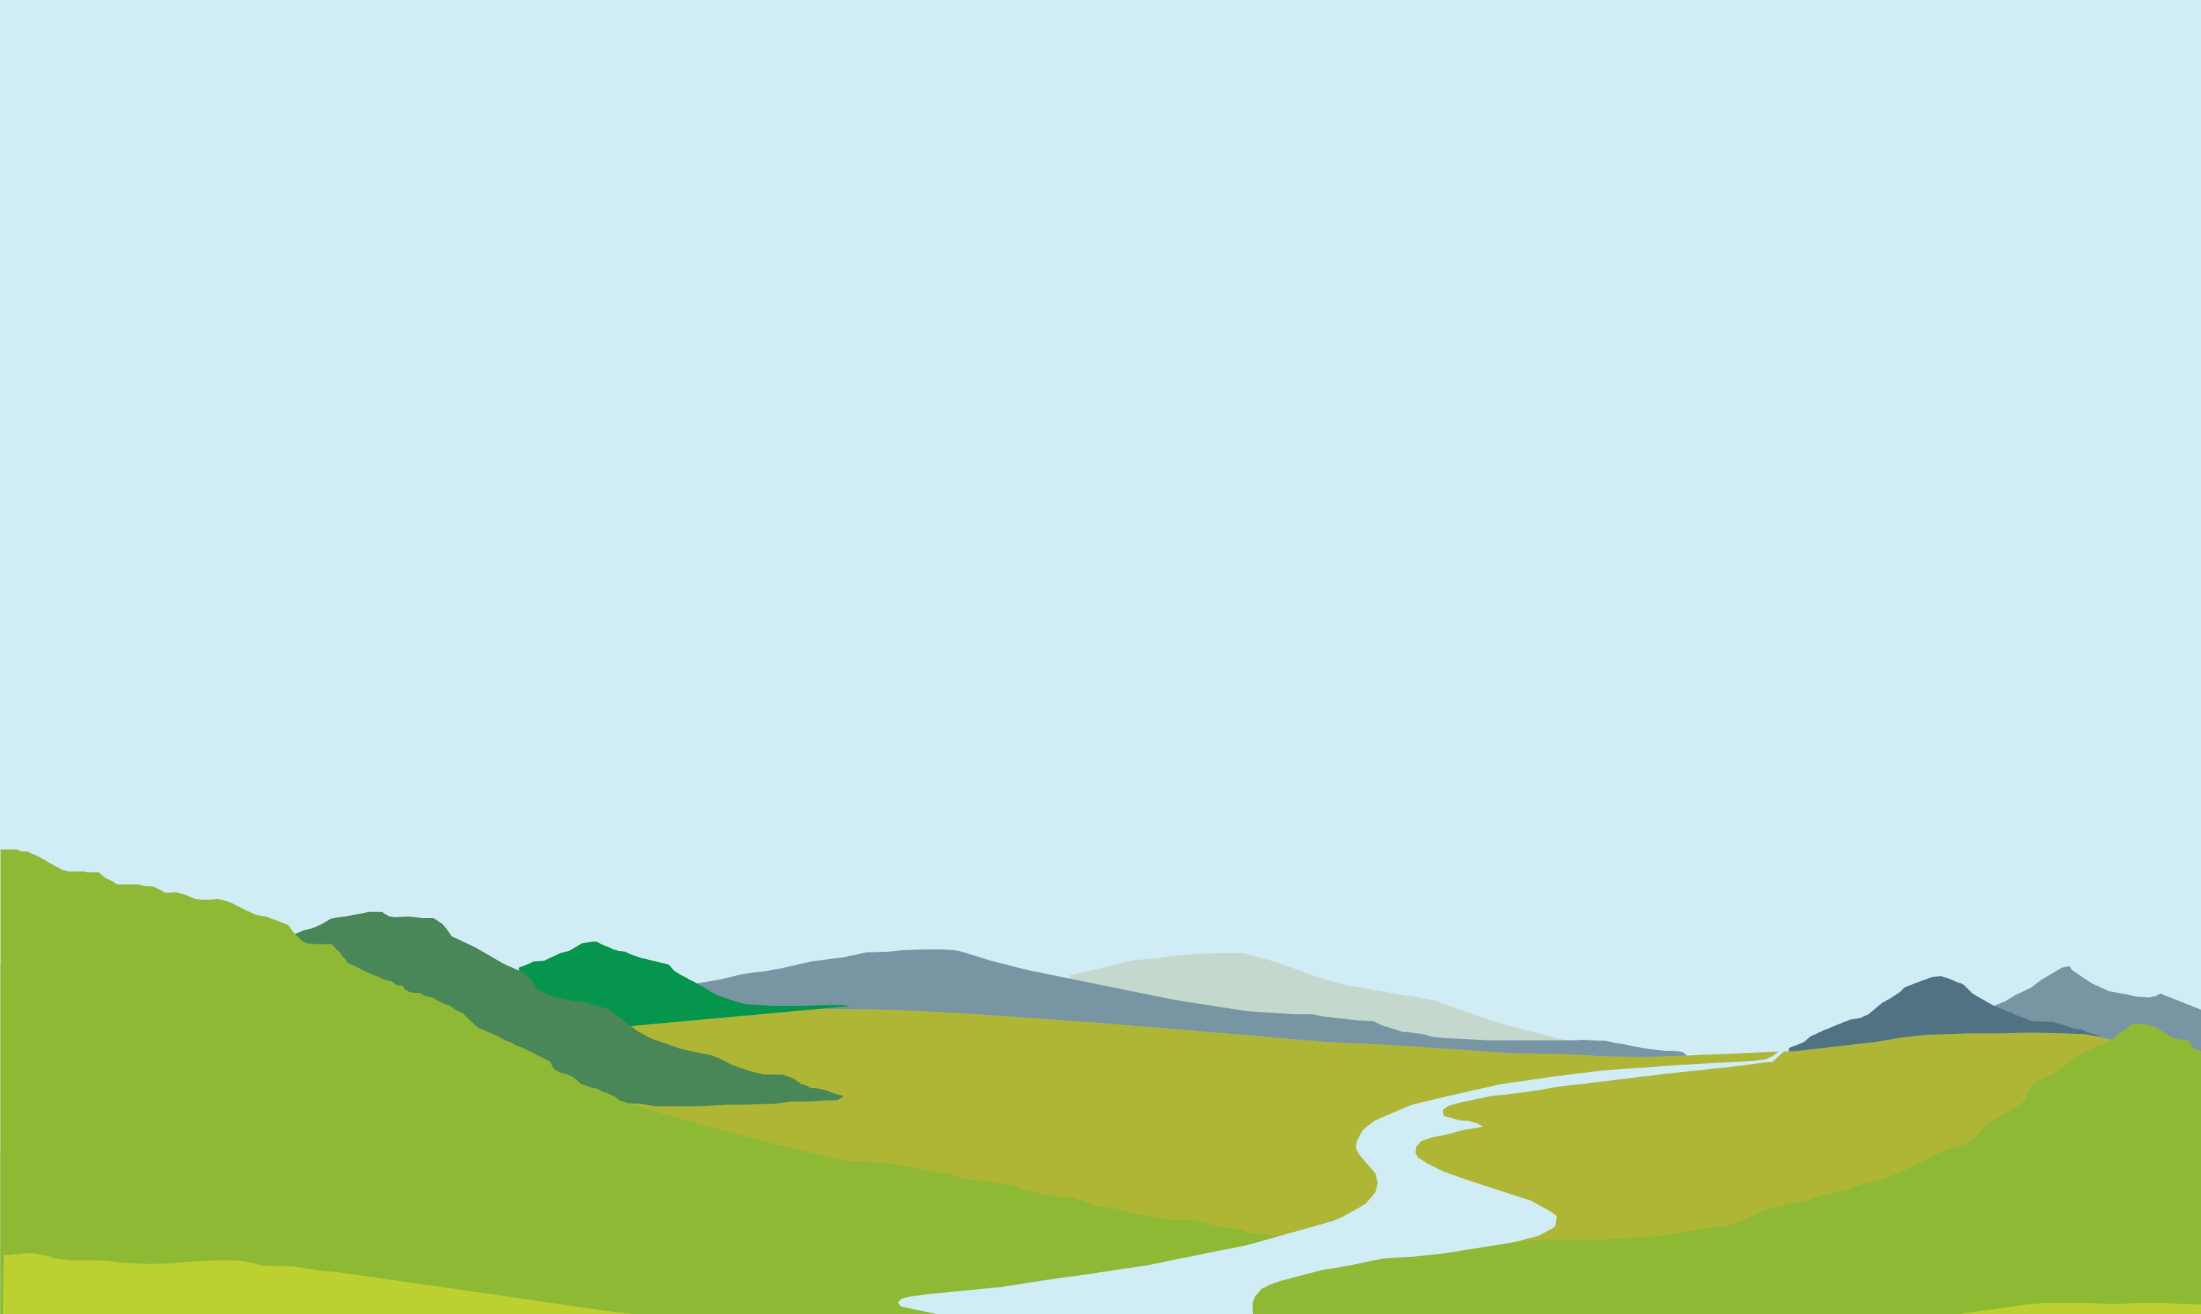
Matching features
d
Step 1
Match corresponding features and measure distances between them on the camera image plane d, d’
The Scale-Invariant Feature Transform is key to matching corresponding features despite varying distances
d'
Figure Ed Nissen
Notes:
The first step in actually creating the product we saw on the previous slide is to find the same feature in multiple photographs. You can see [spacebar] the red and purple lines tracing the line of sight from the two camera locations to two different features on the ground. This is done using an algorithm called SIFT: Scale-Invariant Feature Transform.

Slide 35
Find camera locations
d
Step 2
When we have the matching locations of multiple points on two or more photos, there is usually just one mathematical solution for where the photos were taken.
Therefore, we can calculate individual camera positions (x, y, z), (x’, y’, z’), orientations i, i’, focal lengths f, f’, and relative positions of corresponding features b, h, in a single step known as “bundle adjustment.”
f
(x, y, z)
i
f’
d'
(x’, y’, z’)
i’
h
b
Figure Ed Nissen
Notes:
When we have the matching locations of multiple points on two or more photos, there is usually just one mathematical solution for where the photos were taken. [spacebar] This step, bundle adjustment, results in the locations of the cameras and a sparse point cloud—like the one we saw on the earlier slide, but with significantly fewer points.

Slide 36
Multi-view stereo
d
Step 3
Next, a dense point cloud and 3D surface are determined using the known camera parameters and the sparse point cloud as input.
All pixels in all images are used so the dense model is similar in resolution to the raw photographs (typically 100s–1000s point/m²). This step is called “multi-view stereo matching” (MVS).
f
(x, y, z)
i
f’
d'
(x’, y’, z’)
i’
h
b
Figure Ed Nissen
Notes:
Multi-view stereo is a process that results in the creation of a dense point cloud, like the example on the earlier slide. The MVS algorithm takes the sparse point cloud and camera locations to populate the model with more points. The resultant point cloud may have millions of points.

Slide 37
georectification
d
Step 4
Georectification means converting the point cloud from an internal, arbitrary coordinate system into a geographical coordinate system. This can be achieved in one of two ways:
f
(x, y, z)
i
f’
d'
(x’, y’, z’)
i’
h
b
Figure Ed Nissen
Notes:
Georectification means converting the point cloud from an internal, arbitrary coordinate system into a geographical coordinate system. This step is essential; we want to be able to link the model to where it actually is in space. This results in the ability to measure features in the model, because it will be correctly scaled. [spacebar]

Slide 38
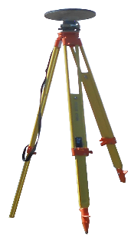
georectification
d
Step 4
Georectification means converting the point cloud from an internal, arbitrary coordinate system into a geographical coordinate system. This can be achieved in one of two ways:
• directly, with knowledge of the camera positions and focal lengths
• indirectly, by incorporating a few ground control points (GCPs) with known coordinates. Typically these would be surveyed using differential GPS.
f
(x, y, z)
i
f’
d'
(x’, y’, z’)
i’
h
b
GPS base station
GCPs surveyed
with roving receiver
Figure Ed Nissen
Notes:
The process of georectification can be achieved in two ways: directly or indirectly. Generally, the indirect process is what scientists use. This way, the model is not only correctly scaled but also correctly located geographically. The number of ground control points varies project to project; however, a minimum of three is needed. It is recommended to use more than 10 per project. Find points that are clearly recognizable or use targets (usually the recommended option).

Slide 39
products
d
Optional Step 5
Generate derivative products:
Digital Surface Model
Orthomosaic for texture mapping
f
(x, y, z)
i
f’
d'
(x’, y’, z’)
i’
h
b
GPS base station
GCPs surveyed
with roving receiver
Figure Ed Nissen
Notes:
The last step in the production of an SfM model is to create the final products. Generally, people use the topography (digital surface model) or the imagery (orthomosaic). The next slides show some examples.

Slide 40
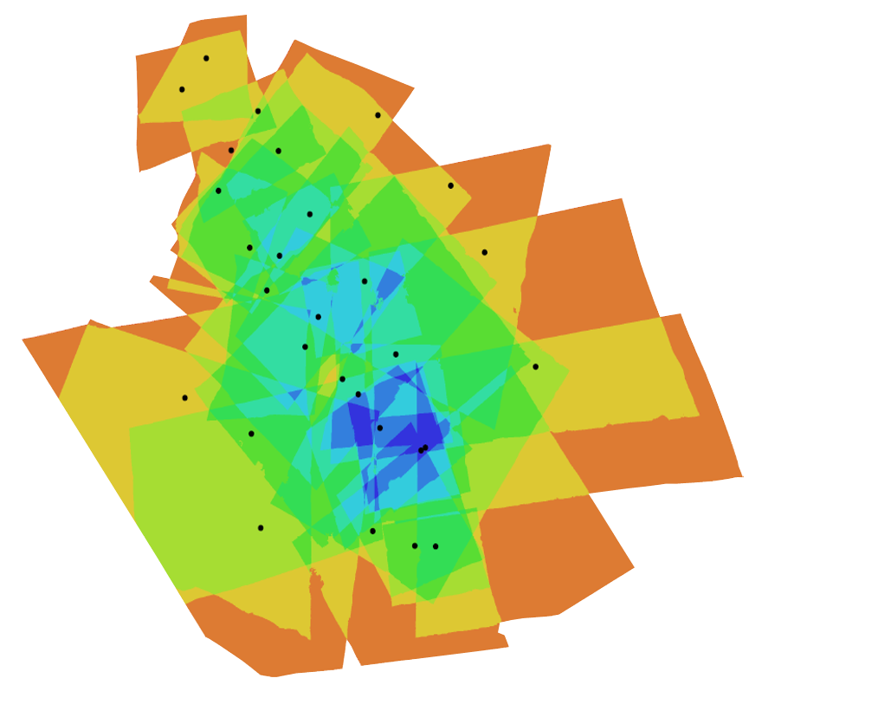
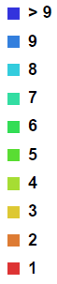
Photo density map
Figure Ed Nissen
Notes:
This photo density map shows the amount of overlap between the photos in a dataset. Each dot is a camera location. You can see the photos are the most dense around areas with lots of camera locations like the center, but that in this model every spot was seen by at least two photographs.

Slide 41
platforms
Figure Kate Shervais
Notes:
Many platforms exist to assist in capturing SfM data. The figure above shows a range of platforms, from UAV on the far left, handheld mid-left to pole photography on the mid-right and a balloon on the far right. The squares with a black pattern are targets, places to survey in, so the model can be linked to geographic coordinates. A handheld platform is best for doing detail work and some outcrop scale work, but has limited applications and is not ideal for areas larger than 100–200 square meters. The slides following will go into the details of the other platforms.

Slide 42
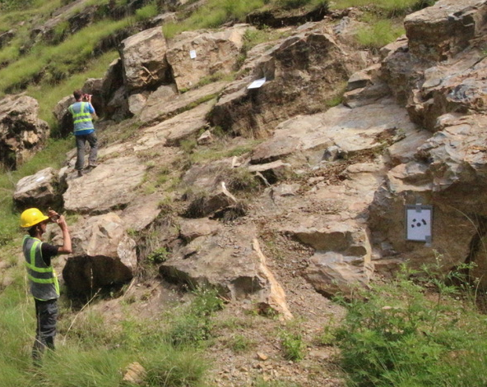
Platforms - handheld
Notes:
Although it does not work for large aerial areas, just simply taking pictures with a handheld camera can work great for small-scale fairly-vertical outcrops. Sometimes handheld combined with a pole can be a good combination.

Slide 43
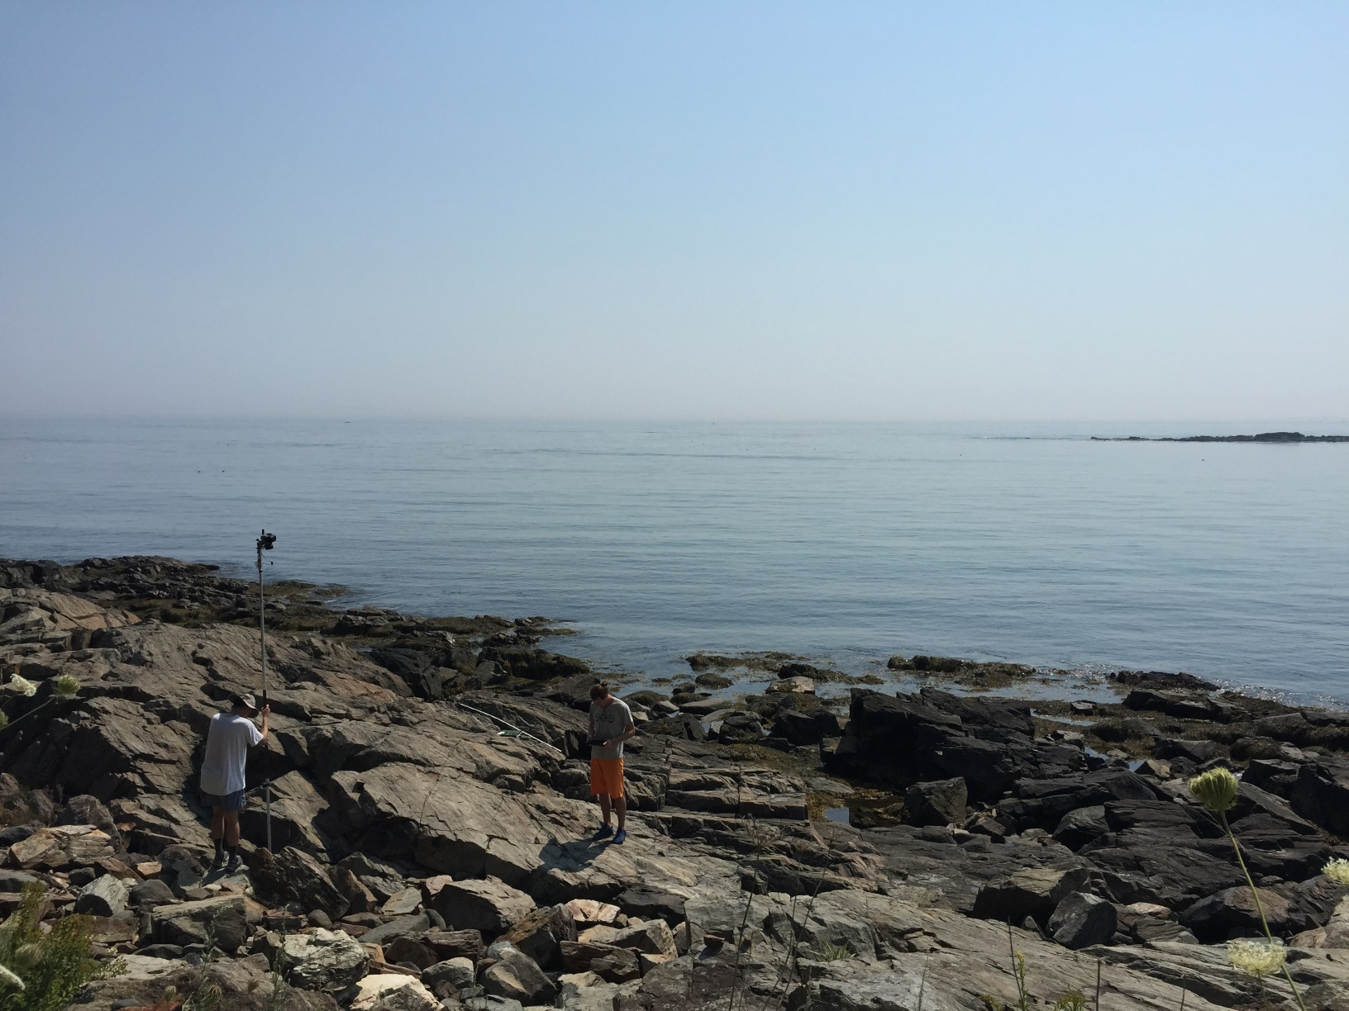
Platforms – pole
Figure Kate Shervais
Notes:
One form of ground-based SfM is pole photography. In the photo shown, the pole is used to take photographs of the horizontal outcrop. For scale, the man holding the pole is 1.85 m tall. Poles are useful because they are inexpensive, good for photographing outcrops, easy to use, and lightweight. They can be quite high—although poles higher than around 20 feet generally need a tripod for stability. However, poles are inefficient in comparison to using an aerial system and require a mount for the camera, as most poles are intended for other applications.

Slide 44
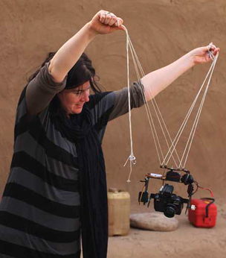

Platforms – kite
Figure Neal Spencer
Notes:
Kites are used frequently as a platform. This example is from Amara West, an archaeological site. Kites are inexpensive, but reliant on wind. Kites also require a picavet (shown in the left photo). Kites allow photographs from a useful height for photographing topography, require no helium (unlike balloons), and have no legal complications (unlike UASs) because they use a tether.

Slide 45

Platforms - balloon
Figure Kate Shervais
Notes:
This is just an example of one type of balloon. This one is called a heli kite because it has a kite-like tail but is filled with helium. The heli kite carries small cameras only (other balloons may carry larger cameras). Balloons and kites having similar advantages/disadvantages, as well as similar applications. The main difference is balloons have no weather requirements, but do need helium (~$180 per canister). Figure Kate Shervais, photographs taken by UNAVCO

Slide 46

Platforms – uaV (uncrewed Aerial vehicle)
Figure Mike Bunds
Notes:
UAVs are the final category of SfM platform. This had become much more common since about 2017 when FAA rules changed to give clearer guidance on UAV useThe cost is highly variable depending on type—one can spend thousands of dollars. The UAV shown in this photograph was around 1000 dollars. The height, camera position, and flightlines are easily controlled using an UAV. However, they require a skilled operator, batteries may limit the survey time (to ten minutes or less), and may require a lighter camera than a balloon. The legal landscape is also quite complex and frequently changing, so consult legal counsel before using.

Slide 47

Video of UAV flight – Pofadder Shear Zone
Video Jamie Kirkpatrick
Notes:
This video shows the view of a UAV during flight in the Pofadder shear zone between South Africa and Namibia. At the end of the video, you can see the operator on the left side of the frame wearing a baseball cap. This flight was one of many used to create a model of the outcrop.

Slide 48


Pofadder shear zone model – photo locations
Figure Jamie Kirkpatrick
Notes:
The blue rectangles show the camera locations for the photos used for the model. The photos line up and show the flight paths taken [spacebar]. As you can see, many flight paths were combined to create the model of the shear zone, not just the one shown in the video.

Slide 49

Rock sample model
Figure Sean Bemis
Notes:
The first example of a ground-based SfM model is this basalt sample. Photographs were taken at each of the blue rectangles (indicating the calculated camera location).

Slide 50
Rock sample model
Figure Sean Bemis
Notes:
When the camera locations are removed, you can see the sample a bit better. The black patterns on the cloth underneath the sample are used to scale the image. This model is used for students; they can look at hand samples in a digital form in addition to the hand sample in the classroom.

Slide 51
Conducting an sfm survey

Slide 52
Structure-from-motion
Use the locations of the camera (motion) to interpret the geometry or 3D model (structure) of a scene
Notes:
As a review, Structure-from-Motion works by finding matching features in multiple photographs and then using the relative size and orientation of the matching features to construct the geometry of a scene. In this presentation, we will walk through the process of designing and conducting a survey as well as the steps in a SfM program to create a model.
Image: Kate Shervais (Figure modified from Chris Sweeney, UCSB)

Slide 53
Parameters
Photo characteristics
Survey considerations
Camera focal length
Camera sensor size
Aspect ratio of photograph
Effective megapixels of camera
Distance between camera and feature
Scale of feature
Angle of photographs
Overlap between photographs
Platform
Targets/GPS
Surface texture
Lighting
Notes:
Before beginning your survey, you need to consider a variety of factors that influence the data you collect. We will cover each of the factors listed above so you can keep these in mind as you design your own survey with the class today. These are also covered in the field manual in case you need a reminder in the future.

Slide 54

Photo characteristics
Notes:
Camera focal length
Camera sensor size
Aspect ratio of photograph
Effective megapixels of camera
Distance between camera and feature
Scale of feature

Slide 55

overlap, distance from feature
Notes:
Photos also need to overlap. The amount of overlap depends on the specific software program, but approximately 60–80% overlap is needed. The other factor shown here is distance from the feature of interest; a range of photos both close and far away will add detail to the model without a large increase in processing power.
Image: Kate Shervais

Slide 56

Angle of photographs
Nadir
Divergent
Convergent
Notes:
There are three ways to orient the photographs: nadir, or exactly orthogonal to the feature of interest in a plane; divergent, or with a rotating camera based in one location; and convergent, or converging on the scene. The nadir and divergent methods may actually create a model with some distortions.
Image: Kate Shervais

Slide 57
platforms
Notes:
We went over the details of the various SfM platforms in the previous presentation. However, the platform is an essential thing to consider for survey design as it controls the duration of the survey as well as the path needed to collect photos. A few questions to consider are here (next slide)
Image: Kate Shervais

Slide 58
Platform selection
How large is the area of interest?
What is financially feasible?
How large is the intended camera?
Are UAV allowable? Or would a tethered option (balloon, kite) be needed?
What additional components are needed and does the field area support these? (i.e., batteries, helium, specific weather)
Notes:
How large is the area of interest?
Larger areas of interest will need aerial platforms. The dimension of individual photographs will be large enough to not require an egregious amount of time to collect photographs. Smaller areas may be described by handheld or pole photography.
2. What is financially feasible?
The platform should not be cost prohibitive; select a platform that is appropriate for the area of interest but also for your budget.
3. How large is the intended camera?
The camera must be able to be supported by the platform. If using a DLSR (so higher resolution photographs) is more important to you, a platform like a balloon or pole may be more appropriate. If using a point and shoot, balloons with smaller amounts of lift or some UAVs may be usable.
4. Is the survey collection path accessible or will a UAV need to be used?
If the area is non-accessible, a UAV may need to be used instead. UASs should always be in your line of sight, but if they are and the area that needs to be photographed is hazardous, they are a more appropriate platform.
5. What additional components are needed, and does the field area support these?
If batteries are needed to power the platform, these are only useful (for multi-day surveys) if you have a way to charge them or many, many batteries (cost-prohibitive). If using a kite, the weather needs to include enough wind to lift a kite, picavet camera mount, and camera. If using a balloon, helium is necessary (~180 dollars a canister). The helium will need to be transported or the balloon filled prior to approaching the field area.

Slide 59
Georeferencing
In nearly all cases it is important to georeference the point cloud. This can be in a local or global coordinate system
Local – references to an local zero point
Hand measuring with tape and compass
Total station – laser for distance, inclinometer for angles
Global – latitude/longitude (possibly converted to UTM projection or other)
GPS (global positioning system) – high grade survey system (note: GPS is the US system. The broader term is GNSS [Global Navigation Satellite System] and includes satellites from other countries such as Russia, China, and Europe. But we retain the use of GPS here because that is more familiar)

Slide 60

Targets/Ground control points (GCP)
Notes:
We need a way to link the survey to physical space. Otherwise, it is impossible to actually extract a measurement of the feature of interest because there is no scale.
Most commonly survey grade GPS are used to tie the SfM model into global coordinates (survey grade is much more precise than the GPS in your cell phone).
Local coordinates can be done with handheld or total station surveying methods and also work fine for a project that does not need to be tied in globally.
Within reason, more GCP/targets are better, because there is less error. However, they also take more time on the processing end so there is a balance.
Any ideas about other things to keep in mind when you set up targets? Where should they be in relation to each other? Class discussion [brief]. Ideally they will be triangular and also incorporate multiple elevations.

Slide 61


Local system
Reference to a local zero point
Notes:
Left image: https://scotthuckphoto.wordpress.com/2014/03/05/geology-sed-strat-spring-break-day – used with permission
Right image: https://commons.wikimedia.org/wiki/File:US_Navy_070801-F-8678B-039_Engineering_Aide_2nd_Class_Randy_Felipe_attached_to_Naval_Mobile_Construction_Battalion_(NMCB)_4,_trains_on_the_new_Trimble_5600DX_Total_Station_series,_survey_equipment.jpg

Slide 62
Global positioning system
Constellation of ~30 satellites; each houses an atomic clock.
Precise time information is sent to a receiver on Earth.
A minimum of 4 satellites in sky view is needed to obtain a coordinate (but >6 is better)
X,Y,Z
Notes:
Constellation of 31 satellites; each houses an atomic clock.
Precise time information is sent to a receiver on earth.
A minimum of 4 satellites in sky view is needed to obtain a coordinate.
[This slide is fairly straightforward; the information off the slide is really all that needs to be included.]

Slide 63



GPS errors
Ionosphere
Troposphere
Multi-Path
Notes:
Error can be introduced into your GPS survey in a number of ways. Distortion could come from the [space bar] ionosphere, [space bar] troposphere, or from [space bar] “multi-path,” which simply means that the signal is reflected off something else before you receive it. Because the location is determined from the time it takes a signal to be received, these factors can distort your location. Do not set the GPS up somewhere where the signal will be distorted. NOT next to a car. NOT next to power line, not next to a tree. Don’t forget about the influence of clouds.

Slide 64
Equipment list
Platform: pole, kite, balloon, UAS
Camera
Camera mount: how are you going to attach the camera to the platform?
Targets/Ground Control Points (GCP)
GPS for global georeferencing
Scale bars and/or distance/angle measuring devices for local georeferencing
Extra SD cards and batteries for camera
Extra supplies for platform (helium for balloon, batteries for UAS) if necessary
Notes:
Once you have considered the GPS stations nearby and the accessibility of your site, check that you have all equipment before you leave for the field.

Slide 65

Survey workflow: in the field
Make a plan
Is everything visible?
Collection path
Always record metadata
Number of photos, where they are stored, file names
Target type(s), locations
Planned collection path
Anything that went wrong during the day—how did the plan change?
Notes:
Read the slide. You might look at data a few days later—it is hard to remember the details.
Image: Chris Crosby

Slide 66
Survey workflow: target placement
Evenly distributed
Don’t bunch the targets or put them in a single straight line
Example to the left shows a good target distribution, because targets are in every section
Make sure targets are not obscured by vegetation or other features
Notes:
[Read this slide.]

Slide 67
Software workflow
Notes:
The photographs, after a quality check, will be aligned. This means the matching features are found, generating a sparse point cloud and the camera locations. The next step is to generate the high density point cloud. This is one of the products you may end up using; millions of points will be in the point cloud, creating a very realistic model of the feature. This point cloud can be used to calculate a mesh. The “mesh” uses the points to create a surface composed of thousands of triangles. This mesh can be draped with the texture atlas, like draping a photograph.
Image: UNAVCO

Slide 68
At home Sfm
You will pick a simple feature such as sofa, small berm, two adjoining walls, side of a shed.
Place 3 ground control points (GCP) or “targets” and measure
Take 15-20 pictures using best practices
Process using Agisoft MetaShape into 3D point cloud model
Files you should have with you
Prep exercise – should have all these things ready
Student exercise for today – will guide what you do today
MetaShape Quick Guide – what you need to start photo processing
SfM Manual - for reference about the method

Slide 69
Apps / Supplies you should have
?
?
?
?
?
?
Notes:
Discuss with student and generate list based on their prep exercise

Slide 70
Apps / Supplies you should have
Compass (physical or app)
Inclinometer (physical or app. Ex. iMetalBox, protractor)
Measuring tape (or marked string – along w ruler & marker)
Camera (digital)
GCP (paper, markers, tape)
Software (today we use Agisoft MetaShape Professional)
Notes:
Discuss with student and generate list based on their prep exercise

Slide 71
Measuring GCP
What measurements are needed?
?
?
?
Notes:
Have the students give input on what measurements are needed. They should come up with distance (diagonal), azimuth, inclination

Slide 72




How I did it

Slide 73

Taking the pictures

Slide 74

Doing the trigonometry
Sin 22º = z / 7 meters
In Excel = 7*sin(22*(pi()/180))
2.62 meters
Cos 22º = h / 7 meters
In Excel = 7*cos(22*(pi()/180))
6.49 meters

Slide 75

Doing the trigonometry
Sin 34º = x / 6.5 meters
In Excel = 6.5*sin(34*(pi()/180))
3.64 meters
Cos 34º = y / 6.5 meters
In Excel = 6.5*cos(34*(pi()/180))
5.39 meters

Slide 76
Over the Break
Place your GPC
Measure their locations
Take your photos
Transfer photos from camera to computer
Trig?

Slide 77
Discussion questions
What are some errors associated with the local coordinate system GCP method we used?
What are some shortcomings of the model you built?
What are some better parts for the model you built?
What else could you apply this SfM method to?
What are pros and cons of SfM method?
Knowing you will need to do SfM again, what is at least one piece of advice you want to leave for yourself?

