Slide 1
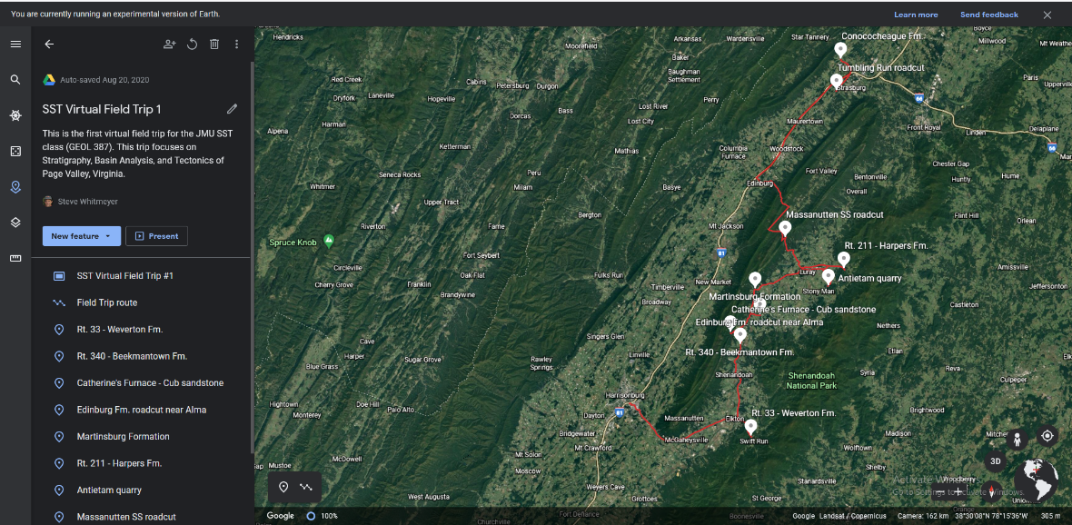
Virtual Field Trip #1 – Part Two
Department of Geology and Environmental Science
James Madison University
Harrisonburg Virginia 22807
The Rodinia Rift-to-Drift Sequence and Taconic Orogeny in Page Valley, Virginia:
Stratigraphy and Basin Analysis
Steven Whitmeyer
Lynn S. Fichter

Slide 2
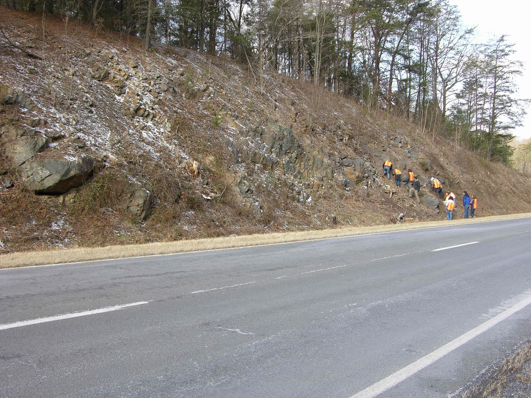
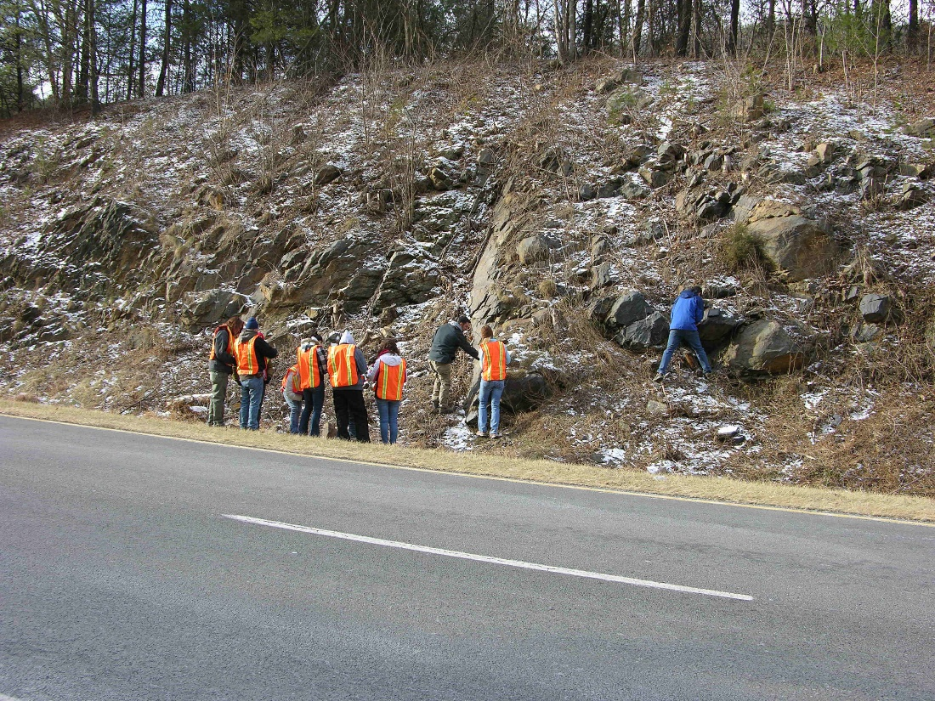
Trip 1:
Chalk Talk 7
Harpers Formation

Slide 3

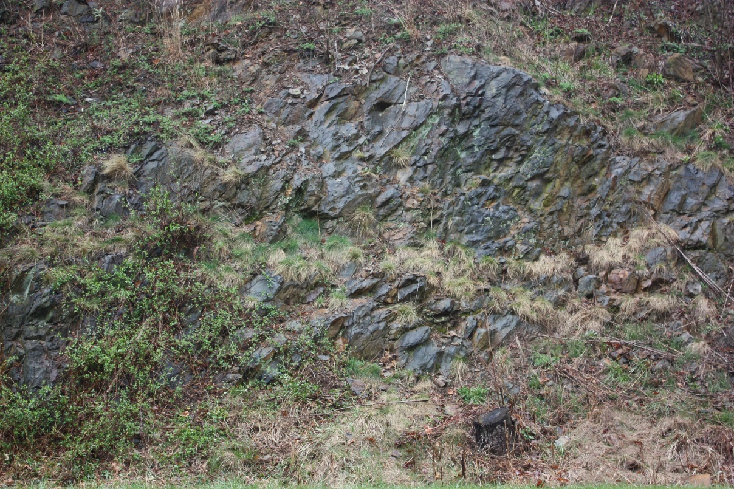
Begin with observations.
Exposures of the Harpers are not common, and because it has undergone low grade greenschist metamorphism, and often structural deformation, stratigraphic information can be hard to get.
In summer it is so overgrown you can hardly see anything. In winter it is easier.
The metamorphic overprint often makes it difficult to separate sandstones from shales. Bedding can be difficult.
Looking south, west is to right.
Beds dip east (this view is the west bound lane looking south).
But, the section is overturned, so up-section is in fact facing downward and to the west.
Up-section is this way

Slide 4
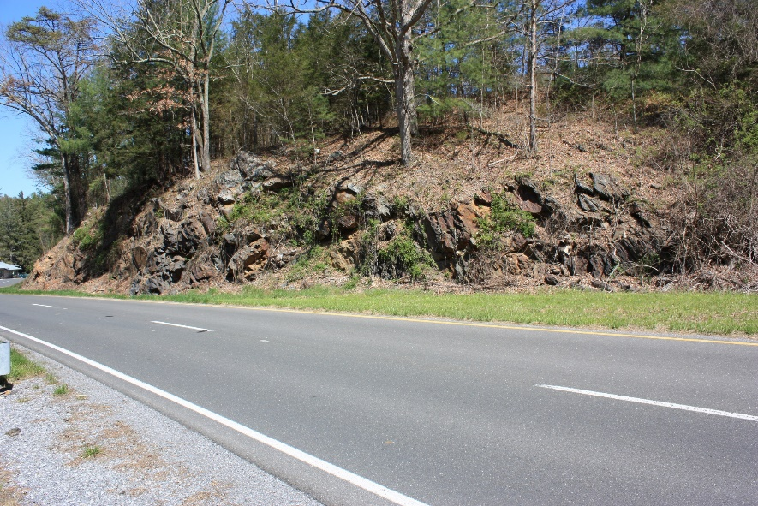
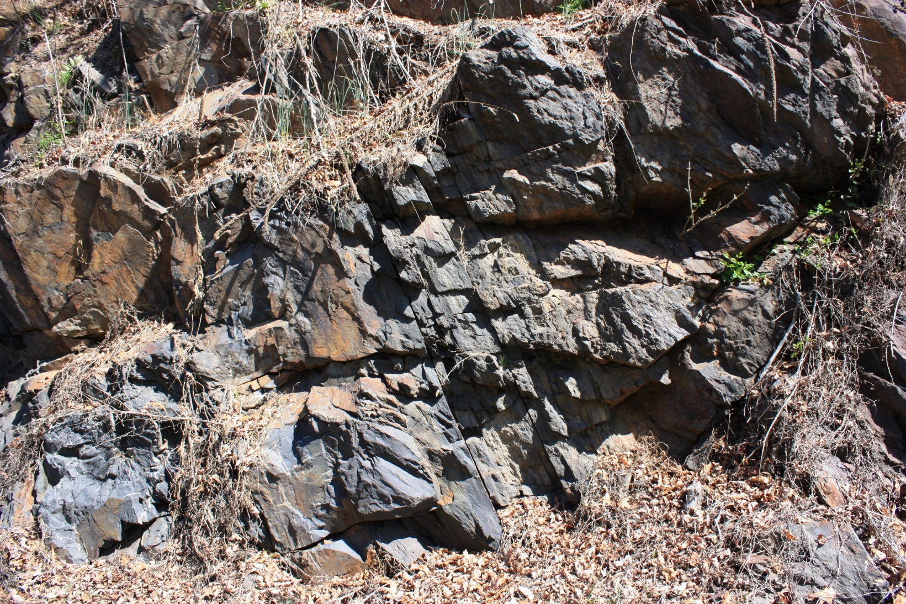
Begin with observations.
East bound lane outcrop; better exposed.
Beds are dipping east.
But up is to the left; overturned beds.
Dip direction
Looking north, west is to left.
Notice this outcrop is almost completely amalgamated sand with reactivations surfaces.
Up (top of bed) is this way
HINT: Thick amalgamated beds usually means we are proximal in the system; closer to the source
Reactivation surface

Slide 5
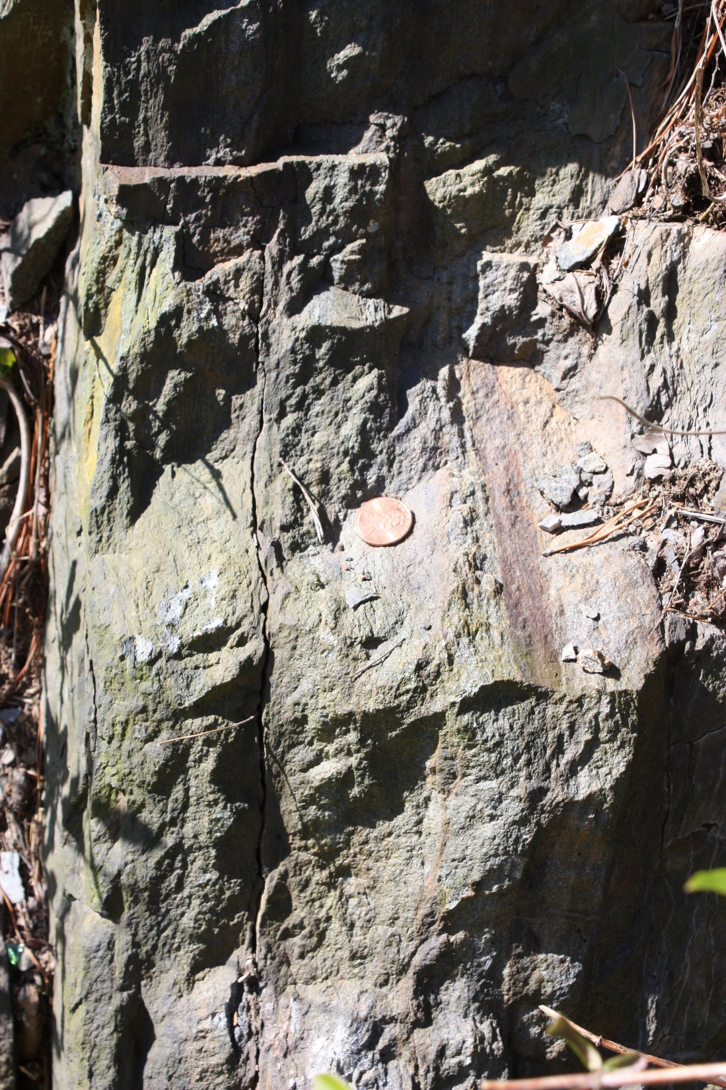
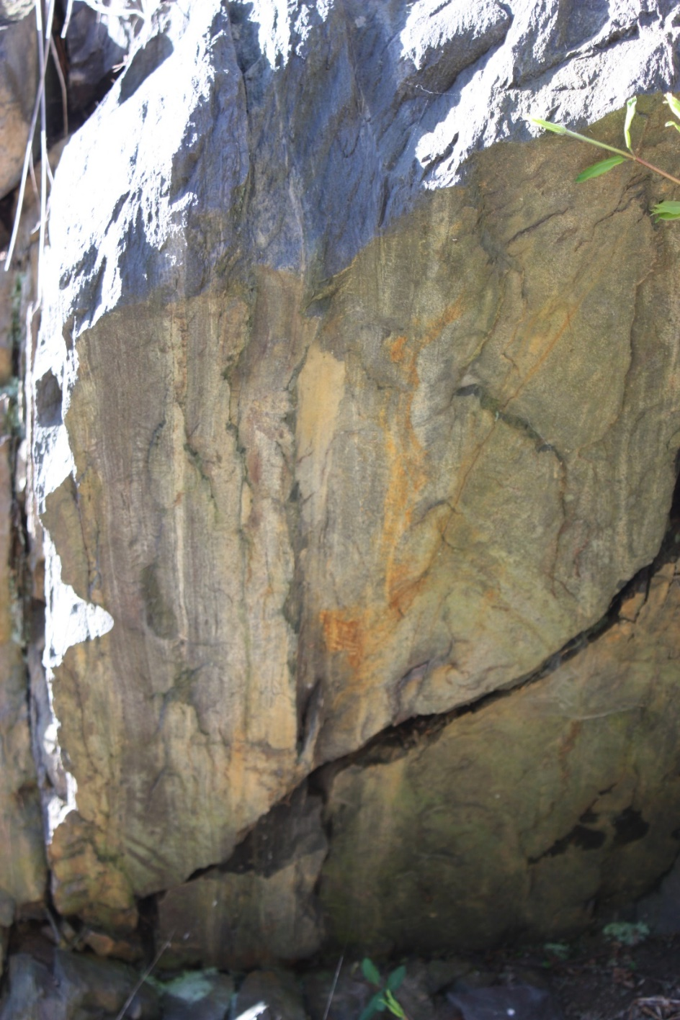
Begin with observations.
The sandstones are often amalgamated, implying there are proximal Coarsening Upward Sequences
Notice diverging low angle bedding.
Reactivation surface
Up

Slide 6
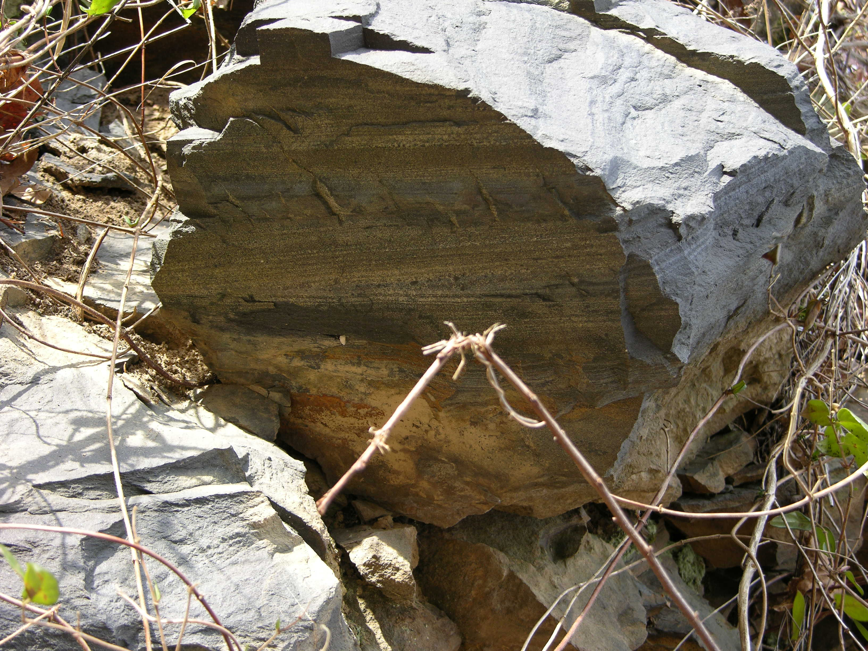
2. Environmental interpretations:
Notice diverging low angle bedding.

Slide 7
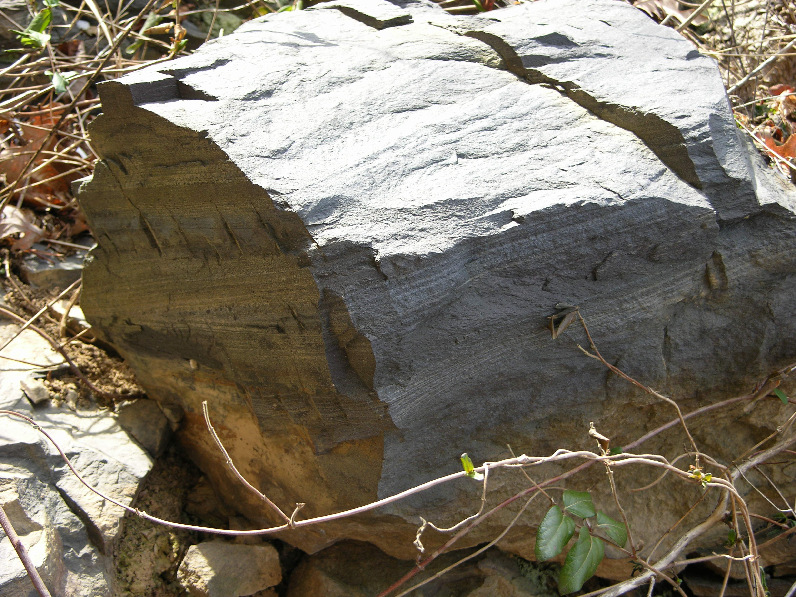
2. Environmental interpretations:
Notice how lamination bundles thicken and thin.
Notice how bundles intersect.
All this is consistent with hummocky cross stratification, and does not easily fit any other kind of sequence, so the interpretation of this outcrop is the Harpers is a Storm Shelf environment.

Slide 8
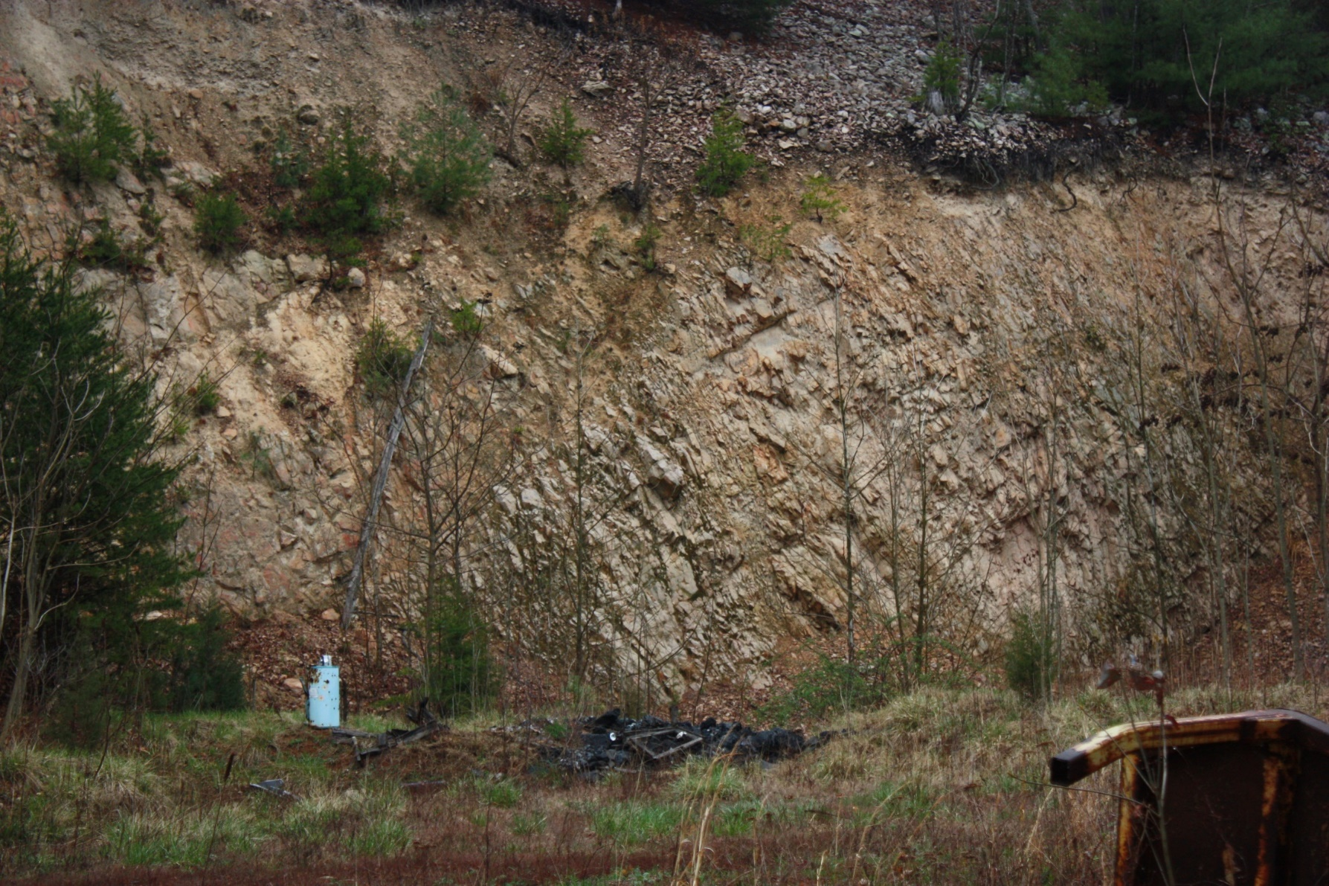
Trip 1:
Chalk Talk 8
Antietam Formation

Slide 9

Begin with observations.
The Antietam formation is a very common rock in western Virginia because it is a very tough quartzite.
Because it is so tough it is also very resistant to weathering and is quarried out of river beds for landscaping gravel.

Slide 10
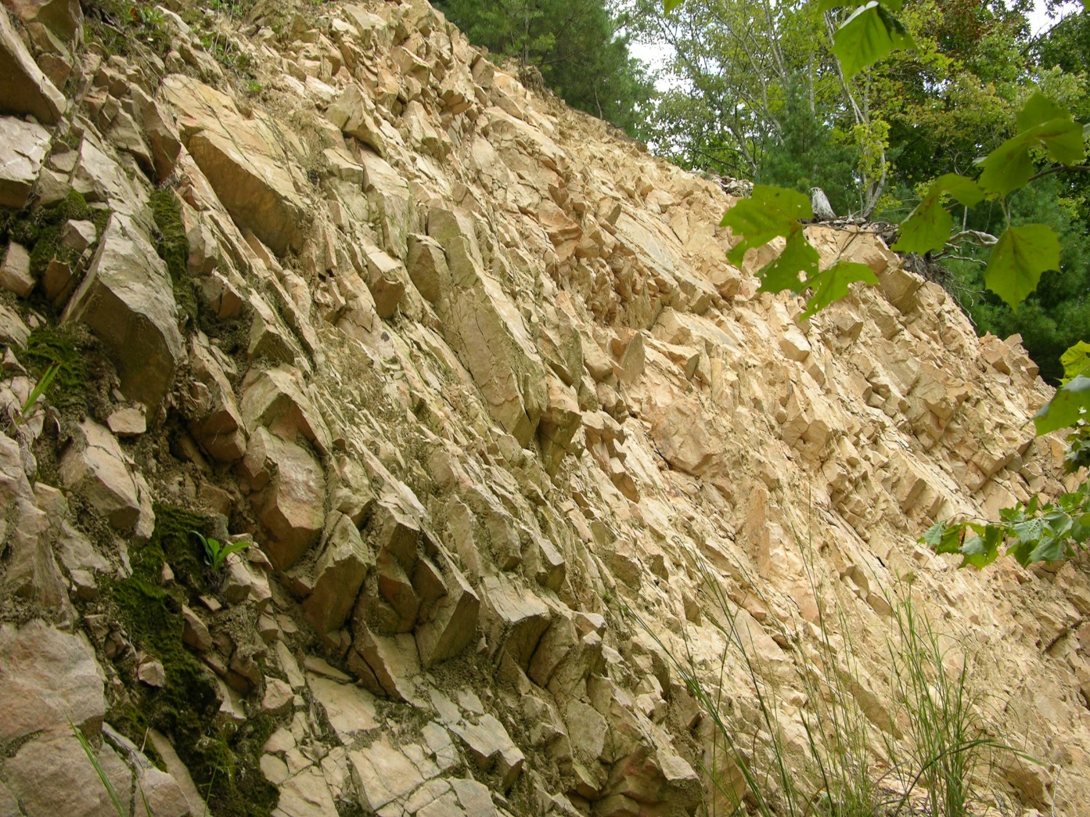
Begin with observations.
On the other hand, because it is the leading edge of the Blue Ridge thrust sheet it is commonly so badly deformed and fractured that traces of bedding have been lost – like here.
There are better exposures in the southern Blue Ridge province where it has been well studied.

Slide 11
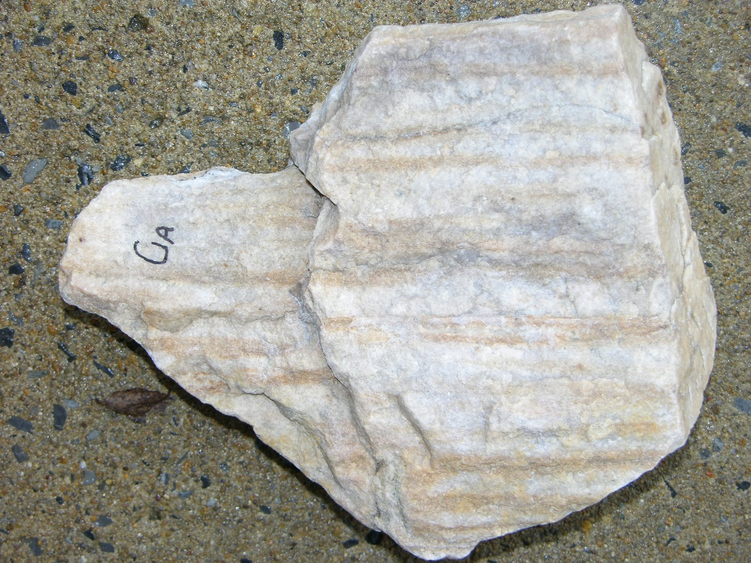
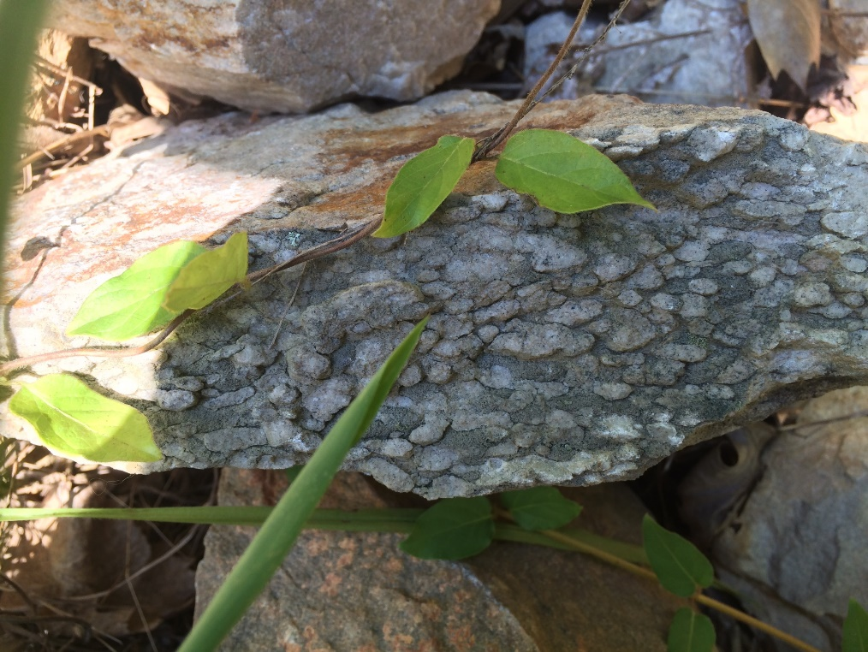
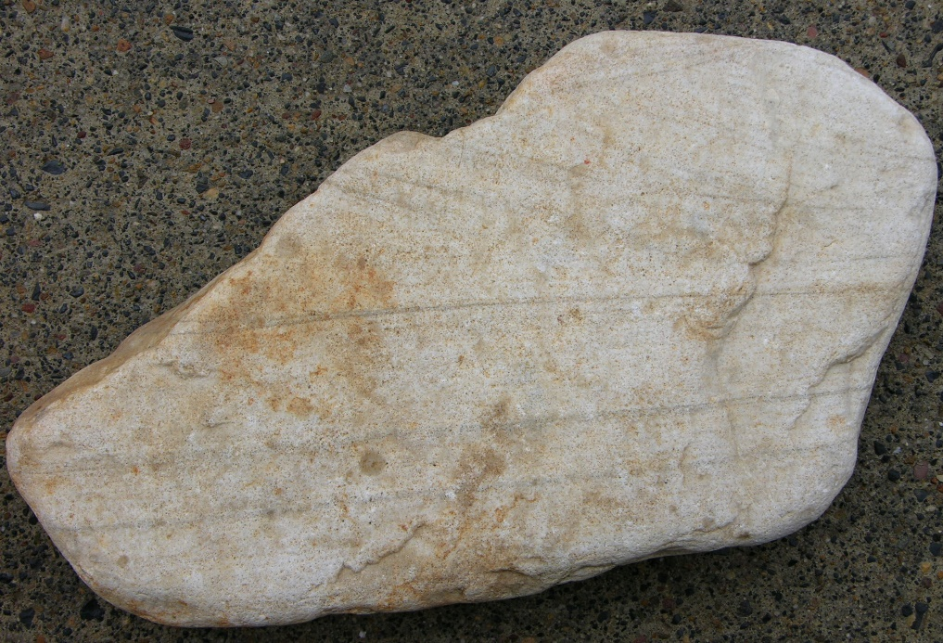
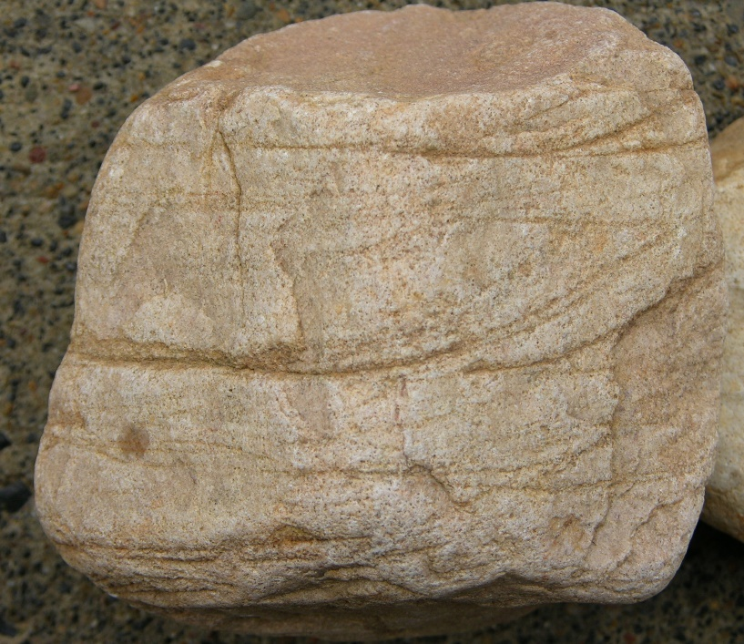
Begin with observations.
However, some samples show primary structures.

Slide 12
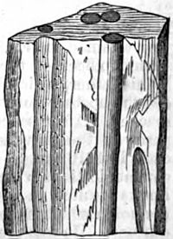
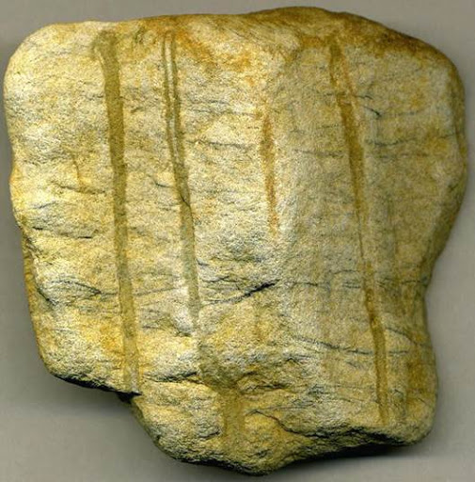
2. Environmental interpretations:
Skolithos burrows are common trace fossils ranging from early Cambrian to the present and are found throughout the world. They occur primarily in sands and sandstones. Typically marine in origin, and commonly associated with high-energy coastal environments (beach/barrier island systems.)
Skolithos along with the amalgamated clean quartz nature of the sands, and evidence of abundant cross bedding points to the Antietam being a
Beach Environment
3-4. Basin and tectonic interpretations:
Our main interests are three:
Why is the Antietam such a pure quartz when the underlying Harpers and Weverton are not?
From what source direction did it come?
Where does it fit into the tectonic history of the region?

Slide 13
3-4. Basin and tectonic interpretations:
Rodinia supercontinent eroded after Grenville orogeny
Beginning Stage 1 rifting of Rodinia
Hot spot uplift, horse and graben formation, lots of plutonic/volcanic activity
Stage 2 Rodinia rifting
(next page)

Slide 14
3-4. Basin and tectonic interpretations:
Second Stage Rifting: Several things are going on sequentially and simultaneously during the rifting event.
Hot spot uplift creating horsts and graben.
A lot of volcanic activity (e.g. Catoctin).
Subsidence of graben (subareal followed by subaqueous) leading to Weverton Fm.
Sea level begins a 1st order rise (Sauk Sequence) with 2nd and 3rd order cycles superposed.
Transition to shelf (Harpers) then shoreline deposits (Antietam) as DCM sinks and sea level rises.
Be aware these are not all being deposited in the same place. This is a composite sequence of a much more complicated geography.

Slide 15
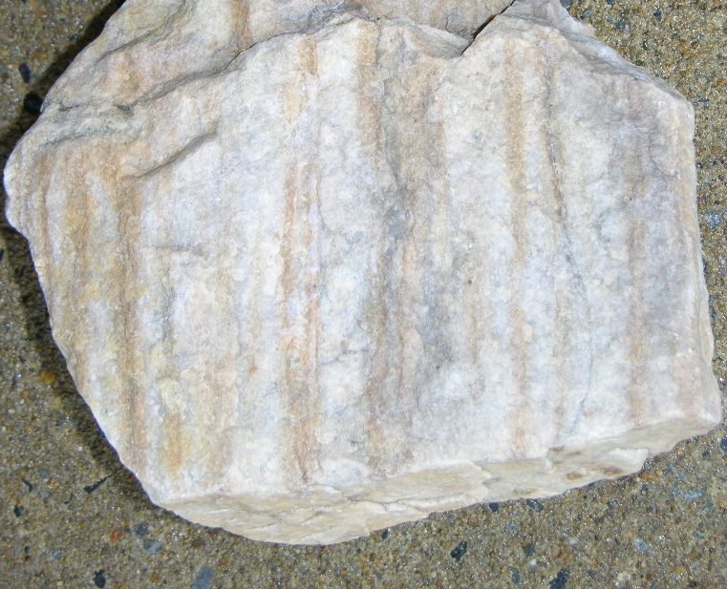
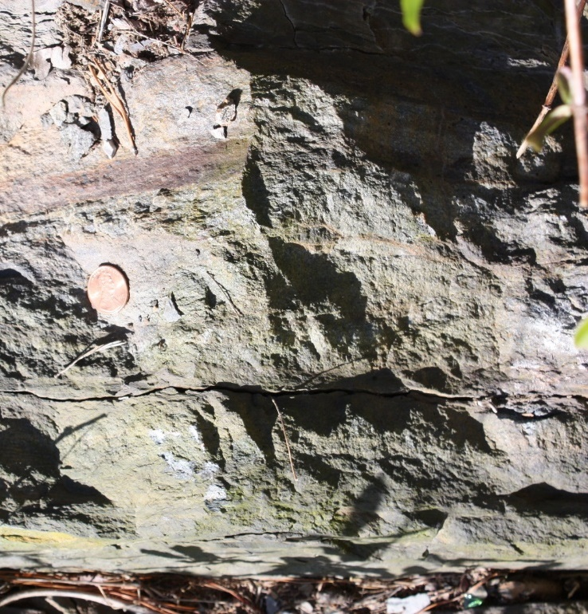
3-4. Basin and tectonic interpretations:
A Conundrum: There is a striking difference between the Harpers and Antietam QFL’s.
The Antietam is a very clean mature quartz arenite.
The Harpers is a sublitic/ subarkosic sandstone with some amount of matrix and interbedded shale. Looks like a “dirty” sandstone.
Yet these two are stratigraphically adjacent: Harpers changing up section into the Antietam.
Why are they so different?

Slide 16
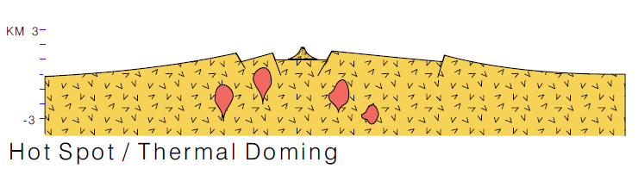
3-4. Basin and tectonic interpretations:
Mostly we see rock units in their pure form: straight forward and easy to interpret.
But more interesting are the “boundary conditions”: what it looks like to transition from one regime to another regime.
Let’s imagine a bunch of graben have been created. They are filled with sediment derived from the horsts.
The graben begin subareal: alluvial fans, braided river, lakes.
With time the graben sink below sea level and are filled with short system, immature sediments deposited in a submarine fan deposits (Weverton).
But sediment transports both directions, into the graben, and out onto the craton.
But the craton bound sediment is in a long system: the sands mature to pure quartz (future Antietam).
For example this section represents the Rift-to-Drift phase of the Second Rodinia rifting event: early thermal uplift, horst and graben formation, and volcanic activity.

Slide 17
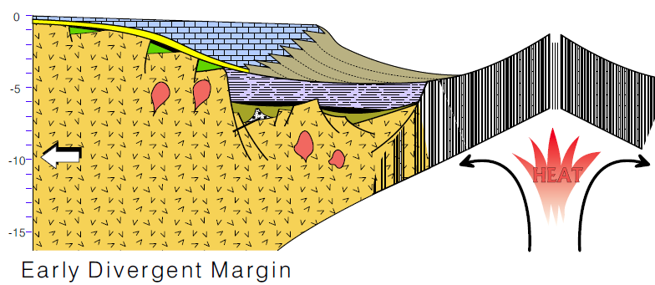
3-4. Basin and tectonic interpretations:
We are now at the to-Drift phase: an ocean basin has begun to open.
Drainage reversal
(yellow is Antietam Fm.)
Old drainage
As the ocean basin opens the source of heat that created the hot spot moves to the ocean.
The new Divergent Continental Margin cools, becomes denser and subsides.
As the sea transgresses the now filled graben become subaqueous. Shelf environments replace the graben (Harpers Fm.)
At the same time there is a Drainage Reversal. Rivers that used to flow from the horsts toward the craton now reverse and flow toward the subsiding continental margin.
The cratonic sediment is now highly weathered quartz rich sands (Antietam Fm.)
Two Key Items:
This is why the Antietam is quartz rich while Harpers is sublithic/feldspathic.
2. Quartz sands are common geological boundary conditions, a switch from one tectonic regime to another.

Slide 18
3-4. Basin and tectonic interpretations:
A model of the Rift-to-Drift transition.

Slide 19
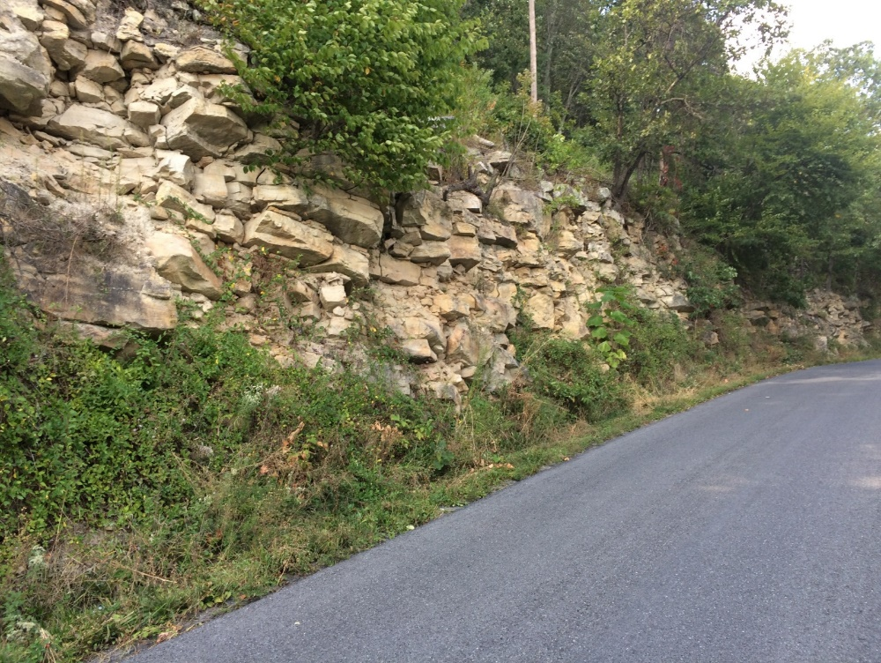
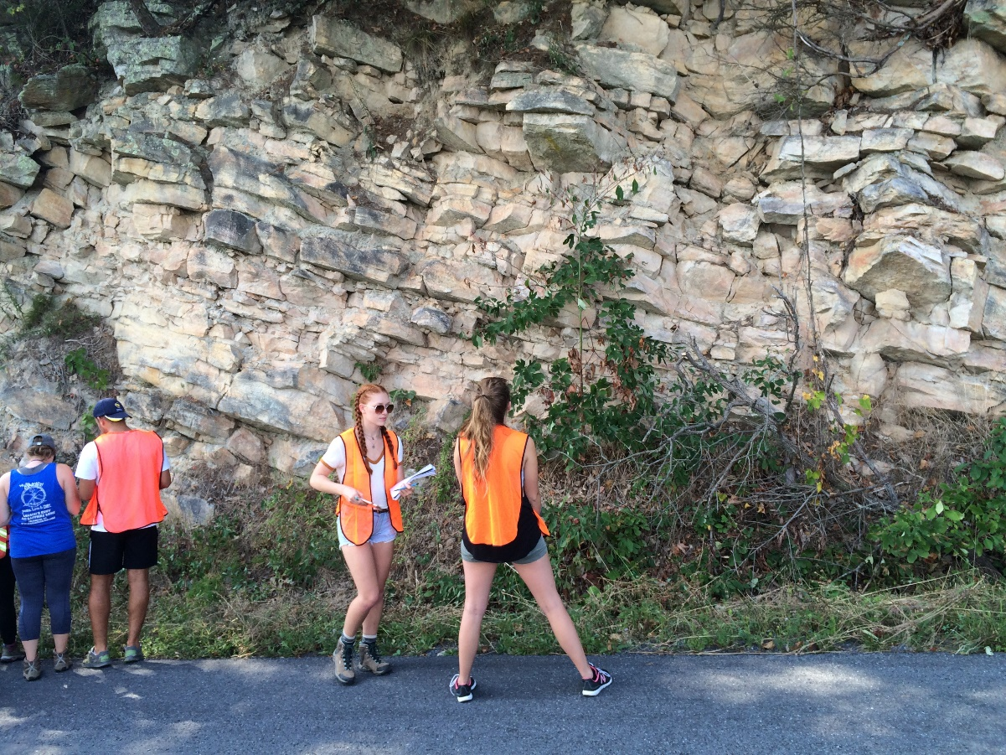
Trip 1:
Chalk Talk 9
Massanutten Formation

Slide 20
Begin with a review of flow regime concepts.

Slide 21
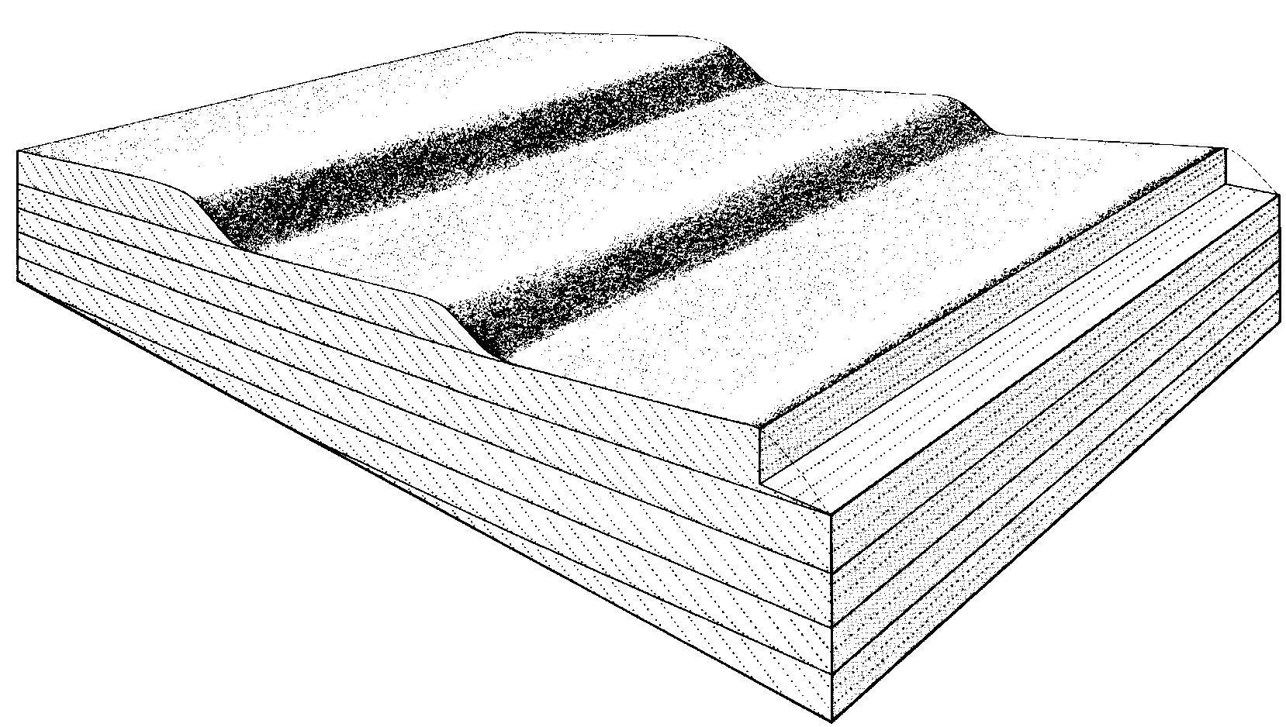
And sedimentary Structures:
Planar Cross Bedding: bed forms and internal structure

Slide 22
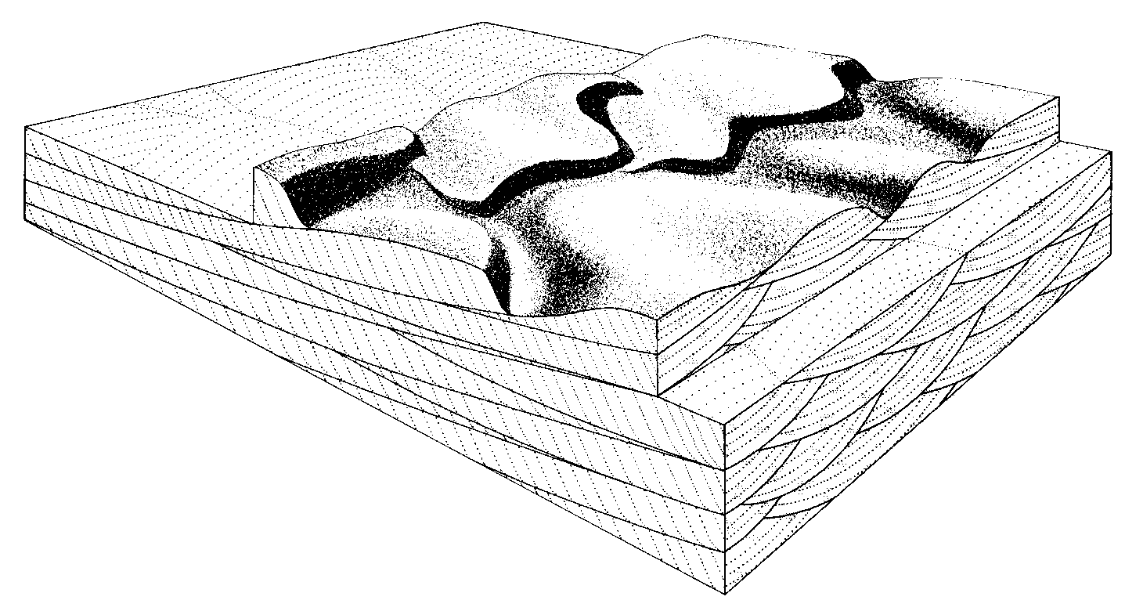
And sedimentary Structures:
Linguloid Cross Bedding: bed forms and internal structure

Slide 23
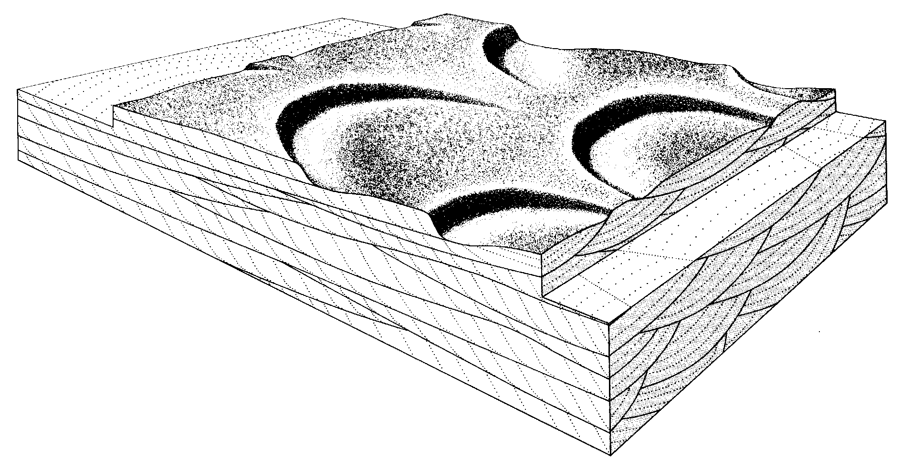
And sedimentary Structures:
Lunate Cross Bedding: bed forms and internal structure

Slide 24
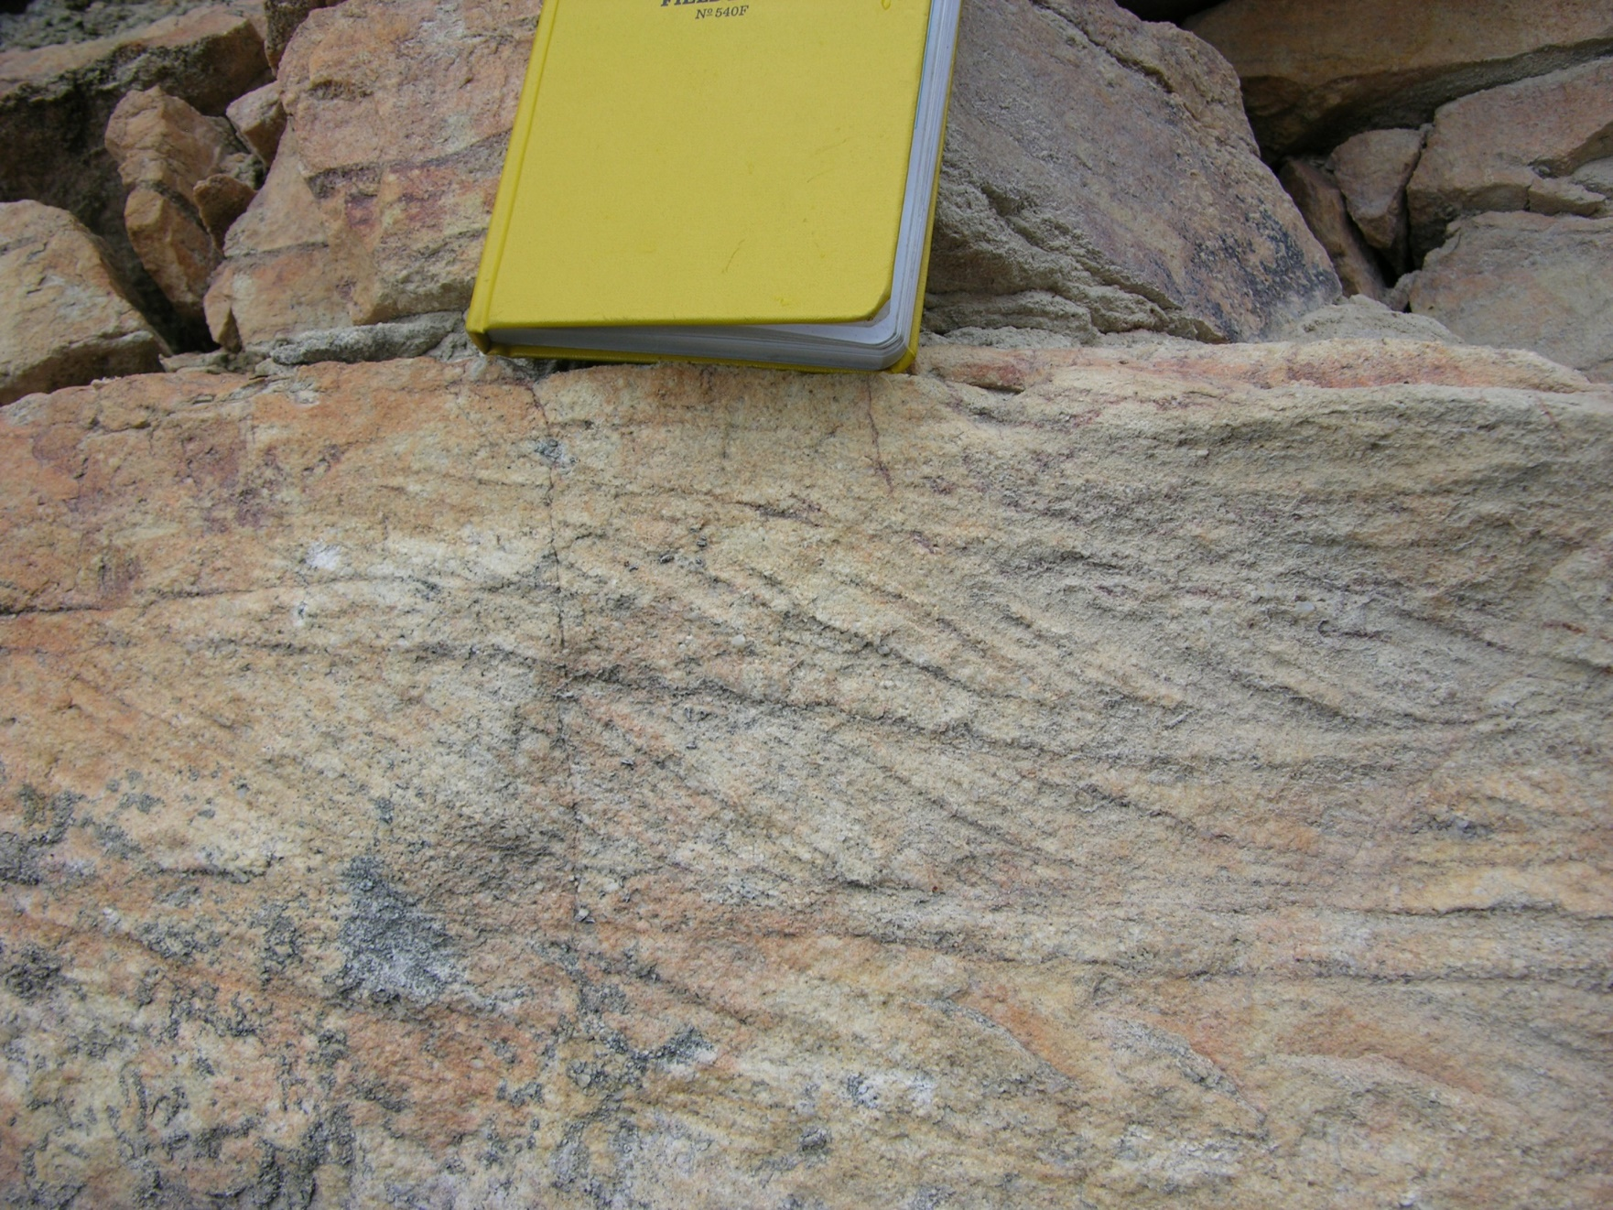
Observation:
Planar or Trough?
-

Slide 25
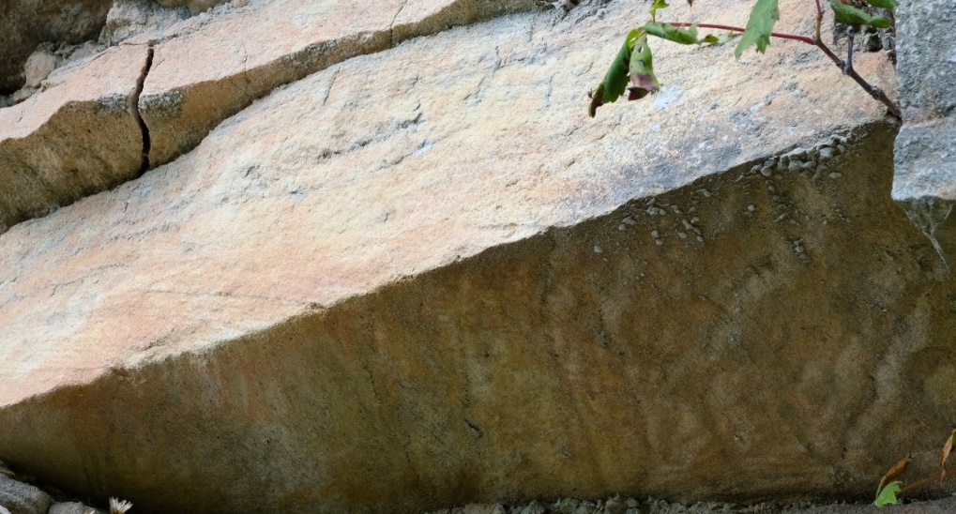
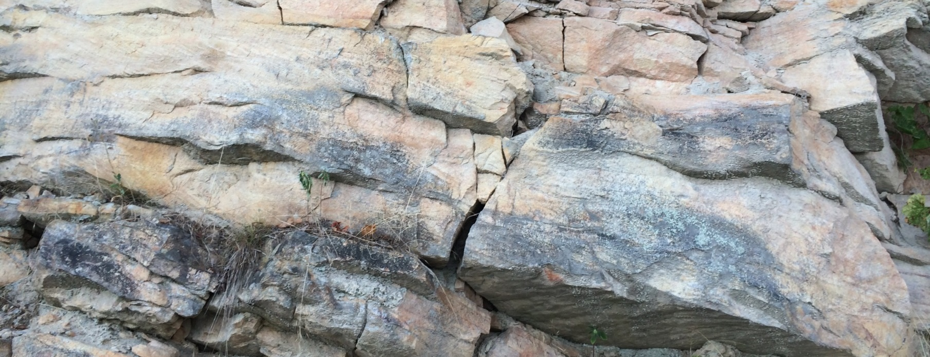
Observation:
Planar or Trough?
Hard to see isn’t it.
Look here
Look here
Look here
Let me point out some cross beds.

Slide 26
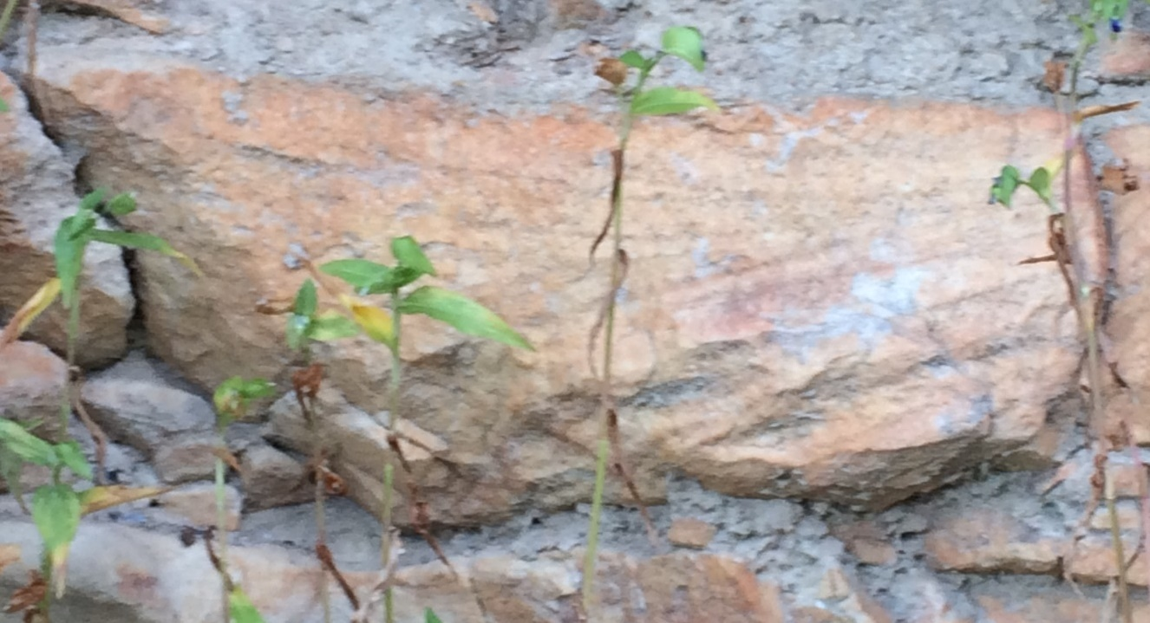
Observation:
Planar or Trough?

Slide 27
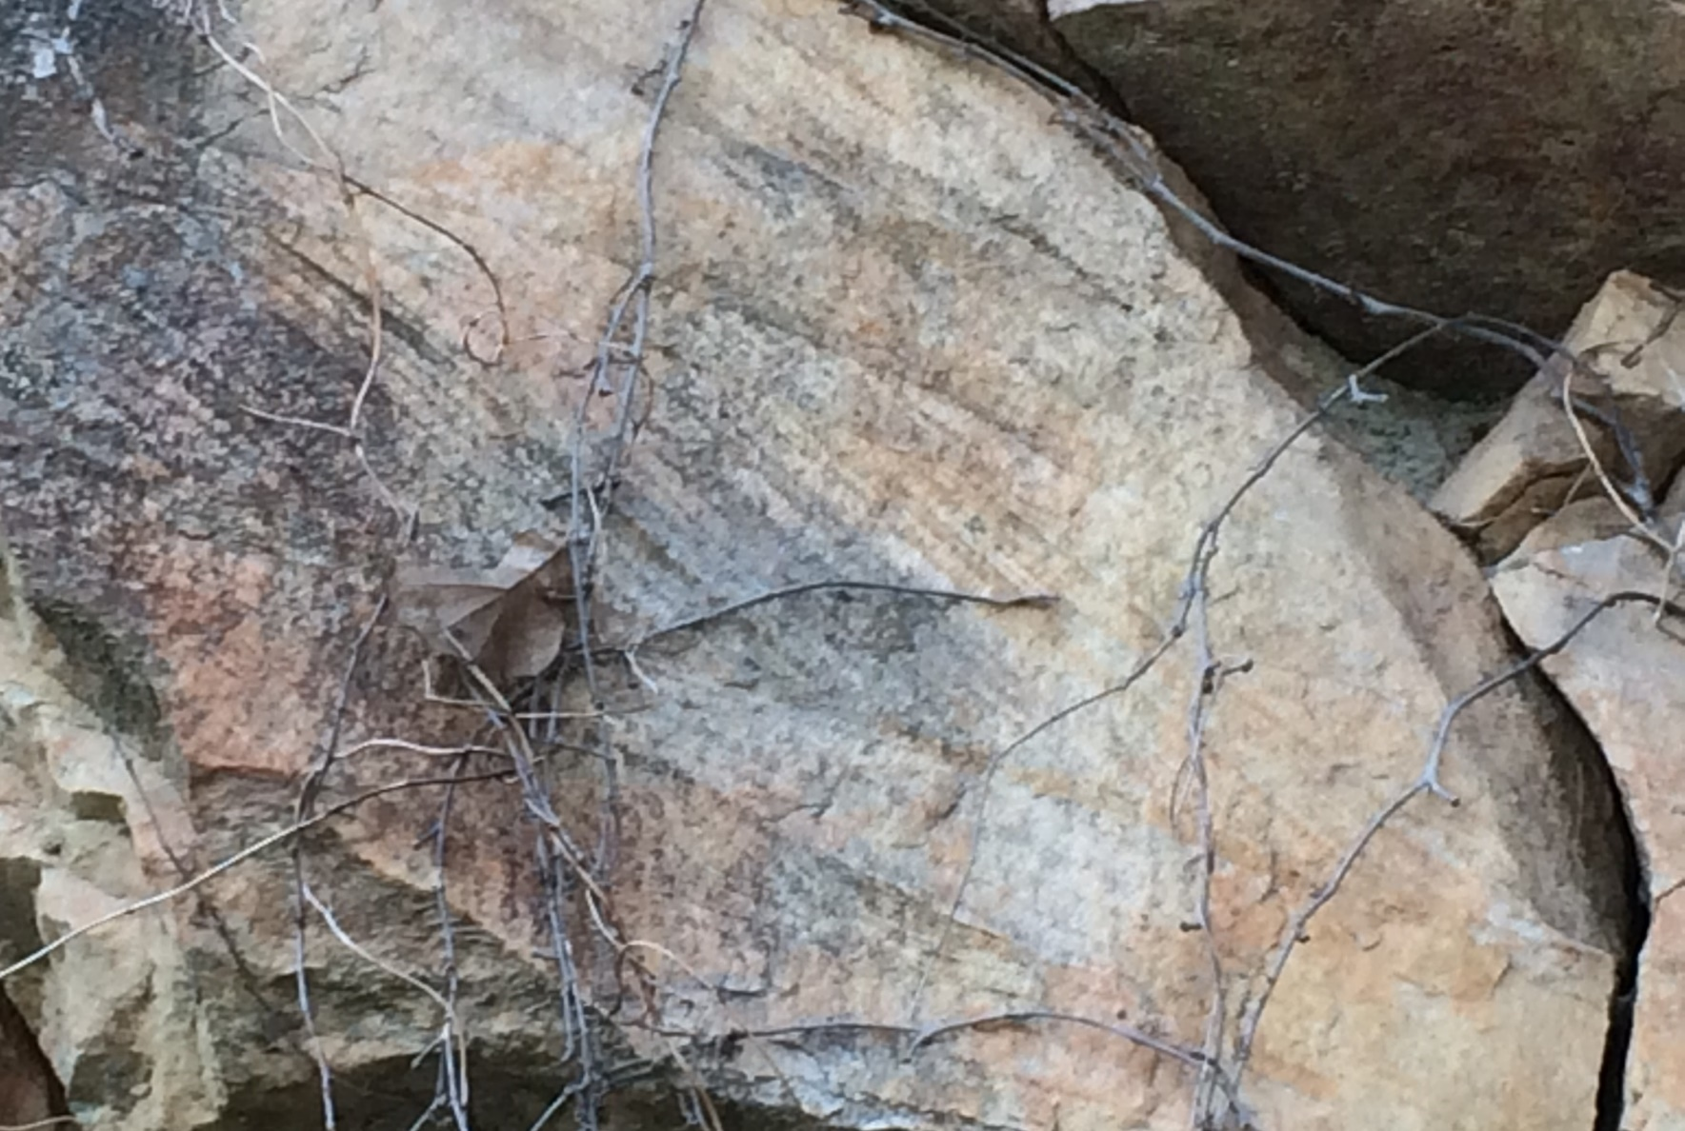
Observation:
Planar or Trough?

Slide 28
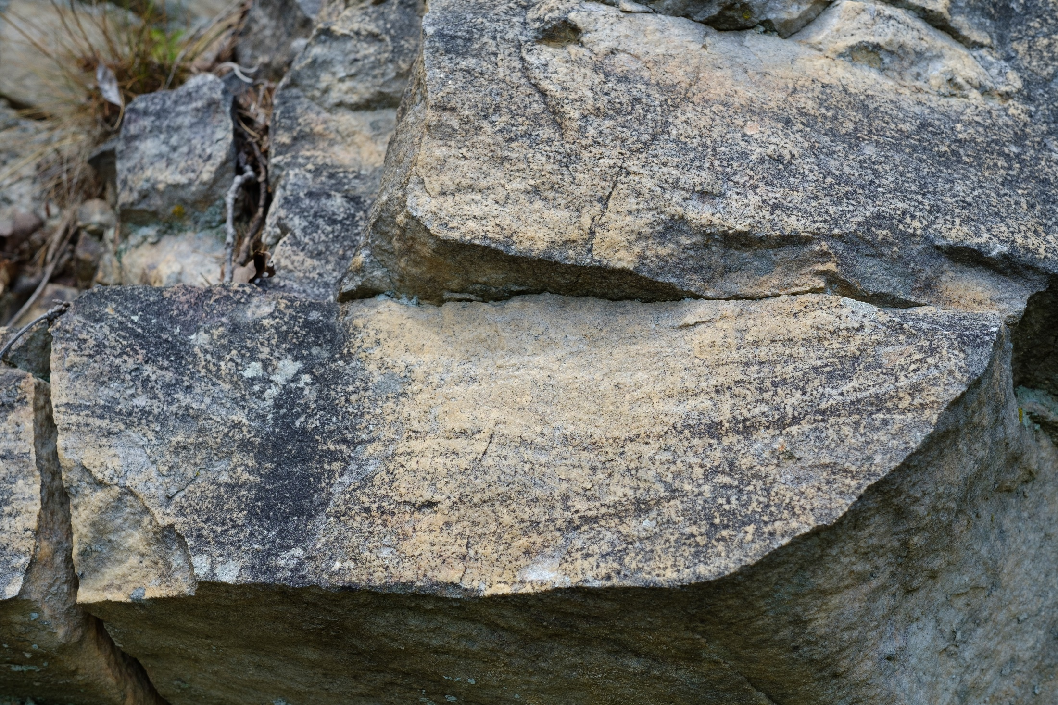
Observation: planar or trough?

Slide 29
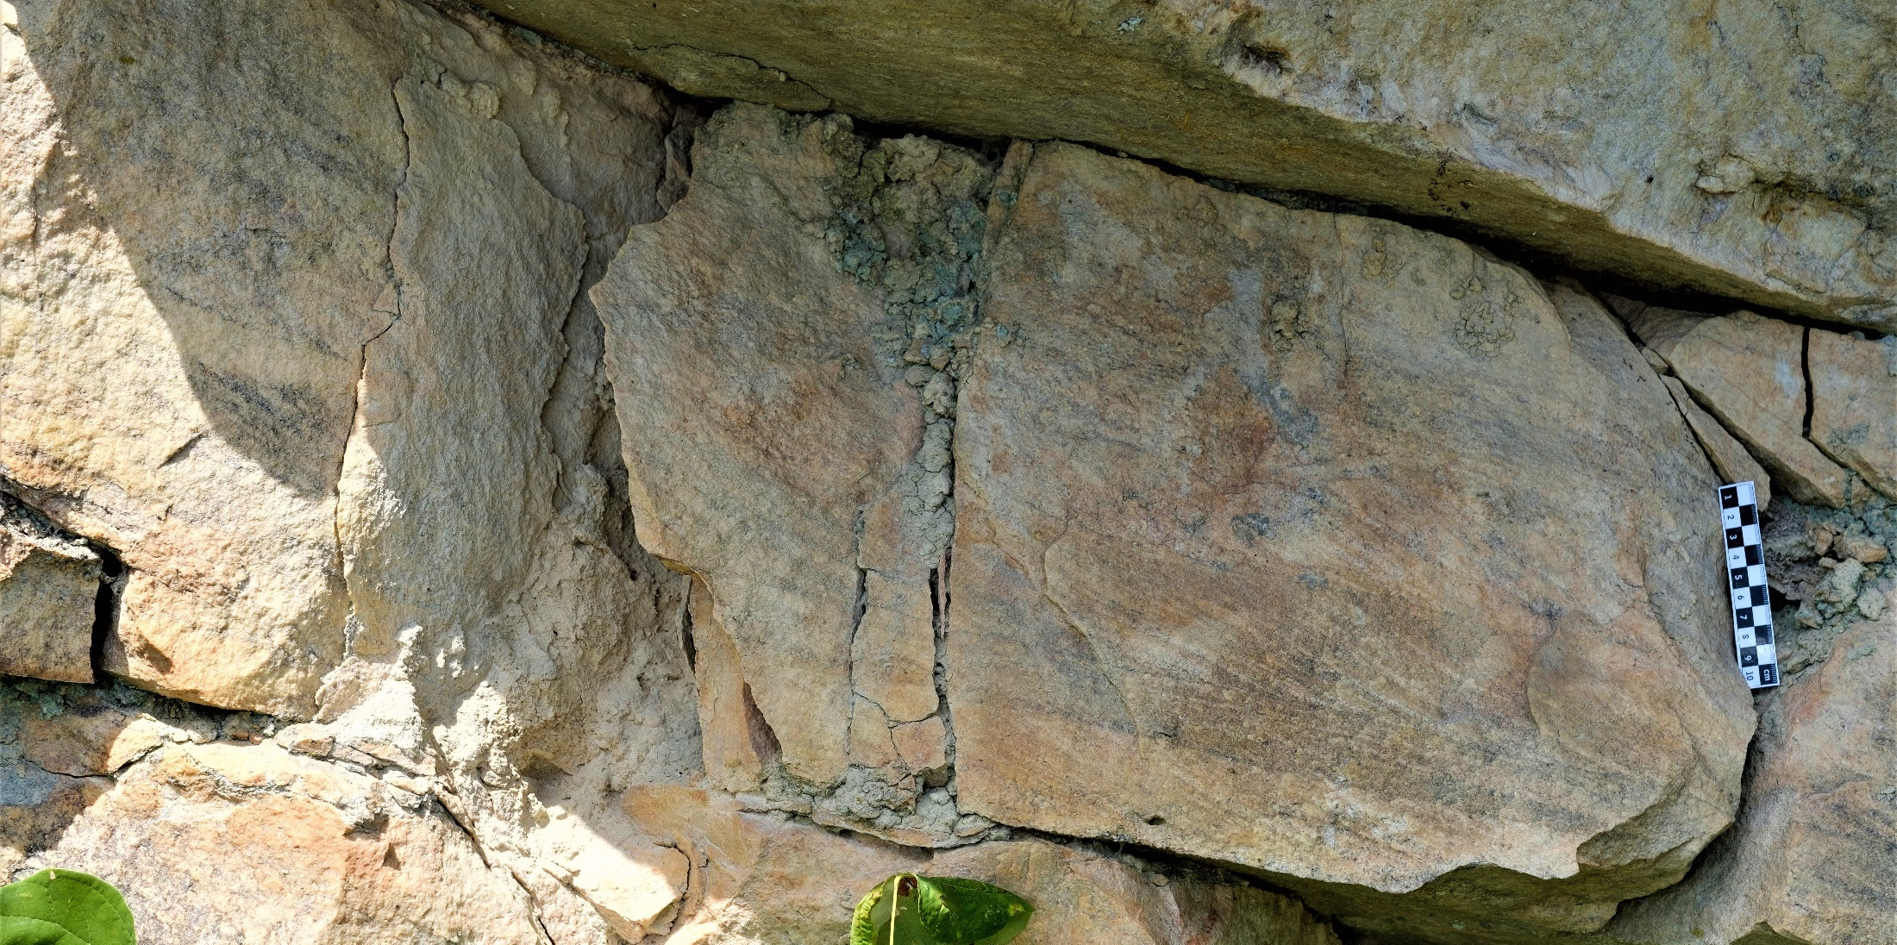
Observation:
Planar or Trough?

Slide 30
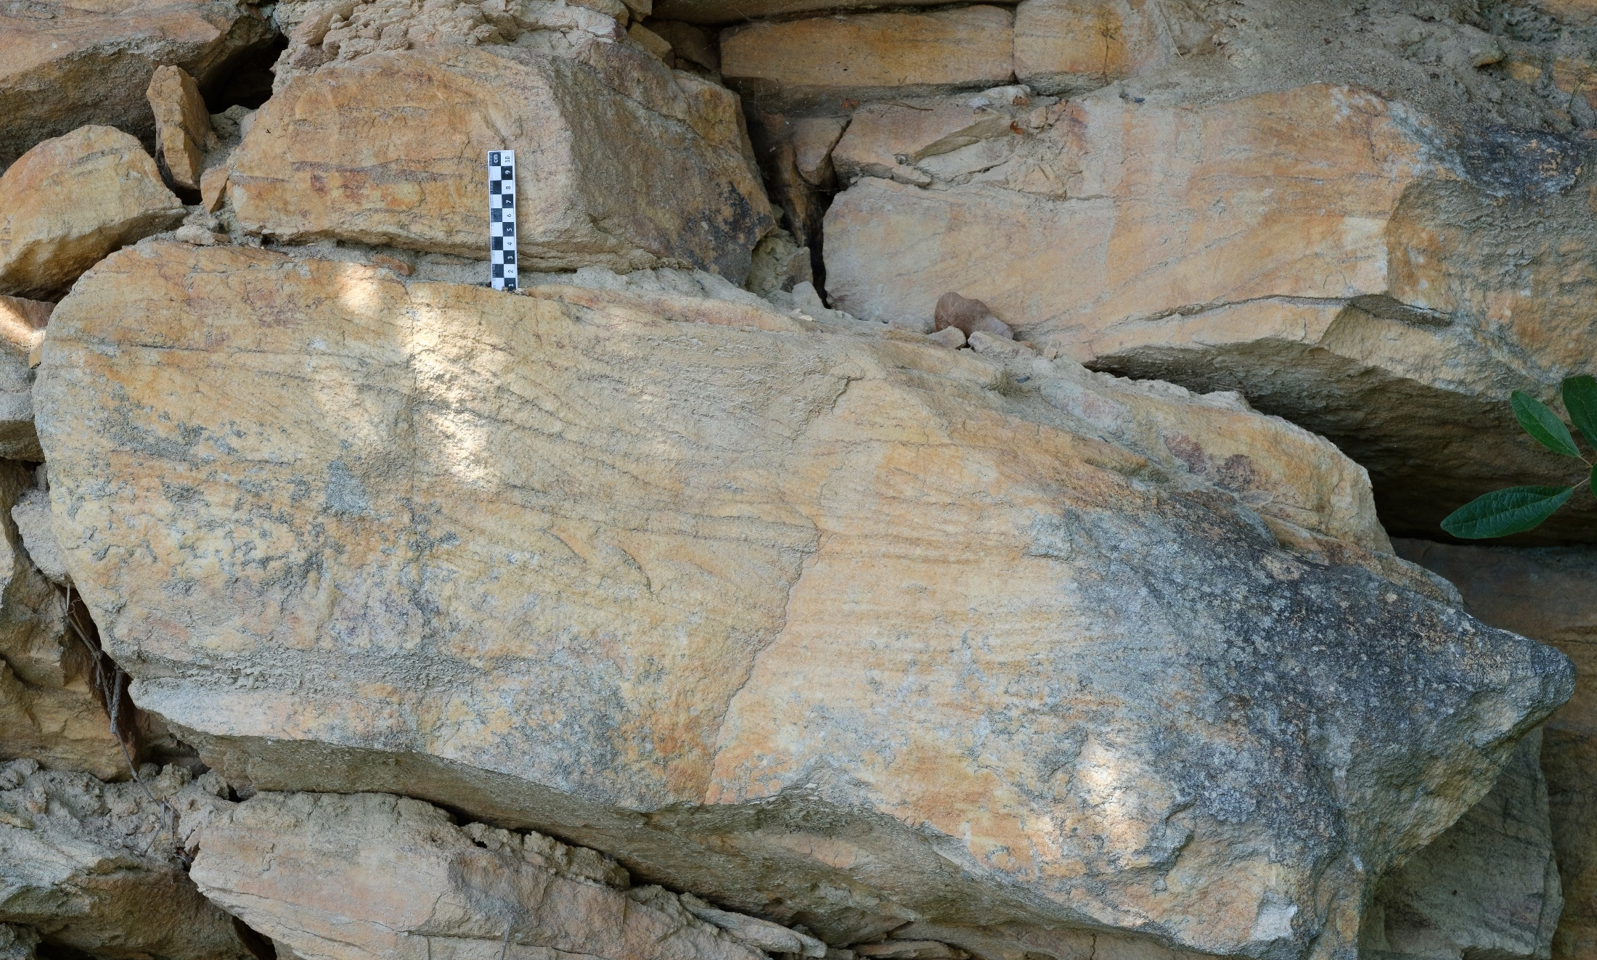
Observation:
Planar or Trough?

Slide 31
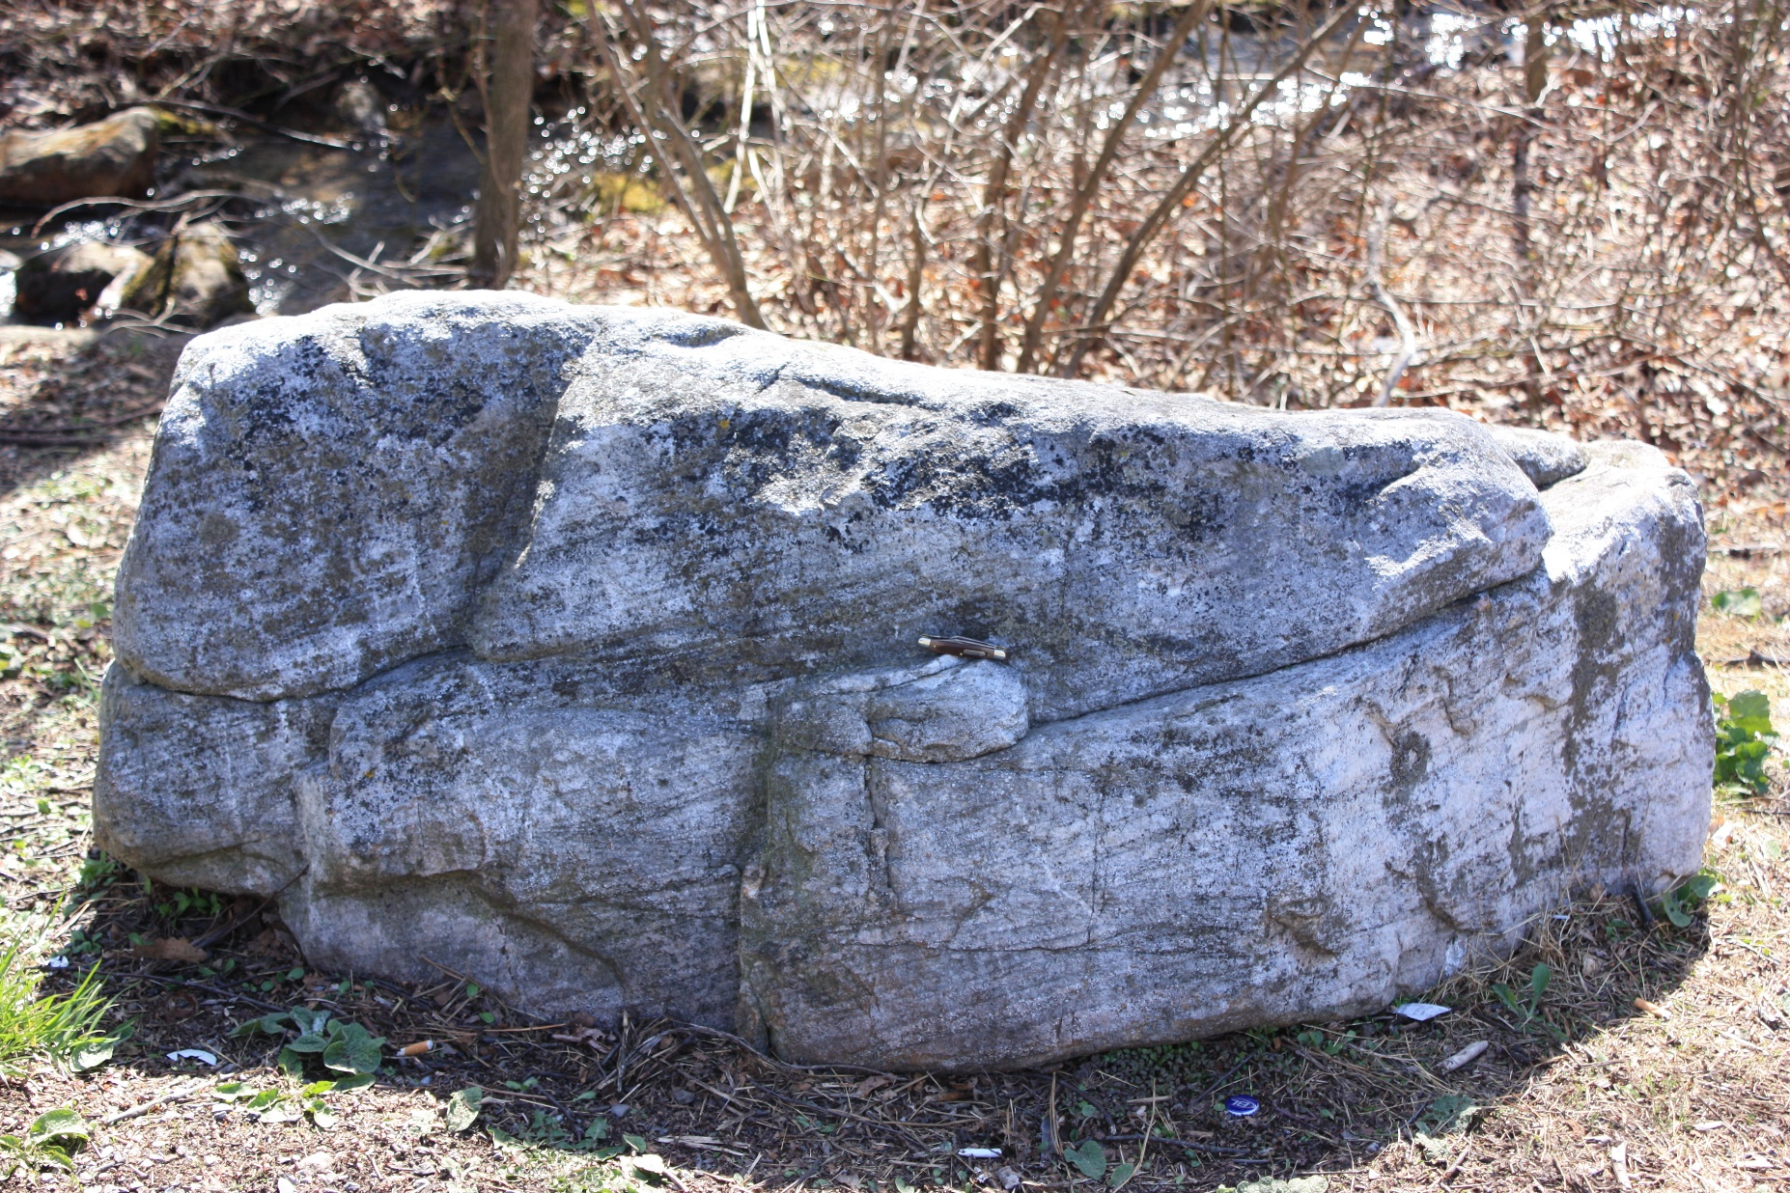
Observation:
Planar or Trough?

Slide 32
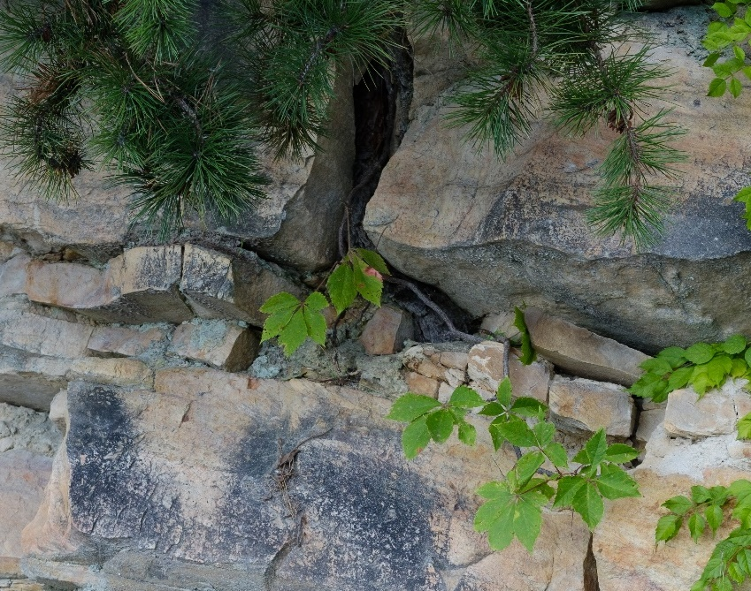
Observation: large scours
Scour
Scour

Slide 33
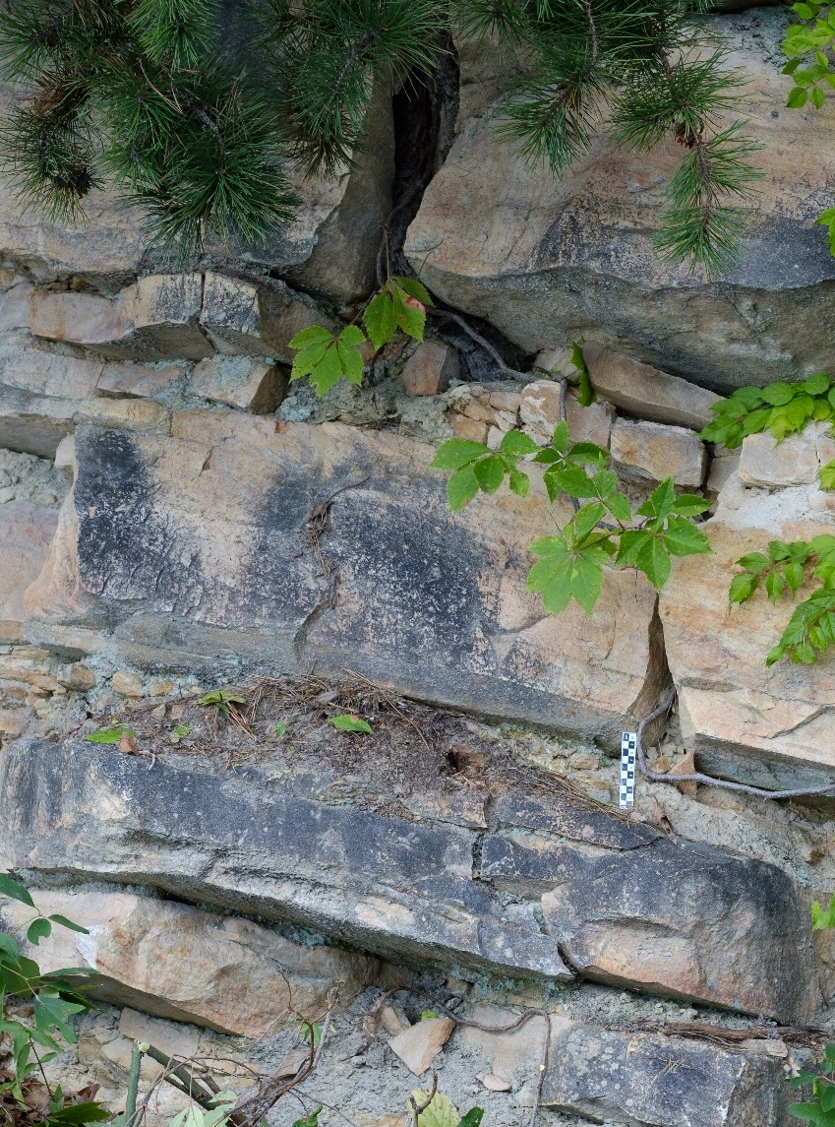
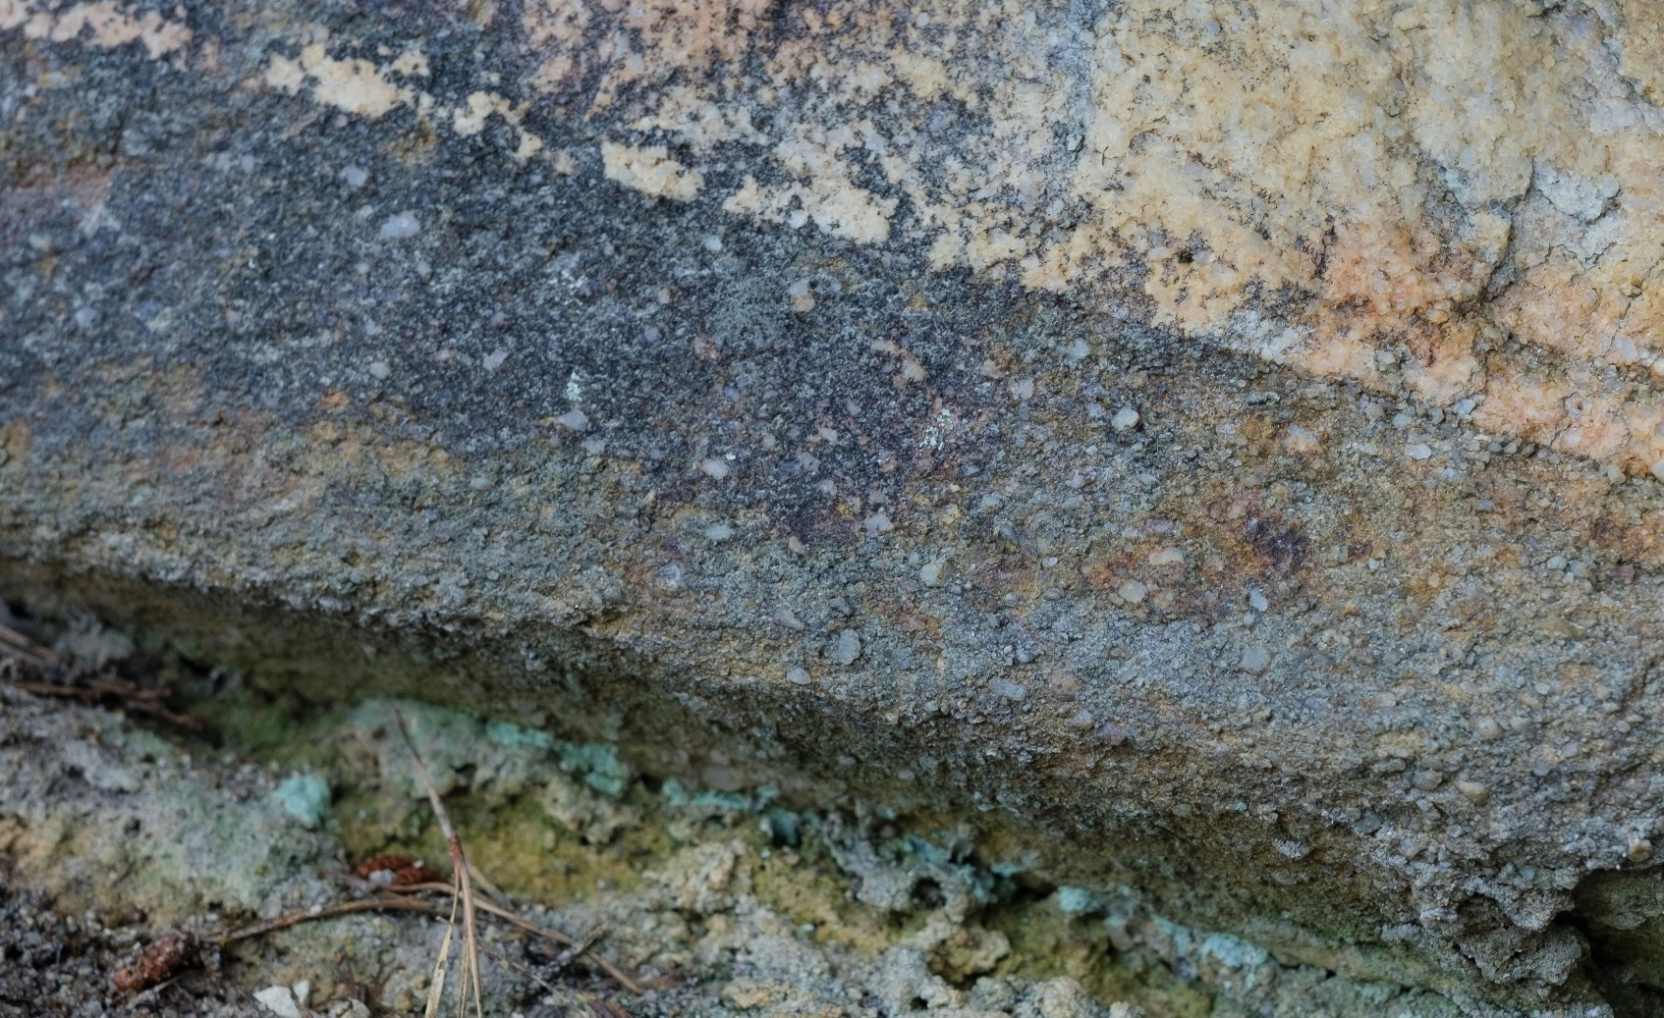
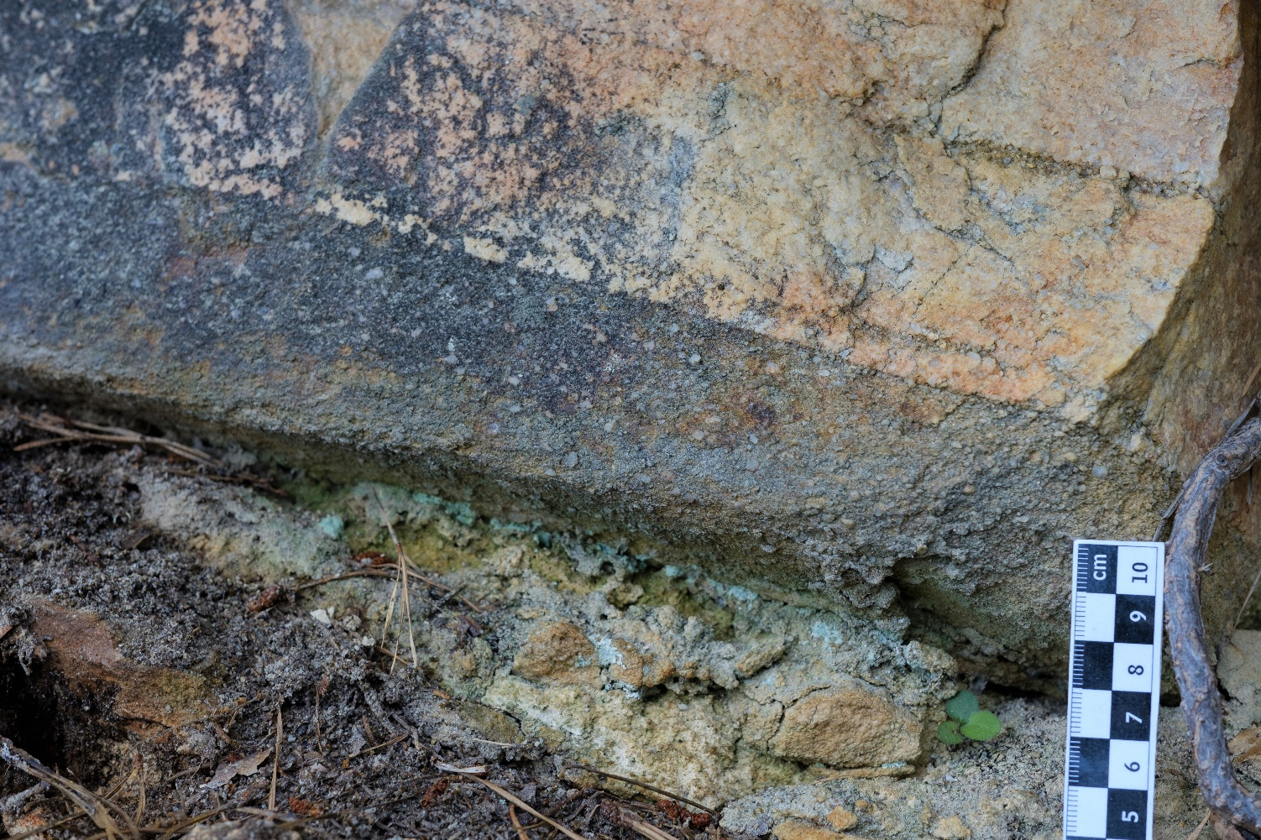
Observation: Gravel Beds
Also present are gravel beds (cm to dm) with granule sized quartz pebbles.

Slide 34
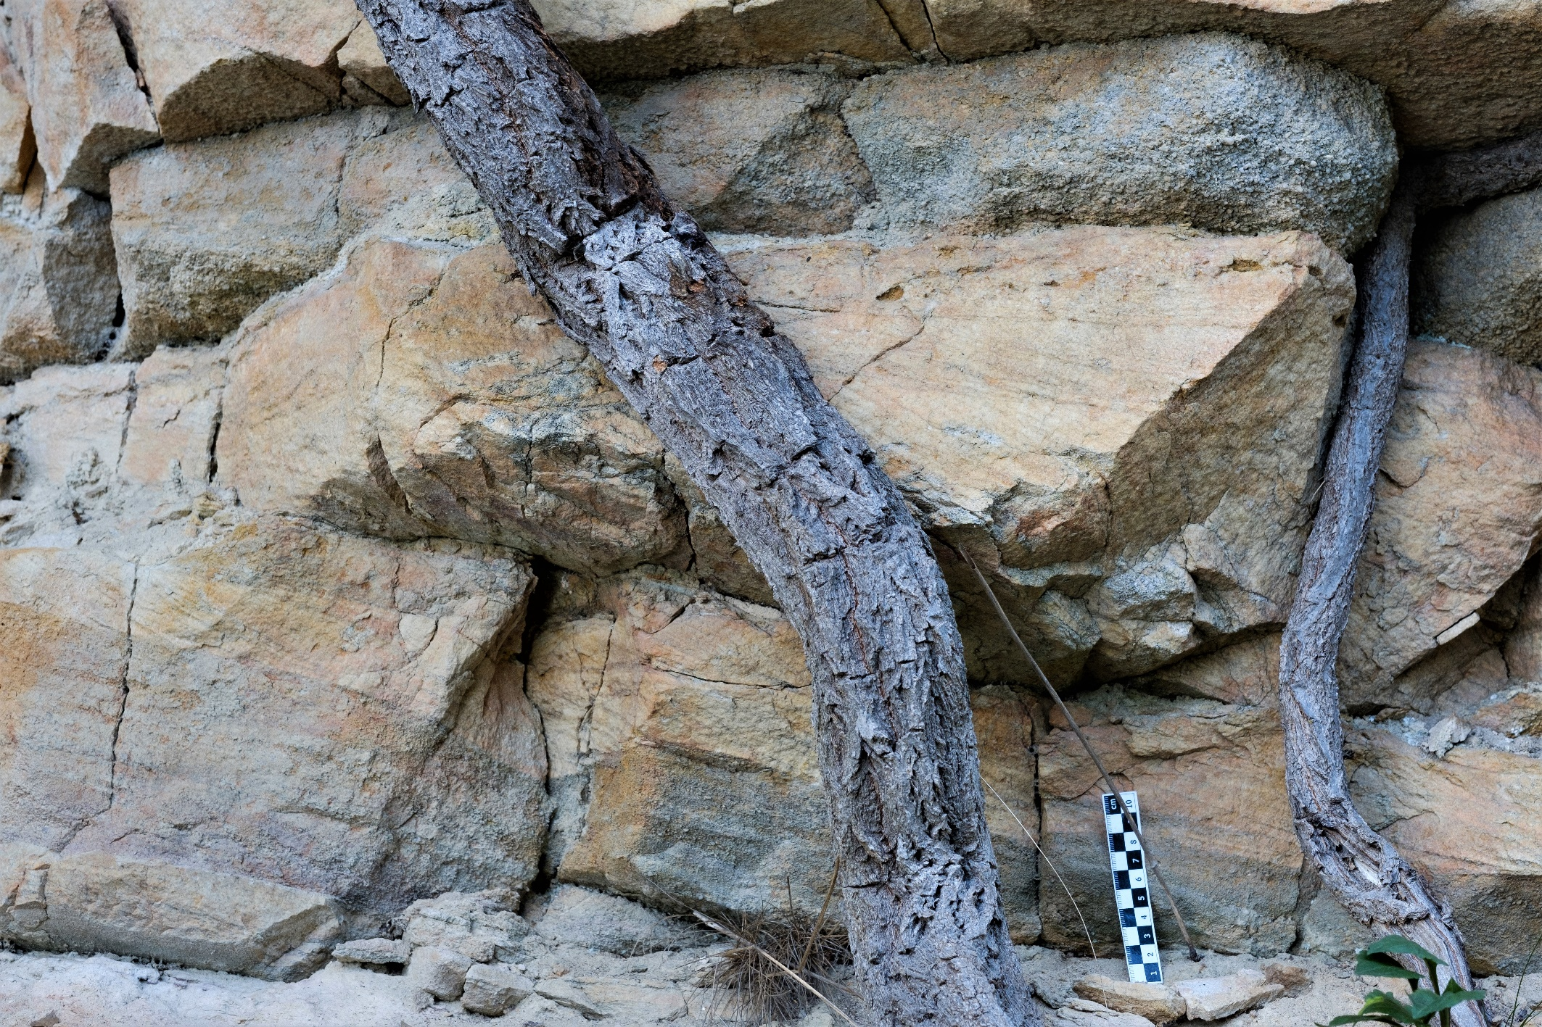
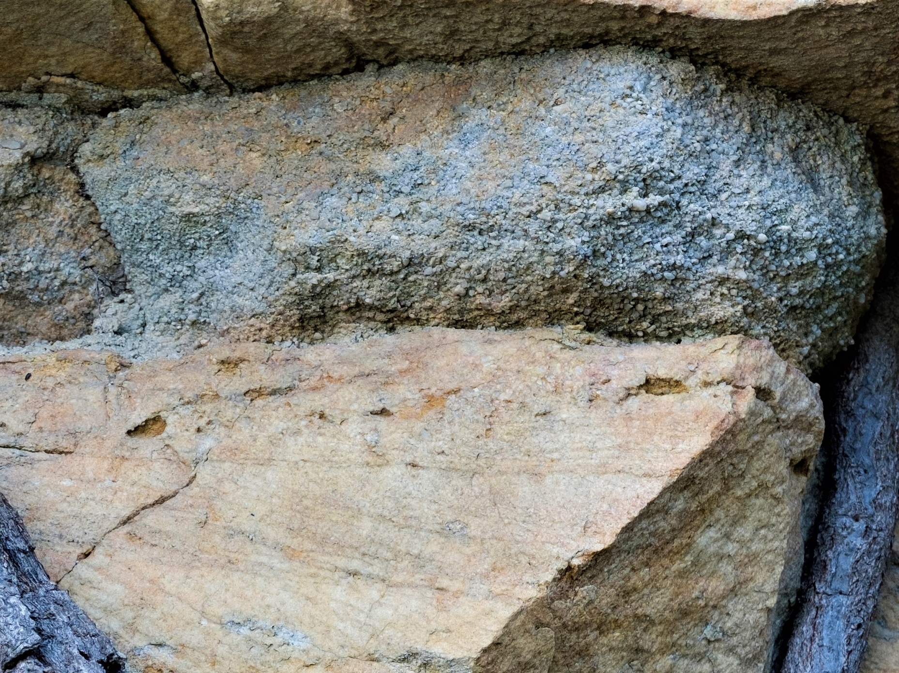
Observation: Gravel Beds
Also present are gravel beds (cm to dm) with granule sized quartz pebbles.

Slide 35
2-3. Flow Regime and Environmental interpretations:
What is the depositional system of the Massanutten Fm.?
Describe this systems behavior.
The Evidence?
Coarse to very coarse quartz sands.
Well developed upper-lower flow regime planar cross beds.
Well developed upper-lower flow regime trough cross beds.
Lots of scours.
Quartz gravel beds.
This is a high energy system too proximal to have shale.
The energy fluctuates a lot in the upper flow to erosional regimes.
What is the depositional sequence of the Massanutten?
Bouma sequence?
Hummocky sequence?
Point Bar sequence?
L-Bar/T-Bar sequence?
None of the above?
None of the traditional sequences match with the Massanutten.

Slide 36
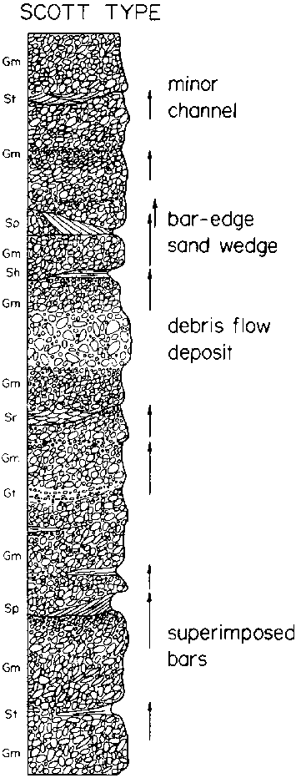
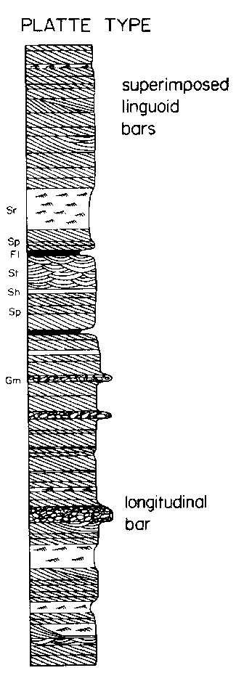
2-3. Flow Regime and Environmental interpretations:
Modern braided river systems:
The Scott type is an example of a proximal gravel dominated L-Bar system.
The Platte type is an example of a sand dominated T-Bar system.

Slide 37
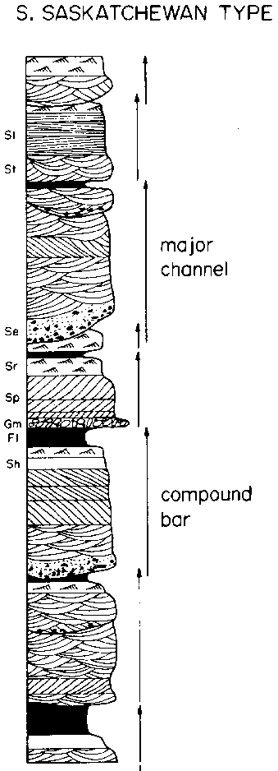
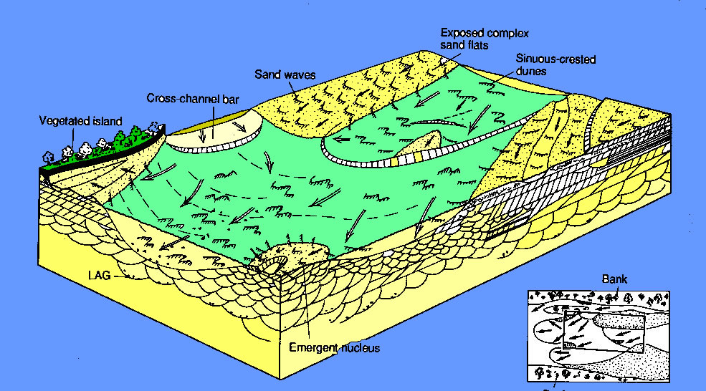
2-3. Flow Regime and Environmental interpretations:
Modern braided river systems:
Below illustrates a transition between a distal braided river (planar T-Bars) and a meandering river (Lunate trough cross beds).
A third type is the Saskatchewan river with rare L-bars, common T-Bars, lots or large trough cross bedding, and scours.

Slide 38
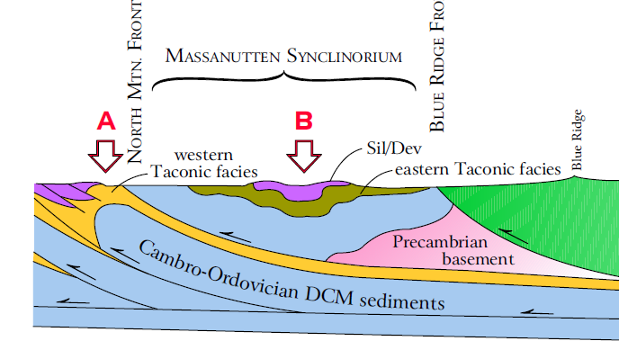
4. Tectonic Interpretations:
One of the other enigmas of the Masanutten SS is why it is isolated in the Massanutten mountains.
It is correlated with the Tuscarora and Keefer, but that is interpretation. There is no direct connection
Plus, although the Massanutten and Tuscarora outcrops are today close together, in the past they were widely separated.
Plus, even though both formations are quartz rich, the sand is not the same. Tuscarora tends to be fine to medium grained, very well sorted. Massanutten coarse to very coarse to gravel and poorly sorted.

Slide 39
4. Tectonic Interpretations:
Paleocurrent studies (compass roses) give us some insight into this.

Slide 40
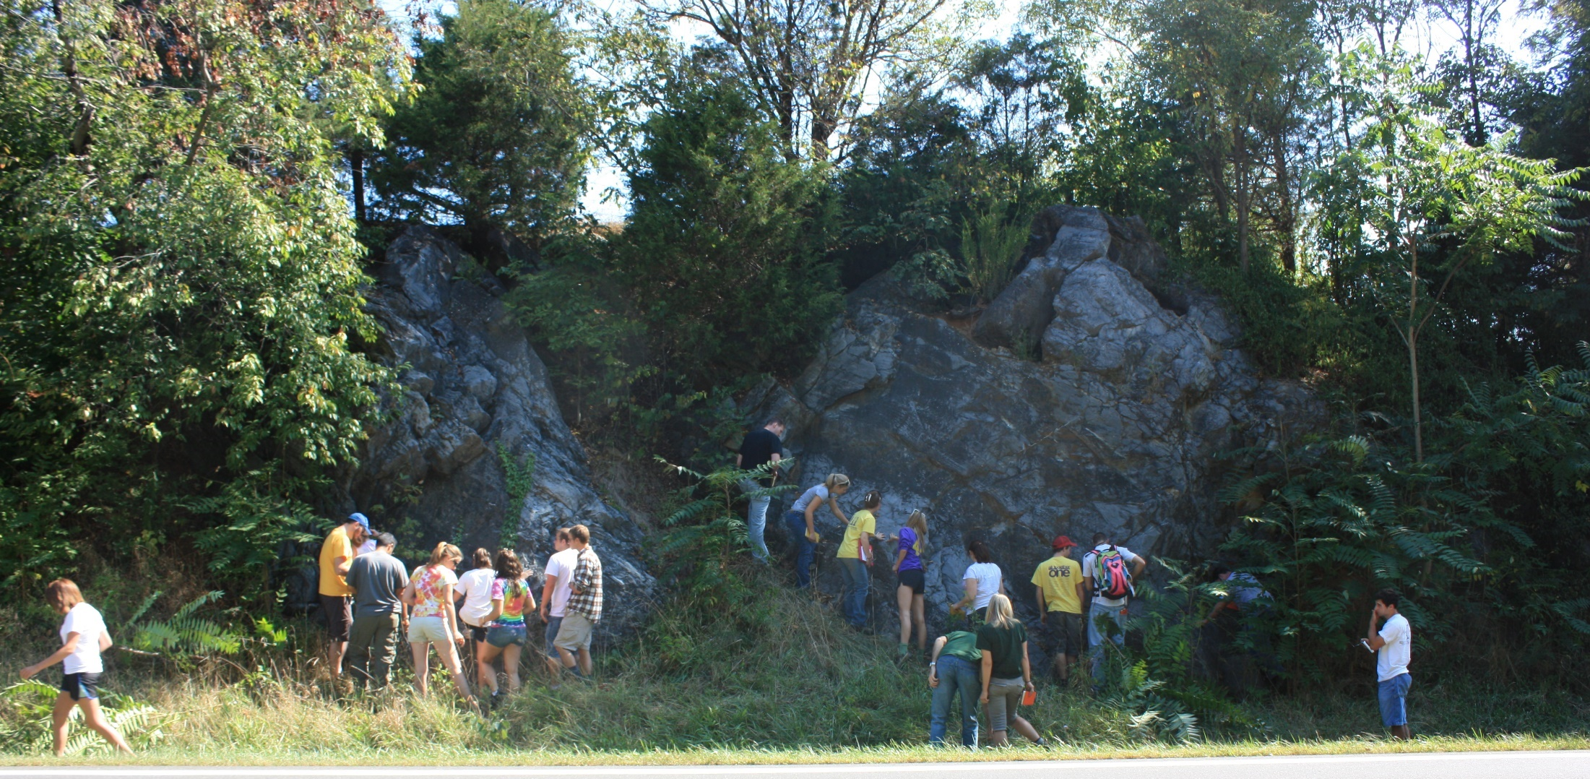
Trip 1:
Chalk Talk 10
Conococheague Fm.

Slide 41
The Cambro-Ordovician DCM rocks in NW Virginia include the Shady, Rome, Elbrook, Beekmantown, New Market and Lincolnshire formations. They are all dominantly tidal to shallow marine carbonates.
Yet, what is fascinating is that each is distinctively different from the others. The Beekmantown and Conocheague formations both have tidal facies, yet they are totally different. The Beekmantown is a lot of ALM and ALD, with evaporate facies (Leopard rock) and occasional cherts. Pretty tame, even boring.
Conococheague facies include:
Herringbone
Stromatolites
Flat pebble conglom.
Pelletal limestone
Ribbon rock (2 kinds)
Algal laminated ribbon rock
Mud (prism) cracks
The Conococheague on the other hand has a large spectrum of facies, most rare or not found in the Beekmantown. Perhaps this represents differences in ocean geochemistry, or ocean circulation patterns, or the evolution of new life forms.

Slide 42
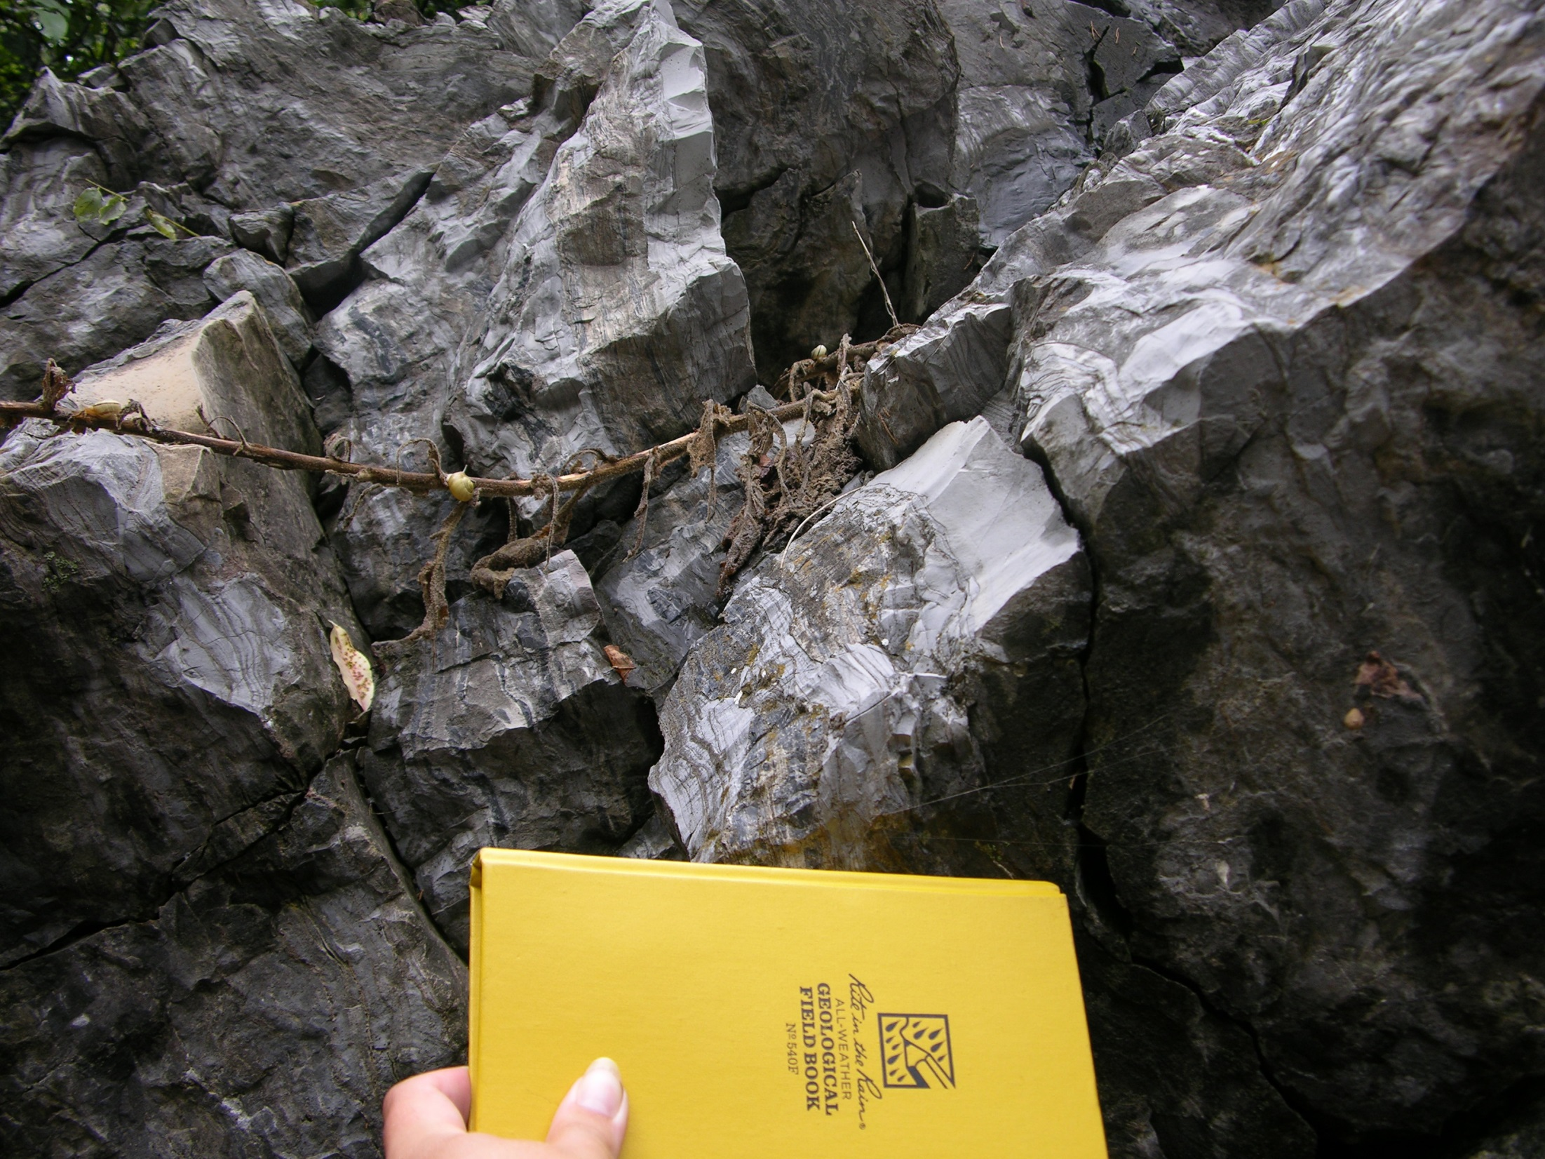
Micrites/Dolomites
There are a lot of non-descript micrite and dolomite beds, most not showing many internal structures. That may because there were none (quiet water deposition), or they were overprinted by diagenesis and pressure solution.

Slide 43
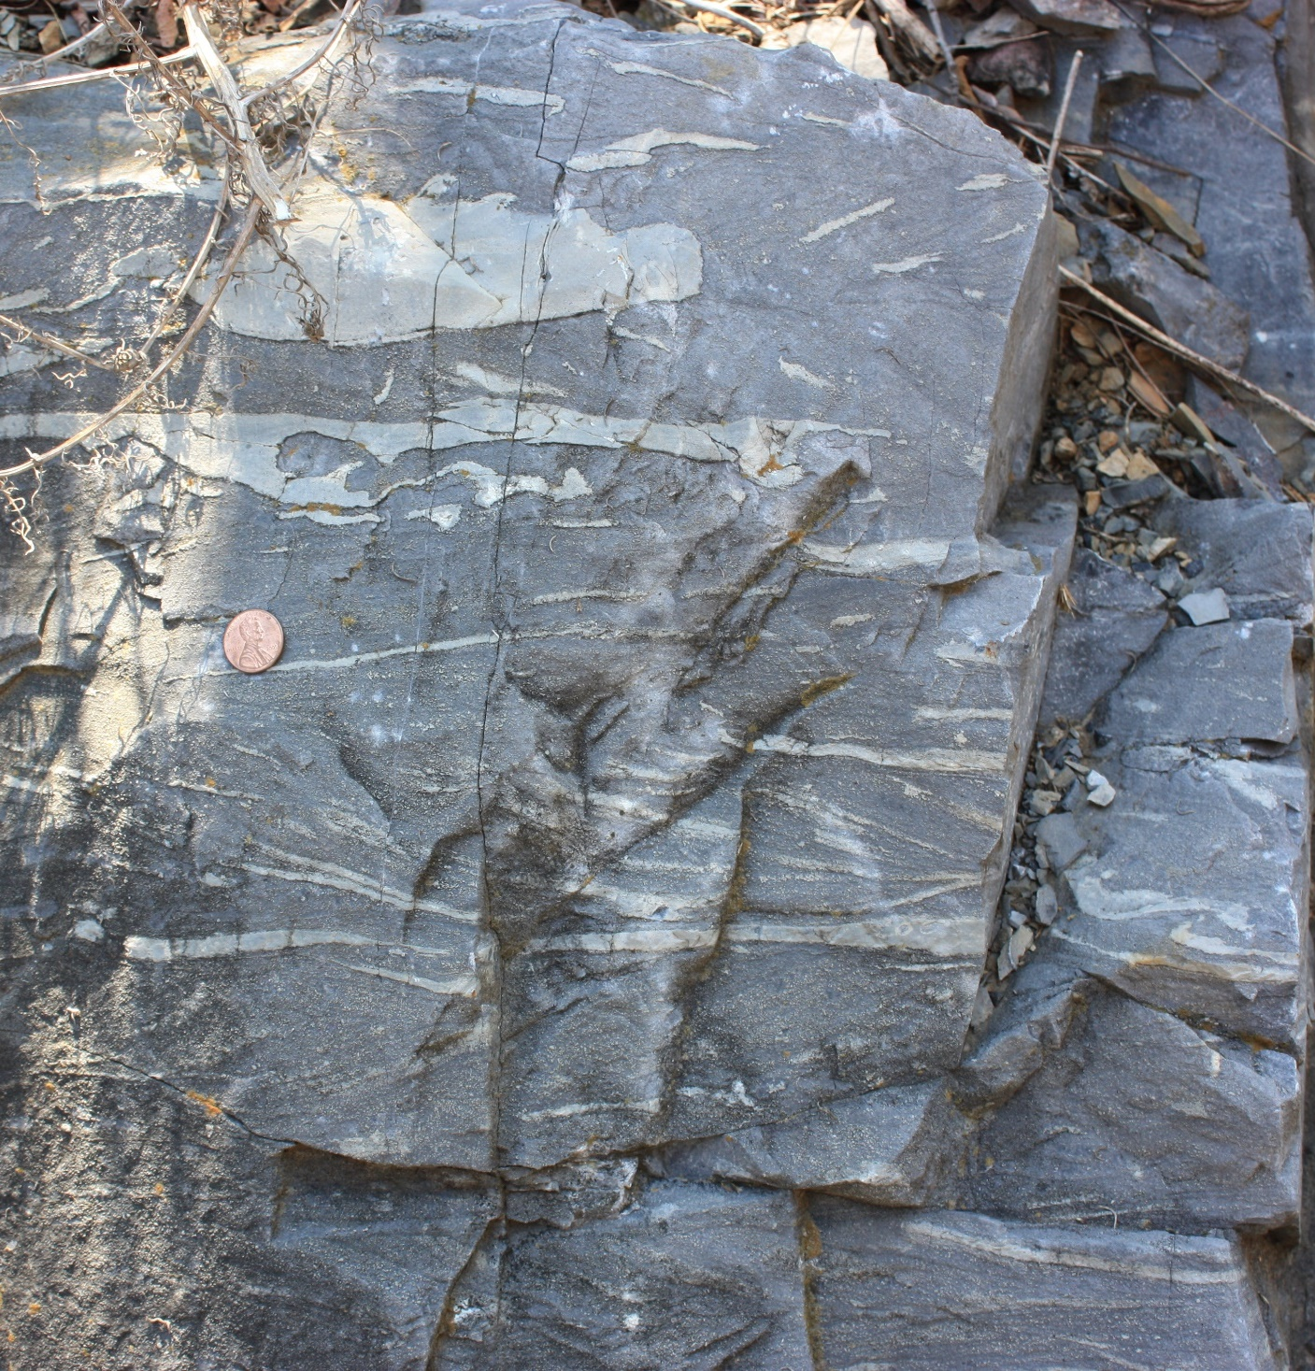

Herringbone X-Bedding
If you break this rock onto a fresh surface you see nothing.
The light gray layers are dolomite. The darker gray are carbonate sands; probably pellets or oolites.
The light colored dolomite layers are because the sandstone was more porous there and Mg rich ground water preferentially move through there creating dolomite.
If we could see this on a tidal flat today it would look like a sandbar, probably with upper flow regime ripples on top.

Slide 44


Herringbone X-Bedding
Herringbone is a tidal signature. On the flood tide cross beds are formed going in. On the ebb tide cross beds are formed going out. That is in opposite directions.

Slide 45

Stromatolites
You just might be able to see the Stromatolite mounds peeking out. They are often invaded by black cherts, which are common in the Conochocheague.

Slide 46


Stromatolites
A good example of a stromatolite mound.
Hamlin Pool, Australia

Slide 47


Flat Pebble Conglomerates:
Intraformational Conglomerate
This layer is a tidal channel. Strong currents or maybe storm surges would rip up some of the sediment, transport, and deposit it.

Slide 48

Flat Pebble Conglomerates:
Intraformational Conglomerate
Easier to see in a closeup

Slide 49


Massive Micrites
These may have been deposited in a relatively calm tidal lake as a “whiting” (direct precipitation of carbonate from saturated water.)
Stylolites: result of pressure solution; always post depositional.
Micrites probably formed in bays or lakes like this: Exuma Cay, Bahamas

Slide 50

Micrites and (fecal) Peletal Limestones
Fecal pelletal limestones; by this time animals were common, especially snails and trilobites, feeding on the abundant algae on the tidal flat, and pooping a lot.
Micrites with stylolites

Slide 51

(Fecal) Peletal Limestones
If we get closer you just might be able to see the dark dots. They are the pellets, which are essentially sand sized particles. That makes this layer a sandbar, blowing across the underlying micrite lake.

Slide 52


Peletal Limestone & Intraformational Conglomerate
Pelletal or oolitic carbonate sand bars
The pellets are here
Notice the intraformational conglomerate chips. This layer is probably a storm ripup surface

Slide 53

Ribbon Rock
Ribbon rock is common in the Conococheague
Gray zones are pressure solution formed dolomite. Note they not only run parallel to bedding but also cross it.
The light gray layers are micrite, and probably the original sediment

Slide 54

Algal Laminated Ribbon Rock with Prism Cracks
The algal laminates are crinkly, unlike the ones in the Beekmantown which tend to be smooth and flat.
Prism cracks are mud cracks that penetrate long ways below the surface – a feature common in carbonates.

Slide 55

Algal Laminated Ribbon Rock with Prism Cracks
Easier to see crinkly laminates close up
Prism (mud) cracks

Slide 56

Mud (Prism) Cracks
As seen on bedding surface. (Note: mud cracks usually have 3 or 4 sides, not six.

Slide 57

Mud (Prism) Cracks
The block the cracks in the last slide came from
Notice prism cracks penetrating below surface.

Slide 58

2. Environmental interpretations:
Unlike the Beekmantown the Conococheague is a high energy, macro tidal environment. The differences may be from a change in continent location, ocean circulation, or something else.
Supertidal
Intertidal
Subtidal
Algal Laminated Rocks
Upper intertidal & supertidal
Most Cco facies are from the high energy intertidal
Ribbon Rock
Note there is not strong evidence of evaporates in the Conococheague; a difference with the Beekmantown
Flat pebble congl.
Herringbone
Stromatolites
Pelletal sandbars
Mudcracks
Some of the ribbon rock limestones are probably subtidal

Slide 59


2-3. Environmental and Basin Interpretations:
During low sea levels like today the best place for carbonates to form are divergent continental margins, like the Great Barrier reef in northern Australia.
The critical needs are a tropical climate, and a lack of tectonic activity.
During high sea levels carbonate deposition is common in the epicontinental (epeiric) seas that cover the tectonically stable continents, like the late Cambrian to the right.

Slide 60
4. Tectonic interpretations:
Tectonically the situation might look like the cross section below of the Early Cambrian margin. Continued deposition will lay down 10’s of thousands of feet of carbonate sediment as the edge of the continent subsides.

Slide 61
Trip 1:
Chalk Talk 11
Tumbling Run Section:
Beekmantown, New Market, Lincolnshire, Edinburg and Martinsburg Fms.

Slide 62


The Tumbling Run section, looking eastward toward Massanutten Mtn., location of the Massanutten Sandstone.
Martinsburg and Cub SS are inbetween
Massanutten Mtn.
Edinburg
Lincolnshire
New Market
Knox Unconformity is under the bridge
Behind us are Beekmantown outcrops.
Beekmantown outcrops are behind us
Under the bridge is the Knox Unconformity (Beekmantown/New Market contact).
Down the road are the Lincolnshire and Edinburg formations.
Between Tumbling Run and Massanutten mountain are the Martinsburg and Cub Sandstone (submarine fan/shelf environments), a complete stratigraphic sequence.
Which means somewhere between Tumbling Run and Massanutten Mtn. we transition from a DCM to a foreland basin.

Slide 63

The Set Up:
If we are looking for evidence pointing to a transition from the DCM regime (e.g. Beekmantown, New Market, Lincolnshire) to the foreland basin regime (Edinburg, Martinsburg, Cub) we would predict a number of indicators:
At some point the foreland basin will begin to subside and the water get deeper.
At some point clastic sediments will begin to replace carbonate sediments.
We might also expect volcanic ash deposits to appear.
The practical problem is: none of this evidence is clear cut, or exclusive to this transition. For example, volcanic ash gets blown long distances, and just because we find it in the section does not mean it is coming from the hinterland mountains.

Slide 64
The Proposition:
We are going to focus on water depth indicators. We can do that with facies analysis.
Below is an interpretive time series of the evolving Taconic foreland basin.
It is a time series because we are at one geographic location (Tumbling Run) while the environments change upsection through time.
Time
So, we imagine tidal environments
Evolving upsectioin into coastal environments
Evolving up section into deepening shelf environments
Evolving upsection into subsiding basin environments
Water is getting progressively deeper
Evolving up section into a deep water basin
And these are stacking vertically.
But what is driving these changes?

Slide 65
The Proposition:
There are at least two mechanisms controlling water depth:
Two Ways to Create Accommodation
1. Eustatic Sea Level Changes
2. Tectonic Basin Subsidence
Raise sea level; a transgression.
Initiate basin subsidence.
Fill tectonic accommodation
Continue basin subsidence.
Eustatic Accommodation
New Accommodation Space
(sedimentary record)
Now return to base line conditions.
Land surface/Surface Water Interface
Base line Sea Level
Base line Sea Level
Tectonic load
Tectonic accommodation
Tectonic loading

Slide 66
Two Ways to Create Accommodation
There are a few consequences to all this:
1. Amount of accommodation space created by the two different processes is roughly the same.
2. Yet, the sedimentary records under both conditions can be identical: sediment responds to depth, not how depth was created
Eustatic Accommodation
Increased Eustatic accommodation
Base line Sea Level
Increased tectonic accommodation
Tectonic accommodation
Tectonic basin subsidence
On the outcrop, what evidence can be used to definitively distinguish depth created by Eustasy vs depth created by Tectonics??

Slide 67


Walking the section:
Walking the section looking for the first evidence that the basin has begun to tectonically subside and the orogeny begun.
Knox Unconformity
Recall the Edinburg, its description and interpretation.
New
Market
Beekmantown
Lincolnshire
Edinburg
Bridge
We are only interested in this part of the section
Somewhere between these two boundaries the basin switched from a DCM to a Foreland Basin.

Slide 68




The Walk: New Market Limestone
1. Observations:
The New Market limestone is thin (40-250 feet) compared to the DCM formations.
It is the purest carbonate in the region: no Mg, no clastics, no organic matter.
On both fresh and weathered surfaces color is light gray, indicating no contamination.
Mostly massive micrite with ‘birdseyes’ (small random dark splotches that on close study turn out to be clear rhombohedral calcite crystals (in some cases recrystallized fossils).
There are, however, algal laminates, small stromatolites, and the coral Tetradium in life position.
Environmentally:
a low energy tidal deposit.

Slide 69



The Walk: New Market / Lincolnshire Contact
At the top of the New Market is a disconformity caused by a sea level drop, exposure and dissolution.
The basal Lincolnshire is a very coarse grained biosparite, a much higher energy deposit that the New Market micrites.
Lincolnshire
New Market
And not very thick; maybe a few meters.
It is very coarse and rough

Slide 70


The Walk: New Market/ Lincolnshire Contact
This is the first evidence of changing water depth; a lowering of sea level (in Sequence Stratigraphy terminology, an off lap) leading to a disconformity.
It is a much smaller scale cycle than the Knox and is completely eustatic.
But, how do we interpret the basal Lincolnshire high energy biosparite?
The easiest way is through a rise in sea level (an on lap), and since sea level is cyclical (not really a sine wave, but close) that is not unexpected.
So, imagine rising sea level, and a beach transgressing across the surface.
A beach is a high energy environment and will result in clean sands, and if carbonates are the source, the result is a clean sand carbonate beach – like a packed biosparite.

Slide 71



The Walk: Lincolnshire: Facies Two
Above the biosparite there is a dramatic shift.
Black micrites; thin bedded; dark gray weathering.
Interpretations? Black micrite implies 2 things.
1. Low energy.
Thin bedded black micrites
2. Anoxic conditions.
Anoxic is sometimes associated with deep water environments, and if we accept that it means a catastrophic increase in depth.
Biosparite
If that were true it would have to be tectonic.
But it is an unlikely scenario. Its just implausible to increase depth that much, that fast – even tectonically.
But anoxic can occur in shallow water environments.

Slide 72


The Walk: Lincolnshire: Facies Two
For example, a lagoon separated from the open sea by some kind of barrier
In clastic systems that would be a barrier island. Like to the right.
What would be the barrier in a carbonate system?
? ? ? ________________________?
So, let’s set this up as a hypothesis and continue up section.

Slide 73


The Walk: Lincolnshire: Facies Three
To continue up section we are crossing the road to the south side where the outcrop is better.
Coarse to very coarse packed biosparite with whole body fossils, including some in life position:
Contact: evidence of biosparite washing in over the micrite
Black, thin bedded anoxic micrites:
Conclusion: this could easily be a reef deposit

Slide 74

The Walk: Lincolnshire: Facies Three
This can easily be interpreted as a reef deposit.
So, if we take the sequence . . . Beach -> Lagoon -> Reef we have a transgressive system.
That is, sea level is rising and the water is getting deeper.
Or the basin is tectonically subsiding.
The stratigraphic evidence would look the same in both circumstances.
This evidence by itself does not really tell us how the water is getting deeper, so this is not definitive evidence the Taconic orogeny has begun.

Slide 75

Back on the outcrop, we are now again on the north side of the roadcut, and the reef deposit is apparent.

Slide 76


So we continue walking up section, doing facies analysis,
The practical problem is, these facies are hard to read. Carbonates undergo geochemical alteration with burial. So, there are no sedimentary structures to analyze, and it is very hard to tease out Coarsening or Fining Upward Sequences.

Slide 77


In areas like this we can find layers of coarse biomicsparite.
We may be seeing traces of CUS parasequences, which would be consistent with a shelf interpretation.

Slide 78


All of this would be consistent with an Eustatic sea level rise, but would not falsify a tectonic deepening.
The Lincolnshire is also known for its layers of abundant black cherts.
If these are parasequences then we would be able to easily detect CUS and FUS sequences (like we did at the Cub Sandstone.)
But one trend is the rocks are haltingly getting darker up section.

Slide 79

So we just continue to walk up section, looking for something different.
. . . and it shows up here.

Slide 80


This is something like the black shales in the Edinburg.
In this zone there is a very black layer (actually several) that look shale like.
It is black, soft, smudgy, typical of organic rich shales.

Slide 81
This is something like the black shales in the Edinburg.
And is indicative the water is now quite deep.
But, the question remains, is this depth the result of a sea level rise, or a tectonic basin drop?
There is no clear answer to this, because in Sequence Stratigraphy these are known as condensed sections; very black, very organic rich shales that deposit in a Maximum Flooding event, deposited slowly, over very long periods of time.
All the evidence so far is consistent with Sequence Stratigraphy theory, and does not provide a test of the tectonic hypothesis
So, by default – “in the absence of evidence to the contrary” – we have to stick with the mechanism we have been using all along: depth is increasing because of eustatic sea level changes.

Slide 82



So we just continue to walk up section, looking for something different.
Just a short distance up section there is another bed that looks like shale, . . . Except it is very light colored, not soft, not smudgy.
Ok, this is a conundrum: we have conflicting pieces of evidence.

Slide 83
So we just continue to walk up section, looking for something different.
If we were to assume that this layer is in fact shale then we have some explaining to do.
The lack of a black color would indicate this is not an anoxic environment . . .
Which would imply the water is now shallow.
Except that just a few feet away we have the condensed section – a deep water deposit.
All the evidence so far has pointed to deepening water, so why would it get shallow all of a sudden?
> Tectonics is not likely to explain this because we would expect tectonics to produce a deepening, not a shallowing
Besides the required change in depth from deep to shallow would not happen in this short a time frame.

Slide 84

So, . . .
. . . to paraphrase Sherlock Holmes:
if you keep getting the wrong answers go back and examine your assumptions.
We have been working on the assumption that both these deposits that look like shale are in fact shale.
The upper black “shale” has so much organic matter in it that what ever clay there is in it is being masked; it may be more like coal than shale.
It is a pelagic (open sea not near land) deposit made mostly of the remains of pelagic organisms, volcanic dust, and meteoritic particles.
And the lower “shale” . . . Well it does have bentonite clay in it which would make it a “shale”. . . but . . .
. . . if you put a Geiger counter on it, it goes crazy.
Conclusion: the light colored ‘shale’ is a volcanic ash.

Slide 85
Now, . . .
. . . a volcanic ash is an indicator of volcanic activity, and since we do know an orogeny is coming it would be reasonable to deduce this is coming from a subduction (strato) volcano.
But, that is NOT the same thing as that volcano being our volcano – marking the beginning of basin subsidence.
Volcanic ash can be blown around the world so while it is a nice indicator, it is not the definitive indicator.

Slide 86

So:
keep walking up section.
To here
Volcanic ash

Slide 87

. . a closer look
. . . superficially this looks like interbedded shales
. . . and micrites
But, in fact, the ‘shales’ are also volcanic ash.
The micrites are just micrites ☺

Slide 88
. . an even closer look
. . . But if we look closer, there is something else
Note the micrite layer is not uniform, it thickens and thins, and pieces are rounded

Slide 89

. . an even closer look
Notice most of the micrite beds change thickness, and are rounded into ball and pillow structures.

Slide 90

So, let’s think deductively about this.
All the evidence we have seen so far walking the section points to a transgressive sequence across a shallow but deepening shelf environment.
Deduction: So, between the Lincolnshire shelf, and this Edinburg outcrop the depositional slope must have changed from very shallow to steep.
Slope angles 2 – 5 degrees, but can be more
Conclusion: this is the first definitive evidence we have that sea level changes have switched from eustatic driven to tectonic driven.

Slide 91
Leading to these conclusions
Stratigraphically the tectonic loading and basin subsidence of the Taconic Orogeny begins here.
Condensed section: deep water but still eustatic
Volcanic ash deposits: Carolina Terrane approaching but not yet causing subsidence.
Eustatic control: a transgressive sequence
Micrite/ash load structures.
Edinburg/Martinsburg basin
Time
So, we imagine tidal environments
Evolving upsectioin into coastal environments
Evolving up section into deepening shelf environments
Evolving upsection into subsiding basin environments
Water is getting progressively deeper
Evolving up section into a deep water basin

