Slide 1
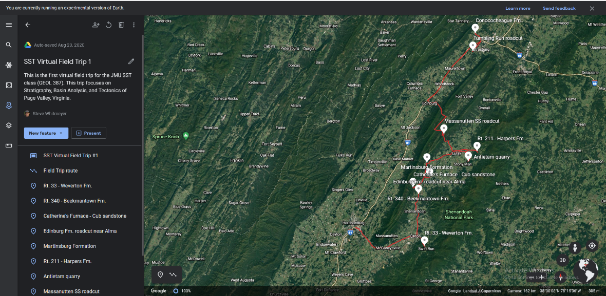
Virtual Field Trip #1 – Part One
Department of Geology and Environmental Science
James Madison University
Harrisonburg Virginia 22807
The Rodinia Rift-to-Drift Sequence and Taconic Orogeny in Page Valley, Virginia:
Stratigraphy and Basin Analysis
Steven Whitmeyer
Lynn S. Fichter

Slide 2
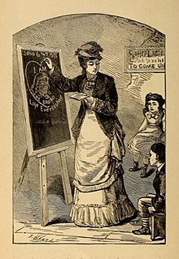
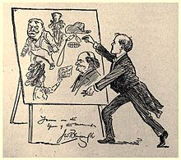
Introduction to Chalk Talks
A chalk talk is an illustrated presentation in which the speaker draws pictures to emphasize lecture points
Back in the days before photocopy machines, iPads, and other electronic gadgets, field trip leaders would carry a portable chalk board, and during stops would hold it up next to the vehicle and give an on-the-spot lecture sketching cross sections, etc.
We don’t use chalk boards anymore, but these kinds of on-the-outcrop lectures, discussions, debates, arguments are still an integral part of field trips. In the Stratigraphy, Structure, Tectonics class we do dozens of chalk talks, from small and short, to long and extended.
During on-location field trips we mount posters on the side of the vans, and provide handouts of the illustrations, and we do our explorations and interpretations.
Our virtual field trips are run as Google Earth presentations, and they are run in the same order and timing as the on-location field trips. We can make observations and interpretations with the virtual field trips, but there will be times when the discussions require more time, more slides, more explorations and explanations.
For those, we do Power Point Chalk Talks; where we will break away from Google Earth, load a Power Point, and do our interpretations. We are going to attempt to do these as close as possible to the way we would on an on-location field trip.

Slide 3
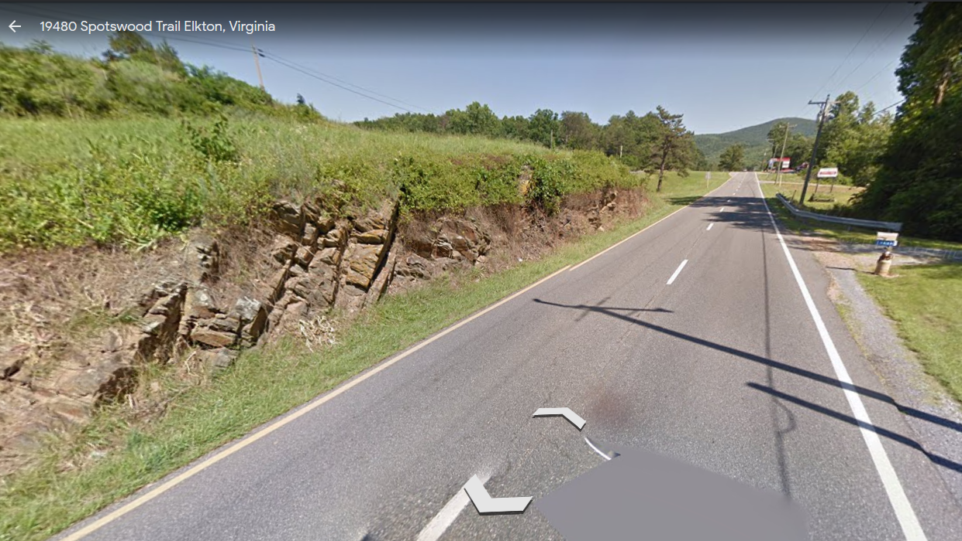
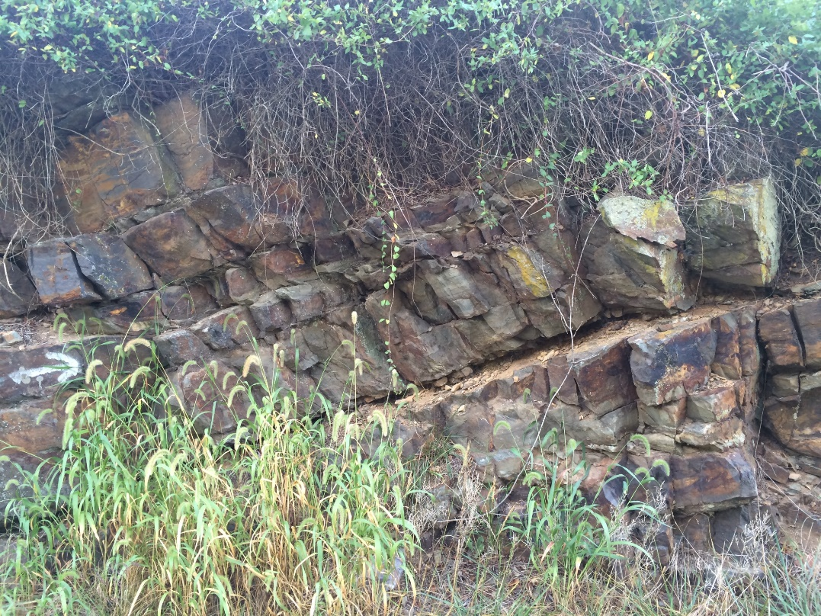
Trip 1:
Chalk Talk 1
Weverton Formation
Weverton outcrops are not common, or very large. The first thing is to take in what we are observing. So, observe the outcrop, note what you see, and sketch it.
One of the obvious things are these surfaces.
Superficially we might think these are bedding planes, until we look this direction.
Here we see definite bedding planes dipping west (to the left) at a very different angle

Slide 4
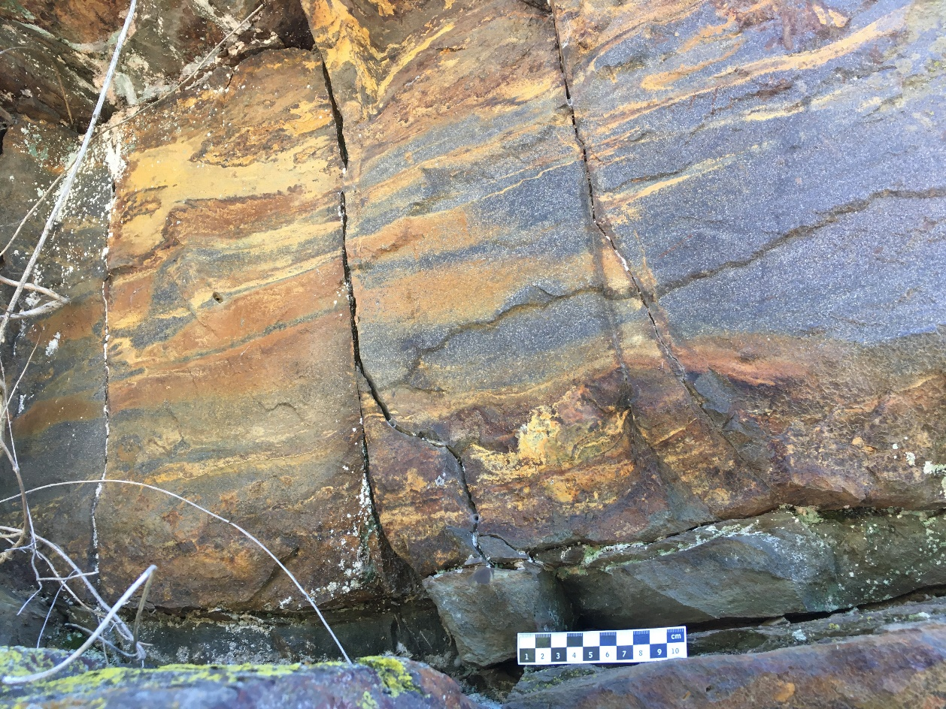
Signal vs Noise
A common way to think about this is Signal and Noise. For us, the signal is stratigraphy.
Noise consists of anything that is not stratigraphy. Notice noise does not mean bad; noise is just someone else’s information, and consists of:
1. Structure (folds, faults, cleavages, etc.)
2. Metamorphism: this outcrop has undergone low grade greenschist facies metamorphism. Shales are now slates or phyllites sandstones are some sort of meta (highly indurated) sandstone.
3. Weathering:
Fresh surface
Liesegang
(subarkosic/sublithic) “quartzite” with greenschist overprint.
Iron staining from weathering of high iron minerals; reds, purples, browns, tans, etc. Often forms swirl patterns or other fantastic shapes. Extremely common (but they mask the underlying rock).
Phyllite (shale)

Slide 5
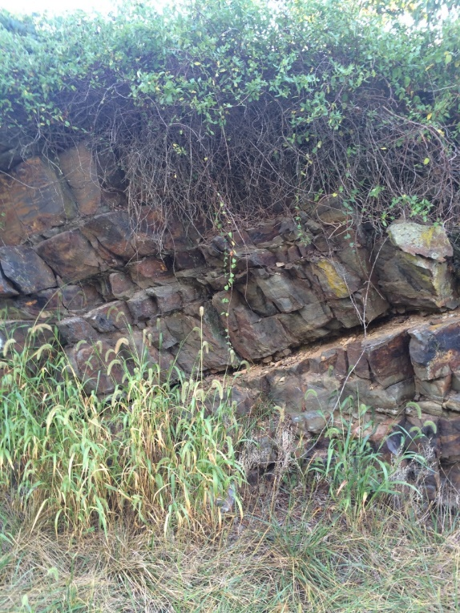
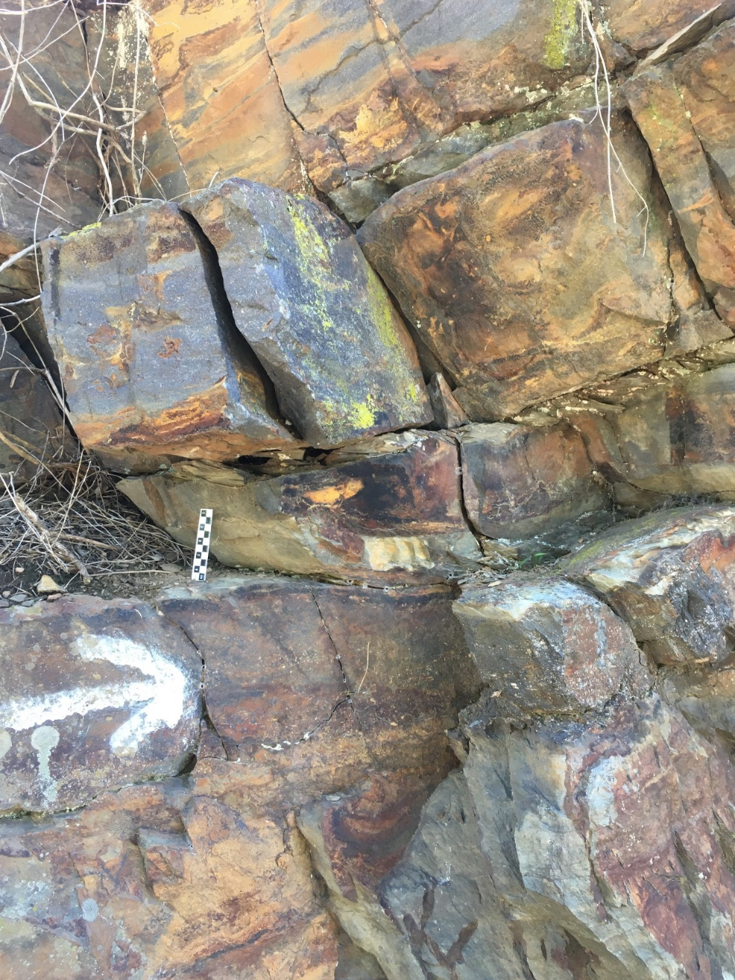
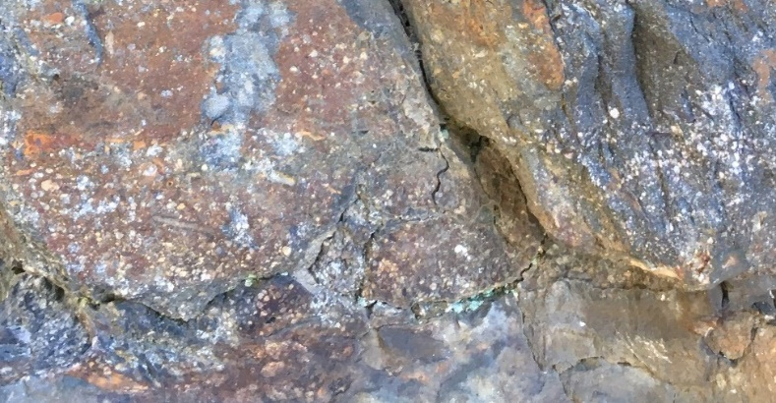
Because of the metamorphism and weathering it is hard to see the bedding, let alone internal structures.
For example, how well can you distinguish the bedding here?
Reactivation surface (a scour or thin shale separating different events.)
Very coarse sandstone
Shale (phyllite)
Qtz pebble conglomerate
Reactivation surface (scour with quartz pebbles)

Slide 6

Draw a strip log as best you can (5 minutes).
Here is my strip log

Slide 7
Remember the sequences: point bar, hummocky, Bouma, L-Bar/T-Bar? If your memory needs refreshing, here, look at the examples below.
So, which sequence does the Weverton strip log most resemble?

Slide 8
Identifying the strip log as a particular sequence is just an observation. What we want are interpretations.
First level interpretation: the outcrop
But interpretations come in a hierarchy, and you always respect the hierarchy. So, we start with the most local specific interpretation, and step back step by step.
The most immediate interpretation is energy. Everything is about energy; we always want to interpret things in terms of energy. “Follow the energy.”
The energy in this case is flow regime. Note the flow regime diagram to the right.

Slide 9
3 amalgamated events
Using the flow regime diagram indicate the various energy regimes up through the strip log. Here is an example.
Erosion regime
Reactivation surfaces (calms in between)
Calm
Upper flow regime (HVL’s)
Event
Erosion regime (after calm)
Decreasing energy (into upper)
Event
Beyond the upper flow regime, but decreasing energy (grading)
Beyond upper
Calm
Erosion regime
Event
Reactivation surface (after calm) erosion regime)

Slide 10
So, think about how the energy is passing through this section. If you had to graph it as energy through time, what would it look like?
Do you think the energy represented by each sequence is like A, B, C, or D?
A
B
C
D
Now lets think of the energy from event to event from sequence to sequence up the strip log; does it go like this?
E
What do you think the time scale is here?
Or, like this?
F
What do you think the time scale is here?
To understand this recall two concepts, Self Organized Criticality, and Power Laws.

Slide 11
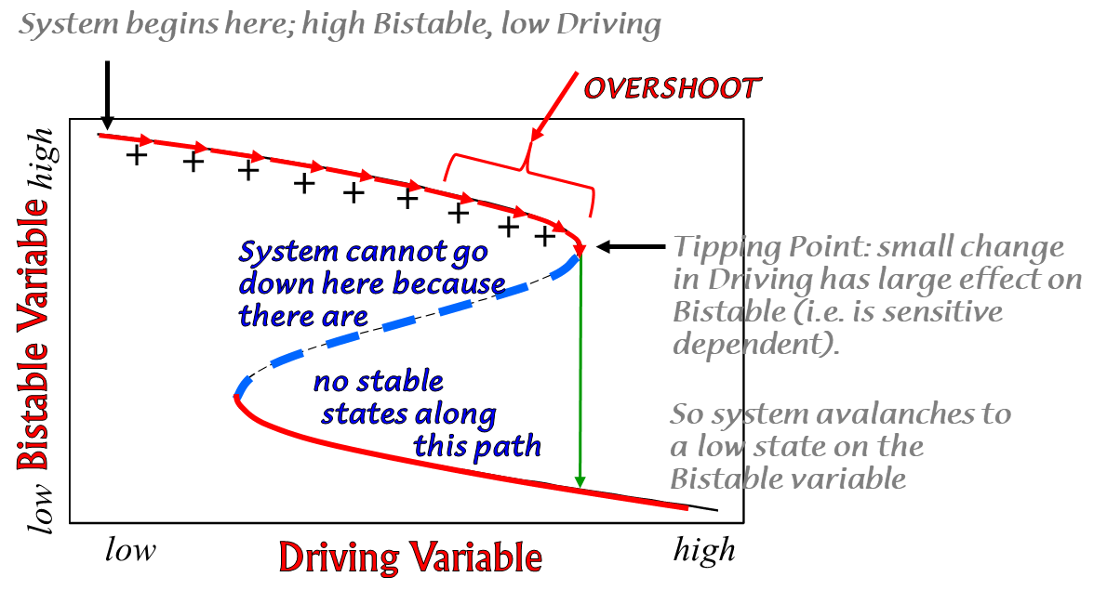
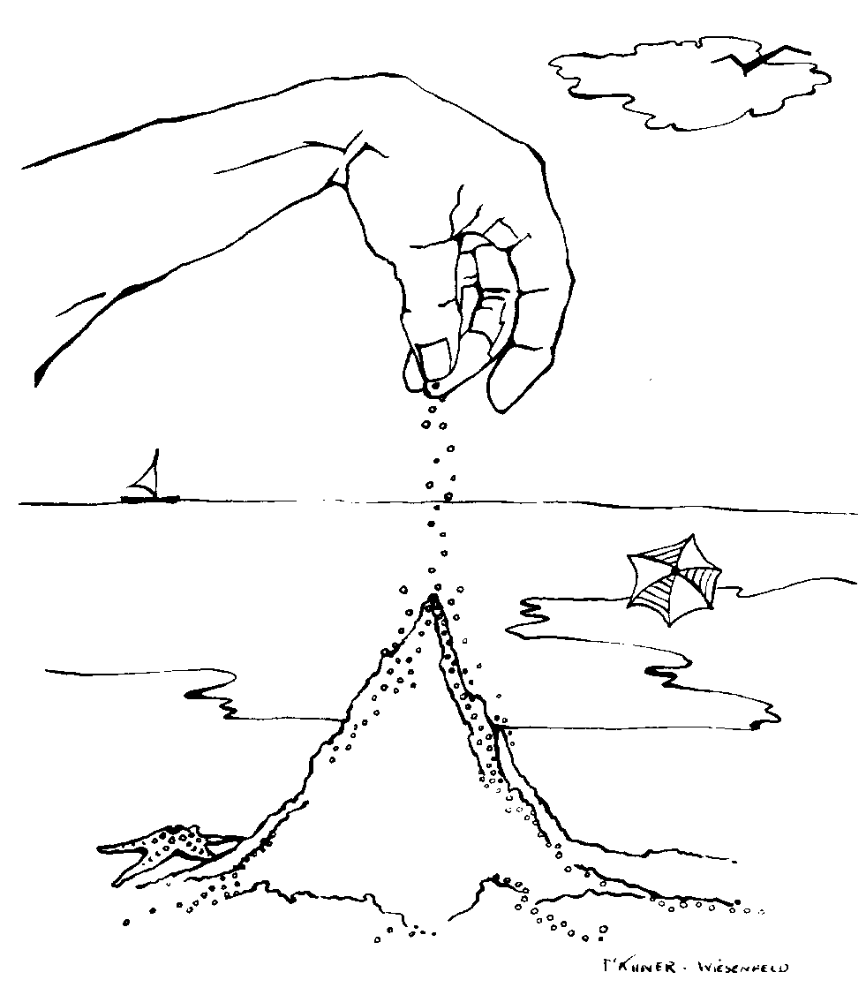
Self Organized Criticality
SOC demonstrates there is a lag between cause (accumulation of individual sand grains), and the effect (avalanche).
Building
= lag
Building
= lag
Building
= lag
Avalanche
= effect
Avalanche
=effect
Avalanche
= effect
We also modeled this with a hysteresis diagram.
It takes long periods of time, months, years, decades, or more to set up the criticality for a large event, but the event itself lasts only days. How often does a hurricane hit a particular coast, and how long does the hurricane last?

Slide 12
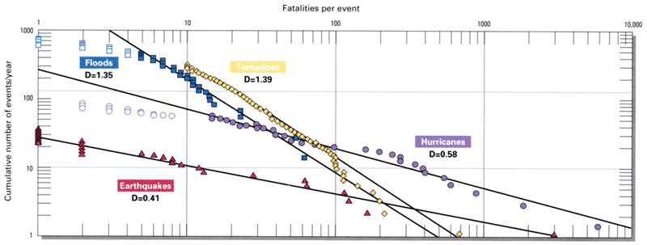
Power Law Relationships
Thus, the empirical data on natural disasters shows they follow a power law.
But, of course, the observation is not the interpretation. Interpretation required a theoretical model, which is something wholly different.
What do you think the time scales are here?
A
C
And the heights of these peaks would follow a power law
B
D
Days
Months to years
Days
Months to years

Slide 13
Now Level 2: Environmental Interpretations. Bouma sequences are usually associated with Submarine Fan environments (although that is not always true, but we will begin with that premise for this argument).
But, if we look at the Weverton strip log we do not see the classic T_{ABCDE} sequence. Instead, we see massive to graded sands, maybe laminations, and phyllites (shales)something like T_{ABE} or T_{AE} Simplistically, these do not look like Bouma sequences and so maybe our whole interpretation is wrong.
The reality is, mass sediment flows (of which a turbidity current is one example) are much more complicated.
Here we now need a new theoretical model based on lots of other studies. A brief explanation is this . . .
Proximal-Distal changes in a turbidity current

Slide 14
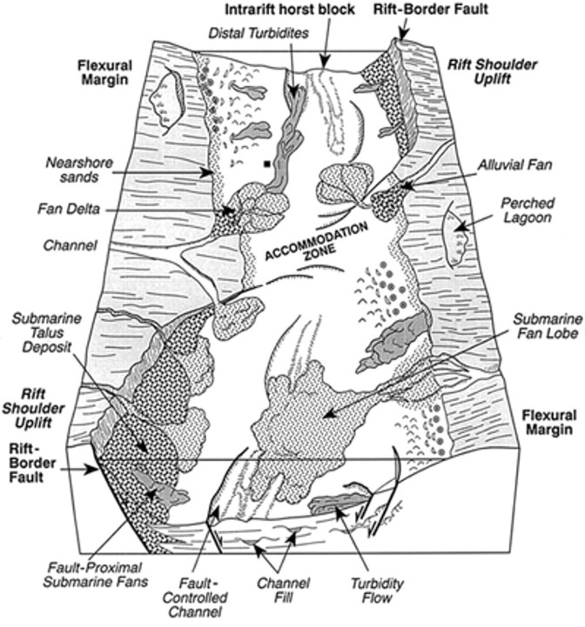
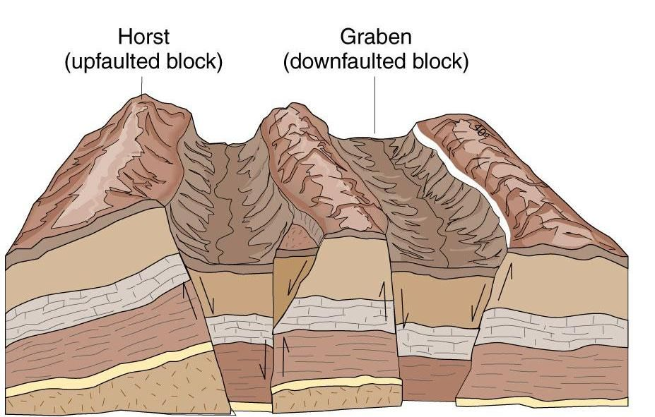
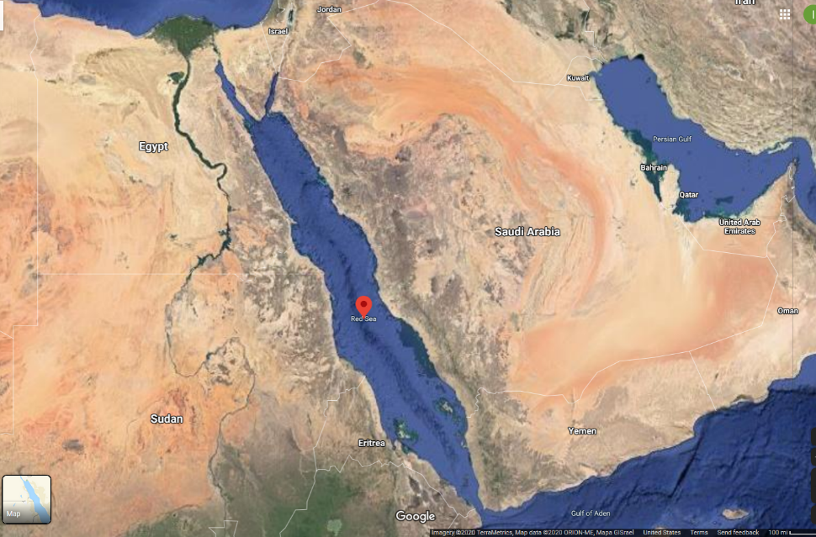
Level 3: Basin Interpretation. The interpretations we are doing now can only be done regionally, and the models we have for the Weverton (and Harpers, and Antietam) formations are the result of a couple of hundred years of work by hundreds of geologists.
But we have some questions: under what conditions might we get a deposit like we see in the Weverton?
Coarse grained sands/gravels.
Graded bedding
Relatively thick T_{ABE} sequences.
Submature QFL.
These usually come down to proximal environments in short systems of rapid deposition in high relief basins
Something that might look like this: an extensional system with high relief horsts adjacent to a graben: a short system.
Only for the Weverton the graben may be like the Red Sea rift, that is, is filled with water.

Slide 15
Level 4: Plate Tectonics.
The best interpretation of the Weverton is a Rift-to-Drift plate tectonic model, like the diagrams below interpreting the early Rodinia rifting in the mid-Atlantic region.

Slide 16
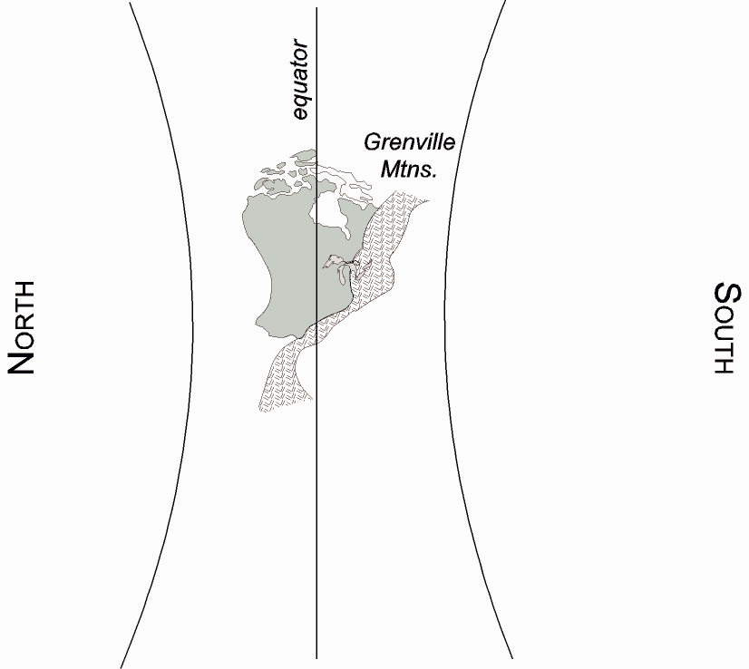
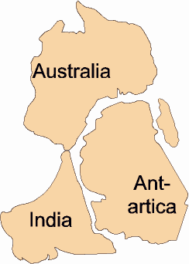
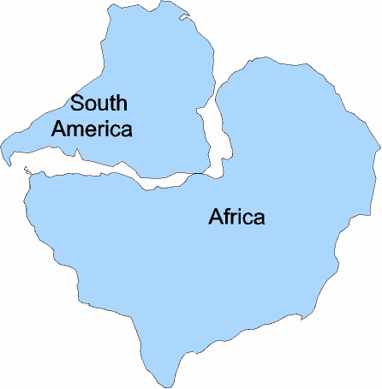
Rifting of Rodinia Supercontinent
First on the west
AUSWUS leaves
780-750 Ma

Slide 17
Rodinia begins to rift apart
First on the west
Second on the east
AUSWUS leaves
780-750 Ma
Gondwana leaves
570-540 Ma

Slide 18
Rift-to-drift systems are some of the most complicated in geology. So, if we look at it through a different lense we can envision models like these:
There are many sub-environments that evolve through time. For the Weverton we want to know at what stage in the Rift-to-Drift model it was deposited, relative to other formations.
To answer this requires looking at a lot of other formations, like the Mechum River (Field Trip 2), which is stratigraphically below the Weverton, and looking at those stratigraphically above the Weverton (Harpers, Antietam, Shady).

Slide 19
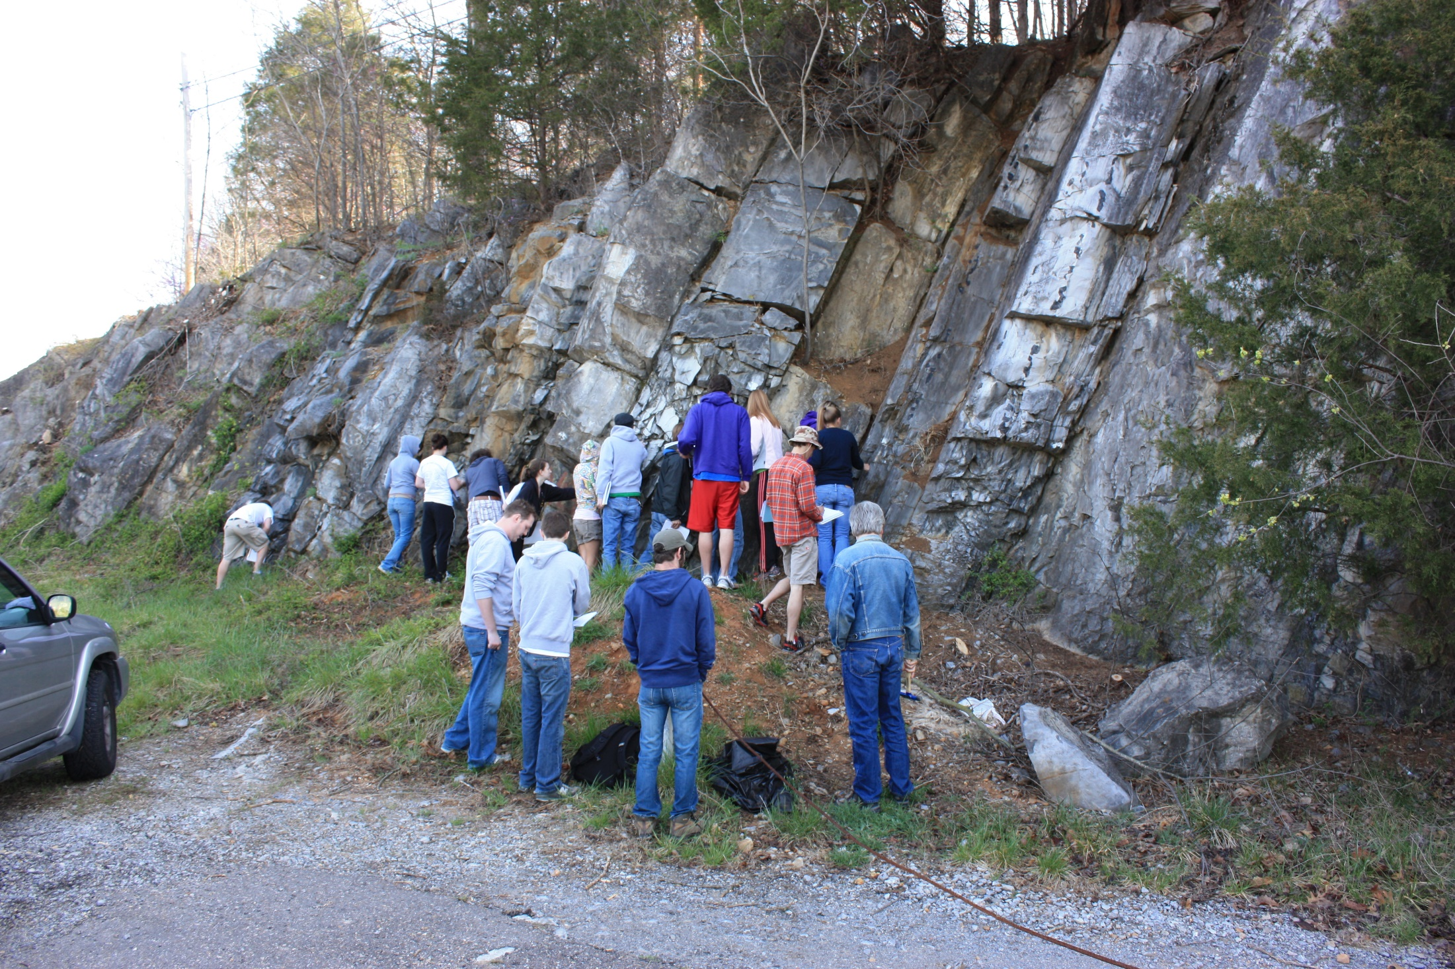
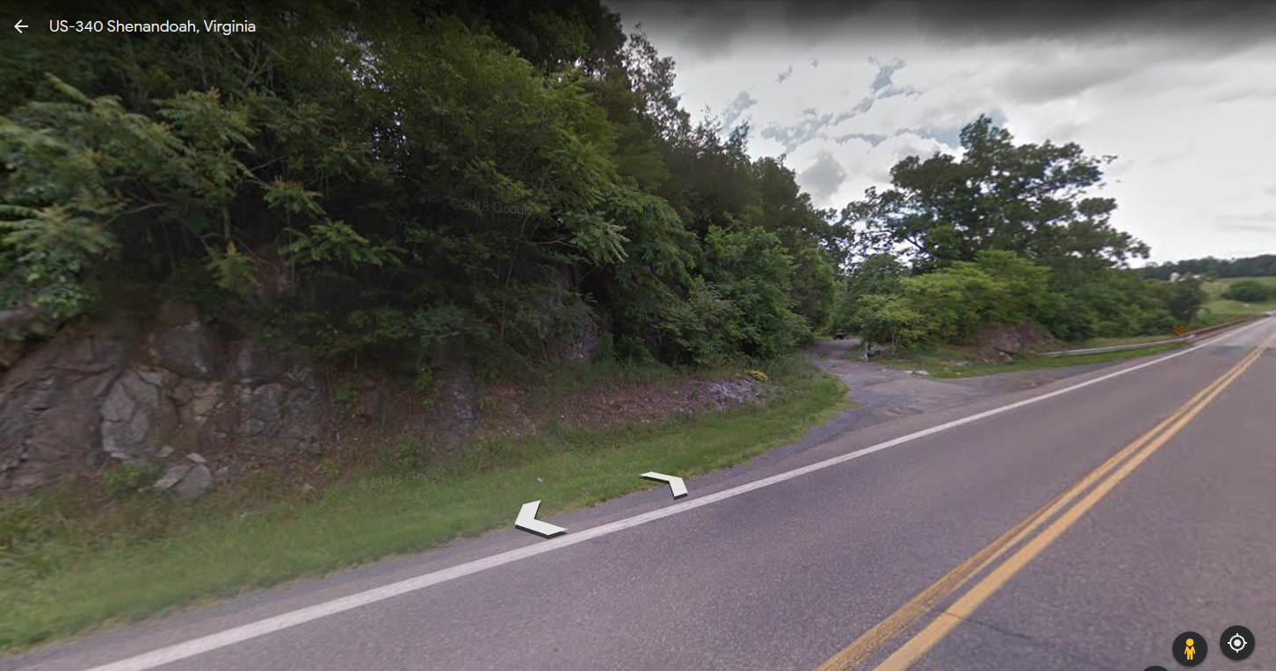
Trip 1:
Chalk Talk 2
Beekmantown Fm.
The Beekmantown is one of the more common and widespread formations in the area.

Slide 20
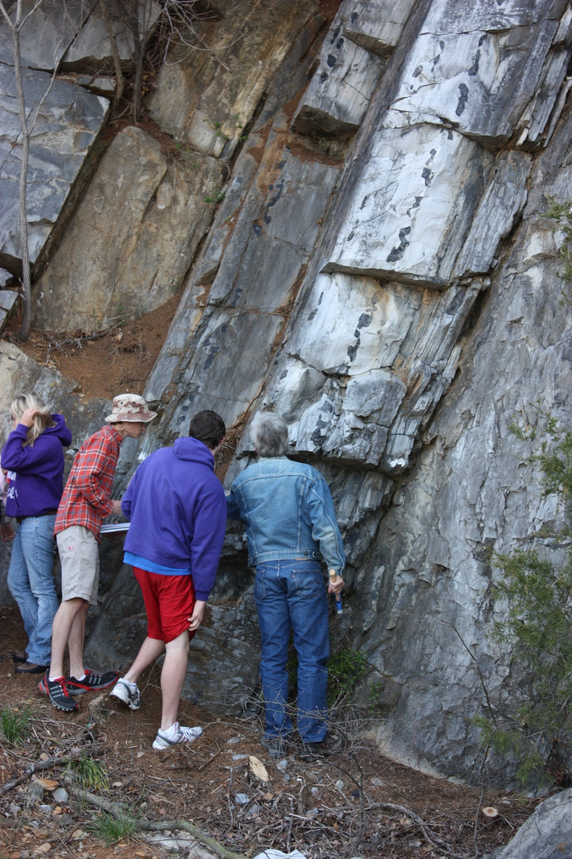
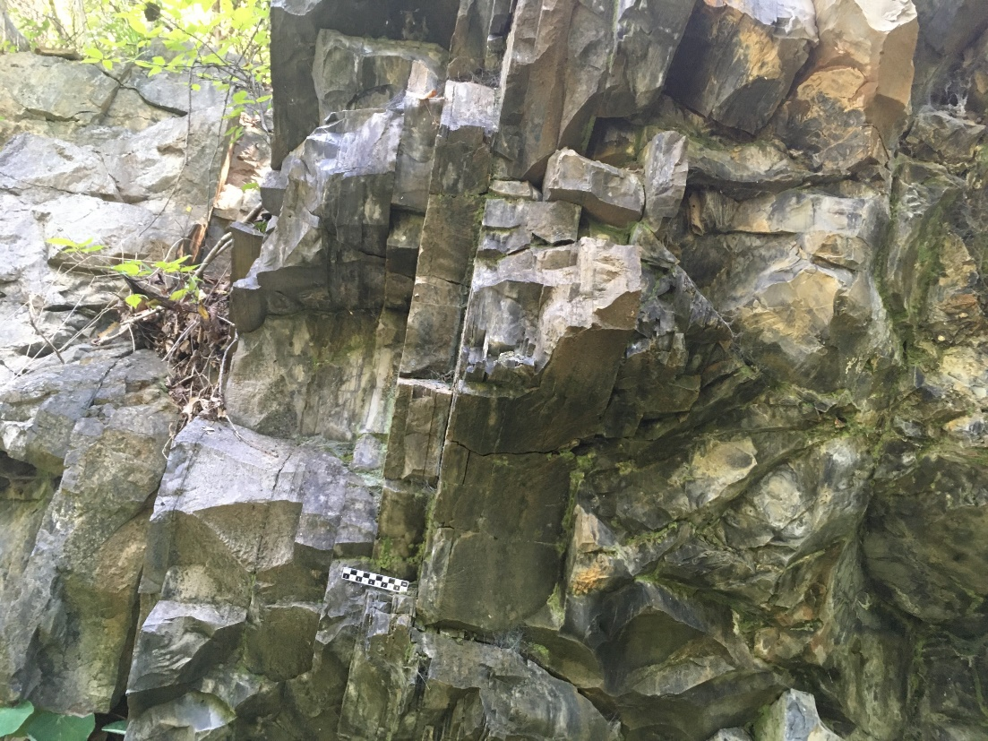
Depending on who’s counting there are about half a dozen carbonate facies.
1. Algal laminated micrites (ALM)
2. Algal laminated dolomite (ALD)
3. Massive dolomites
Massive dolomite (with chert)
4. Massive micrites
Algal laminates (ALM)
Algal laminates (ALM)

Slide 21
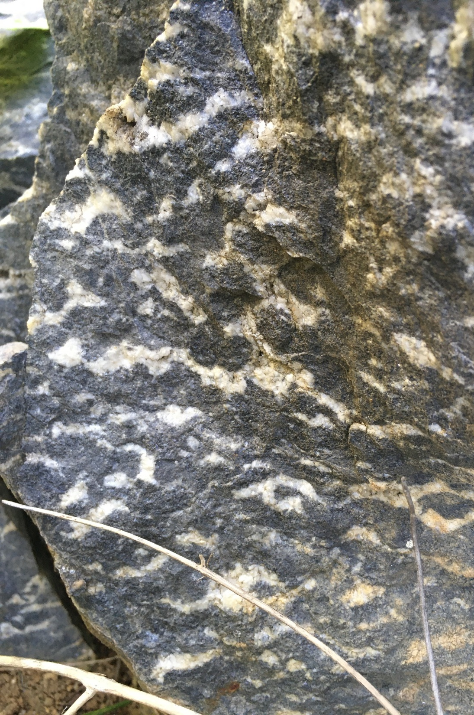
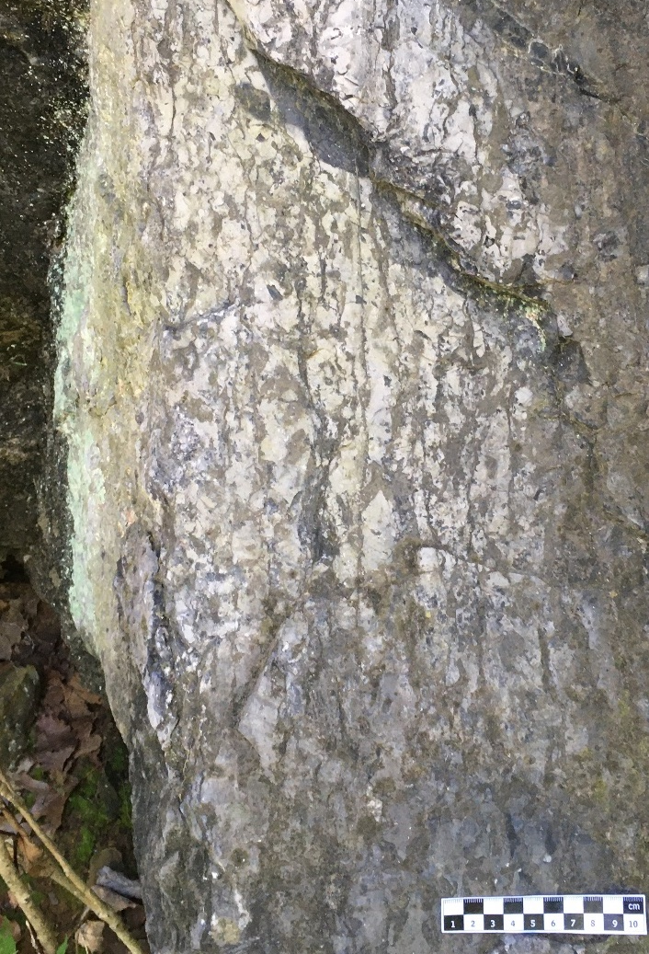
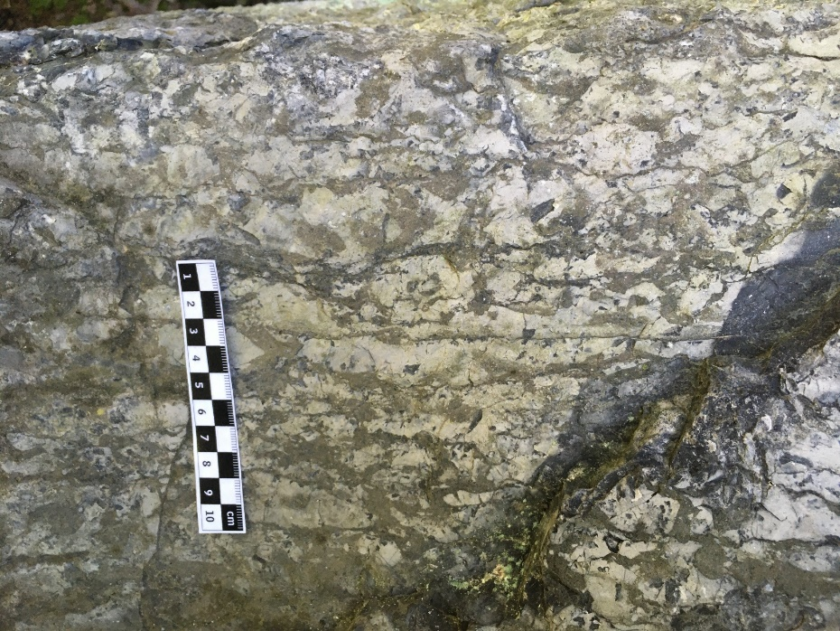
Depending on whose counting there are about half a dozen carbonate facies.
1. Algal laminated micrites (ALM)
2. Algal laminated dolomite (ALD)
3. Massive dolomites
4. Massive micrites
5. Ribbon rock
6. Leopard rock

Slide 22
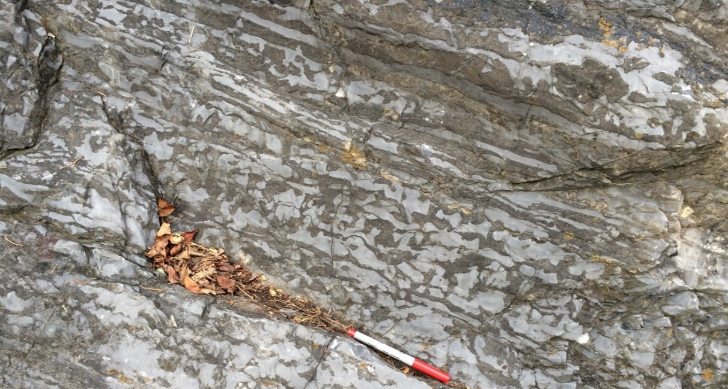
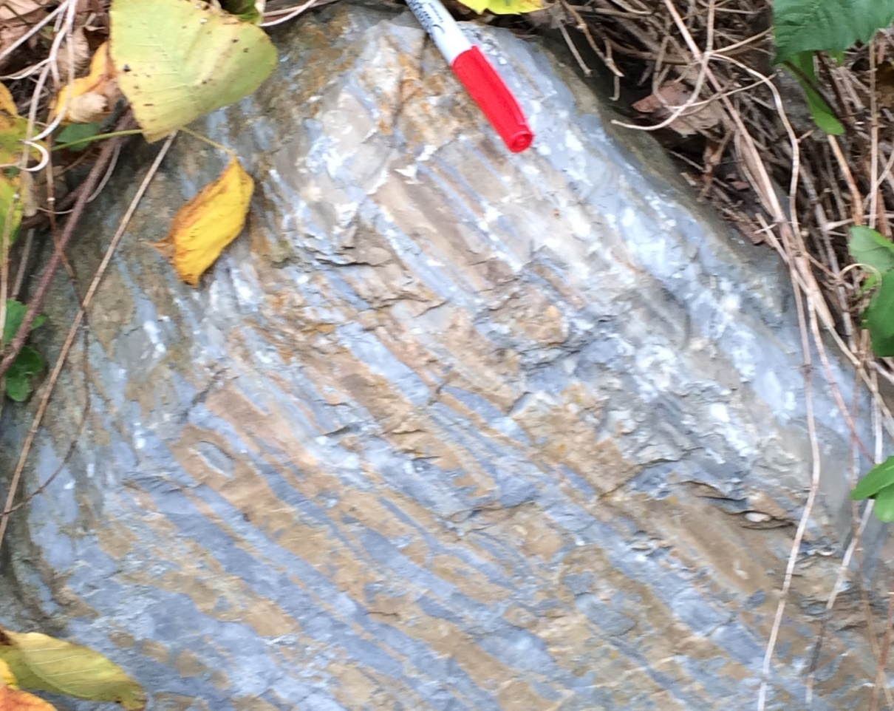
5. Ribbon rock
1. Diagenesis and pressure solution: during burial carbonate is compacted to form a rock. At the same time some of the carbonate dissolves back into solution under the pressure (pressure solution) and along with the geochemistry changes dolomite is formed.
Pressure Solution
Ribbon rock
Micrite interlayered with dolomite
Probably not closely correlated with the depositional environment in which the rock was originally deposited.
Observationally ribbon rock consists of layers of micrite (often fossiliferous) interlayered with dolomite, which may come in nice layers (tan to right), or be splotchy (dark gray above.)
Conococheague ribbon rock

Slide 23
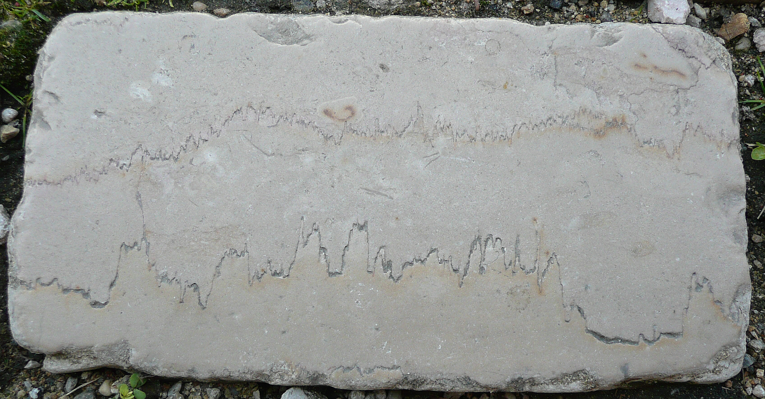
1. Diagenesis and pressure solution: during burial carbonate is compacted to form a rock. At the same time some of the carbonate dissolves back into solution under the pressure (pressure solution) releasing Mg ions into the ground water that changes calcite into dolomite.
Pressure Solution
Zig-zag stylolites
(boundary of pressure solution)

Slide 24
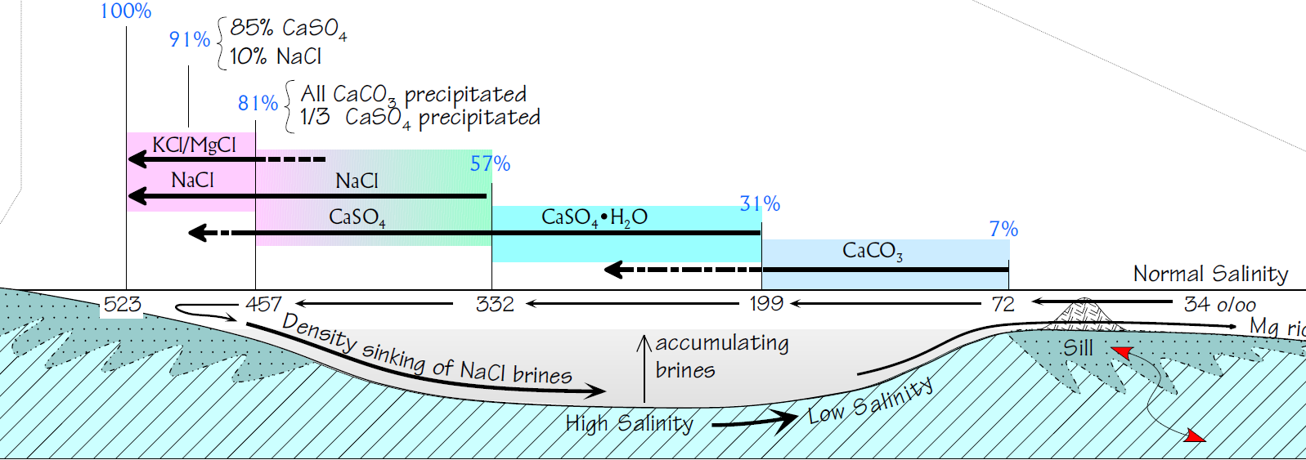
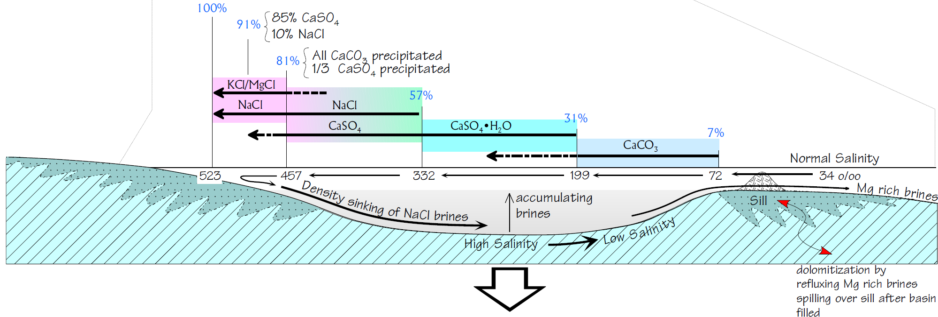
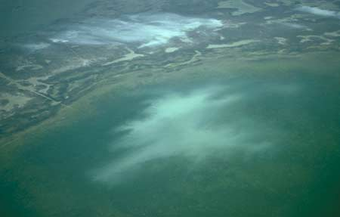
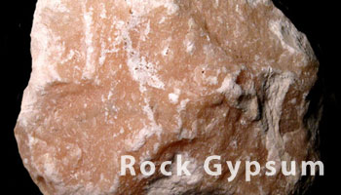
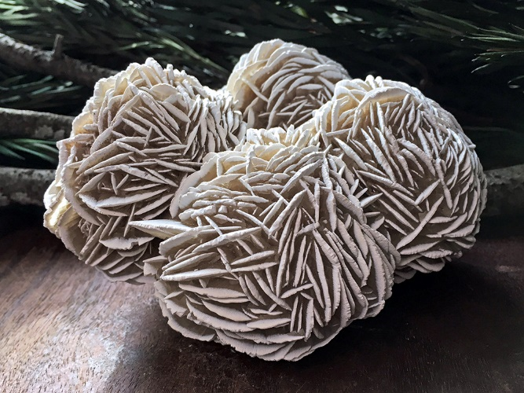
Usiglio Evaporate Sequence
Notice Mg brines represent extreme evaporation and salinity.
Gypsum precipitates out here.
Micrite “whiteings”

Slide 25
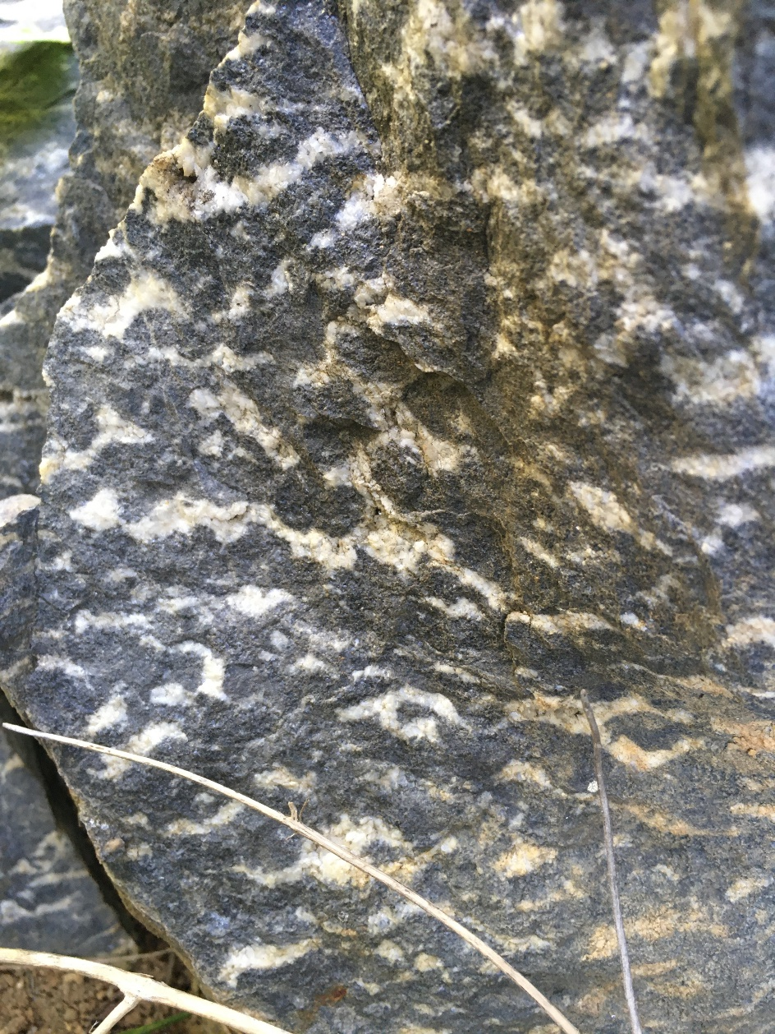
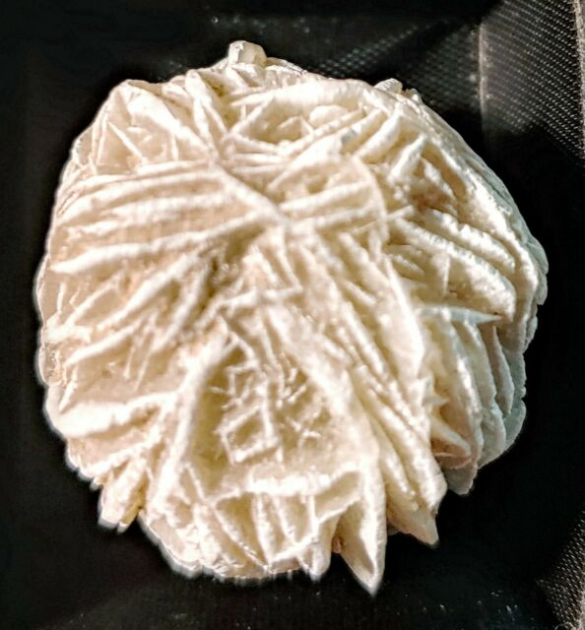
5. Leopard (evaporate) rock
Leopard rock is carbonate that has been so completely recrystallized and replaced with dolomite that getting it to react with acid is a challenge.
The darker gray part has a sugar texture; coarse grained dolomite crystals that have grown in the rock and replaced what ever else was originally there.
The white crystals are rhombohedral dolomite crystals that precipitated in vugs that formed in the original rock.
The thinking is they started off as gypsum rose crystals formed during extreme evaporitic conditions, but dissolved away after burial, and the vugs left behind were filled with the rombohedral dolomite.

Slide 26
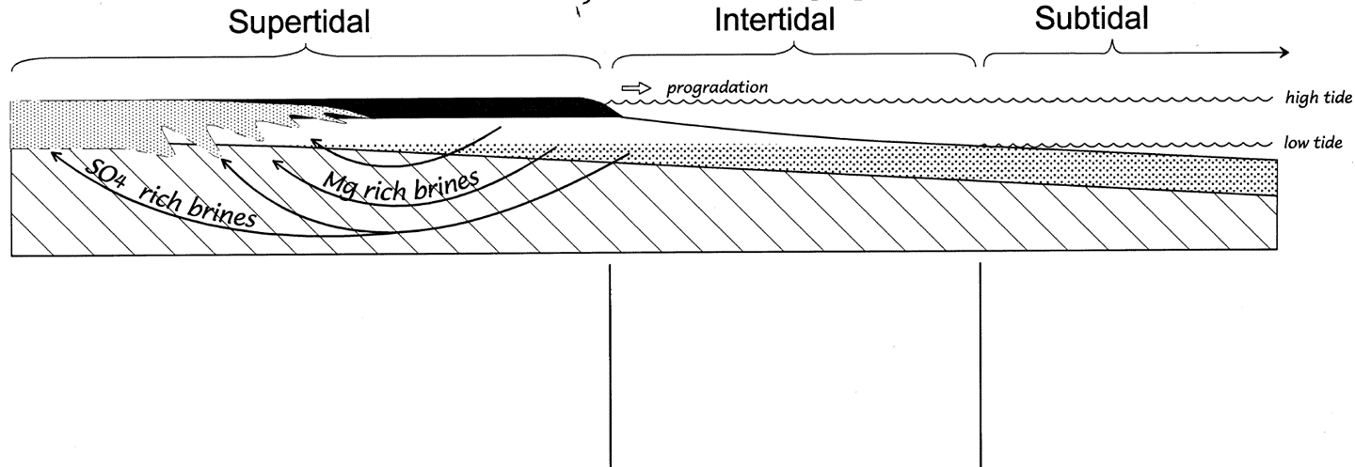
2. Environmental interpretations: these are a bit difficult because of pressure solution and other diagenetic alterations, but simplistically . . .
ALM
ALD
Supertidal under normal to slightly briny water
MM
ALM’s converted to ALD under high evaporate conditions
May be intertidal lake deposits during slight salinity
Converted to MD with evaporates
LR
RR
Extreme evaporate conditions; Mg rich brines convert MM to MD, while precipitating CaSO4 . H2O
Subtidal carbonates, often with fossils, deposited under normal salinity. Dolomitic ribbons are result of later diagenesis.
3. Basin interpretations: since carbonates require warm, clear, shallow water in tectonically stable regions (no clastic sources) any tectonically stable region with shallow water and tropical climates can generate these rocks.
So, we know in the Cambrian, the mid-Atlantic region was tropical and tectonically stable.

Slide 27
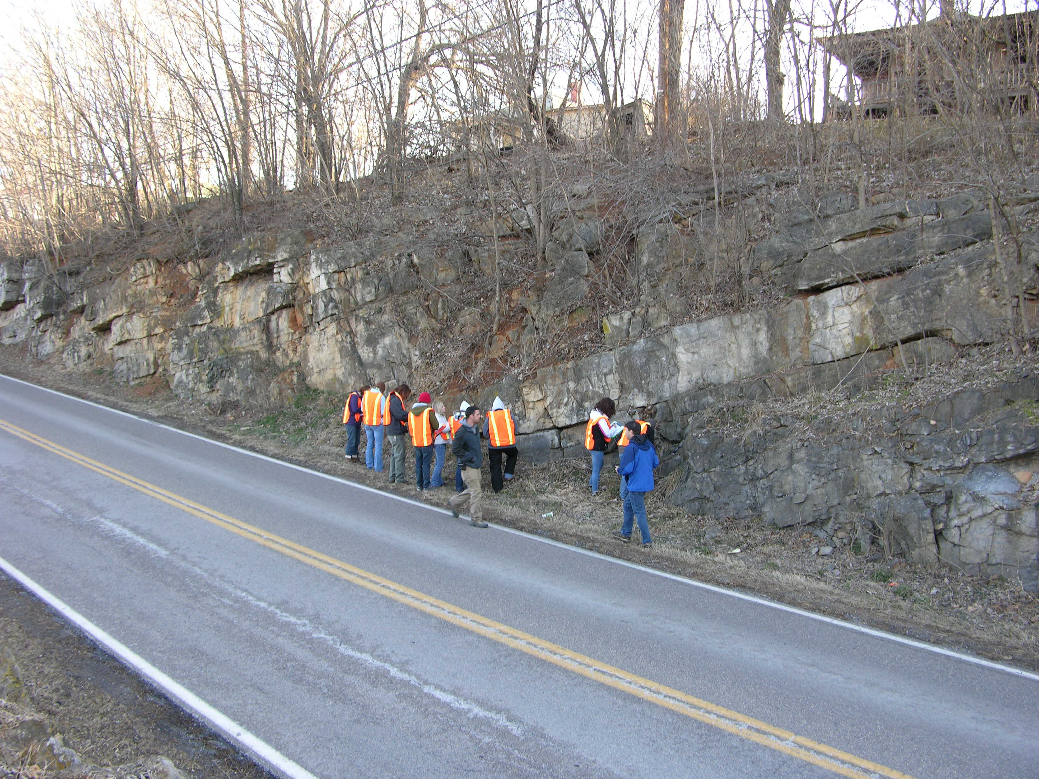
2. Environmental interpretations: an alternate Beekmantown outcrop
This Beekmantown outcrop is feature in the Blue Ridge field trip.

Slide 28
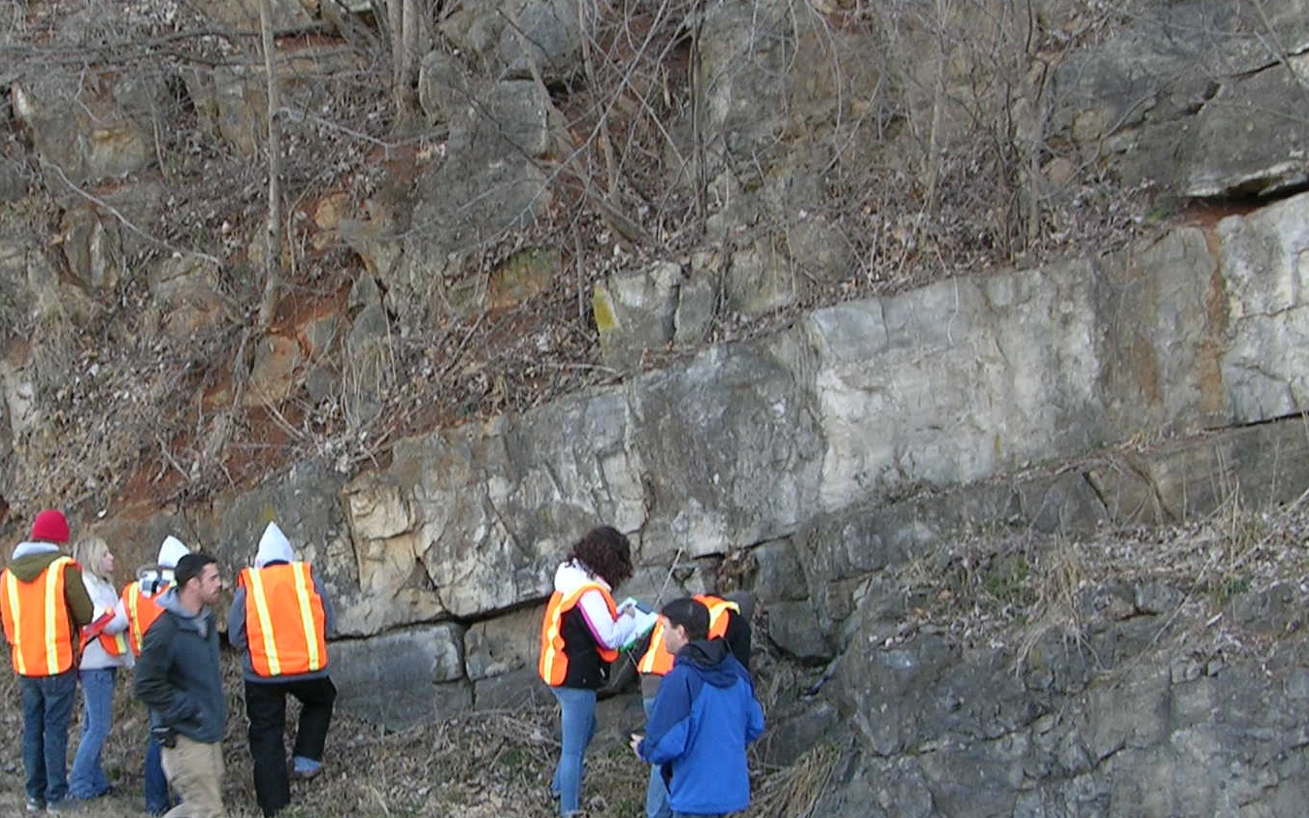
2. Environmental interpretations: an alternate Beekmantown outcrop
We find at this outcrop things typical of the Beekmantown.
Algal laminates

Slide 29
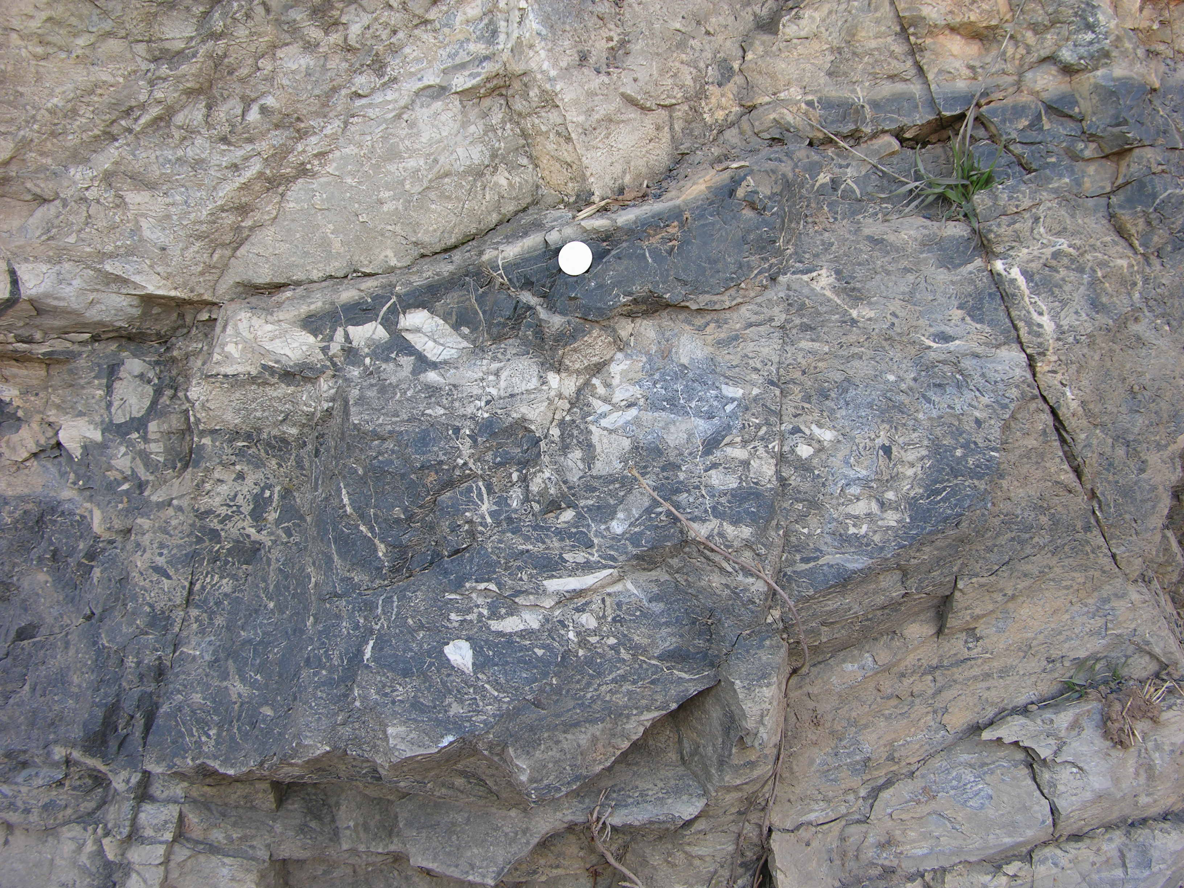
2. Environmental interpretations: an alternate Beekmantown outcrop
Some earlier geologists interpreted these as fault breccias, zones where rocks broke and slid over each other, like this . . .
But, there are also these strange breccias.

Slide 30
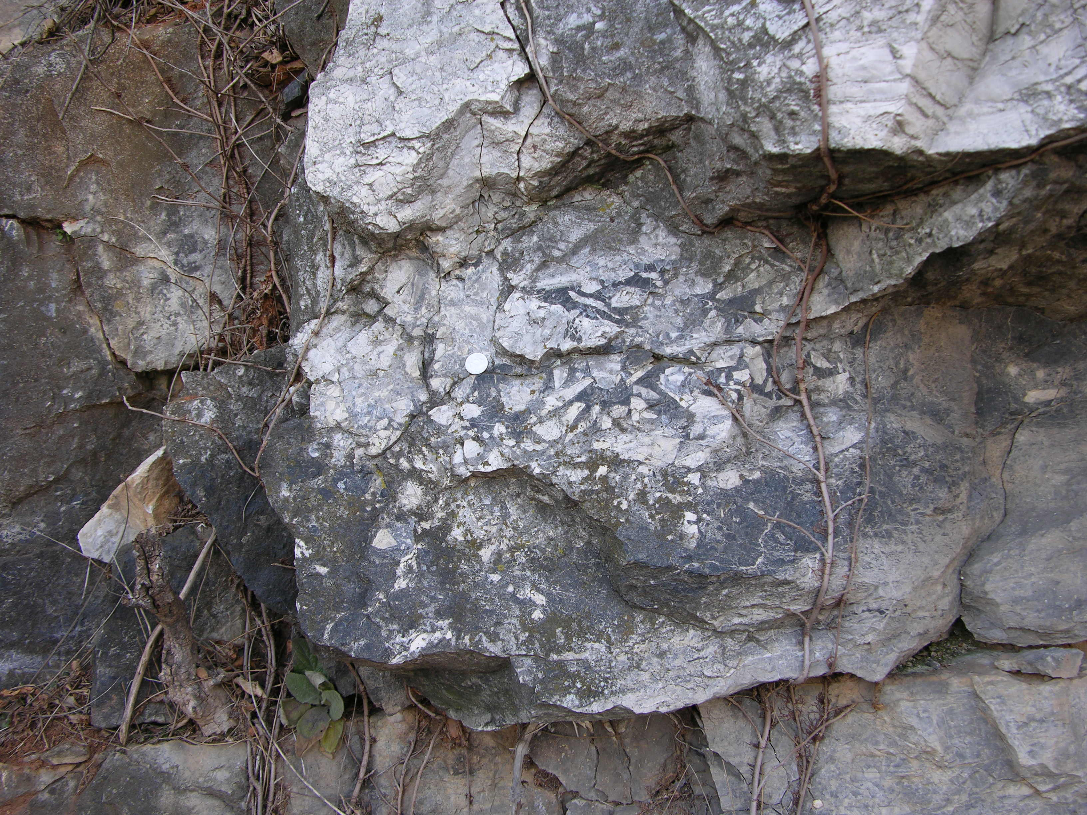
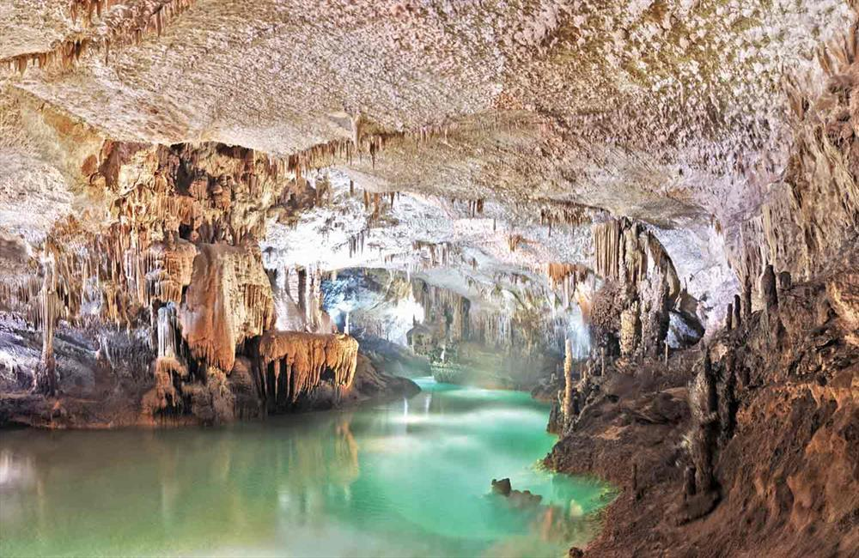
2. Environmental interpretations: an alternate Beekmantown outcrop
But, breccias like this are common in the Beekmantown and are now interpreted as karst breccias – collapsed caves and sink holes.
Karst breccia
At the end of the period of Beekmantown deposition there was a sea level drop, which left the carbonate exposed to dissolution and karst development, represented by the Knox unconformity. With the subsequent rise of sea level the karst surface was covered and the New Market deposited.

Slide 31
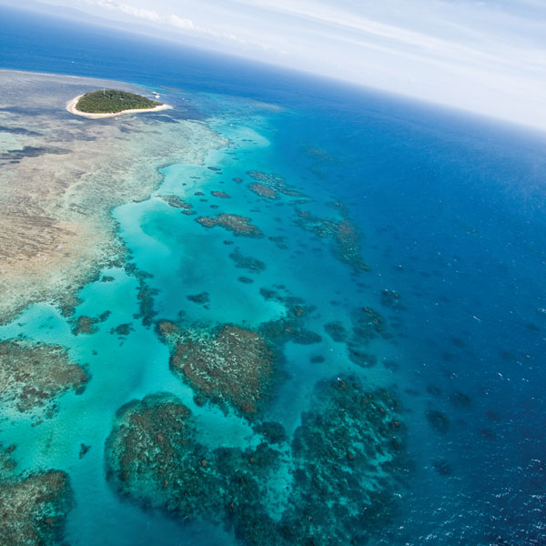
4. Tectonic interpretations: during high sea levels carbonates can form on equatorial continental cratons.
During low sea levels the best place for carbonates are divergent continental margins, like the Great Barrier reef in Australia, or the Bahamas.
We will need to put the Beekmantown in the larger geologic history of the region, but we will interpret it as a DCM along with the other Cambro-Ordovician carbonates.

Slide 32
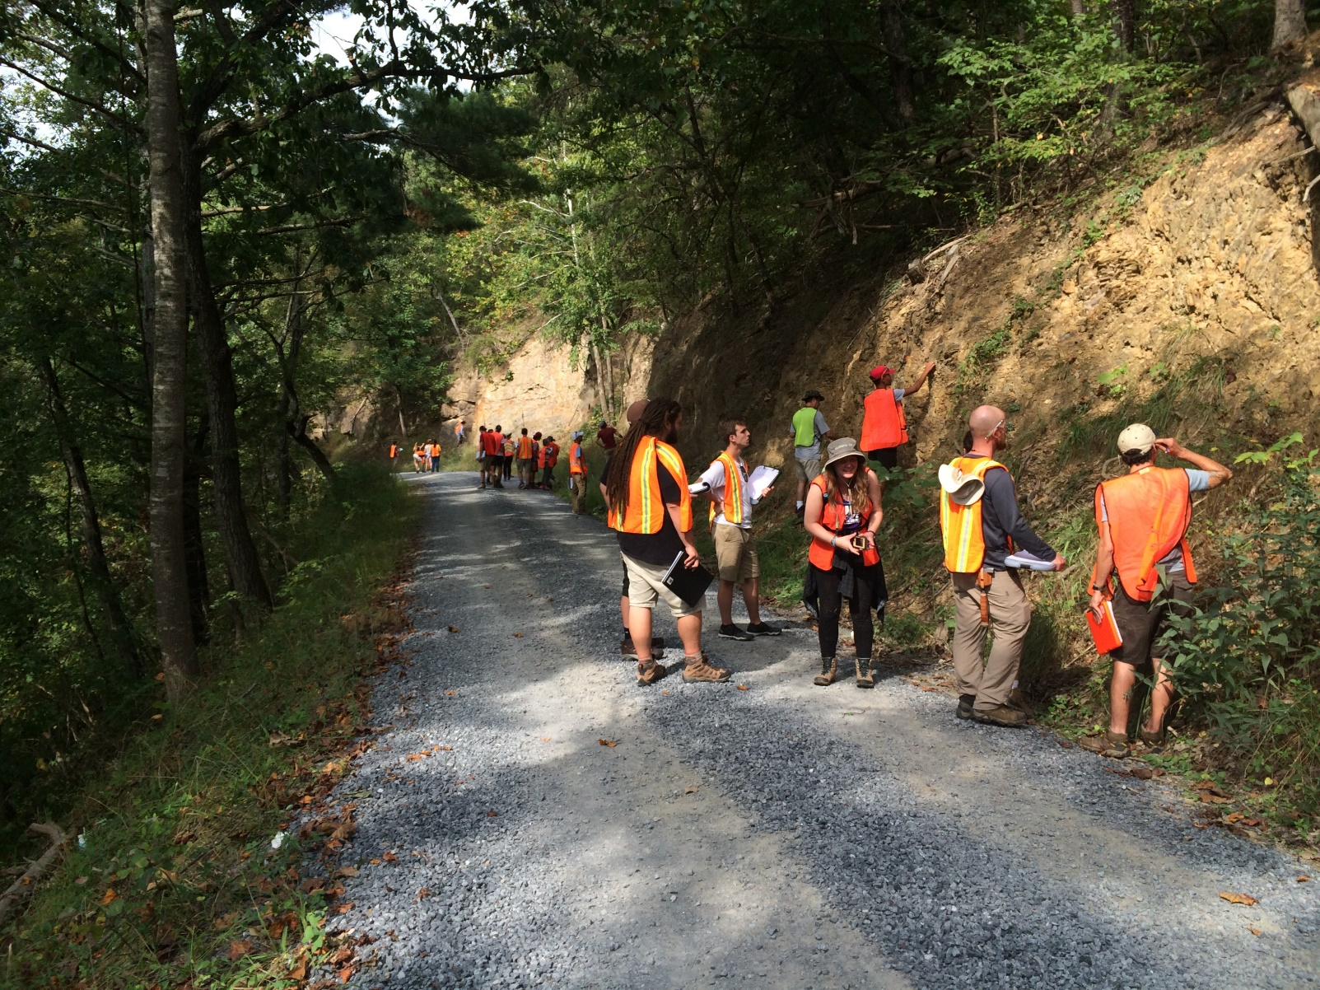
Trip 1:
Chalk Talk 3
Cub Sandstone

Slide 33
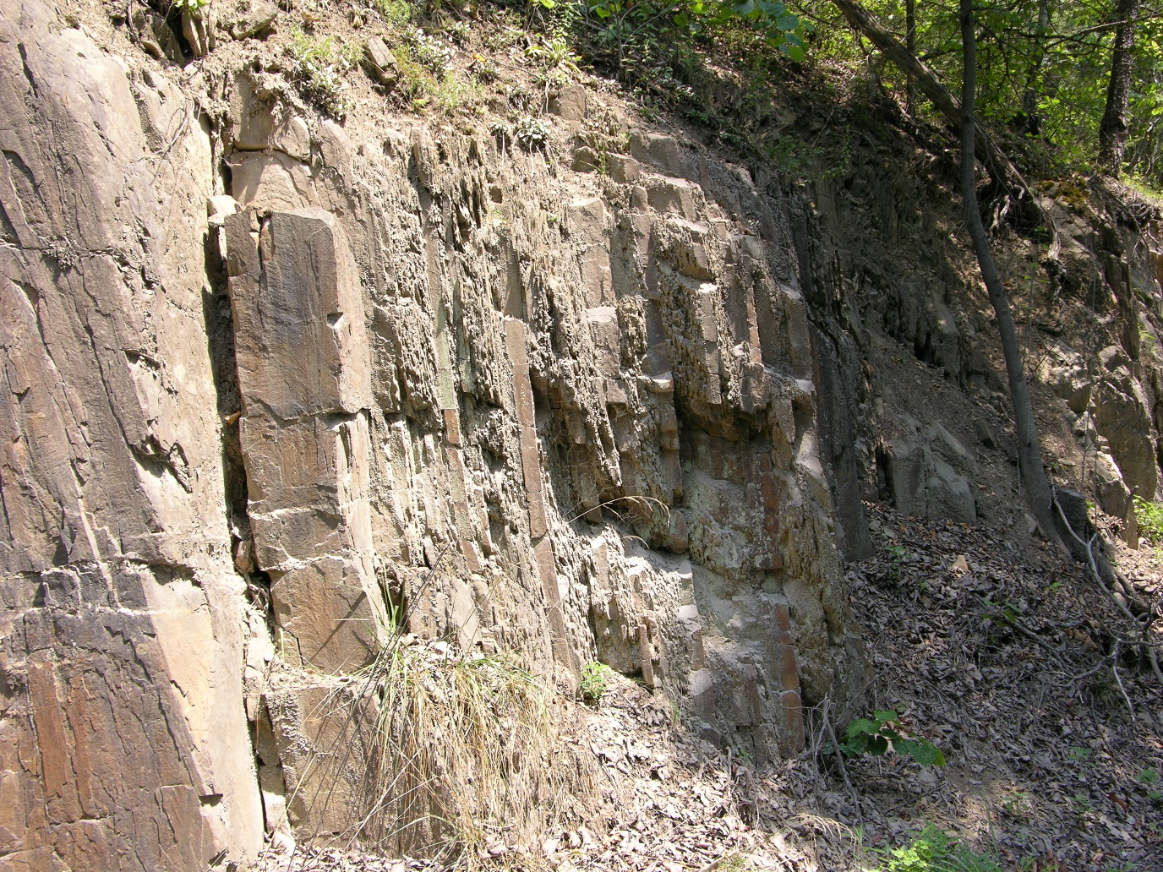
This is a section of the Cub Sandstone. It is badly weathered, making it hard to see some of the beds, thus adding a “noise” component. Plus, there is often structural deformation – another noise component.
For example, storm shelves form hummocky sequences, i.e. individual storm events, that are Fining Upward Sequences with thickening/thinning sandstones.
And storm shelf hummocky sequences form Coarsening Upward (regressive) Parasequences.
CUS
And a series of parasequences can form either a Coarsening Upward (prograding) or Fining Upward (transgressive) sequence.

Slide 34
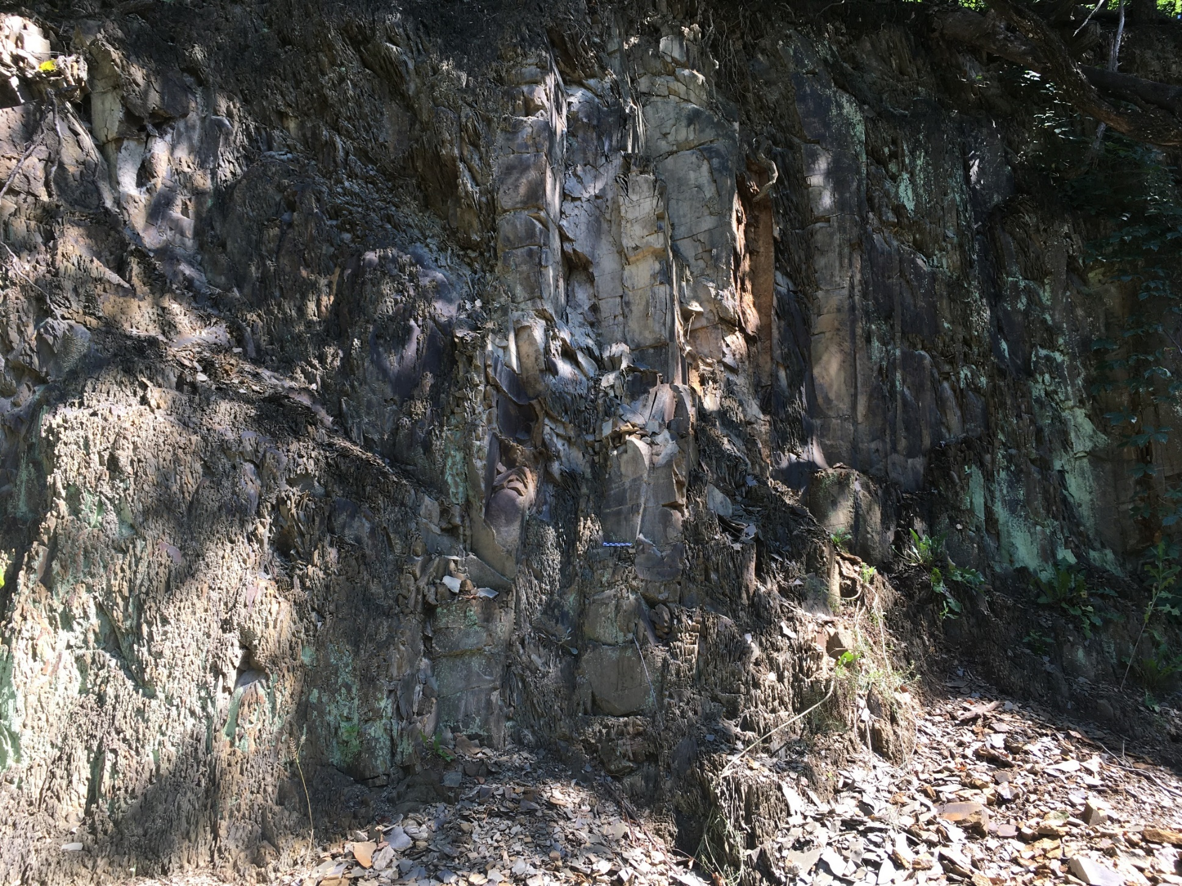
Fining upward storm sequences with hummocky stratification

Slide 35
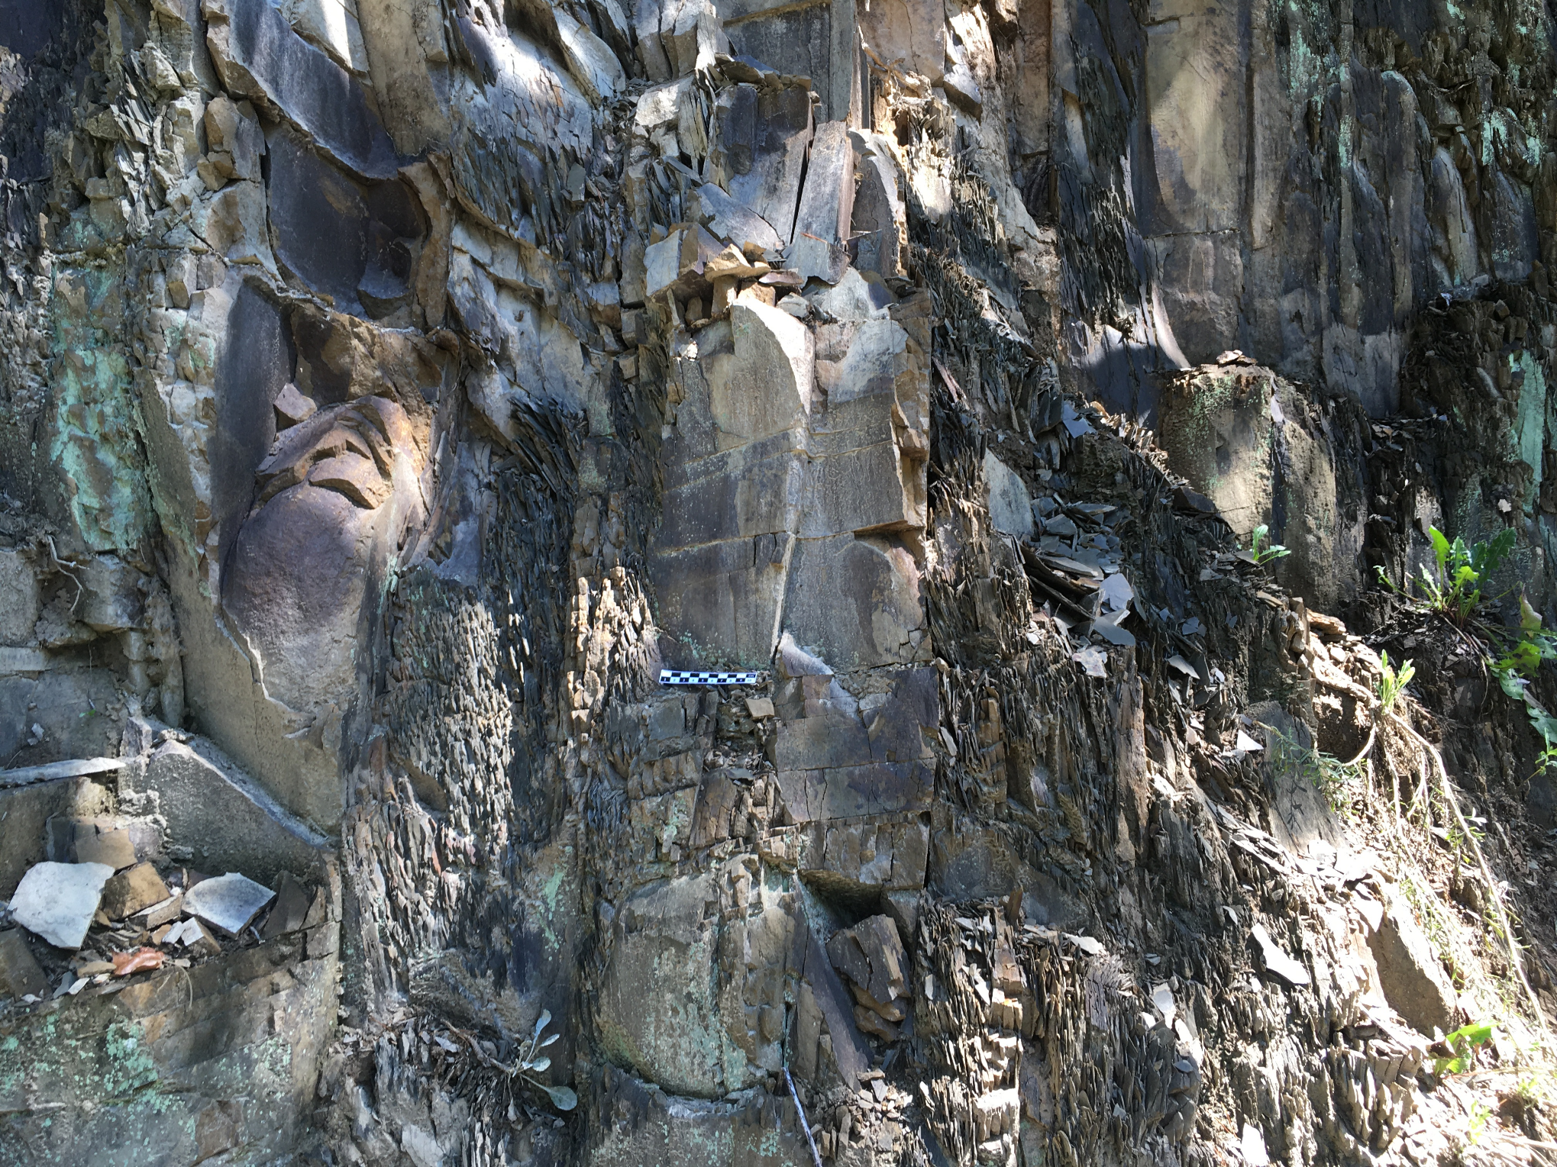
Fining upward storm sequences with hummocky stratification
Up section (bedding is vertical)
Spheroidal weathering
FUS
FUS
FUS
SS
SH
SS
SH
SS

Slide 36
2. Environmental interpretations: we have some sophisticated models for the formation of hummocky sequences, which will take a couple of lectures.
Like with proximal-distal Bouma sequences, hummocky sequences range from distal (shelf) to proximal (shelf.
The model we will use is the one below – developed fully in lecture later.
Note that the hummocky sequences become thicker and more complicated as we get closer to shore.

Slide 37
2. Environmental interpretations: we have some sophisticated models for the formation of hummocky sequences, which will take a couple of lectures.
The strip log to the right is a complete CUS prograding shelf parasequence.
Notice the sandstones get thicker, get coarser, begin to pinch, swell and undulate up section.

Slide 38
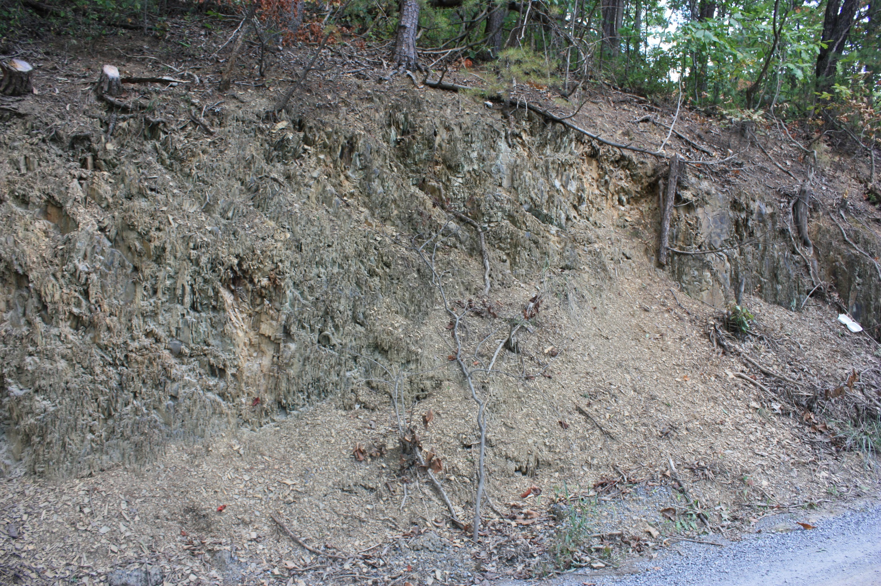
Walking the Cub Sandstone at Catherine Furnace
Walking to the left (west)

Slide 39
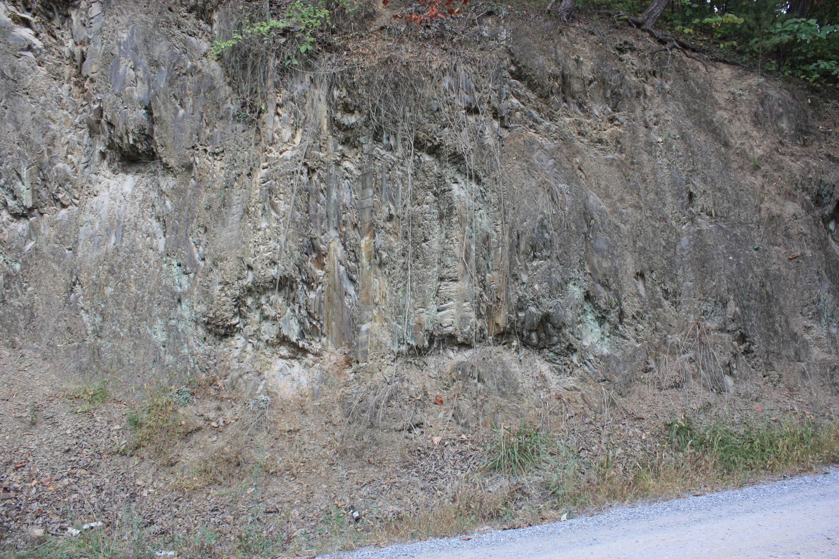
Walking to the left (west)

Slide 40
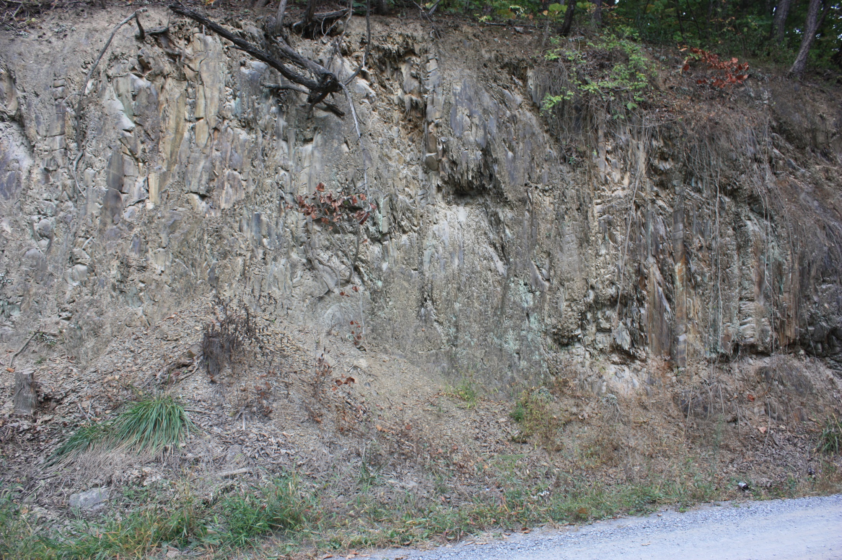
Walking to the left (west)

Slide 41
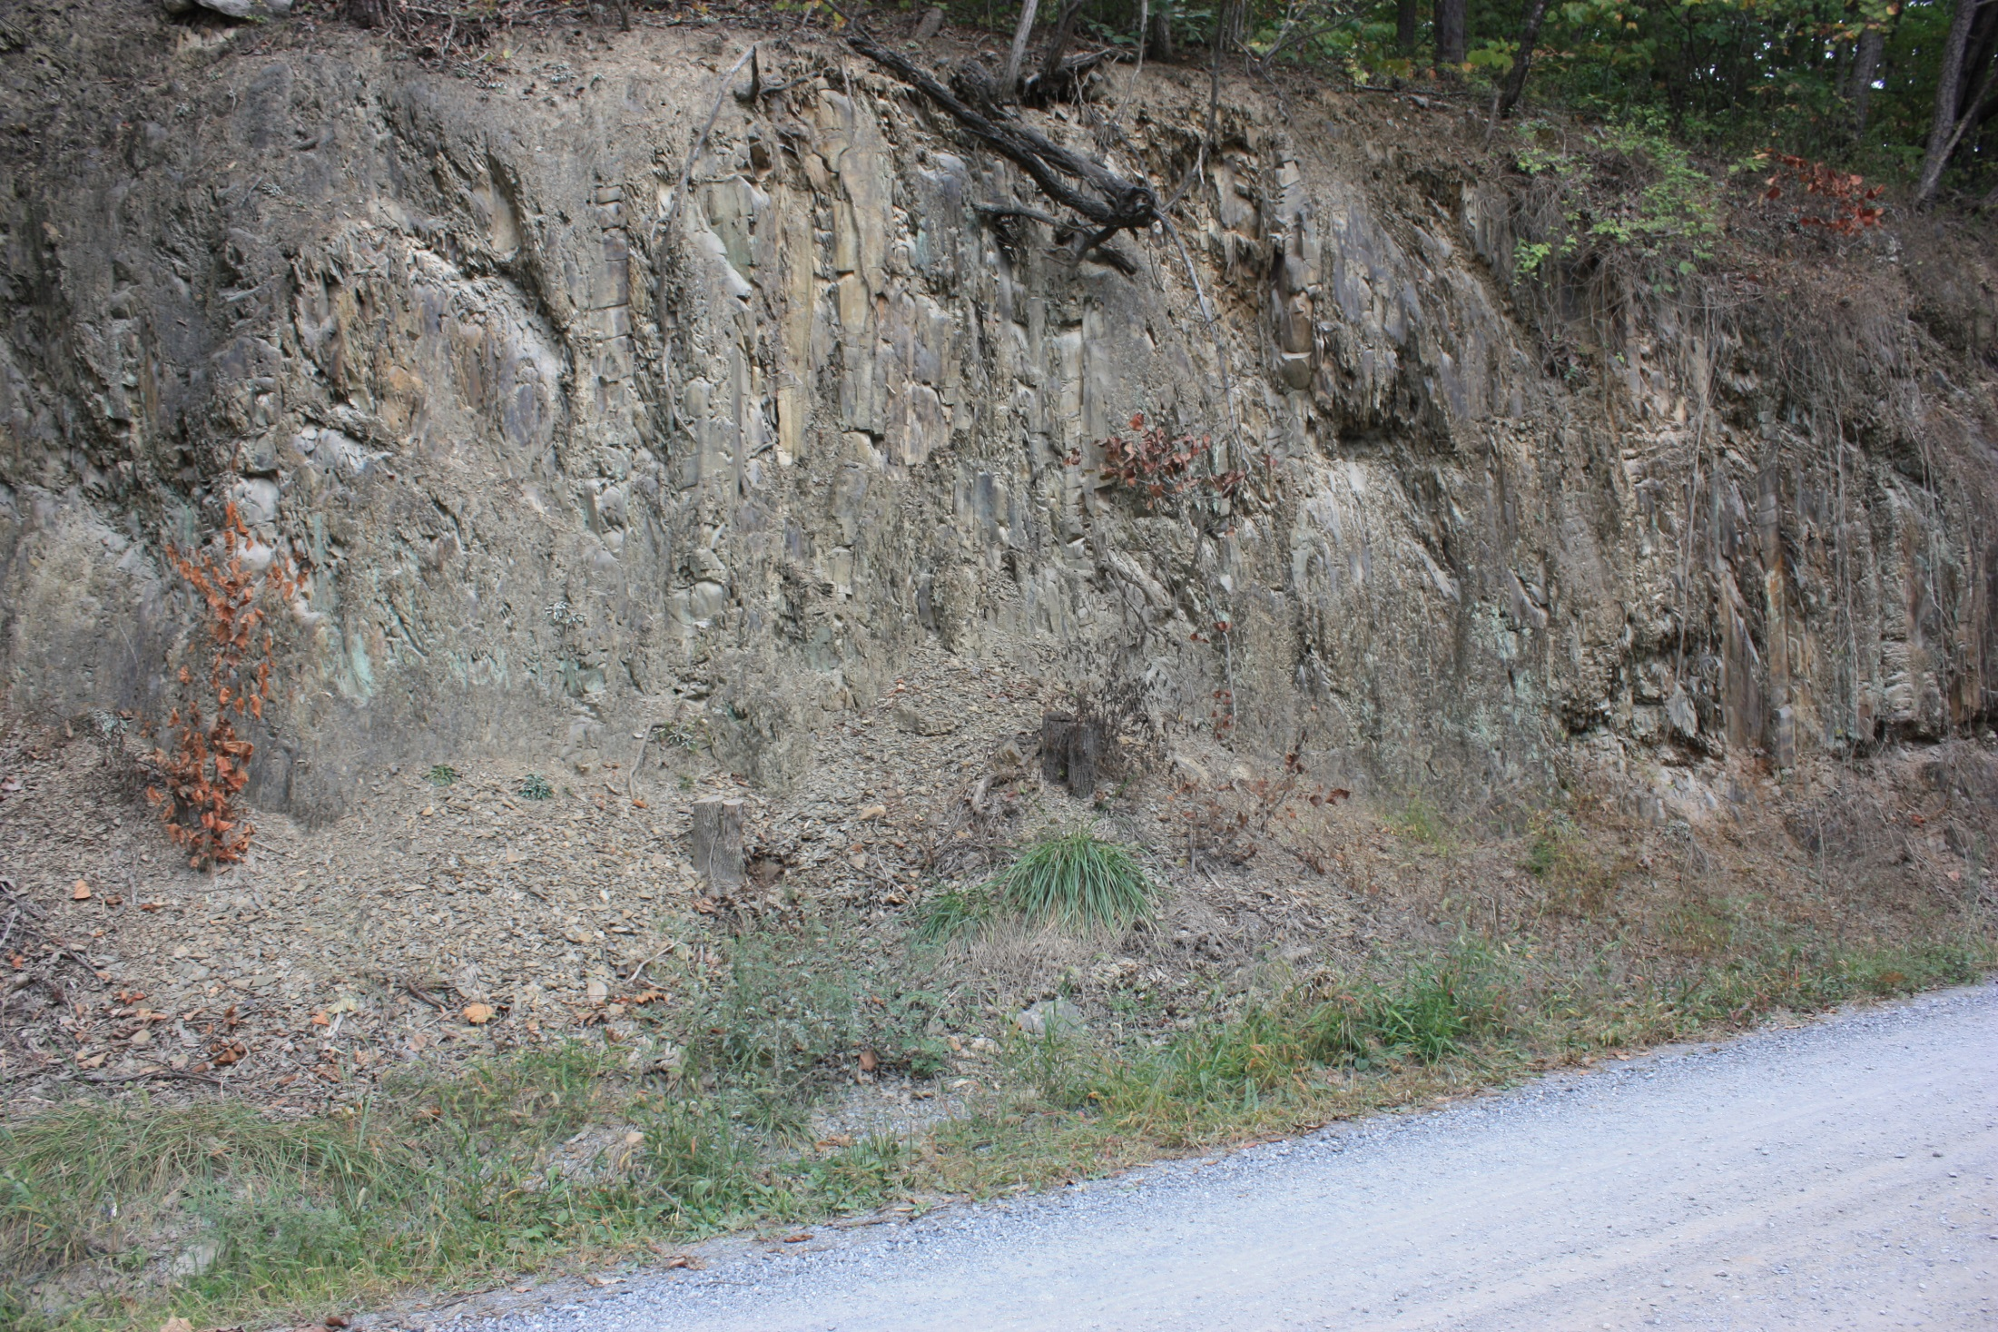
Walking to the left (west)

Slide 42


Walking to the left (west)

Slide 43

Walking to the left (west)

Slide 44

Walking to the left (west)

Slide 45

Walking to the left (west)

Slide 46

Walking to the left (west)

Slide 47

Up section
Walking to the left (west)

Slide 48

Walking to the left (west)

Slide 49

Walking to the left (west)

Slide 50


Walking to the left (west)

Slide 51


Slide 52


Slide 53




Slide 54



Getting a lot of power law distributed storm events.

Slide 55


3. Basin interpretations: below is a basic model
Coastal Plain
Shoreface
Overall 3rd order progradation, made up of four 4th order progradations
Offshore Shelf
Note, each parasequence is a CUS, and from parasequence to parasequence is a CUS, resulting in an overall prograding (regressive) sequence. Patterns, within patterns, within patterns.

Slide 56
3. Basin interpretations:
And what drives all this are sea level changes.
4. Tectonic Interpretations: we will hold off on this until we have seen a few more formations.

Slide 57

Trip 1:
Chalk Talk 4
Edinburg Formation

Slide 58

Begin with observations.
Interbedded micrites and shales. On a strip log they are both the same fine grained texture.(clay sized).

Slide 59

Begin with observations.
Shales are black and smudgy (like charcoal) – high organic content.
What does that tell us about the environmental conditions?

Slide 60

Begin with observations.
Micrites weather medium gray, but on a fresh surface are also black.

Slide 61


Begin with observations.
Bedding thickness varies from thin interbedded micrites sometimes with clay drapes…
To interbedded shales and micrites.

Slide 62

Begin with observations.
To relatively thick micrites.

Slide 63

Begin with observations.
And, some of the thick micrites have undulating scoured bottoms.

Slide 64



2. Environmental interpretations: now we just look for patterns in the signs.
Parasequences: study the patterns; can you determine whether these are Coarsening or Fining Upward?
Thick micrite
Thick micrite
Thick micrite

Slide 65


2. Environmental interpretations: now we just look for patterns in the signs.
It might be easier to see it in a pano view that puts all these shots together.
Now can you determine whether they are Coarsening (thickening) or Fining (thinning) Upward Sequences?
Thick micrite
Thick micrite
Thick micrite
Coarsening upward parasequences are found in storm shelf environments. Fining upward parasequences are found in tidal flat environments, and submarine fans.
Beds are thinning
Beds are thinning
I see two “Fining (Thinning)Upward” Para-Sequences.
Note parasequences come in both patterns: Coarsening (thickening) & fining (thinning) upward. These are environmentally significant.

Slide 66


2. Environmental interpretations: now we are analyzing for other facies elements.
Questions:
What is the energy of deposition of fine grained sediments?
Under what environmental conditions do carbonates form?
What is the environmental indicator of black, organic rich color?
Anybody see any contradictions here?
What would be the energy interpretations of the undulating base of the thick micrite?
Anybody see any contradictions with that?
What depositional mechanisms can we attribute to massively bedded, fine grained sediment with an erosional bottom?

Slide 67
2. Environmental interpretations: now we are analyzing for other facies elements.
Contradictions:
Carbonates are shallow water sediments, but these were deposited in deep water (anoxic color).
Fine grained sediments indicate low energy (standing water), but these have evidence of being high energy events.
The energy systematically declines in Fining Upward Parasequences.
The resolution of these contradictions tell us a lot about the tectonic evolution of the region.

Slide 68
3. Basin interpretations:
Some Deductive arguments:
During the Beekmantown the region was tectonically stable and shallow with tidal tropical carbonates – a passive margin.
By the Edinburg this area had subsided into a deep water basin (outcrops are geographically close).
But somewhere nearby there was still a shallow, tropical platform still generating carbonates.
These micrites were transported into the deep water basin via mass sediment flows (turbidity currents?)
While at the same time a new clastic (shale) source formed (carbonates and clastics cannot come from the same source.)
The most reasonable direction for the micrite to come from would be west (a shallow, tectonically stable continental platform).
And by comparison the shale would come from the east (ocean ward) because it is there we could build a tectonic mountain.

Slide 69

4. Tectonic Interpretations:
We are going to need many conversations, and a slew of theoretical models to come to understand this evolution, but a quick summary goes like this.

Slide 70


Trip 1:
Chalk Talk 5
Martinsburg Formation

Slide 71


Observations:
1. Bedding orientation (red line)
{This is the east flank of the Massanutten synclinorium}
2. The bedding is of consistent and uniform thickness
{unlike what we saw in the Cub SS where beds thicken and thin}
West
Looking northeast
East

Slide 72

Observations:
In a close up we see interbedded sandstones and shales.
SS
SH
SS
SS
SH
SS
SH
SS
SH

Slide 73

Observations:
Even closer, sedimentary structures start to show up.
The bottoms of many of the sands also have flute and tool marks.
Shales
Reactivation surface (scour)
Finer sands
Event
Calm
Event
FUS
Laminations
FUS
Graded bedding
FUS
Graded bedding
Coarse sands

Slide 74

Observations:
A closer picture under different lighting brings some of the features out better.

Slide 75


Observations:
Don’t be fooled by the axial plane cleavage (which is structural) throughout the outcrop.
Cleavage also propagates through sands, but at a different angle than through shales.
Cleavage
Cleavage
This looks like cross bedding, but the rock is a shale, and shale does not form cross beds.
Cleavage
Cleavage

Slide 76

1. Outcrop interpretations: interpreting only what is actually observed on the outcrop. This mostly comes down to energy, which is flow regime.
Ok, draw a strip log: 5 minutes.

Slide 77
2. Environmental interpretations: interpreting only what is actually observed on the outcrop. This mostly comes down to energy, which is flow regime.
My strip log through same part of the outcrop, but mine is longer.
What sequence is this?
What are the specific sequences?
What is the mechanism of transportation?
What depositional environment?

Slide 78



3-4. Basin and Tectonic Interpretations:
One more piece of observational data to examine – QFL.
A cut and polished section of the rock to the left. A coarse-grained sand. Martinsburg Formation, Verona Va.
Where would you plot the QFL?

Slide 79

Trip 1:
Chalk Talk 6
Synthesis:
Tectonic Evolution of the Taconic Foreland Basin:
Map of the Mid-Atlantic region in the Cambrian

Slide 80

A Top-Down Theoretical Tectonic Model
This starts with a Rift-to-Drift sequence after the break up of Rodinia, followed by closing of the ocean basin that leads to the Taconic orogeny.
Two Colliding Plates
Tectonic Loading
σ₁
Tectonic stress
Increasing accommodation
Crustal thickening by rising
thrust stack
Sediment accumulation
Lithospheric flexure

Slide 81

A Top-Down Theoretical Tectonic Model
This generates a foreland basin that develops adjacent and parallel to a mountain belt, created during a collision, when the hinterland places an enormous weight on the foreland, causing it to flex down into a basin..
A modern example is the Persian Gulf (foreland basin) and Zagros Mountains (hinterland).

Slide 82

The Set Up
Post Rodinia Rifted Divergent Continental Margin
A normal Rift-to-Drift DCM record

Slide 83
Complication One: a ragged coastline
Significant deformation and metamorphism. Some preserved in Maryland/Pa region.
Collision of the Taconic (Carolina) terrane
2nd collision
The Taconic record we study is in the protected reentrant: minimal deformation, except for foreland basin formation
Protected reentrant
(minimal deformation)
First collision
Significant deformation and metamorphism. Mostly masked by later events.

Slide 84


Complication Two: the peripheral bulge
When it hits continent will cause uplift
Compression
Peripheral bulge
(an uplift that migrates in front of the subduction zone)
Causes uplift here
Bulges like this are common, either as a result of compression, or because of a load.
Load here

Slide 85
Complication Two: the peripheral bulge
When it hits continent will cause uplift
Compression
Peripheral bulge
(an uplift that migrates in front of the subduction zone)
The result is two foreland basins separated by a peripheral bulge (the Little North Mountain Arch).
Peripheral bulge
Eastern deep water basin
Western shallow water basin
Thrust stack loading
Compressional uplift

Slide 86


In the local geography these are the locations
Germany Valley
Brocks Gap
Massanutten Mtn.
Peripheral bulge
(sediment can’t cross until the Tuscarora/Massanutten)
Eastern deep water basin
Western shallow water basin
Field Trip 3
This Field Trip
Field Trip 4

