Slide 1
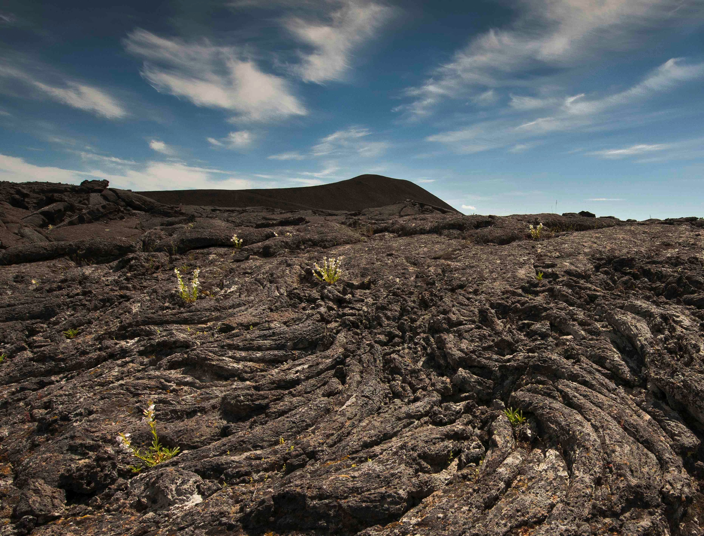

GEOPHOTOGRAPHY:
From Shooting to Post-processing:
Making the Most of your Camera’s Capabilities.
Ellen Morris Bishop, Whitman College

Slide 2
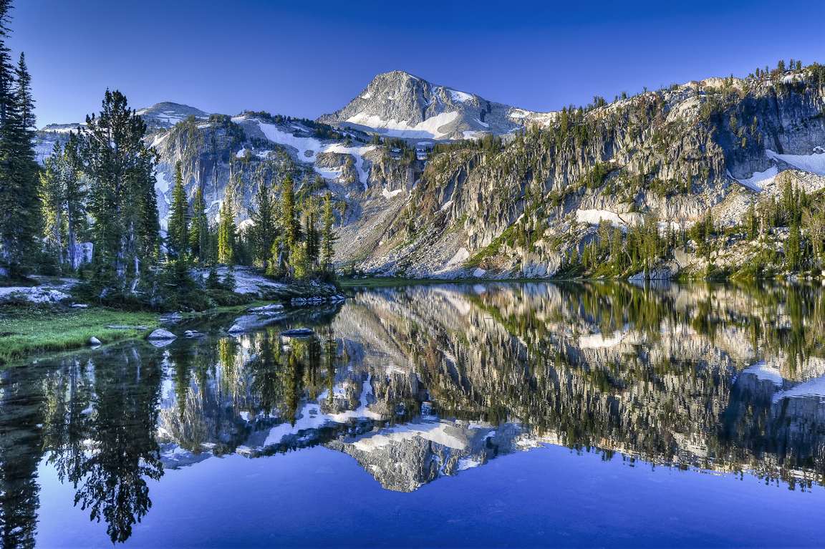
“The best camera is the one you have with you.”
Chase Jarvis

Slide 3
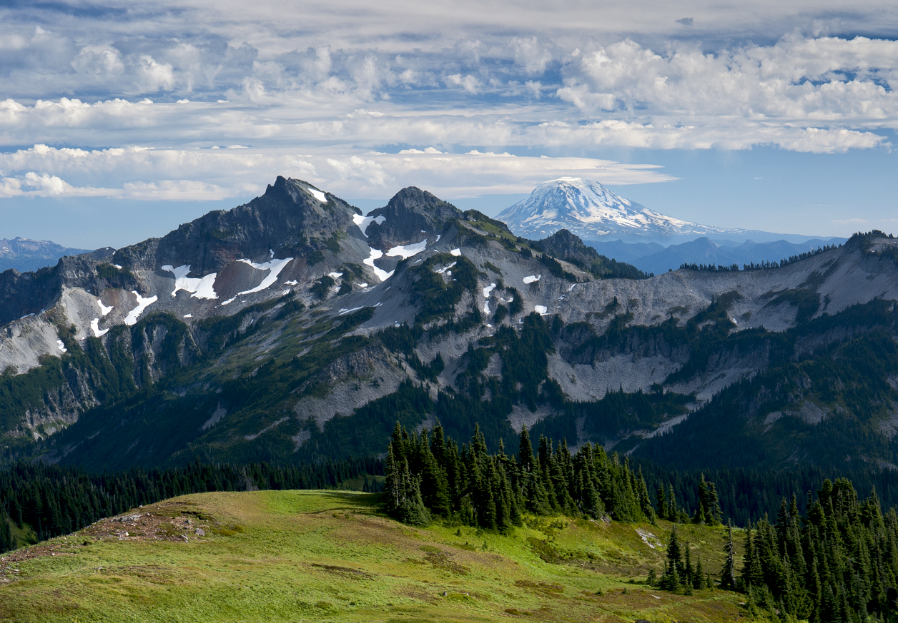
Color, composition, exposure, and an invitation into the landscape are important in presentations

Slide 4
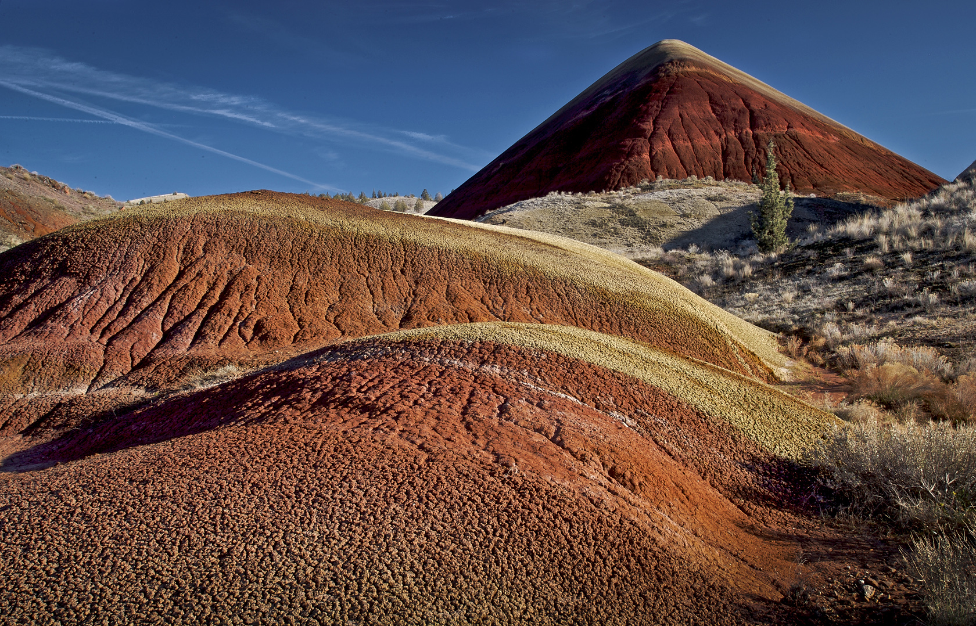
As geologists, we want to show as much information as possible in our images.

Slide 5
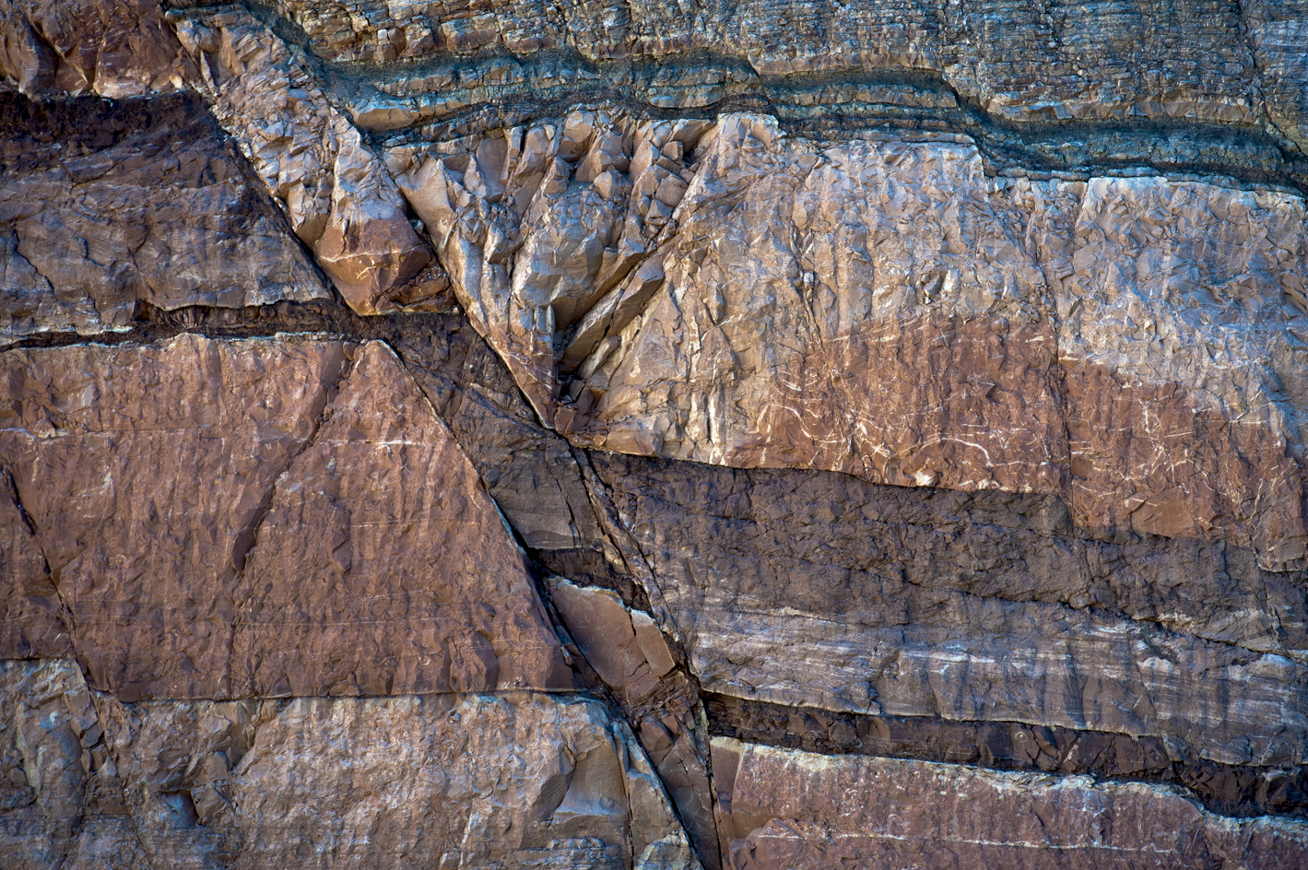
Sharpness and color balance/temperature are important as well.

Slide 6
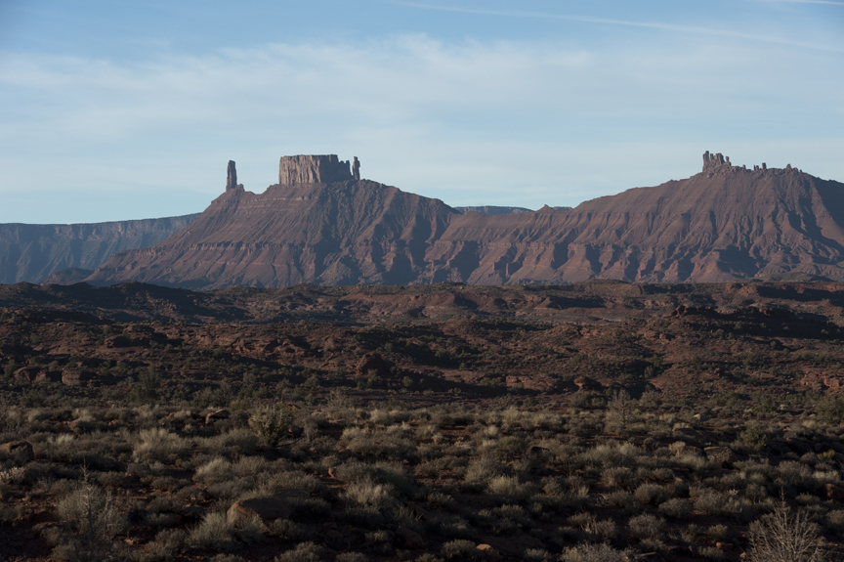
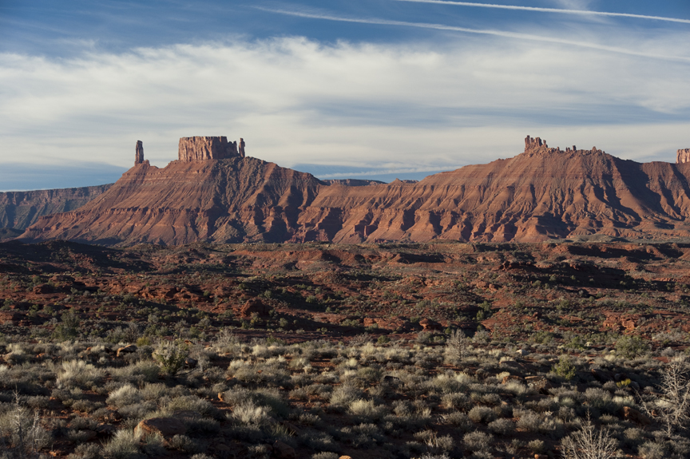
Without Polarizer
With Polarizer
Getting exposure right, and using an appropriate filter (polarizer) are important in the original image.

Slide 7
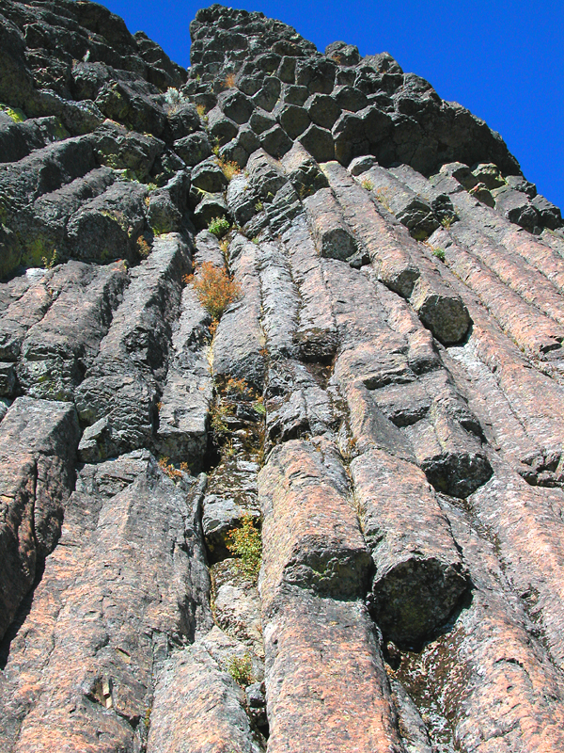
Finding a unique perspective,
And ensuring that what we want viewers to see is sharp, , also is important to making our point.

Slide 8
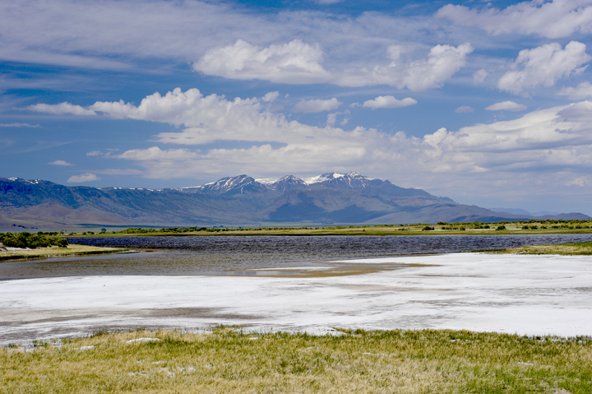
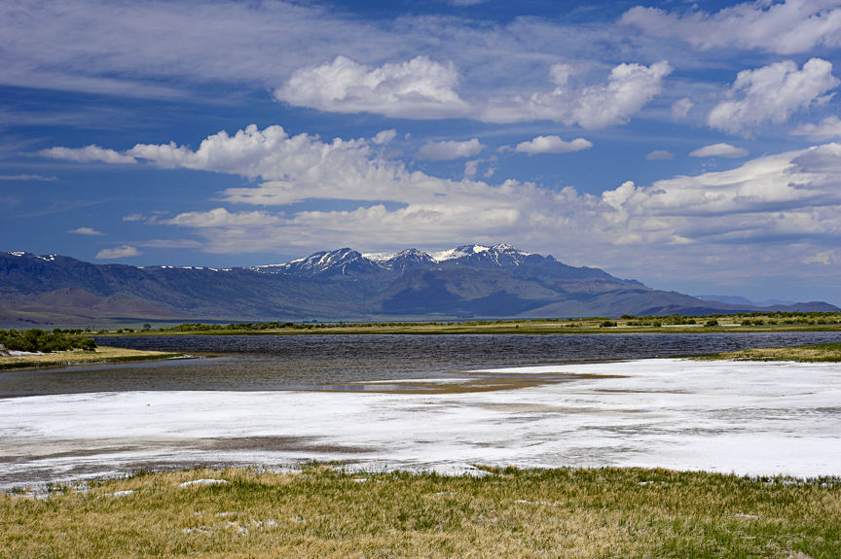
But a few standard adjustments in Lightroom, Photoshop, or other post-processing software can really make your image sing, while remaining a valid, rather than “Photoshopped” image.
This is really no different than what we used to do in the darkroom while making a print.

Slide 9
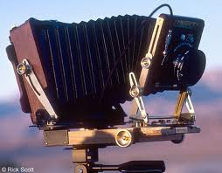
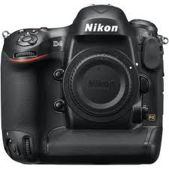
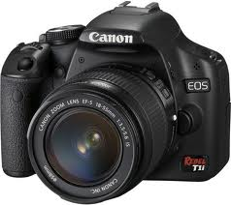
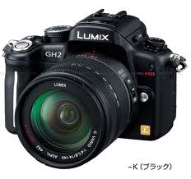
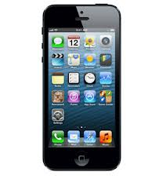
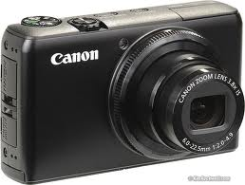
There are many tools and options for digital photography

Slide 10
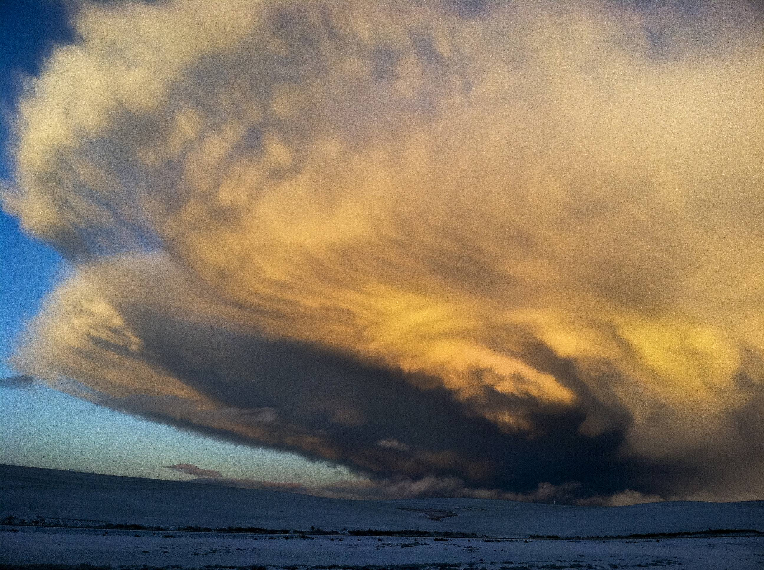
iPhone image

Slide 11
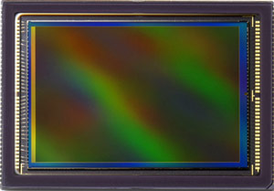
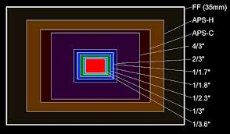
Digital sensor
Sensor sizes vary

Slide 12
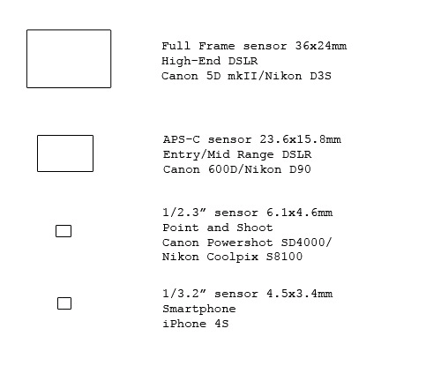
http://www.dxomark.com/
Provides test data on sensors and lenses.

Slide 13
EXPOSURE:
the total amount of light allowed to fall on the photographic medium during the process of taking a photograph.
Correct Exposure: The amount of light that allows you to see detail across the entire dynamic range of the image—or as close to that as your camera can come.

Slide 14
EV: Exposure Value:
Generally: How many “Stops” of exposure
(doubling of the amount
of light that falls on the sensor)
up or down (more light or less)
you set your camera for.

Slide 15
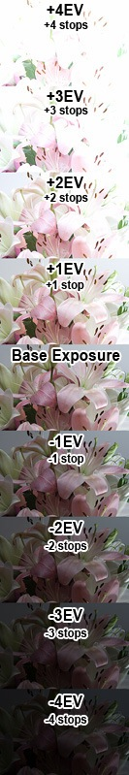

Slide 16
F 8 @ 8
F 8 @ 15
F 8 @30
F 8 @ 60
F 8 @ 125
F 8 @ 250
F 8 @ 500
F 8 @ 1000
F 8 @ 1250

Slide 17
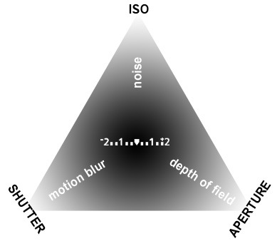
THREE WAYS TO CONTROL EXPOSURE OPTIONS

Slide 18
APERTURE:
How wide your shutter opens.
THE BIGGER THE NUMBER, the less the light!
1.0 1.4 2.0 2.8 4 5.6 8 11 16 22 32 45 64
Expensive lenses
Large Format
Each f-stop lets in half as much light as the next larger opening and twice as much light as the next smaller opening.

Slide 19
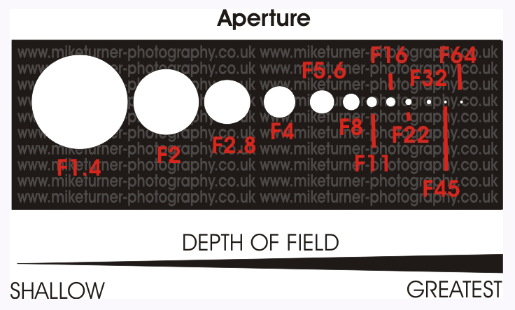

Slide 20
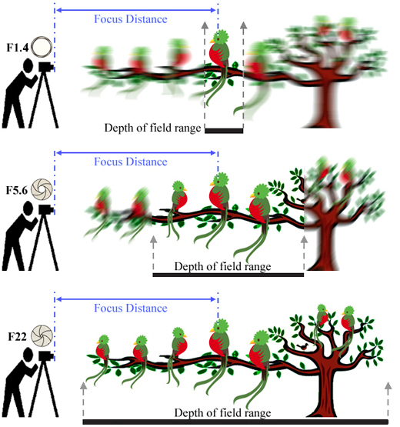

Slide 21
DEPTH OF FIELD: the distance between the nearest and farthest objects in a scene that appear acceptably sharp in an image.
Although a lens can precisely focus at only one distance at a time, the decrease in sharpness is gradual on each side of the focused distance,
so that within the DOF, the unsharpness is imperceptible under normal viewing conditions.

Slide 22
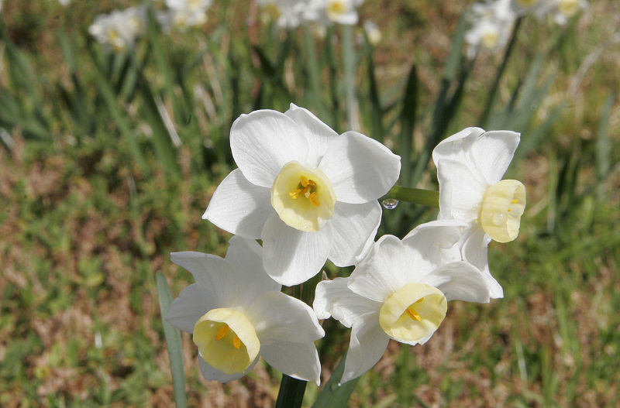

Slide 23
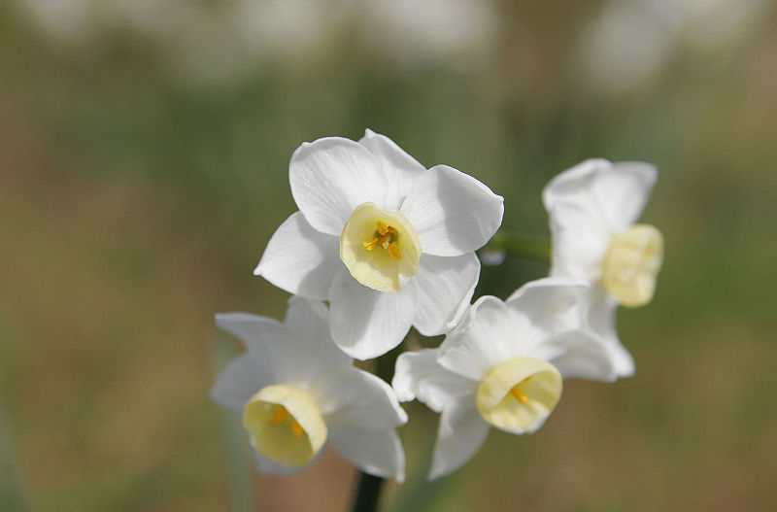

Slide 24
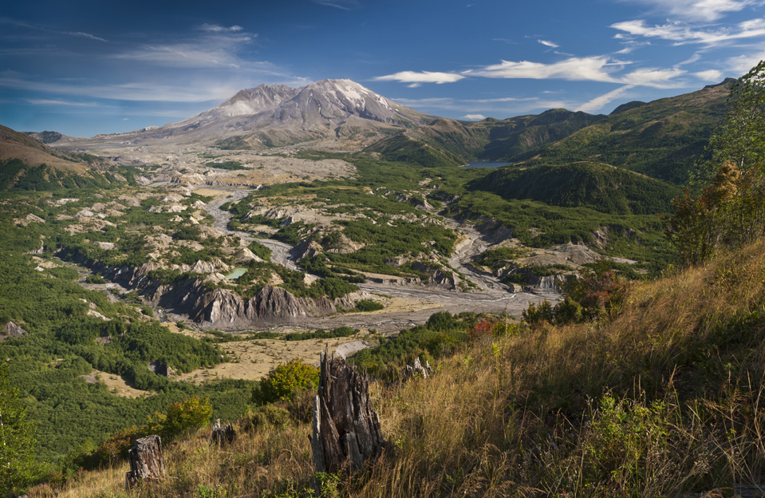

Slide 25
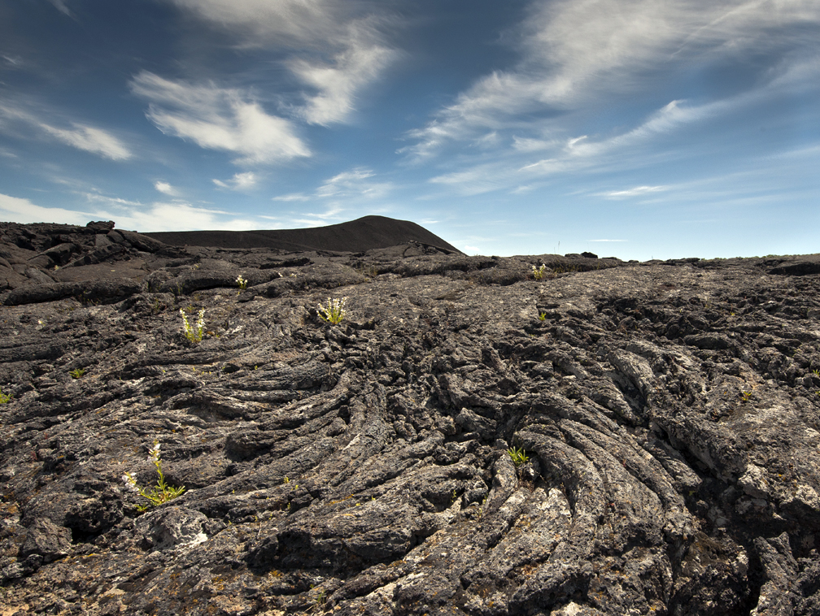

Slide 26
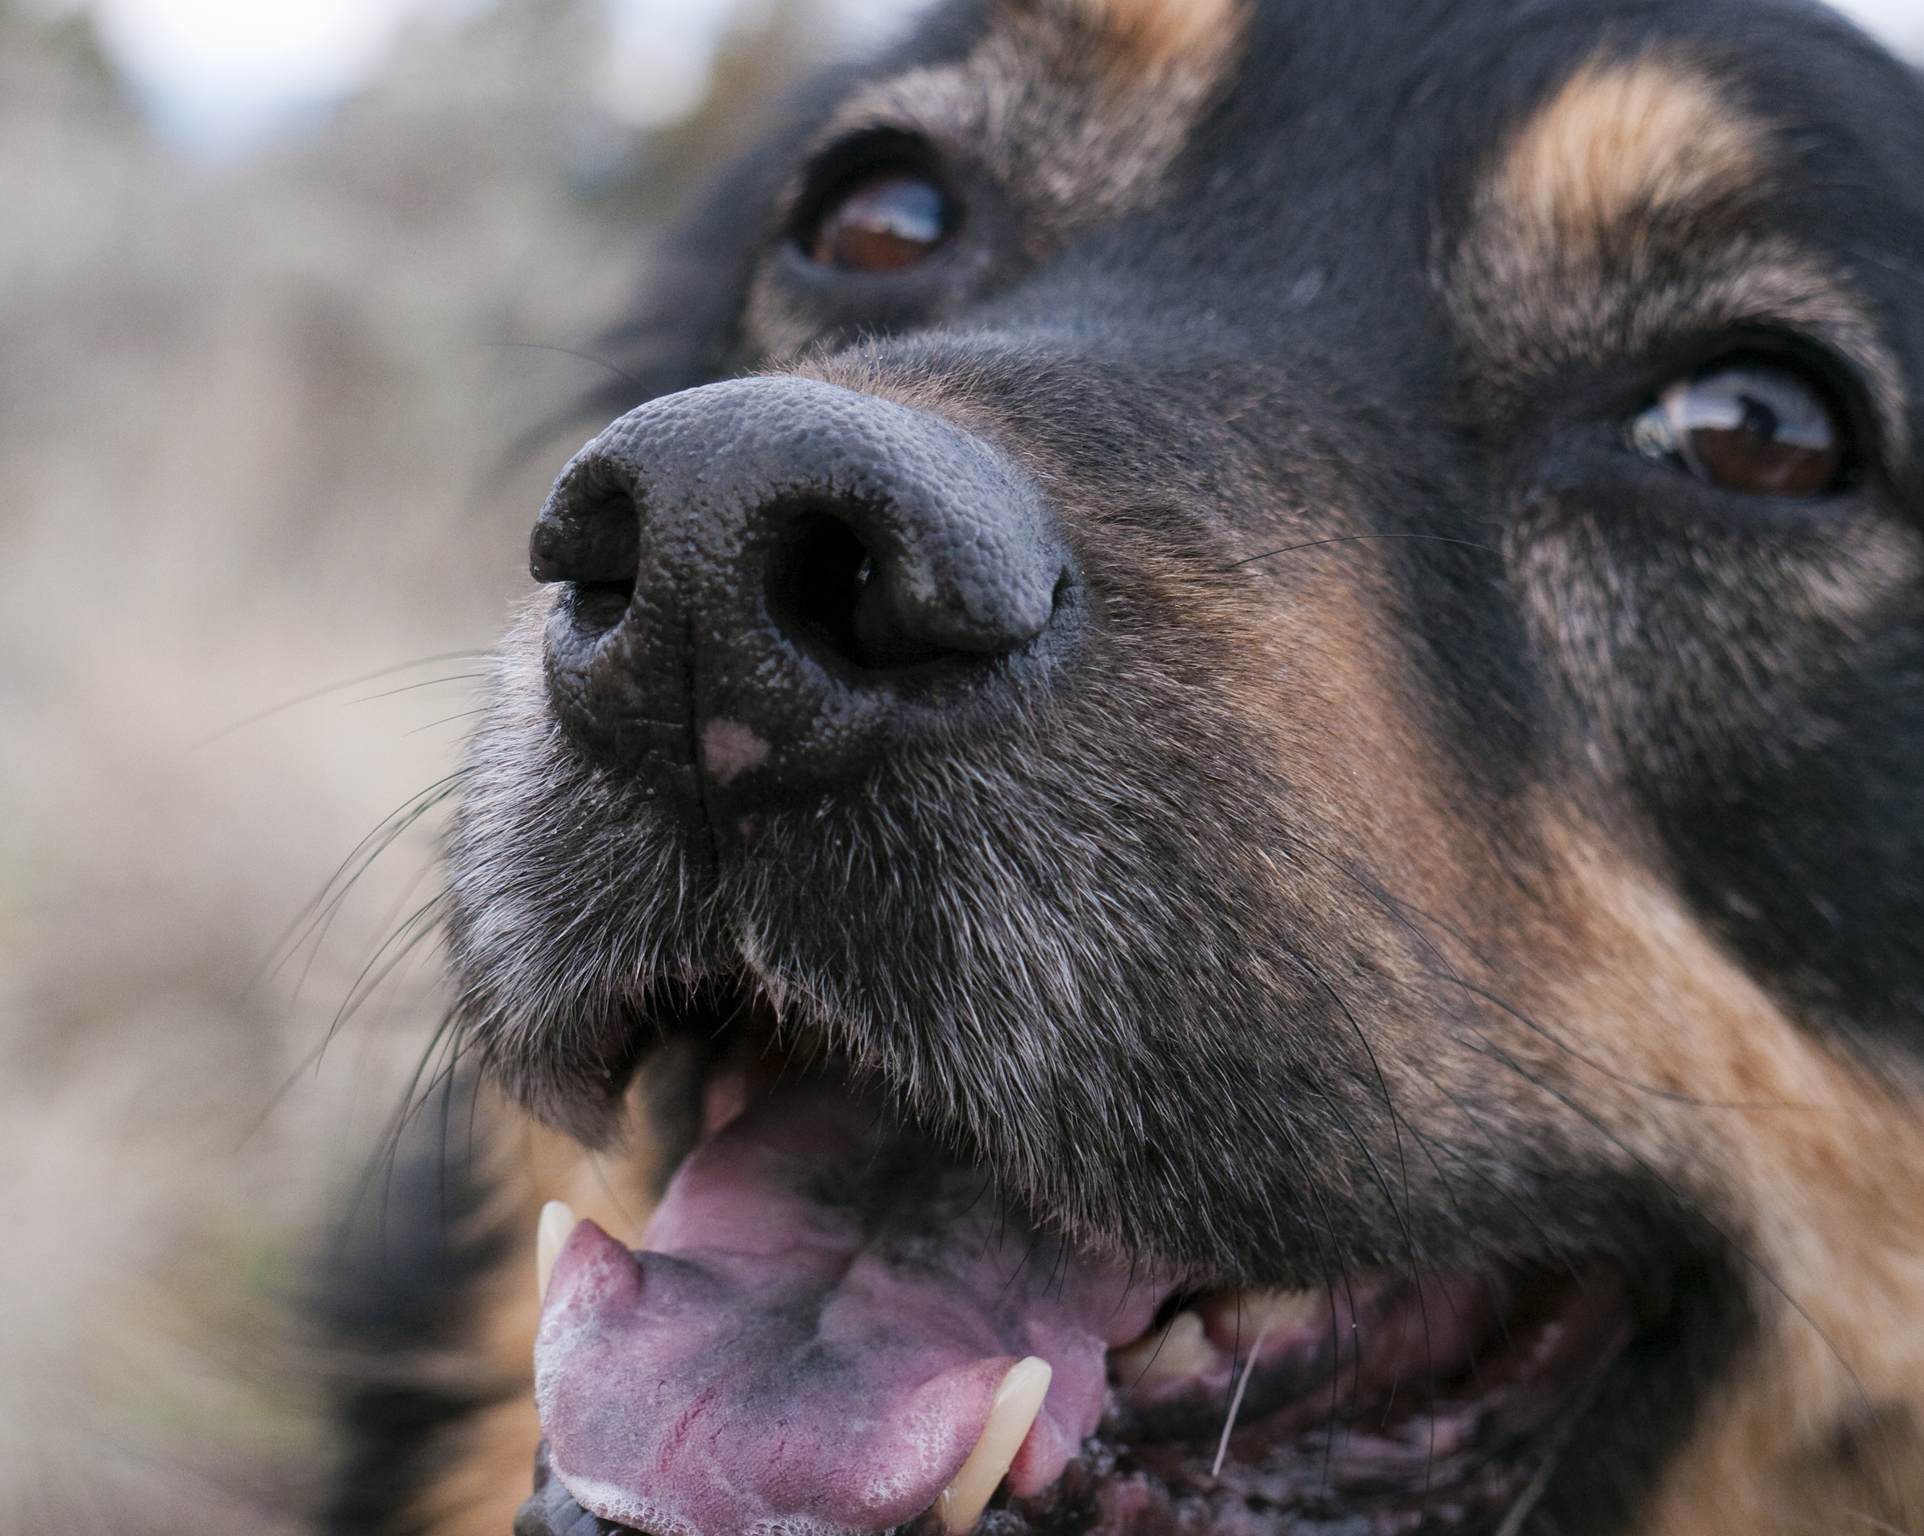

Slide 27
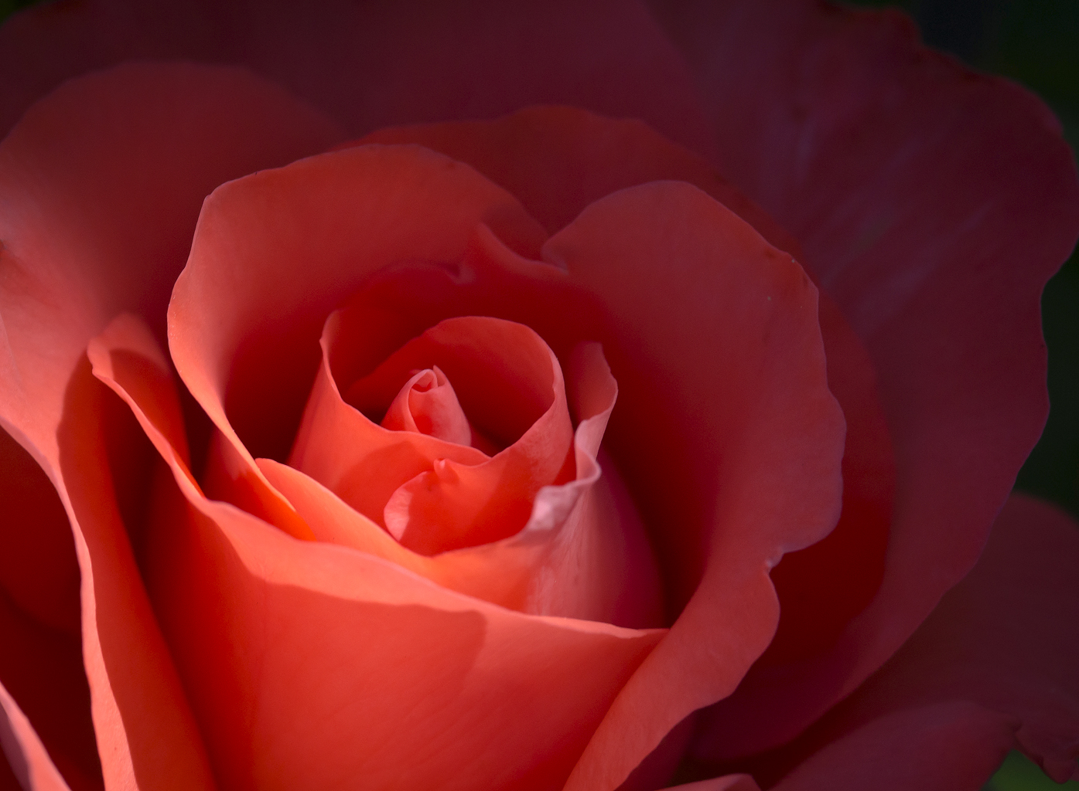

Slide 28
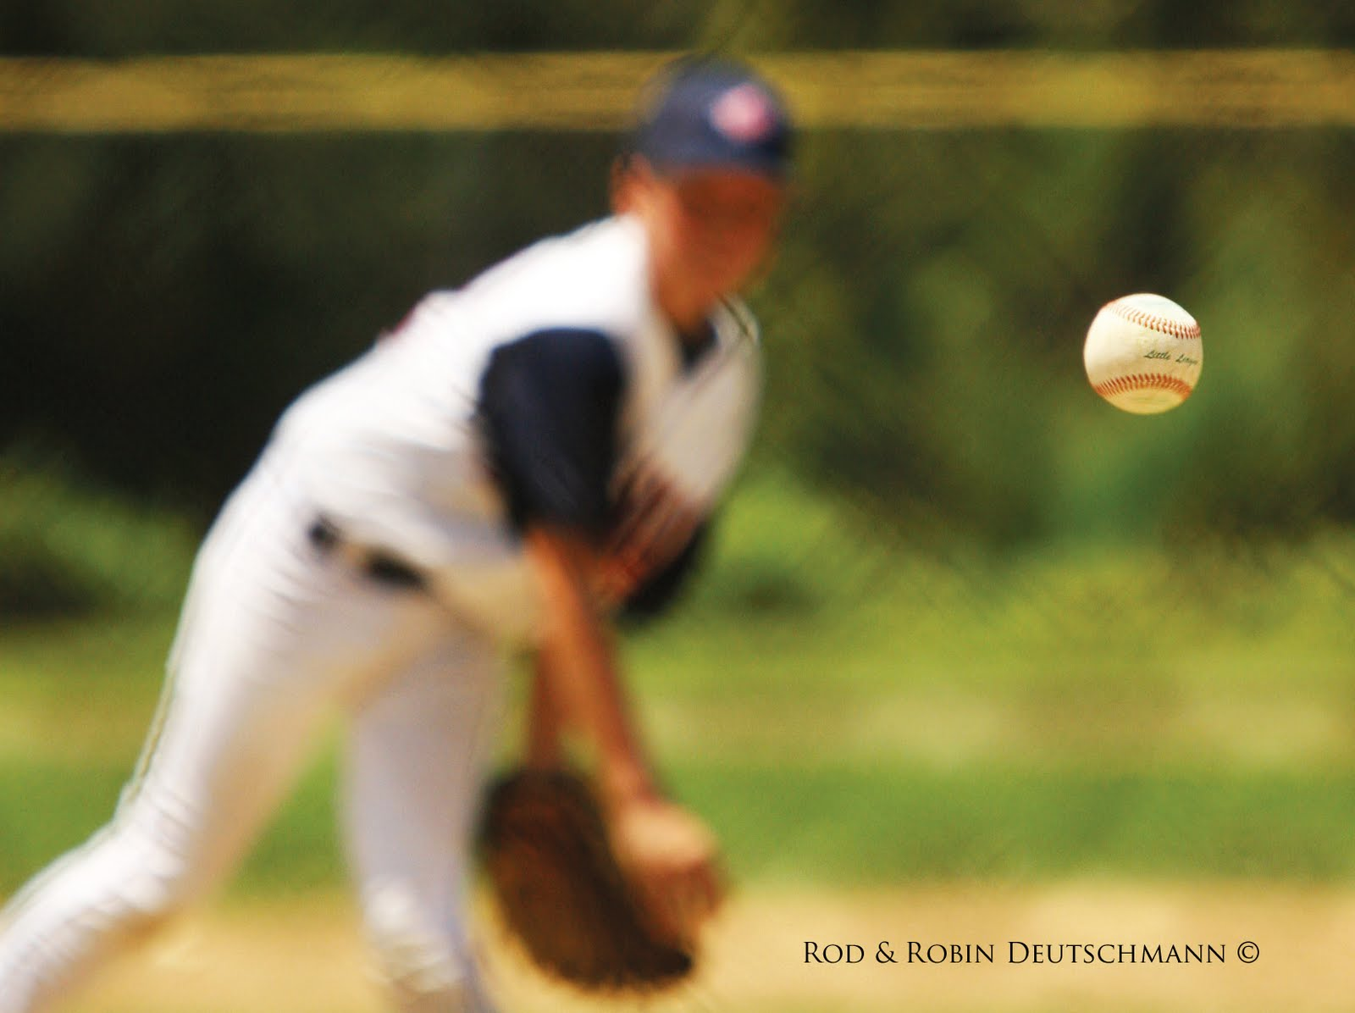

Slide 29
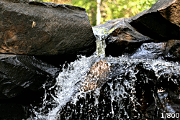
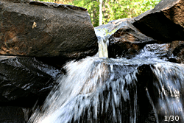
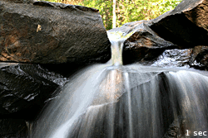
SHUTTER SPEED:

Slide 30
ISO
In Digital Photography ISO measures the sensitivity of the image sensor.
The same principles apply as in film photography – the lower the number the less sensitive your camera is to light and the finer the grain.
Higher ISO settings are generally used in darker situations to get faster shutter speeds (for example an indoor sports event when you want to freeze the action in lower light) – however the cost is noisier shots.

Slide 31
ISO is the abbreviation for the International Organization of Standardization, a governing body based in Europe that provides the standards for a wide variety of subjects.
In the past this was known as ASA or the American Standards Association (Now discontinued and replaced by the American National Standards Institute or ANSI), and you could buy your films in ASA 50, 100, 200, 400, 800 and 1600.

Slide 32
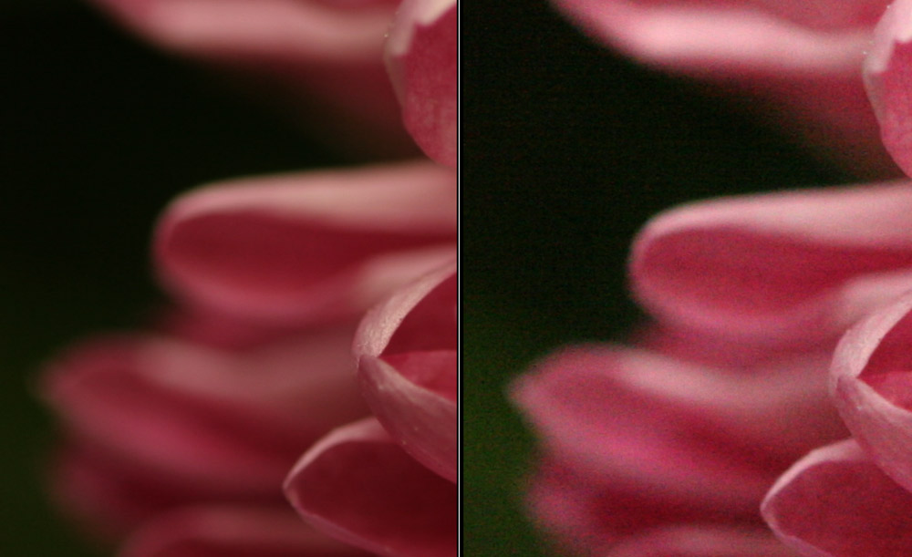
ISO 100
ISO 3200

Slide 33
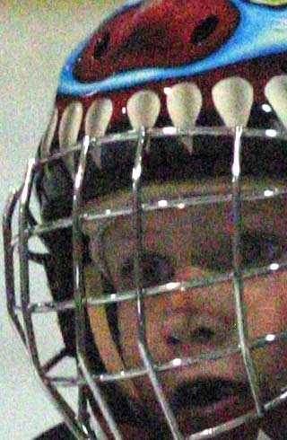
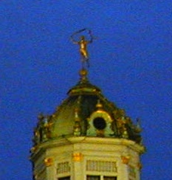
HIGH ISO
Chromatic Aberation/digital noise

Slide 34
Color temperature is conventionally stated in the unit of absolute temperature, the kelvin, having the unit symbol K.
Color temperatures over 5,000K are called cool colors (blueish white), while lower color temperatures (2,700–3,000 K) are called warm colors (yellowish white through red)
In digital photography, color temperature is sometimes used interchangeably with white balance, which allow a remapping of color values to simulate variations in ambient color temperature.
Most digital cameras and RAW image software provide presets simulating specific ambient values (e.g., sunny, cloudy, tungsten, etc.) while others allow explicit entry of white balance values in kelvins.

Slide 35
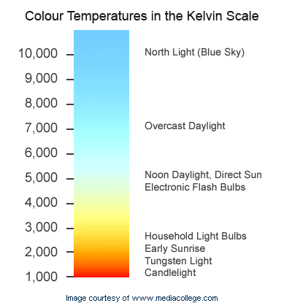

Slide 36
FILE FORMATS:
RAW: (Nikon: NEF; Canon: CR)
What the sensor sees. Un-processed. Requires that you do the processing, and requires software: RAW conversion.
Allows most latitude for post processing
JPG: also jpeg: Joint Photographic Experts Group
Camera processes image based on manufacturer’s idea of what the consumer prefers.
File is then compressed. Every time you process and save a JPG file, it is damaged slightly. (Lossey)
TIFF: (Tagged Image File Format):
Non-Lossey, uncompressed file. Large size. Used post-processing for archival storage.

Slide 37
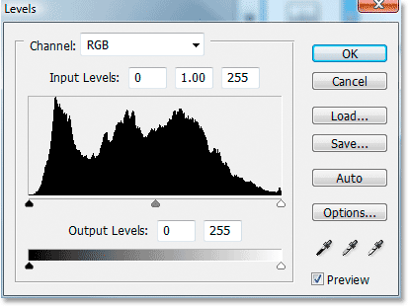
Post Processing:
Important adjustments to fine tune your image:
LEVELS:
HISTOGRAM in LEVELS:

Slide 38
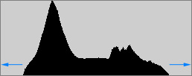

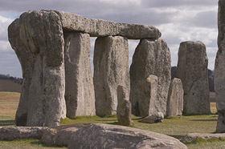
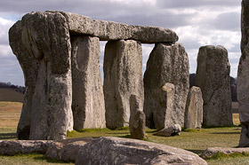
Most images look best when they utilize the full range dark to light which can be displayed on your screen or in a print.
Images which do not extend to fill the entire tonal range often look washed out and can lack impact.
Credit: Cambridge in Colour.com

Slide 39
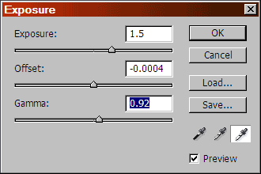
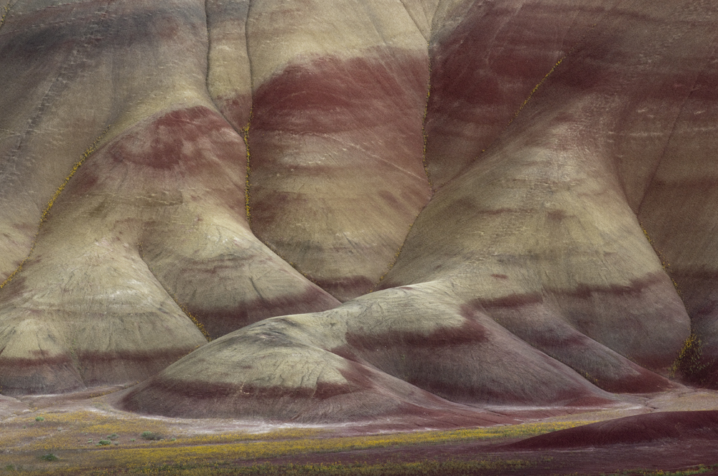
EXPOSURE
Image: Earthbound Light.com

Slide 40
Increase the Exposure sufficiently and the image will turn solid white.
Set it low enough and you will end up with solid black.
The Exposure Adjustment dialog has three controls: Exposure, Offset, and Gamma.
Exposure slider increases brightness throughout the image:
Increases brightness of highlights more than shadows.
Offset stretches the tonal range downward:
Darkens the shadows without overly influencing the highlights.
while only moderately affecting the rest of the image.
Gamma slider increases or decreases the mid-tone brightness of the image,

Slide 41
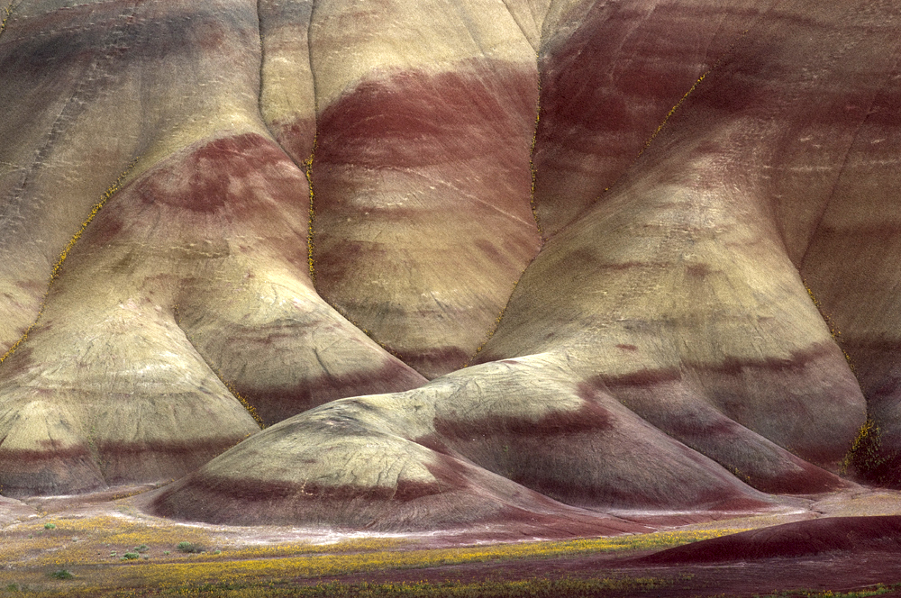
Original
JUST using Exposure

Slide 42
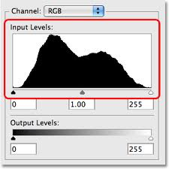
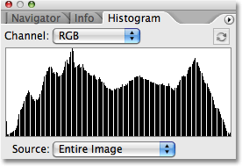
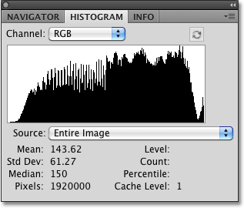
Original
Missing substantial tonal information
Moderate adjustment

Slide 43
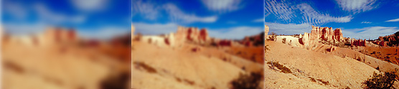
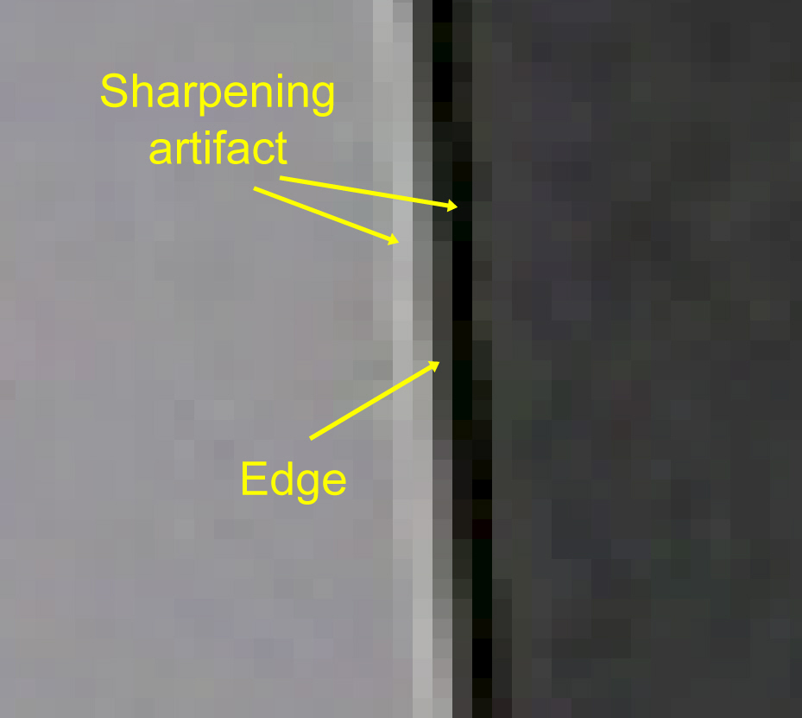
SHARPENING: THE LAST STEP !!!!!!
A digitally necessary optical illusion
Sharpening makes
the edge of the lighter block a lighter value of gray,
and
the edge of the darker block a darker value of gray.
Over-sharpening produces irregular edges.
Don’t go there

Slide 44


No Sharpening in RAW
Sharpened 45% in Smart Sharpen

Slide 45


DON’T OVER-Sharpen.
Sharpening should be a step of fine-tuning.
IT IS THE LAST ADJUSTMENT YOU MAKE.
Sharpened
OVERSHARPENED

Slide 46



Slide 47

HDR Images
HDR, or High Dynamic Range, allows us to produce an image where deep shadows and highlights are readily seen.
It replicates the way we might see a high contrast scene by allowing our eyes to adjust for shadows, and then highlights.
The technique requires that you shoot multiple, bracketed exposures, over-exposed to under-exposed, and then combine them in software such as Photomatrix Pro.
Some newer cameras also allow you to do this “in camera” and produce a finished jpg.

Slide 48


Slide 49

It is possible to produce a natural-looking scene,
and for geophotography, it is important to avoid extremes.
Your objective should be to reveal geologic features, rather than an off-color or extreme image.

Slide 50


Slide 51


Slide 52


Slide 53


Slide 54


Slide 55


Slide 56


Slide 57


Slide 58

Phyllite, Salmon River, ID
CAPTURE THE EYE

Slide 59

Yellow Aster Meadows, North Cascades
Use images that capture
the curiosity of the audience and the beauty of your subject.

Slide 60

FOREGROUND plus Background tell the story.
Chert, Franciscan Melange, Eureka, CA

Slide 61

Getting the image right in the start is important:
a. Composition: Leading lines, capture the eye.
b. Foreground, mid-ground, background
c. Polarizer
d. Exposure– Expose for highlights; Watch what you are metering.
e. Keep depth of field, ISO, aperture, and
shutter speed in mind.
2. Shoot in the RAW. Don’t let your camera make all the decisions.
3. Post-processing: A few adjustments can make your image show what you envisioned.
a. Levels
b. Exposure
c. sharpening
d. and many others.
4. Practice, Practice, and Play.
SUMMARY: Most important points:

Slide 62

Thanks
for your
time!
Ellen Morris Bishop
Scale is good!

Slide 63

Geophotography
Webinar Series
March 12: No session. Work independently on your personal portfolio development
March 19: Steve Weaver, Beyond the snapshot: making the excellent Geo-photograph in the field
March 26: Marli Miller, Geophotography as Public Outreach
April 2: David Mogk, Geophotography as Pedagogy: Students Creating and Using Geologic Images

