Slide 1
Planning for Post-Event Personal and Community Resilience
The next big disaster is not a matter of if, but when.
It’s time to get ready, Alaska!

Slide 2

How do you respond, SMILE?

Slide 3
Resilience is the ability to anticipate risk, limit impact, and bounce back rapidly through survival, adaptability, evolution, and growth in the face of turbulent change
Resilient communities minimize any disaster’s disruption to everyday life and their local economies. Resilient communities are not only prepared to help prevent or minimize the loss or damage to life, property, and the environment, but they also have the ability to quickly return people to work, reopen businesses, and restore other essential services needed for a full and timely economic recovery.

Slide 4
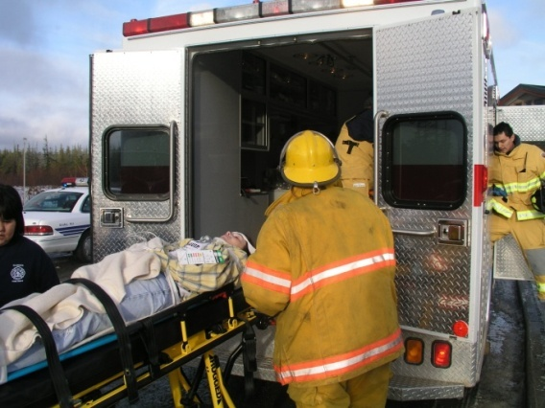
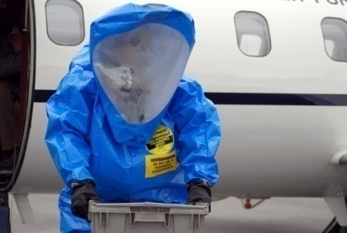
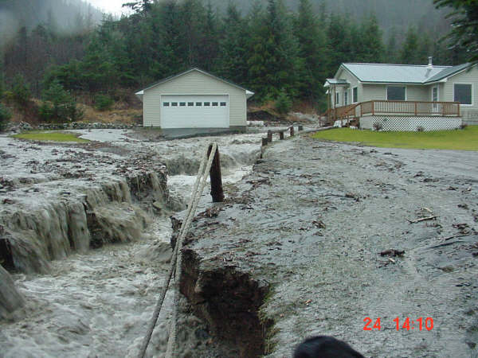
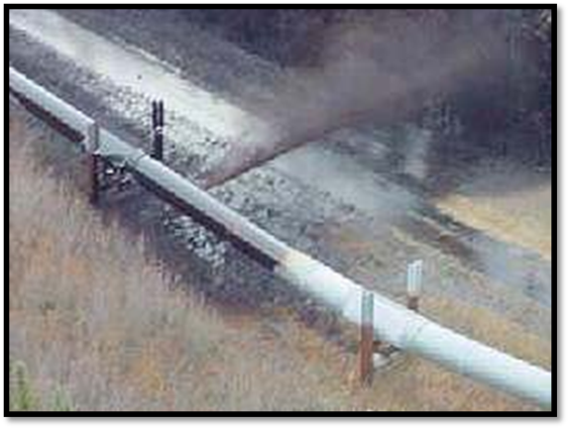
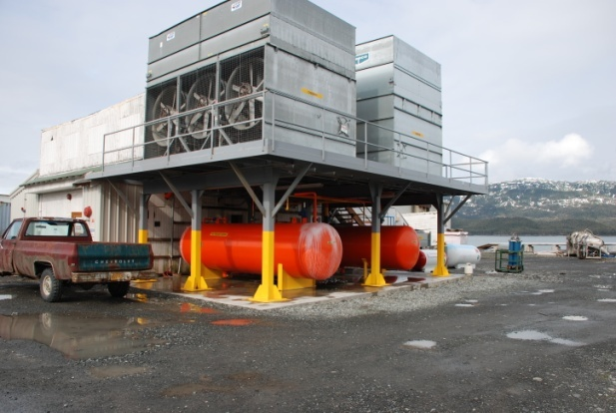
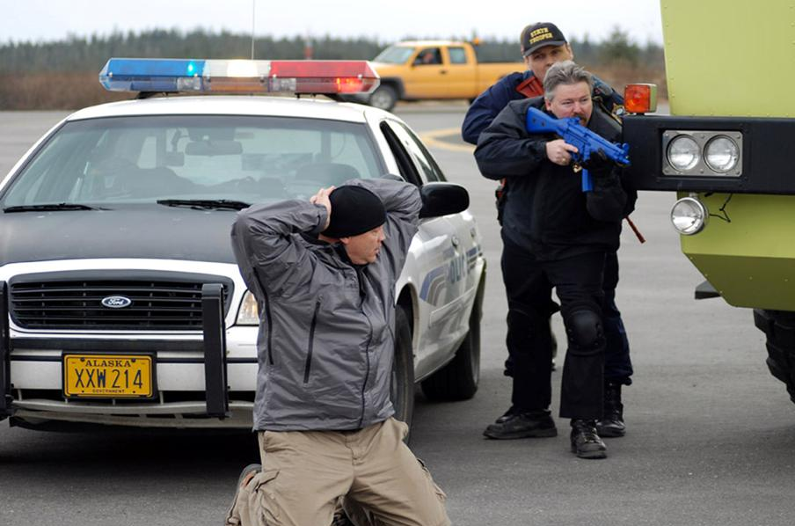
Alaska faces a wide variety of natural, and man-made hazards
Avalanche
Earthquakes
Landslides/Mudslides
Tsunamis
Volcanic Eruption
Coastal Storm Surge
Extreme Cold
Flooding
Ice Jams/Flows
Wildfires
Drought
Disease/Epidemics
Hazardous Materials Leak
Train Derailment
Building Collapse
Dam failure
Terrorist threats
Oil Spill/Pipeline Disruption
Fuel Storage Rupture
School violence

Slide 5
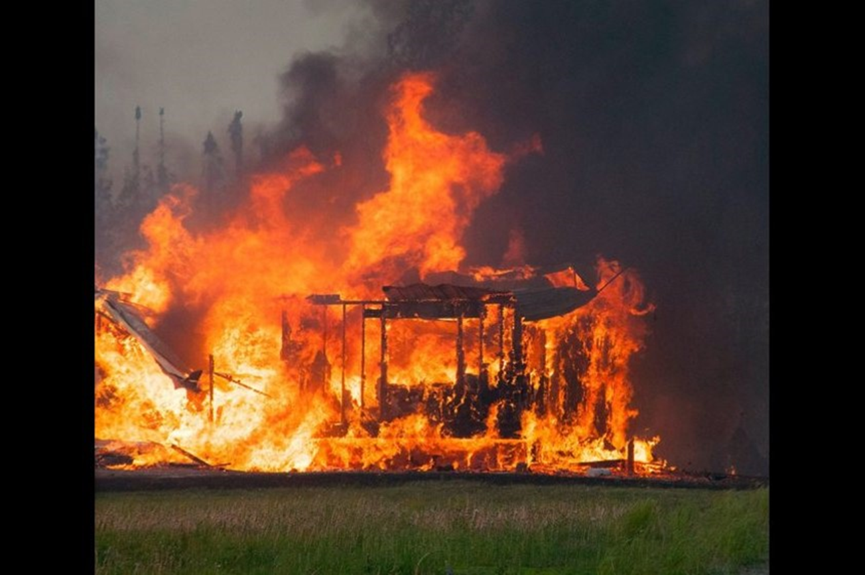
Wild Fires – 2015 Sockeye Fire
Notes:
At one point more than 300 fires were burning in summer of 2015

Slide 6
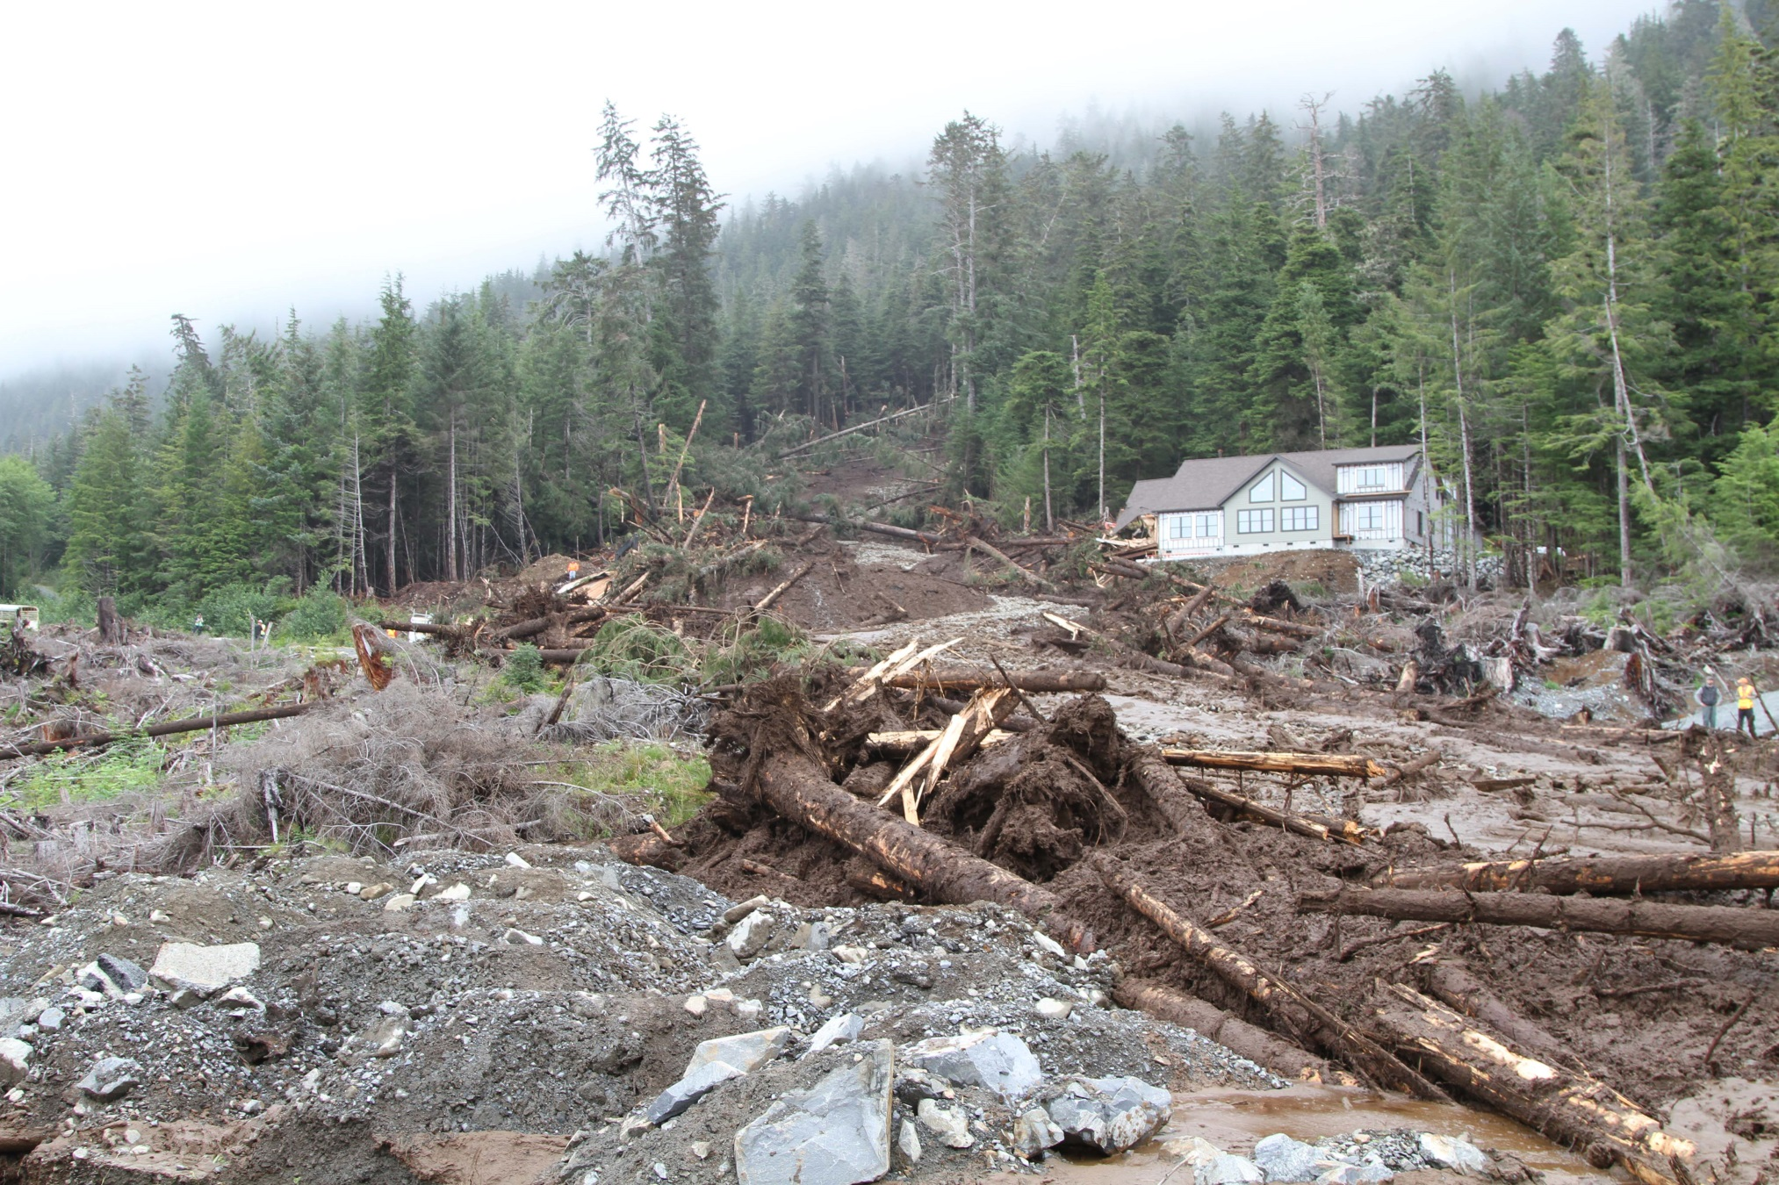
Landslides - 2015 Southeast Rains ,Sitka
Notes:
3 people lost their lives
Caused by heavy rain and high winds

Slide 7
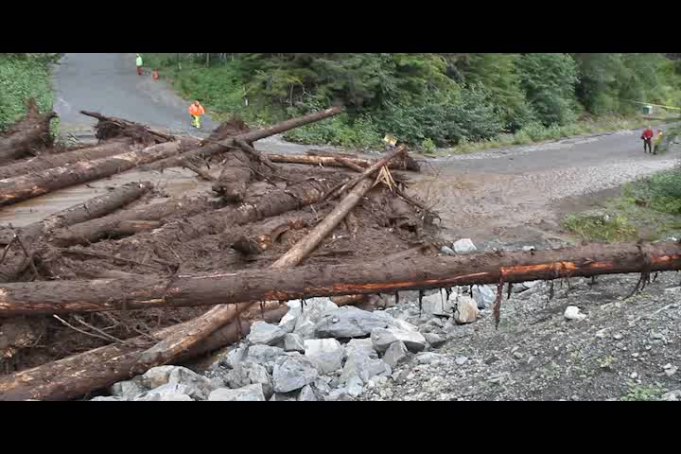

Slide 8
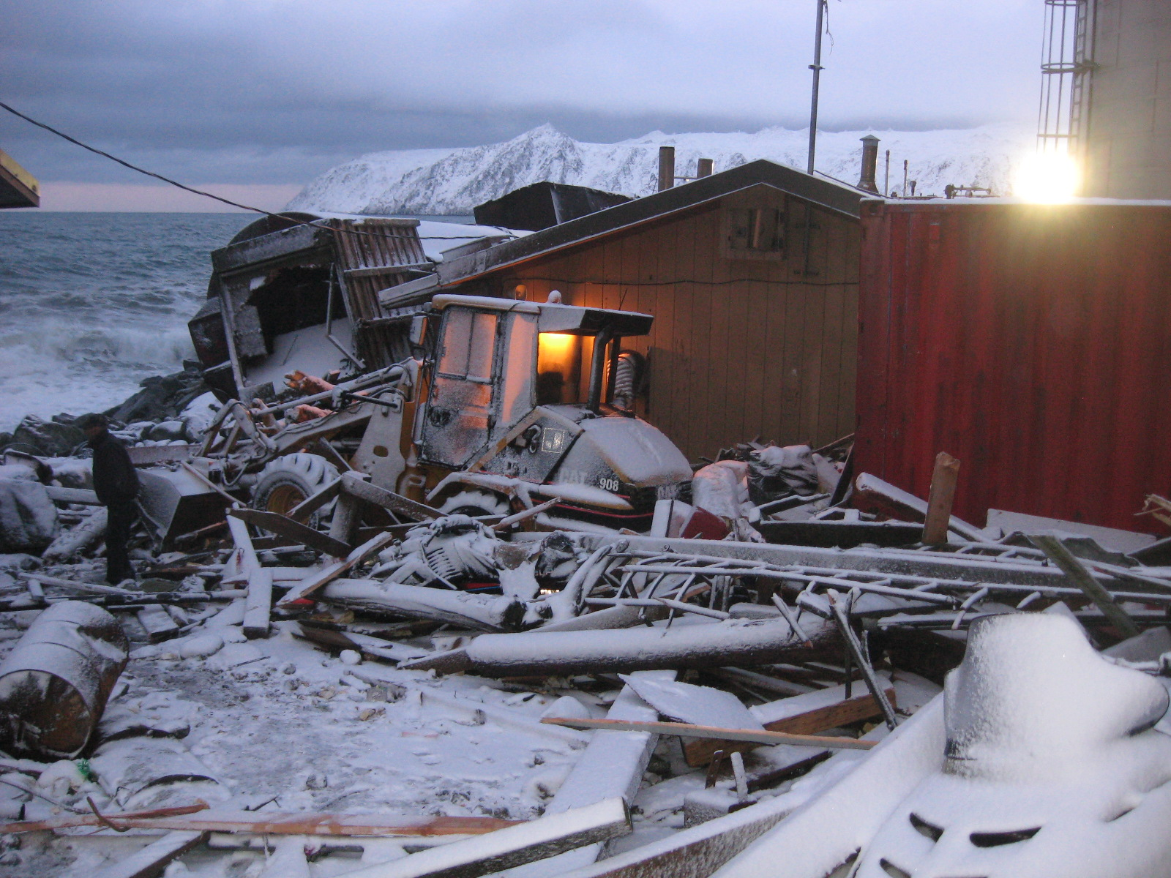
Sea Storms – 2011 Sea Storms, Little Diomede
Notes:
Previously called “Fall Sea Storms” – now shore fast ice that protects them from storms is coming later and later in the year, leaving Western Alaskan communities vulnerable for a longer period of time every year.

Slide 9
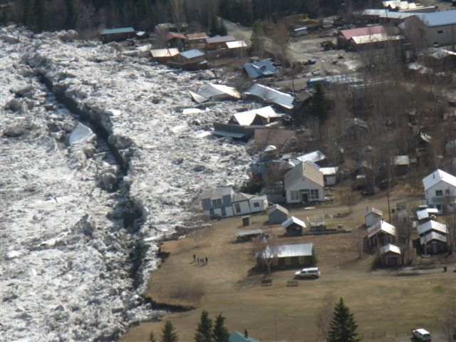
Floods - 2009 Spring Floods, Eagle
Notes:
Flooding is Alaska’s most common type of disaster. Ice jam flooding (when, why, how) Alaska deals with this on a larger scale than any other State.
Challenge is helping people rebuild – ice jams occur in spring, rebuilding before winter is difficult

Slide 10
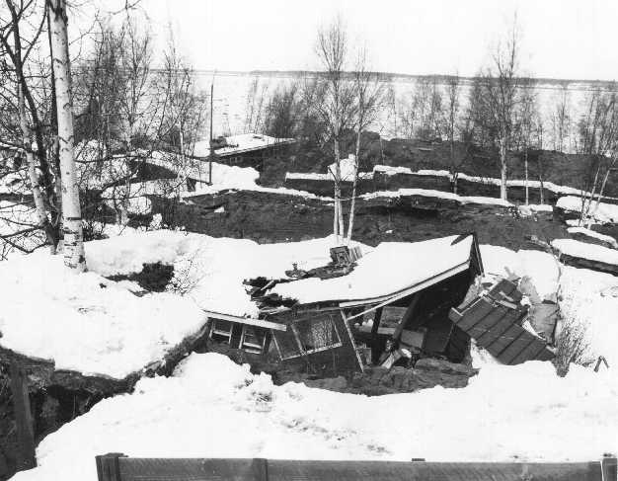
Earthquakes – 1964 Good Friday, Anchorage
Notes:
Largest EQ ever recorded in N. America, 2nd largest EQ ever recorded in the world (Chile, 9.5 in 1968)

Slide 11
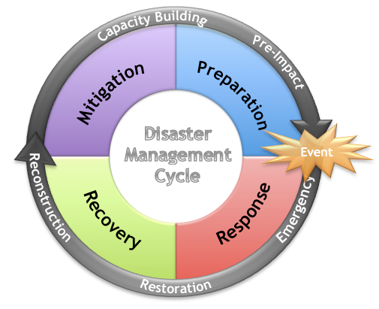

Slide 12
Prevention
Prevention of catastrophic breakdown of the system can take place from a breakdown of key elements.
Situational awareness is imperative to alerting people to impending emergencies or risk to the environment.
C-Cert (Campus Emergency Response Teams) increase situational awareness

Slide 13
Situational Awareness
Situational awareness enables students and staff to be informed and ready to accept breakdowns in communications and disruptions.
Society tends to be fairly resilient to high probability events because collectively we are accustomed to dealing with them. We learn ways to adapt to temporary disruption, but we tend to be much worse at displaying resiliency towards low probability/high consequence events.

Slide 14
How to Prepare For Disasters
Have a Plan
  How will your family communicate?
  Where will you go?
Have a Kit
  Supplies for 7 days (at least)
  Important personal items (medication, critical documents, pet supplies)
Mitigation
  Identify your community’s risk
  Mitigate against damages
Exercise
  Practice make a big difference

Slide 15
Emergency Plan
Primary emergency contact – phone/email
Secondary emergency contact – phone/email
Local Police number
Out-of-town contact – phone/email
Neighborhood meeting place
Out-of-neighborhood meeting place
Out-of-town meeting place
Other critical information
Why is it important to write an emergency plan?
Not only is it important to have a plan, but it is also imperative to share these plans with departments, faculty, and students so that everyone knows their responsibilities in the event of an emergency.
A well formulated plan, aids the school based law enforcement officer in being prepared in times of crisis.
A written plan can aid in planning contingencies if the plan is well formulated but still fails.
The written plan can help educate those who are directly impacted by the effects of an emergency situation on campus or its surroundings.

Slide 16
Building An Emergency Kit
Water
Food
Battery-powered radio
+ extra batteries
First Aid kit
Whistle
Personal protection supplies
Sanitation supplies
Plastic sheeting
  + duct tape
Tool kit
Garbage bags
Indoor safe heat source
Cold weather clothing
Unique family needs
Notes:
What different types of batteries do you need?
Extra shoes, gloves
Have a wood burning stove? Do you have extra firewood on hand?

Slide 17
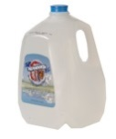

SUPPLIES FOR 7 DAYS
1 Gallon of water per person, per day for drinking, cooking, and cleaning.
=
A family of four needs
28 gallons of water
Notes:
Don’t need to use gallon jugs, can use larger water storage containers.

Slide 18
Building An Emergency Kit
Water
Food
Battery-powered radio
+ extra batteries
First Aid kit
Whistle
Personal protection supplies
Sanitation supplies
Plastic sheeting
  + duct tape
Tool kit
Garbage bags
Indoor safe heat source
Cold weather clothing
Unique family needs
Notes:
What different types of batteries do you need?
Extra shoes, gloves
Have a wood burning stove? Do you have extra firewood on hand?

Slide 19
Mitigation
Through mitigation and preparedness a campus has many tools available to educate, prepare, and inform of emergencies and disasters.
The most important aspect to resilience is through effective communication

Slide 20
Response and Recovery
Response and recovery happen at the same time. It is imperative that law enforcement communicates the response to an emergency as well as the recovery process.
Another facet of this communication can come from: web-site development and social media

Slide 21
Mock exercises
The tabletop exercise is a meeting to discuss a simulated emergency situation. Members of the campus emergency management team review and discuss the actions they would take in a particular emergency, testing their emergency operations plan in an informal, low-stress environment.
Tabletop exercises are used to clarify roles and responsibilities and to identify additional campus mitigation and preparedness needs. They should result in actions plans for continued improvement of the campus emergency operations plan.

Slide 22

www.ready.alaska.gov

