Slide 1
Teaching 3D visualization skills through the web-based Visible Geology application
Hannah Blatchford, Eastern Michigan University
Amy Weislogel, West Virginia University
Rory McFadden, Carleton College
Visible Geology Teaching Materials: https://serc.carleton.edu/310982

Slide 2
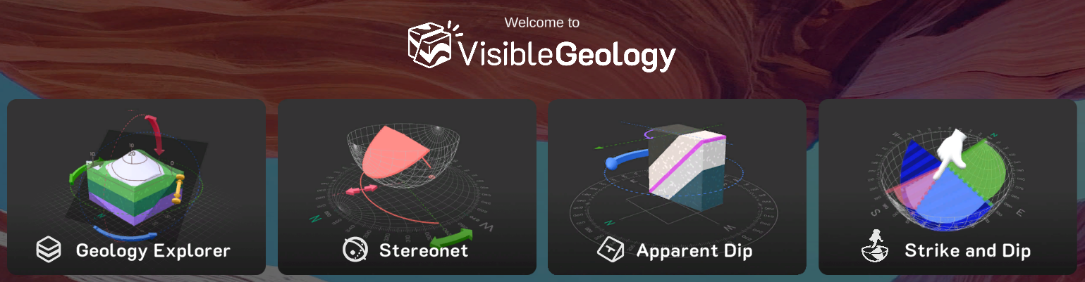
Welcome and Goals
Explore the Visible Geology web-based applications
Review example activities for majors-level courses including field methods, structural geology, and sedimentology/stratigraphy
Learn strategies for using the Visible Geology web-based applications in your courses
Notes:
Visible Geology was developed by Seequent. The new updates included additional tools in the Geology Explorer, Stereonet, and Apparent Dip, as well as a new module
the SERC teaching activity collection was launched in 2026

Slide 3
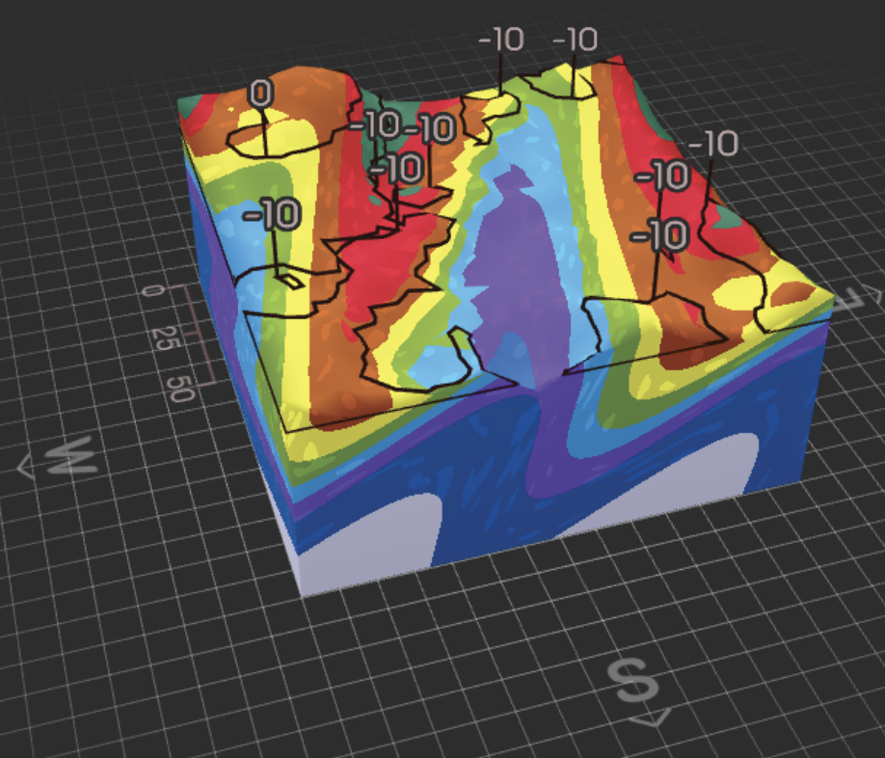
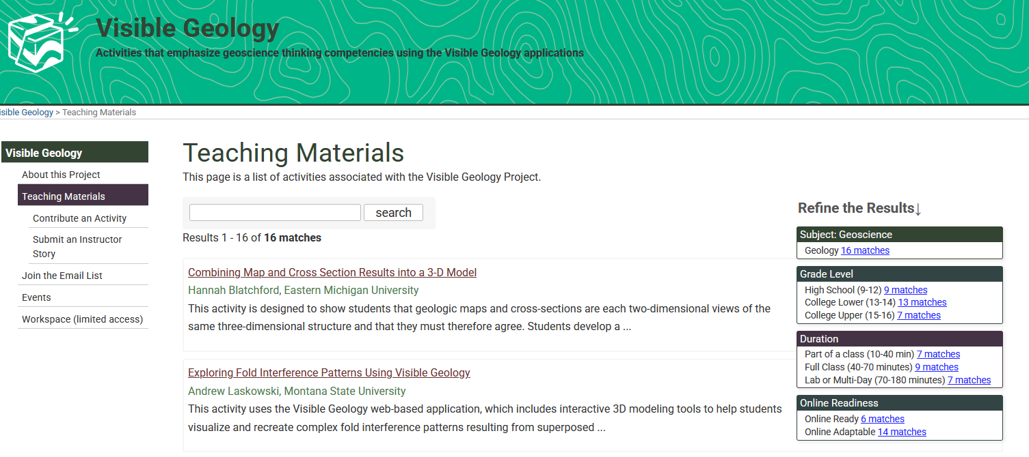
Visible Geology Teaching Materials
Collaboration between Seequent and SERC
Funding from Seequent
Author team created the majors-level activities over the 2025-2026 academic year
  Hannah Blatchford, Eastern Michigan University
  Amy Weislogel, West Virginia University
  Alyssa Abbey, California State University - Long Beach
  Andrew Laskowski, Montana State University
Pilot tested the activities in their courses
Over the same time period, group from University of Canterbury, led by Kate Pedley, developed activities for introductory courses

Slide 4
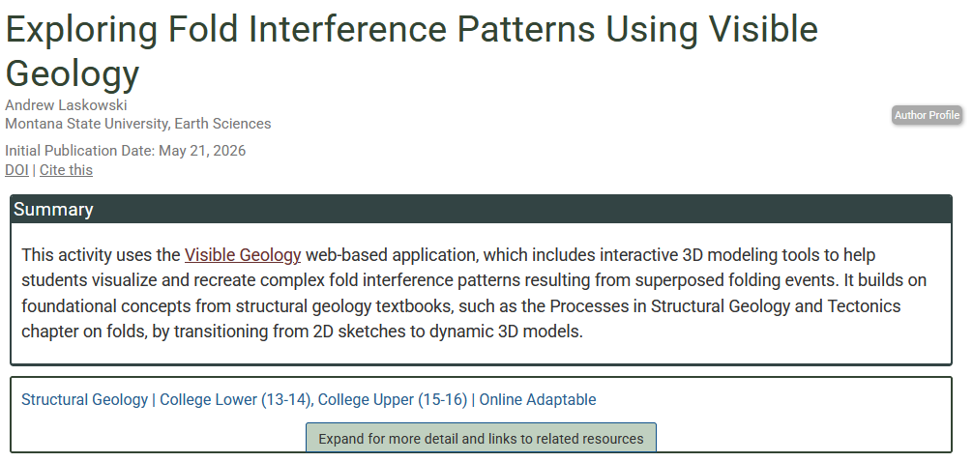
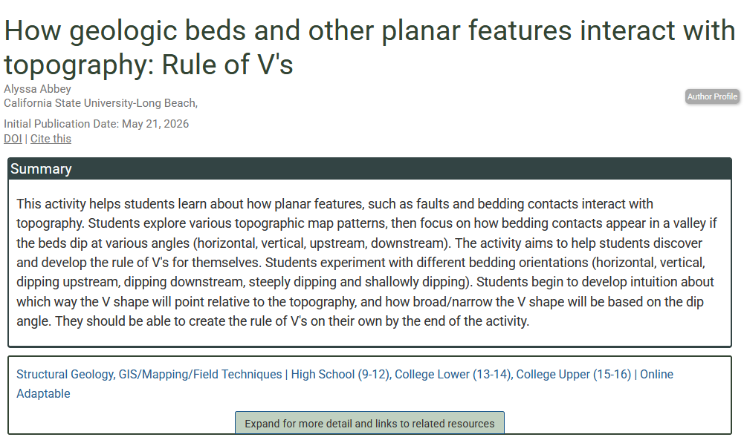
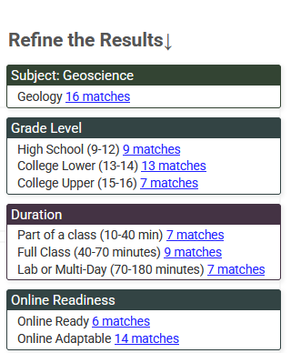
Teaching Activity Collection
Set of 16 activities
  For undergraduate students and appropriate for high school
    Introductory or field methods course
    Structure, tectonics, and field courses
    Sedimentology and stratigraphy
  Range from homework, in-class activity, or lab
  Learning goals, context, teaching materials, teaching tips
  Peer-reviewed
  Meet accessibility standards

Slide 5
Geoscientific Thinking
Interactive models - Provide students with 3D visualization practice
Scaffolded practice (through teaching activities) - Can improve 3D visualization and strengthen geoscientific thinking skills
Spatial reasoning and temporal reasoning are key parts of geoscientific thinking and important skills for the geoscience workforce
High variance in spatial reasoning
Spatial reasoning
Geologic structures in 3D, but maps, cross-sections, and stereonets are 2D
Students need to develop fluency move comfortably between 2D and 3D
Temporal reasoning
Deciphering geologic histories includes ordering events such as deposition, folding, faulting, intrusion, and erosion

Slide 6
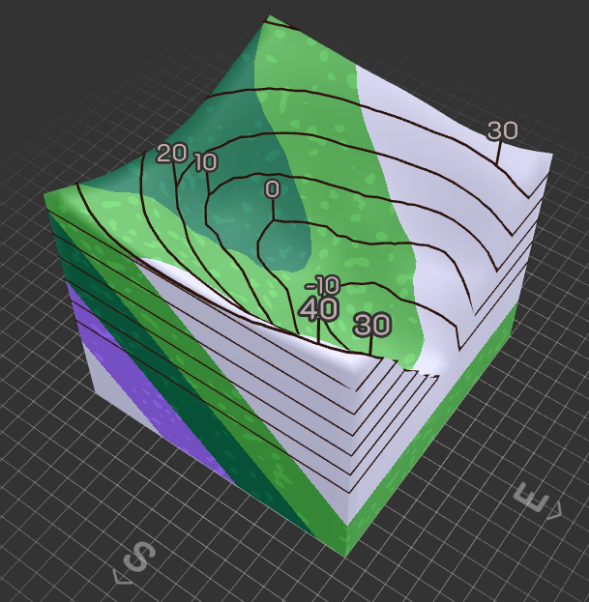
Why Visible Geology?
Freely available - log in with Google account
Easy to use - the interface is intuitive
Projects and groups make it easy share and organize models for classes and teams
Students assess pre-made models - interpret, critique and reverse-engineer an instructor model
  Practice visualizing structures and geologic relationships
Students create models - build a structure from maps, cross sections, and/or field data
  Part of geologic workflow
Notes:
Add images to highlight some of this

Slide 7

Poll Question
Who has used Visible Geology in teaching?
Notes:
Question mark - Piotr Siedlecki @ PublicDomainPictures.net

Slide 8
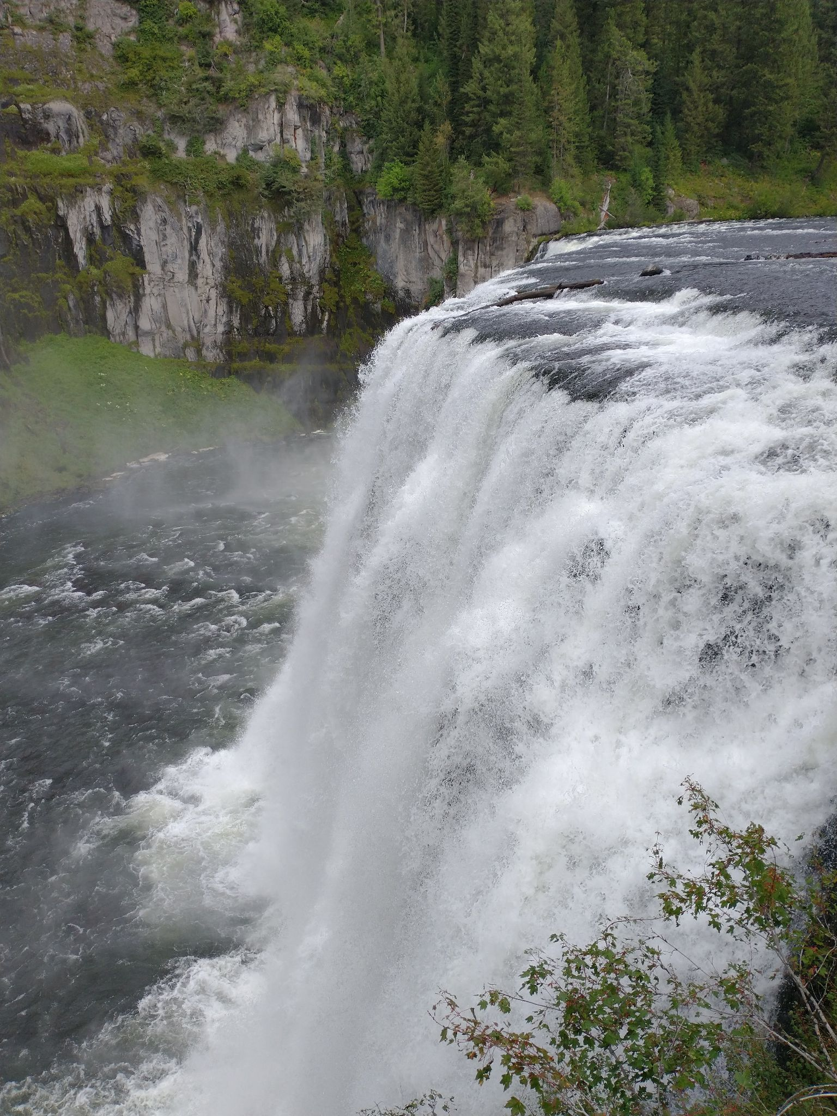
Waterfall Question
What is a positive outcome of using Visible Geology in your course?
Think about this for 15 seconds and then we’ll ask people to type their responses in the chat
Photo by Rory McFadden

Slide 9
Visible Geology Modules
Build and inspect 3D structures (folds, faults, intrusions, unconformities) with topography, strike/dip symbols, cross-sections, and cores
View stereographic projections in 2D and 3D
Link to geology explorer structures
Manipulate orientations of planes to build sense of true dip vs. apparent dip
Notes:
Brief overview of the modules. Highlight Geo Explorer and Stereonet

Slide 10
Model construction using maps and cross sections
Learning Goals
Evaluate accuracy and internal consistency of a hand-drawn map and cross section
Practice reading and interpreting topographic maps and producing 3-D models from 2-D representations
Predict the type and geometry of structures in part of field area lacking data
Audience
Geological Field Methods students (upper level)
Hannah Blatchford
Eastern Michigan University

Slide 11
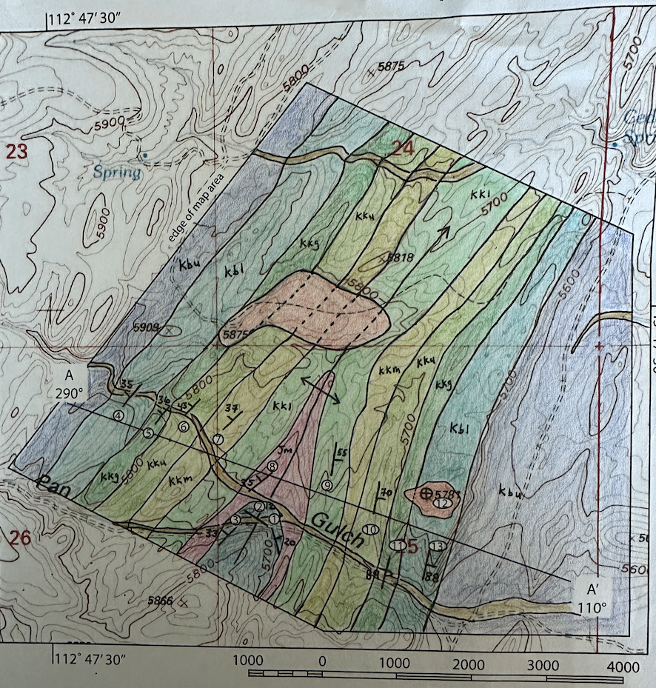
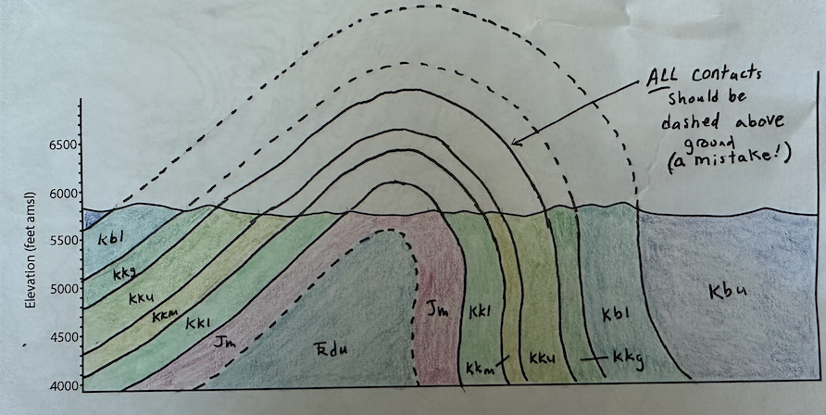
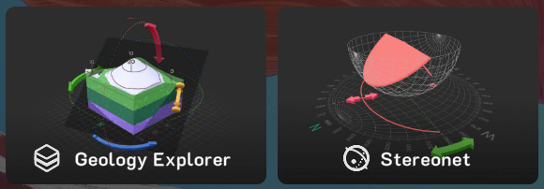
Activity is embedded within an established project
Students have already completed a paper-based map and cross section. Their final products are starting material for their 3D model.
Location: Frying Pan Gulch, part of Sevier fold and thrust belt of southwestern MT. Students mapped an east-vergent, north-plunging anticline within a larger field area.
Students use Visible Geology to construct a 3D model that allows them to make predictions about areas outside of their paper-based map area.
Module(s) used: Geology Explorer

Slide 12
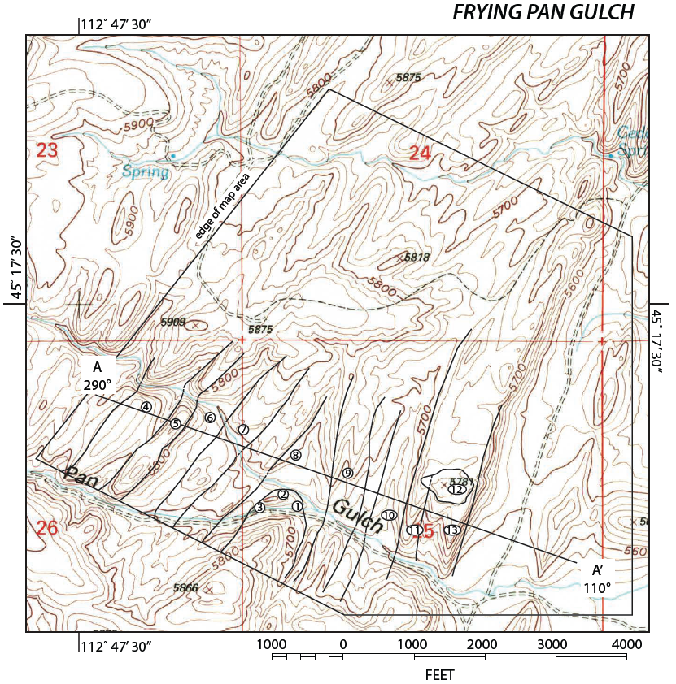
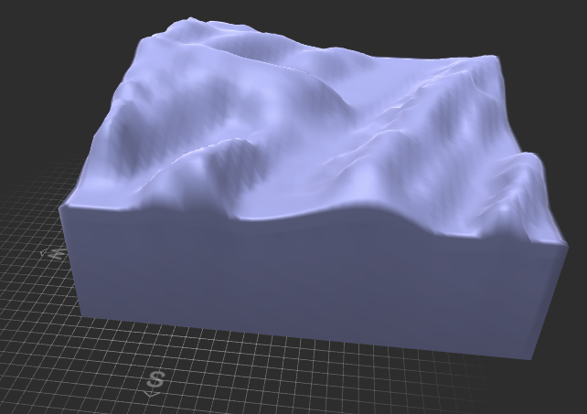
Describe the structure and deformation history evident from paper map and cross section as fully as possible.
Construct generalized topography of region, including area not mapped on paper. Use the geologic events tab to reproduce the geologic history and match the map and cross section.
Notes:
Rory: could demo the terrain sculpting tool if that would be useful
FPG consists of higher elevations to the west, a series of NE/SW-trending ridges. Some students identify the tilted layering is locally covered by younger gravel deposits.
For the depth of the project, relevant structures consists of an east-vergent, north-plunging anticline-syncline pair.

Slide 13
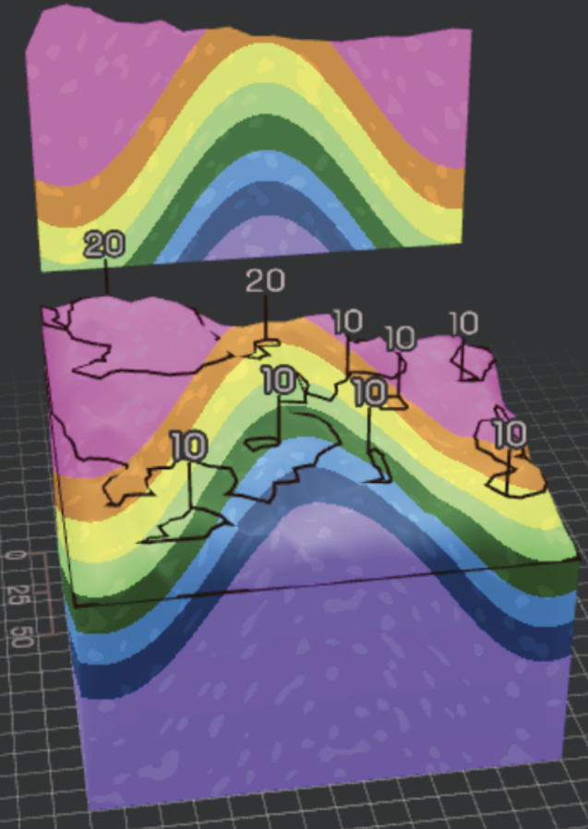
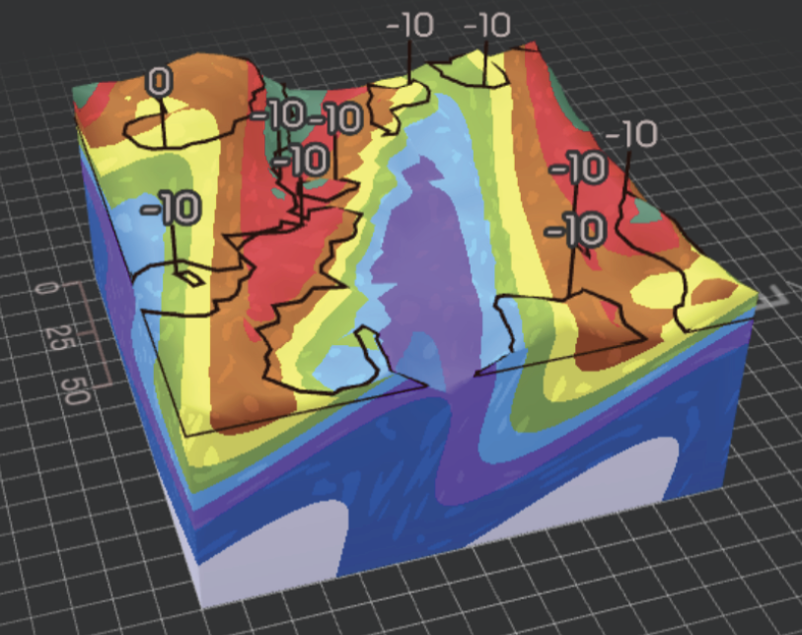
Reflect on differences between map, cross section, and model. Use the cross section tool to compare.
Use the model to make predictions about areas not initially mapped. Students only mapped the anticline, so their model allows them to predict the position and geometry of nearby folds.
Notes:
Students should be picking up on instances where their map and cross section did not agree
Upper model was produced by a student who was taking the class as an elective, an environmental science major
Lower model was produced by a geology major who had already taken structural geology and was selected for a mining internship. Their background before finding geology is in architecture/CAD.

Slide 14
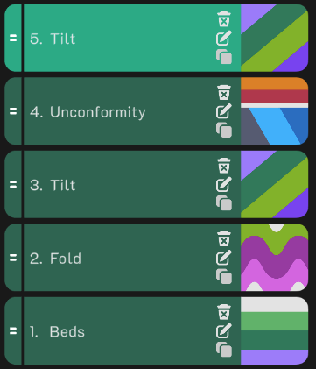
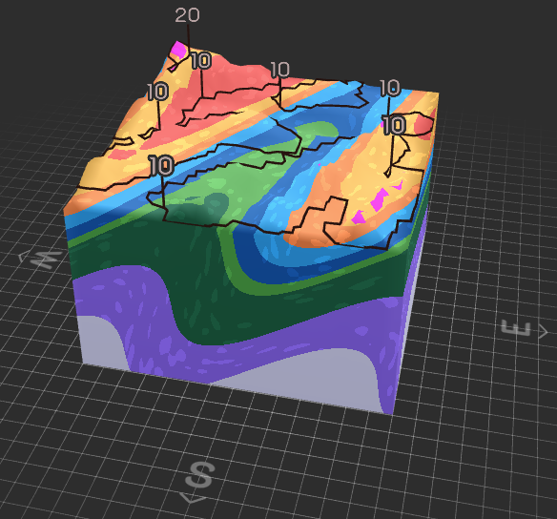
LEARNING GOAL | ASSESSMENT CRITERIA
Evaluate accuracy and internal consistency of a hand-drawn map and cross section | Identify discrepancies and offer revised interpretations
Practice reading and interpreting topographic maps and producing 3-D models from 2-D representations | Accurately represent generalized topography and a model of bedrock geology that adheres to provided constraints
Predict the type and geometry of structures in part of field area lacking data | Identify structures within model but outside of initial map area
Notes
  Easily adaptable to other field locations and courses.
  Introduce students to the relevant subset of tools ahead of time. It is easy to lose time sculpting terrain.
  Elevations do not match topography data.
  Relatively simple structures may require multiple "events” to produce, even though the structures show no evidence of overprinting deformation events.
Notes:
All pretty self-explanatory. I include these images to show that the process of reproducing the unconformably overlying gravels (hot pink) involves extra tilting steps that are not geologically meaningful.
If worthwhile, we can link to this model to rotate around, select a cross section, etc.

Slide 15
Cylindrically folded layers represented with maps and stereonets
Learning Goals
Develop an understanding of how map patterns and stereonets are related
Appreciate the ambiguity of some fold data presented on a stereonet
Discover independently how fold axes are represented on stereonets
Audience
Structural Geology students (upper level), assumed familiarity with planes and lines on stereonets and with basic fold geometry.
Hannah Blatchford
Eastern Michigan University

Slide 16
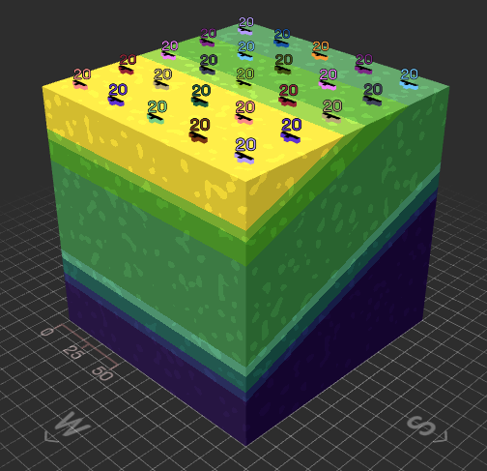
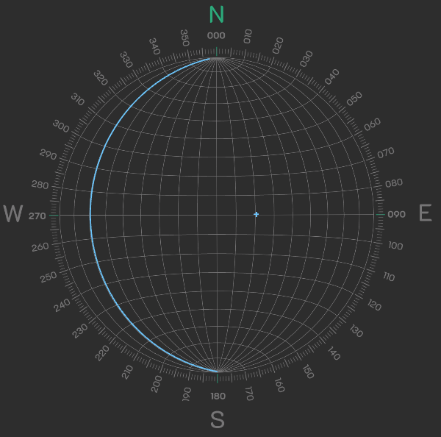
Activity is a standalone lab or homework assignment
Modules used: Geology Explorer, Stereonet
Students use paper-based assignment to answer questions about read-only models shared via URL.
Open model, describe structure as fully as possible using (fold) terminology discussed in lecture.
Import to stereonet module, describe pattern, consider where measurements in different parts of the stereonets are sourced from in the model.
Notes:
Motivation: Students are taught about folds and how folds appear on stereonets, but nuances are commonly missed, or not retained well.
-Ambiguity of stereonet patterns
-Loss of geographic information
-shape of fold and pattern of poles to planes
Activity: Investigate a series of tilted, folded, and tilted + folded layers in block models and stereonets to build appreciation of what stereonets do (and do not) reveal about cylindrically folded layers.
Modules used: Geology Explorer, Stereonet

Slide 17
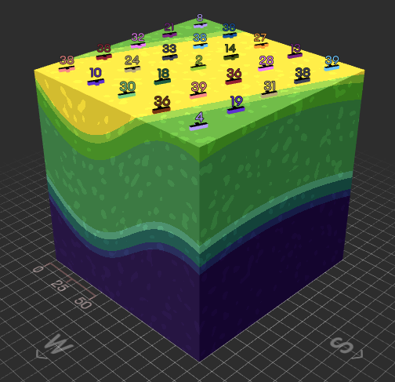
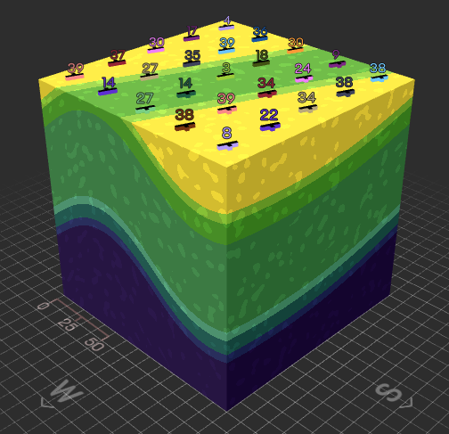
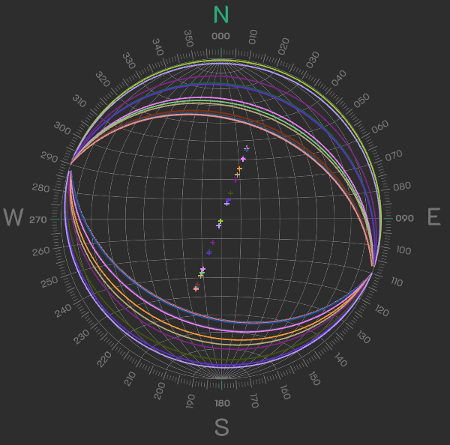
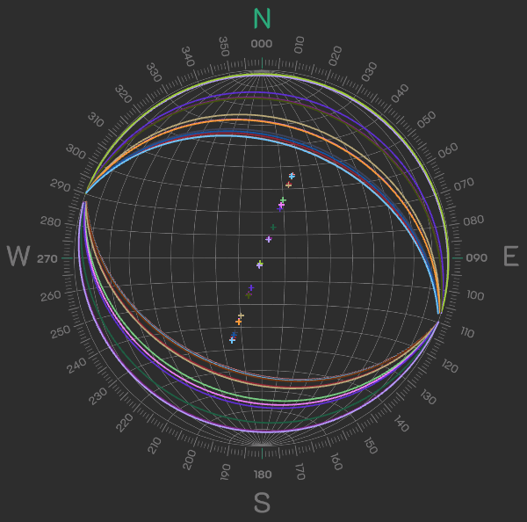
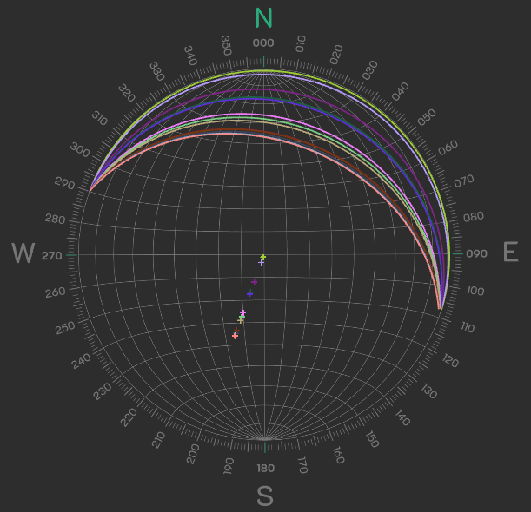
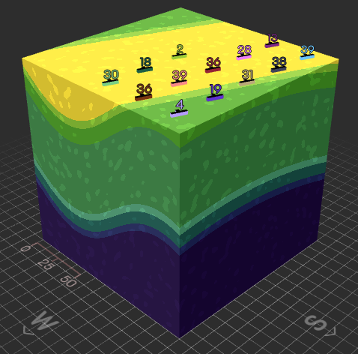
Anticlines and synclines produce the same pattern.
Position in stereonet independent of geographic position (i.e., north-dipping limbs need not be in the northern part of a map area)

Slide 18
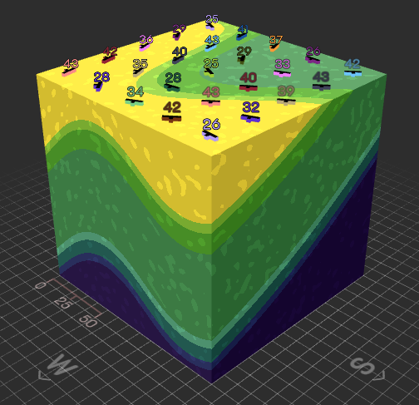
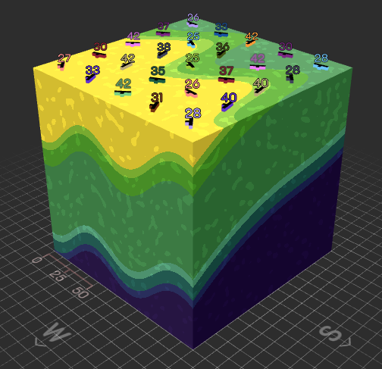
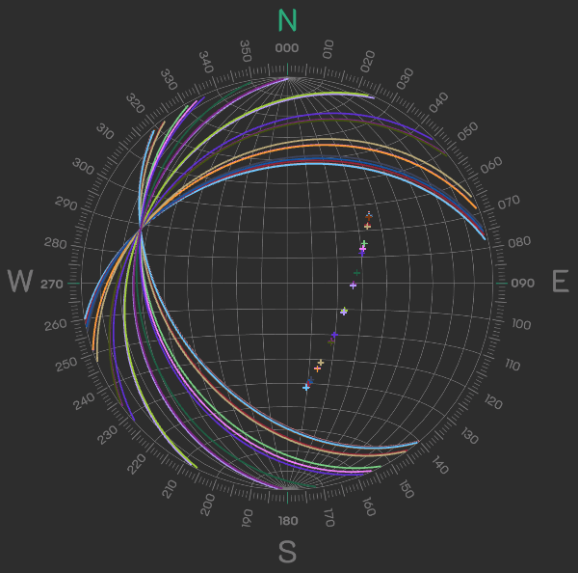
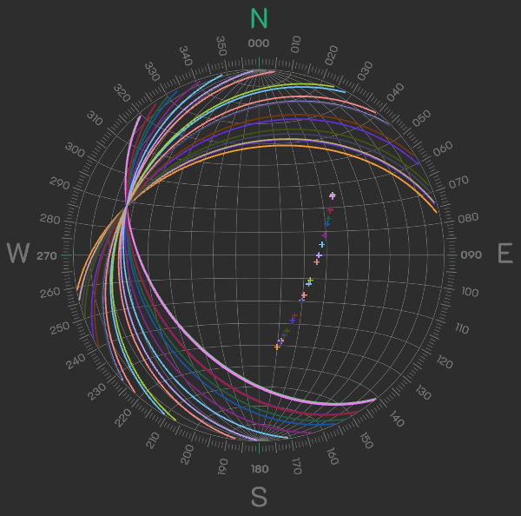
Folds of different amplitudes/wavelengths produce the same stereonet pattern
Default representation of data allows students to identify two ways that fold axes are represented (𝛽 and 𝜋 axes)
E.g., plunging folds: https://www.visiblegeology.com?sharecode=gG3KmVwUYwB7euQ8aeUmx2
Notes:
Students have already described the orientation of the fold axis qualitatively from their initial inspection, so they are then able to seek out features in the stereonet that correspond to that orientation. Ideally, they will stumble upon beta and pi axes. These can then be formally defined in a subsequent lecture or reading.

Slide 19
LEARNING GOAL | ASSESSMENT CRITERIA
Develop an understanding of how map patterns and stereonets are related | Describe how multiple map patterns may produce the same distribution of data on a stereonet
Appreciate the ambiguity of some fold data presented on a stereonet | Recognize that stereonets do not differentiate between folds of different scale or indicate relative position of fold limbs
Discover independently how fold axes are represented on stereonets | Accurately describe 𝜋 and 𝛽 axes, although correct terminology is not necessary
Notes:
  Fold models are easy to share, and other aspects of fold shape can be changed (e.g., chevron folds)
  Color-coding of strike/dip symbols is possible
  Show students how to move between modules. Must relaunch VG for each new stereonet import.
  All folds currently are similar in their geometry (Ramsay Class 2)

Slide 20
Basin Stratigraphic Correlation
Learning Goals
Develop geologic map reading skills
Practice basic lithostratigraphic correlation
Infer basin sedimentation history
Create a basin model
Audience
Introductory-level majors course or introductory activity of upper level majors course
Amy Weislogel
West Virginia University

Slide 21
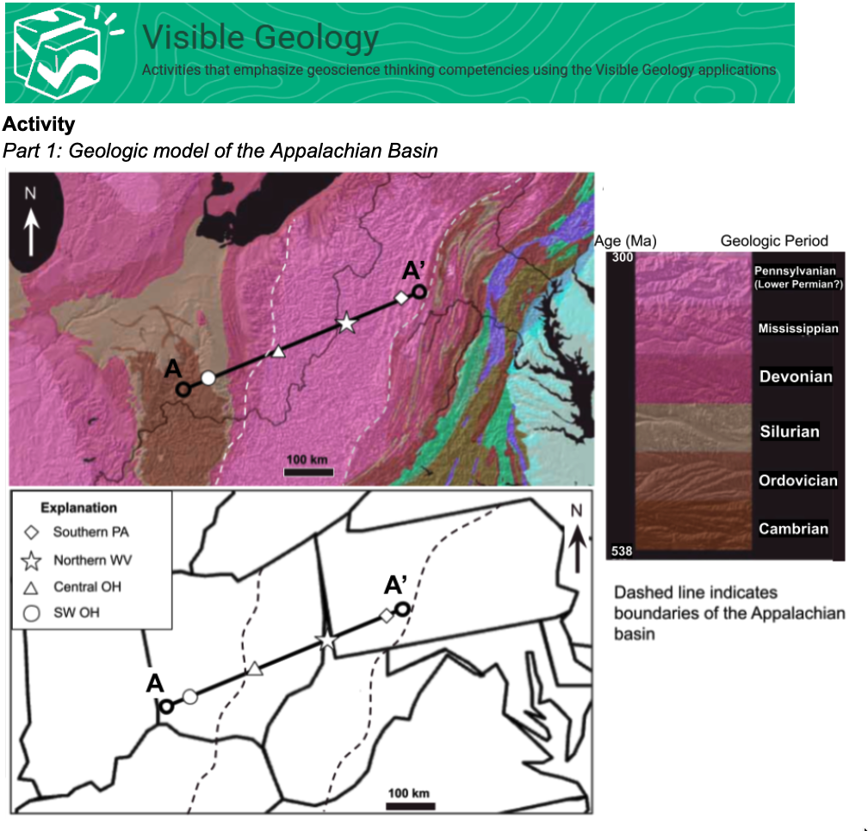
Geologic Map
Accessible color scheme
E-W transect
Several location of core
  3 locations are “known”
  Students are asked to predict relative thickness of units in northern WV as an “unknown”

Slide 22
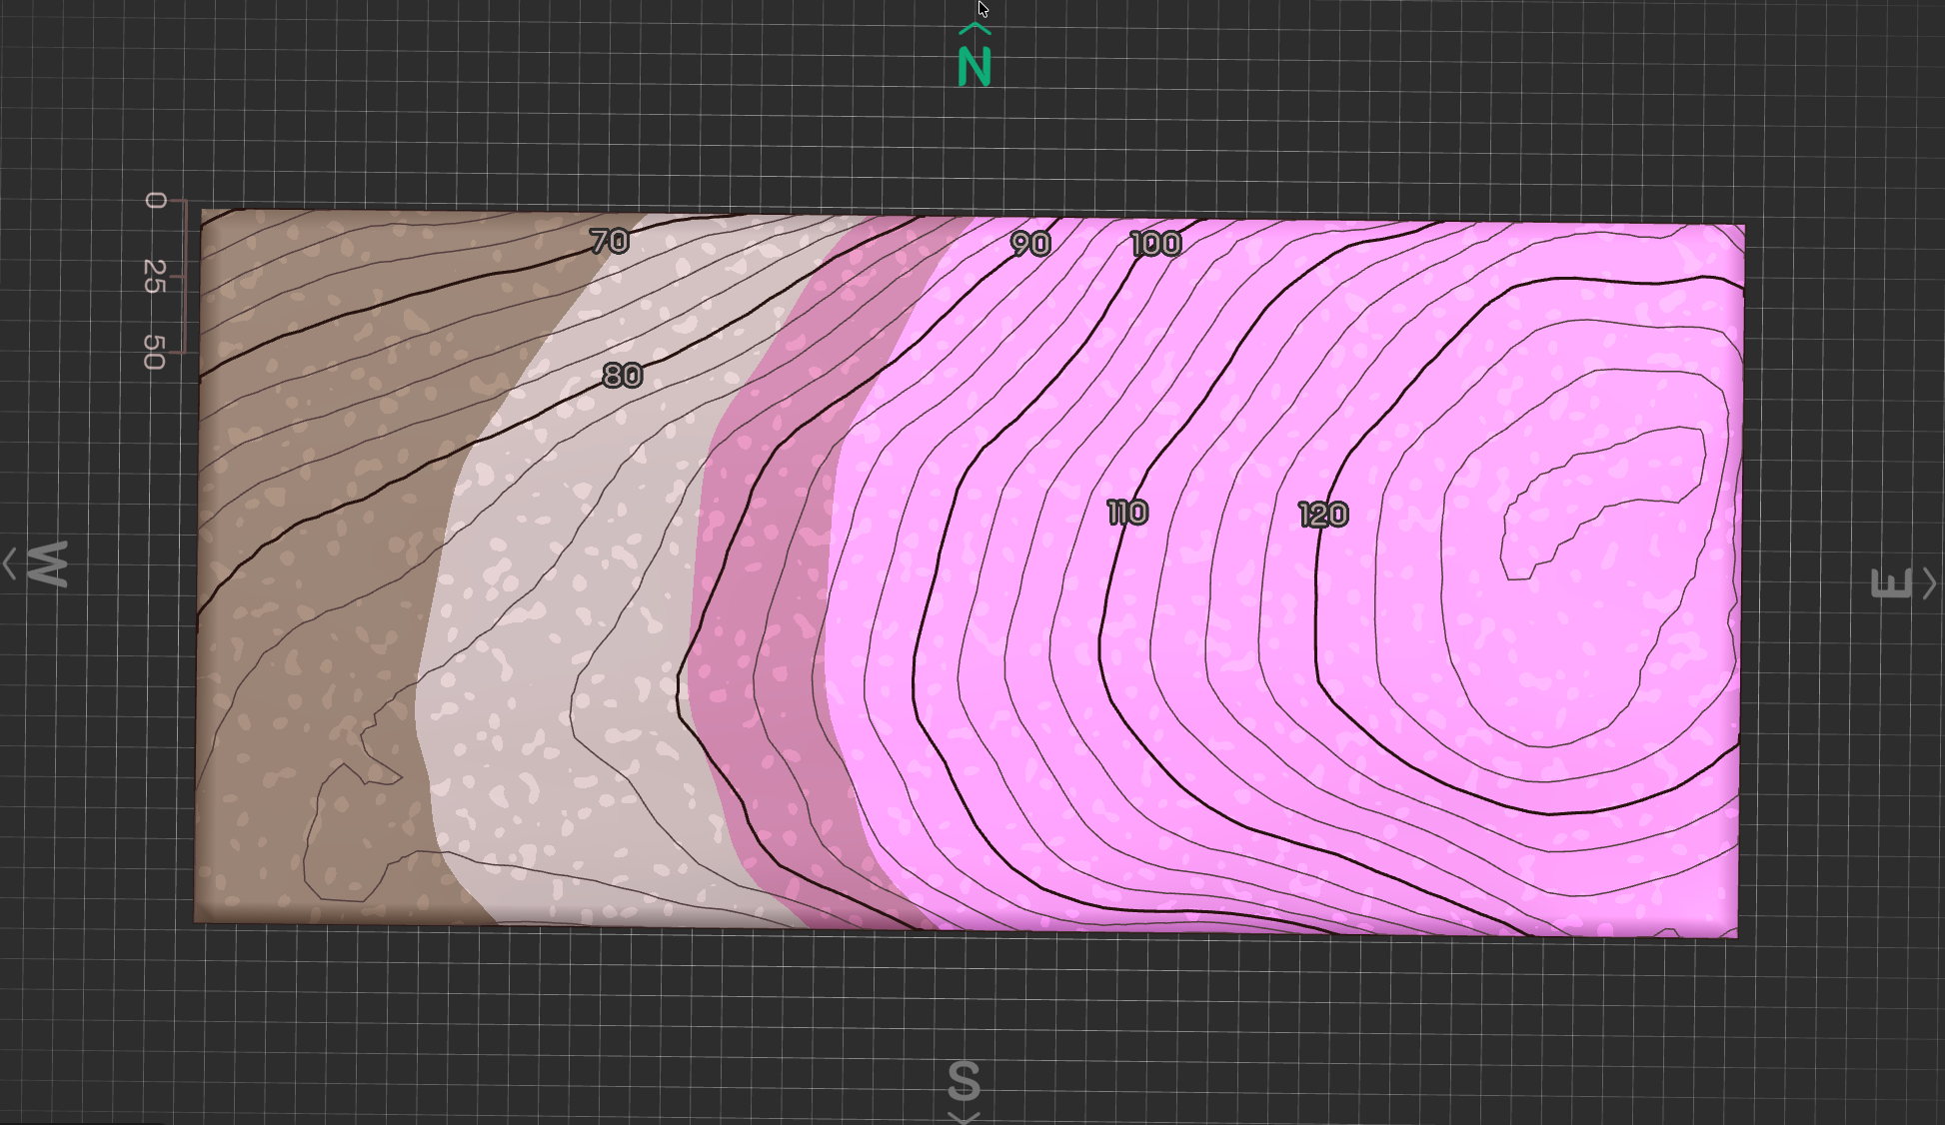
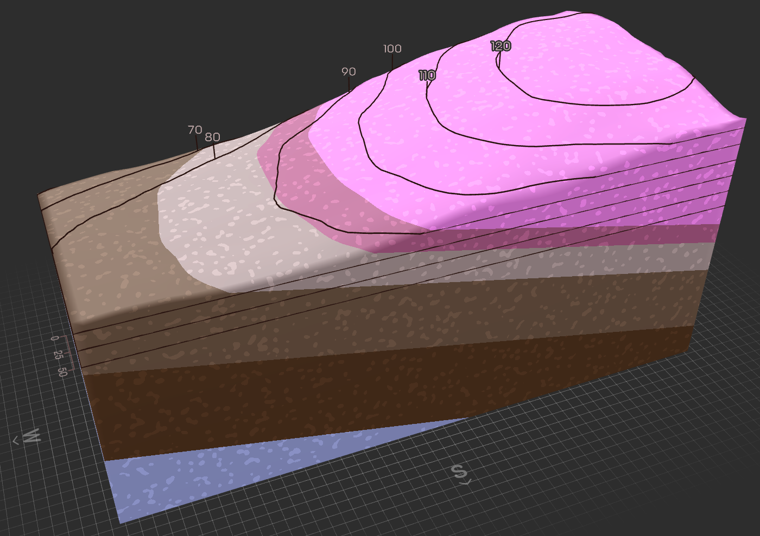

Slide 23
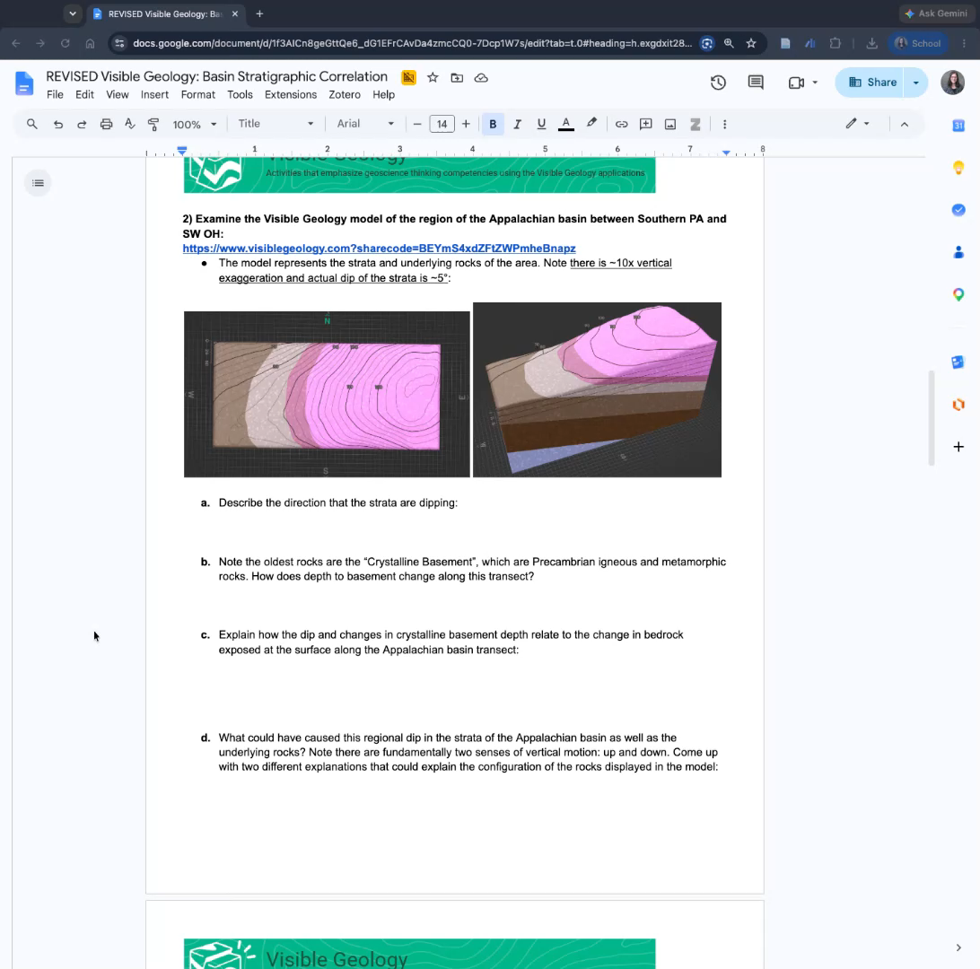
Visible Geology Model
Built representative virtual replica of regional stratigraphy using the Geology Explorer app in Visible Geology
Screencast video shows how students can access a publish shared model
Note: student link access is “read only”

Slide 24
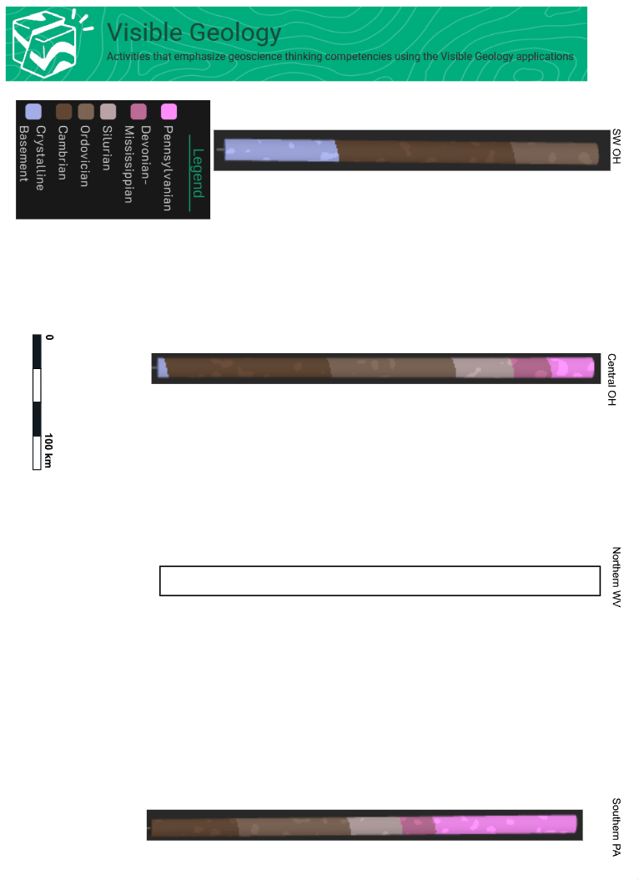

Slide 25
Questions students address along the way:
How does depth to basement change along a basin transect?
How do basin fill strata change with respect to basement dip?
What could cause the dip in basement?
What could cause thickness variation of basin fill?
Where were areas of greatest subsidence and sediment accumulation?
Hypothesize cause of basin subsidence and propose a test of this hypothesis.

Slide 26
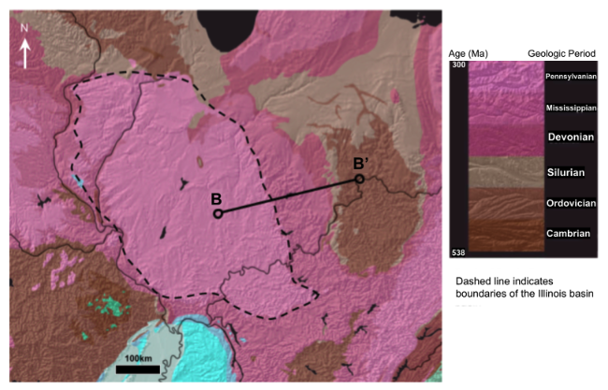
Student Map Models
Similar to the exemplar
  Accessible color scheme
  E-W transect
Difference from the exemplar
  no “known” locations
  Students are asked to “collect” core
Students contend with youngest strata that are absent to the east

Slide 27
Use as a teaching tool:
LEARNING GOAL | ASSESSMENT CRITERIA
Develop geologic map reading skills | Can relate spatial geometries of sedimentary strata to geologic map patterns
Practice basic lithostratigraphic correlation | Produce a lithologic correlation model using core information
Infer basin sedimentation history | Uses stratigraphic information to produce an explanation of where and why sediment accumulations form
Create a valid basin model | Basin model honors all constraints provided by the assignment and of the geologic map pattern
Students use spatio-temporal analysis
Recognize basin formation as regional and variable lithosphere response
Identify implications for the distribution of stratal units

Slide 28
Reservoir Sandstone Stratigraphic Correlation
Learning Goals
Develop stratigraphic column construction skills
Create core models that can be used to predict stratigraphic variability that can influence storage reservoir rock
Infer stratigraphic variability from basin context
Audience
Upper-level majors course
Amy Weislogel
West Virginia University

Slide 29
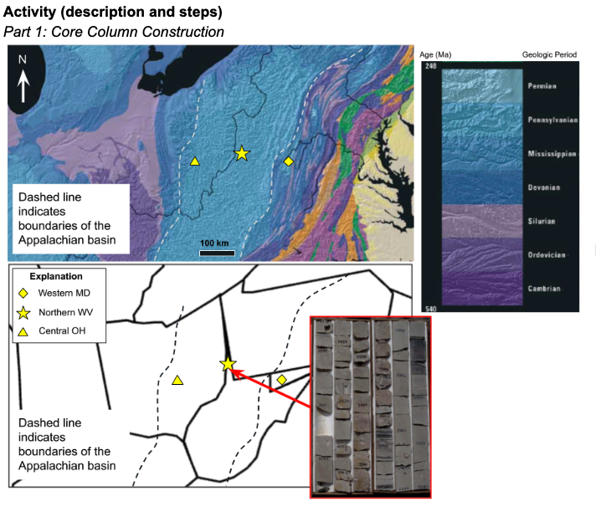
Geologic Map
USGS aligned color scheme
E-W transect
1 location with “known” sedimentology
Students are asked to predict thickness reservoir sandstone in more distal and proximal areas of the basin

Slide 30
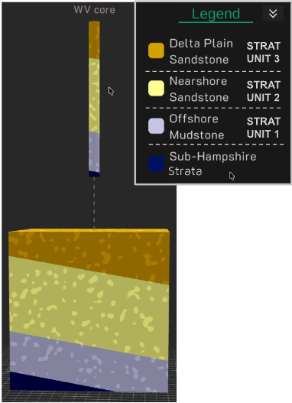
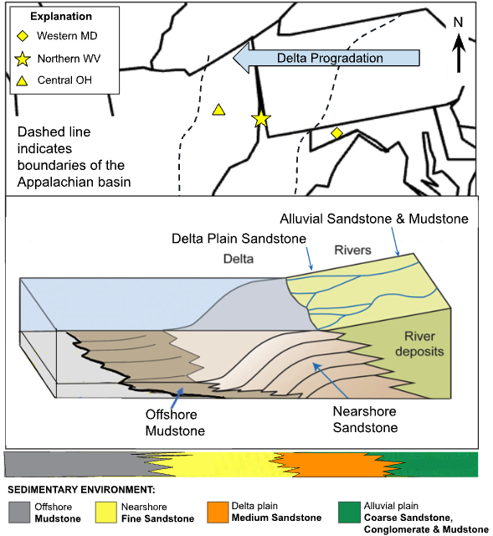

Slide 31
Use as a teaching tool:
LEARNING GOAL | ASSESSMENT CRITERIA
Develop stratigraphic column construction skills | Create an accurate sedimentary log following professional conventions
Create core models that can be used to predict stratigraphic variability that can influence storage reservoir rock | Identify greater proportion of offshore facies toward the west and potential for alluvial plain facies in the east
Infer stratigraphic variability from basin context | Identify storage opportunities
Students use spatio-temporal analysis
Relate rock properties to model representation
Infer change in distribution of facies across a basin transect

Slide 32
Q&A
Any questions on the activities?
Please type your questions in the chat OR
Raise your hand with the ‘React’ tools
We will answer them as time permits. If we get too many, we will post answers on the webinar webpage

Slide 33

Wrap Up
Take a moment to provide feedback on the webinar:
https://serc.carleton.edu/313097
Use the activities and the modules in your courses
Use the Community Contribution Tool if you adapt any of the activities or models
Help & Resources: https://www.seequent.com/products-solutions/academic-program/visible-geology/support/
GSA:
  Visit Seequent (#832) and NAGT (#801) booths
  GSA Session: T92. Technology and tools for 3D visualization of field and lab data in teaching and research
    #188 - Tuesday morning: Oral session
    #227 - Tuesday afternoon: Poster session

