Slide 1
Topography & Geologic Map features
Learning objectives:
Practice comparing map view and cross-section view
Explore how topography and different features interact

Slide 2
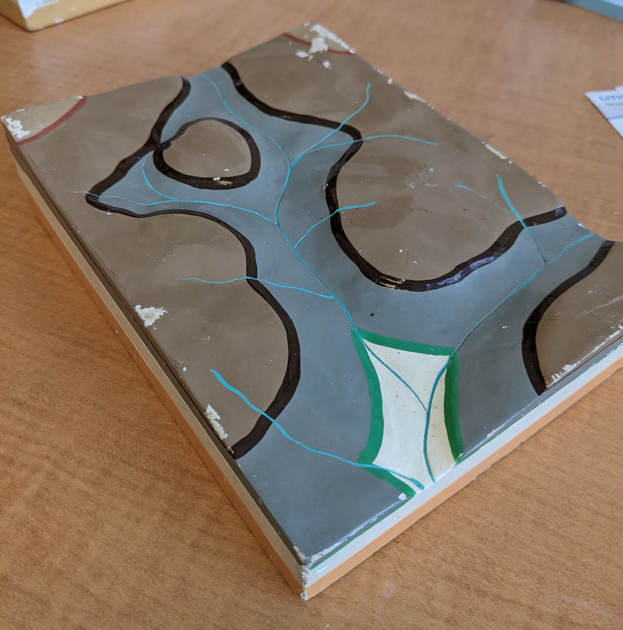
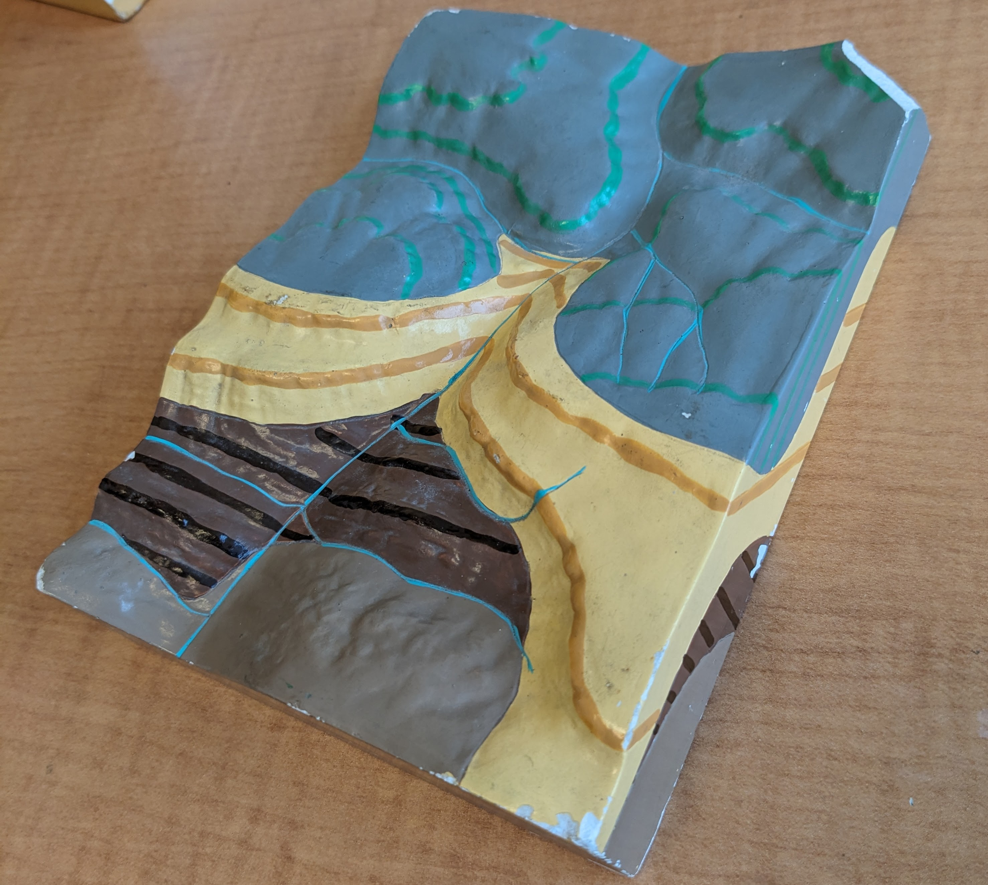
Activity Introduction
Activity : Describing Block Models

Slide 3
Block 1 Introduction
Activity : Describing Block Models
Block 1 → erosion exposing the sub-surface

Slide 4
Block 1 cross-section
Activity : Describing Block Models
Block 1 → erosion exposing the sub-surface
In your notes or on scratch paper:
Describe the subsurface bedding of the block (i.e., cross-section view)

Slide 5
Block 1 Map view
Activity : Describing Block Models
Block 1 → erosion exposing the sub-surface
In your notes or on scratch paper:
How do the exposed beds appear in map view?

Slide 6
Block 1 relationship between bedding contacts and topography
Activity : Describing Block Models
Block 1 → erosion exposing the sub-surface
In your notes or on scratch paper:
What is the relationship between bedding contacts and the topography?

Slide 7
Block 2 Introduction
Activity : Describing Block Models
Block 2 → exposure of units with differently dipping layers

Slide 8
Block 2 Units
Activity : Describing Block Models
Block 2 → exposure of units with differently dipping layers
There are four different units here:
green/grey
Yellow/mustard
Brown/dark brown
Light brown/tan

Slide 9
Block 2 Dip
Activity : Describing Block Models
Block 2 → exposure of units with differently dipping layers
There are four different units here:
green/grey
Yellow/mustard
Brown/dark brown
Light brown/tan
In your notes or on scratch paper:
Describe the orientation in detail (i.e., dip direction and angle).

Slide 10
Block 2 relationship between beds and topography
Activity : Describing Block Models
Block 2 → exposure of units with differently dipping layers
There are four different units here:
green/grey
Yellow/mustard
Brown/dark brown
Light brown/tan
In your notes or on scratch paper:
How does each bed interact with the topography?

